Slide 1
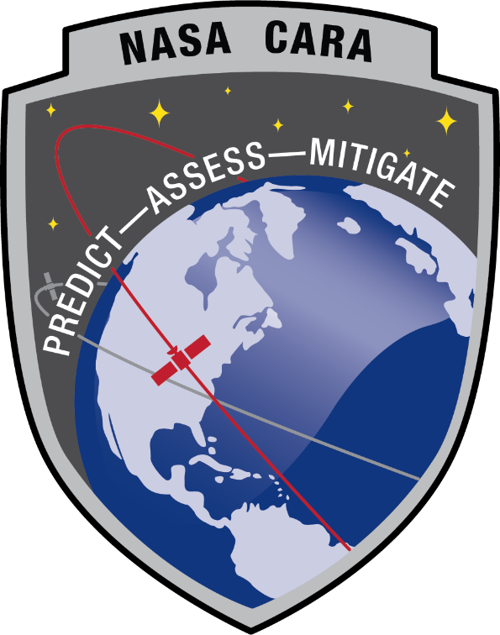

Conjunction Assessment Risk Analysis
Collision Avoidance “Short Course”
Part III: CA Challenges and Opportunities
Lauri Newman
NASA Conjunction Assessment Program Officer

Slide 2
Agenda
Major CA Challenges
COLA gap
Need for new methodologies
Autonomous maneuvering
Multiple CA prediction sources
Cislunar/non-Earth-Centered CA
Opportunities
Use best practices
Take advantage of large Constellations
AI/ML
NRT screenings – SpaceX tool

Slide 3
Changing Space Environment
Space environment has been changing, and will continue to evolve rapidly over the coming years due to the following drivers:
  Active payload proliferation/large constellations
  SmallSat proliferation
  New space actors
  Importance of Cisluanr environment
Conjunctions with other spacecraft now outnumber conjunctions with debris
CA practices will need to evolve to meet growing needs

Slide 4
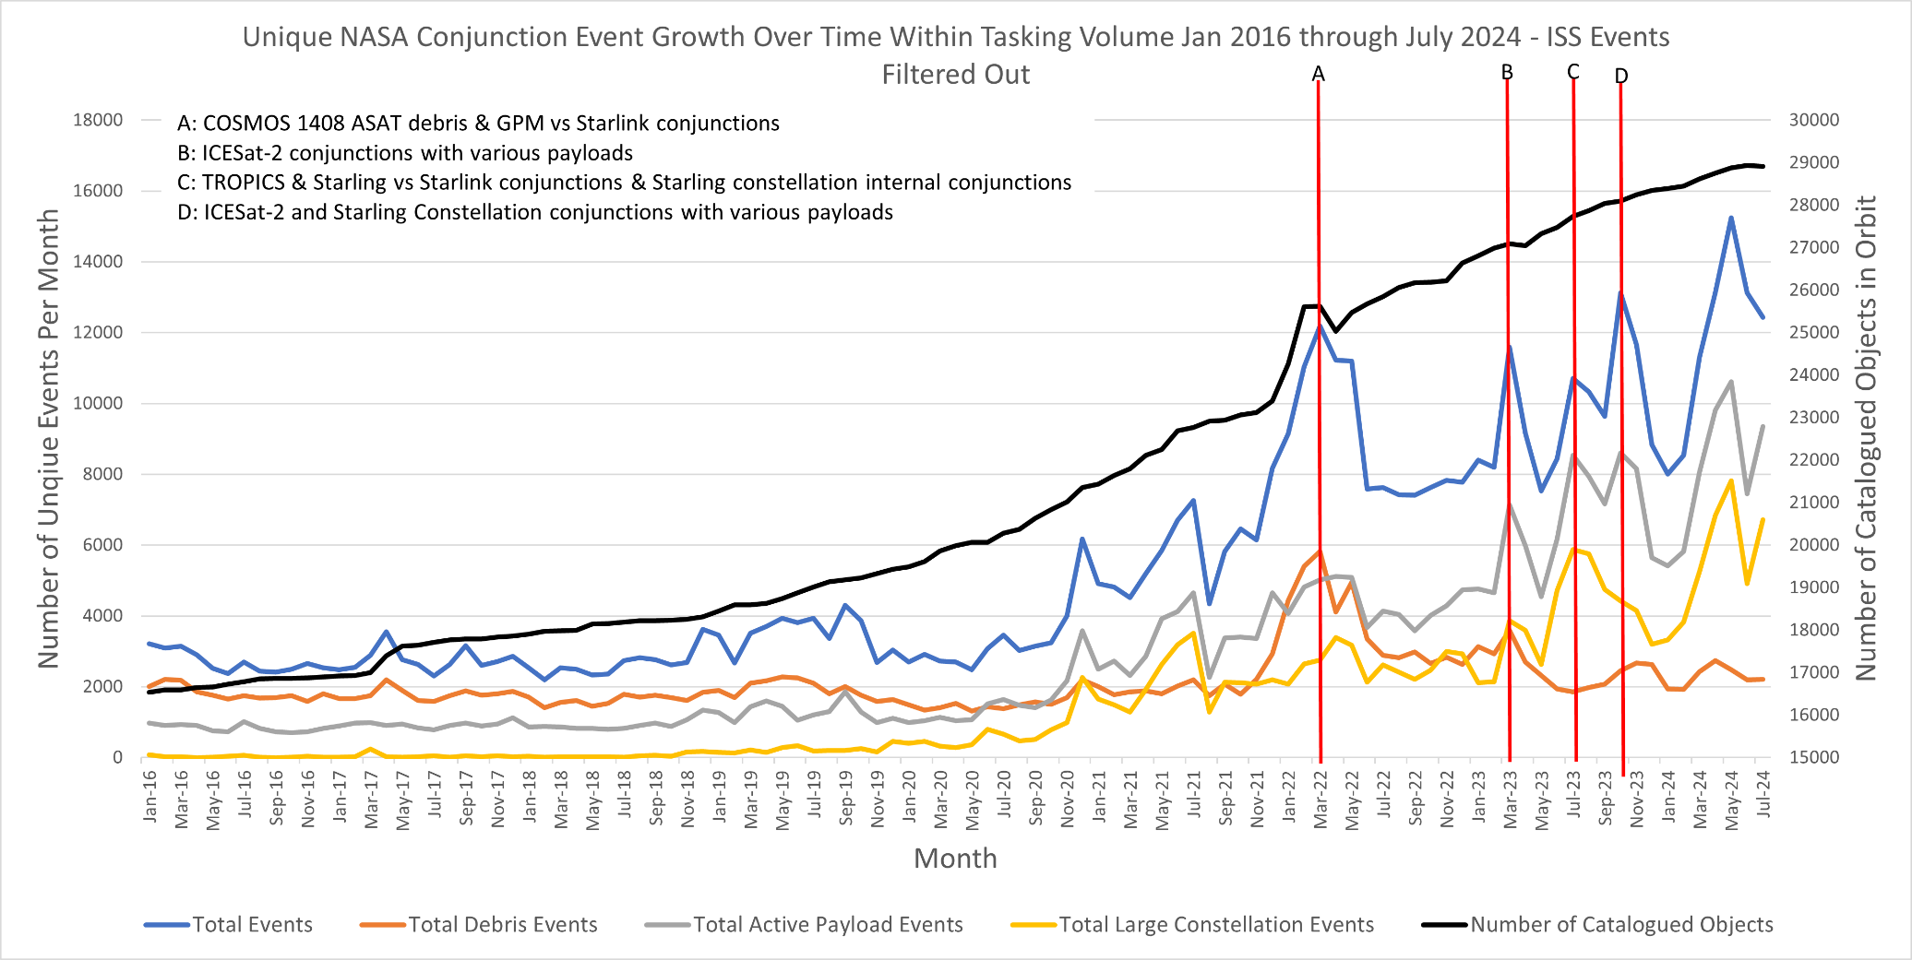
Conjunction Assessment Trends:
Situation is Getting Worse!
Russian ASAT test
15 NOV 2021
1st Starlink launch
23 MAY 2019
Current CA workload is large and continues to grow
  Across the LEO fleet, NASA CARA sees about 12,000 unique conjunctions each month
    Quadrupled since 2018 primarily due to Starlink and OneWeb conjunctions
    Russian ASAT test in 2021 added 30% more events
Large constellations will continue to drive the close approach event risk.
Notes:
The number of satellites over time continues to grow.
Number of conjunctions with operational spacecraft now outnumbers conjunctions with debris
Several ultra-large constellations (up to 30k space vehicles) have been announced (for Low Earth Orbit), though not yet deployed.

Slide 5
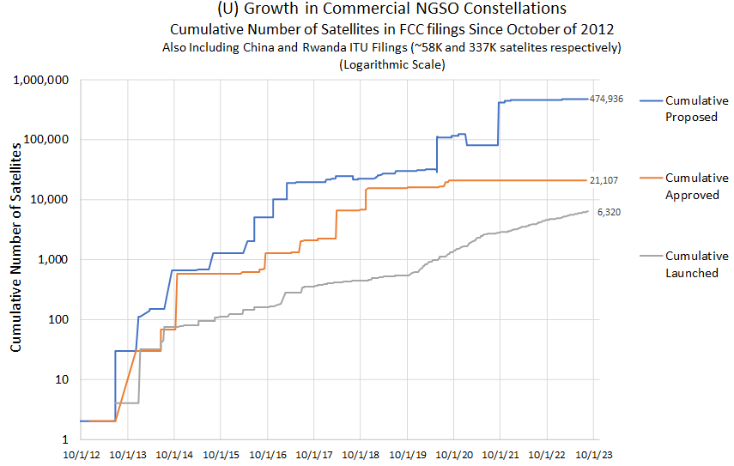
Active Payload Growth:
“Large Constellation” Effect
New active payload growth due to large constellations substantial
  21,000 new satellites approved, of which only ~6300 launched
  Filings for new constellations exceed 400,000 satellites
Active payload conjunctions more demanding than with debris
  Coordination/negotiation with other O/O required—more demanding
  Potential consequence higher: collision would destroy two active satellites and create substantially larger debris field
Imputed additional operational workload considerable
Proposed/Approved/Deployed Constellation Satellites vs Time

Slide 6
SmallSat Proliferation:
Small Doesn’t Mean “Safe”
In a collision, small satellites can destroy large satellites and create large debris clouds
Small satellites must be tracked in order to prevent collisions
  Small satellites harder to track, and some below regular tracking threshold
  Many small satellite operators do not compute their own ephemeris and rely on TLEs, making SSN tracking essential to their position determination
Maneuverable small satellites must have their maneuvers screened
  Neighbors unaware of intended trajectory cannot mitigate close approaches
In short, it is a fallacy that small, cheap satellites do not require CA
  In fact, in some respects more dangerous than traditional satellites
Smallsat operators should share their ephemerides including planned maneuvers (if applicable) with DOD and be prepared to perform avoidance maneuvers if capable.

Slide 7
Major Challenges: COLA Gap
Conjunction Assessment requires that objects in space be catalogued in order to know where they are
  DOD performs this, but it takes time after launch before they are tracked well enough to put them in the catalog
The time between when a spacecraft is separated from the launch vehicle and the time it is put in the catalog is called the “COLA gap”
  Conjunction Assessment can’t be preformed during this time, jeopardizing the spacecraft, its neighbors, and the environment
  Typically 1 day to 2 weeks
Small spacecraft are vulnerable because they are often launched in groups, making it hard for trackers to find and catalog individual spacecraft
Consider mitigations during design and development phase:
  Beacon with ground processing
  GPS with rapid activation
  Obtaining ephemerides from deployers

Slide 8
Major Challenge: New Methodologies
Potential new CA paradigms to handle growing workload
  CA remediation against “grouped” events using an aggregate Pc
  Station-keeping burn strategy to minimize conjunction risk, without actually remediating individual events unless an extremely high Pc
  Consideration of consequence in addition to risk to determine which events to remediate—already moving towards implementation at NASA
CARA tools are available free to the public as Software Development Kits (SDKs) on the CARA repository (https://github.com/nasa/CARA_Analysis_Tools)
  Contain benchmark test cases in addition to Matlab source code

Slide 9
Major Challenges:
Autonomous Maneuvering
Many operators are employing automated maneuvering vs ground-controlled maneuvers to manage workload
  Large constellations are hard to operate without automation
Automated maneuvering is often near-real-time without CA screening
Imperative to screen maneuvers before execution
  Two satellites may be planning mitigation actions, but neither knows what the other is planning to do
  Satellites could therefore maneuver into each other
  Collison would not only potentially destroy involved spacecraft but also put debris in orbit that jeopardizes other third-party spacecraft
Automated maneuvers do not always need to be real-time
  Can build in time for screenings with appropriate latency
  Can still be automated (no human in loop)
If real-time automated maneuvers are necessary, other CA means must be employed

Slide 10
Major Challenges: Multiple Solutions
Many entities are planning to emulate the US DOD in producing their own catalogs and screening them for close approach predictions
  DOC/OSC, EU SST, JAXA, commercial companies
Screenings against each of these will yield different predictions due to use of different input data
When an operator receives notices from multiple sources (e.g. during close approach resolution with another operator), how to determine preferred solution?
  Single binary decision to be made: should conjunction be mitigated or not?
  Decision-making challenge in the presence of multiple solutions
Area for future research

Slide 11
Major Challenges: Non-Earth-centered CA
Deep space shared environments are growing increasingly crowded, with many more missions planned in coming years
Due to the lack of passive tracking capability in deep space:
  Keeping these environments safe is reliant on self-reported ephemeris and uncertainty data from mission teams.
  The consequences of creating debris is higher than at Earth due to the inability to track debris objects in these environments
The Multimission Automated Deep-space Conjunction Assessment Process (MADCAP) at the Jet Propulsion Laboratory is used to perform conjunction assessment at Mars, the Moon, and Sun/Earth libration points.
  Contact david.s.berry@jpl.nasa.gov
MADCAP prevents collision by screening ephemerides against each other.
  No other CA method exists for these environments (no catalog of objects)
MADCAP service is free to commercial and international entities
Sharing ephemerides with MADCAP is critical for safety in these environments

Slide 12
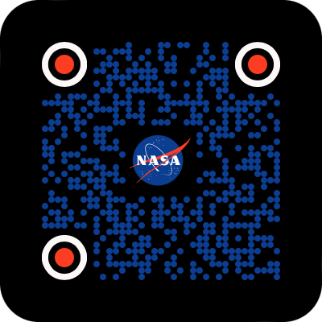
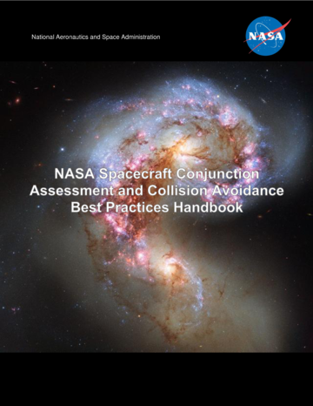
Opportunities: Best Practices [1 of 2]
Several entities publish best practices for CA.
Sources of existing best practices:
  AIAA, Iridium, OneWeb, SpaceX released “Satellite Orbital Safety Best Practices” Reference Guide September 2022
  Best practices for using 18 SDS/19 SDS support are available on Space-Track.org website
  Secure World Foundation publishes “Handbook for New Actors in Space”
  Best practices for satellite operations at Spacesafety.org
  CONFERS publishes best practices for Proximity ops
NASA published CA best practices Handbook (update Feb 2023); contains analysis describing the technical/scientific foundations of best practices
  Covers the current USG CA process end-to-end, including high-level details of DOD screening process.
  Provides list of best practices with rationale and appendices on methodologies
  Comments or suggestions are welcome at ca-handbook-feedback@nasa.onmicrosoft.com
NASA CA Handbook

Slide 13
Opportunities: Best Practices [2 of 2]
Key common items:
  Share ephemerides
    Predicted ephemerides are not proprietary—they are needed for safety of flight, and the satellite’s future position will be openly discoverable anyway
    Without shared data, other operators have no way to tell where these assets are
  Have a CA plan/CONOPS pre-launch
    It is cheapest to incorporate needed CONOPS from design
    Consider debris environment when selecting orbit
    Plan for making ephemeris if maneuvering or in orbit where free data doesn’t meet accuracy needs
    Plan for covariance realism to inform Pc calculation

Slide 14
Opportunities: Lage Constellations
There are unique opportunities available for large constellations to contribute to space situational awareness:
  Density model improvements
    Collecting the data from all spacecraft in a constellation that experience the same drag environment could help to calibrate drag modelling for other spacecraft
  Star tracker data
    Data from star tracker could be mined for observation of other on-orbit objects
    Objects would need to be identified and catalogued in order to repeatably incorporate into the CA process

Slide 15
Opportunities: AI/ML
AI/ML becoming more available – may present opportunities to streamline CA process
Potential applications
  May be useful in screenings; DOD/DOC investigation
  May assist in risk mitigation decision-making
Challenges: no truth data - makes training the system hard
  Dog-vs-cat AI/ML trained against millions of curated dog/cat photographs
  In CA, only a few verified collisions, and these often lack modern data
  Similar to predicting 1000-year floods: have no modern empirical data
NASA initial CA AI / machine learning studies show little improvement
  Reports available at nasa.gov/cara
Area for future research

Slide 16
Opportunities: NRT CA [1 of 2]
For autonomous CA using CDMs from other active satellites to be successful, latency is currently required
  Non-autonomous active satellites need to refrain from maneuvers 12-24 hours before close approaches with autonomous satellites that use CDMs
  Allows sufficient time for screening and upload of CDMs to spacecraft
NASA and SpaceX are demonstrating a prototype autonomous CA approach to manage collision risk with autonomous systems
  Starlink/Starling formal experiment for autonomous CA (JAN-SEP 2024)
    Starling is a NASA constellation of 4 cubesats that is collocated with the SpaceX Starlink constellation
    Both constellations perform automated maneuvering
    Reduces latency to <1 min
Experiment approach
  Ground system provides extremely rapid screening of maneuver ephems
  Mitigation action management systems assists responsibility assignment
  To be fully effective, must incorporate all O/O ephemerides and full catalog; hoping DOC/OSC may incorporate this capability in future once prototype is tested.

Slide 17
Opportunities: NRT CA [2 of 2]
Collaborative
  Participants are free to pursue their own strategies; only the state of conjunctions is centrally tracked
When the ground node finds a conjunction between ephemerides in its DB, alert sent to both O/Os
  CDM accompanies alert to provide basic astrodynamics info and other event details
O/Os can choose from among three categories to indicate their posture toward
this collision:
Allow O/Os to follow any imposed constraints while still enabling robust CA

Slide 18


Summary
Exciting growth offers opportunities that will change society, but needs to be done safely to ensure that we have continued use of the space environment for future generations
NASA CA website
NASA CA Handbook
CARA Tools

Slide 19


