Slide 1
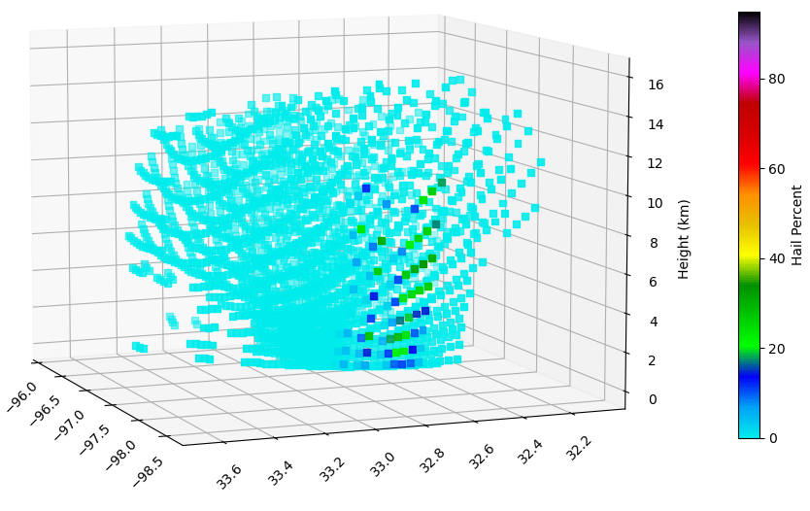
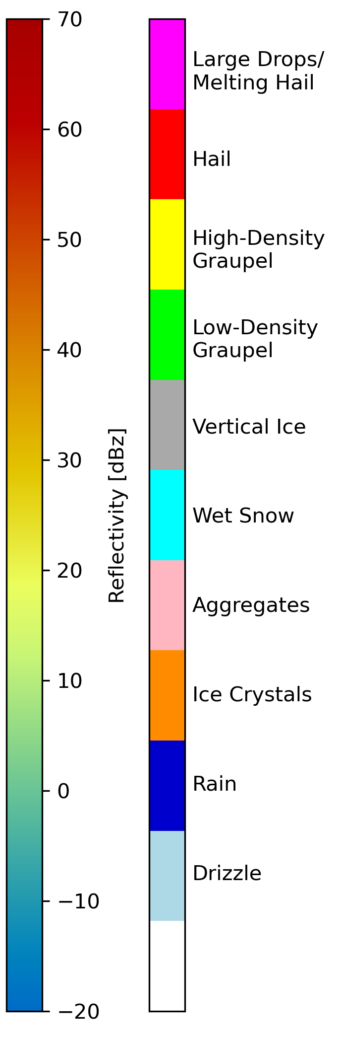
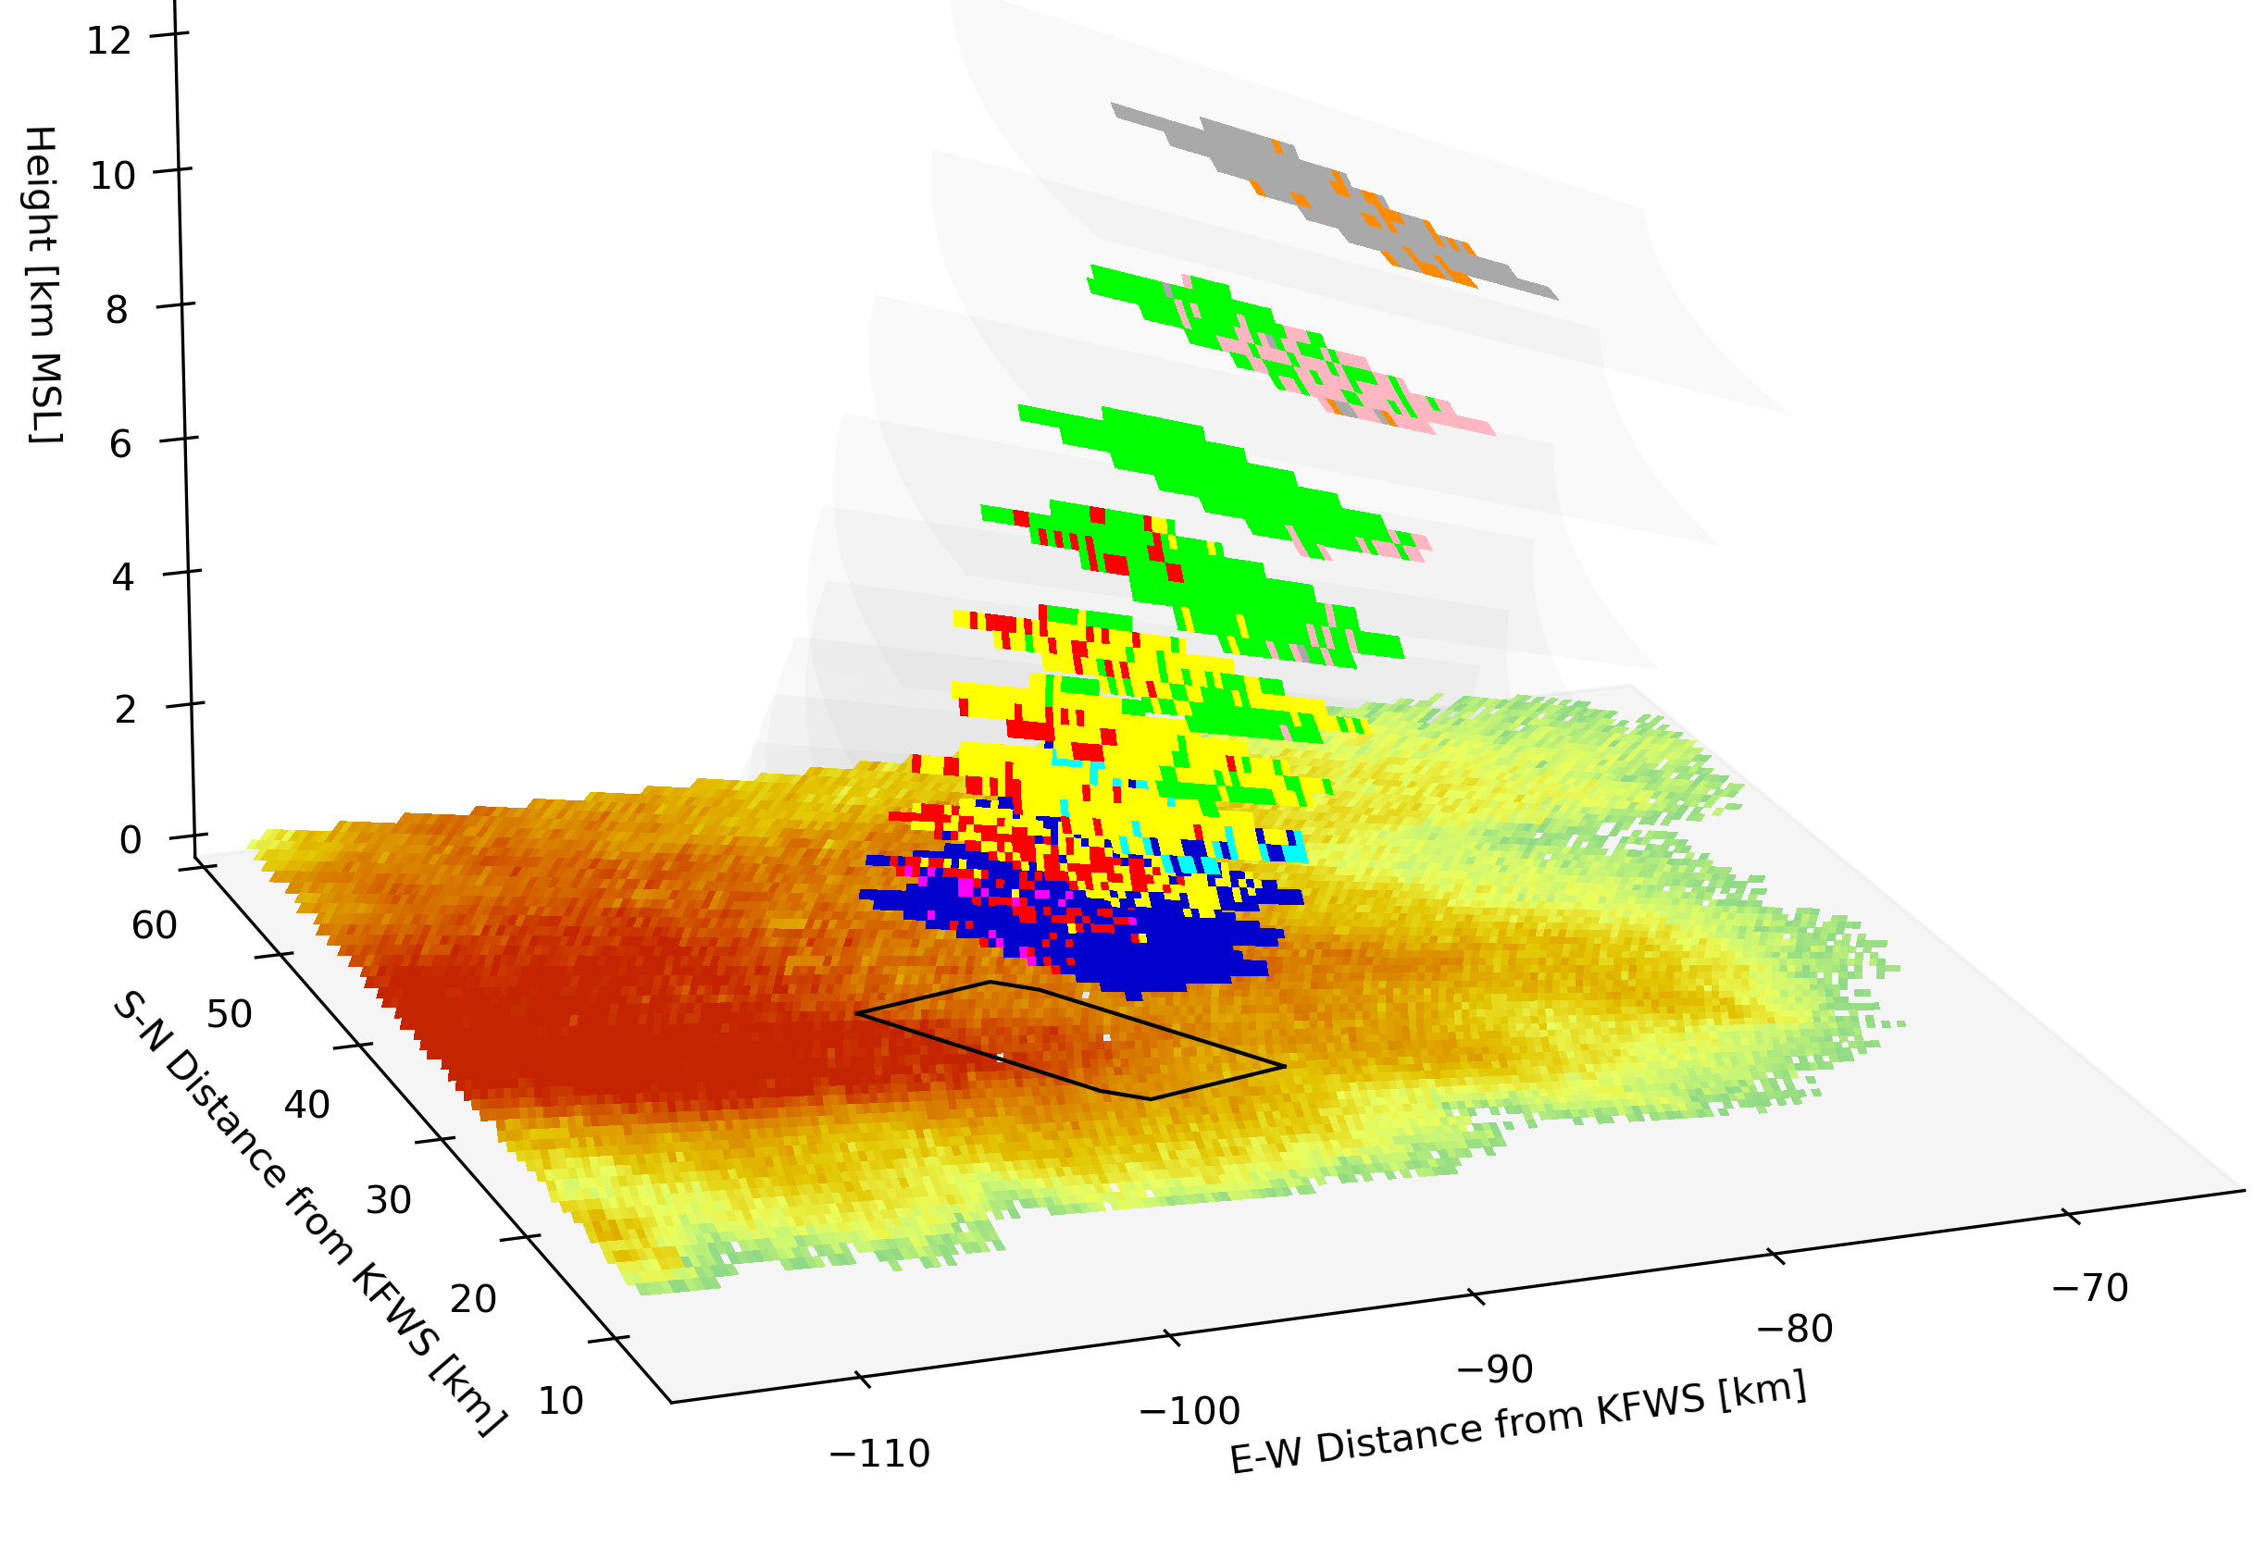
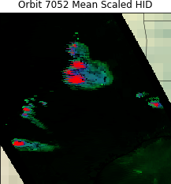
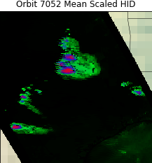
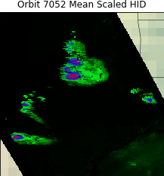
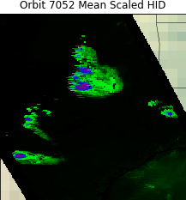
Retrieving Hydrometeor Information from GMI Brightness Temperatures
Daniel J. Cecil, NASA MSFC, Daniel.J.Cecil@nasa.gov
Michael B. Solomon, University of Alabama-Huntsville, mbs0025@uah.edu
Example radar gates matched to one GMI pixel
Graphic courtesy Sarah Stough, UAH
Each ground-based radar gate from VN gets an HID, but a given GMI footprint (left) can include every hydrometeor type.
Even for a strong thunderstorm cell, a small % of the radar gates within the GMI footprint are identified as hail (right).
Weakest threshold – at least 1 radar gate in the matched volume has hail
At least 1% of radar gates in the matched volume have hail
At least 2.5% of radar gates in the matched volume have hail
At least 5% of radar gates in the matched volume have hail
Lookup tables trained on stricter criteria (toward the right) identify smaller areas of hail (red) and graupel (blue), with lower probabilities assigned to those HID types.

