Slide 1
A Synthesis Method to Auralize Rotor Noise During Transitional Flight
Siddhartha
Krishnamurthy
Applied Acoustics Branch
NASA Langley Research Center
Hampton, VA, USA
Quiet Drones 2024
September 11, 2024
Co-Authors:
Brian C. Tuttle (Analytical Mechanics Associates)
Aric R. Aumann (Analytical Services and Materials)
Stephen A. Rizzi (NASA Langley)
Leonard V. Lopes (NASA Langley)
Stefan J. Letica (NASA Langley)
D. Douglas Boyd, Jr. (NASA Langley)

Slide 2
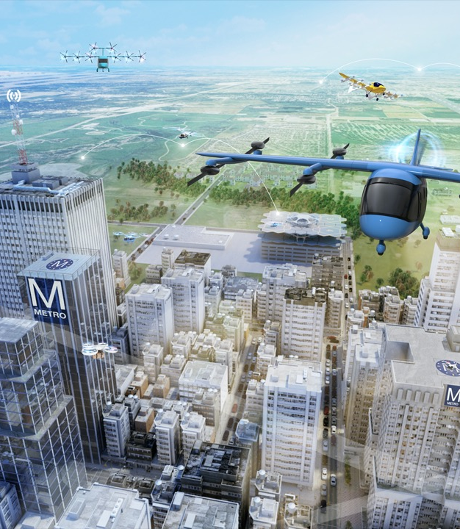
Auralizations can help understand human response to Urban Air Mobility (UAM) vehicles in transitional flight

Slide 3
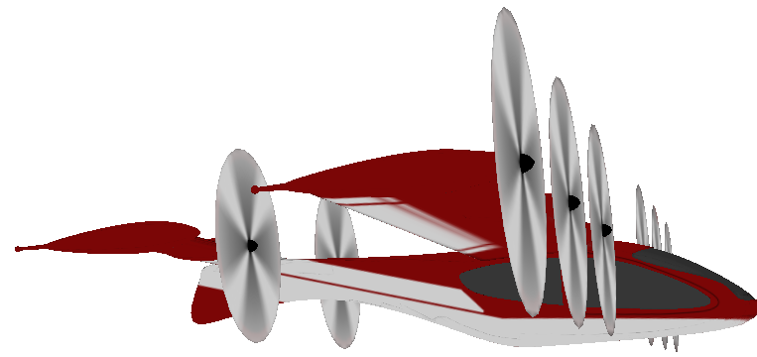
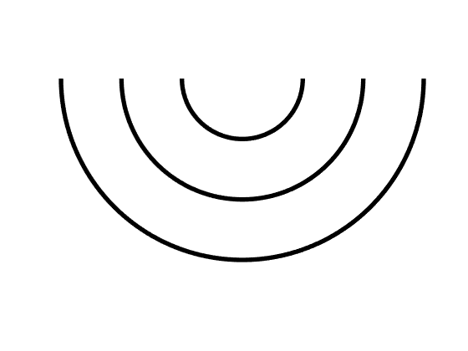
In aircraft auralization, sound is synthesized near the aircraft (paper focus) before being propagated to a ground observer
Synthesized Sound
NASA Auralization Framework (NAF) performs sound synthesis and propagation
Direct Path
Reflected Path
Ground Observer

Slide 4
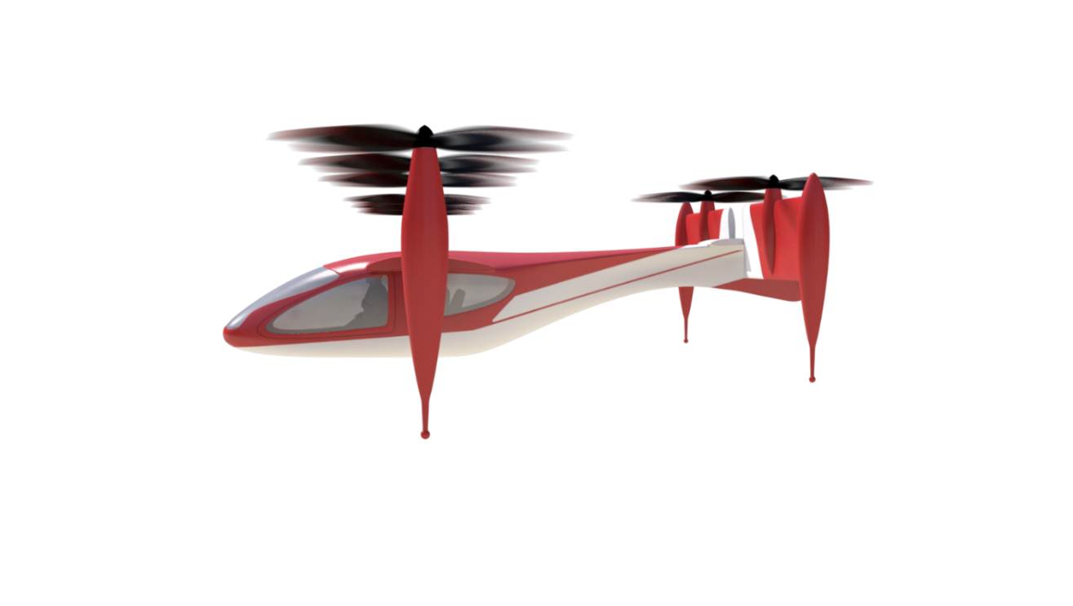
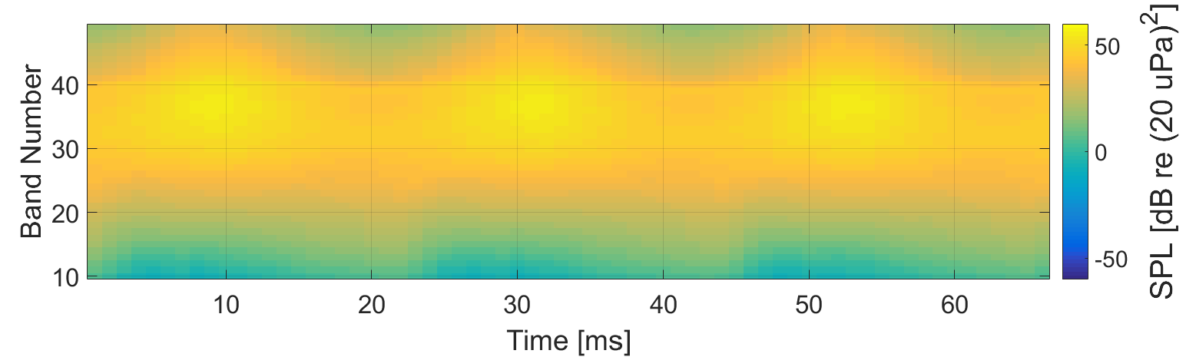
Methods exist to synthesize loading and thickness (tonal) noise and broadband self noise
Blade Thickness & Loading
Blade Self Noise
Self Noise 1/3 Octave Band Spectral Time History

Slide 5
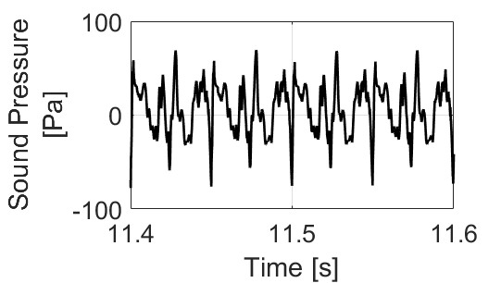
Blade aerodynamics and geometry data are needed for acoustic predictions, which are then used to synthesize sound
At/Near Source
Input Blade Data
Acoustic Predictions
Flyover Sound Synthesis
Propagate Synthesized Sound
At Ground Observer
Complete Auralization
:
:
:

Slide 6
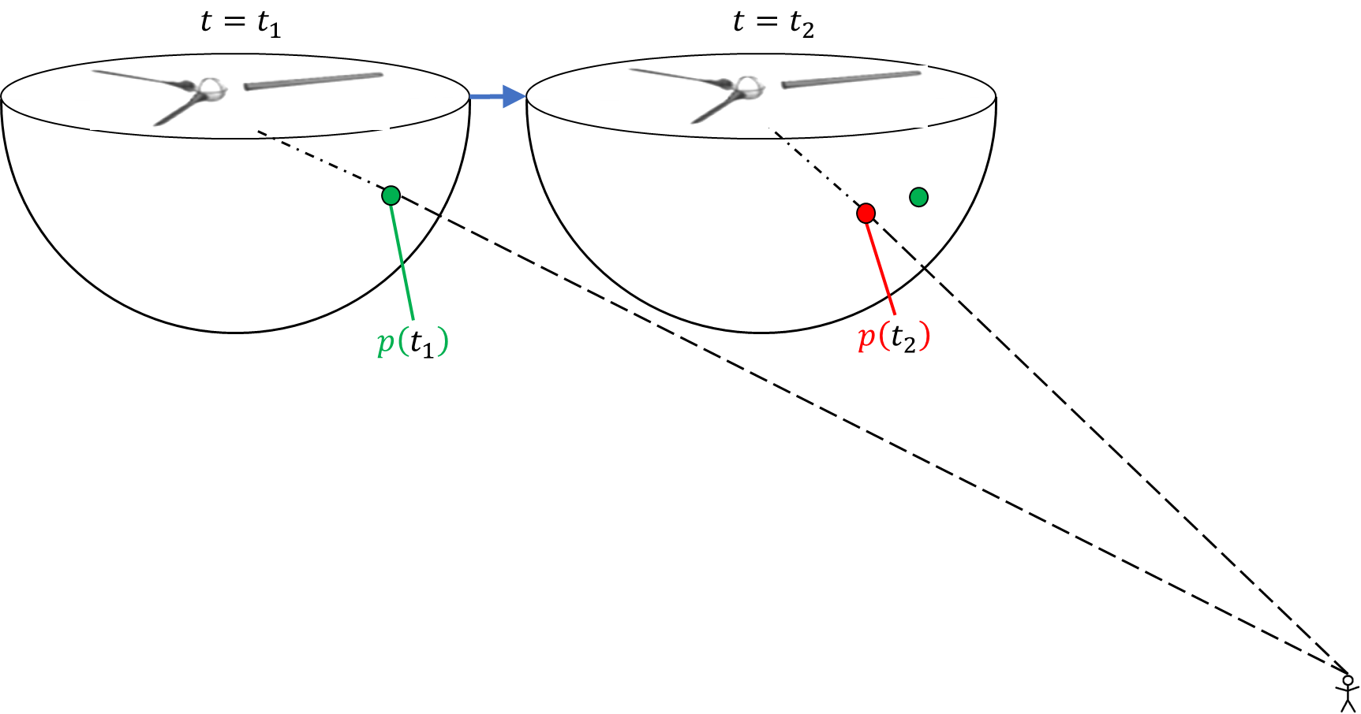
NASA Auralization Framework (NAF) Formulation 1A (F1A) Synthesis Plugin generates loading and thickness noise
Inputs
Vehicle Flight Path
Output
Blade loadings, motions, geometry
NAF F1A Synthesis Plugin
Audible Loading and Thickness (Tonal) Noise

Slide 7
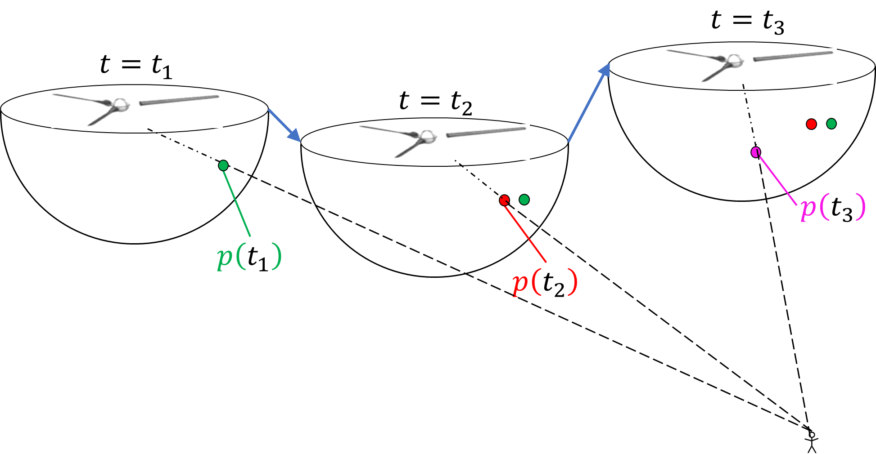
For transitional flight sound synthesis, combine blade aerodynamics and geometry data from many flight conditions
Trimmed State 1 Data
Trimmed State 2 Data
:
Inputs
Trimmed State N Data
Vehicle Flight Path
Output
ANOPP2 Series of Periodic to Aperiodic Interpolated Data (ASPAID)
Interpolated Blade loadings, motions, geometry
NAF F1A Synthesis Plugin
Audible Loading and Thickness (Tonal) Noise

Slide 8

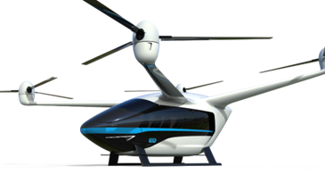
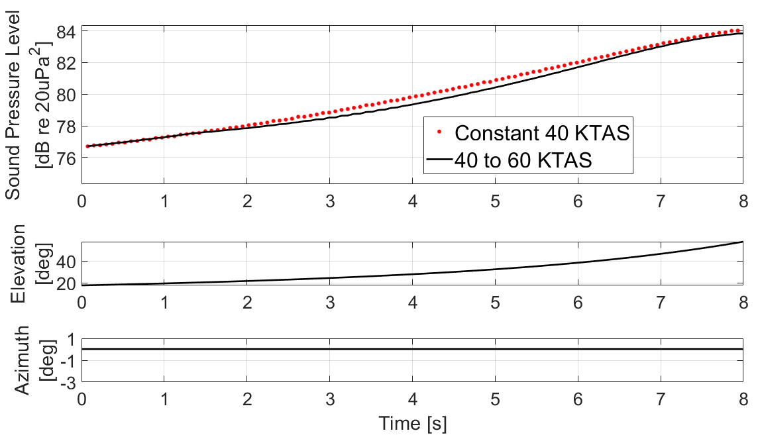
Loading and thickness noise synthesized for transitional flight from interpolated blade loading, motion, and geometry
Constant 40 KTAS Airspeed, 5 Degree Climb
Airspeed changing from 40 KTAS to 60 KTAS, 5 Degree Climb
NASA Urban Air Mobility (UAM) Quadrotor Reference Vehicle

Slide 9

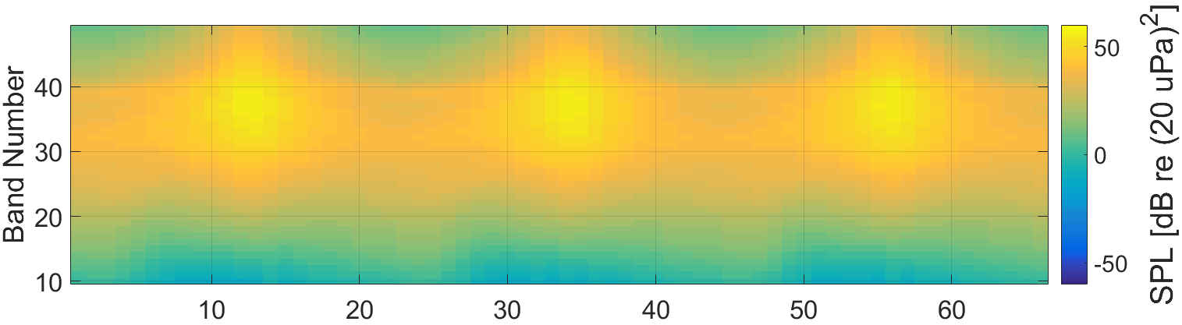














Methods exist to synthesize broadband self noise hemisphere predictions into sound
Exaggerated illustration shows single flight condition
$$t=t_{A}$$
$$t=t_{B}$$
$$t=t_{C}$$
$$(θ_{C},φ)$$
$$(θ_{B},φ)$$
$${(θ}_{A},φ)$$
$$θ$$
Observer
$$θ_{C}$$
$$θ_{B}$$
$$θ_{A}$$
$$t$$
$$t_{A}$$
$$t_{B}$$
$$t_{C}$$

Slide 10

















Self noise predictions are interpolated between different hemispheres for transitional flight synthesis
Trimmed State $S_{1}$
Trimmed State $S_{2}$
$$t=t_{A}$$
$$\overline{{S_{1}S}_{2}}$$
$$t=t_{B}$$
$$t=t_{C}$$
$$(θ_{C},φ)$$
$$(θ_{B},φ)$$
$${(θ}_{A},φ)$$
$$θ$$
$$θ_{C}$$
$$θ_{B}$$
$$θ_{A}$$
Observer
$$t$$
$$t_{A}$$
$$t_{B}$$
$$t_{C}$$

Slide 11
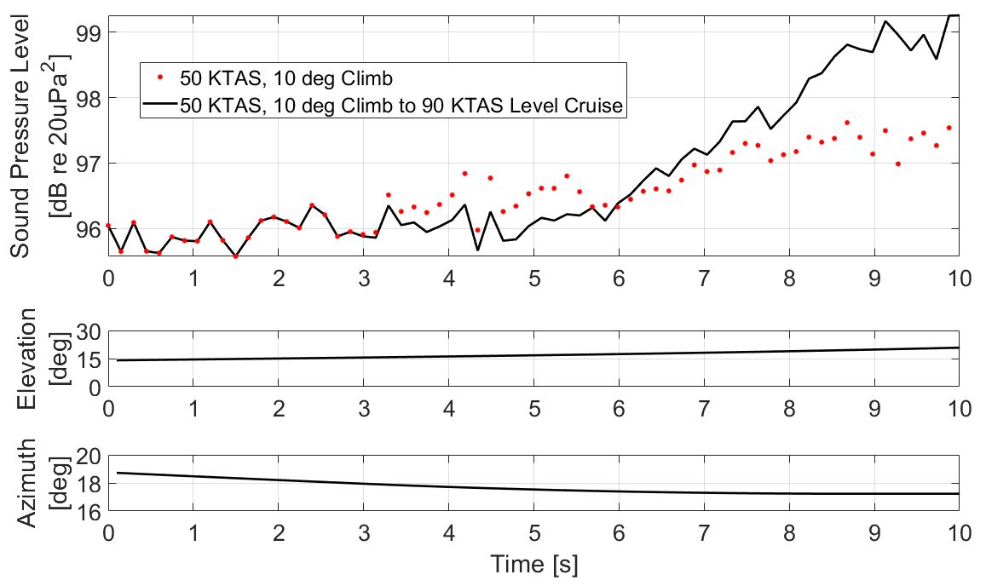
Self noise synthesized for transitional flight from interpolated source noise hemispheres
50 KTAS, 10 deg Climb Only
50 KTAS, 10 deg Climb to 90 KTAS Level Cruise
NASA Urban Air Mobility (UAM) Quadrotor Reference Vehicle

Slide 12
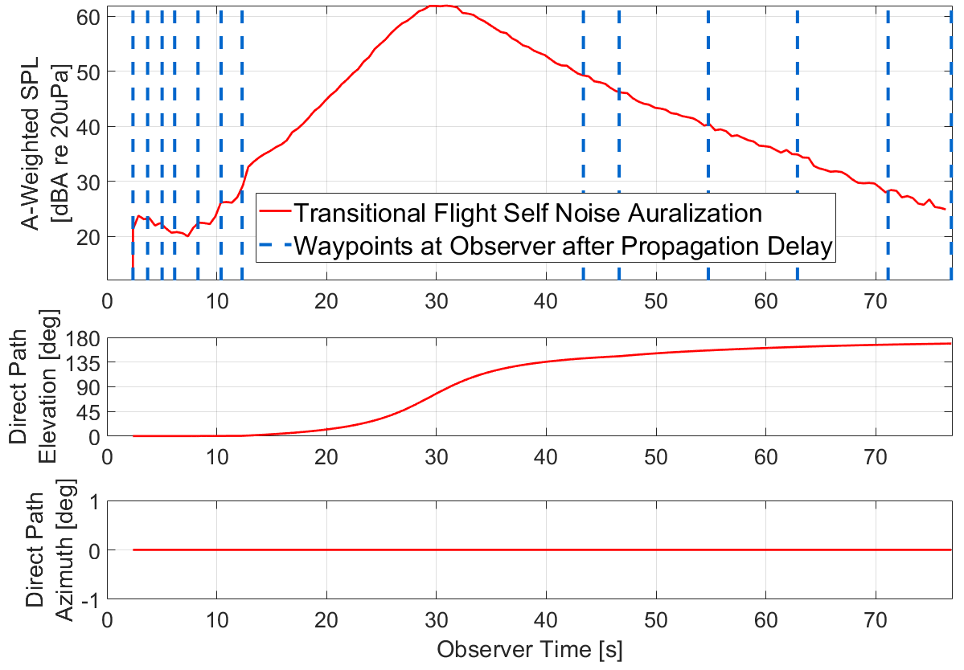
Departure and approach maneuvers with changing flight conditions auralized with self noise
Departure Sound Pressure Level (SPL) Time History
NASA Urban Air Mobility (UAM) Quadrotor Reference Vehicle

Slide 13
Methods developed to synthesize rotor loading and thickness noise and broadband self noise for transitional flight
Future work includes:
  Complete departure and approach auralizations with loading and thickness noise
  Prepare public release of NAF Modulated Broadband Synthesis Plugin for transitional flight
Experimental data on rotor transitional flight anticipated in the coming year (2024-2025) for comparisons with auralizations
This work is in support of NASA’s Revolutionary Vertical Lift Technology Project of the NASA Advanced Air Vehicles Program
Questions?

Slide 14
Image Sources
All images in this presentation were provided internally by NASA or generated by presenter

