Slide 1
Comparing the X-ray Polarization Properties of Stellar and Supermassive Black Holes
Lynnie Saade^{1,2}, Phil Kaaret², Ioannis Liodakis², and Steven R. Ehlert²
1- Universities Space Research Association 2 – NASA’s Marshall Space Flight Center

Slide 2
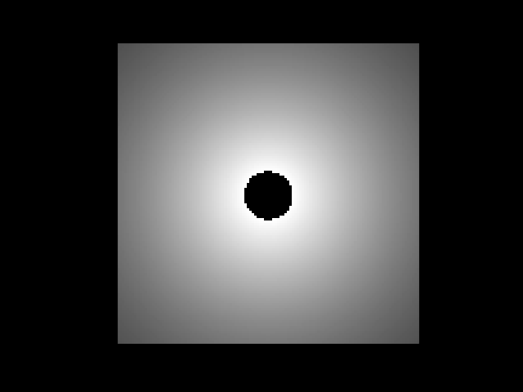
Is Black Hole Accretion Similar Across Mass Scales?
Black hole accretion is theoretically expected (at least approximately) be the same in both stellar and supermassive black holes
The geometry of the accretion disk, corona, jet etc. thought to be similar
Physics of the accretion flow should be similar except for scaling factors based on mass (e.g. temperature in SMBH accretion disk is lower)
Is this a simulation of a stellar or supermassive black hole?
Credit: Leon Geiger

Slide 3
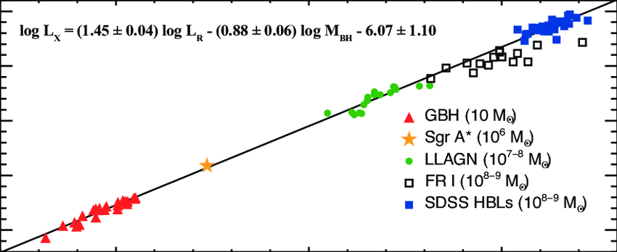
Evidence for Similarity Across the Mass Scale
Radio and X-ray luminosity of accreting black holes scales linearly with black hole mass
Indicates that mass acts primarily as a scaling factor---the disk-jet coupling is similar for all black holes
Related correlation between radio luminosity and mass was found for blazars & microquasars (Liodakis 2017)
Kinetic power same fraction of jet power for AGN and GRBs (Nemmen 2012)
Plotkin 2012

Slide 4
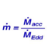
Black Hole Accretion States
Black hole X-ray binaries have two main states: soft and hard
Soft – dominated by thermal emission from optically thick geometrically thin accretion disk
Hard – dominated by Comptonized emission from corona
In the hard state the thin disk might be truncated and replaced with an optically thin, geometrically thick accretion flow in the inner reaches
The primary driver of state changes is thought to be accretion rate
The result is that the accretion geometry changes between the different states
There are also other states, such as the steep power law (SPL) state, which has both strong accretion disk and coronal emission
0.01-0.1
0.1-0.5
Liu & Taam 2009

Slide 5
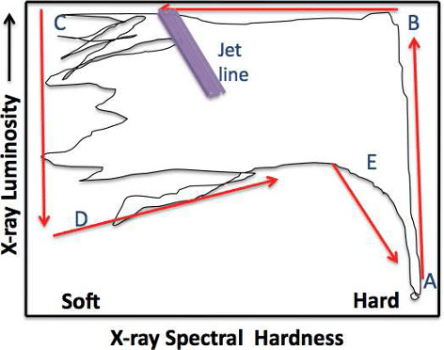
Evidence for Accretion States in SMBHs
State transitions in AGN are hard to observe because the viscous timescale is much longer
But population studies of AGN can place them on the Q diagram where BHXBs move around in during outburst
Marscher 2013
Kording 2006

Slide 6
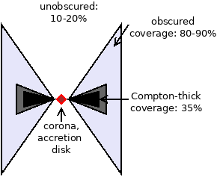
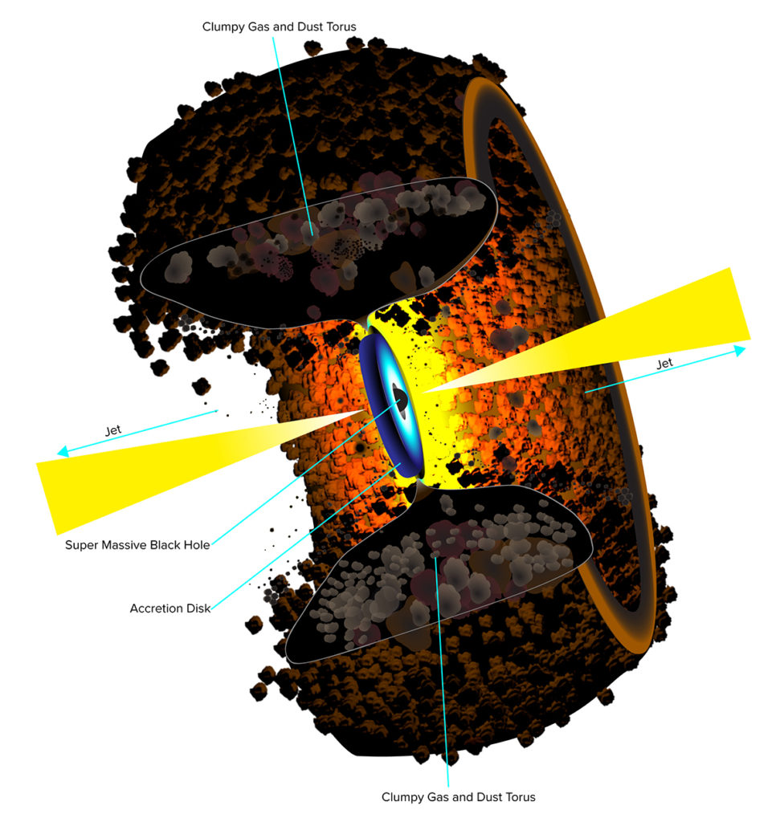
Obscured Black Holes
The majority of accreting supermassive black holes, and many accreting stellar black holes, are obscured
This is caused by a torus or funnel-shaped distribution of gas in the outer regions of the accretion flow
In these sources we cannot see the corona or accretion disk directly
We see X-ray radiation that scatters off the inner walls of the torus/funnel into our line of sight
This occurs when the opening angle of the torus/funnel is less than the inclination of the accretion disk
So typically these are high inclination sources, but can sometimes be low inclination
Dr. Buchner personal website
A more artistic rendition…
B.Saxton NRAO/AUI/NSF

Slide 7
Polarization Records Geometry
Krawczynski 2022

Slide 8
Polarization Doesn’t Depend on Mass
No trend is observed with mass
Evidence that accretion geometry doesn’t depend on black hole mass

Slide 9
Polarization Depends on Inclination
A trend is observed with inclination
Cyg X-3 is the main outlier
With Cyg X-3 the trend is not statistically significant
Without Cyg X-3 linear regression has a p-value of 0.003
This is expected…generally get higher polarization when observing things at higher inclinations

Slide 10
Polarization Properties in the Hard State
PA offset = PA – jet axis position angle
Note the blue cluster of points in the lower left with PD~ 2-4% and PAs parallel to system axis
This consists of BHXBs in the hard state, and AGN that are predicted to be in the hard state from their accretion rates
In the corona-dominated hard state, stellar black holes and supermassive black holes have the same polarization properties
This implies they have similar coronal geometry
Hard & unobscured

Slide 11
Black Hole Coronae Are Extended In Accretion Disk Plane
PA offset from system axis tells you something about geometry:
  Compton scattered radiation is polarized perpendicular to the plane of scattering
  So if PA parallel to system axis, plane of scattering is perpendicular to system axis
This means the corona in both supermassive and stellar black holes is extended in the plane perpendicular to the system axis

Slide 12
Polarization Properties in Soft State and Obscured Black Holes
Soft state black holes: PD is very low (≤1%)
PA appears to be parallel to system axis---polarization perhaps originating from accretion disk?
HOWEVER! Lack of solid detection for the two soft state sources with known system axes means this is very tentative
Obscured
Obscured black holes: PD is high (>10%)
PA is perpendicular to system axis
Soft & unobscured

Slide 13
Obscuring Material in Black Hole Systems Is Vertically Extended
PA perpendicular to system axis indicates region of scattering is extended parallel to the system axis
For the obscured AGN, this material presumably is the torus of gas and dust used to explain obscuration in optical/UV and X-ray
For Cyg X-3, the inclination is very low, so the obscuration might be due to a narrow funnel around the source

Slide 14
Conclusions & Future Observations Needed
All IXPE black holes in the hard state share similar polarization properties
All IXPE black holes for which corona is directly observed appear to have coronas that are extended in the accretion disk plane
This is tentative evidence against some corona models (e.g. lamppost, conical outflow)
This raises the possibility that high SNR polarimetric observations of stellar black holes can inform our understanding of the polarimetric properties of AGN
  AGN are much harder for IXPE to observe
We need more polarimetric observations of black holes so we have larger sample sizes
We need deeper observations of soft state stellar black holes to detect polarization and measure the orientation of their PAs
Observations of soft state AGN are also very well motivated—they provide the only way of measuring the polarization properties of the corona in a soft state black hole
  In soft state stellar black holes the X-ray emission from the accretion disk dominates over the corona. In a soft state SMBH the accretion disk would not emit in the X-rays so the corona would always be visible

Slide 15

THANK YOU

