Slide 1
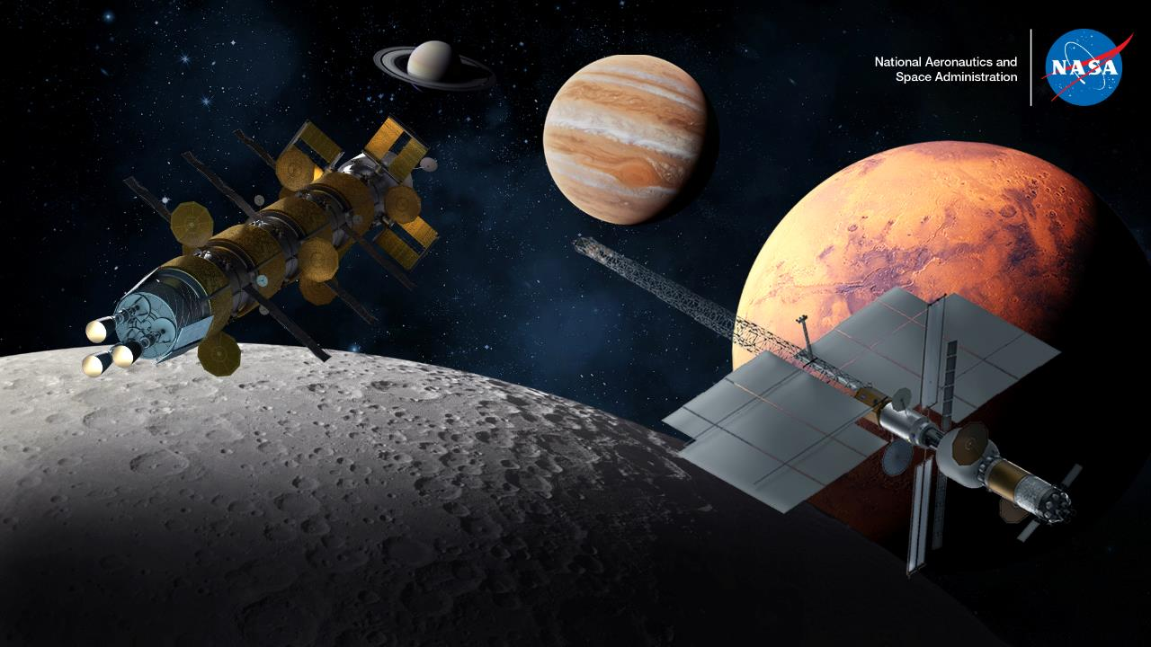
Space Nuclear Propulsion 101
Space Technology Mission Directorate
Space Nuclear Propulsion

Slide 2
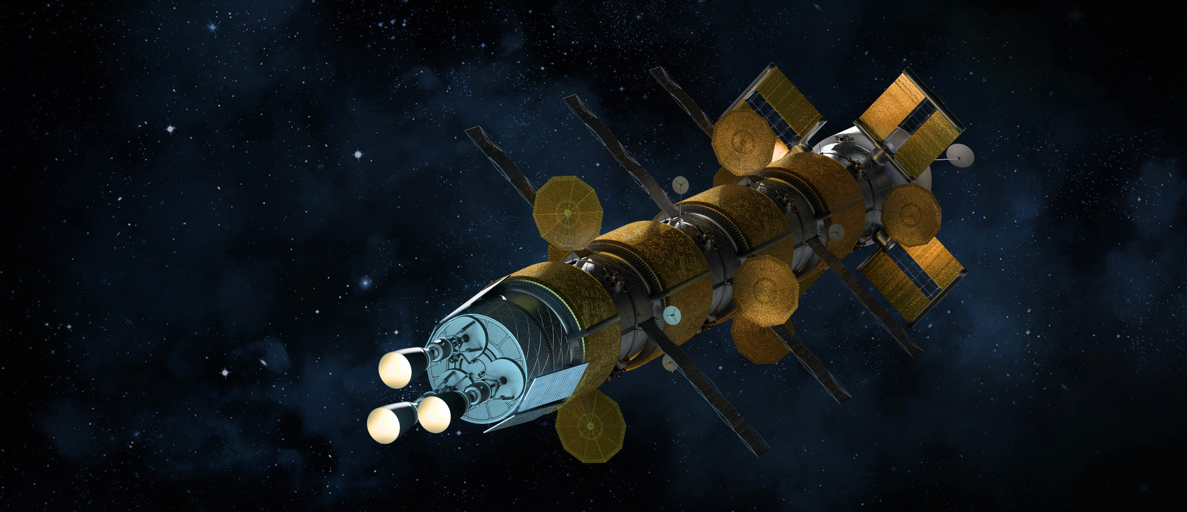
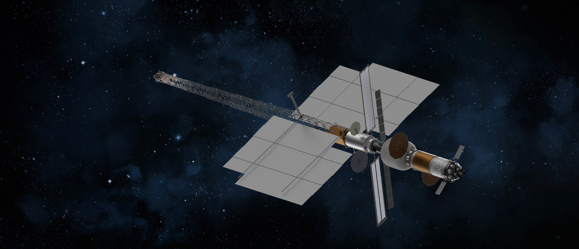
NASA Space Nuclear Propulsion (SNP)
Overview
Vision
Robust and enduring access to destinations throughout the solar system
Space Nuclear Propulsion is an enabling capability
Nuclear Thermal Propulsion (NTP)
Nuclear Heat
Heat Propellant
Exhaust Through Nozzle
High Thrust / 2x Chem Prop Efficiency
Thrusting 4-8 times for thirty minutes for a Mars mission
Nuclear Electric Propulsion (NEP)
Nuclear Heat
Generate Electricity
Electrically Accelerate Plasma
Low Thrust / ≥ 5-10x Chem Prop Efficiency
Thrusting ≥ 20,000 hours for a Mars mission

Slide 3
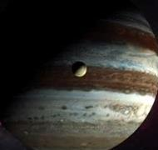
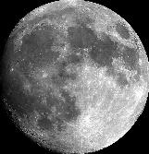

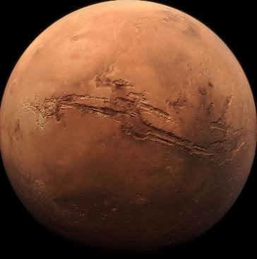
Why Nuclear Propulsion?
Floor performance is 2X current chemical systems
Crewed Interplanetary Missions
Next-Generation Science Missions
Reduced transit times and exposure to space hazards (space radiation, microgravity, prolonged confinement)
Increased robustness: larger launch windows, more abort and contingency opportunities
Maximize payload, enable more science at the destination
Increased power capability to enabling more science
Reduced mission times – achieve objectives sooner
Space Nuclear Propulsion Mission Spaces
Orbital Transfers, Loitering, and Maneuvering
Cis-Lunar Maneuvering and Transportation
Deep Space Exploration and Science
Mars Cargo and Crew Transit

Slide 4
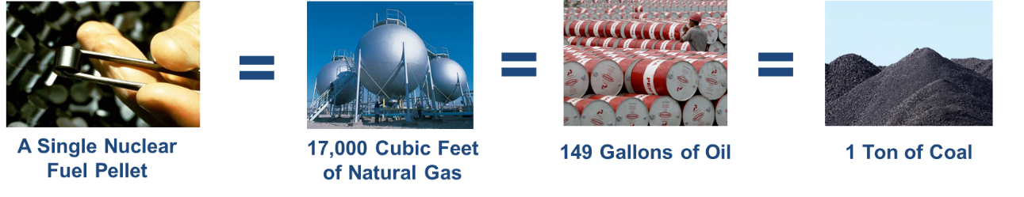
Benefits of Nuclear
Fission provides the potential for the highest power density per unit mass

Slide 5
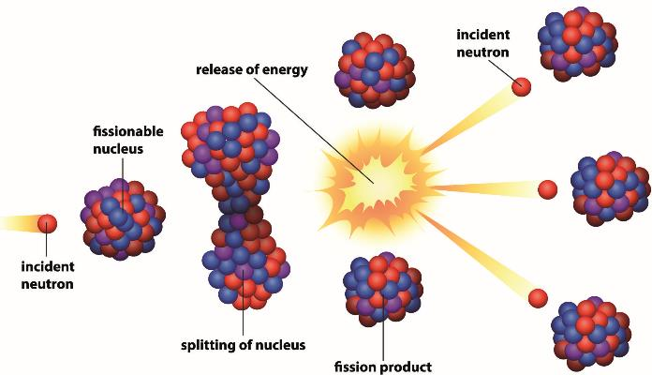

How Fission Works
Two fundamental ingredients: neutron and an atom

Slide 6
How Fission Works
Decomposition of the unstable new nucleus results in the release of energy, fission products, and subatomic particles

Slide 7
How Fission Works
New neutrons produced from fission keep the process going as a chain reaction, making energy generation continuous

Slide 8
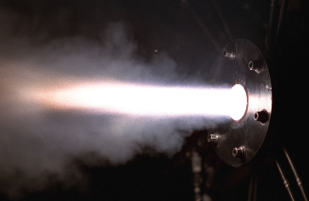


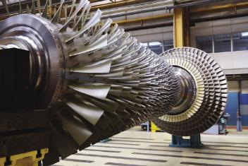


There are two options for NASA to use the energy from fission once it’s produced
Use Energy to Heat a Propellant
Convert Energy into Electricity

Slide 9



Historic NTP Programs
USSR Solid-Solution Carbide Fuels (1955-1993)
NASA’s SNP Project
(FY20 – Present)
1950
1960
1970
1980
1990
2000
2010
2020
NERVA/Rover
(1955 – 1972)
Space Nuclear Thermal Propulsion
(1987 – 1993)
Recent NASA NTP Development
(2010-2019)
Cermet Development
ANL, NASA LeRC, GE 710
(1962-1968)

Slide 10
Historic NEP Programs
TOPAZ (1970 – 1989)
Romashka (1964 – 1966)
Buk (1970 – 1988)
NASA’s SNP Project
(FY20 – Present)
1950
1960
1970
1980
1990
2000
2010
2020
SNAP Program (1957 – 1973)
SP-100 Program
(1983 – 1993)
Project Prometheus
(2003 – 2006)

Slide 11
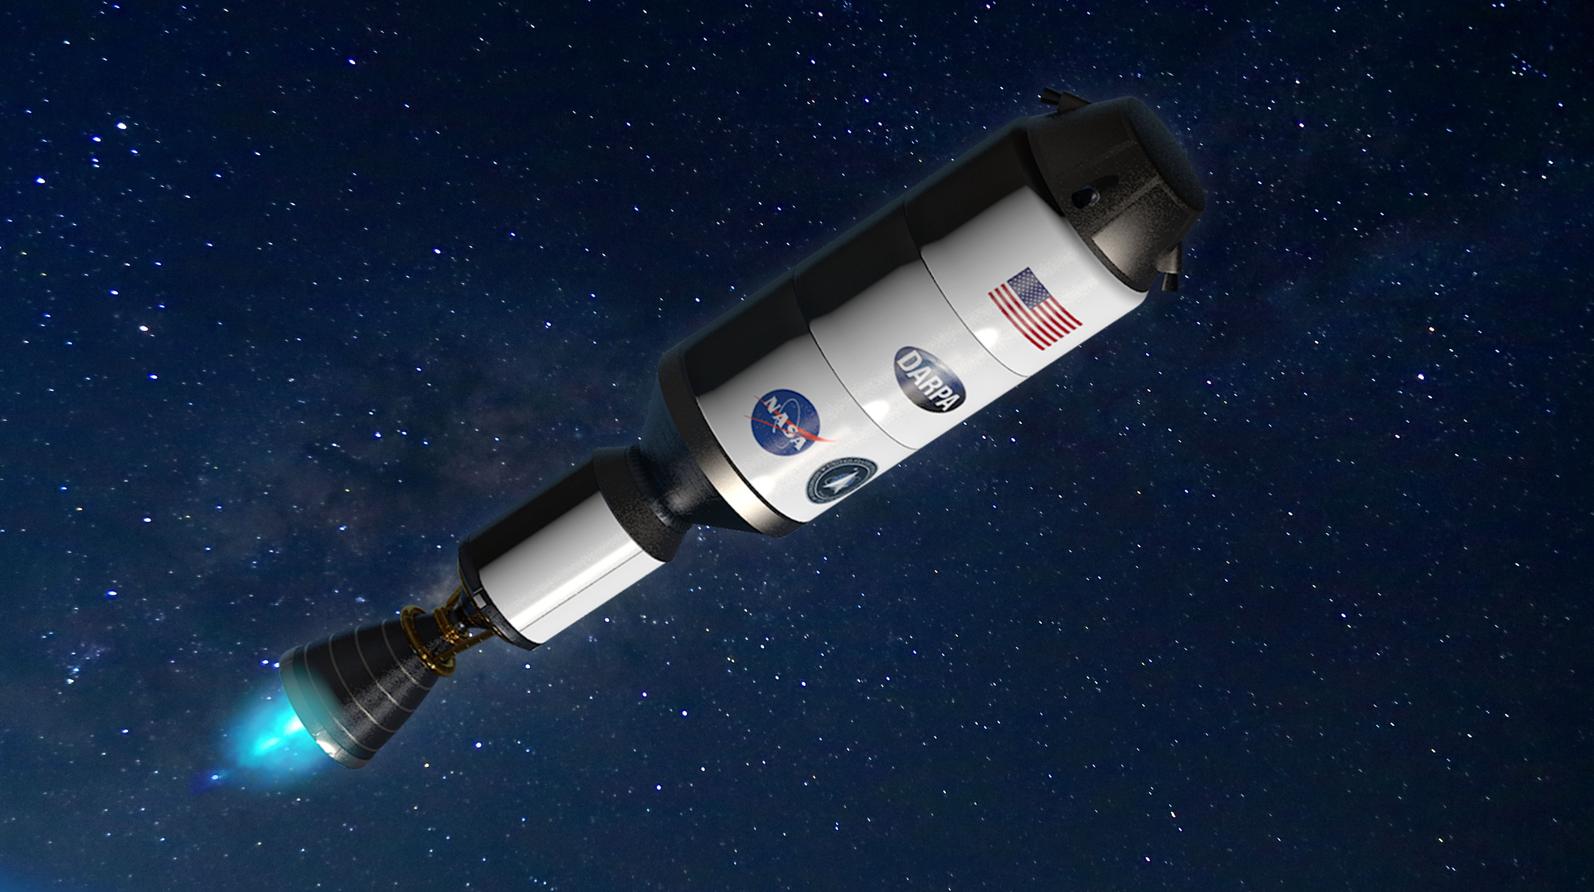
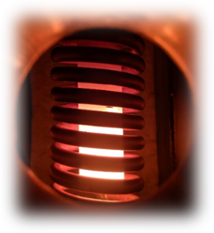
Current Development to Support NTP Systems
Partnering with DARPA on the DRACO flight demonstration
Reactor development (Government + 2 industry designs)
Developments include
Fuel and other materials development and testing
Engine development and integration
Non-nuclear engine development
Instrumentation and control
Risk reduction
Ground and flight test development
Safety & Mission Assurance
_{DRACO concept}
_{Fuel specimen testing}
Notes:
*Fuel specimen testing: In CFEET

Slide 12
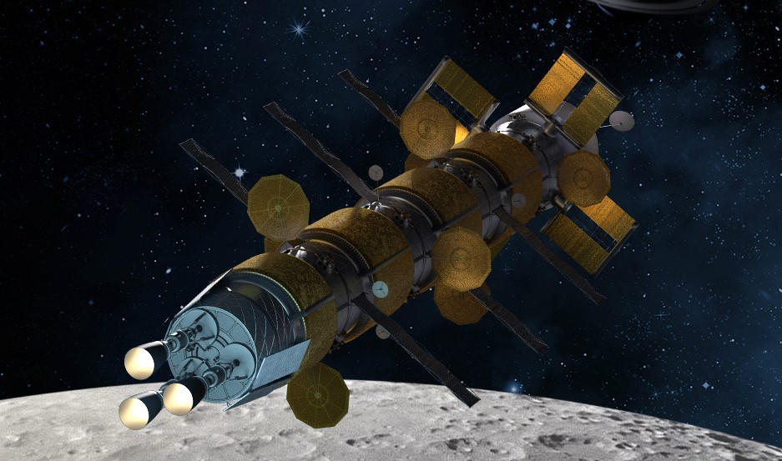
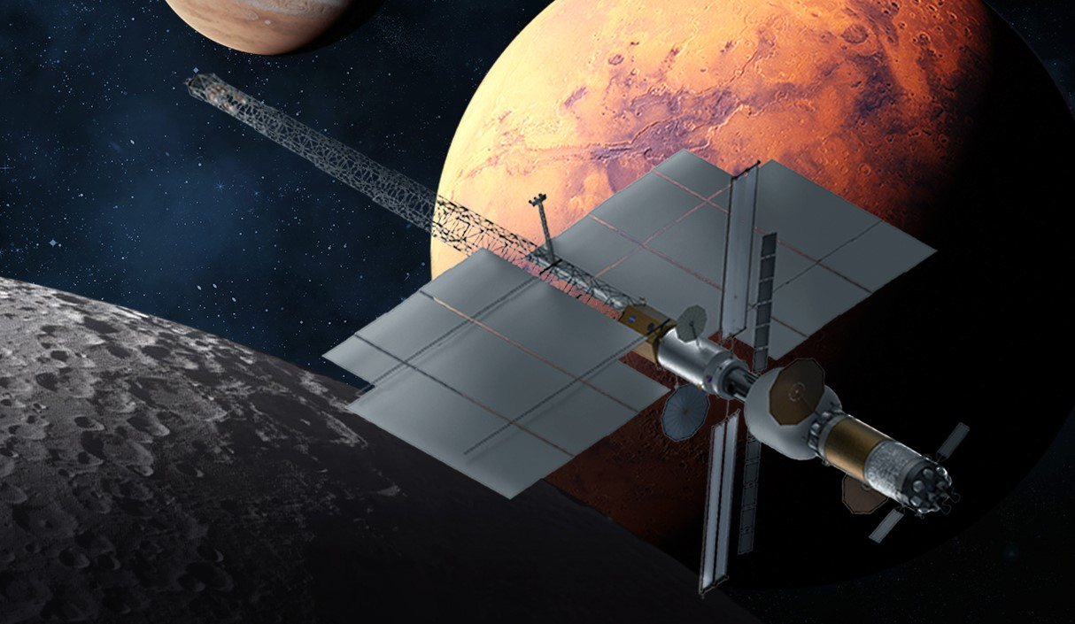
Space nuclear propulsion technologies meet NASA’s advanced propulsion needs
Both NTP and NEP enable faster crewed trip times to Mars as well as faster and more capable science missions
  This is a huge advantage to reduce crew exposure to space hazards and to do more science!
NASA’s Space Nuclear Propulsion Project is leading the nation
  Advancing space nuclear technologies by partnering NASA centers and resources with Department of Energy labs and Department of Defense projects
  Performing the development and technology maturation needed to reliably use nuclear propulsion
  Executing (with DARPA) the first in-space flight demonstration of an NTP system
  Testing facilities within the government provide unique test environments for understanding reactor material performance under extreme nuclear conditions
_{NTP concept}
_{NEP concept}

Slide 13
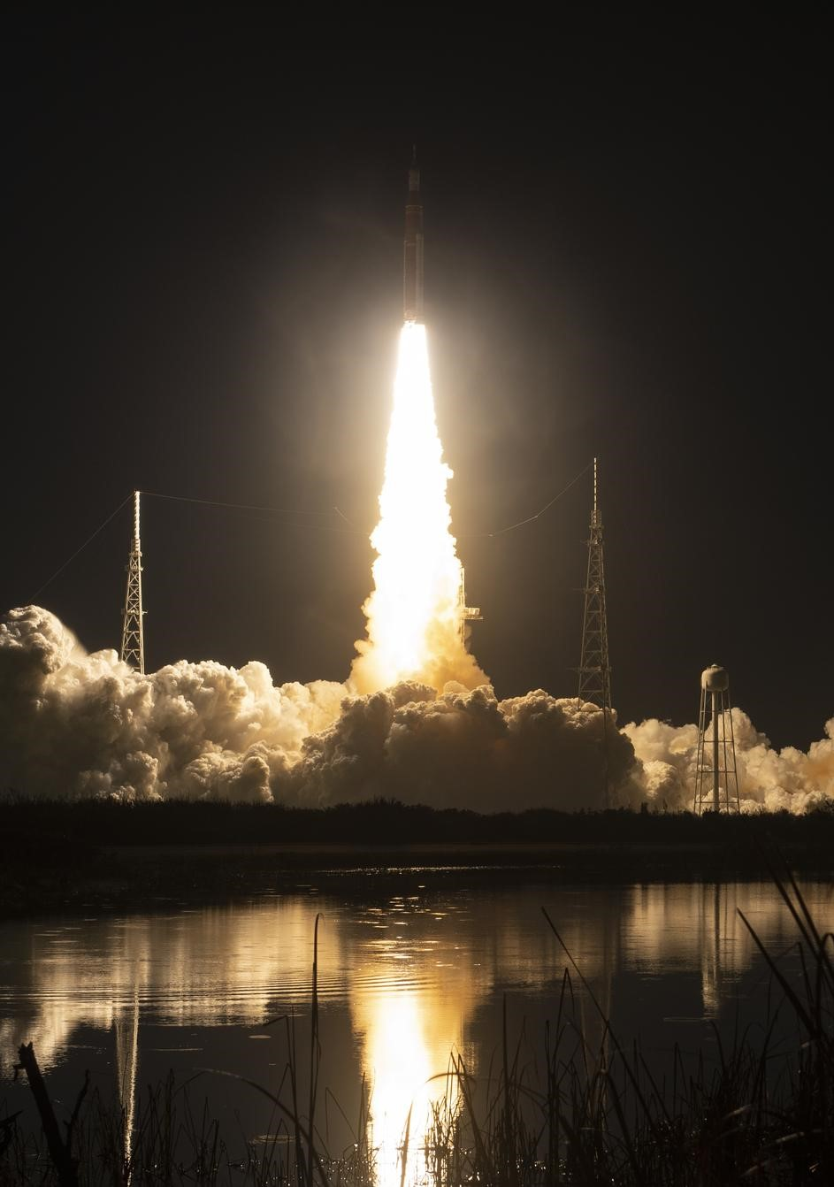
Nuclear Safety is Key
Nuclear fuel, prior to use, can be held in your hand with no adverse effects
The U.S. has made nuclear reactor technologies incredibly safe over the last 50 years, leading to better safety metrics than even wind and hydroelectric power
Chemical propulsion – like that used for Apollo, space shuttle, and Artemis – is expected to be used for launch
Space reactor systems are inactive and produce NO radiation through launch since they don't begin operation until they reach a nuclear safe orbit
Nuclear-powered spacecraft will be placed in orbits that have a decay lifetime which greatly exceeds the time required for any radioactivity to reduce to a safe limit
_{Artemis I launch}

Slide 14

Learn more, and stay up to date with
everything Space Nuclear Propulsion
https://go.nasa.gov/SNP

