Slide 1

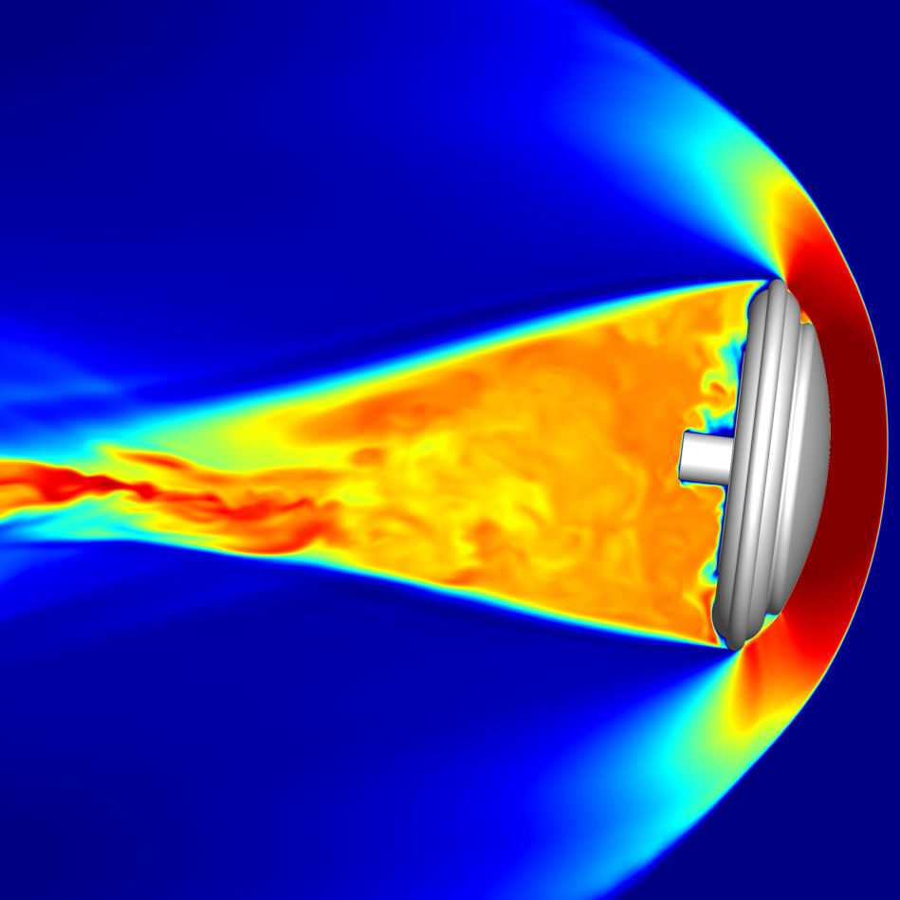
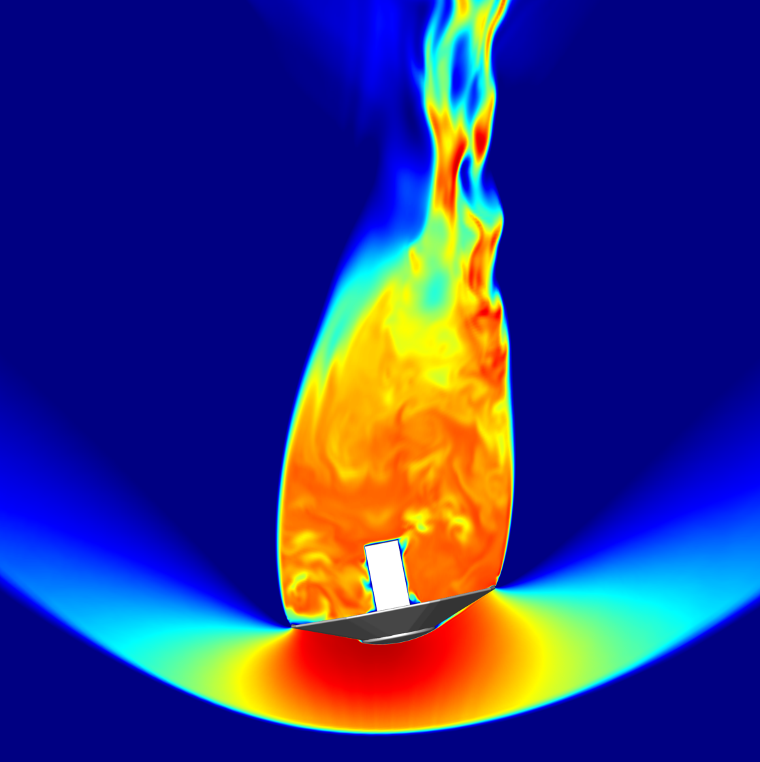
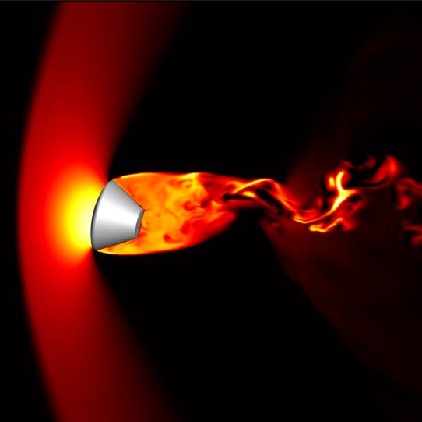
  Rathakrishnan Bhaskaran
  AMA Inc. at NASA Ames Research Center
Towards Reentry Capsule Dynamic Stability Prediction: Recent Experience using PyFR for Capsule Wake Flow
  With Contributions from: Eric Stern, Dirk Ekelschot,
  Joseph Brock & Kyle Thompson (LaRC)

Slide 2
Outline
Objectives
Background: Capsule Dynamic Stability
  Reentry capsule design and dynamic stability considerations
  Free-flight CFD: Computational tools for dynamic stability prediction
  Need for new tools for modern HPC hardware
Test case: Viking’75 capsule wake prediction
PyFR development needs for dynamic stability
Conclusions
PyFR Seminar, September 5, 2024

Slide 3
Objectives
Gain experience with exascale ready high-order solver for capsule reentry problems
  Benchmark high-order GPU solver’s accuracy and speed against experimental data and workhorse finite volume solver US3D for static capsule wake flow problem
Static wake prediction as first step towards 6-DoF prediction for dynamic stability
PyFR Seminar, September 5, 2024

Slide 4
Background:
Capsule Dynamic Stability

Slide 5
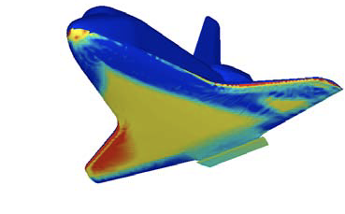
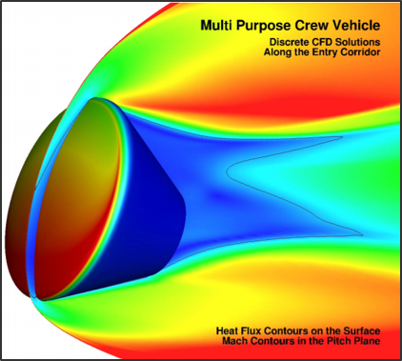
Entry, Descent and Landing
NASA interplanetary missions involve entering planetary atmospheres at extremely high speed
  “Entry, Descent and Landing” (EDL) phase of a mission
  Computational Fluid Dynamics (CFD) is employed to understand complex high-energy gas dynamics
A vehicle heat shield is required to protect against the intense heat generated by air resistance
  Lifting entry: Shuttle orbiter was a wing-body design that used a tile system for the heat shield
  Ballistic entry: Eg. Stardust/O-Rex/EES. Apollo/Orion/MSL feature blunt-body capsule designs with low L/D.
Space Shuttle
Crew module
PyFR Seminar, September 5, 2024

Slide 6
Benefits of Blunt-body Capsule Design
Blunt body capsule design is the most common design for interplanetary missions
  For eg., NASA’s flagship missions to Mars (MSR) and Titan (Dragonfly) will feature blunt body capsules
  Heat shield can be designed to withstand higher temperatures and heating rates
  Blunt shape keeps high-temperature bow shock away from the heat shield surface
Fishtail
shock
Wake shear layer
Bow shock
PyFR Seminar, September 5, 2024

Slide 7
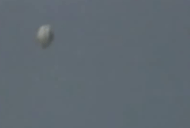
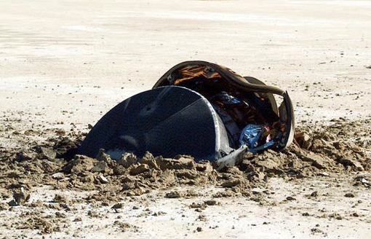
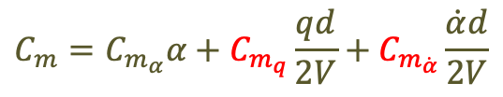
Blunt-body Capsule Dynamic Instability
Blunt-body capsules are subject to dynamic instabilities at low-supersonic and transonic Mach numbers
Dynamic stability typically characterized via experiments: forced-, free-to-oscillate, and ballistic range
  These methods have a long pedigree of producing dynamic aero for missions
  However, each method has drawbacks resulting in uncertain predictions
  Insufficient data to retire dynamic stability risks between Mach 2 and subsonic regime
NASA investing in free-flight CFD capability in US3D flow solver
$$C_{m}=C_{m_{α}}α+C_{m_{q}}\frac{qd}{2V}+C_{m_{\dot{α}}}\frac{\dot{α}d}{2V}$$
Genesis Sample Return
Capsule (Desai, NASA LaRC)
PyFR Seminar, September 5, 2024

Slide 8
US3D Flow Solver Overview
Primary developed at the University of Minnesota (Prof. Graham Candler)
  3D, parallel, cell-centered finite-volume Navier-Stokes solver written in Fortran 95
    Ability to solve on structured, unstructured, and hybrid grid topologies
    Spatial flux schemes
        2nd and 3rd order upwind fluxes
        2nd, 4th, and 6th order Kinetic Energy Consistent (KEC), low-dissipation fluxes
    Time integration schemes
      3rd order explicit (RK3)
      2nd order implicit (DPLR and FMPR) schemes
    Finite Rate chemistry and vibrational-electronic energy relaxation
    Turbulence modeling
      Algebraic Baldwin Lomax model
      One equation Sapalart-Almaras model
      K-Omega / Shear-Stress-Transport (SST) models
      Hybrid RANS-LES flavors including DES97, DDES and IDDES
PyFR Seminar, September 5, 2024

Slide 9
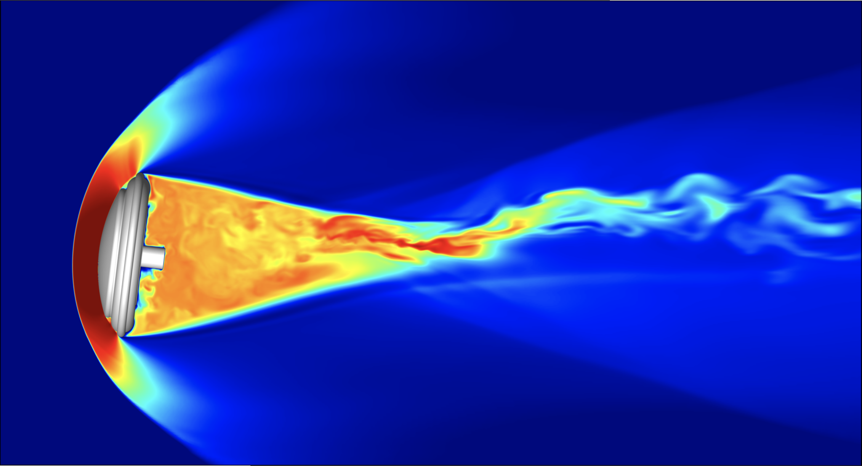
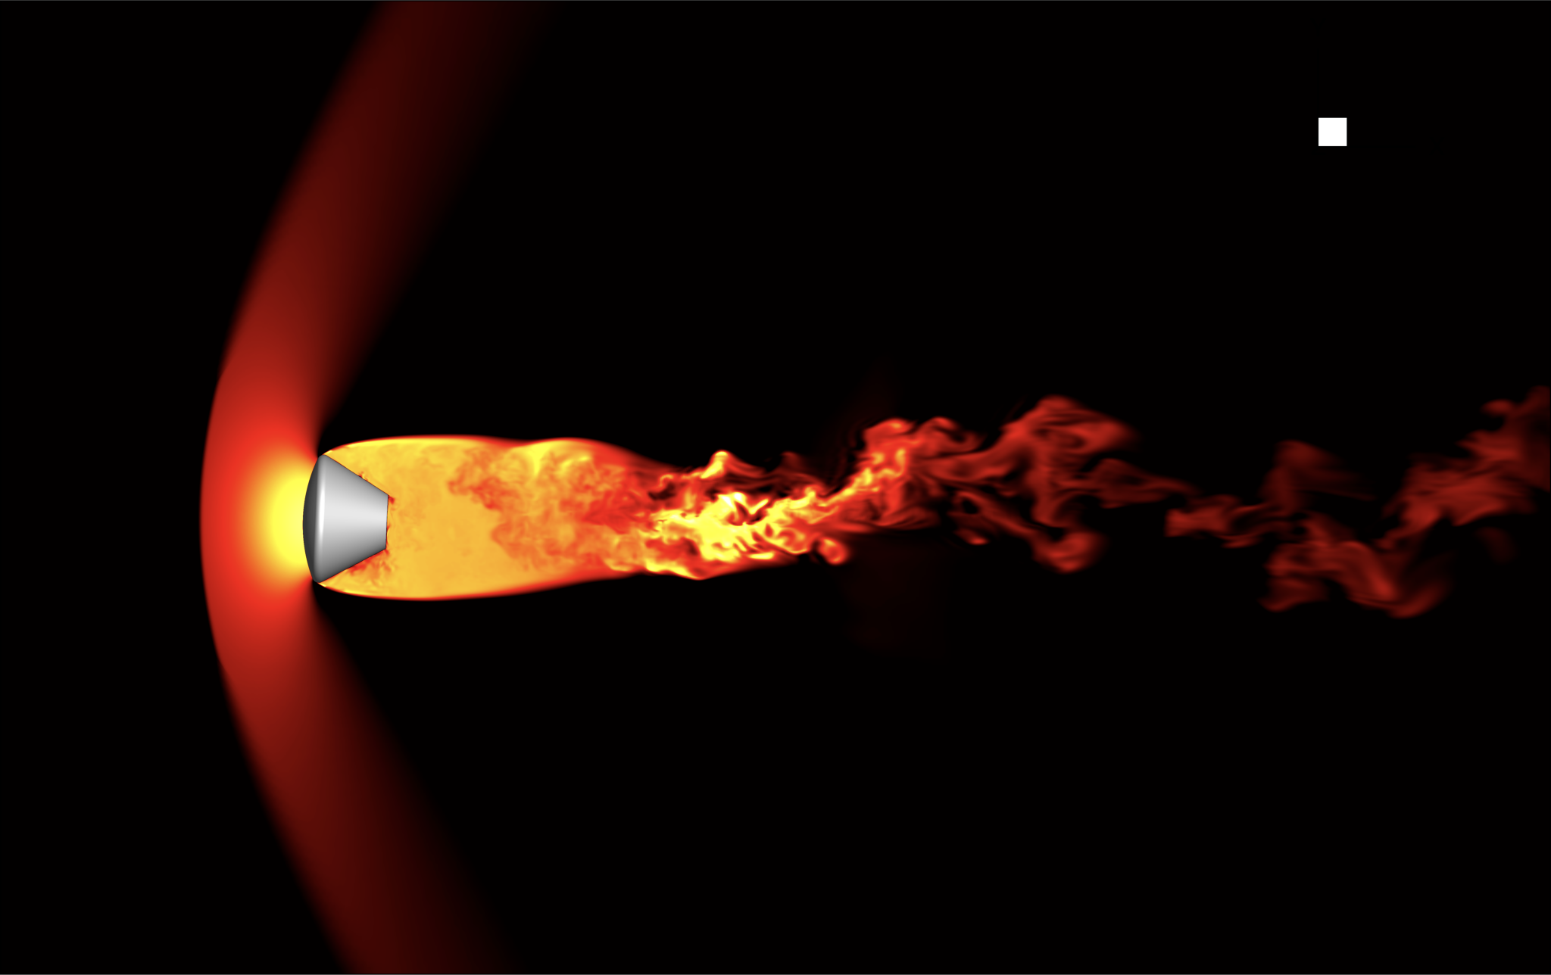
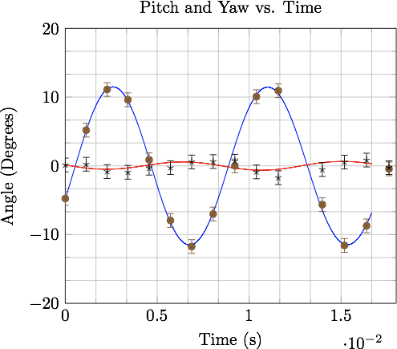
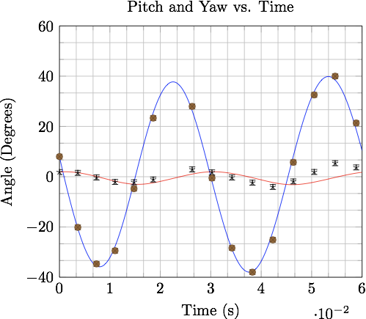
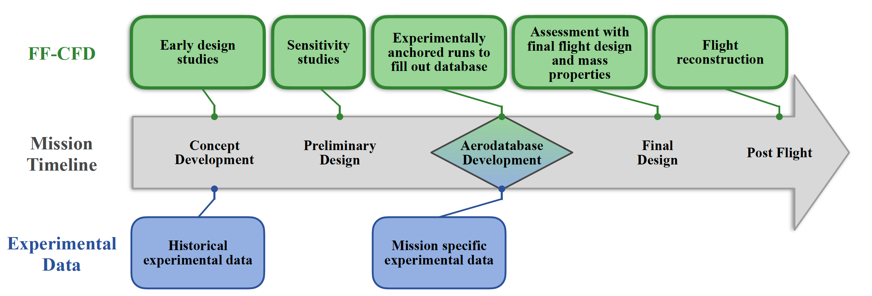
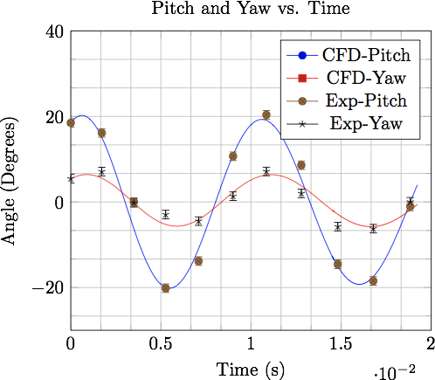
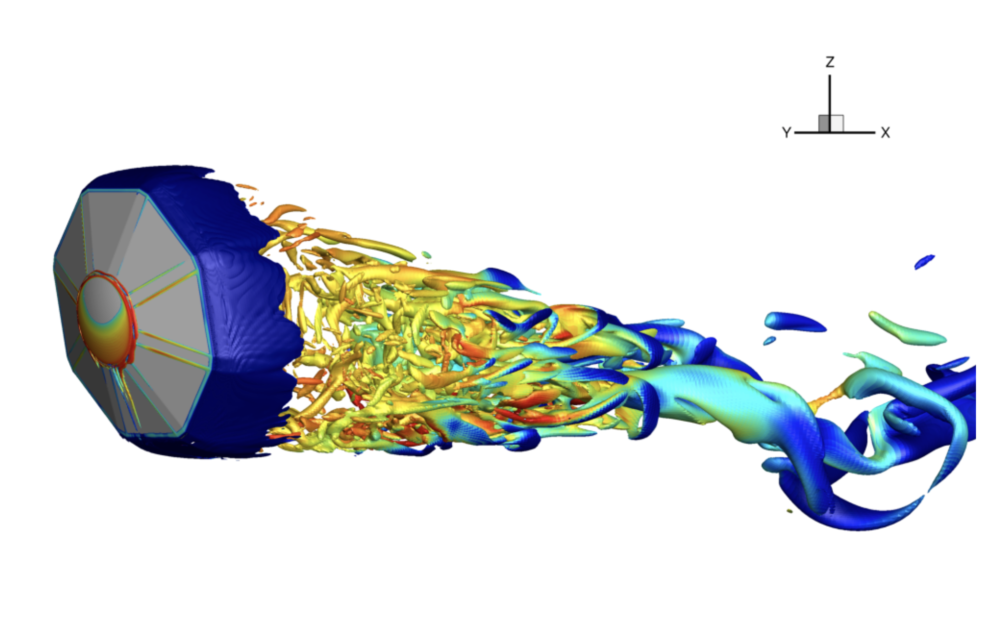
US3D Free-Flight Plugin
NASA’s Entry Systems and Modeling (ESM) Project has invested in a Free-Flight Computational Fluid Dynamics (FF-CFD) plugin for US3D to build a computational tool for characterizing dynamic stability
  6-DoF free-flight simulation capability
  Hybrid RANS-LES for unsteady wake dynamics
  Simulations validated with ballistic range data
Mach: 3.8-2.9
Mach: 1.1-1.0
Mach: 2.4-1.2
FF-CFD can be useful in all phases of NASA missions
Various Entry Capsule FF-CFD Simulations (Brock and Stern)
PyFR Seminar, September 5, 2024

Slide 10
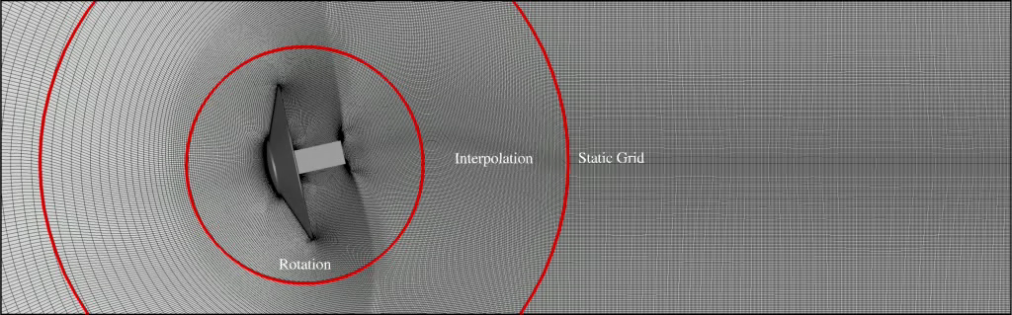
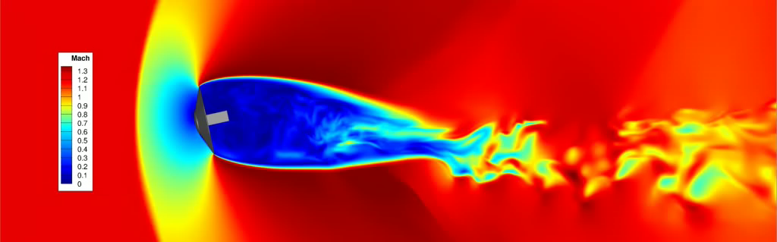
Free-Flight CFD Process
US3D computes the flow field
Forces & moments on the vehicle obtained using the flow information
Forces & moments used to adjust vehicle orientation
Mesh is deformed to reflect new vehicle orientation
Free-Flight CFD Solver Loop
FF-CFD simulation in US3D (Brock et al.)
PyFR Seminar, September 5, 2024

Slide 11
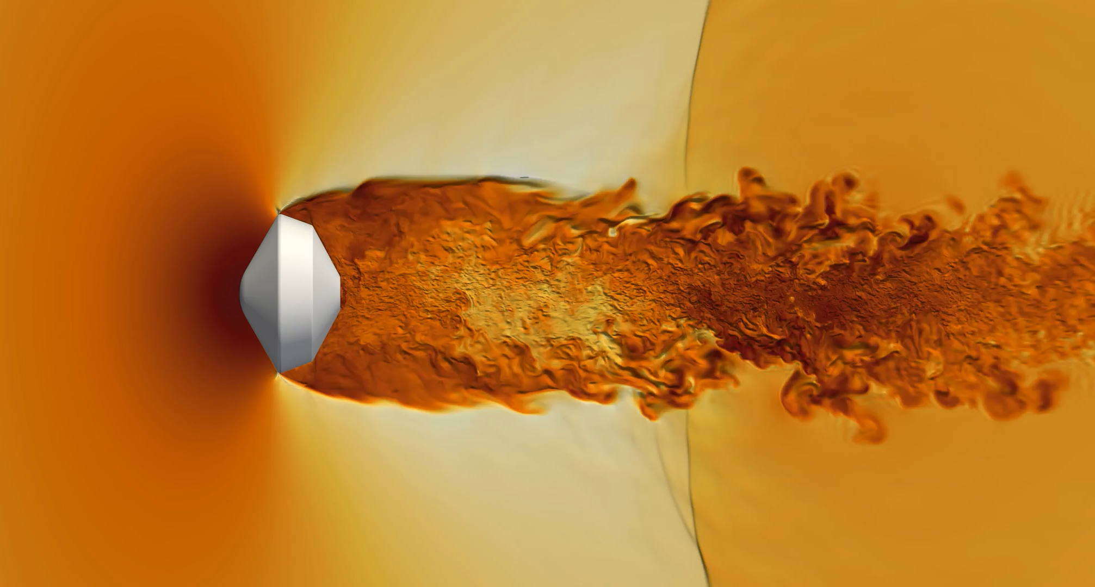
Computationally Intensive Simulations
These free-flight simulations are a powerful but computationally expensive tool for engineering analysis, with a single simulation requiring about 250,000 CPU core hours (~10 days on 1000 cores)
Dragonfly Capsule (Stern)
Can we do better?
PyFR Seminar, September 5, 2024

Slide 12
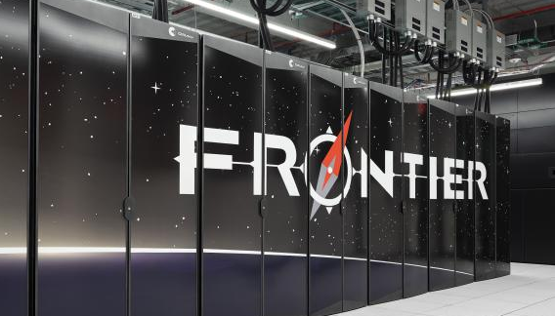
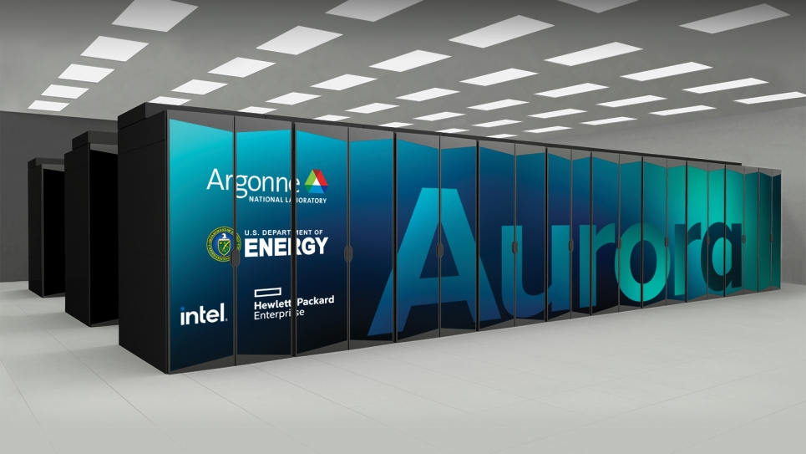
HPC Hardware Landscape
OLCF Frontier
(AMD MI250X)
ALCF Aurora
(Intel GPU Max)
NNSC El Capitan
(AMD MI300A)
GPUs are the main performance accelerators on modern HPC
  All 3 US based exascale computers use GPUs
  9 of the top 10 supercomputers currently run on GPUs according to the June 2024 Top 500 List (https://www.top500.org)
PyFR Seminar, September 5, 2024

Slide 13
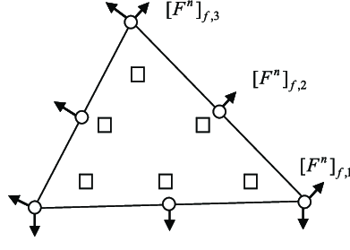
PyFR Flow Solver Overview
Open-source solver, primarily developed by Imperial College / Texas A&M
  3D, parallel, high-order Euler/Navier-Stokes solver written in Python/Mako
    Ability to solve on unstructured grids
    Flux Reconstruction scheme
        Solution represented as a polynomial
        Discontinuous across element boundaries
        High-order by adding internal solution points
        Number of solution points scale roughly as P3
    Time integration schemes
      3rd / 4th order explicit Runge-Kutta
      2nd order implicit (dual time stepping) schemes
    Turbulence modeling
      DNS / Implicit LES
    Exascale ready, supports many compute platforms, including GPUs
Solution and flux points for a triangle at P2 (Huynh et al, 2013)
P-order | Tetra | Pyramid | Prism | Hexa
0 | 1 | 1 | 1 | 1
1 | 4 | 5 | 6 | 8
2 | 10 | 14 | 18 | 27
3 | 20 | 30 | 40 | 64
4 | 35 | 55 | 75 | 125
5 | 56 | 91 | 126 | 216
Solution points count for element type & P-order
PyFR Seminar, September 5, 2024

Slide 14
Viking’75 Test Case

Slide 15
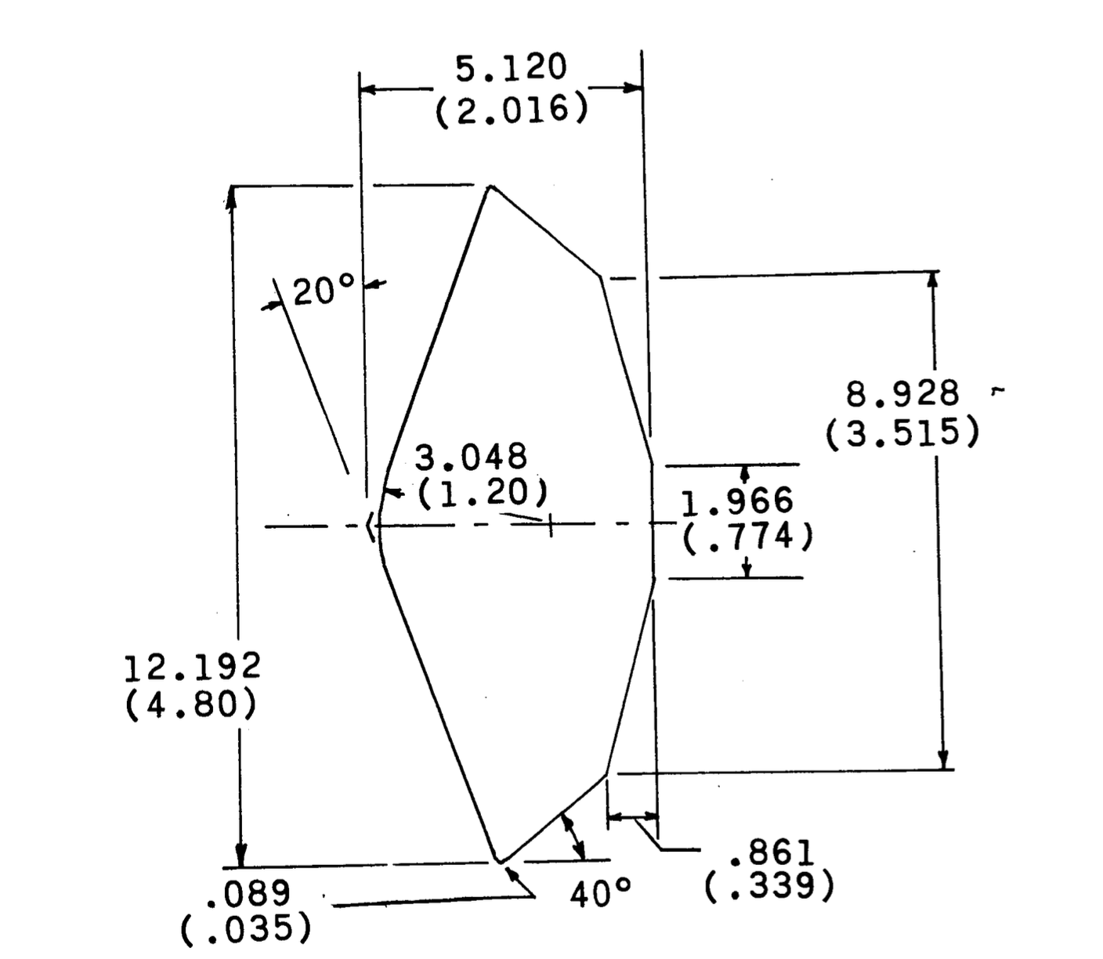
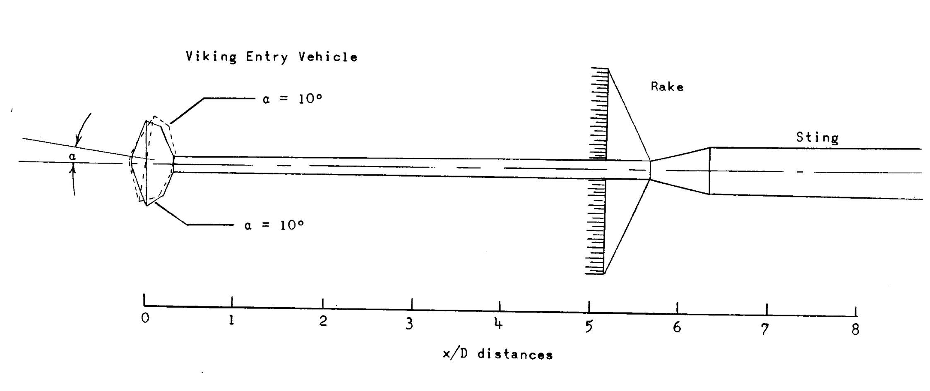
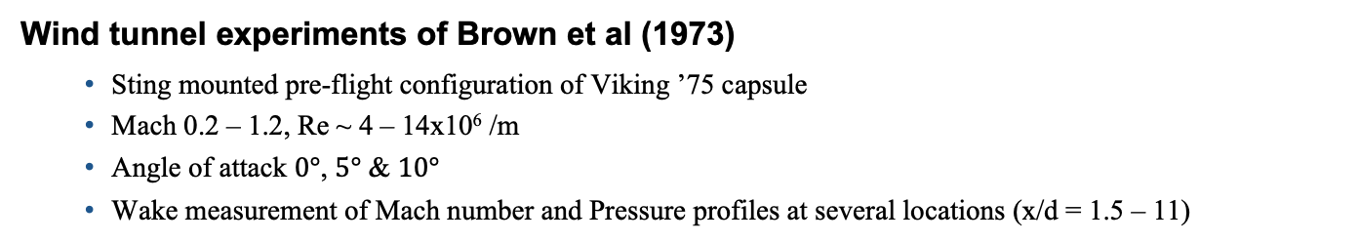
Test Case: Viking ’75 Experiment
Wind tunnel experiments of Brown et al (1973)
  Sting mounted pre-flight configuration of Viking ’75 capsule
  Mach 0.2 – 1.2, Re ~ 4 – 14x10⁶ /m
  Angle of attack $0°$, $5°$ & $10°$
  Wake measurement of Mach number and Pressure profiles at several locations (x/d = 1.5 – 11)
PyFR Seminar, September 5, 2024

Slide 16
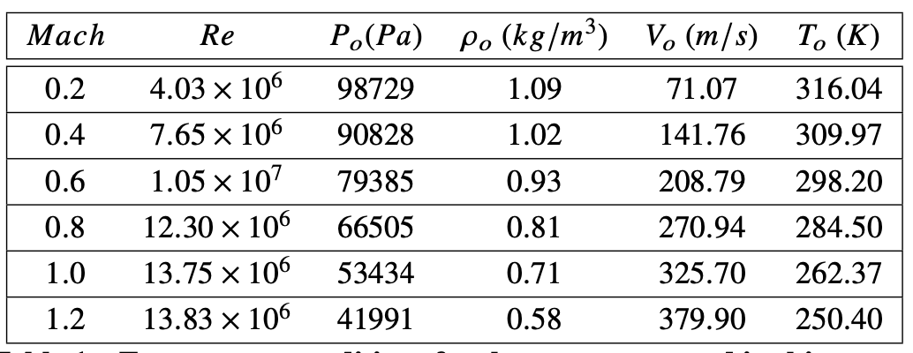
Boundary Conditions
Free-stream conditions for the simulations
Angle of attack of $0°$
Free-stream temperature obtained using a Newton solver to match measured total pressure, pressure and Reynolds number
PyFR Seminar, September 5, 2024

Slide 17
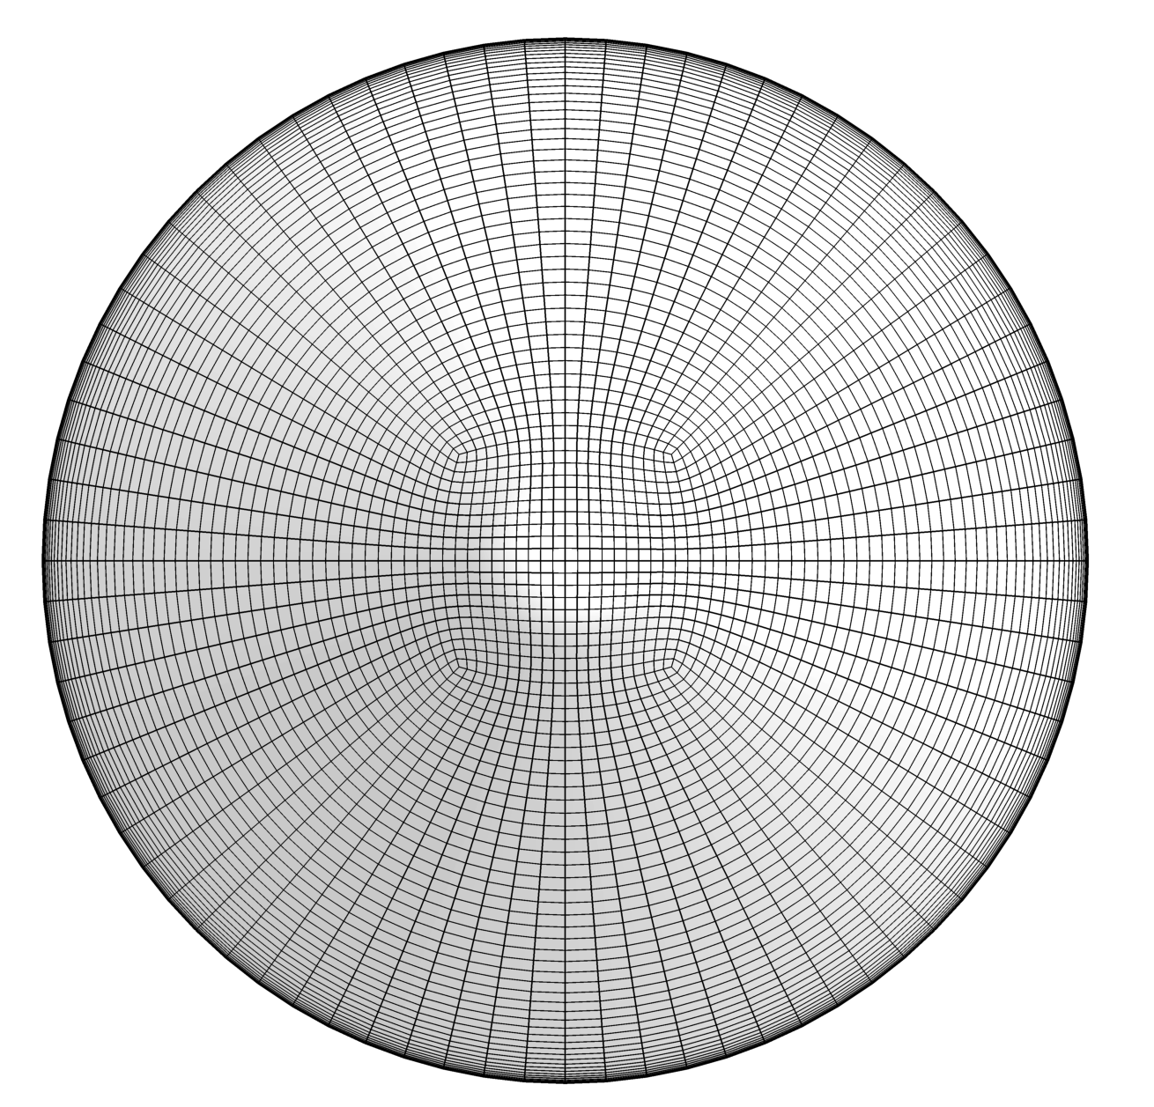
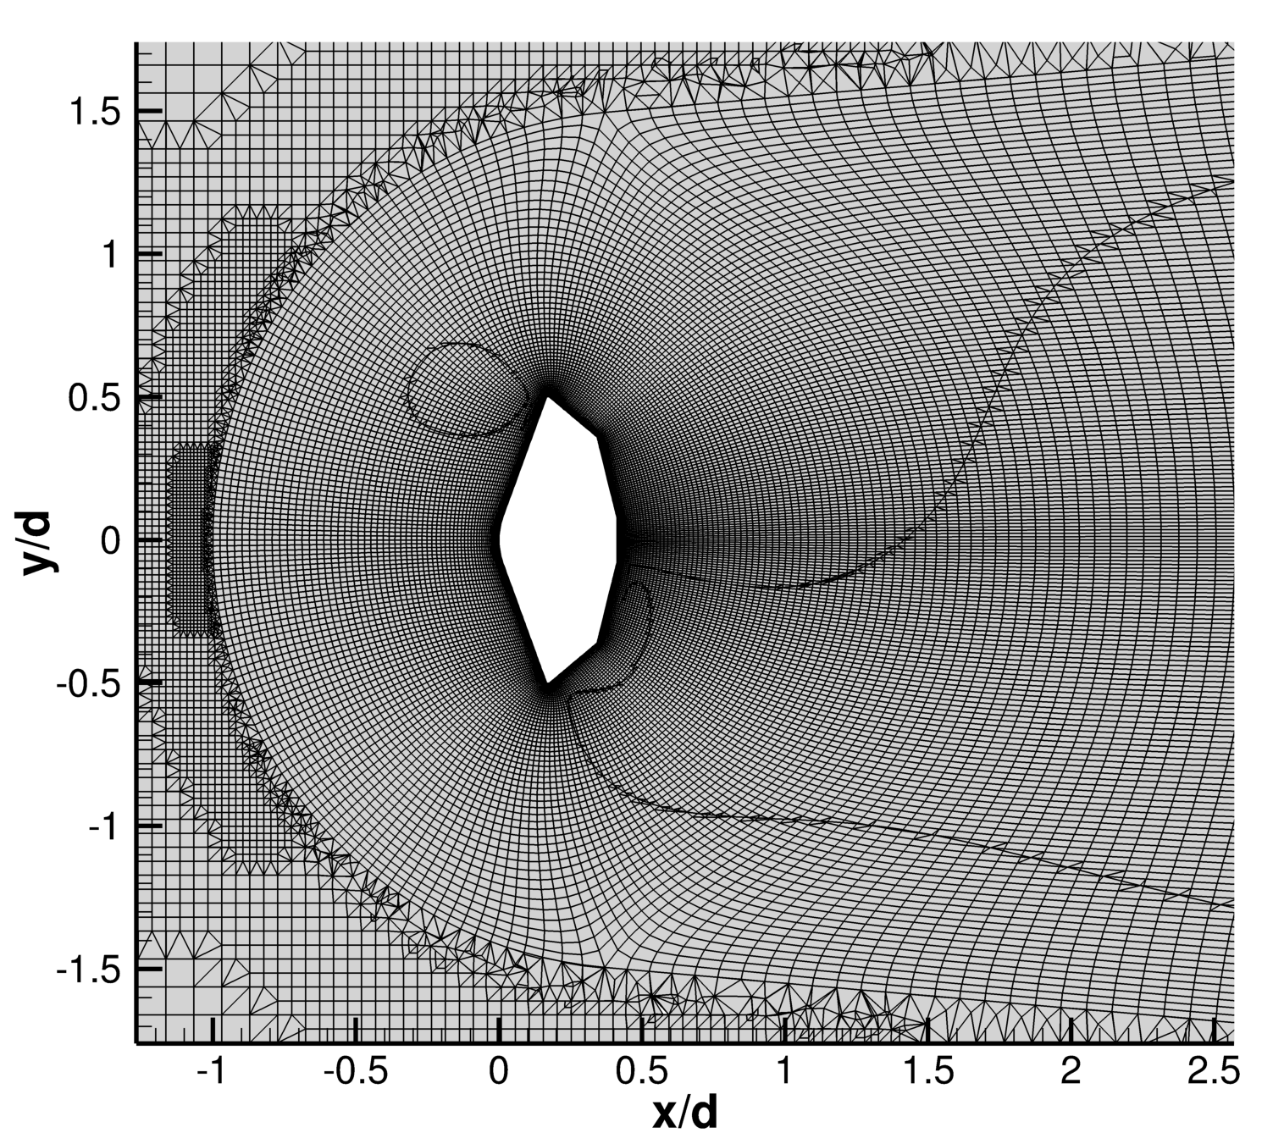
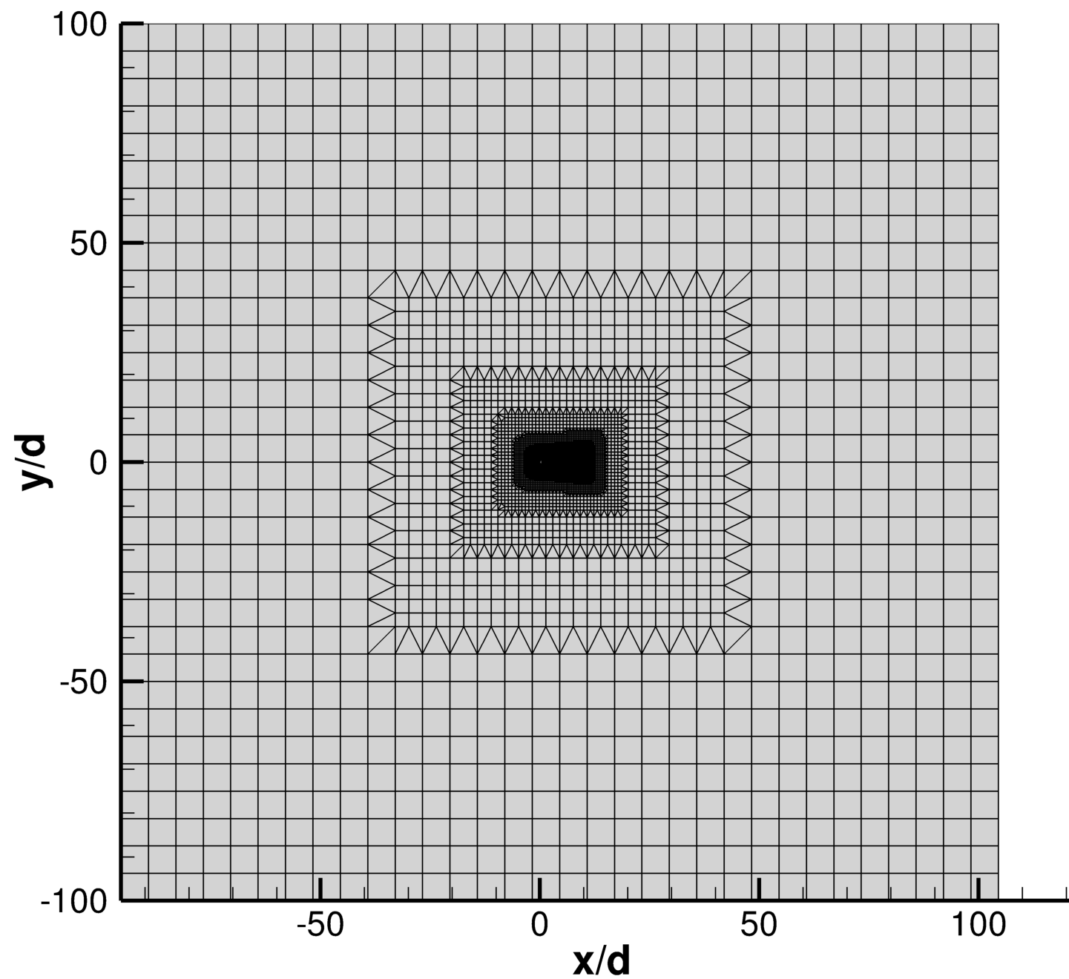
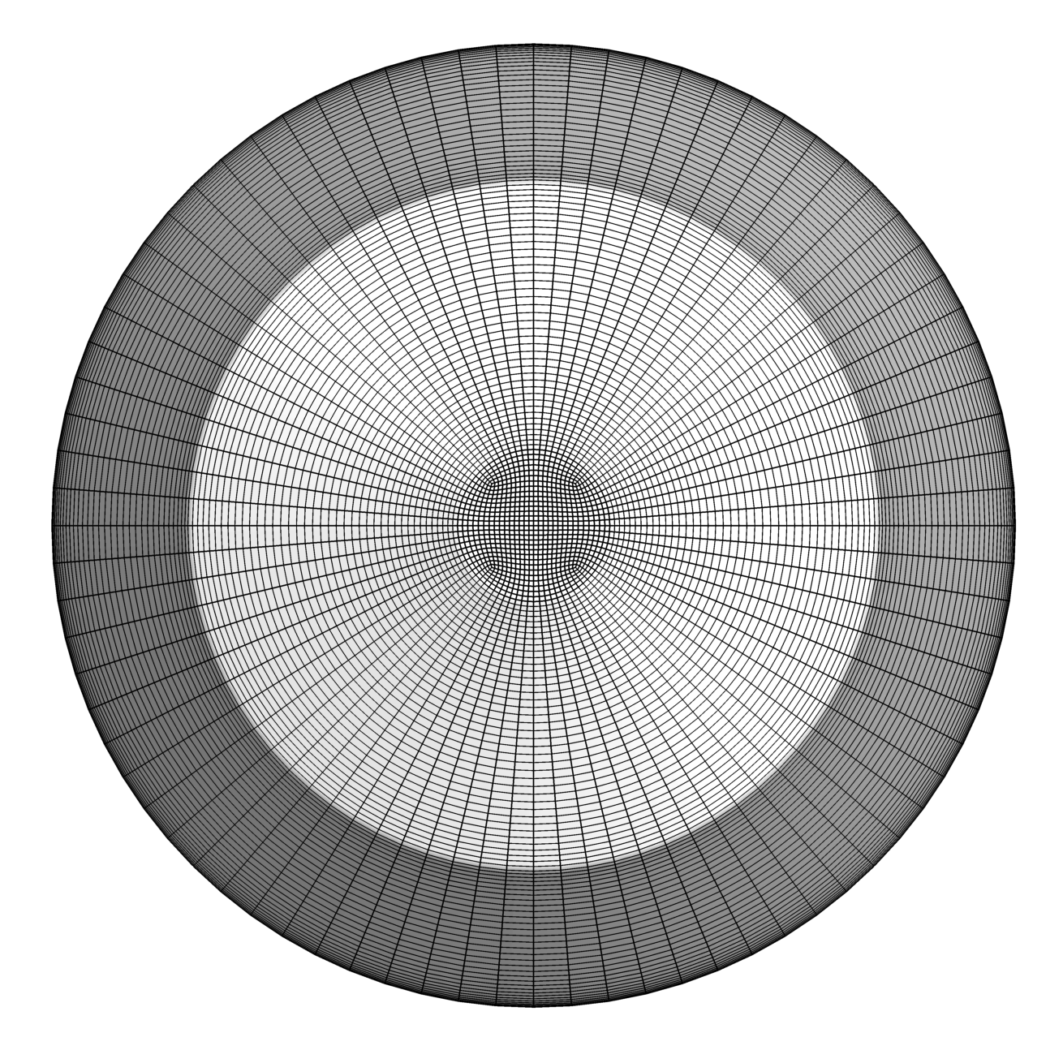
Computational Grid: US3D
Isothermal wall
Mesh | Size (M)
Coarse | 3.5
Medium | 14.4
Fine | 96.1
Heat shield (coarse)
Inflow
Outflow
Back shell (coarse)
PyFR Seminar, September 5, 2024

Slide 18
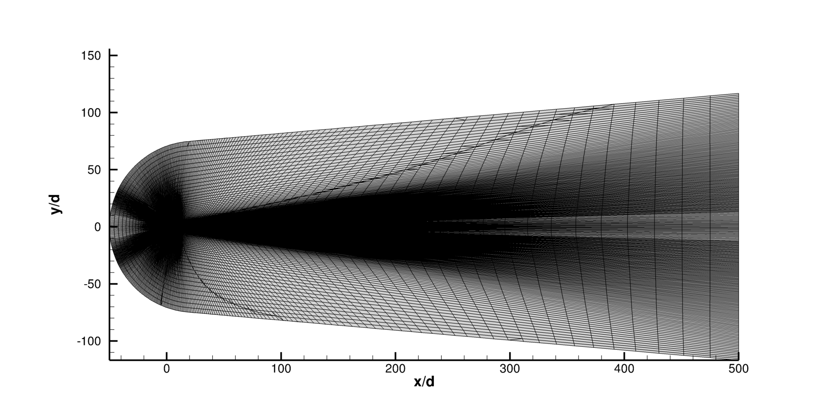
Computational Grid: PyFR
P-Order | DoF (M)
P1 | 28.5
P2 | 96.1
Same grid around capsule and wake as US3D (coarse)
Extended hex mesh to Far-field
Riemann Invariants BCs applied at free-stream
PyFR Seminar, September 5, 2024

Slide 19
Solvers Settings
 | US3D | PyFR
Version | 1.1.18 | 2.0.0
Method | Finite Volume | Flux Reconstruction (FR)
Spatial order | 2nd order KEC | 2nd (P1) and 3rd (P2) order
Time integration | 2nd order DPLR | 3rd order Runge-Kutta
Turbulence model | IDDES with SA, Catris-Aupoix correction | ILES
Hardware | Intel Ivy Bridge | Nvidia A100
PyFR Seminar, September 5, 2024

Slide 20
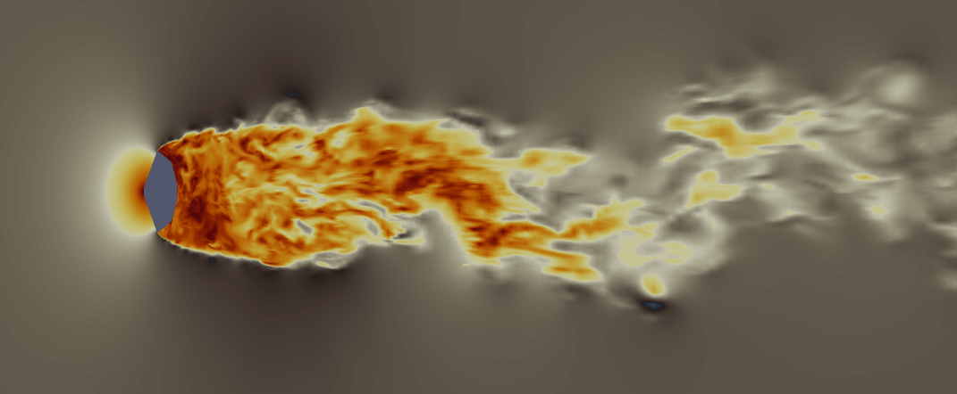
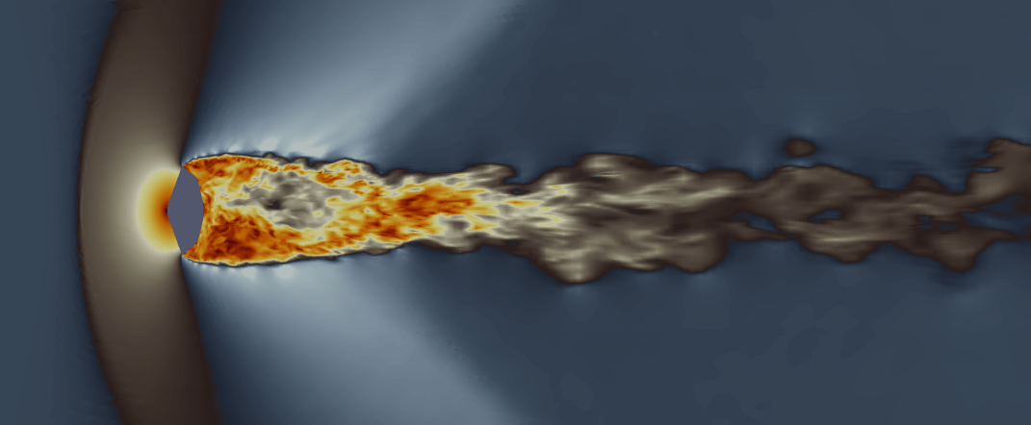
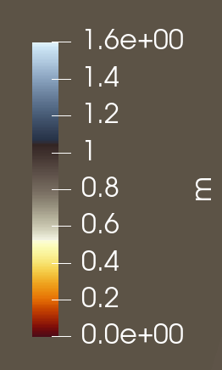
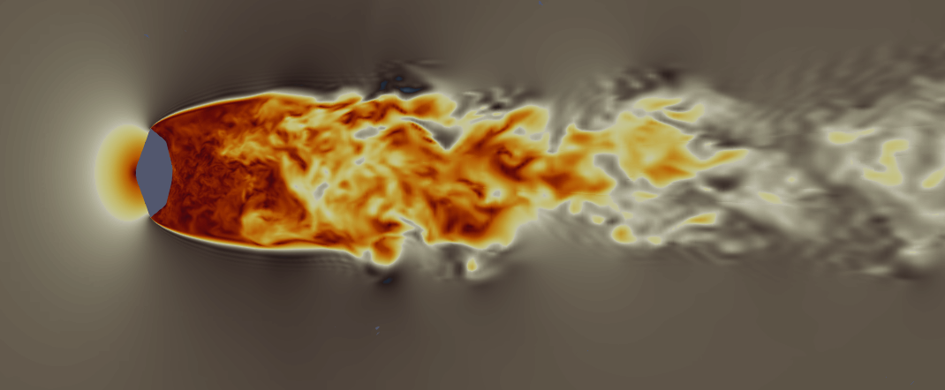
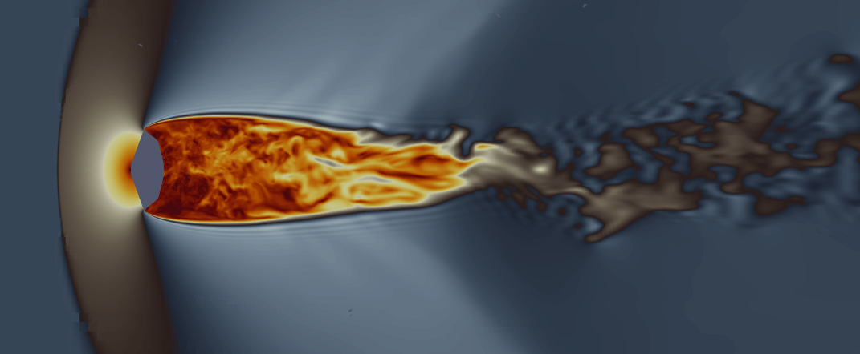
Instantaneous Flow Field
PyFR P1
US3D (Medium grid)
Mach 0.8
Mach 1.2
Overall similar flow features, PyFR has finer structures
PyFR Seminar, September 5, 2024

Slide 21
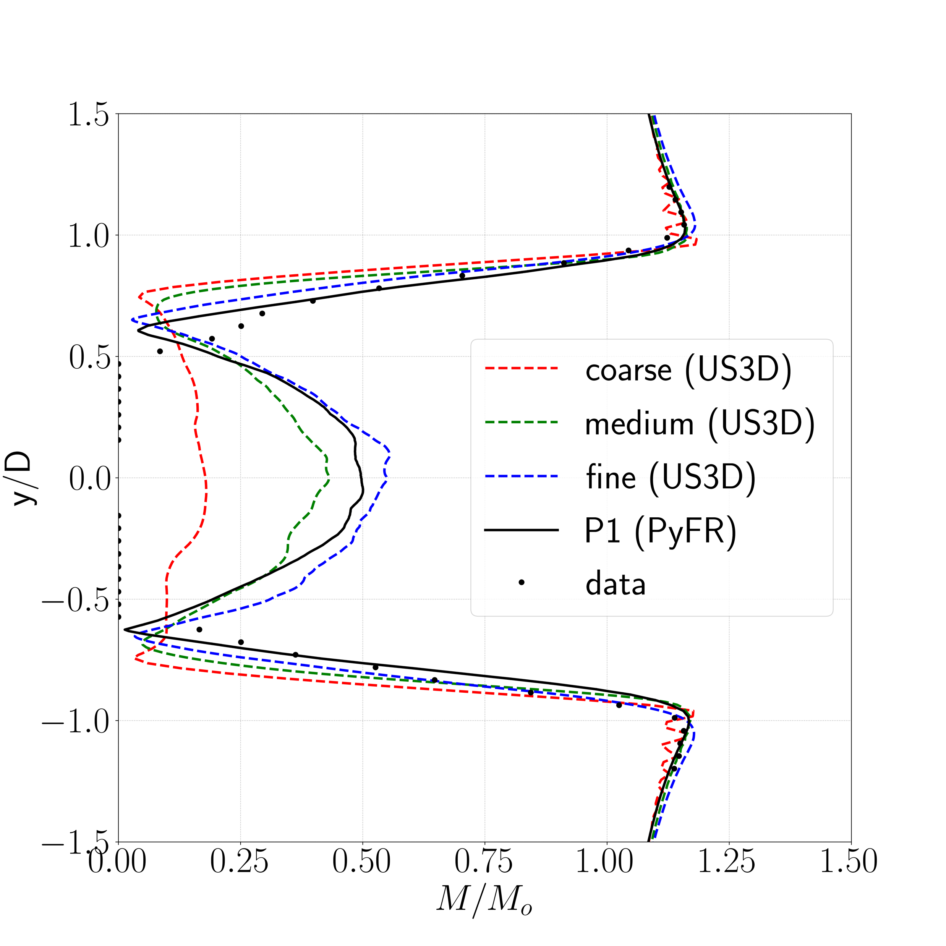
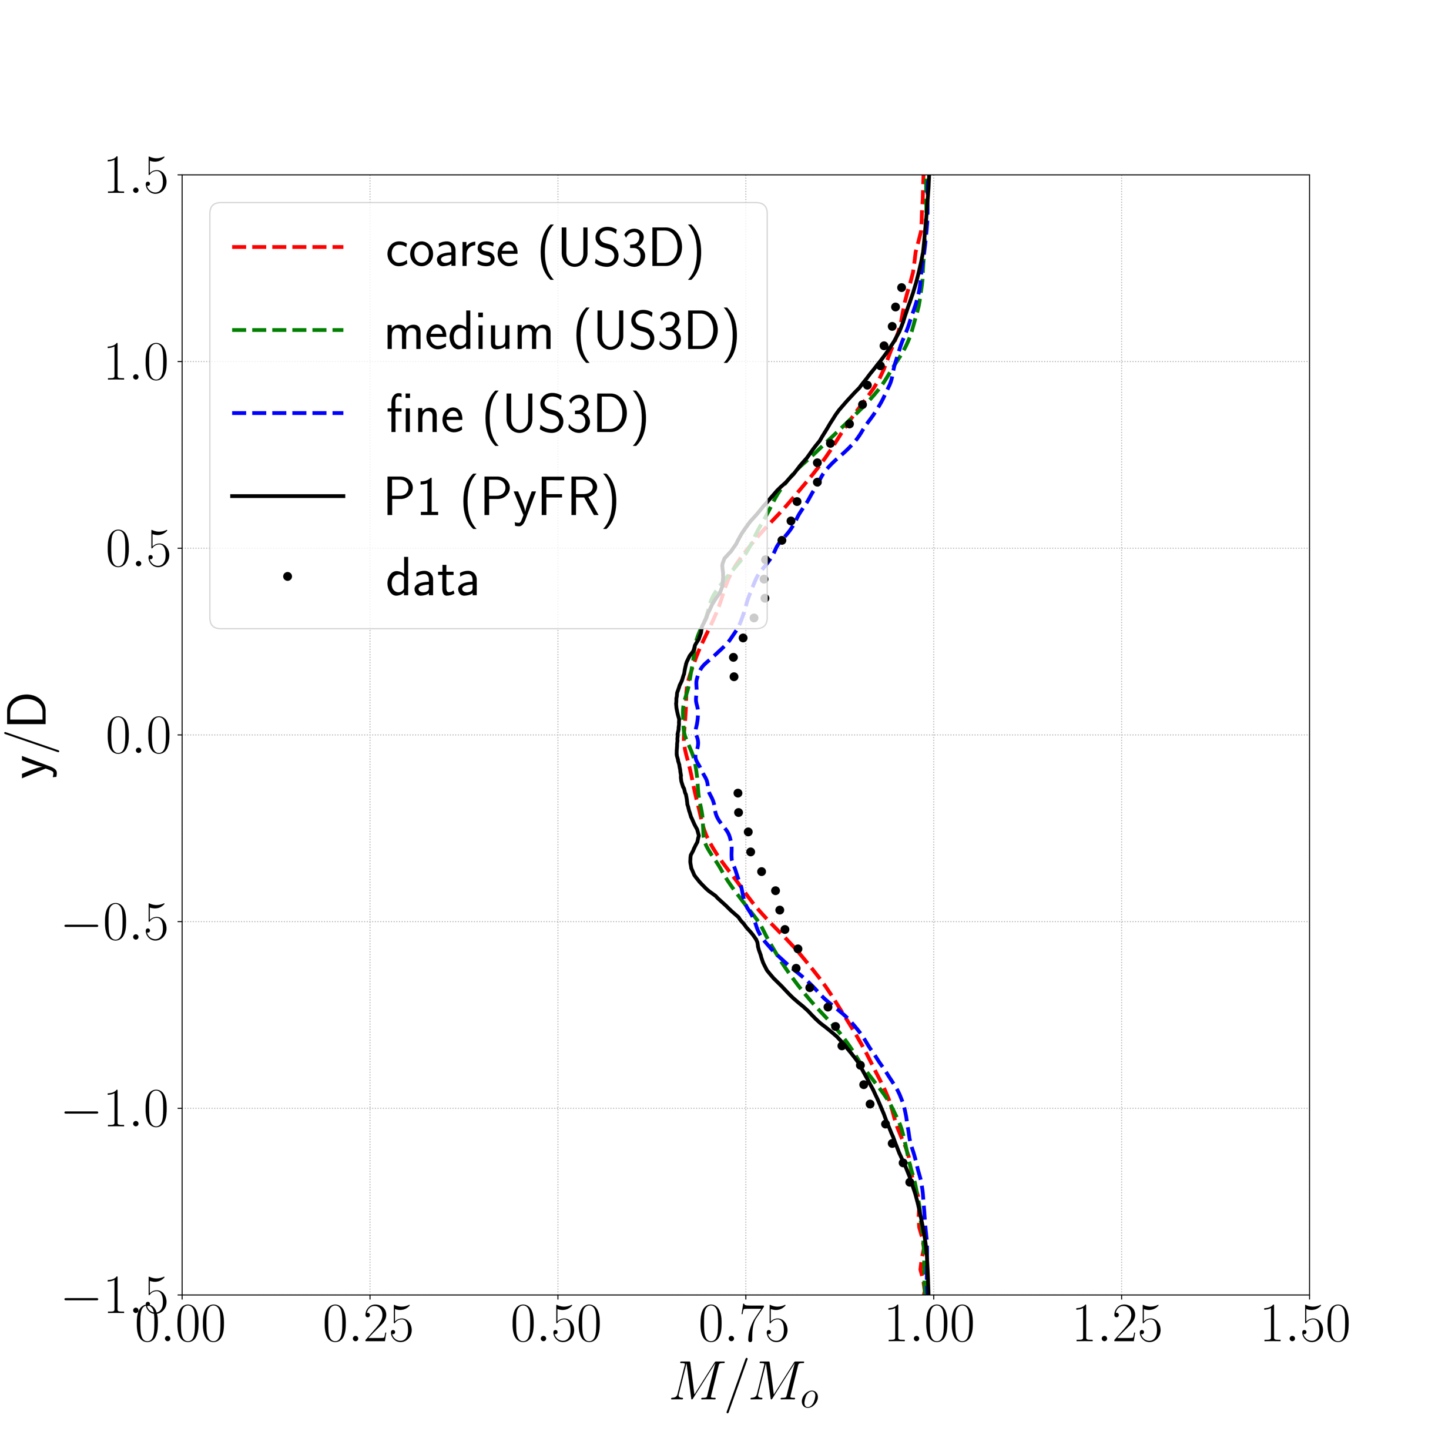
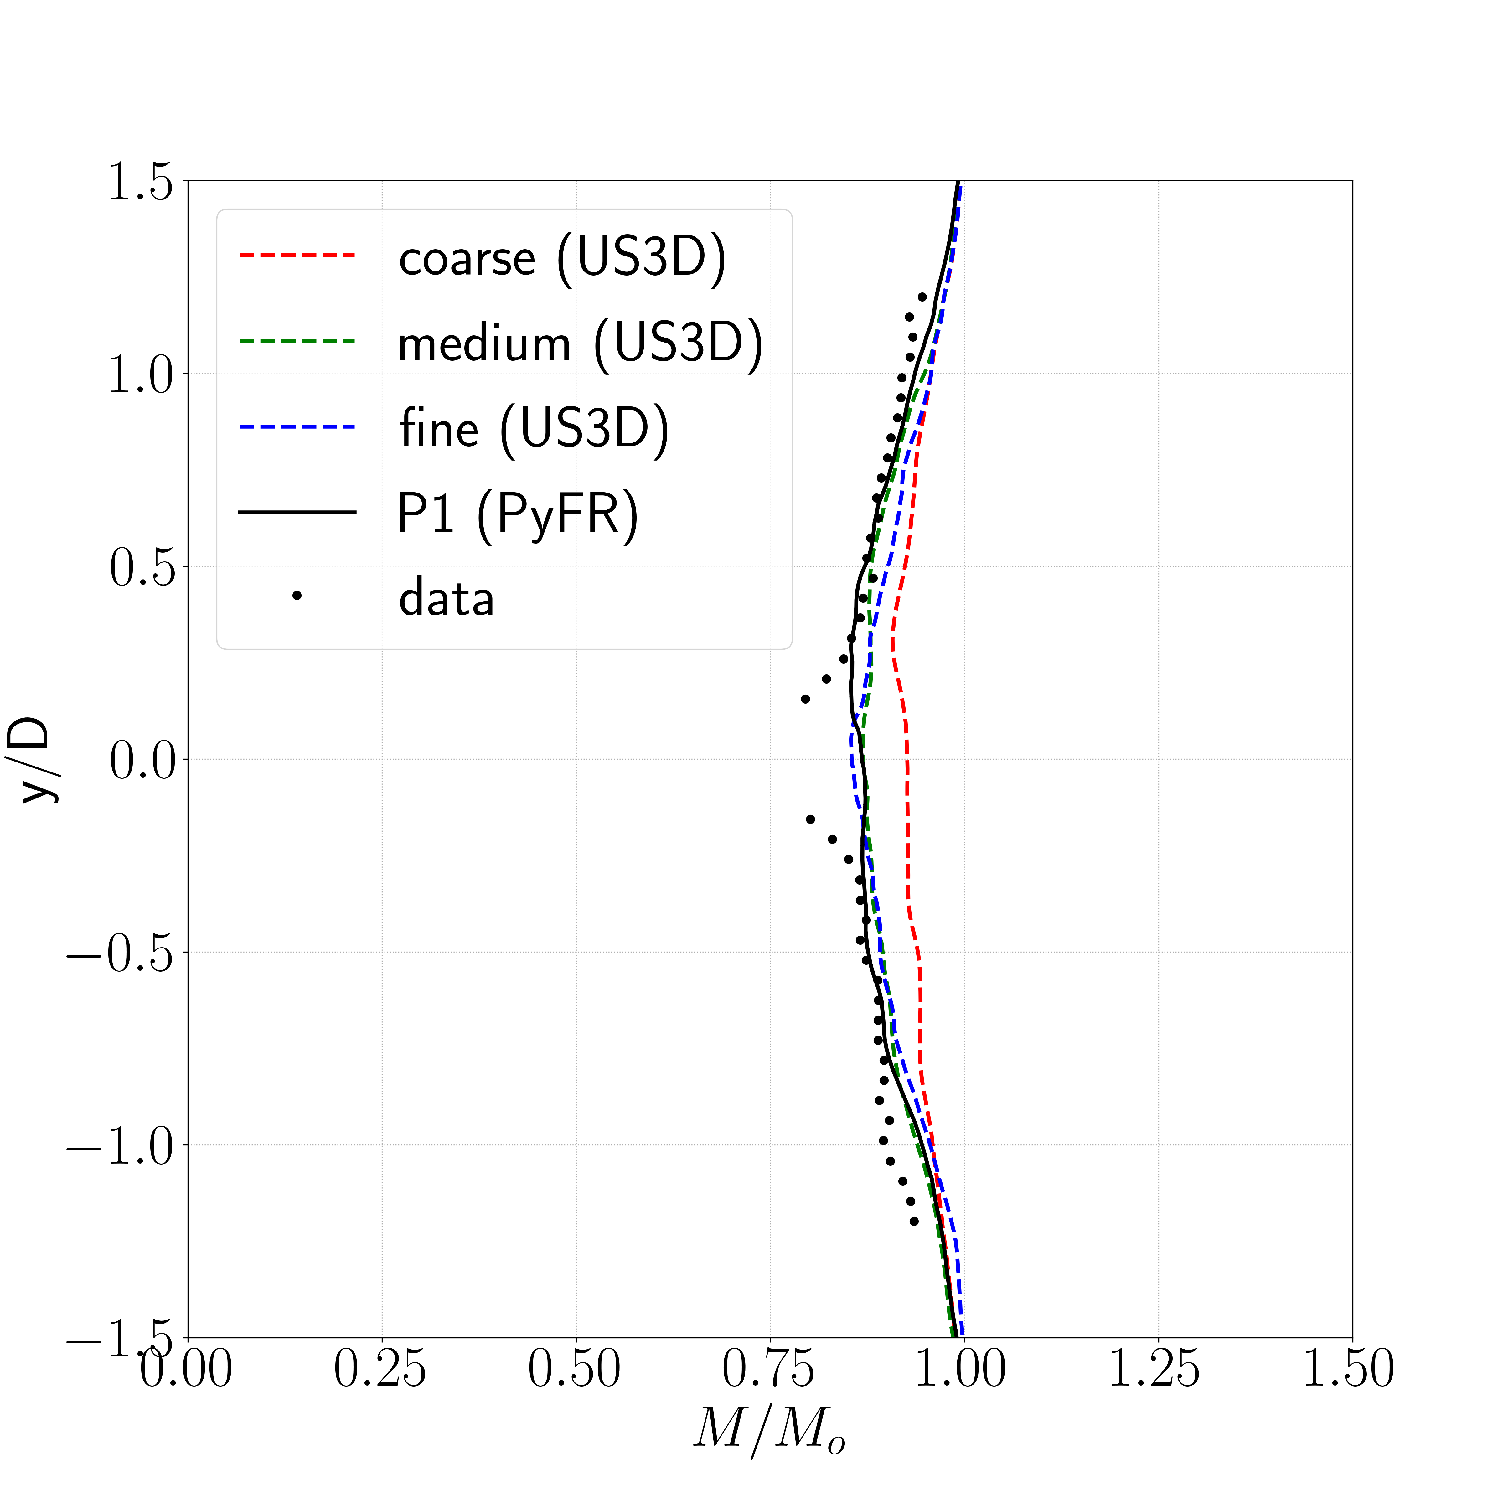
Wake Profile Comparisons: Mach 0.4
x/d=1.5
x/d=5
x/d=10
Fine mesh US3D and PyFR results match well against experimental data
PyFR Seminar, September 5, 2024

Slide 22
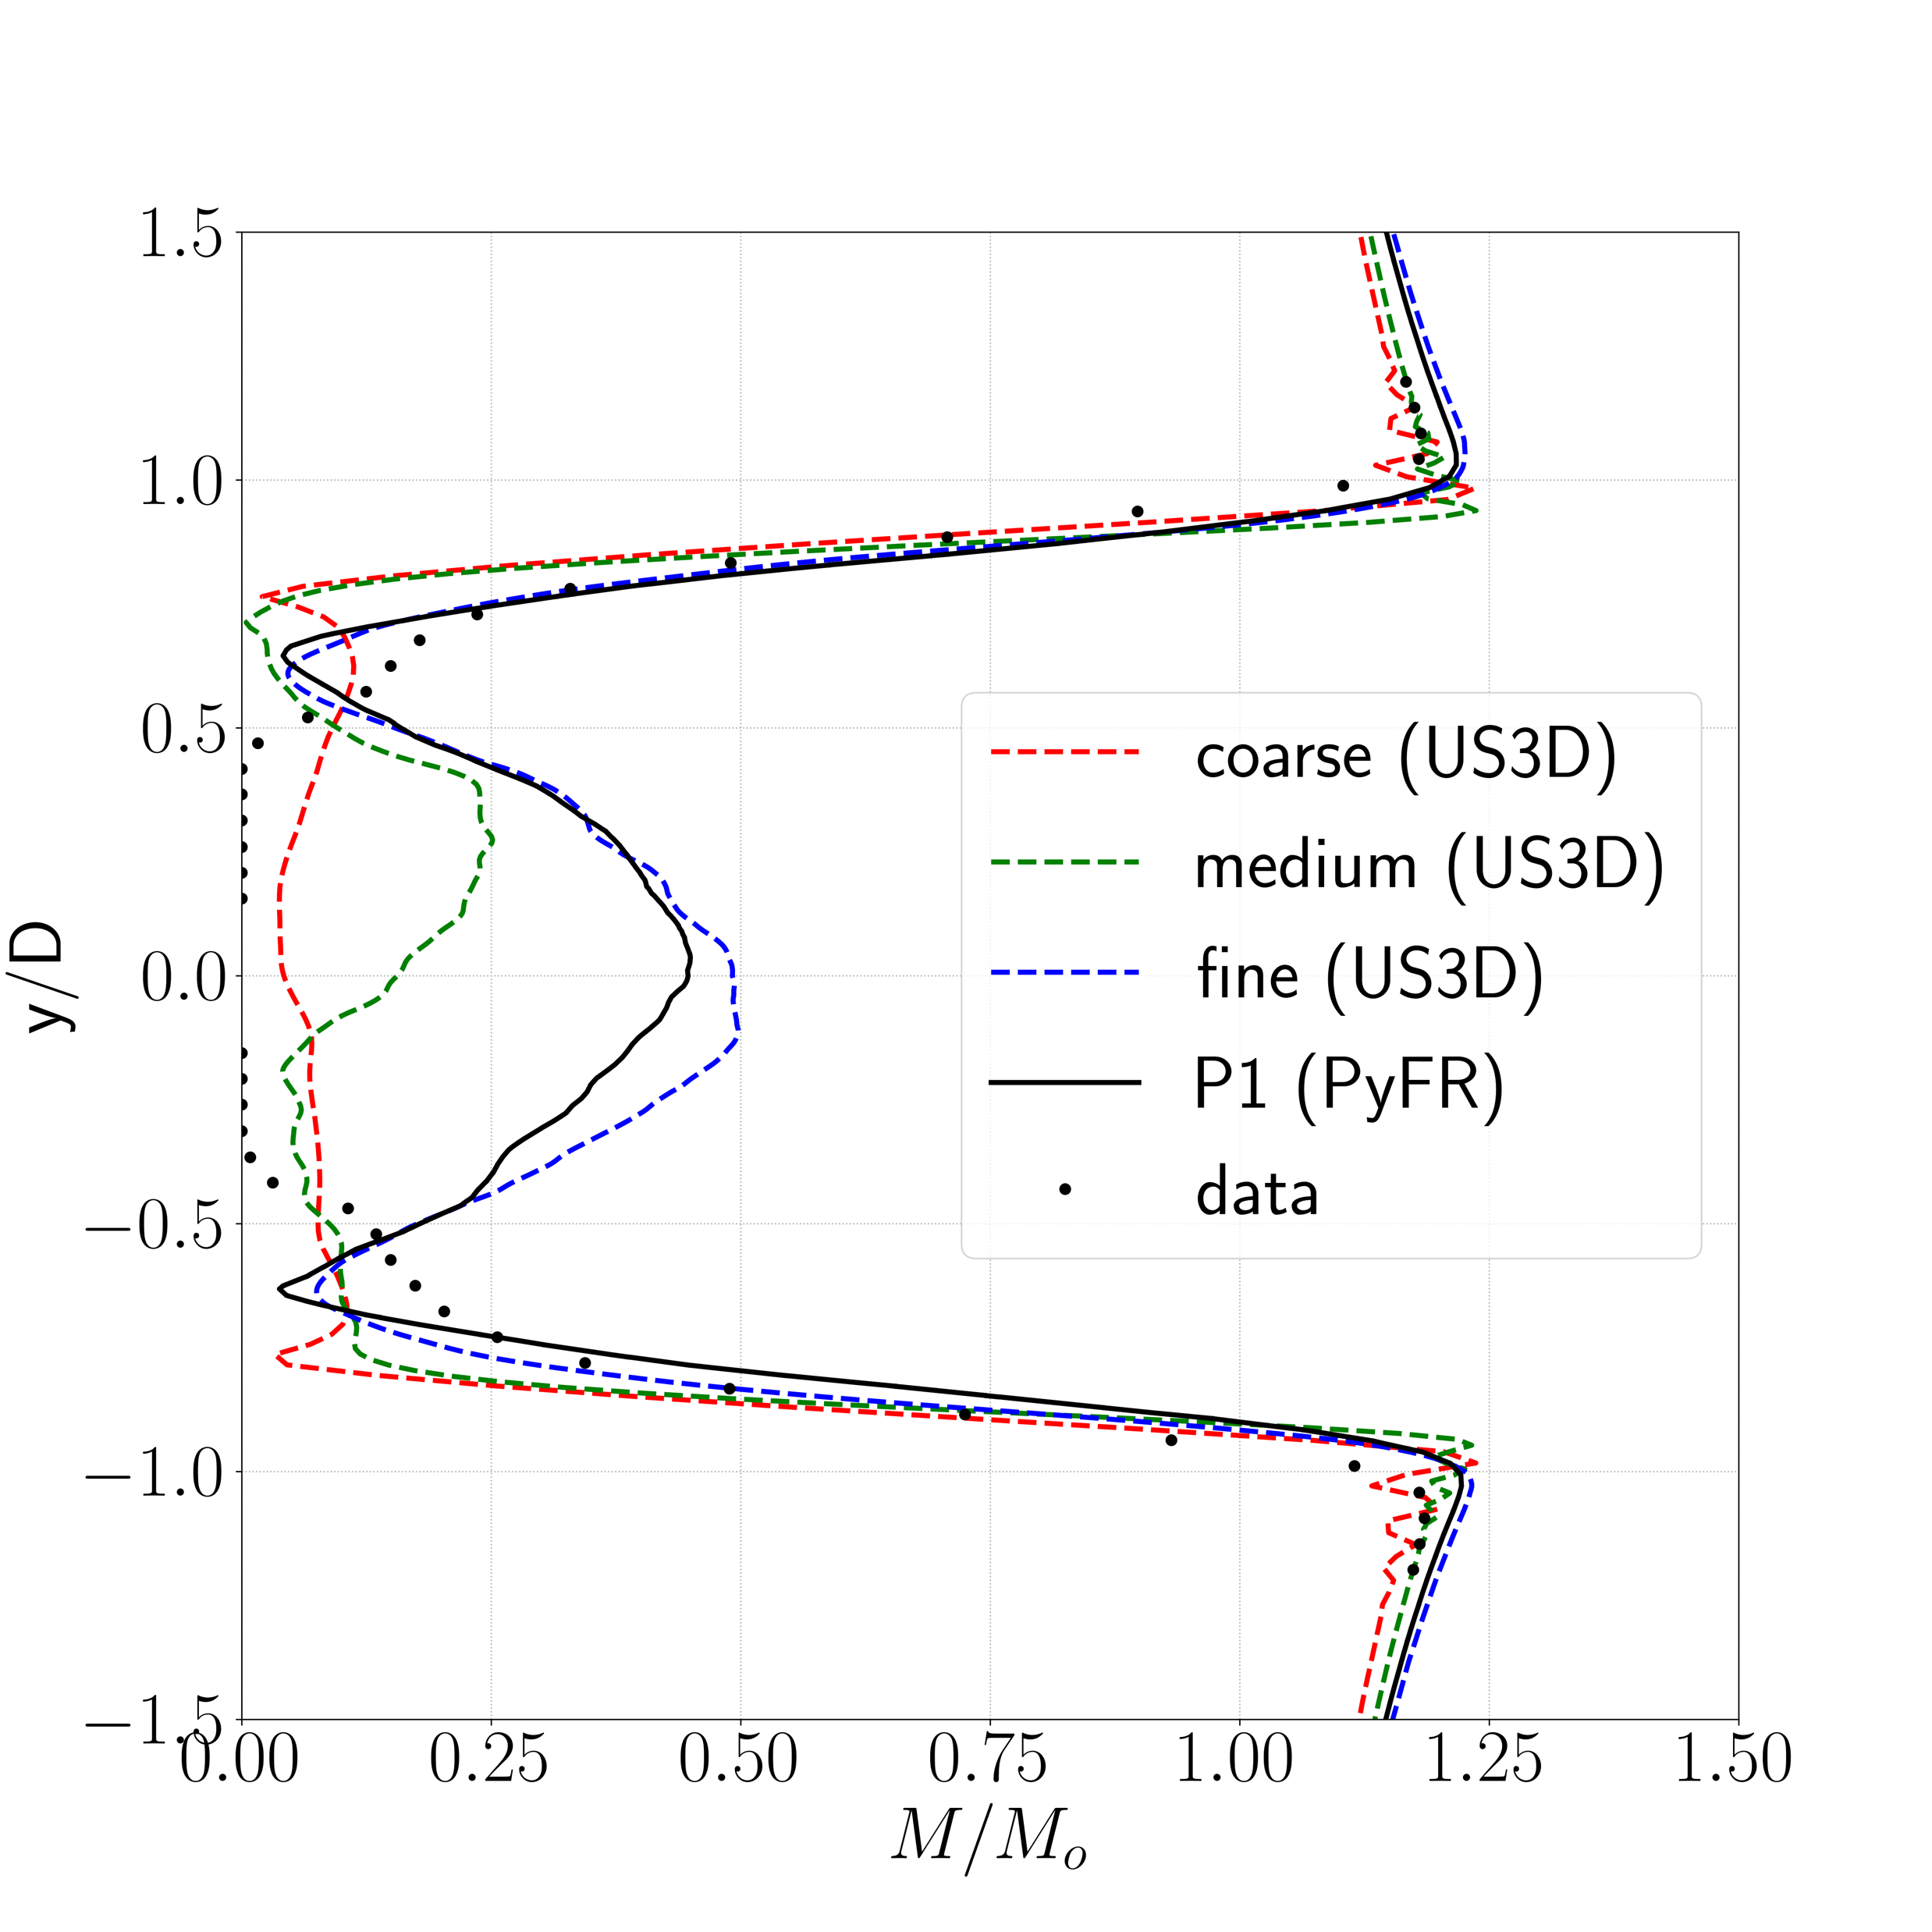
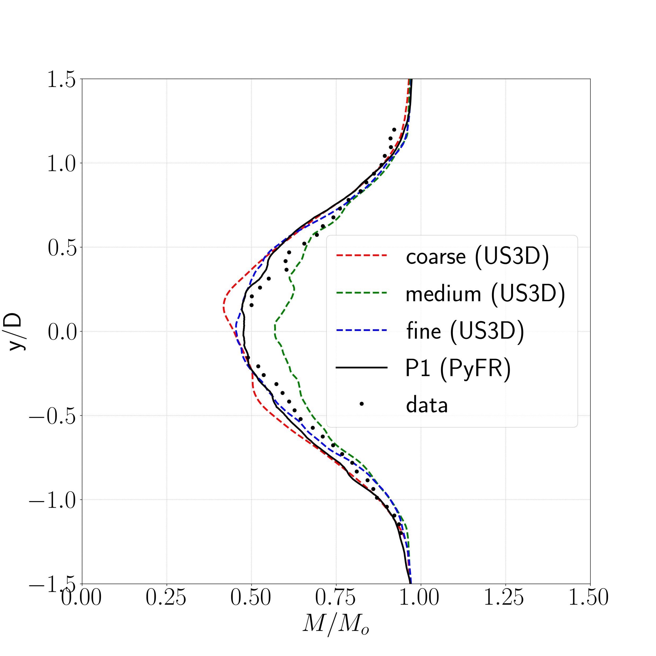
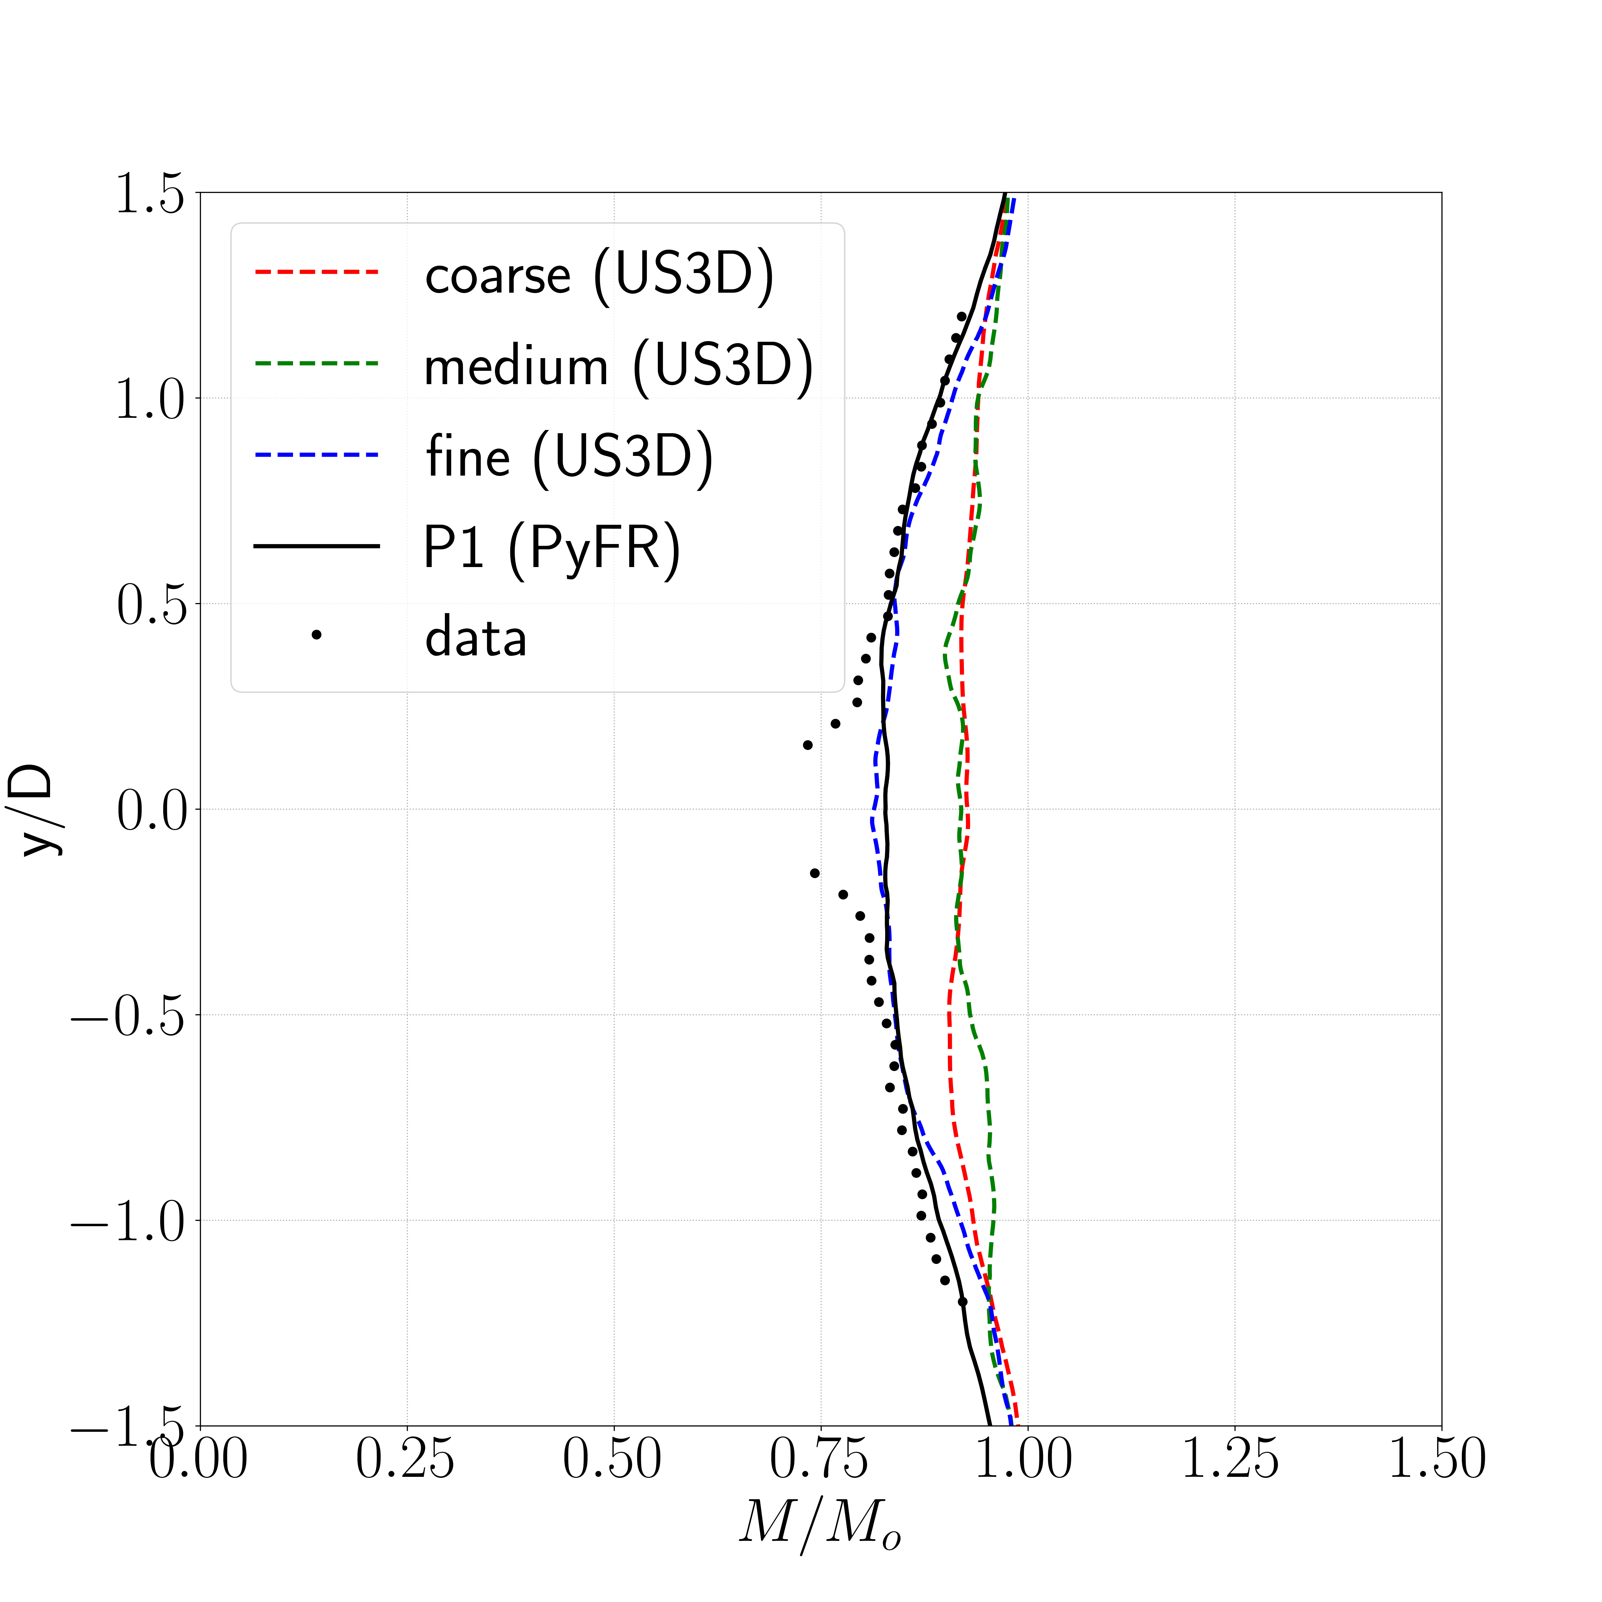
Wake Profile Comparisons: Mach 0.8
x/d=1.5
x/d=5
x/d=10
Discrepancy at y/d=0 due to sting effect. Worse at x/d=10.
PyFR Seminar, September 5, 2024

Slide 23
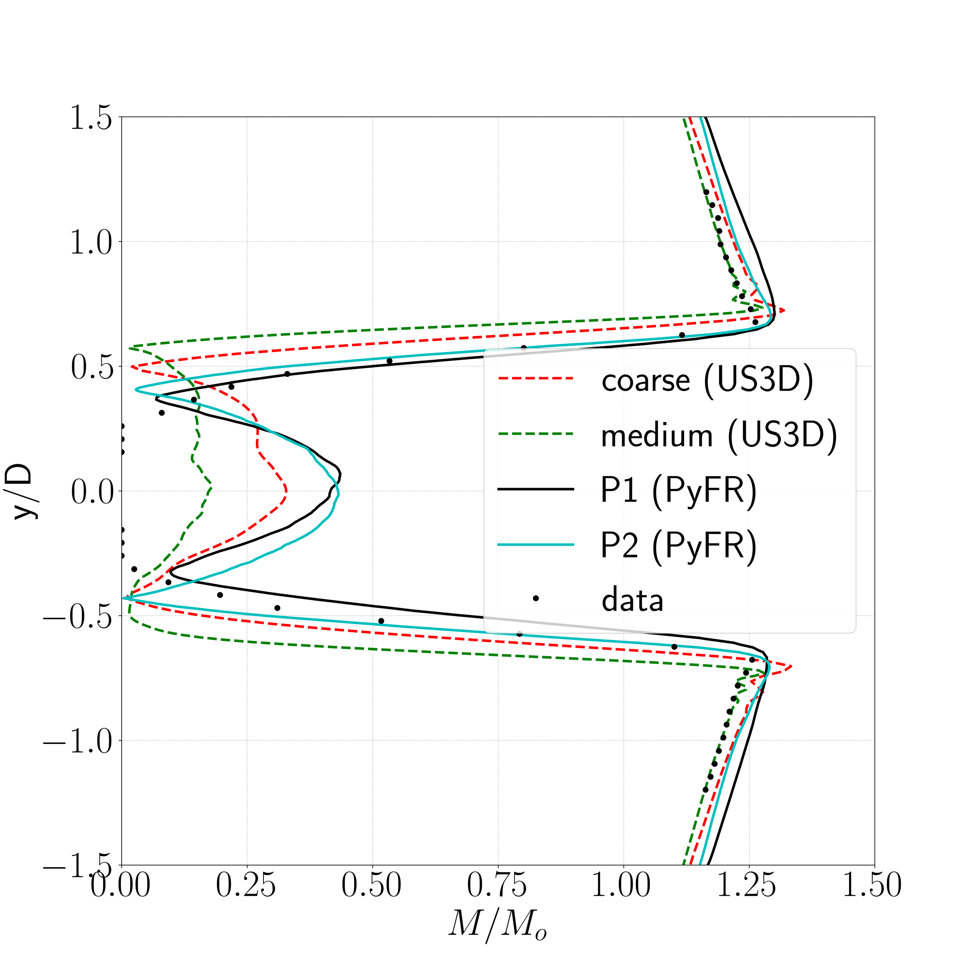
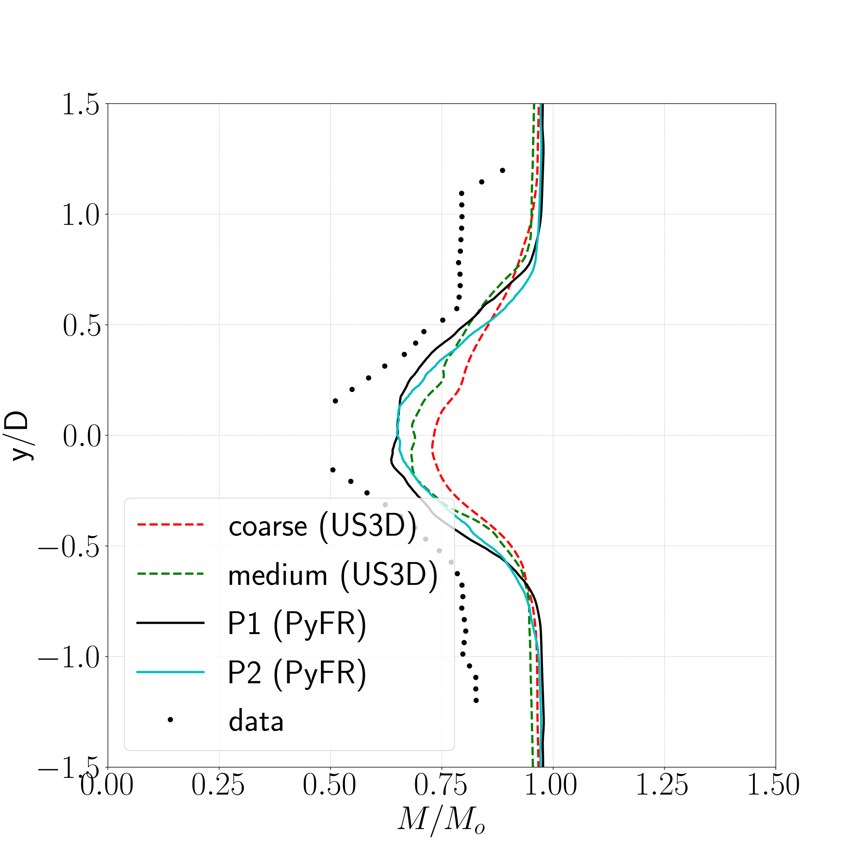
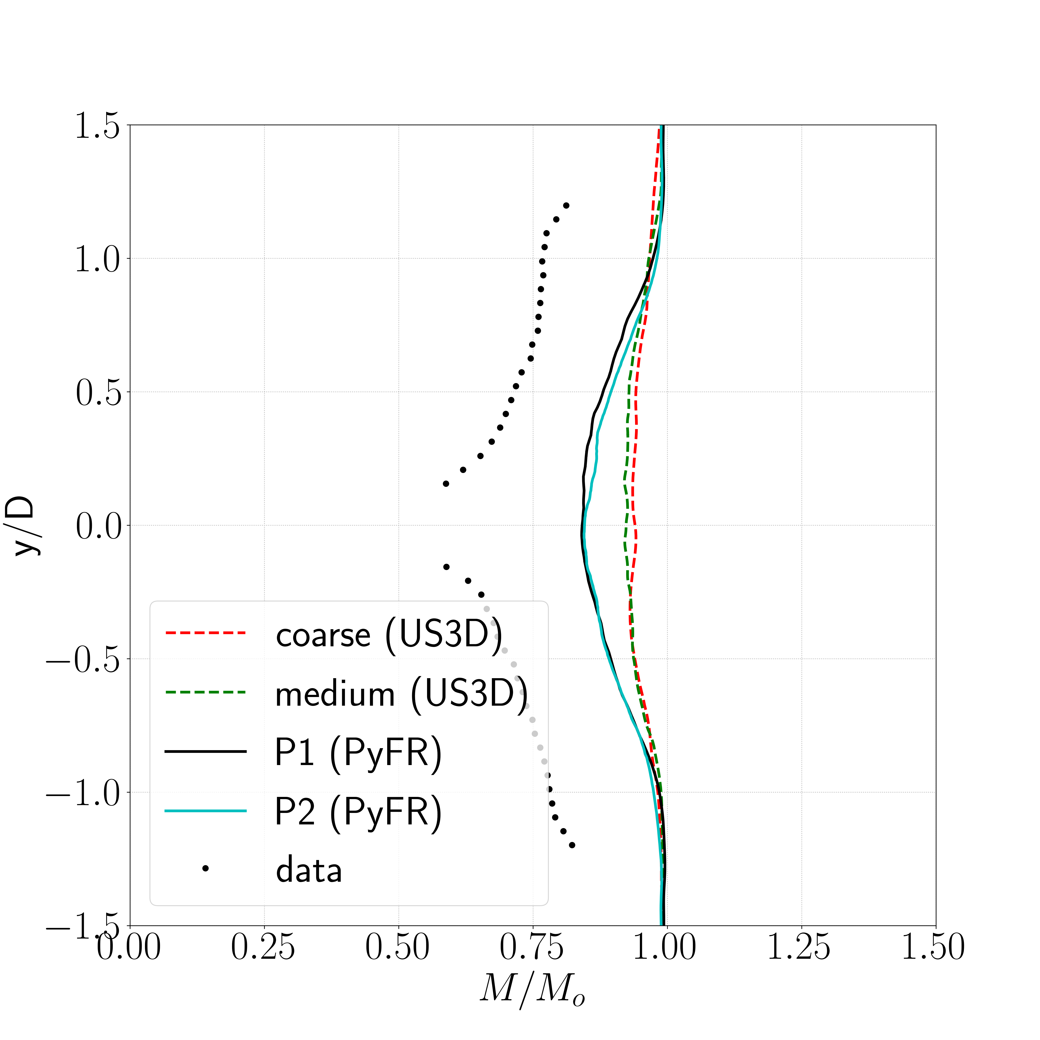
Wake Profile Comparisons: Mach 1.2
x/d=1.5
x/d=5
x/d=10
Large discrepancy with data, possibly due to increased blockage due to interaction of bow shock with wind tunnel end walls.
PyFR Seminar, September 5, 2024

Slide 24
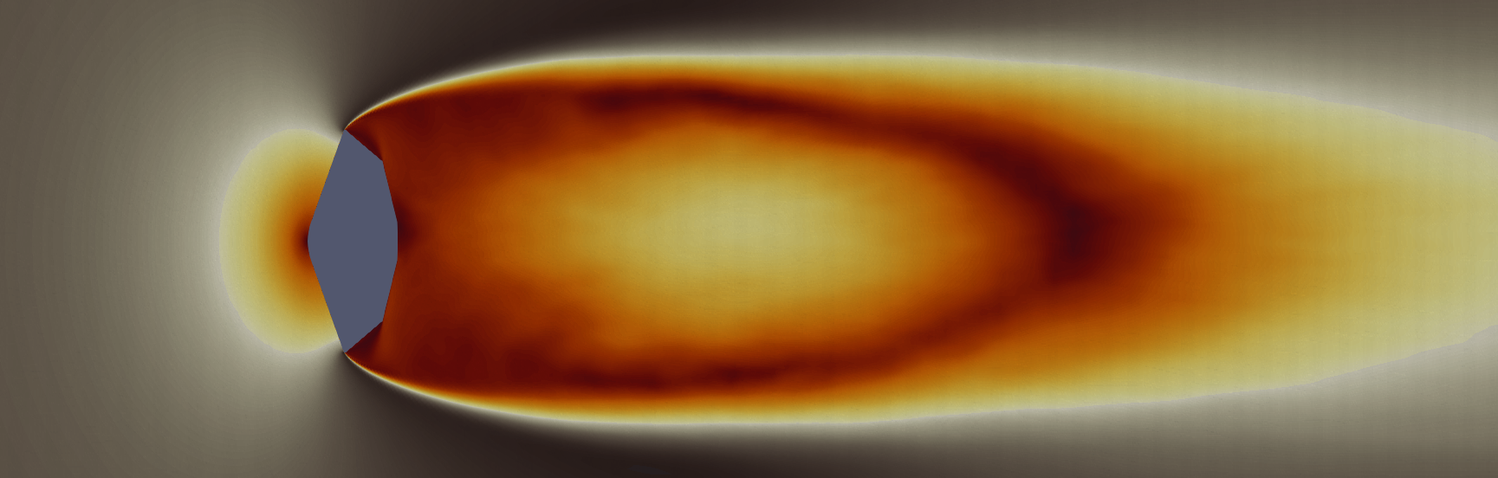
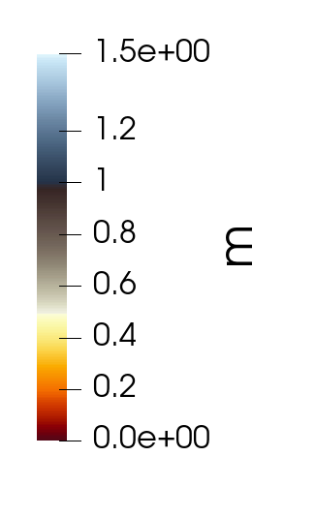
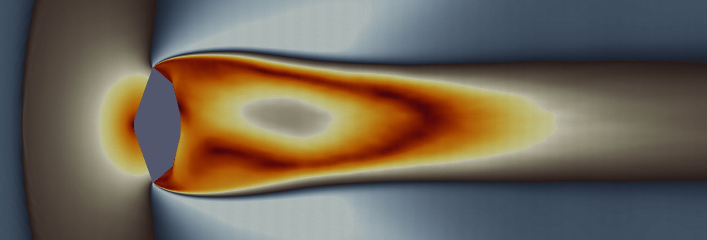
Average Mach Number
Mach 0.8
Mach 1.2
Mean Mach contours (P1, PyFR)
Strong shear layer and significantly narrower wake observed at supersonic Mach number
PyFR Seminar, September 5, 2024

Slide 25
Computational Cost
Solver | Mesh/P-Order | CPU/GPU | # ranks | Mesh DoF/rank | Wall-clock time / flow-thru (min) | Cost ($) / flow-thru
US3D | Coarse | Intel Ivy bridge | 100 | 35.0 K | 2.99 | 0.017
US3D | Medium | Intel Ivy bridge | 500 | 28.8 K | 2.53 | 0.072
US3D | Fine | Intel Ivy bridge | 1400 | 68.6 K | 6.13 | 0.490
PyFR | P1 | Nvidia A100 | 16 | 1.78 M | 6.12 | 0.474
PyFR | P2 | Nvidia A100 | 16 | 6.00 M | 6.00 | 0.465
Good weak scaling behavior seen for US3D.
GPUs are not fully saturated for PyFR.
PyFR Seminar, September 5, 2024

Slide 26
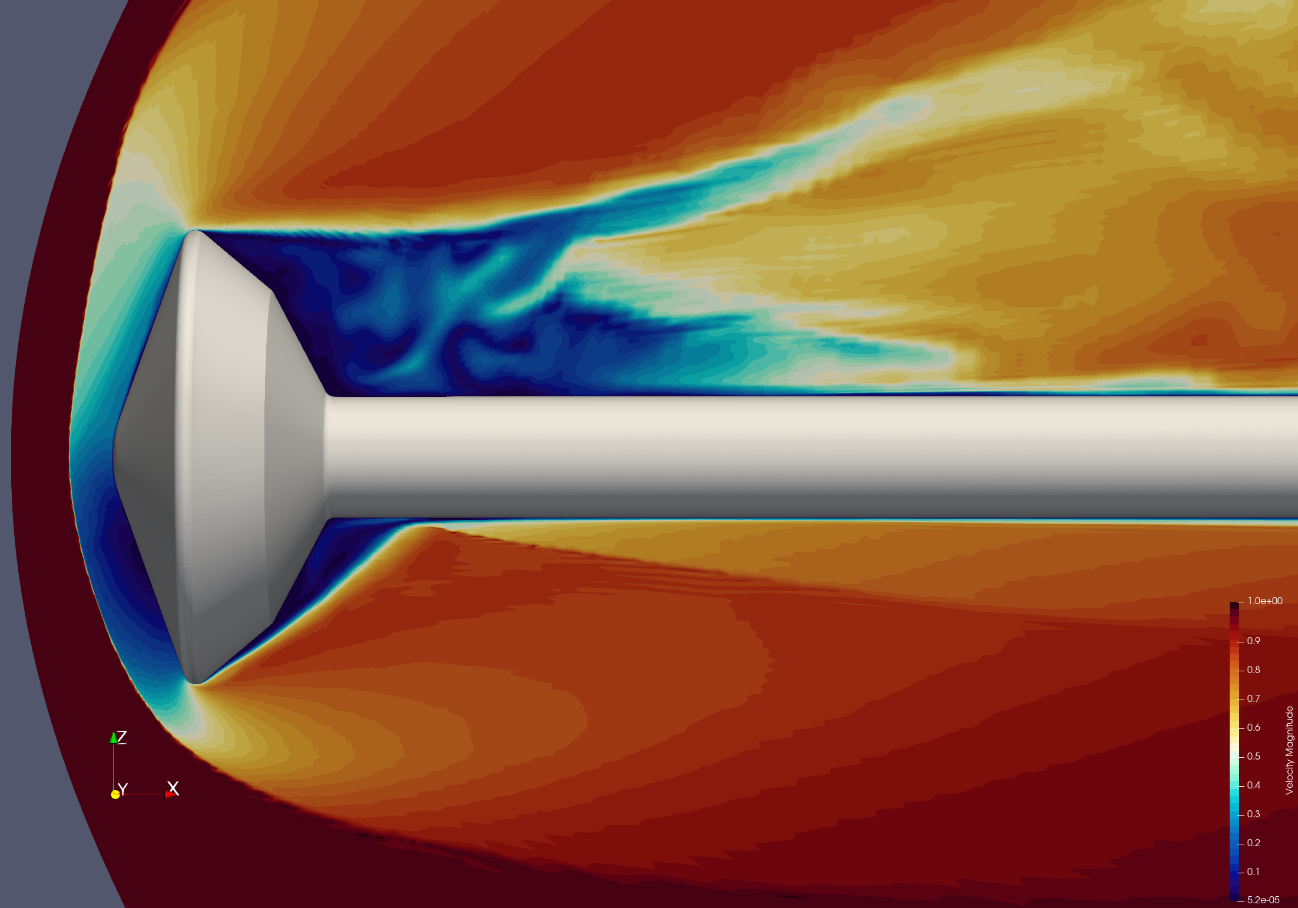
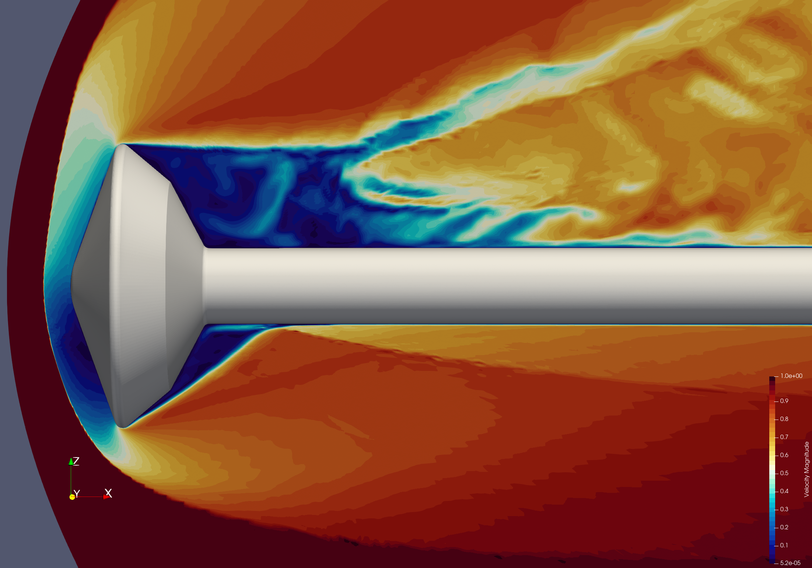
Other Applications
P1
P2
P3
MSL test case with sting, M=9.47, 𝜶 = 16, Re=6.0e05
(Work of Dirk Ekelschot)
Observing increased stiffness and dissipative behavior at P2.
PyFR Seminar, September 5, 2024

Slide 27
PyFR Development Needs for Free-Flight CFD
Starting with 1-DoF free-to-pitch capability, develop framework for full 6-DoF motion simulation
Ability to output surface forces and moments
Better support for Pyramids
Understand higher p-order behavior, especially around shocks
PyFR Seminar, September 5, 2024

Slide 28
Conclusions and Future Work
PyFR and fine mesh US3D solutions compare well against data for the Viking’75 capsule static wake problem
Explore possible computational cost saving by going to higher P-order
PyFR has the potential & needs investment to become an exascale capable tool for dynamic stability prediction and other capsule flow problems
PyFR Seminar, September 5, 2024

Slide 30
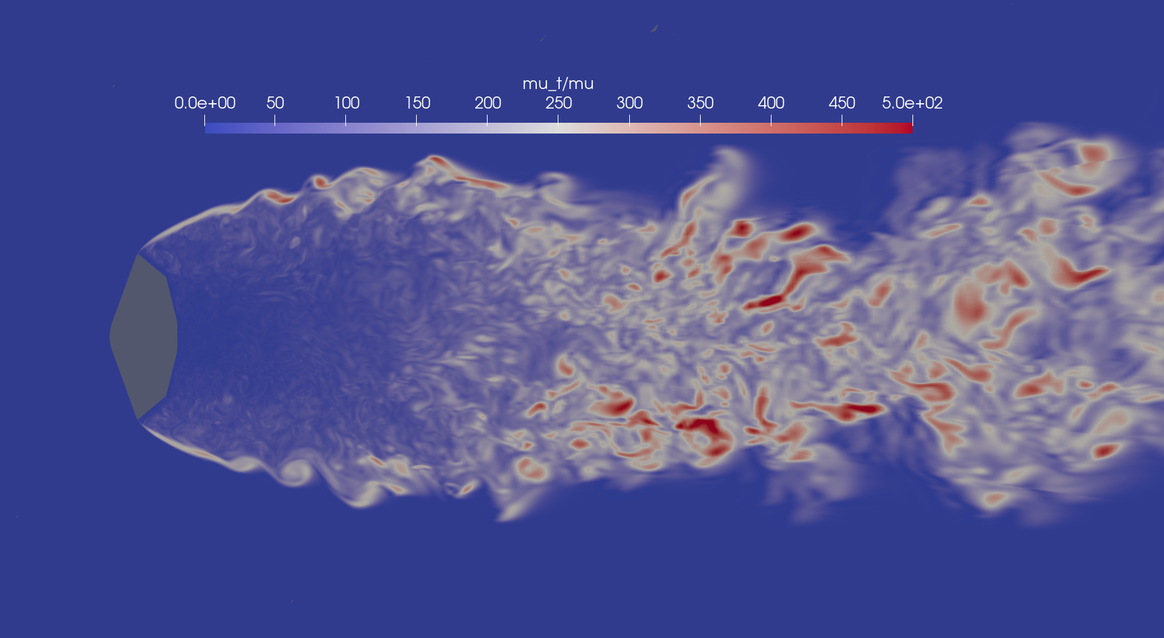
US3D Hybrid RANS-LES
Eddy viscosity ratio
PyFR Seminar, September 5, 2024

