Slide 1
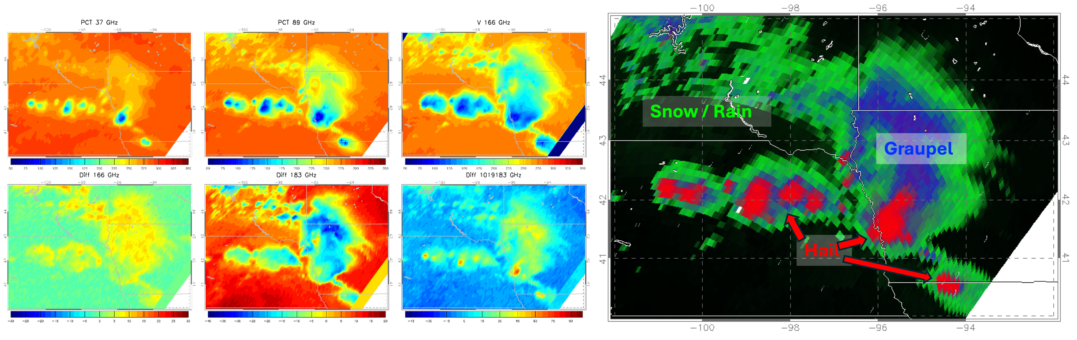
Hydrometeor Type Identification from GMI Brightness Temperatures
Daniel J. Cecil, NASA MSFC, Daniel.J.Cecil@nasa.gov
Michael B. Solomon, University of Alabama-Huntsville, mbs0025@uah.edu

Slide 2
Objectives
Use observational datasets to build empirical relationships between brightness temperatures (TB) and hydrometeor types (hail, graupel, snow, rain)
  GMI TB (10, 19, 37, 89, 166, 183 GHz – ranges from ~3-cm to 1.6 mm wavelengths)
  GPM Validation Network Hydrometeor Identifications (HID) (from dual-pol radar, matched to GMI field of view)
Use physical understanding to interpret empirical relationships
Construct lookup-tables of the likelihood of a hydrometeor type being present, based on multi-channel TB
Map the hydrometeor types in individual cases
Accumulate climatological maps of hydrometeor types
Lookup tables, interpretation, and verification published in Cecil et al. 2024 JAMC
https://doi.org/10.1175/JAMC-D-23-0196.1

Slide 3
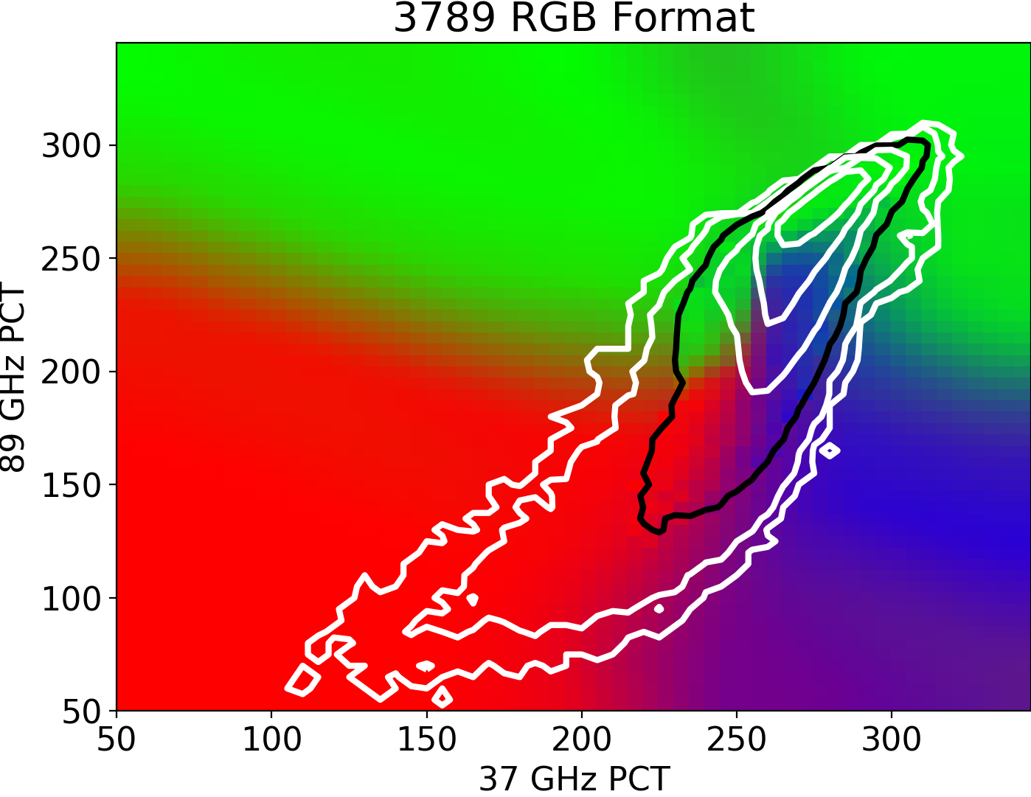
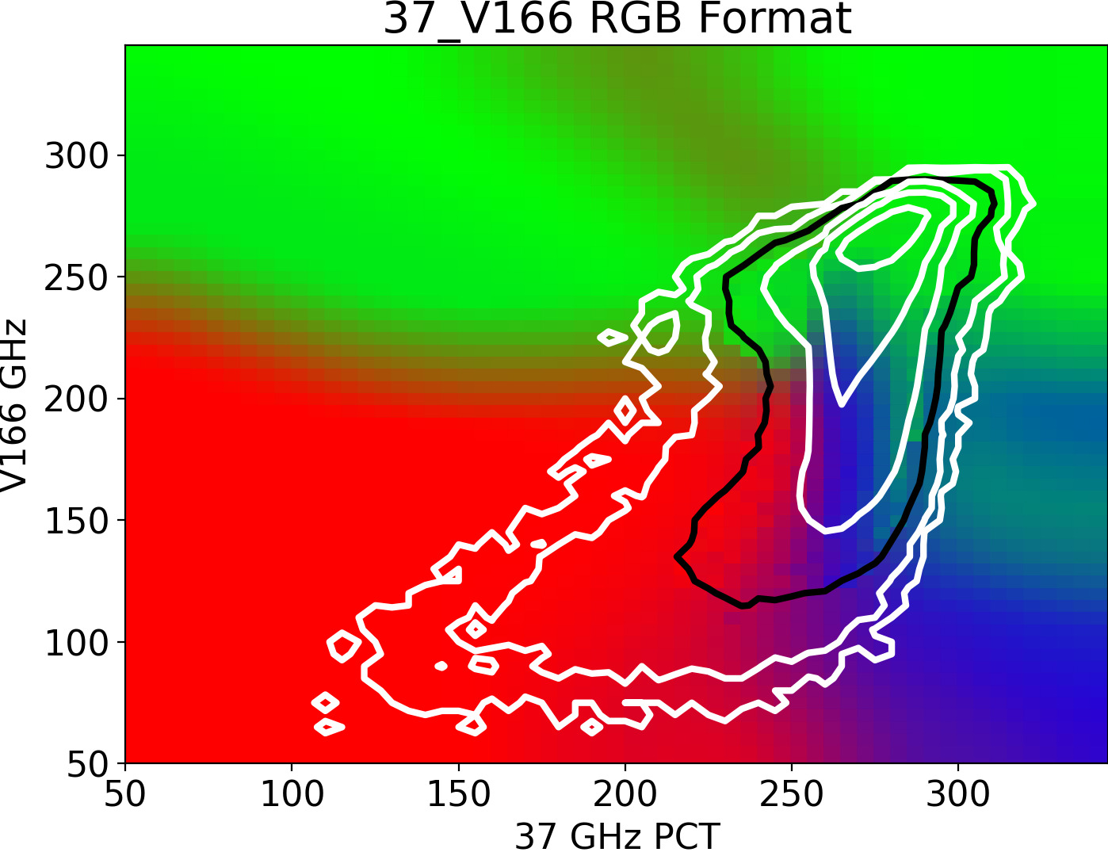
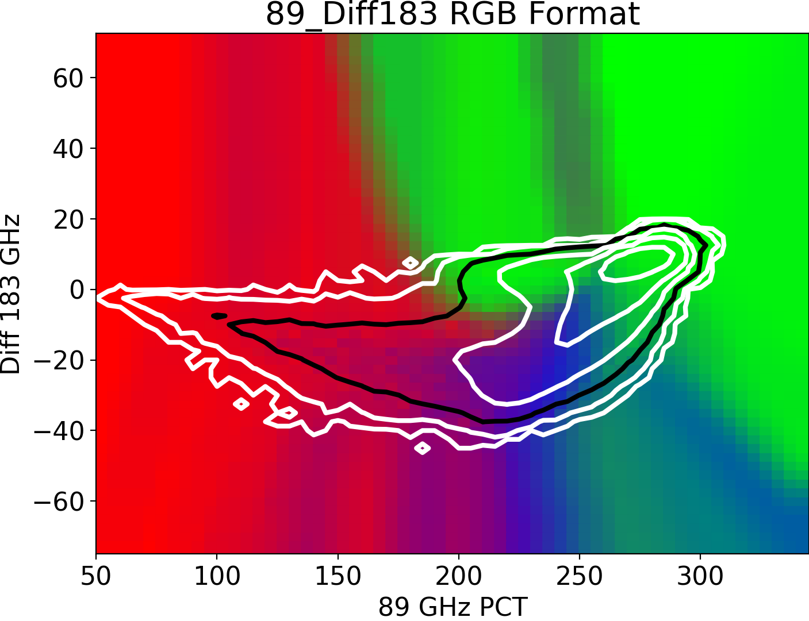
Objectives
Use observational datasets to build empirical relationships between brightness temperatures (TB) and hydrometeor types (hail, graupel, snow, rain)
  GMI TB (10, 19, 37, 89, 166, 183 GHz – ranges from ~3-cm to 1.6 mm wavelengths)
  GPM Validation Network Hydrometeor Identifications (HID) (from dual-pol radar, matched to GMI field of view)
Use physical understanding to interpret empirical relationships
Construct lookup-tables of the likelihood of a hydrometeor type being present, based on multi-channel TB
Map the hydrometeor types in individual cases
Accumulate climatological maps of hydrometeor types
Snow / Rain
Hail
Graupel
6 multi-channel lookup tables; 3 shown here as examples. For a set of measured TB, look up the % likelihood (from Validation Network matchups) that it corresponds to hail, graupel, other ice, or just liquid.

Slide 4
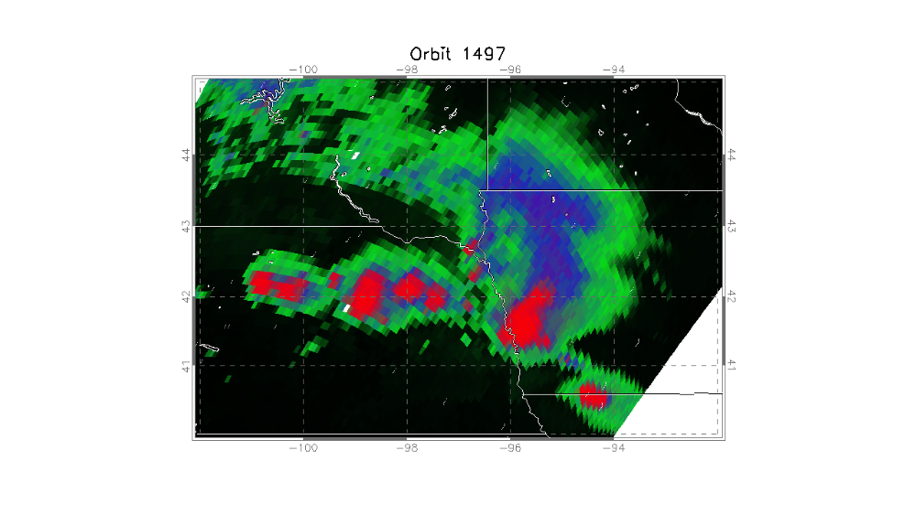
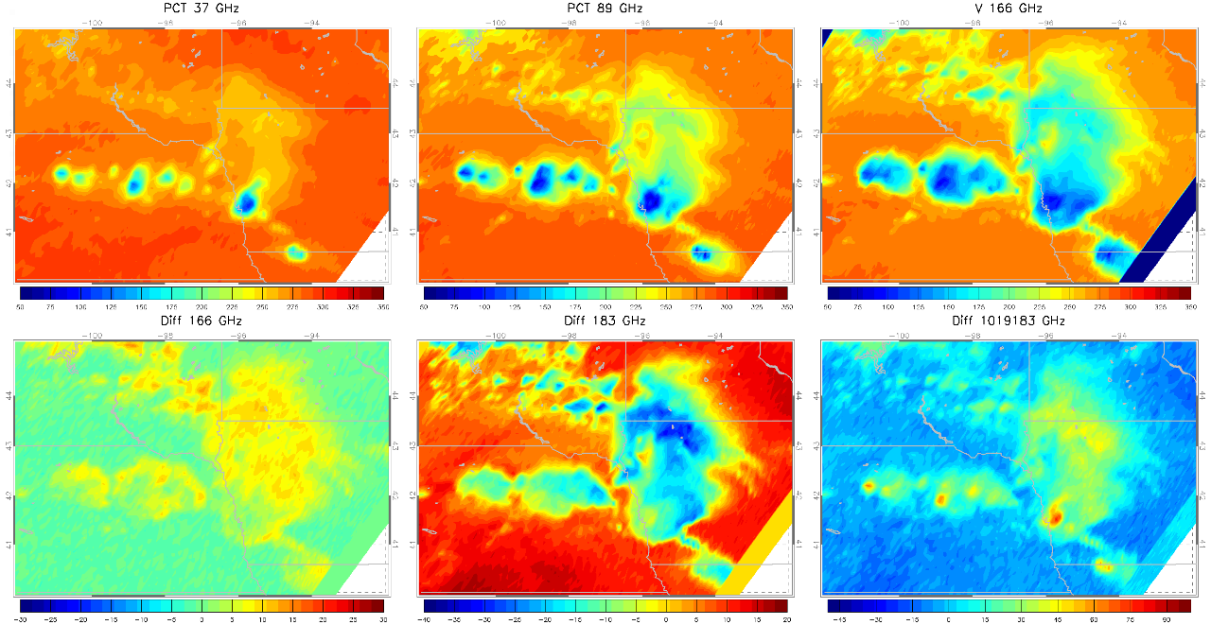
Objectives
Use observational datasets to build empirical relationships between brightness temperatures (TB) and hydrometeor types (hail, graupel, snow, rain)
  GMI TB (10, 19, 37, 89, 166, 183 GHz – ranges from ~3-cm to 1.6 mm wavelengths)
  GPM Validation Network Hydrometeor Identifications (HID) (from dual-pol radar, matched to GMI field of view)
Use physical understanding to interpret empirical relationships
Construct lookup-tables of the likelihood of a hydrometeor type being present, based on multi-channel TB
Map the hydrometeor types in individual cases
Accumulate climatological maps of hydrometeor types
Snow / Rain
Graupel
Hail
GPROF Probability Of Precip is used to scaled the brightness, so black = no precip

Slide 5
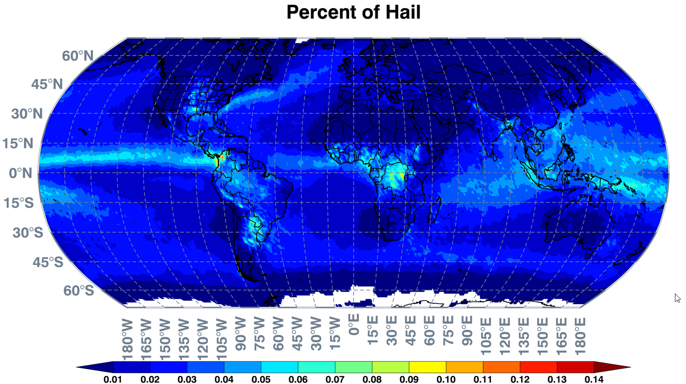
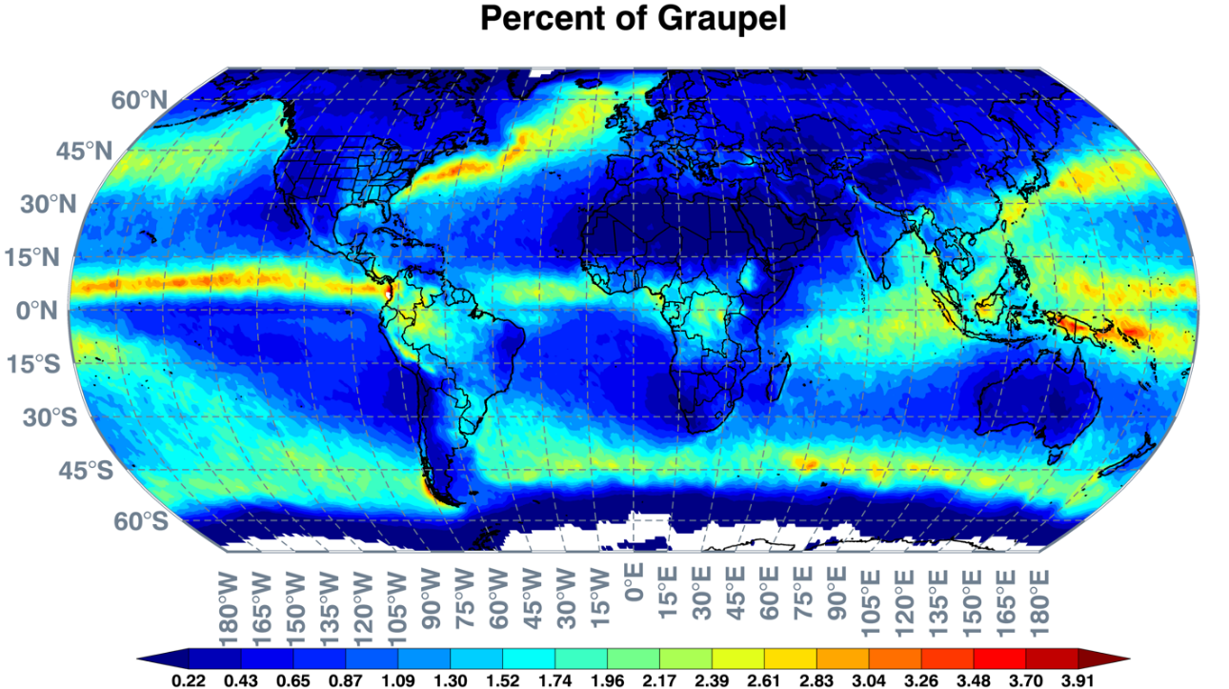
Objectives
Use observational datasets to build empirical relationships between brightness temperatures (TB) and hydrometeor types (hail, graupel, snow, rain)
  GMI TB (10, 19, 37, 89, 166, 183 GHz – ranges from ~3-cm to 1.6 mm wavelengths)
  GPM Validation Network Hydrometeor Identifications (HID) (from dual-pol radar, matched to GMI field of view)
Use physical understanding to interpret empirical relationships
Construct lookup-tables of the likelihood of a hydrometeor type being present, based on multi-channel TB
Map the hydrometeor types in individual cases
Accumulate climatological maps of hydrometeor types

Slide 6
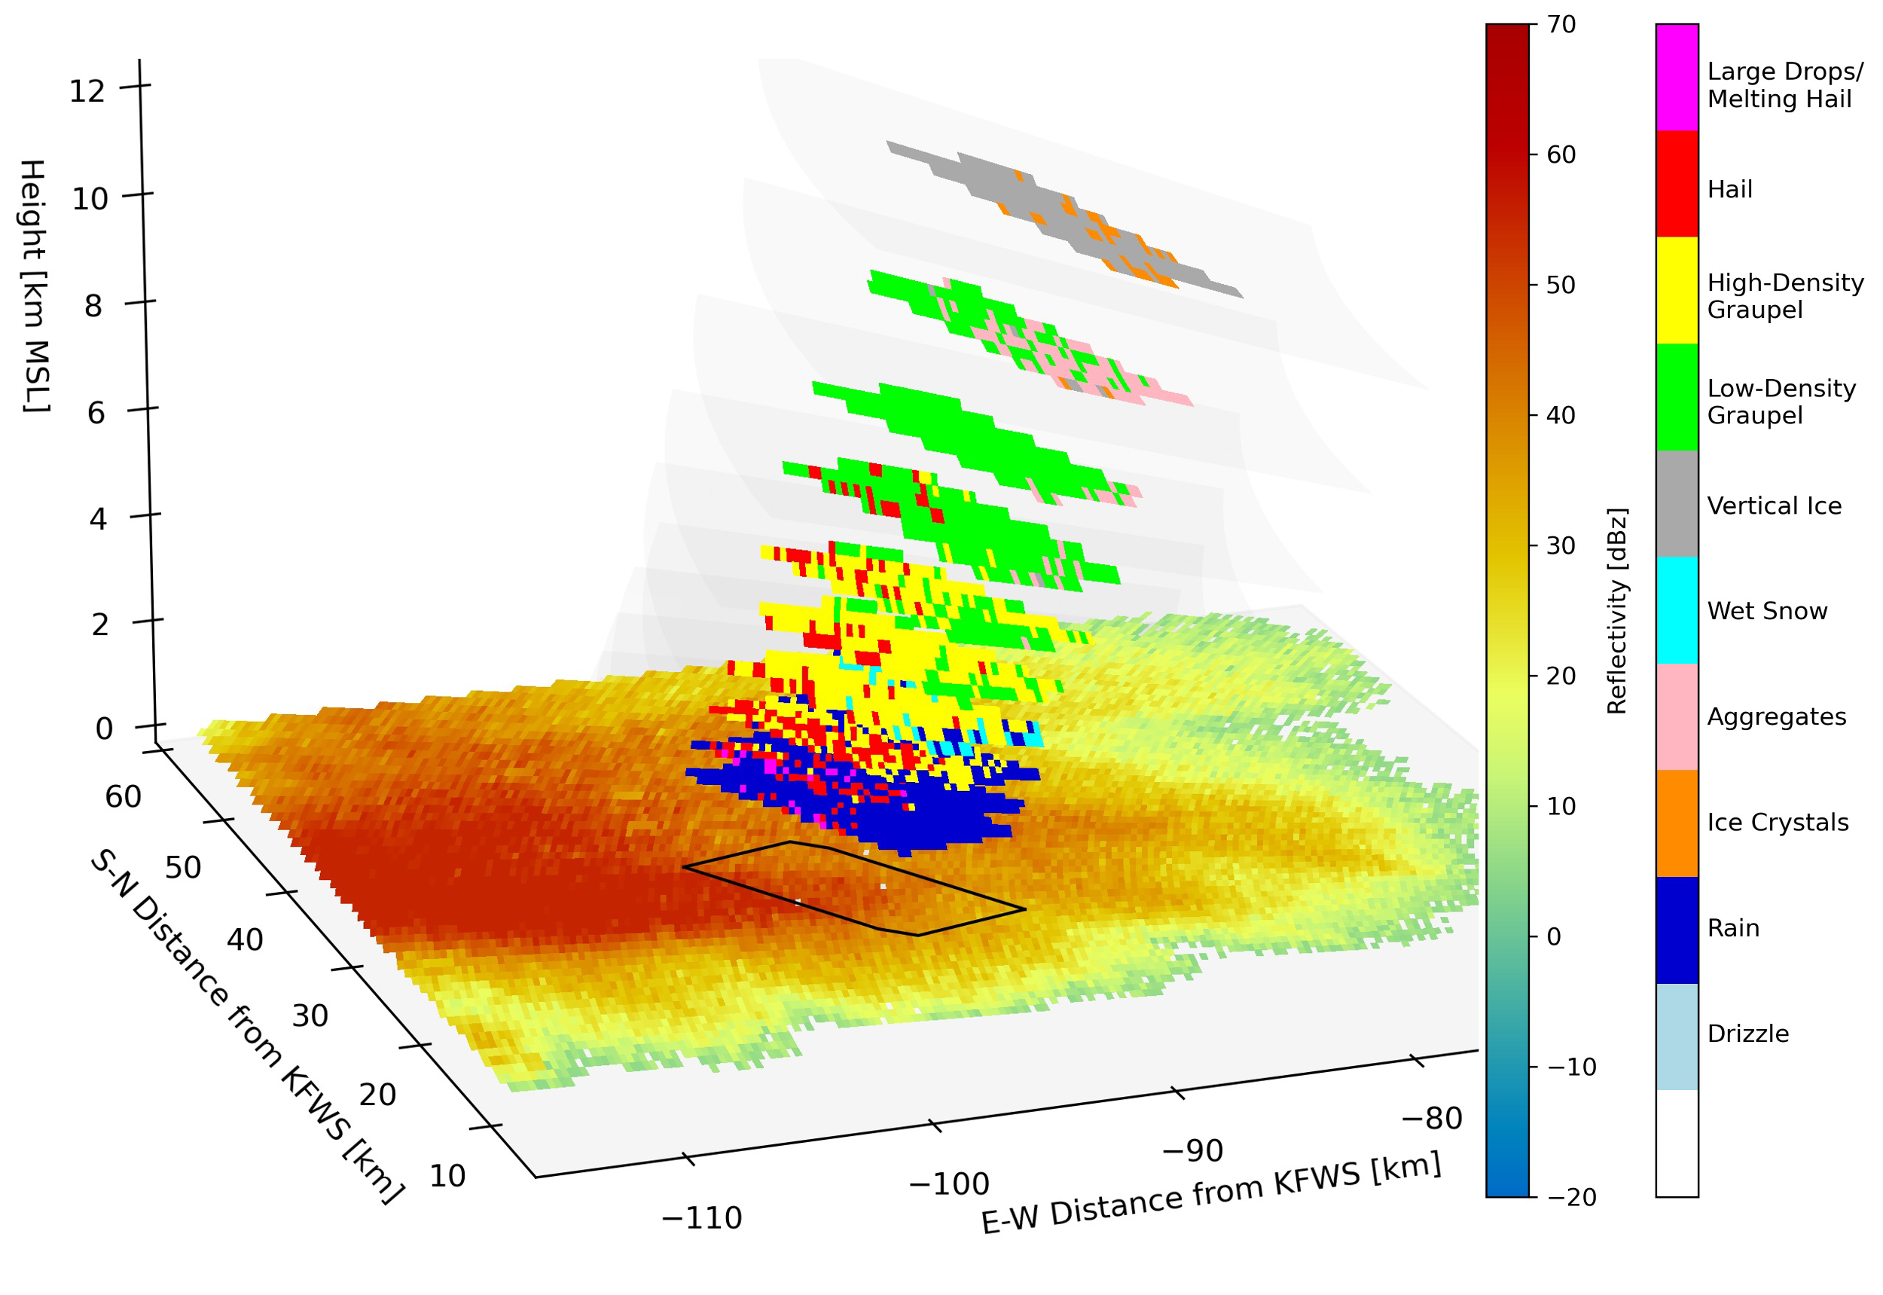
Building the TB-HID Lookup Tables
GPM Validation Network (VN) matches polarimetric radar data to GMI and DPR footprints, accounting for viewing angles. Each GMI footprint has many individual radar gates matched to it, at multiple elevations.
GMI footprint size ~ 10 km x 15 km
A subset of VN radars were used here from around the USA. We tested subsets by region and season. TB-HID relationships were not sensitive to those distinctions.
Our training and verification is entirely over land (USA)
VN data includes hydrometeor types from CSU algorithm (Dolan et al. 2013).
Example radar gates matched to one GMI pixel
Graphic below courtesy Sarah Stough, UAH

Slide 7
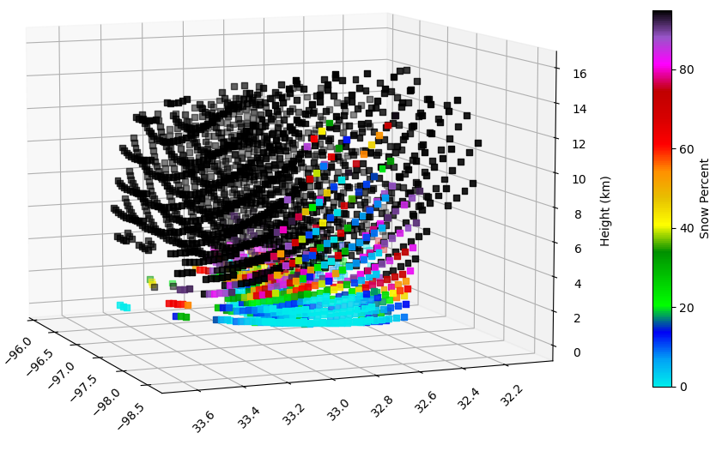
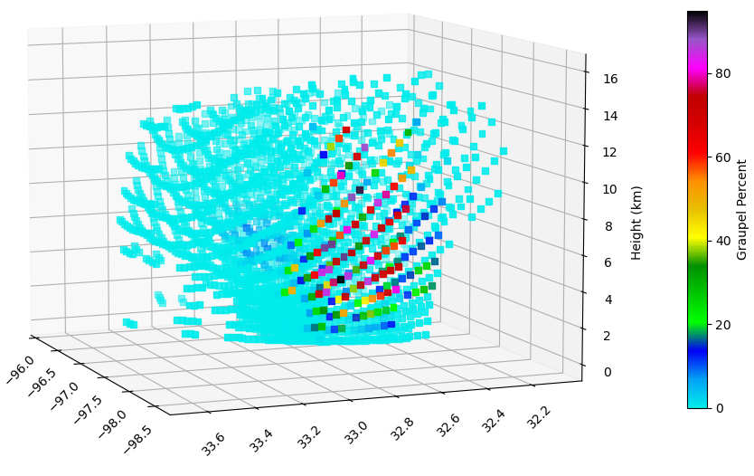
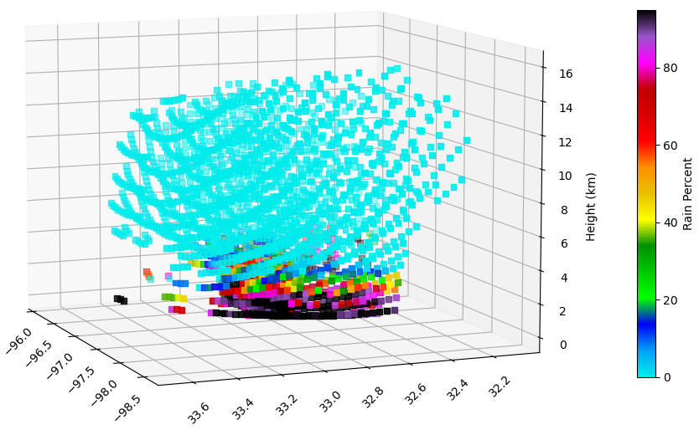
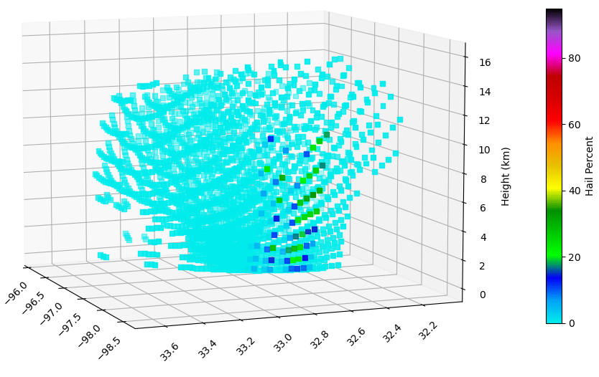
Percentage of GMI footprint with each HID type
Each ground-based radar gate from VN gets an HID, but hundreds of gates are matched with each GMI footprint.
A given GMI footprint can include every hydrometeor type.
Each colored square represents the intersection of the GMI scan with a VN radar elevation angle.
Colors indicate the % of the GMI footprint with the specified HID type at that altitude.
Even for a strong thunderstorm cell, a small % of the radar gates within the GMI footprint are identified as hail.
SNOW (Aggregates, Dry Snow, Vertically Oriented Ice, or Ice Crystals)
GRAUPEL (High density or low density graupel)
RAIN
HAIL

Slide 8
Percentage of GMI footprint with each HID type
Our original approach used the weakest possible threshold for identifying a GMI footprint as hail.
Originally checked a footprint for any radar gates identified as hail, then checked for any gates with graupel, then snow and other ice, then rain.
Even requiring at least 1% of the gates to have the specified HID turns out to be a much stricter test.
Very few footprints have as much as 5% coverage by hail.
The example here is a severe thunderstorm with extremely low TB.
SNOW (Aggregates, Dry Snow, Vertically Oriented Ice, or Ice Crystals)
GRAUPEL (High density or low density graupel)
RAIN
HAIL

Slide 9
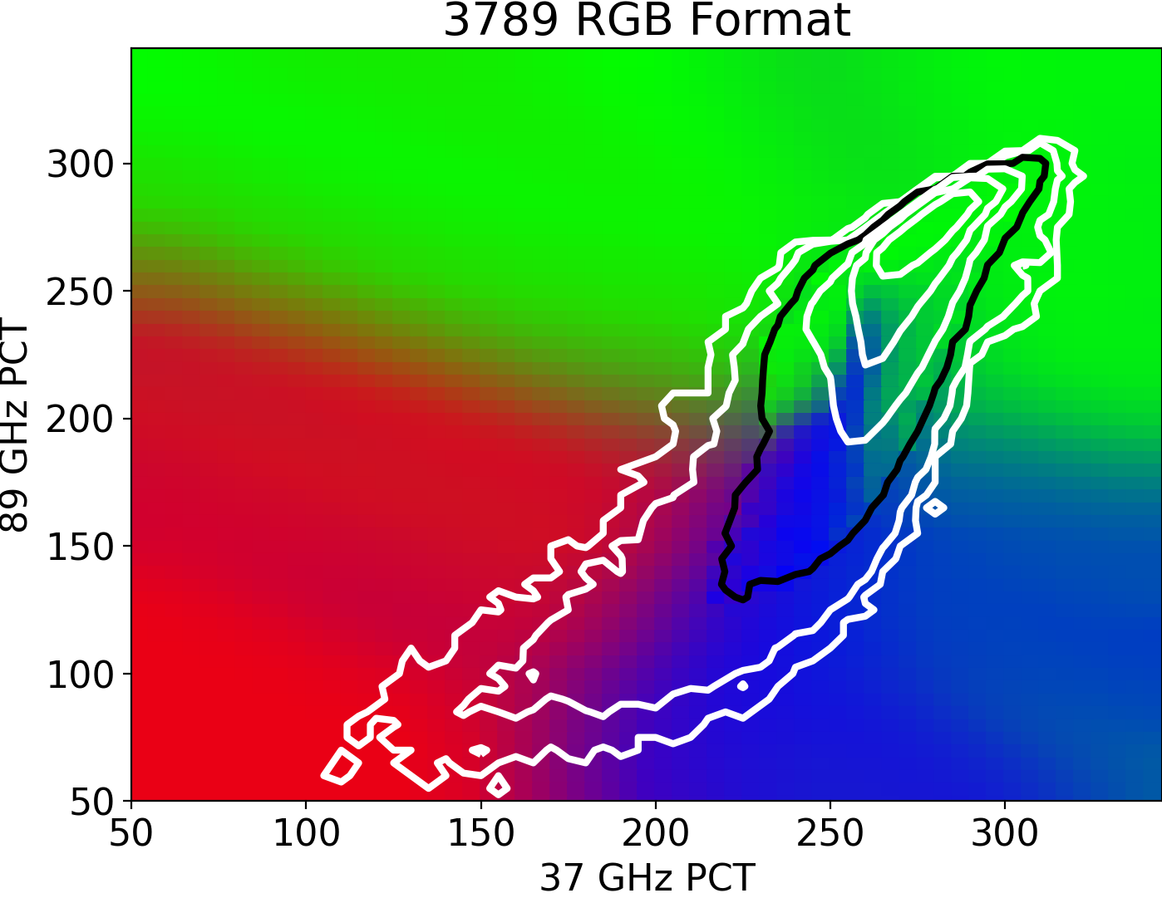
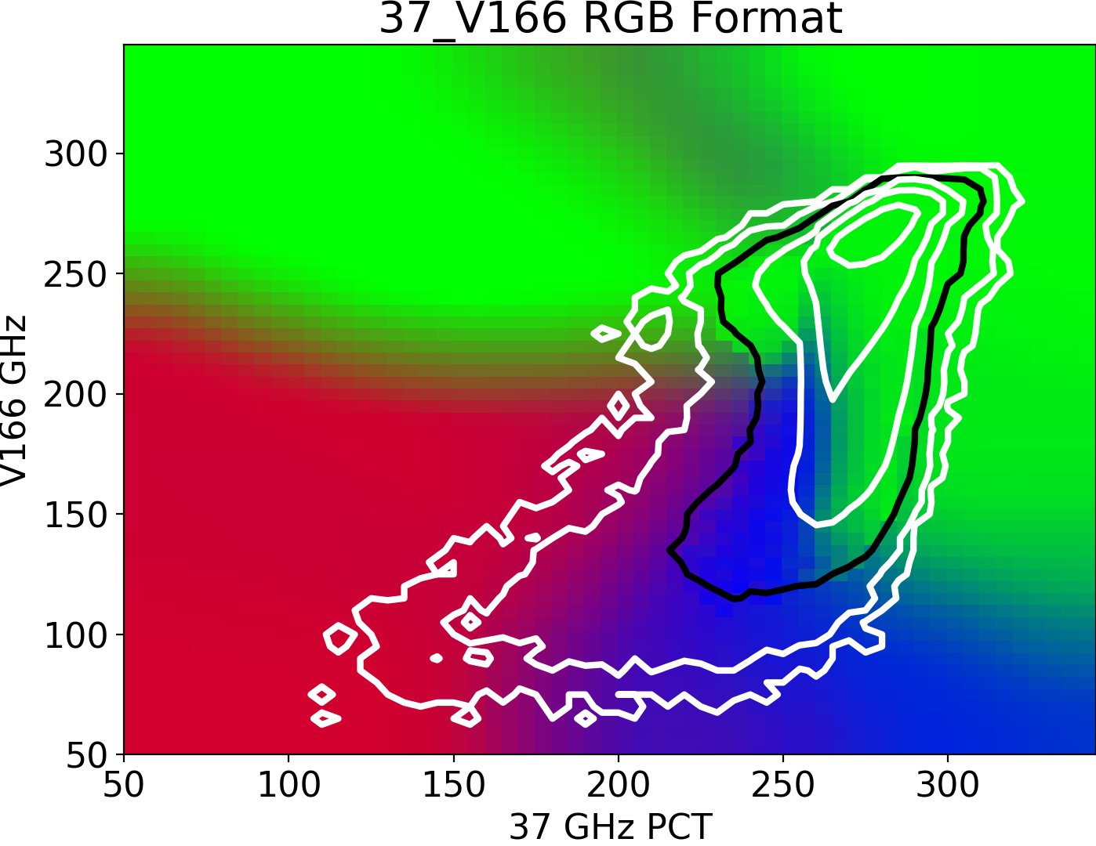
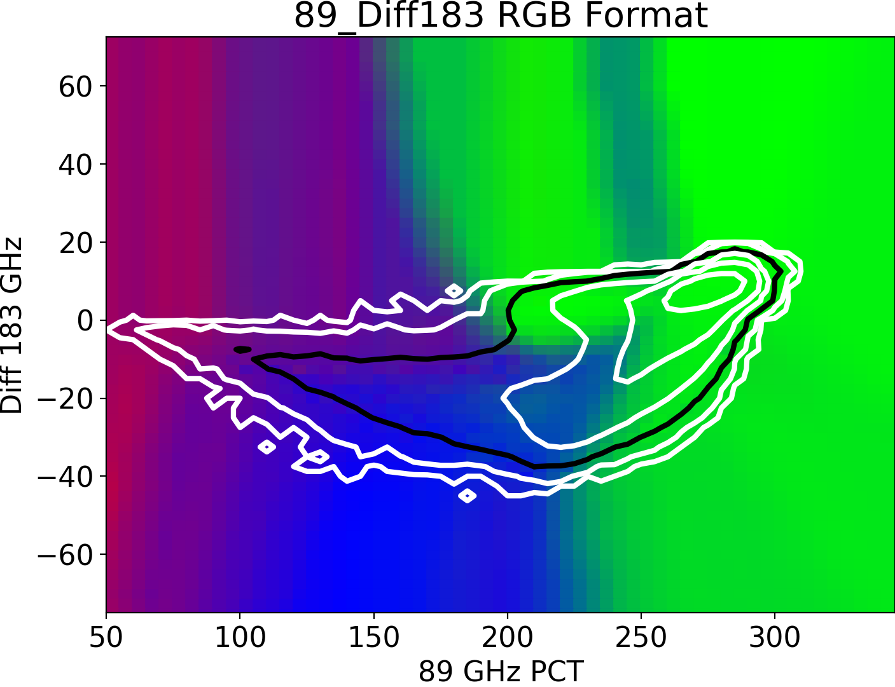
Changing the training data from “any gate” with the HID threshold to “1%” threshold
Original version
Snow / Rain
Hail
Graupel
Top panels from original (any-gate threshold) lookup tables. Bottom panels use stricter 1%-coverage threshold. More TB combinations align with a higher likelihood of graupel, lower likelihood of hail using the stricter threshold.
Stricter
1% threshold
Snow / Rain
Hail
Graupel

Slide 10
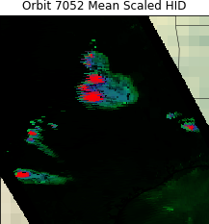
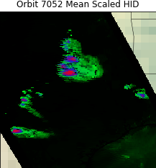
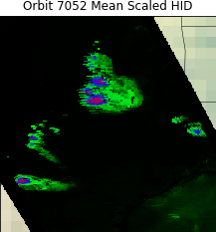
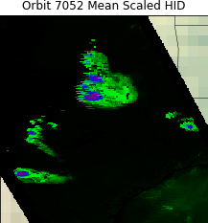
Stricter training thresholds applied to severe thunderstorm overpass
Original approach (weakest threshold; upper-left) identifies large areas in many storm cores as very likely hail.
Lookup tables trained on stricter criteria (strictest is at bottom right) identify smaller areas of hail (red) and graupel (blue), with lower probabilities assigned to those HID types.
Pro: Stricter criteria are not as prone to “over-warning” – identifying a hydrometeor type that likely is not present in meaningful quantities.
Con: Stricter criteria rarely give a very high percentage probability of hail being present, even for extreme TB cases where that seems like the obvious interpretation.
Weakest threshold – at least 1 radar gate in the matched volume has hail
At least 1% of radar gates in the matched volume have hail
At least 2.5% of radar gates in the matched volume have hail
At least 5% of radar gates in the matched volume have hail

Slide 11
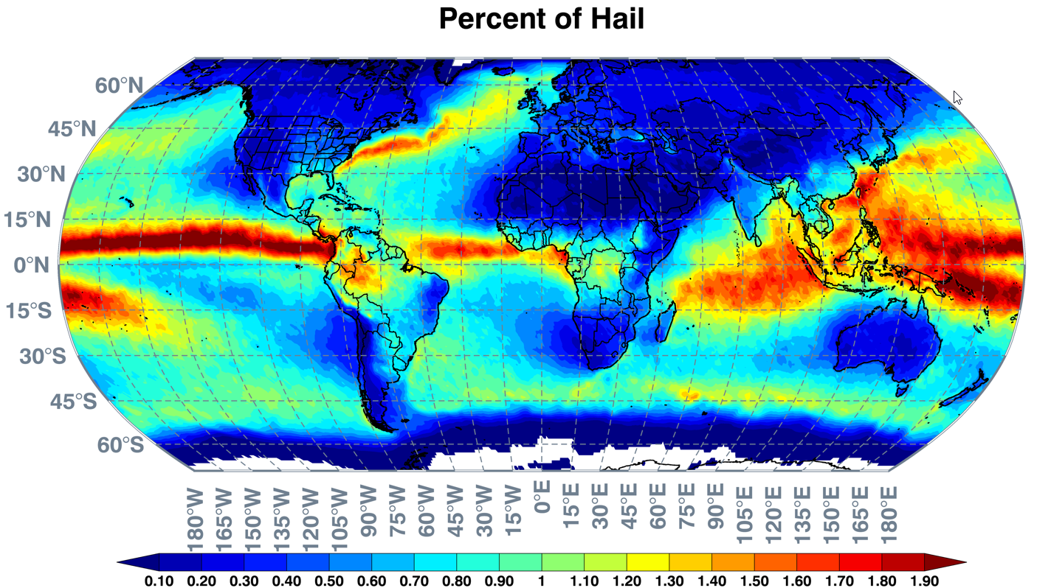
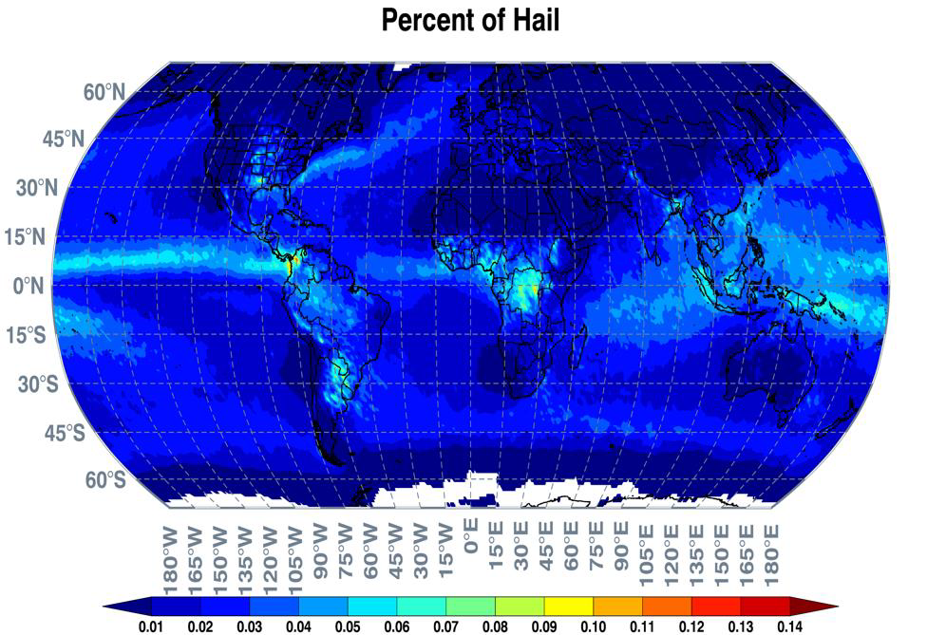
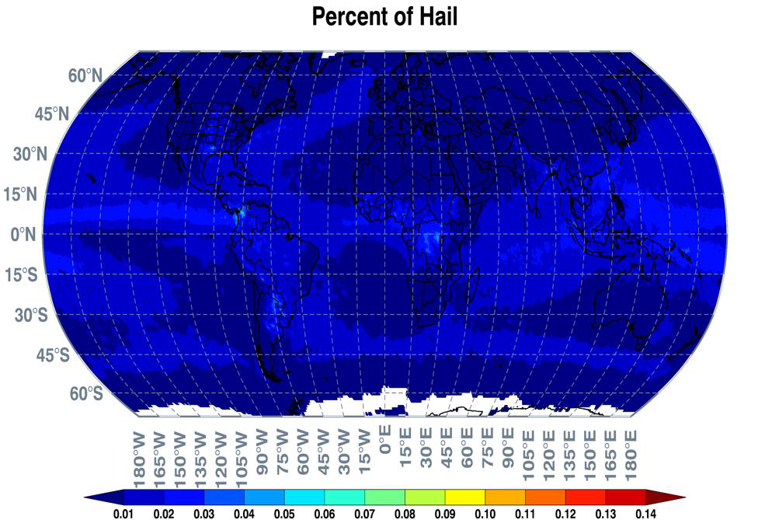
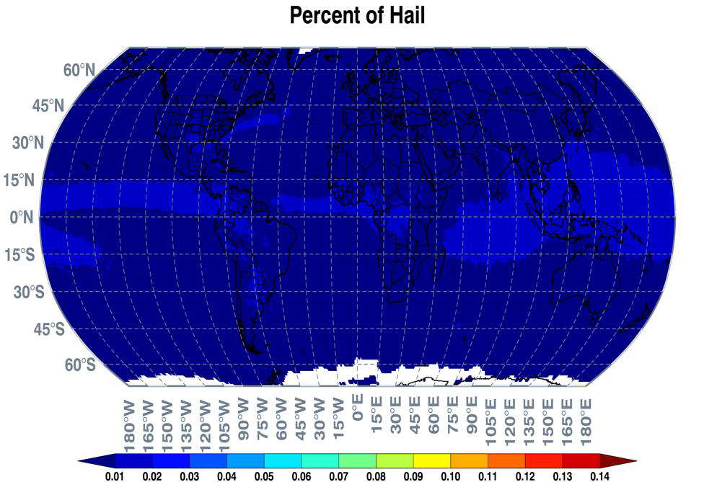
Accumulated percentage of pixels with hail from the different threshold approaches
Original 1-gate threshold
1% of gates threshold
Different color scales, with about a factor of 30 reduction!
2.5% of gates threshold
Stronger thresholds shift the maxima toward continental hotspots
5% of gates threshold

Slide 12
Summary
Lookup tables map GMI brightness temperatures to probabilistic hydrometeor type (hail, graupel, snow / other ice, rain)
  Trained using GPM Validation Network Hydrometeor Identifications (HID) (from dual-pol radar, matched to GMI field of view)
Lookup tables, interpretation, and verification published in:
Cecil et al. 2024 JAMC https://doi.org/10.1175/JAMC-D-23-0196.1
Original version uses a weak threshold for identifying hail
Stricter thresholds in the training data limit the areal extent and the probability of retrieved hail
  Better isolate potential hail and graupel cores
Stricter thresholds fail to produce the high-confidence (probability approaching 100%) identification of hail that seems appropriate with some extremely low TB combinations

