Slide 1

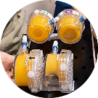
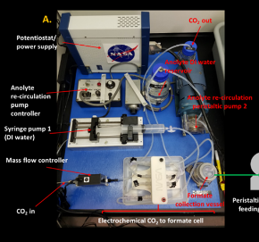
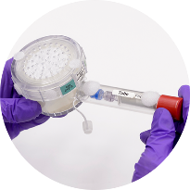
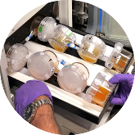
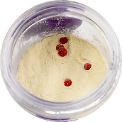
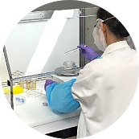
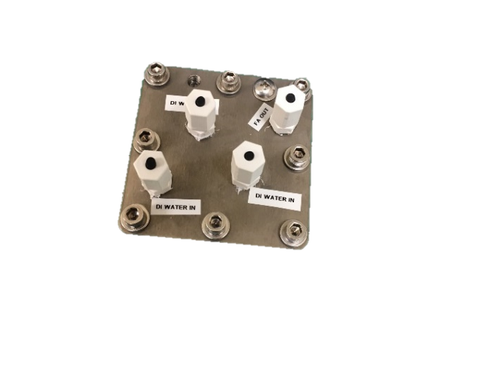
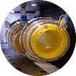
Space Technology Mission Directorate
Game Changing Development Program
Frances Donovan, Synthetic Biology (SynBio) Project | Annual Program Review | September 11, 2024

Slide 2
BioNutrients Element Overview
Needs Addressed by Project
Live/MCO | The system provides in-mission microbial food production (yeast, yogurt/kefir) that provide fresh nutrients, probiotics, and with genetic engineering, additional nutrients or delivery of therapeutics. | AH: Food and Nutrition for Mars and sustained Lunar missions1525, SS 1610 Crew medical care 1524
Live/MCO | The system provides food production from a fully dehydrated, low mass/volume/complexity system with up to 5 years ambient shelf life. | Logistics Man: Safe, acceptable and nutritious food system 800, 1013,1610 Adv Thermal 1620
Technology Goals
Goal #1 | Develop a platform technology for safe, on-demand microbial production of nutrients during missions.
Goal #2 | Demonstrate hardware and microbes in space and use results to guide this technology development effort.
Goal #3 | Develop in-space implementation requirements and methods for initial deployment.
Project Objectives
Objective #1 | Conduct 5-year test to verify concept and create space-adapted hosts for future tests.
Objective #2 | Develop space-ready low mass/volume storage and growth system.
Objective #3 | Develop and verify a food safety plan for implementation.
Notes:
2021-2944-​TX06Safe, Acceptable, and Nutritious Food System
2021-2945-​TX06 Food Resources Requirements and Efficiency
2021-3616-​TX11 Low-Hydration Food for Exploration Missions

Slide 3
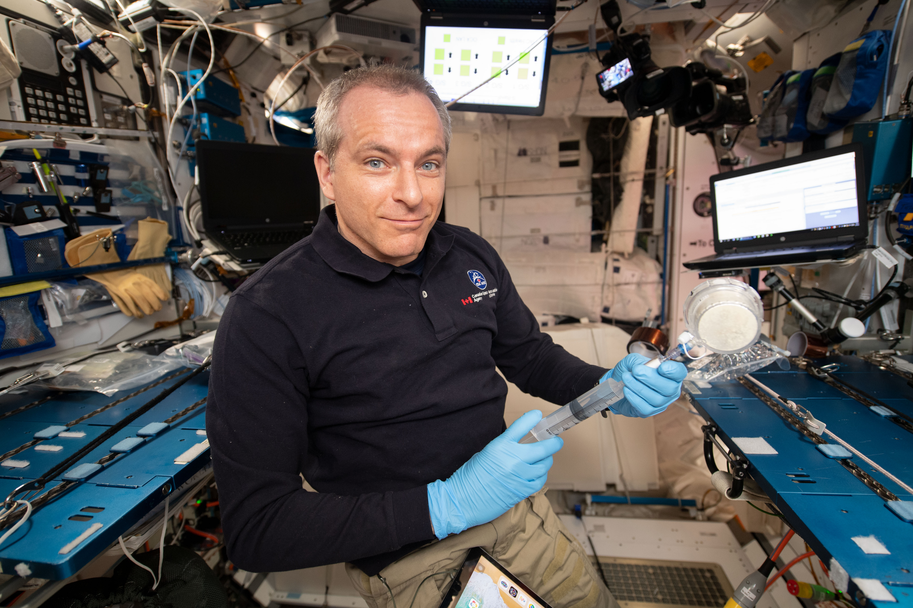
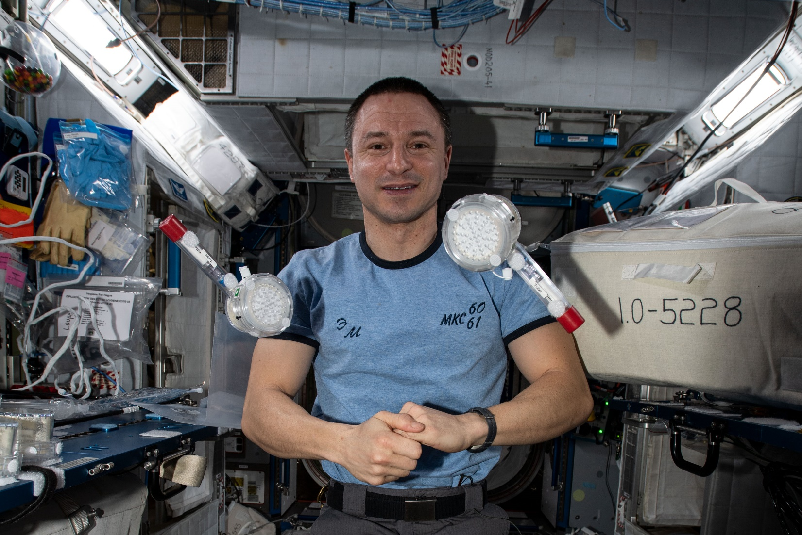
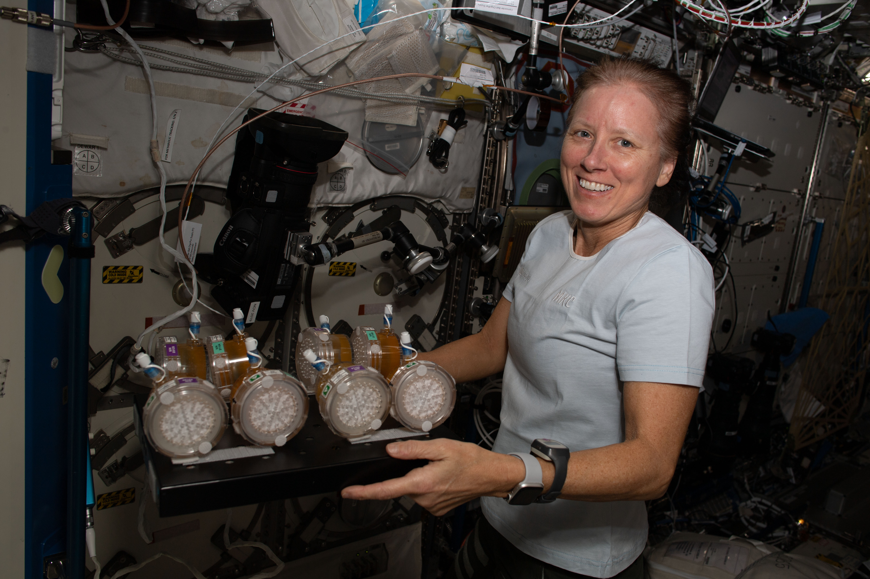
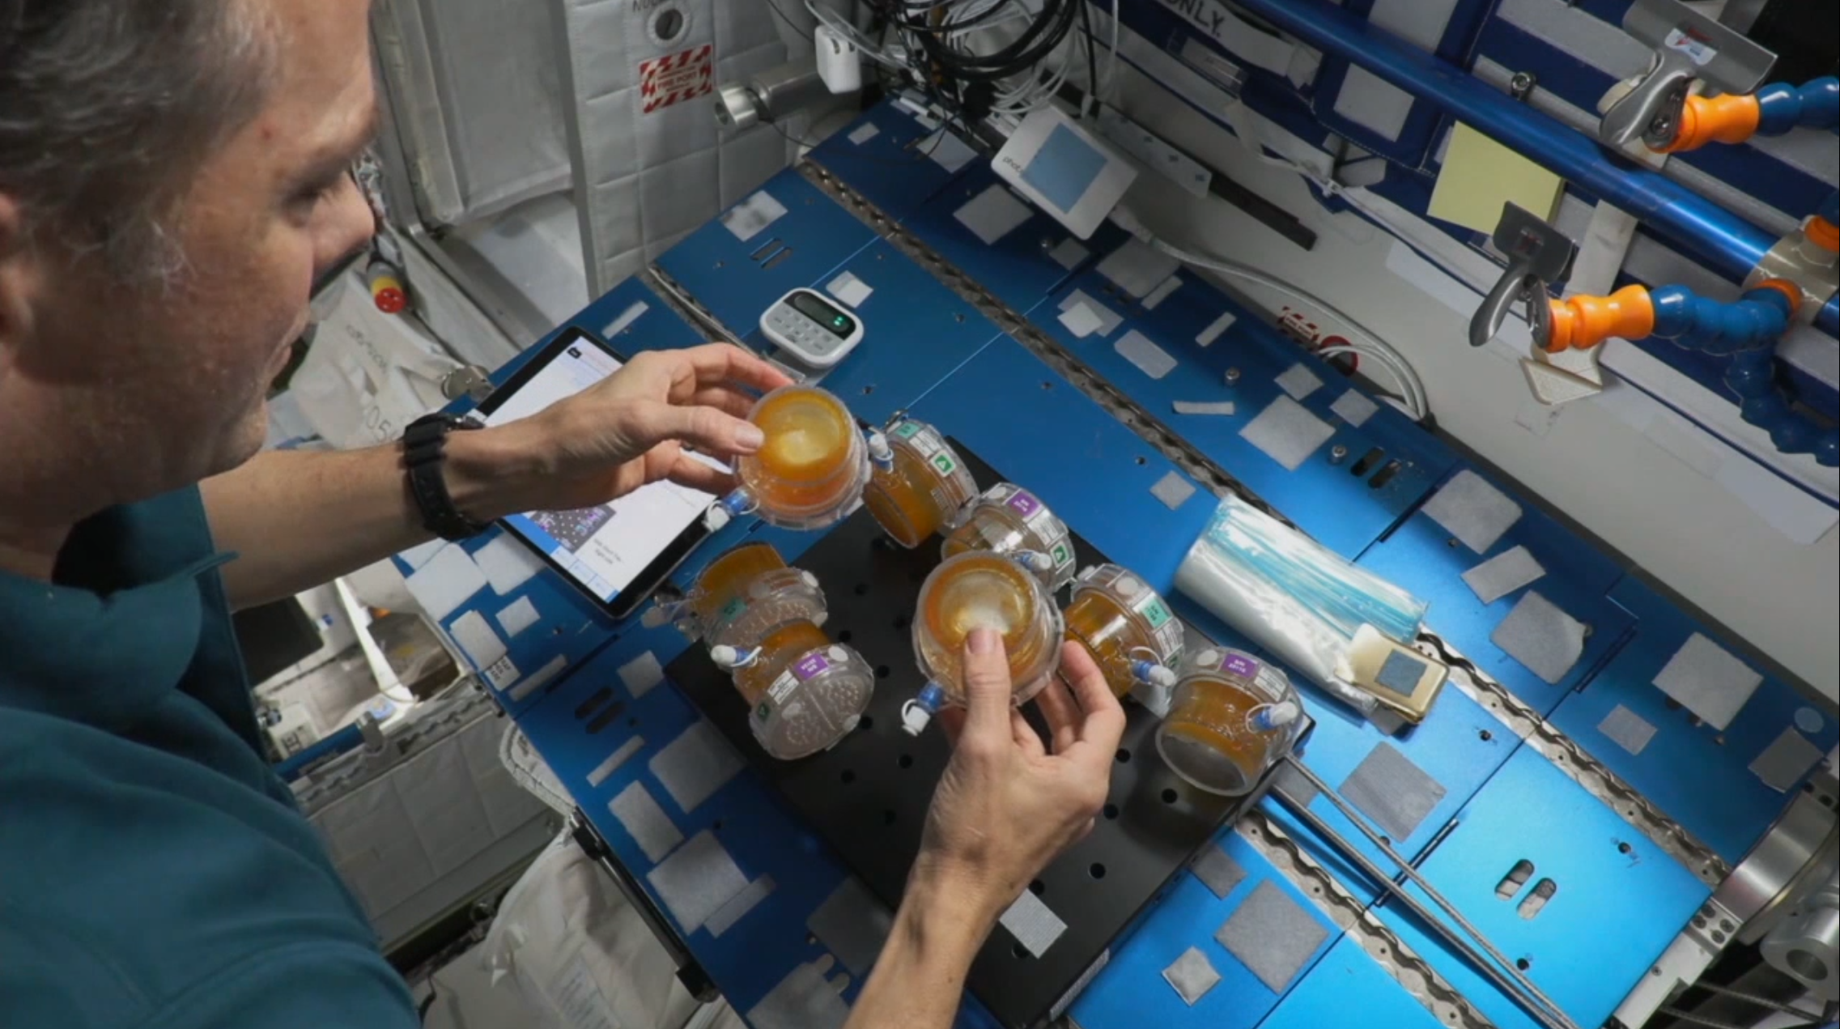
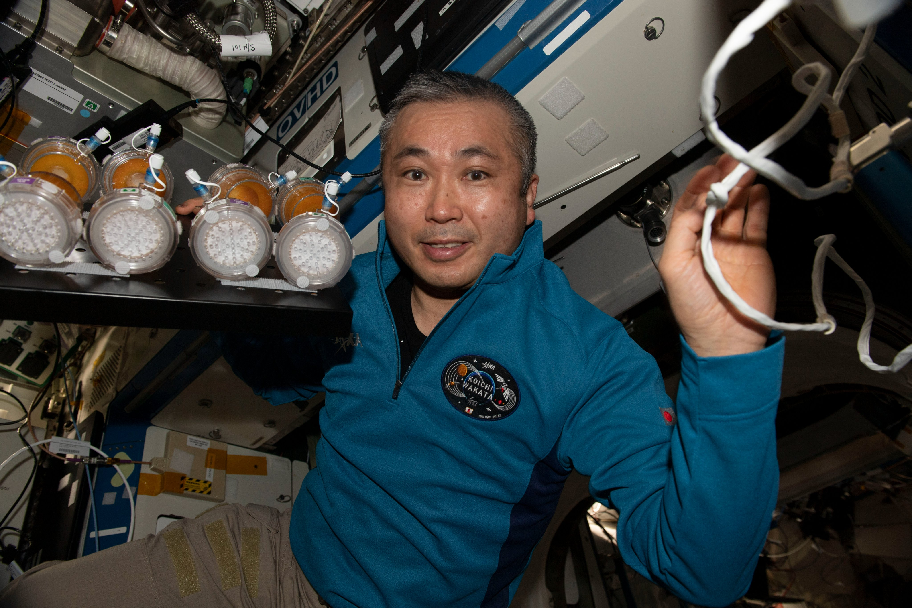
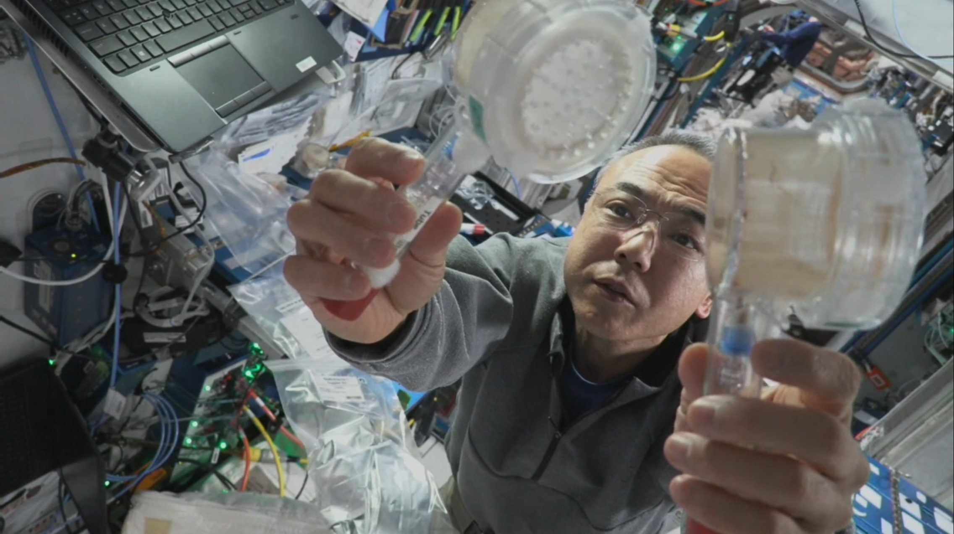
Five Years and Six Runs Complete!
BioNutrients-1 Crew Members (left to right, top to bottom): David Saint-Jacques (Run 1, June 2019), Drew Morgan (Run 2, January 2020), Shannon Walker (Run 3, January 2021), Thomas Marshburn (Run 4, January 2022), Koichi Wakata (Run 5, January 2023), Satoshi Furukawa (Run 6, January 2024)

Slide 4
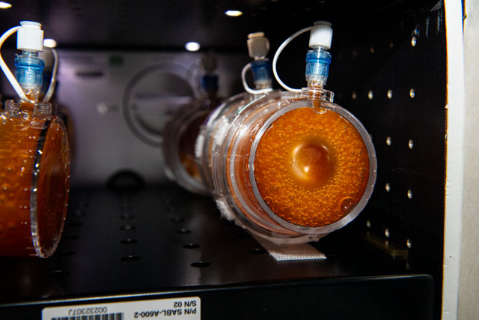
Technical Progress and Results : BioNutrients BN-1/Gen-0 System
BN-1 five-year shelf-life production pack study complete with Run 6 Production Pack operation on ISS and return on Ax-3.
  On-orbit hydration and production of yeast producing beta carotene and zeaxanthin was performed January 2-4, 2024. This was the sixth of six planned runs for the experiment occurring 57.4 months after launching on NG-11 (April 17, 2019), with 59-63 months shelf life from organism preparation. No anomalies, no contamination, operated as planned. Ground controls and flown controls also completed as planned.
  Independent vendor analysis to confirm nutrient production is underway.
  NPP fellowship (for Omics investigation of BN-1 samples) started on April 1, 2024.
(Left) JAXA Astronaut Satoshi Furukawa (JAXA) displays Run 6 ISS Production Packs to camera prior to hydration. (Right) Post agitation of Run 6 ISS Production Packs.

Slide 5
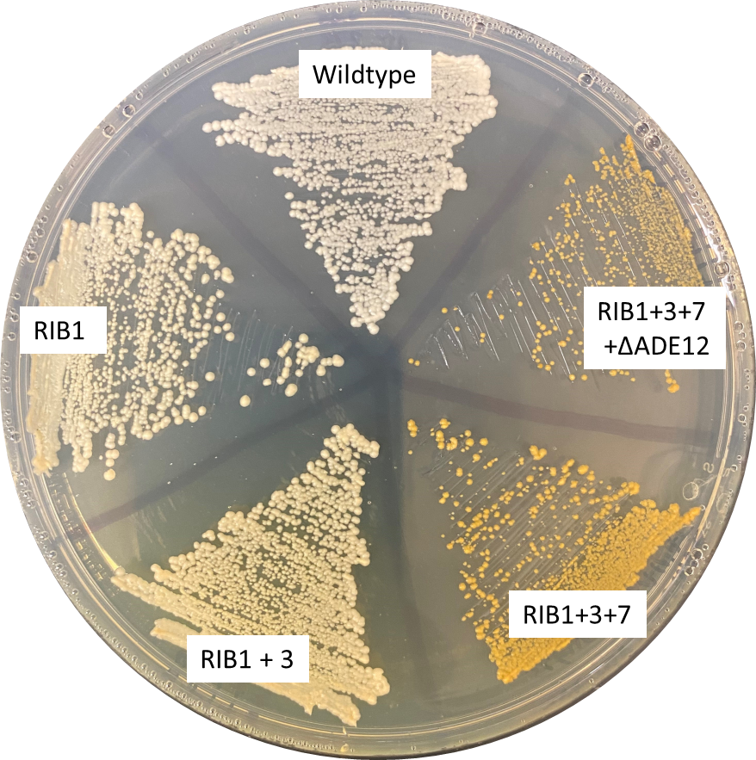
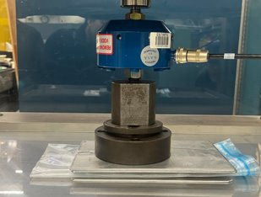
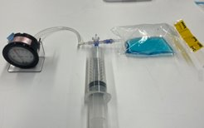
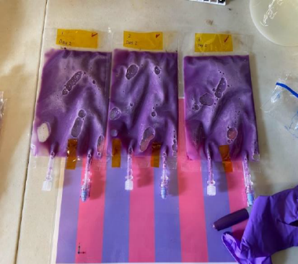
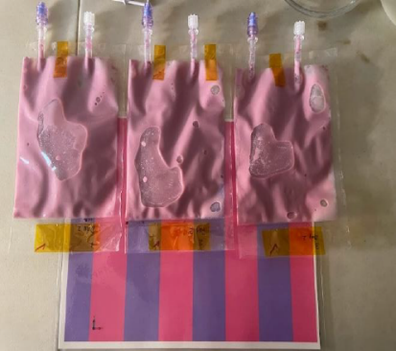
Technical Progress and Results : BioNutrients BN-3/Gen-2 System
BN-3: on track to produce multiple nutrients in a single pack, (fig.1).
  Independent vendor analysis confirms Riboflavin and Folate production in yeast. Vitamin K (MK-7) confirmed in BN-1 stasis pack samples.
Gen 2 Critical Design Review completed April 23, 2024
  Pre-Qualification testing with prototype bags fully completed, including maximum design pressure (MDP) testing, static load test, and freezer thermal cycling testing at JSC. Fit checks for SABL and MELFI complete.
  FEP and PDMS bioreactors were developed. PDMS permeability results in excessive ethanol release.
  Pasteurization in mock ISS food warmer successful, testing in flight-like engineering unit at JSC planned for Fall 2024.
  New edible pH indicator dye performance confirmed, (fig. 3).
  Product viability/biomass production, nutrient production and volumes required for all testing and analysis confirmed in larger Gen-2 FEP bag design.
Received guidance on process to apply for crew testing from Human Research Program.
  Began discussions with FDA to obtain approval for human consumption.
HACCP baselined
  Hazard Analysis Critical Control Point (HACCP) plan was reviewed with Advanced Food Systems lead, KSC Veggie team and Eurofins food safety consultant prior to baselining in April 2024.
Figure 1: genetically engineered yeast strains developed to co-produce carotenoids, riboflavin and folate.
Figure 2: photos from static load test and functional leak testing of FEP bags. Freezer test was conducted at JSC cold stowage group.
Figure 3: New edible pH indicator dye confirmed (pre and post growth pictured above. Endpoint pH, syneresis (whey/yogurt), and yogurt viabilities show no significant differences with and without the pH indicator dye.
Notes:
Pasteurization in Galley Rack Food Warmer (GRFW) – initial discussion and examination of test data makes this a potential option.
Shuttle era food space_food_types_s93-32499.jpeg (4078×4086) (nasa.gov)
Spoilage/pathogen detection
E-nose Began investigations using ARC-based E-Nose technology for rapid in situ detection of volatiles associated with microbial contamination. Potential platform system for wider use.
Image credit: https://astronautfoods.com/blogs/news/space-food-101

Slide 6
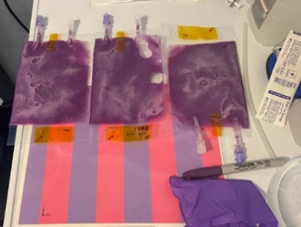
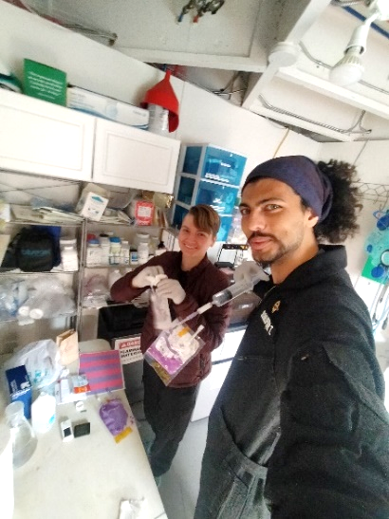
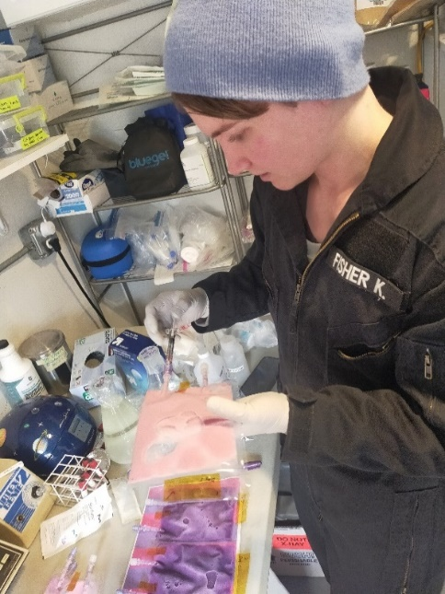
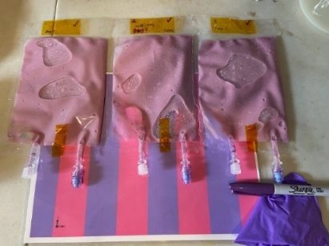
Technical Progress and Results : Yogurt and Kefir Passaging
Due to concerns over the shelf life of yogurt and kefir organisms, we have proposed passaging of these products, or serial production – using a small portion of a completed product to “seed” and produce a new product. This requires sterile transfer from one product bag to a new bag containing only non-fat milk powder. Activity must be successful under non-sterile conditions and performed by non-expert crew.
Yogurt and Kefir passaging have both been successfully demonstrated in our lab.
Kefir passaging was demonstrated March 4-9th, 2024 at the Hawaiian Space Exploration Analog and Simulation (HI-SEAS) located on Mauna Loa volcano, Hawaii.
Analog Astronauts Katie Fisher and Tuğcağ Dumlupinar of Turkey perform bag hydration and passaging step of kefir cultures. Top right: Pre-incubation. Bottom right: 24 h post-incubation. Pictures courtesy of Katie Fisher.

Slide 7
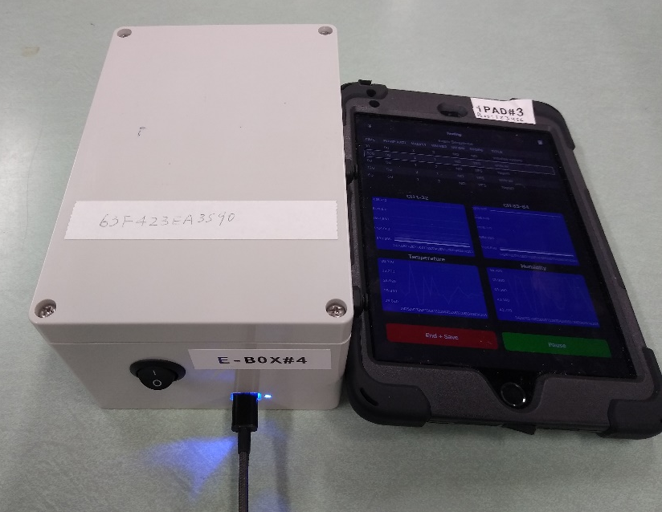
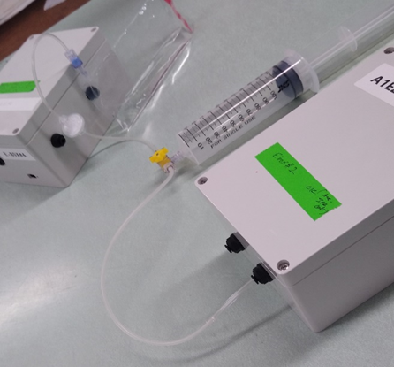
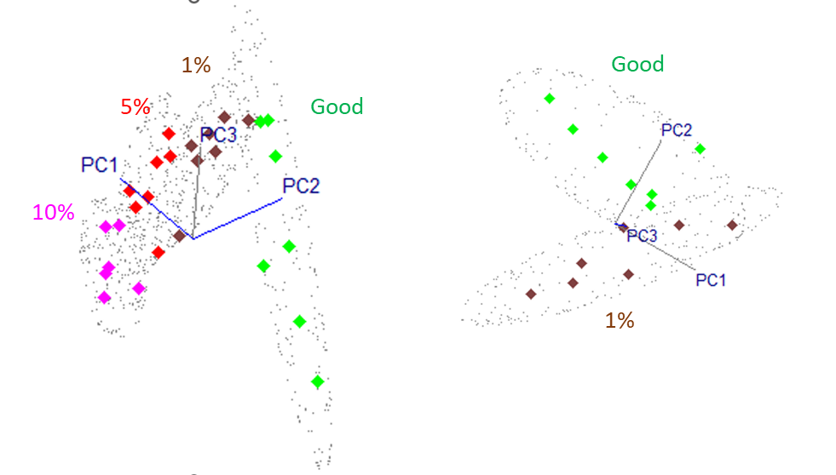
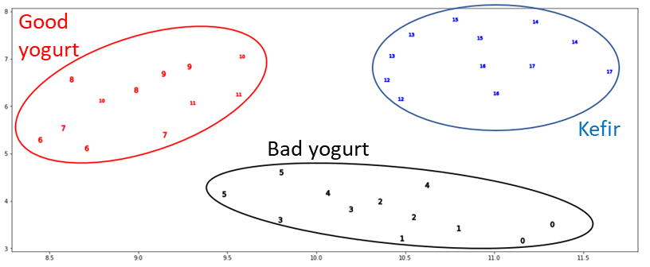
Technical Progress and Results : E-Nose food spoilage detection in BioNutrients System
Spoilage and pathogen detection via E-Nose: successful discrimination between samples demonstrated.
E-Nose ground unit integrated design including pump
Three categories of milk products (good yogurt, Kluyveromyces marxianus contaminated yogurt, and kefir) were tested with six (6) samples/category. For each sample, two (2) technical replicate sensor response peaks were used for linear support-vector machine (SVM) modeling.
  Leave-one-out cross-validation of individual technical replicates showed 100% identification accuracy.
A total of 27 samples from four different categories (100% good, 1%, 5%, and 10% contaminated yogurt) were tested to learn E-Nose detection limits in identifying K. marxianus contaminated samples.
  Linear SVM leave-one-out identification showed 100% sensitivity for all samples, and 100% specificity accuracy for 5% and 10% contaminated samples.
  One out of seven “good yogurt” samples was misidentified as 1% contaminated yogurt which resulted in 86% specificity.
  37 CFU/ml (1.3 x 10³ CFU/35 ml of bag) of the intentional contaminant was successfully detected in the 1% contaminated yogurt.
Contaminated yogurt
E-Nose Interface design for use with BioNutrients Bag designs
(A) Uniformed Manifold Approximation and Projection (UMAP) plot showing discrimination of three different groups: Good yogurt (red), K. marxianus contaminated yogurt (black), and Kefir (blue). (B) Principal Component (PC) analysis 3D scatterplots showing the first three PCs discriminate good yogurt (green) relative to contamined groups: 1% (brown), 5% (red), and 10% (purple).

Slide 8
BioNutrients-1, -2, and -3 ISS TRL Lifecycle Maturity/Milestone Schedule
(pending GCD review of trait tool entries, some entries are likely to be revised downwards based on mission location)
Project Milestone
GCD (Key) Milestone
Controlled Milestone
TRL/SRL/MRL Progression
9
FY18 | FY19 | FY20 | FY21 | FY22 | FY23 | FY24 | FY25
BN-1 Gen-0 bioreactor TRL
BN-1 organisms (IPP and stasis pack)
BN-2 Gen-1 bioreactor TRL and organisms
BN-3 Gen-2 bioreactor TRL
BN-3 organisms
Flight Results
Final Report on Flight Results BN1, 3
8
Run 3 IPP
Flight report/final results
Flight Results
T8 SP
Run 4 IPP
Run 5 IPP
Run 6 IPP
7
TRL
Run 2 IPP
Set 2
On orbit ops
Run 1 IPP
Set 1
6
BN-1 Gen-0 Design review; EVT
BN-2 ground test
BN-3 Gen 2 CDR
BN-3 Gen 2 ground Test
5
BN-2 Gen1 Design review
BN-3 Gen 2 PDR
4
3
BN-3 kick off
BN-1 Launch to ISS
BN-2 Launch to ISS
BN-3 Launch to ISS
Notes:
Chart purpose: show TRL/SRL/MRL advancement over the project lifecycle schedule. Show TRL advancements as whole integer increases. Show how Key and Controlled milestones align with TRL advancement.
TRL/SRL/MRL may not advance at each milestone. Often several milestones are required to produce a step increase in TRL/SRL/MRL.
There can be one, or more, of these charts per project as needed.
For projects with fewer technical elements, the TRL/SRL/MRL data can be combined on one chart.
For more complex projects, the TRL/SRL/MRL progression can separated into multiple charts by project technical area.
Show TRL, SRL, and MRL data for each technical element on the same chart.
Delete TRL/SRL/MRL axis-labels that do not apply – e.g., remove SRL/MRL for projects/technical areas where SRL and MRL do not apply.

Slide 9
BioNutrients-1, -2, and -3 MARS TRL
Lifecycle Maturity/Milestone Schedule (pending GCD review of trait tool entries)
Project Milestone
GCD (Key) Milestone
Controlled Milestone
TRL/SRL/MRL Progression
9
FY18 | FY19 | FY20 | FY21 | FY22 | FY23 | FY24 | FY25
BN-1 Gen-0 bioreactor TRL
BN-1 organisms (IPP and stasis pack)
BN-2 Gen-1 bioreactor TRL and organisms
BN-3 Gen-2 bioreactor TRL
BN-3 organisms
8
7
Final Report on Flight Results BN1, 3
Flight Results
Run 3 IPP
Flight report/final results
Flight Results
TRL
Run 2 IPP
T8 SP
Run 4 IPP
Set 1
On orbit ops
Set 2
Run 6 IPP
Run 1 IPP
Run 5 IPP
6
BN-1 Gen-0 Design review; EVT
BN-2 ground test
BN-3 Gen 2 CDR
BN-3 Gen 2 ground Test
5
BN-2 Gen1 Design review
BN-3 Gen 2 PDR
4
3
BN-3 kick off
BN-1 Launch to ISS
BN-2 Launch to ISS
BN-3 Launch to ISS
Notes:
Chart purpose: show TRL/SRL/MRL advancement over the project lifecycle schedule. Show TRL advancements as whole integer increases. Show how Key and Controlled milestones align with TRL advancement.
TRL/SRL/MRL may not advance at each milestone. Often several milestones are required to produce a step increase in TRL/SRL/MRL.
There can be one, or more, of these charts per project as needed.
For projects with fewer technical elements, the TRL/SRL/MRL data can be combined on one chart.
For more complex projects, the TRL/SRL/MRL progression can separated into multiple charts by project technical area.
Show TRL, SRL, and MRL data for each technical element on the same chart.
Delete TRL/SRL/MRL axis-labels that do not apply – e.g., remove SRL/MRL for projects/technical areas where SRL and MRL do not apply.

Slide 10
CO₂-Based Manufacturing Overview
Mark Settles
Needs Addressed by Project
Live/MCO | The platform can use CO2 derived carbon feedstocks for biomanufacturing of many products including plastics, binders, enzymes, nutrients, fertilizers and feedstocks. | Shortfall IDs ISRU1333, 589,1583, 1584 AH 358, SS 1611
Live/MCO | CO₂ as waste or in atmosphere can be converted to feedstocks for biomanufacturing, system can also use wastes (urea, salts, organic waste), and support closed loop life support via breakdown/recycling/repurposing of materials.
CO₂-Based Manufacturing Goals
Goal #1 | Develop microbiological techniques using ISRU to widely broaden In Space Manufacturing capabilities.
Goal #2 | Provide technology tests and trade studies demonstrating the technology’s potential impact on lunar and Mars surface missions.
CO₂-Based Manufacturing Objectives
Objective #1 | Perform an initial integration of the developed CO₂ conversion, bioreactor, engineered organism and purification systems to both demonstrate the validity of the concept, and to identify needs/challenges for prototype development.
Objective #2 | Develop “space-ready” engineered microorganism(s) capable of making a targeted mission product (carbonic anhydrase), and test with an improved production and product harvesting system.
Objective #3 | Develop use case scenarios for this overall approach, identify needed future areas of research and development, and provide recommendations for forward work.
Notes:
2021-2896-​TX06 Highly reliable, closed-loop-forward carbon dioxide removal systems
2021-3579-​TX07 ISRU from waste materials - plastics
Summary of the CO2-Based Manufacturing task objectives:
1) CO2-Based Manufacturing: Perform an initial integration of the developed CO2 conversion, bioreactor, engineered organism and purification systems to both demonstrate the validity of the concept, and to identify needs/challenges for prototype development.
2) CO2-Based Manufacturing: Develop “space-ready” engineered microorganism(s) capable of making a targeted mission product (carbonic anhydrase), and test with an improved production and product harvesting system that is compatible with spacecraft environments during lunar and Mars missions.
3) CO2-Based Manufacturing: Develop use case scenarios for this overall approach, identify needed future areas of research and development, and provide recommendations for forward work.

Slide 11
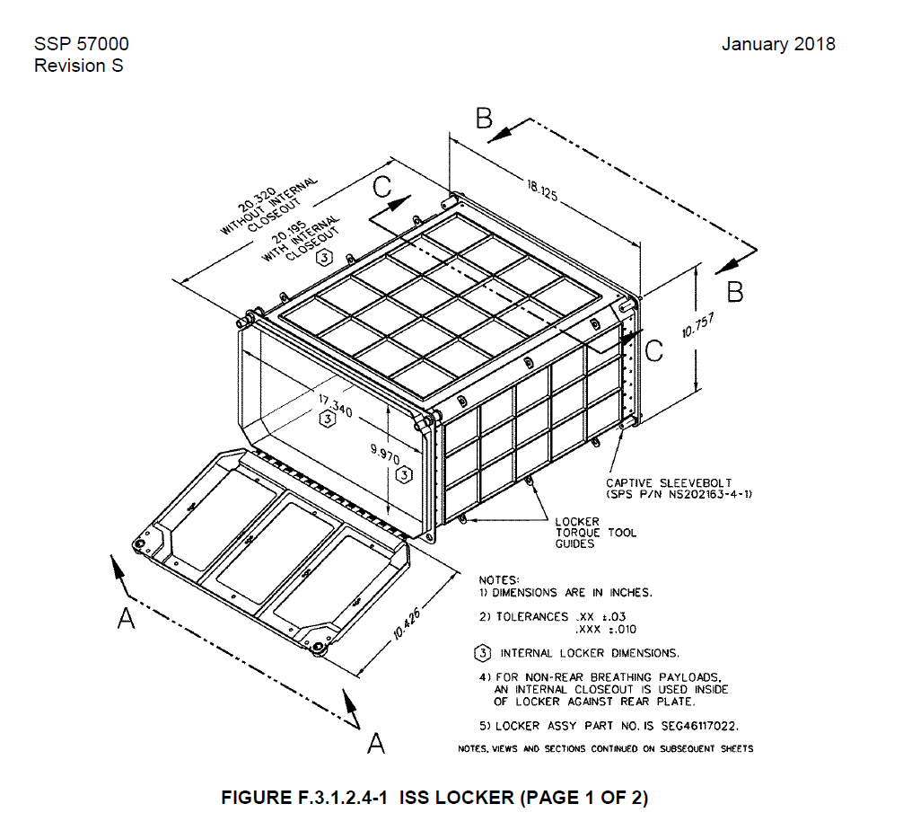
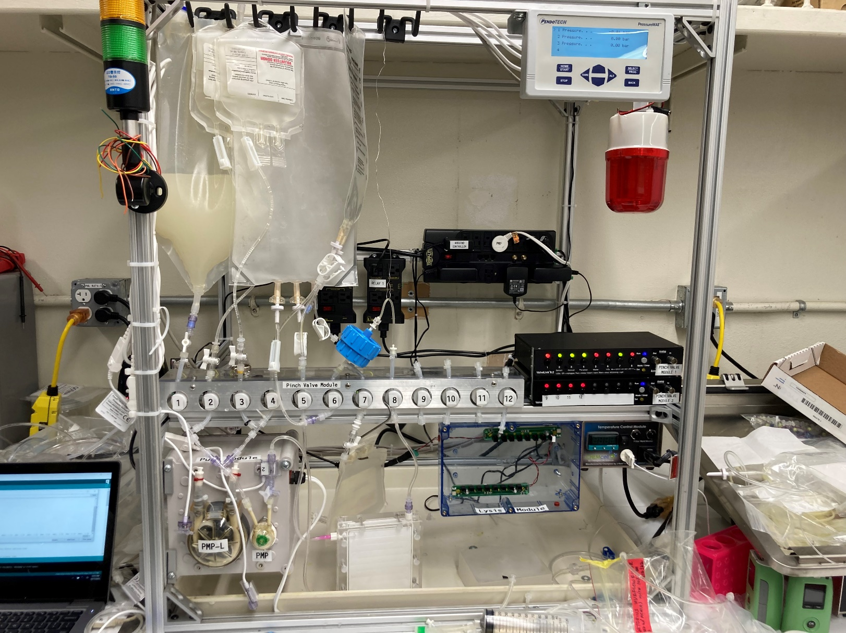
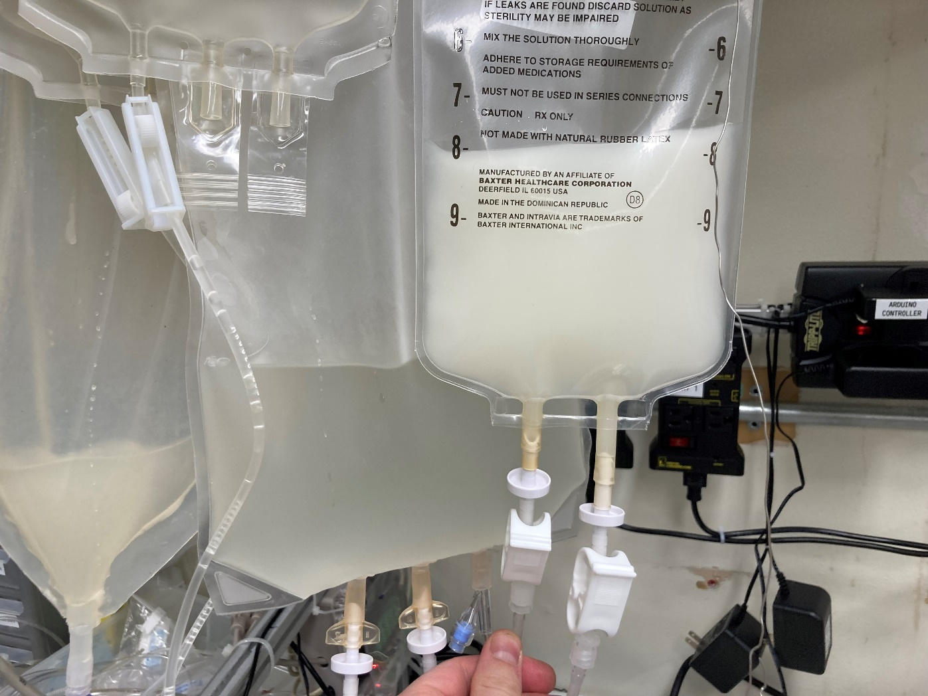
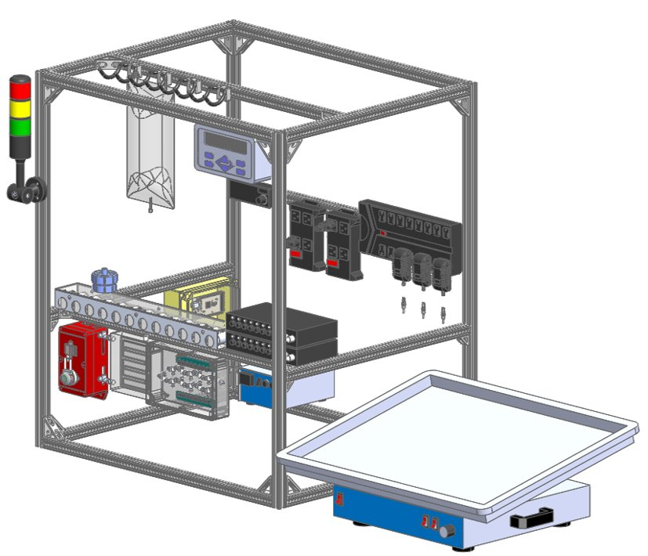
Technical Progress and Results :CO₂-based Manufacturing Platform
Platform testing complete, Test Report delivered. Carbonic Anhydrase and Cutinase production and purification demonstrated.
CO₂-based Manufacturing Platform Beats KPP Threshold Value for Harvest Efficiency of Bioreactor, (fig. 3).
  Threshold value was 85% recovery. Two organisms, E. coli in AMM media and K. phaffii in YEMM media, were tested in the platform, and 93% recovery efficiency was achieved for E. coli, and up to 98% recovery efficiency was achieved for K. phaffii. Both organism production values beat the threshold and approached the industry standard and project goal of 97%.
Pro-E drawing of CO₂-based Manufacturing Platform frame with assemblies.
Pre and post harvesting of concentrated K. phaffii biomass with a 98% separation efficiency.
Subsystem volume within the platform is approximately 770 in ³. Internal Volume of Middeck Locker is 3512 inch ^{3.}
Notes:
Pasteurization in Galley Rack Food Warmer (GRFW) – initial discussion and examination of test data makes this a potential option.
Shuttle era food space_food_types_s93-32499.jpeg (4078×4086) (nasa.gov)
Spoilage/pathogen detection
E-nose Began investigations using ARC-based E-Nose technology for rapid in situ detection of volatiles associated with microbial contamination. Potential platform system for wider use.
Image credit: https://astronautfoods.com/blogs/news/space-food-101

Slide 12
Platform performance with yeast, bacteria, intercellular and secreted products
Requirements |  |  | The CO2 Based Manufacturing Platform shall grow engineered microorganisms that produce a purifiable product (and shall support purification of that product) in a configuration suitable for space exploration and operation in Earth, Moon, and Mars gravity. |  | The platform shall operate semi autonomously (requiring minimal manual/crew intervention) and allow for flexibility in organism growth times, and product purification requirements. | Platform components that do not interface with the organism or sample directly shall be reusable (pumps, controller, mixing capability, sensors, thermal control). | The platform shall have replaceable subsystems including all components with direct interfaces with culture and culture products (media, culture, lysed culture, product purification components). | The bioreactor shall support batch biomanufacturing, specifically it will support media addition and product recovery. | The bioreactor shall contain a homogenous culture. | The product harvesting subsystem shall harvest and purify recombinant proteins. | The percent of solid media components sourced from CO2, H2, and mission wastes shall be 50% or greater. KPP
Success Criteria |  |  | product purified from platform as documented by SDS PAGE | Enzyme activity detected | Run includes use of programmed pump controls and automated pressure sensor feedback | Repeated platform runs. | Repeated platform runs. | Repeated runs with product recovery demonstrated by gel electrophoresis and/or Elisa or activity assay | Visual inspection | Products isolated from his-tag capture purification system analysis | Calculation based on weight
E. coli | Carbonic Anhydrase | 1/5 | +/- |  | Lysers failed | ✔ | ✔ | +/- | ✔ | +/- | 49.3% achieved for E. coli with theoretical as high as 59.8%.
 |  | 1/8 | ✔ | ✔ | Lysers failed | ✔ | ✔ | ✔ | ✔ | ✔
 |  | 1/9 | ✔ | ✔ | Lysers failed | ✔ | ✔ | ✔ | ✔ | ✔
 |  | 7/15 | ✔ | - | Lyser failed | ✔ | ✔ | +/- | ✔ | +/-
 |  | 7/17 | ✔ | ✔ | Lyser failed | ✔ | ✔ | ✔ | ✔ | ✔
 |  | 7/18 | ✔ | +/- | Lyser failed | ✔ | ✔ | ✔ | ✔ | ✔
K. phaffii | Carbonic Anhydrase (secreted) | 1/26 | +/- | - eng enzyme | ✔ | ✔ | ✔ | +/- | ✔ | +/- | 47.2% (YEMM) and 56.2% with YEAMM) and used with theoretical as high as 95.2%
 |  | 1/29 | +/- | - eng enzyme | ✔ | ✔ | ✔ | +/- | ✔ | +/-
 |  | 1/30 | +/- | - eng enzyme | ✔ | ✔ | ✔ | +/- | ✔ | +/-
 | Cutinase (alternate product) | 6/7 | ✔ | n/a | ✔ | ✔ | ✔ | ✔ | ✔ | ✔
 |  | 6/10 | ✔ | n/a | ✔ | ✔ | ✔ | ✔ | ✔ | ✔
 |  | 6/11 | ✔ | n/a | ✔ | ✔ | ✔ | ✔ | ✔ | ✔

Slide 13
CO₂-Based Manufacturing Lifecycle Maturity/Milestone Schedule (pending GCD review of trait tool entries)
Project Milestone
GCD (Key) Milestone
Controlled Milestone
TRL/SRL/MRL Progression
9
FY18 | FY19 | FY20 | FY21 | FY22 | FY23 | FY24
8
7
ESDMD
6
TRL
CO₂ Prototype Gen 2 Test
5
CO₂ Prototype Gen 1 Test
Bioreactor Design Review
CO2-based manufacturing close out report
4
CO₂ Prototype Assembly
Bioreactor materials test
3
Platform fab complete
Production strain ground test
CO₂ Prototype concept
Notes:
Chart purpose: show TRL/SRL/MRL advancement over the project lifecycle schedule. Show TRL advancements as whole integer increases. Show how Key and Controlled milestones align with TRL advancement.
TRL/SRL/MRL may not advance at each milestone. Often several milestones are required to produce a step increase in TRL/SRL/MRL.
There can be one, or more, of these charts per project as needed.
For projects with fewer technical elements, the TRL/SRL/MRL data can be combined on one chart.
For more complex projects, the TRL/SRL/MRL progression can separated into multiple charts by project technical area.
Show TRL, SRL, and MRL data for each technical element on the same chart.
Delete TRL/SRL/MRL axis-labels that do not apply – e.g., remove SRL/MRL for projects/technical areas where SRL and MRL do not apply.

Slide 14
Plans Forward and Transition / Infusion Plan
Mission Transition/Infusion
LIVE Domain/Mars Campaign Office (Exploration Capabilities Tech Maturation Program) is our target NASA customer.
  MCO partially funded FY 23 BioNutrients flight experiments, provided guidance on advancing BioNutrients TRL/HRL.
Working towards FDA approval for consumption BioNutrients Products, continuing shelf-life studies in FEP system
  BioNutrients work is aligned with HRP goals addressing food, nutrition, and pharmaceutical shelf-life shortfalls in future long-duration missions.
  Currently on Food Systems Roadmap – providing status with lead G. Douglas.
  Ensuring safe consumption in flight, and human ground testing of products are required for infusion.
Make it there, not take it there: BioNutrients and CO₂-Based Manufacturing technologies support future long duration missions where product shelf-life or supply chain pose significant risk, as well as providing mission products via ISRU.
  Mars surface missions and other low/no resupply flight/surface missions are key infusion targets.
  Investigating use-case scenarios and infusion with ISRU and In-Space Manufacturing programs – including supporting feedstocks production, BioMining
Partnerships & Commercial Transition
2024 Crowdsourcing Contenders recipient for the 3D Printable Bioreactor for Food Production submission. An on-demand bioreactor build would enable biomanufacturing and fermented food production with minimal mass, power, and volume. The Design Challenge is anticipated to kick-off mid-late 2024 with the finalists/winners announced early-mid 2025.
We are reviewing the SynBio created organisms and bioreactors with NASA Ames Technology Transfer office to determine potential for commercial infusion.
NASA SMD: Results from genomic analysis of 5-year shelf-life study of microbes on the ISS will be shared with the Space Biology GeneLab data depository to contribute to knowledge of microbial responses to ambient storage on the ISS. BN-1 yeast to be used in SMD LEIA (Lunar Explorer Instrument for Space Biology Applications) award.

Slide 15
Synthetic Biology
Assessment Summary
Project Name | Performance |  |  |  | Comments
 | C | S | T | P
Annual |  |  |  |  | Schedule –BioNutrients impacted by procurement delays threatening BioNutrients-3 Launch Schedule. Vendor now has SAM.gov registration. Schedule has no slack and requires parallel work and later delivery but meets target manifest. CO₂ close out report will be 30 days late as key personnel are out of office. No impact to budget.
 | Oct | Nov | Dec | Jan | Feb | Mar | MYR | May | Jun | Jul | Aug | APR
C
S
T
P
BioNutrients
 | Oct | Nov | Dec | Jan | Feb | Mar | MYR | May | Jun | Jul | Aug | APR
C
S
T
P
CO₂-Based Manufacturing

Slide 16
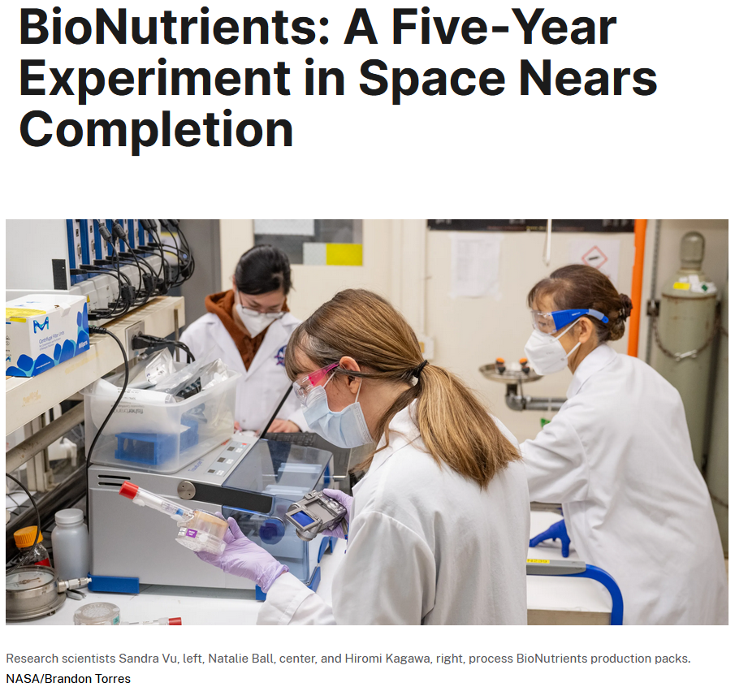
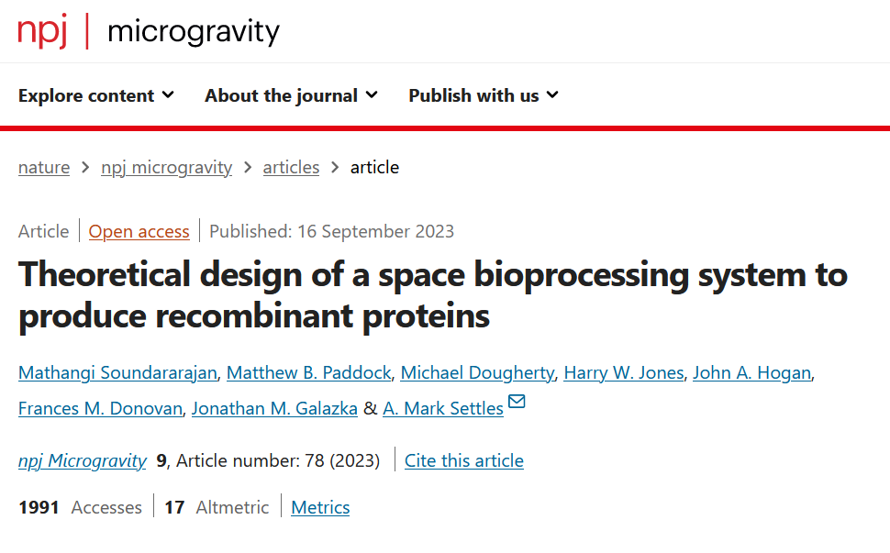
Additional Content
External presentations and posters from FY24:
  Poster presented at American Society of Agricultural and Biological Engineers (ASABE) in July 2024. Poster: CO₂-Based Manufacturing System for Recombinant Protein Production
  Poster presented at Human Research Program Investigators’ Workshop (HRP IWS) in February 2024. Poster: Strategies for Determining Safety of Fermented Foods Produced in Space
  Poster presented at 6th International Conference on Microbiome Engineering in December 2023. Poster: Biomanufacturing in Space: BioNutrients and CO2-Based Manufacturing
  Presented at the annual meeting of the American Society of Gravitational and Space Research (ASGSR) in November 2023. Presentation: BioNutrients: Microbial Production of on-Demand Nutrients on the International Space Station
Publications over course of project:
  NPJ Microgravity: Theoretical design of a space bioprocessing system to produce recombinant proteins (published September 2023)
  International Conference on Environmental Systems (ICES) Manuscripts:
    BioNutrients-1: Development of an On-Demand Nutrient Production System for Long-Duration Missions (published July 2020)
    BioNutrients-2: Improvements to the BioNutrients-1 Nutrient Production System (published July 2021)
NASA Image Highlights and Other Outreach:
  BioNutrients: A Five-Year Experiment in Space Nears Completion (January 2024)
  Astronaut Nicole Mann works on the BioNutrients-2 investigation (January 2023)
  Astronaut Josh Cassada works on the BioNutrients-2 investigation (January 2023)
  Cutting-edge Experiments Ride SpaceX’s 26th CRS Mission to Space Station (November 2022)
  A Fresh Take: NASA BioNutrients for Future Artemis Missions (March 2022)
  A Space Traveler’s Recipe for Sweet Potato Pie? (November 2019)
Space Station Research Explorer pages for BioNutrients-1, BioNutrients-2, and BioNutrients-3

Slide 17

News of CO₂ conversion products on Earth
Savor – butter and milk ( 'Butter' made from CO2 could pave the way for food without farming | New Scientist)
Air Company – Vodka, perfume and Jet Fuel
C2CNT and academia Licht lab - carbon nanofibers
Carbon Upcycling Technologies -Nanoparticles for plastics, concrete and coatings
Newlight Technologies- Bioplastics from methane and CO2, Mango Materials – bioplastics from methane
Breathe - methanol
C4X -Chemicals, bio-composite foamed plastics
Upcoming NASA SBIR investments T7.05Climate Enhancing Resource Utilization -- may provide new/better feedstocks for biomanufacturing
  Lead Center: GRC
  Solicitation Year: 2023
  Scope Title: Sustainable Atmospheric Carbon Dioxide Extraction and Transformation
  Scope Description: Component and subsystem technologies are sought to demonstrate sustainable, energy-efficient extraction of carbon dioxide (CO₂) from a defined planetary or habitable atmosphere fully integrated with CO₂ transformation into one or more stable products such as manufacturing feedstock polymers or readily storable, noncryogenic propellants or fuels.
Notes:
5 surprising products made from carbon dioxide | World Economic Forum (weforum.org)
“One pot facile transformation of CO₂ to an unusual 3-D nano-scaffold morphology of carbon” https://doi.org/10.1038/s41598-020-78258-6
Photo is fd personal photo

