Slide 1
@MSFC
Renee Weber
September 2024
Notes:
STILL

Slide 2
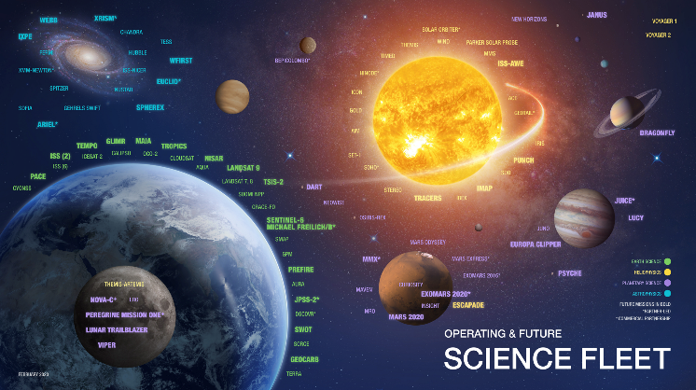
Science @ MSFC
Research areas:
Earth Science
Astrophysics
Heliophysics
Planetary Science
Biological and Physical Science
Implementation efforts:
Flight projects
Instrumentation development
Research & analysis
Applications
Data science
Notes:
Image source: NASA

Slide 3

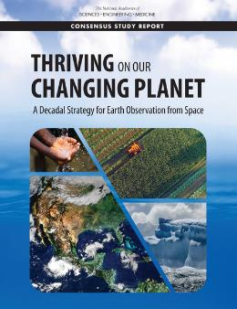
Earth Science
Integrating space-borne observations, data, and models to
Advance understanding of the Earth’s weather & its energy and water cycles
Develop scientific & technical solutions to coupled Earth-atmosphere systems problems, and
Transition research to applications that enable decision support for societal benefit.
Supporting Decadal-priority science
Developing the Earth observing systems of tomorrow – leadership roles in several DO missions
Taking the measurements from those systems and applying them to improve understanding of our home planet & its diverse physical processes, using NASA data for the benefit of society & setting us up to go beyond
Notes:
Image source: National Academies, https://www.nationalacademies.org/our-work/decadal-survey-for-earth-science-and-applications-from-space

Slide 4
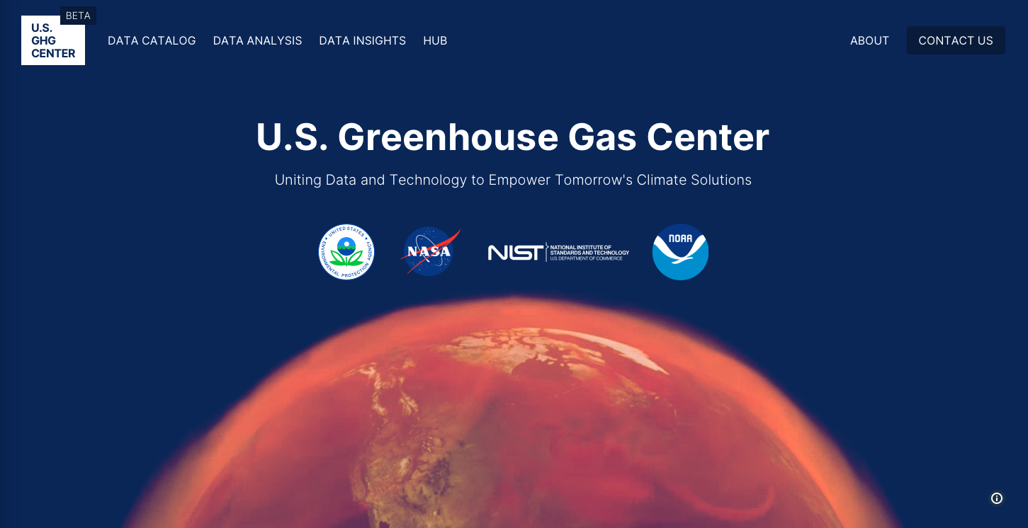
Notes:
Image source: https://earth.gov/ghgcenter
On 6/10/24, the U.S. GHG Center (beta) went live with its v2.0.5 release, featuring updated GHG datasets, a new data insight, the May newsletter, and other changes and improvements. The IMPACT Greenhouse Gas Center portal development continues in beta until full release expected in September. The work is carried out by Interagency Implementation and Advanced Concepts Team (IMPACT) and Development Seed team members with guidance from GHG Center leadership. For more information on the U.S. Greenhouse Gas Center please visit: https://earth.gov/ghgcenter.

Slide 5

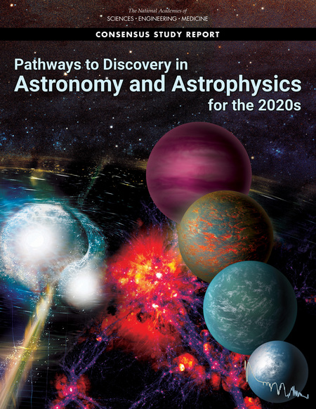
Astrophysics
Leaders in NASA’s high energy astrophysics with an emphasis on X-ray (IXPE) and Gamma-ray space flight missions (Chandra & Fermi GBM), peering back to the earliest epochs of the Universe to unravel its mysteries by studying the most violent explosions in space in our galaxy and beyond.
Black Holes, Neutron Stars, Nebula, Pulsars, Gamma-ray Bursts, extreme-energy particles and their sources
Supporting Decadal-priority science
Advancing lightweight, high-resolution X-ray optics
Instrumentation and mirror technology development, including normal incidence/UVOIR
Researching gravitational waves & their electromagnetic counterparts through multi-messenger & multi-wavelength astrophysics
Major roles in decadal-priority missions and concept studies
  Habitable Worlds Observatory
  Future x-ray mission (LYNX)
Notes:
Image source: National Academies: https://nap.nationalacademies.org/catalog/26141/pathways-to-discovery-in-astronomy-and-astrophysics-for-the-2020s

Slide 6
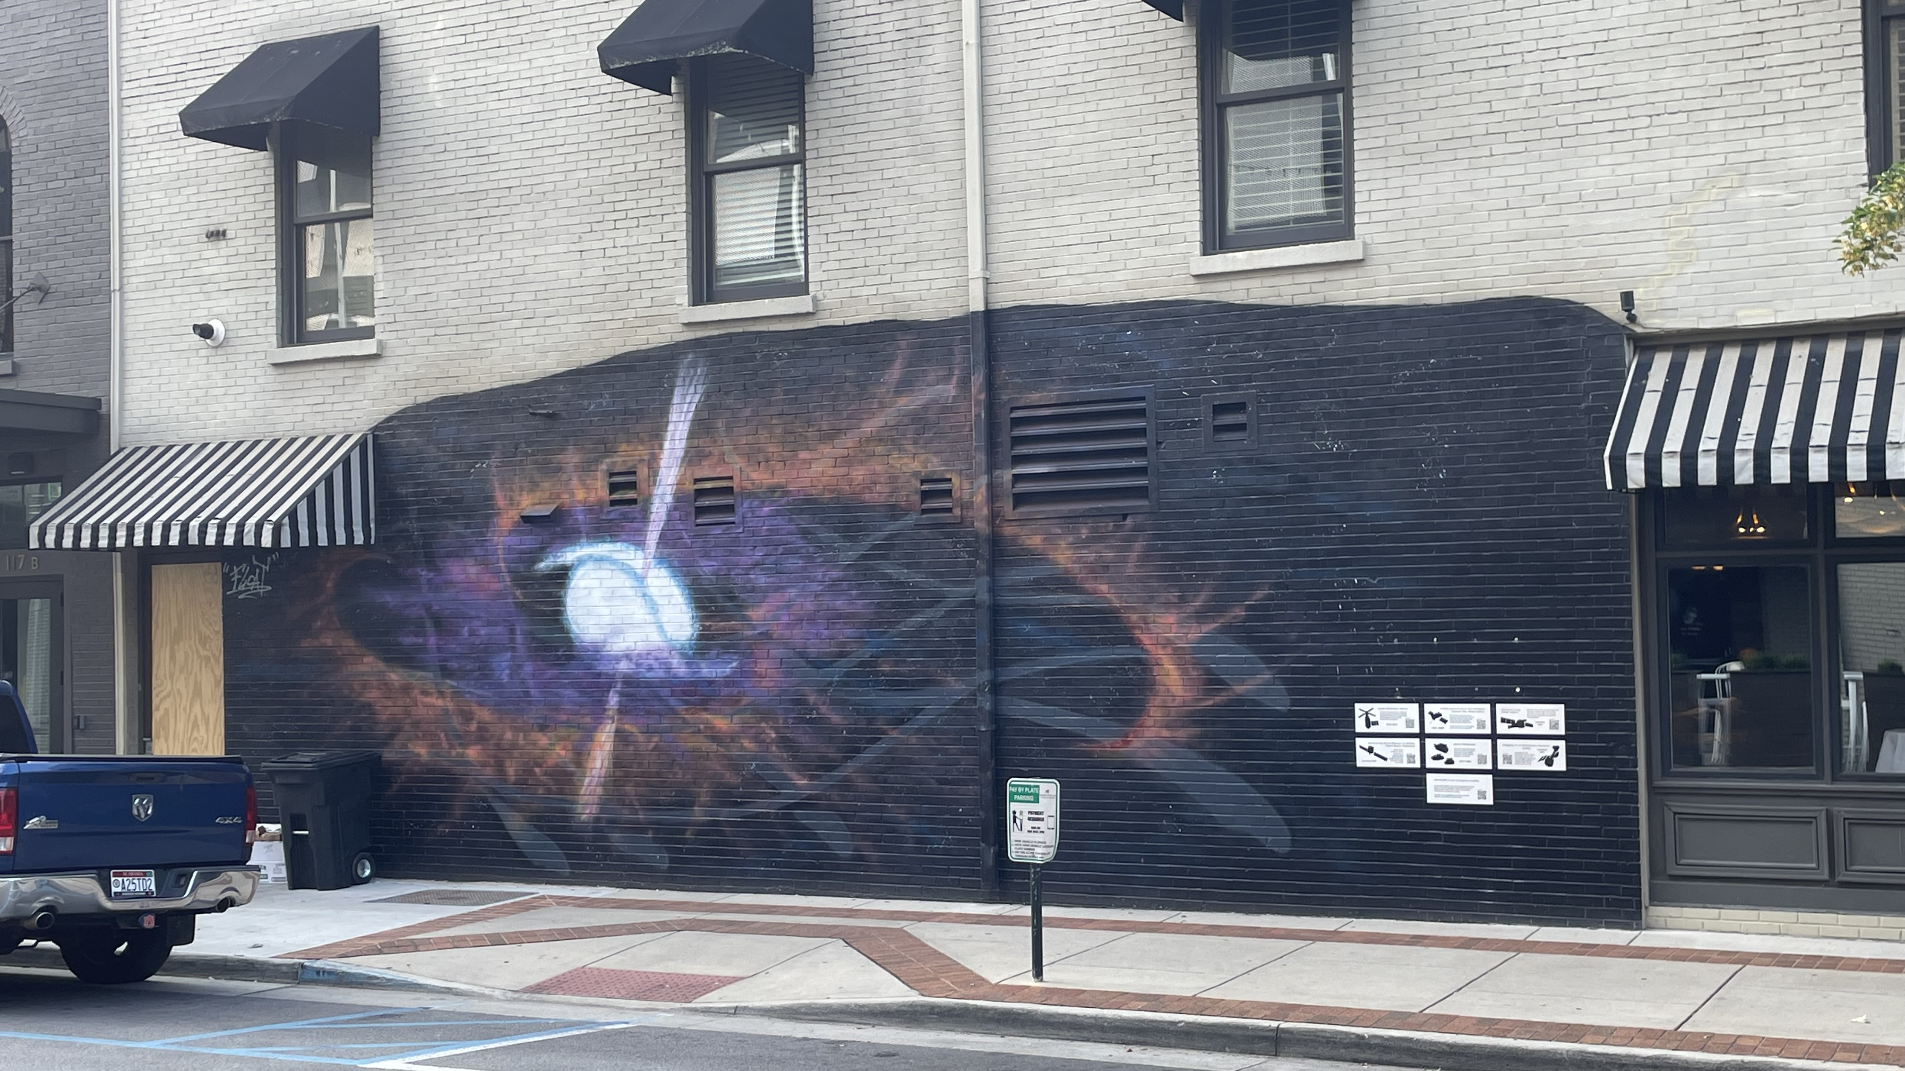
Notes:
Photo credit: me
Huntsville’s newest art installation “No Straight Lines” by local artist Float in collaboration with Arts Huntsville and MSFC. Corner of Clinton Ave. and Washington St. downtown
The artwork stands as a testament to Huntsville's enduring legacy in pushing the boundaries of human knowledge. Celebrating the Legacy of the Invisible & Chandra X-ray Observatory’s 25th Anniversary

Slide 7

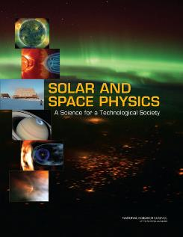
Heliophysics
Instrumentation development, sounding rocket flight, and basic research focusing on energy transfer across physical scales throughout the solar atmosphere, specifically investigating processes converting magnetic energy into heat, particle acceleration, and dynamic plasma motions
Solar transition region and magnetic atmosphere
Magnetosphere/plasmasphere/ionosphere
Space weather leveraging Earth science R2O/O2R model
Supporting Decadal-priority science
Heliophysics System Observatory (HSO)
  Management of Hinode
DRIVE initiative
  Suborbital (including flare campaign) & cubesats at MSFC
  Space environments and exoplanets
Space weather
  “Nowcasting” capability
  Numerical modeling
Science strategy
  Gateway science utilization
Notes:
Photo credit: National Academies: https://www.nationalacademies.org/our-work/a-decadal-strategy-for-solar-and-space-physics-heliophysics

Slide 8
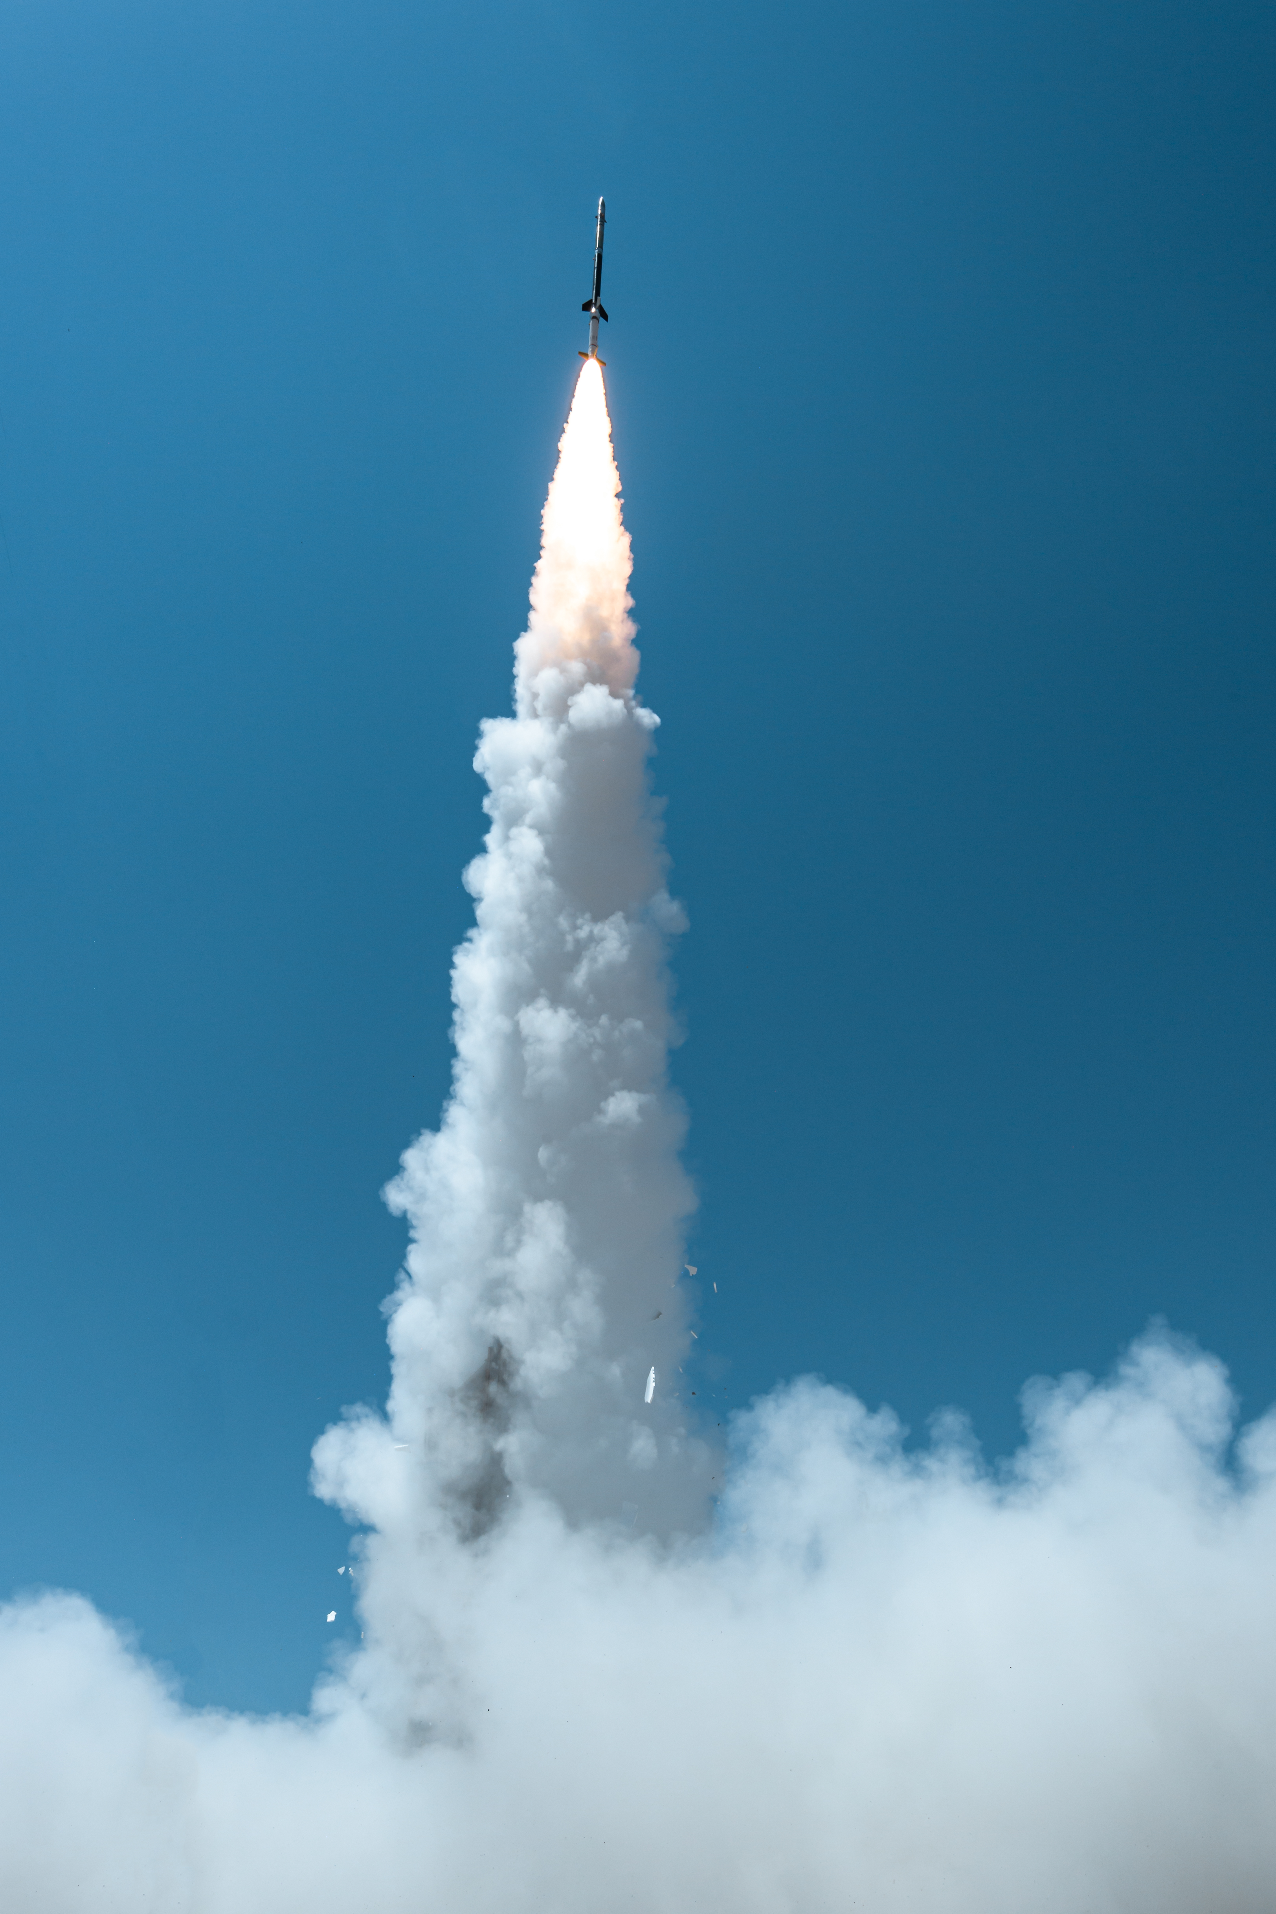
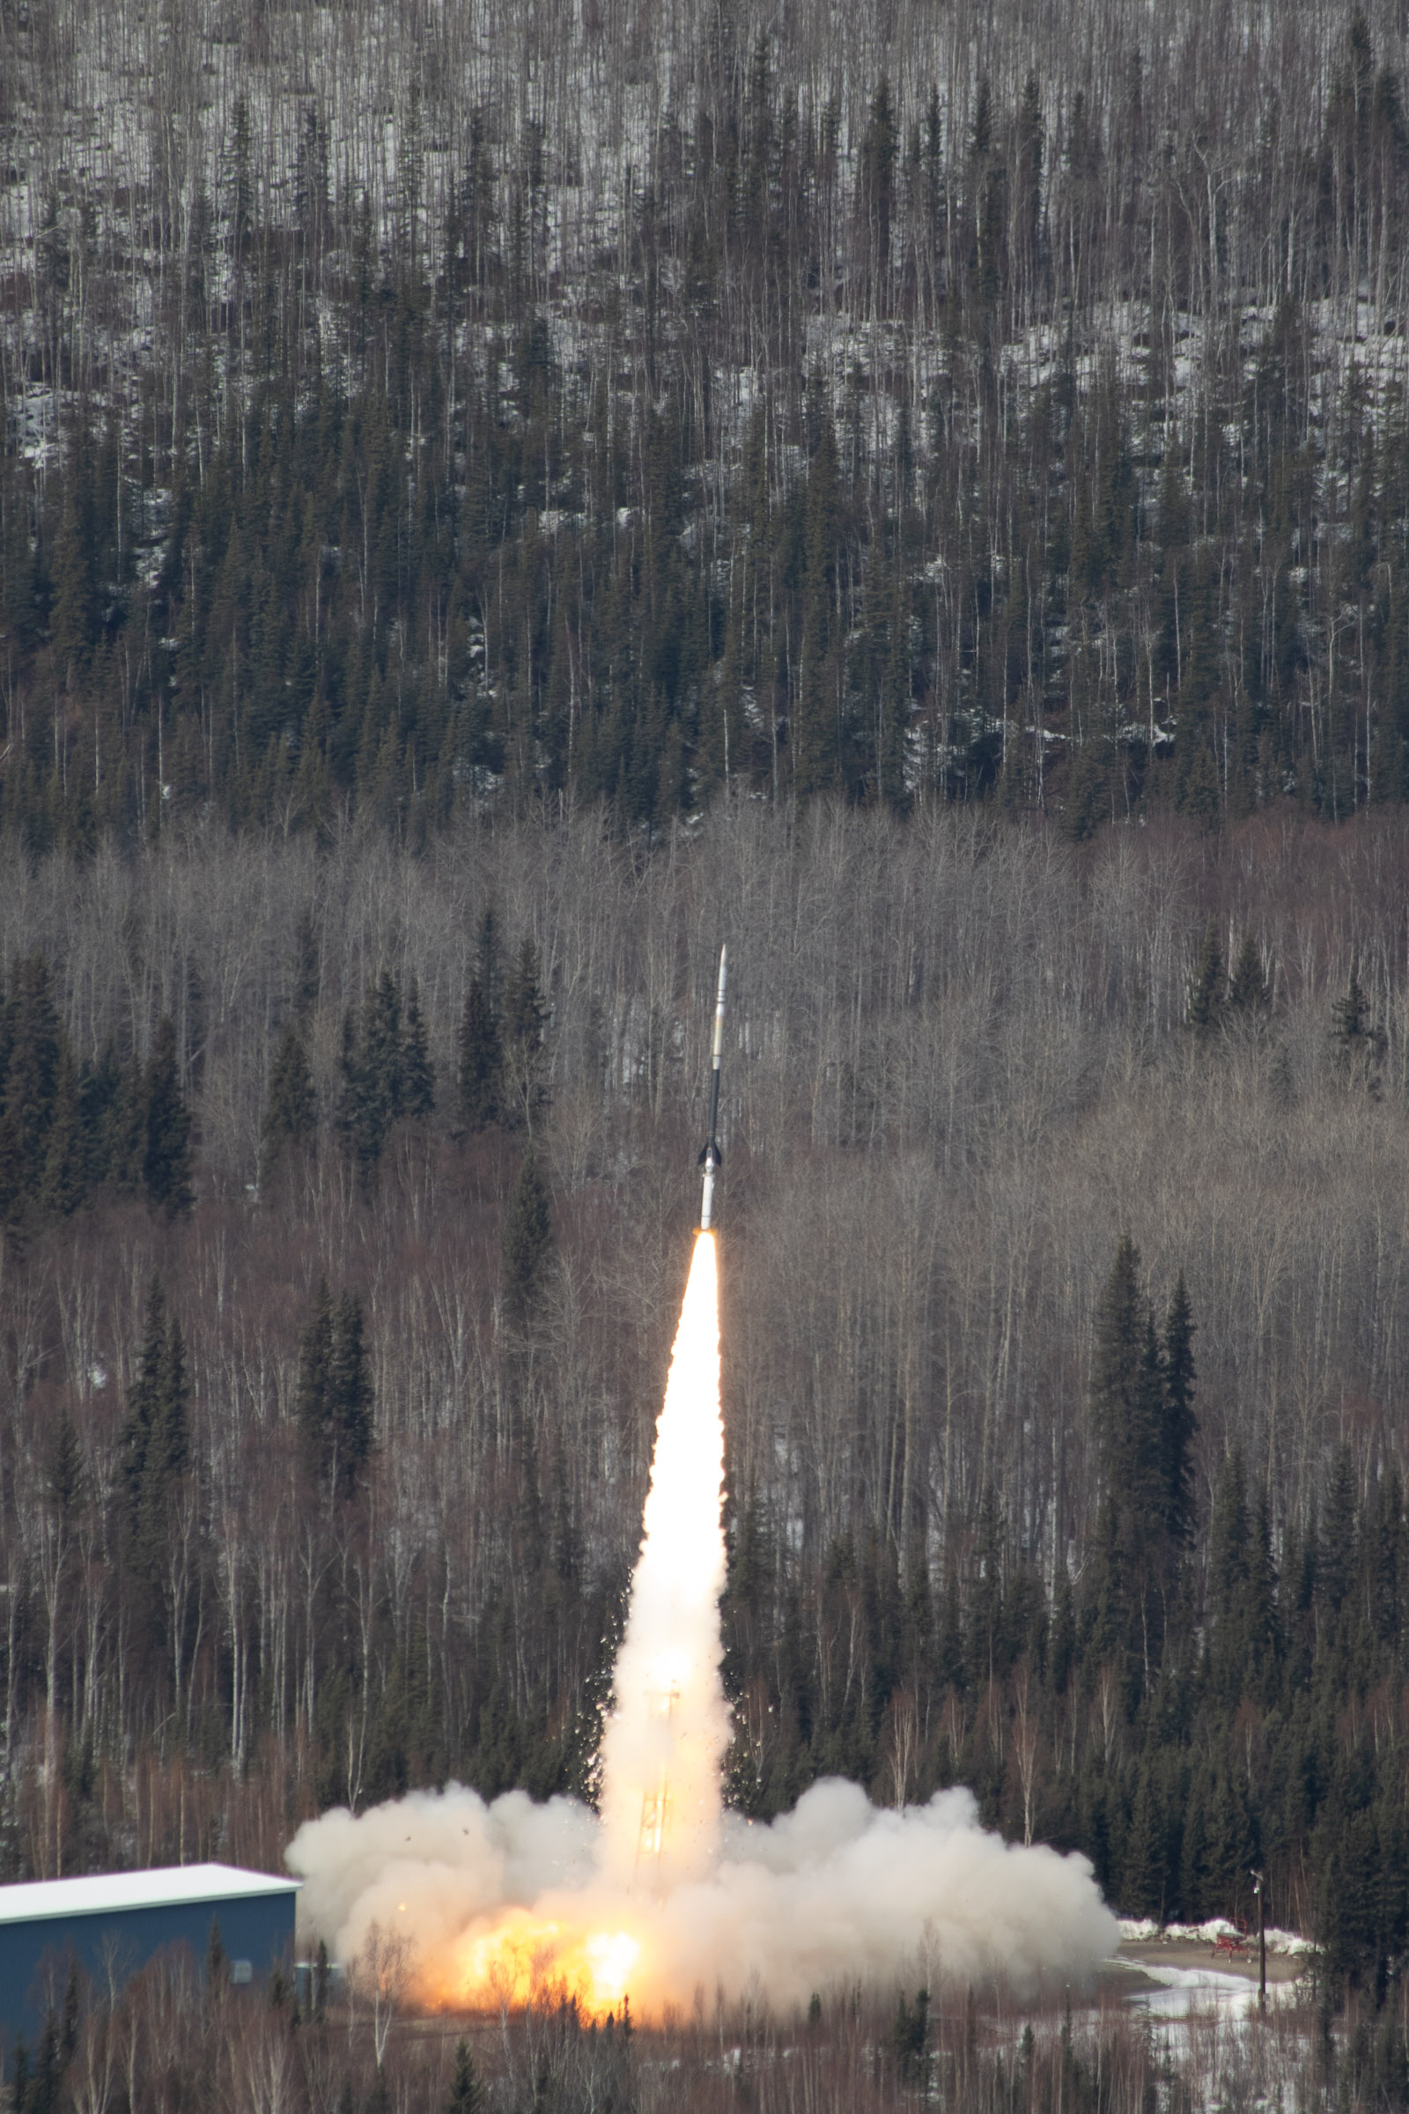
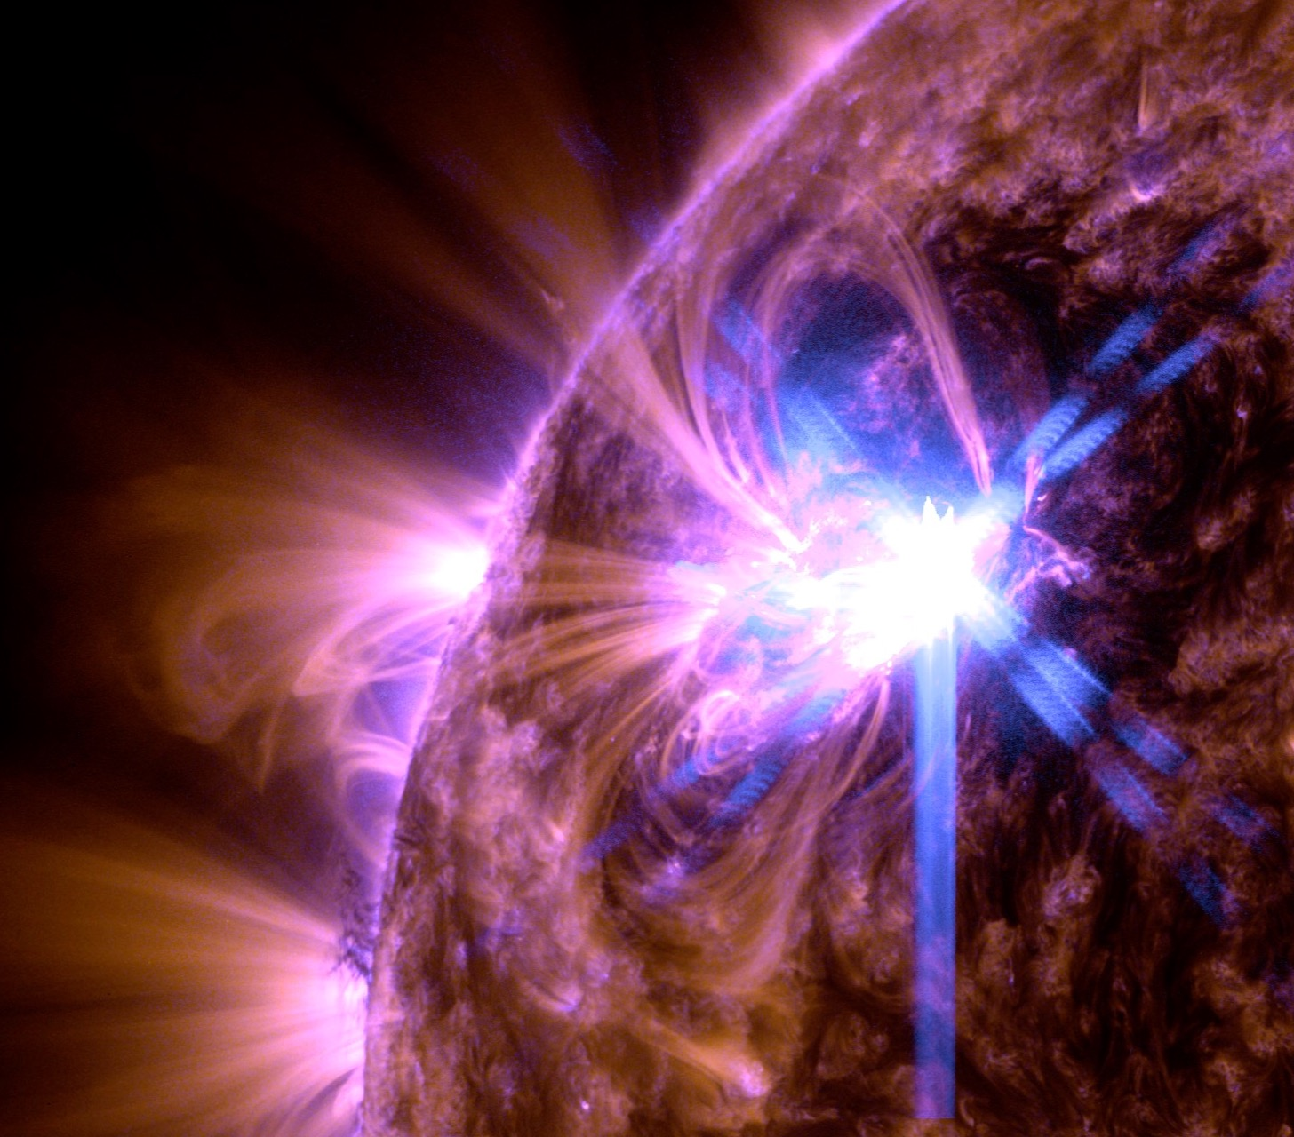
Hi-C Flare, April 17
MaGIXS-2, July 16
Notes:
Photo credits: NASA

Slide 9
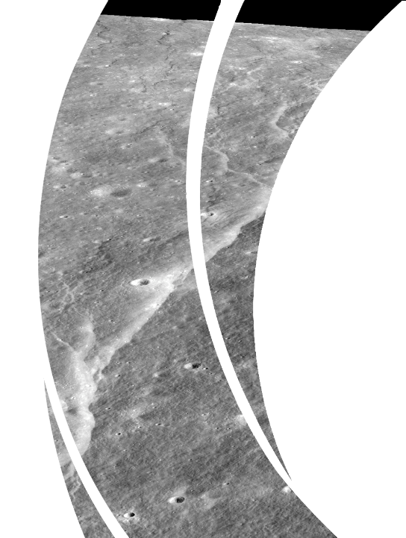
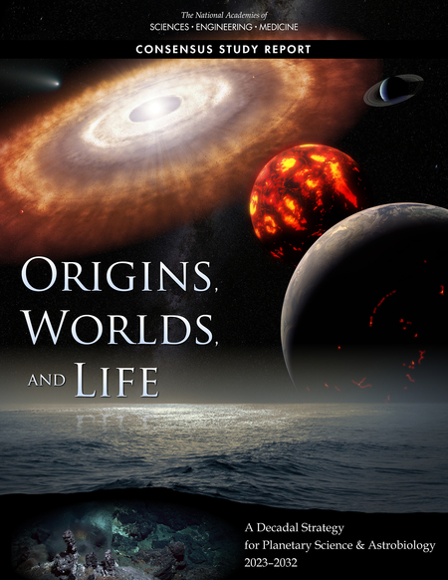
Planetary Science
Research on the origin, composition, and evolution of terrestrial planetary bodies, focusing on geological and geophysical models, experiments, and observations conducted in the field, laboratory, or via analysis of remotely sensed data from space-based missions
Planetary surfaces, interiors & atmospheres
Planetary science integration with MSFC exploration capabilities
Supporting Decadal-priority science
Artemis integration
Science instruments for CLPS landers
Planetary Mission Program Office
Mars Sample Return
  MAV
Technology development for future missions
  KNaCK portable LIDAR mapping and navigation instrument
Notes:
Photo credit: National Academies: https://nap.nationalacademies.org/catalog/26522/origins-worlds-and-life-a-decadal-strategy-for-planetary-science

Slide 10
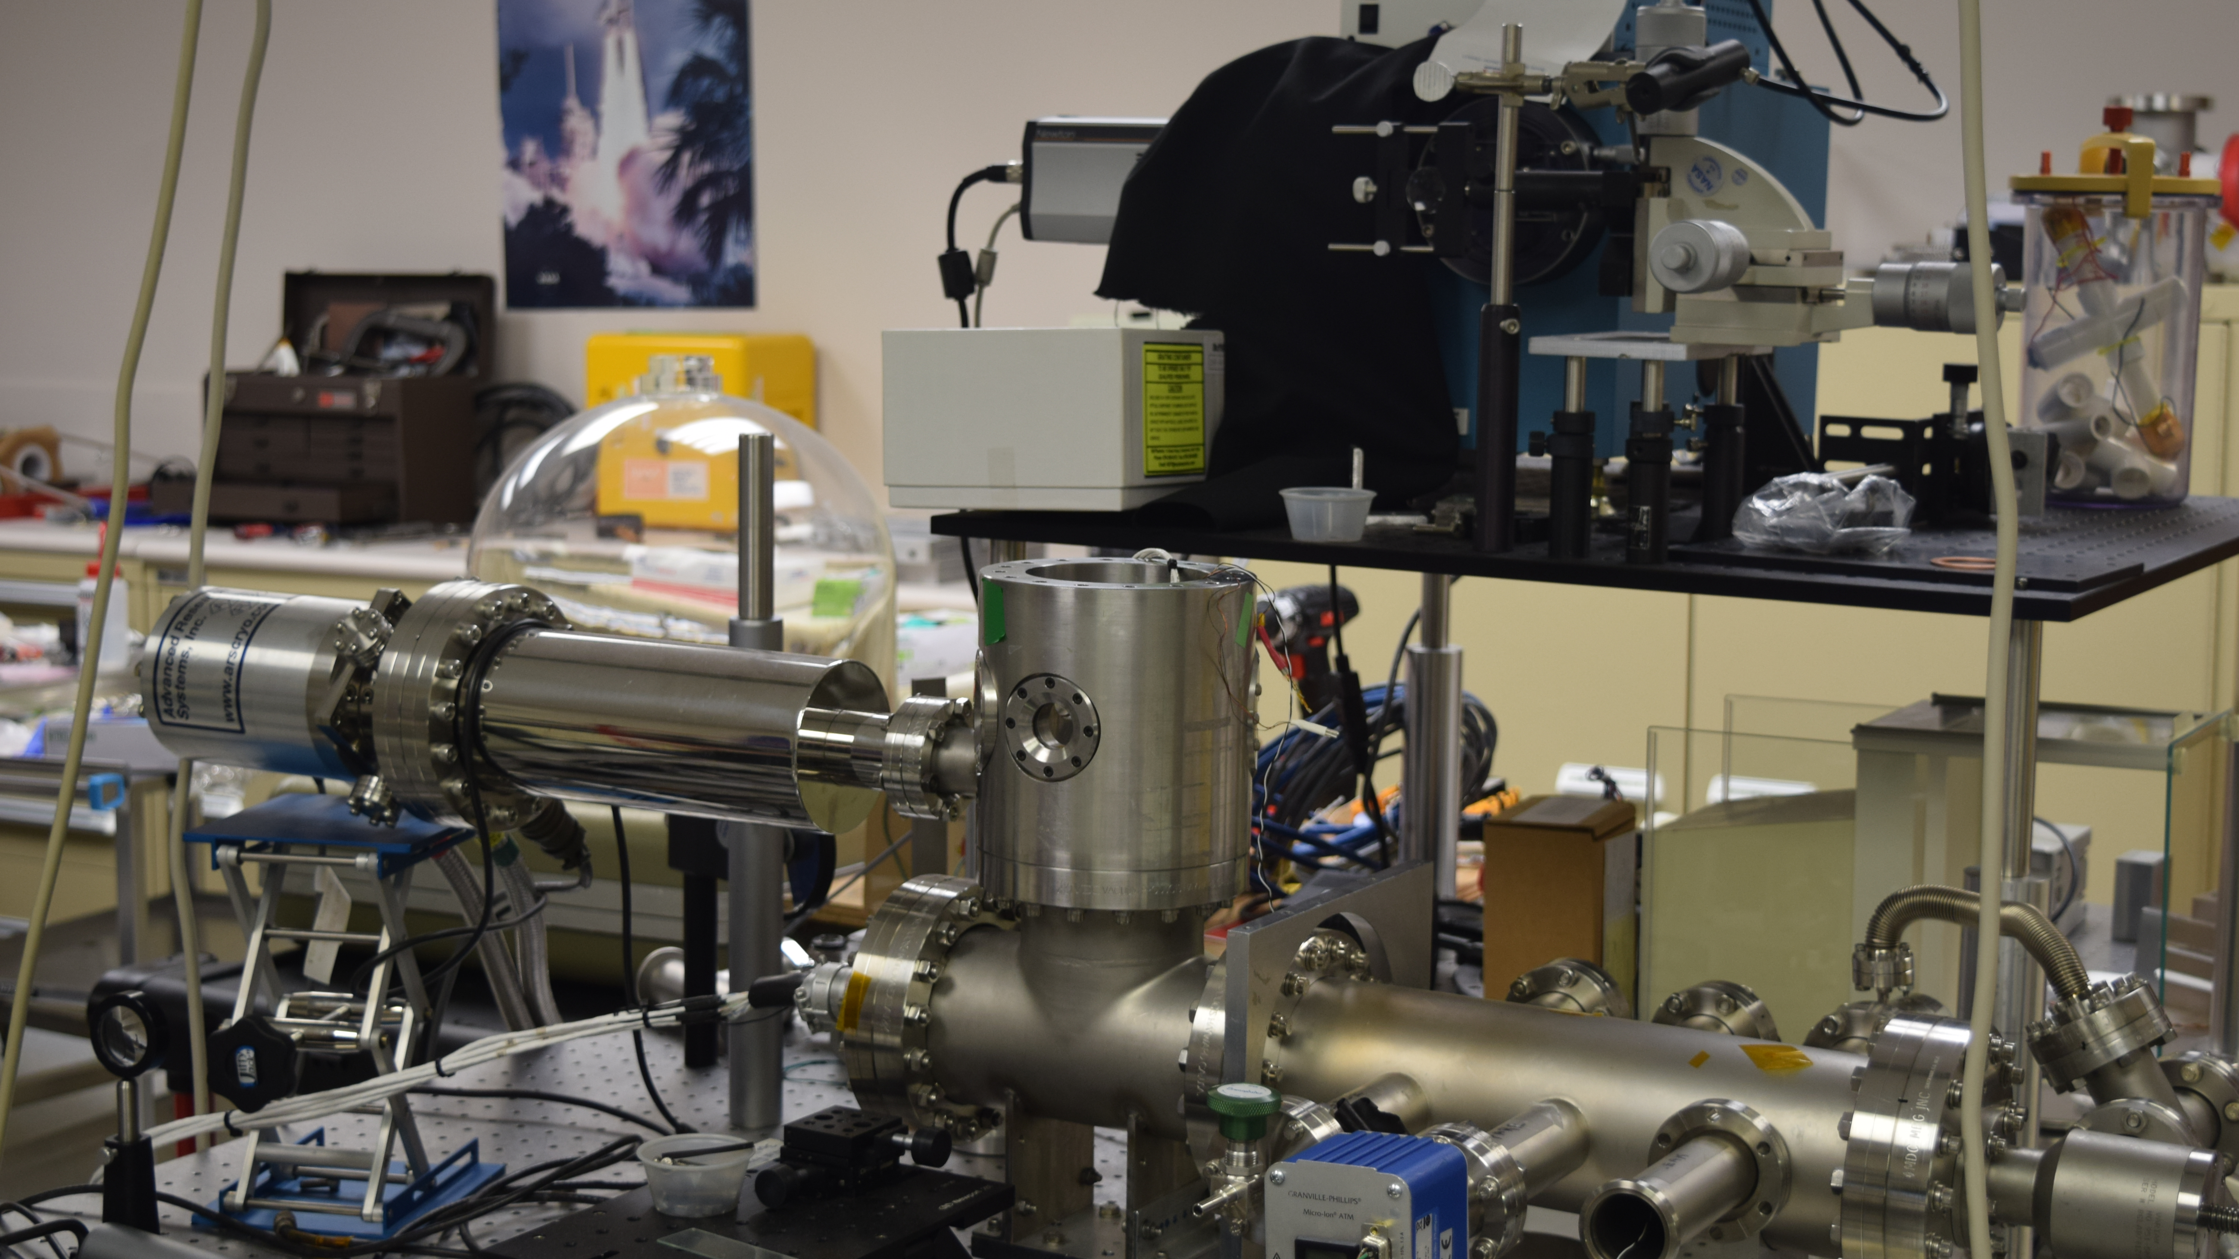
Notes:
Photo Credit: NASA/Dennis Gallagher (used with permission)
Dennis Gallagher (ST13) reports receiving on 3/1/24, one gram of Apollo 16 regolith of 1 mm and smaller dust regolith from the Johnson Space Center (JSC) Apollo Archive. The material request is motivated by the planned NASA Artemis missions to the Moon’s south polar region where the surface is generally expected to be like that found at the Apollo 16 landing site. Electrostatic charging driven by the solar wind and ultraviolet light from the Sun is known to be important for small particles of lunar regolith that must be understood for potentially dust coated struts of the Human Lander System (HLS) that will cycle between the surface and Gateway. Presently, the charging properties of individual dust grains are not adequately characterized for this purpose. The measurements to be obtained by the MSFC Dusty Plasma Laboratory using Apollo 16 dust are intended to fill this knowledge gap are being obtained in support of the Gateway Cis-Lunar Dust Transfer Modeling and Analysis Task and HLS at JSC.

Slide 11

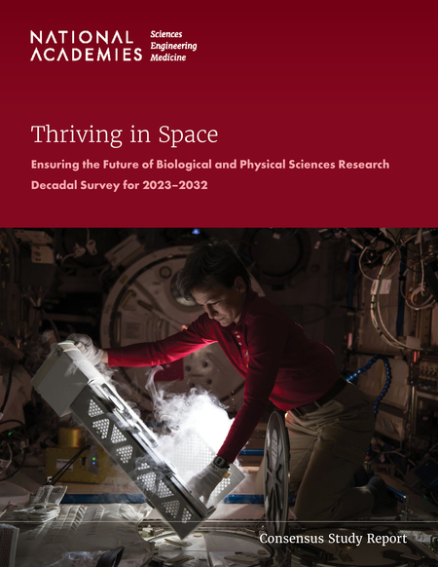
Biological and Physical Science
MSFC manages the materials research portfolio for SMD:
Investigate fundamental laws of physics and physical processes, often using either microgravity or interplanetary distances as research tools
Provide a mechanistic understanding of processes underlying space exploration technologies such as power generation/storage, space propulsion, and ECLSS
Support the transfer of knowledge/technology of space-based research to terrestrial systems to benefit life on Earth
Supporting Decadal-priority science
Sustainable and functional extraterrestrial habitats
ISRU & ISAM
Fundamental principles that organize the structure and functionality of materials
Fundamental laws that govern the behavior of systems that are far from equilibrium
Notes:
Photo credit: National Academies: https://nap.nationalacademies.org/catalog/26750/thriving-in-space-ensuring-the-future-of-biological-and-physical

Slide 12
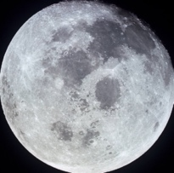

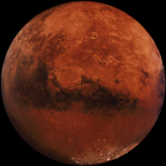
Desired Future State
Leveraging the data of today and driving the missions of tomorrow to make impactful scientific discoveries
Pursuits
High energy astrophysics
Ionosphere/space weather
Moon/Mars surface processes
Lightning
Solar atmospheric processes
Moon/Mars interior
Data applications science
Physical Science
Low-Earth Orbit
Cislunar
Lunar Surface
Mars
Terrestrial
Uniquely Positioned to Capitalize
Experience & Capability
Relationships
Bridge to other Opportunities
Science expertise
Engineering expertise
Science test facilities
Industry
Academia
Local, national, & international
Larger roles in flagship/strategic missions
Implementation of new technologies
Strategic Approach
Successfully execute current activities
Identify and capture future opportunities
Develop and optimize a highly capable & integrated Center workforce supporting science
Grow Center Roles
for SMD missions

Slide 13
MSFC Science Research and Projects Division
Part of the Science & Technology Office at Marshall Space Flight Center (MSFC)
5 Branches: Astrophysics, Earth Science, Heliophysics & Planetary Science, Science Test Management, and Science Test.
Located at the National Space Science and Technology Center (NSSTC) on the University of Alabama in Huntsville campus.
Scientists, engineers, and contractors interacting with national and international counterparts in industry, academia, and with resident agencies such as NOAA-NWS, to perform cutting-edge research in the Space, Earth and Data sciences.
Unique multi-institutional environment including large academic departments (e.g, Space, Earth Sciences), IT/Data Centers, labs, and offices enabling collaborative science instrument/tech development and research ranging from insights on the structure and evolution of the universe to understanding Earth’s climate system.
Science instrument development via collaborative use of NSSTC labs, offices, people and a robust space environments test capability resident on MSFC

Slide 14
MSFC Science Test Branch
Assembly, integration, and environments test/metrology/calibration services. Our skilled test engineers and technicians operate and maintain specialized equipment and facilities to enable technology maturation and pre-flight verification of science instruments and missions.
The X-ray and Cryogenic Facility (XRCF):
The world’s largest x-ray optical test facility, provides evaluation and readiness testing for advanced telescope mirrors, video guidance systems, and other space structures in thermal environments to 20K
Technical Capabilities:
Thermal Vacuum Chamber
Thermal Environments
Clean Rooms
Illumination Beam Line Capabilities
Beamline/Optical Shared In-Chamber Systems
Beamline associated In-Chamber systems
Optical Test Capabilities (Optical Test Window, Metrology Positioning/Alignment, Metrology Instruments, Optical Test Stability, Mirror Test Capability)

Slide 15
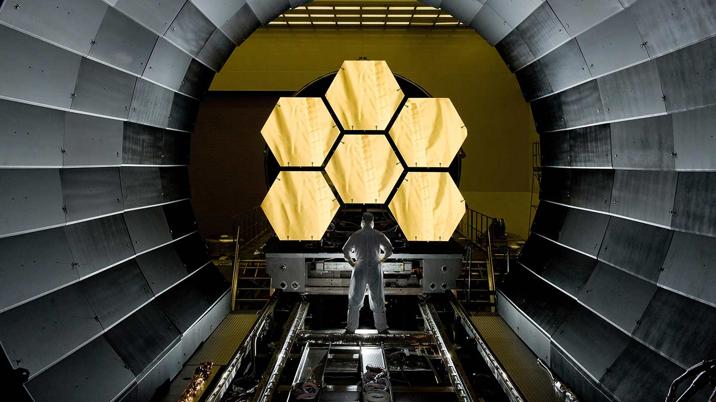
Notes:
Image credit: NASA

Slide 16
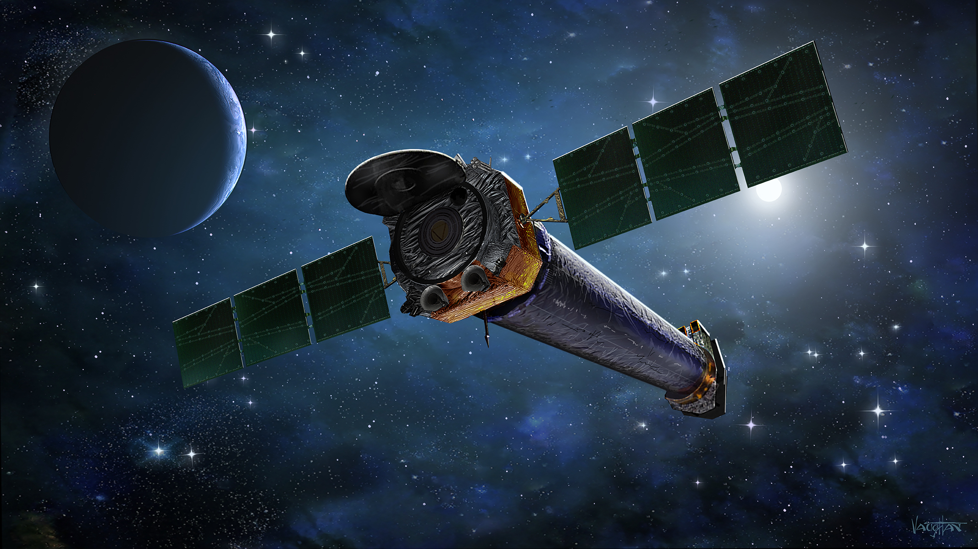
CHANDRA
X-Ray Great Observatory
Launch: July 23, 1999
Science goals:
Determine the nature of celestial objects from normal stars to quasars
Understand the nature of physical processes which take place in and between astronomical objects
To generally study the history and evolution of the universe
Notes:
Image credit: NASA

Slide 17
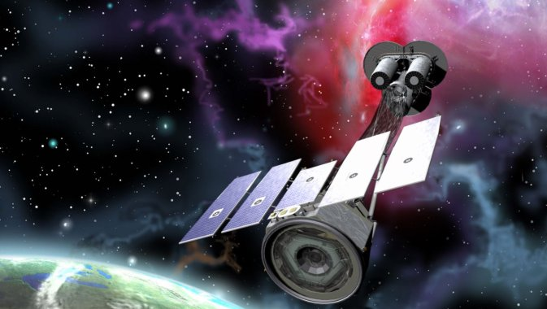
IXPE
Imaging X-ray Polarimetry Explorer
Launch: December 9, 2021
Science goals: advance our understanding of black holes, supernovae, pulsars, and other sources of energetic x-rays
Notes:
Image credit: NASA

Slide 18
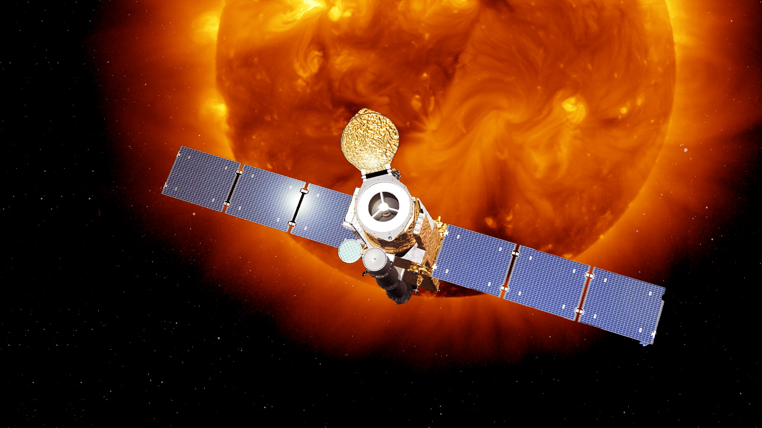
HINODE
Optical, EUV, & X-Ray Telescope
Launch: September 23, 2006
Science goals: understand the causes of eruptions in the solar atmosphere and relate those eruptions to the intense heating of the corona and the mechanisms that drive the solar wind.
Notes:
Image credit: NASA

Slide 19
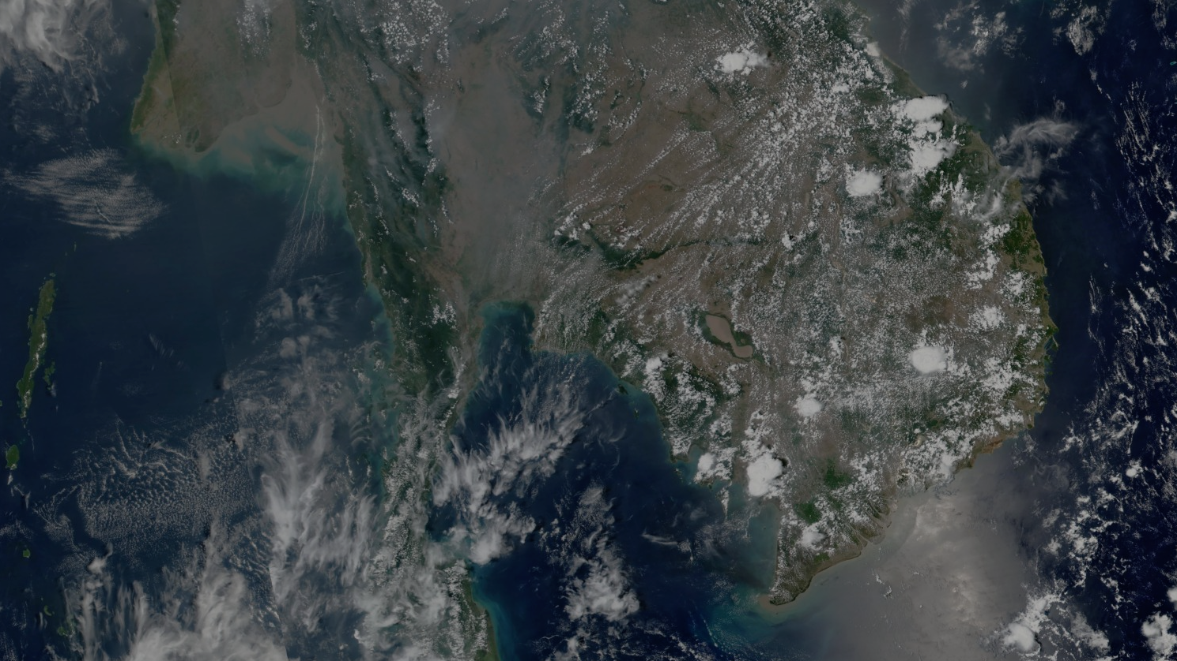
SERVIR
A joint initiative of NASA, the United States Agency for International Development (USAID), and leading geospatial organizations in Asia, Africa, and Latin America, SERVIR partners with countries and organizations in these regions to address critical challenges in climate change, food security, water and related disasters, land use, and air quality.
Notes:
Image credit: NASA

Slide 20
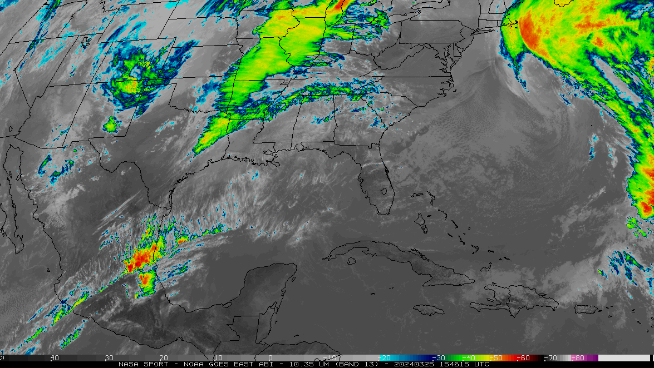
SPoRT
Short-term Prediction Research and Transition Center
The SPoRT center was established in 2002 to transition NASA satellite products and capabilities to the operational weather community to improve short-term weather forecasting.
Notes:
Image credit: NASA

Slide 21
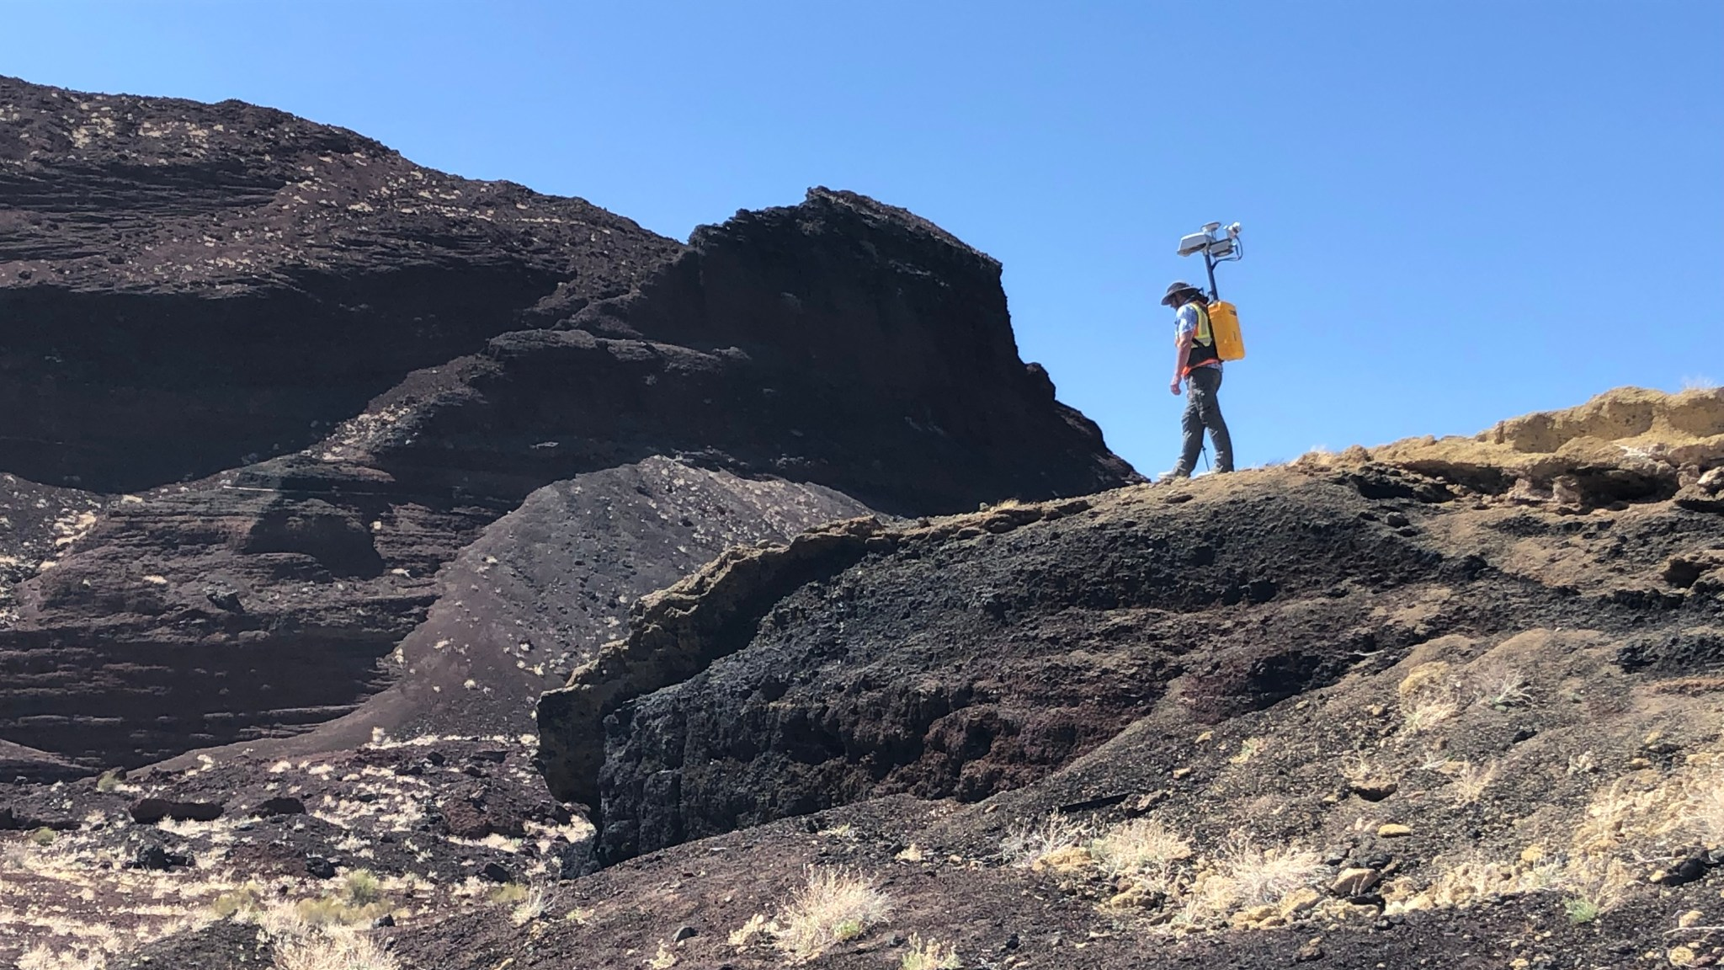
KNaCK
Kinematic Navigation and Cartography Knapsack
Science goals: mobile LIDAR system for mapping and navigation in GPS-denied environments
Notes:
Image credit: NASA/Mike Zanetti (used with permission)

Slide 22
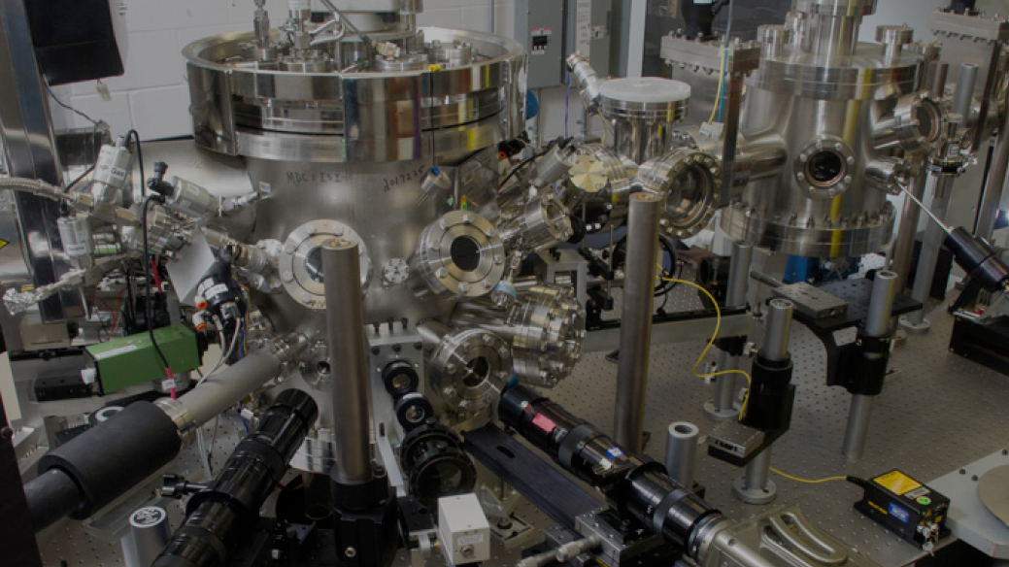
ESL
Electrostatic Levitation Lab
Science goals: Electrostatic levitation minimizes gravitational effects and allows materials to be studied without contact with a container or instrumentation, avoiding any container-sample interaction. ESL has been used for many materials science discoveries and in support of research onboard the ISS.
Notes:
Image credit: NASA

