Slide 1
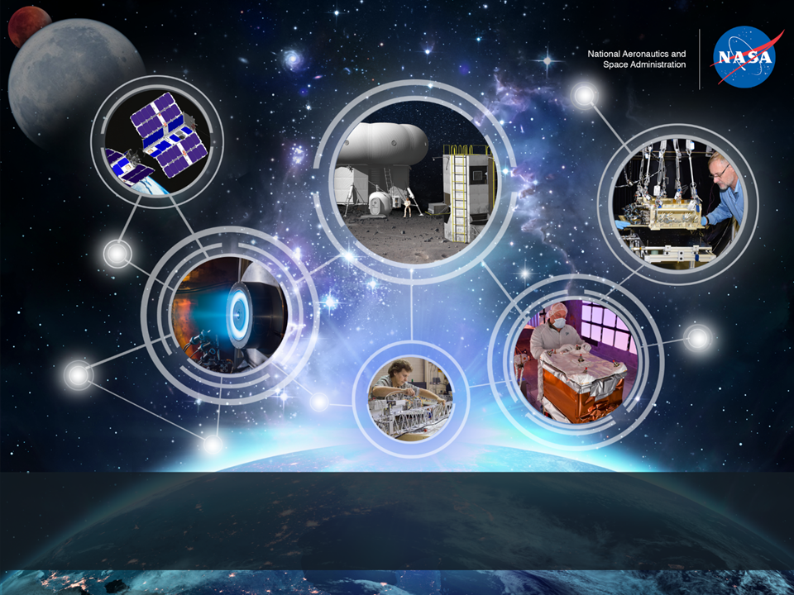
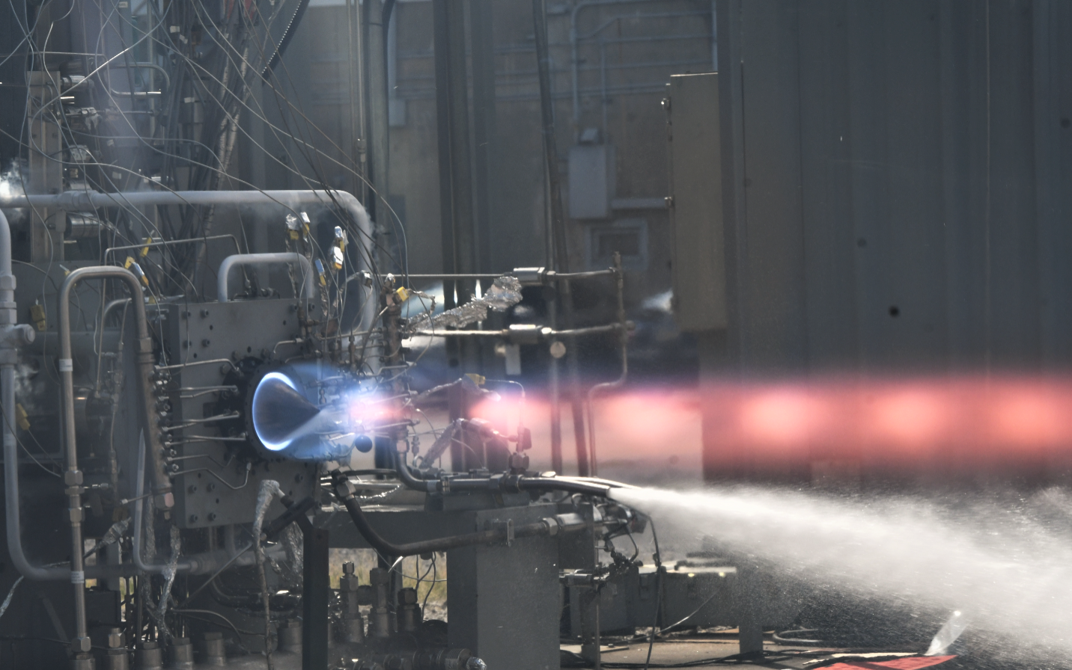
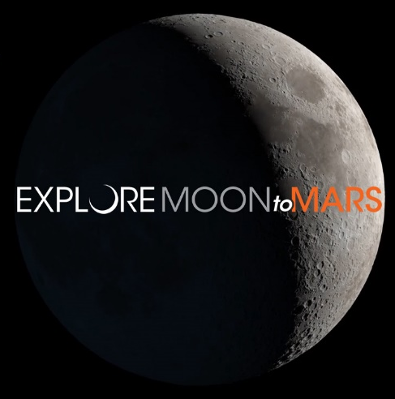
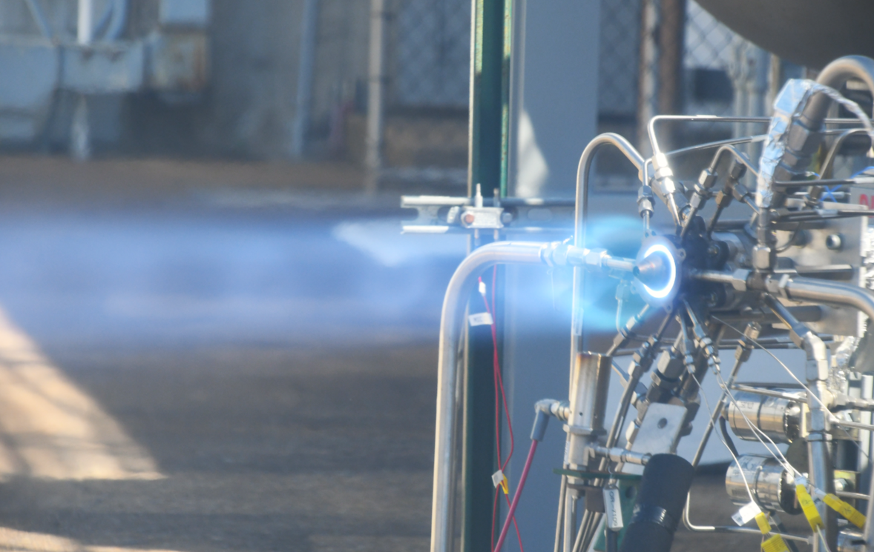
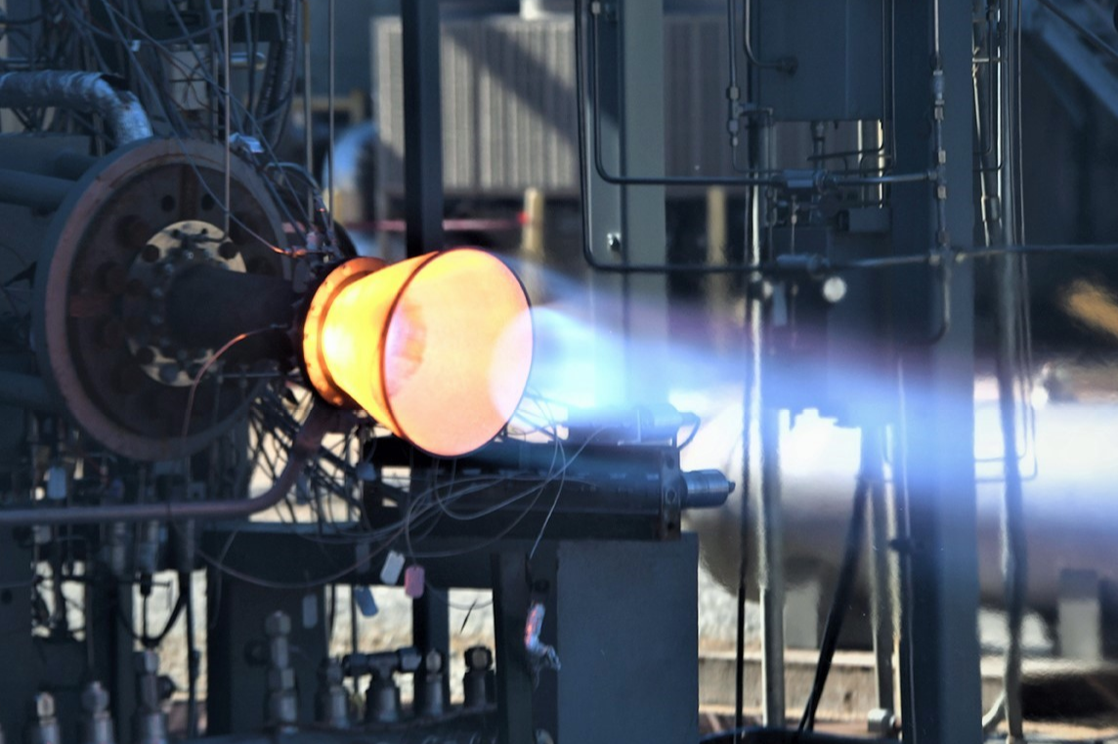
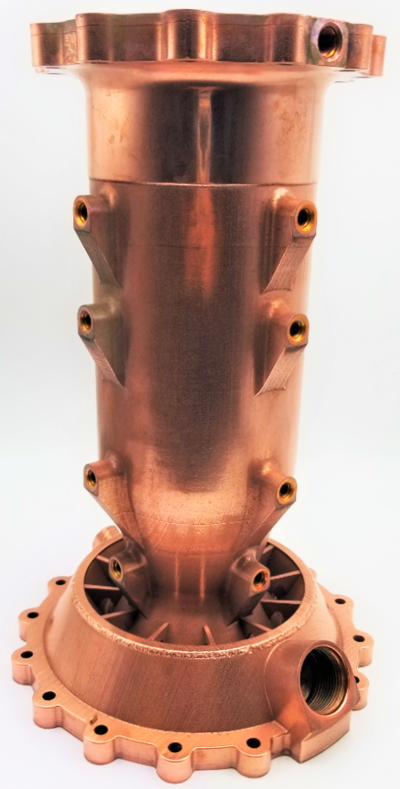
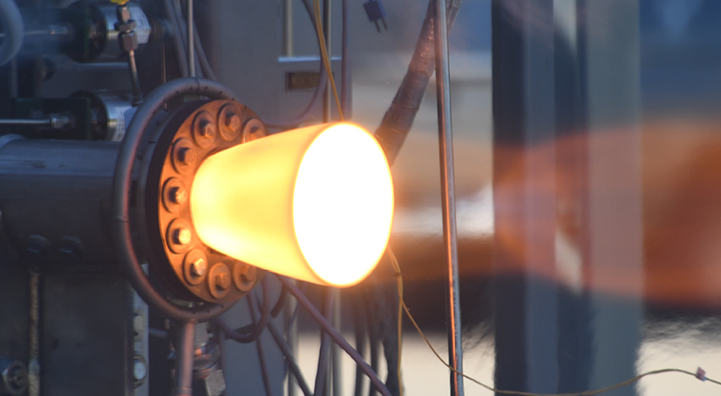
NASA MSFC Rotating Detonation Rocket Engine Development
Thomas Teasley GCD Principal Investigator
Liquid Propulsion Systems Development Engineer
Engine Components Development Branch
NASA Marshall Space Flight Center | 8/21/2024

Slide 2
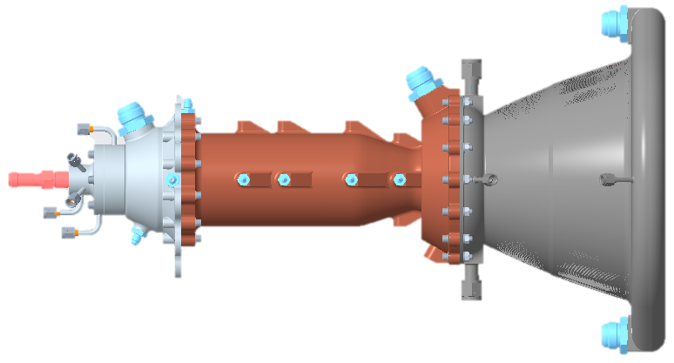
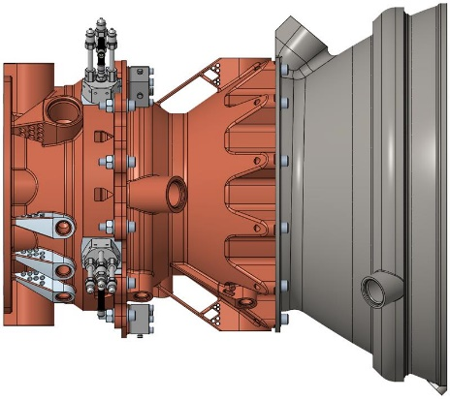
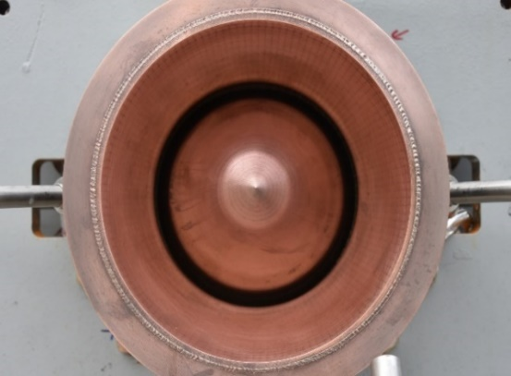
So what is an RDRE?
Traditional Rocket:
RDRE is a ring-shaped chamber that enables supersonic combustion of propellant unlike a conventional rocket engine.
RDRE
RDRE is 50% shorter and 15% more fuel efficient than traditional liquid rocket

Slide 3
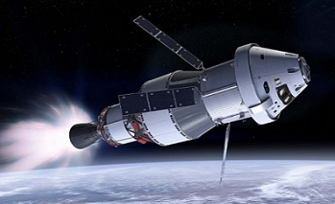
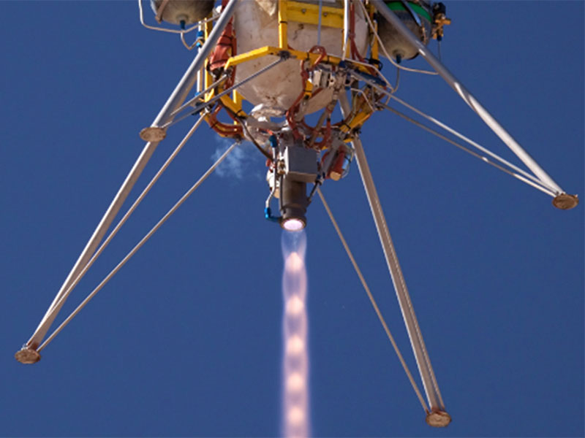
Applications and Benefits
SLS
Upper Stage / In space
Astrobotic
Landers
RDRE near term applications:
In space/ upper stages and landers. This is the first applications interest for commercial partners and largest benefit for the scale.
Best possible Isp, length reduction, and lowest cost to industry.
Broadly applicable to all space and in-atmosphere propulsion systems.

Slide 4










Partnerships
NASA is leading the effort across industry and government.
Nearly 25 industry partners, 36 academic partners, and several government collaborators including DARPA, DOD, and GRC.
Many partners contributing IRAD funds to develop RDRE in partnership with NASA.

Slide 5
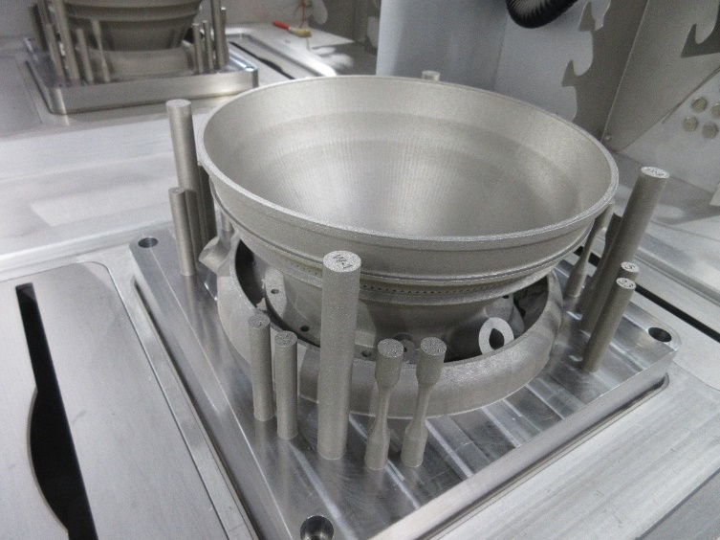
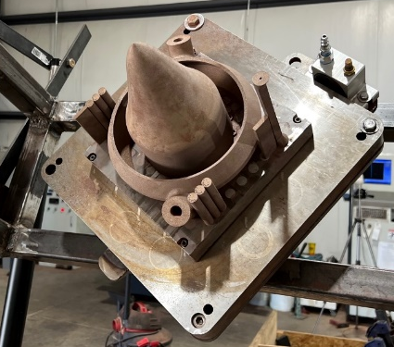
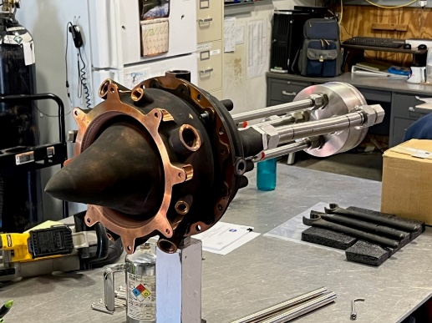
So why now?
RDRE has been theoretical for nearly 70 years, but we only now have the materials that can survive the extreme combustion.
Specially designed alloys like GRCop-42 and and GRX-810 have enabled RDRE.
They are the only alloys capable of withstanding the EXTREME combustion environments.
This was not possible even 10 years ago.
GRCop-42, (High conductivity)
GRX-810 (high strength and Extreme Temperatures)

Slide 6
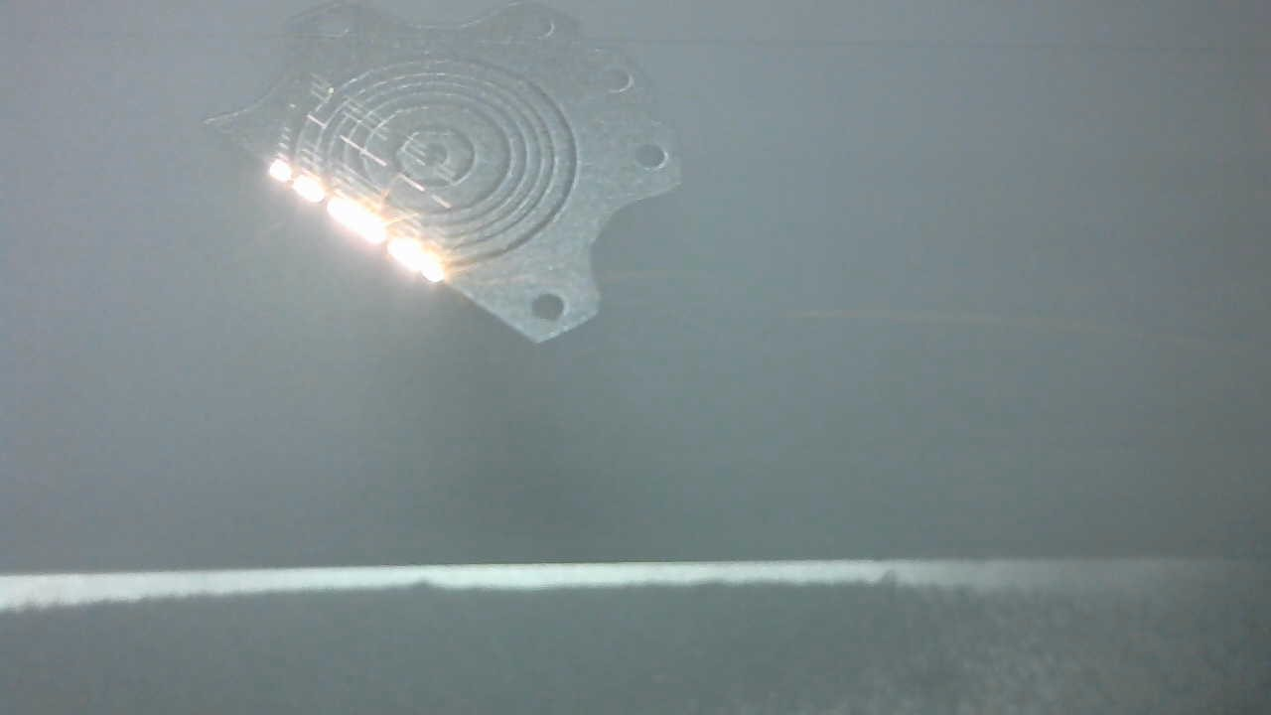
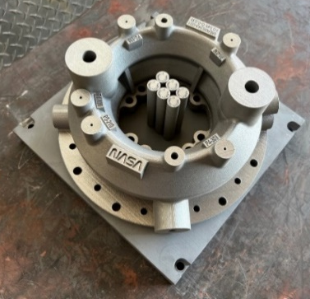
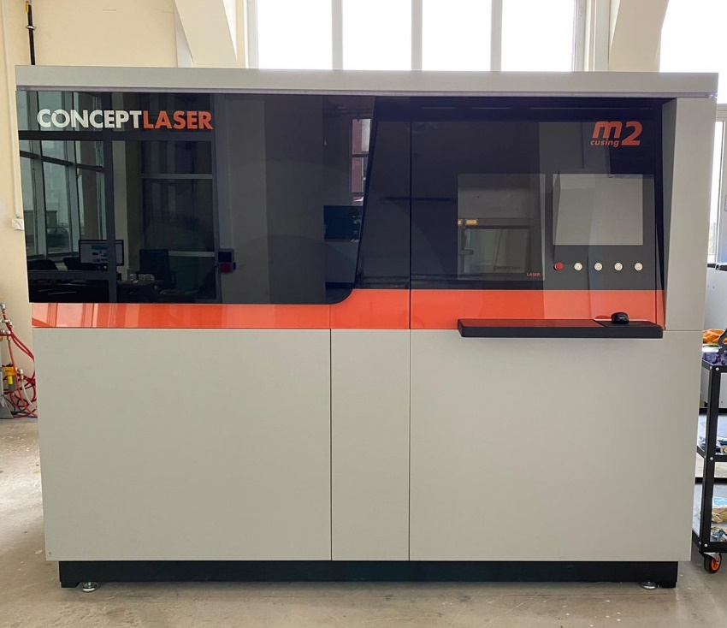
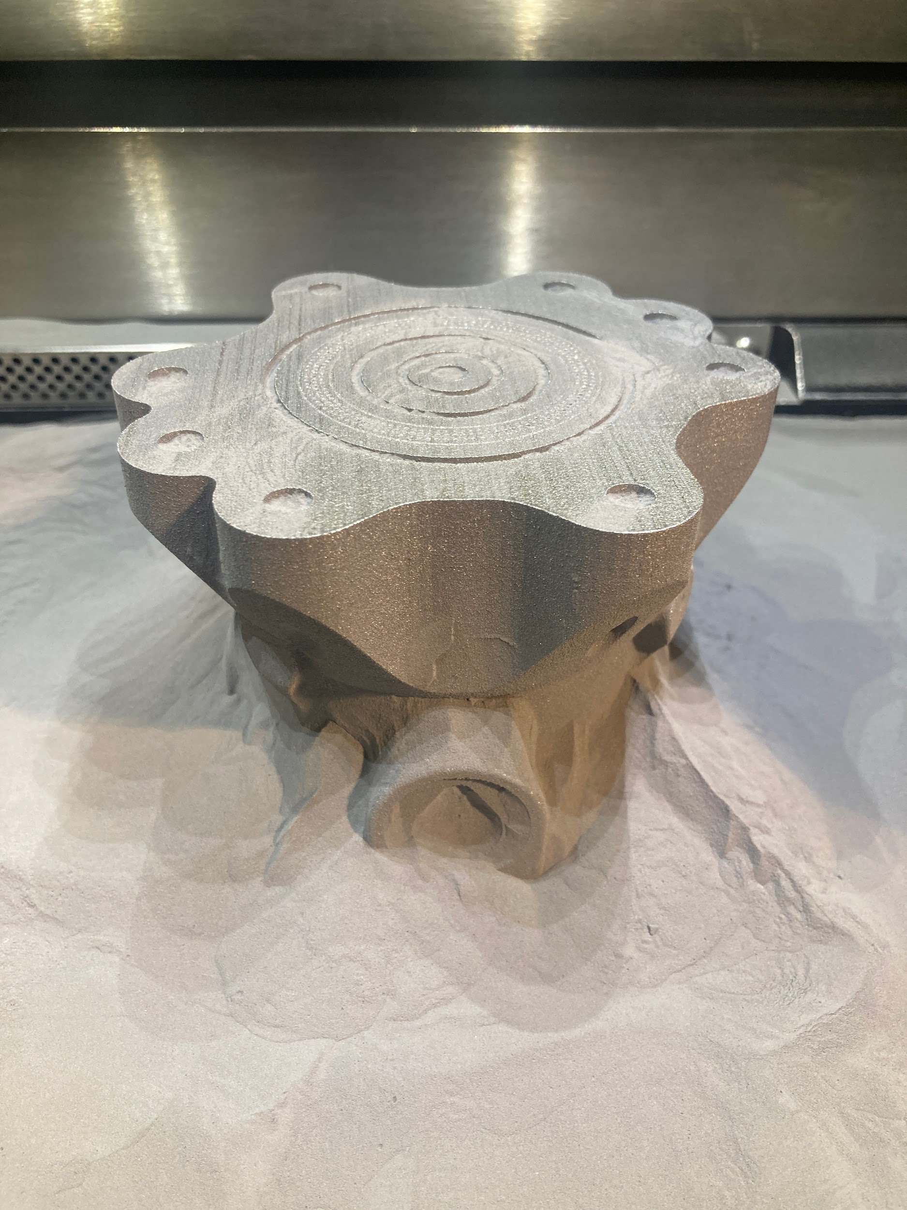
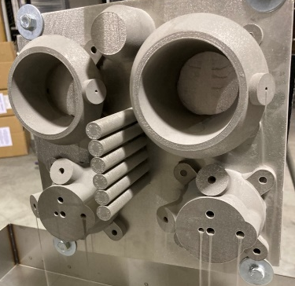
So why now?
New materials can be used with additive manufacturing (3d printing) techniques that enable the RDRE to be built now.
Additive allows us to print complex integrated structures that we just couldn’t make before.

Slide 7
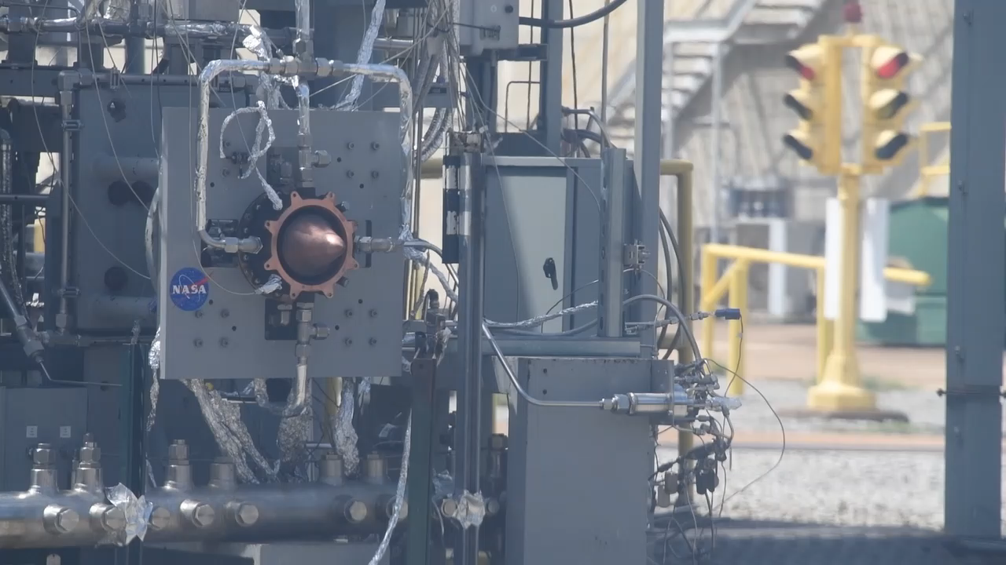
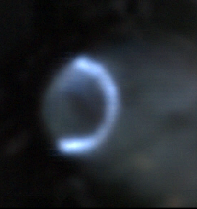
Current and Future Technology Readiness Level
Supersonic
Combustion!!!!
TRL 4 complete by Oct 1, 2024 funding provided by STMD Early Career Initiative
TRL 6 completion planned FY24 with approved funds from GCD program.

Slide 8

Thomas Teasley
Liquid Propulsion Systems Development Engineer
NASA Marshall Space Flight Center
Thomas.w.Teasley@nasa.gov

