Slide 1


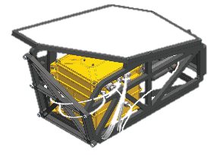
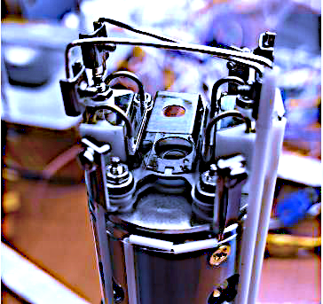


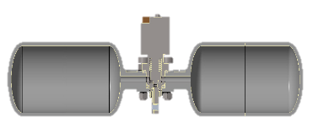
Space Technology Mission Directorate
Game Changing Development Program
Jackie Quinn / Amy Eichenbaum, PRIME-1 | Annual Program Review | September 10-12, 2024 | Jacqueline.W.Quinn@NASA.gov:

Slide 2
PRIME-1 Overview
Needs Addressed by Project
ISRU | PRIME-1 is an ISRU payload to be mounted on a polar-bound CLPS lander for the purpose of regolith volatiles detection up to a meter depth. ISRU seeks to understand composition and ability to use lunar ice for sustained presence as a resource for mission consumables (propellants/life support). Addresses STARPort Capability Areas and Gap IDs: 439 Detection of subsurface ice at less than 10’s m scale, 1191 Lunar PSR Terrain/Resource Mapping for Mine Site Selection & Operation, and 747 Geotechnical properties of regolith
PRIME-1 Level 1 Requirements
Requirement #1 | PRIME-1 shall operate on the surface at a lunar polar region
Requirement #2 | PRIME-1 shall expose a subsurface regolith sample from up to a 1-meter depth drill hole
Requirement #3 | PRIME-1 shall analyze the exposed subsurface regolith sample to detect water and other volatiles
Project Objectives
Objective #1 | TRIDENT will drill into the lunar subsurface up to a meter deep and deliver regolith cuttings to the surface for water and other volatiles evaluation by MSolo
Objective #2 | MSolo will measure within its field of view, the composition of gases emanating near the TRIDENT drill before, during and after drilling activities

Slide 3
PRIME-1 TRL Progression
Project Start
Project Milestone
GCD (Key) Milestone
Controlled Milestone
TRL Progression
PRIME-1
Closeout
Review
FY20 | FY21 | FY22 | FY23 | FY24
Lunar Surface Operations
7
6
Launch
5
PRIME-1 Delivery to Lander
TRL
4
MSolo V&V Complete
TRIDENT V&V Complete
3
MSolo Critical Hardware Ready for Assembly
TRIDENT Critical Hardware Ready for Assembly
2
PRIME-1 Interfaces CDR
TRIDENT CDR
MSolo CDR
Lander Selection
TRIDENT PDR
PRIME-1 Interfaces PDR
1
MSolo PDR
Notes:
Chart purpose: show TRL/SRL/MRL advancement over the project lifecycle schedule. Show TRL advancements as whole integer increases. Show how Key and Controlled milestones align with TRL advancement.
TRL/SRL/MRL may not advance at each milestone. Often several milestones are required to produce a step increase in TRL/SRL/MRL.
There can be one, or more, of these charts per project as needed.
For projects with fewer technical elements, the TRL/SRL/MRL data can be combined on one chart.
For more complex projects, the TRL/SRL/MRL progression can separated into multiple charts by project technical area.
Show TRL, SRL, and MRL data for each technical element on the same chart.
Delete TRL/SRL/MRL axis-labels that do not apply – e.g., remove SRL/MRL for projects/technical areas where SRL and MRL do not apply.

Slide 4
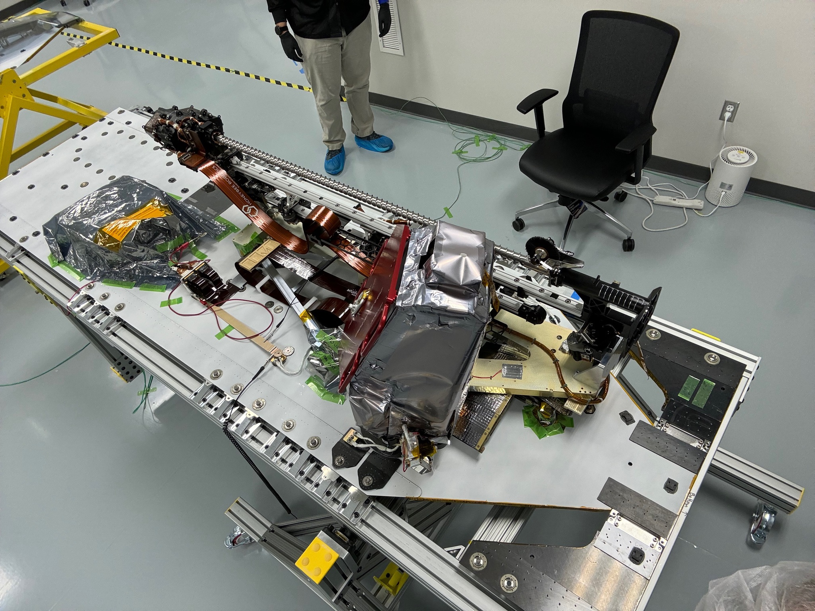
PRIME-1
Technical Progress and Results
Technical Accomplishments through project life cycle
    MSolo PDR 4/28/20
    MSolo CDR 8/13/2020
    PRIME Interfaces PDR 2/19/21 (TRIDENT) 3/12/21 (MSolo)
    PRIME-1 Interfaces CDR 4/30/21 (TRIDENT) 5/25/21 (MSolo)
    TRIDENT Flight Avionics Fabrication 4/7/22
    MSolo Thermal TVAC 5/15/22
    MSolo Engineering Unit test with IM 1.0 FlatSat 5/17/21
    MSolo Vibration preliminary test 8/5/22
    TRIDENT Flight Mechanism Build 8/9/21
    MSolo Vibration test 10/12/22
    MSolo pre-ship review 12/16/22
    TRIDENT Mechanism Vibe and TVAC 2/24/23
    TRIDENT Avionics Vibe and TVAC 1/19/23
    TRIDENT Lower Launch Lock TVA 4/20/23
    TRIDENT EMI/EMC 3/8/23
    TRIDENT end-to-end CPT 06/09/23
    TRIDENT pre-ship review 06/15/23
    PRIME 2.0 FlatSat testing with flight hardware 08/16/23
    TRIDENT mechanical Integration with Lander 08/20/23
    PRIME 3.0 FlatSat testing with flight hardware and control from KSC 10/31/23
    PRIME Hardware in the Loop Simulation Training 11/2/23
    MSolo Flight Hardware successfully rechecked after 1.5 years of storage 2/2024
    PRIME Sim architecture updated to reflect a new PRIME console, in addition to TRIDENT loop and MSolo loop 2/2024
    New replacement drill stem built and delivered (Feb-May 2024)
    Installed new drill stem onto TRIDENT at Intuitive Machines June 24th, 2024
    Re-mounted TRIDENT onto a new IM Panel
    Received landing coordinates from Intuitive Machines which fall within the NASA-specified target zone.
    Received an updated integration schedule and testing/sim schedule from Intuitive Machines
    MSolo installed on IM Lander Panel C 07/19/24
    MSolo final MLI closeout performed 07/30/24
PRIME-1 on Intuitive Machines lander panel

Slide 5
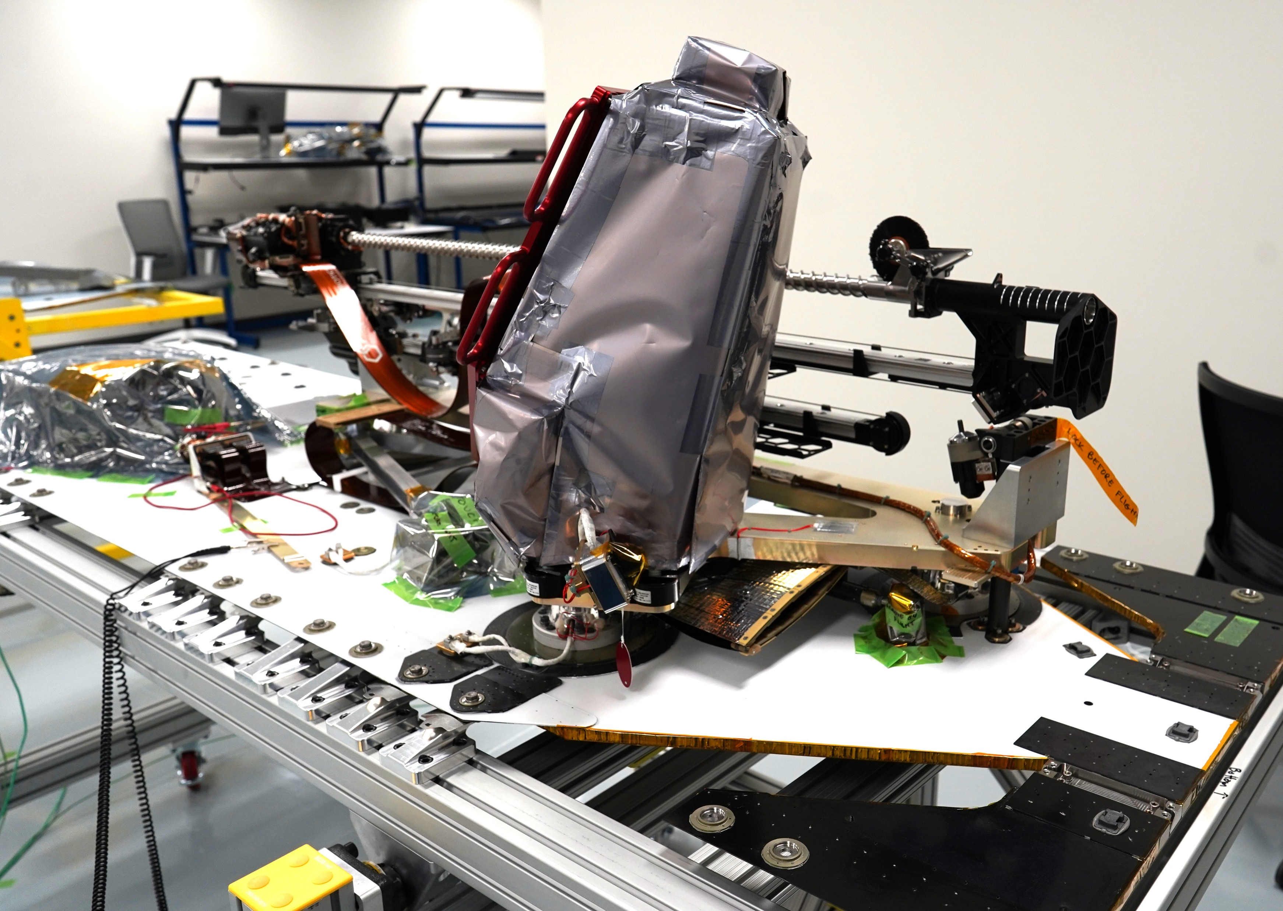
PRIME-1
Transition/Infusion Status
  PRIME-1 is currently targeting an early 2025 CLPS mission to Shackleton’s connecting ridge at the lunar south pole; carried by Intuitive Machines
  PRIME-1 will help to inform the Agency plan for ISRU prospecting at the lunar poles
  PRIME-1’s ability to measure water will depend on Intuitive Machines’ landing location. However, if water is not detected at the drilling location, the two instruments that makeup PRIME-1 will still provide scientific geotechnical information to Artemis and to the VIPER mission.
  Any data acquired from the operation of PRIME-1 will be uploaded to the Planetary Data System for use by the lunar science community and the ISRU community
Science team working with Artemis team members to maximize science from PRIME-1 and its infusion into Artemis planning (eg geotechnical data and volatiles data).

Slide 6
PRIME-1
Assessment Summary
Project Name | Performance |  |  |  | Comments
 | C | S | T | P
Annual | G | G | G | Y | Technical – Payload delivered to lander partner and awaiting flight Cost – Payload delivered within budget Schedule – Payload delivered on schedule Programmatic – Lander partner delays and landing location target compromise payload KPPs
 | Oct | Nov | Dec | Jan | Feb | MYR | Apr | May | Jun | Jul | Aug | APR
C
S
T
P
Original landing dates of late 2023 and into 2024 slid into CY2025. All Programmatic Yellows are a result of landing location selection and mission schedule slips. Landing location selected by landing partner specifically lies within a NASA-specificied landing ellipse, but location selected Intuitive Machines does not specifically target potential ice-rich location. Landing partner is placing lighting and mission duration as higher priority. Competing objectives amongst the Intuitive Machines payload portfolio specifically jeopardizing PRIME-1 KPPs and mission objectives. Yellow Technical, Schedule and Cost bars were linked to a VIPER drill technical finding, which was repaired on PRIME-1.

Slide 7
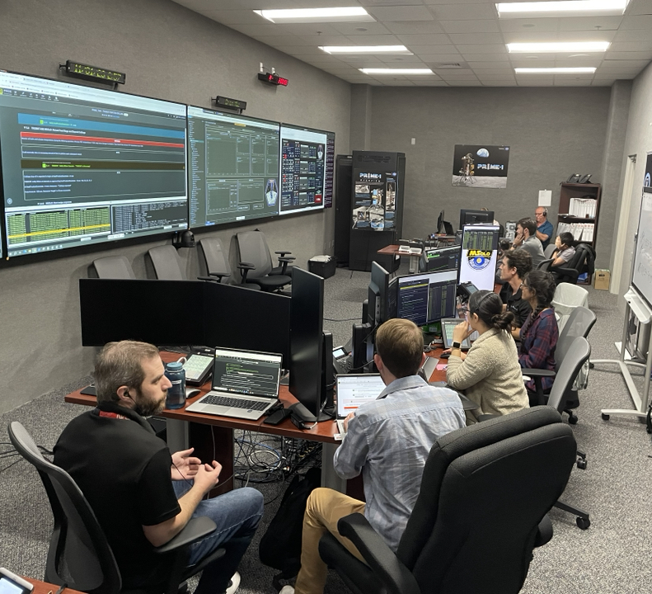
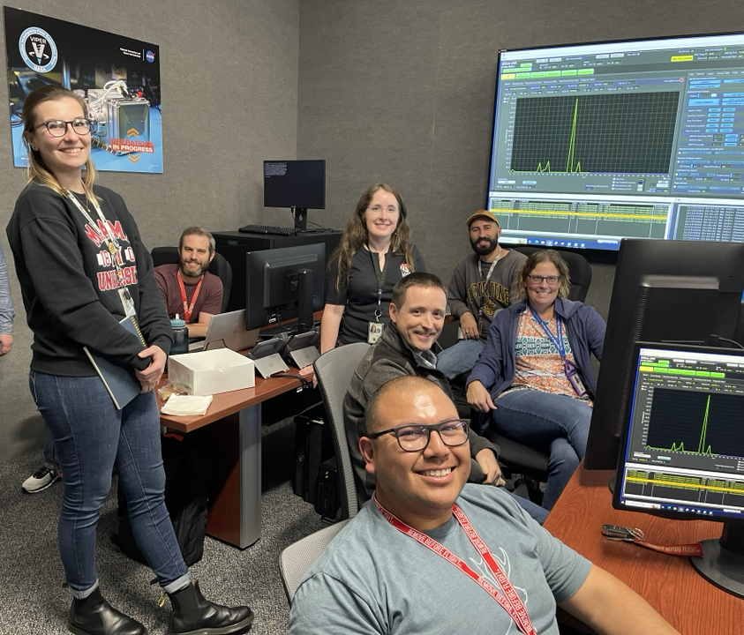
PRIME-1-Simulation Training

Slide 8
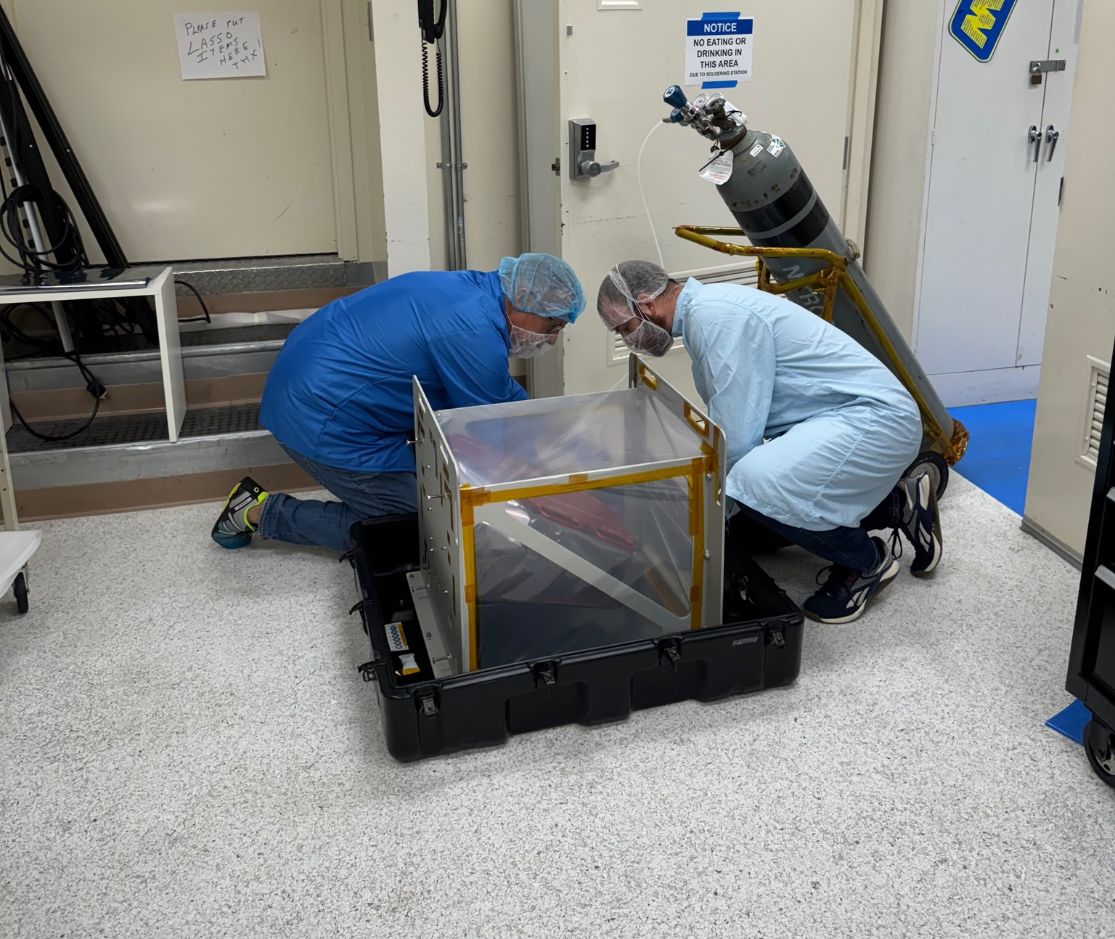
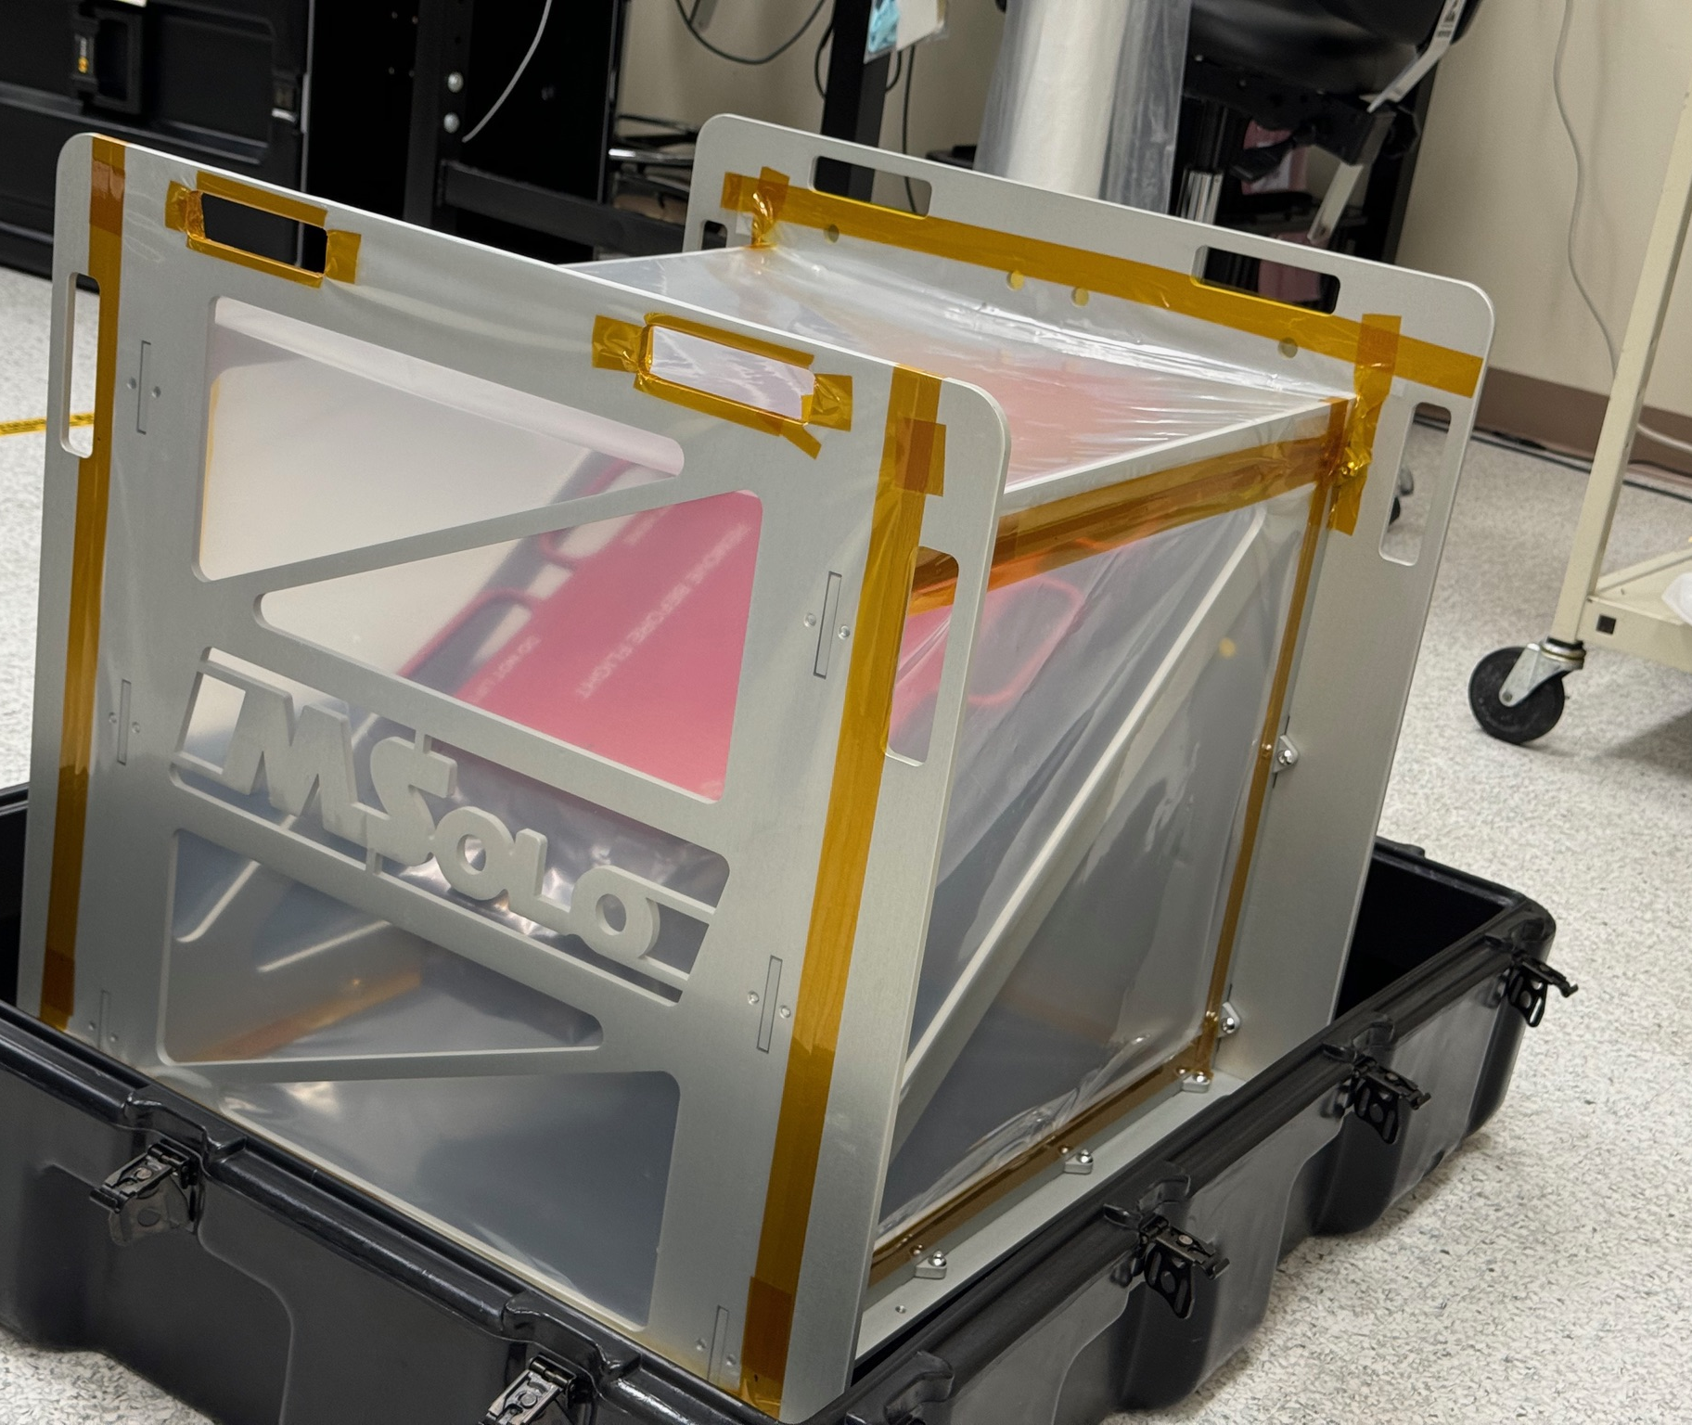
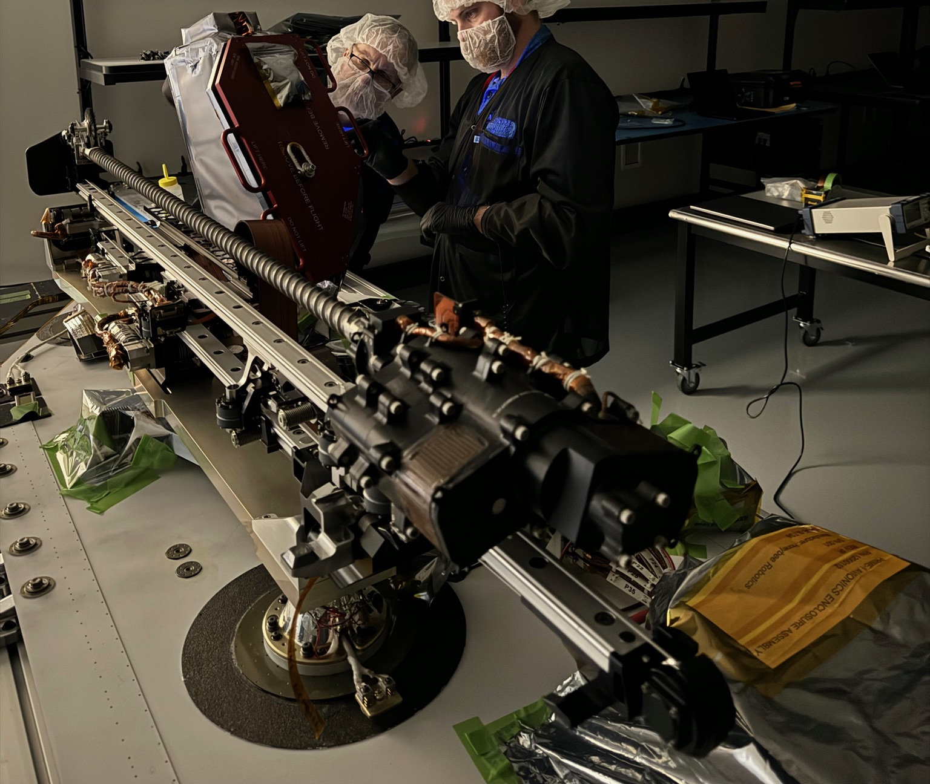
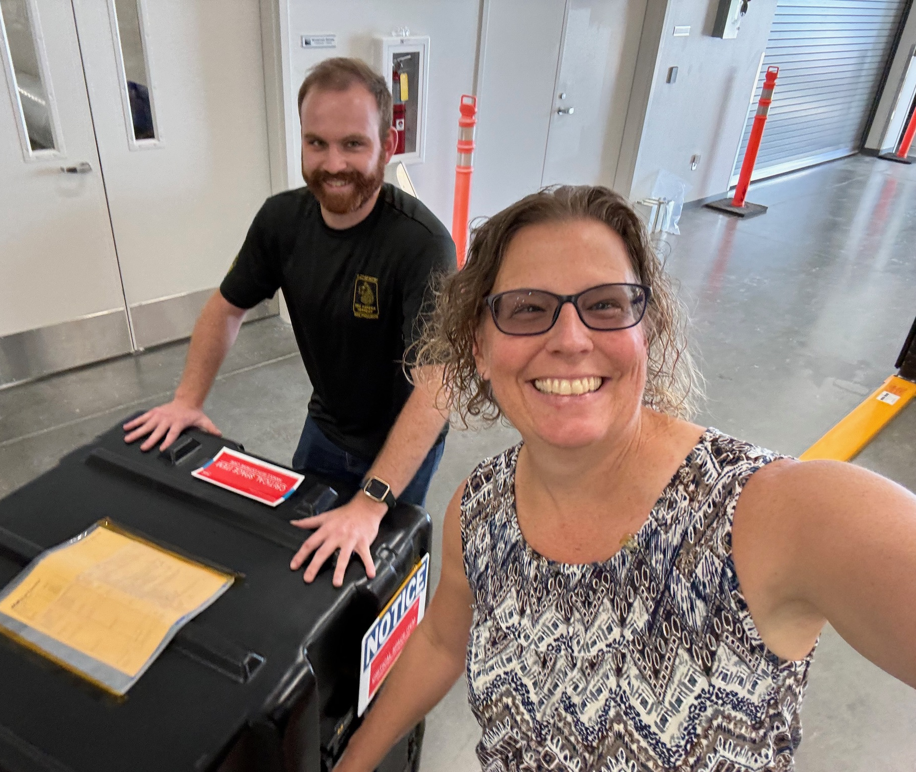
PRIME-1 MSolo hardware arrival at Intuitive Machines and MLI closeout

Slide 9
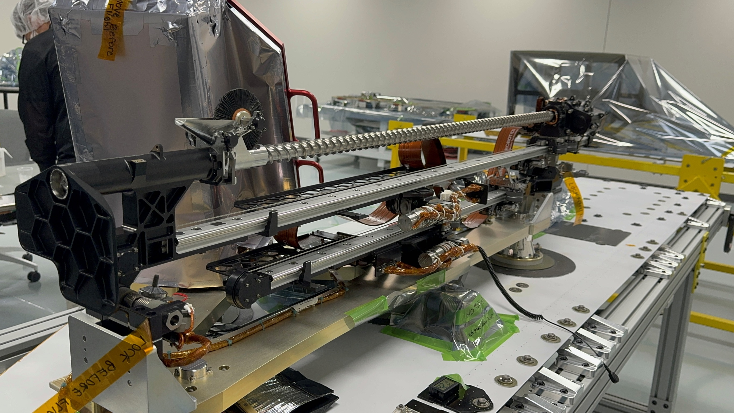
PRIME-1-Lander Mechanical Integration

Slide 10
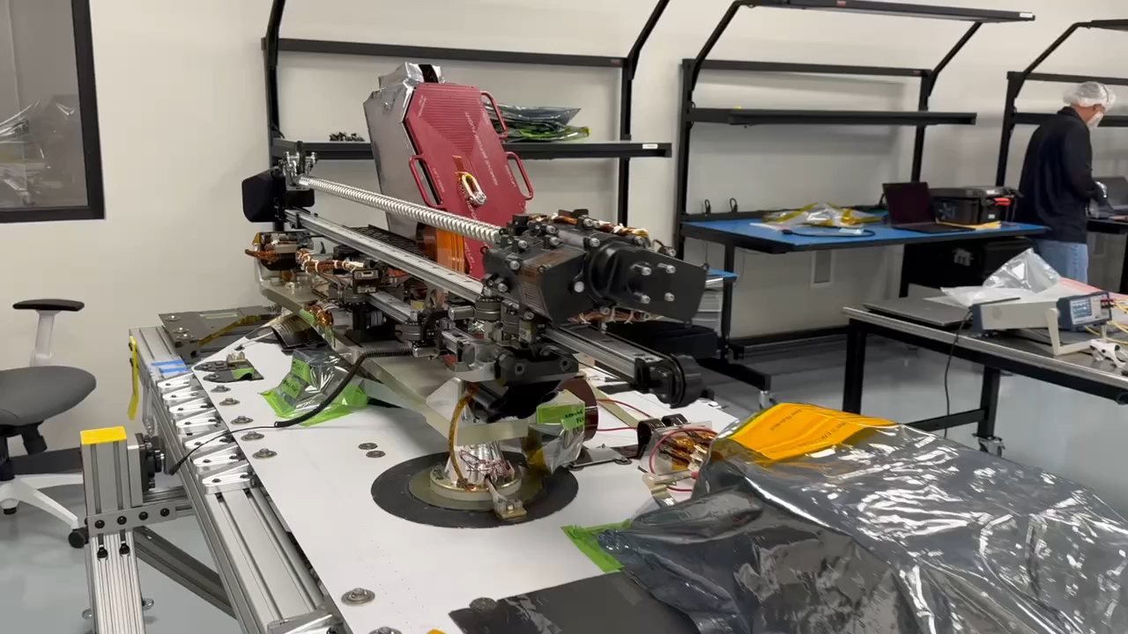
PRIME-1: mechanical integration complete

Slide 11
PRIME-1 Key Performance Parameter (KPP) Status
Key Performance Parameters
Parameter | Units | State of the Art (SOA) | Threshold | Goal | Current Value To Date | Verified By: | Current State
Regolith sample-depth resolution | Number of linear depths along single drill hole¹ | N/A² | 3 | 5 | 5 | Test ⁽⁴⁾ | In-work
Volatile species identification | Number of volatiles (#) | 1 | 2 | 3 | 2 | Test ⁽⁴⁾ | In-work
Water detection accuracy for regolith³ | Percentage by mass water grade in regolith (%) | N/A | 2 | 1 | 2 | Test ⁽⁴⁾ | In-work
Notes:
¹ Threshold linearly along a depth up to 0.6-m total. Project Goal linearly along a depth up to 1-m total.​
² No drill samples for State of the Art. Orbital spatial scale is 10s of km at a depth of up to 1 meter, but only for hydrogen.​
³ Assumes 2.0-5.0% water by mass in the regolith which encapsulates ISRU’s definition of a critical cutoff concentration for water harvesting.
⁴ Tested as part of MSolo and TRIDENT verification and validation plan and readiness for flight. 50%​

Slide 12
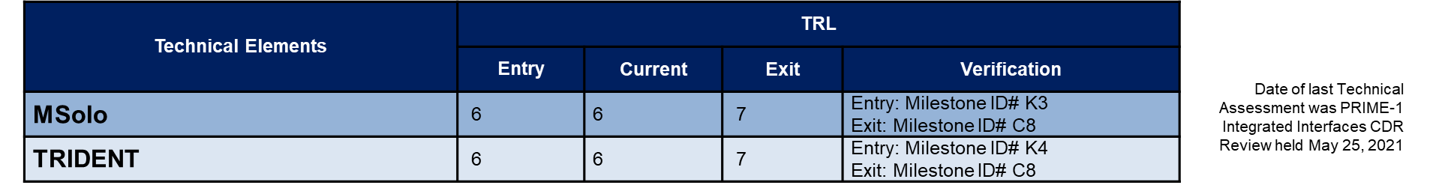
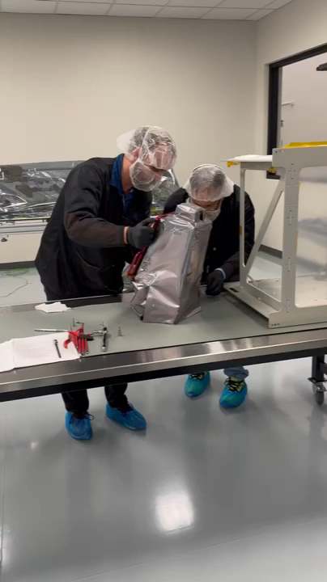
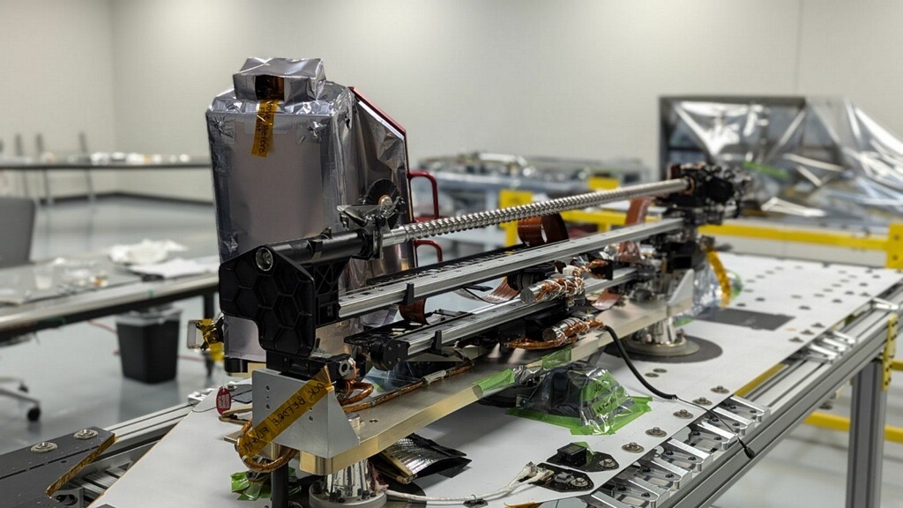
PRIME-1 Technical Assessment

