Slide 1
Space Technology Mission Directorate
Game Changing Development Program
GCD Digital Operations and Transformation (DOT)
Wade May, Daniel Yoo, Chris Munk, Farley Reynolds
September 2024
PLEASE HAVE YOUR NASA LAPTOP AND PIV BADGE WITH YOU FOR THIS INTERACTIVE SESSION

Slide 2
    GCD Portal Team
    for
    Links to all tools
    GCD Portal | General | Microsoft Teams

Slide 3
    MBPM “Desirements”
  MBPM solutions for all processes, products, and HQ reporting
    Instantaneous real-time updated data for all technical activities in a secure, cloud-based, Agency-supported solution
    Coordination tools and a comprehensive data model ensure data is synched from a single, yet distributed, initial authoritative source
    Flexible and customizable data visualization of technical reporting for various management levels and stakeholders
    Real-time project performance analysis (e.g. Technical, Resource allocation)
    Intelligent Programmatic Requirement Development, Control and Presentation
      “Control the data not the documents”
    Program risk management analysis and reporting
  MBPM = Model Based Program Management

Slide 4
    Existing Tools

Slide 5
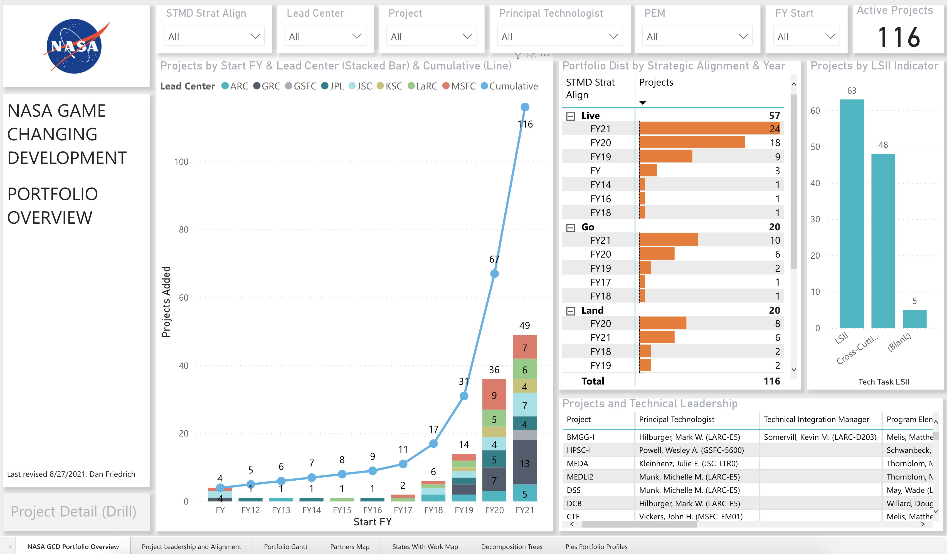
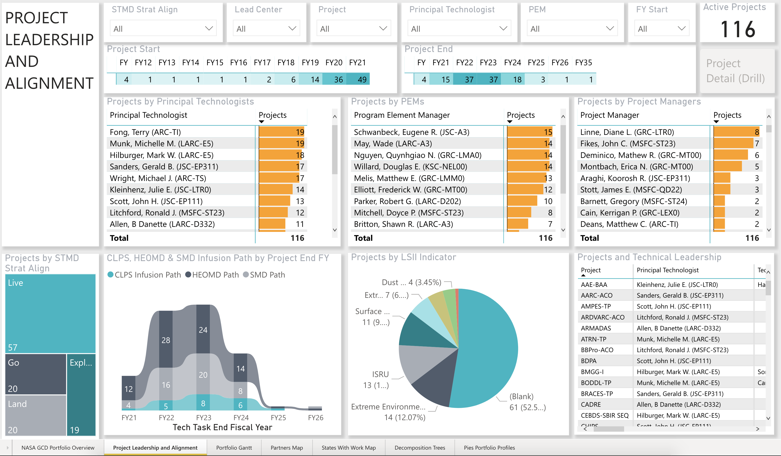
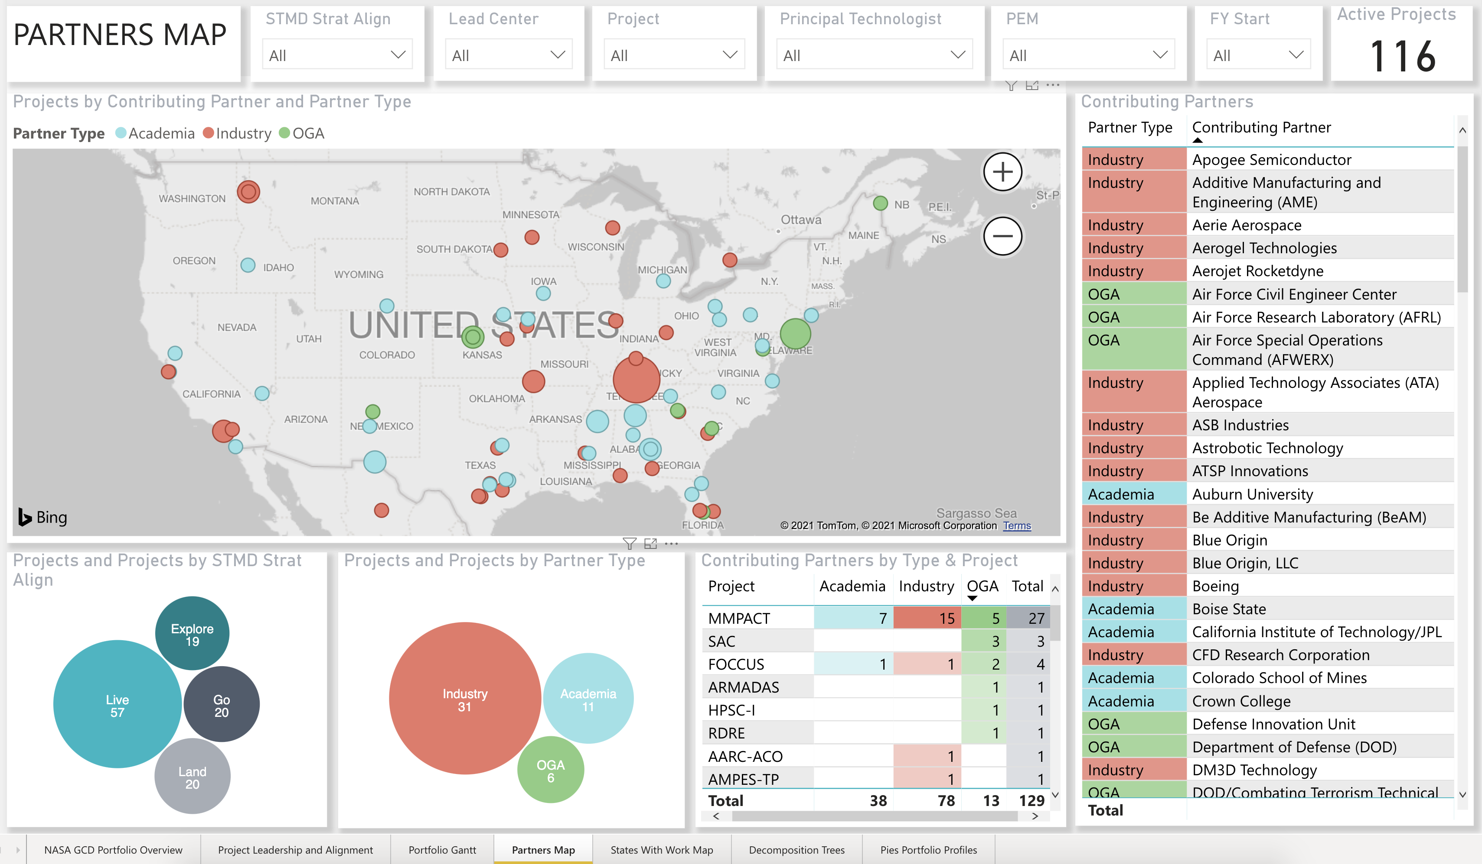
    Program Analytics Dashboard

Slide 6
PURPOSE OF WHY WE HAVE A MIPR APP
HOW WILL THIS HELP ME AS A PROJECT MANAGER?
  Gets rid of Monthly PowerPoint charts! (ironic this is a bullet on a PowerPoint chart)
  Consistent information month to month (any changes will be reflected in the app)
  Only information that is needed (know exactly what program is asking for)
  Stores information into a database for trending
  Don’t have to check to see if there is a new template
  You know exactly what milestones need to be reported
HOW WILL THIS HELP THE PROGRAM OFFICE?
  Allows for cross program interrogation
  Single database for all projects that all program can access (no more emails)
  See trending by project, by domain, or by the program
  Will allow projects in need to rise to the top
  Can change data being requested
  Manage Data Not Documents!

Slide 7
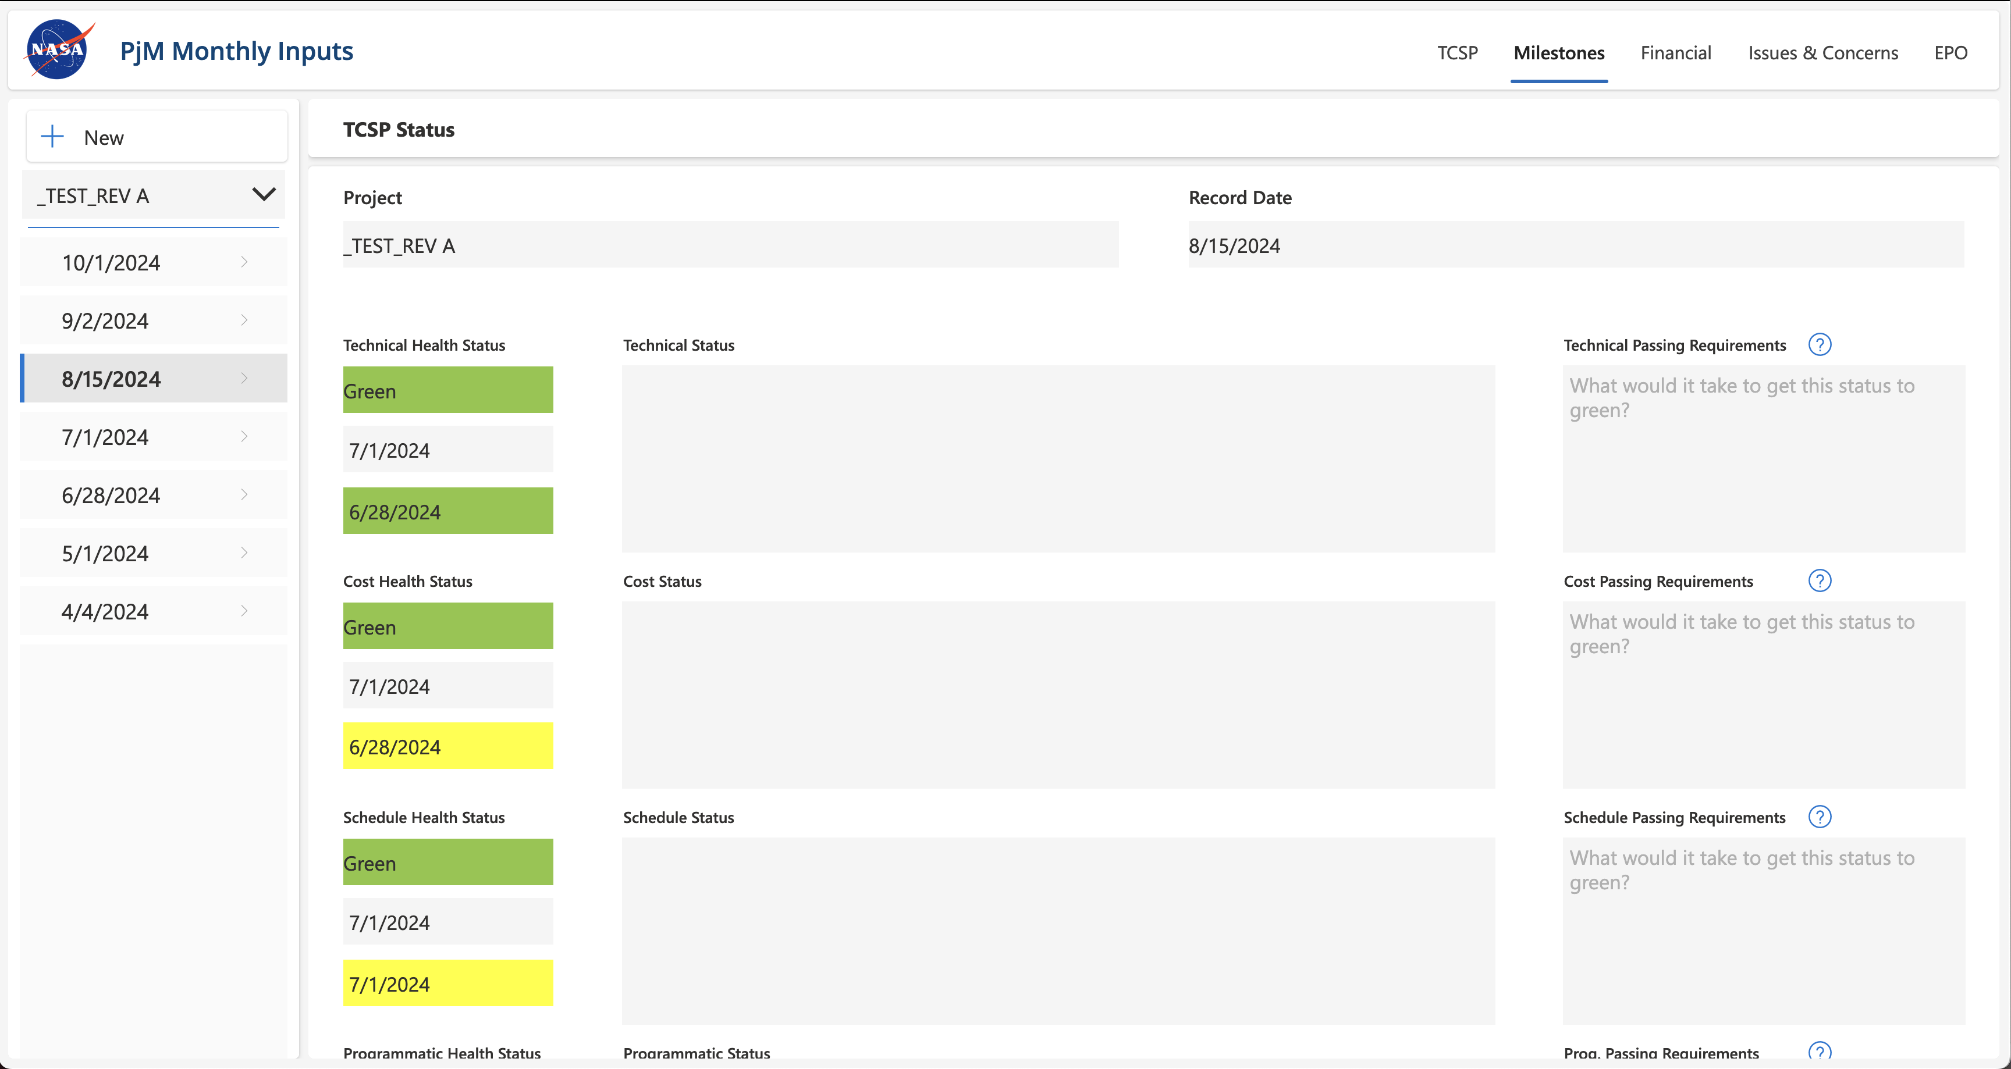
    Project Manager Monthly Status Reporting

Slide 8
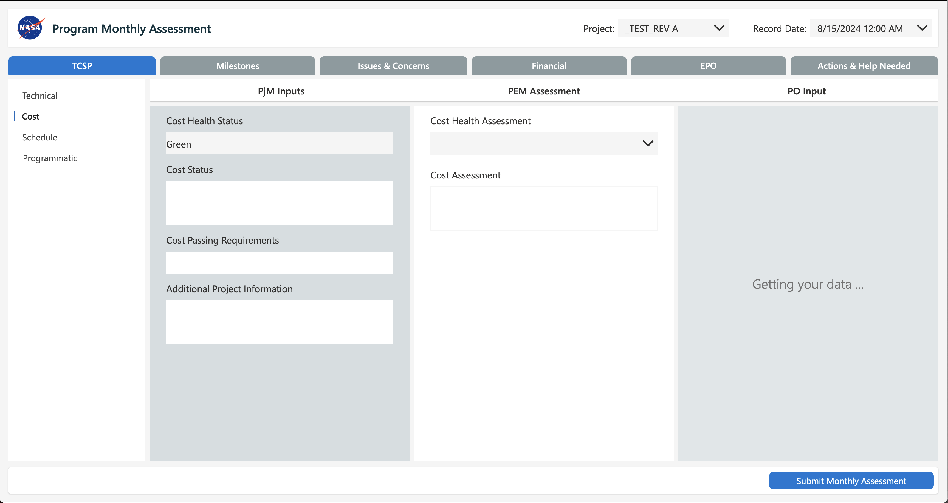
    Program Monthly Assessment

Slide 9
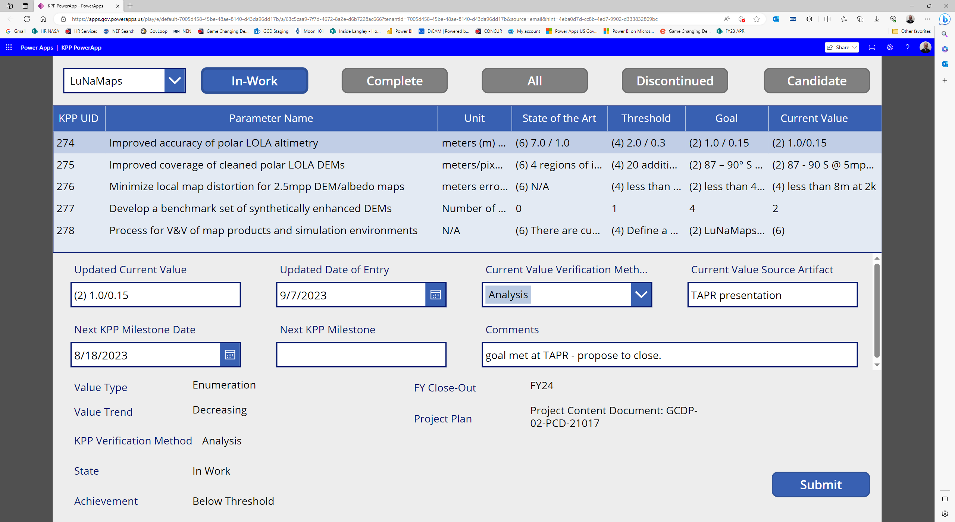
    Key Performance Parameter PowerApps
Details of App will be covered in CE workshop

Slide 10
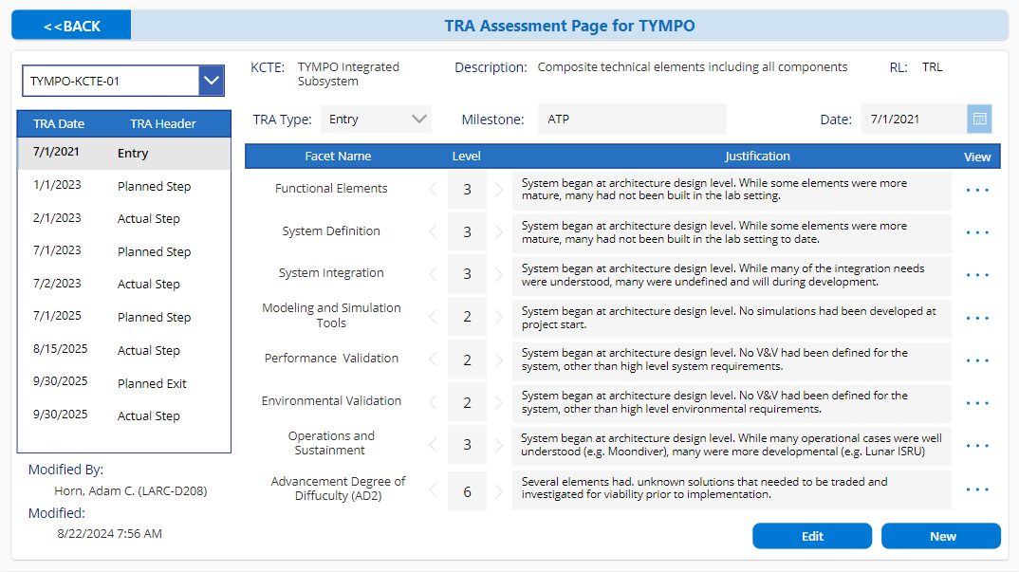
    Technical Readiness Assessment PowerApp
Details of App will be covered in CE workshop

Slide 11
    Planned Tools

Slide 12
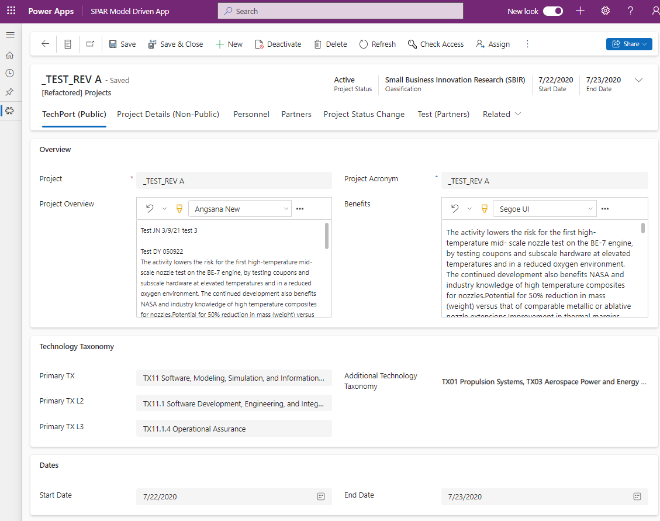
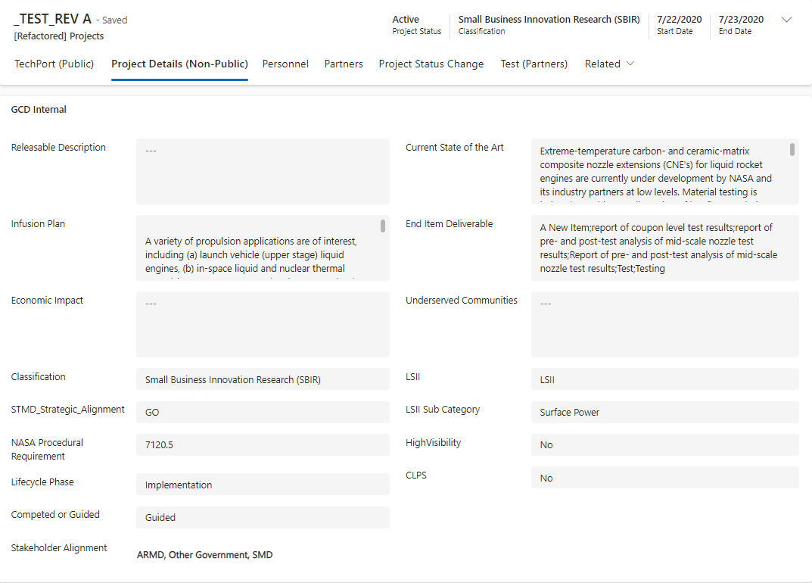
Project Details / SPAR PowerApps

Slide 13
NASA Data Management
Random thoughts from GCD

Slide 14
Background and Challenges of Data Management
GCD has 10+ years of program and project data
Across multiple centers
Partnering with multiple mission directorates
Hard to analyze program, portfolio, center, or mission directorate performance

Slide 15
Projects Report through Institutional Authority and Programmatic Authority
Agency AA
Center
Mission Directorate
Mission Directorate
Division
Division
Division
Branch
Program
Program
Project 1
Project 2
Project 3
Project n
Notes:
Projects sometimes report to multiple programs / mission directorates
Projects sometimes report to multiple centers
Projects sometimes report to multiple programs and centers at the same time!

Slide 16
Typical Data Management for a Project (SharePoint Online Folder Structure)
Project 1
Project 2
Project n
WBS 1
WBS 2
WBS 3

Slide 17
Flipping typical data management on its side for programmatic analyses
Project Details
Documents
Change Requests
City, State
Project 1
Project 2
Project 3
Notes:
Project Details typical across all projects: NPR governance, Lead Center, TRL start, TRL end, Start Year, End Year, Scope, Background, Public Description, Taxonomy, Project Type, etc.

Slide 18
    Program Analytics Dashboard

Slide 19
Considerations / Status
Project managers don’t care about the big picture. They have a job to do. They will keep their project level structure at their center, and they should.
But any organization larger than a project should organize differently.
Programs deal with projects across center and each center manages differently. How should programs deal with data?
We need a NASA Common Data Model (CDM) for organizing information.
  GCD summer interns in 2023 used NPR 7123 to draft a CDM
This is a larger question maybe for our Chief Data Officer?

Slide 20
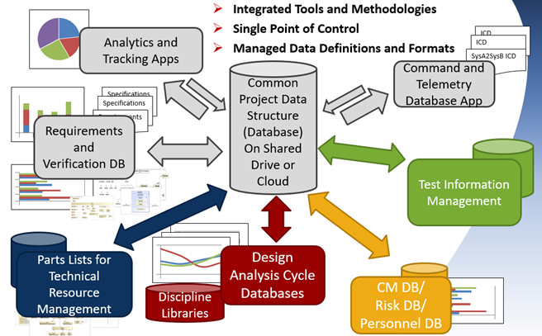
A Common Data Structure for NASA Projects and Programs
Kevin Kempton (GCD/CoECI programs)
Challenge:
The Common Data Structure Recommendations seek to make NASA Data Management more effective and help with compliance to our NPRs. Almost everyone is impacted.
Solution:
Develop Recommendations for a Common Data Structure that NASA Programs and Projects can tailor at startup.
Path Forward:
Work with new projects to incorporate the CDS recommendations.
  Discuss ideas on a Common Data Structure at a future Information Ecosystem meeting
  Elicit participation and collaboration using NASA Spark (Formerly NASA@Work)
Key Partners:
GCD DOT Team, TDM Management, ESDMD ExCap, and CoECI Cost Breakdown & Expected Completion Date:
ACT2 Culture Tenet Alignment:
Purpose Driven to improve data management across NASA
Approach:
Extract the requirements from the NASA Procedural Requirements (NPRs)
Determine what data is captured to show compliance to each Requirement
Develop a database schema that captures the data required for compliance
Identify and test methods for collaboration on a database schema
Meet with and elicit feedback from potential project and program stakeholders.
Impact and Metrics:
NASA Projects/Programs now have a starting point for a Data Structure that can be used at start-up to reduce the data management workload

Slide 21
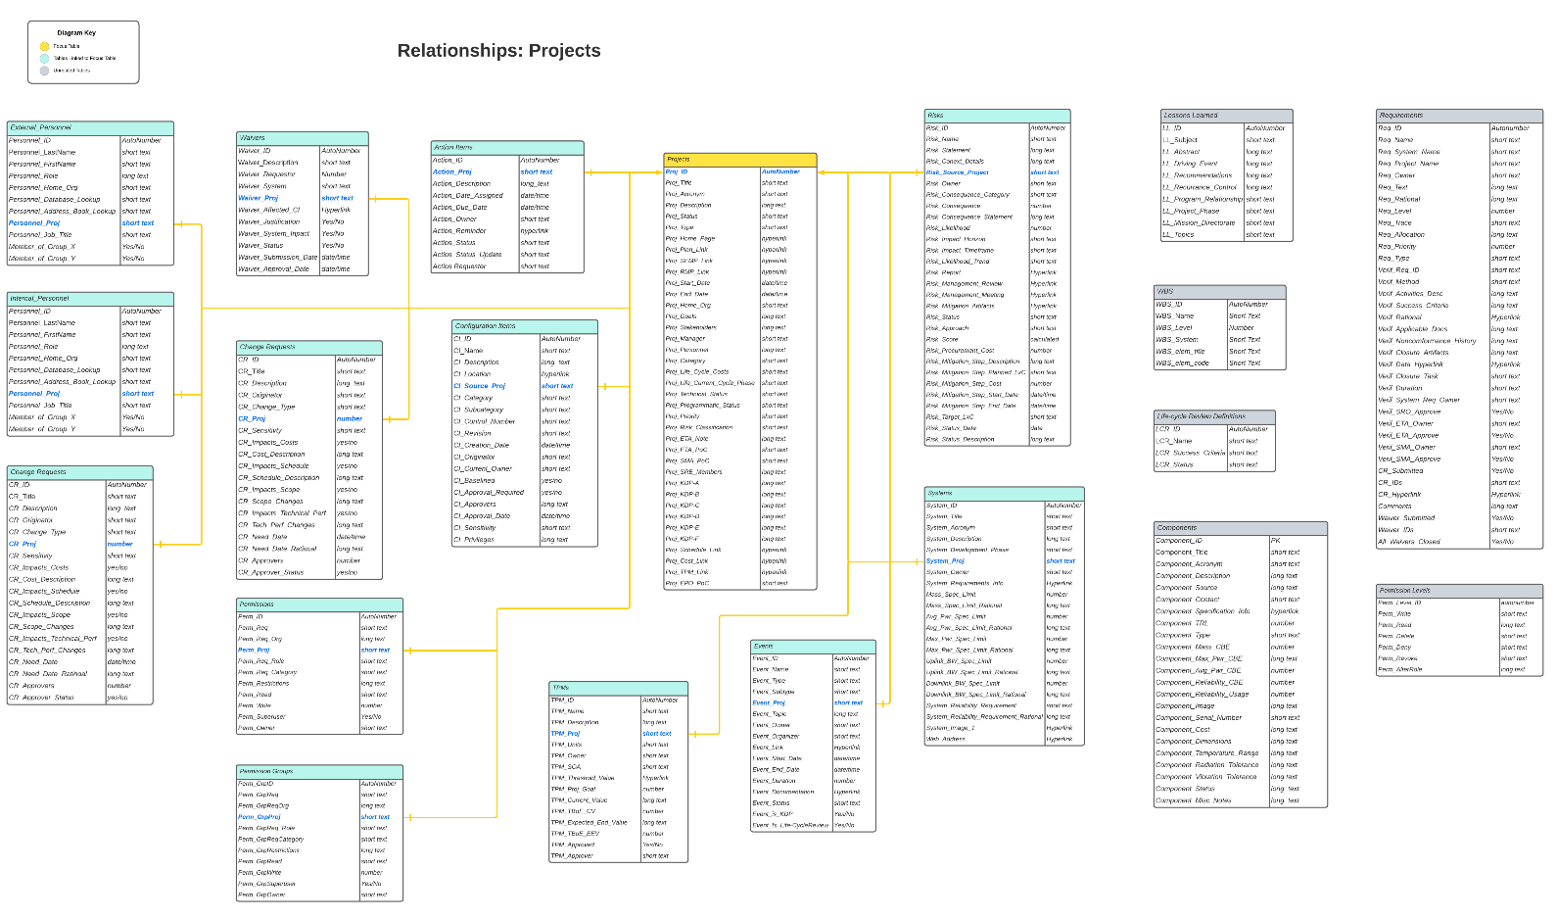
Schema Example from Lucidchart

Slide 22
Implications from STMD Re-organization
But what to do during a re-org?
How to separate information in containers to the appropriate new org?
What system(s) do we need to push data to?
Or should we have a common system across the mission directorate to provide a common data structure that will allow for high level analyses?
And that will allow centers to analyze the projects they lead.

Slide 23
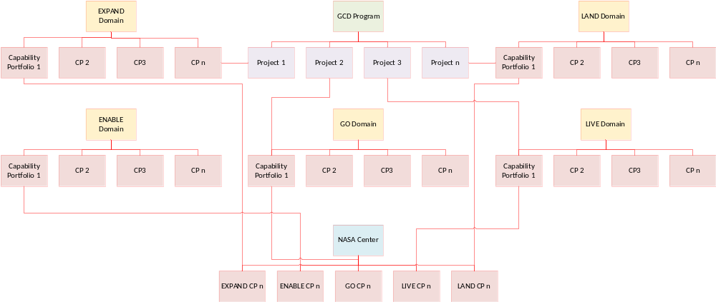
Transformation of Regions of Data Management

Slide 24
Proposed Solution
GCD would propose a single solution environment for the Domains since it is an extension of what we are already doing
Each Domain would have their own “business unit” in the environment for security and control
It would allow centers to see their projects across Domains

Slide 25
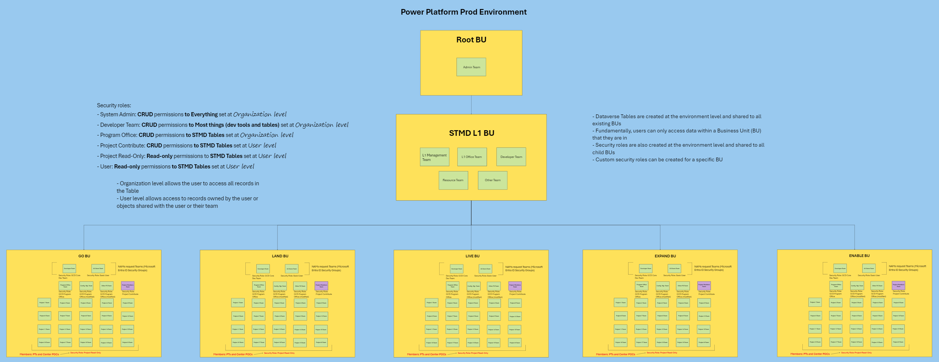
Dataverse Structure / Business Units

Slide 26
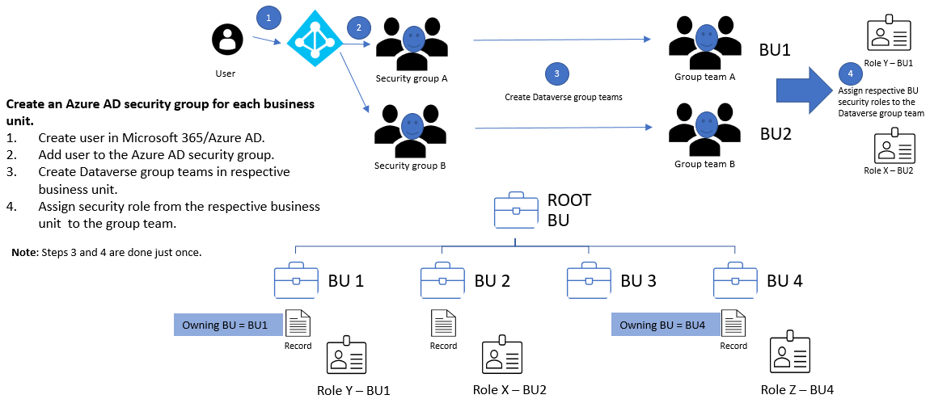
Security for Dataverse Business Units

Slide 27
BACKUP

Slide 28


    DOT Functional Architecture
    (The ABCs)
A.
B
B’
C
1..n
BI Layers
Source Systems
(SharePoint Lists, Databases, Agency/STMD Systems, Tools, Spreadsheets, emerging O365 apps, etc.)
Source Systems
(SharePoint Lists, Databases, Agency/STMD Systems, Tools, Spreadsheets, emerging O365 apps, etc.)
Project
Inputs
Source Systems
Program Mgmt. (Core)
Financial (RMO)
Technical, KPP (CE)
Risk
CDM, CRs
Program Coord.
Schedule
EPO
Repository
(Data Sync,
Data Refresh,
Extract Transform Load (ETL),
Data History,
etc.)
Analytic
Model
(Data Model,
Relationships,
Model of Models,
etc.)
Data Presentation Visualization and Analytics
(Dashboards)
Project / SPAR Details, Plans, KPPs, CRs, Highlights, Risks, Facilities, etc.
Users and Stakeholders
Program Office,
Project Managers, HQ, STMD, SPI, Stakeholders, etc.
Program Inputs
Produce Data
(Create, Update, Delete, Store)
Extract, Transform,
Load, Archive Data
Relate and Model
Data
Consume Data
(Visualize, Analyze)
Milestones, Approvals,
Actions, Controlled data,
Financials, Risks, etc.
WORKFLOW ENGINE

Slide 29
    Information Domains (Datasets)
A.
B
B’
C
1..n
BI Layers
Source Systems
(SharePoint Lists, Databases, Agency/STMD Systems, Tools, Spreadsheets, emerging O365 apps, etc.)
Source Systems
(SharePoint Lists, Databases, Agency/STMD Systems, Tools, Spreadsheets, emerging O365 apps, etc.)
Project
Inputs
Source Systems
Program Mgmt. (Core)
Financial (RMO)
Technical, KPP (CE)
Risk
CDM, CRs
Program Coord.
Schedule
EPO
Repository
(Data Sync,
Data Refresh,
Extract Transform Load (ETL),
Data History,
etc.)
Analytic
Model
(Data Model,
Relationships,
Model of Models,
etc.)
Data Presentation Visualization and Analytics
(Dashboards)
Project / SPAR Details, Plans, KPPs, CRs, Highlights, Risks, Facilities, etc.
Users and Stakeholders
Program Office,
Project Managers, HQ, STMD, SPI, Stakeholders, etc.
Program Inputs
Produce Data
(Create, Update, Delete, Store)
Extract, Transform,
Load, Archive Data
Relate and Model
Data
Consume Data
(Visualize, Analyze)
Milestones, Approvals,
Actions, Controlled data,
Financials, Risks, etc.
WORKFLOW ENGINE

Slide 30
    DOT Technical Architecture
1
2
3
4
1..n
BI Layers
BI Layers
Cloud-based and/or On-Prem based | Source Systems | Repository | Analytic Model | Visualization and Analytics
Cloud-based or On-Prem based
Source Systems
(SharePoint Lists, Databases, Agency/STMD Systems, Tools, Spreadsheets, emerging O365 apps, etc.)
Source Systems
(SharePoint Lists, Databases, Agency/STMD Systems, Tools, Spreadsheets, emerging O365 apps, etc.)
Project
Inputs
Source Systems
Program Management (Core)
Financial (RMO)
Technical (CE)
Schedule
CDM
Program Coordination
EPO
Repository
(Data Sync,
Data Refresh,
Extract Transform Load (ETL),
Data History,
etc.)
Analytic
Model
(Data Model,
Relationships,
Model of Models,
etc.)
Data Presentation Visualization and Analytics
(Dashboards)
Project / SPAR Details, Plans, Plans, KPPs, CRs,
Highlights, Risks, etc.
Users and Stakeholders
Program Office,
Project Managers, HQ, STMD, SPI, Stakeholders, etc.
Program Inputs
Produce Data
(Create, Update, Modify)
Extract, Transform,
Load, Archive Data
Relate and Model
Data
Consume Data
(Visualize, Analyze)
Milestones, Approvals,
Actions, Controlled data,
Financials, Risks, etc.
WORKFLOW ENGINE

Slide 31


    DOT Current Architecture
1
2
3
4
1..n
BI Layers
On-Prem | Source Systems | Repository | Analytic Model | Visualization and Analytics
On-Prem | SharePoint 2016 (Including Document Uploads) SharePoint Designer | N/A | Power BI Service | Power BI Service
Program/ Project
Inputs
Stakeholders and Users (PO, HQ, PMs, Centers, etc.)

Slide 32




    DOT Desired Architecture
1.
2
3
4
1..n
BI Layers
 | Source Systems | Repository | Analytic Model | Visualization and Analytics
O365 Cloud Service | PowerApps SharePoint Online Excel MS Project Power | Dataverse (Enterprise) Automate | Power BI Service | Power BI Service
On-Prem | Legacy Data Source Systems
Program/ Project
Inputs
Stakeholders and Users (PO, HQ, PMs, Centers, etc.)
Data Service Connection

