Slide 1


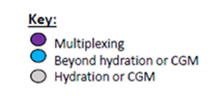
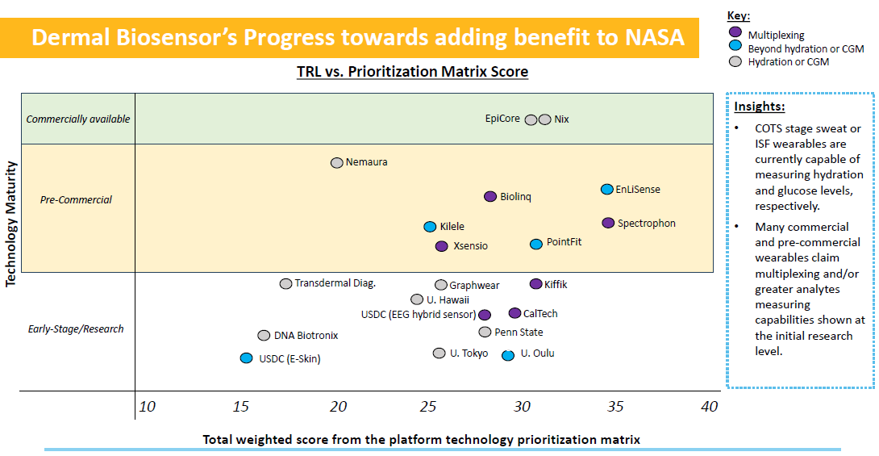
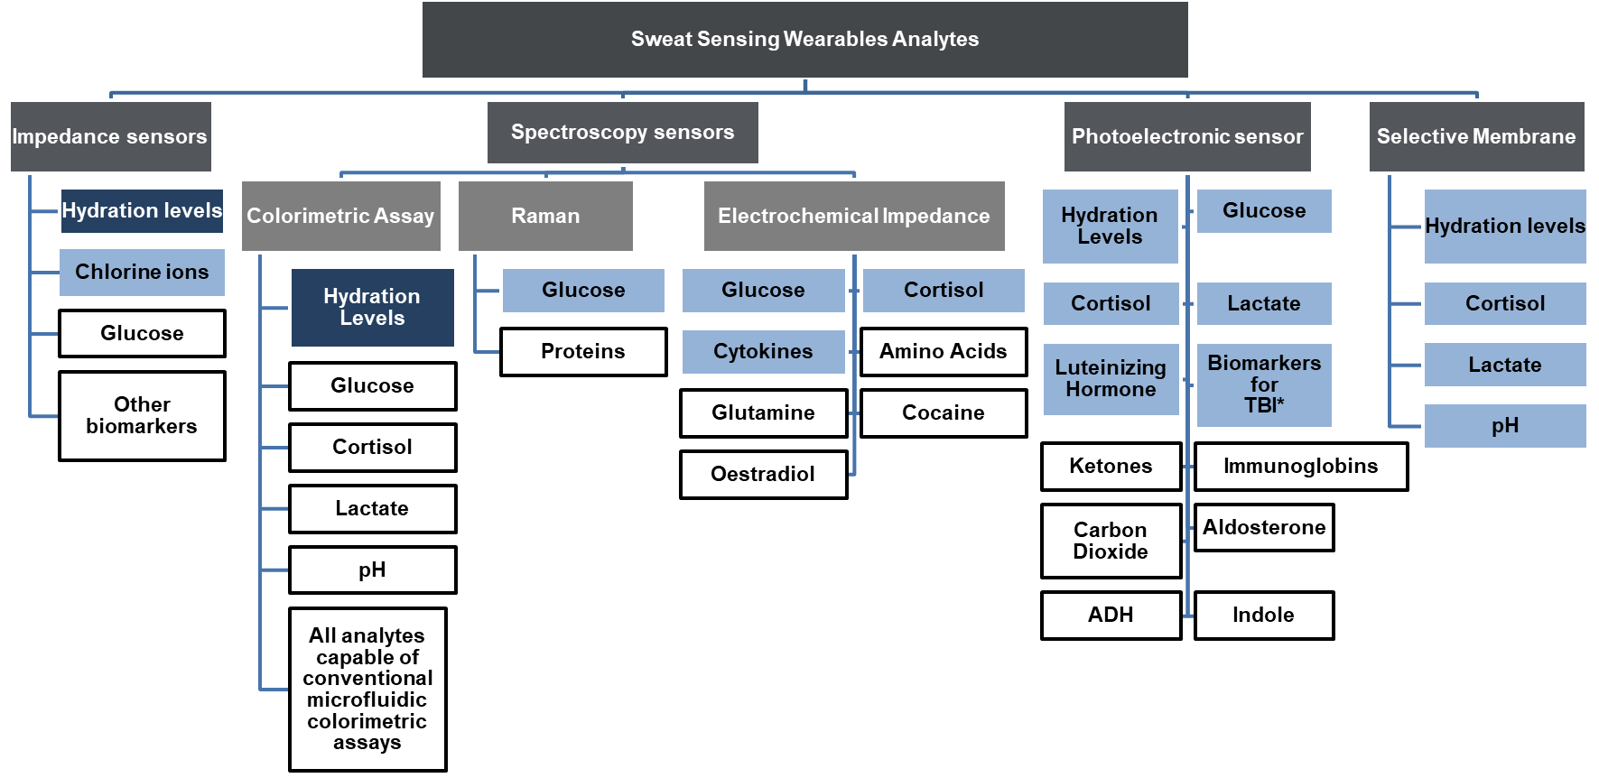

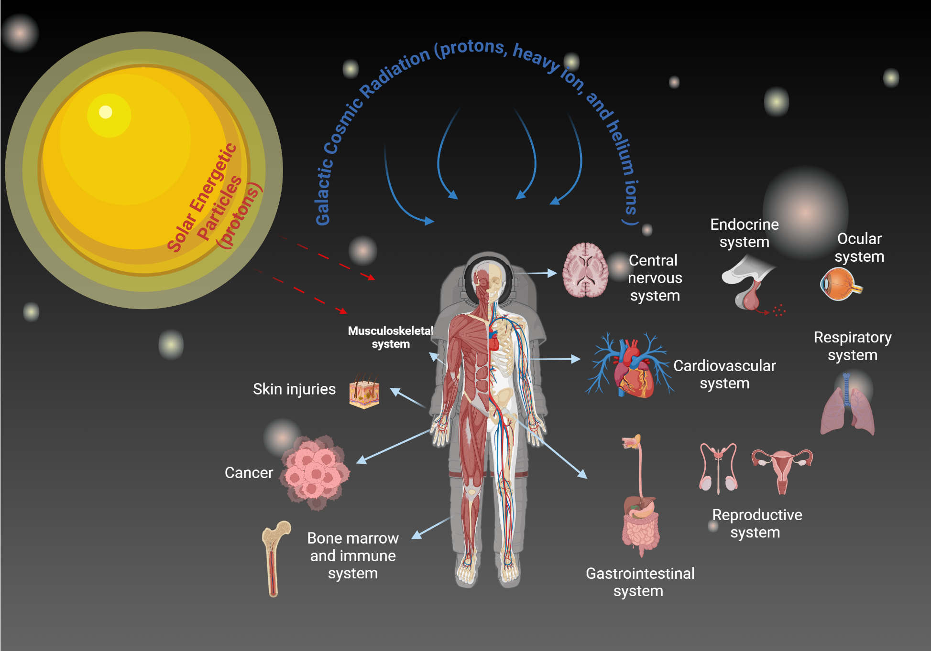

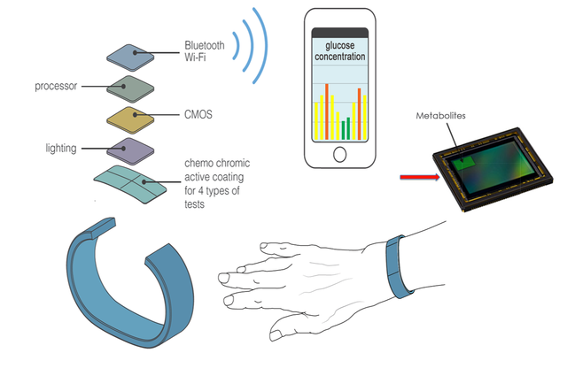
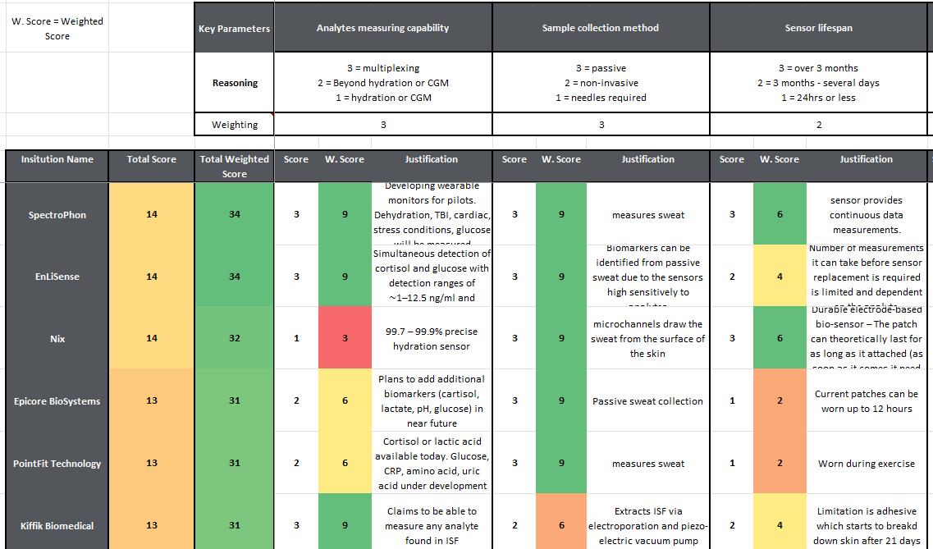
Minimally invasive wearables for assessing astronauts’ physiological response to space stressor
Diana Cruz-Topete, Ph.D.¹, Corey Theriot, Ph.D², Rory Curtis, Ph.D³, Kim Ayers³, Megan Waldock³,
Janapriya Saha, Ph.D.⁴, Jason Weeks⁵, Janice Zawaski, Ph.D⁵
¹Aegis Aerospace Inc. Houston, TX, ²KBR Wyle, Houston, Tx, ³yet2 North America, Waltham, MA, ⁴Leidos Inc. Houston, TX, ⁵NASA Johnson Space Center, Houston, TX
Contact: diana.cruztopete@nasa.gov or jsc-hrp-space-radiation-element@mail.nasa.gov
Background
Background
The Space Radiation Element (SRE), as part of NASA’s Human Research Program (HRP), is dedicated to understanding and mitigating the health risks associated with exposure to space radiation. Missions to the Moon and Mars will subject astronauts to chronic physiological stressors, including ionizing radiation (IR). Exposure to IR can lead to disrupted hemodynamics, metabolism, endocrine and immune responses, and inflammation, thereby increasing the risk of conditions such as cancer, central nervous impairments, and degenerative tissue damage. Therefore, it is critical to measure biomarkers responsive to space stressors to monitor the individual responses of crew members and their susceptibility to develop health complications. In collaboration with the Defense Threat Reduction Agency (DTRA), NASA HRP is exploring the use of dynamic, minimally invasive wearables that measure biochemical markers in dermal fluids such as sweat and interstitial fluid. These devices aim to provide near-continuous physiological data to monitor changes in astronaut health in real time. In a detailed analysis of 350 potential devices, three leading wearables were identified based on their ability to measure relevant analytes, sample collection methods, sensor lifespan, design, and placement on the body. Evaluation of these prototypes indicates that sweat sensors equipped with spectrometry and electrochemical impedance biosensors show great promise. These sensors can measure hormones, tissue damage and inflammatory markers, providing a comprehensive tool for accurately assessing health risks associated with human space exploration and minimizing damage from IR. Future research should focus on advancing the technology of these biosensors to enhance their accuracy and range of measurable indicators. Additionally, long-term studies are needed to understand the effects of continuous wear in the challenging environments of space, ensuring that these devices are both practical and durable under extended exposure to IR.
FIGURE 4
(A) (B)
Figure 4: (A) Sweat or interstitial fluid (ISF) wearables are currently capable of measuring hydration and glucose levels (light gray), respectively. Many commercial and pre-commercial wearables claim multiplexing (purple) and/or greater analytes measuring capabilities shown at the initial research level (light blue). (B) Current commercially available sensors only can measure hydration (dark blue). There are several scientifically validated sensor with the ability to measure glucose, chlorine ions, cortisol, lactate, pH, and cytokines (light blue). These sensors are currently going through or have passed regulatory approval. Sensors with beyond hydration and/or glucose sensing capabilities are currently at the research stage (white) and some have been validated at the research level (light blue).
Space radiation effects on the human body
FIGURE 1
FIGURE 5
  Figure 1: Ionizing radiation (IR) effects on different organ systems during space flight. Exposure to solar particle events and galactic cosmic radiation can lead to changes at the cellular level (e.g., DNA damage) that contribute to late degenerative processes in several organ systems and carcinogenesis. To ensure safe space travel, it is essential to predict the health risks. Gaining the capability to evaluate the physiological status of in-mission crew via noninvasive dermal bioindicator wearables that measure biomarkers of tissue damage/degeneration could help to predict the long-term effects of space radiation and reduce the health risk by allowing early intervention.
(A)
Spectroscopy-based biosensors claim a wide range of potential analytes
Sweat components
Light Emitting Diode (LED)
Chemochromic material
Photodiode
Type of sensor
Wrist-worn sensor that uses a chemochromic filter that undergoes a change in optical characteristics from contact with different metabolites.
Dermal Fluid
Sweat
Targeted Biomarkers
Photon
Digital Signal Filtration and Stabilization
Color change
Raw Electronic signal
Glucose
Water
Ketones
Salt
Lactate
Carbon dioxide
Cortisol
Troponin (cardiac biomarker)
Immunoglobulins
Biomarkers for TBI (trauma brain injury)
LH
Aldosterone
ADH (dehydration body biomarkers)
Indole
Calcium ions
Potassium ions
Glycated hemoglobin
Digital signal
Illustration created with BioRender.com for this poster.
Signal Decoding
Digital signal
Algorithm (digital signal translational chemical units)
Project background and Search criteria
Display
FIGURE 2
(A) (B)
Search Criteria
(B)
Images from http://www.spectrophon.com/technology.html
Technical Survey of Wearables for Dermal Bioindicators
Non-invasive
Non-invasive measurements of biochemical markers in biofluids, specifically sweat and dermal interstitial fluid.
Range of TRL for innovative Electrochemical Impedance sweat sensors
What We Did
What Stood Out
What We Learned & Why It Matters
Works in spaceflight environments
Particularly microgravity or transient high G periods for any microfluidics.
Key Insights
Example Technologies
Compact
Have minimal mass, power, and volume requirements.
Electrochemical Impedance sensors are targeting a unique range of biomarkers in sweat:
Simultaneous detection of cortisol and glucose
Cytokines (interleukin-6, interleukin-8, interleukin-10)
Simultaneous detection of IL-1β and CRP
Nine essential amino acids
Multiple vitamins (including Vitamin C, B6, D and E)
Wrist-worn non-invasive electrode strip coated with antibodies that bind to and measure target analyte with electrochemical impedance spectroscopy (EIS).
Unobtrusive
Wearables must not obstruct or distract the user.
Molecularly Imprinted Polymers (MIP) that can be oxidized or reduced under an applied electrical voltage when it meets human sweat.
High TRL
Prioritize COTS (commercial off the shelf) solutions. Research level solutions without operational validation are of less interest.
Actionable Measurements
Be able to accurately measure suitable biomarkers that can provide insight into in-mission crew and war-fighter performance
  Figure 2: From September 2023 to January 2024, yet2 (a technology scouting and open innovation consulting firm) worked with NASA HRP and the Defense Threat Reduction Agency (DTRA) to identify wearables for dermal bioindicators. (A) The goal of this project was to identify wearables to monitor dermal Bioindicators from sweat and interstitial fluid (ISF). We performed an assessment of the available devices and identified the most promising solution providers. (B) The selection of potential devices was based on the following criteria: non-invasive, adaptability to space environments, size, cost, and biomarkers detected.
https://enlisense.com/2021/04/16/sweat-sensor-warns-of-impending-covid-19-cytokine-storm/
https://enlisense.com/2021/06/02/to-measure-ibd-activity-sweat-the-small-stuff/
https://www.bbe.caltech.edu/news/new-wearable-sensor-detects-even-more-compounds-in-human-sweat
Methodology
Figure 5: Wrist-worn and wearable skin sweat sensors to measure biomarkers in sweat. (A) SpectroPhon has developed a non-invasive wrist worn sensor capable of measuring metabolites that can be used determine key biometrics such as blood glucose levels, dehydration levels, or calories burned. The technology uses a chemochromic filter in front of a photoelectronic sensor. The chemochromic filter’s optical characteristics temporarily change when in contact with different metabolites emitted from the human body, which effects the amount of light passing through to the photoelectronic sensor. (B) EnLiSense have developed a wrist-worn non-invasive electrochemical sensor platform that uses electrochemical impedance spectroscopy (EIS). A team of researchers from Caltech's Department of Medical Engineering has demonstrated the first use of Molecularly Imprinted Polymers (MIP) in a wearable sensor, able to detect biomarkers and measure nutrients in human sweat. The MIP are described as reusable, artificial antibodies. The technology involves a specially formed polymer with a material that can be oxidized or reduced. Sweat contacts the sensor’s inner layer and generates an electrical signal as long as the glutamine-shaped holes in the polymer are open. Glutamine molecules fill the holes and prevent sweat from reaching the inner layer. Researchers can monitor the electrical signal to evaluate how much glutamine is present in the sweat. A weaker signal means there is more glutamine.
FIGURE 3
(A) (B)
23 leads from 7 different countries
92 leads reviewed in detail by yet2
~350 relevant candidates
3 Highly Interesting Leads Prioritized
& 13 Leads on the Watchlist
Future opportunities
  Sweat sensors with the ability to measure cortisol, lactate, pH, and cytokines are currently going through or preparing for regulatory approval.
  Spectroscopy and electrochemical impedance biosensors currently offer the most promising sweat sensing mechanisms.
  While the market is currently limited to hydration and glucose sensors, multiplexing sensors and biomarkers beyond hydration and/or glucose sensing are in the development pipeline of many companies in the wearables space.
  Further advancement for these research stage sensors appears to be limited by market demand rather than technical barriers. Without a specific market or target disease state, it is unclear how other biomarkers would gain the necessary traction to widely offer low-cost sensors.
  Figure 3: (A) Platform technology prioritization table. The devices were prioritized based on six key dimensions, including analysis measuring capability, the method used for sample collection, and sensor lifespan. (B) Approximately 350 relevant technologies related to dermal bioindicator wearables that measure sweat, or interstitial fluid were identified. A Prioritization chart, based on ranking criteria confirmed in partnership with NASA, narrowed the search from 92 to 3 leads. Thirteen devices were added to the watchlist of potential future candidates.

