Slide 1



National Aeronautics and
Space Administration
STMD Game Changing Development FY24 Annual Review – Surface Habitation Systems
Previous ECLSS-CHP SCLT Alignment to STMD LIVE – Surface Habitation
Jim Broyan – Environmental Control and Life Support Systems – Crew Health and Performance (ECLSS-CHP) System Capability Leadership Team (SCLT) – Lead
11 September 2024
www.nasa.gov

Slide 2
Overview
ECLSS-CHP related Shortfalls
Collaboration between mission directorates
Review Traditional ECLSS-CHP Scope
Question and Answers
Notional transition from current SCLT structure to STMD Domain structure
2

Slide 3

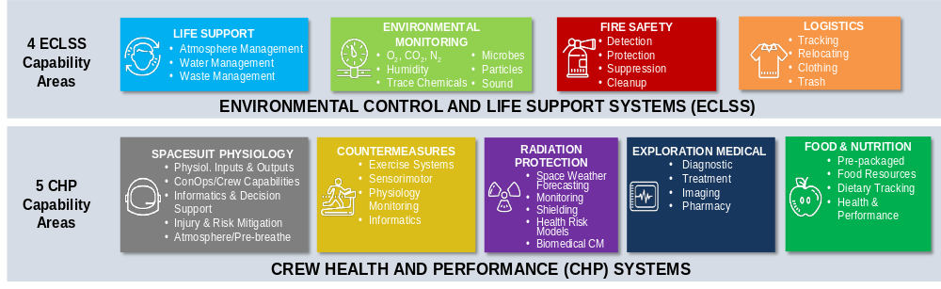


ECLSS-CHP SCLT – Scope of Capability Areas
Previous STMD
Live Thrust
  In the previous STMD Strategic Framework under the Live Thrust, ECLSS-CHP was called the Advanced Habitation Systems supporting the Live Thrust
6
New: EARTH INDEPENDENT HUMAN OPERATIONS TECHNOLOGIES
    Decision Support & Situation Awareness Tools
    Human-Hardware Maintenance Interfaces and Tools
    Procedure Execution Support Tools
    Asynchronous Distributed Operations Management Systems
    Integrated Earth-Independent Human Systems Simulation Technologies

Slide 4










Previous (2021-2023) STMD ECLSS-CHP Envisioned Future (goals) by Capability Area – SCLT identified ‘needs’
(Mission need)
L = Lunar surface
T = Transit to Mars
M = Mars surface
2024 GCD project alignment
Pre-2024 GCG project alignment
LIVE
LIFE SUPPORT
ENVIRONMENTAL
MONITORING
FIRE SAFETY
  LOGISTICS
Reliable long-duration life support with Earth independent diagnostics and repair (L,T,M)
  >20% reduction in spares and installed mass (T)
  Enable single missions >800 days w/o resupply (T)
  Repeated missions with >9 months dormancy (L,T,M)
  >75% oxygen recovery at 2 mm-Hg CO₂ (T)
  High pressure oxygen recharge for EVA (L,M)
  >98% water recovery (L,T,M)
  Remove respirable lunar and Mars dust (L,M)
  Planetary protection compatible ECLSS venting (M)
Identify and quantify chemical (>12 water, >33 air) and microbial species in-mission with out sample return (L,T,M)
Ability to detect unknown constituents (T,M)
Distinguish between fire, habitat dust, and surface dust particles (L,M)
Support forward and backward planetary protection detection (both microbial and non-DNA techniques) (M)
Test-verified partial gravity flammability characteristics and countermeasures (L,M)
ECLSS compatible fire suppression (L,T,M)
Reduce post fire clean-up time (L,T,M)
Common fire safety strategy across element architectures (L,T,M)
Jettison >90% of trash mass during Mars transit (T)
Mars trash disposal compatible with planetary protection (M)
In-flight autonomous logistics (L,T,M)
Reducing clothing and wipes mass by >50% (L,T,M)
Clothing flammability (and other non-metallics) >36% O2 (L,M)
SynBio- CO₂ Mfg
SCOR
  SPACESUIT PHYSIOLOGY
COUNTER-MEASURES
RADIATION PROTECTION
EXPLORATION MEDICAL
FOOD & NUTRITION
EARTH INDEPENDENT HUMAN OPERATION
SynBio-Nutrients
SynBio-Nutrients
100% of tasks within human performance (L,T,M)
Predict and mitigate decompression sickness for surface EVA (L,M)
Predict and mitigate suited injury (L,M)
6 Major physiological informatics parameters provided in-suit to enable real time self-assessment or loss of communication areas (L,M)
Reduce mass and volume (L,T,M)
Maintain/monitor fitness in-flight to enable unassisted landing egress & EVA (L,T,M)
Validated lunar and Mars fitness standards (L,M)
24-hr prediction of solar storm duration and intensity to >90% (L,T,M)
High energy neutron detectors (L,T,M)
Earth independent monitoring/forecasting (T,M)
GCR shielding (T,M)
In-mission diagnostics and treatment for 100 of 120 medical risk conditions (L,T,M)
Autonomous medical
skill and & decision
support systems (T, M)
Integrated data architecture (L,T,M)
100% of nutrient stability
>5-year shelf life (T,M)
Food acceptability >90% (L,T,M)
<30% launched water content (T,M)
Exploration counter-measure in-mission nutrition intake monitoring (L,T,M)
Crew decision support systems (L, T, M)
Asynchronous communication and control systems (L, T, M)
Autonomous response to time to effect emergency
<40 min (T,M)
Autonomous critical unplanned repair/stabilization <20 days (T,M)
4

Slide 5
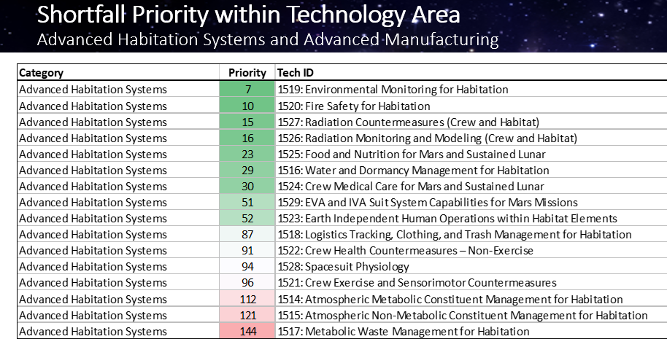
STMD Shortfall Survey Results Summary for Advanced Habitation Systems
2024 GCD project alignment
Pre-2024 GCG project alignment
1st Quartile
SynBio-Nutrients
SynBio-Nutrients
2nd Quartile
SynBio- CO₂ Mfg
3rd Quartile
SCOR
5

Slide 6
ECLSS-CHP SCLT Gaps are Closed Across Programs
Program-specific implementation of tech / CM
Programmatic Infusion
Technology gaps | Habitation & CHP systems
SOMD and ESDMD Flight Programs
Technology / Countermeasure Dev and Maturation
ESDMD
Moon-to-Mars (M2M)
Low TRL | Technology / Countermeasure Feasibility | Industry & Academia
STMD GCD
SOMD Human Research Program (HRP)
STMD Early Stage
Gap Closure and Infusion Activity Coordination
Applied Research
Knowledge gaps | physiological /
psychological research | medical technology
| human standards & reqs | grants | academia
SMD Biological and Physical Systems (BPS)
Knowledge gaps | mechanistic research | organism level |
cells or plants
ESDMD Architecture Definition Document (ADD)
Determines future mission needs and new gaps
Strategic Planning & Integration
TRL 1
Technology / Countermeasure Readiness Level
TRL 9
6

Slide 7






STMD Tech Base Functional Domains
ECLSS-CHP SCLT Alignments
GO
Space Transportation
Advanced Propulsion
Nuclear Propulsion
Flight Vehicle Systems (including Ascent Systems)
Cryogenic Fluid Management
LAND
Space to Surface Operations
Deceleration Systems
Guidance & Nav Systems
Landing Systems & Environments
Entry Modeling & Instrumentation
LIVE
Surface Infrastructure/ Exploration
Surface Power
In Situ Resource Utilization
Surface Structures & Construction
Dust Mitigation & Environments
Surface Mobility & Transportation
Surface Habitation Systems
Surface Sustainability
& Logistics
EXPAND
In-Space Infrastructure/ Discovery
Observation Systems
In-Space Sustainability
Communications, Positioning, Navigation, & Timing
In-Space Servicing, Assembly, & Manufacturing
Small Spacecraft & Distributed Systems
ENABLE
Foundational Capabilities
Avionics & Sensors
Robotics & Autonomy
Advanced Materials, Structures, & Manufacturing
Advanced Power & Thermal
Capability Portfolio
CATALYSTS
Innovative Mechanisms
NIAC/CIF/ECI
STRG
PCC
Tech Transfer
SBIR/STTR
Flight Opportunities
TP/ACO
Inclusive Innovation
2024-06-28

Slide 8
Notional transition from current ECLSS-CHP SCLT structure to STMD Domain structure
ECLSS-CHP technology development traditionally has been primarily funded by ESDM Moon to Mars (Mars Campaign Office) with key low to mid-TRL technology development funded by STMD
STMD LIVE – Surface Habitation will include portions of ECLSS-CHP scope but will also identify and include key ESDMD and SMD content
STMD, ESDMD-MCO, and SOMD-HRP are initiating a process of defining technology development scope and handoffs
  Technology roadmaps and shortfalls that align with M2M ADD functions remain critical tools
  The ECLSS-CHP SCLT has an internal set 27 technology roadmaps that will be used support development of the LIVE and other domain roadmaps
ECLSS-CHP scope addresses both surface and ug transit to Mars habitation technologies
  LIVE/Surface Habitation Systems – is primarily ECLSS-CHP transition for surface scope
  LIVE/Surface Sustainability & Logistics –includes some ECLSS-CHP surface scope (e.g., consumables and waste)
  GO/Flight Vehicle Systems – is primarily ECLSS-CHP transition for ug transit to Mars but STMD/ESDMD role definition is forward work
8

