Slide 1
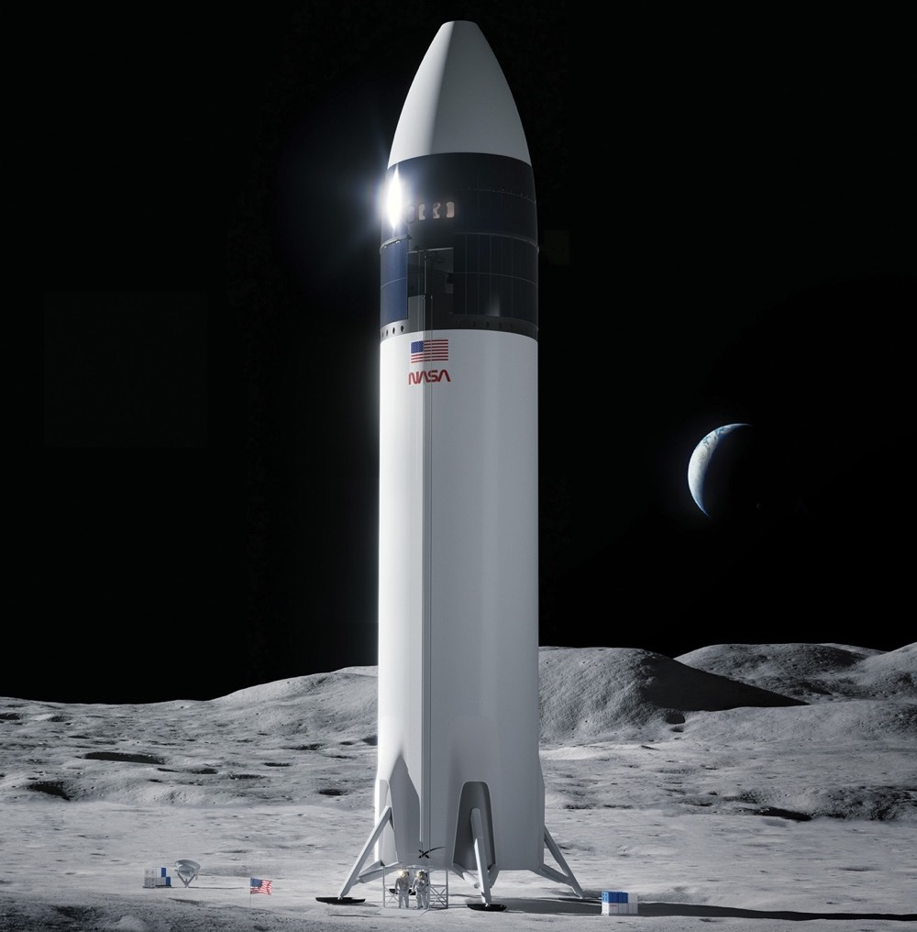


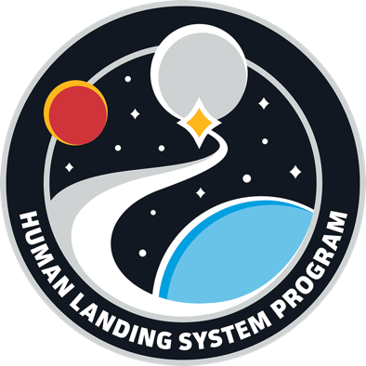
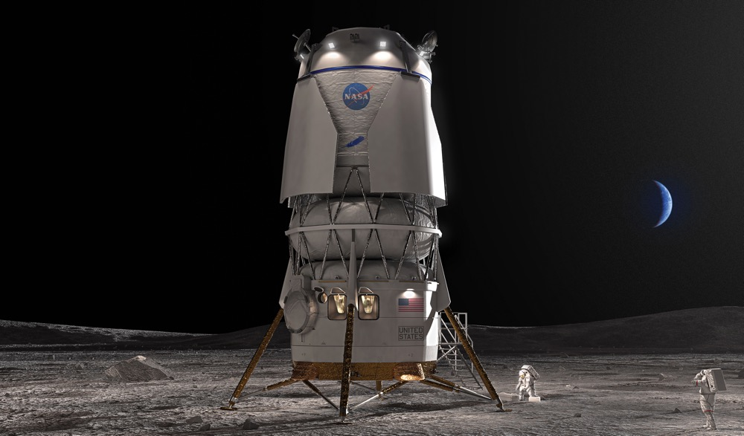
Artemis III & IV
SpaceX Starship HLS
Artemis V
Blue Origin Blue Moon MK2 Lander

Slide 2
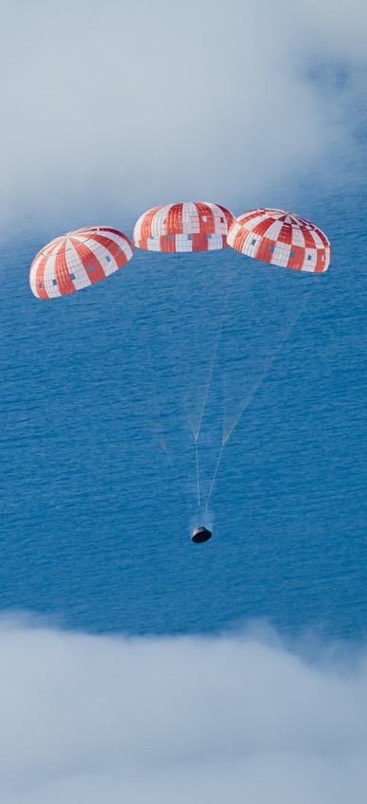
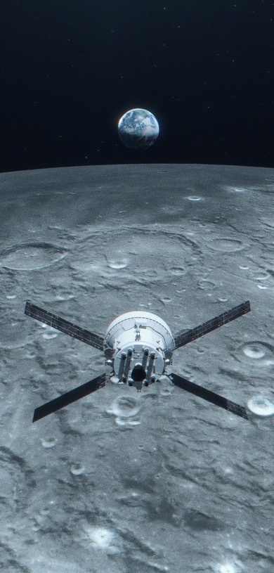
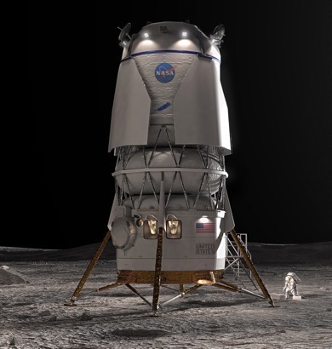
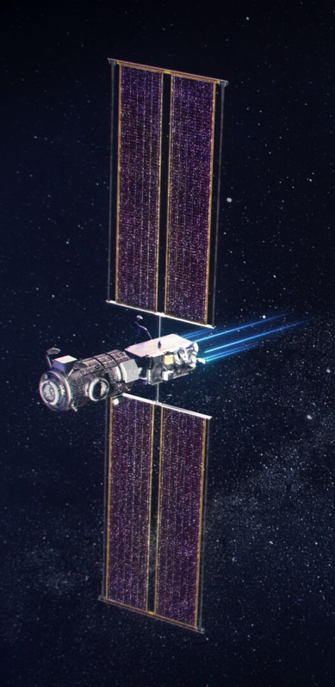
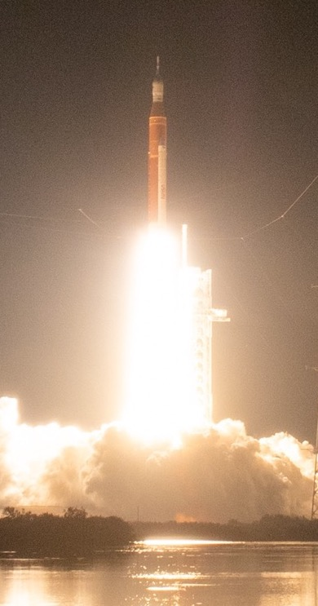
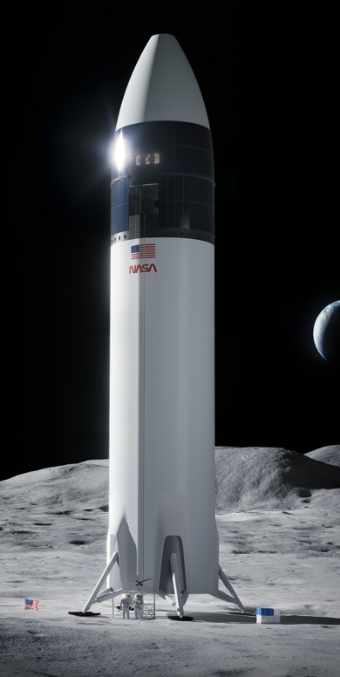
Artemis I
Uncrewed flight test
COMPLETE
Artemis II
Crewed flight test
Artemis III
Crewed surface expedition
Artemis IV
Gateway assembly, crewed sustaining lander expedition
Artemis V
Crewed mobile
surface exploration, Gateway expansion
Illustration
Illustration
Illustration
Illustration
SLS, Orion, EGS
SLS, Orion, EGS
SLS, Orion, EGS, HLS
SLS, Orion, EGS,
HLS, Gateway (PPE/HALO, I-HAB)
SLS, Orion, EGS,
HLS, LTV, Gateway (ESPRIT, Canadarm3)

Slide 3
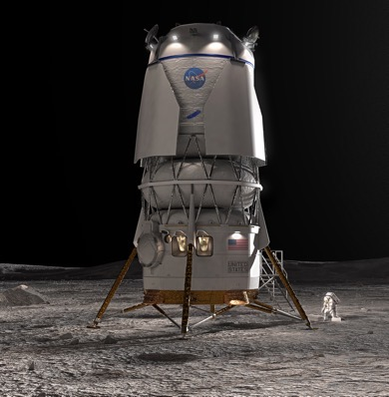
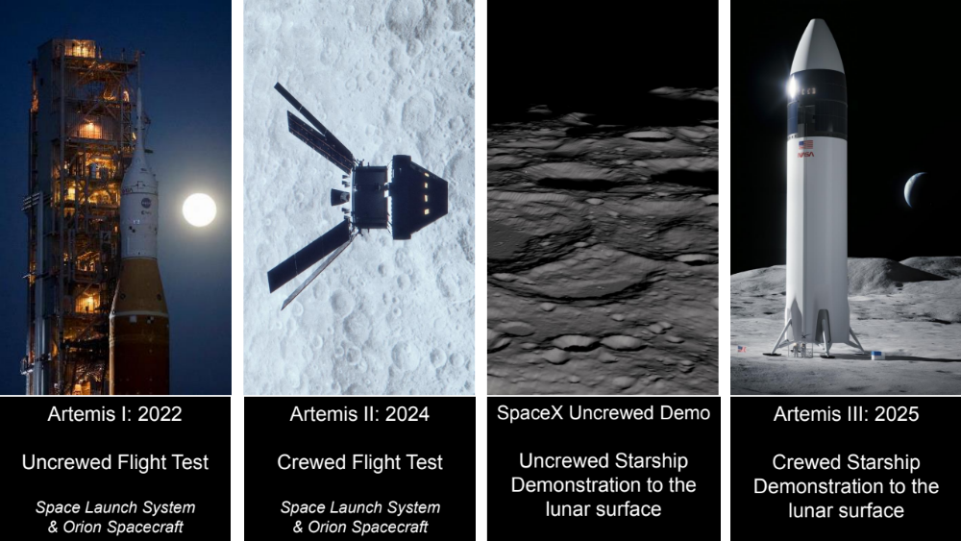
HLS Uncrewed Demo
SpaceX Starship
Artemis III
SpaceX Starship
Artemis IV
SpaceX Starship
HLS Uncrewed Demo
Blue Origin
Blue Moon
Artemis V
Blue Origin
Blue Moon
Illustration
Illustration
Illustration
Illustration
Illustration

Slide 4
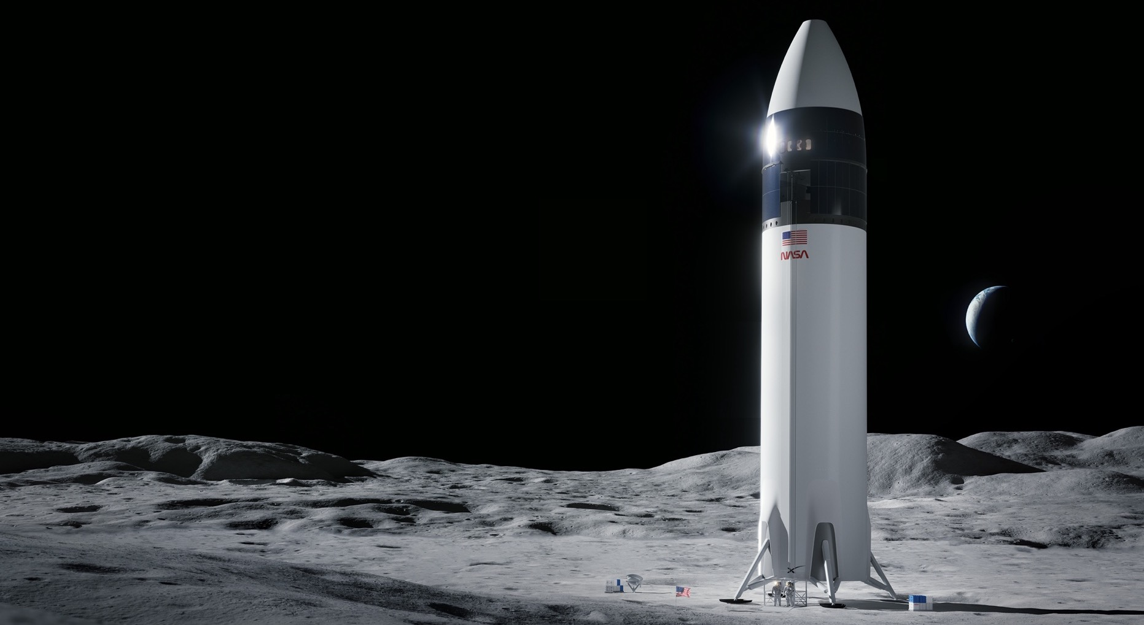
Human Landing System (HLS)
NASA is working with SpaceX to develop its Starship Human Landing System for use on:
Artemis III - the mission that will put the next two Americans on the surface of the Moon
Artemis IV - which meets an extended set of requirements such as docking with Gateway for crew transfer, more mass to the surface, and longer mission durations
SpaceX will perform an uncrewed demonstration mission prior to the crewed Artemis III mission.
Image Credit: SpaceX

Slide 5
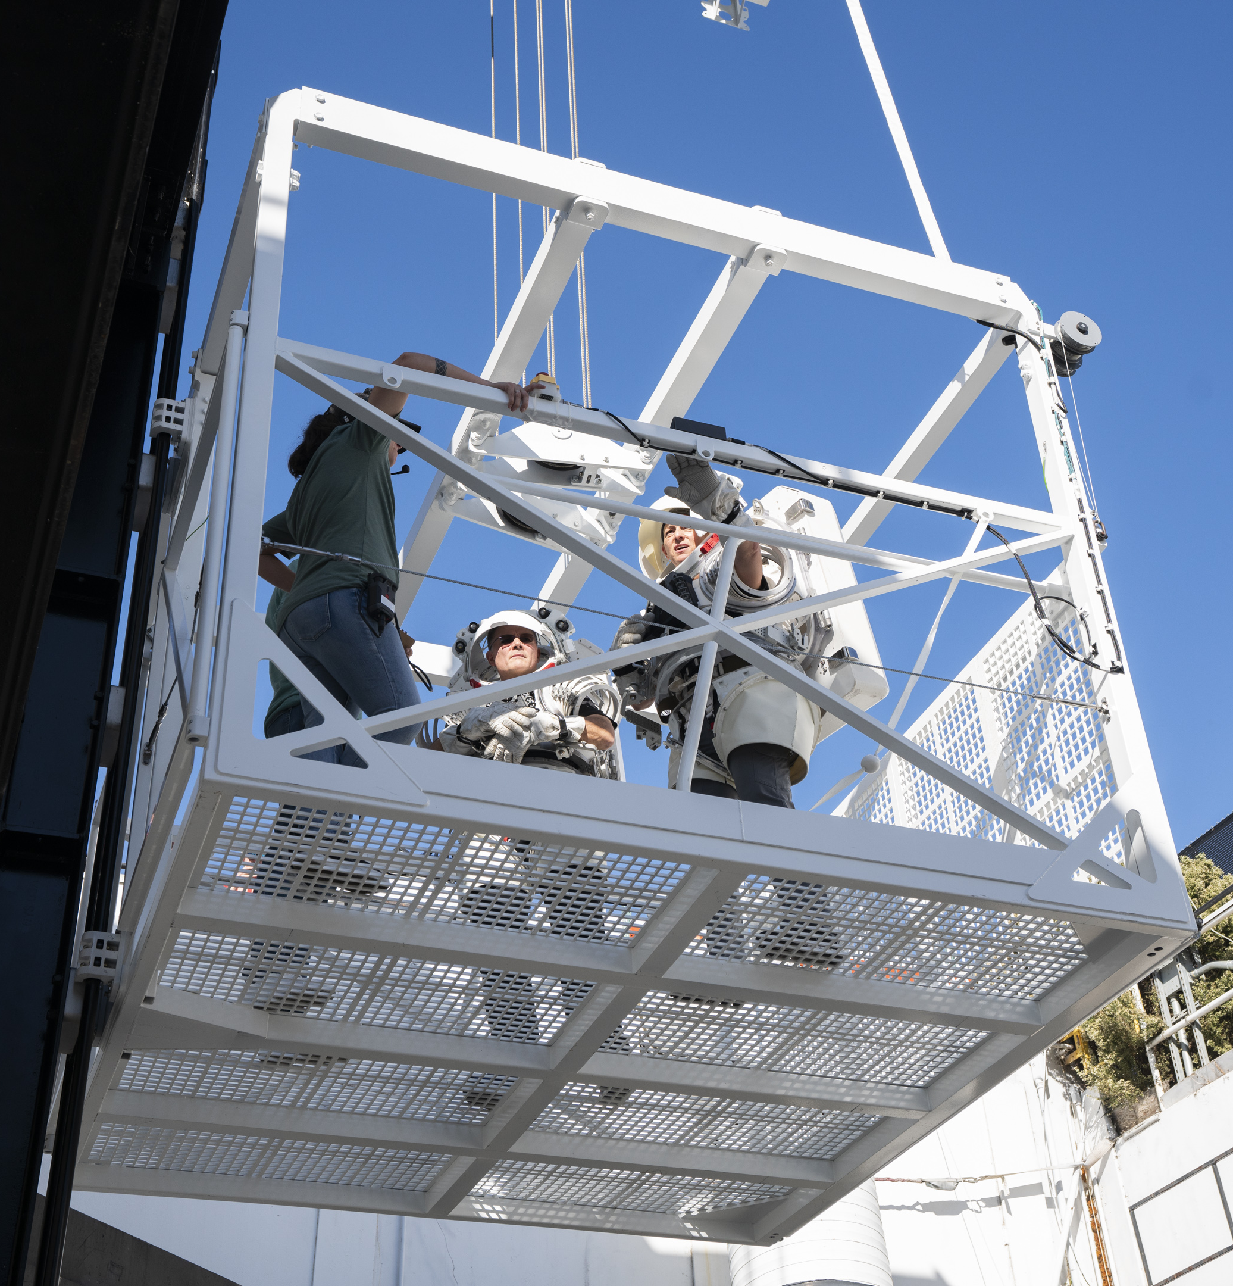
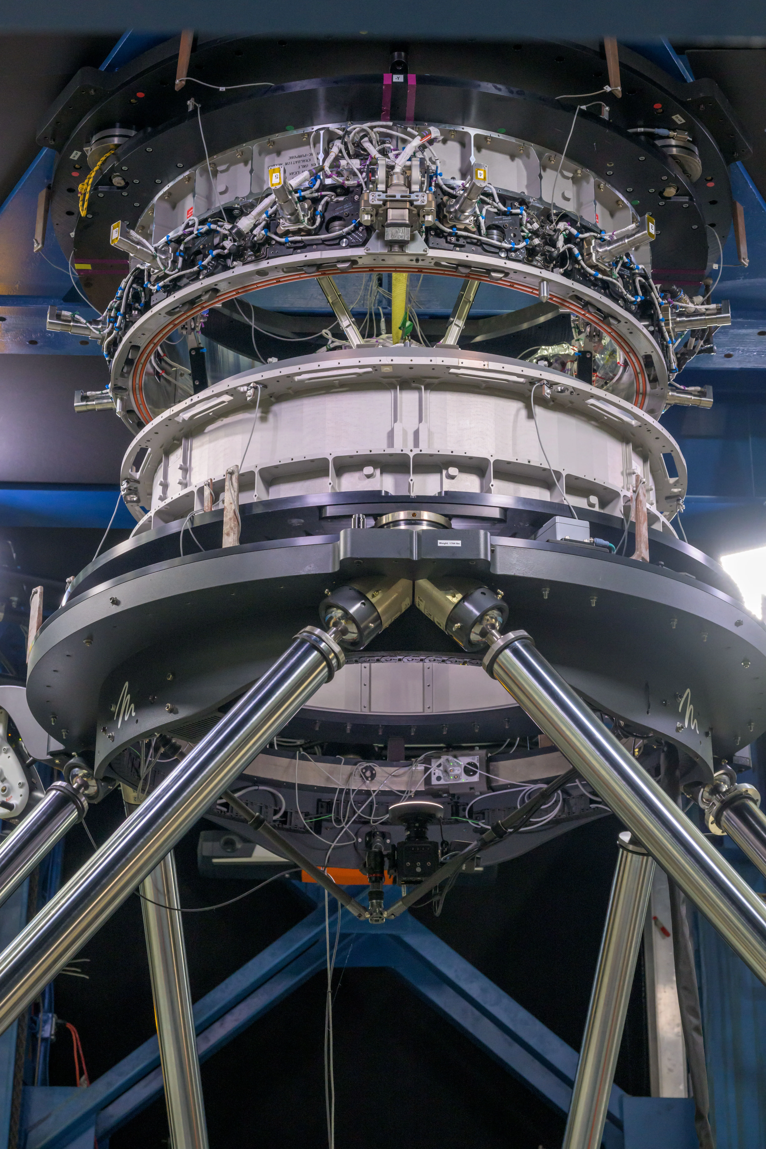
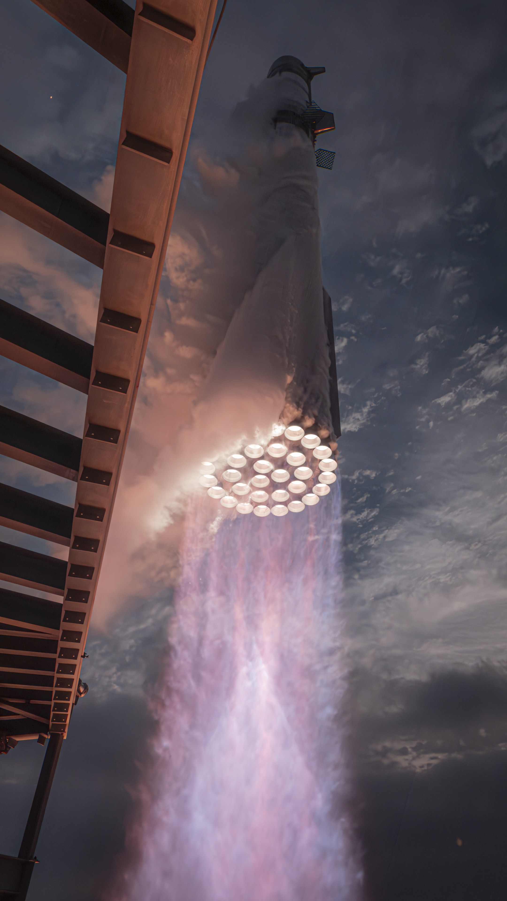
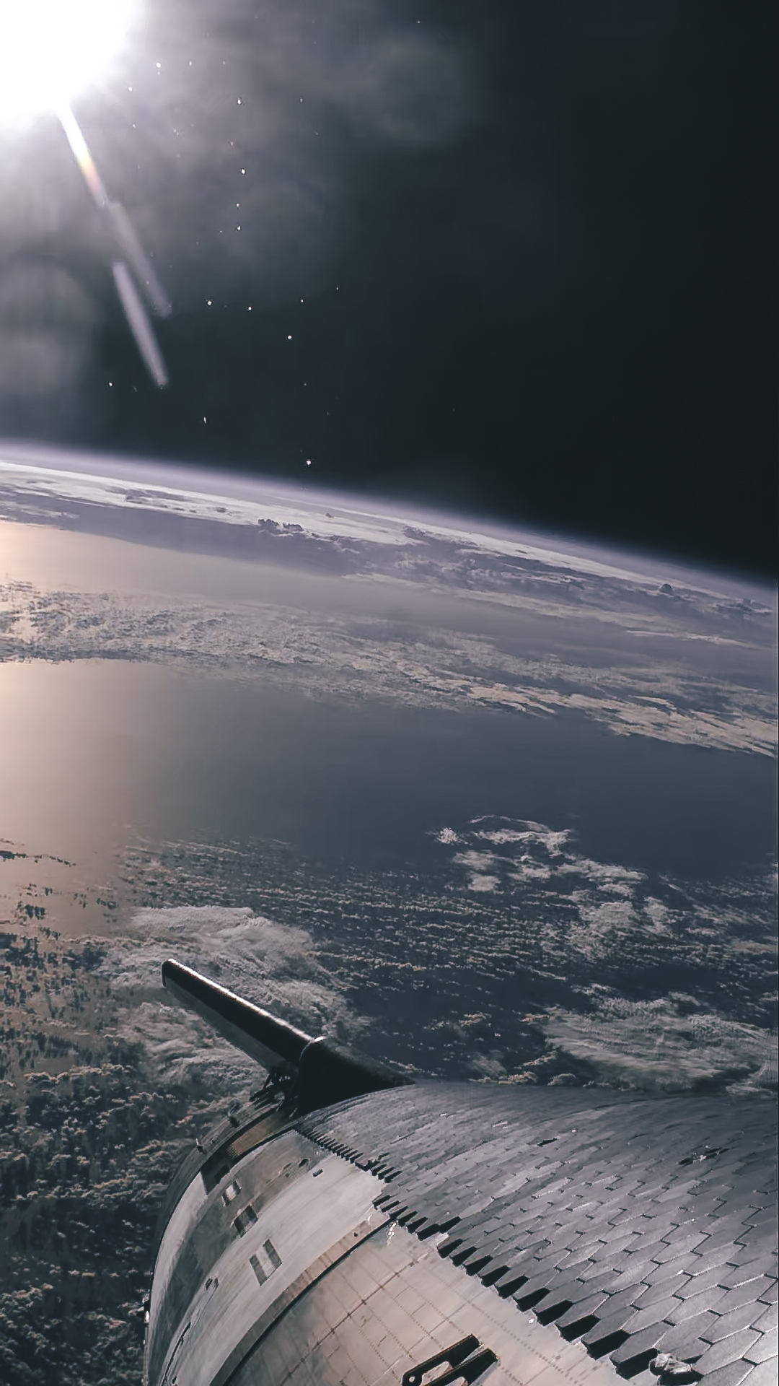
Starship Human Landing System (HLS)
Artemis III & IV Progress
Suited Crew-in-the-Loop Elevator Testing
Docking System
Qualification Testing
Third Integrated Flight Test

Slide 6
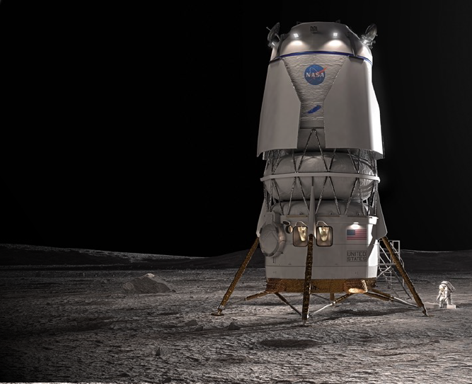

Human Landing System (HLS)
NASA is working with Blue Origin to develop a human landing system
for use on:
Artemis V – meets NASA’s extended set of requirements such as docking with Gateway for crew transfer, more mass to the surface,
and longer mission durations
Blue Origin will perform an uncrewed demonstration mission prior to
the crewed Artemis V mission.
The team’s approach consists of: Blue Origin’s Blue Moon lander
and Lockheed Martin’s Cislunar Transporter along with partners:
Astrobotic
Honeybee Robotics
Draper
Boeing
Image Credit: Blue Origin

Slide 7
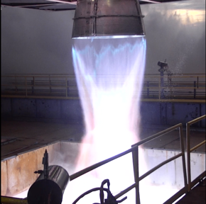
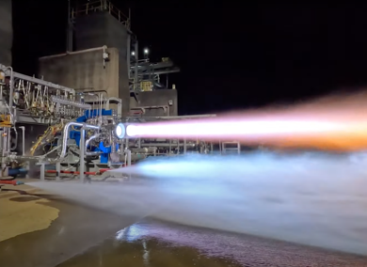
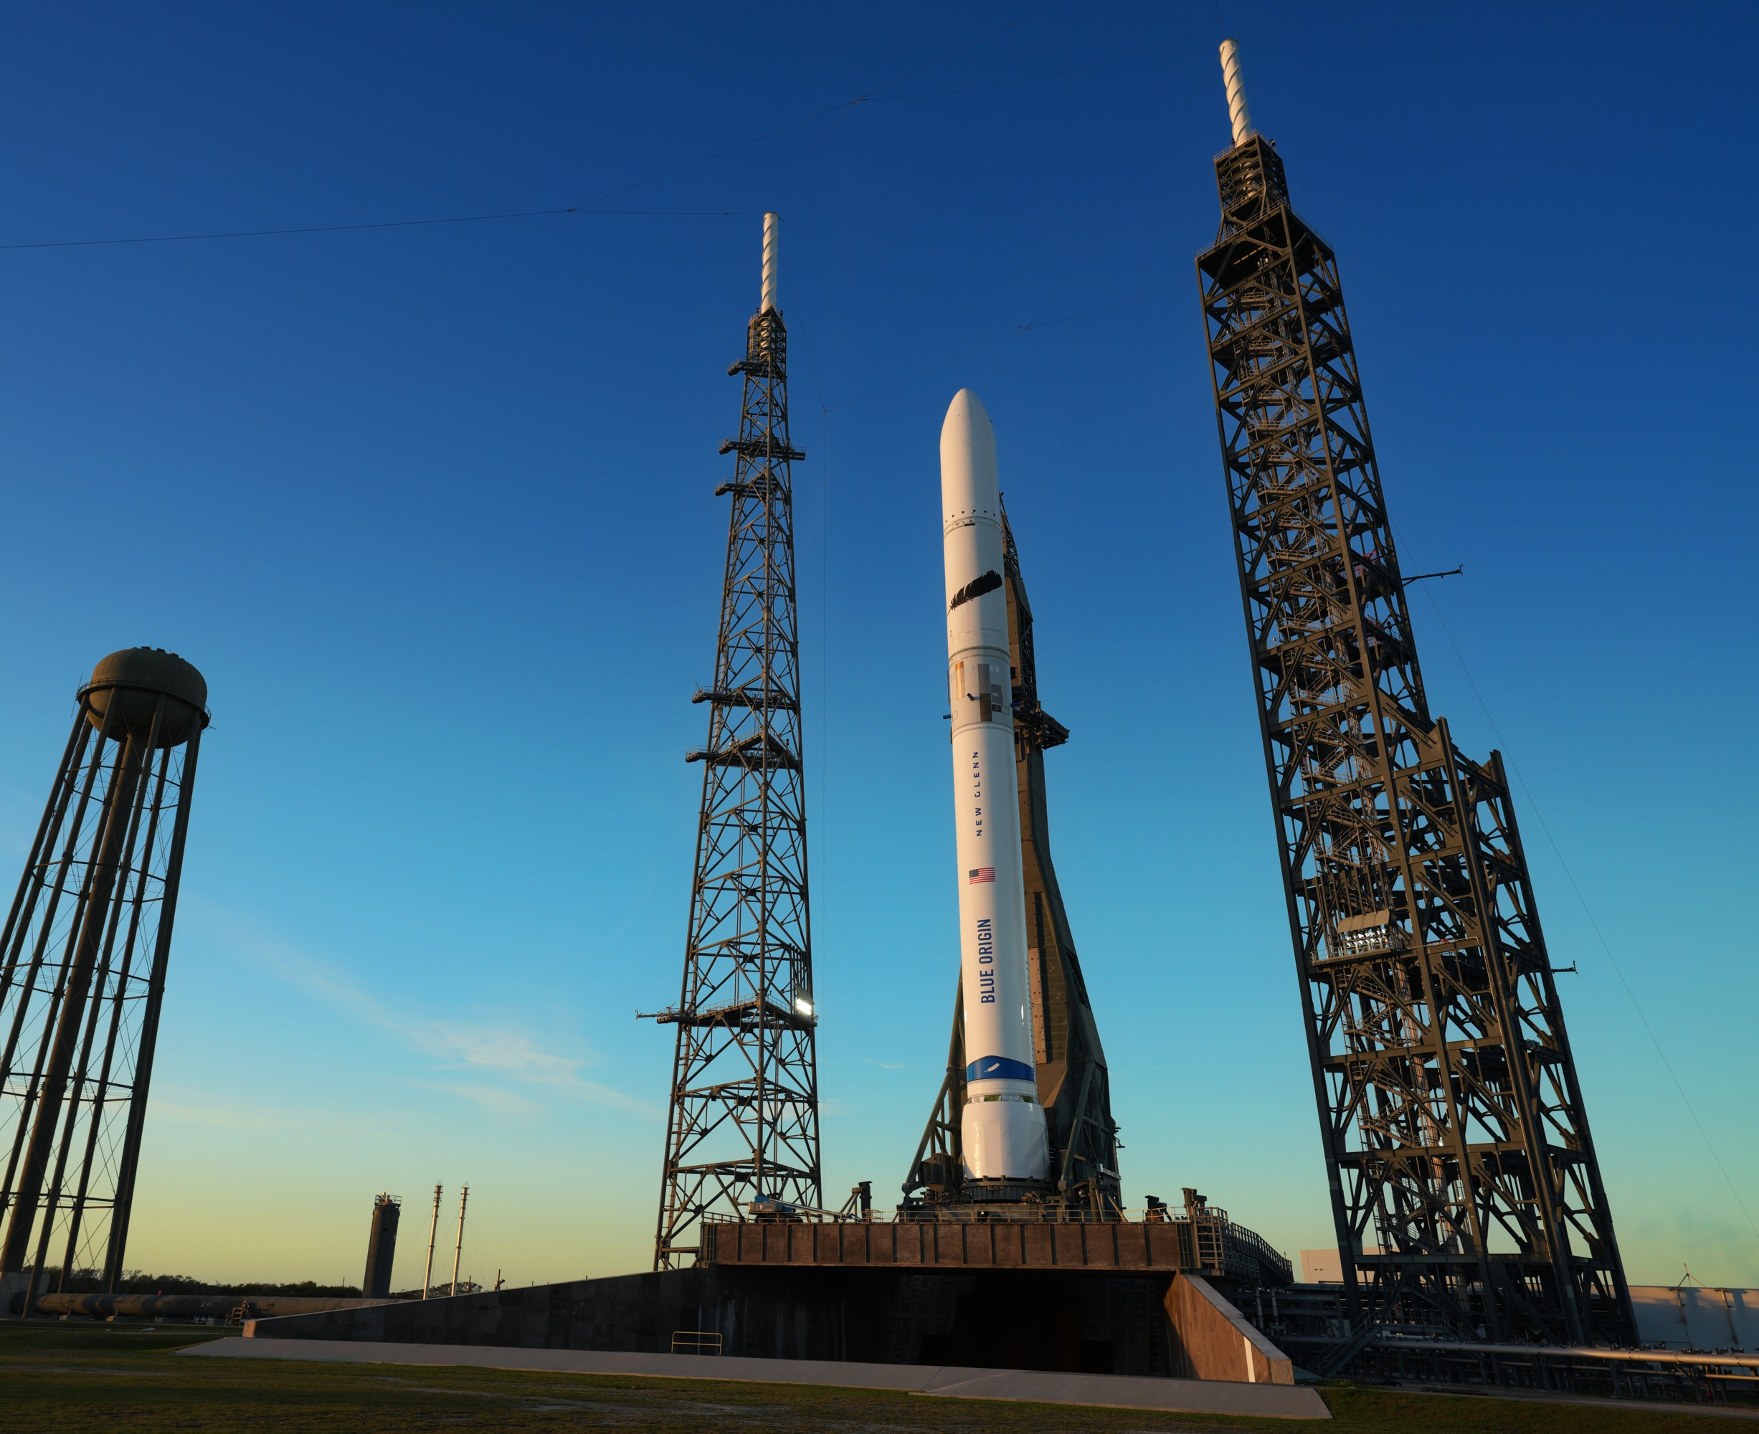
Blue Origin Human Landing System (HLS)
Artemis V Progress
BE-4 Testing
BE-7 Testing
New Glenn Testing at LC-36

Slide 8
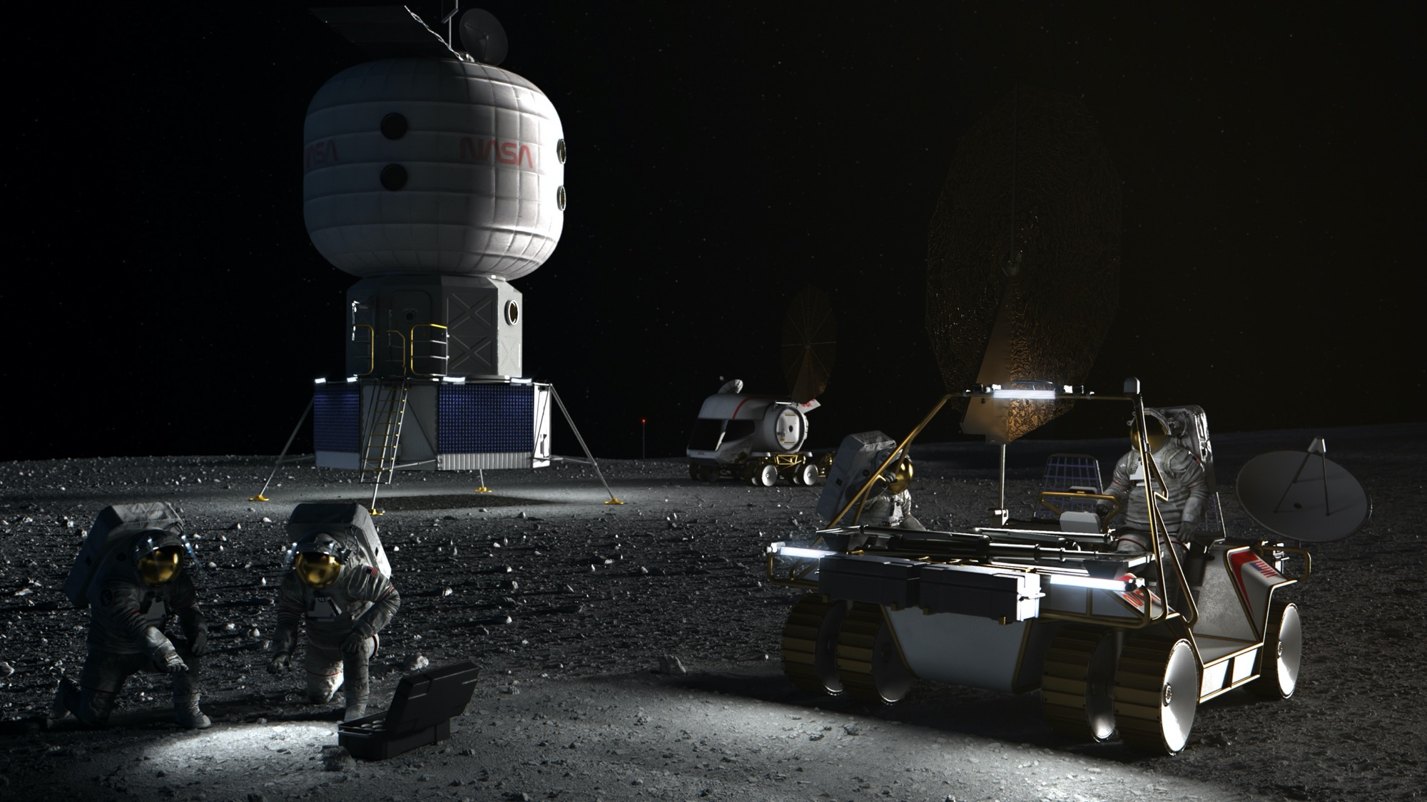

Future Elements
A sustainable environment to live and work on the lunar surface
Artist’s Concept
Notes:
The Artemis era is here, heralding a future of long-term scientific exploration and discovery in deep space. Through Artemis, NASA will explore more of the Moon than ever before with highly trained astronauts and advanced robotics.
The Moon is a rich destination for scientific discovery. Studying and sampling the lunar environment will help NASA unravel some of the greatest mysteries of our solar system for the benefit of all. Ultimately, what we build, test, and discover at the Moon will determine the human capacity to live and work in deep space for longer periods of time, setting NASA on a steady path for our next giant leap – sending the first astronauts to Mars.
A pressurized rover expands exploration range
A surface habitat enables longer duration stays
Supported with small logistics landers including commercial lunar payloads services
A wide range of opportunities for international partnerships
Science investigations, technology demonstrations, and operational analogs for Mars missions

Slide 9
Follow the missions

