Slide 1

FireSense plans for using UAS for fires
Measurements for the project are co-developed with stakeholders.
6th Federal UxS Users Workshop
September 10th, 2024

Slide 2


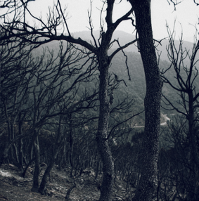
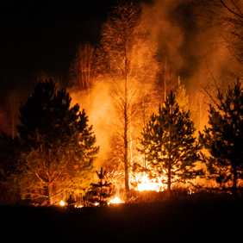
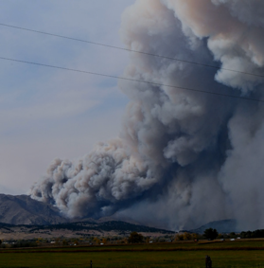
NASA FireSense Project
NASA SMD FireSense is stakeholder driven. Defined by initial stakeholder engagement activities, the FireSense project is focused on technology development and capability transition in four use-cases critical to wildfire management.
Pre-fire: Improved fire prevention by providing fire fuel maps with higher accuracy and resolution.
Provision of near real-time fire risks assessments based on fuel conditions, soil moisture, surface temperature
Improved assessment of pre-fire (fuel, weather, etc.) conditions to enable more prescribed fire.
Post-Fire: Improved maps of burn severity for post-fire ecosystem rehabilitation efforts.
Improved predictions of post fire hazards and impacts including debris flow and landslide risks and water quality impacts.
Active Fire: Detection and tracking via satellite and airborne imagery with higher spatial resolution and update frequency - towards 24/7 fire prioritization and monitoring
Development of new, innovative sensors and models for precisely tracking fires, fuels conditions, and smoke.
Air Quality: Enhanced tracking and characterization of smoke plumes and smoke transport.
Improved forecasts of air quality impacts to human health and safety.

Slide 3





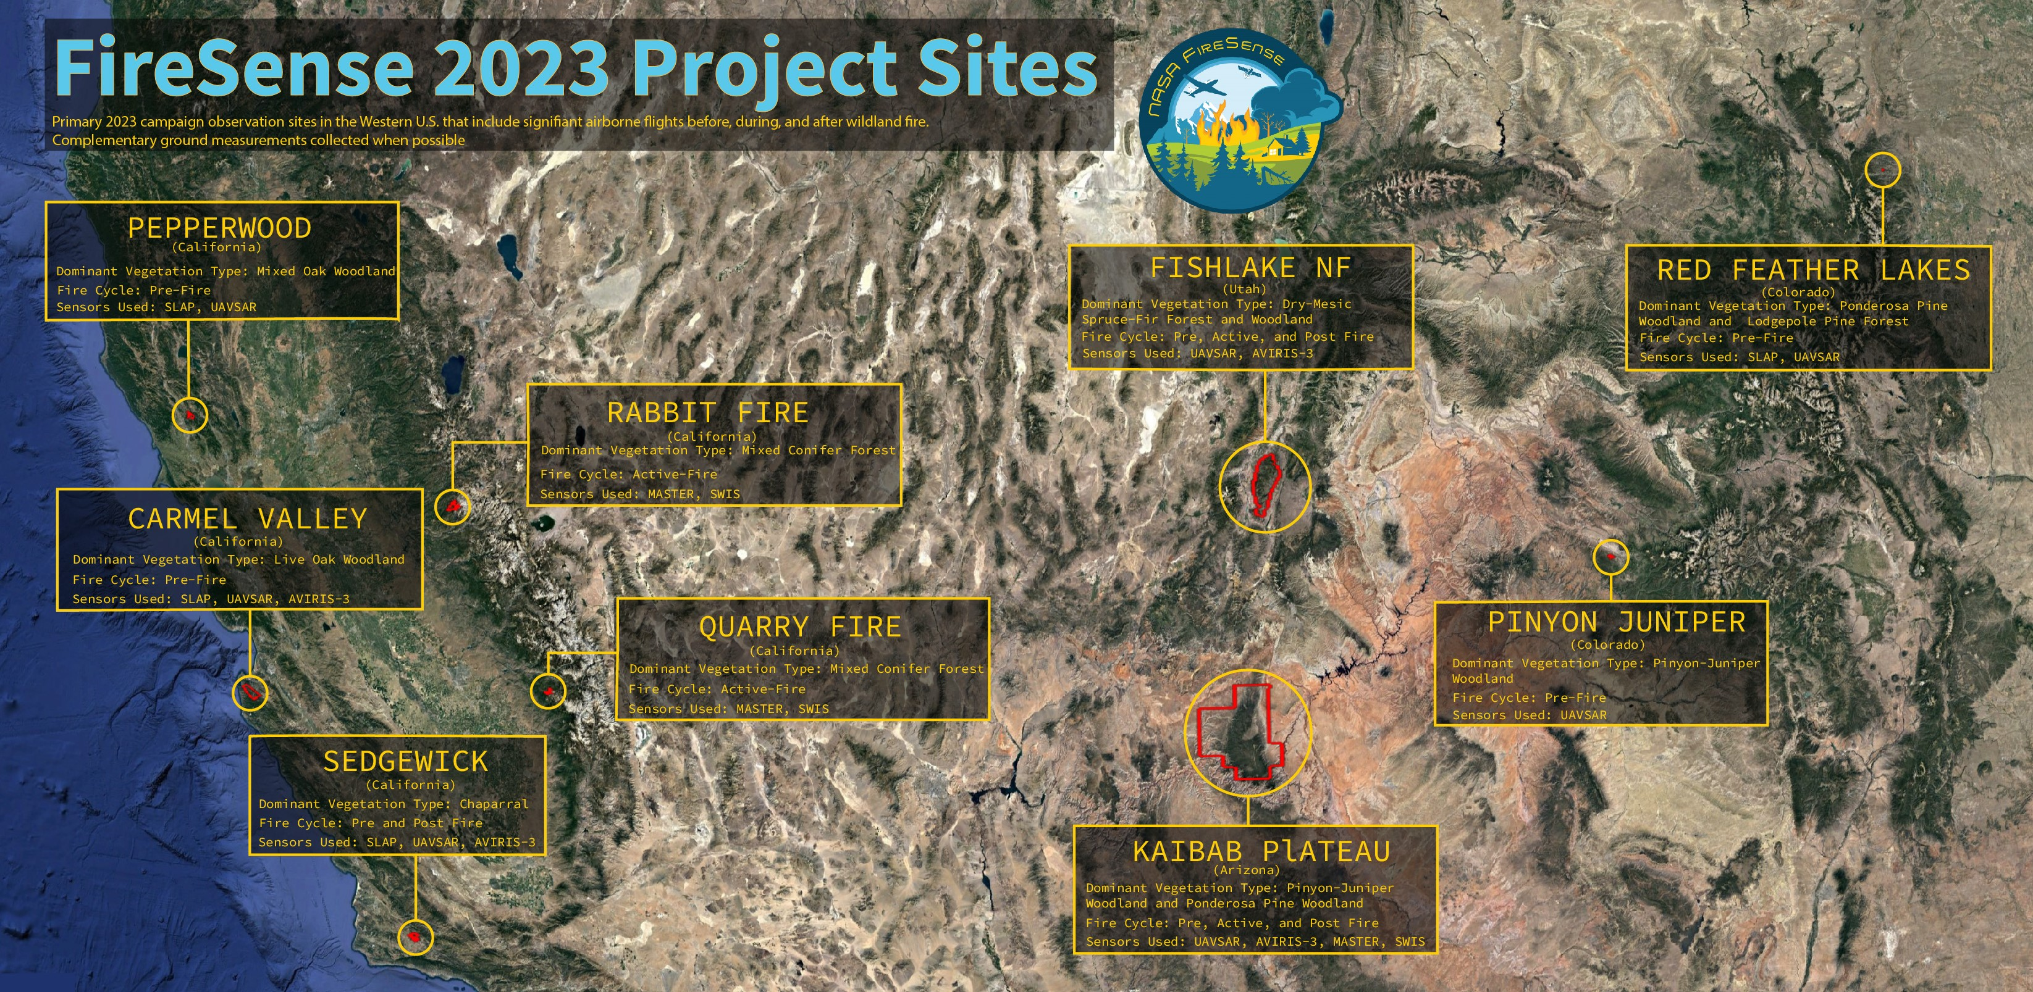
2023 airborne Campaign
~8 weeks, 9 locations, 4 states, 5 aircraft
45 participants, 21 institutions
Airborne Sensors: AVIRIS-3,
UAVSAR, SLAP, MASTER, SWIS
Coordination with USFS
  Flir (day), Phoenix (night)
Before fire: moisture, composition
  radar, imaging spectroscopy
During fire: energy and behavior
  thermal IR, imaging spectroscopy
After fire - consumption
  radar, imaging spectroscopy
Notes:
Identifying where we can do more together through partnerships. AFRC B200, AFRC Gulfstream, DA B200, Piper Twin Comanche, LaRC B200
Coordinated investment supports a more comprehensive and cohesive response that will advance fire through integrated measurement, monitoring and modeling. These activities can be used to support the operational needs of interagency partners and is an excellent example of NASA’s Earth Science to Action strategy.
Different sensors can help understand pre-fire risk (e.g., SAR measurements of fuel and soil moisture), active fire behavior and effects (e.g., fire temperature from thermal sensors), and fire impacts to ecosystems (e.g., burn extent and vegetation consumption with hyperspectral data).

Slide 4
2024/2025 Field Campaigns
Missoula, Montana
Aug. 27th - 29th , 2024
Technology Demonstration
Richfield, Utah
October/November 2024
Pre & Post Prescribed Fire Data Collection
Merritt Island, Florida
April 7th -21st , 2025
Pre, Post, & Active Prescribed Fire Data Collection

Slide 5
Fall 2024/2025 Field Campaigns
Science Goals
Pre-fire fuels conditions – fuel loading and consumption evaluation
Active fire dynamics – accurate perimeter mapping, rate of spread determination, and classification
Active fire dynamics – fire weather forecasting model evaluation
Post fire impacts and threats – canopy scorching evaluation
All FireSense data collection in 2024 is being done with small Uncrewed Aircraft Systems (sUAS)

Slide 6
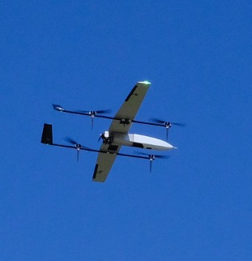
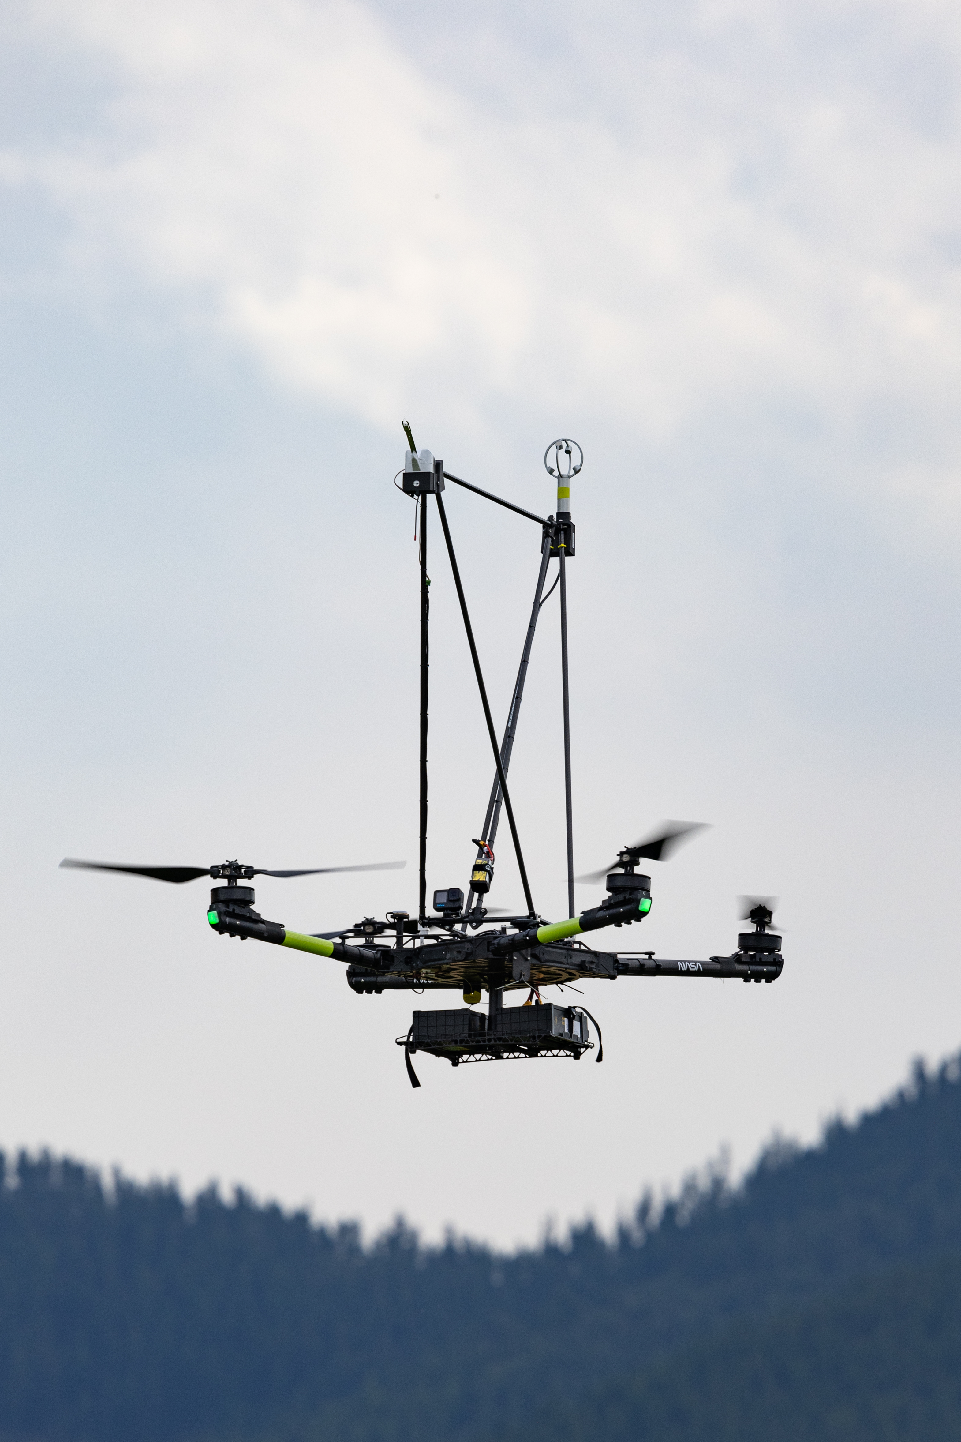
2024 Field Campaign UAS
NASA Hybrid Project SuperVolo(s) – Vertical take-off and lift, long endurance (6-8 hours)
NASA Freefly Alta X – quadcopter, large carrying capacity (up to 35lbs)

Slide 7
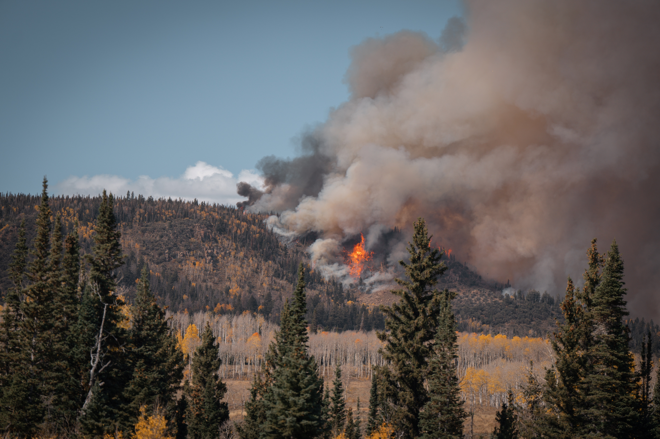
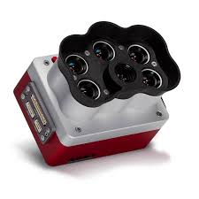
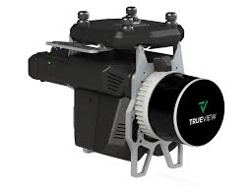
Pre and post fire data collection
GeoCue TrueView 535 3D imaging System for 3D fuels structure, Flying on NASA Alta X
MicaSense RedEdge P multispectral Camera, flying on NASA SuperVolo
Notes:
Add images

Slide 8
B. Imagery - Active fire
Flir Vue Pro R paired with a ThermalCapture Calibrator to increase temperature accuracy for absolute temperature measurements up to 70% by a regular recalibration of the camera using an attached blackbody shutter.
MicaSense RedEdge P multispectral Camera
SuperVolo VTOL Photo by NASA Langley UASOO
Notes:
Basis of imagery on guidance from the USFS UAS Contract Requirements
640x512 IR (radiometric)
2464 x 2056 (5.1MP panchromatic band use pansharpening for EO, assuming EO is 360 nm and 830 nm, i.e. visible)
Basis of imagery on guidance from the National Light Fixed Wing Multiple Award Task Order Contract (MATOC) written by USFS National Fire Imaging/ Incident Awareness and Assessment (IAA) Program (pgs. 28 – 47 provide specific requirements for sensors, data formats, and data management.)
MATOC motivated in part by imagery collected from Aerial Firefighting Use and Effectiveness (AFUE) Study: https://govtribe.com/file/government-file/1202sa22r9102-1202sa22r9102-a0001-nlfw-matoc-conformed-copy-dot-pdf
Center wavelengths and bandwidth
Center Bandwidth
Blue. 475 nm. 32 nm
Green. 560 nm 27 nm
Red. 668 nm. 16 nm
Red edge. 717 nm. 12 nm
Near infrared 842 nm. 57 nm
Panchromatic. 634.5 nm. 463 nm

Slide 9
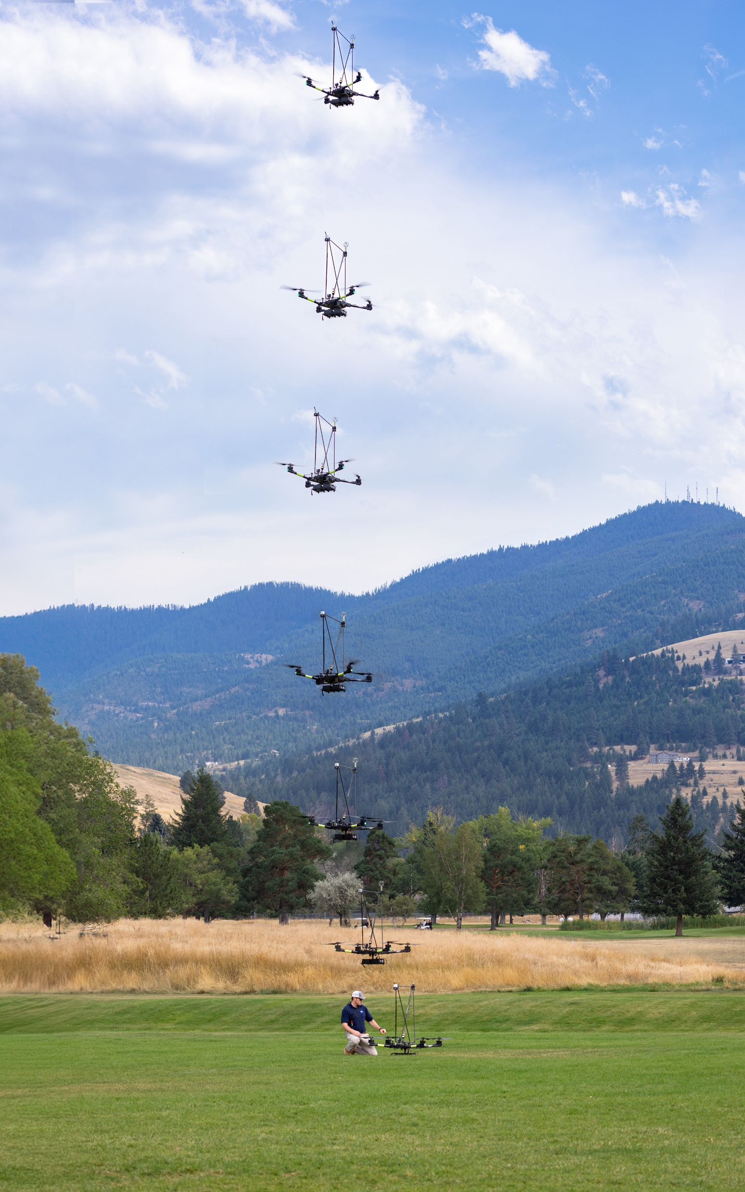
C. Vertical Atmospheric Profiles
Based on discussion with NOAA’s Fire Weather Test Bed staff, Fire Weather Program Manager, and National Fire Weather Operations Coordinator
Request is to assess three systems for ease of use, data quality, and technology readiness for operations on fire.
  InterMet CopterSonde (1.5 km AGL max altitude)
  Meteomatics Meteodrone (6 km AGL max altitude)
  NASA Langley Sounding System (3 km AGL max altitude) – flying on NASA Alta X

Slide 10
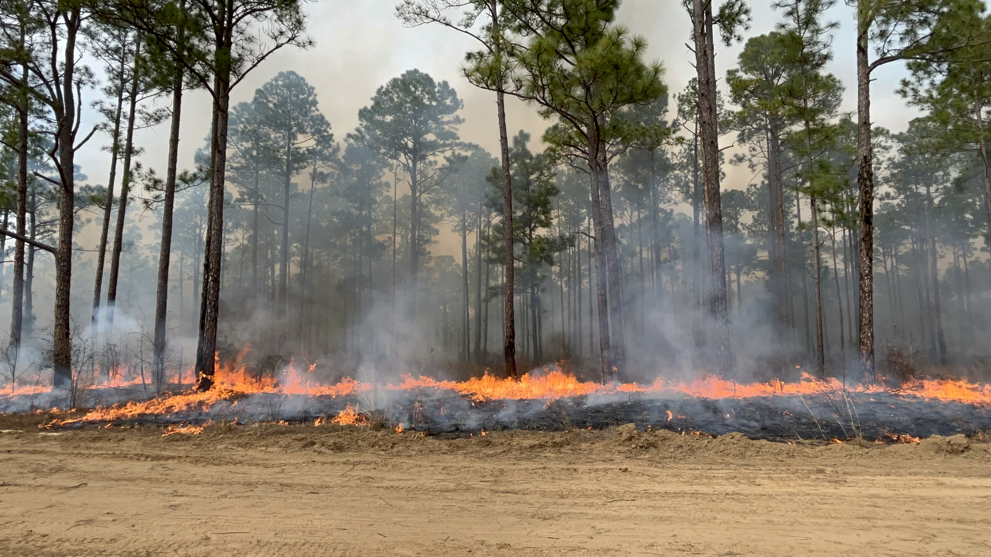
Project Risks with Field Campaign
sUAS pros
sUAS cons
High resolution data from terrain following
Cost?
Smaller airspace volume for airspace deconfliction
Single payload attachments therefore multiple reviews for swapping payloads or multiple reviews and crews for multiple aircraft
Ground operations coordination
Logistics coordination
Cost?
Mitigations
Additional airspace coordination
Leveraging partnerships
Flight crew training for complex terrain (density altitude), high elevations, and fire environment
Notes:
Add images

Slide 11
Project Risks with Field Campaigns
Bridging the “last mile” gap. . .
Mitigations
Identify priority stakeholders - NOAA, USFS, FAA, NASA coordination
“Near” fire rather than “on” fire demonstration
Leverage partnerships
After action reviews for continued improvement of operations
Notes:
Add images

Slide 12
Interagency Coordination
Who has jurisdictional authority on the ground and in the air?
What are our agency timelines from ideation to flight?
What are the requirements for Operational vs Research Agencies?
Notes:
Add images

Slide 13
Questions?
Thank you!!!
For further information, please contact:
Michael Falkowski, FireSense Program Manager
michael.falkowski@nasa.gov
Jacquelyn Shuman, FireSense Project Scientist
jacquelyn.k.shuman@nasa.gov
Jennifer Fowler, FireSense Project Manager
jennifer.w.fowler@nasa.gov
https://cce.nasa.gov/firesense/index.html
Notes:
Add images

