Slide 1
Plume Surface Interaction Modeling for Lunar Site Planning and Design Applications
  Andrew Weaver*, Thomas Shurtz*, and Jeff West
  NASA MSFC Propulsion Fluid Dynamics Branch (ER42)
  *Jacobs Space Exploration Group
  and
  Ruthan Lewis
  NASA GSFC
  LSSW 25, Sept. 17-18, 2024

Slide 2
Outline
Introduction
Overview of PSI modeling capabilities for lunar site planning
Integration of PSI modeling capabilities into lunar site planning
Summary and conclusions

Slide 3
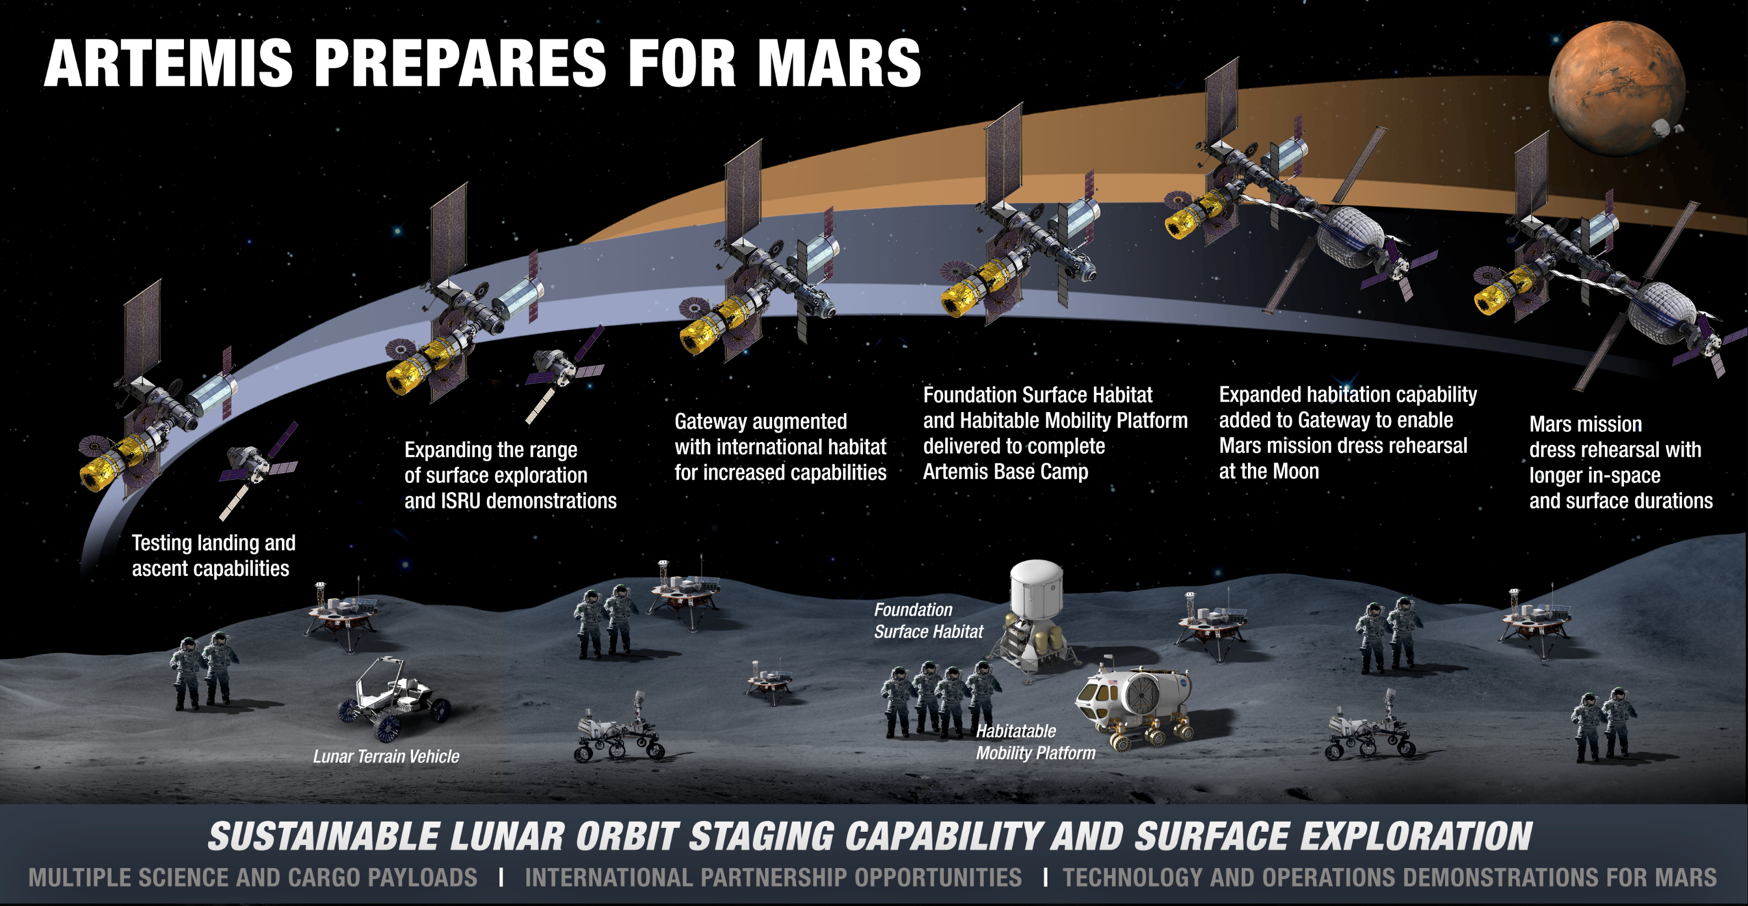
Introduction
NASA is preparing to return to the Moon as part of the Artemis program’s Moon-to-Mars goals
First step in the journey to Mars is to test system on Moon with sustained Lunar presence
SUSTAINABLE MOON
For sustained Lunar presence, need to develop a site plan to integrate multiple elements within the environment over time and space to achieve objectives
One component of site planning is therefore the environmental effects (natural and induced) on each element, which includes PSI
Sample of Elements in Site Planning
Integrated Design and Architecture
Power
Land & Environment Analysis
Con-Ops
Science
Habitation
Mobility
Communication & Navigation
Civil Engineering
Technology & Utilization
EVA
ISRU
Visualization
Plume Surface Interactions (PSI)
Focus of this presentation on integration of PSI modeling into lunar site planning

Slide 4
Overview of PSI Modeling Capabilities

Slide 5



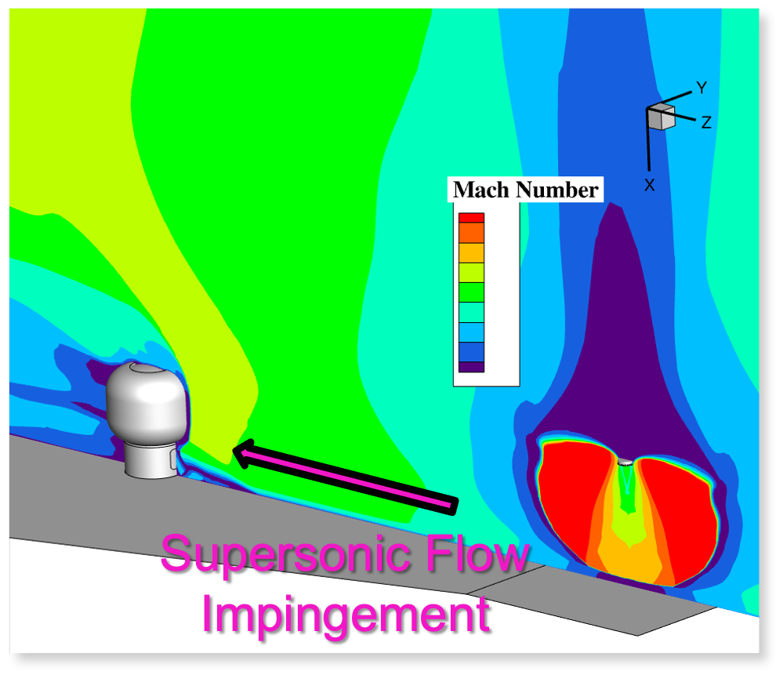
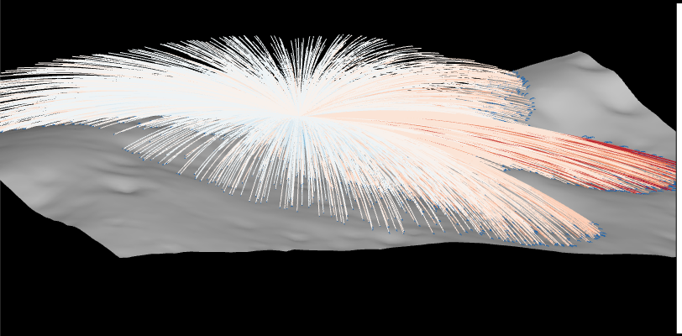
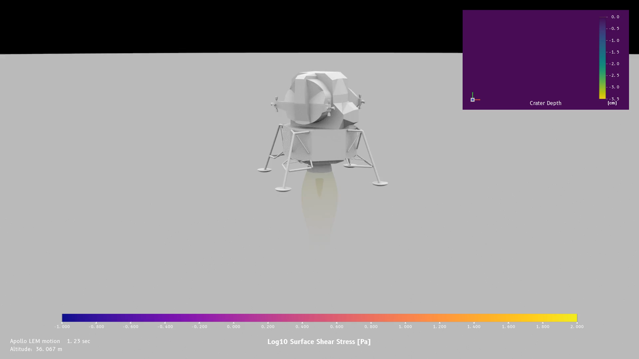

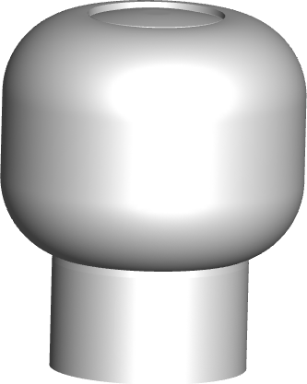
Overview of Modeling Capabilities for Lunar Site Planning
ER42 Fluid Dynamics Branch at NASA MSFC pushes the current state of the art for PSI modeling through continual development of a cascade of predictive simulation tools, including:*
  Loci/CHEM: Computational Fluid Dynamics (CFD) tool to predict flowfield and plume impingement metrics
  DTA: Debris Transport Analysis (DTA) tool to predict particle transport and impact metrics
  Loci/CHEM-DIGGEM + DTA: Hybrid CFD/engineering model to predict plume-induced cratering and particle impact frequency and accumulation
  Loci/GGFS: (Emerging) Gas Granular Flow Solver (GGFS) tool to predict complex, multi-phase, multi-physics plume interactions with regolith
Loci/CHEM:
Plume Flowfield/Impingement on Asset
DTA:
Particle Transport and Impacts to Assets
Loci/CHEM-DIGGEM:
Surface Cratering; Video from P. Moran, A. Weaver
Example Habitat
Particle Trajectories
Output
Particle trajectories
Particle sizes
Fluxes and impacts to assets
Particle velocities
Particle kinetic energies
Pressure
Heat flux
Integrated forces
Crater evolution
Soil accumulation
Validation assessments performed as continual development process using available flight data and ground test data (more tests currently planned)
* Shurtz, T. P., Weaver, A. B., and West, J. S., “A Suite of Tools for Predictive Simulation of Plume Surface Interactions,” LSSW 25, Sept. 17-18, 2024.

Slide 6
Integration of PSI Modeling Capabilities into Lunar Site Planning

Slide 7




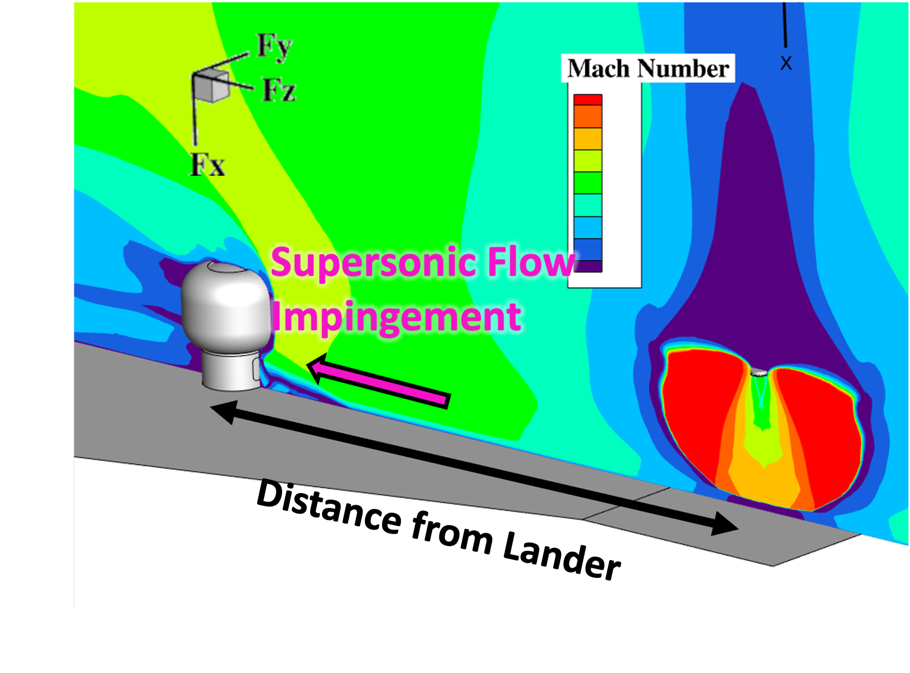
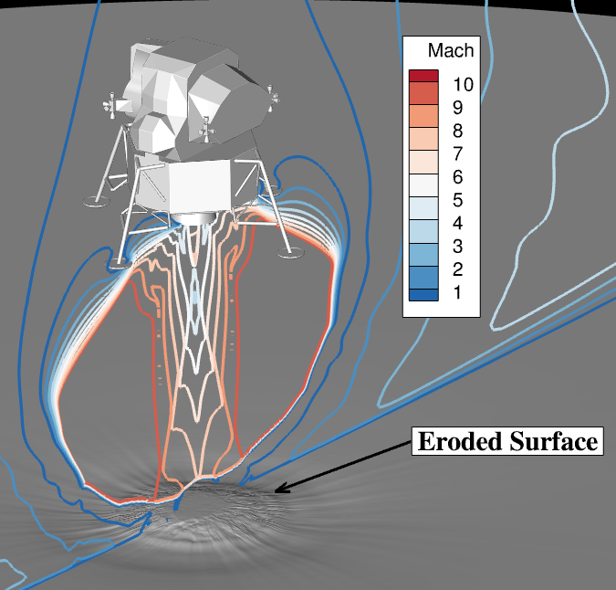
Integrating PSI Modeling into Lunar Site Planning: Plume Impingement and Cratering
PSI induced environments pose multiple risks to nearby assets that need to be understood and integrated into site planning:
  Plume impingement: Damage from plume (pressure, thermal loads) [ e. g. Landing Pads, Habitats, Payloads, other Nearby Assets ]
  Cratering: Excessive slopes for mobility traverses [ e. g. EVA/Mobility ]
  Ejecta impacts: Damage from ejecta (pitting, denting, holes, etc.). [ e. g. Nearby Assets, Gateway ]
  Soil accumulation: Accumulation of soil on sensitive equipment or [ e. g. Surface Power, Science Sites, Gateway (dust on lander)]
  science operation sites
Example:
Plume Impingement on Nearby Habitat
Example:
PSI-Induced Cratering
Loci/CHEM used to support assessing potential for:
  Tipping over habitat/payload
  Thermal degradation of habitat/payload
Loci/CHEM-DIGGEM used to support assessing potential for:
  Excessive cratering/slopes for mobility traverses
  Excessive cratering/slopes for landing reusability

Slide 8
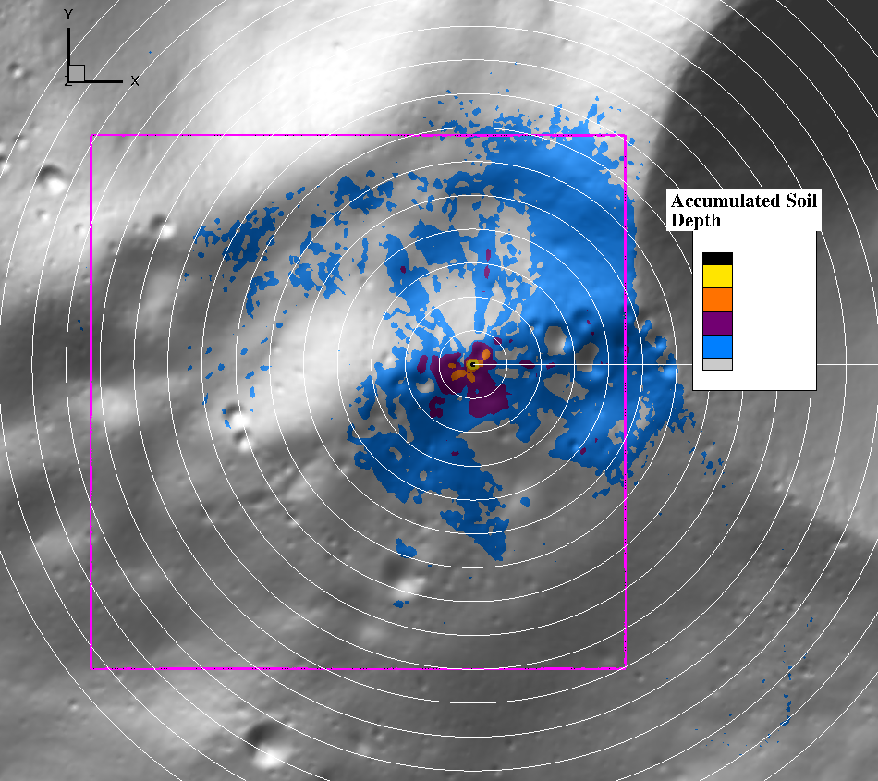
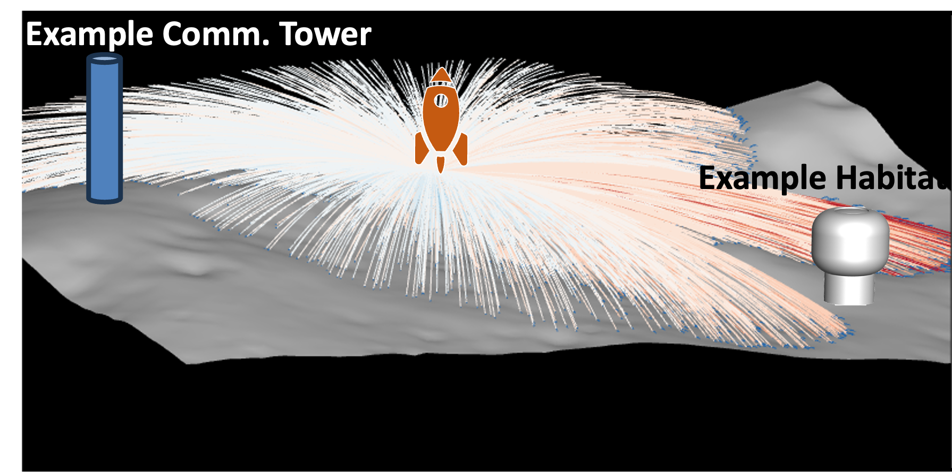
Integrating PSI Modeling into Lunar Site Planning: Ejecta Impacts and Soil Accumulation
PSI induced environments pose multiple risks to nearby assets that need to be understood and integrated into site planning:
  Plume impingement: Damage from plume (pressure, thermal loads) [ e. g. Landing Pads, Habitats, Payloads, other Nearby Assets ]
  Cratering: Excessive slopes for mobility traverses [ e. g. EVA/Mobility ]
  Ejecta impacts: Damage from ejecta (pitting, denting, holes, etc.). [ e. g. Nearby Assets, Gateway ]
  Soil accumulation: Accumulation of soil on sensitive equipment or [ e. g. Surface Power, Science Sites, Gateway (dust on lander)]
  science operation sites
Example:
Soil Accumulation on Lunar Surface Due to a Lander Landing on Moon
Example:
Particle Trajectories Impacting Lunar Surface Due to a Lander landing on Moon
Loci/CHEM and DTA used to support assessing potential for particle impacts to a nearby asset
Loci/CHEM-DIGGEM and DTA used to support assessing potential for particle accumulation on Lunar surface/nearby assets

Slide 9
Summary and Conclusions
PSI is an integral part of lunar site planning that affects multiple, architectural surface elements, i. e.:
  Science operations
  Surface power
  Habitats
  Communications
ER42 Fluid Dynamics Branch at NASA MSFC has been and continues to develop PSI modeling tools, which are currently being used to support lunar site planning needs
PSI modeling capabilities have been experiencing rapid growth which can be used to continue support of lunar site planning and other PSI customers’ needs
Modeling capabilities growth includes
  Predicted metrics (growing list in each of the environments mentioned previously)
  Predictive simulation methods (including Loci/GGFS tool for its accuracy in the prediction of deep craters)
  Validation assessments of PSI modeling tools
  Surface mobility
  In-situ resource utilization (ISRU)
  Surface construction (landing/launch facilities)
  Etc.

