Slide 1
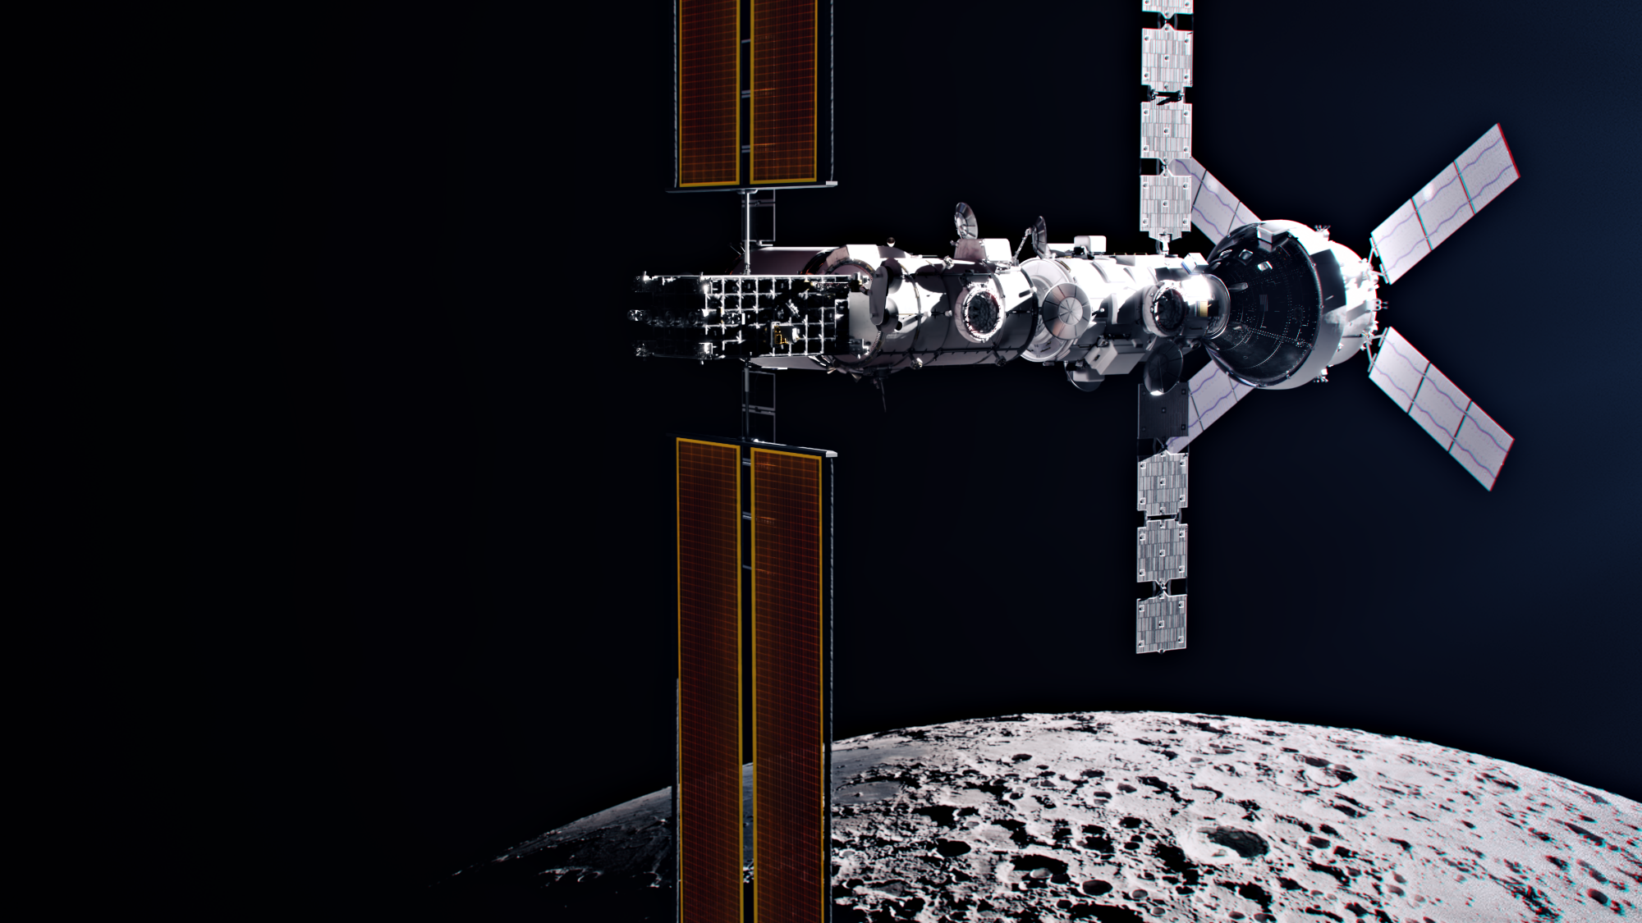

Overview of the Lunar Gateway External Contamination Environment
Crystal A. Quiroz
Oceaneering, JETS Contract, Houston, TX, USA
crystal.a.quiroz@nasa.gov
Courtney A. Steagall
NASA Johnson Space Center, Houston, TX, USA,
Brian Tulaba
Frederick Lutfy
Jacobs, JETS Contract, Houston, TX, USA,
Ronald G. Lee, Jr
Booz Allen Hamilton, Houston, TX, USA
John T. Yim
NASA Glenn Research Center, Cleveland, OH, USA
John M. Alred
William A. Hoey
Maxwell G. Martin
Carlos E. Soares
Jet Propulsion Laboratory, California Institute of Technology, Pasadena, CA, USA
16th International Symposium on Materials in the Space Environment
Saint-Raphaël, France
Oct. 7-11, 2024
Public Release NASA NF-1676 20240011495
Image courtesy of NASA

Slide 2
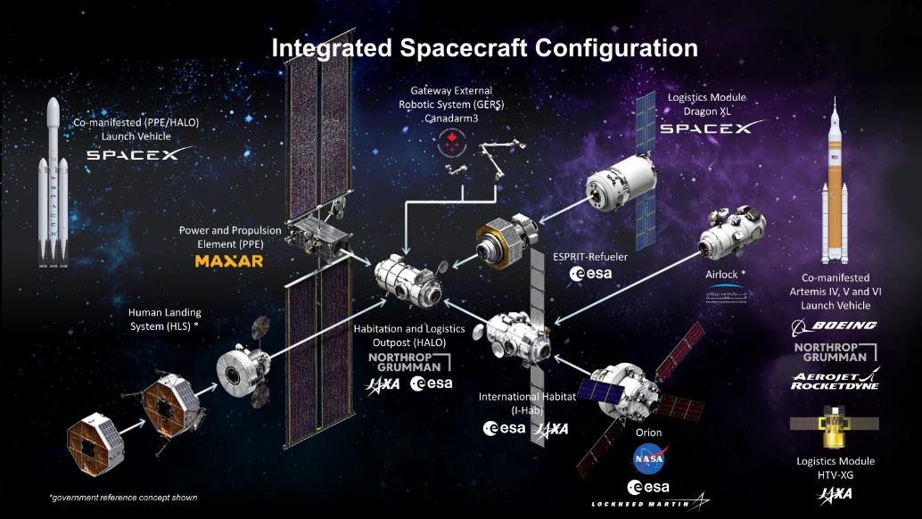
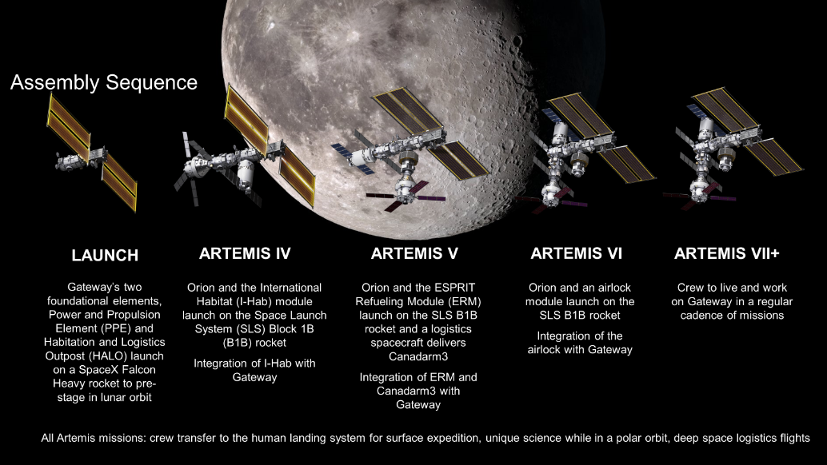
Introduction
As a part of the Artemis mission, Gateway will be a long duration space station in a near rectilinear halo orbit around the Moon.
Gateway is an international collaboration to establish humanity’s first space station in lunar orbit.
Gateway will be constructed over several Artemis missions starting no earlier than 2026
Images courtesy of NASA
2

Slide 3
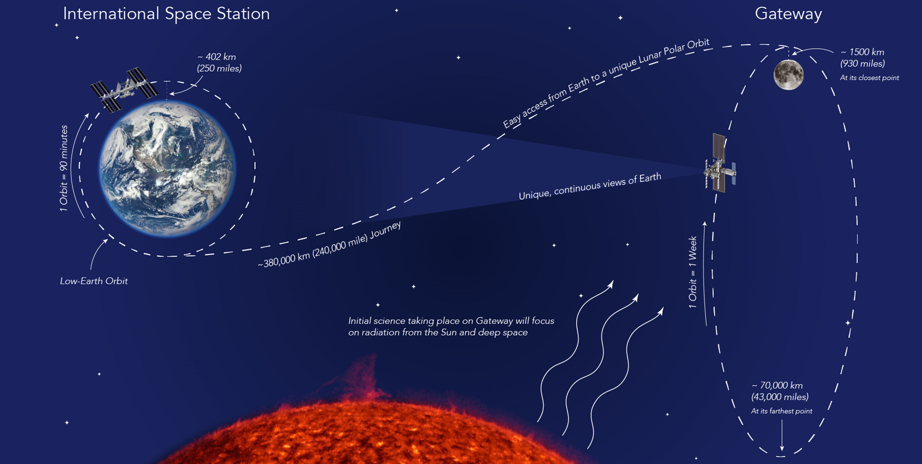
The ISS versus Gateway Orbit
Image courtesy of NASA
3

Slide 4
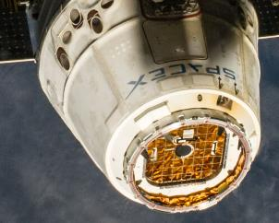
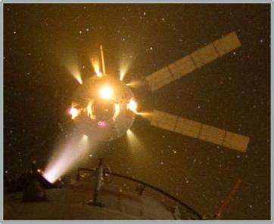
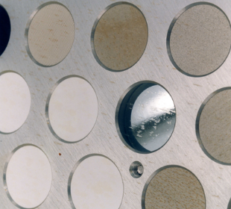
Gateway Induced Environments
Material
Outgassing
Over its assembly and lifetime, Gateway will be exposed to a variety of induced environments, including:
  Lunar dust transport
  (from the Human Lander System, HLS)
  Chemical and electric thruster plumes
  Materials outgassing
  Vacuum vents
Gateway elements and visiting vehicles will also contribute to these induced environments.
Induced environments can impact vehicle performance, utilization, and mission success.
Thruster Plumes
Wastewater Contamination
Plume droplet impact features from SPIFEX and PIC Flight Experiments
The Gateway Induced Environments Team has developed induced environments requirements and methodologies to support successful Gateway system integration.
Image courtesy of NASA

Slide 5
Gateway Induced Environments System
GP 10057 ‘Gateway Space Induced Environments Requirements’ | Description
Induced Environments Limits Verified by Gateway analysis | Defines Gateway induced environments limits that Gateway will be managed to: Specifies lunar dust contamination due to transfer from of a returning Lunar Surface excursion vehicle. Specifies sputter erosion limit of 100Å/year due to electric propulsion thrusters plume impingement on Gateway sensitive surfaces. Specifies a molecular contamination limit of 250 Å/year on contamination sensitive surfaces from all sources (Note: Includes corresponding element-level allocations.) Limits venting of substances that contaminate or degrade external surfaces.
Vehicle Performance (Design to’s) Verified by hardware owners (e.g. hardware impact assessments / mitigations) | Defines the on-orbit induced environments that Gateway elements, visiting vehicles, payloads, etc. must operate in (e.g. hardware impact assessments / mitigations): Lunar dust contamination Electric propulsion induced sputtering and plasma. Molecular contamination limit of 250 Å/year.
Gateway Induced
Environments System
Lunar
Dust
Electric Propulsion
Plumes
Molecular Contamination

Slide 6

Spotlight on Lunar Dust
The return of lunar surface vehicles, samples, and suits contaminated by lunar dust to Gateway can have serious impact on the environment, equipment/systems, and crew health.
Gateway Induced Environments is working to address:
  Characterization of external dust transport due to
  lunar return vehicle
  External lunar dust mitigation
Gateway also addresses lunar dust internal environments, primarily by subsystem requirements.
  Controlling dust (Environment Control and Life Support)
  Managing dust (Crew Systems; e.g. vacuuming)
  Monitoring dust (Crew Health and Performance)
Gateway Induced
Environments System
Lunar
Dust
Electric Propulsion Plumes
Molecular
Contamination
More details presented at this conference
by Ron Lee / Booz Allen Hamilton:
“Status of Gateway Lunar Dust Modeling and the Study of Dust During Docking”
Image courtesy of NASA
6

Slide 7
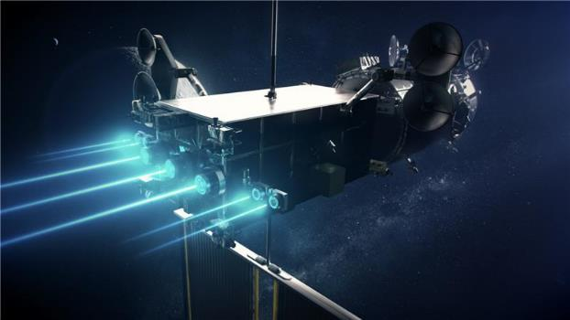
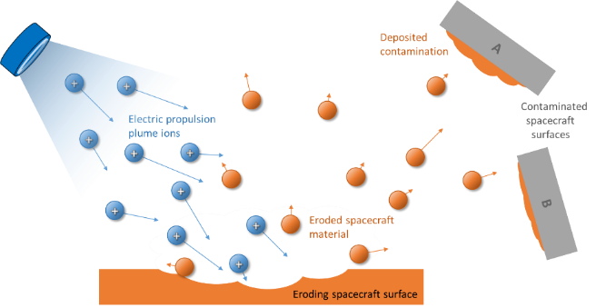
Spotlight on Electric Propulsion
Gateway Induced
Environments System
Electric thrusters on Gateway’s
Power Propulsion Element (PPE)
provide primary thrust for lunar
transit, most orbit maintenance,
and orbit transfer operations.
Induced environments resulting
from Electric Propulsion (EP)
plumes include:
  Sputter erosion: ions impacting s/c surfaces may sputter material off and result in loss of material over time
  Sputter redeposition: sputter eroded s/c material may transport to other s/c surfaces with line-of-sight and deposit as a contaminant
  Electrical: the EP plumes are a relatively cold and quasi-neutral plasma that can interact electrically with s/c surfaces
Lunar
Dust
Electric Propulsion
Plumes
Molecular Contamination
EP Plume induced environments at Gateway are characterized by the Ion Propulsion System Team at Glenn Research Center (GRC)
EP Plume Induced Erosion / Redeposition Visualization
Image courtesy of NASA

Slide 8

Spotlight on Molecular Contamination
The Gateway induced molecular contamination environment includes contributions from Gateway elements, visiting vehicles, and external payloads.
  Molecular contamination sources include:
    Materials outgassing
    Thruster plume-induced contamination
    Redeposit of sputtered material (due to ion thrusters)
    Vacuum vent releases
  Materials outgassing is expected to be the dominant molecular contamination source during quiescent periods.
  Localized deposition possible during non-quiescent periods (e.g., thruster operations, vents/purges, visiting vehicle proximity operations).
Contamination-sensitive surfaces include solar arrays, thermal control surfaces, optical sensors, windows, and science instruments.
Gateway Induced
Environments System
Lunar
Dust
Electric Propulsion Plumes
Molecular
Contamination
The Gateway Induced Environments Team is collaborating with the JPL Contamination Control Engineering Team on early look Gateway external contamination assessments.

Slide 9

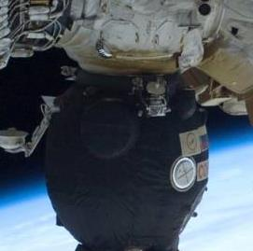

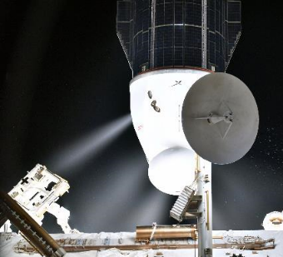
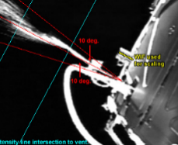
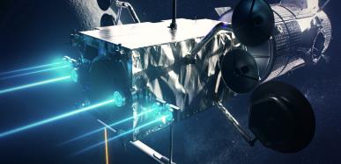
Molecular Contamination Modeling Approach
Thruster information
Thruster design information
Thruster performance data
Firing data (prox ops / attitude control)
Vacuum-Exposed Materials
Identification / usage
Operating temperatures
Materials
processing
(If Necessary)
Plume modeling
Bipropellant Plume Model
ASTM E1559 Outgassing rate test data
Transport Modeling
View factor calculations Transport routines
Outputs
Element- & System-level deposition
(source-to-receiver)
Products
GP 10057 verification
Operational constraints (TBD)
Vent modeling
Point source (gas)
Multi-phase flows
Spacecraft Information
Gateway geometry, configurations
Assembly sequence, traffic model
Contamination-sensitive surfaces
Conops including thrusters, vents, array & radiator articulation
Redeposited sputter material
from ion thrusters
Vent information
Vent Design
information
Composition
Images Courtesy of NASA

Slide 10
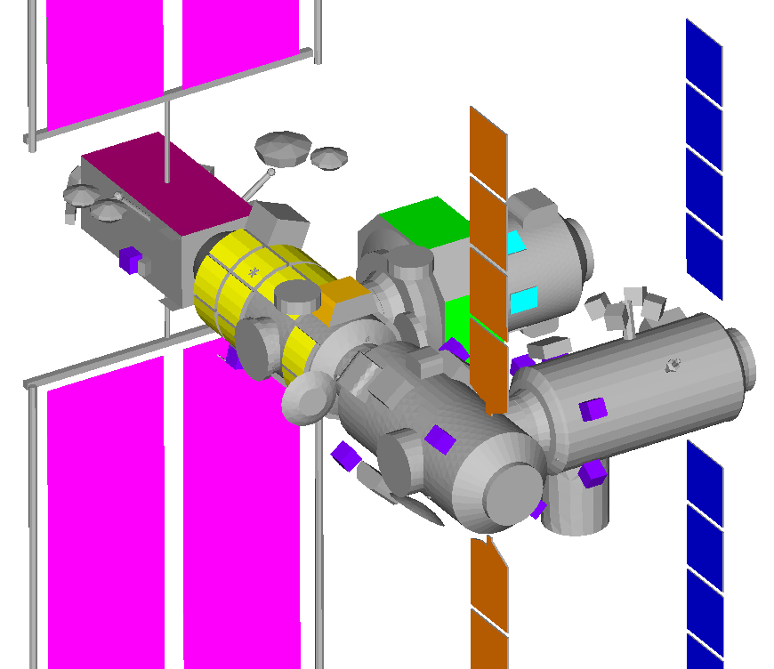
Example System Level Contamination Assessment
Early look Gateway integrated external contamination assessments needed to:
  Inform Gateway system-level and element-level requirements (and associated data requirements).
  Conduct system studies to identify integration issues / risks.
  Formulate long-term strategy for addressing external contamination tools/process/verification.
This example assessment represents a summation of all induced contamination sources, including
  Materials Outgassing
  Chemical Thruster Plume-Induced Contamination
  Redeposited Sputter Material (due to ion thrusters)
  Vacuum venting
Results considered against the system level molecular contamination limit of 250 Å/year on contamination sensitive surfaces.
Gateway External Contamination Analysis Model
Assembly Complete
Contamination-sensitive (receiver) surfaces:
Radiators Solar Arrays
Windows Payload Sites

Slide 11
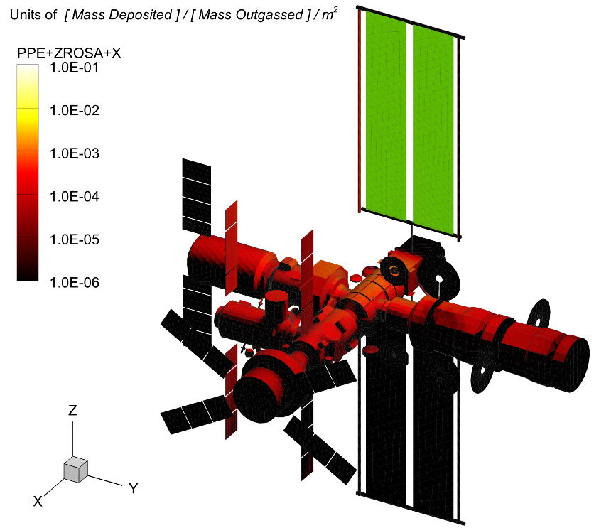
Materials Outgassing
Gateway utilizes a predictive model developed by JPL which allows manipulation/scaling of analysis inputs for early look assessments.
  Incorporates a Gateway view factor matrix to compute molecular transport for outgassing source / receiver combinations.
  Provides materials outgassing deposition results based on outgassing rate assumptions and durations.
  Enables system trade studies and evolving assessments as analysis inputs are better defined (materials, temperatures, etc.)
Example System Assessment (Assembly Complete):
177 source groups × 164 receiver groups
= 29,028 view factor coefficients
Outgassing rate source terms based on similarity to other spacecraft and ASTM E1559 outgassing rate test data
(time-phased arrival of elements and outgassing rate decay included)
Direct flux outgassing only
(i.e. first line-of-sight from source to receiver)
Example View Factor Visualization
This direct flux transport visualization shows the fraction of total mass outgassed from the source group (in green) that arrives at each receiver facet.

Slide 12
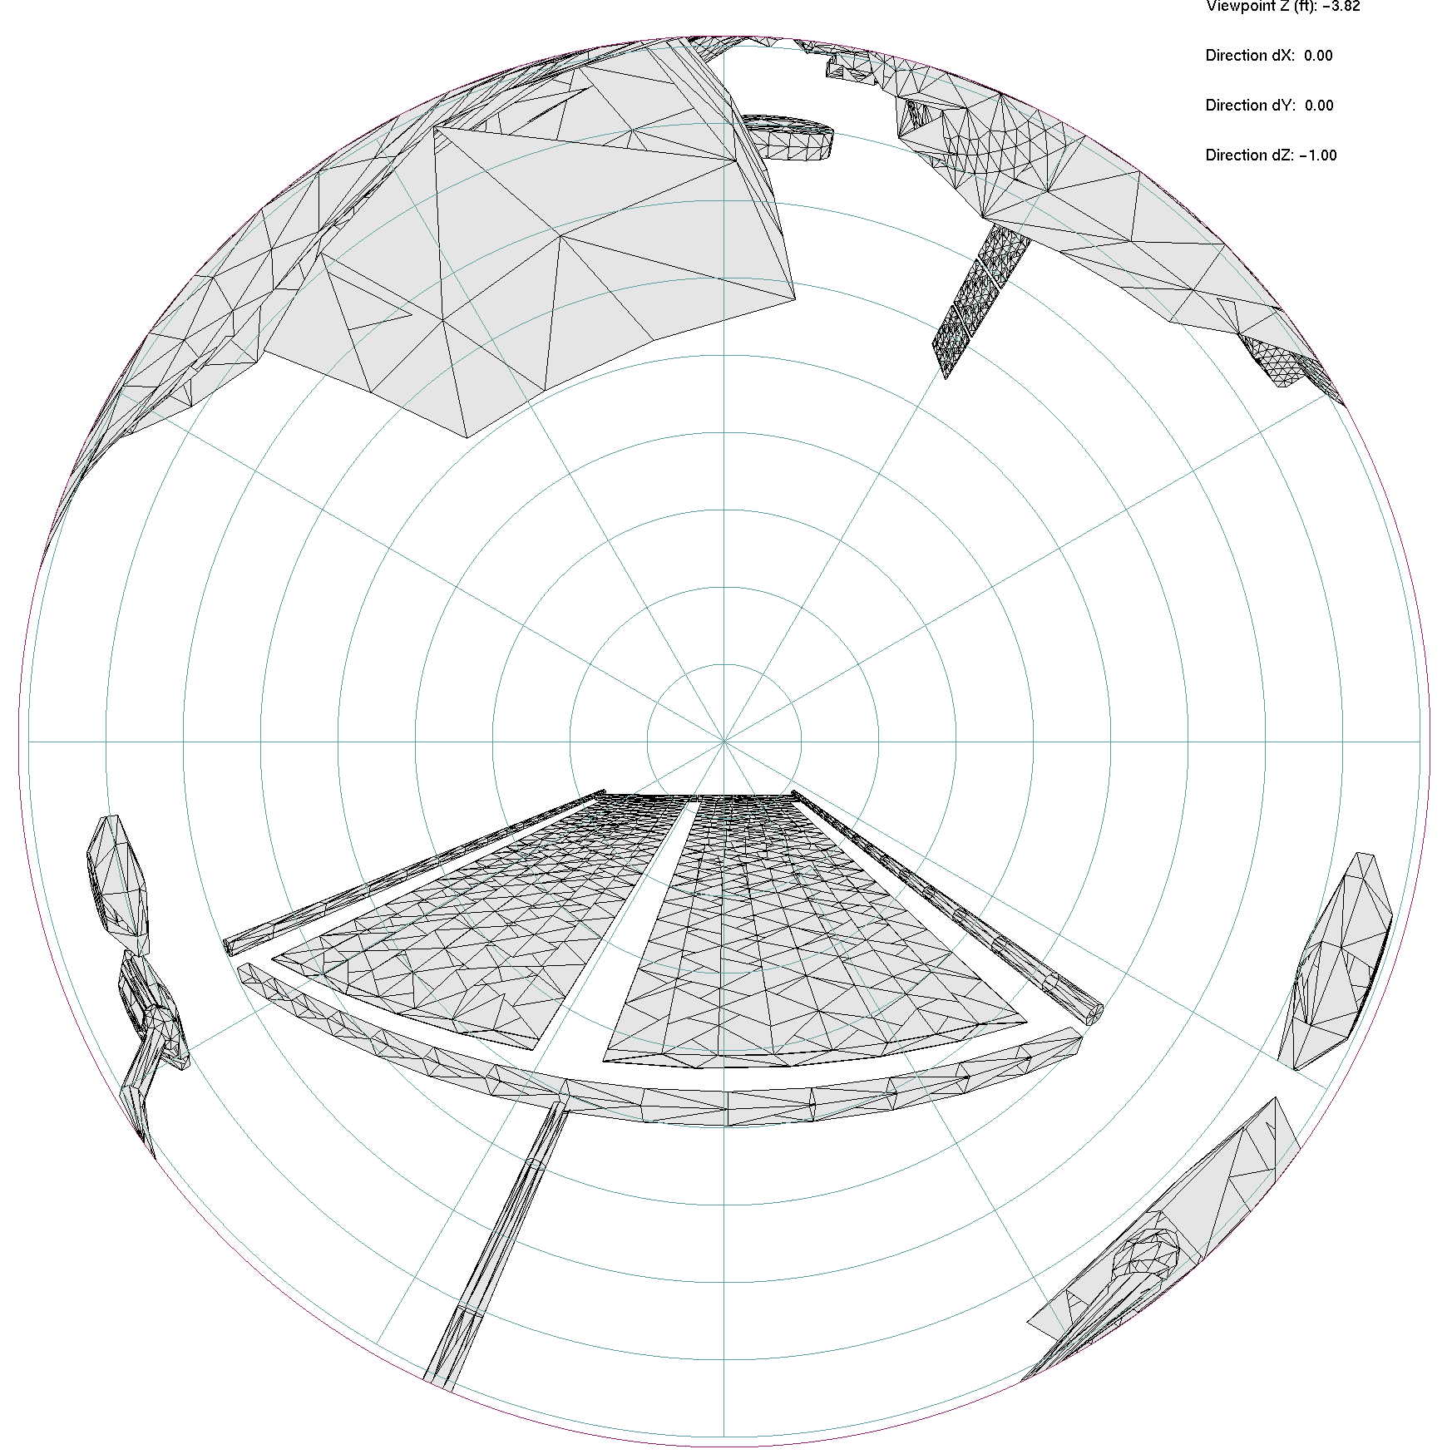
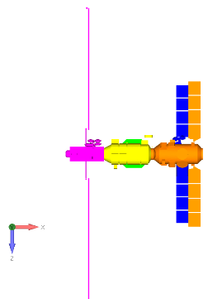
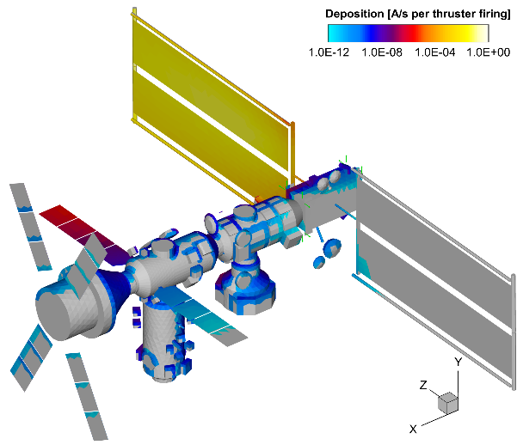

  Thruster Plume-Induced Contamination
Gateway will be exposed to multiple chemical thruster plumes:
  Reaction Control System (RCS) Thrusters
  Visiting vehicle thrusters
  (e.g. Artemis mission elements)
Gateway collaborated with the JPL on a simplified thruster plume contamination model for conducting parametric assessments for select Gateway thrusters.
  Contamination is calculated using the heritage ISS bipropellant plume contamination model.
  Analysis data provided in tabular format (separated by thruster / receiver surface) to allow manipulation/scaling of thruster on-time assumptions for analysis scenarios of interest.
  Estimated annualized thruster on-time used for example
  system assessment.
Example JPL Plume Contamination Analysis Plot
(Å/sec of thruster firing)
Example
PPE Thruster Hemispherical View

Slide 13
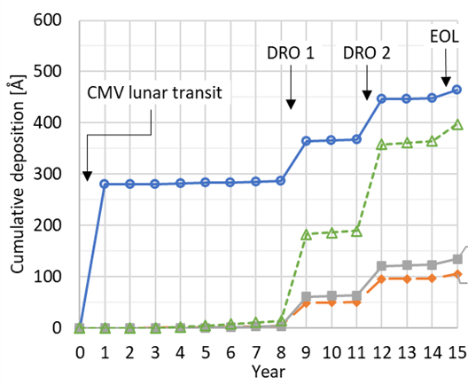
  Redeposited Sputter Material
Example GRC EP Plume Redeposition Analysis
(Å)
Sputter erosion from EP plume impingement and redeposit of EP sputtered material is modeled/analyzed by NASA GRC / Gateway Ion Propulsion Team.
GRC provides estimates of redeposited sputtered material on Gateway contamination-sensitive surfaces for incorporation into the system contamination analysis.
  Analysis shows insignificant levels of contamination during nominal operations / orbital maintenance.
  Some EP plume induced contamination is expected if cis-lunar orbit transfers are performed. However, orbit-transfers are expected to be infrequent and are not included in this example assessment.
Orbit Transfers
Lunar Transit
Radiator 1
Radiator 2
Body panel
End cone
EP thrusters will be used heavily during transit of the first co-manifested elements to the Gateway orbit. EP plume contamination may be more significant during this lunar transit phase. GRC provides EP plume analysis data for lunar transit to affected hardware owners.

Slide 14
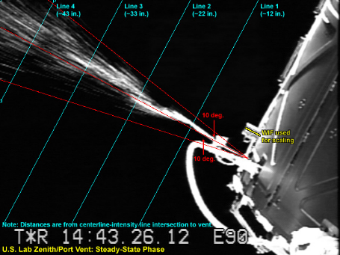
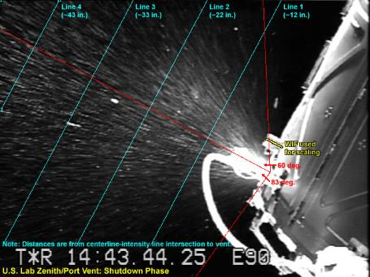
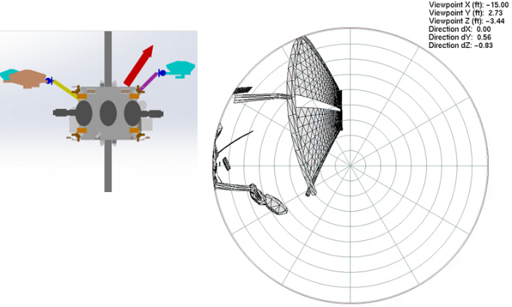
  Vacuum Venting
ISS U.S. Lab Condensate Vent
Steady-state (Left) and Shutdown (Right)
Vacuum vents not expected to be a significant contamination source at Gateway (controlled via requirements).
  Most Gateway vents are inert gases, water vapor, etc.
  Neglected in this example system assessment.
Substances of concern requiring integrated analysis:
  Liquids (which can cause impact damage to sensitive surfaces via direct or orbital recontact).
  Chemically reactive substances (e.g. fuels/oxidizer, corrosives).
  Substances that can condense at Gateway surface temperatures, resulting in a permanent deposit.
Induced Environments is tracking several items for continued evaluation including:
  Orion wastewater venting (primarily a transit concern;
  Orion will limit wastewater venting at Gateway)
  Propellant purging (associated with refueling operations).
  Payload waste gas venting.
PPE Propellant Purge Port Hemispherical View
Hypothetical Propellant Purge Hemispherical View
Images courtesy of NASA

Slide 15
  Example System Level Contamination Results
> 250 Å/Year (System Limit)
Summary:
  Material outgassing is the overwhelming dominant molecular contamination source.
  Assessment shows localized exceedances → focus areas for more detailed modeling/analysis.
  Results give support to Gateway external contamination requirements/allocations as
  appropriate and achievable.
  Gateway hardware providers should evaluate to the Gateway on-orbit external contamination environment of 250 Å /year - not accounting for margin in system analysis (given analysis uncertainty and design immaturity).
These results reflect an ‘early look’ system study aimed to give indication of contamination drivers based on view factors and lots of assumptions. Determining actual deposition levels is future work for Gateway integration / verification.

Slide 16
External Contamination Analysis Work Flow
System Studies
Technical Interchange Meetings
Final Data Delivery
Finalized Input Data
Launch!
Preliminary Analyses
Preliminary analyses
Identify contamination issues and make recommendations
Final Verification Analysis
Element-Level Contamination Analyses
Preliminary Data Delivery
Requirements and Data/ Verification Plans
Parametric Studies
Materials data
Thruster data
Vent data
ASTM E1559 Testing Complete
Gateway System-Level Contamination Analysis
Interim Updates
Design changes / data refinements
ASTM E1559 test coordination
Thruster test coordination
Analysis updates
Hardware
Provider
Induced
Environments
Hardware
Provider
Current system studies will evolve into a high-fidelity analytical model incorporating detail contamination characterization data for Gateway elements / interfaces as design maturity milestones are reached
  Integrated analyses will be conducted at the element level and system level tied to Gateway design / analysis cycles.
  Verification analyses will be tied to launch of Gateway elements as well as Artemis / visiting vehicle missions to Gateway.
  Preliminary analyses must be conducted for early identification of contamination / input data concerns.
Induced
Environments

Slide 17
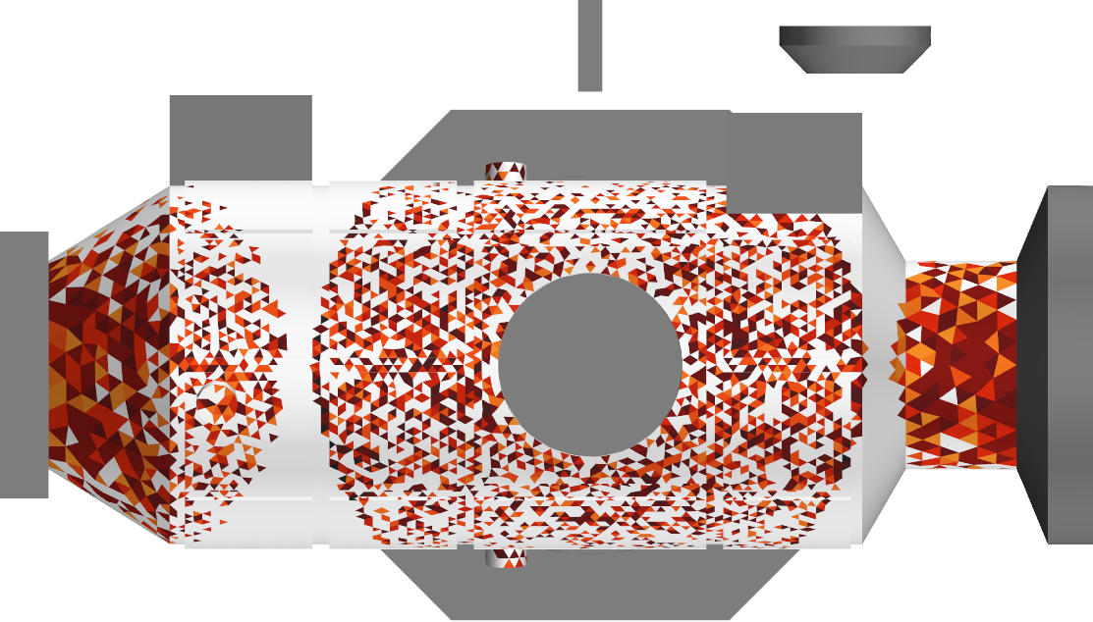
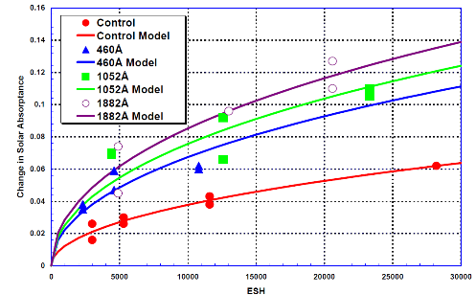
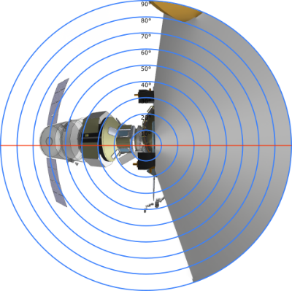
Other External Contamination Activities
Induced contamination transport and hardware impact assessments
Placement/orientation assessments
Risk reduction efforts
Payload sensor placement / orientation to minimize contamination effects.
Vacuum vent nozzle orientations.
MLI configuration / preferential vent paths to mitigate outgassing impacts.
Ionized contamination return flux assessment
Multispecies modeling demonstration test / outgassing rate testing process improvement
External Lunar Dust transport and mitigation
(See “Status of Gateway Lunar Dust Modeling and the Study of Dust During Docking” presentation by Ron Lee / Booz Allen Hamilton)
Modeling Material Outgassing
Optical property degradation / optics testing coordination
(See “ Continuation of Solar Absorptivity Degradation of Spacecraft Materials Due to UV and Charged Particles in the Gateway Environment” by Brandon Hoffman / NASA-JSC)
Bipropellant Thruster Plume Characterization Test
(See “The Effect of Impingement Angle on Bipropellant Thruster Plume Degradation of Spacecraft Materials” by Courtney Steagall / NASA-JSC).
(See “A Predictive Model of Lunar Gateway Molecular Contamination” presentation by William Hoey / JPL)
Example Lunar Dust Transport Map
Absorptivity Change Due to Contamination
Example Payload View (Obstructed)

Slide 18
Special Study: Ionized Contamination Return Flux Assessment
In the Gateway environment, released molecular contaminants can become ionized and attracted back to Gateway surfaces.
The Gateway Induced Environments team tasked JPL to perform a physics-based assessment of ionized contamination return flux in comparison to direct flux materials outgassing effects.
  JPL conducted an order-of-magnitude assessment considering nominal and higher electron energy solar wind conditions
The JPL assessment shows that the ionized contamination return flux is negligible compared to neutral contamination transport to Gateway surfaces, by several orders of magnitude.
Ionized contamination return flux is not expected to be a significant activity for Gateway verification.
Example Sheath and Contamination Ionization Rate Solution
(Nominal Solar Wind Conditions)
  Contamination ionization increases in sheath as the electron density increases and then decreases as the contamination density decreases due to the 1/r² expansion.

Slide 19

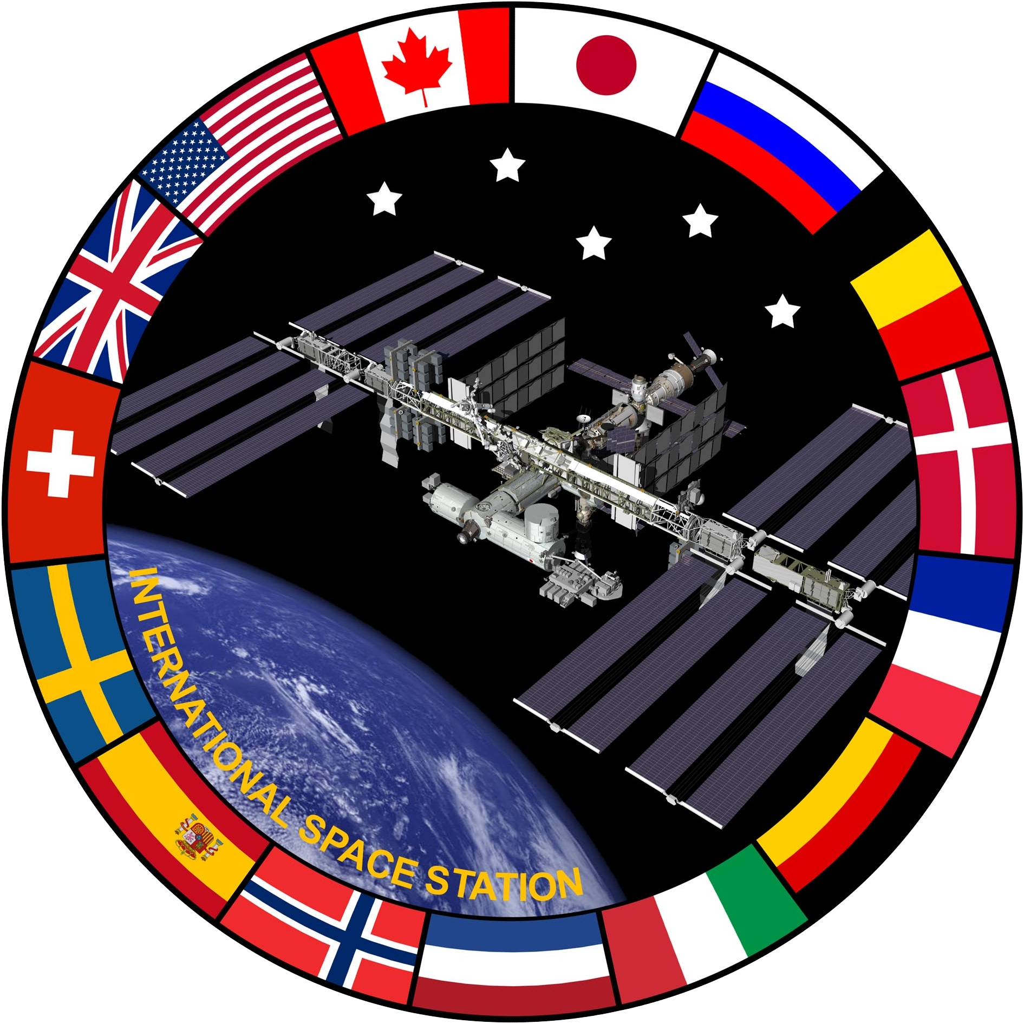
Multispecies Modeling Demonstration Test
ESA and Gateway Induced Environments collaborating to evaluate the equivalency between ASTM E1559 testing and the ESA standard ESA-Q-ST-70-52.
  Both use similar chamber setup/equipment and take similar measurements, but there are key differences in approach (summarized below).
  JPL has developed a methodology (‘multispecies model’) which could bridge the gap between ISS heritage process and ESA’s process. It could also bring about cost savings / process improvements for any future Gateway outgassing rate tests.
Gateway Induced Environments has proposed a demonstration test be conducted to compare the JPL multispecies model results with the ISS heritage approach and ESA approach.
  Proposal involves 2 materials, 5 tests per material (4 standard iso-thermal tests; 1 test with increasing source temperature)
First round of testing planned for Fall 2024.
ISS Heritage Approach | ESA Approach | JPL ‘Multispecies Model’ Approach
Modeling as a diffusion limited process. | Modeling as a desorption limited process. | Modeling diffusion (for outgassing) and coupled adsorption/desorption (for collection)
Testing at multiple sample source temperatures (~3-4 tests per material) which are held constant for direct outgassing measurement at set source/receiver temperature combinations – no interpolation/extrapolation. | A single test is performed to characterize material outgassing by stepping up the source temperature during the test. Test data used to determine modeling parameters for interpolation. | Simultaneous solving and fitting all test data to determine kinetic contaminant parameters which characterize outgassing and contaminant condensation at a range of conditions. Can accommodate a single test with stepping up the source temperatures.
The ISS methodology has been demonstrated with on-orbit measurements / correlation. | ISS has historically not been able to use ESA test data as interchangeable. | Could bridge the gap between heritage ISS and ESA processes, reducing number of required tests.
Gateway Induced Environments gratefully acknowledges our partners in this collaboration!

Slide 20
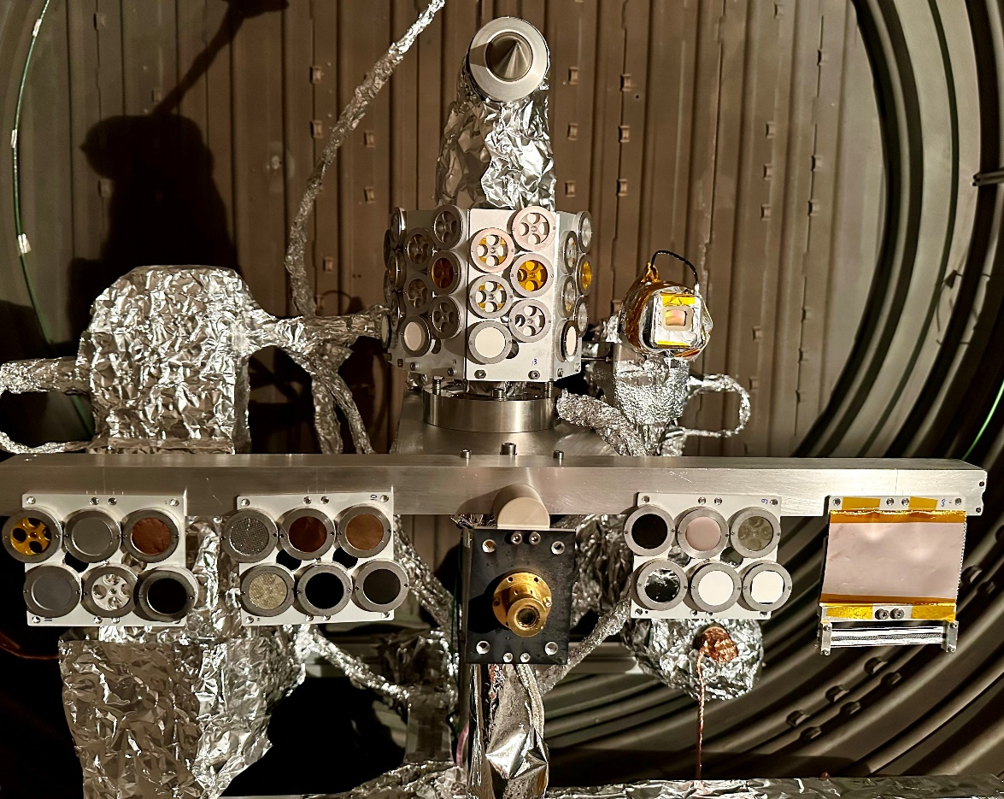
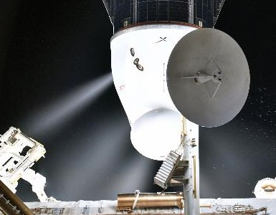
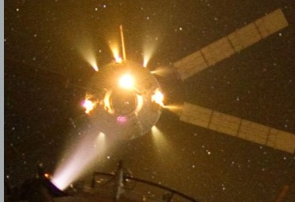
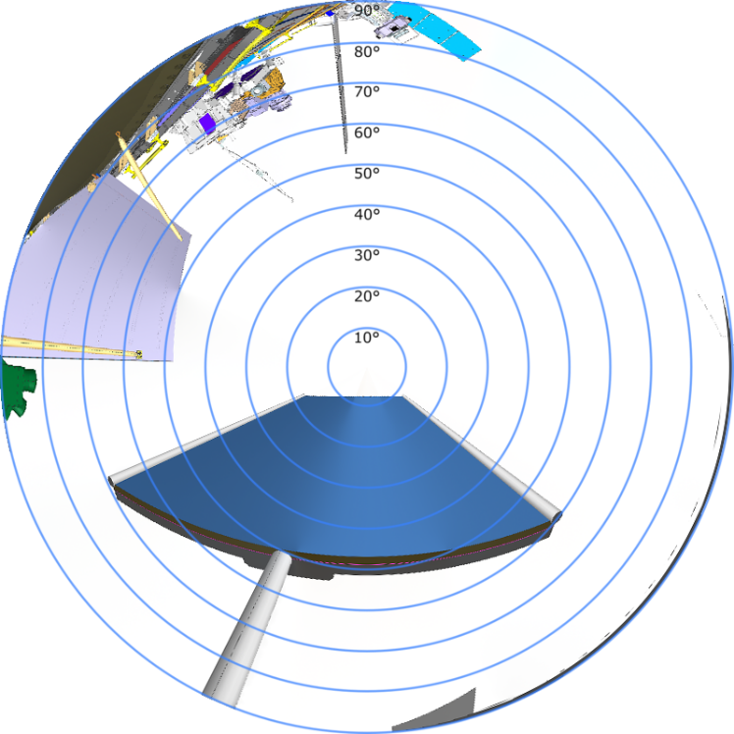
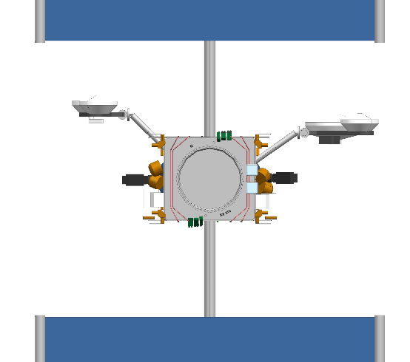
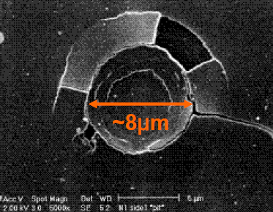


EPIC-2 Bipropellant Thruster Plume Characterization Test
Joint ESA, DLR, NASA JPL, and NASA
JSC test campaign
LOCATION: DLR-Göttingen’s STG-CT
High-Vacuum Plume Test Facility
THRUSTER (provided by ESA):
10N Biprop Thruster
  Same thruster family as Gateway and
  Orion attitude control thrusters
INSTRUMENTATION: Manometers,
heat flux gauges, QCMs, material samples.
BENEFITS:
  Improved modeling of the spatial distribution of plume effluents for structural, thermal, and induced environments disciplines
  Assess thruster plume induced degradation of select spacecraft materials including
  MLI, Kapton, and solar cell coverglass.
JPL/JSC Test completed in March 2024; sample analysis in work!
Thruster Plume Examples
(Liquid phase is a fine mist)
Images Courtesy of NASA
NASA JSC Samples
Example Thruster Hemispherical View
Plume Droplet Impact Features
Gateway Induced Environments gratefully acknowledges our partners in this collaboration!
Glass Lens
Kapton
Images Courtesy of NASA

Slide 21
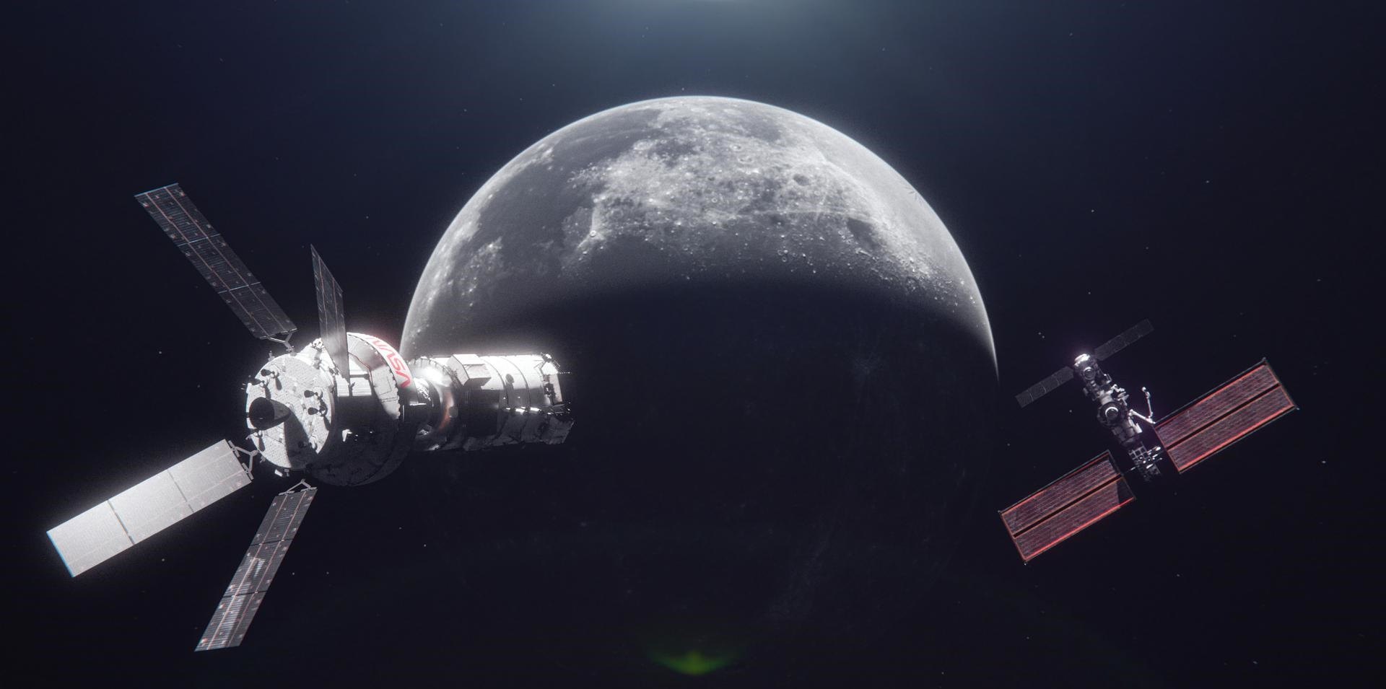
Concluding Remarks
The Gateway Induced Environments team defines the induced space environment, conducts integrated induced environments analyses, and provides technical and integration support for the Gateway system in regard to the induced environment from materials outgassing, vacuum venting, external lunar dust, and electric propulsion thruster plumes
Requirements and methodologies for managing induced environments have been established for managing induced environments within acceptable system limits
Forward work remains to refine current understanding of the induced environment, develop and validate models, and finalize integration / verification workflow with hardware providers and international partners
Early and close coordination with hardware owners on Gateway induced environments requirements and data deliveries is essential for early issue resolution and successful integration.
Image courtesy of NASA
21

Slide 22
Thank you!
Image courtesy of NASA
22

Slide 23
References
Gateway Overview. https://www.nasa.gov/gateway/overview
NASA’s Lunar Exploration Program Overview, September 2020. https://www.nasa.gov/sites/default/files/atoms/files/artemis_plan-20200921.pdf
NASA GP 10057, “Gateway Space Induced Environments Requirements.”
NASA SLS-SPEC-159, Cross-Program Design Specification for Natural Environments (DSNE).
R.G. Lee, E.S. Worthy, E.M. Willis, G.L. Brown, F. Cipriani, and D.C. Barker, Development of a Comprehensive Physics-Based Model for Study of NASA Gateway Lunar Dust Contamination, IAC-22-D5.3.9, 73rd International Astronautical Congress, Paris, France, 18-22 September 2022.
ASTM E1559, “Standard Test Method for Contamination Outgassing Characteristics of Spacecraft Materials.”
Hoey, W. A., et al., “A Predictive Model of Lunar Gateway Molecular Contamination,” Proceedings of the 15th International Symposium on Materials in the Space Environment, Leiden, The Netherlands, 18-23 Sept. 2022.
A. Huang, G. Kastanas, L. Kramer, C. Soares, and R. Mikatarian, “Materials Outgassing Rate Decay in Vacuum at Isothermal Conditions”, SPIE Proceedings Volume 9952, Systems Contamination: Prediction, Control, and Performance, 27 September 2016.
C. Soares, R. Mikatarian, and H. Barsamian, “International Space Station Bipropellant Plume Contamination Model”, Proceedings of the 8th AIAA/ASMT Joint Thermophysics and Heat Transfer Conference, AIAA 2002-3016, St. Louis, Missouri, 24-27 June 2002.
C. Soares, R. Olsen, C. Steagall, W. Schmidl, B. Myers, R. Mikatarian, S. Koontz, and E. Worthy, “Improvements in Modelling Thruster Plume Erosion Damage to Spacecraft Surfaces”, Proceedings of the 13th International Symposium on Materials in a Space Environment, Pau, France, 22-26 June 2015.
JSC Image Science and Analysis Group, “SDTO 16004-A: Characterization of U.S. Non-Propulsive Condensate Water Vents.”
https://isal-web1.jsc.nasa.gov/Content/folder587/sdto_video.htm
Schmidl, W.D., et al., “Characterization of On-Orbit U.S. Lab Condensate Vacuum Venting”, International Astronomical Federation Conference, IAF-02-T.P.06, International Astronomical Federation, Paris, 2002.
Alred, J. W., and Soares, C. E., “ Solar Absorptivity as a Function of Spacecraft External Contamination,” 33rd SAMPE Technical Conférence, 2001.
Zinecker, et al., “Solar Absorptivity Degradation of Spacecraft Materials due to UV and Charged Particles in the Gateway Environment.” Proceedings of the 15th International Symposium on Materials in the Space Environment, Leiden, The Netherlands, 18-23 Sept. 2022.
C. Soares and R. Mikatarian, “Thruster Plume Induced Contamination Measurements from the PIC and SPIFEX Flight Experiments,” SPIE 4774-20 International Symposium on Optical Science and Technology, Seattle, July 2002.
Anderson, J. R., et al., “Assessment of Contamination Ionization Due to Interaction with the Natural Environment for Gateway,” IEEE Aerospace Conference, Big Sky, MT, 4-11 Mar 2023.
Alred, J. M., et al. “Development of Multispecies Model for Comprehensive Characterization of Outgassing Molecular Constituents.” Proceedings of the 15th International Symposium on Materials in the Space Environment, Leiden, The Netherlands, 18-23 Sept. 2022.
Koontz, Steve, et al. "Progress in Spacecraft Environment Interactions: International Space Station (ISS) Development and Operations." ISCD 2007. 2007.
Steagall, Courtney A., et al. "Gateway Induced Environments Overview." Contamination, Coatings, Materials, and Planetary Protection Workshop (CCMPP). 2023.
Alred, J. M., et al. "Development of multispecies model for comprehensive characterization of outgassing molecular constituents." Proc. 15th Int. Symp. on Materials in the Space Environment. 2023.
Lee, R, et all. “Status of Gateway Lunar Dust Modeling and the Study of Dust During Docking”. Proceedings of the 16th International Symposium on Materials in the Space Environment, Saint-Raphael, France, 7-11 October, 2024.

Slide 24
Abstract
Overview of the Lunar Gateway External Contamination Environment
Crystal A. Quiroz^{a*}, Courtney A. Steagall^{b}, Brian Tulaba^{c}, Frederick Lutfy^{c}, , John T. Yim^{d}, John M. Alred^{e}, William A. Hoey^{e}, Maxwell G. Martin^{e}, Carlos E. Soares^{e}
ª Oceaneering, JETS Contract, Houston, TX, USA, crystal.a.quiroz@nasa.gov
^{b} NASA, Johnson Space Center, Houston, TX, USA
^{c} Jacobs, JETS Contract, Houston, TX, USA
^{d} NASA, Glenn Research Center, Cleveland, OH, USA
^{e} Jet Propulsion Laboratory, California Institute of Technology, Pasadena, CA, USA
* Corresponding Author
As a part of the Artemis mission, Gateway will be a long duration space station in a near rectilinear halo orbit around the Moon. Gateway will be exposed to a variety of external contamination sources, which can degrade external hardware / surfaces and impact science utilization objectives.
Requirements and methodologies addressing material outgassing, chemical and electric thruster plumes, vacuum venting, and visiting vehicle interactions have been developed by the Gateway Induced Environments team to ensure vehicle performance and mission success. The external contamination requirements and integration process are described along with required data deliverables. Integrated external contamination analyses are conducted by the Gateway Environments Team to assess compliance with external contamination requirements. This paper provides a current status of integration activities and analysis results, as well as future plans to improve external contamination characterization.

