Slide 1
PRE-LAUNCH ANALYSIS AND TEST OF THE OCEAN COLOR INSTRUMENT MODULATION TRANSFER FUNCTION
SPIE Sensors + Imaging
September 2024
SPIE Paper Reference 13192-17

Slide 2
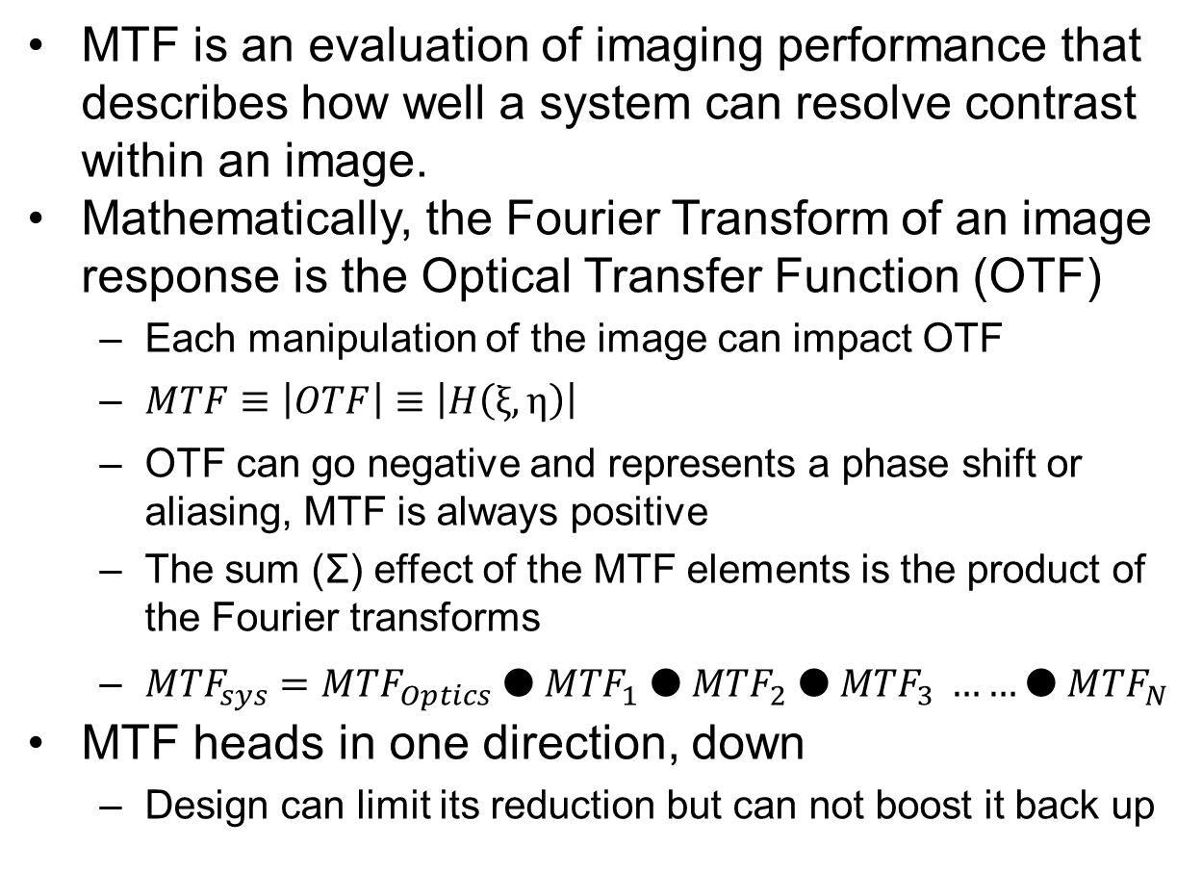
Modulation Transfer Function MTF
MTF is an evaluation of imaging performance that describes how well a system can resolve contrast within an image.
Mathematically, the Fourier Transform of an image response is the Optical Transfer Function (OTF)
  Each manipulation of the image can impact OTF
  $MTF≡\left|OTF\right|≡\left|H\left(ξ,η\right)\right|$
  OTF can go negative and represents a phase shift or aliasing, MTF is always positive
  The sum (Σ) effect of the MTF elements is the product of the Fourier transforms
  ${MTF}_{sys}={MTF}_{Optics} ●{ MTF}_{1} ●{ MTF}_{2} ●{ MTF}_{3} ……●{ MTF}_{N}$
MTF heads in one direction, down
  Design can limit its reduction but can not boost it back up

Slide 3
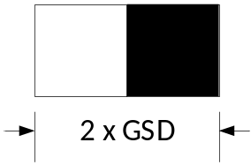
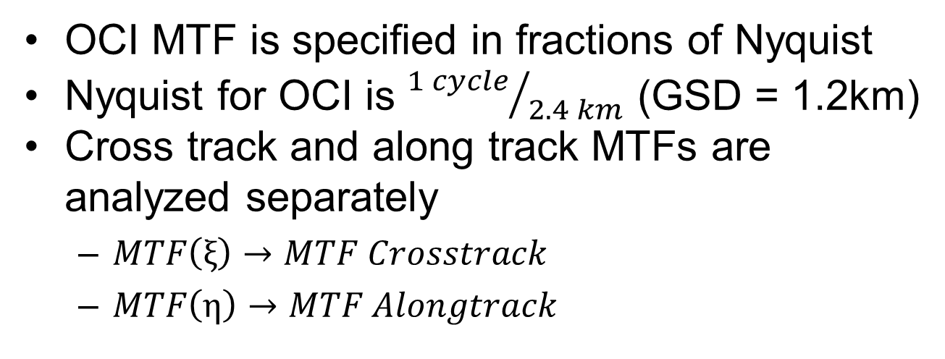
OCI MTF Requirements
OCI MTF is specified in fractions of Nyquist
Nyquist for OCI is ${1 cycle}/{2.4 km}$ (GSD = 1.2km)
Cross track and along track MTFs are analyzed separately
  $MTF\left(ξ\right)→MTF Crosstrack$
  $MTF\left(η\right)$ $→MTF Alongtrack$
1.2 km
1.2 km
Along Track
Fraction of Nyquist | Spatial Cycle Period | Requirement
0.0 | Uniform | 1.0
0.25 | 8 x GSD | 0.9
0.5 | 4 x GSD | 0.7
0.75 | 2.67 x GSD | 0.5
1.0 | 2 x GSD | 0.3
Cross Track Pattern
Nyquist Frequency
September 24
3

Slide 4
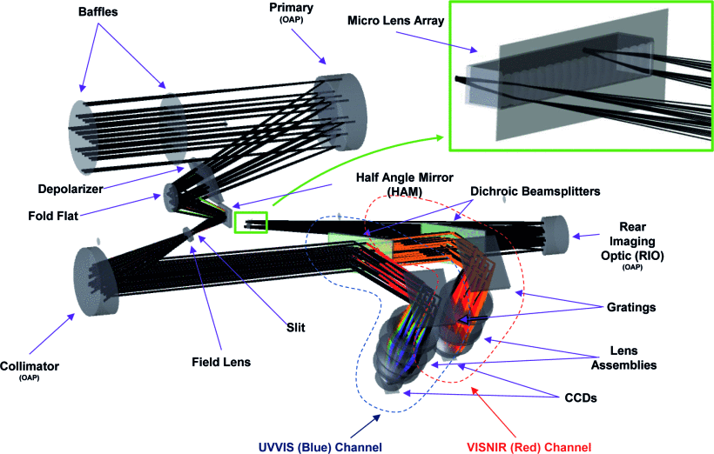
OCI Design
Rotating telescope / half-angle mirror architecture
2 CCD spectrograph detectors (UVNIR)
  315-607 nm
  597-887 nm
Fiber fed multi-band SWIR detection assembly
  940, 1038, 1250, 1378, 1615, 2130, and 2260nm
September 24
4

Slide 5
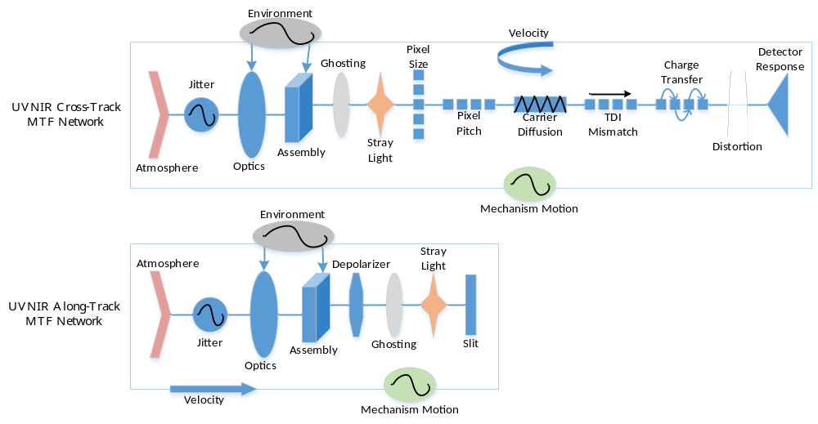
UVNIR MTF Networks
CCD Primary Contributors
Cross Track
  Image Velocity
  Jitter
Along Track
  Slit Size (effective pixel)
  Jitter
September 24
5

Slide 6
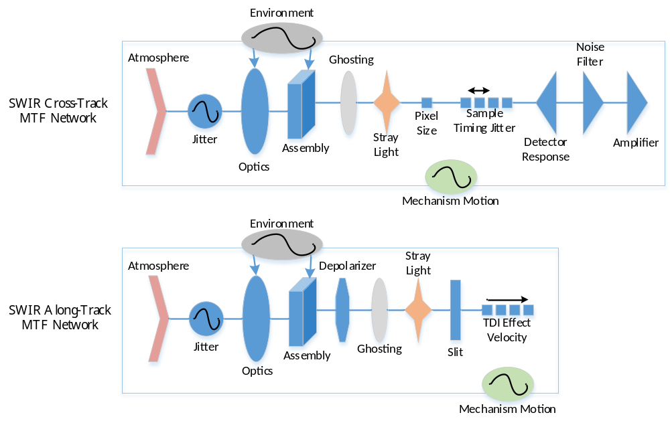
SWIR MTF Networks
SWIR Primary Contributors
Cross Track
  MLA element size (effective pixel)
  Electronic Filtering
Along Track
  Slit Size (effective pixel)
  Jitter
September 24
6

Slide 7
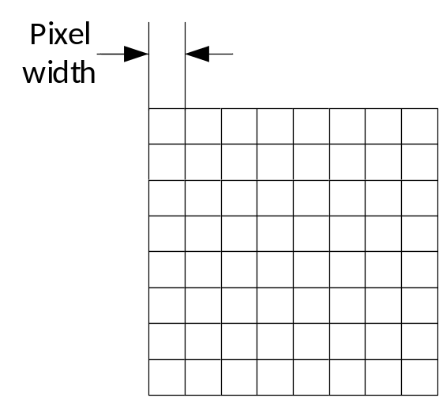
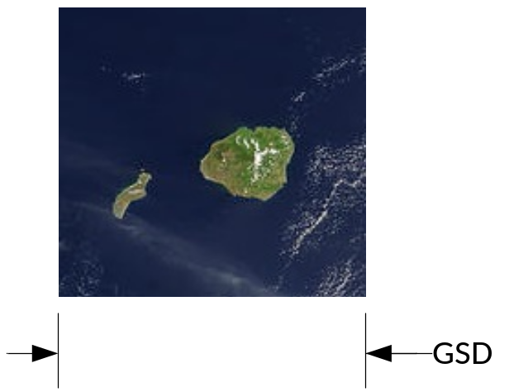
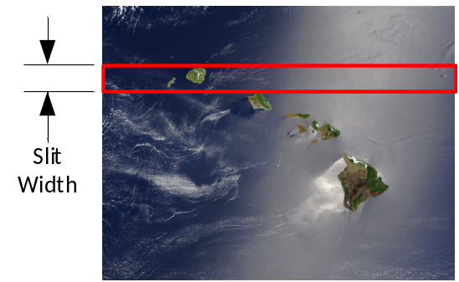
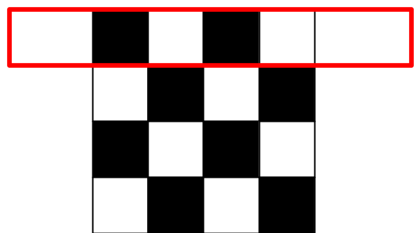
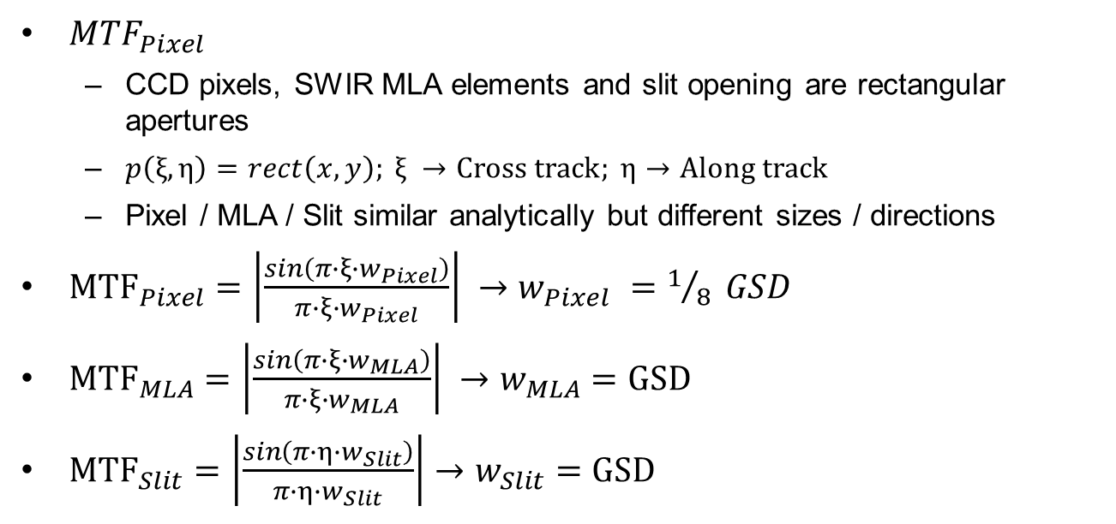
Pixel Size / MLA / Slit Contributions
${MTF}_{Pixel}$
  CCD pixels, SWIR MLA elements and slit opening are rectangular apertures
  $p\left(ξ,η\right)=rect\left(x, y\right); ξ →Cross track; η→Along track$
  Pixel / MLA / Slit similar analytically but different sizes / directions
${MTF}_{Pixel}=\left|\frac{sin\left(π∙ξ∙w_{Pixel}\right)}{π∙ξ∙w_{Pixel}}\right| →w_{Pixel} =1/8 GSD$
${MTF}_{MLA}=\left|\frac{sin\left(π∙ξ∙w_{MLA}\right)}{π∙ξ∙w_{MLA}}\right| →w_{MLA}=GSD$
${MTF}_{Slit}=\left|\frac{sin\left(π∙η∙w_{Slit}\right)}{π∙η∙w_{Slit}}\right|→w_{Slit}=GSD$
*Pictures not to scale
September 24
7

Slide 8
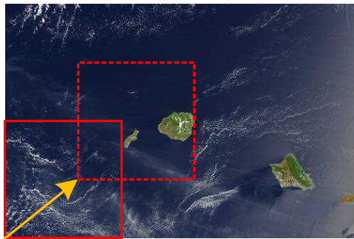
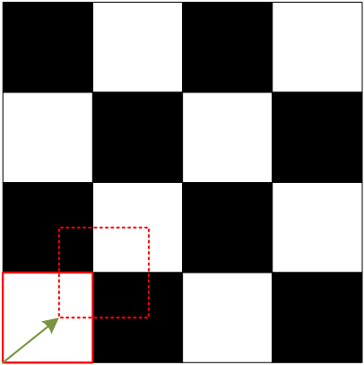
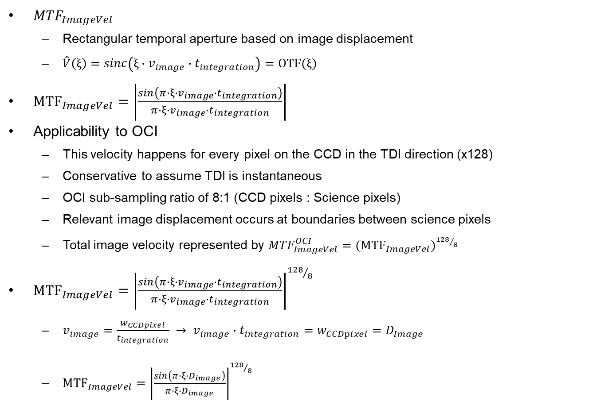
Image Velocity MTF
${MTF}_{ImageVel}$
  Rectangular temporal aperture based on image displacement
  $\hat{V}\left(ξ\right)=sinc\left(ξ∙v_{image}∙t_{integration}\right)=OTF(ξ)$
${MTF}_{ImageVel}=\left|\frac{sin\left(π∙ξ∙v_{image}∙t_{integration}\right)}{π∙ξ∙v_{image}∙t_{integration}}\right|$
Applicability to OCI
  This velocity happens for every pixel on the CCD in the TDI direction (x128)
  Conservative to assume TDI is instantaneous
  OCI sub-sampling ratio of 8:1 (CCD pixels : Science pixels)
  Relevant image displacement occurs at boundaries between science pixels
  Total image velocity represented by ${MTF}_{ImageVel}^{OCI}={{(MTF}_{ImageVel})}^{{128}/8}$
${MTF}_{ImageVel}={\left|\frac{sin\left(π∙ξ∙v_{image}∙t_{integration}\right)}{π∙ξ∙v_{image}∙t_{integration}}\right|}^{{128}/8}$
  $v_{image}=\frac{w_{CCDpixel}}{t_{integration}} → v_{image}∙t_{integration}=w_{CCDpixel}=D_{Image}$
  ${MTF}_{ImageVel}={\left|\frac{sin\left(π∙ξ∙D_{image}\right)}{π∙ξ∙D_{image}}\right|}^{{128}/8}$
GSD
September 24
8

Slide 9
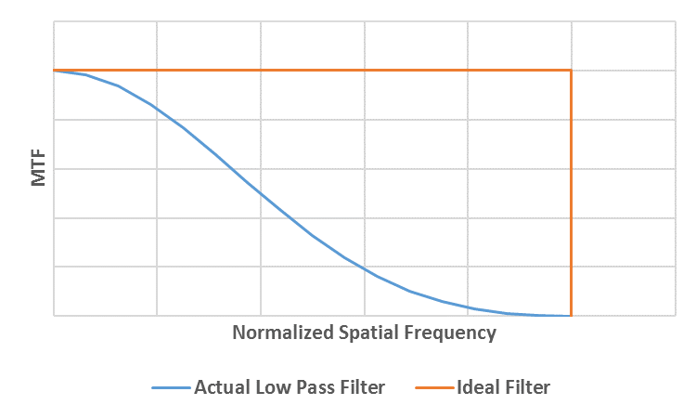
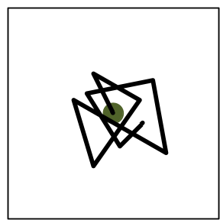
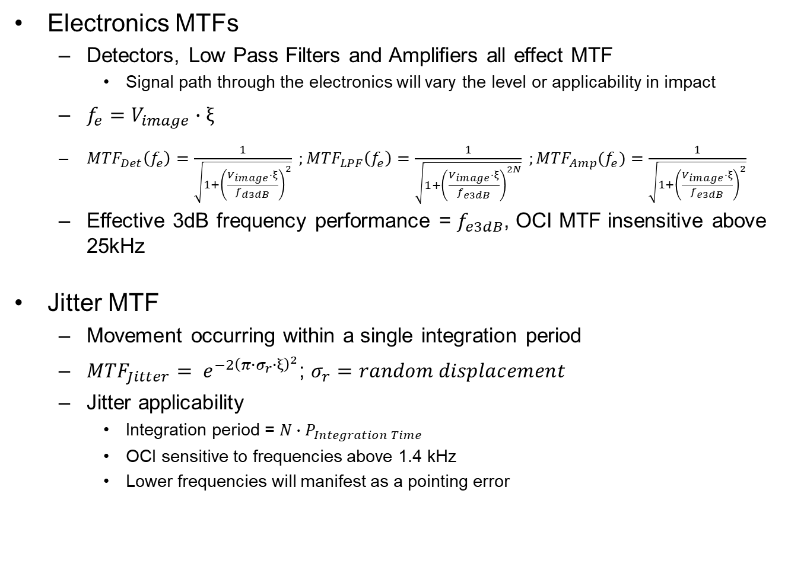
Electronics and Jitter MTF
Electronics MTFs
  Detectors, Low Pass Filters and Amplifiers all effect MTF
    Signal path through the electronics will vary the level or applicability in impact
  $f_{e}=V_{image}∙ξ$
  ${MTF}_{Det}\left(f_{e}\right)=\frac{1}{\sqrt{1+{\left(\frac{V_{image}∙ξ}{f_{d3dB}}\right)}^{2}}} ;{MTF}_{LPF}\left(f_{e}\right)=\frac{1}{\sqrt{1+{\left(\frac{V_{image}∙ξ}{f_{e3dB}}\right)}^{2N}}} ;{MTF}_{Amp}(f_{e})=\frac{1}{\sqrt{1+{\left(\frac{V_{image}∙ξ}{f_{e3dB}}\right)}^{2}}}$
  Effective 3dB frequency performance = $f_{e3dB}$, OCI MTF insensitive above 25kHz
Jitter MTF
  Movement occurring within a single integration period
  ${MTF}_{Jitter}= e^{{−2\left(π∙σ_{r}∙ξ\right)}^{2}}$; $σ_{r}=random displacement$
  Jitter applicability
    Integration period = $N∙P_{Integration Time}$
    OCI sensitive to frequencies above 1.4 kHz
    Lower frequencies will manifest as a pointing error
September 24
9

Slide 10
UVNIR MTF Analysis Results
September 24
10

Slide 11
SWIR MTF Analysis Results
September 24
11

Slide 12
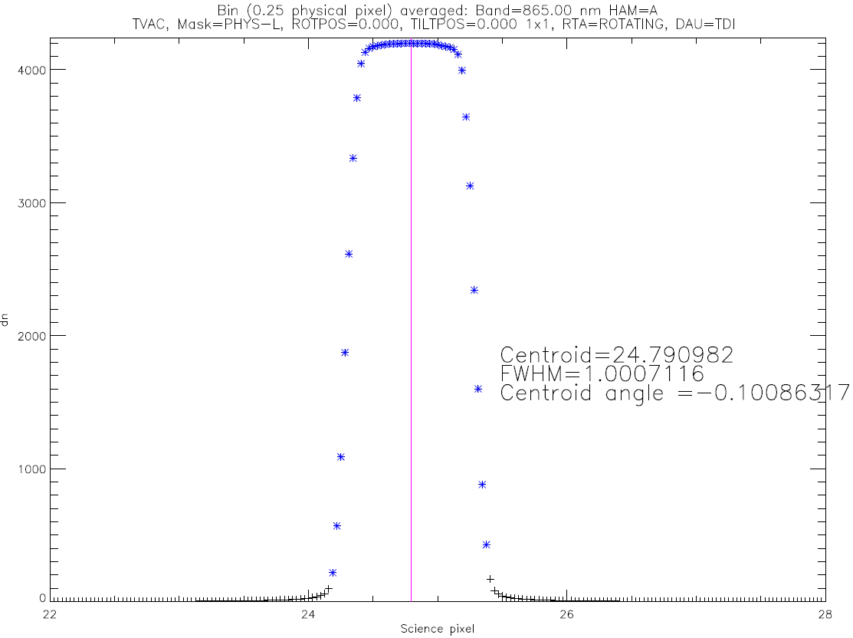
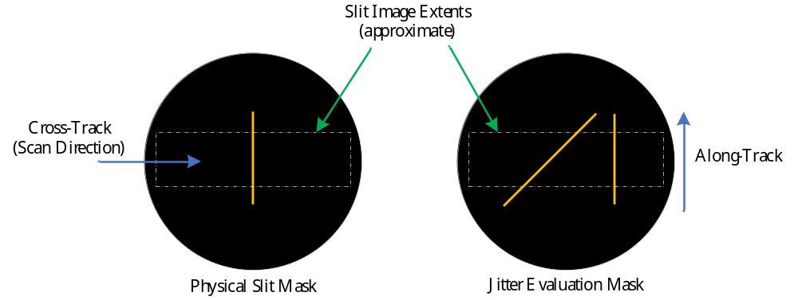
Testing Description
Testing was performed using a collimated scene projected into the OCI telescope
Time adjusted collections of the scene were superimposed to produce a detailed characterization of the OCI IFOV
The Fourier Transform of the IFOV was calculated for each direction
September 24
12

Slide 13
CCD LSF Bench Test Results
September 24
13

Slide 14
SWIR LSF Bench Test Results
September 24
14

Slide 15
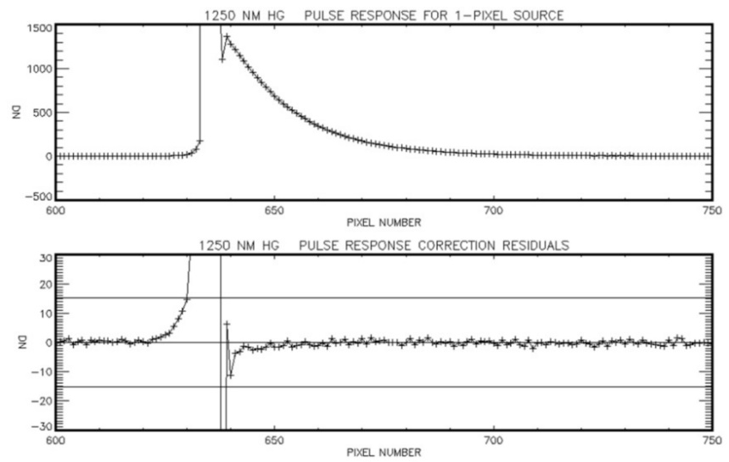
Analysis vs Testing
UVNIR cross-track analysis and test results are in good agreement (sub-sampling advantage)
UVNIR along-track analysis shows better than expected performance
SWIR testing showed MTF performance worse in some bands than predicted by analysis
  Cause suspected to be extended tail response
  Flight data utilizes a correction, not yet in place for testing
 |  | UVNIR Along-Track (Wavelength average) |  | SWIR Cross-Track (Wavelength average) |  | SWIR Along-Track (Wavelength average)
 |  | MTF | % Diff from Analysis | MTF | % Diff from Analysis | MTF | % Diff from Analysis
0.25 Nyquist | Test | 0.95 | 3% | 0.94 | 2% | 0.94 | 1%
 | Test w/ Analytical Aperture | 0.94 | 2% | 0.92 | -1% | 0.91 | -2%
0.5 Nyquist | Test | 0.84 | 10% | 0.83 | 11% | 0.82 | 7%
 | Test w/ Analytical Aperture | 0.78 | 2% | 0.75 | -0.40% | 0.74 | -4%
0.75 Nyquist | Test | 0.69 | 24% | 0.68 | 24% | 0.65 | 15%
 | Test w/ Analytical Aperture | 0.57 | 2% | 0.53 | -2% | 0.51 | -10%
1.0 Nyquist | Test | 0.53 | 34% | 0.49 | 43% | 0.47 | 27%
 | Test w/ Analytical Aperture | 0.36 | 3% | 0.31 | -9% | 0.3 | -19%
September 24
15

Slide 16
Conclusions
Complex instruments can benefit from detailed MTF analysis.
Identifying the primary contributors can assist to focus resources and efforts toward most impactful elements.
Testing provides confidence in analysis and more robust verification of requirements.
Comparison of analysis with test results provides insight into test adequacy and nuance of instrument data collection.
September 24
16

