Slide 1



Lunar Position, Navigation, and Timing
  Presented by: Juan Crenshaw
  NASA Goddard Space Flight Center
September 19, 2024
Institute of Navigation, GNSS+
Baltimore, Maryland

Slide 2
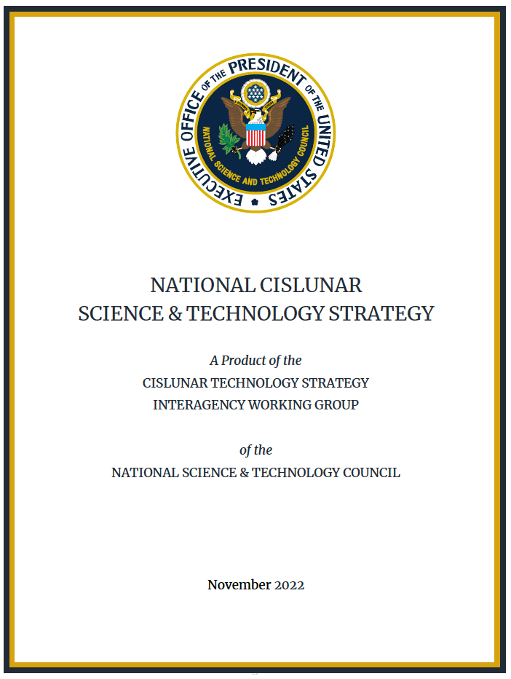

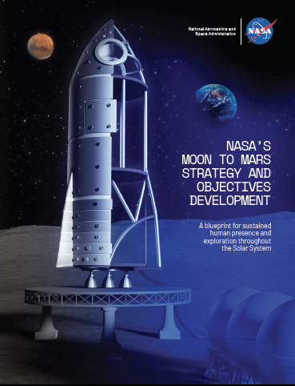
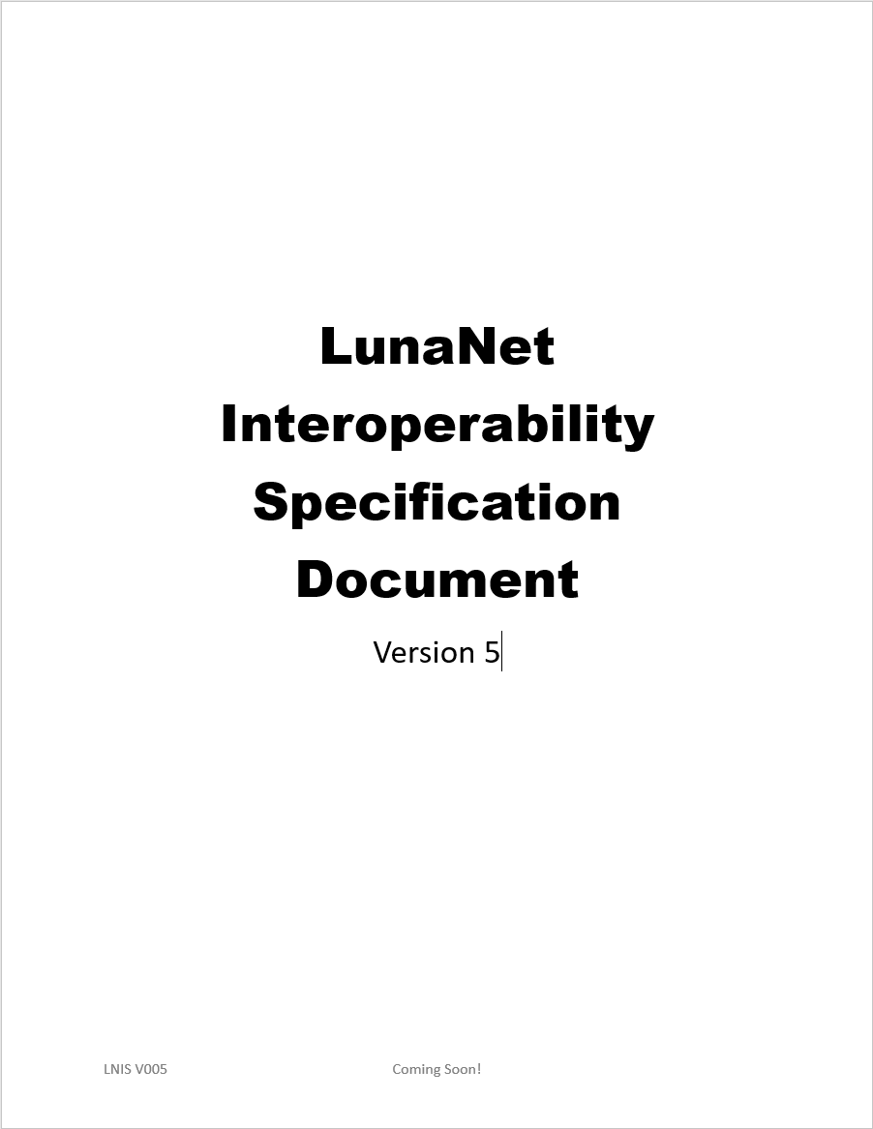
Objectives Sources & Drivers
OSTP National Cislunar Science & Technology Strategy: Objective 4
M2M Strategy & Objectives:
Lunar Infrastructure-3,
Global PNT
Implement Cislunar communications and positioning, navigation, and timing capabilities with scalable and interoperable approaches…
Communications and positioning, navigation, and timing (PNT) are the common information infrastructure needed for all activities in Cislunar space…
Create an interoperable global lunar utilization infrastructure …
LI-3: Develop a lunar position, navigation and timing architecture capable of scaling to support long term science, exploration, and industrial needs.
LunaNet Interoperability Specification:
PNT Services
Coming Soon!

Slide 3
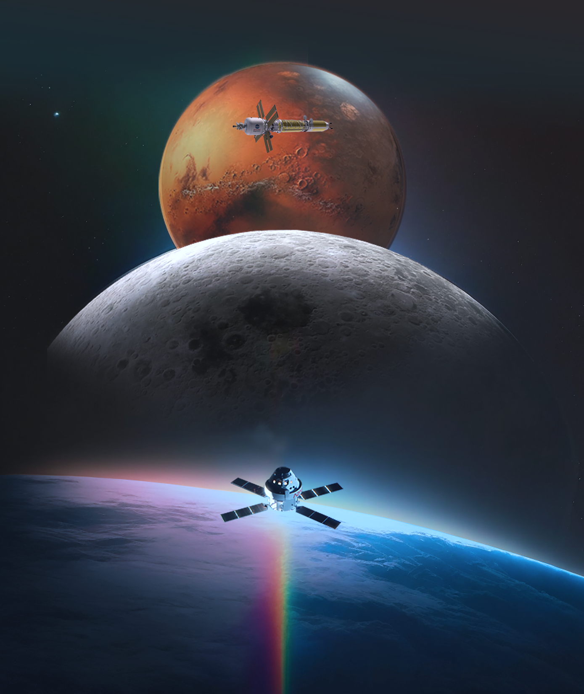



Moon to Mars Objectives
10
63
GOALS
OBJECTIVES
…reflect a matured strategy … for sustained human presence and exploration throughout the solar system via the Moon to Mars endeavor
...RTs describe aspects ...that are fundamental to achieving the Moon to Mars objective
Recurring Tenets (RT)
RT-1: International Collaboration: Partner with the international community to achieve common goals and objectives.
RT-2: Industry Collaboration: Partner with U.S. industry to achieve common goals and objectives.
RT-7: Interoperability: Enable interoperability and commonality (technical, operations, and process standards) among systems, elements, and crews throughout the campaign .
Operations | Infrastructure | Transportation and Habitation | Science
3

Slide 4

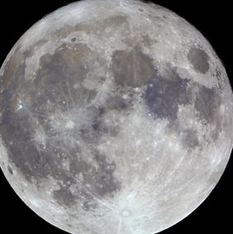
Phased Expansion of Lunar PNT
GNSS-only Lunar demonstrations
GNSS Lunar Operations
Combined GNSS, Lunar PNT & Op Nav Service Demos
Broad Infusion
Relative use of signal sources
Terrestrial GNSS
Lunar PNT Services
(e.g. LunaNet)
Time
Today
Transit use of GNSS and Lunar PNT Services
Lunar PNT Services
(e.g. LunaNet)
GNSS Use
Lunar PNT Use
Transit Distance

Slide 5

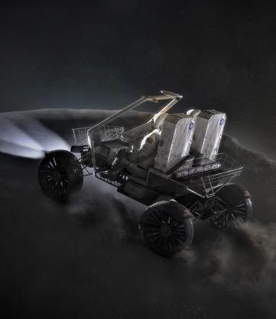

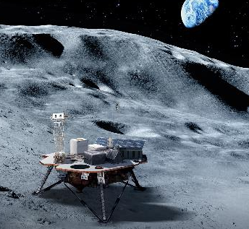

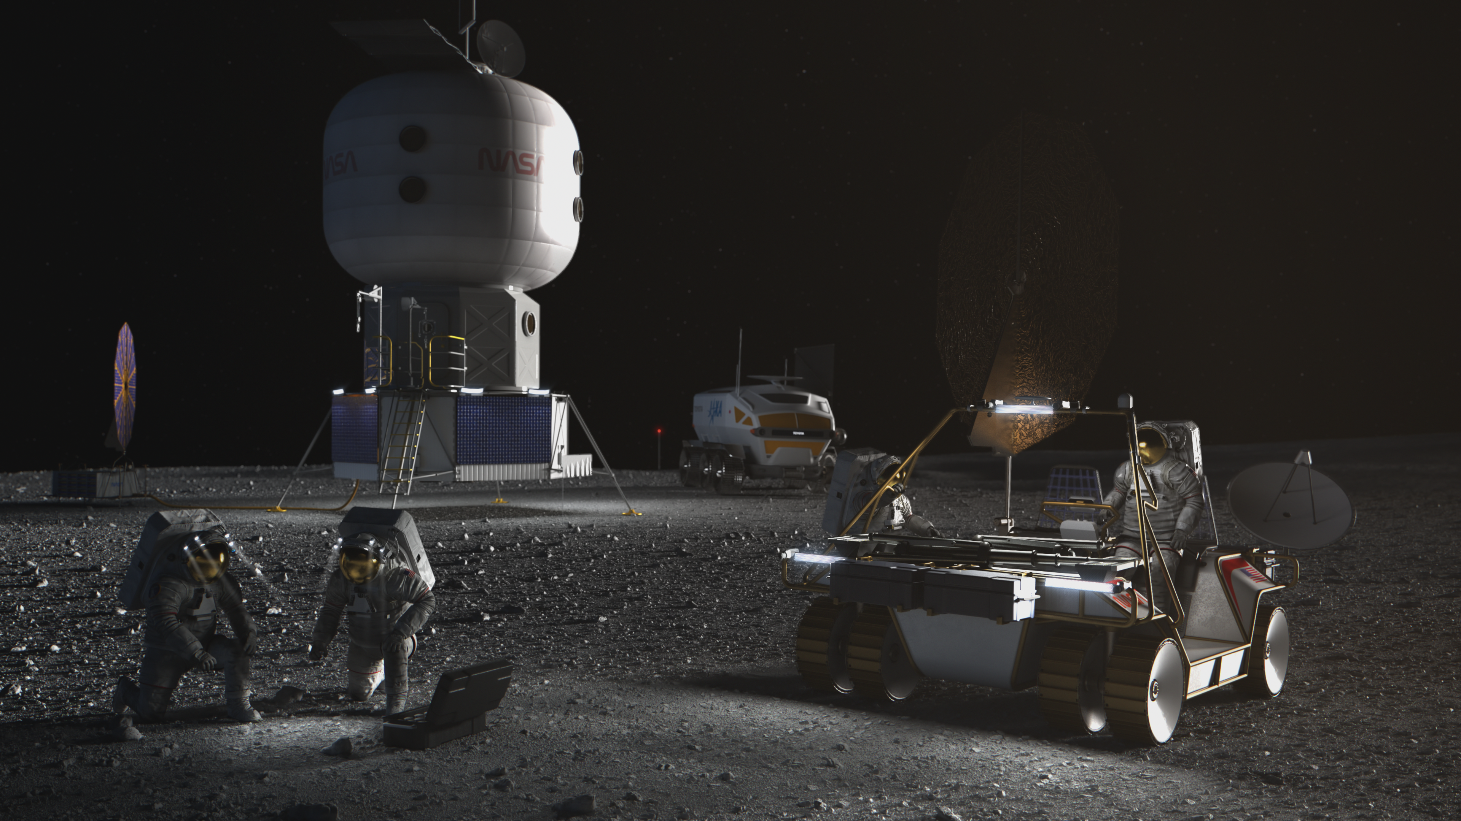
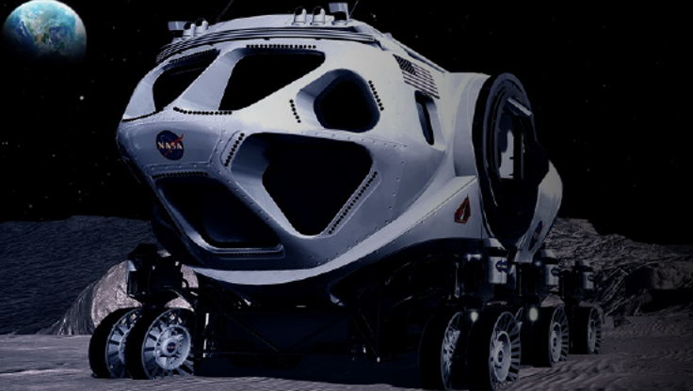
User Drivers
Global, safe, real-time navigation
Highly dynamic environment (e.g. descent, ascent)
Situational Awareness
Efficient operations due to EVA time constraints and multiple mission objectives
  Limited survivability resources
  Apollo-type navigation (orienteering) requires stop-time
  Contingency walk-back scenarios
Telerobotic operations, e.g. Lunar Terrain Vehicle surface prep for crew
Real time localization on a map
Accurate science

Slide 6
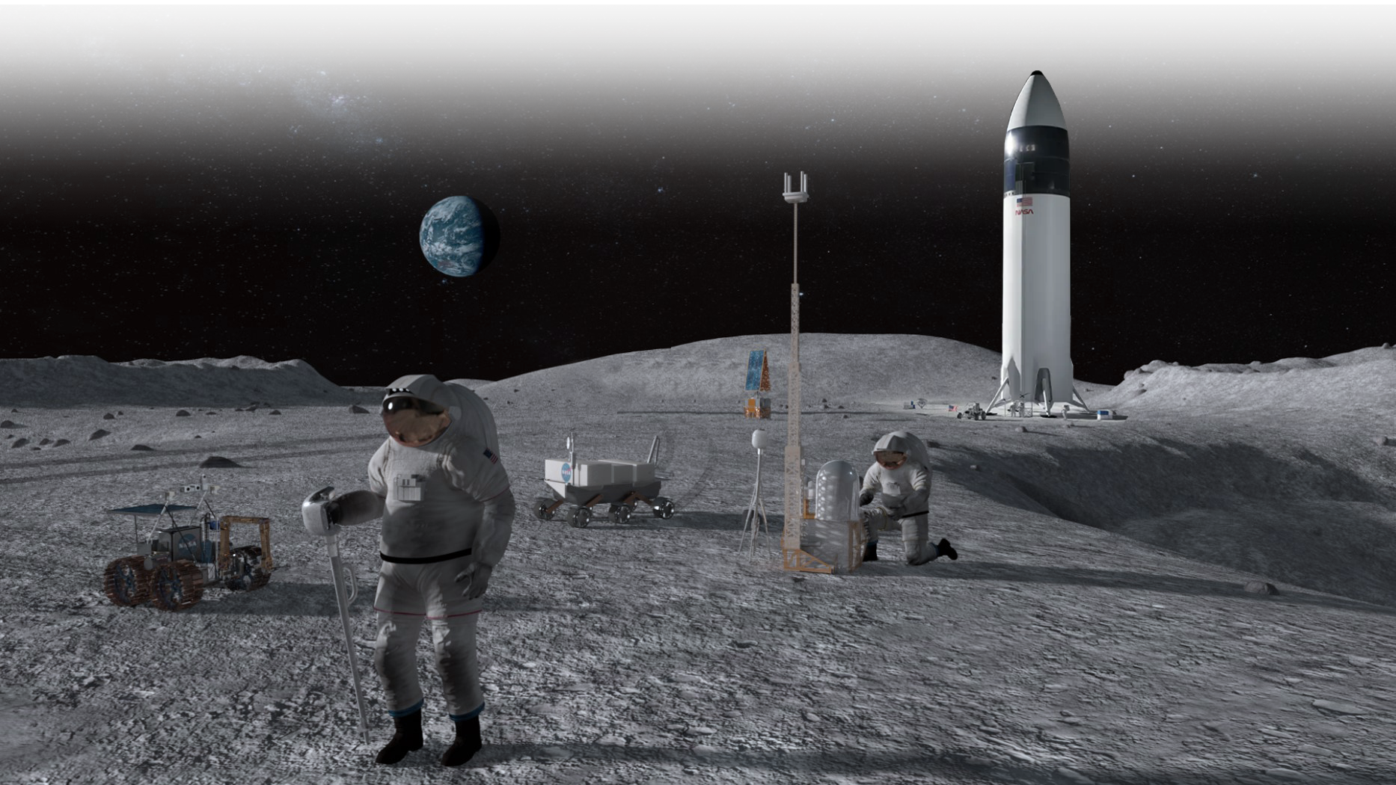
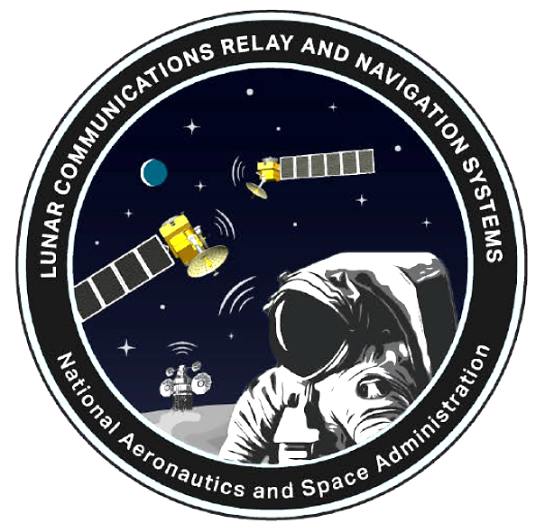
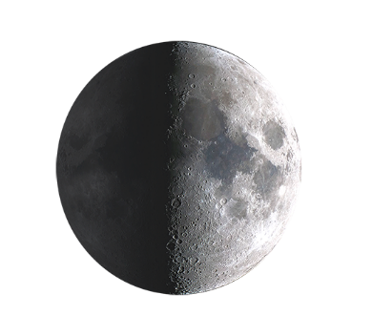

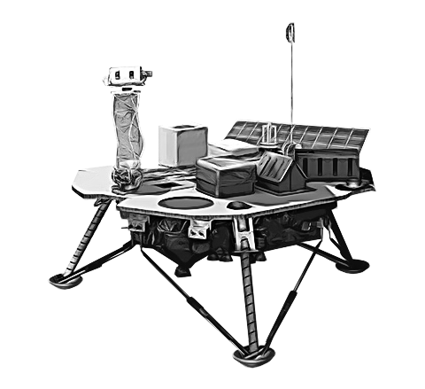




Initial Capability for LCRNS
Initial Capability is expected to consist of three distinct phases over a period of approx. 5 years:
  Phase Alpha, with a minimum of one Augmented Forward Signal (AFS) expected to broadcast over the South Pole region.
  Phase Bravo, with a minimum of two AFS expected over the same South Pole region.
  Phase Charlie, with an expected minimum of four AFS in view for a limited portion of an Earth day, also meeting a requirement for GDOP.
The LCRNS AFS will comply with the LunaNet Interoperability Specification.
LCRNS orbit(s) will be defined by the service provider and are expected to meet the Signal-in-Space-Error.
It is expected that LCRNS will be capable of providing two-way measurements from Point-to-Point (P2P) signals.
Service delivery is reliant on defined lunar geodetic system and lunar time.
6
Notes:
Interoperability reduces risk of vendor lock-in, provides a more robust service set
LunaNet is a framework for universally cooperative commercial and government service providers
Engaged in 3GPP to advocate for longer-term standards based

