Slide 1
A GLM Thunder Hour Climatology
Katrina Virts
University of Alabama in Huntsville (UAH)
Steven Goodman
Thunderbolt Global Analytics (TGA)
William Koshak
National Aeronautics and Space Administration (NASA)
GLM Science Team Meeting
24 September 2024

Slide 2
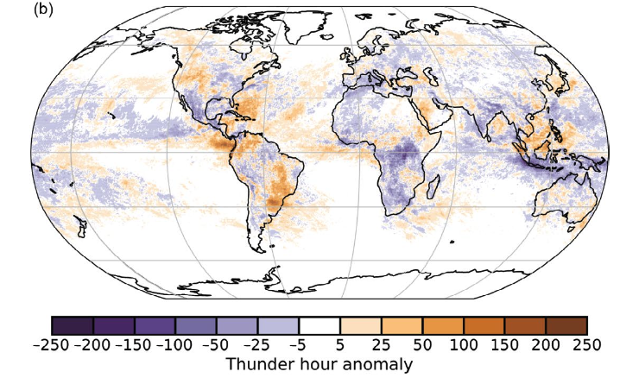
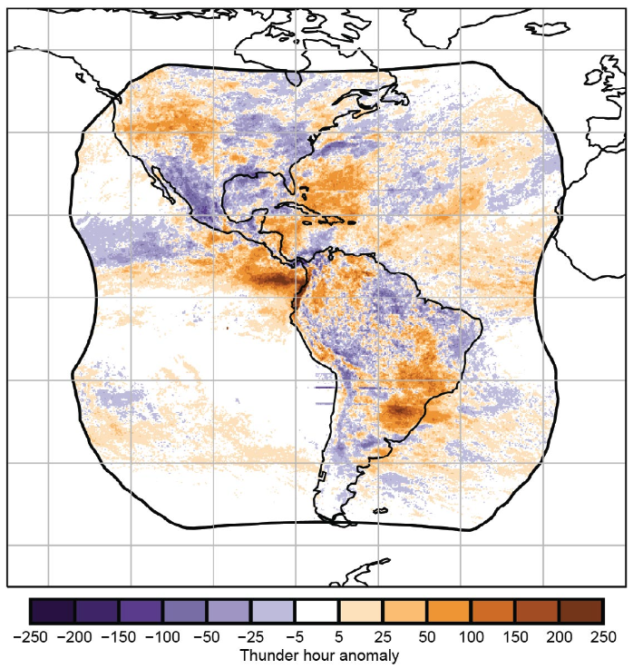
Thunder hour climatologies
Lightning has been declared by WMO to be an Essential Climate Variable
Current effort is to publish standardized thunder hour datasets or climatologies from multiple different sensors and networks
  Calculated in analogy to traditional thunder hour observations
Monthly GLM and WWLLN thunder hour datasets will be hosted at GHRC
BAMS “State of the Climate in 2023” included the 2023 thunder hour anomaly (with respect to the 2018-2022 mean) for three ground networks and GLM16
Ground-based networks
GLM16

Slide 3
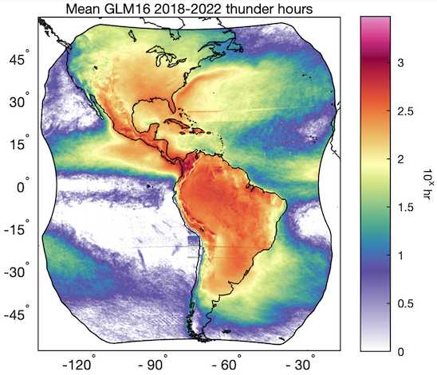
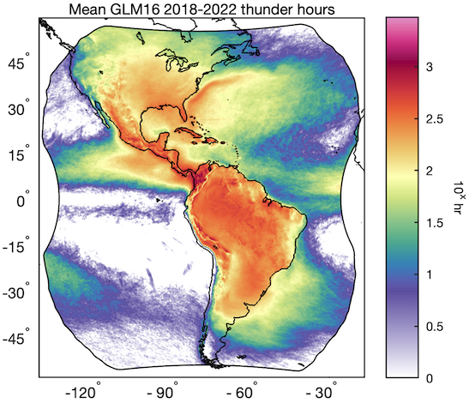
Thunder hour logistics
Following DiGangi et al. (2022), a thunder hour is recorded on a 0.05° grid when at least two GLM groups are within 15 km of the grid point during that hour
“Likely false” groups (no reference strokes within ±10 min, 50 km) removed from analysis
Before
After

Slide 4
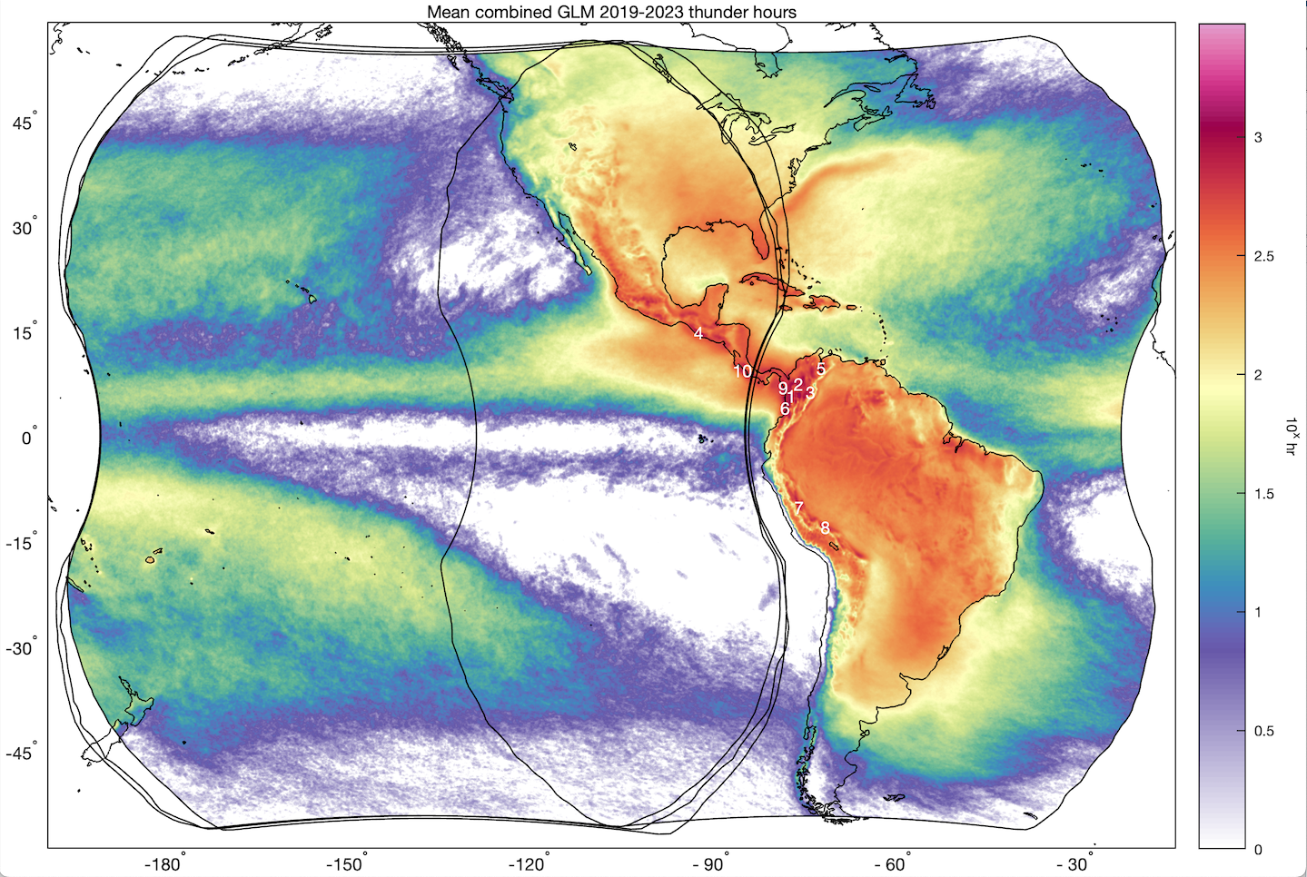
Combining GLM domains
GHRC will host a “combined” GLM thunder hour climatology
Thunder hours calculated from:
2019-2022: GLM17 and GLM16
2023-2024: GLM18 and GLM16
Eventually: GLM18 and GLM19
A thunder hour is recorded if either GLM recorded a thunder hour

Slide 5
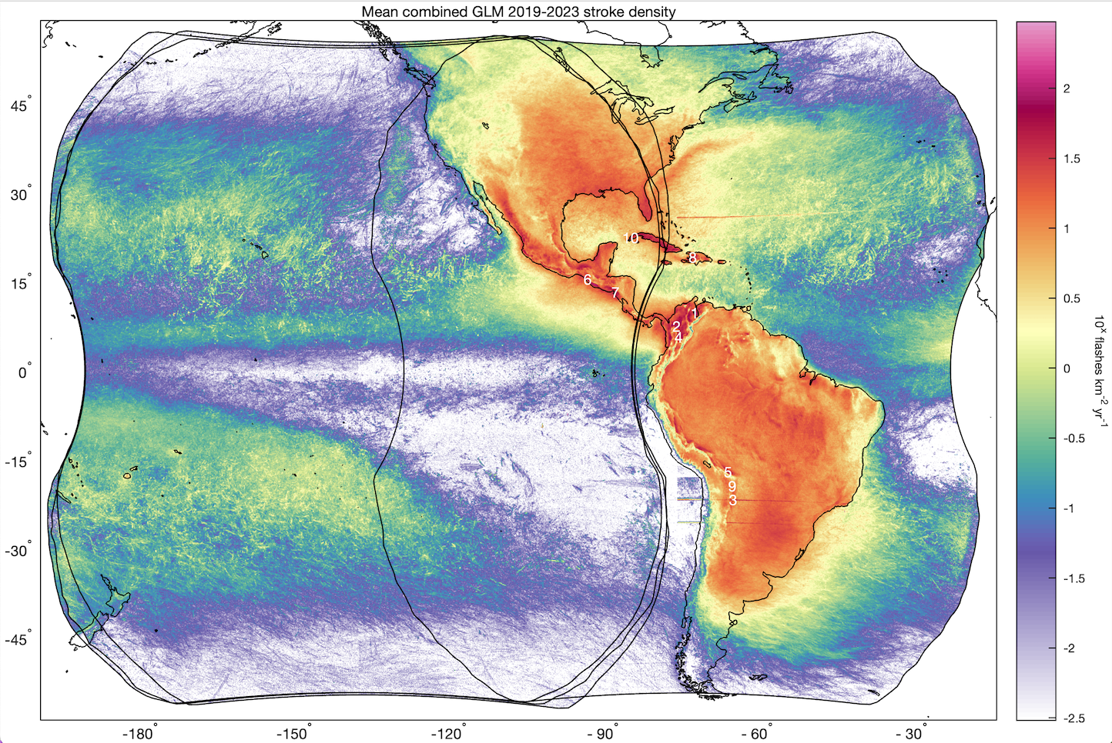
Comparison with GLM stroke density
Both climatologies have hotspots over the complex terrain of the northern Andes
Lake Maracaibo is #1 hotspot for stroke density but #5 for thunder hours
Central/eastern USA and Argentina maxima are weaker for thunder hours than stroke density

Slide 6
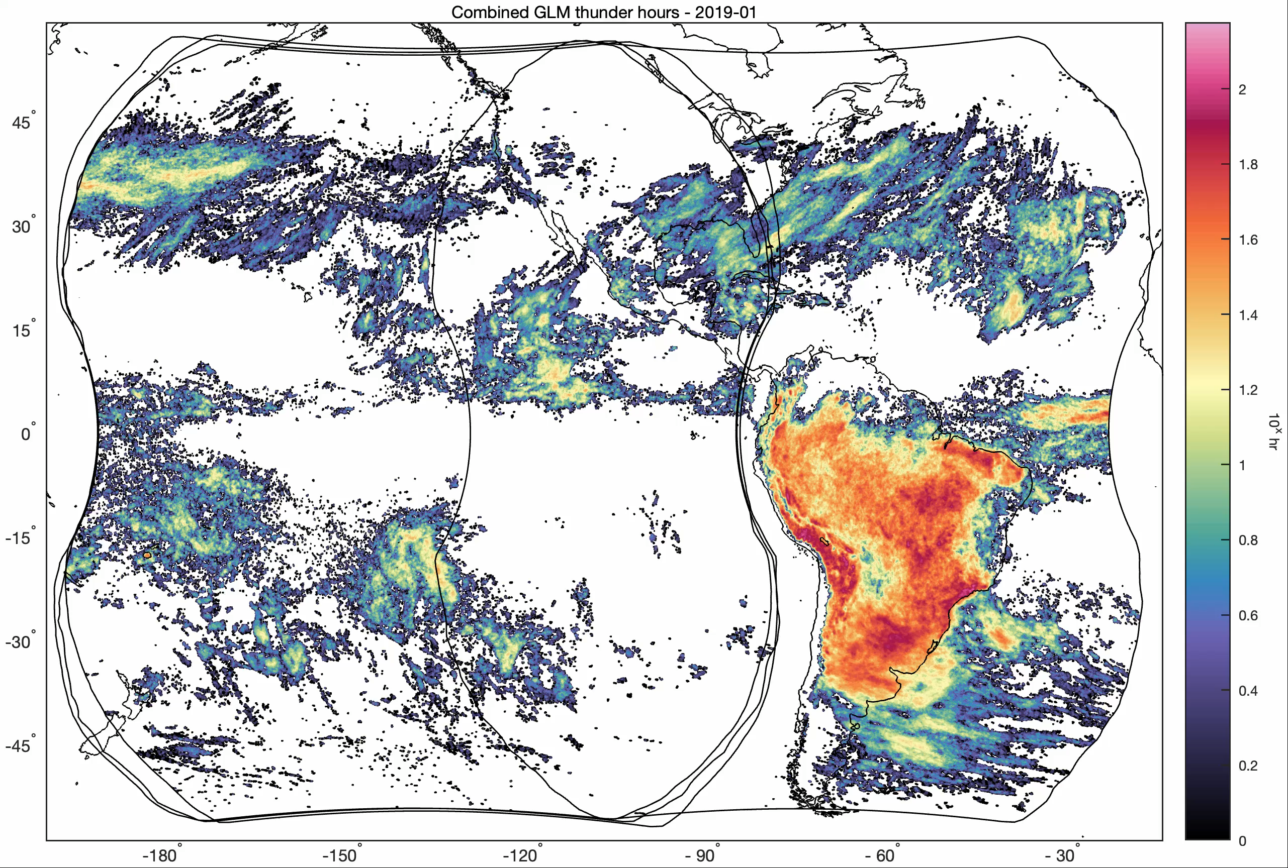
Monthly thunder hours

Slide 7
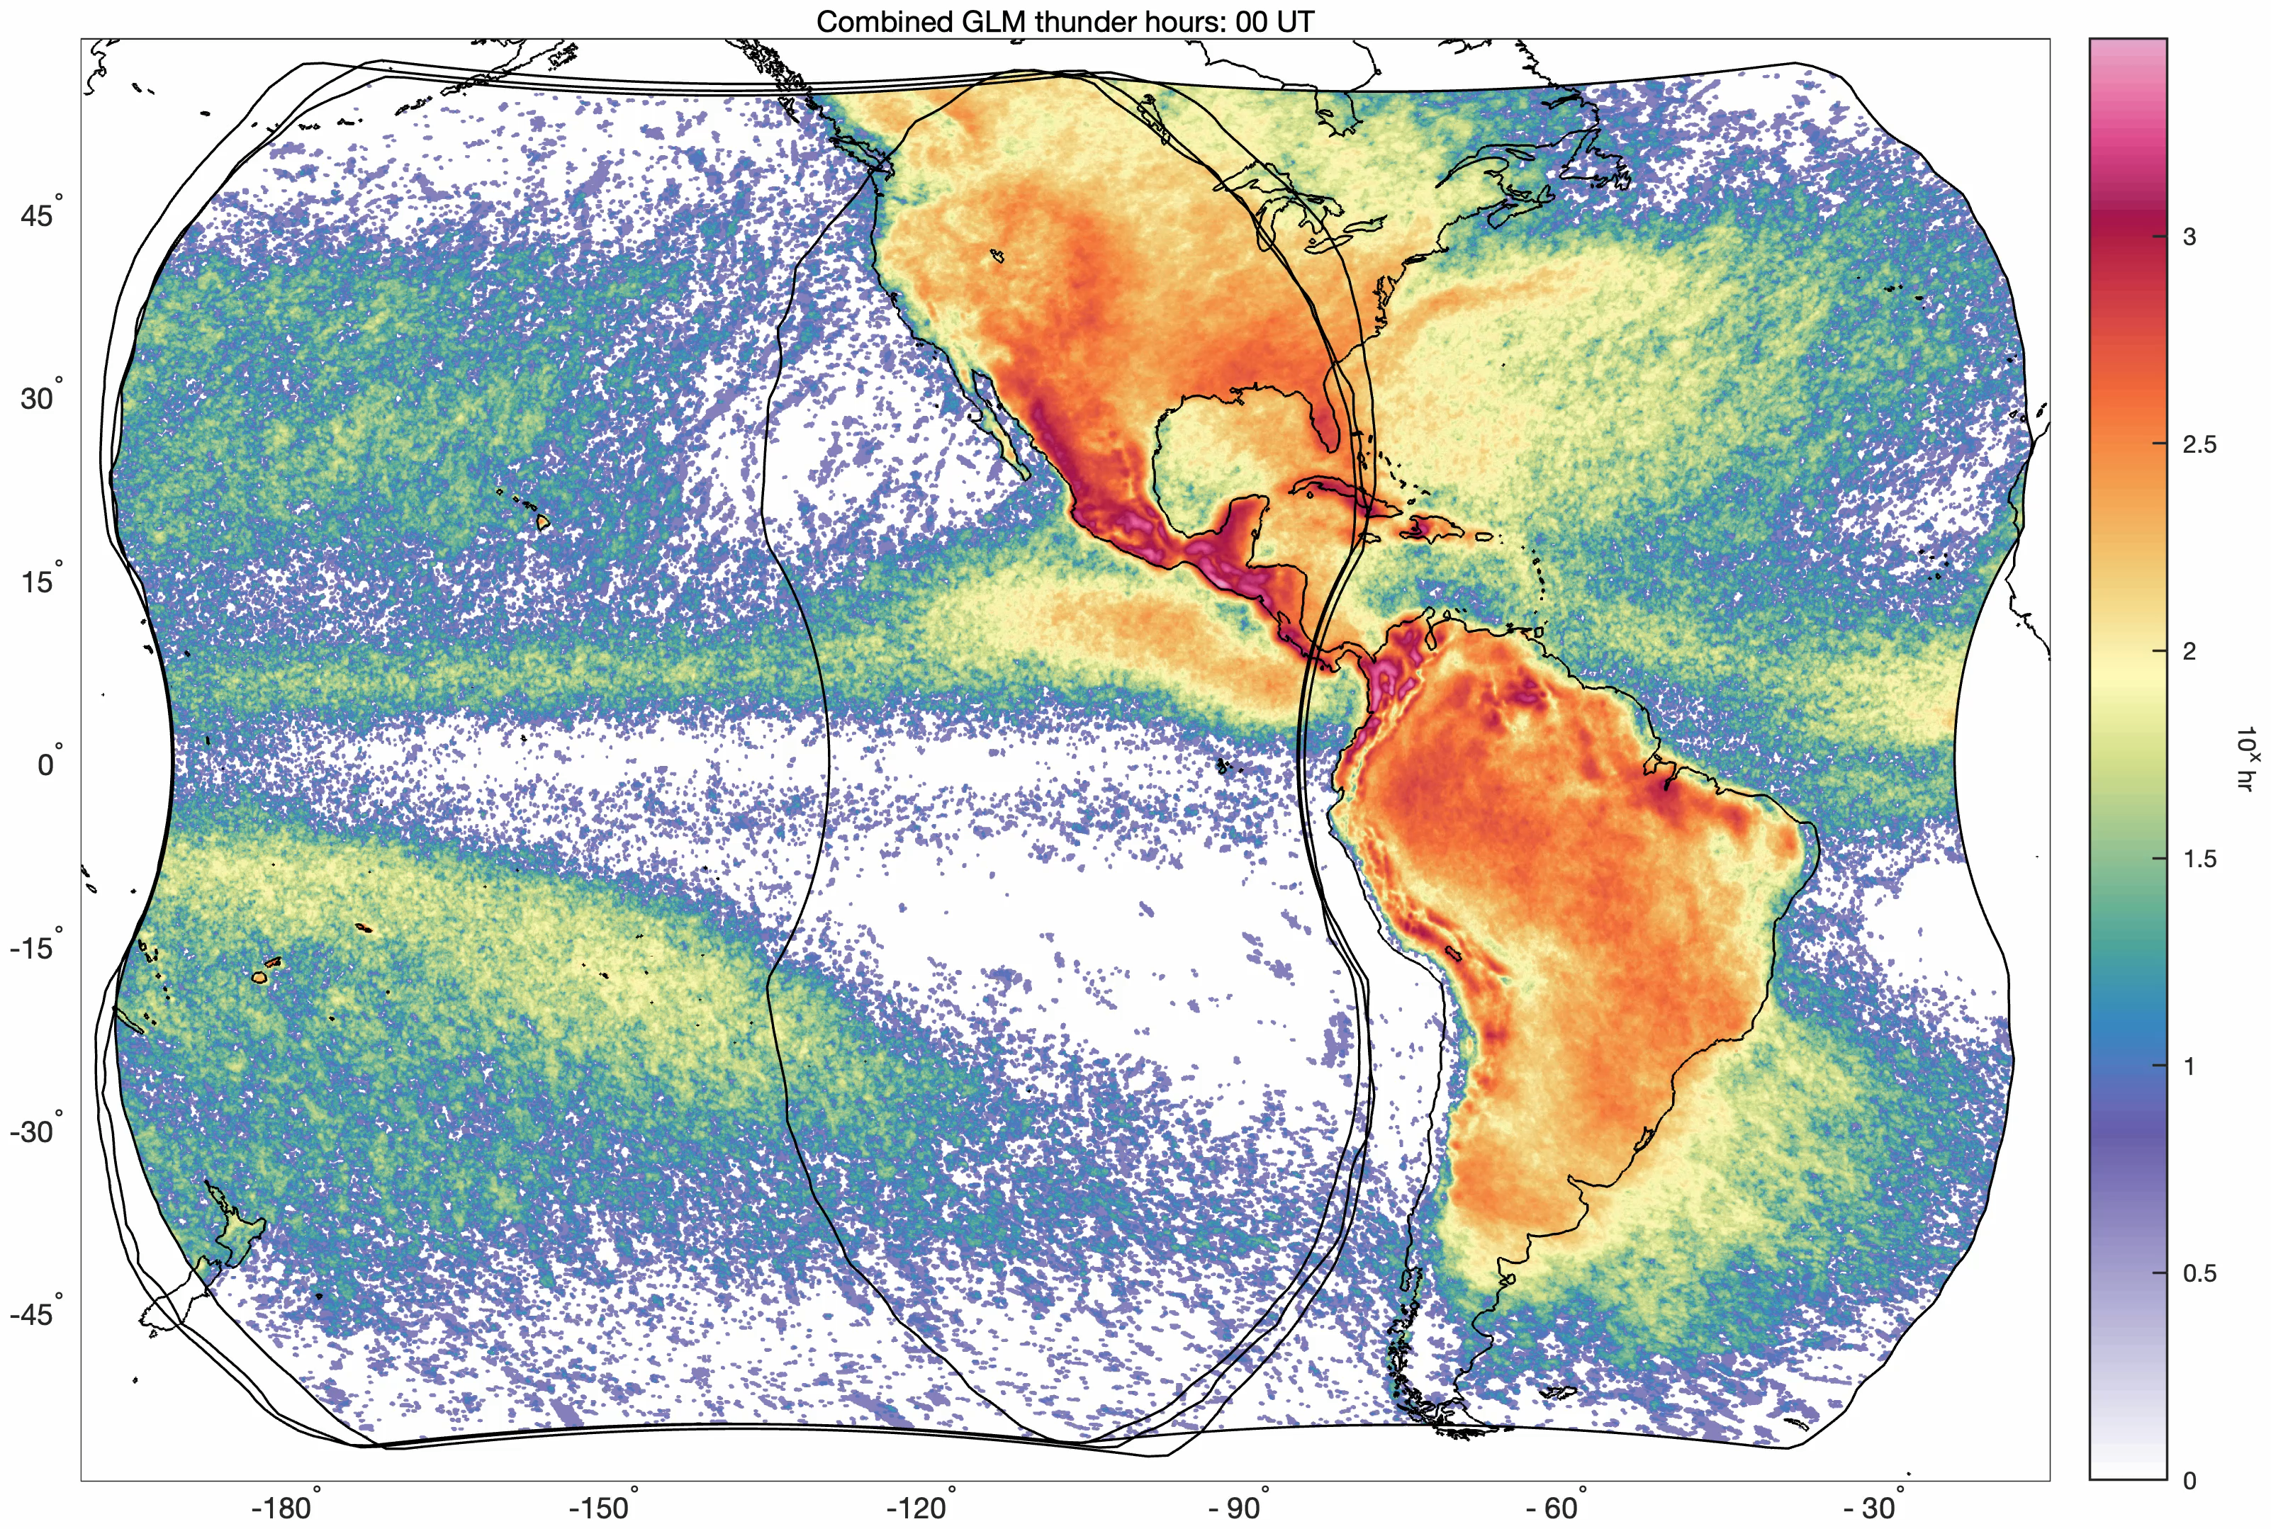
Ongoing work: Monthly and hourly climatology

Slide 8
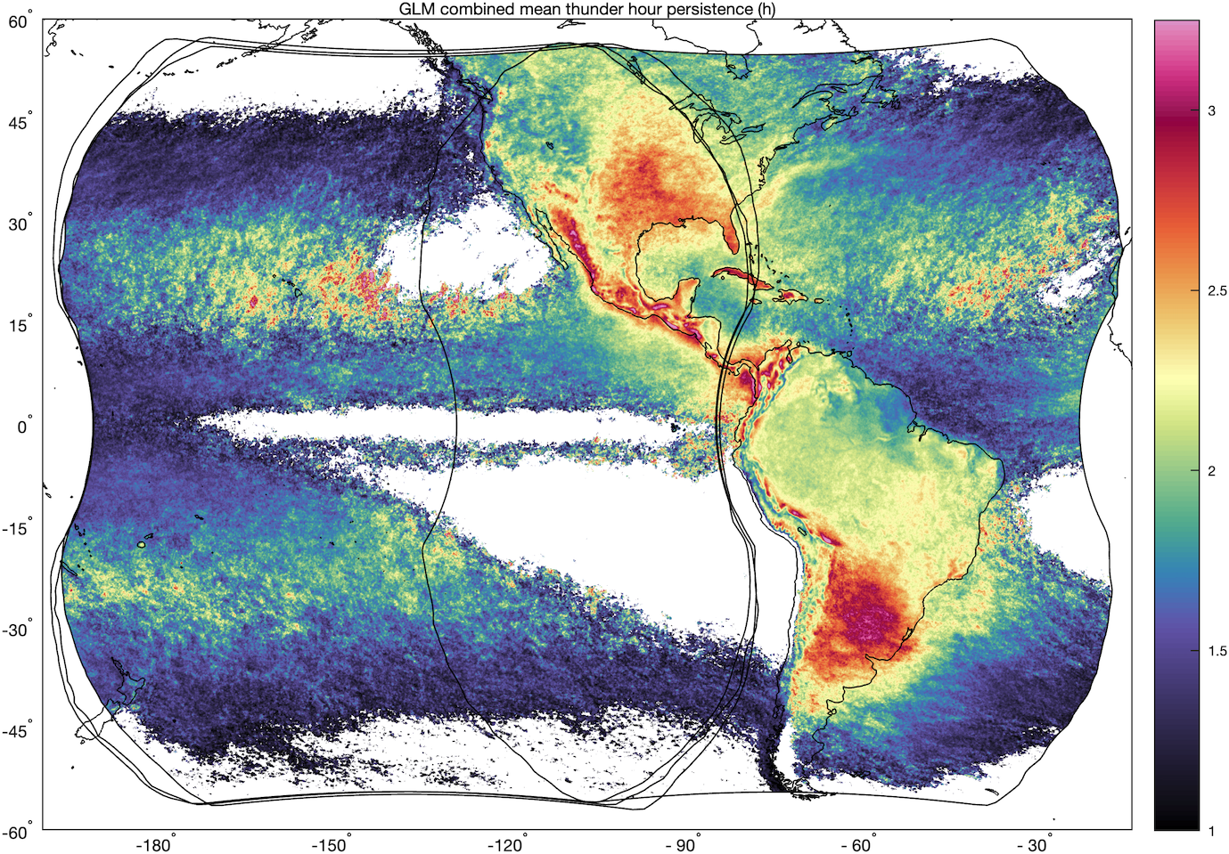
Ongoing work: Thunder hour persistence
Persistence: number of consecutive hours recording a thunder hour
Mean persistence: Maximum over northern Argentina, with hotspots over complex terrain in Central America and northern/central Andes

Slide 9
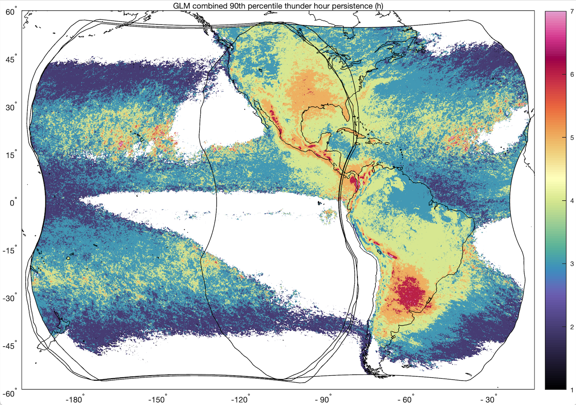
Ongoing work: Thunder hour persistence
90th percentile persistence: Andes foothills and northern Argentina have extrema of 6-7h

Slide 10
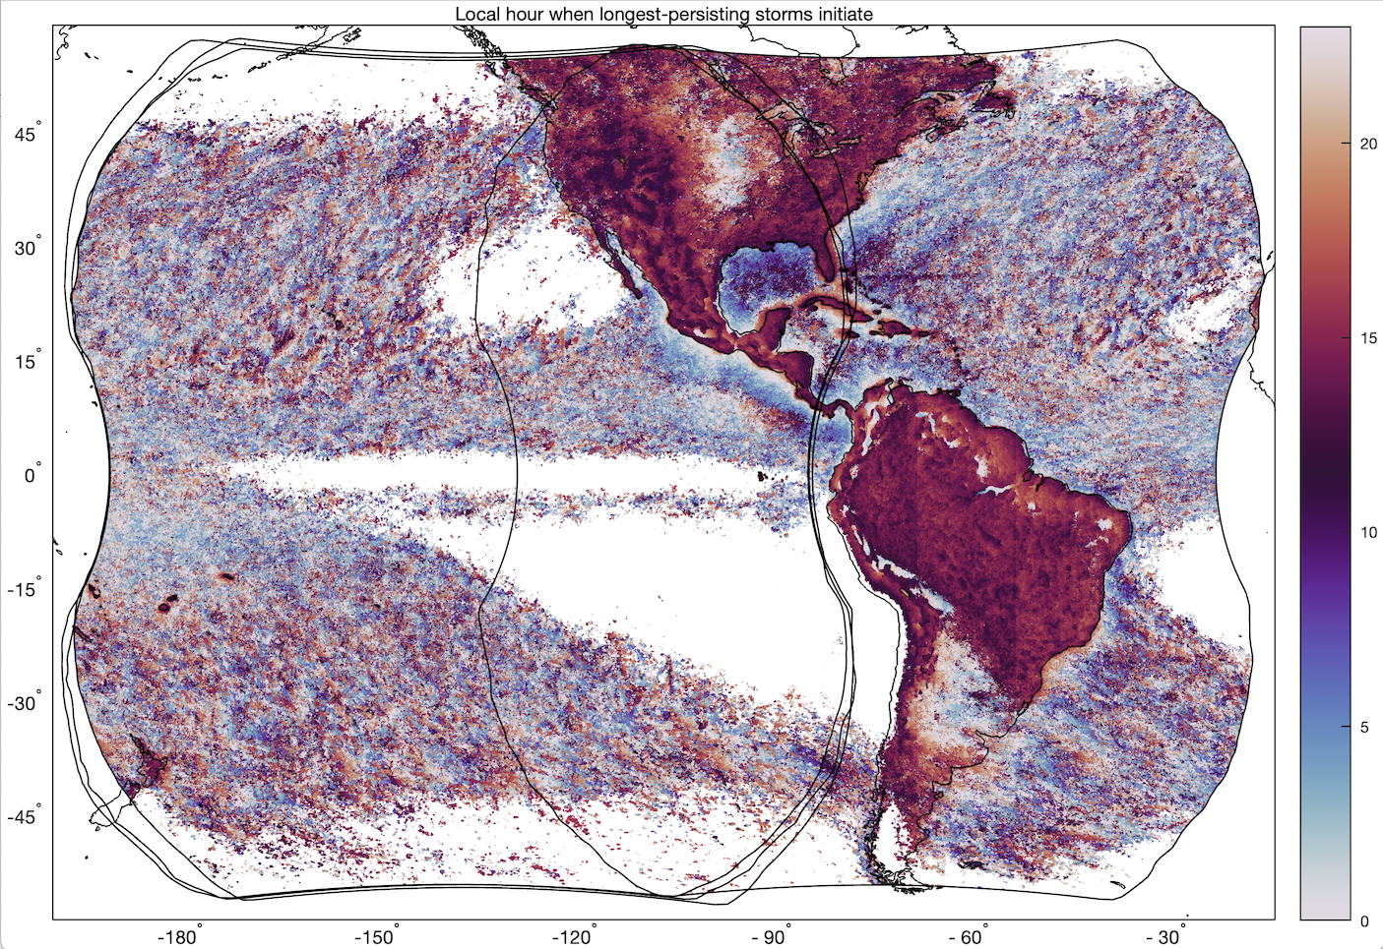
Ongoing work: Thunder hour persistence
For most land areas, most-persistent storms initiate early to mid afternoon
Anomalous behavior over Andean foothills, Argentina, central US, and portions of northeast Brazil
Most-persistent storms over Gulf of Mexico initiate in mid morning

Slide 11
Conclusions
A monthly GLM thunder hour dataset will be published through GHRC for climatological comparison with other lightning sensors/networks
  Long-term record based on combined observations from GOES-West and -East GLMs
Eliminating “likely false” groups reduces areas of obvious artifacts
Ongoing work on thunder hour persistence illustrates areas prone to prolonged lightning activity, including maxima in persistence over Andean foothills and northern Argentina where the longest-lived storms initiate late night/early morning

Slide 12
Thank You!
Katrina Virts
(katrina.virts@uah.edu)

