Slide 1
SCALPSS and NASA PSI Flight Instrumentation
Rob Maddock
NASA Langley Research Center
Space Technology and Exploration Directorate
SCALPSS Project Manager
PSI Instrumentation Project Manager
Lunar Surface Science Workshop
17 September 2024

Slide 2
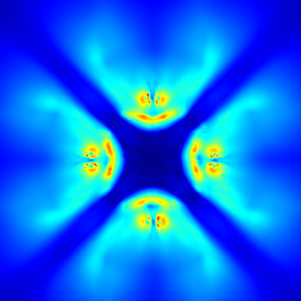
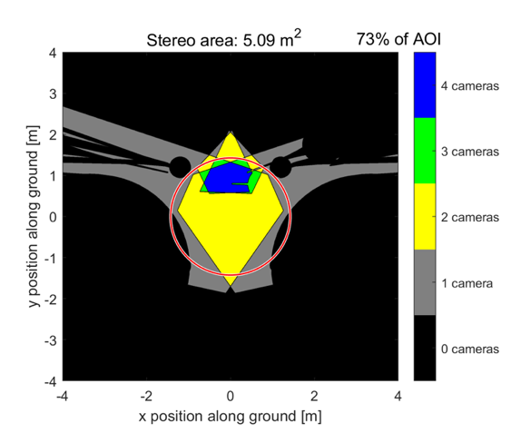
SCALPSS Overview
The Stereo Cameras for Lunar Plume-Surface Studies (SCALPSS) is the first ever dedicated instrument for directly measuring PSI erosion accurately from the lunar surface.
  pre-flight camera characterization and calibration (e.g., distortion coefficients)
  high resolution images from known (e.g., measured and calibrated) camera locations and with known pointing directions (e.g., external calibration)
Future versions of the SCALPSS instrument will also be able to take measurements of the ejecta sheet using a (laser or passive) dot grid projection system.
SCALPSS 1.1 (Blue Ghost) pre-flight prediction of erosion using CFD
lander diameter
SCALPSS 1.1 (Blue Ghost) estimated stereo coverage using 2-4 cameras (increased data reduces uncertainties in measurement)

Slide 3
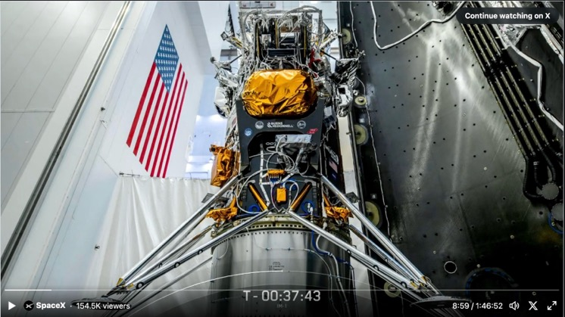
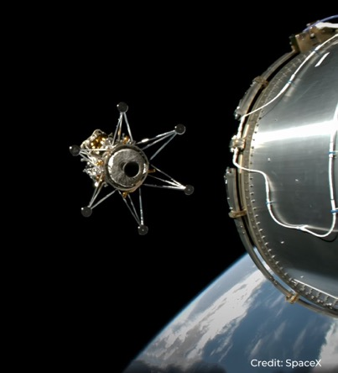
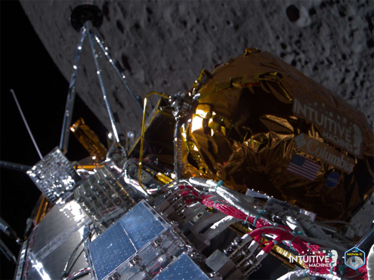
SCALPSS 1.0 (CLPS / Intuitive Machines)
Funded by SMD/NPLP (CLPS TO2) beginning in FY19.
Primary Objective: Collect stereo images of the disturbed lunar surface post landing to estimate the volume of regolith eroded due to PSI.
Secondary Objectives: Collect stereo images during descent (possibly beginning prior to the onset of PSI)
Configuration: 4 ea. 3.2 MP cameras (3.37mm focal length) on individual camera mounts, Data Storage Unit, USB Hub (Mars2020 EDLCam heritage)
Payload Delivery: October 2020
Payload Integration to Lander: August 2023
Launch: 15 February 2024
Lunar Orbit Insertion / Landing : 22 February 2024

Slide 4
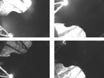
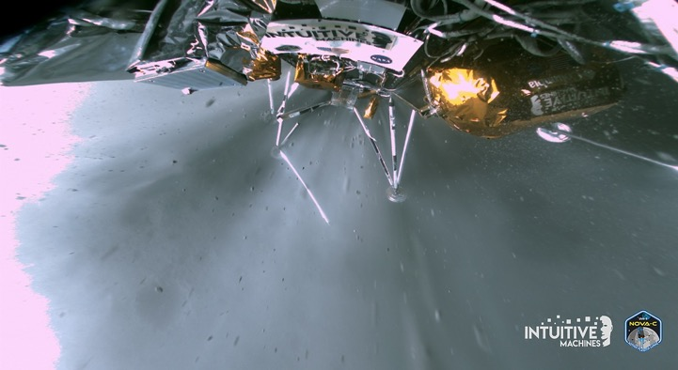
SCALPSS 1.0 Payload Performance
The SCALPSS 1.0 payload did survive launch and was able to perform a nominal transit checkout.
The lunar orbit checkout was canceled due to troubleshooting being done on the lander.
During descent, the payload was not powered on as expected due to erroneous altitude data on the lander resulting in a faster than expected descent and ”hard/skip” landing.
  evidence seems to indicate that the payload was powered on at the correct “time”, however, the lander was already on the ground at that point
Due to these and other lander faults as well as the final lander orientation (on its side), no PSI data was collected.
Late in the surface mission (day 5 of 6-day surface mission), the payload was able to operate successfully on the lunar surface in both “checkout” and “manual” modes.
  one camera was inoperable due to high temperatures ( predicted)
  lander FSW was updated to utilize redundant command channel
  due to the lander orientation and sun position, images taken were oversaturated
  the payload team was not given the opportunity to correct for this and collect additional imaging data

Slide 5
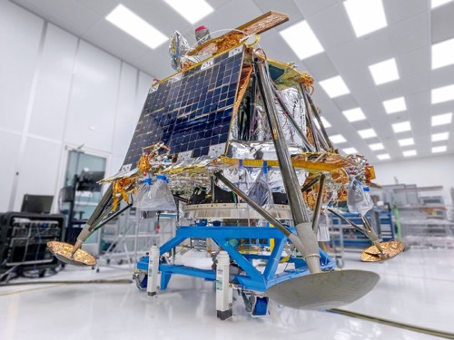
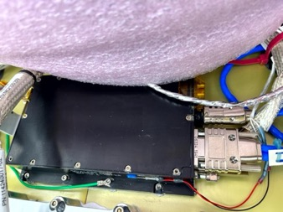
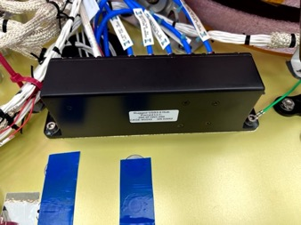
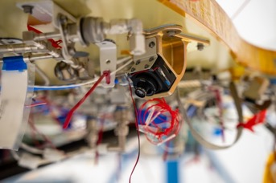
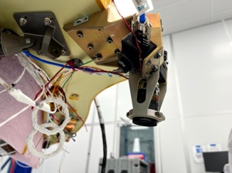
SCALPSS 1.1 (CLPS / Firefly Aerospace)
Funded by STMD/GCD (CLPS 19D) beginning in FY20.
Primary Objectives: Collect stereo images of the lunar surface prior to being disturbed (pre-PSI), during descent (transient), and post landing to better estimate the volume of regolith eroded due to PSI; determine when PSI onset occurred.
Secondary Objectives: Detect and measure ground obscuration due to PSI ejecta.
Configuration: 6 ea. 3.2 MP cameras (2 @ 3.37mm, 2 @ 5.4mm, and 2 @ 50mm focal lengths) on 4 camera assemblies, Data Storage Unit, USB Hub (SCALPSS 1.0 heritage)
  utilizes full data handling capabilities of DSU design
Payload Delivery: October 2022
Payload Integration to Lander: April 2024
Launch: “late 2024”
Lunar Orbit Insertion / Landing : “early 2025”
  ~30 day lunar transit
  ~15 days in lunar orbit
Firefly Blue Ghost 1 Lander
Data Storage Unit
USB Hub
Single Camera Mount (1 of 2)
(5.4 mm FL)
Combo Camera Mount (1 of 2)
(3.37 and 50 mm FL)
Credit: Firefly Aerospace (all images)

Slide 6
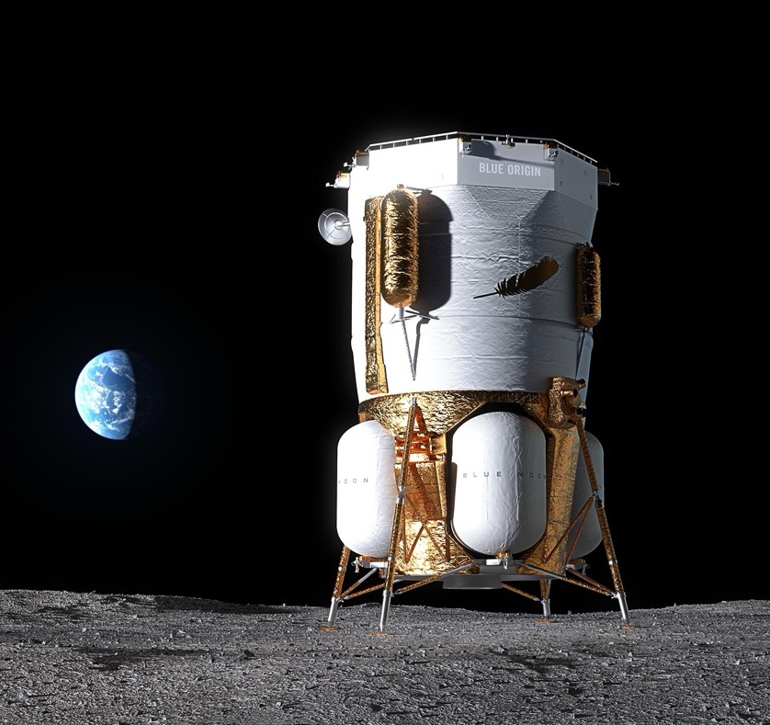
SCALPSS 1.x (Blue Origin Mk1-101)
Funded by STMD/GCD and SMD (CLPS CT-3) beginning in FY24 as part of the SCALPSS 1.1 Project utilizing spare SCALPSS 1.0/1.1 hardware.
Primary Objectives: Collect stereo images of the lunar surface prior to being disturbed (pre-PSI), during descent (transient), and post landing to estimate the volume of regolith eroded due to PSI; determine when PSI onset occurred.
Secondary Objectives: Detect and measure ground obscuration due to PSI ejecta.
Configuration: 4 ea. 3.2 MP cameras (3.37 mm focal lengths) Data Storage Unit, USB Hub (SCALPSS 1.1 heritage)
  utilizing custom camera mount design optimized for Mk1 lander
Payload Delivery: Dec 2024
Payload Integration to Lander: ”early 2025”
Launch: March-May 2025
Courtesy: Blue Origin

Slide 7
SCALPSS 2.0 (Blue Origin Mk1-102)
Funded by STMD/GCD beginning in FY24 as part of the PSI Instrumentation Project.
Primary Objectives: Same objectives as SCALPSS 1.1 with improved coverage and/or resolution, and the addition of measurements of the ejecta sheet structure (ejecta angles, sheet morphology, etc.)
Secondary Objectives: Measure ejecta particle size and velocity.
Configuration: 6 ea. 12.3 MP cameras (3.37 - 50mm focal lengths), Mini-Suite Electronics (MSE-lite), and laser dot grid projector
  will also test a passive reflector for generating dot grid
Payload Delivery: December 2025 (TBR)
Payload Integration to Lander: March 2026 (TBR)
Launch: “mid 2026” (TBR)
Lunar Orbit Insertion / Landing : TBD
Courtesy: Blue Origin

Slide 8
Moving Forward – PSI Instrumentation
In FY24, the PSI Instrumentation (PSII) Project was established to manage the following activities:
  Development and operation of photogrammetry measurement system in support of the HLS PSI Ground Test in FY24-25.
  Development of SCALPSS 2.0.
  Development of Mini-Suite Electronics (MSE) which is a centralized payload control and data storage and transfer to simplify interface with lander to multiple sensors of varying (interface) types.
    Improved data interface(s) to lander (100+ Mbps capability)
    Improved data handling capabilities
    Capable up to 2 GBbs write speed to memory
    Designed to be modular, flexible, and expandable to accommodate additional sensors with various data interfaces (e.g., serial, USB, LAN, LVDS, Spacewire, etc.)
    Smart power management / switching capability for sensors
    MSE-lite is a smaller version of the MSE with a focus on LAN interfaces for a SCALPSS 2.0 imaging system.
Under the re-structured STMD organization, PSI work will be located within the LAND Domain, Landing Systems and Environments (LS&E) Capability.

Slide 9
PSI Instrument Suite (example)
In FY25, it is expected that a “new” PSI Instrument Suite (PSIIS) Project will be established to provide payloads for both CLPS and HLS/Artemis flight opportunities as early as CY2029.
Leveraging the work done in FY23 on the CLPS PSI Mini-Suite (PLUMES), one possible architecture for the PSIIS payload could include:
  (full) MSE
  SCALPSS 2.0
  Lunar Lander Base Instrumentation (LLBI): Measure the environment induced (temperature, heating, and pressure) below the lander base by landing thruster(s) and PSI. (LaRC)
  Particle Impact Event (PIE) Sensor: Measure velocity/energy of regolith particles from PSI. (GRC)
  Dust Ejecta Radar Technology (DERT): millimeter-wave doppler radar measurement of particle velocity and direction of particles resulting from PSI. (KSC)
LS&E is also interested in identifying overlaps and learning more about how certain measurements and sensors could be leveraged for PSI and other related communities such as dust mitigation, surface architecture, etc.

Slide 10
Backup

Slide 11
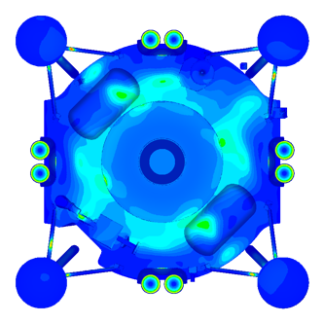
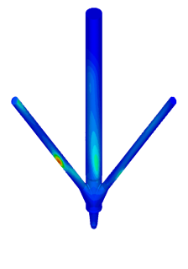
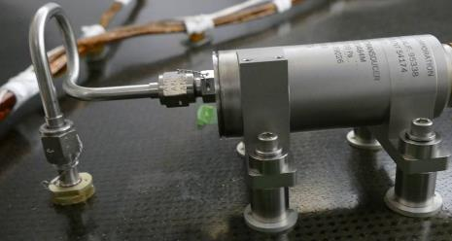
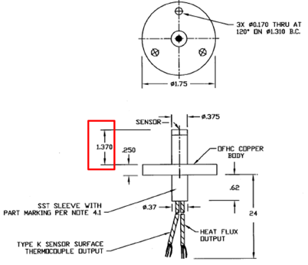
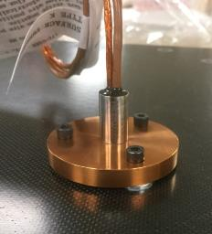
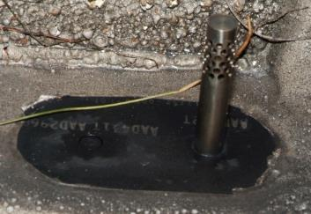
Lunar Lander Base Instrumentation (LLBI)
Technology Product Capability:
  LLBI will collect pressure and thermal data during late descent and landing under the lander base and on the landing legs to support computational Fluid Dynamics (CFD) model validation and knowledge of PSI contribution from the descent/landing engine configuration.
LLBI will capture the fundamental physics using a suite of flight proven sensors.
Pressure from (3 -TBR) pressure transducers
  Range: 0 - 400Pa (2ea. on lander base)
  Range: 0 – 1000Pa (1ea. on leg strut).
Total Heat Flux/Calorimeters (3 – TBR)
  Range: 0 – 15W/cm^2 (2 ea. on base)
  Range: 0 – 20W/cm^2 (1 ea. on leg strut)
Radiative heating (1 - TBR) Radiometers
  Range: 0 – 1W/cm^2 (2 ea. on base)
  Range: 0 – 1W/cm^2 (1 ea. on Leg strut)
Type C Gas Temperature Probe (1 – TBR)
  Range: 0 – 2000 Kelvin (1 ea. on Leg strut)
Temperature from (12 - TBR) RTDs and/or Thermocouples
  Range -273 to 226°C TPS performance
  Engineering/Health Statue Measurements
Hot Spot
Hot Spot
Medium Spot
Tavis Corp Variable Reluctance
Pressure Transducer
Heat Flux/Calorimeter Sensor
Gas Temperature Probe
Radiometer with Saphire Window

Slide 12
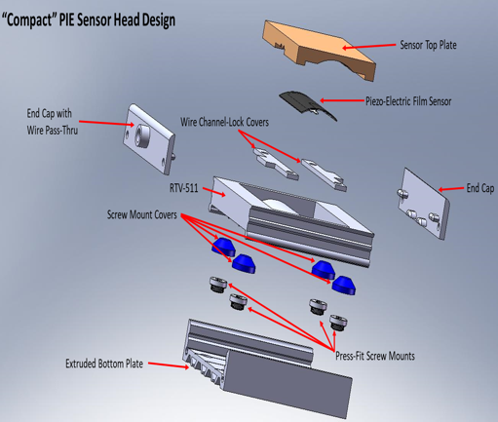
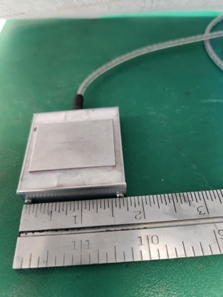
Particle Impact Ejecta (PIE) Sensor
Instrument Overview and Technical Status
Early prototype of PIE V1
The Particle Impact Event (PIE) sensor will characterize the flux and energy of lunar dust from plume effects
Includes thin-film piezoelectric appliances with sensitivity to low energy impacts Validates computation particle transport models on the moon
  Specific emphasis on the effects caused by Lunar landings
Proof of Concept (PIE V1) created; calibration is in progress via graduate cooperative agreement with U of Michigan
  Student will utilize data from Apollo missions to determine energy range for calibration
The PIE sensor will be able to support multiple configurations of landers (number of thrusters) from CLPS to HLS lander classes
Technology is at TRL 3
  Future plans are to miniaturize sensor for a flight-ready design (PIE V2) and combine microcontroller, log-amp, and piezoelectrics into single sensor enclosure; design is ~60% complete
Proposed Cost
No current budget
Proposed cost is 0.7-1.5 M / year FY25-28
Instrument Specifications:
Current prototype Mass
  Sensor Head with 1m cabling~200g
  Electronics ~130g w/out enclosure
Prototype Power ~1W w/o heater, 5V @ 200mA
Communication interface: RS-485/422 Serial @115.2kBaud
Electronics Operating Temp Range: -40°C to +85°C
Samples Particle Impacts at ~330kHz
Onboard data storage until host requests
Proposed Schedule
PIE V2 Design - Apr 2026
Calibration apparatus – Apr 2026
Function testing & risks mitigated – Dec 2026
Final flight sensor build – Aug 2027
Flight qual testing – Apr 2028
Delivery to CLPS provider – Mid 2028
Notes:
Provide a brief 1 or 2 line description of the Project and the Current TRL
Provide a quarterly assessment for each area Cost, Schedule, Technical, and Programmatic (top right corner of each section). Do not change the colors for previously reported months
Red: Challenge or risk requires program support
Yellow: Challenge or risk can be managed within the project
Green: All project performance is satisfactory
Primarily focus on notable achievements or challenges your Project would like to highlight for awareness in that month
Portfolio Projects: Just speak to the ones that are yellow/red – speak to the specific element that has issues…

Slide 13
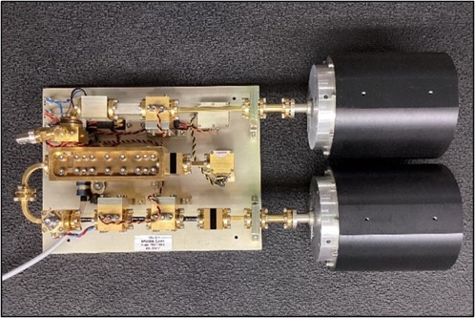
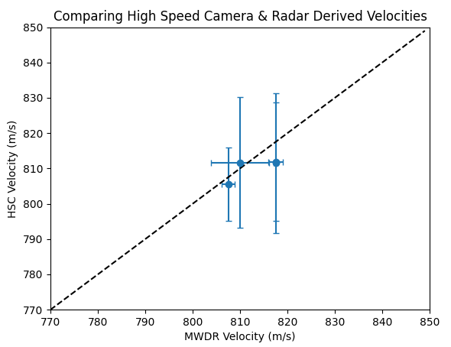
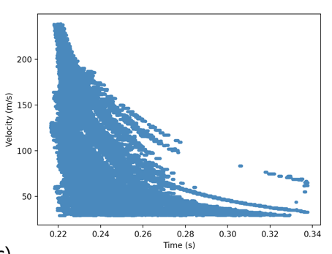
Dust Ejecta Radar Technology (DERT)
DERT is a 94 GHz doppler radar that is used to measure the speeds of PSI ejecta particles.
The transmitted RF waves are scattered off the moving PSI regolith ejecta particles, resulting in a doppler shifted return signal. The doppler shift of the return signal is proportional to the speed of the regolith ejecta particles.
DERT instrument developed for the HLS PSI Ground Test and LaRC in FY25
Testing at the KSC Weapons Training Area provided proof of concept data for high-speed projectiles up to 820 m/s
 | Threshold | Goal
KPP1: Velocity Range | ≥ 250 m/s | ≥ 800 m/s
KPP2: Velocity Uncertainty | < 25% | < 10%
KPP3: Pressure Range | ≤ 100 Pa | ≤ 10 Pa
KPP4: Particle Size Range | 40 – 200 µm | 5– 1000 µm
Testing at the KSC Weapons Training Area provided proof of concept data for BP-1 regolith particles up to 250 m/s.

