Slide 1




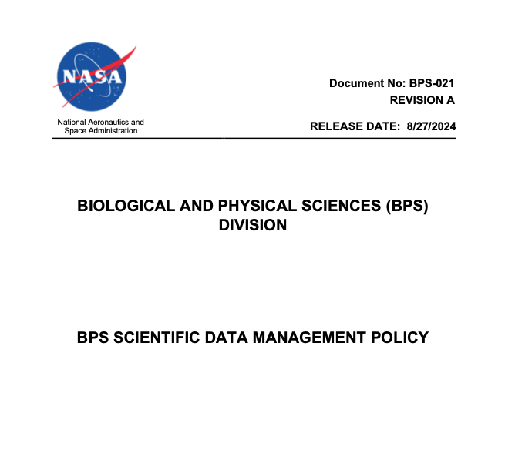


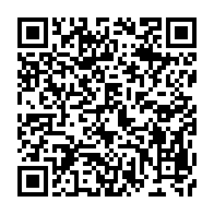

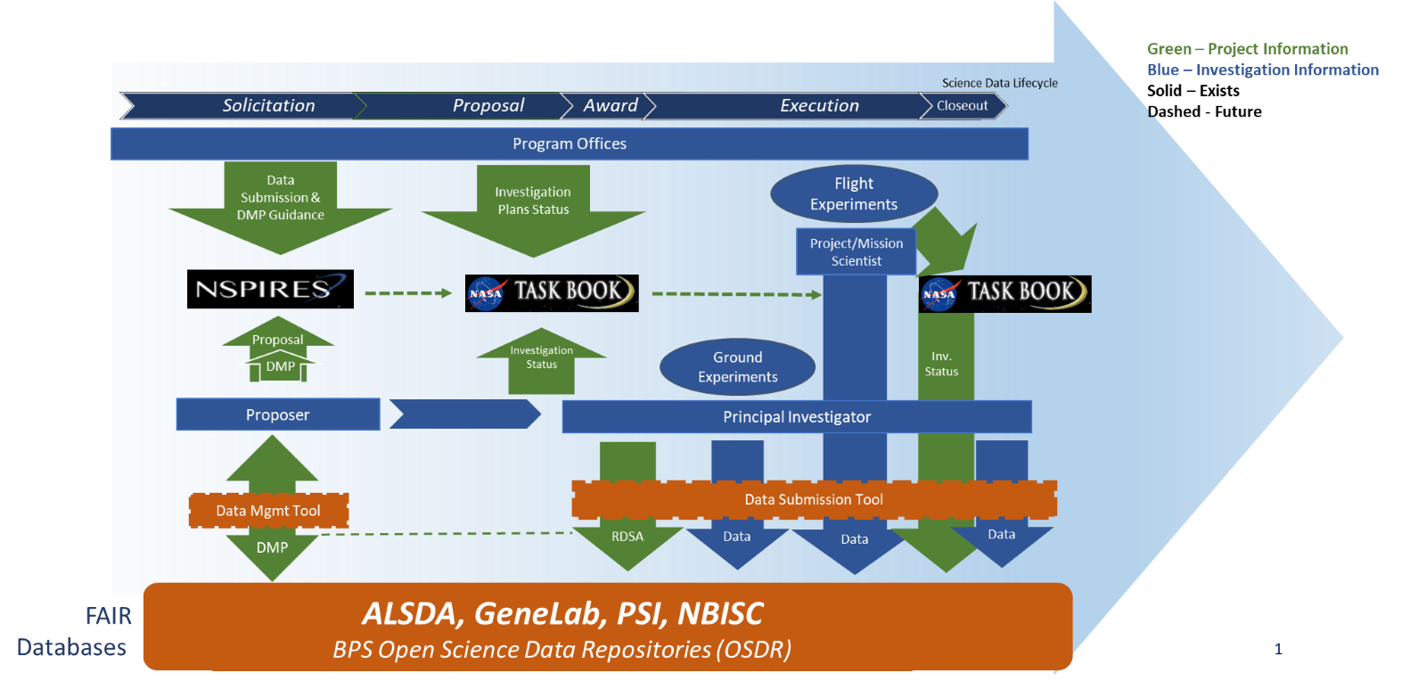
Meeting SPD-41a Requirements for BPS
Alan E. Wood¹, Danielle K. Lopez¹, Daniel C. Berrios³, Karen L. Stephens² , Shawn E. Reagan² , Sylvain V. Costes³ , and Samrawit G. Gebre³,
¹KBR, Moffett Field, CA; ²Marshall Space Flight Center, Huntsville, AL: ³Ames Research Center, Moffett Field, CA
1. Interpreted SPD-41a requirements to fit BPS
BPS SDMWG
3. Highlights of New Data Requirements
Unlike other SMD Divisions, most of BPS science is experimental rather than observational based.
    SPD-41a definition and use of ”Mission Data” does not fit BPS - agreement reached to use “Operation Data” instead.
    Organized Data Management Policy around Roles and Responsibilities i.e. Program Management, Project and Portfolio Management, Investigators, and Repositories.
    Established deadlines for operational and research data product deliveries. (much discussion)
    Task Book introduced a new tool allowing BPS-funded PIs outside of NASA to make their presentations open access, similar to how NASA-employed PIs use the STRIVES system.
    Minimize PI burden from new requirements.
In April 2021 BPS formed the Science Data Management Working Group.
Physical Sciences and Biological Sciences represented with a rep for each data repository.
Compiled inventory of existing data management requirements.
Open process with emphasis on review/input from outside WG
Investigators shall:
  Complete, ASAP after award, a Research Data Submission Agreement (RDSA).
  Submit all data to the OSDR
  Have a PI unique identifier, ORCID
  Submit all data supporting any publication to OSDR in time for data release at publication.
  Report and release research software developed to support published results as open source
  Submit any data not used to support a publication prior to close out of grant.
  Obtain a No-Cost Extension (NCE) for a grant to delay public release of any non-published data.
  Submit BPS funded presentations to Task Book..
PIs are urged to submit data throughout award period of performance.
2. Draft BPS Science Data Management Policy
Circulate draft to continue development of plan AND concurrently engage the BPS community with the issues & decisions.
      Technical reviews from L3 & L4
      Portfolio and Project Management reviews
      Program Management.
      Review and concurrence from BPS Control Board (BCB)
      Town Halls: internal, then external.
      Present policy at select conferences & workshops.
4. Next Steps
Implementation Plan (underway)
Compliance metrics, work with SMD e.g., Pub tracking
Annual Updates to Policy, Rev A released Sept 2024
Add Guideline documents. OS-DMP, PI Reporting Guidelines,
Continue communication/education with PIs and all stakeholders.
Sylvain V. Costes
Karen L. Stephens
Daniel C. Berrios
Matthew J. Casiano
Samrawit G. Gebre
Shawn E. Reagan
Alan E. Wood
Special Thanks to Past and Present Working Group Members

