Slide 1

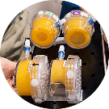
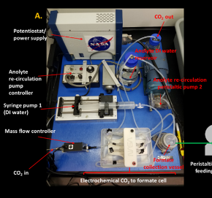
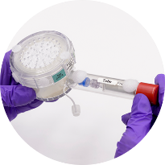
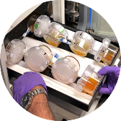
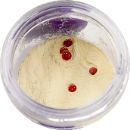
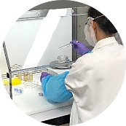
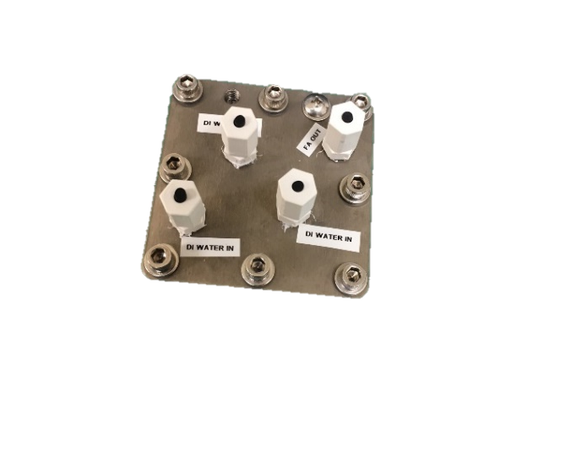
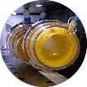
Space Technology Mission Directorate
Game Changing Development Program
Synthetic Biology Project | Overview –REDACTED For Tours August 21, 2024

Slide 2





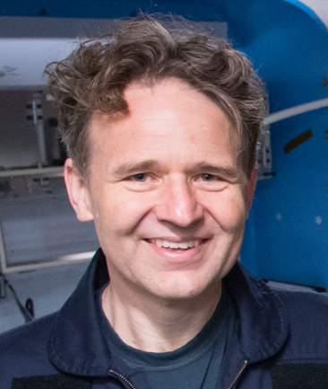


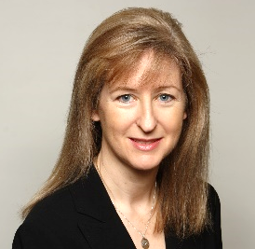

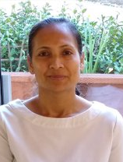









Team and our supporting contributors
Program Management
STMD/GCD
Jim Broyan STMD PT
Kevin Kempton PEM
MCO/Exploration Cap
JJ Edelmann FY’23
Kevin Sims
Payload Manager
Alyssa Villanueva
Engineer
Sadie Downing
Support Scientist
ARC
Harry Jones, PhD
Systems Engineer
Matthew Paddock
Bioengineer
A. Mark Settles, PhD
Omics Lead
Project Management
NASA Ames Research Center
Q/A: Paul Milazzo/Leonard Lee
Lisa Anderson
Ops, Scheduler
Natalie Ball
Scientist
Frances Donovan, Ph.D. Project Manager, Principal Investigator
Sean Sharif
Mechanical Engineer
Hiromi Kagawa, PhD
Scientist
Hami Ray, PhD
Deputy Project Manager
JSC
Daniel Varnum-Lowry
Safety Engineer
Jing Li, Ph.D.
E-Nose PI
Ami Hannon, Ph.D.
Scientist
Oscar Roque
Engineer
Sandra Vu
Support Scientist
KSC
Satro Narayan
Support Scientist, Logistics
Marilyn Murakami Resource Manager

Slide 3
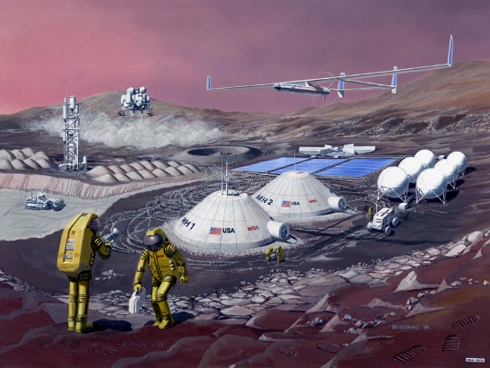
Potential of Synthetic Biology in Space
Biological systems are:
Scalable
Programmable
Precise (pure isomers)/selective
The only route of production in some cases (protein therapeutics)
Low Tº and pressure
Regenerable

Slide 4
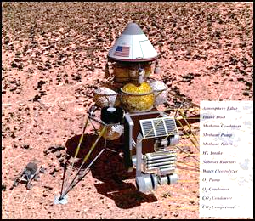
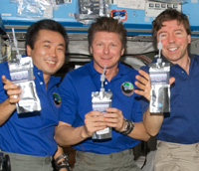
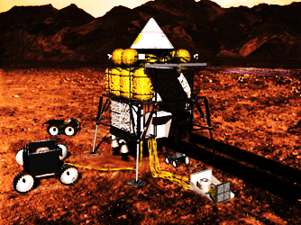
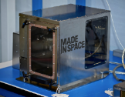
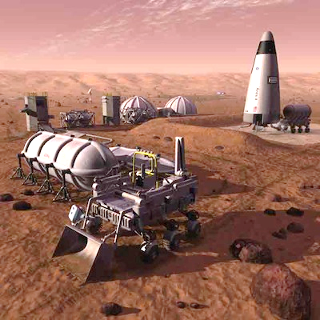
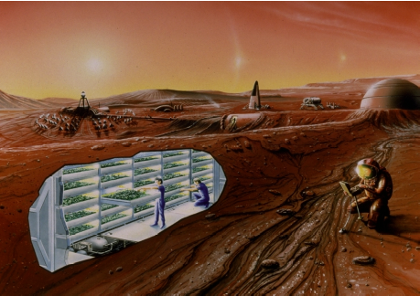
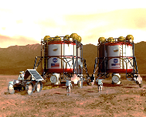
In Space Production of Mission Products
A wide array of different mission resources will eventually need to be produced on-site for mission sustainability/cost effectiveness
  Fuels, foods/nutrients, chemicals, plastics, binders, medicine
  Biomanufacturing can provide compounds abiotic systems cannot
  Biomining – highly selective trace element sourcing

Slide 5
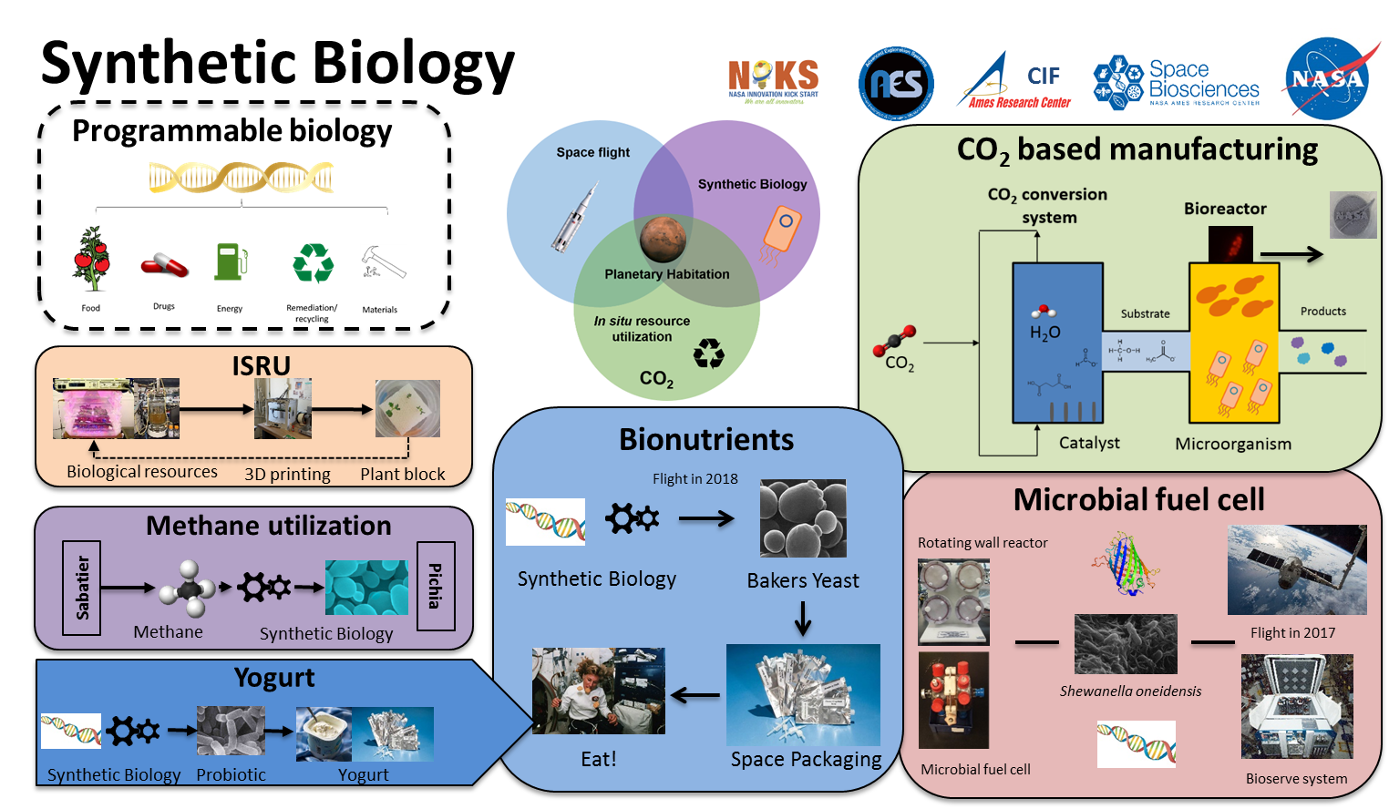
Overview of Projects

Slide 6
Products and Data of Potential Interest
Data on 5+years of ambient, lyophilized storage of microbes in ISS – BioNutrients system
  9 strains, multiple treatments, uv irradiated potential novel strains, omics information is coming). Demonstrated to make nutrients/yogurt/kefir
  Data on Media (YPD/yeast formulas and non-fat milk powder) 5+ years ISS storage
Low volume, low mass “bioreactor” systems/ Materials data
  Considerable test data on many materials, thicknesses, and biocompatibility/ workability
  Space feasible Biomanufacturing and product purification platform
CO2- based Media formulations and recycled waste formulations
  Acetate, ethanol, acetate+ethanol, and combinations with Urea and wastewater effluents ---HOW TO FEED YOUR BIOMINING ORGANISMS
The CO2-based BioManufacturing Platform can help with generating complex feedstocks, performing biomining, purifying products in a low mass, volume system. 1Liter.

Slide 7
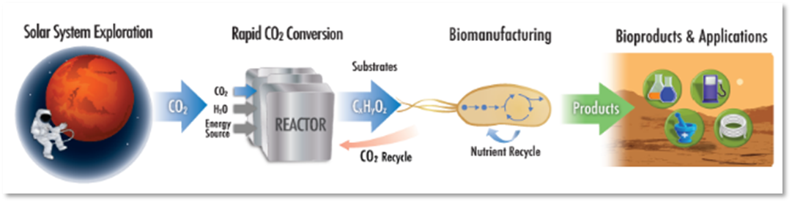
CO2-based Manufacturing
Space Exploration supported with CO₂-based Biomanufacturing
(Lunar CO₂ sources = humans ~1kg-CM/d, wastes: Mars = atmospheric CO₂ @95%)
Notes:
Dr. Marcus Karel, MIT, Evaluation of Engineering foods for closed ecological life support system (CELSS)

Slide 8
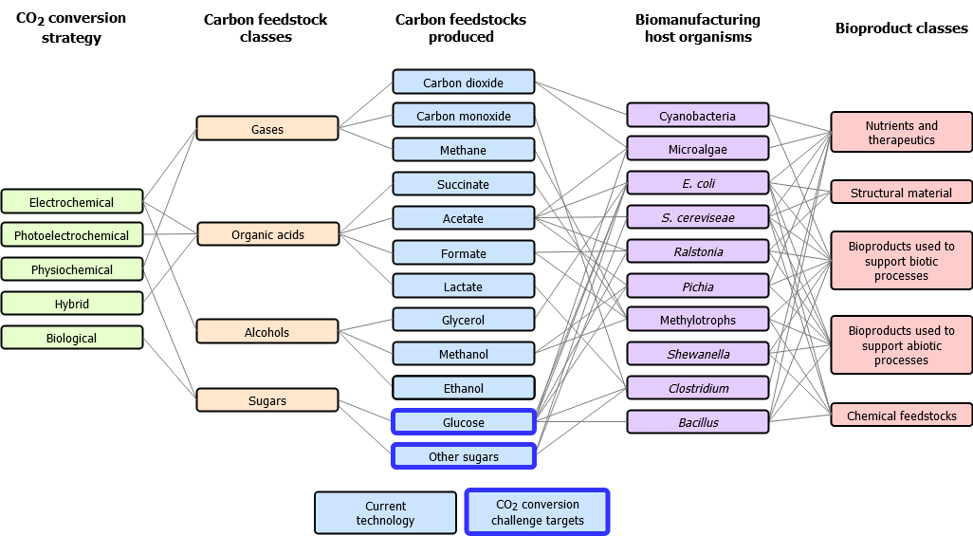

CO₂ -Derived Products, Feedstocks and Organisms
S. cerevisiae
K. phaffii

Slide 9
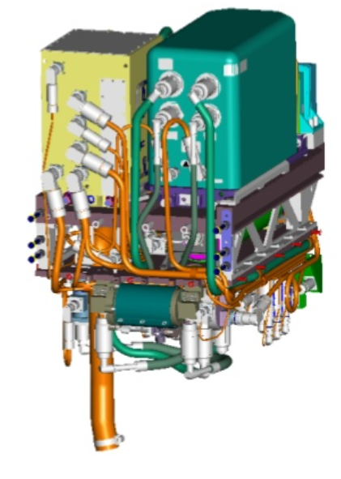
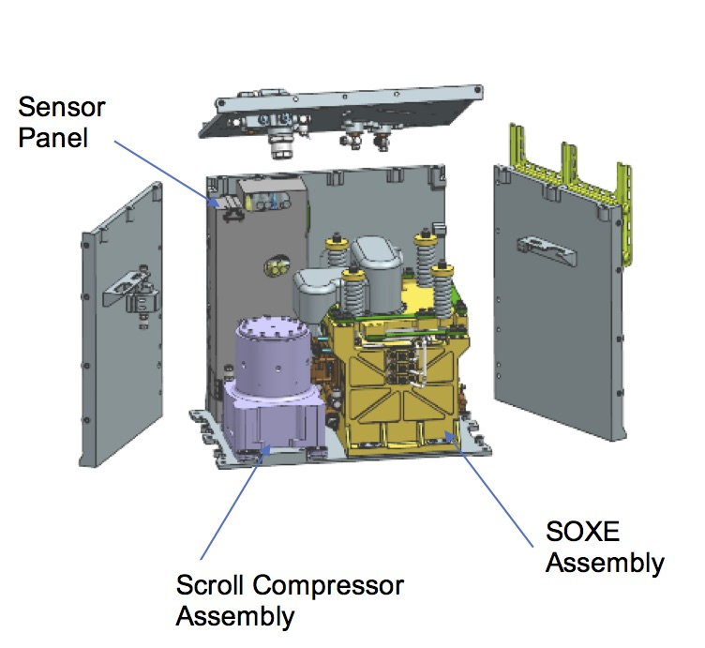
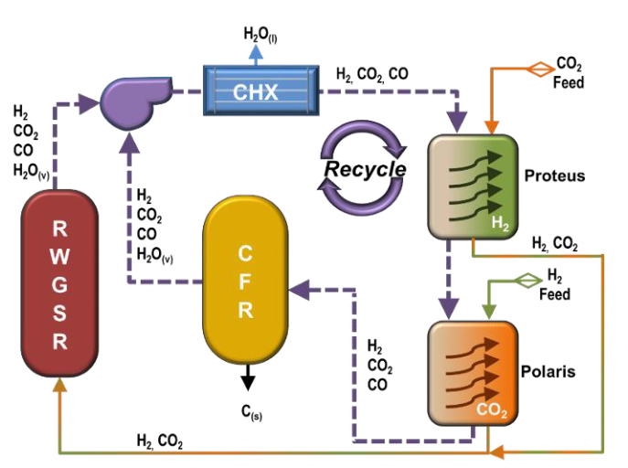
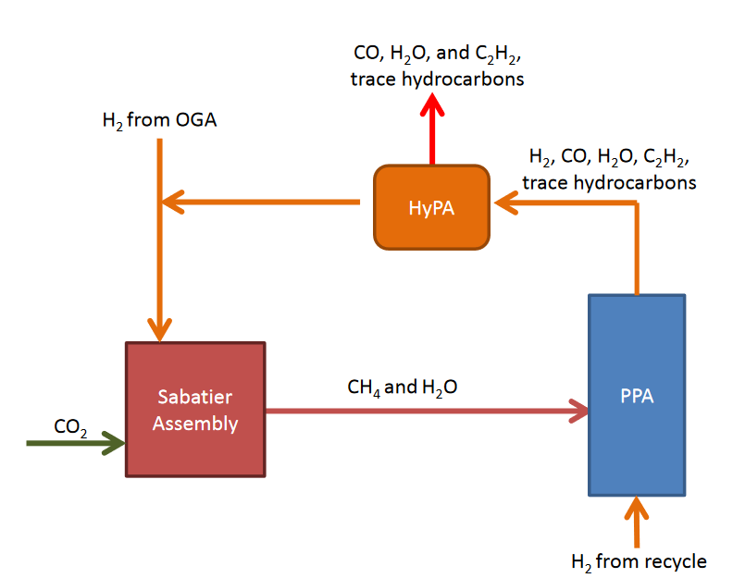
Current Extra-terrestrial Technologies that Support CO₂ Conversion
RWGSR: Reverse water gas shift reactor
CFR: Carbon formation (Bosch) reactor
Proteus: H₂ extraction assembly
Polaris: CO₂ extraction assembly
HyPA: Hydrogen purification assembly
PPA: Plasma pyrolysis assembly
OGA: Oxygen generation assembly
Sabatier reactor
Input: CO₂
Output: CH₄, H₂O
Technology maturity: Flight qualified hardware
MOXIE [1]
Input: CO₂
Output: O₂, CO
Technology maturity: in situ demo testing on Mars
Bosch reactor [2]
Input: CO₂
Output: O₂, C
Technology maturity: In development
Plasma pyrolysis [2]
Input: CH₄
Output: H₂, C₂H₂, maybe C
Technology maturity: In development
Of the existing conversion technologies Sabatier and MOXIE produce compounds that can be used as feedstock for biomanufacturing (CH₄ and CO respectively, acetylene is a potential feedstock).
Notes:
References:
mars.nasa.gov. MOXIE for Scientists [Internet]. [cited 2020 Sep 2]. Available from: https://mars.nasa.gov/mars2020/spacecraft/instruments/moxie/for-scientists/
Greenwood ZW, Abney MB, Brown BR, Fox ET, Stanley C. State of NASA Oxygen Recovery. ICES 2018. 2018;14.
Plasma pyrolysis produces acetylene C2H2 which is also a carbon source for bacteria, though less well studied Akob D M et al2018

Slide 10
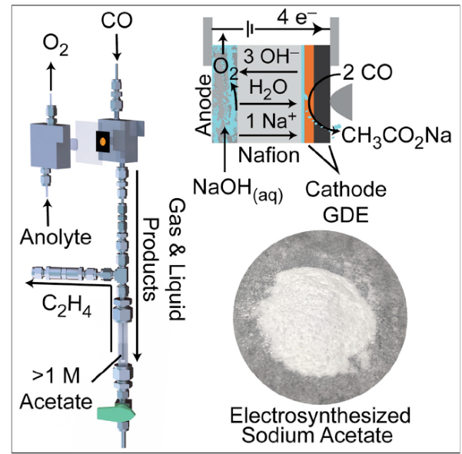
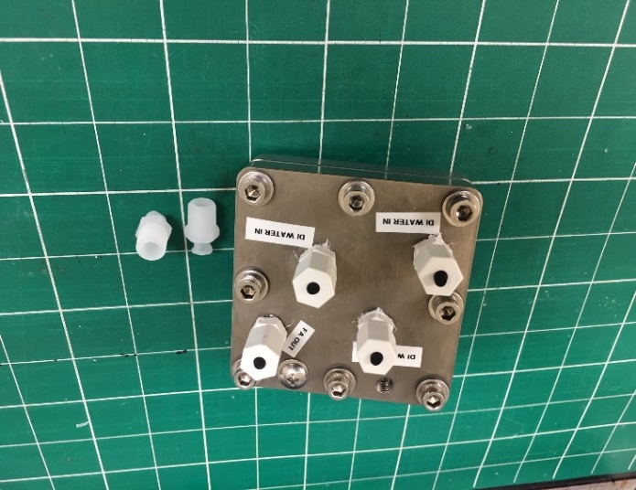
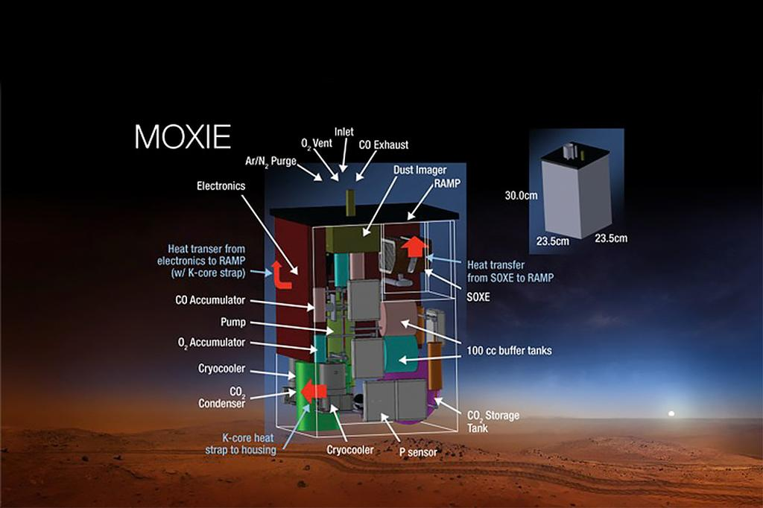
CO₂ Conversion Methods Produce Acetate, Formic Acid, Ethanol, and potentially Sugars
Acetate
Formic Acid
Commercially
available
reactor
Formic acid reactor. Selectivity (Faraday efficiency) above 95%.
CO₂
CO
Sugars
$1M NASA Centennial Challenge
Completely abiotic conversion of CO₂ to sugars – glucose was main target
3 Phase 2 awards distributed
One contestant, the Air Co. also makes ethanol, a viable substrate tested in our system
MOXIE is a solid oxide electrolysis system that can be used to produce O₂ and CO from CO₂ [1] and has now demonstrated oxygen production on Mars. Acetate production from CO has been demonstrated at Stanford University to produce 1M acetate using gas diffusion electrolysis [2]. Theoretically, these two systems could be connected to each other to produce acetate for biomanufacturing.
NOTE: References in notes section below
Notes:
References:
Meyen FE. System Modeling, Design, and Control of the Mars Oxygen In-Situ Resource Utilization Experiment (MOXIE) and Implications for Atmospheric ISRU Processing Plants. MASSACHUSETTS INSTITUTE OF TECHNOLOGY; 2017.
Ripatti DS, Veltman TR, Kanan MW. Carbon Monoxide Gas Diffusion Electrolysis that Produces Concentrated C2 Products with High Single-Pass Conversion. Joule. 2019 Jan;3(1):240–56.

Slide 11

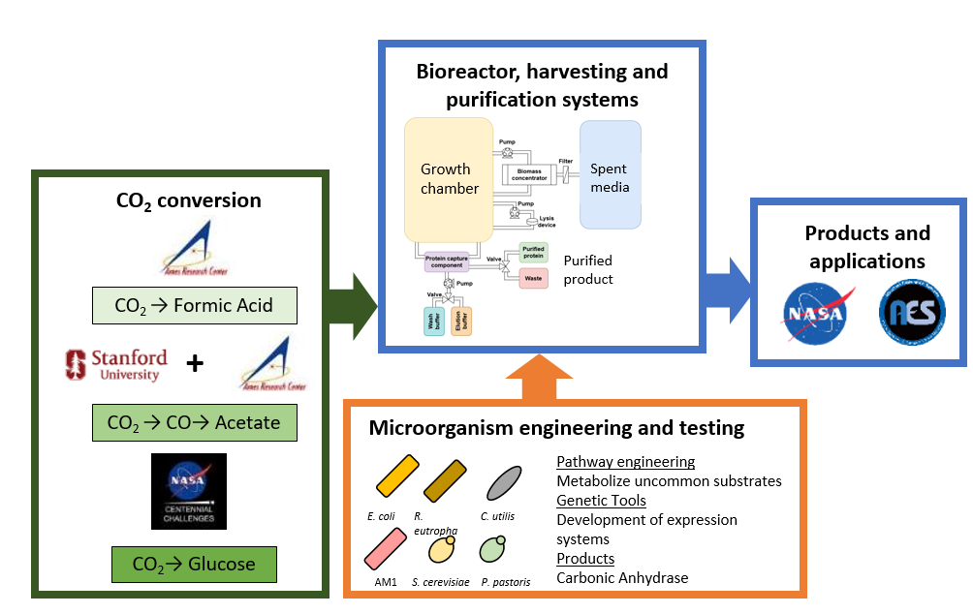
Microorganism Engineering and Testing
Matt Paddock

Slide 12
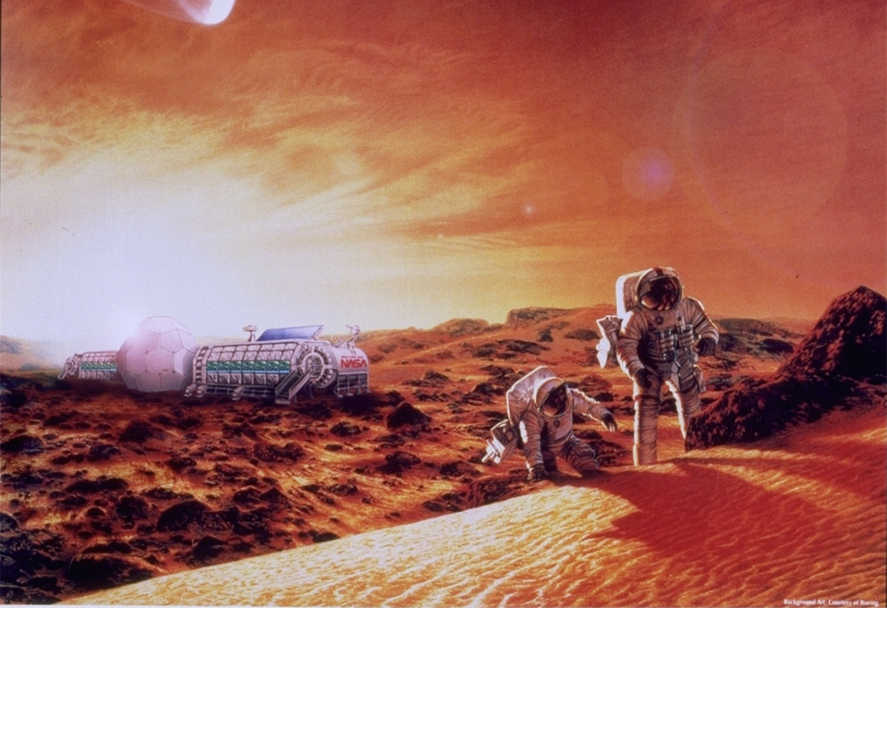
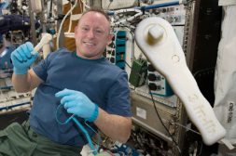
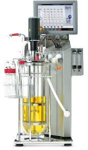



Assumptions, Design Drivers, and ConOps
Assumes platform is inside a temperature/pressure/radiation shielded structure.
Assumes 100 batch runs (~6 days/run) for purposes of trade studies and systems analyses.
Design drivers include consideration of mass, volume, power, crew interfaces and time, repeated use/growth cycles, and flexibility.
Application
Concept Example:
CO₂ + H₂
+
P/C Conversion
System
Microbial
Medium
Production platform
Product
Notes:
Platform launched to moon or Mars.
Crew set up inside structure.
Crew obtains the carbon source from the CO₂ conversion system and adds to media mixing bag and water. Mixes by shaking. Hydrates wash and elution buffer bags.
Crew attaches to bioreactor and peristaltic pump, checks all connectors.
Crew member hits start.
Cells grow in media for ~24-120 hours, then pump automatically pumps biomass into dewatering system, through to cell lysis system, to final wash and elution stages. Waste water and eluted product can then be recycled or used as appropriate.
At end of cycle, crew member takes purified product for use or storage.
Crew member removes all bags and tubing and replaces with fresh stored bag and loop set and begins the process again.

Slide 13
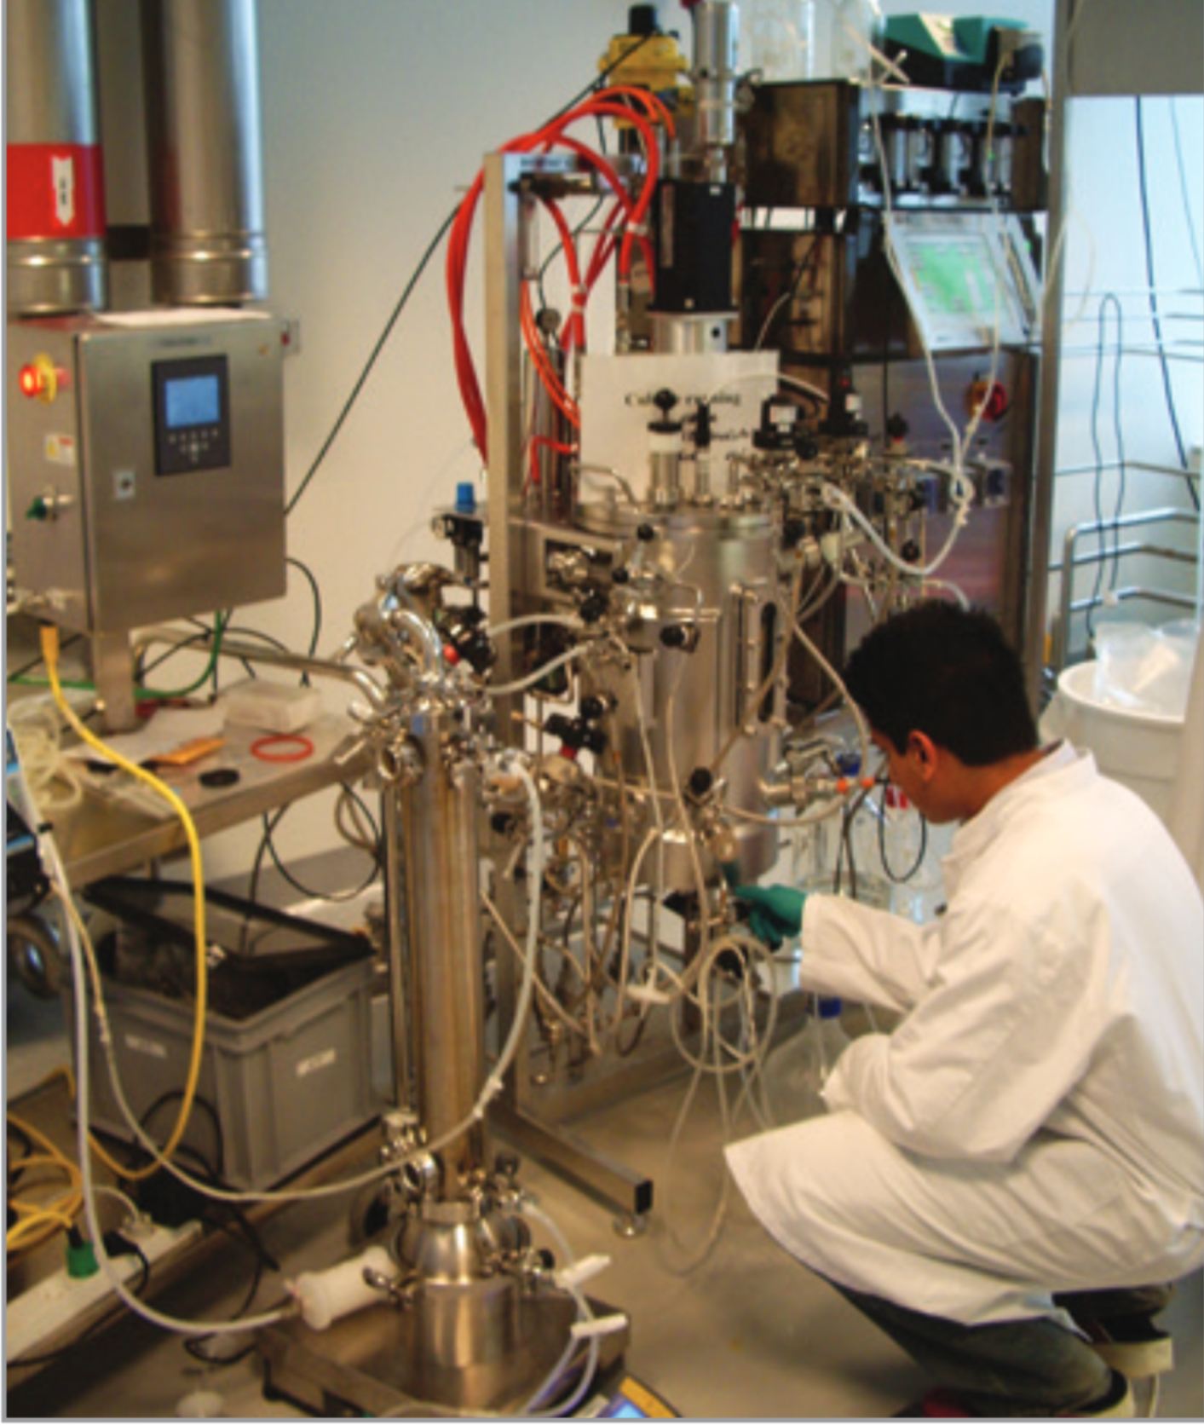
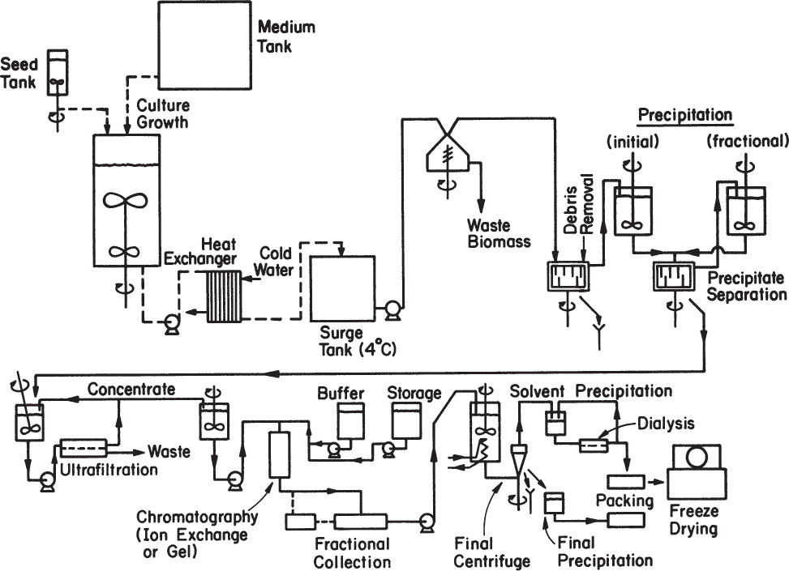
Commercial Biomanufacturing on Earth
Industrial system for Recombinant Enzyme Production
Process Flow for Industrial Production of Enzymes
Source: https://www.repligen.com/application/files/2015/3961/3373/Continuous_Processing_Book_Volume_1_2014.pdf
Bioprocess Engineering: Basic Concepts, 3rd Edition
10L Bioreactor and Dewatering System
13

Slide 14
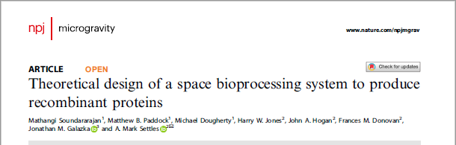
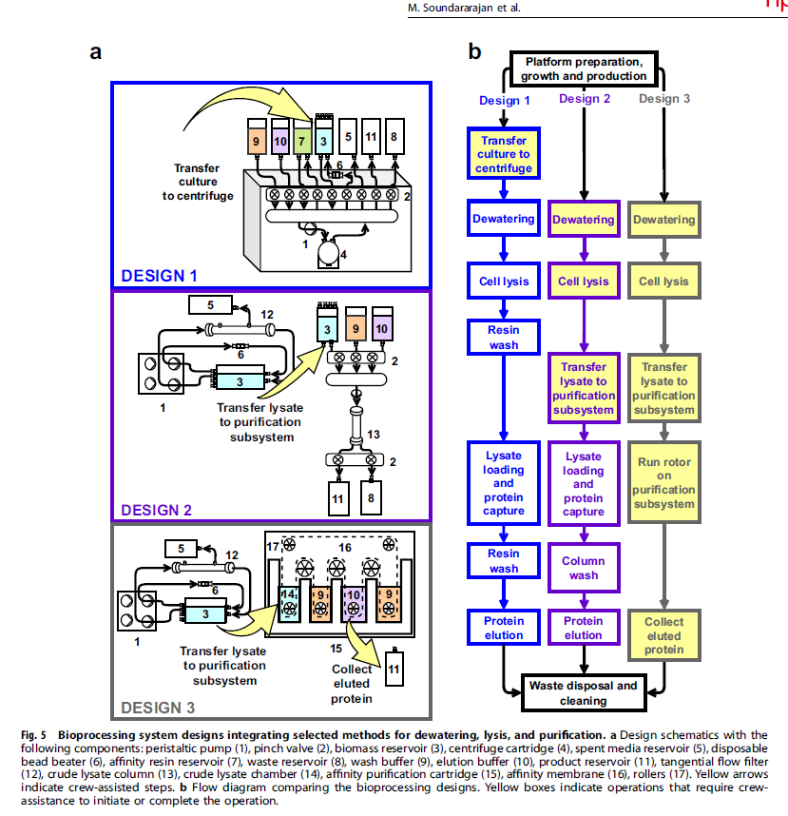
Modeling Subsystem Options to Drive Selection
Equivalent system mass modeling was performed comparing design options for the biomass dewatering, cell lysis, and product purification subsystems.
Additional considerations such as storage condition requirements, reliability, crew interface requirements, and chemical or buffer requirements were also weighed.
Analysis helped derive weighted options for application in the platform.

Slide 15
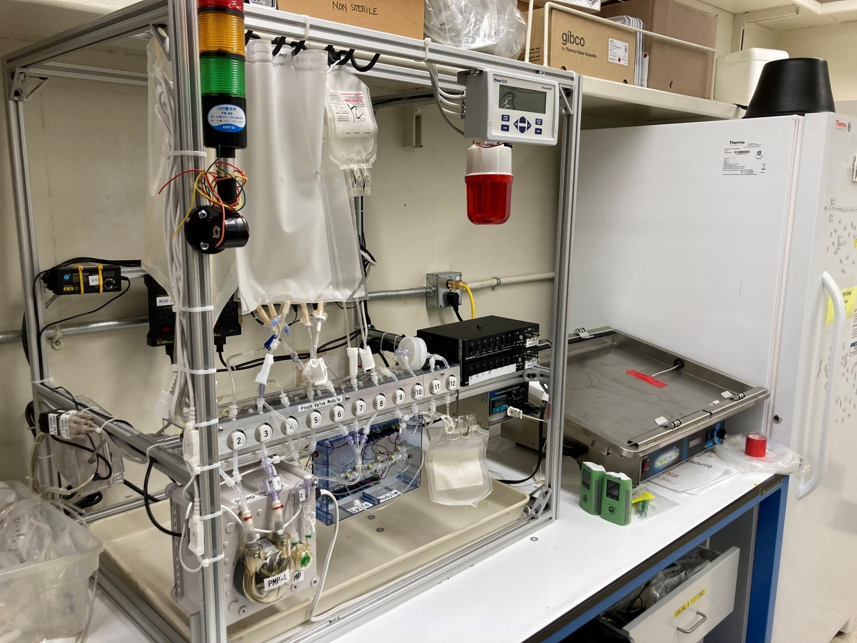
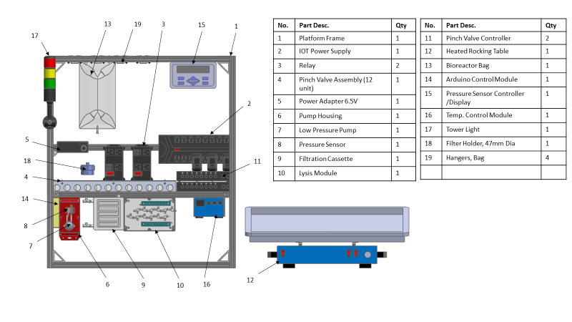
Platform Breadboard Design
Flexible modified COTS design, reconfigurable, subsystems are re-usable/replaceable

Slide 16
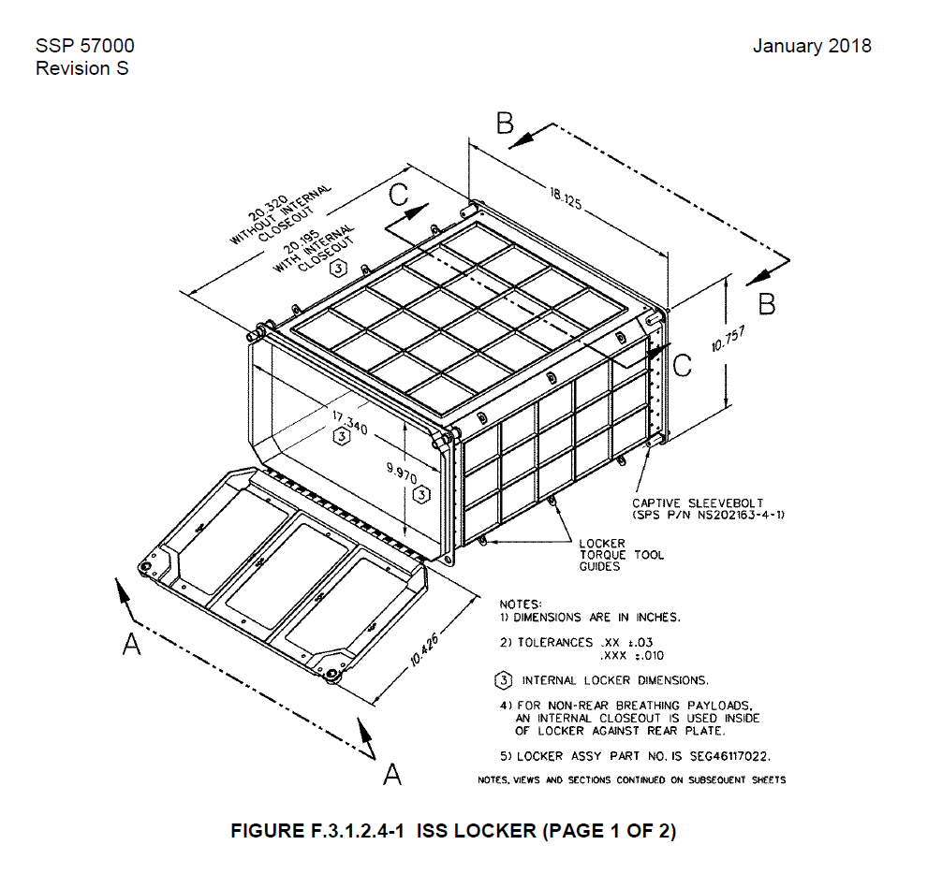
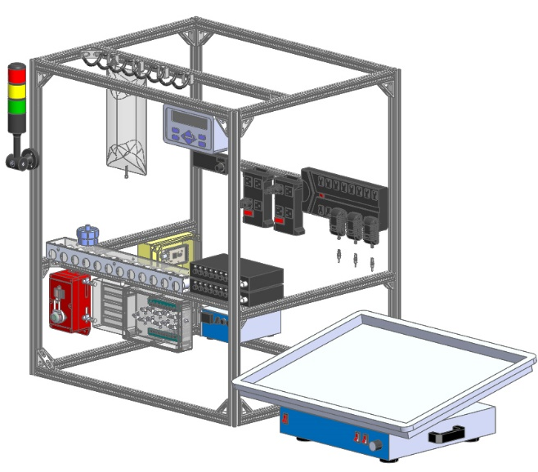
Platform Volume vs Middeck Locker
Requirement 1.3:The System shall be implemented in a flight-like configuration that would operate in a volume similar to an ISS middeck locker and under moon and Mars gravity.
Subsystem volume within the platform is approximately 770 in ³. This does not include heated rocking table, light tower, frame or any electrical harness or flexible tubing. Internal Volume of Middeck Locker is 3512 inch ³

Slide 17
Results

Slide 18
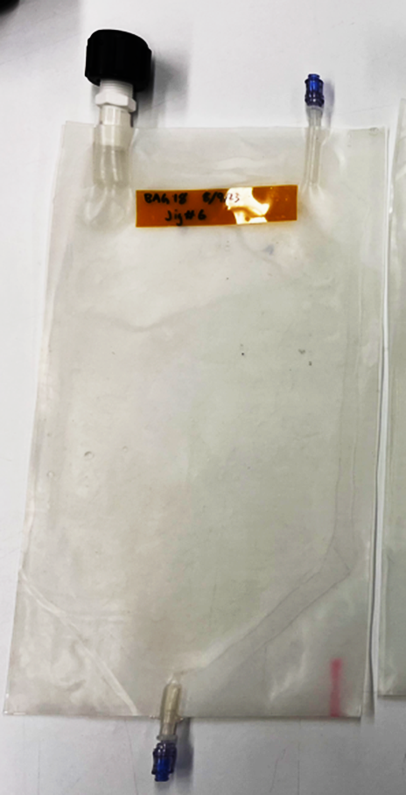
Bioreactor Design: flat, packable, gas exchange via materials, strong, simple, replaceable, re-usable
Custom designed membrane bioreactor
  Higher gas transfer than traditional FEP bags
  Made from durable food grade silicone (PDMS)
31 Mil Silicone Bag – data redacted
E. coli Grown on AMM in Different Bioreactors – Data redacted/data upon request

Slide 19
K.phaffii Growth on Acetate and Ethanol-based Medias
Matt Paddock
Ethanol is an established CO₂-derived carbon source
K.phaffii can utilize acetate and ethanol
Ethanol Media (YEMM) Compositions -data redacted/ data upon request
Acetate + EtOH reached % ISRU – data redacted
Carbon utilization efficiencies – data redacted

Slide 20
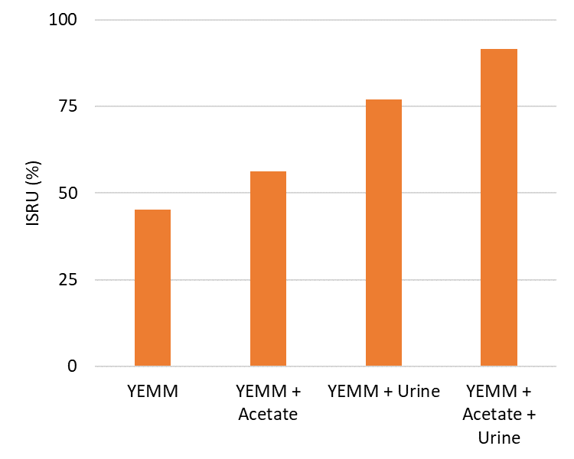
% ISRU for Ethanol-based Media Potentially Increased Through Salt Recovery from Waste or Regolith
Matt Paddock
Media | YEMM | YEMM + Acetate | YEMM + Urine | YEMM + Acetate + Urine
Component | g/L
Ethanol (ISRU)
Acetate (ISRU)
Urine (ISRU)
Total
Percent Mass ISRU | 47.2 | 56.3 | 76.9 | 91.5
KPP Goal
Data upon request
KPP Threshold

Slide 21
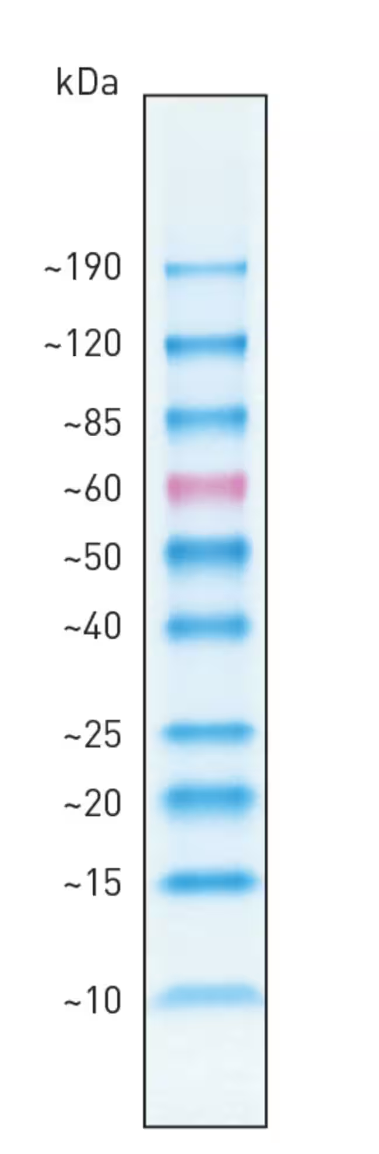
K. phaffi Produced Cutinase – Run June 6, 10, 2024
KEY:
Lane 1: leading buffer (blank)
Lane 2: BenchMark Prestained Protein Ladder
Lane 3: leading buffer (blank)
Lane 4: K. phaffi Run 1 1X Effluent Post Filter
Lane 5: K. phaffi Run 1 10X Concentrate Effluent
Lane 6: K. phaffi Run 1 Wash
Lane 7: K. phaffi Run 1 Elution
Lane 8: K. phaffi Run 1 Post Wash
Lane 9: leading buffer (blank)
Lane 10: : BenchMark Prestained Protein Ladder
Lane 11: leading buffer (blank)
Lane 12: K. phaffi Run 2 1X Effluent Post Filter
Lane 13: K. phaffi Run 2 10X Concentrate Effluent
Lane 14: K. phaffi Run 2 Wash
Lane 15: K. phaffi Run 2 Elution
Lane 16: K. phaffi Run 1 Post Wash
Lane 17: blank
1 2 3 4 5 6 7 8 9 10 11 12 13 14 15 16 17
Data upon request
Expected
Cutinase
Band Size

Slide 22
Platform performance with yeast, bacteria, intercellular and secreted products
Requirements |  |  | The CO2 Based Manufacturing Platform shall grow engineered microorganisms that produce a purifiable product (and shall support purification of that product) in a configuration suitable for space exploration and operation in Earth, Moon, and Mars gravity. |  | The platform shall operate semi autonomously (requiring minimal manual/crew intervention) and allow for flexibility in organism growth times, and product purification requirements. | Platform components that do not interface with the organism or sample directly shall be reusable (pumps, controller, mixing capability, sensors, thermal control). | The platform shall have replaceable subsystems including all components with direct interfaces with culture and culture products (media, culture, lysed culture, product purification components). | The bioreactor shall support batch biomanufacturing, specifically it will support media addition and product recovery. | The bioreactor shall contain a homogenous culture. | The product harvesting subsystem shall harvest and purify recombinant proteins. | The percent of solid media components sourced from CO2, H2, and mission wastes shall be 50% or greater.
Success Criteria |  |  | product purified from platform as documented by SDS PAGE | Enzyme activity detected | Run includes use of programmed pump controls and automated pressure sensor feedback | Repeated platform runs. | Repeated platform runs. | Repeated runs with product recovery demonstrated by gel electrophoresis and/or Elisa or activity assay | Visual inspection | Products isolated from his-tag capture purification system analysis | Calculation based on weight
E. coli | Carbonic Anhydrase | 1/5 | +/- |  | Lysers failed | ✔ | ✔ | +/- | ✔ | +/- | 49.3% achieved for E. coli with theoretical as high as 59.8%.
 |  | 1/8 | ✔ | ✔ | Lysers failed | ✔ | ✔ | ✔ | ✔ | ✔
 |  | 1/9 | ✔ | ✔ | Lysers failed | ✔ | ✔ | ✔ | ✔ | ✔
 |  | 7/15 | ✔ | - | Lyser failed | ✔ | ✔ | +/- | ✔ | +/-
 |  | 7/17 | ✔ | ✔ | Lyser failed | ✔ | ✔ | ✔ | ✔ | ✔
 |  | 7/18 | ✔ | +/- | Lyser failed | ✔ | ✔ | ✔ | ✔ | ✔
K. phaffii | Carbonic Anhydrase (secreted) | 1/26 | +/- | - eng enzyme | ✔ | ✔ | ✔ | +/- | ✔ | +/- | 47.2% (YEMM) and 56.2% with YEAMM) and used with theoretical as high as 95.2%
 |  | 1/29 | +/- | - eng enzyme | ✔ | ✔ | ✔ | +/- | ✔ | +/-
 |  | 1/30 | +/- | - eng enzyme | ✔ | ✔ | ✔ | +/- | ✔ | +/-
 | Cutinase (alternate product) | 6/7 | ✔ | n/a | ✔ | ✔ | ✔ | ✔ | ✔ | ✔
 |  | 6/10 | ✔ | n/a | ✔ | ✔ | ✔ | ✔ | ✔ | ✔
 |  | 6/11 | ✔ | n/a | ✔ | ✔ | ✔ | ✔ | ✔ | ✔

Slide 23
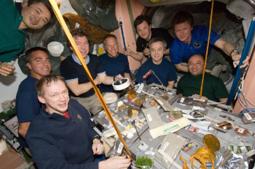
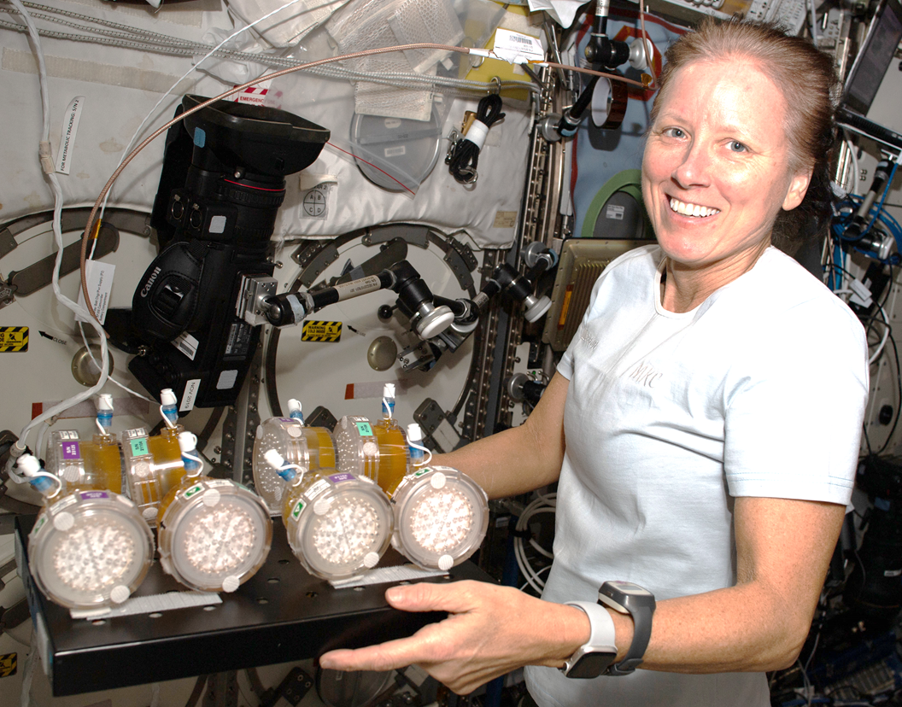
Nutrition in Space – Mitigations using Fermented Foods
Nutrients degrade with time in food and supplements
  Enhanced nutritional needs in space travel
  Radiation and microgravity countermeasures
  Disease-specific concerns
Psychology of food/isolation
Need to produce some foods in situ
Adapted from Zwart et al (2009) Food Science 74(7):H209-H217.
https://doi.org/10.1111/j.1750-3841.2009.01265.x
Credits: NASA

Slide 24
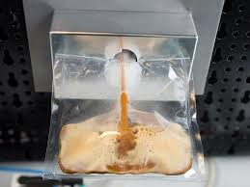
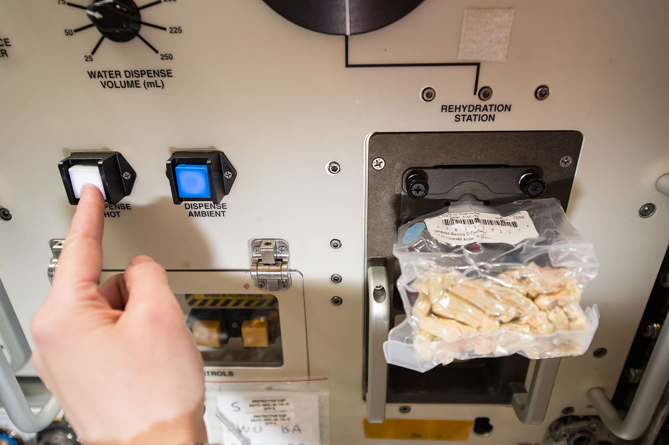
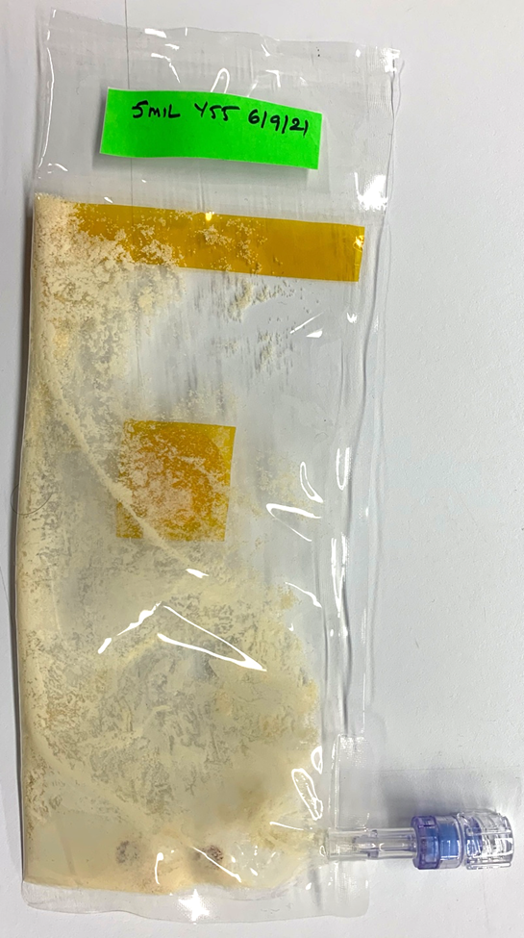
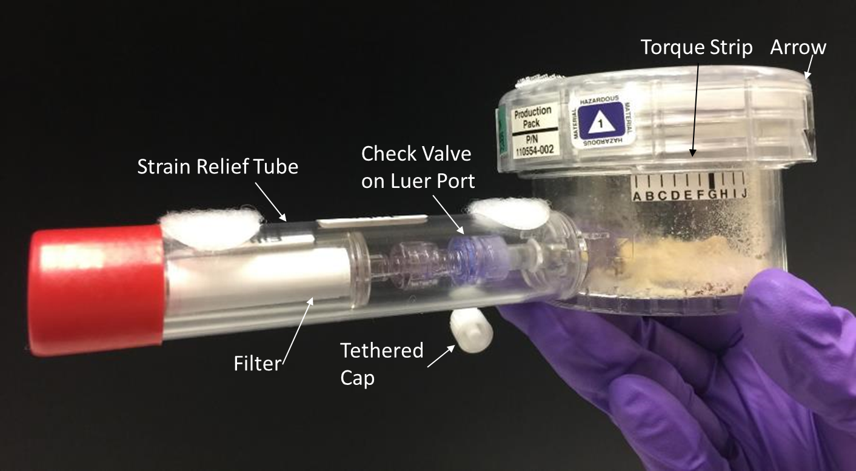


BioNutrients Concept – on demand nutrients
Frances Donovan
5-Year ISS Storage-Reactivation Demonstration – NG-11 (04/17/19)
Future Mission Implementation Concept
Develop and Demonstrate an on- demand nutrient production system for long duration missions to support nutrient degradation in stored foods.
Incubation
Safety
Test
BioNutrients-1 Flight Production Pack Development for on-orbit testing
Engineering microbes to produce nutrients and medicines on-demand
Developing microbes adapted for use
in space

Slide 25






Five Years and Six Runs Complete!
BioNutrients-1 Crew Members (left to right, top to bottom): David Saint-Jacques (Run 1, June 2019), Drew Morgan (Run 2, January 2020), Shannon Walker (Run 3, January 2021), Thomas Marshburn (Run 4, January 2022), Koichi Wakata (Run 5, January 2023), Satoshi Furukawa (Run 6, January 2024)

Slide 26






BN-2: Flat Pack FEP system, adds Yogurt and Kefir
Yeast carotenoids and Follistatin (protein therapeutic) production Yogurt and Kefir production (vitamin K, gfp demo product)
ISS
90% reduction in mass
Flat pack system
2 successful runs
No contamination
BN-2 yeast ISS production packs (S. boulardii producing beta-carotene, S. cerevisiae producing zeaxanthin, and K. lactis producing follistatin).
Run 1 of yogurt and kefir on ISS. Left: kefir (blue color at initial hydration turns yellow as culture grows and pH lowers), Upper right: yogurt.
Nicole Mann and Josh Casada hydrating and shaking the yeast and yogurt packs respectively. Featured in Space Station Science Highlights: Week of January 2, 2023 | NASA ISS Research on Twitter: "BioNutrients-2 tests an on-demand system to produce key nutrients from yogurt, kefir, and a yeast-based beverage. 🥛 The study could help maintain the crew's health while reducing launch mass and volume requirements. https://t.co/fuxW39uTWd https://t.co/bzFZVYMIxS" / Twitter

Slide 27
BN-1 Stasis Pack Overview
Species/Sample Description | Treatment variable | >1M CFU at 3 years storage
Saccharomyces cerevisiae (ATCC BY4743) knockout lines | Heterozygous/ Homozygous
Saccharomyces cerevisiae subsp. boulardii (SB2022, β-carotene production) | Encapsulated
Saccharomyces cerevisiae subsp. boulardii (DT3032, β-carotene production, desiccation tolerance)
Saccharomyces cerevisiae (Y55-1034, zeaxanthin production)
Kluyveromyces lactis (ATCC 8585) | UV treated
Komagataella phaffii Kurtzman (ATCC 20864) | UV treated
Streptococcus thermophilus (ATCC BAA-491) with GFP plasmid | Encapsulated
Lactobacillus delbruekkii subsp. bulgaricus (ATCC-BAA-365) | Encapsulated
Bacillus subtilis (ATCC 6633) | Encapsulated
Bacillus coagulans (ATCC 7050) | Encapsulated
Methylobacterium extorquens AM1 (ATCC 14718) | UV treated
Cupriavidus necator (ATCC 17699) | UV treated
Media A (Production Pack media)
Media B (Vitamin K production media)
Skim milk powder (Yogurt/Kefir media)
Expected outcome and data from the stasis packs:
Tests for long shelf-life organisms
  Query into genomic changes* within a given organism sample (spontaneous mutation, early vs late samples)
  Comparison of genome of long shelf life organisms vs those with short shelf life
  Organisms mutagenized pre-flight to derive a population or long shelf life mutants for future use/characterization.
Assess alginate encapsulation effect on long-term viability
Assess engineering for desiccation tolerance
Assess shelf life of BioNutrients media and milk powder in this packaging on the ISS
Assess Vitamin K in B.subtilis (natto producers)
Data upon request
*Note, RNA from BN-1 production pack samples is also captured and will be queried for expression changes
27

Slide 28
CO₂- Based Manufacturing Platform
Current products:
Carbonic Anhydrase
Cutinase
Acetate, Ethanol based media
E.Coli and K.phaffi
MOXIE [1]
Input: CO₂
Output: O₂, CO
Technology maturity: in situ demo tested on Mars

Slide 29
Advances that would help our development
Plastics
  Industry has advanced layered plastics with well characterized gas permeabilities that allow for control of specific gasses (i.e.salad bag)
  New edible food coatings have these properties and may become applied in unique ways for NASA missions.
BioManufacturing organisms with NASA desired properties
  E.g. Halophiles or salt tolerance introduced into a readily engineerable, lyophilization tolerant organism.
  Work we are engineering/looking to collaborate on: reduction of ethanol production during precision fermentation to increase product yield vs ethanol release
Pathogen detection
  E-nose VOC detection on carbon-nanotube sensor based technologies – DATA upon Request
Pathogen elimination
  Pasteurization/cooking in space doesn’t require new technology
  We’re proposing phage control of unwanted microbes and biofilms

Slide 30

News of CO₂ conversion products on Earth
Savor – butter and milk ( 'Butter' made from CO2 could pave the way for food without farming | New Scientist)
Air Company – Vodka, perfume and Jet Fuel
C2CNT and academia Licht lab - carbon nanofibers
Carbon Upcycling Technologies -Nanoparticles for plastics, concrete and coatings
Newlight Technologies- Bioplastics from methane and CO2, Mango Materials – bioplastics from methane
Breathe - methanol
C4X -Chemicals, bio-composite foamed plastics
Upcoming NASA SBIR investments T7.05Climate Enhancing Resource Utilization -- may provide new/better feedstocks for biomanufacturing
  Lead Center: GRC
  Solicitation Year: 2023
  Scope Title: Sustainable Atmospheric Carbon Dioxide Extraction and Transformation
  Scope Description: Component and subsystem technologies are sought to demonstrate sustainable, energy-efficient extraction of carbon dioxide (CO₂) from a defined planetary or habitable atmosphere fully integrated with CO₂ transformation into one or more stable products such as manufacturing feedstock polymers or readily storable, noncryogenic propellants or fuels.
Notes:
5 surprising products made from carbon dioxide | World Economic Forum (weforum.org)
“One pot facile transformation of CO₂ to an unusual 3-D nano-scaffold morphology of carbon” https://doi.org/10.1038/s41598-020-78258-6
Photo is fd personal photo

Slide 31

Company | Molecules
Genomatica | 1,4-butanediol | butadiene | hexamethylenediamine | caprolactam | adipic acid
Amyris | farnesene
REG Life Sciences | fatty acid derivatives
Dupont | 1,3-propanediol
Butamax | butanol
Gevo | isobutanol
OPX (now owned by Cargill) | 3-hydroxypropionic acid | fatty acid derivatives
Solazyme | fatty acid derivatives
Bioamber | succinic acid | 1,4-butanediol
Reverdia | succinic acid
Myriant | succinic acid
Succinity | succinic acid
Lygos | malonic acid
Lanzatech | 2,3-butanediol | 1,3-butadiene | acetic acid | isopropanol | isobutylene
Calysta | lactic acid
Industrial microbes (iMicrobes) | malic acid | methane/ethane
MOgene Green Chemicals | malic acid | propylene
Manus Biosynthesis | terpenes
Cambrian Innovation | methane | electricity
Proterro | sugars | organic acids | amino acids
NovoNutrients (OakBio) | carotenoids | PHB
AirProtein (Kiverdi) | PHB
Mango Materials | PHB
Solar Foods | carotenoids
invizyne | carotenoids | cannabinoids
Cemvita Factory | ethylene
More commercial CO₂ conversion

Slide 32

Backup/discard slides
Thank you

