Slide 1
Burst-Mode Frequency-Scanning Planar Laser-Induced Fluorescence for Multi-Parameter Measurements
09/26/2024
Amanda M. Braun
Neil S. Rodrigues
Paul M. Danehy

Slide 2
Acknowledgements
NASA STMD ESM Project
SBIR Program
Dr. Paul Hsu and Dr. Naibo Jiang, Spectral Energies, LLC

Slide 3
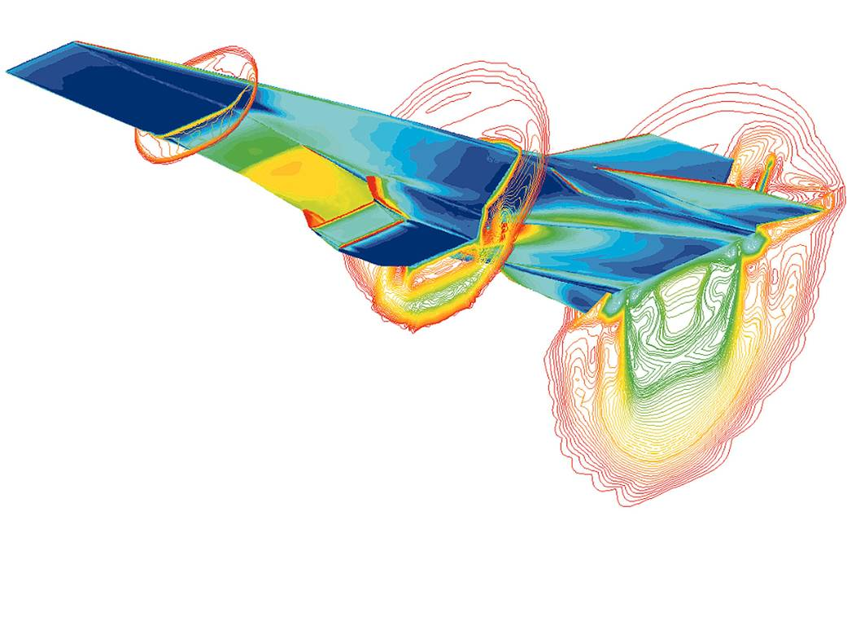
Why use optical diagnostics?
Surface Temperature
Non-intrusive
Spatio-temporally resolved
In situ measurements
P, T, V
Mach Number
Hyper-X^{[1]}

Slide 4
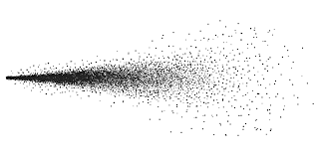
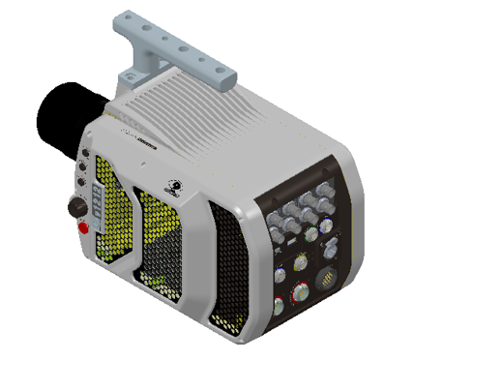
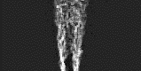


Why use planar laser induced fluorescence
Flow Molecules (NO)
$$T, P, ρ, \vec{V}$$
Spatially resolved (2D)
Temporally resolved
Species specific
Laser Sheet
Usually qualitative (visualization)
$$T, P, ρ, \vec{V}$$

Slide 5
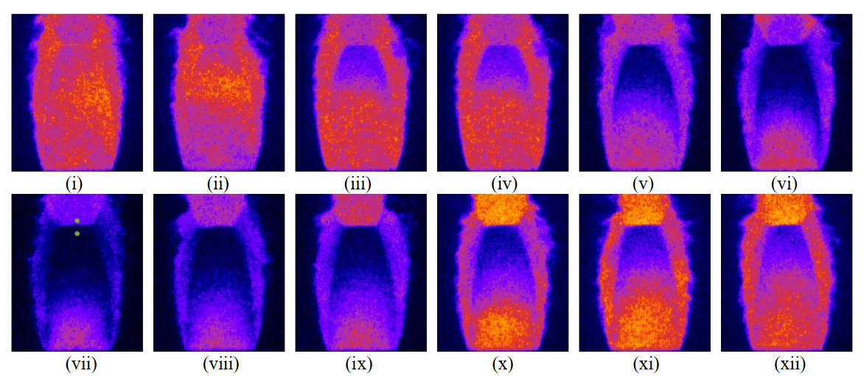
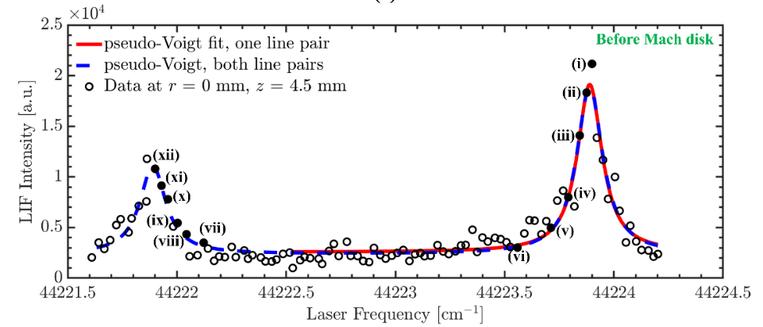
Frequency-scanning Burst-mode PLIF
Rodrigues et al.^{[2]}

Slide 6
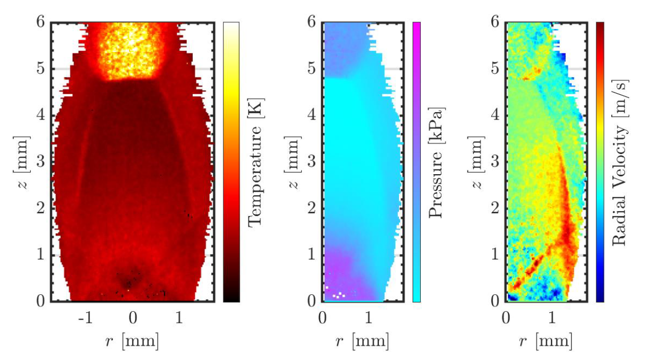
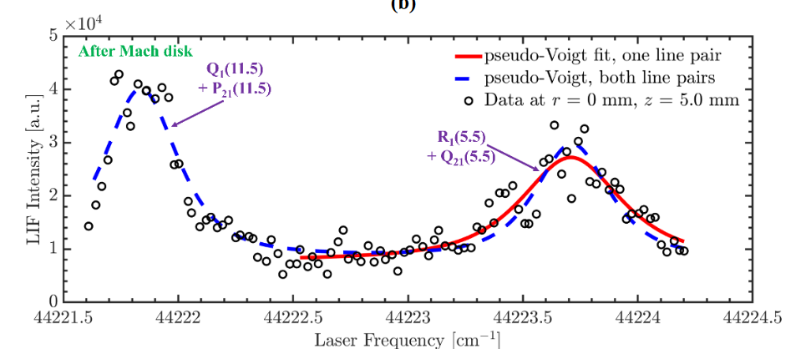
Frequency-scanning Burst-mode PLIF
Rodrigues et al.^{[2]}
Requires high-speed wavelength measurement!

Slide 7
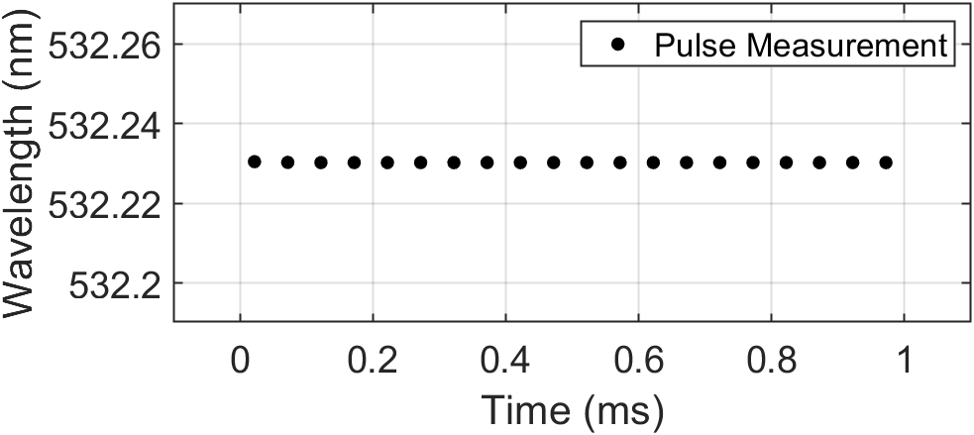
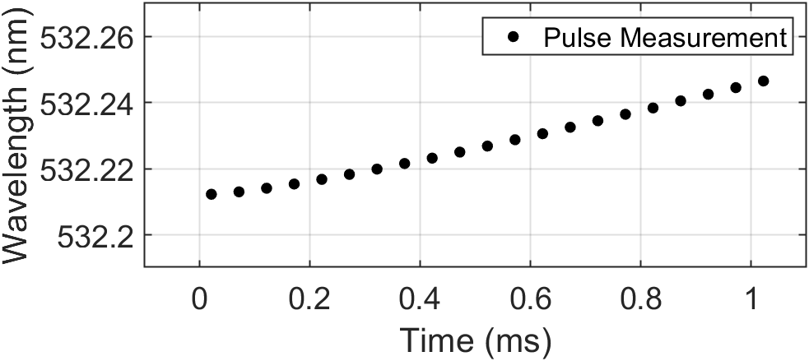
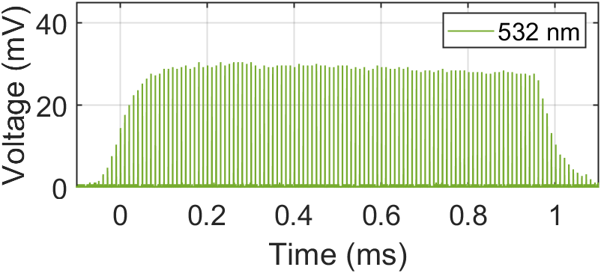
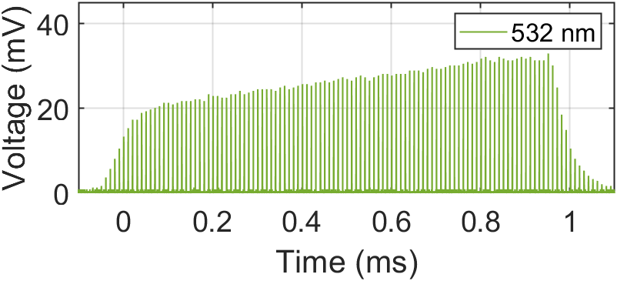
Experimental Setup
532 HWP
532 HWP
PBS
PD1
R532
PBS
R355
R355
Wavemeter
THG
SHG
30/70 BS
355 HWP
R355
W
Power Amplifier
355 HWP
R800
T600
PD2
Pulse Slicing
R355
BBO1
BBO2
R355
T600/800
600 HWP
SFG
20% R600/800
T355
R355
Cw Laser
R600/800
Idler Seed
R800
FG
W
PD3
1064 nm
532 nm
355 nm
800 nm
600 nm
226 nm

Slide 8
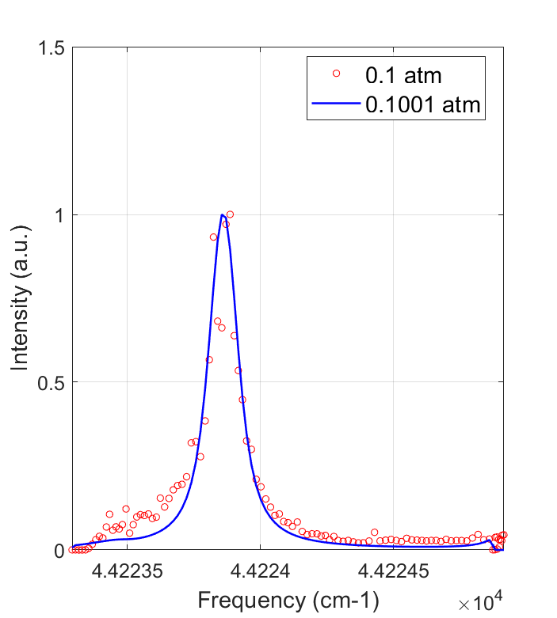
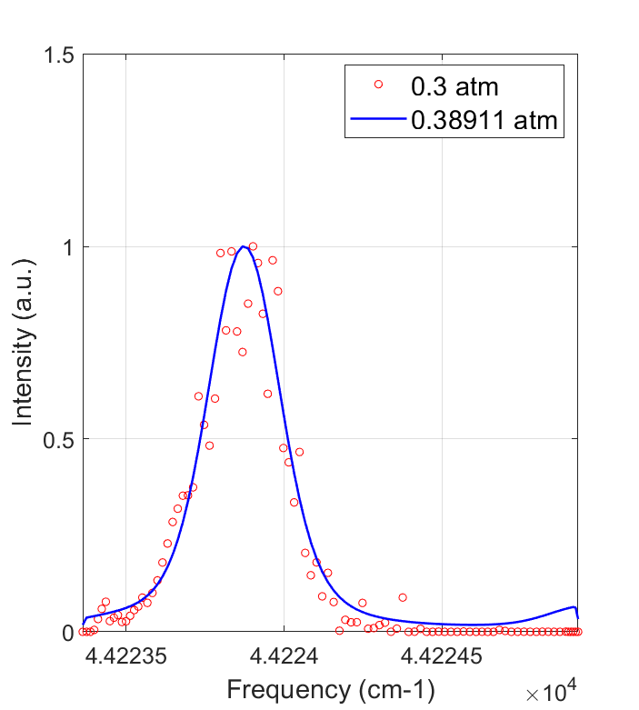
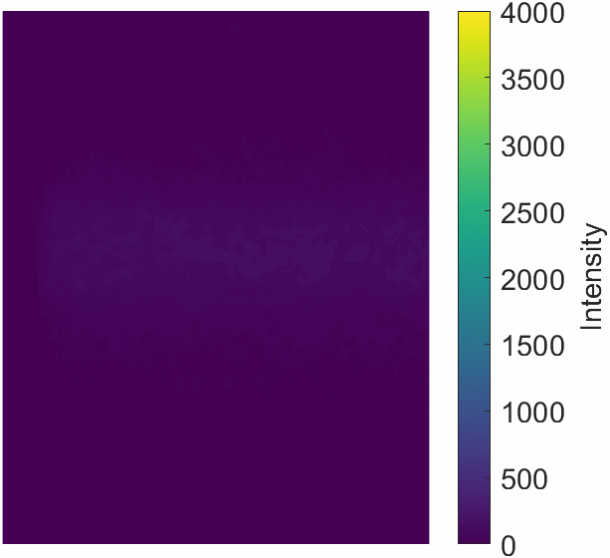
Preliminary Results
0.1 atm, 293 K, 0 m/s

Slide 9
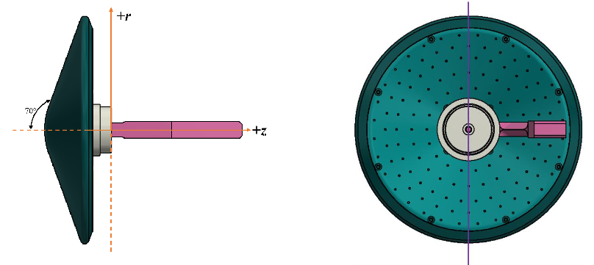
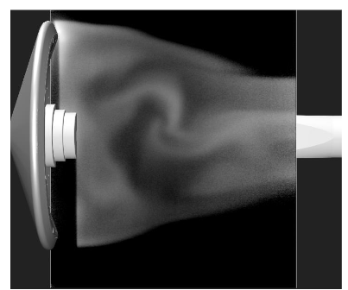
Planned Mach 10 Wake Flow Measurements
10 Hz → 100 kHz Flow Visualization
Towards kHz-rate temperature, velocity, and pressure measurements
Rodrigues et al.^{[3]}

Slide 10
References
[1] “Hyper-X ED97-43968-1: Computational Fluid Dynamics (CFD) Image of Hyper-X Research Vehicle at Mach 7 with Engine Operating.” https://www.dfrc.nasa.gov/Gallery/Photo/X-43A/HTML/ED97-43968-1.html (accessed Oct. 02, 2022).
[2] N. S. Rodrigues, P. M. Danehy, N. Jiang, P. Hsu, J. Leicht, and S. Roy, “100 kHz High-Spectral-Resolution NO-PLIF Measurements for Compressible Flows,” in AIAA SCITECH 2023 Forum, National Harbor, MD & Online: American Institute of Aeronautics and Astronautics, Jan. 2023. doi: 10.2514/6.2023-0405.
[3] N. S. Rodrigues, O. K. Tyrrell, E. Rieken, B. R. Hollis, and P. M. Danehy, “FLEET and PLIF velocimetry within a Mach 10 hypersonic air flow,” in AIAA SCITECH 2024 Forum, American Institute of Aeronautics and Astronautics. doi: 10.2514/6.2024-2323.

