Slide 1
Innovation in Action
Dr. Kyle Ellis – NASA
Tzvetomir Blajev – Flight Safety Foundation
Jodi Baker – Federal Aviation Administration
Alan Sternberg – Beams Safety AI
IATA World Safety and Operations Conference
3 October 2024

Slide 2
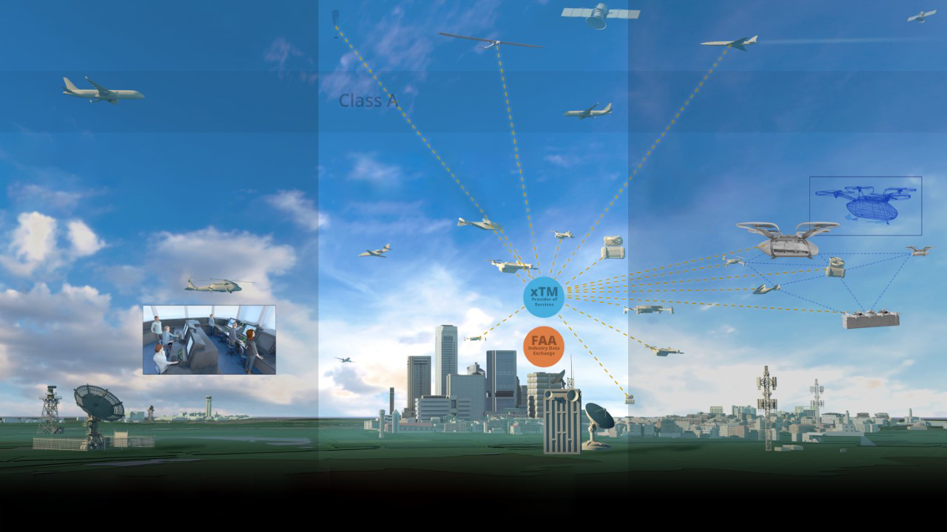
Innovating the Future of Aviation
Digitally Transformed Infrastructure
Human-Centric Capabilities
Automation-Enabled Diversity
Safety + Density
Collaborative Environment
Highly Automated
Human centered traffic &
Safety management
Service oriented architecture
for tailored mission services
+ ML
+ IoT
Complexity, scalability,
And dynamic adaptation
+ digital mesh
+ AI
+ IoT
Evolution of Aviation

Slide 3
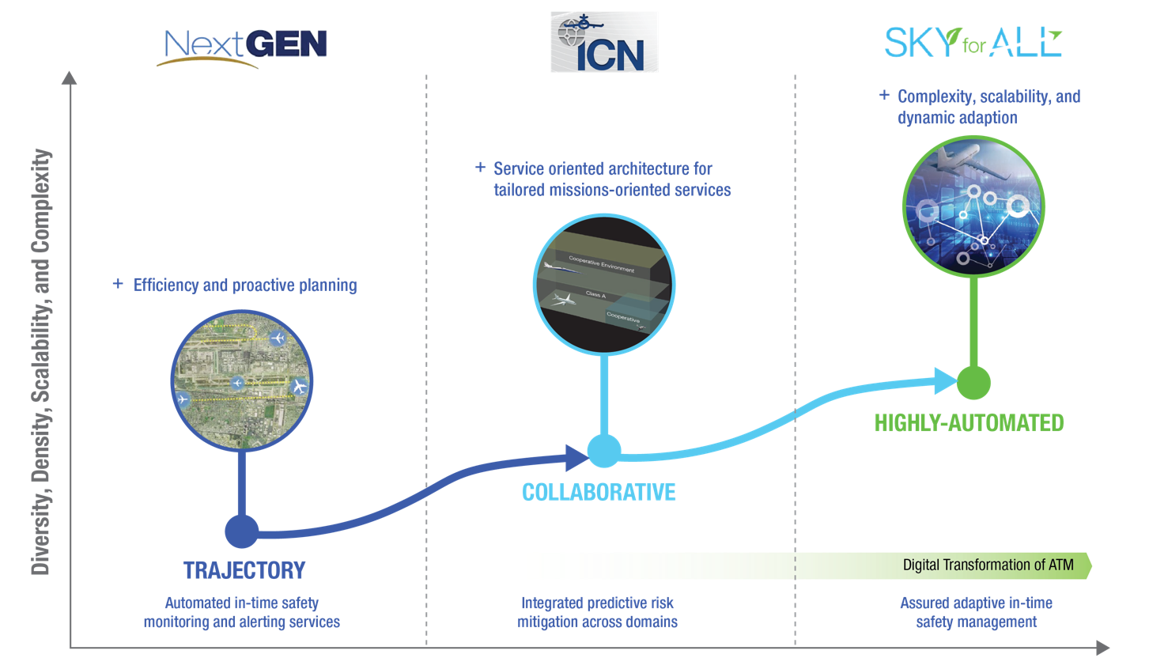
Future Airspace and Safety
Notes:
KEY MESSAGE: NASA Aeronautics’ ongoing work to advance airspace and safety are foundational elements to the future of aviation, from sustainability to traditional airline operations and advanced air mobility to high-speed flight. Our research enables the FAA and industry to keep pace with required change and enable aviation to safely grow at the expected pace. ​
NOTE: NextGEN and NAS 2040 are FAA-developed concepts.
We are leaving one era of evolution for our national airspace system – NextGen; entering another – NAS 2040; and planning for the next – Sky for All.
With years of NextGen tech transfer from NASA to the FAA now behind us, we are transitioning to developing tools that increase options for safe, sustainable decision-making in an an even more collaborative environment.
Our decades-long partnership with the FAA continues as we build on the efficiency gains, leveraging digital capabilities on the road to an airspace that is safe, adaptable, scalable, and now as a primary goal for NASA – that measurably contributes to more sustainable aviation.
In the 2040 timeframe, the FAA plans to make changes to the NAS to modernize aging infrastructure and transform to a more digital, information-based environment
This information-based environment will enable a digital transformation of the way air traffic management is done, creating airspace that is more dynamic and adaptive, allowing for increased diversity, density and complexity of operations and more proactive safety management
NASA is testing technologies and developing requirements to enable this future system. Our mid-century vision for the future of airspace and safety is called Sky for All

Slide 4
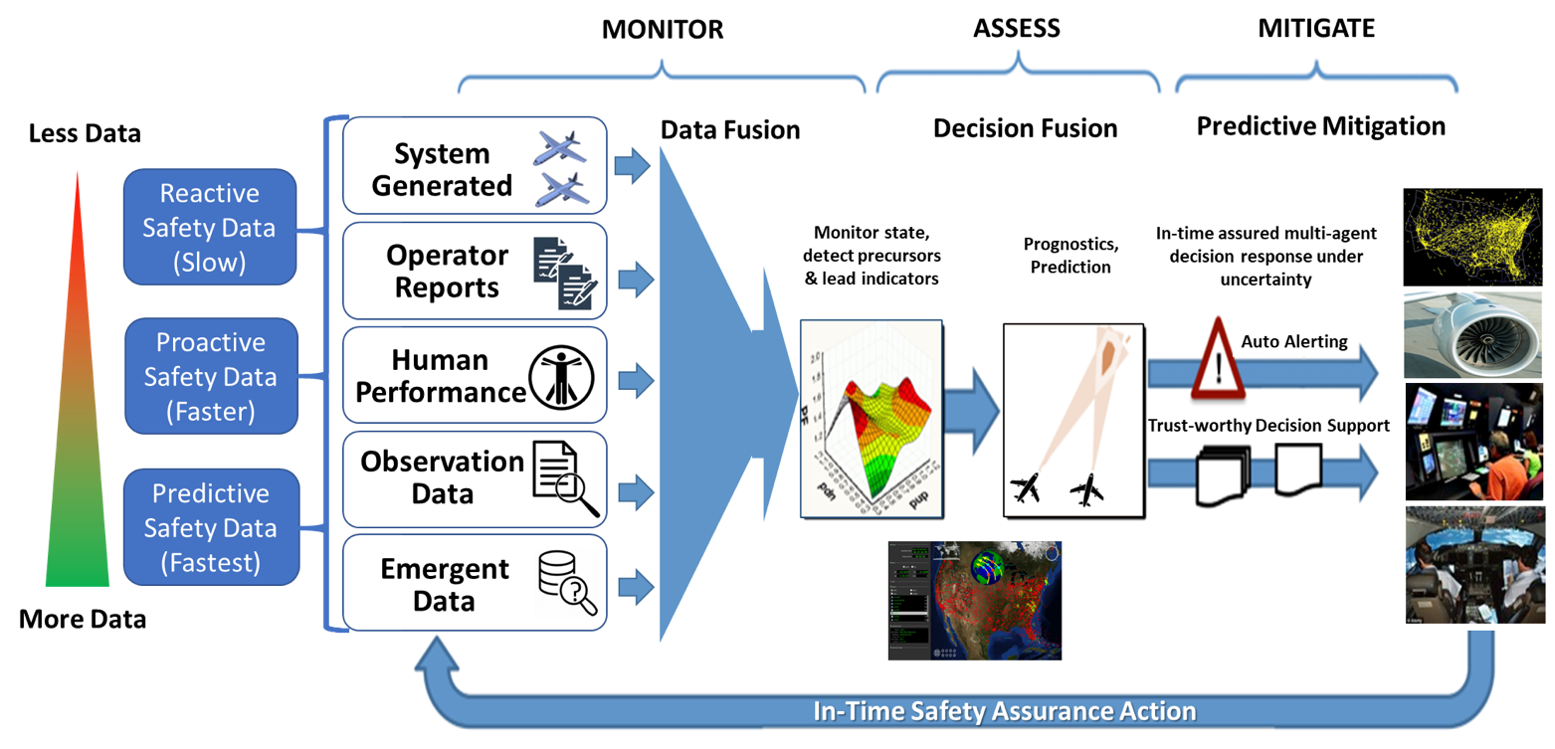
System-Wide Safety Assurance
Operational Needs
Improve in-time safety | Improve scalability | Improve accessibility | Increase participation
In-time Safety Assurance | Tailored Safety | Interoperability
Transformation Goals
Notes:
KEY MESSAGE: NASA Aeronautics’ ongoing work to advance airspace and safety are foundational elements to the future of aviation, from sustainability to traditional airline operations and advanced air mobility to high-speed flight. Our research enables the FAA and industry to keep pace with required change and enable aviation to safely grow at the expected pace. ​
NOTE: NextGEN and NAS 2040 are FAA-developed concepts.
We are leaving one era of evolution for our national airspace system – NextGen; entering another – NAS 2040; and planning for the next – Sky for All.
With years of NextGen tech transfer from NASA to the FAA now behind us, we are transitioning to developing tools that increase options for safe, sustainable decision-making in an an even more collaborative environment.
Our decades-long partnership with the FAA continues as we build on the efficiency gains, leveraging digital capabilities on the road to an airspace that is safe, adaptable, scalable, and now as a primary goal for NASA – that measurably contributes to more sustainable aviation.
In the 2040 timeframe, the FAA plans to make changes to the NAS to modernize aging infrastructure and transform to a more digital, information-based environment
This information-based environment will enable a digital transformation of the way air traffic management is done, creating airspace that is more dynamic and adaptive, allowing for increased diversity, density and complexity of operations and more proactive safety management
NASA is testing technologies and developing requirements to enable this future system. Our mid-century vision for the future of airspace and safety is called Sky for All

Slide 5
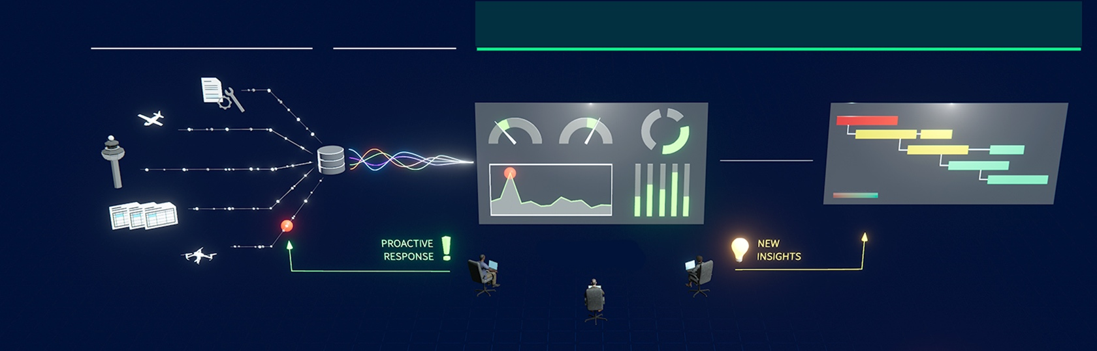
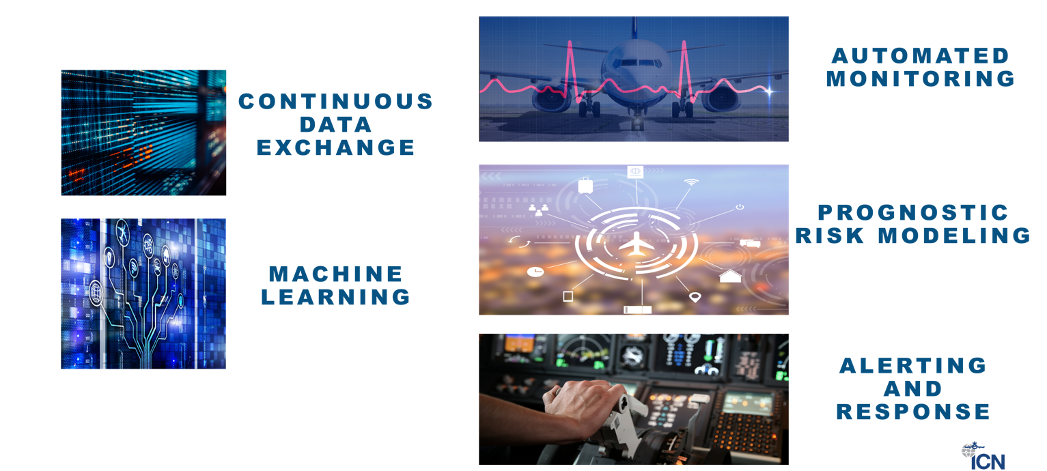

DATA COLLECTION &
AGGREGATION
FUSION OF BIG
DATA SETS
RISK MITIGATION
Safety Data
Safety Information
Actionable Safety Intelligence
INTERPRETATION &
UNDERSTANDING
Monitor – Assess - Mitigate

Slide 6
Innovation in Action
Panel Discussion
Kyle Ellis – NASA
Tzvetomir Blajev – Flight Safety Foundation
Jodi Baker – Federal Aviation Administration
Alan Sternberg – Beams Safety AI
IATA World Safety and Operations Conference
3 October 2024

