Slide 1
Temperature Boomlet Modeling and Analysis for Venus Environmental Descent
Joe Durante

Slide 2
Outline
Introduction
  About me
  Internship objectives
DAVINCI Temperature Boomlet Modeling
  Mission Overview
  Thermal Model Methodology and Setup
  Convective analysis using Fluent
  Parasitic Heating Investigation
  Radiation Effects on Venus
  Platings and Optical Properties
  Adhesive Choices
  Final Conclusions and Future Work
Additional Work and Closing Remarks

Slide 3
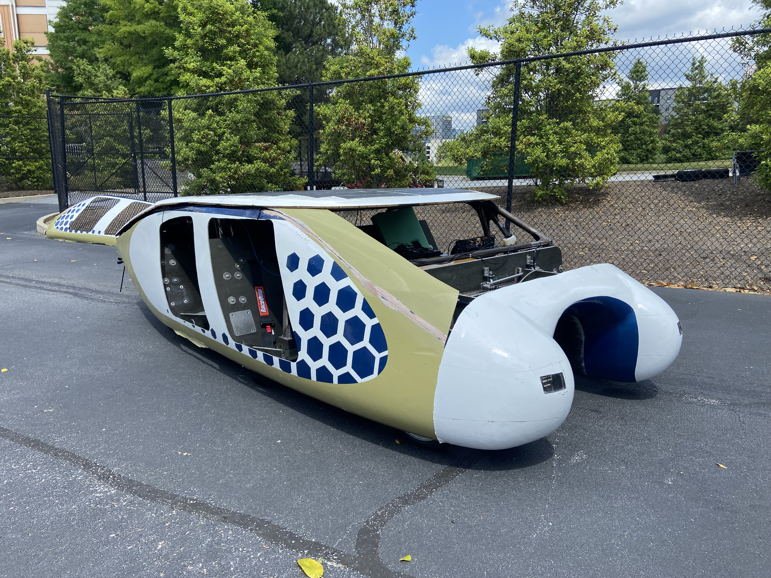
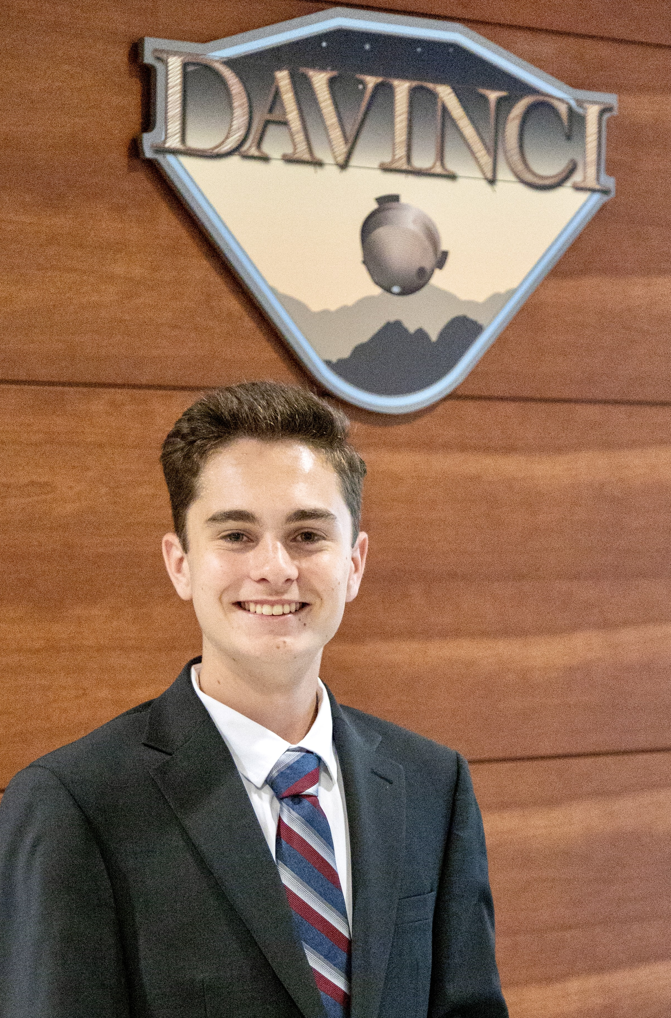

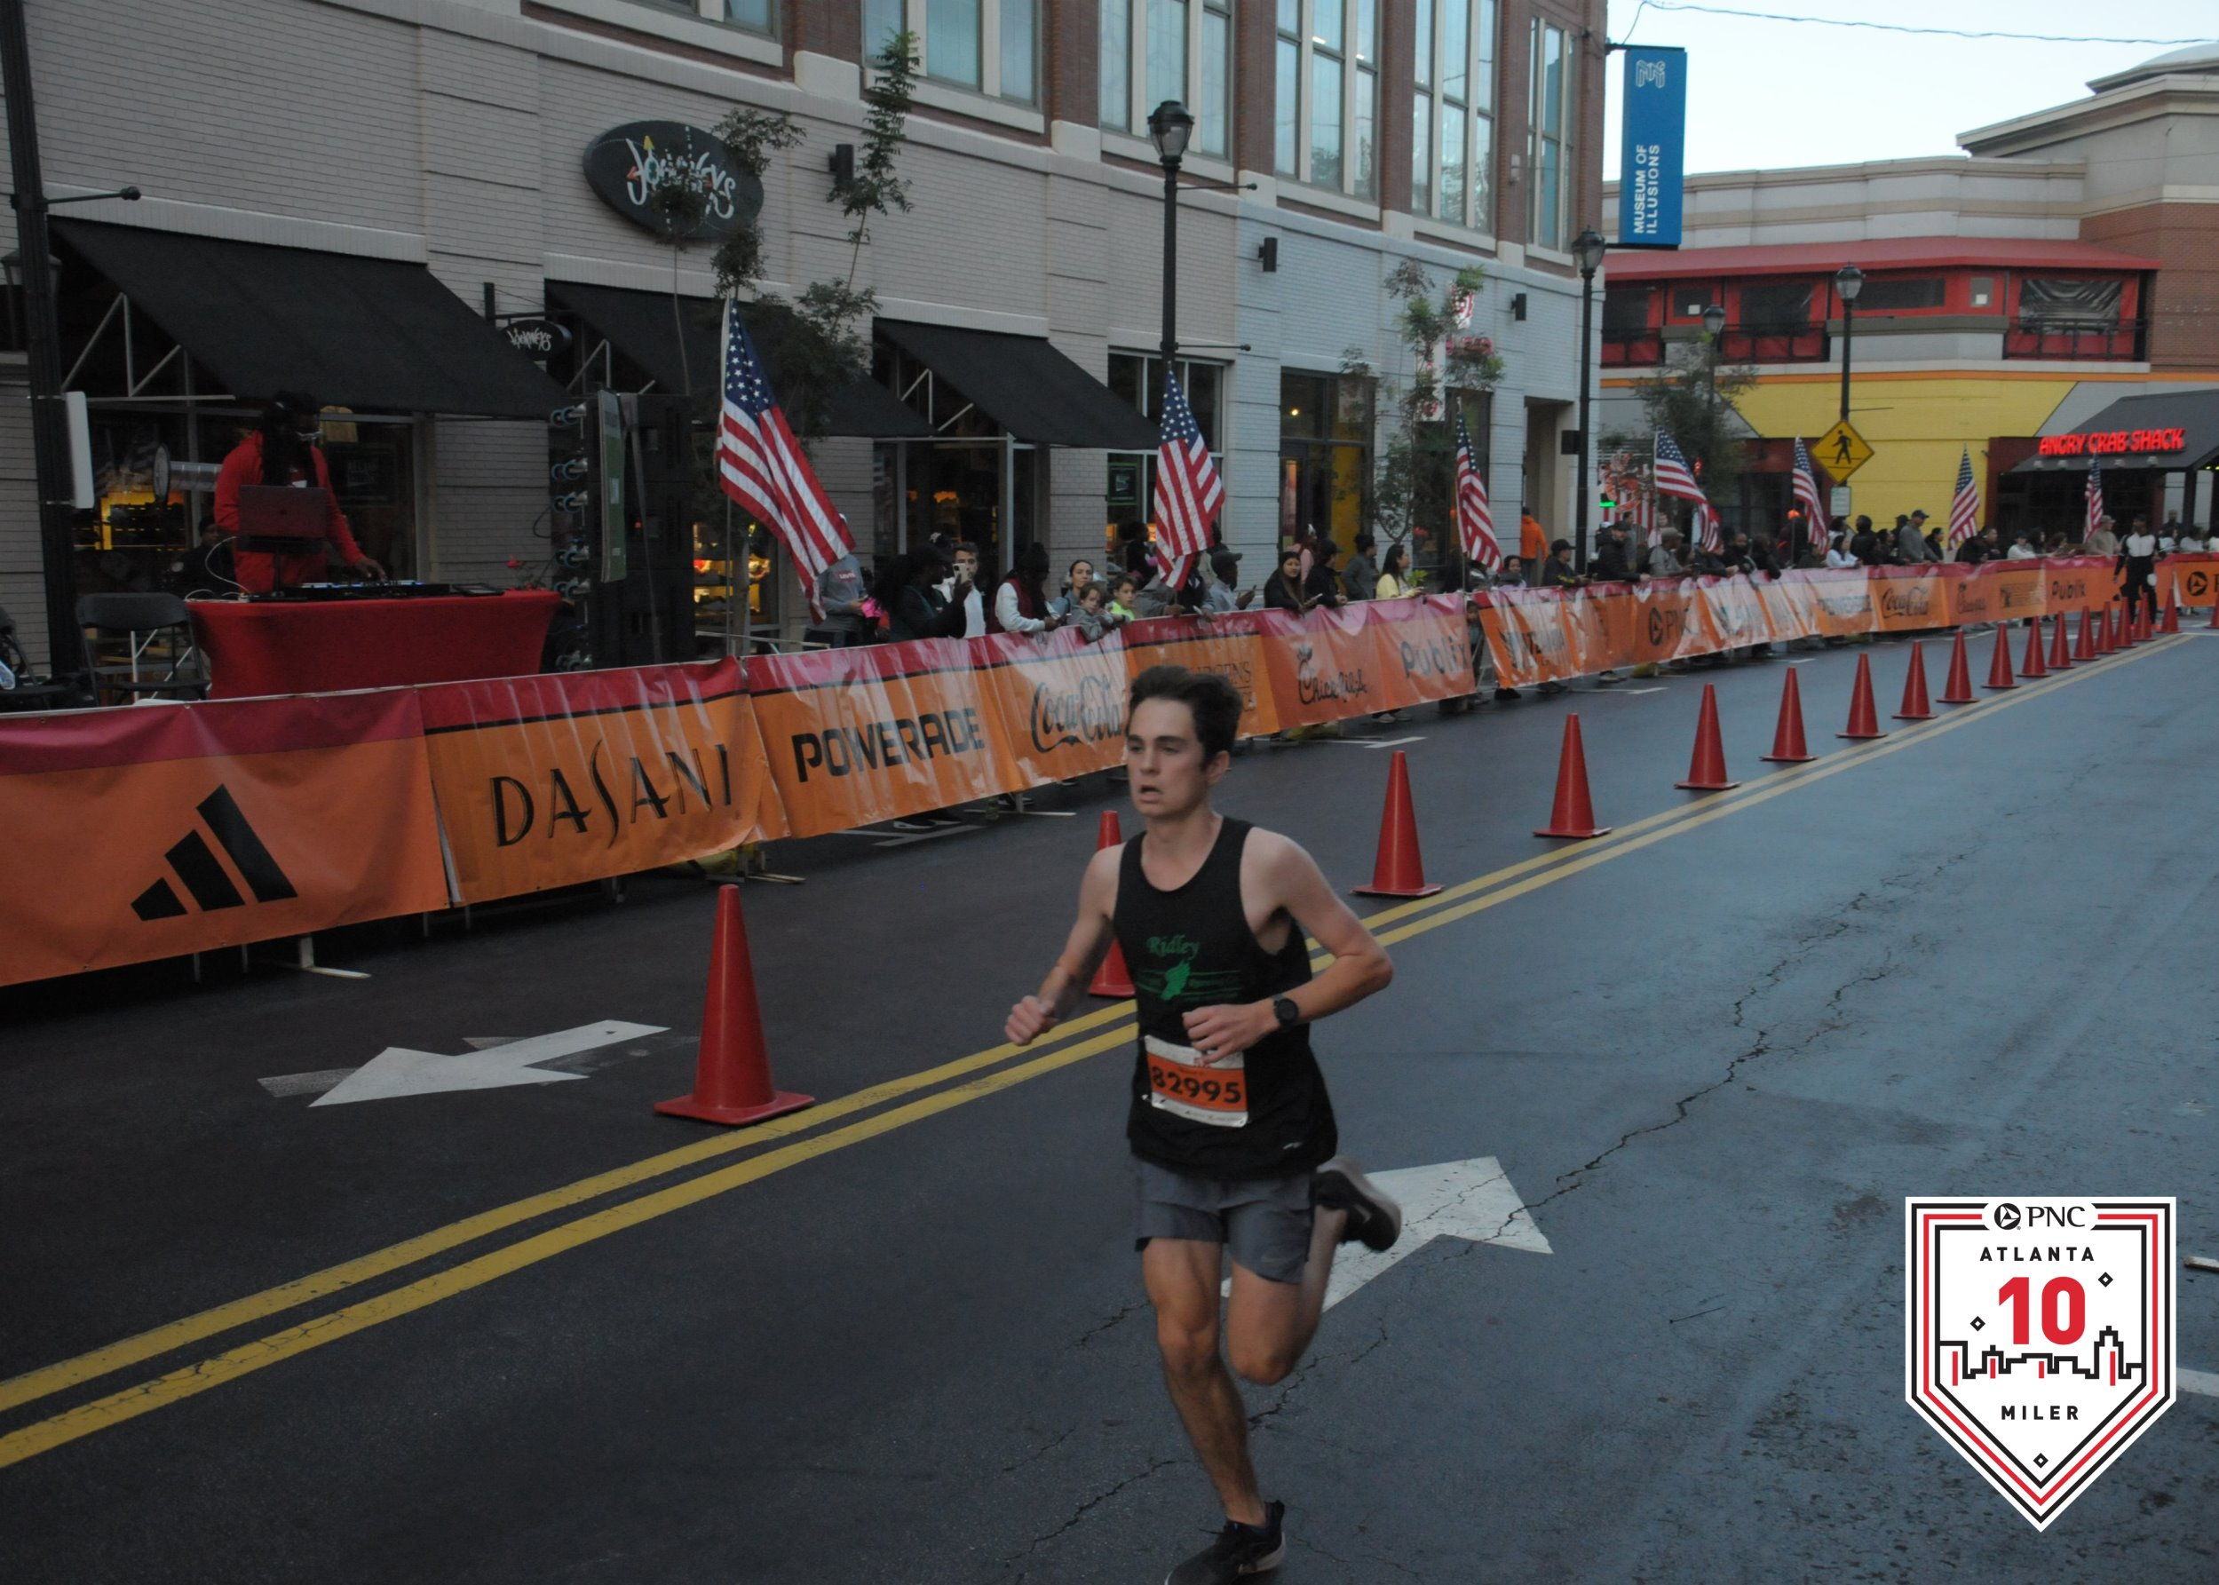

About me
Rising Junior Mechanical Engineering student at Georgia Tech
  From Ridley, PA
OSTEM Intern
Enjoy running, traveling, and cheering on Philly sports!

Slide 4
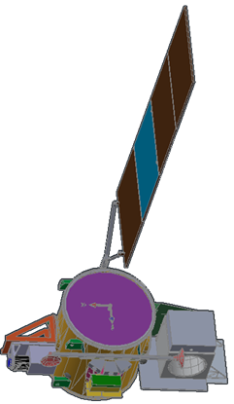
Internship Objectives
Learn basics of spacecraft thermal control
Learn Thermal Desktop/SINDA/RadCAD
See day-to-day work of a thermal engineer
Learn thermal design, analysis and testing
Learn about conduction, convection, and radiation
Use FEMAP for high fidelity meshing
Learn ANSYS Spaceclaim/Fluent (CFD Software)

Slide 5
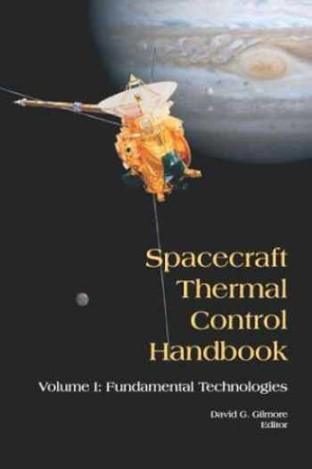
Materials Used for Learning
Spacecraft Thermal Control Handbook
Fundamentals of Heat and Mass Transfer
  Mostly to understand convection
Brian's TD Guide
  Which includes Hume's videos/tutorial
Daniel's Project-specific tutorial
  Introductory Problem Set TD and HT.docx
NESC Academy
  Thermal videos and overall spacecraft videos
The Efficient Engineer
  YouTube videos to effectively teach the basics of important engineering concepts

Slide 6
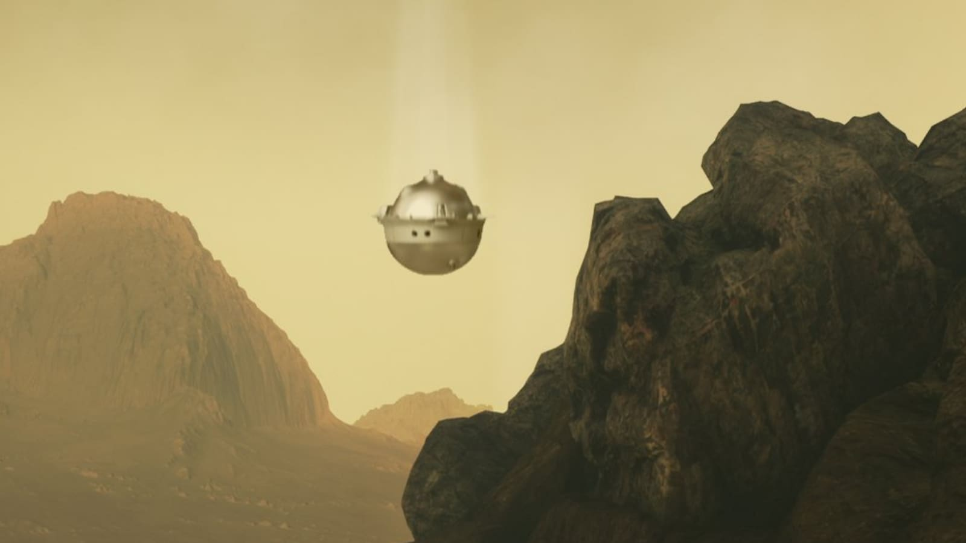
DAVINCI Mission Overview
DAVINCI stands for Deep Atmospheric Venus Investigation of Noble Gases, Chemistry, and Imagery
  First mission to Venus since the Soviet Vega program in 1985
  Set to launch in 2030
This mission will record data on the makeup of the Venus atmosphere as well as map out the cloud layer to better understand the origin and evolution of Venus
  This will help answer long-standing questions like if Venus was ever habitable, the atmospheric composition and surface interaction, and the surface properties.
There will be two flybys of Venus and then a full descent
  This descent will last approximately 1 hour, collecting valuable data throughout.
Challenges of the mission
  Temperature gets up to nearly 475 degrees Celsius (887 degrees Fahrenheit)
    Atmosphere is 96% CO2
  Crushing air pressure (92 bar)
  Clouds made of sulfuric acid

Slide 7
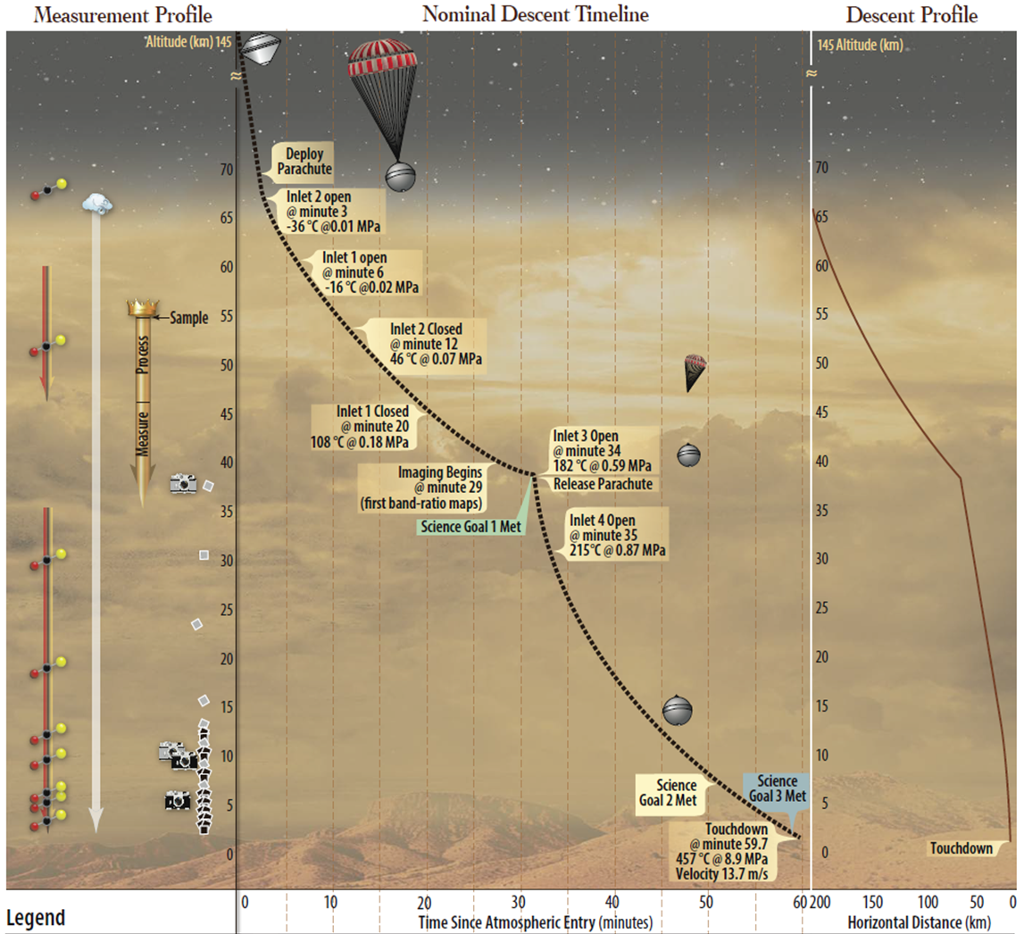
Venus conditions
Wide variation in temperature, pressure, and radiative heat transfer throughout the descent
Probe initially starts warmer than atmospheric temperature before being ejected from probe flight system
  Probe flight system keeps the temperature around -20 degrees C.
Descent simulation data is used in analysis
  Used to calculate Reynolds number, Nusselt Number, and Convection coefficient
  Temperatures are around 230 K at the start of the descent, and end around 735 K.

Slide 8
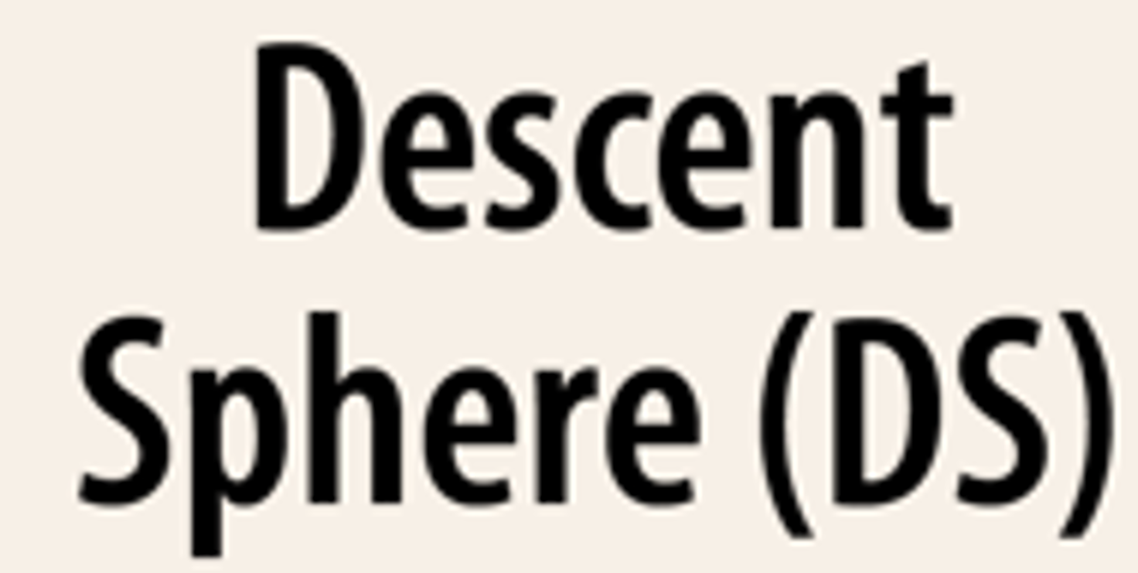
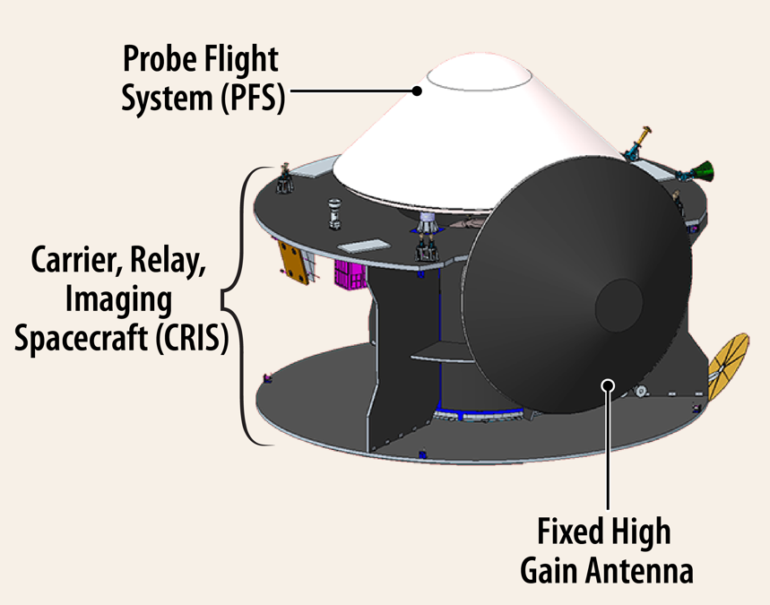
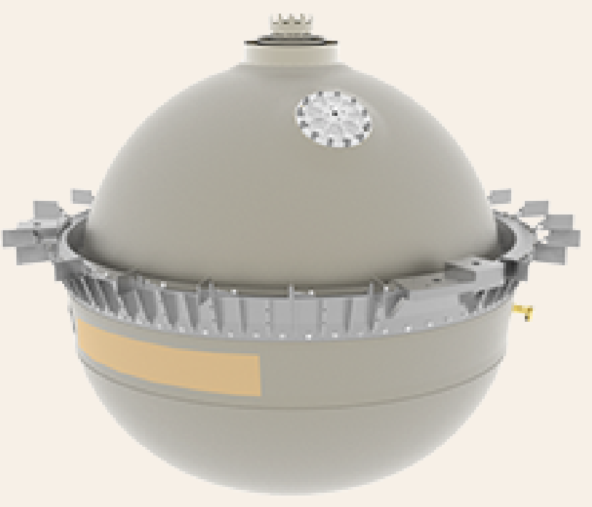
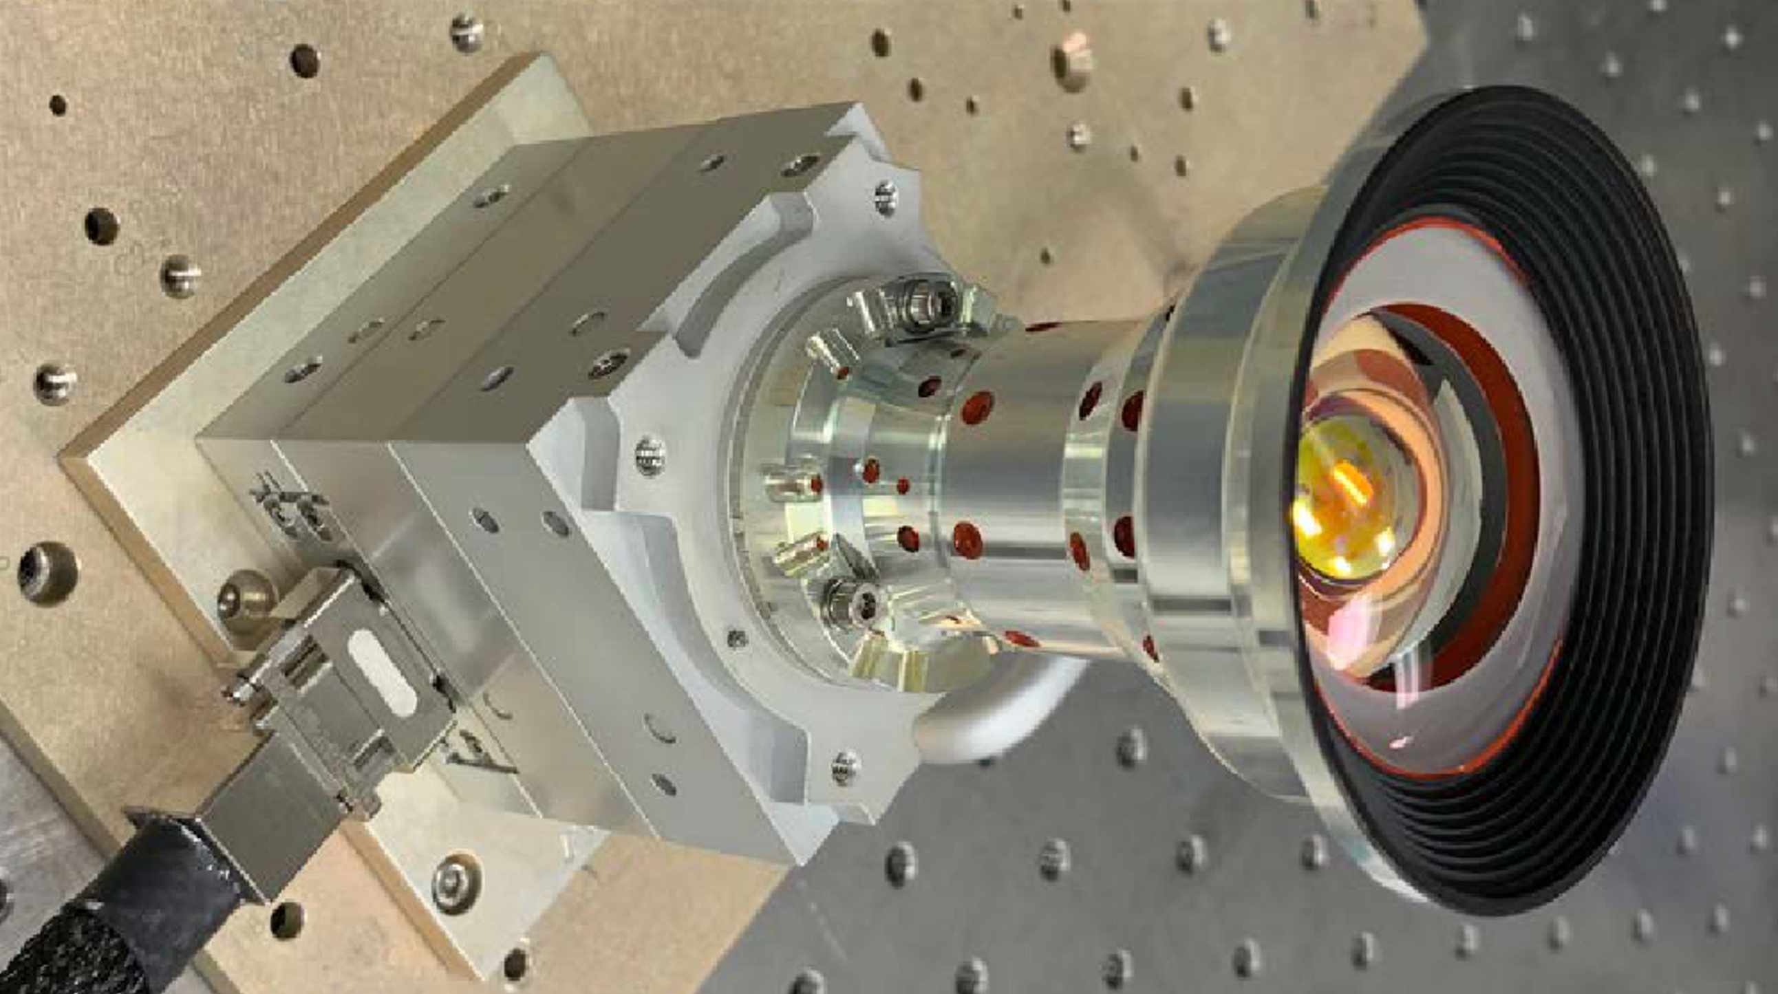
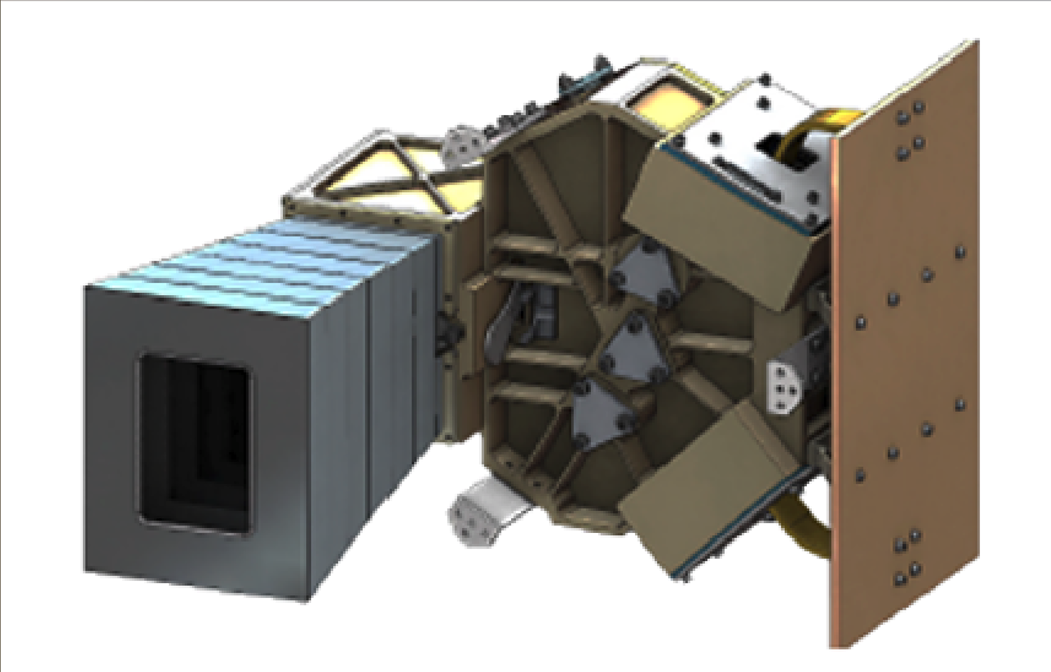
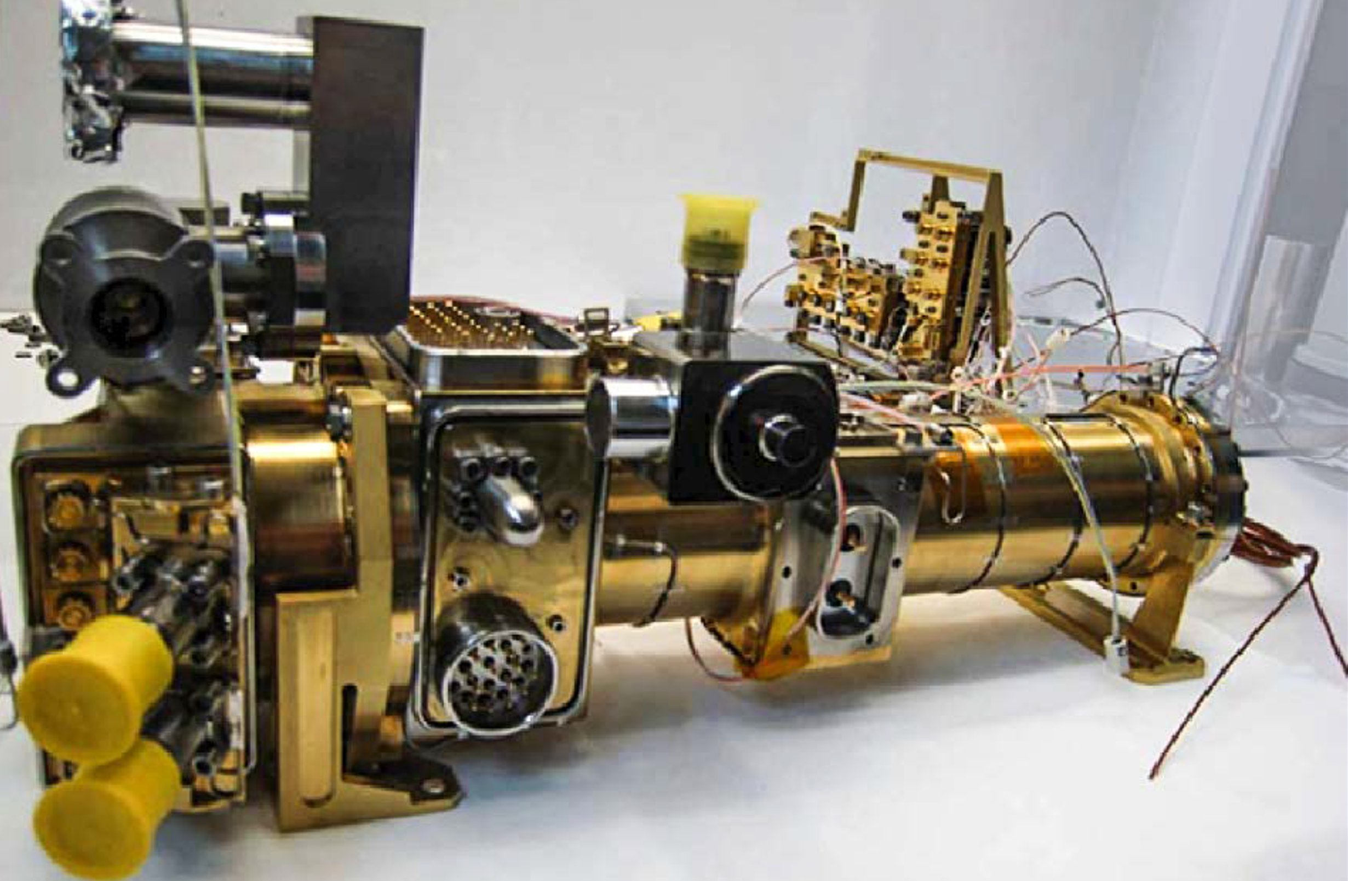
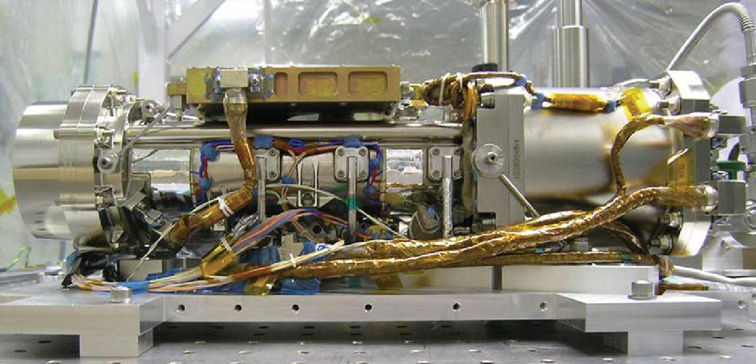
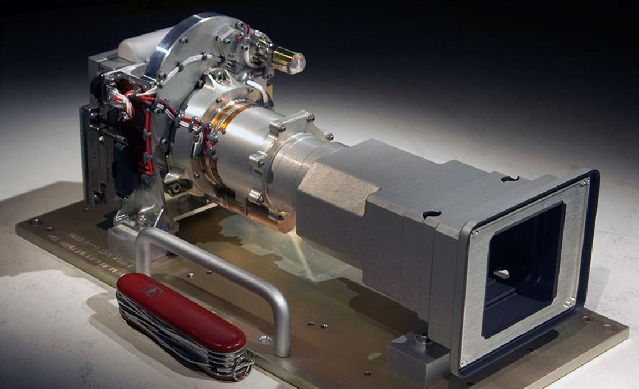
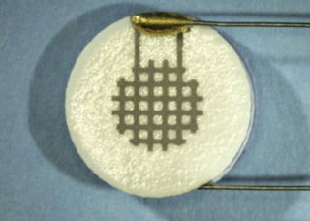
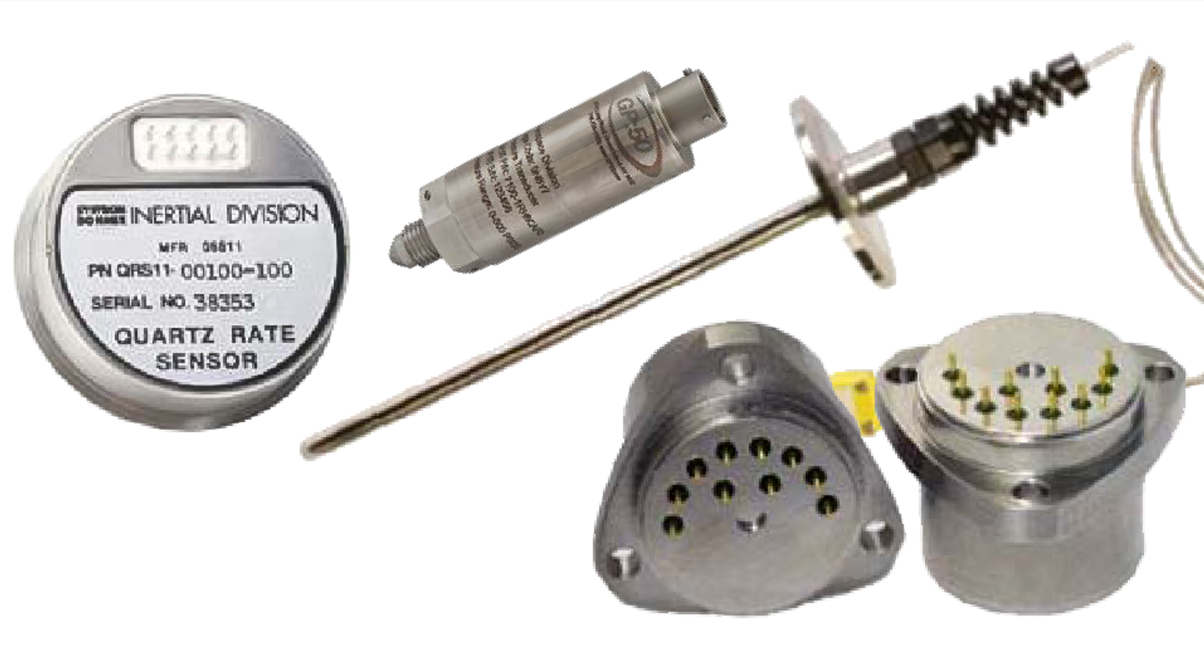
The DAVINCI Instruments
VISOR (Venus Imaging System for Orbital Reconnaissance)
CUVIS (Compact Ultraviolet to Visible Imaging Spectrometer)
In-situ measurement
VfOx (Venus Oxygen Fugacity Student Collaboration Experiment)
VMS (Venus Mass Spectrometer)
VTLS (Venus Tunable Laser Spectrometer)
VenDI (Venus Descent Imager)
VASI (Venus Atmospheric Structure Investigation)
Notes:
DAVINCI will tackle these objectives…

Slide 9
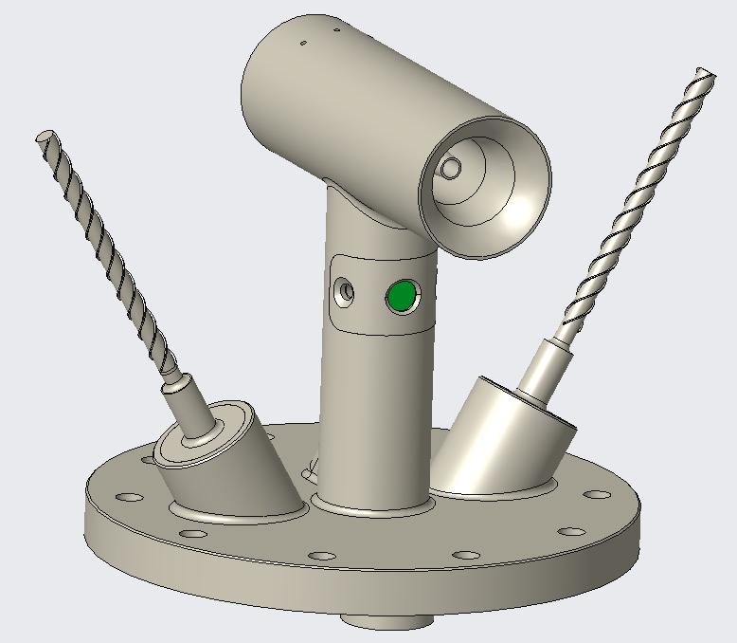
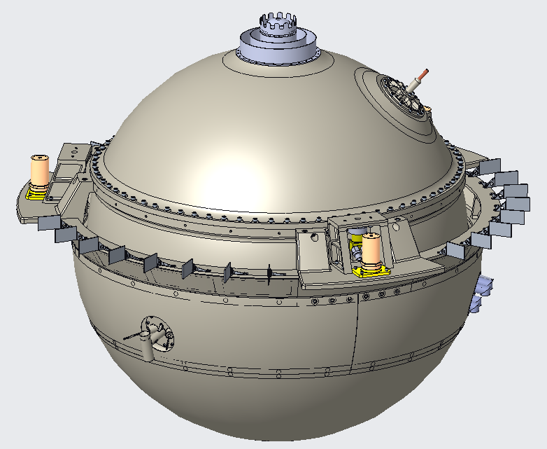
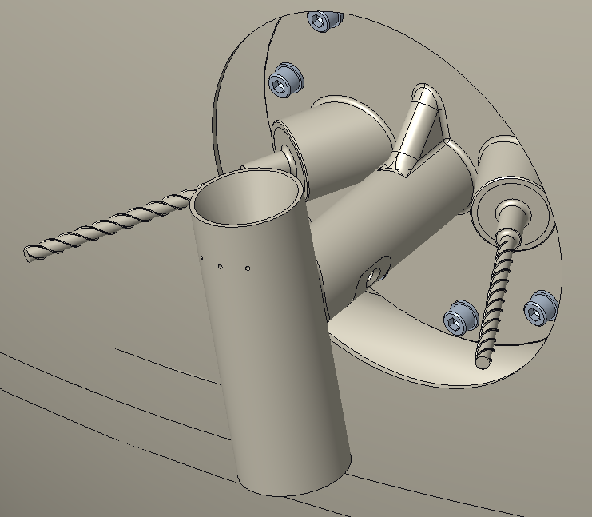
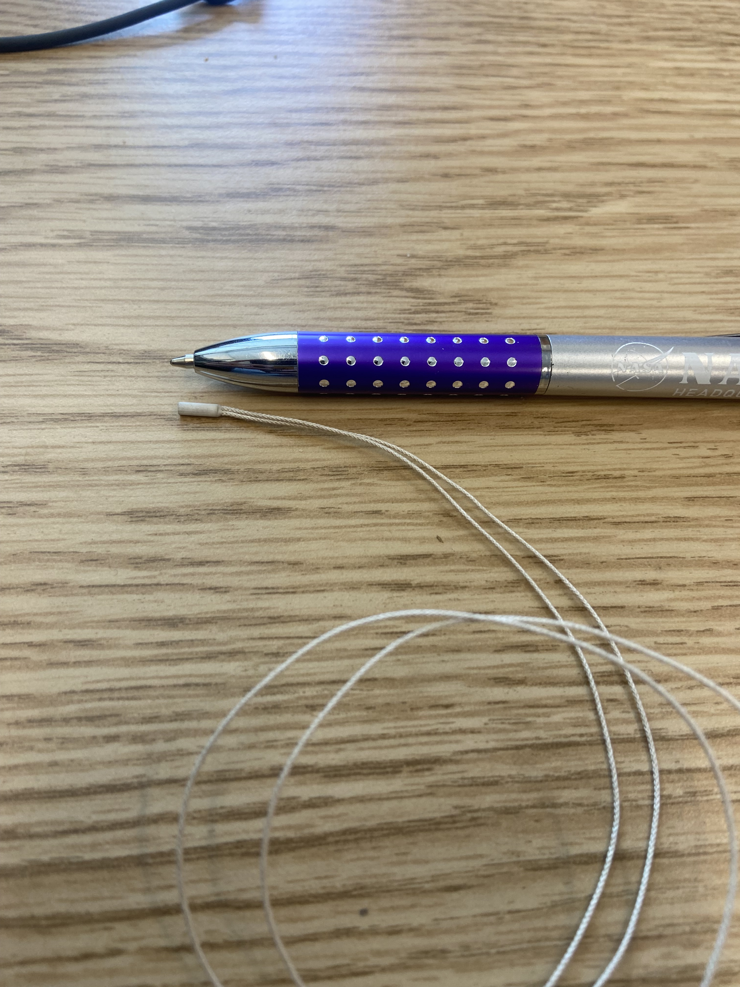
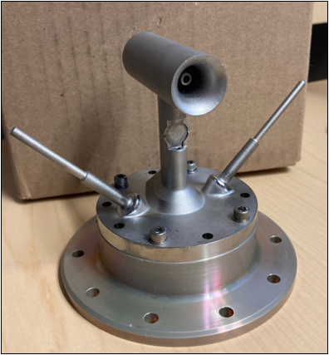
VASI System Overview
Descent direction
Ø 33 in
Kiel tube
VASI, Venus Atmosphere Structure Investigation, is one of the scientific tools used in the DAVINCI Mission
  Goal is to measure pressure, temperature, and wind speed throughout the probe's descent
The VASI port is made up of two temperature sensors with protective titanium casings as well as a Kiel tube to measure pressure
  Temperature sensor is a PRT, to allow for accurate temperature readings
  Pioneer Venus used external PRTs, which failed during flight. Therefore, this casing is required to protect the sensor from the harsh Venus atmospheric conditions
VASI will measure wind speed and direction using accelerometers and gyroscopes installed in the descent sphere
VfOx
Temp. boomlet 1
Temp. boomlet 2
Main flange
Additive Manufacturing Prototype courtesy of Mitch Haglund

Slide 10
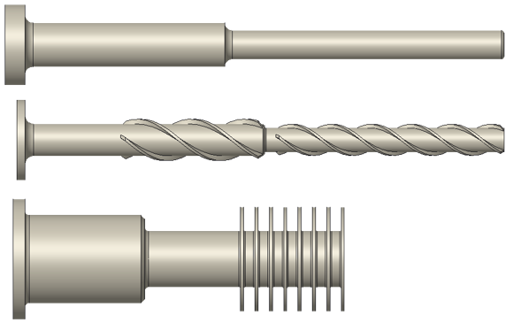
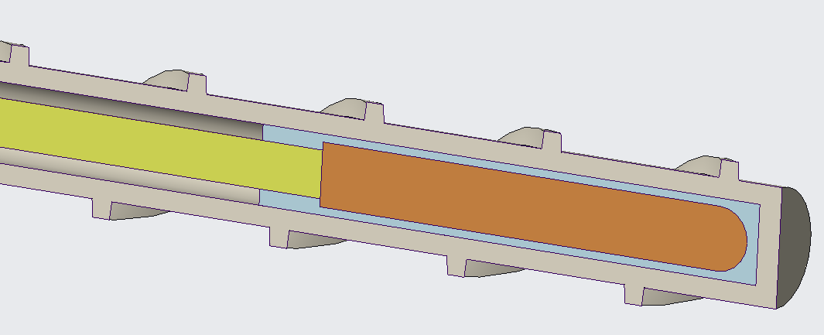
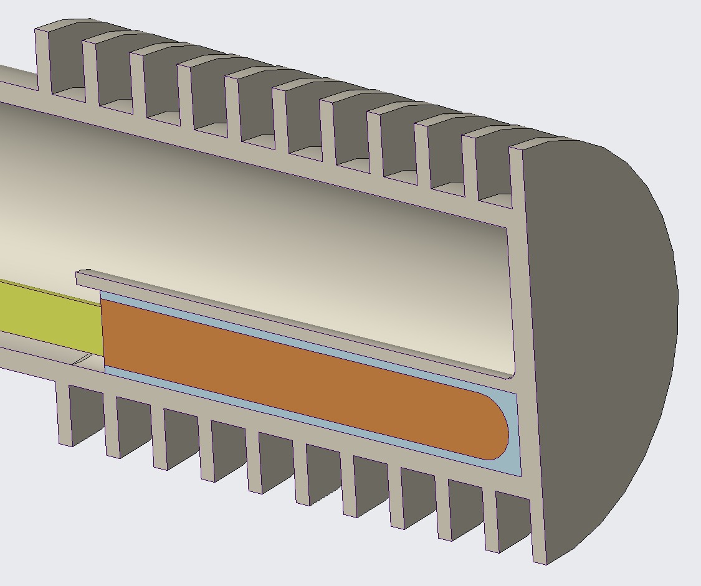
Temperature boomlet designs
The boomlet design must allow the PRT to effectively capture the temperature of the atmosphere to within 1 degree kelvin.
  This means the design must be optimized to stay structurally intact as well as allow for the most accurate temperature readings.
The goal is to maximize convection, since this is what will enable the boomlet and sensor to get to the true atmospheric temperature, while minimizing parasitic heat loads
These are the three initial designs
  Very small (Straight boomlets are 3mm in diameter )
PRT
Potting

Slide 11
What are my project objectives?
3D Thermal Desktop model of the VASI temperature boomlets.
  Transient model to capture the sensor response times and expected measured temperatures during Zephyr descent.
  Characterize errors due to extraneous heat inputs (radiation, conduction through boomlet stem, conduction through sensor wires, sensor self-heating, stagnation heating).
  Capture the response time impacts of various sensor mounting methods.
  Compare results with existing Engineering Equation Solver (EES) model.
  Provide suggestions to optimize the temperature boomlet thermal design.
Characterize VASI temperature boomlet convection coefficient using Fluent.
  Generate estimates for the convection coefficient of various boomlet designs as a function of Zephyr descent altitude.
  Provide estimated uncertainties in convection coefficient values.
Support VASI temperature sensor mounting trade.
  Research, design, and analysis support for determining the optimal temperature sensor mounting approach (adhesive vs mechanical mounting).
Investigate low-emissivity platings/coatings for the VASI temperature boomlet exterior surface.
Temperature Boomlet Performance
L2 Requirement | L3 Requirement
DAVINCI shall measure atmospheric temperatures with sampling interval <= 100 m, from prior to the first gas sample ingest and above 60 km altitude to <= 100 m above the surface. DAVINCI shall measure atmospheric temperatures with <= 0.5K relative precision, <= 1K absolute accuracy, over the expected range of 200 to 750K. | Temperature measurements shall be performed in the range of 200 to 750 K
 | Temperature measurements shall meet or exceed the accuracy requirement of ±1 degrees K.
 | VASI shall provide a minimum of two independent temperature sensors to measure the external temperature.

Slide 12
On to the model!
The boomlet designs are created to survive the mechanical loads while allowing for a fast response time to the sensor
  The basic boomlet is mostly used for design studies
  The straked boomlet (middle) and finned boomlet (bottom) are being investigated to be used as true designs.
Vortex-induced vibrations are an issue, which is why the strakes are included on the middle boomlet
  The third boomlet has a high natural frequency

Slide 13
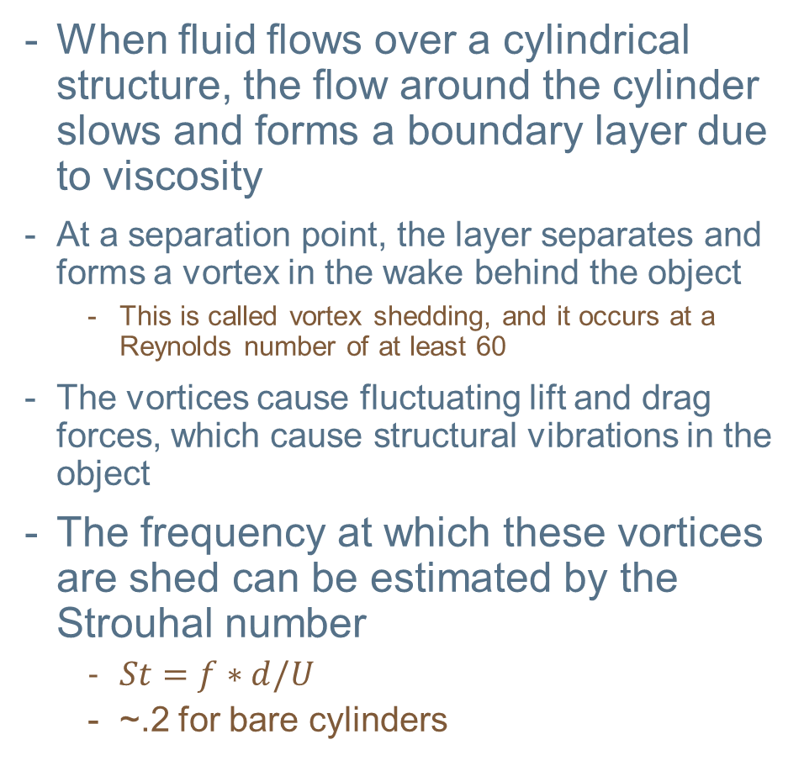
What are vortex-induced vibrations?
When fluid flows over a cylindrical structure, the flow around the cylinder slows and forms a boundary layer due to viscosity
At a separation point, the layer separates and forms a vortex in the wake behind the object
  This is called vortex shedding, and it occurs at a Reynolds number of at least 60
The vortices cause fluctuating lift and drag forces, which cause structural vibrations in the object
The frequency at which these vortices are shed can be estimated by the Strouhal number
  $St=f∗d/U$
  ~.2 for bare cylinders

Slide 14
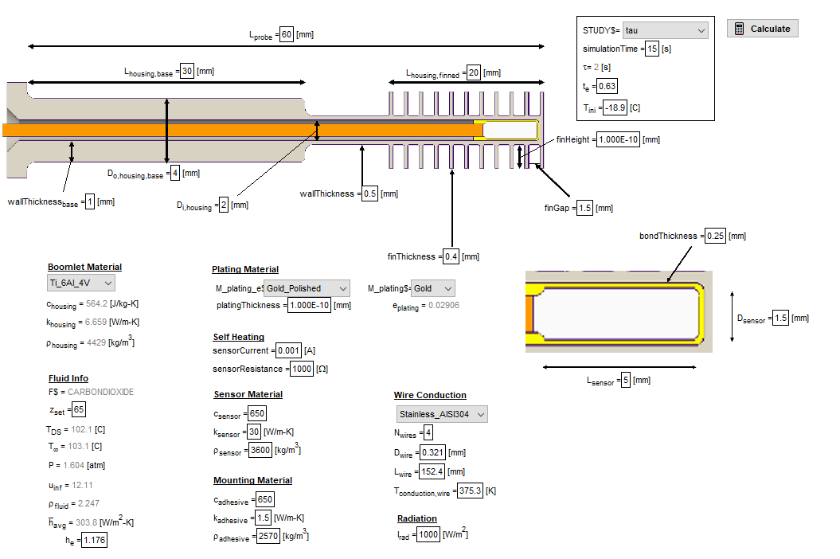
EES Model by Mitch Haglund
Model diagram
Mitch Haglund (Code 543) created his own 2D model using Engineering Equarion Solver (EES) to conduct thermal analyses of the initial boomlet designs. Based initial validation of TD model off of this
  Limitations in fidelity of the EES model. Cannot replicate some complex geometries of boomlets
  TD allows for complex thermal radiation modeling

Slide 15
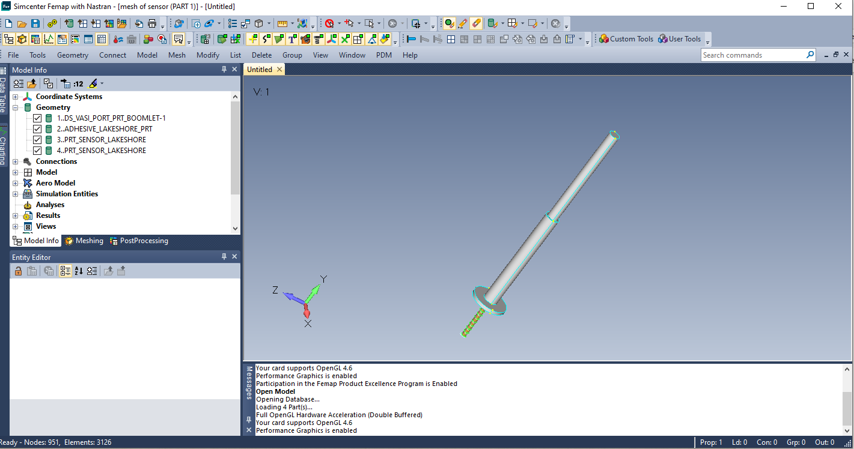
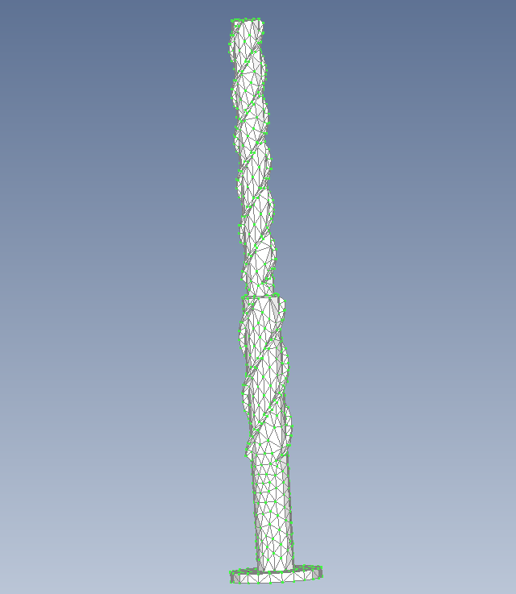
Using FEMAP
Due to the tight temperature sensing requirements, the model must be as geometrically close to the real designs as possible
Utilized FEMAP to do this, which allows for automatic meshing of parts of the boomlets.
  Thermal desktop allows for importing meshed parts from FEMAP
Could not accurately model the geometry of the adhesive in TD, and needed to model the complex strakes.

Slide 16
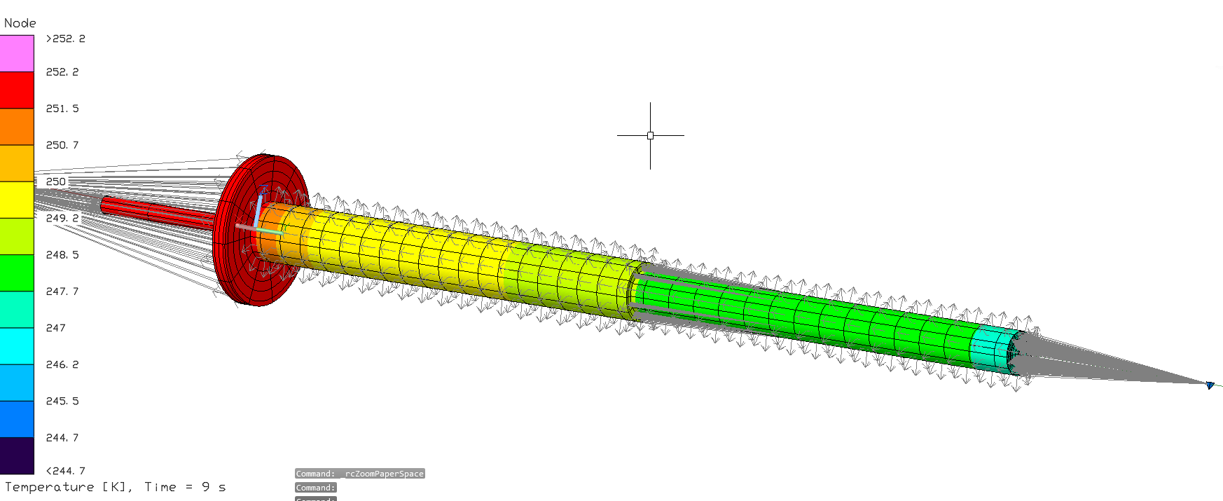
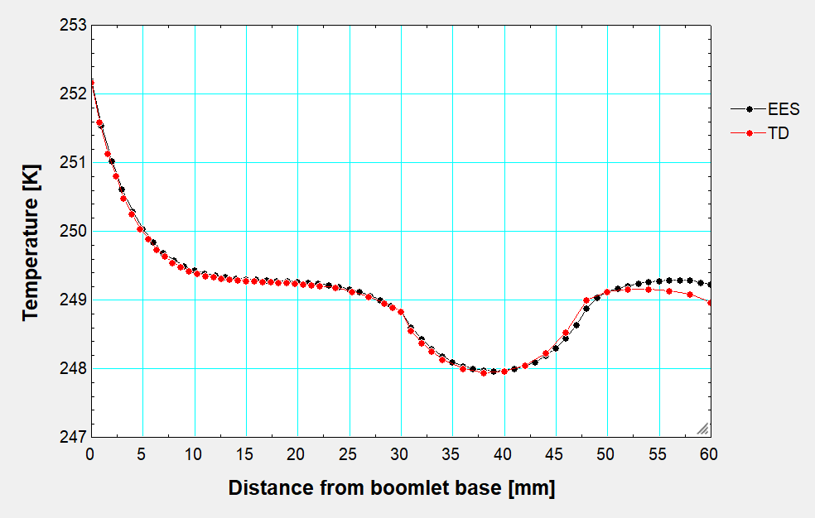
Initial Model
First real thermal desktop design
  Had to get used to understanding node count, merging nodes, running case sets, and the general user interface
Modeled the convection using node to surface conductors
  Important to only select outer surface
  Used Venus descent properties to calculate Nusselt Number and convection coefficients. Uniform value around circumference.
Validated model with Mitch by looking at a basic transient case where the air is about 10 K cooler than the initial temperature of the boomlet

Slide 17
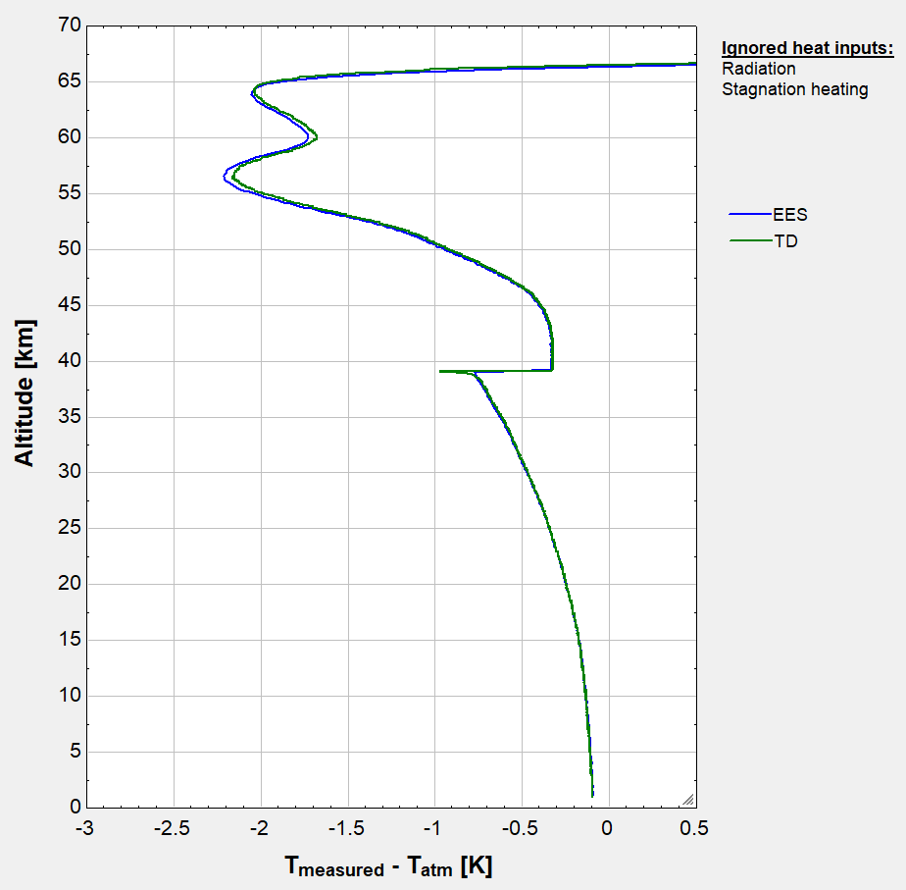
Full descent comparison
This is the plot that is most important to the VASI team. It looks at the difference in temperature between the sensor and the atmosphere throughout the entire descent
Here is how the TD and EES models compared; they were quite close!

Slide 18
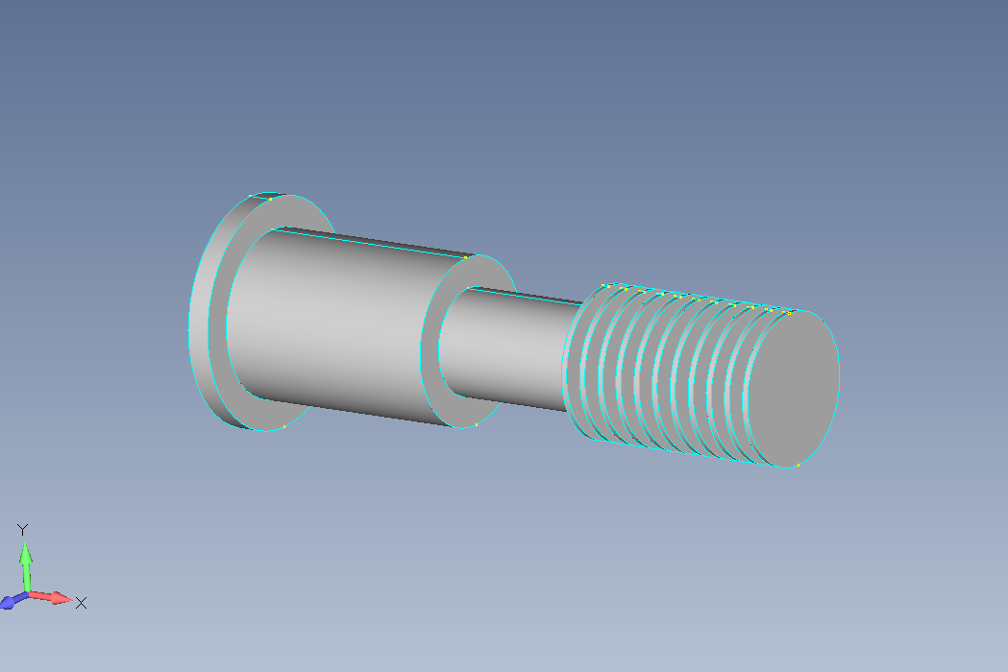
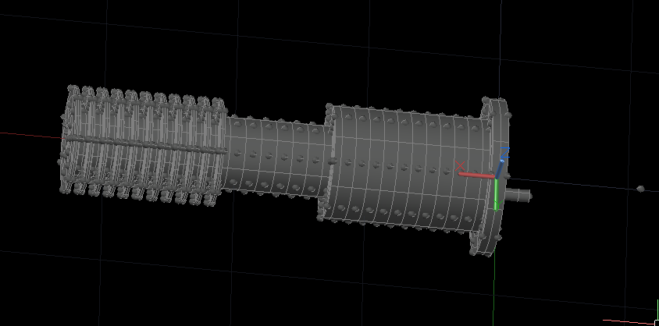
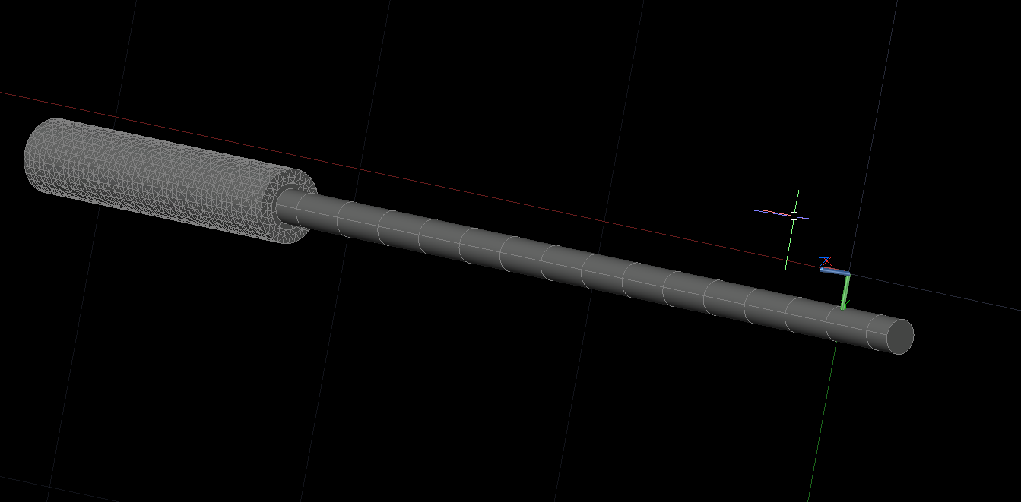
Finned Model
The next task was to model the finned boomlet in TD
Decided the only parts that would need to be meshed in FEMAP were the holder and the adhesive. The adhesive has a geometry that cannot exactly be modeled in TD and meshing the holder allows for better control of the conductance to the inner boomlet.
For the creation of the boomlet in TD, separation of the cylinders between and under the fins allowed for accurate application of the convection only on the outer surface.

Slide 19
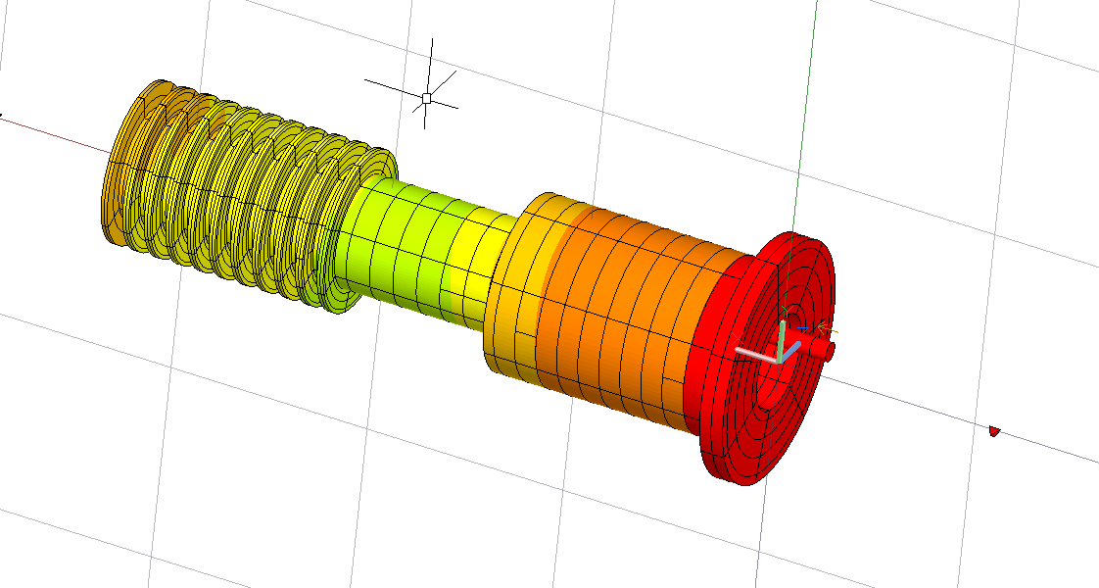
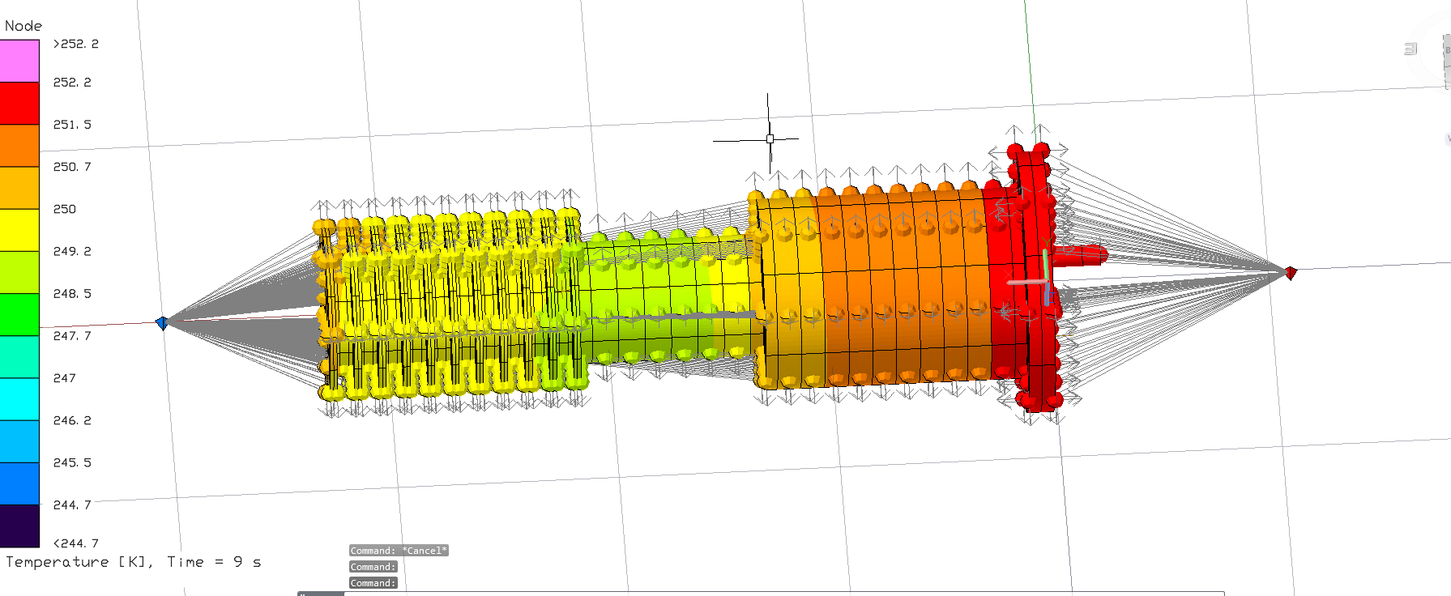
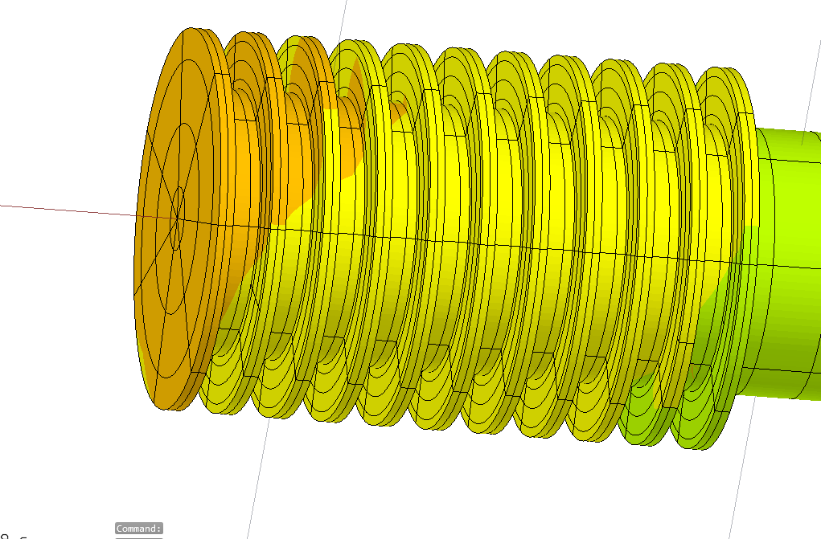
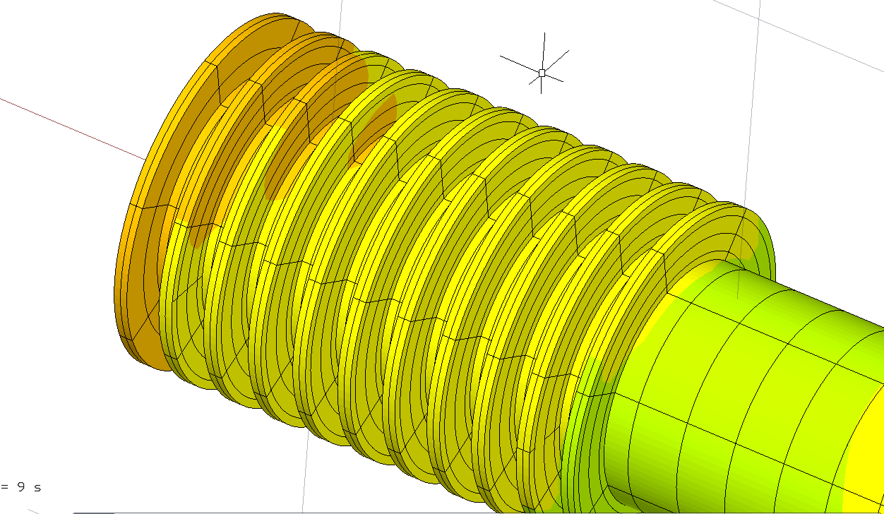
Finned Model
M

Slide 20
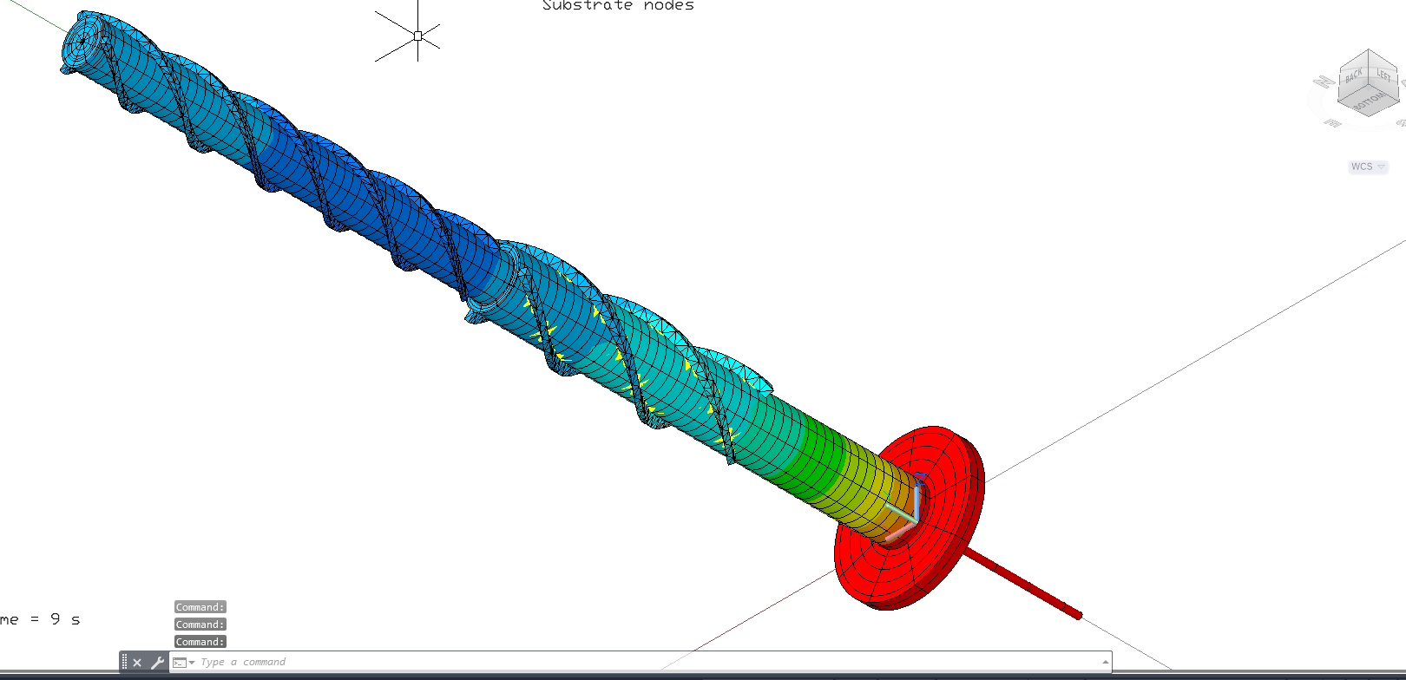
Straked Model
Modeled the straked boomlet in TD next
Used the straight boomlet from before, but this time used FEMAP to mesh the strakes, and then added them to the original model
  Had to increase the number of nodes along the boomlet to get the conductance between the strakes and the boomlet to be more accurate.
  The utilization of FEMAP was most important for this design, as this geometry cannot be made in TD

Slide 21
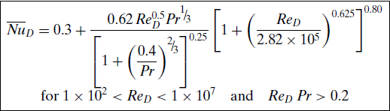
Using Ansys Fluent
Nusselt number is a dimensionless value used to characterize the convection. It is the ratio of the convective heat transfer to the conductive heat transfer.
  Used the equation below for our descent calculations
Fluent allows for confirmation of the calculated values for the convection coefficient, as well as to see how the convective gradient forms around the circumference of the boomlets.

Slide 22
Atmospheric Properties at Each Altitude
60km
  Velocity = 26.97 m/s
  Density = .454 kg/m^3
  Viscosity = 1.32 * 10^-5 Pa*s
  Conductivity = .0138 W/m-K
  Specific heat = .805 kJ/kg-K
30km
  Velocity = 33.52 m/s
  Density = 10.043 kg/m^3
  Viscosity = 2.39 * 10^-5 Pa*s
  Conductivity = .0335 W/m-K
  Specific heat = 1.014 kJ/kg-K
2.5km
  Velocity = 13.58 m/s
  Density = 57.99 kg/m^3
  Viscosity = 3.27 * 10^-5 Pa*s
  Conductivity = .0522 W/m-K
  Specific heat = 1.132 kJ/kg-K

Slide 23
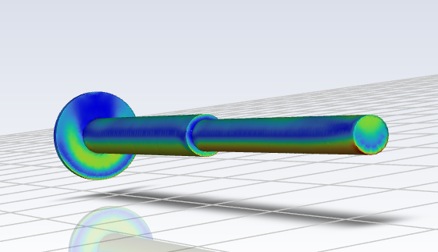
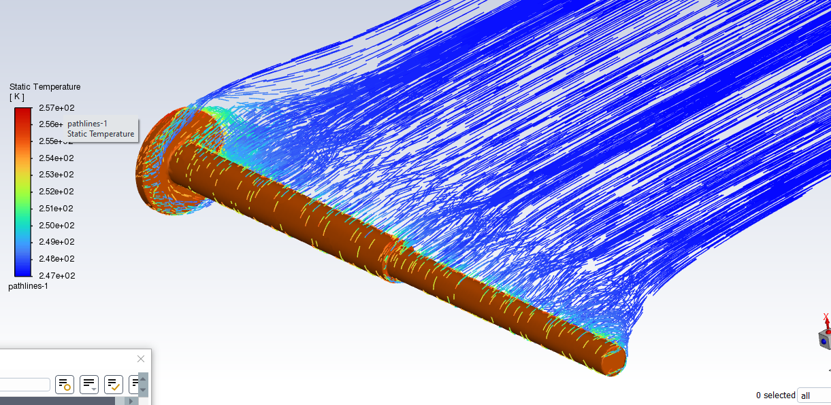
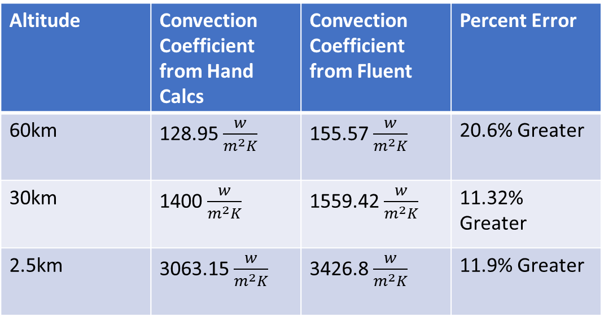
Straight boomlet comparison to Fluent
Altitude | Convection Coefficient from Hand Calcs | Convection Coefficient from Fluent | Percent Error
60km | 128.95 $\frac{w}{m^{2}K}$ | 155.57 $\frac{w}{m^{2}K}$ | 20.6% Greater
30km | 1400 $\frac{w}{m^{2}K}$ | 1559.42 $\frac{w}{m^{2}K}$ | 11.32% Greater
2.5km | 3063.15 $\frac{w}{m^{2}K}$ | 3426.8 $\frac{w}{m^{2}K}$ | 11.9% Greater

Slide 24
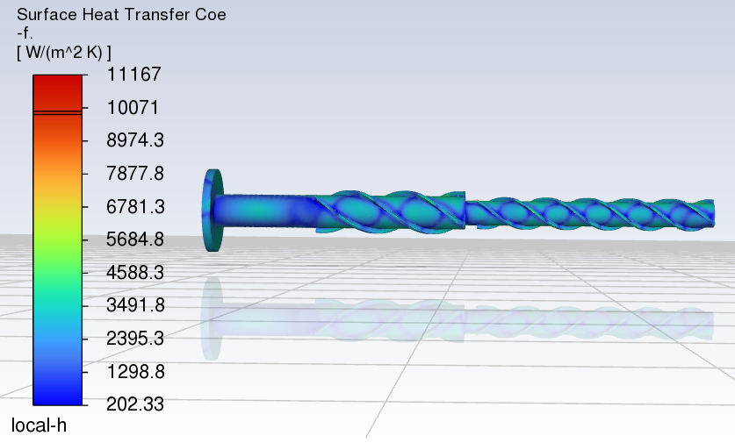
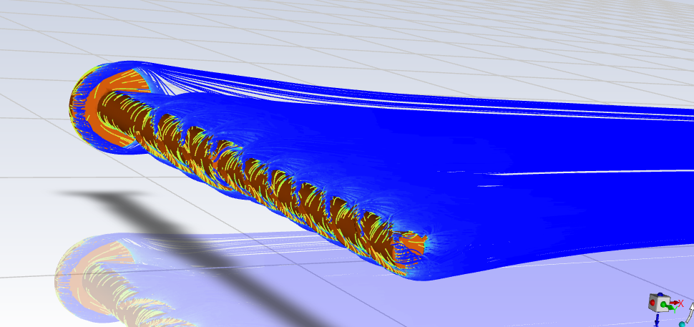
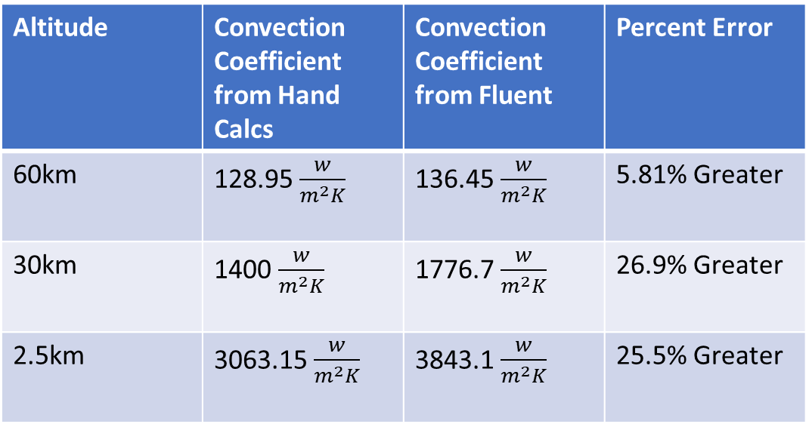
Straked boomlet comparison to Fluent
Altitude | Convection Coefficient from Hand Calcs | Convection Coefficient from Fluent | Percent Error
60km | 128.95 $\frac{w}{m^{2}K}$ | 136.45 $\frac{w}{m^{2}K}$ | 5.81% Greater
30km | 1400 $\frac{w}{m^{2}K}$ | 1776.7 $\frac{w}{m^{2}K}$ | 26.9% Greater
2.5km | 3063.15 $\frac{w}{m^{2}K}$ | 3843.1 $\frac{w}{m^{2}K}$ | 25.5% Greater

Slide 25
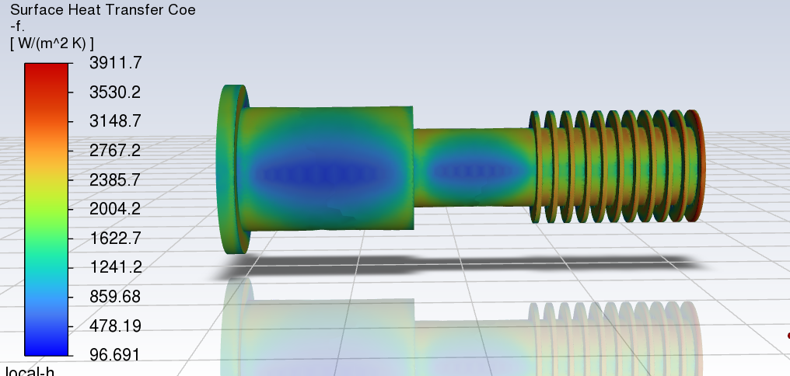
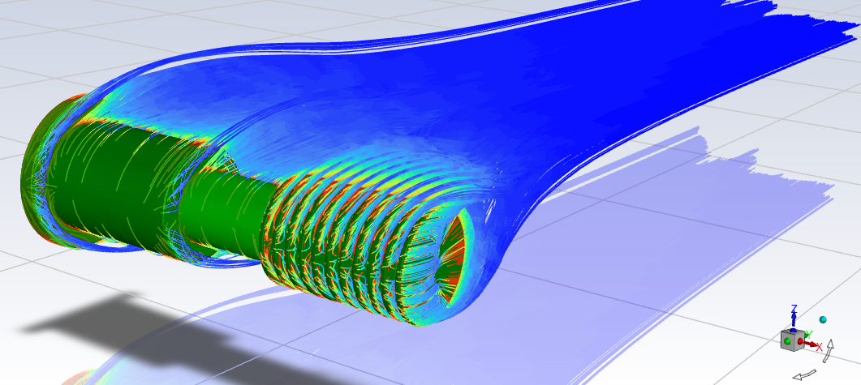
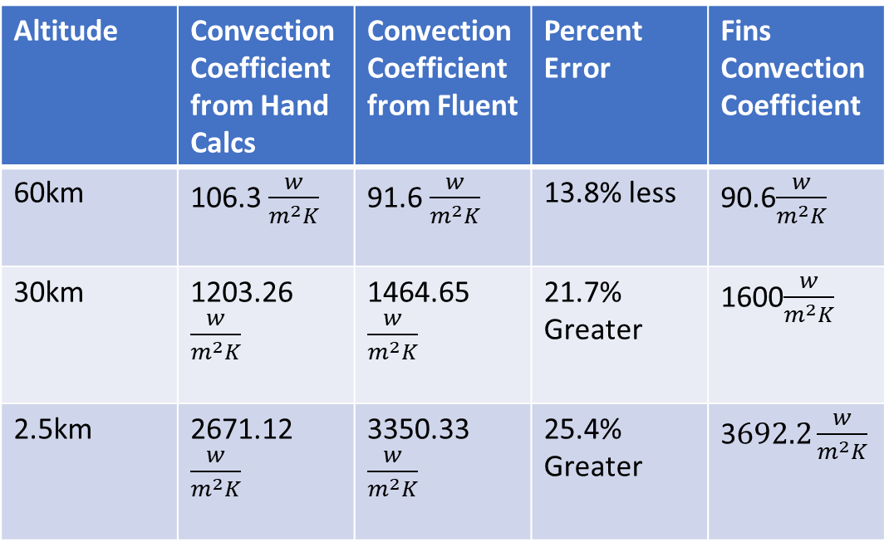
Finned boomlet comparison to Fluent
Altitude | Convection Coefficient from Hand Calcs | Convection Coefficient from Fluent | Percent Error | Fins Convection Coefficient
60km | 106.3 $\frac{w}{m^{2}K}$ | 91.6 $\frac{w}{m^{2}K}$ | 13.8% less | 90.6$\frac{w}{m^{2}K}$
30km | 1203.26 $\frac{w}{m^{2}K}$ | 1464.65 $\frac{w}{m^{2}K}$ | 21.7% Greater | 1600$\frac{w}{m^{2}K}$
2.5km | 2671.12 $\frac{w}{m^{2}K}$ | 3350.33 $\frac{w}{m^{2}K}$ | 25.4% Greater | 3$692.2\frac{w}{m^{2}K}$

Slide 26


Convection circumference effect
Studied effects of varying convection around the circumference of the boomlet.
  Kept the average values around the boomlet the same, but increased the ram direction half of the boomlet by the same percentage the opposite half decreased.

Slide 27

Straight boomlet results
Almost no difference

Slide 28

Finned boomlet
More significant differences here, so for future work the circumference differences should be explored more.
  Since the sensor will be placed at ram direction, this would only improve response
PRT
Potting

Slide 29

Finned boomlet, importance of sensor location

Slide 30




Characterizing Parasitic Heat Loads
Since convection allows for heat transfer of the true atmospheric temperature, it’s necessary to characterize any heating “errors”
  Some of these are shown to the right here
Thermal mass lag
Sensor self-heating
Thermal resistance between boomlet exterior and the sensor element
Conduction along the boomlet stem to the descent sphere
Conductance along the copper wire
Thermal radiation
Stagnation heating
6
4
1
2
5
7
3

Slide 31
Characterizing Parasitic Heat Loads
Important
Not significant
Need to be investigated in the future
Thermal mass lag
Sensor self-heating
Thermal resistance between boomlet exterior and the sensor element
Conduction along the boomlet stem to the descent sphere
Conductance along the copper wire
Thermal radiation
Stagnation heating
Chemical Reactions
6
4
1
2
5
7
3

Slide 32

Thermal mass lag
Thermal mass lag is especially demonstrated with the finned boomlet
  Hence why sensor placement is important

Slide 33

Descent Sphere Temperature
DAVINCI team provided values for the average skin temperature of the descent sphere, but this is in reality variable around the whole outer diameter
  This study demonstrates how the descent sphere’s temperature can influence the sensor reading due to conduction from the boomlet to the DS

Slide 34

Straked Boomlet, not a worry

Slide 35
Radiation
Venus has a quite complex radiative environment
  Located at .72 astronomical units, the solar flux is around 2600 w/m^2 at the upper atmosphere, twice that of Earth
  However, the thick cloud layers absorb and scatter the incident light, significantly reducing the solar flux but still contributing significant diffuse solar flux
    This is reduced as altitude lowers
  Since atmosphere is 96% CO2, the greenhouse effect causes the surface heat to be absorbed
  This means in terms of thermal radiation, the boomlet is viewing temperatures above and below it at similar temperatures to the atmosphere.
Note: Zenith angle of 24 degrees during descent
  Dave Crisp (JPL) provided thermal radiation data from Venus descent simulation.

Slide 36


Direct Solar impingement flux
(2622 W/m²)
See Venus environment calculation.xls
for calculations
3 K Space
~0 W/m2
(Global)
Credit: Shaun Thompson
Updated with data provided by Dave Crisp
Atmosphere temp
(variable with altitude)
Clear
Bond Albedo (0.77)
(1800 W/m²⁾
230 K IR (e=1, blackbody
(“Planetary” IR)
(159 W/m² Global)
Aeroheat
196.3 K Sky IR
90 km
516 W/m² Direct Solar
Thin Haze
1900 W/m² Diffuse Solar
Atmosphere temp
(variable with altitude, 230 K here)
High
Cloud Layer
Middle
~550 W/m² diffuse solar flux
241 K IR (e= 1)?
(Planetary IR)
Low
70 km
Radiating absorbed heat
Diffuse Sky IR
510 K IR (e=1, blackbody)
48 km
57 km
Thin
Haze
51 km
Atmosphere temp
(variable with altitude, 503 K here)
16500 W/m2
Atm Absorbed (Greenhouse)
~550 W/m² diffuse solar flux
32 km
512 K IR (e= 1)
(Planetary IR)
Clear
735K Ground IR

Slide 37

Modeling the Radiation in TD
Terrestrial Orbit
  Made by Shaun Thompson, updated data for VASI requirements’ case
  Did test runs to understand how TD models diffuse/direct/ground/sky values

Slide 38

Result
Used emissivity of .55 and absorptivity of .4 (Bare Titanium According to Spacecraft Thermal Control Handbook)

Slide 39

Straked boomlet emissivity study

Slide 40

Finned boomlet emissivity study

Slide 41

Finned Boomlet Absortivity Study

Slide 42
Optical Properties
Titanium may react with the Venus environment which could lead to color changes
  This would affect the optical properties
Ideally want lower emissivity properties, but as shown by the results this is only really needed in the upper atmosphere
  In the lower atmosphere the IR radiation actually “helps” the boomlet’s temperature response time
Low absorptivity plating would also be nice, as that would reduce effects in the upper atmosphere significantly

Slide 43


Adhesive Options
Many PRT mounting options are being investigated right now by Mitch Haglund and David Steinfeld
Cannot use epoxy due to outgassing
  Interior of DS is a vacuum
A copper foam press fit could be a great option
  Very low thermal mass, high conductance (10 w/m-k)
  Particles could be dangerous if they enter DS, so investigation will be done
Ceramic adhesive
  Low thermal mass and sufficient conductance (1.5 w/m-k)
  Hygroscopic (absorbs water)
Clamping restraint
  Strong mounting, moderate thermal mass
Clamp welded in place
End cap welded to boomlet tip

Slide 44

Finned Adhesive conductivity

Slide 45

Straked Adhesive Conductivity

Slide 46

Future Design
Both boomlets have potential to be the design choice
  More investigation into number of fins, spacing of fins, diameter of fins could lead to a more optimal design.
  Finned boomlet improvement in thermal mass lag would greatly help under 40km.

Slide 47
Conclusions and next steps
Finned Boomlet has the best response time in upper atmosphere, though not as accurate below 40km (still within .5K though)
  However, investigation should be conducted due to increased convection values according to Fluent
Radiative environment is very significant in the scope of temperature measurement requirements
Optical properties may be beneficial in terms of absorptivity, but not necessary for emissivity.
As design develops, the thermal models developed can be adjusted and tested.
Further Investigation
  Stagnation Heating
  Convection variance
  Titanium chemical reactions

Slide 48

Additional Experiences and Closing Remarks
SSDIF Tour
  Thanks to Brian Parsons and Brian Comber for setting this up
Space Telescope Science Institute in Baltimore
  JWST Mission Operations Center
  Thank you to Bruce Barringer
DAVINCI Venus Chambers Tour
Supercomputer Tour
TARDIS 2.0 Work with Seth Abramczyk
  Along with Elliot Schwartz and Connor Riedman
Many OSTEM Networking and Professional Development events
Cube Sat Thermal Diagnosis
Thank you all for a great experience!
Highlighted on national intern day!

Slide 49
Acknowledgements
Mentors: Daniel Bae and Seth Abramczyk
Kimberly Brown, Veronica Otero, and Branch 545 management for making this opportunity happen!
Thank you to Mitch Haglund (543) for his mentorship as well!
Additional Support from:
  Shaun Thompson
  David Steinfeld
  Xiaoyi Li
  Stephanie Vidal
  Ralph Lorenz (APL)
  Dave Crisp (JPL)
  Matthew Shacka
  Jordan Effron
  Brian Langbein

Slide 50
Backup

Slide 51

Finned Boomlet Wire Cond. Sens.

Slide 52
Finned Boomlet Wire Cond. Sens.

Slide 53

Finned Boomlet Wire Cond. Sens.

Slide 54

Finned Boomlet Wire Cond. Sens.

Slide 55


Radiation Sensitivity Study, before I knew rad

Slide 56

Emissivity sensitivity, outdated radiation

Slide 57

All three boomlets, with additional finned e = .1, outdated radiation

