Slide 1
AATT Propulsion Technologies: Advanced Liner Concept Development
Brian M. Howerton (on behalf of the Liner Physics Team)
NASA Langley Research Center, Hampton VA
Fall 2024 Acoustics Technical Working Group
October 8, 2024
NASA Glenn, Cleveland OH

Slide 2

Liner Physics Team
Applied Acoustics Branch:
Mike Jones (Co-Lead) michael.g.jones@nasa.gov
Doug Nark (Co-Lead) d.m.nark@nasa.gov
Brian Howerton (AATT Tech Lead)
Matt Galles
Jordan Kreitzman
Travis Turner
Chris Shoemaker
Aeroacoustics Branch:
Martha Brown (LTF Facility Manager)
Alex Carr
Eric Nesbitt
Alonzo ‘Max’ Reid (Technician)
Support Contractors:
Scott Haigler (AS&M)
Håvard Vold (Vold LLC)
Fang Hu (Old Dominion University)
Additional Support:
Robert Andrews (LaRC Additive Manufacturing Center)
Emily Grau (LaRC Aeronautics Systems Engineering)
Funding support provided by the Propulsion Technologies subproject of the Advanced Air Transport Technologies (AATT) Project as part of NASA’s Advanced Air Vehicles Program

Slide 3
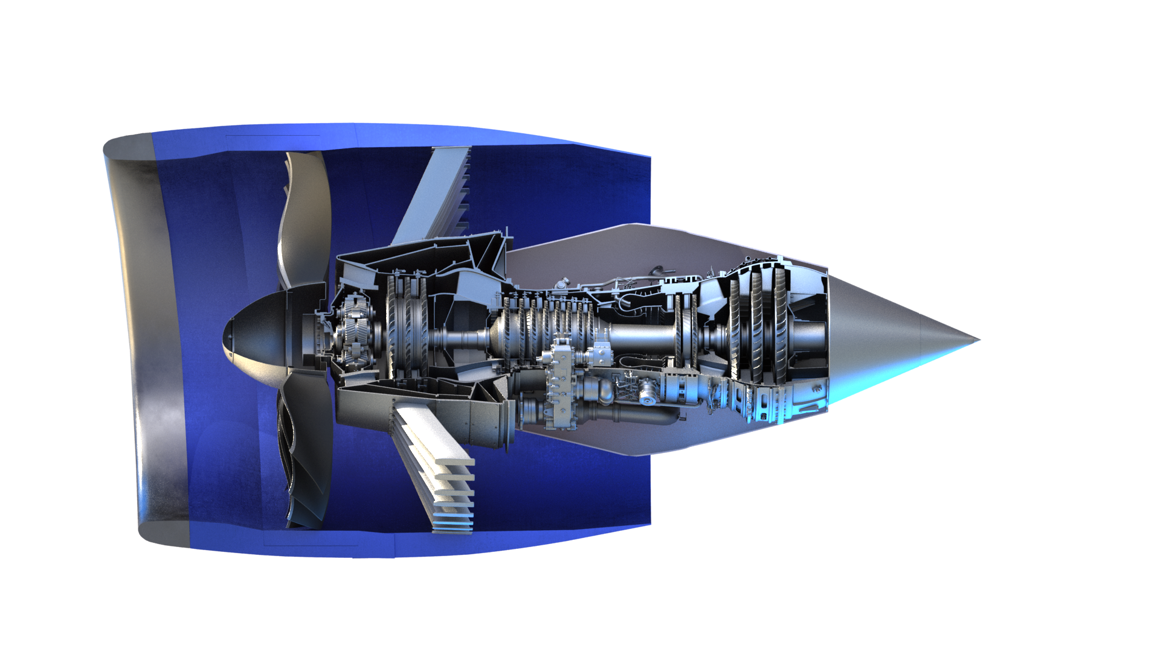
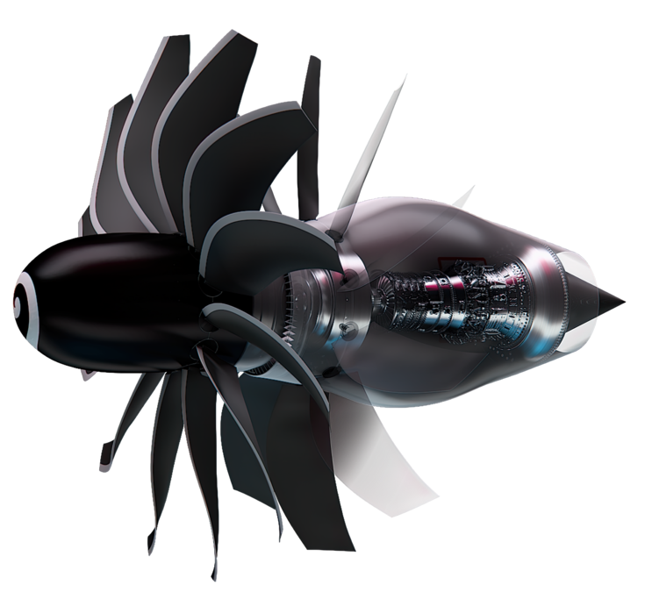
AATT Propulsion Technologies Technical Challenge
TC Goal: Predict, model, and assess the ability for next-generation propulsors to meet market-driven goals for noise (4 dB reduction) and efficiency (3-5% fuel burn reduction) with integration effects, relative to 2021 best-in-class propulsors, and reduce risk to a new single-aisle aircraft in the 2030s.
Liner Concepts and Applications
  Low Pressure Ratio (LPR) Fan - Podded
    Optimized liners for inlet and aft bypass
    Bifurcation liners
  Unducted Single Fan (USF) – Open Fan
    Optimized external core nacelle liner
    Treated OGVs
    External airframe liners
Evaluation
  Liner Technology Facility (TRL 1-4)
  Static Engine Test (TRL 6)
  Virtual 9x15 tests (Performance Assessment)
Podded
NASA
Open Fan
Partnership with Honeywell Aerospace for a static engine test to evaluate advanced liner designs for the aft bypass duct
CFM International

Slide 4
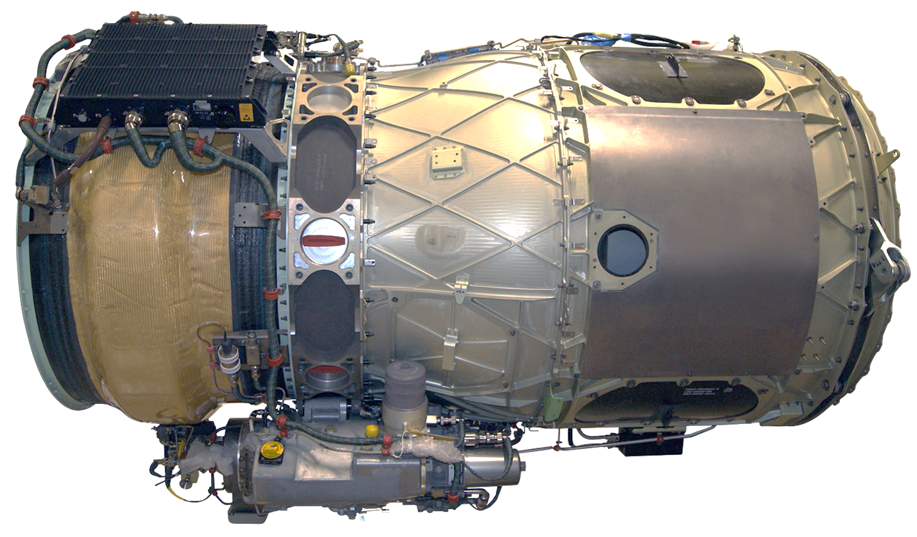
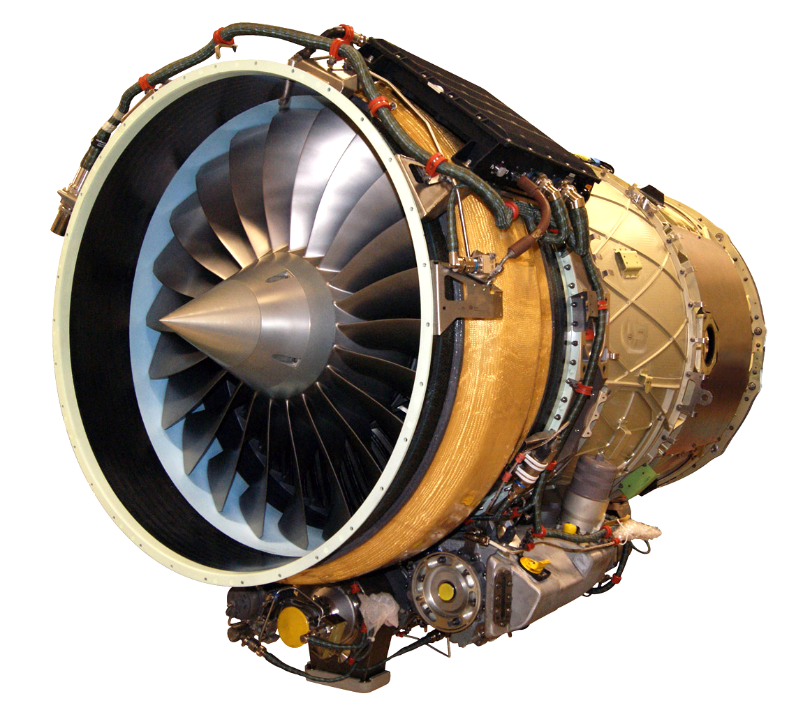
Honeywell Test Engine – AS907-3 (HTF7000-3)
Key parameters
6500-7500 lbf thrust
BPR - 4.4
34.2 in. dia. fan
22 fan blades
51 fan stators
Fixed Panel
Usage
Medium-size biz jets
~2000 units produced
Removable Doors
Honeywell Aerospace
Opportunity to test advanced liner concepts at TRL 6
in the aft bypass duct and validate liner design toolchain
Honeywell Aerospace

Slide 5
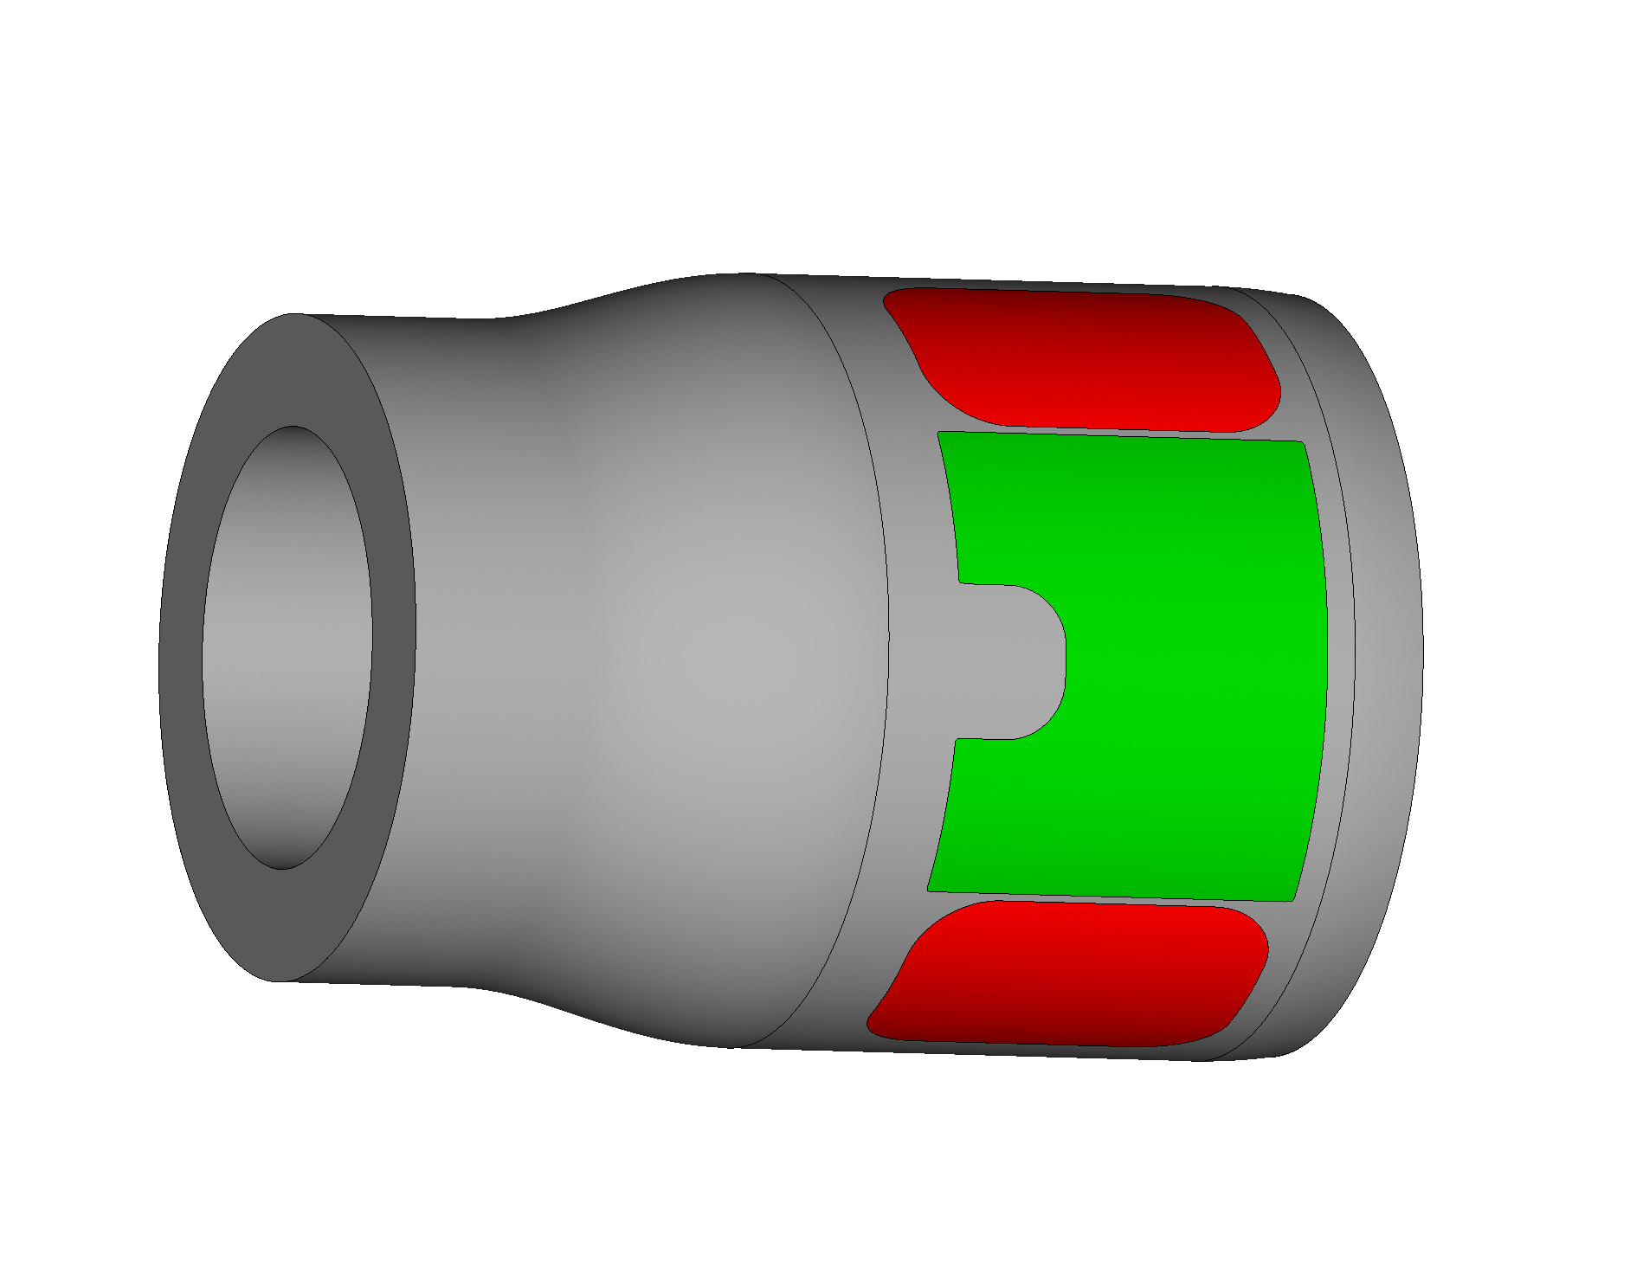
Acoustic Liner Design Method
Indirect Approach
Step 1: Optimize liner acoustic impedance to achieve maximum attenuation over range of frequencies and flow conditions
Step 2: Optimize liner parameters to match target impedance from Step 1 (if possible)
Step 3: Evaluate and iterate designs in the Liner Technology Facility
CDUCT-LaRC (CDL)
Parabolic approximation to the Convected Helmholtz Equation
Acoustic source: All cut-on modes
  11 trials: random amplitude/phase
  combined coherently
ACTRAN TM
Convected Helmholtz Equation
Acoustic source: All cut-on modes
  propagated individually with equal energy
  combined incoherently
Removable Doors
ZKTL
Transmission line approach
Transmission matrix for each liner design element
Predict liner impedance from liner geometry
Fixed Panels
Engine Aft Bypass Duct

Slide 6
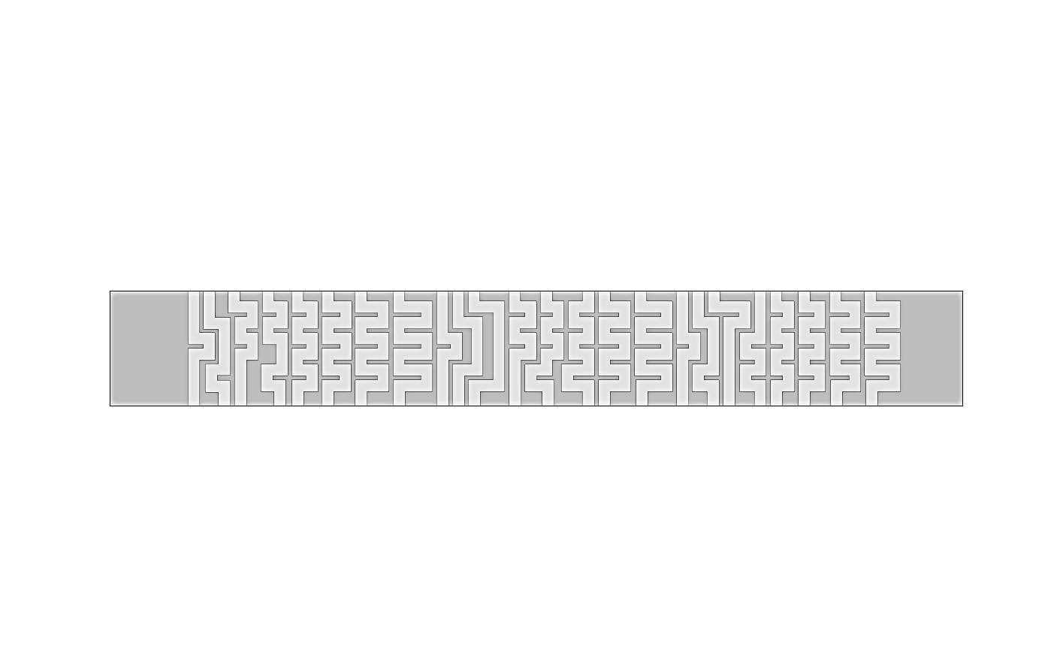
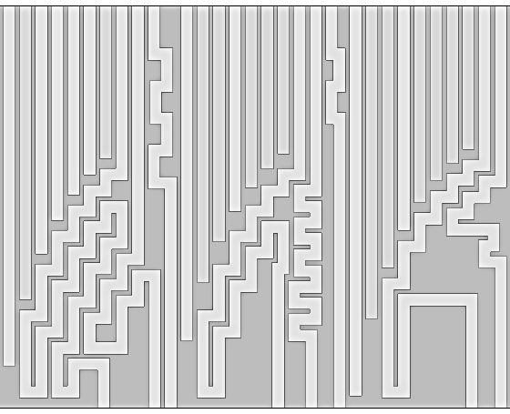
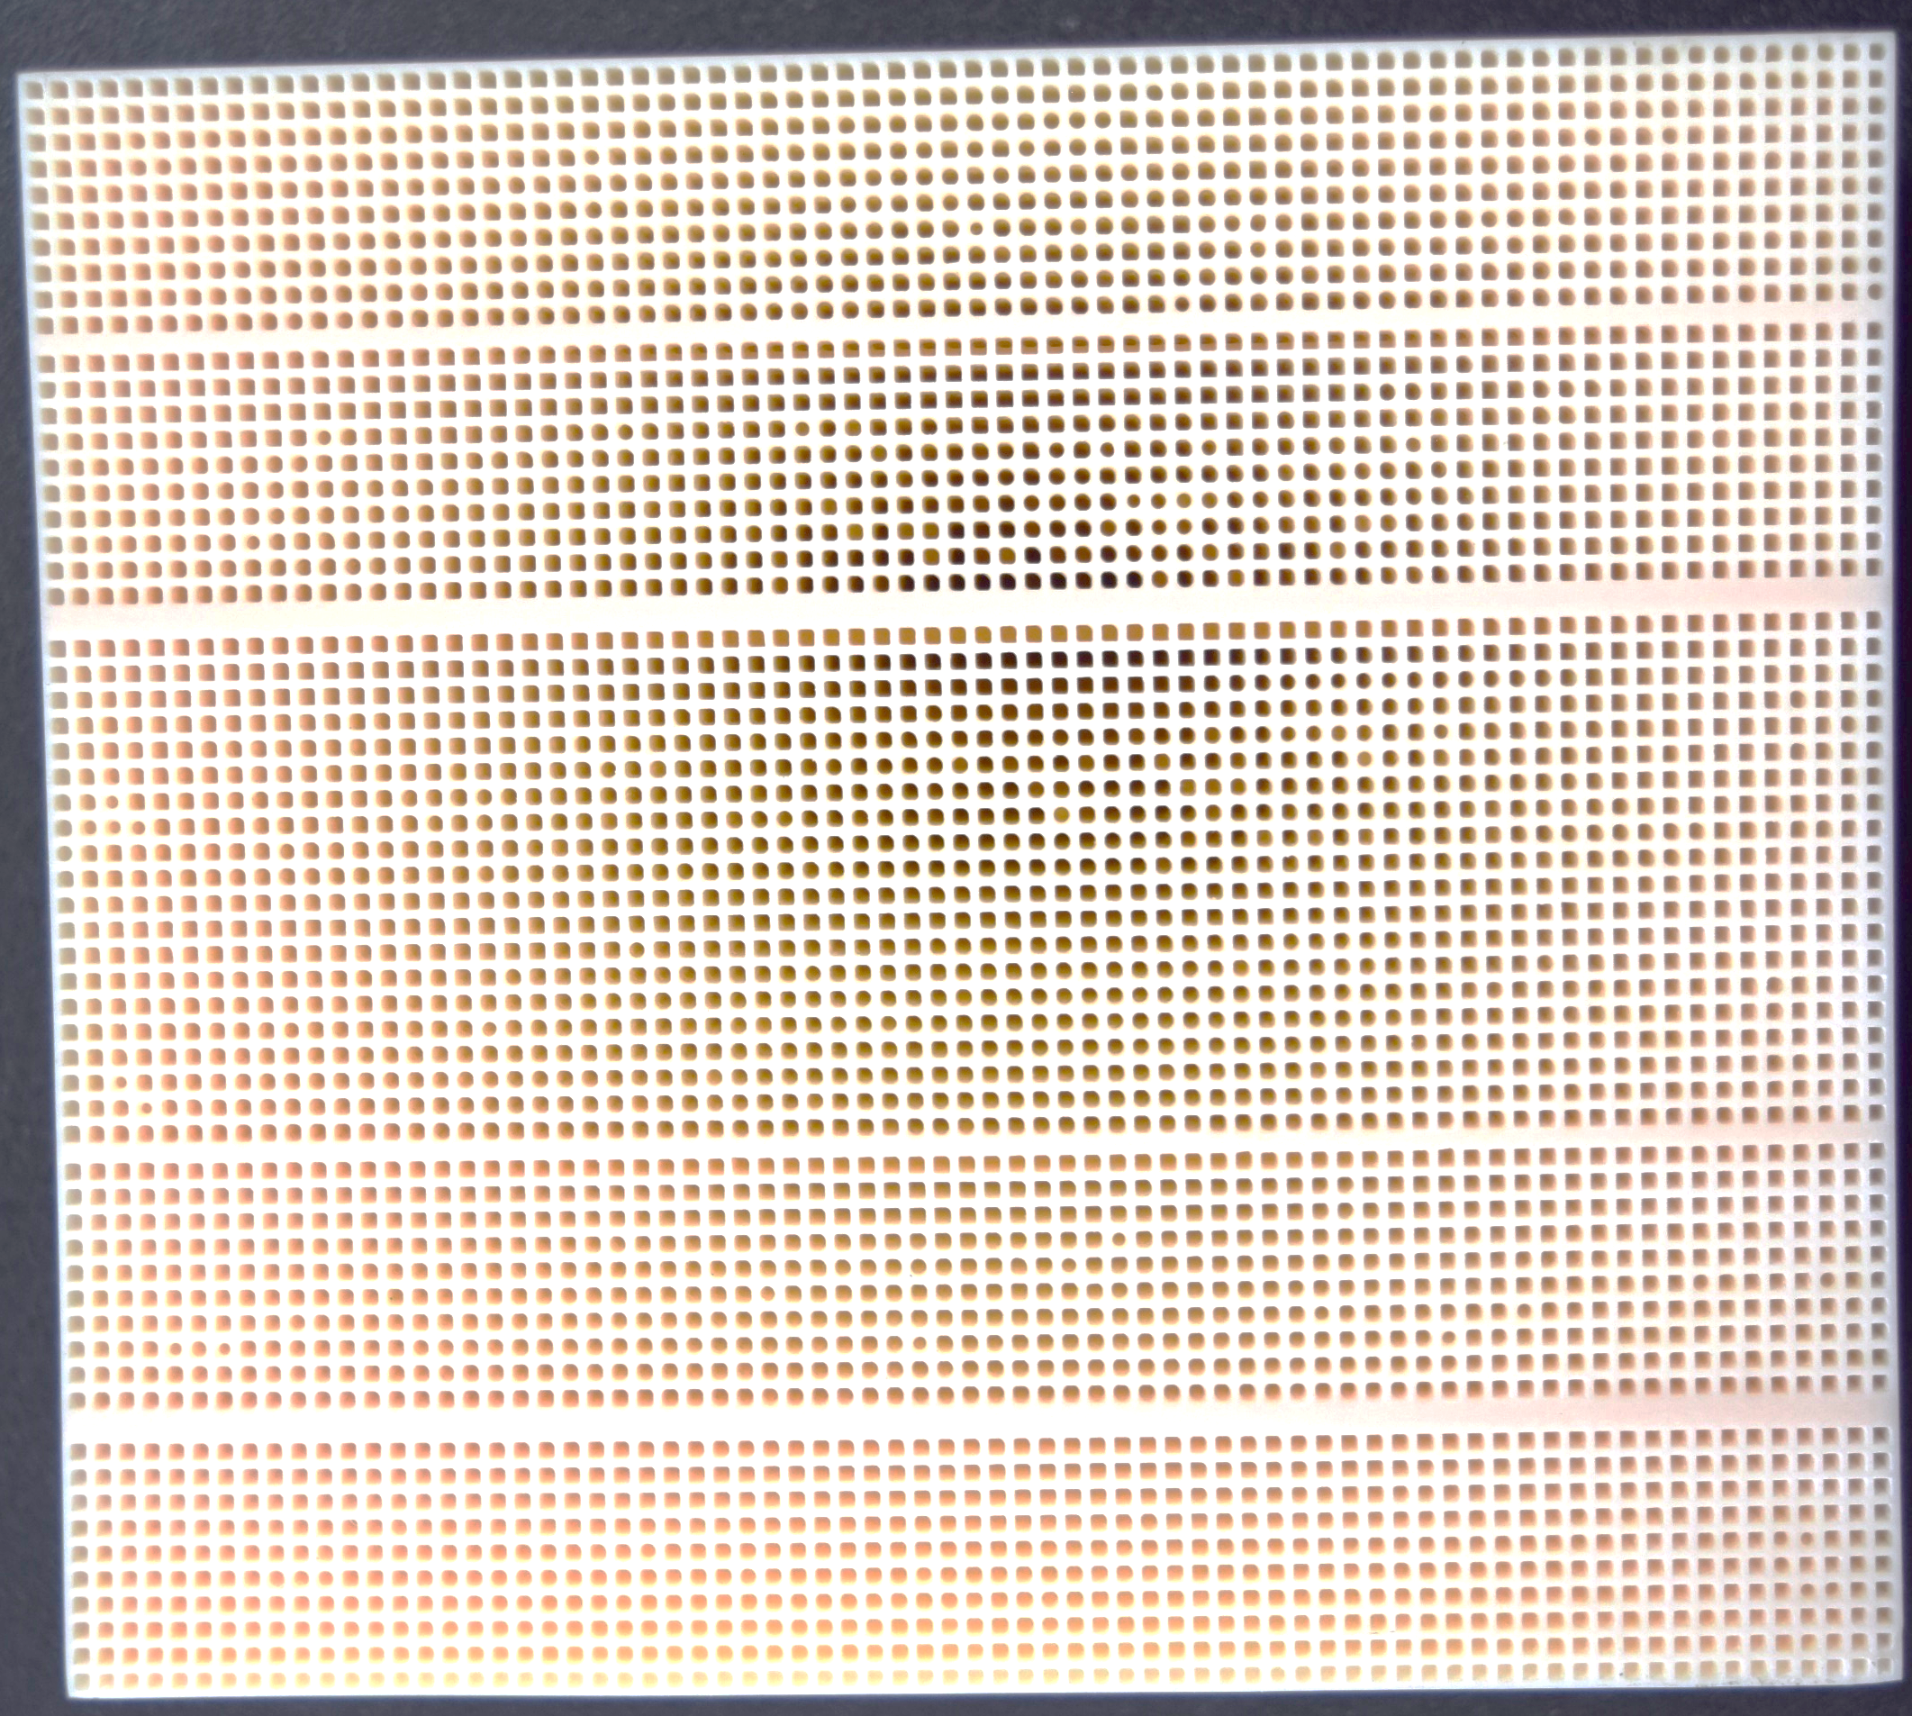
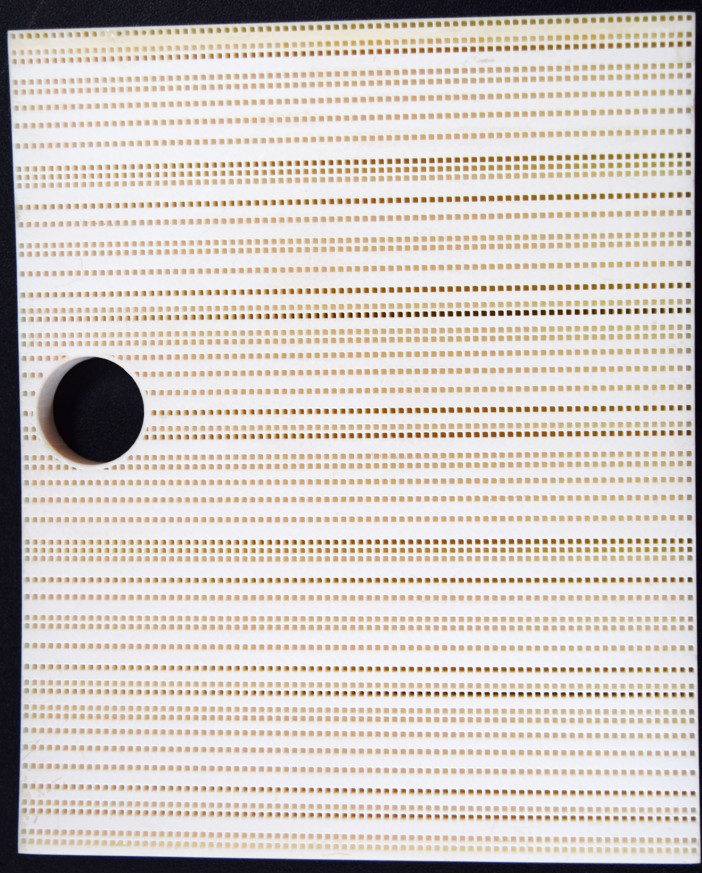
Liner Design Concepts
Narrow Channel (NC)
Array of square cross-section channels
  cross-section: 0.045 in. x 0.045 in.
  minimum partition thickness: 0.015 in.
Replicate unit cell to fill available volume
Variable depth → broadband performance
Bent chambers → reduced core thickness
Resistance from wall scrubbing losses (no facesheet)
Built additively using Ultracur3D RG 3280 resin
NC-24
0.45 in.
24-ch unit cell
Fixed Panel Liner
NC-30
1.5 in.
30-ch unit cell
Flow
Removable Door Liner
Fixed Panel Liner
Removable Door Liner

Slide 7
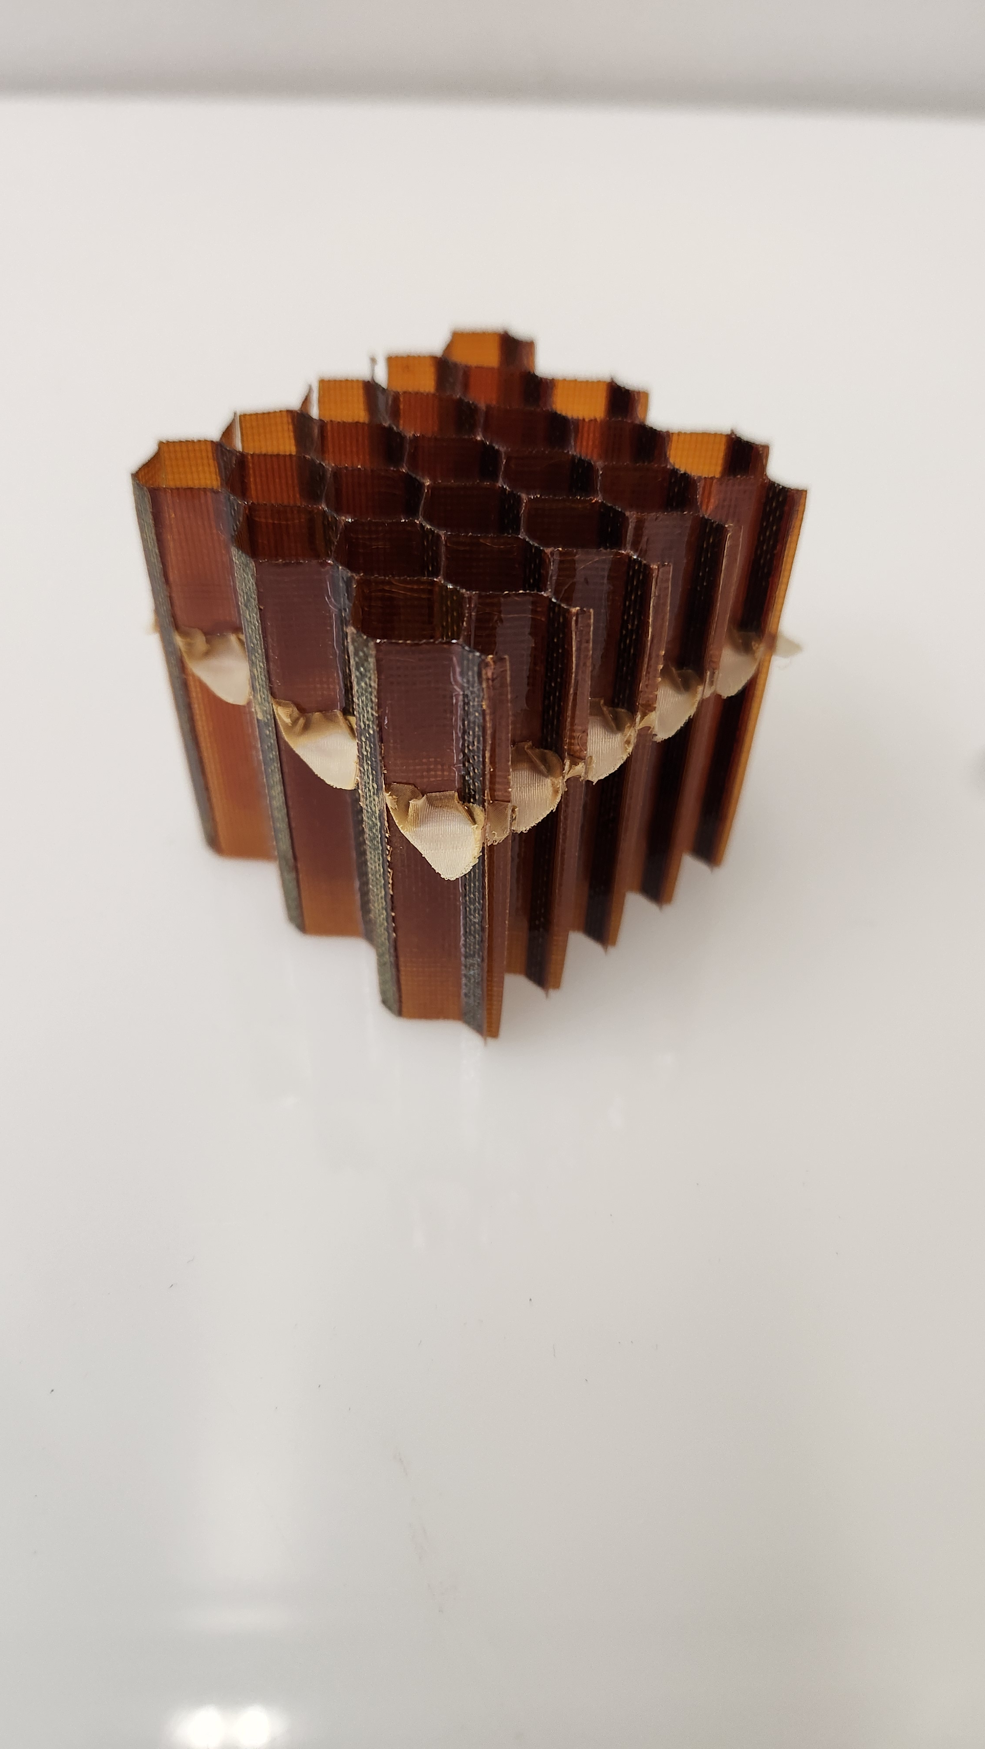
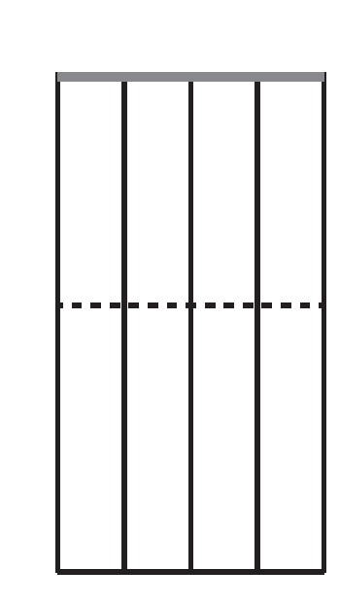
Liner Design Concepts
Optimized Hexcel Acousti-Cap
Tunable for extended frequency range
Proven technology ready for flight
Lightweight construction
Performance: 2DOF ~ 3DOF/MDOF
Applied only to the removable door panels
Acousti-Cap Core
Facesheet
Key parameters
Facesheet POA: 16%
Facesheet thickness: 0.0476 in.
Hole diameter: 0.030 in.
Cavity depth: 1.424 in.
Septum depth: 0.82 in.
Septum resistance: 615 MKS Rayls
1.50 in.
Porous mesh Acousti-Cap septum
0.82 in.
Liner design parameters subject to change based on manufacturing constraints
Backplate

Slide 8
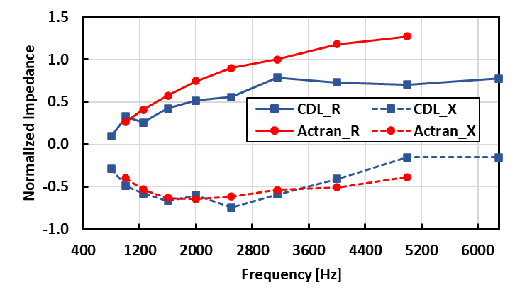
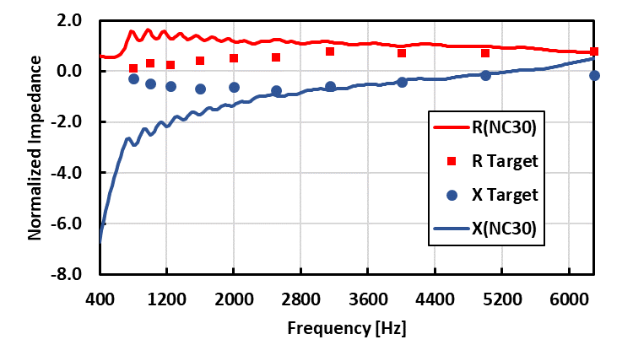
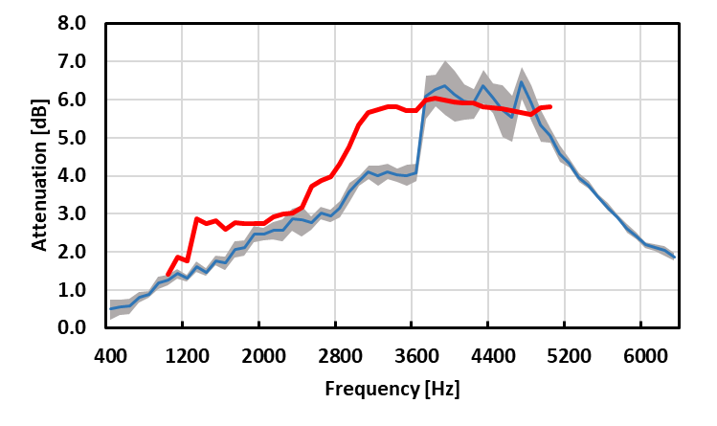
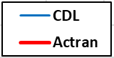
Pre-test Predictions – Approach
Optimal Impedance – Removable Doors
Combined Predicted Acoustics
Optimal Impedance
  Good agreement between CDL and ACTRAN
  Similar resistance trends w/ near identical reactance
  Not physically achievable
NC-30 Design Impedance
  Optimized to best match reactance
  Resistance allowed to deviate from targets
Significant predicted attenuation for all liner configurations
Jump at 3.6kHz due to source modal content
Design Impedance - NC-30 Removable Doors
In-Duct Attenuation - NC-24 fixed panels w/ NC-30 doors

Slide 9
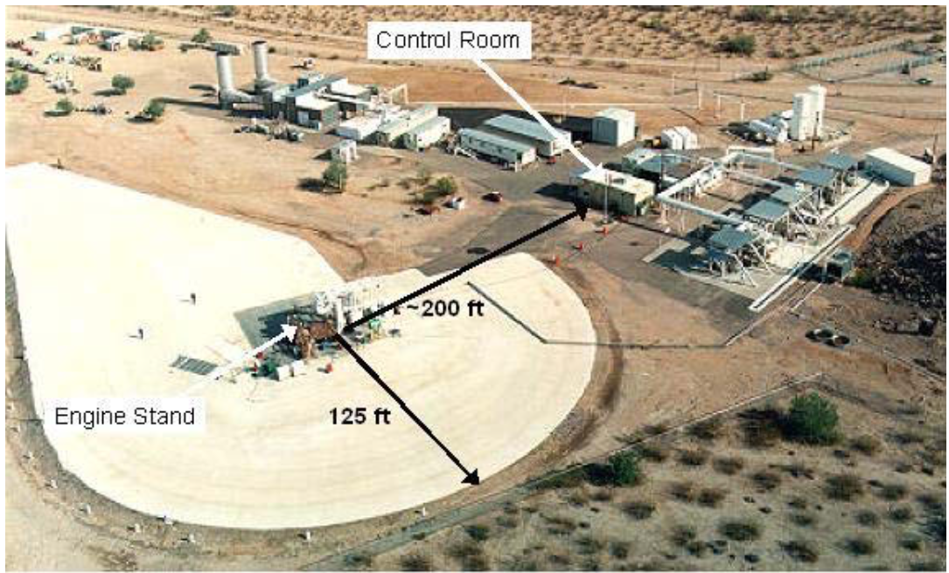
Honeywell Test Facility – San Tan
Key details
South of Chandler, AZ
Operational for over 50 years
Measure engine performance and acoustics
32 microphones spaced at 5° increments*
* 4 additional mics for scattering data off arc (if needed)
Control Room
100’ arc microphone array
~200 ft
Previous NASA collaborations
EVNERT (2005)
EVNRC (1999)
Engine stand
125 ft
Honeywell Aerospace

Slide 10
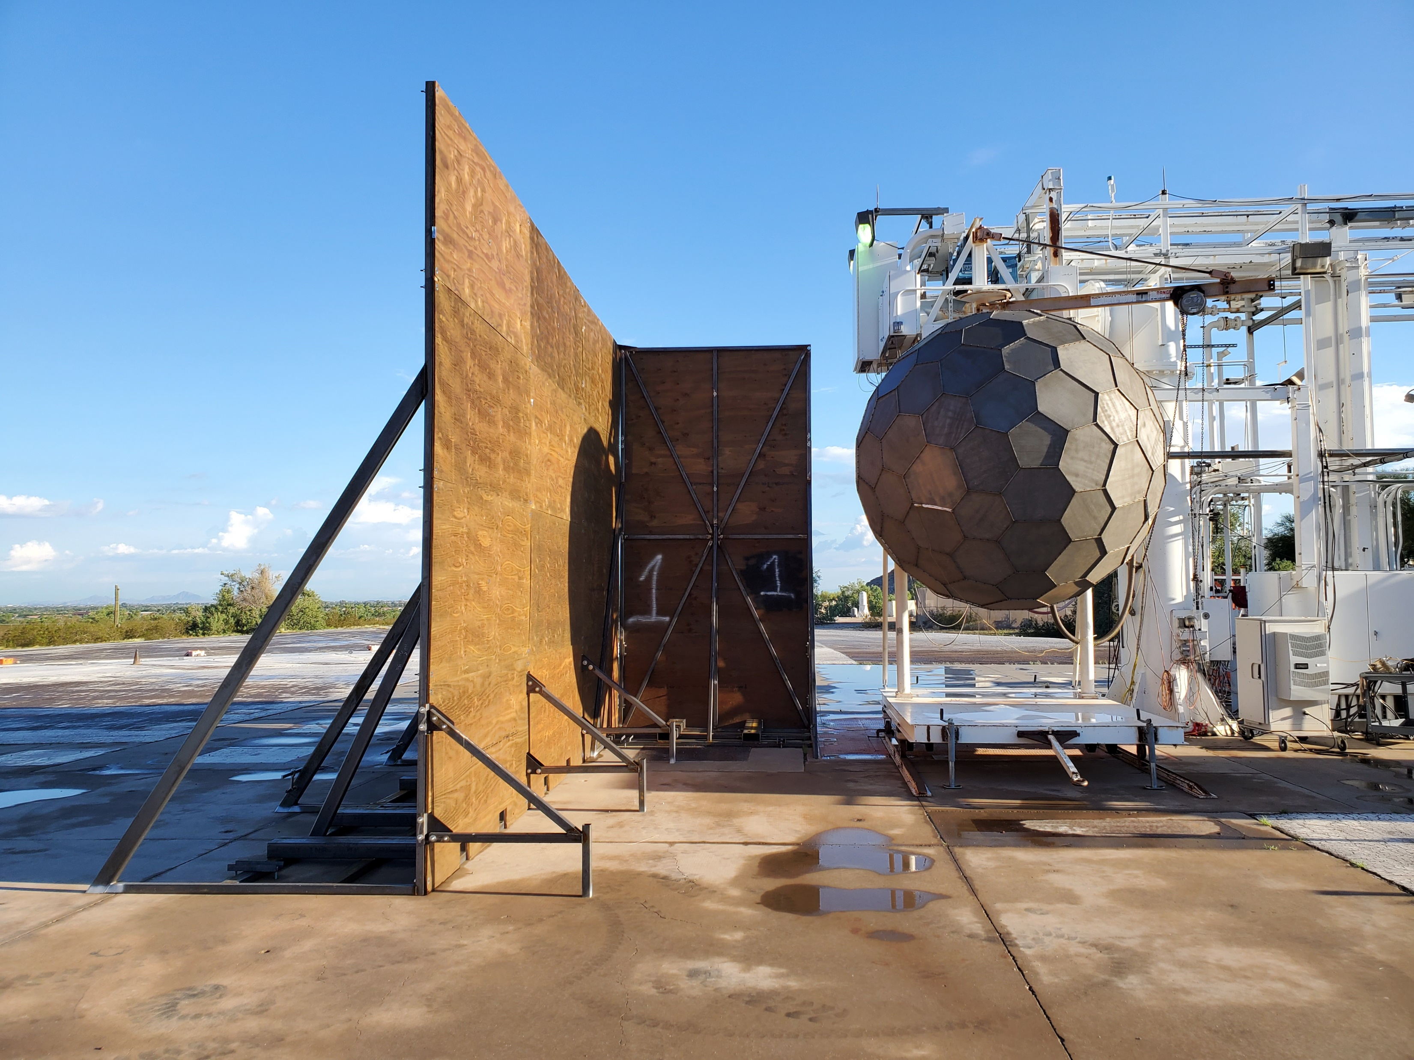
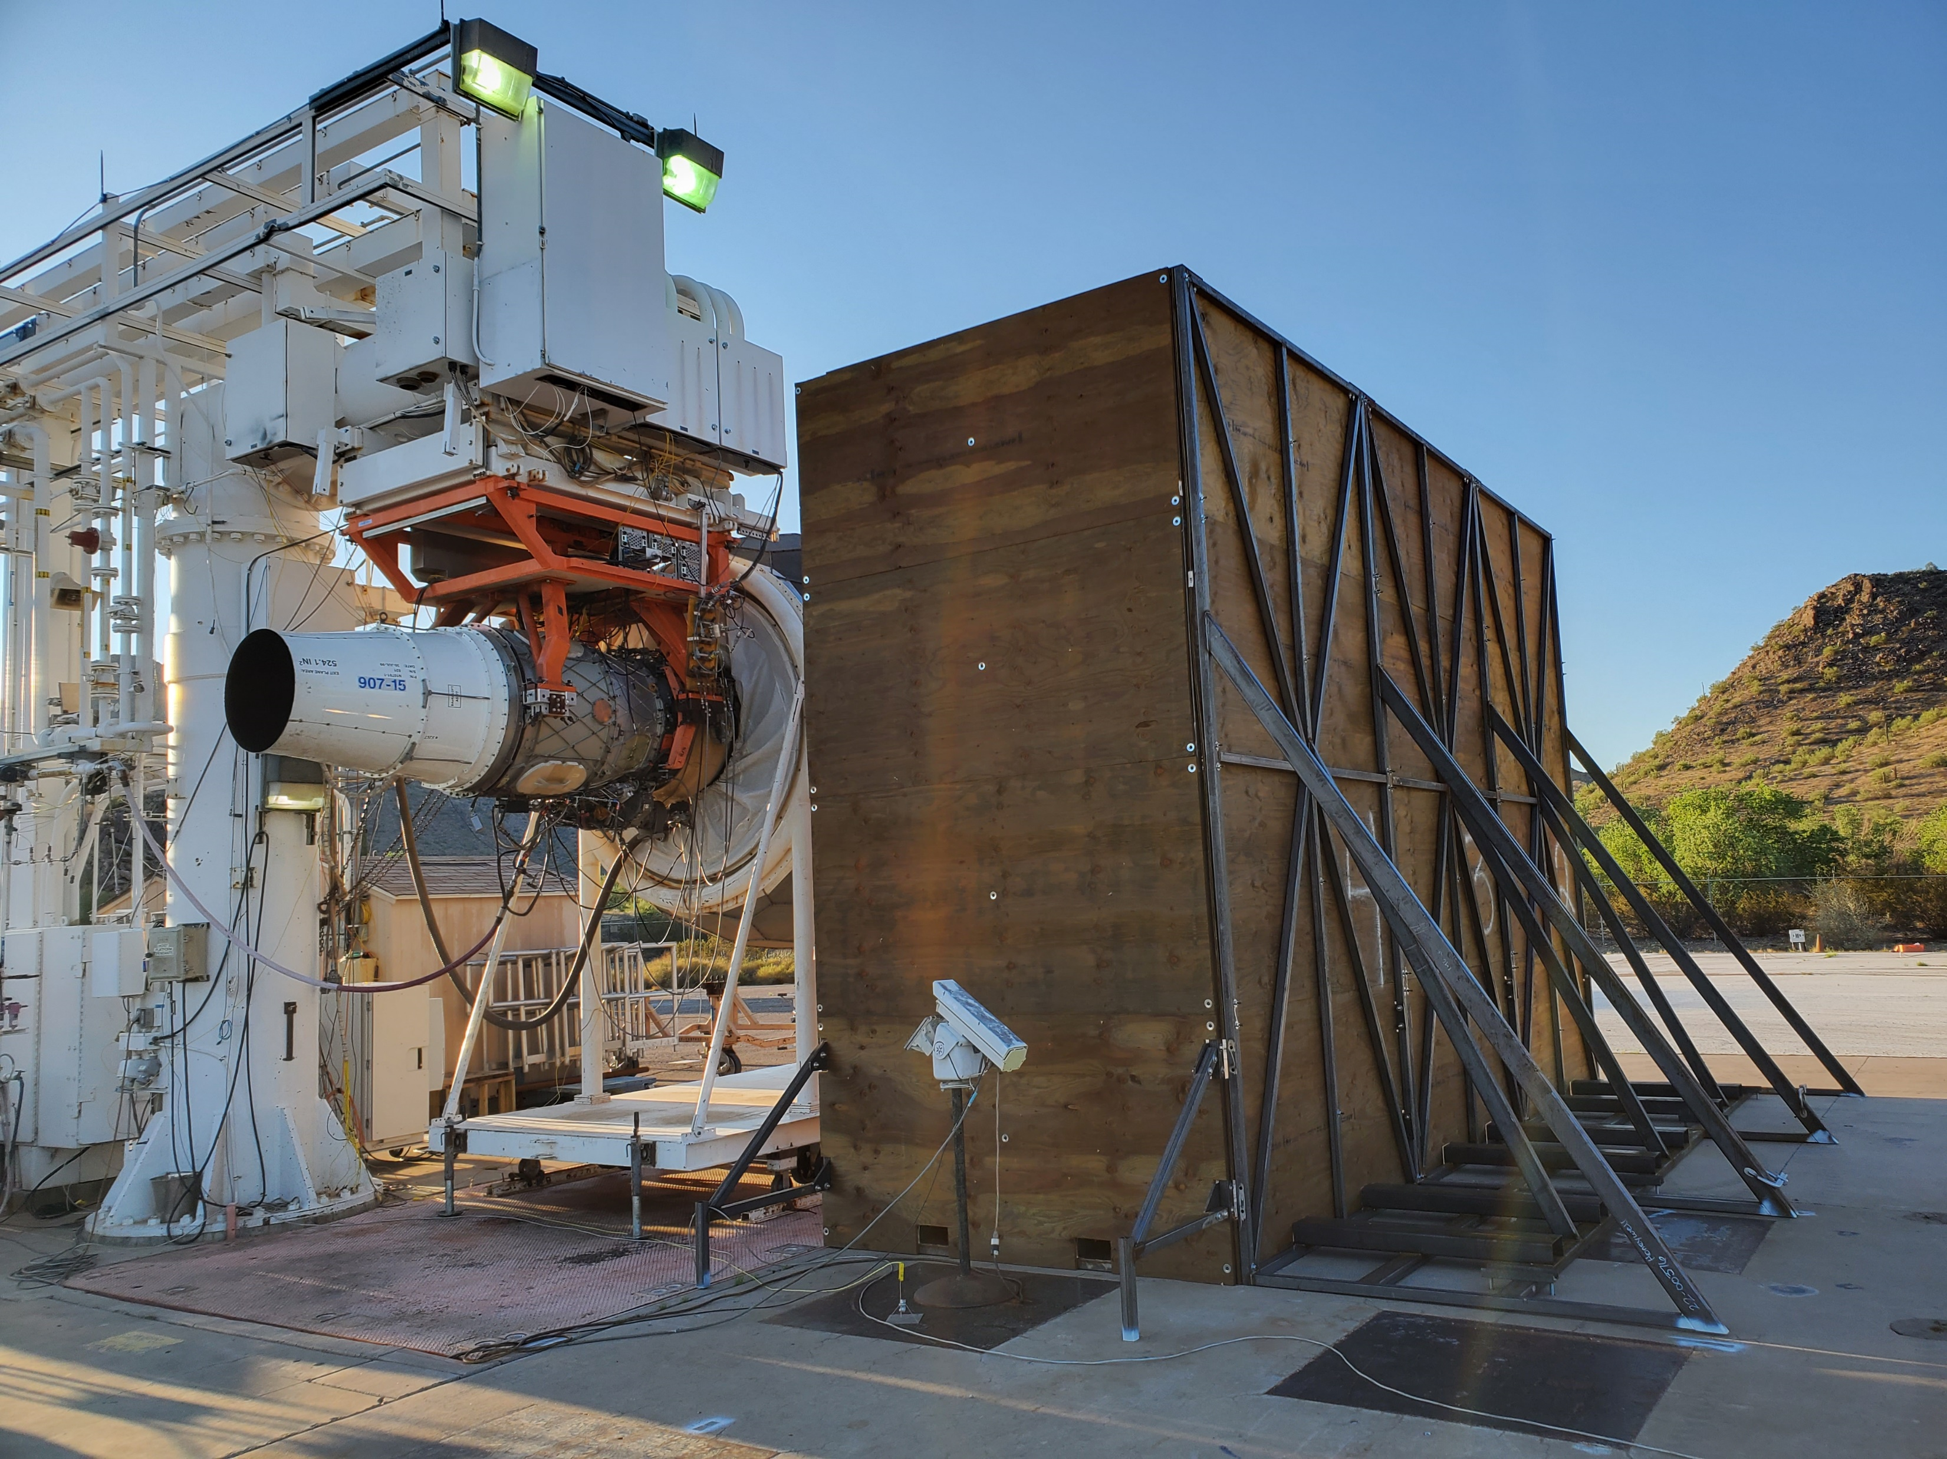
Honeywell Test Facility – San Tan
Mic Array
32’
16’
8’
Honeywell Aerospace
Honeywell Aerospace
Engine centerline @ 10ft height
Acoustic barriers to block engine inlet noise from mic array
Potential runs with acoustically treated barriers to get scattering data (time permitting)

Slide 11
Proposed Test Plan
Order | Priority | Doors | Panels | Barrier | Comments
1 | 1 | HW | HW | Fwd | Baseline configuration, hardwall panels/doors
2 | 3 | NC-30 | HW | Fwd
3 | 3 | 2DOF | HW | Fwd
4 | 3 | HW | NC-24 | Fwd
5 | 2 | 2DOF | NC-24 | Fwd | Downselect between these configurations if test time becomes critical
6 | 2 | NC-30 | NC-24 | Fwd
7 | 4 | NC-30 | NC-24 | None
8 | 5 | HW | HW | Fwd w/ treatment | Dependent on available time and earlier results. Barrier placement is TBD and may also include treatment.
Isolate door effects
Isolate panel effect
Combined treatment
Barrier scattering effects
Five days of testing
Test order driven by time to install fixed liner panels
Potential scattering effects add-on for TDFAST development/validation

Slide 12
Project Schedule
Liner Development to TRL 6
Narrow Channel concept initial design and experimental evaluation
Contract awarded
Engine Test
Project kickoff
Analysis of results
Liner fabrication
Impedance optimization
Liner concept selection and design
Q1 | Q2 | Q3 | Q4 | Q1 | Q2 | Q3 | Q4 | Q1 | Q2 | Q3 | Q4
FY23 | FY24 | FY25
Contract awarded last month ($250K)
Fabrication schedule driven by material availability
Results to support TRL 5 liner development (will achieve TRL 6)
Scattering effects add-on for TDFAST development/validation (future need for open-fan configurations)

Slide 13

Notes:
Thanks for listening and I’ll be glad to answer any questions you may have.

Slide 14
Backup Material

Slide 15

































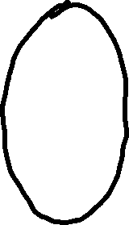



Honeywell Test Engine – AS907-3 (HTF7000)
Fixed Panel
Key parameters
6500-7500 lbf thrust
BPR - 4.4
34.2 in. dia. fan
22 fan blades
51 fan stators
Removable Doors
Usage
Medium-size biz jets
~2000 units produced
Opportunity to test advanced liner concepts at TRL 6

