Slide 1
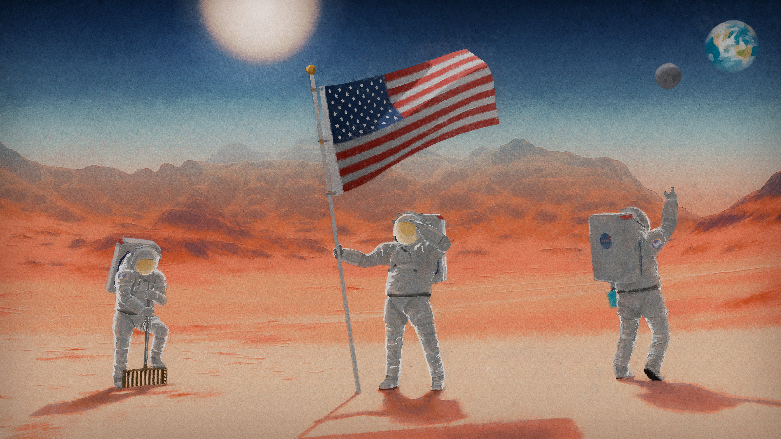


Artificial Intelligence
and NASA’s Moon to Mars Architecture
Paromita Mitra
Data Systems, Lunar Architecture Team
Strategy and Architecture Office
Exploration Systems Development Mission Directorate

Slide 2

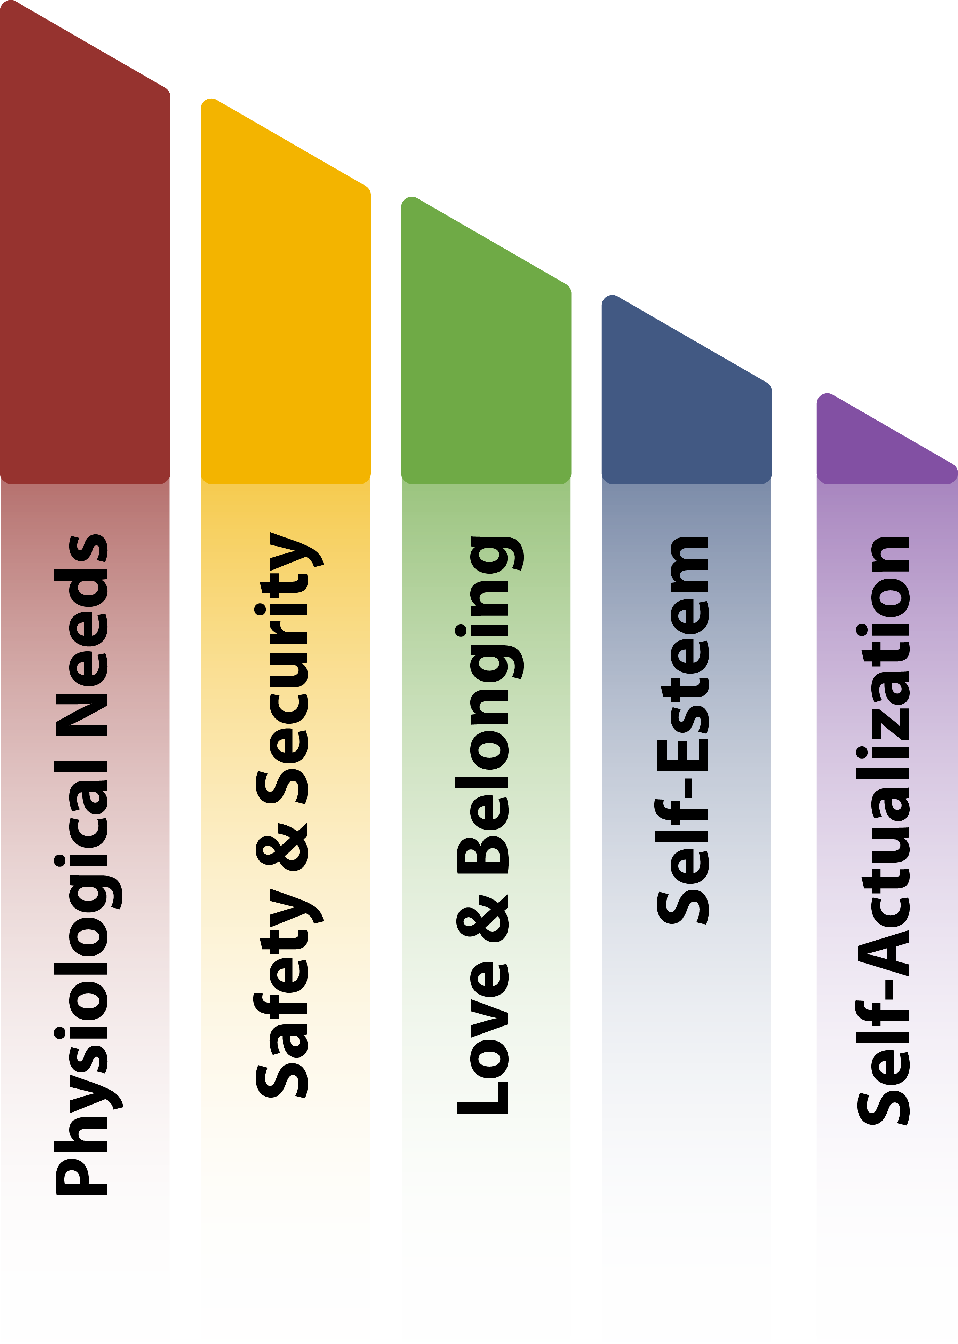

Maslow’s Hierarchy of Needs
Maslow’s Hierarchy of Needs is a humanist philosophy that suggests people fulfill basic needs (e.g., survival) before moving on to other, more advanced needs (e.g., self-actualization.)
Introduction
2

Slide 3
Maslow’s Hierarchy Applied to Data Needs
Purpose
(Self-Actualization)
Why do we explore? The impact of exploration on the world instills crewed missions with purpose.
Importance
(Self-Esteem)
The Moon to Mars Objectives and recurring tenets define the specific importance of science and exploration efforts.
Introduction
Belonging
(Love & Belonging)
The Architecture Definition Document (ADD) outlines how and where systems and people belong in the Architecture.
Safety
(Safety & Security)
The flight certification, mission timelines, and verification & validation processes ensure safety and reliability of systems.
Survival
(Physiological Needs)
NASA must design systems and elements that allow astronauts and technology to survive the harsh environment of deep space.
3

Slide 4
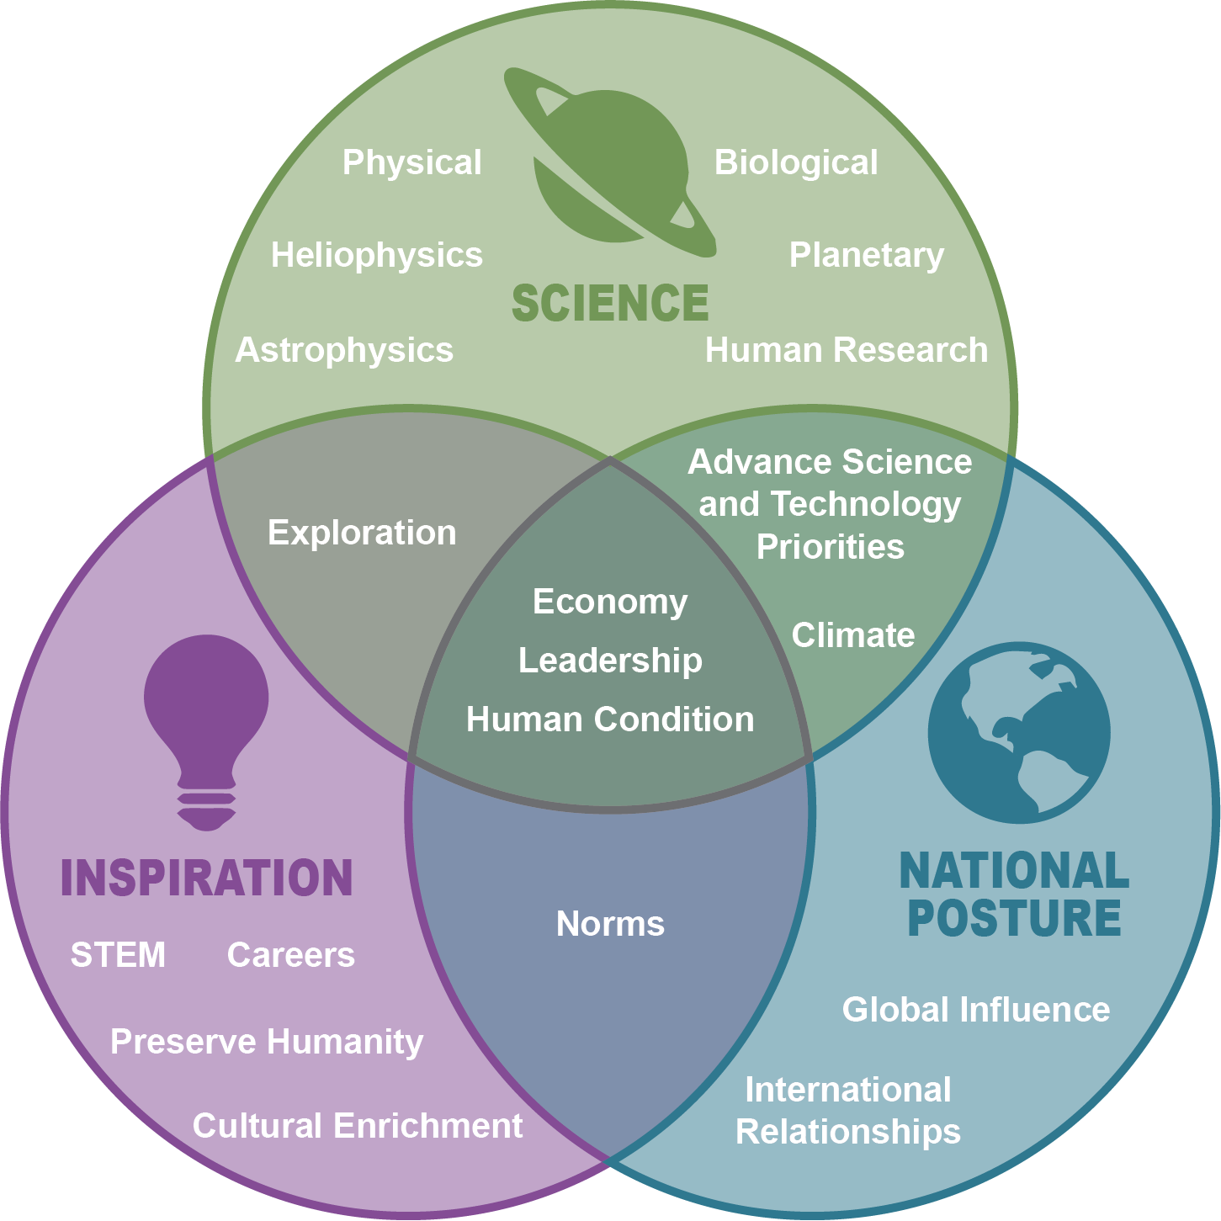
Why We Explore…
Purpose
Maslow’s Hierarchy
Investigations in deep space, on the Moon, and on Mars will enhance our understanding of the universe and our place in it.
Accepting audacious challenges motivates current and future generations to contribute to our voyage deeper into space.
Moon to Mars Objectives
What is done, how it's accomplished, and who participates affect our world, quality of life, and humanity’s future.
4

Slide 5
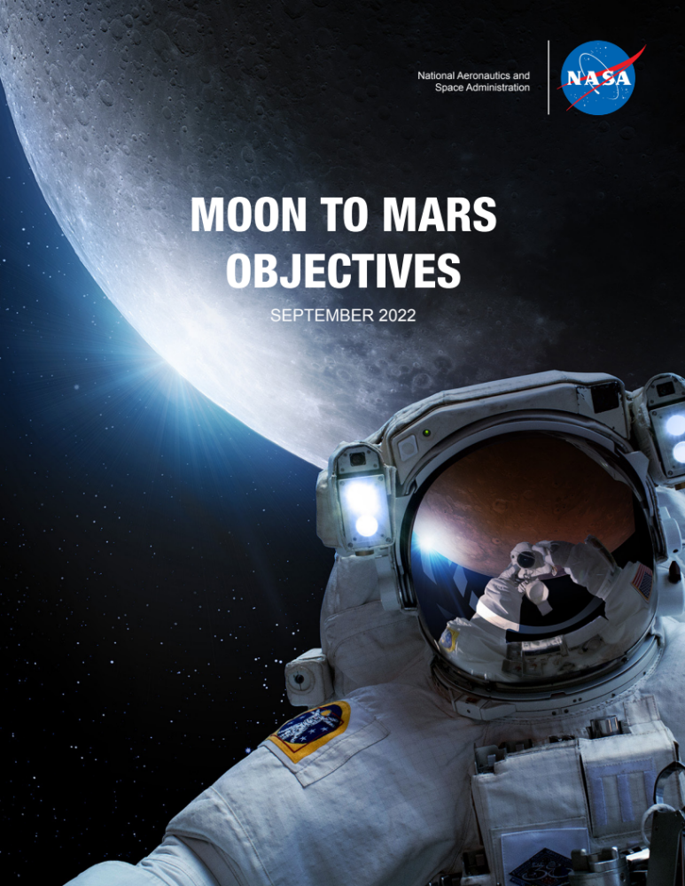

Moon to Mars Objectives
NASA’s Moon to Mars Objectives document a systems engineering approach to crewed deep space exploration.
In contrast to a capabilities-based approach, an objectives-based approach focuses on the big picture, the “what” and “why,” before prescribing the “how.”
The methodology for the Moon to Mars Objectives is guided by five inter-related principles:
Moon to Mars Objectives
Objectives-based Approach
Constancy of Purpose
Enhanced Communication and Engagement
Unity of Purpose
Architect from the Right
Execute from the Left
5

Slide 6
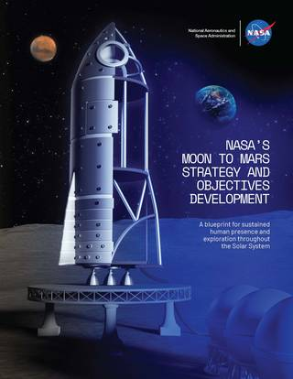



Goals, Objectives, and Strategy
Importance
Maslow’s Hierarchy
RECURRING TENETS
ARCHITECTURE
SCIENCE
TRANSPORTATION AND HABITATION
Iterate and evolve
through annual
Architecture Concept Reviews
LUNAR AND MARS INFRASTRUCTURE
OPERATIONS
Architecture Overview
NASA’s Moon to Mars Objectives and Strategy document a systems engineering approach to crewed deep space exploration.
In contrast to a capabilities-based approach, an objectives-based approach focuses on the big picture, the “what” and “why,” before prescribing the “how.”
Requested feedback on these objectives in summer 2022 from the following key stakeholders:
NASA workforce: our greatest asset
International partners:
our key current and future, anticipated collaborators
U.S. Industry, Academia, OGAs:
our national leaders in space research and capabilities
6

Slide 7
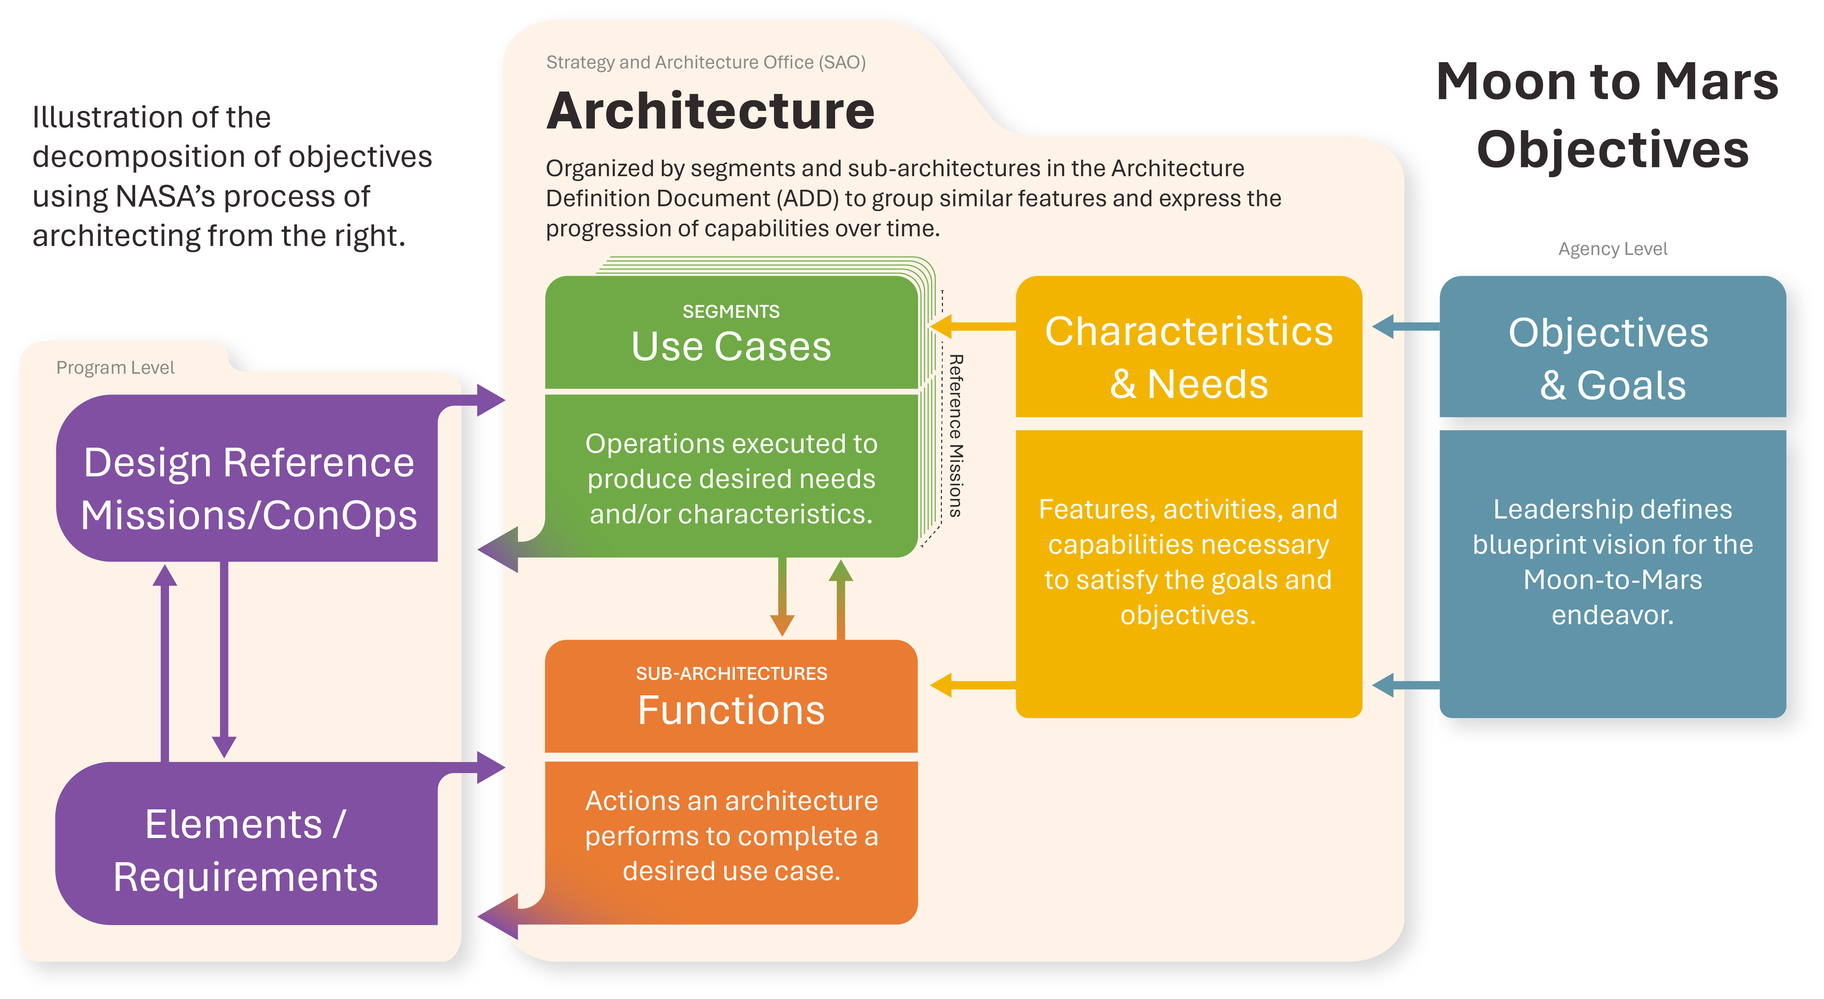
Architecting from the Right
Belonging
Maslow’s Hierarchy
Architecture Overview
7

Slide 8
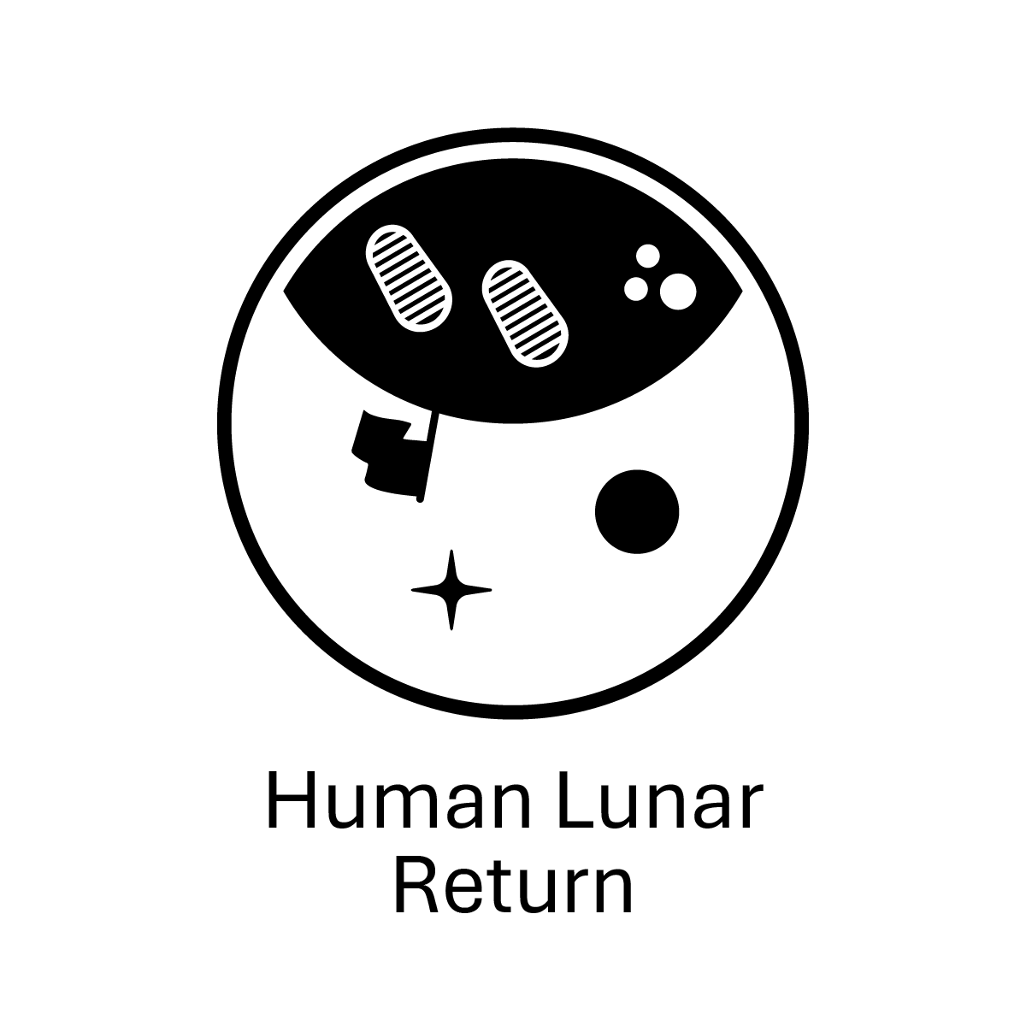



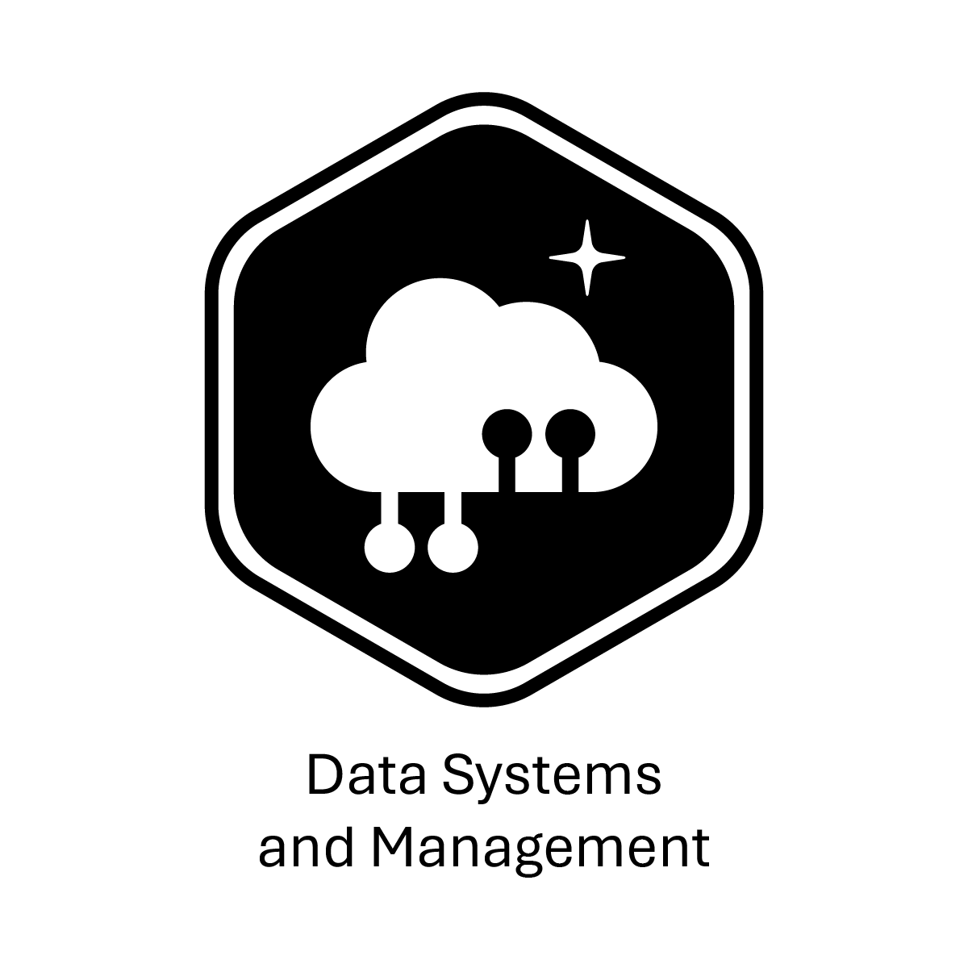
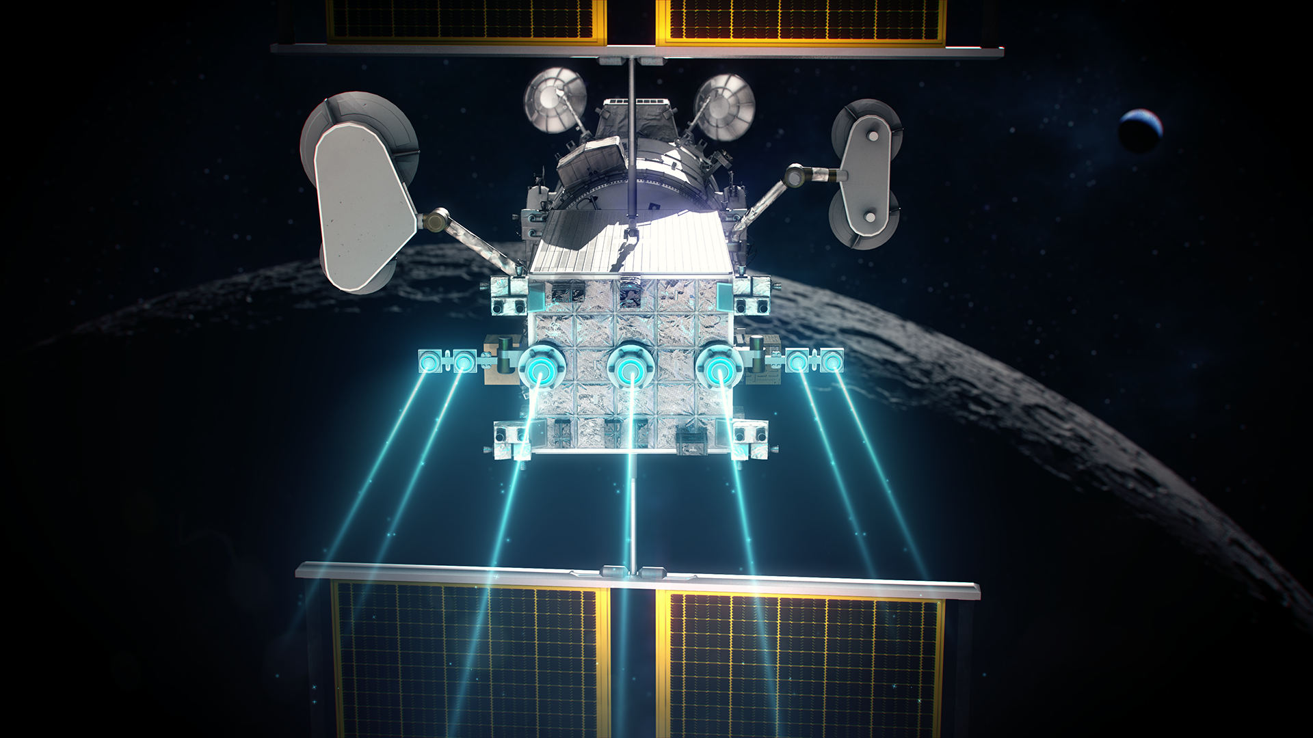
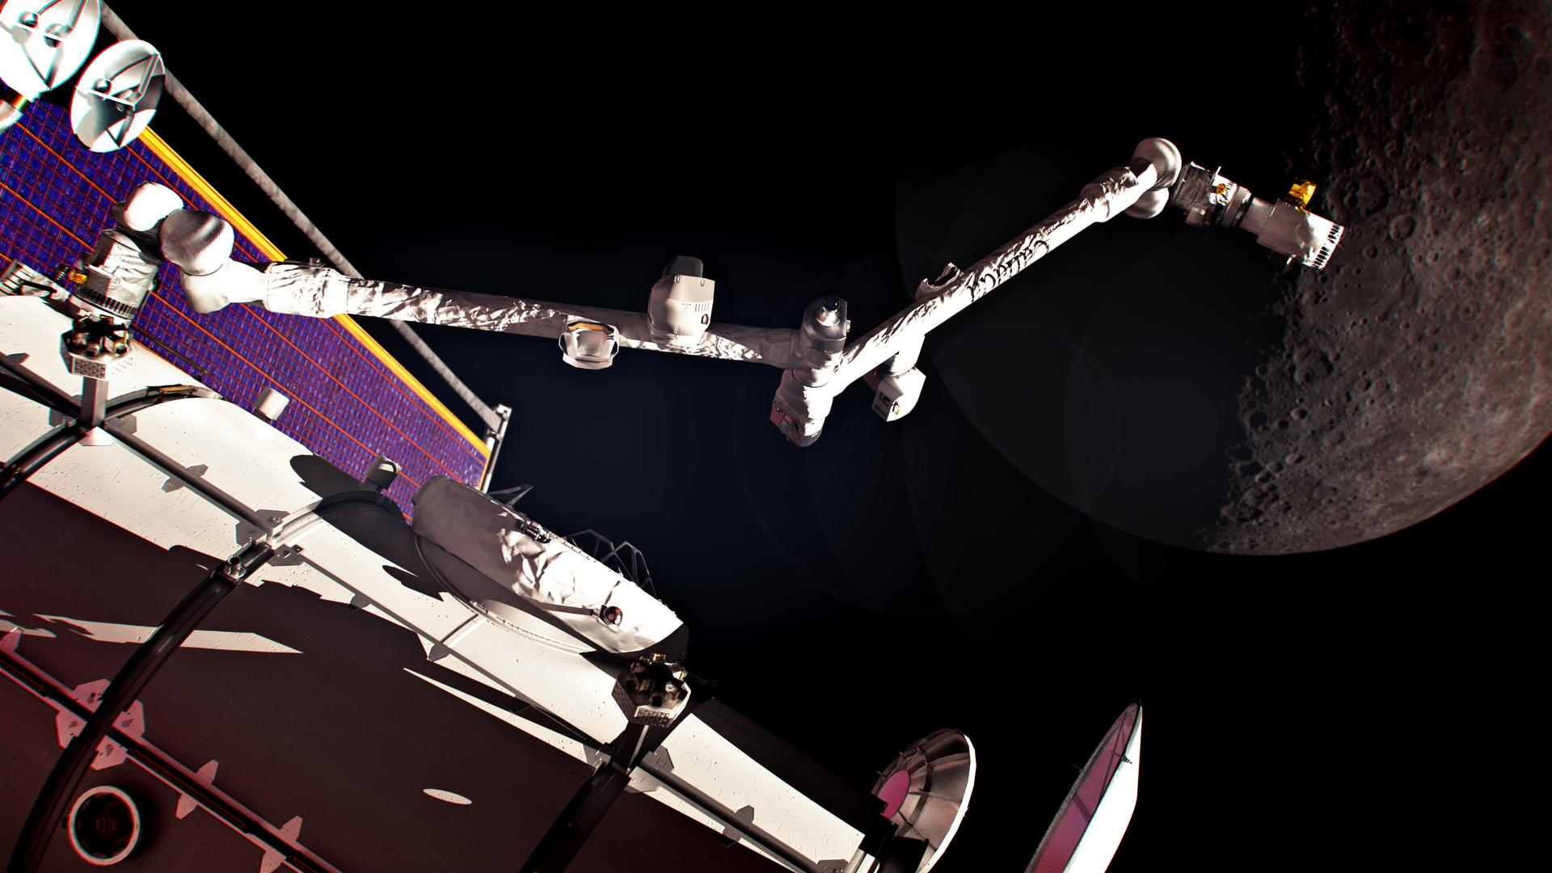
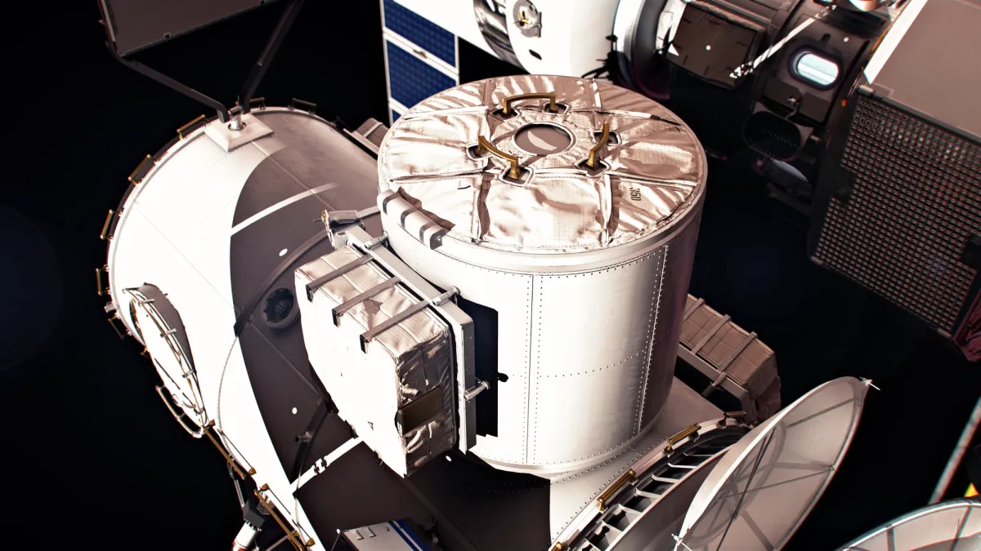
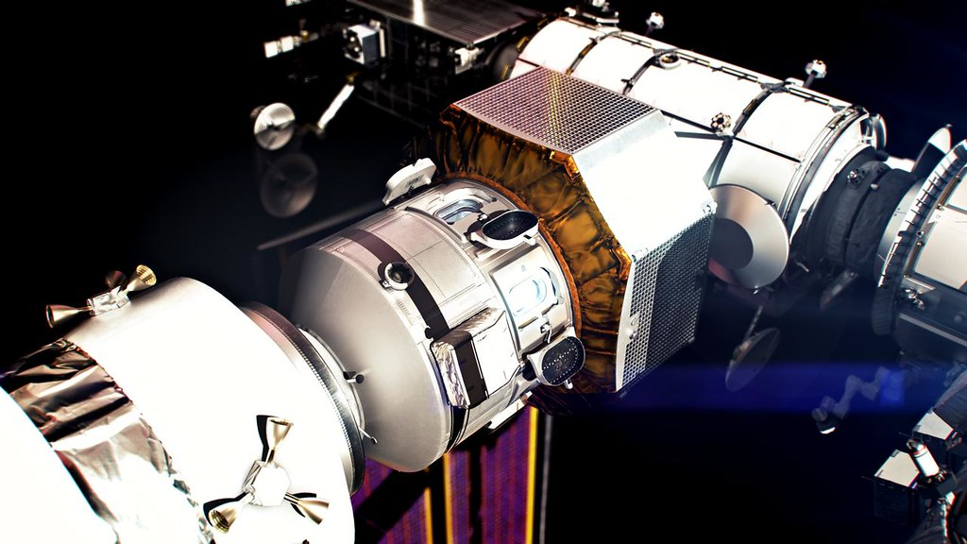
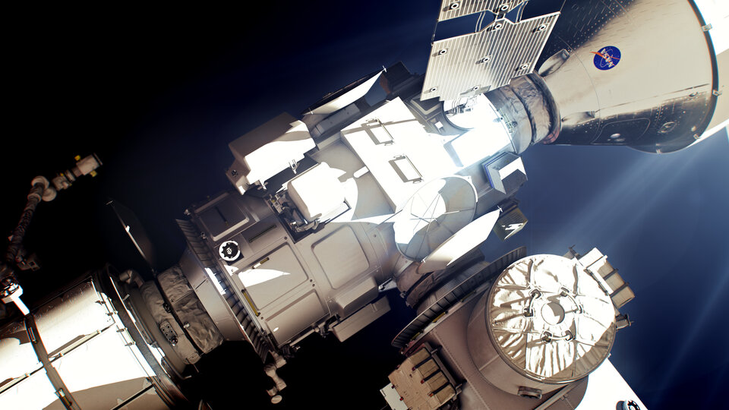



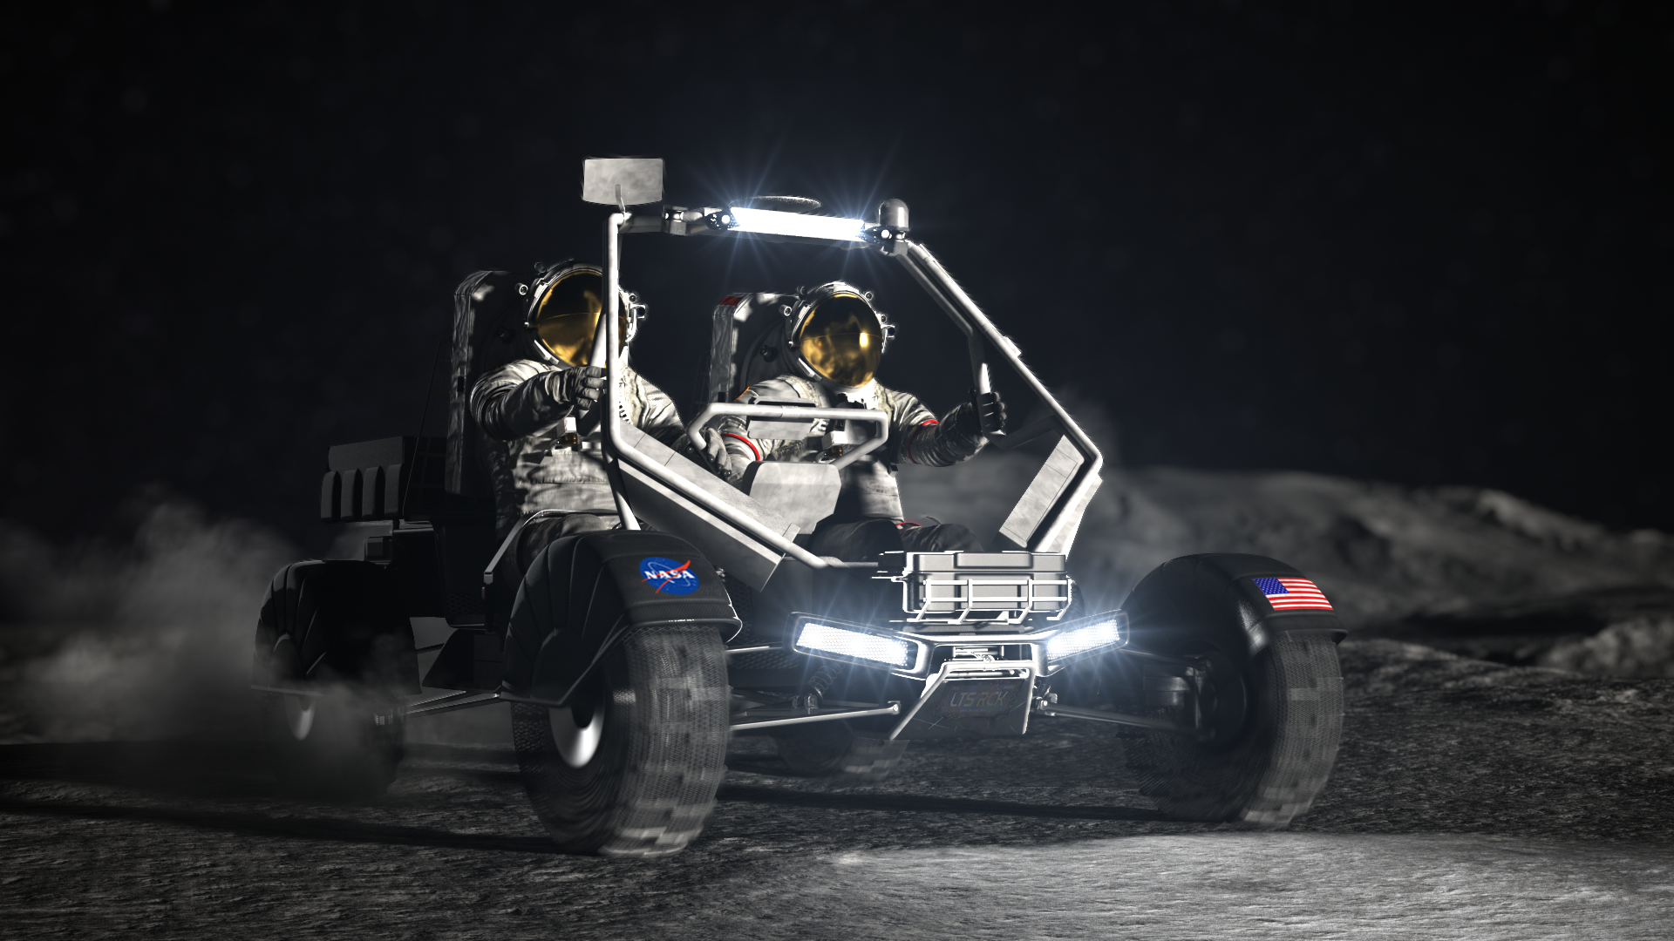
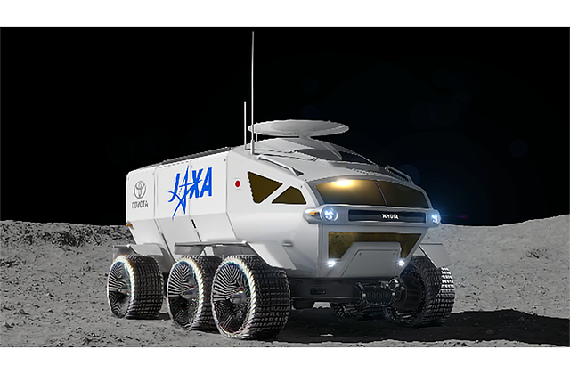
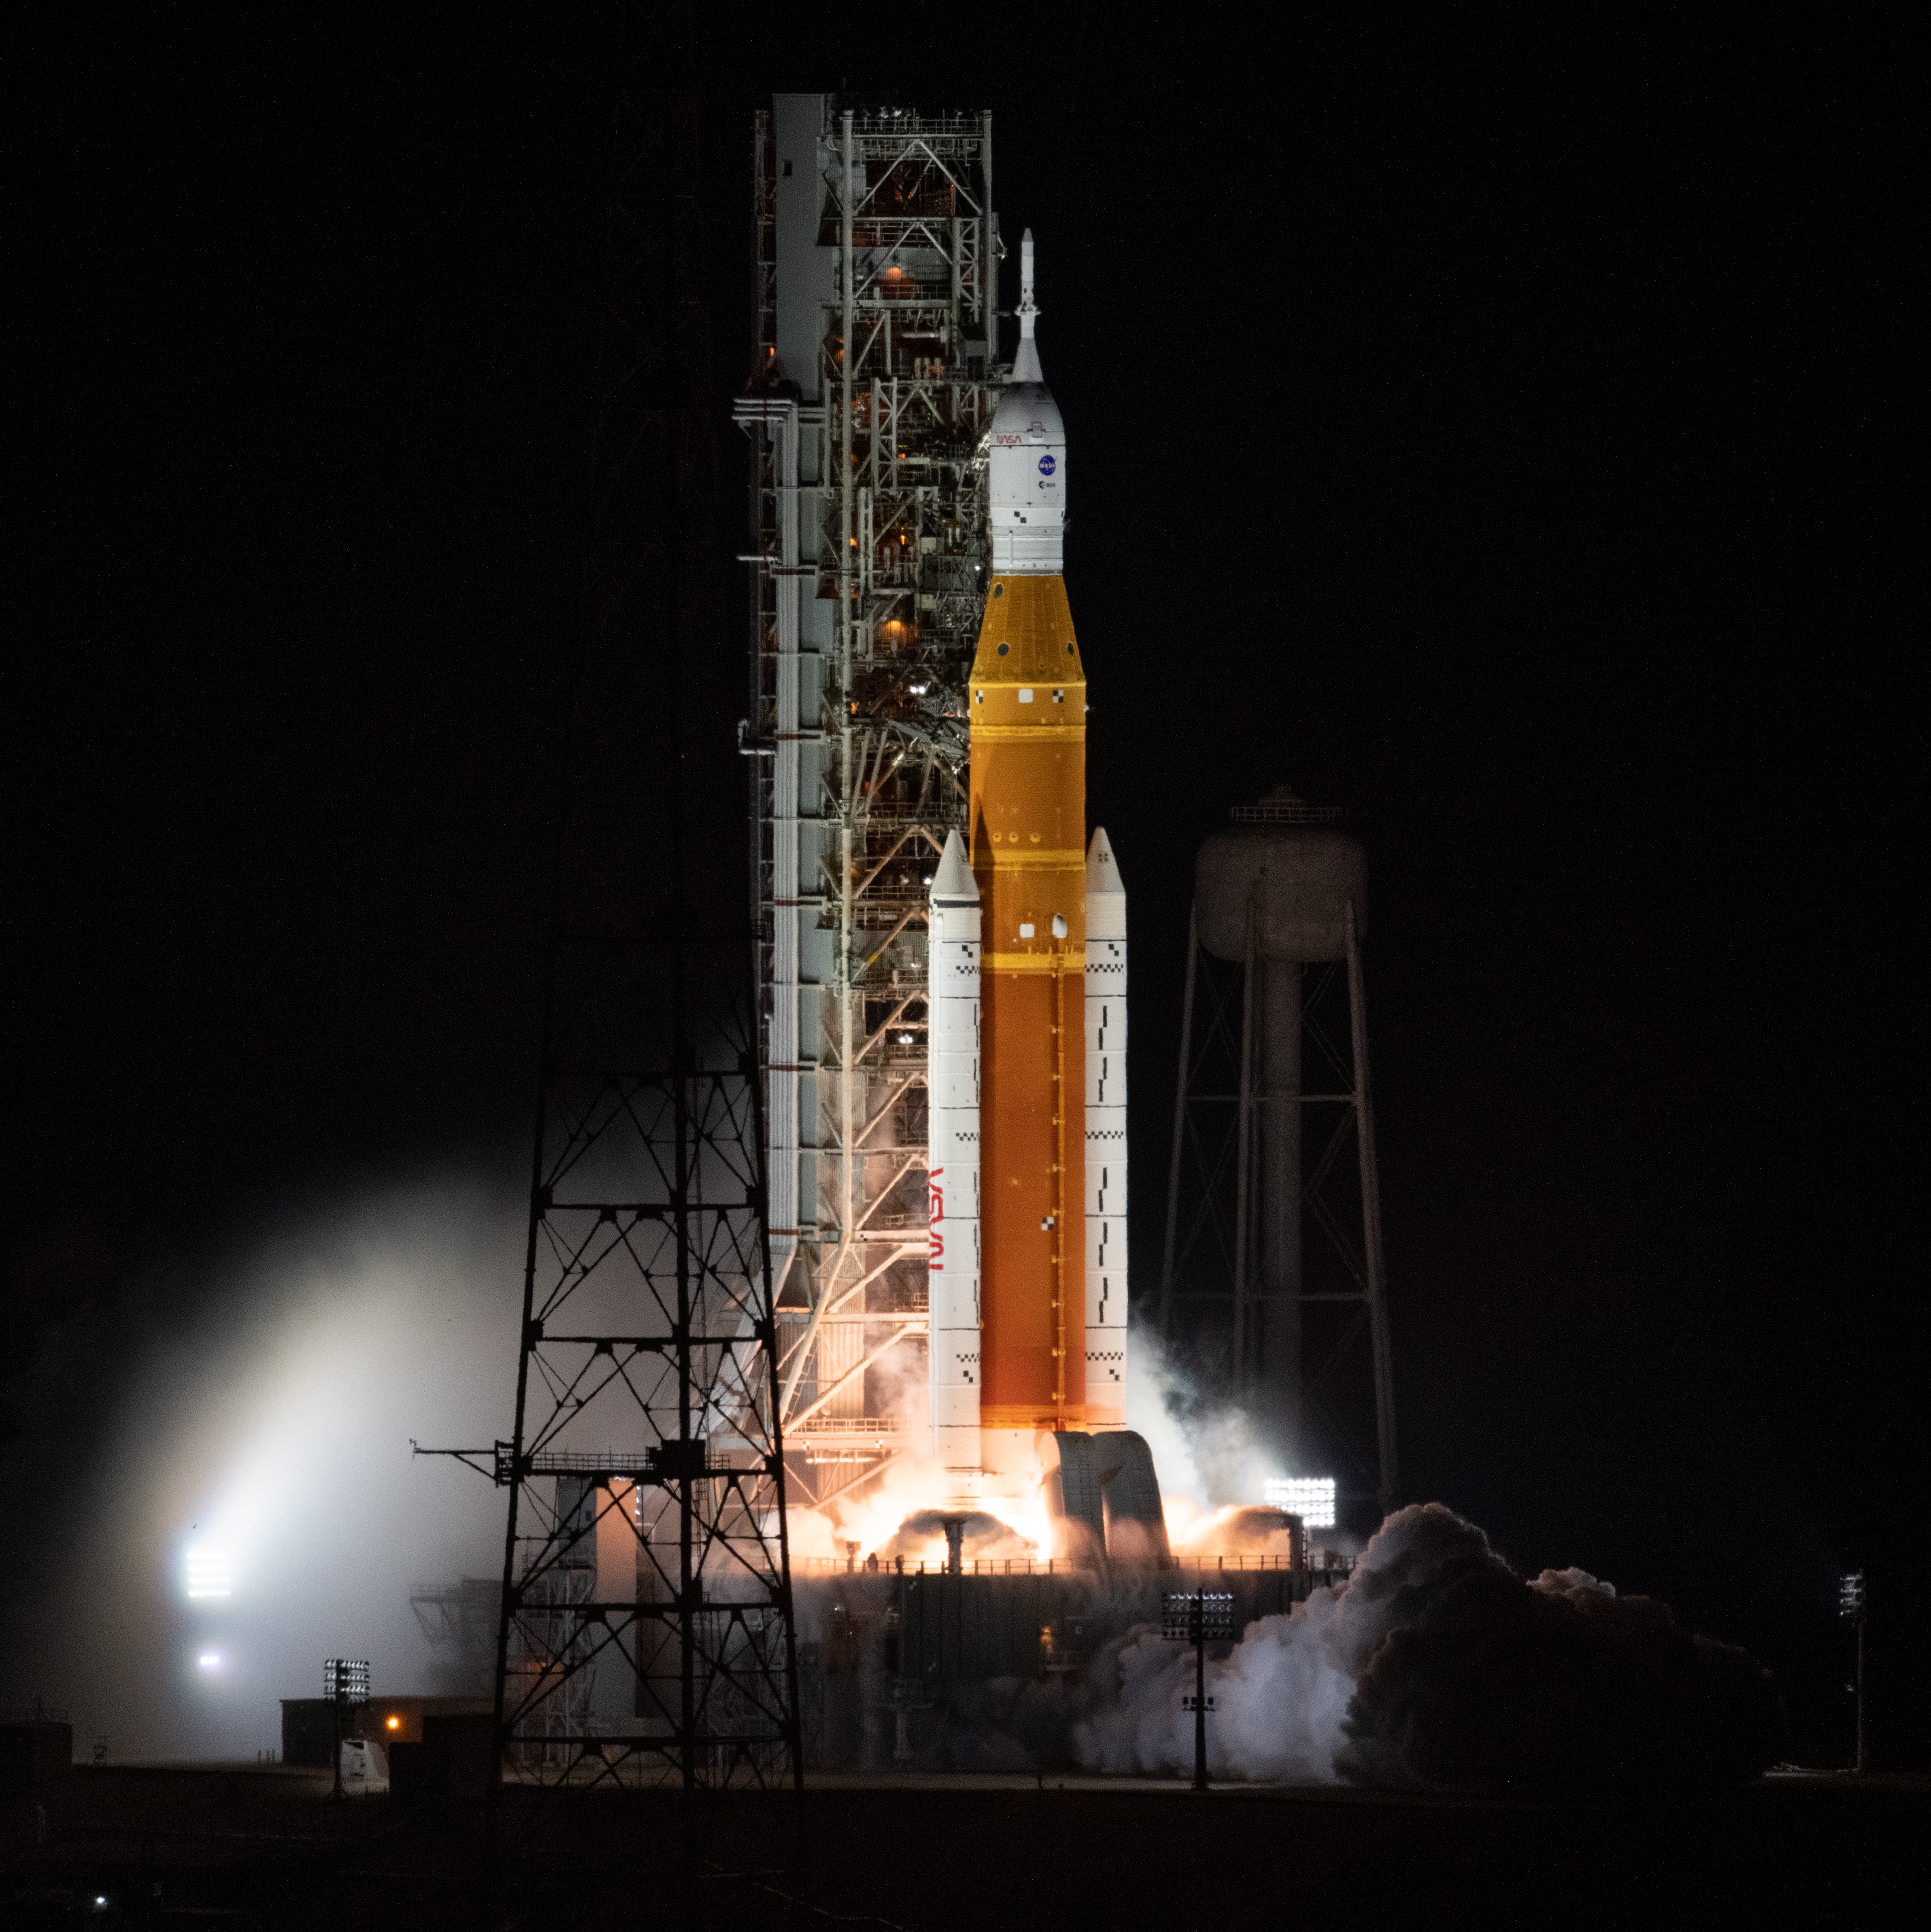
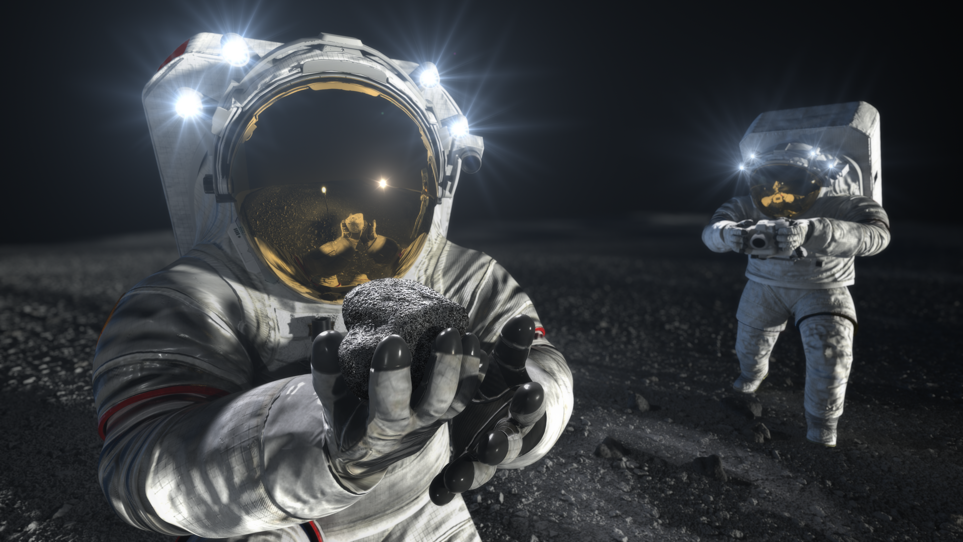
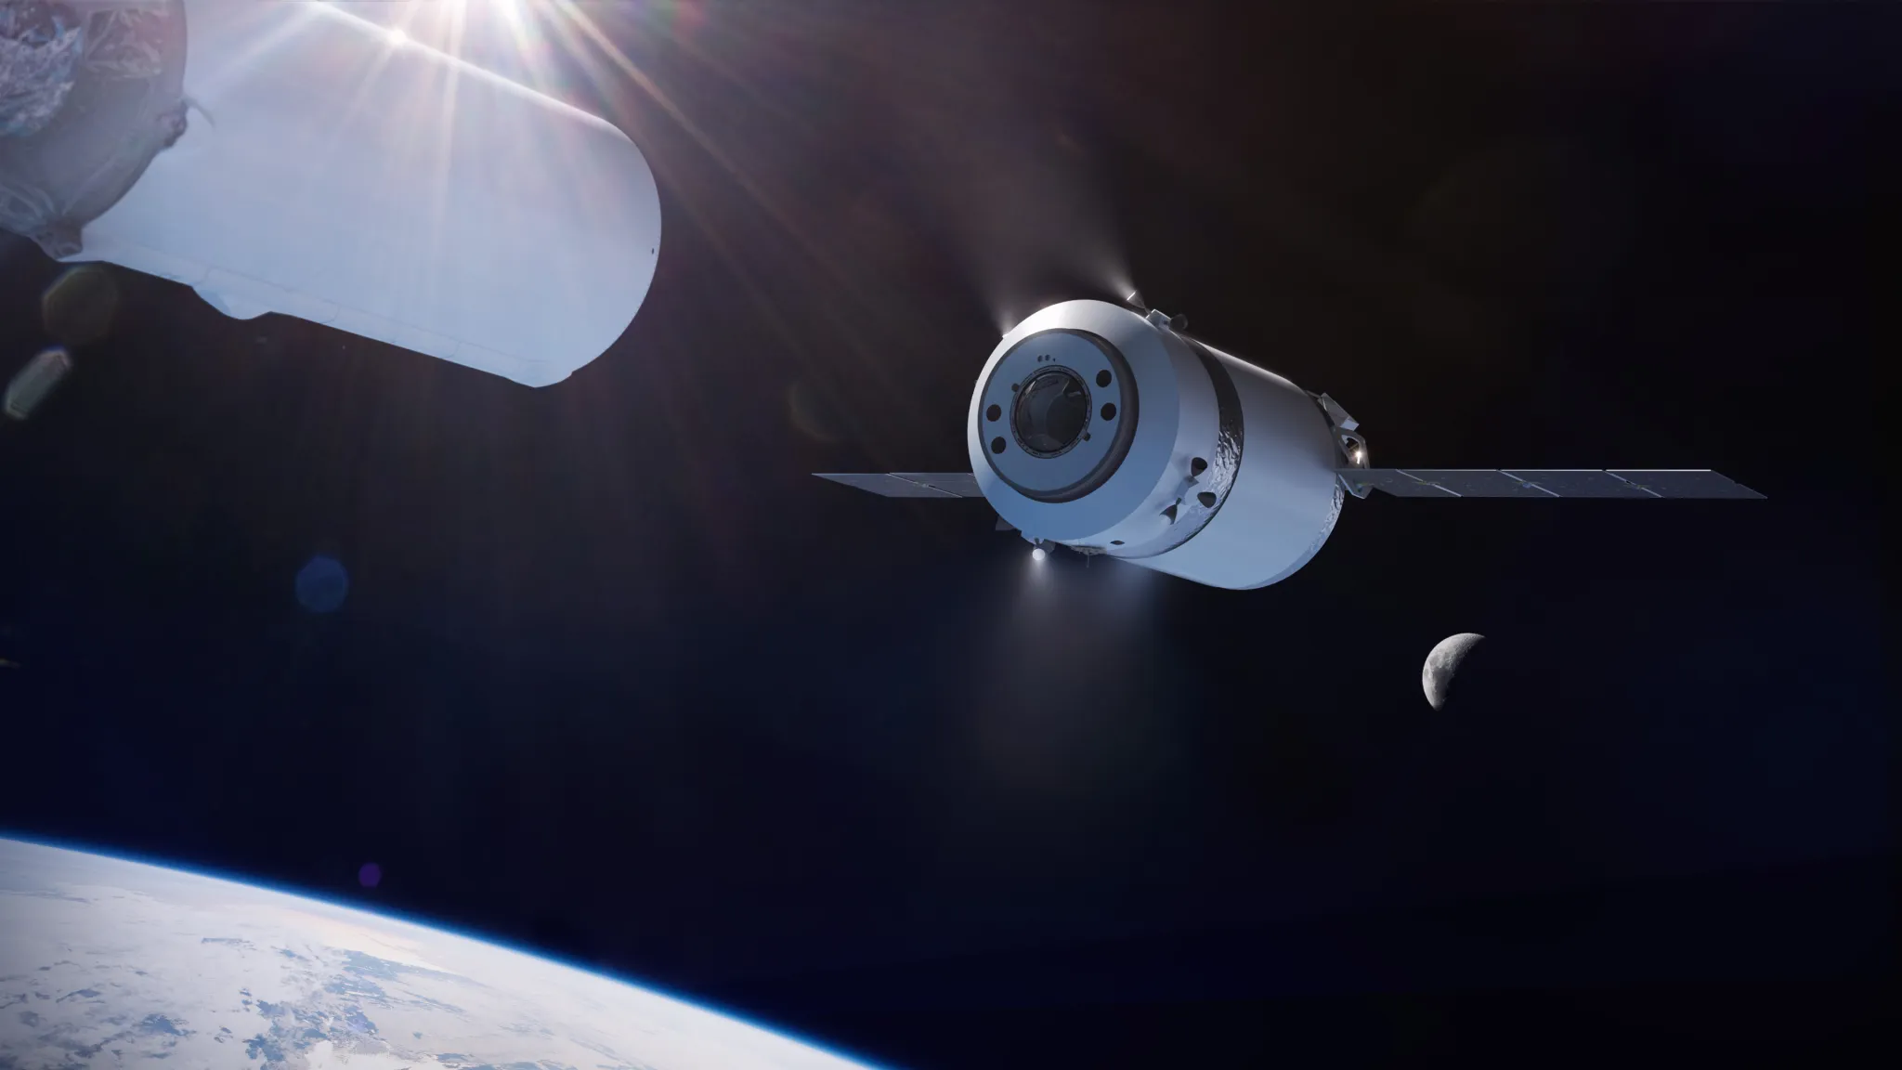

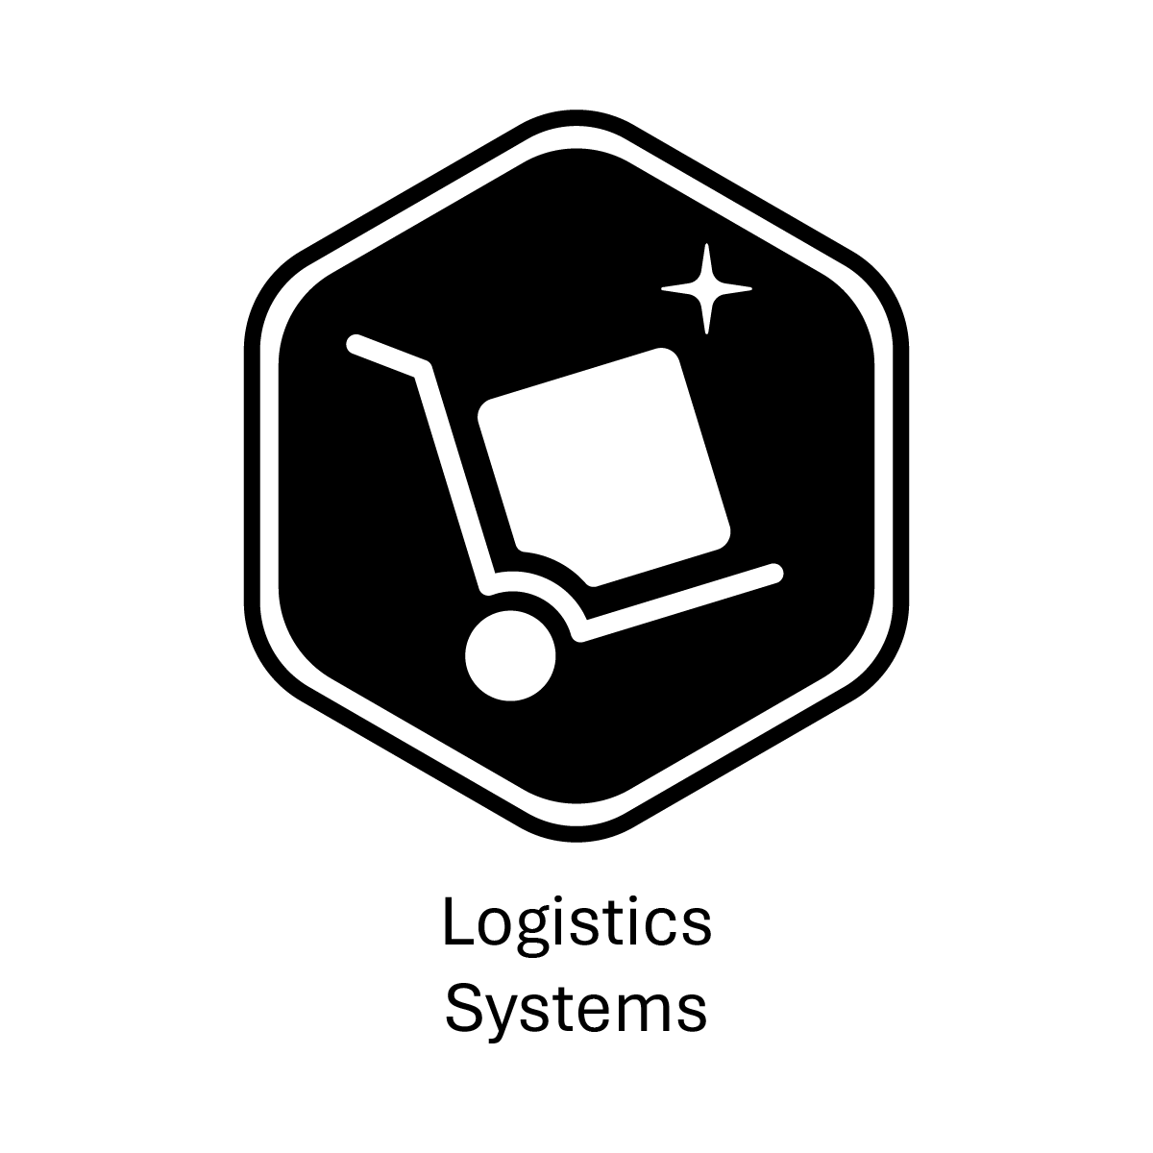

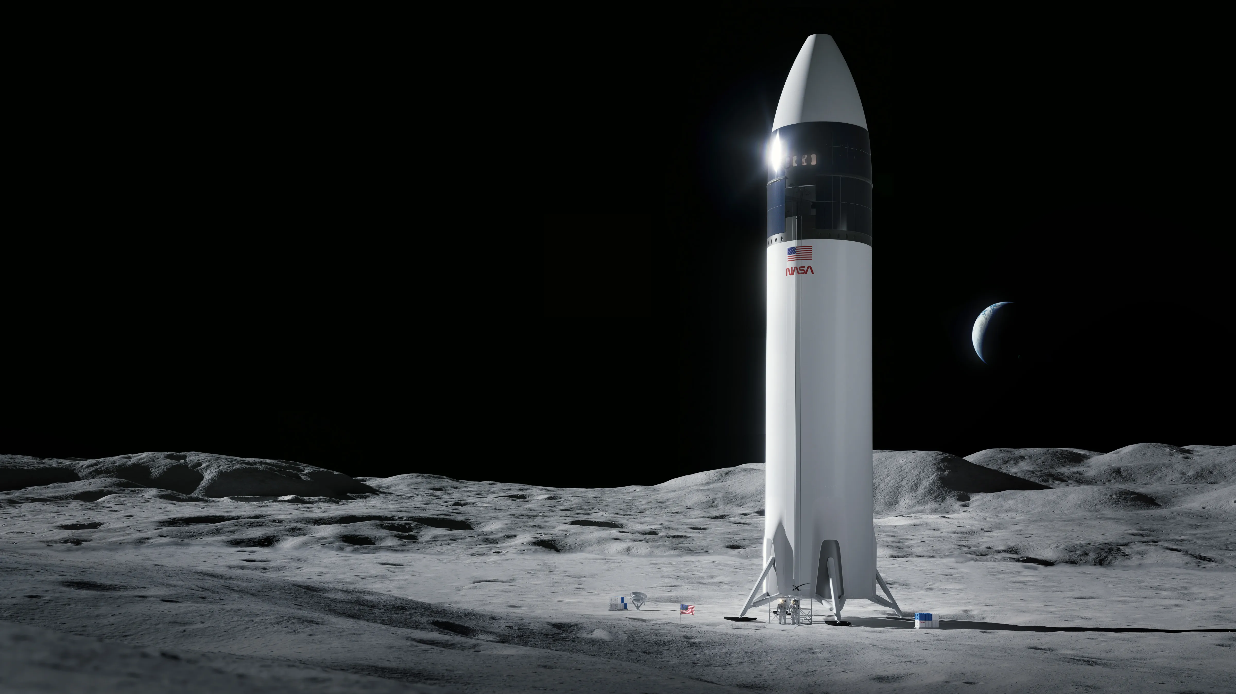
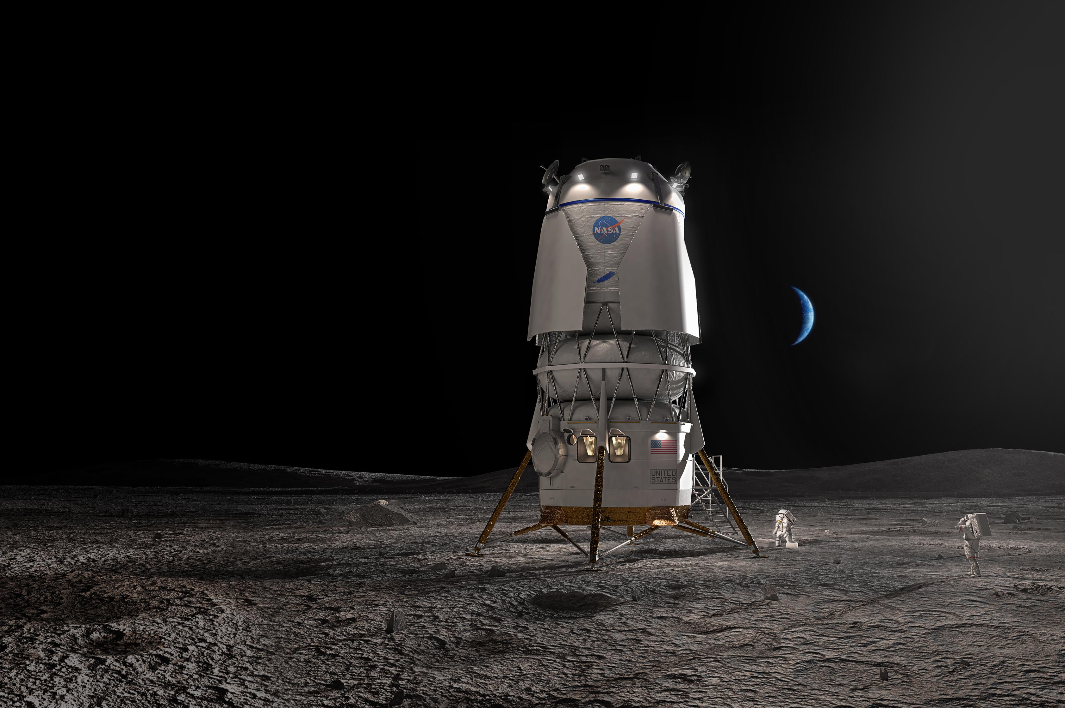


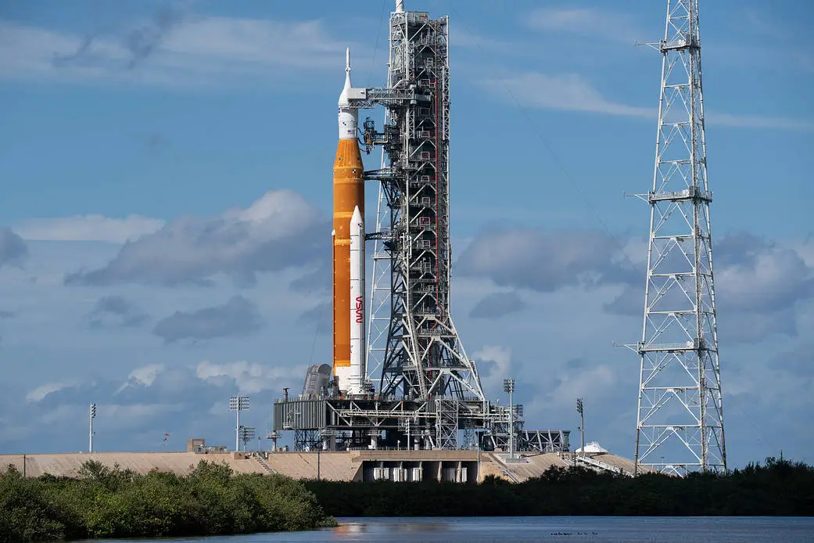
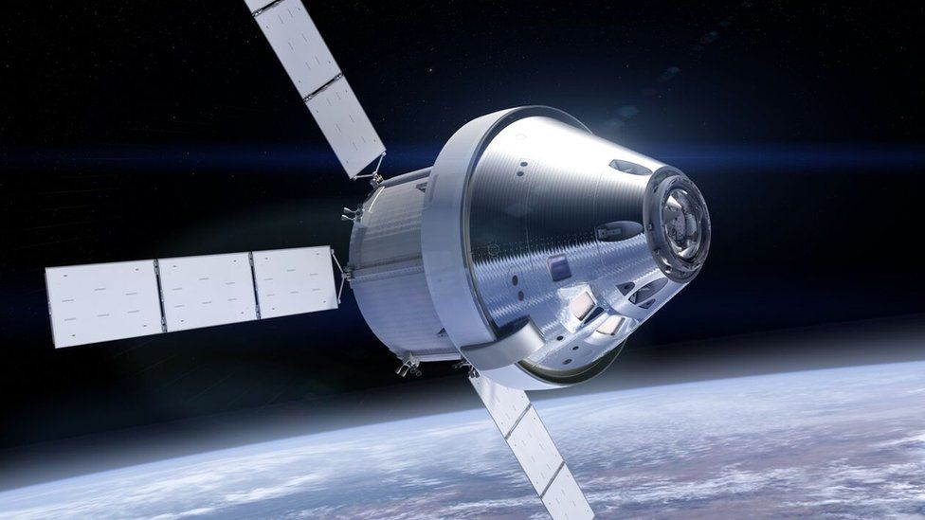
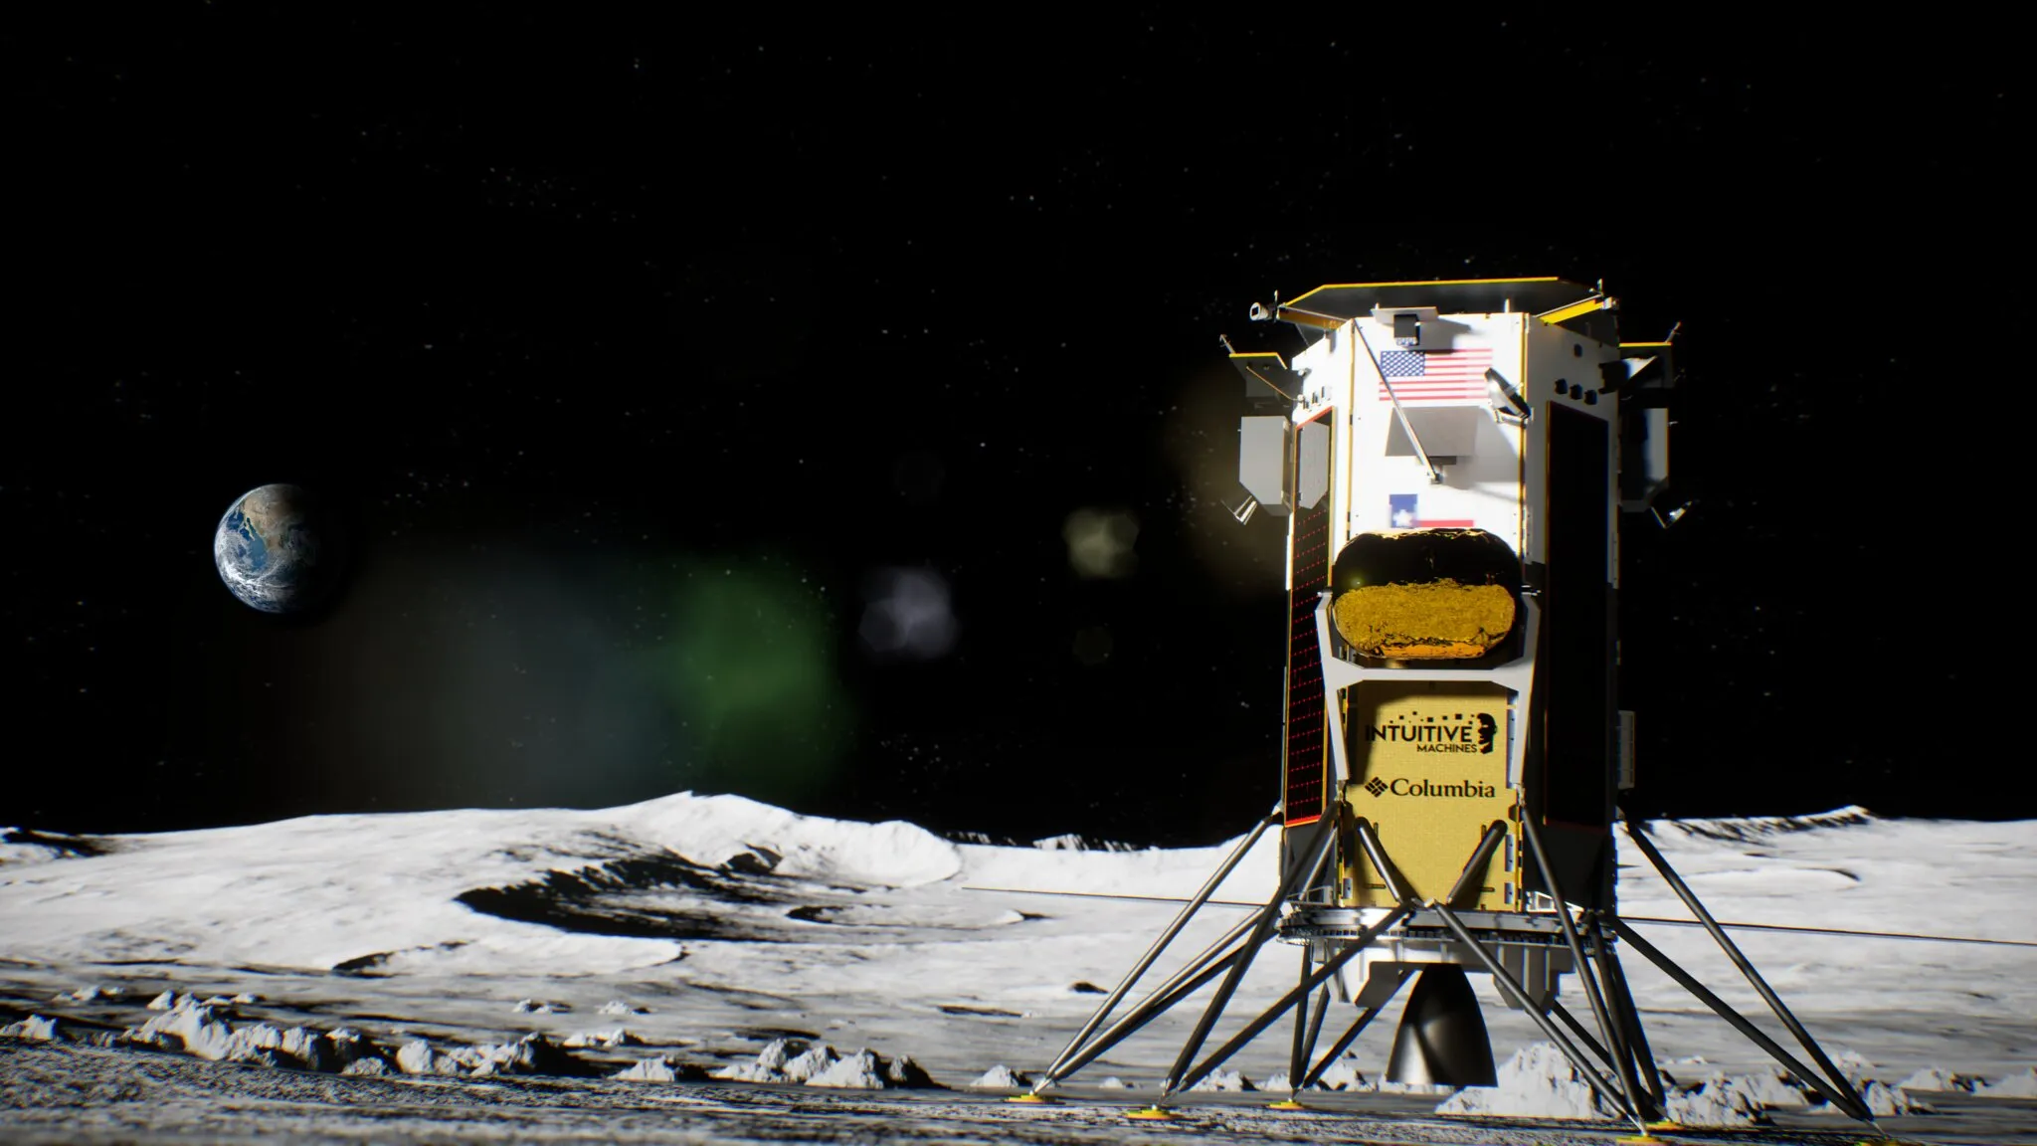


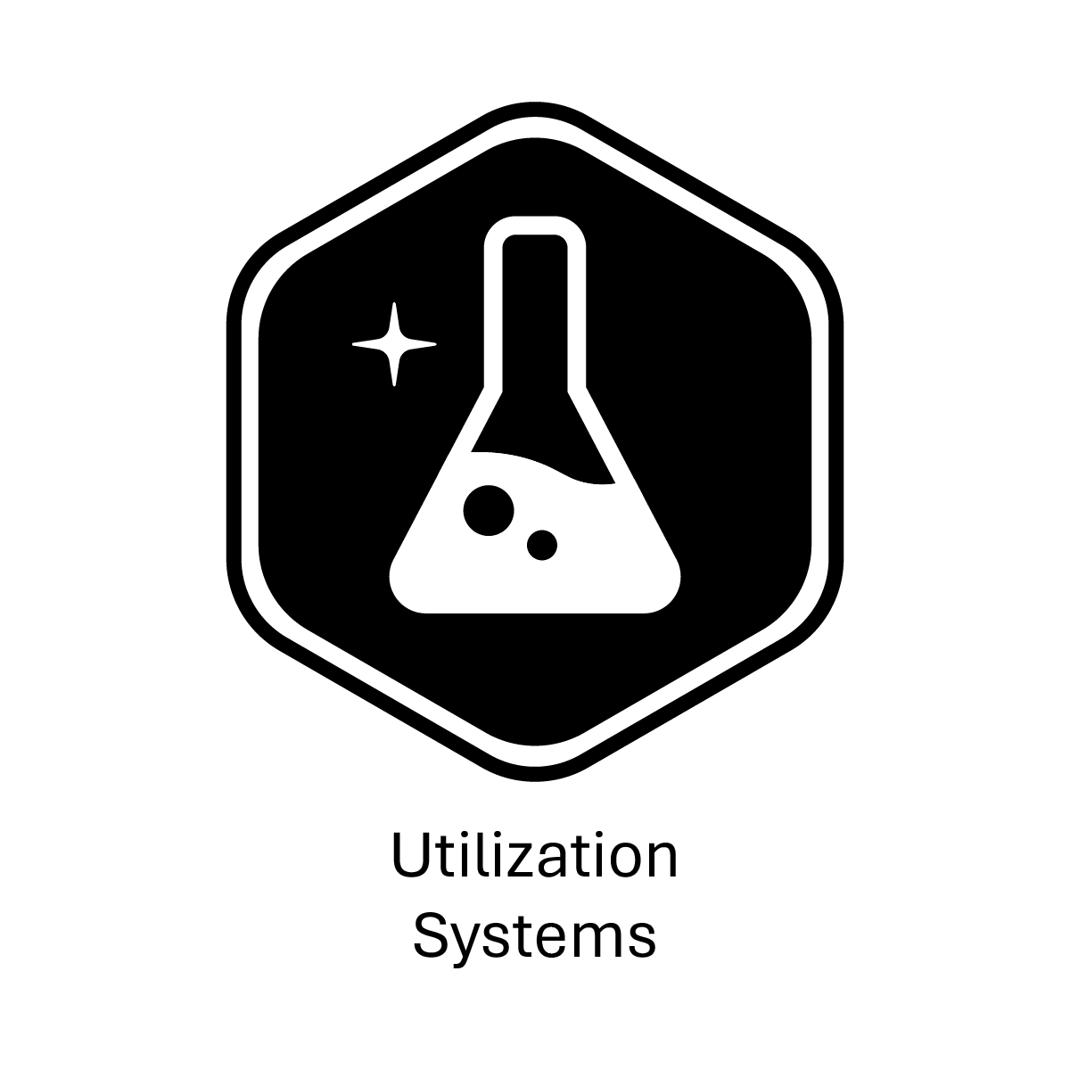
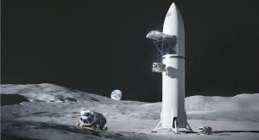
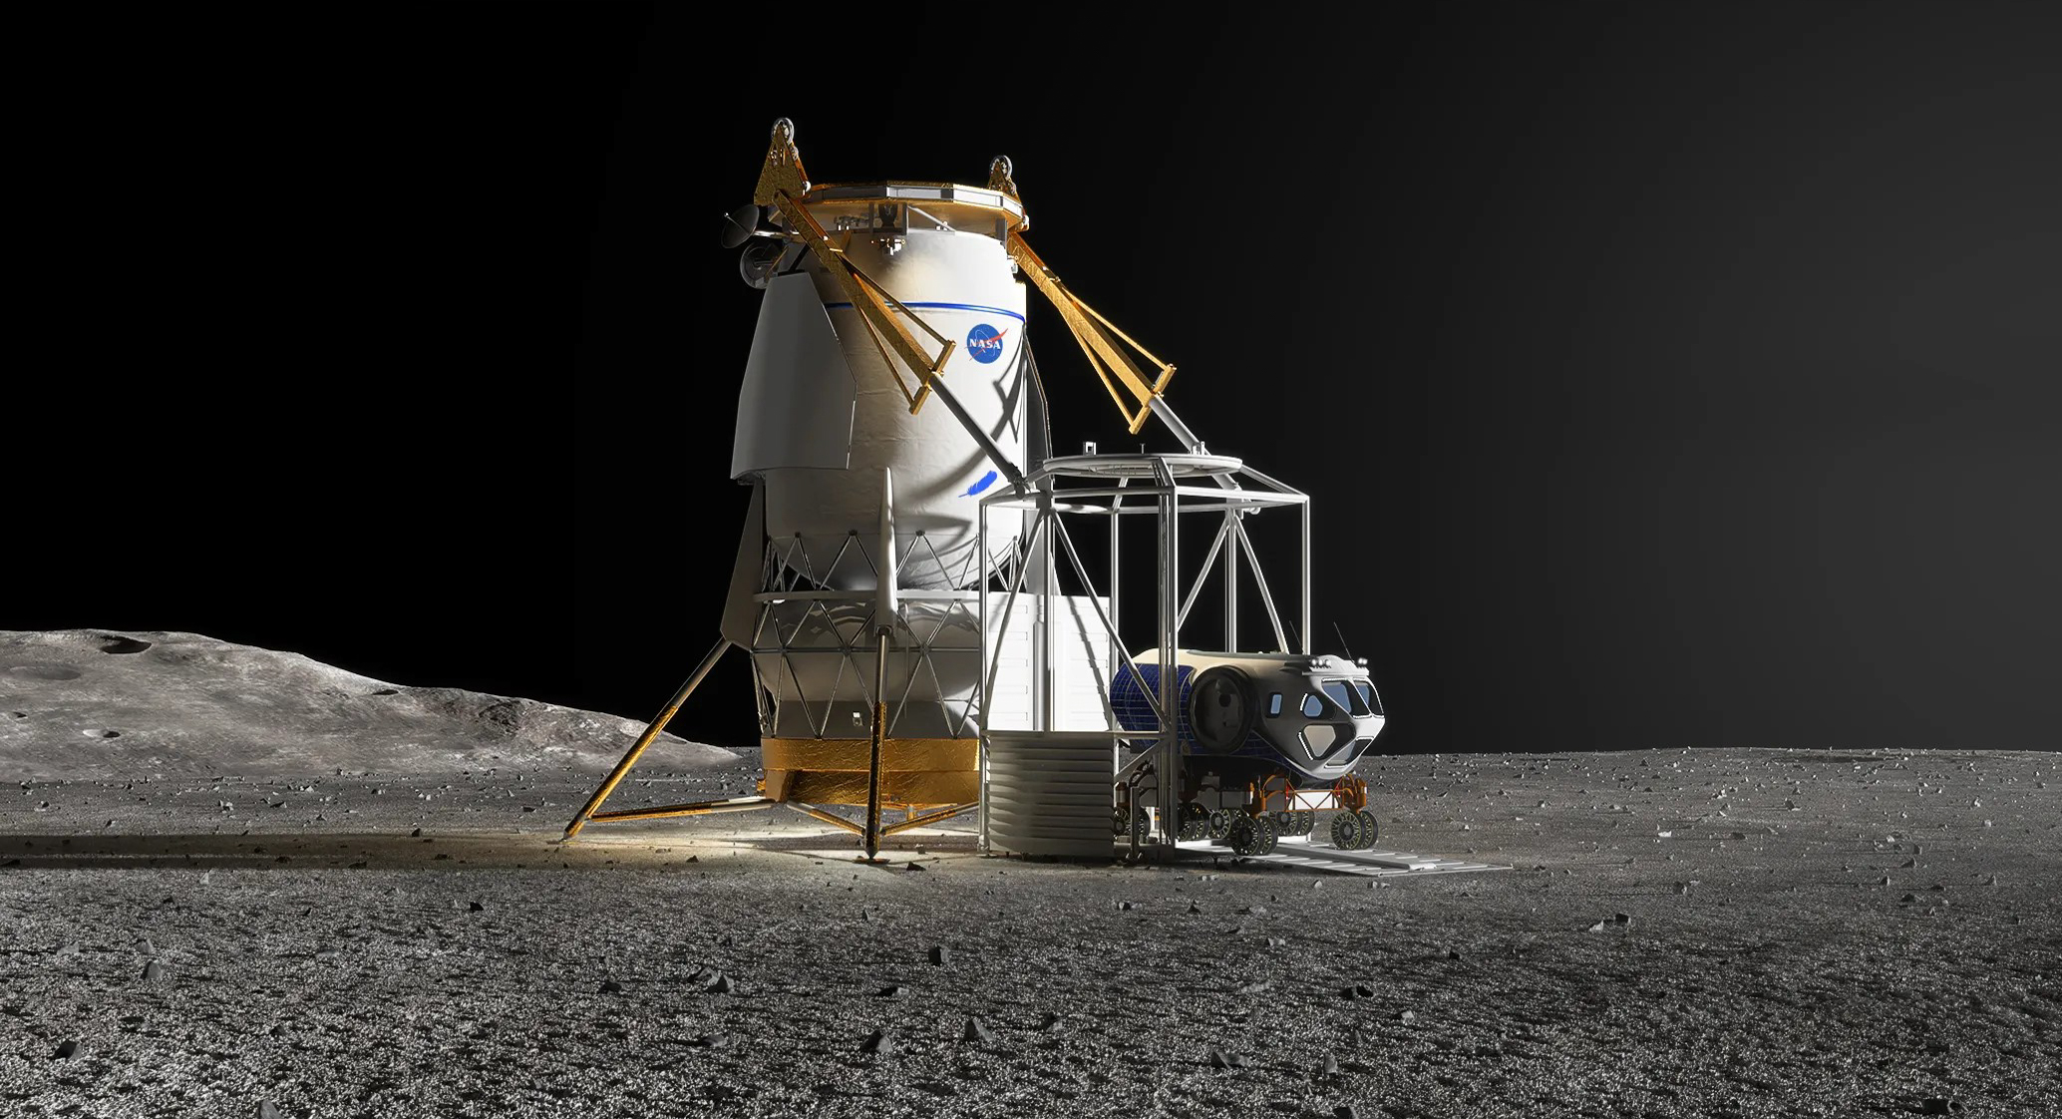
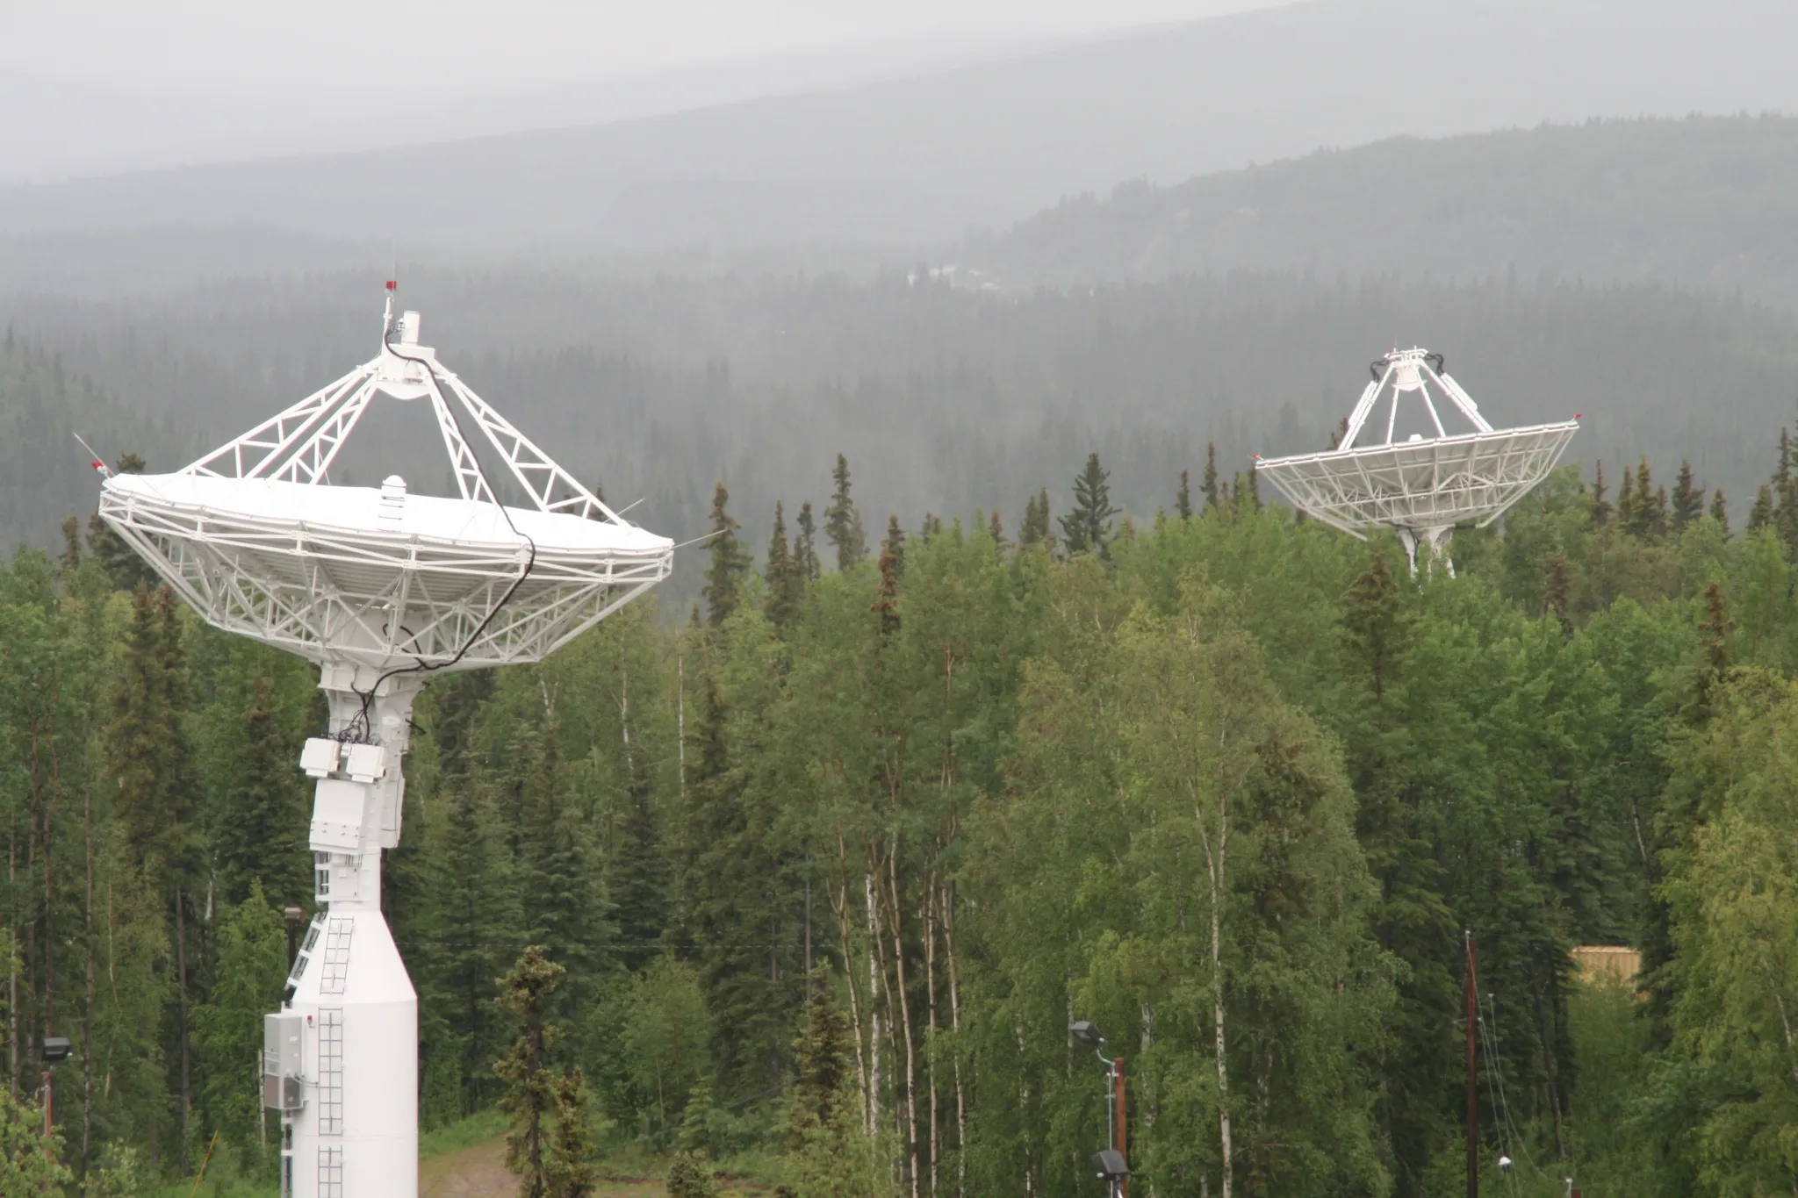
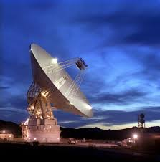
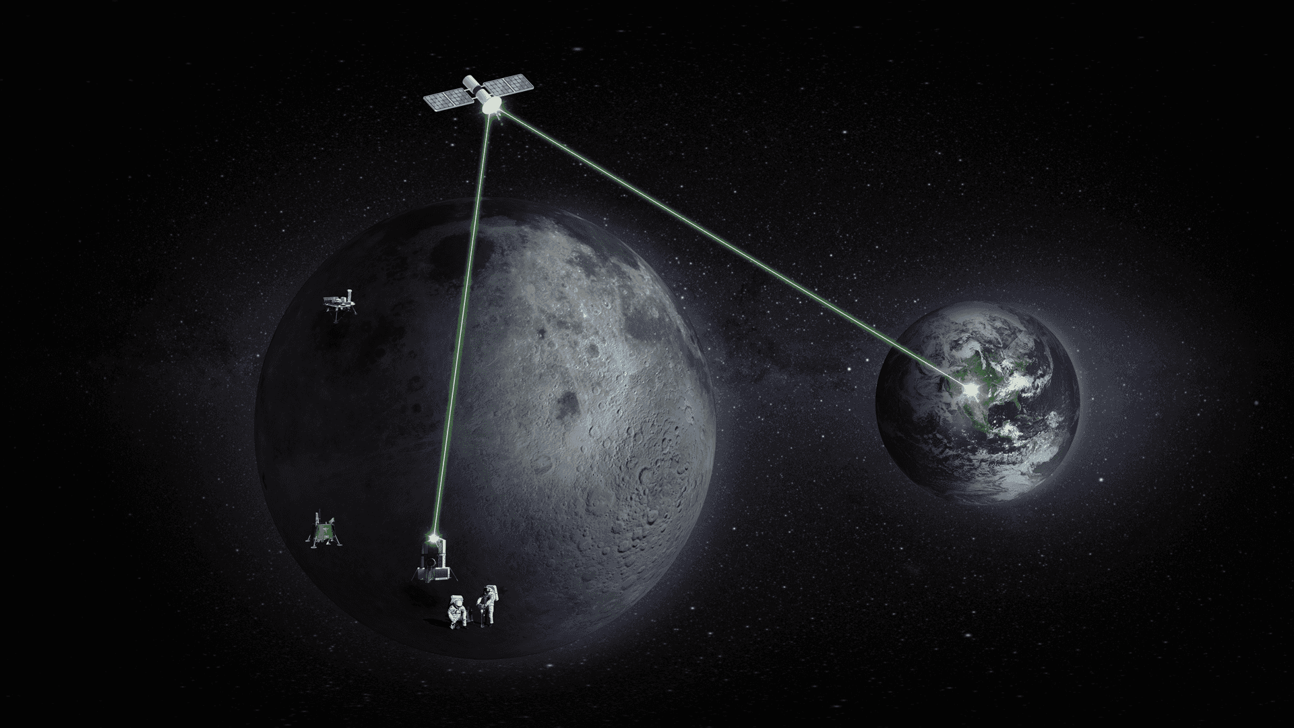
Architecture Components
Safety
Maslow’s Hierarchy
Survival
Maslow’s Hierarchy
Gateway
Power and Propulsion Element
Extra-vehicular Robotics System
Crew and Science Airlock
Lunar View
Module
International Habitat
Lunar Terrain Vehicle
Pressurized
Rover
Space Launch System
Exploration EVA Systems
Gateway Logistics Element
Future Segments
Human Landing System
SpaceX
Starship
Blue Origin
Blue Moon
Architecture Overview
Exploration Ground Systems
Orion
Spacecraft
Commercial Lunar Payload Services
Human-Class Delivery Lander
SpaceX
Starship
Blue Origin
Mark 2 Cargo
Near Space
Network
Deep Space Network
LCRNS
NSN / DSN
Segments
A portion of the architecture that integrates sub-architectures and progressively increases in complexity and objective satisfaction.
Sub-Architectures
A group of tightly coupled elements, functions, and capabilities that work together to accomplish one or more objectives.
Elements
A notional exploration system that enables a set of functions.
8
International
Partnerships
Canadian Space Agency
United Arab Emirates
European Space Agency
Japan Aerospace Exploration Agency

Slide 9

Data Systems and Management
The Data Systems and Management sub-architecture includes capabilities that work together to move, manage, and secure/protect data within acceptable latency constraints for use throughout the architecture. This sub-architecture is tightly coupled with the CPNT and human system sub-architectures to ensure data is shared and made useful across the architecture. Future capabilities may include data fusion, internet of things (IoT), cloud computing, and servers. The implementation of this sub-architecture spans from Earth systems, space, and planetary surfaces. Not all capabilities are expected to reside in-situ; each domain will include a mixture of assets.
Data systems and management play a pivotal role in modern information-driven landscapes. This area encompasses the intricate framework of tools, processes, representations, and technologies designed to capture, store, process, and retrieve data efficiently and securely. From small-scale payloads to large, complex mission sequences, effective data management across the Moon to Mars Architecture ensures that valuable insights can be derived from raw data, driving informed decision making and providing broad access as allowed.
These systems can consist of databases, their management systems, data warehouses, and data lakes that collectively organize and maintain data integrity. With the advent of big data, cloud computing, and advanced analytics, modern data systems not only handle structured information, but also embrace unstructured and semi-structured data formats. A robust data management strategy considers data availability, quality, interoperability, security, privacy, compliance, and access to ensure that we can harness the full potential of the expansive amount of lunar data, fostering innovation across the architecture.
Sub-Architecture Definition
Lunar Architecture
Definition: The group of capabilities that works together to transfer, distribute, receive, validate, secure, decode, format, compile, and/or process data and commands for use throughout the architecture. This includes future capabilities such as internet of things (IoT), cloud computing, servers, etc.
Architecture Definition Document (ADD)
Revision A — Section 1.3.2.1
9

Slide 10
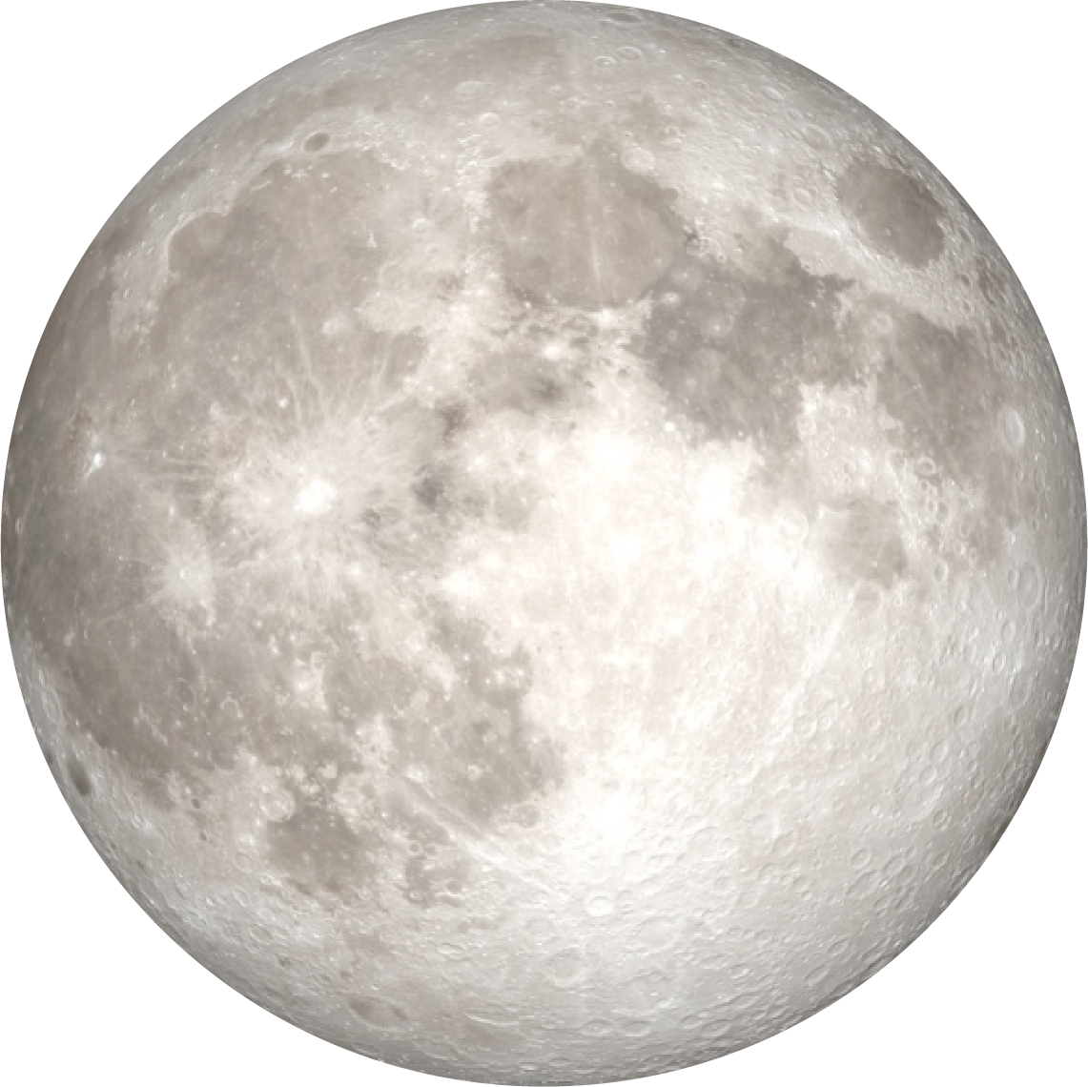



Data Expectations of Artificial Intelligence
Artificial Intelligence
The theory and development of computer systems able to perform tasks that normally require human intelligence, such as visual perception, speech recognition, decision-making, and translation between languages. (Oxford Dictionary)
Data
Lunar Architecture
Visual – imagery/video
Speech – audio
Decision – telemetry, commands
Processing
Perception – ocular/optics inputs
Recognition – acoustic matching
Decision analysis – data handling & pattern recognition
10

Slide 11
Example Functions Fulfilled by xEVA During HLR
ID | Functions | ID | Use Cases
FN-028-L | Conduct crew lunar surface extravehicular activity | UC-011-L | Support crew extravehicular operations on the lunar surface
 |  | UC-014-L | Deploy and setup utilization payload(s) on the lunar surface with long-term remote operation
 |  | UC-024-L | Crew excursions to locations distributed around landing site
 |  | UC-025-L | Crew extravehicular explorations and identification of surface samples
 |  | UC-026-L | Collect surface samples from non-PSRs and sunlit regions
 |  | UC-030-L | Collect surface samples from PSRs
 |  | UC-033-L | Deploy and set up Heliophysics utilization payload(s) on the lunar surface with long-term remote operation
 |  | UC-034-L | Collect sub-surface samples from non-PSRs and sunlit regions
 |  | UC-041-L | Deploy and set up fundamental physics utilization payload(s) on the lunar surface with long term remote operation
 |  | UC-063-L | Deploy and set up physics utilization payload(s) on the lunar surface with long term remote operation
 |  | UC-111-L | Collect sub-surface samples from PSRs
 |  | UC-124-L | Deploy and set up plasma utilization payload(s) on the lunar surface with long term remote operation
 |  | UC-134-L | Deploy and set up demonstration ISRU utilization payload(s) on the lunar surface with long-term remote operation
 |  | UC-142-L | Deploy and set up autonomous construction demonstration utilization payload(s) on the lunar surface with long-term remote operation
 |  | UC-144-L | Deploy and set up advanced manufacturing demonstration utilization payload(s) on the lunar surface with long-term remote operation
 |  | UC-159-L | Deploy and setup of utilization payload(s) related to available resources on the lunar surface with long term remote operation
 |  | UC-169-L | Deploy and set up assets to monitor natural environments on the lunar surface
 |  | UC-171-L | Deploy and set up assets to monitor induced environment on the lunar surface
FN-202-L | Provide common data interface on the lunar surface | UC-085-L | Utilize common interface(s) for data transfer and distribution
Lunar Architecture
EM-007-HLR
xEVA System
11
From ADD Rev-A.

Slide 12












EVA Suit Display Features Derived from Use-Cases
    Annotation of Photos, Videos
    Procedures
    Navigation
    Photo Viewfinder
    Real-time MCC Updates
    AR Graphics and Cues
Lunar Architecture
    Consumables in a Graphical Format
    Crew and MCC Messaging
    Science Tool Interfacing
    Timeline Monitoring
12

Slide 13
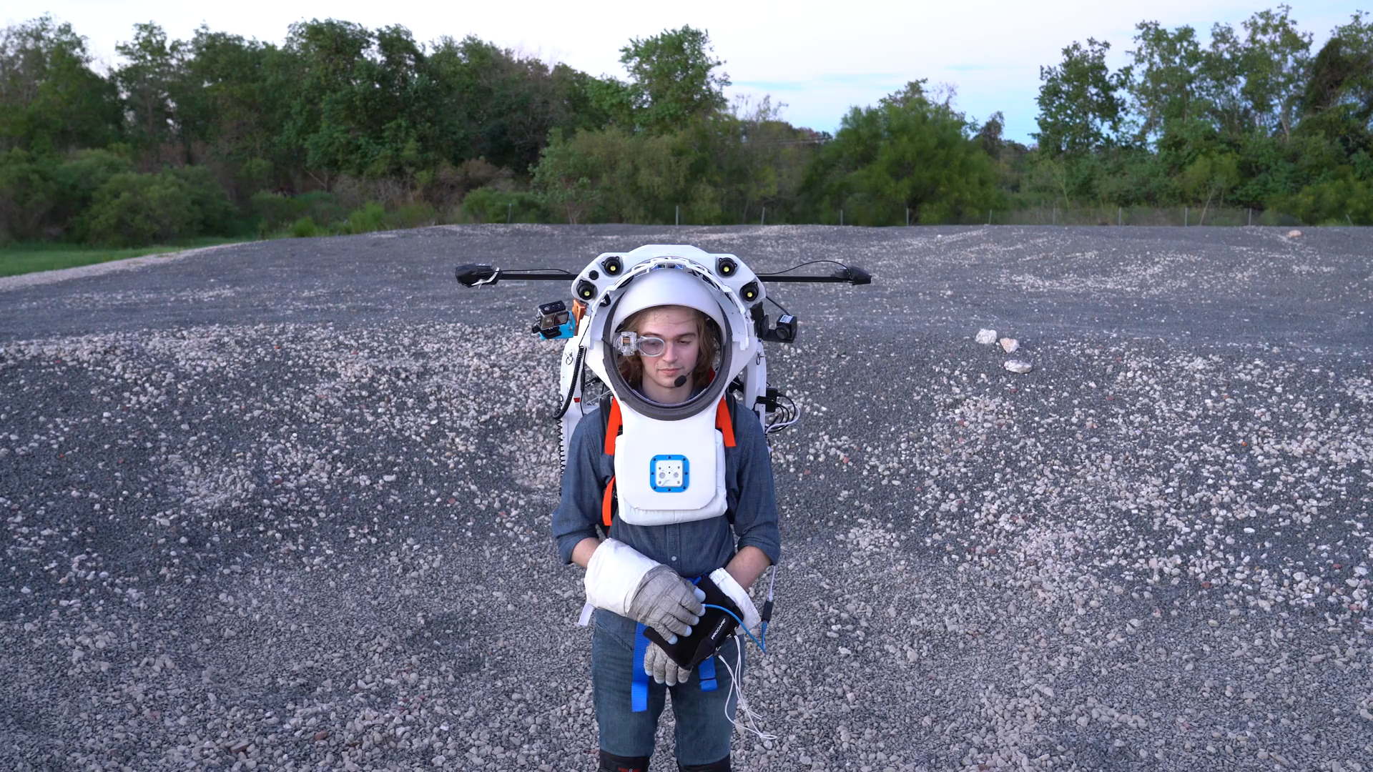
Joint Augmented Reality Visual Informatics System (Joint AR)
Lunar Architecture
13

Slide 14
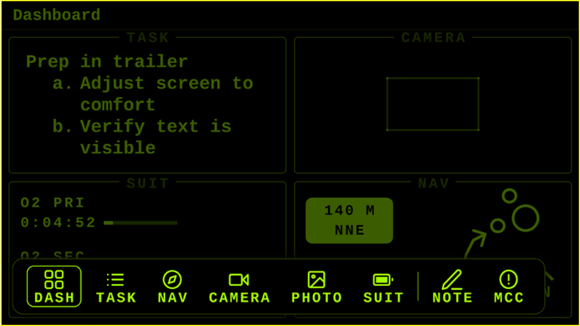
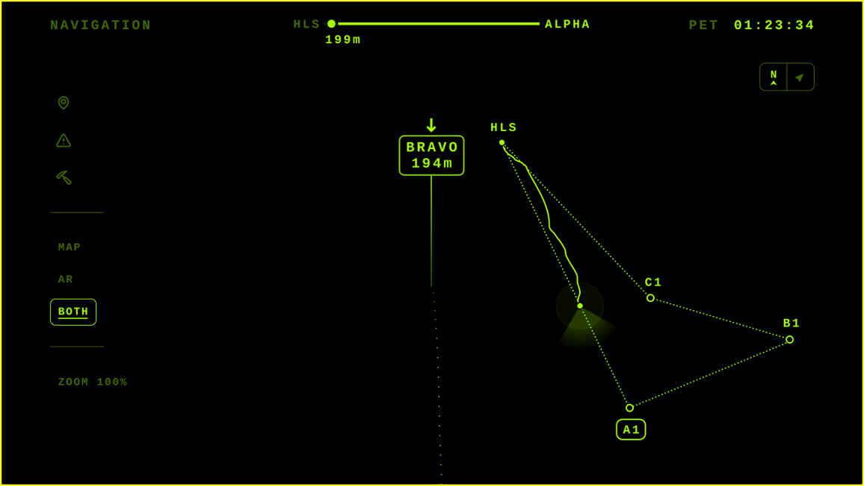
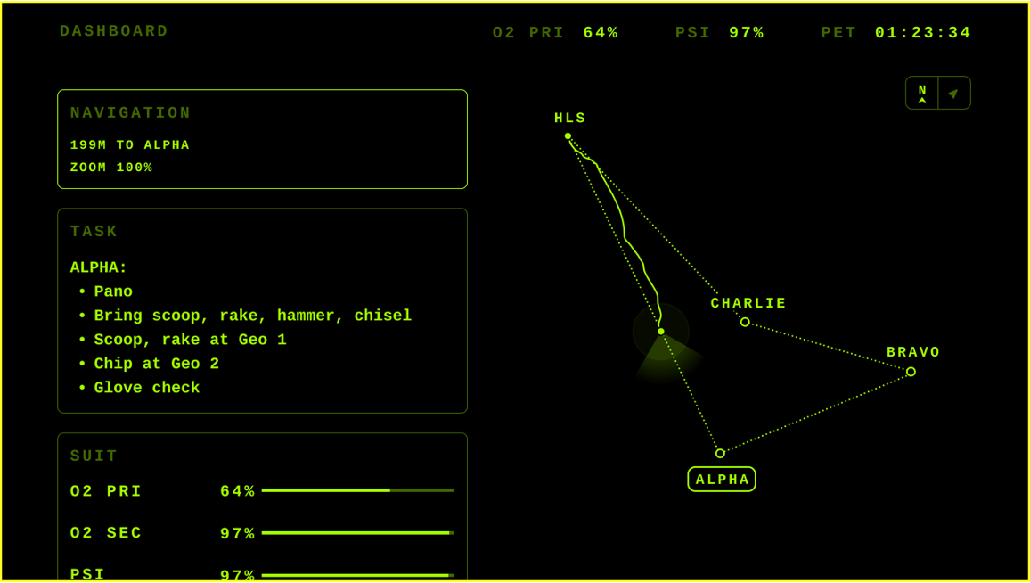
Display Use-Cases & Interface
Lunar Architecture
14

Slide 15
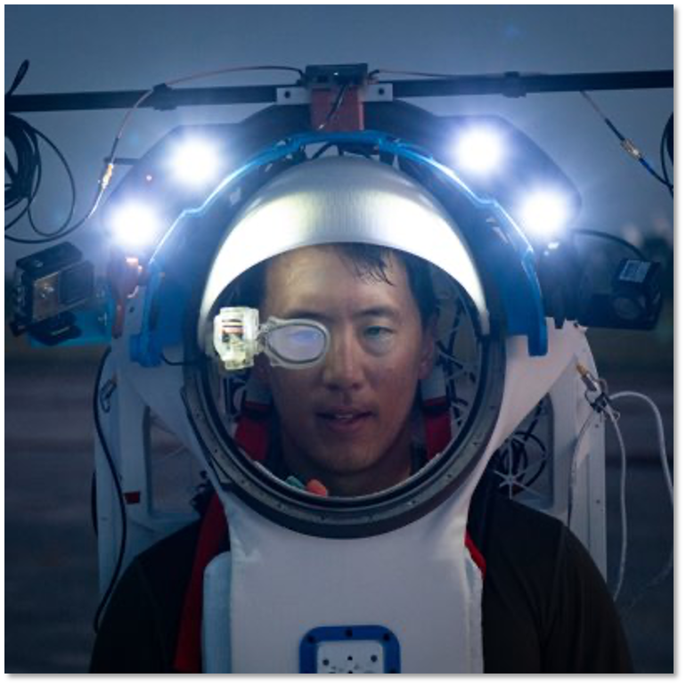
The Novel Problem Spaces
Graphics and flight software must be safety-certifiable per NASA Software Standard (NPR.7150) and able to support constrained processor (possibly GPU-denied) platforms.
With an environment consisting of a cosmic radiant flux several times larger than LEO, the lunar surface represents the most challenging environmental conditions for human-consumable display and compute technology to ever undertake.
These are just the beginning challenges for traditional software and basic display and graphic needs. When introducing larger data sets, training algorithms, and non-deterministic software, it is important to consider how those may fit into the larger certification process.
Lunar Architecture
15

Slide 16
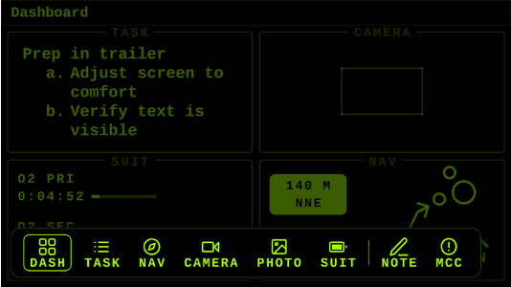
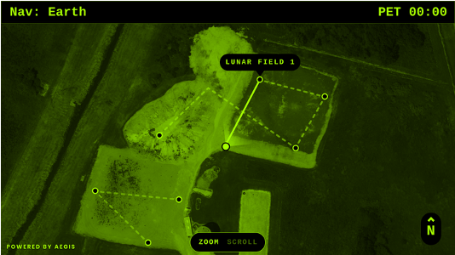

STAR Graphics Engine
Space Technology Application Renderer (STAR) is a low-power, high-performance, zero-dependency graphics engine developed by NASA for next-generation human exploration missions.
The problem motivating the STAR’s development was the need for a an extremely lightweight, high-performance, platform-agnostic, low-power spacesuit graphics augmented reality engine capable of class A, safety-critical display needs and fault-mitigation techniques.
No AI techniques were used for STAR, but this is an example of the need for custom software for complex computation tasks in the constrained flight computer environment.
Lunar Architecture
STAR Engine on the
NASA Software Catalog
US-Only Source Code Release
https://software.nasa.gov/software/MSC-27550-1
16

Slide 17
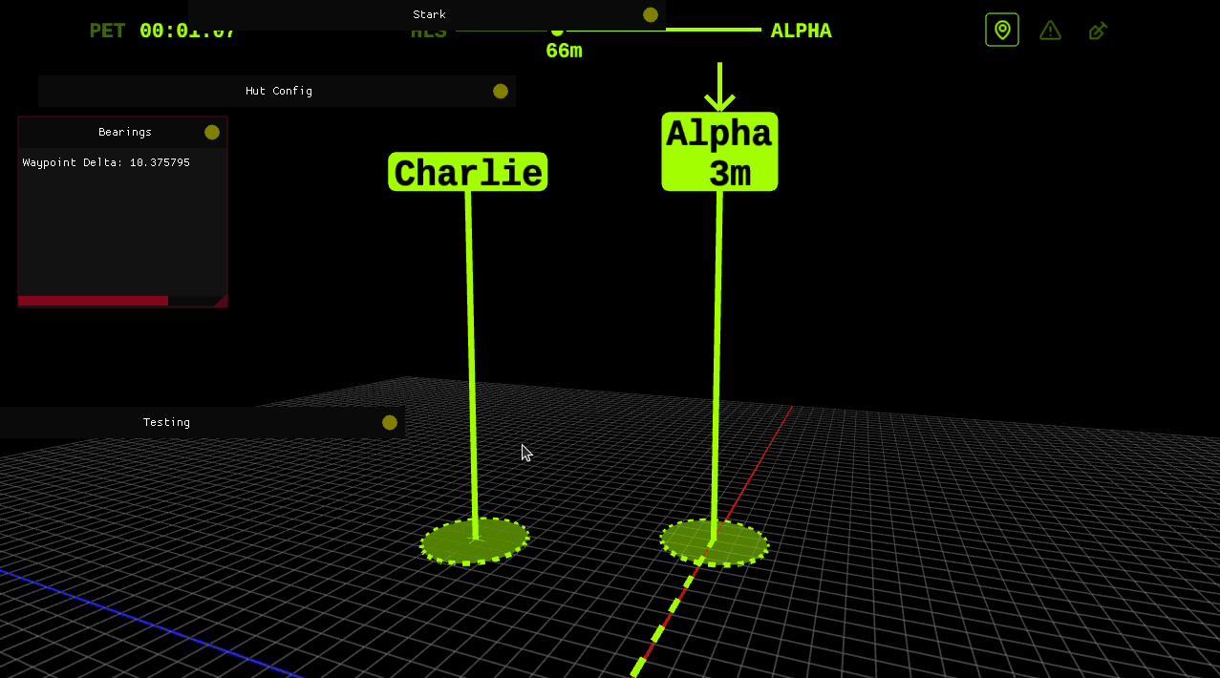
STAR in Action
Lunar Architecture
17

Slide 18
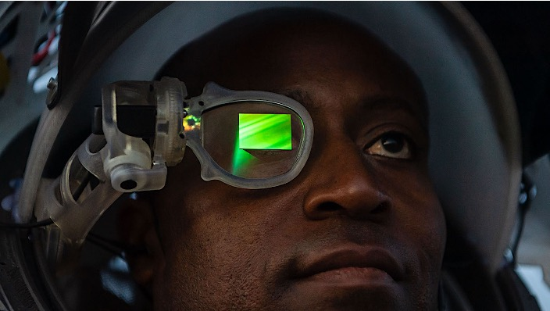
Looking Forward
Consider the criticality for the functions and use-cases you choose to solve using AI.
Consider creative custom solutions for early AI on limited compute and certification processes for human spaceflight.
Build solutions with context to the end goals and objectives.
Please contribute your expertise on gaps, shortfalls, and feedback to the Moon to Mars Architecture Description Document (ADD).
Lunar Architecture
18

Slide 19
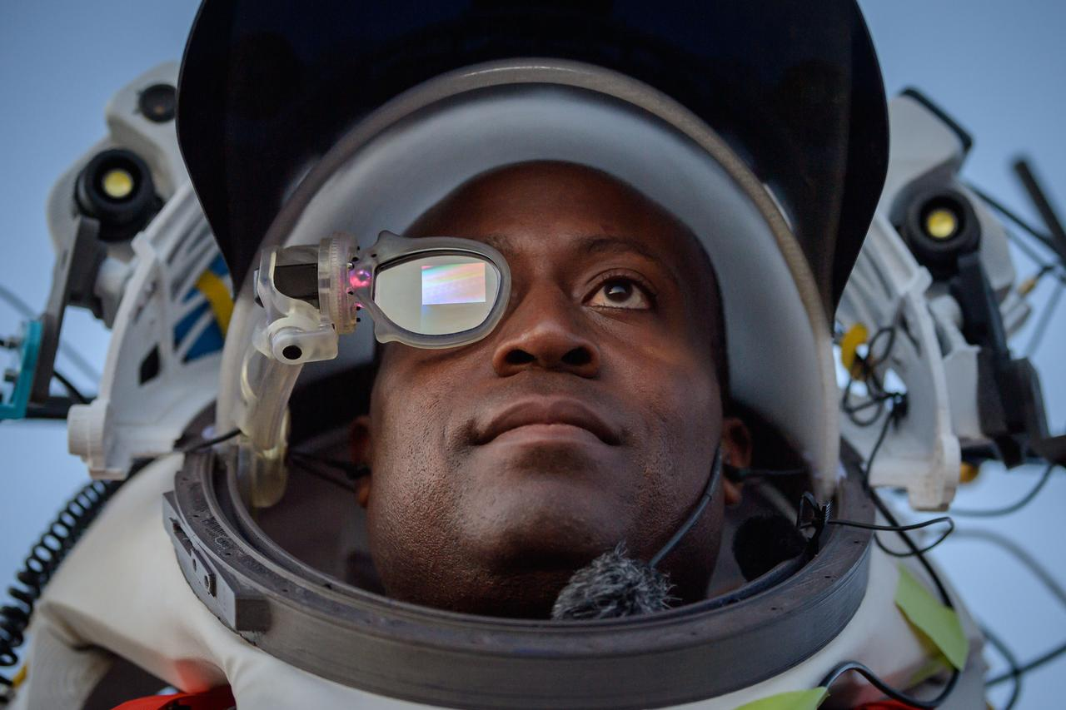
EVA Spacesuit Displays Effort
NASA astronaut Andre Douglas wears AR (Augmented Reality) display technology during an advanced technology run in the San Francisco Volcanic Field in Northern Arizona on May 21, 2024. The monocular lens consists of a pico-projector and waveguide optical element to focus an image for crew to see their real world overlaid with digital information. These unique near-eye form factors may be used to improve the usability and minimally impact the complex biomechanics of working in a pressurized suit environment.
Lunar Architecture
19

Slide 20




Learn More
Joint Augmented Reality Visual Informatics System Concept of Operations
November 2023
Trades, Architecture, and Design of the Joint Augmented Reality Visual Informatics System (Joint AR) Product
July 2023
Lunar Architecture
Using Virtual Reality to Envision Deployment of Spacesuit-Compatible Augmented Reality Displays for Lunar Surface Operations
July 2023
Realizing a Spacesuit Compatible Augmented Reality System to Meet the Work Needs of Future Human Spaceflight Exploration
October 2022
20

Slide 21
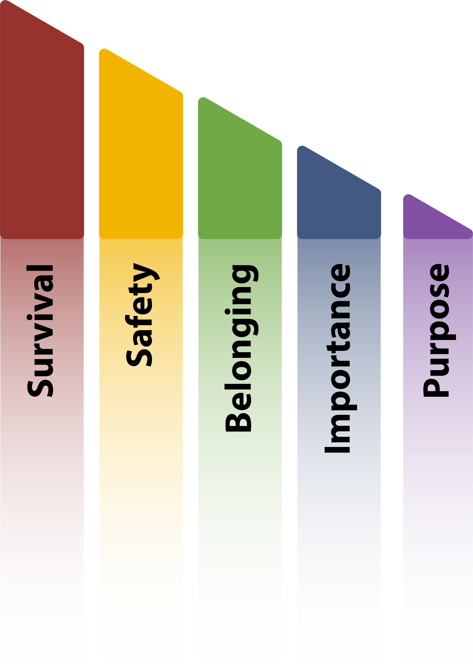
Key Takeaways
The process of architecting from the right allows NASA to address Maslow’s Hierarchy of Needs for crew exploring deep space.
Artificial Intelligence can help NASA to meet gaps in the architecture, empowering astronauts and systems at distant destinations.
The spacesuit display development effort is one example of a potential use case for artificial intelligence within the architecture.
There are many considerations that must be accounted for as the architecture evolves to support artificial intelligence. Consider where along the segment timeline your implementations fall (Human Lunar Return, Foundational Exploration, Sustained Lunar Exploration, Humans to Mars).
Further work and study on artificial intelligence applications is needed before implementation.
Conclusions
21

Slide 22
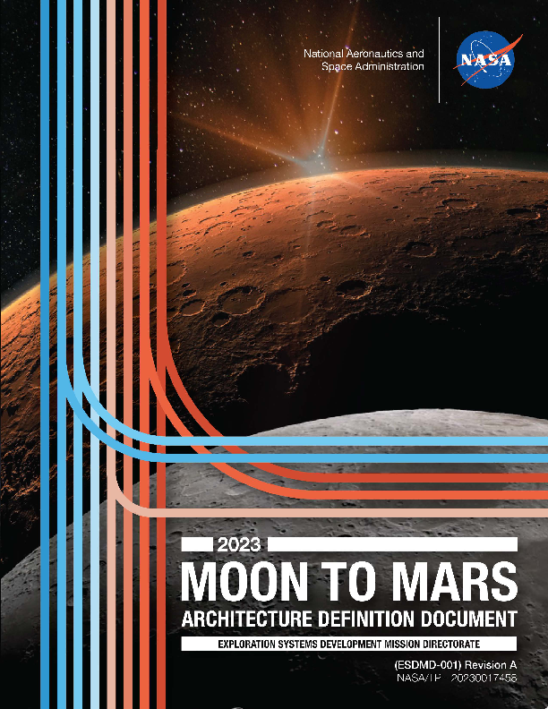
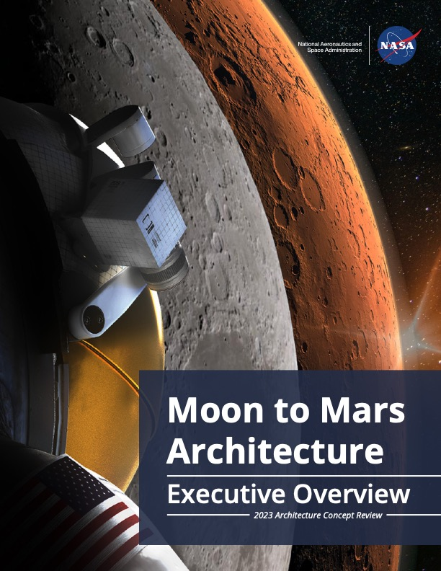
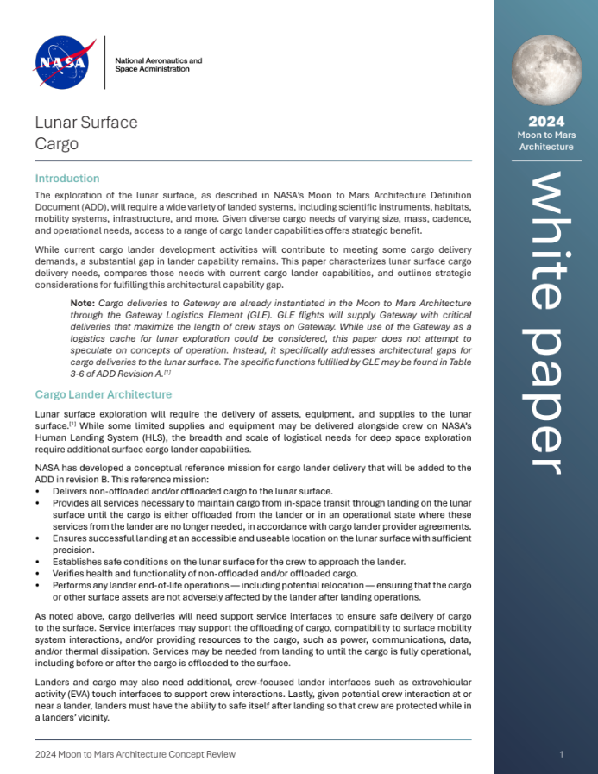

Get Involved in Architecture
Architecture Overview
nasa.gov/architecture
Architecture Definition Document
Revision A (ADD Rev-A)
Moon to Mars Architecture
Executive Overview
White Papers
(19 as of May 2024)
22

