Slide 1
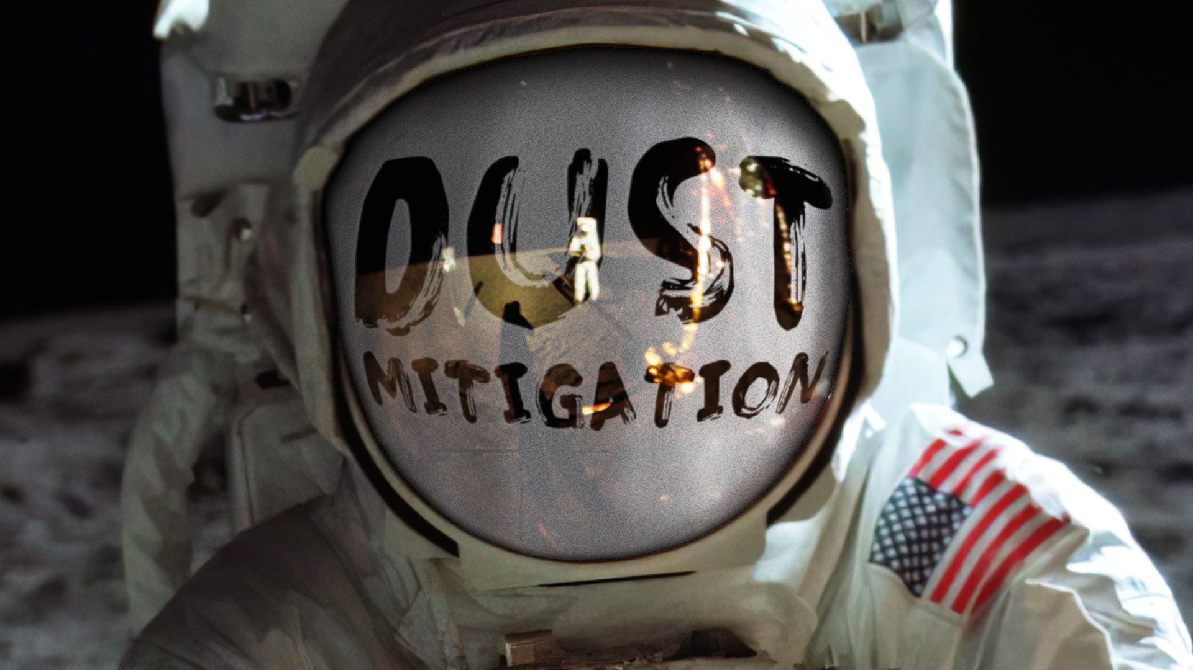

Slide 2


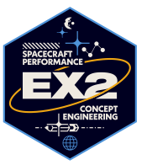

Advancements in
Lunar Dust Mitigation
Ronald Lee
Gateway Lunar Dust Transport Modeling Lead
Kristen John, Ph.D.
Technical Integration Manager
Lunar Dust Mitigation
NASA Space Technology Mission Directorate
Amy Fritz
Gateway Dust Mitigation Subsystem Manager
Approved for Public Release

Slide 3
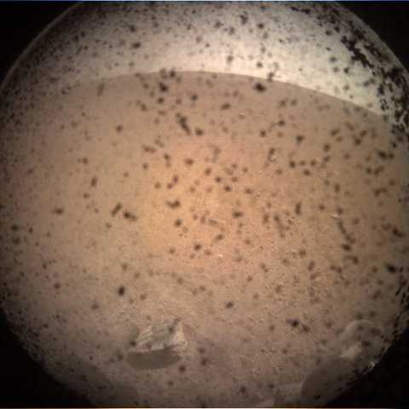
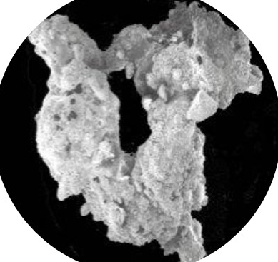
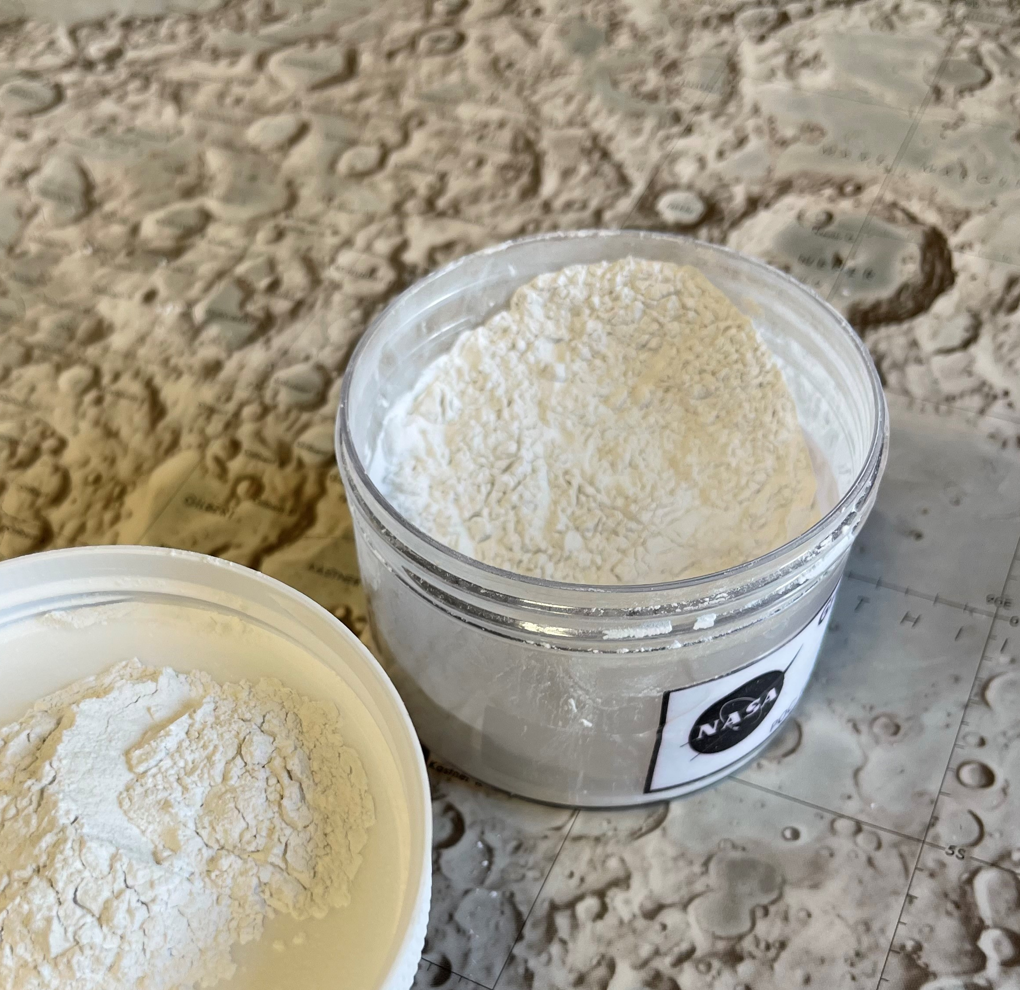
Agenda
Who’s Who
Dust, the dust problem, and dust mitigation
Defining “dust”
NASA’s Perspective
Experiments, Payloads, and Technology
Engagement

Slide 4
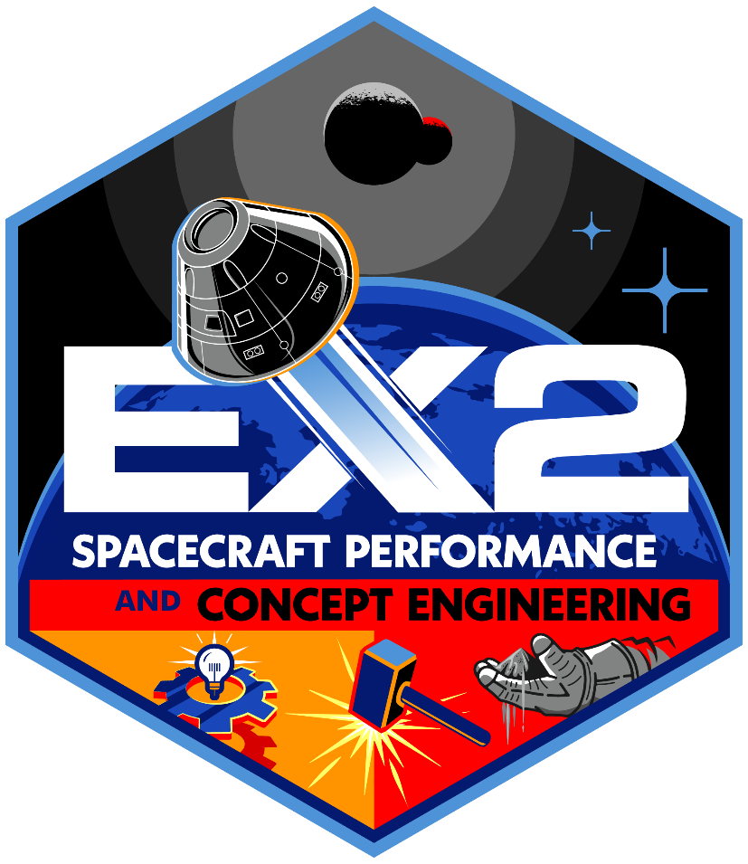



Dust Mitigation Leadership at JSC
EX2 Branch Leads Dust Mitigation at JSC and NASA
STMD Technical Integration Manager/Acting Dust Mitigation and Environments Architect
HLS SE&I System Manager
HLS Crew Compartment System Manager
Gateway System Manager
EHP LTV System Manager
EHP PR System Manager
Dust Testing and Modeling at JSC
Gateway Induced Environments
JSC Engineering

Slide 5
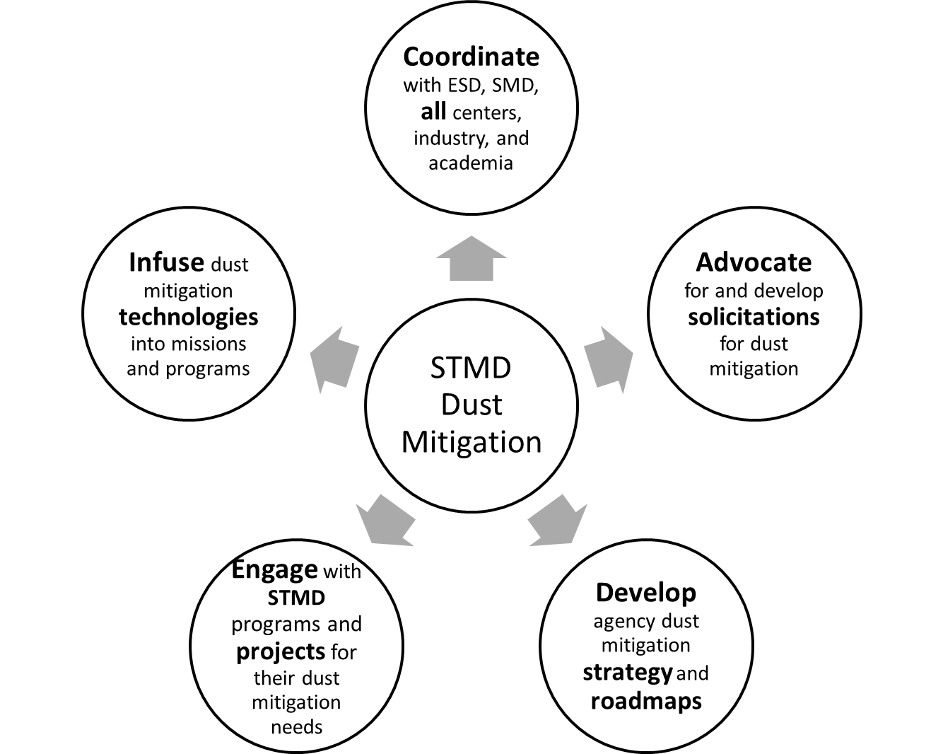
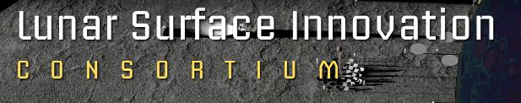
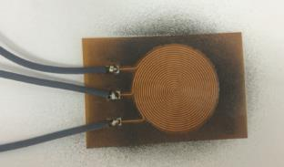
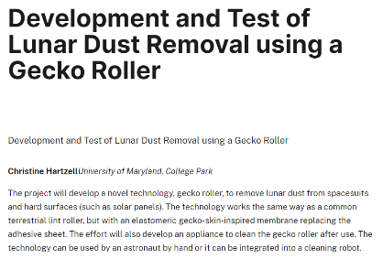
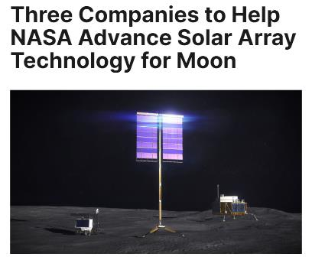
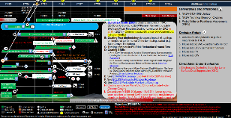
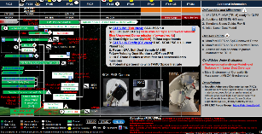
STMD and Dust
Space Technology Mission Directorate = STMD

Slide 6
Agenda
Who’s Who
Dust, the dust problem, and dust mitigation
Defining “dust”
NASA’s Perspective
Experiments, Payloads, and Technology
Engagement

Slide 7
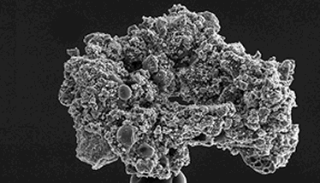
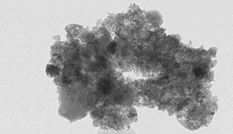
Assumption
You are already aware of the dust and that dust will be a problem…
But in case you’re not…
Courtesy of LeHigh University, Department of Materials Science and Engineering
7

Slide 8
Why is dust such a problem?
Electrostatic and ferromagnetic in an environment with no natural grounding… so it sticks to anything carrying a charge.
Fine-grained, with a significant fraction that is smaller than the human eye can resolve... so visibly clean isn’t clean.
Jagged, so it scratches and abrades everything from suit fabrics to human lungs.
Widely varied - we only really know about the composition of dust in the places we’ve been.
Unpredictable - behavior of lunar dust in space is governed by different forces than on earth.
Difficult to analyze because the behavior can’t be replicated without low gravity and zero atmosphere, making model validation difficult.

Slide 9
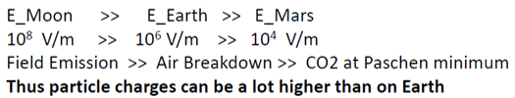
Electrostatics 101
Courtesy of Charlie Buhler (KSC)
Common Electrostatics Misconceptions!
  Non-stick surfaces do not attract dust (Teflon) (FALSE)
  Metals do not tribocharge (FALSE)
  Like materials do not tribocharge (FALSE)
  Disturbed dust is uncharged (FALSE)
  There’s only one sign of charge on the dust particles (FALSE)
  Insulator-insulator contact charging is well understood (FALSE)
What do we know about the electrostatics environment of the Moon?
  The particles are good dielectrics (permittivities between 2-3) and resistivities (ρ above 10¹³ Ωm) and are most likely charged (positive and/or negative) or net zero total charge (bipolar).
  The surface of the Moon is also a dielectric (no electrical ground).
  Very, very dry – no moisture to allow charge decay
  The allowed electric field is much higher than the Earth and Mars

Slide 10
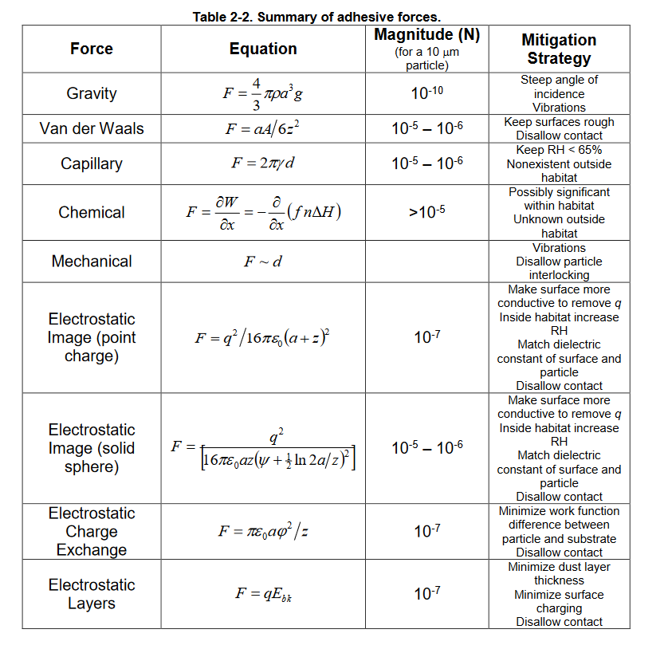
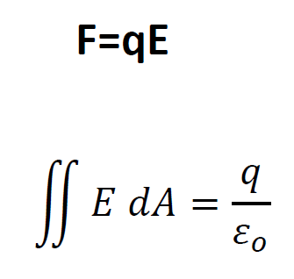
Forces on Dust
The forces acting on dust are well known but complex, time-dependent, multi-disciplinary and work on the level of single particles.
In terrestrial environments, many of these effects are overwhelmed by gravity and atmosphere.

Slide 11
Assumption
Loss of traction
abrasion
false instrument readings
vision obscuration
inhalation and irritation
failure of seals
clogging of joints and mechanisms
thermal control problems
You know that Apollo alerted us to some of the challenges from the dust
But in case you’re not…
Reference: NASA/TM—2005-213610
The Effects of Lunar Dust on EVA Systems During the Apollo Missions by James R. Gaier

Slide 12
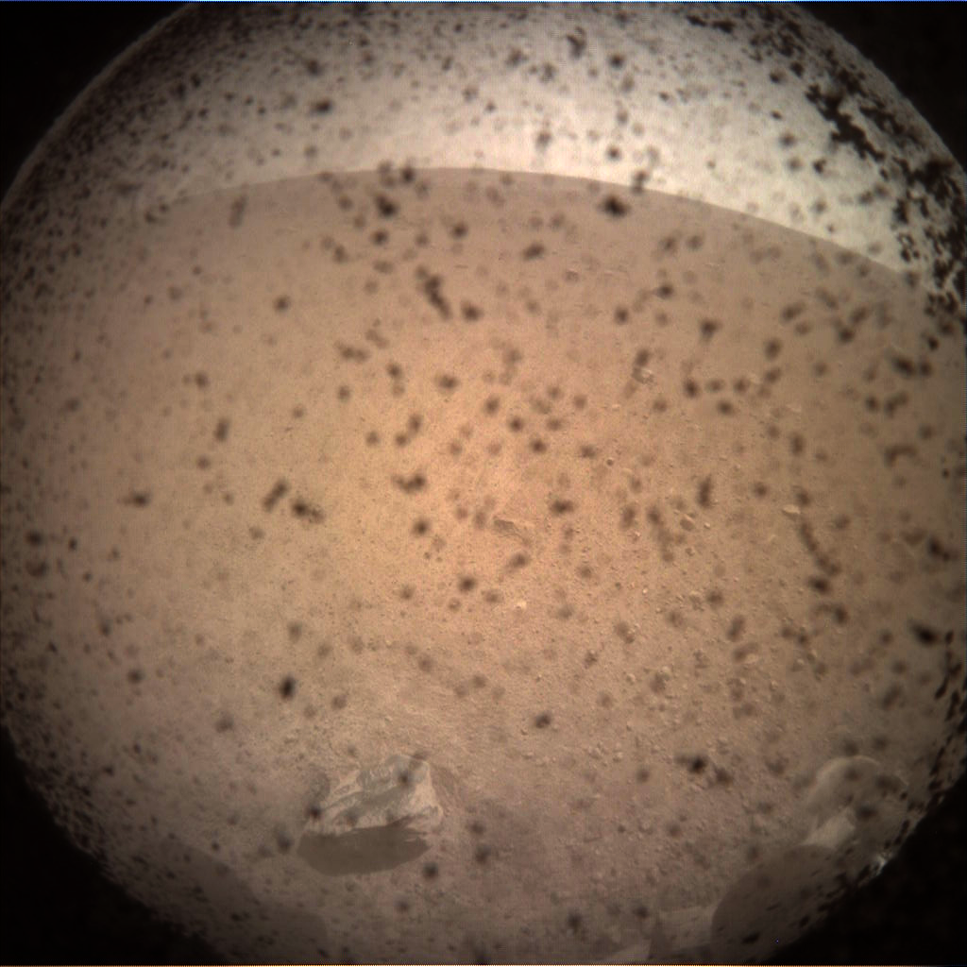
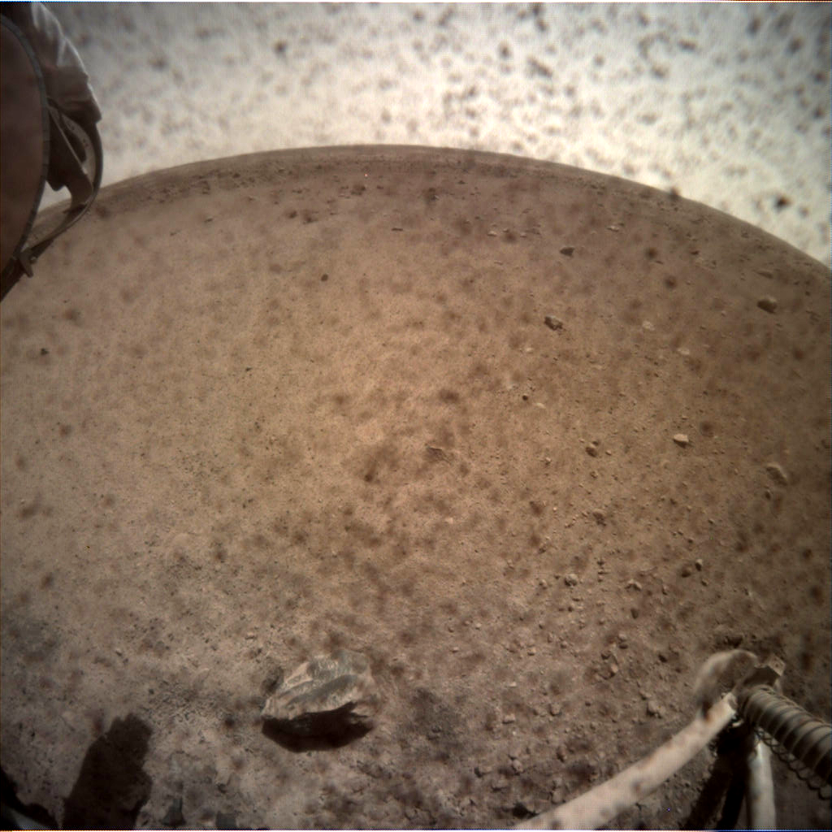
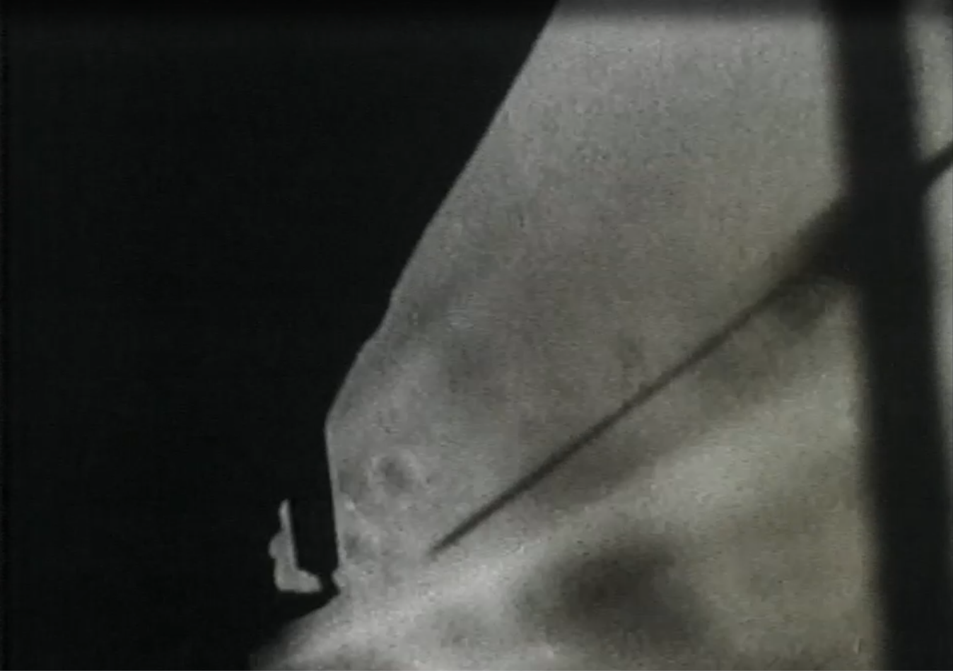
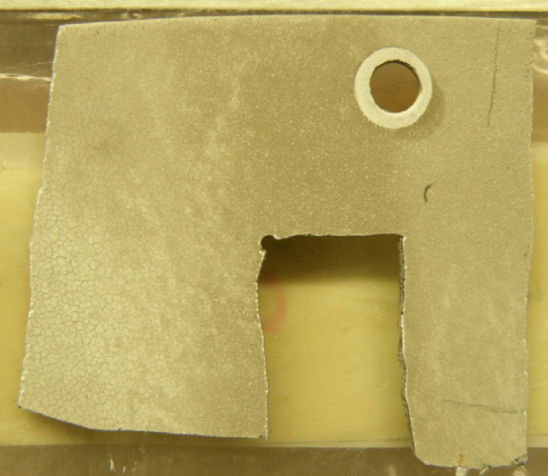
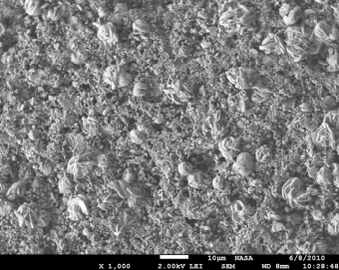
Assumption
You are already aware of the potential impacts from plume surface interactions (PSI)
But in case you’re not…
  Plume-surface interactions (PSI) occur when a rocket engine exhaust (or other gas jet) interacts with a planetary surface
  PSI effects will be a large contributor for lunar dust accumulation on any descending vehicle
  Regolith ejecta poses a hazard to spacecraft and to surrounding assets
  Mars Insight - Material breached lens cover
Ejecta streams visible during Apollo 11 landing
  Apollo 12 landed near Surveyor 3; Scouring, pitting and cracking on Surveyor material coupon & SEM image (See Immer et al. 2010)
      Good resource: Mehta et al. 2011, Rocket Plume Interactions for NASA Landing Systems

Slide 13
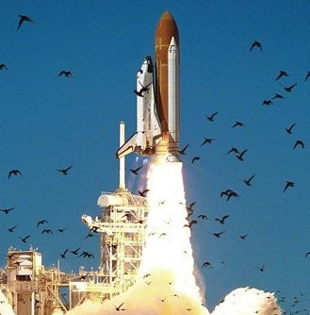
“When large systems fail, it is due to multiple faults that occur together in an unanticipated interaction, creating a chain of events in which the faults grow and evolve.”
Source: National Academy of Sciences,
Why do errors happen?
ncbi.nlm.nih.gov
Examples in history:
Columbia, Challenger, Three Mile Island
Interesting reads: Henry Petroski – To Engineer is Human & Design Paradigms

Slide 14
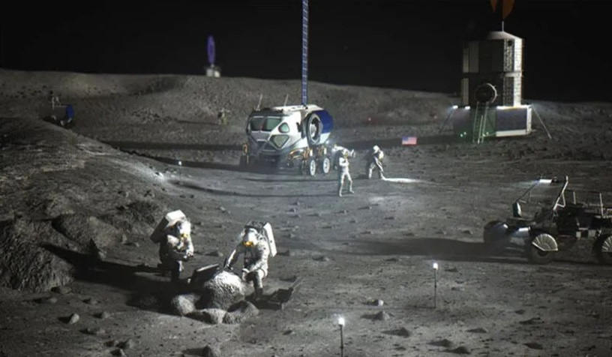
A confluence of environmental factors
How does dust impact hardware?
Power
Dust accumulation on solar panels leads to reduction in available power.
Communications
Communication equipment can be covered in dust.
Thermal
Optics
Dust coats thermal radiators and equipment increases in temperature.
Optics concerns include accumulation on cameras/optics as well as concerns for thermal optical properties (transmittance, reflectance, and absorptance).
What to do about it?
NASA-STD-1008 provides guidance on how to test for this. (Sections on dust testing for thermal & optical testing.)
The Best Practices “Guidebook” discusses potential solutions to mitigate these challenges.
Notes:
Illumination too

Slide 15
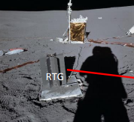
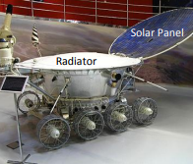
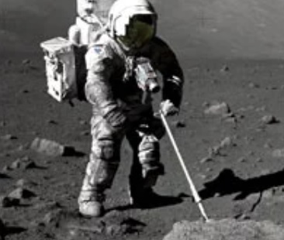
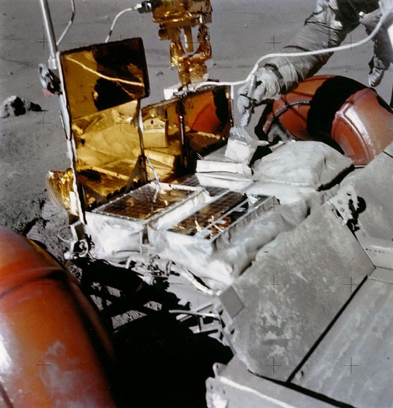
Another one bites the dust
Lessons learned from the surface…
Apollo astronauts could not avoid getting dust on deployed ALSEP Experiments
Lunokhod 2 robotic rover only lasted through 4 lunar temperature cycles
Dust was a problem on the space suits, communications, TV cameras, and other equipment
Dust accumulated on the radiators of the battery for the LRV of Apollo 16
The Apollo astronauts encountered marked degradation of performance in heat rejection systems for the lunar roving vehicle, science packages, and other components. – Jim Gaier
An insulating layer of dust on radiator surfaces could not be removed and caused serious thermal control problems. NASA/TM—2005-213610

Slide 16
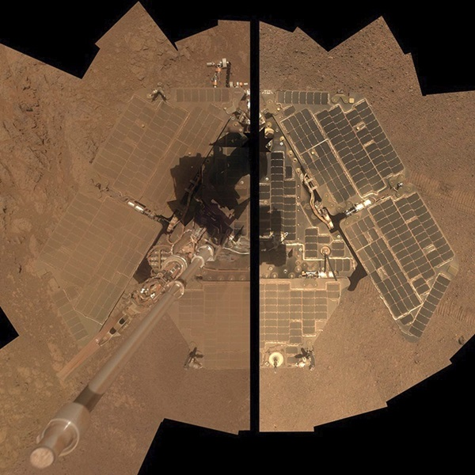
Lunar Dust on Power & Thermal Systems
  Power connectors & heat exchangers → internal clogging, scratching
  Heat rejection/radiators → performance degradation, lower efficiency, system overheat
  Reflective and other surfaces → compromised by excessive dust, mirrors obscured
  Power generation/solar arrays → solar thermal conversion effects such as heat absorption, reduced power output
  PV arrays, cells, sensors → reduced power output, lower efficiency
    Modeling and ground-based analysis shows power output from PV cells is cut in half by a covering of less than 3 mg/cm²; measurements from the Sojourner rover on Mars found that PV cells lost efficiency of 0.28%/day owing to dust deposition.
Mars Opportunity Rover

Slide 17
Did radiators degrade during Apollo?
Yes!
Apollo 12 Temperatures measured were approximately 68 °F higher than expected (3-16)
Apollo 15 LRV batteries ran 68 to 78°F high because dust accumulation on radiators (94)
Apollo 16 Instrument performance degraded by overheating due to dust on radiators (4-10, 4-19)
Apollo 16 Dust on Lunar Rover battery mirrors caused overheating (9-42)
Apollo 17 Instrument shut down when terminator passing to mitigate dust collection (15-29)
NASA/TM—2005-213610
Notes:
3-16
94
4-10, 4-19
9-42
15-29

Slide 18
So you’re going to the surface?
It sure would be nice if you had a…

Slide 19
Dust Mitigation Strategy
Understand Natural Environment
Understand Induced Environment
Understand Tolerance to Dust
Develop Environmental Requirements for Limiting Dust
Select Dust Mitigation Solutions
Test Hardware in Dusty Environment

Slide 20
Dust Mitigation Strategy
Architectural Solutions
Operational Solutions
Passive Technologies
Active Technologies
Dust management
  Tolerating dust exposure
  Detecting/monitoring dust
  Controlling entry of dust into vehicles/systems
  Removal of dust

Slide 21
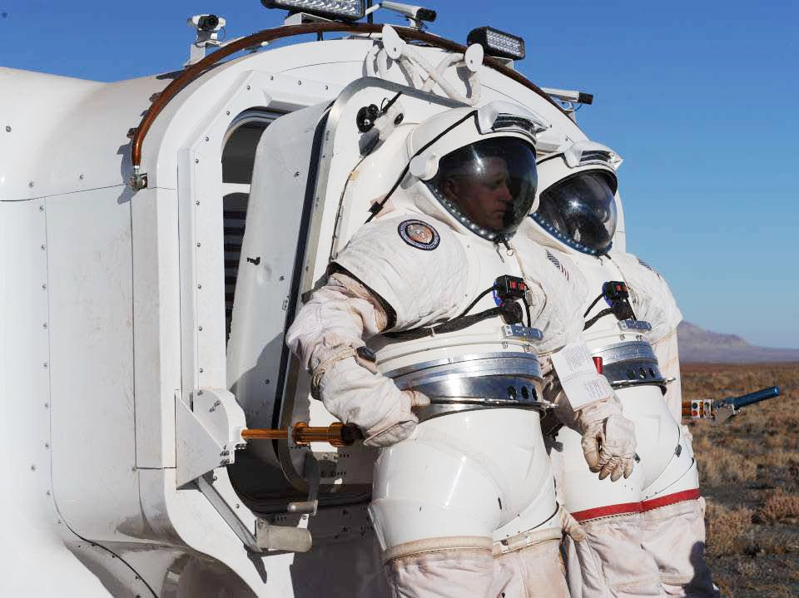
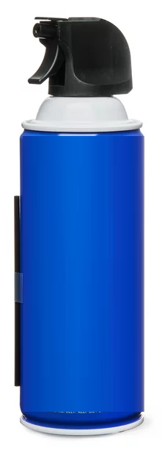
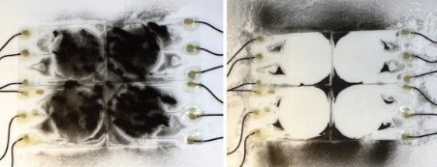
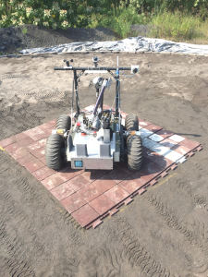
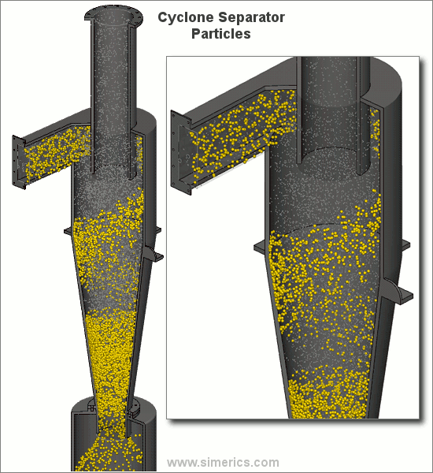
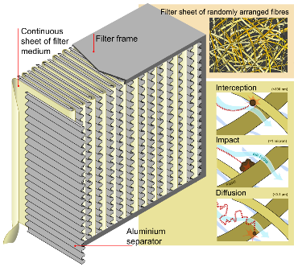
Dust Mitigation Solutions
Architectural Solutions
Operational Solutions
Passive Technologies
Active Technologies
  Active technology solutions:
  Electrostatics
  Compressed air
  Vacuums
  Electrodynamic dust shield
  Passive technology solutions:
  HEPA filters
  Cyclone separators
  Softwalls
  Low-energy surface coatings
  Coveralls/aprons/covers
  Dust tarps
  Brushes
  Tape
  Wipes
  Architectural & Operational solutions:
  Suitports
  Severable airlocks
  Mud-rooms
  Porches
  Landing Site Selection
  Prepared Landing Pad
  Optimized EVA and traverse planning
Notes:
Affected Assets:
Surface operations, habitats, descent/ascent, and orbital assets
Affected Systems:
Most surface systems, subsystems, and equipment

Slide 22
Dust Mitigation Technology “Swimlanes”
Dust Tolerant Components
Dust Tolerant Mechanisms, Seals, Bearings, Joints
Covers
Passive Solutions
Coatings
Materials
Active Solutions
Electrostatics
Compressed air
Dust Measurements
Sensors
Models
Experiments
Characterization
Filtration
Vacuums
etc
etc
etc
etc
Active mitigation: Mitigation measure that require human intervention (or power) to operate properly (FEMA)
Passive mitigation: Mitigation measures that require no human intervention (or power) to operate properly (FEMA)
Notes:
Active mitigation: Mitigation measure that require human intervention (or power) to operate properly
Passive mitigation: Mitigation measures that require no human intervention (or power) to operate properly

Slide 23
Dust Mitigation Efforts at NASA
GCD DM Projects (includes tech dev, characterization, guidance, and testing standards)
STMD DM Collaborations
ESD
SBIRs
ESIs
STRGs
SMD
Industry
Academia
ECIs
CIF IRADs
Challenges & Crowdsourcing
STMD DM Partnerships
LSIC
In-house STMD DM Portfolio
ACOs/TPs
NESC
Flight Ops
“The Big Ole List of Dust Projects”
Several dust mitigation solutions exist or are in work via partnerships

Slide 24

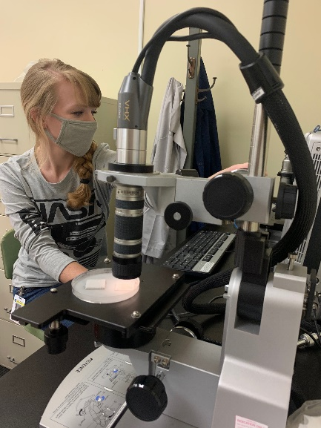
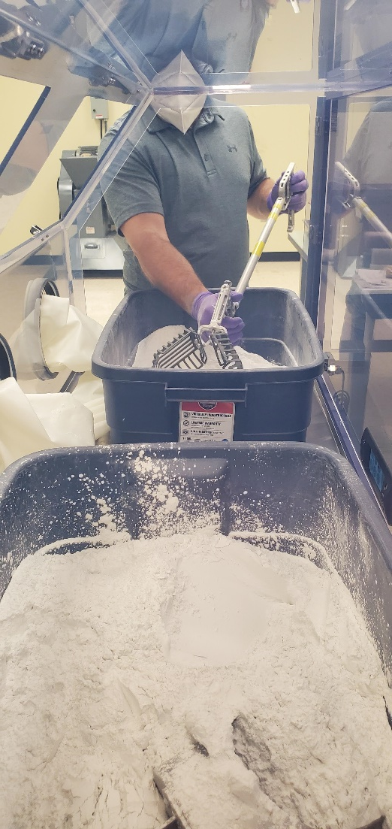
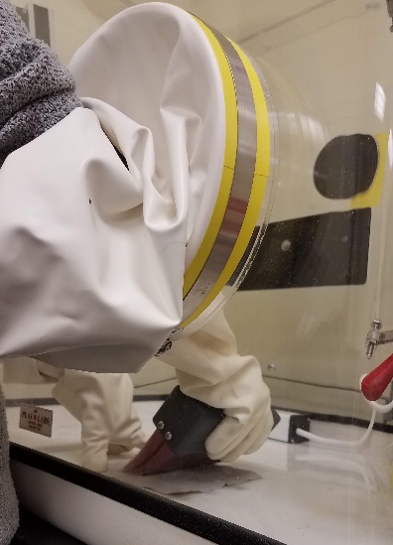
Testing with Dust?
Look at Available Dust Testing Papers & Publications
Review Current Dust Testing Efforts
Read the Dust Mitigation Best Practices Guide
Understand the NASA Standard for Dust Testing
  https://standards.nasa.gov/standard/NASA/NASA-STD-1008
Select your Simulants (Simulant Advisory Committee)
  https://ares.jsc.nasa.gov/projects/simulants/
  https://lsic.jhuapl.edu/Resources/Lunar-Simulants.php
Identify your Facilities (LSIC Facilities Directory) https://lsic-wiki.jhuapl.edu/display/CD

Slide 25
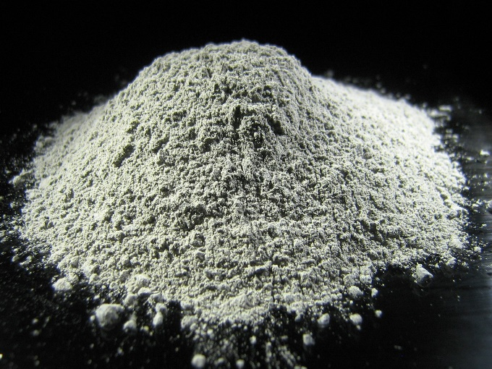
Simulants
“What simulant should I use for testing?”
Simulant Characteristics to Consider
Aerosol Ingestion Testing: PSD, Hardness, Morphology
Abrasion Testing: Hardness, Morphology, PSD
Optical Testing: Opacity, PSD, Albedo
Thermal Testing: Thermal Conductivity, Emissivity
Mechanisms Testing: Hardness, Morphology, Electrostatic Charging, PSD
Seals and Mating Surfaces Testing: Hardness, Morphology, PSD
Reactivity Testing: Chemical Composition, Morphology, PSD
Electrostatic Properties: Electrical Conductivity, Tribocharging, Permittivity
PSI Testing: Geotechnical, Electrostatics, Chemical Composition
One of the most common questions we get
Per Lunar Dust Testing Standards, vetted with NASA Simulant Advisory Committee
Simulant selection is critical to performing relevant tests
Solution: Talk to the NASA Simulant Advisory Committee
https://ares.jsc.nasa.gov/projects/simulants/
Notes:
For verifying future dust mitigation requirements and comparing test results, it will be important that appropriate simulants are used

Slide 26
Agenda
Who’s Who
Dust, the dust problem, and dust mitigation
Defining “dust”
NASA’s Perspective
Experiments, Payloads, and Technology
Engagement

Slide 27
Defining “Dust”
From NASA-STD-1008
Dust: For the purpose of this NASA Technical Standard, we define “dust” pragmatically as the regolith size fraction that poses any functional or longevity concerns or risks to hardware, components, or systems. This is defined by an upper particle size bound and includes smaller particles. Estimates of source size fractions are given in this NASA Technical Standard for various dust transport mechanisms. The unit micrometer (μm) is used to define dust sizes in this NASA Technical Standard.
Note: The definition of “dust” can have different meanings to different scientific groups, and the word “dust” has been used to characterize anything from a very specific size particle distribution to nearly all of the particulate matter in a given sample/volume. Various definitions of dust have been used widely in NASA official documents and in other scientific documents. However, when designing, developing, and testing technologies and systems for dealing with the particulate matter, it is not ideal to have two classes: one for dust and one for larger- or smaller-sized particles.
Or simply put: All lunar particulate that will need to be mitigated.

Slide 28
What do hardware owners/program/projects dust about lunar dust?
Define the natural environment
DSNE
Define the induced environment
Various ways; more in work; system specific
Requirements to survive in the environment
Mitigation solutions
Testing and best practices guidance
Risks
NASA-STD-1008
But we still have a lot to learn!!

Slide 29
Going
Forward
The dust mitigation community is advocating for information on dust characterization needs based on scientific and engineering knowledge gaps that will aid in the design and survival of designed and future systems, and address the challenges related to defining the lunar environment and mitigating lunar dust effects on systems and operations.

Slide 30
Going
Forward
requirements, risks, hazard controls, mission success
capability gaps, technology gaps, program and project needs, etc
The dust mitigation community is advocating for information on dust characterization needs based on scientific and engineering knowledge gaps that will aid in the design and survival of designed and future systems, and address the challenges related to defining the lunar environment and mitigating lunar dust effects on systems and operations.
SLS-SPEC-159 DSNE
dust mitigation technologies or strategies
+use the data to inform models
NASA-STD-1008 (i.e. testing)

Slide 31
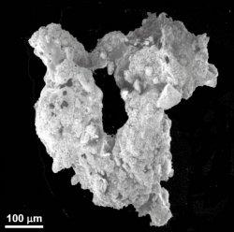
Sources of our list
Guidance and Standards
  SLS-SPEC-159 DSNE
  NASA-STD-1008
  Induced Environments documents in work
Gaps/Areas we need more information on
  2020 publication “The Impact of Lunar Dust on Human Exploration”
  PSI white paper
  Gaps identified within NASA programs and projects
  Lunar simulant limitations
  Dust parameters needed to improve modeling efforts
  What are we missing? Please reach out to me!

Slide 32
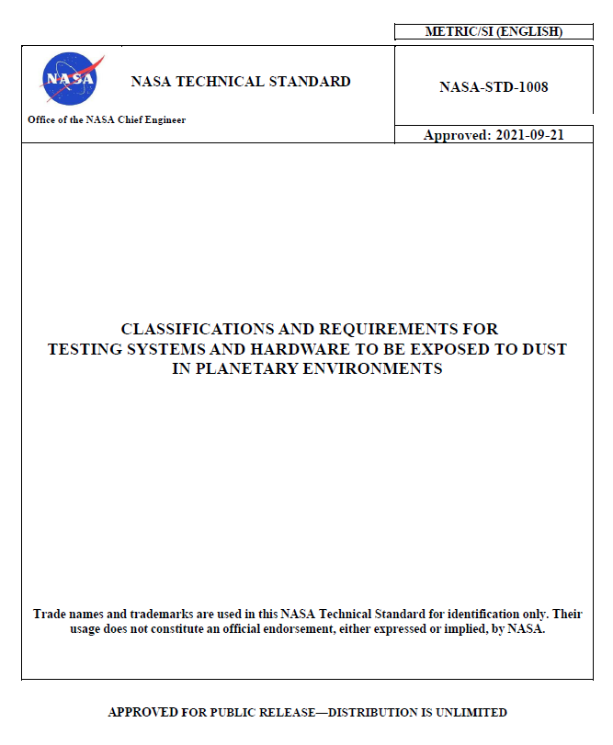
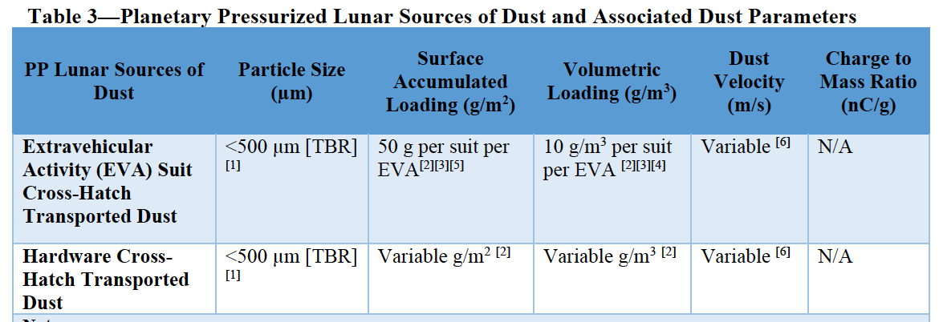
What is NASA-STD-1008?
“Classifications and Requirements for Testing Systems and Hardware to be Exposed to Dust in Planetary Environments” approved by the Office of the NASA Chief Engineer on 2021-09-21 through an Agency-wide review and is publicly available at https://standards.nasa.gov/standard/nasa/nasa-std-1008
“The purpose of this NASA Technical Standard is to establish minimum requirements and provide effective guidance regarding methodologies and best practices for testing systems and hardware to be exposed to dust in dust laden and generating environments. The intent is to facilitate consistency and efficiency in testing space systems, subsystems, or components with operations and missions in dusty environments.”
Section 4 provides estimated dust parameters and references for each estimate.
Section 5 describes testing methods and facility needs.
Notes:
“This NASA Technical Standard is applicable to any system, subsystem, or component that will be exposed to planetary dust.”
“The environmental conditions defined in this NASA Technical Standard (sources of dust, particle sizes, system surface, and/or volumetric loading) are based on estimates from current data sets or studies. Future insight into these environments through missions, technology demonstrations, laboratory studies, modeling, or analyses may unveil new definitions, at which time this NASA Technical Standard will be revised.”

Slide 33
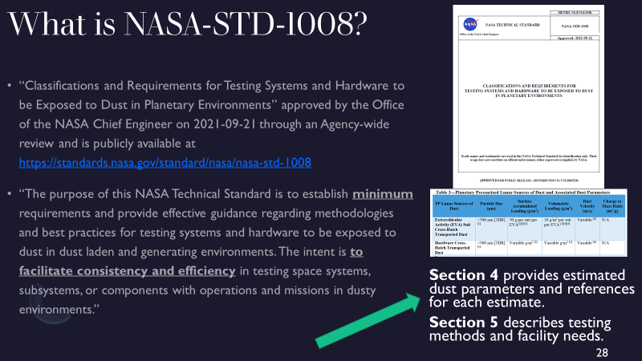
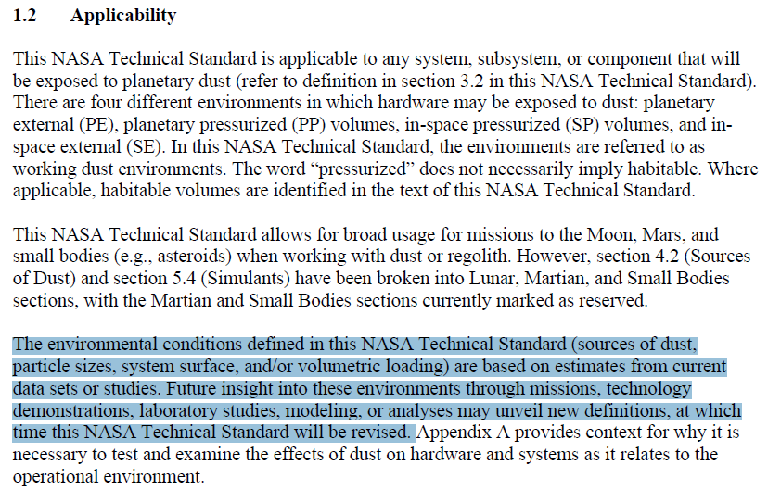

Slide 34
NASA-STD-1008 Section 4
Table provided for each section that contains guidance on particle size, surface accumulated loading, volumetric loading, dust velocity, and charge to mass ratio. It provides this information for various sources of dust depending on the environment.
PE – Human generated surface transported dust, rocket plume dust, natural charged dust transport, natural impact ejecta
PP – EVA suit cross-hatch transported dust, hardware cross-hatch transported dust
SP – micro-G free floating dust, micro-G surface adhering dust
SE – rocket plume dust, natural charged dust transport, natural impact ejecta
SECTION 4. Dust Requirements & Standards
4.1 Dust Impact Assessment Process
4.2 Sources of Dust
a. Planetary External (PE)
b. Planetary Pressurized (PP)
c. In-Space Pressurized (SP)
d. In-Space External (SE)

Slide 35

NASA-STD-1008 Section 5
SECTION 5.
Testing Methodologies & Best Practices
5.1 Simulant Prep & Storage
5.2 Simulant Loading Definitions
5.3 Testing Practices & Categories
5.3.1 Aerosol Ingestion
5.3.1 Simulant Characteristics
5.3.2 Facility Capability
5.3.3 Methodology
5.3.4 Best Practices
5.3.2 Abrasion
5.3.3 Optical
5.3.4 Thermal
5.3 Testing Practices & Categories (cont.)
5.3.5 Mechanisms
5.3.6 Seals & Mating Surfaces
5.3.7 Reactivity
5.3.8 Electrostatic
5.3.9 Plume Surface Interaction
5.4 Simulants
5.5 Facilities
This document has been reviewed for Proprietary, SBU, and Export Control (ITAR/EAR) and has been determined to be non-sensitive. It has been released to the public via the NASA Scientific and Technical Information (STI) Process.

Slide 36
NASA-STD-1008 Testing Categories
5.3.5 Mechanisms
Mechanisms testing supports the development and use of hardware/system(s) that have the potential to have their properties and operation altered by dust. This section is applicable to hardware with interacting surfaces in relative motion (e.g., bearings, gears, screws, and slip rings), mechanism casings and soft goods (i.e., lubricants and grease), and their seals at the system level. Other applicable mechanisms can include, but are not limited to: deployable appendages including solar arrays, retention and release mechanisms, antennas and masts, actuators, transport mechanisms, switches, rotating systems including momentum wheels, reaction wheels, control moment gyroscopes, motors, and roll rings.
5.3.6 Seals & Mating Surfaces
Seals and mating surfaces testing supports the development and use of hardware/system(s) that have the potential to have their properties and operation altered by dust contamination. This section is applicable to static seals for hatches, docking systems, space suits, habitation modules, and sample containers.
5.3.7 Reactivity
Reactivity testing supports the development and use of hardware/system(s) that have the potential to have their properties and operation altered by dust contamination or chemical reactivity. This section is applicable to surfaces and organic and inorganic materials that have the potential to react with activated dust surfaces. This section is different than previous sections in that it serves to show how simulants may be altered to recreate the natural reactivity of lunar surface environment dust particle reactivity.
5.3.8 Electrostatic Properties
Electrostatics testing supports the development and use of hardware/system(s) that have the potential to have their properties and operation altered by the electrical properties of dust. This section encompasses electrostatic properties of granular materials, electrostatic discharge (ESD) circuit shorts from accumulated dust, and electrical arcing.
5.3.9 Plume Surface Interaction
Rocket engines produce gas plumes that interact with the planetary surface environment. When vehicles conduct near-surface operations (e.g., landing or take-off), gas plumes interact with planetary surfaces and may cause erosion, lofting, and/or heating of surface materials. Ejected dust may strike the vehicle producing the plume, hardware/system(s) in the vehicle’s immediate vicinity or objects on orbit. PSI may cause dust loading or impact damage (e.g., media blasting). The nature of PSI effects depends on the target body’s regolith, atmospheric, topographic, and gravitational properties; the vehicle’s architecture, engine configuration and duty cycle, and the flight path of the landing vehicle; and the proximity of nearby hardware/system(s).
5.3.1 Aerosol Ingestion
Aerosol ingestion testing supports the development and use of hardware/system(s) that have the potential to ingest dust. This section is applicable to hardware/systems(s) exposed to dust within any pressurized habitable volumes/compartments and surface atmospheric environments.
5.3.2 Abrasion
Abrasion testing supports the development and use of materials used in hardware/system(s) that frequently interact and wear over time. This section is applicable to soft goods, which are flexible materials (e.g., textiles or thin films of synthetic or natural materials and hard goods, which are inflexible materials (e.g., rigid metals or ceramics).
5.3.3 Optical
Optical testing supports the development and use of hardware/system(s) that have the potential to have their properties and operation altered by dust. This section is applicable to optical equipment (e.g., solar panels, viewports, camera lenses, laser-based optical systems, all mirrors, wavelength filter lenses, and radiative measurement sensors) and relative navigation equipment (e.g., docking targets, reflectors.)
5.3.4 Thermal
Thermal testing supports the development and use of hardware/system(s) that have the potential to have their properties and operation altered by dust. This section is applicable to active thermal management components/systems, dust loading, and associated thermal impacts on hardware/systems. The primary focus is on radiators, as this is expected to be a key component directly impacted by dust buildup/coverage. However, consideration of other hardware/system(s) that generate heat (e.g., motors, power supplies) must be considered to determine potential impact to operational conditions.

Slide 37
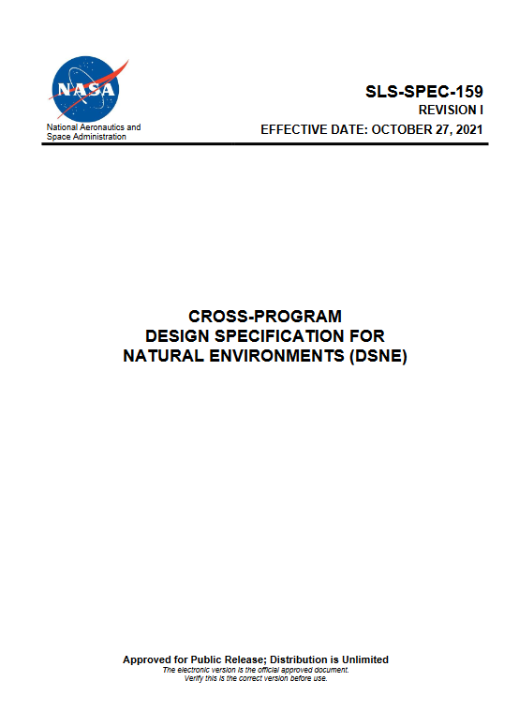
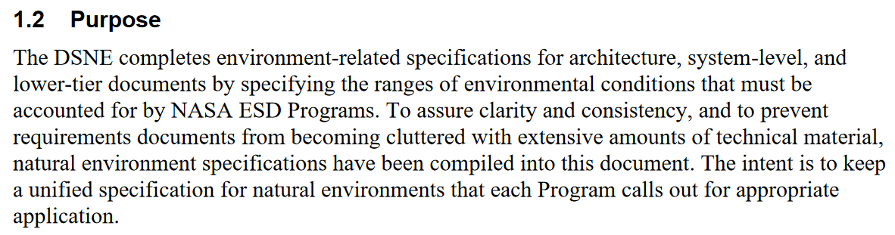
What is the DSNE?
SLS-SPEC-159: Cross-Program Design Specification for Natural Environments (DSNE)
Latest revision available on NTRS
Example programmatic requirement:
The “system” shall meet all safety, functional, performance, utilization, and mission objectives during and after exposure to natural environments as defined in SLS-SPEC-159 Cross-Program DSNE.

Slide 38
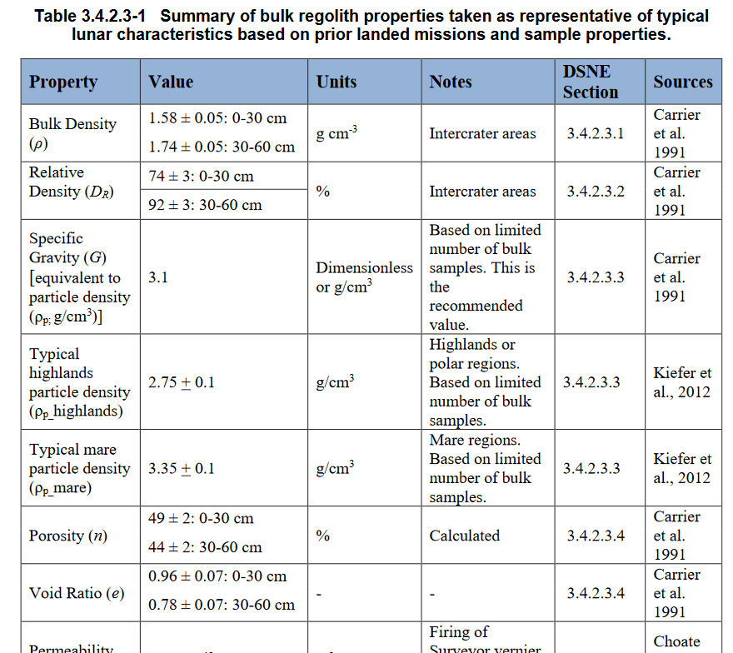
3.0 Natural Environment Specification
3.1 Prelaunch - Ground Processing Phases
3.2 Launch Countdown and Earth Ascent Phases
3.3 In-Space Phases
3.4 Lunar Surface Operational Phases
3.5 Entry and Landing Phases
3.6 Contingency and Off-Nominal Landing Phases
3.7 Recovery and Post-Flight Processing Phases
3.8 Interplanetary Space Specification
3.9 Mars Orbit Specification
3.10 Mars Atmosphere and Surface Phase Specification
3.11 Mars Moon Specification
3.12 Near Earth Asteroid Specification
For section 3.4, numerous published data sets from orbiting spacecraft and analysis of
Apollo and other sample return missions were used. References are cited for all design environment data.
Chapter 9 of Lunar Sourcebook
3.4 Lunar Surface Operational Phases
3.4.1 Lunar Surface Geological and Geomorphological Environment
3.4.2 Lunar Regolith Properties
3.4.3 Lunar Surface Plasma Environment
3.4.4 Lunar Regolith Electrical Properties
3.4.5 Optical Properties
3.4.6 Lunar Thermal Environment
3.4.7 Lunar Ionizing Radiation Environment
3.4.8 Lunar Meteoroid and Ejecta Environment
3.4.9 Lunar Illumination
3.4.10 Lunar Neutral Atmosphere
3.4.2 Lunar Regolith Properties
3.4.2.1 General Description of the Lunar Regolith
3.4.2.2 Particle Size and Shape
3.4.2.3 Mechanical Properties of Lunar Regolith
3.4.2.4 Derived Physical Properties

Slide 39
Agenda
Who’s Who
Dust, the dust problem, and dust mitigation
Defining “dust”
NASA’s Perspective
Experiments, Payloads, and Technology
Engagement

Slide 40
NASA Civil Space Shortfall Ranking
Integrated #63
ESDMD # 1
STMD # 37
1561 Advanced Modeling and Test Capabilities to Characterize Dust Effects on Hardware
Integrated # 47
ESDMD # 1
STMD # 33
844 Passive Dust Mitigation Technologies for Diverse Applications
Integrated # 56
ESDMD # 1
STMD # 36
1047 Active Dust Mitigation Technologies for Diverse Applications
Dust Mitigation ranked #1 by NASA Exploration Systems Development Mission Directorate (ESDMD)
Shortfall document released April 2024
Shortfall ranking released July 2024
Integrated # 1
ESDMD # 4
STMD # 1
1618 Survive and operate through the lunar night
Integrated # 6
ESDMD # 6
STMD # 62
1552 Extreme Environments Avionics
Integrated # 34
ESDMD # 35
STMD # 61
1390 Power and Data Transfer in Dusty Environments
Integrated # 103
ESDMD # 75
STMD # 96
1585 Extraterrestrial surface environmental simulators, test facilities, and test sites
40
Notes:
Give a bit of context. NASA's space tech group develops space technologies for NASA and for civil space. In the last year (really it was done over 6 months which is why it isn't perfect, don't say that part, lol), and so they did a prioritization process taking input from the other mission directorates and industry and academia. For the now what, this is influencing how NASA's space technology group is making decisions on technologies to fund, on what stakeholders are best suited to contribute to what technologies, etc. As solicitations go out for development of technologies for academia, for small businesses, for industry, this will help guide those. (While going over this slide, it is also important to note that ESDMD ranked dust 1/2/3.)

Slide 41
Agenda
Who’s Who
Dust, the dust problem, and dust mitigation
Defining “dust”
NASA’s Perspective
Experiments, Payloads, and Technology
Engagement

Slide 42
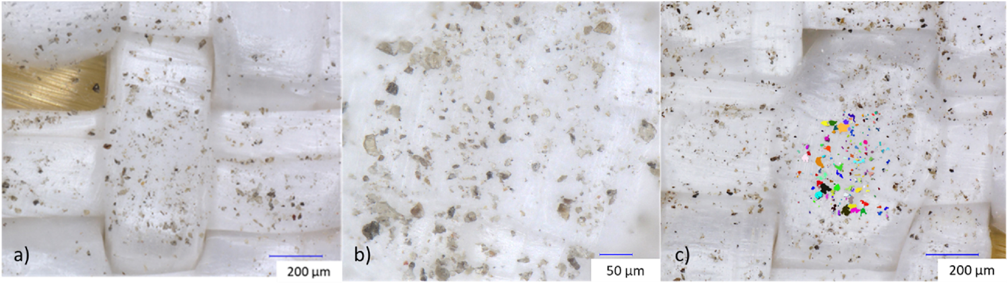
Adhesion Experiment
Goal: Measure adhesion properties of all materials desired to be used on the lunar surface.
Status: Gateway Program funded, currently testing multiple materials at JSC dusty chamber to generate a table of material adhesion values vs. particle size
Images a) and b) show dust that remained on the Ortho fabric after final 400 g rotation (No UV). Image c) shows an example of particle size identification and estimation.

Slide 43
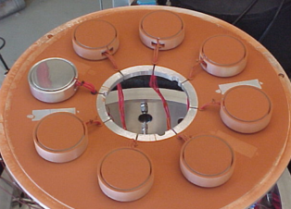
Lunar Dust Level Sensor & Effects on Surfaces (LDES)
  Quantify the effects of lunar dust on external surfaces, materials, and system performance (e.g., radiators); develop a sensor to measure in-situ local dust accumulation using reverse engineering.
  Perform ground testing to determine impacts of dust on radiator heat rejection.
  Test sensor on lunar surface to measure dust accumulation on key systems, study dust transfer on external surfaces, and assess material degradation.
  CLPS candidate payload

Slide 44

CLPS
Firefly Blue Ghost Mission 1 Launching later this year with key payloads
Regolith Adherence Characterization (RAC)
Electrodynamic Dust Shield (EDS)
Stereo Camera for Lunar Plume-Surface Studies (SCALPSS)
Commercial Lunar Payload Services = CLPS

Slide 45









Technology Development
    Astrobee Tests Gecko-Inspired
    Adhesives onboard the
    International Space Station
  The MDECE piezoelectric motor task successfully
  demonstrated its proof-of-concept motor
  in May 2024
      Demonstration of the Electrodynamic
      Dust Shield (EDS) showing dust
      before (left) and after activation (right)
The Gecko roller was designed to remove lunar dust from spacesuits and hard surfaces (such as solar panels). The technology works the same
way as a common terrestrial lint roller, but with
an elastomeric gecko-skin-inspired membrane replacing the adhesive sheet.
Catalysts: STRG, Flight Opportunities
Collaborator: University of Maryland, College Park
The purpose of NASA’s Motors for Dusty and Extremely Cold Environments (MDECE) project is to develop an unheated magnetically-geared motor and an unheated piezoelectric motor so that they can operate continuously for a long duration at an ambient temperature of -240 ºC (33 K).
Catalyst: Internal Award
NASA’s Electrodynamic Dust Shield (EDS) is
a non-contact active dust mitigation technology designed to lift, transport and remove dust from surfaces and prevent accumulation by using a pattern
of electrodes to generate a non-uniform electric field over the surface being protected.
Catalysts: Internal Award, CLPS, Flight Opportunities

Slide 46




Technology Development
    PALETTE thermal management technologies
    enable survival of the extreme lunar and
    Mars environments
    Alloys made of “metallic glass” for gearboxes to
    survive extreme environments without heating
    and lubricant
    Technicians prepare for COLDArm
    cryogenic testing at NASA’s Jet
    Propulsion Laboratory
NASA’s Planetary and Lunar Environment Thermal Toolbox Elements (PALETTE) project successfully developed the passive thermal management tools necessary for future instrument/system operation in extreme environments. This technology will be advanced for the Lunar Surface Electromagnetics Experiment Night Version (LuSEE-Night) mission. LuSEE-Night is slated to land at a low latitude site on the lunar farside to operate there for 24 lunar day/night cycles (2 Earth years).
Catalysts: Internal Award, CLPS
Collaborator: University of California, Berkely
NASA’s Bulk Metallic Glass Gear (BMGG) project
is developing technologies that could be the nuts and bolts of missions to explore destinations throughout the solar system, from the Moon to Mars to the icy worlds such as Jupiter’s moon, Europa. These locations have extreme environments that require technologies to operate at temperatures below –238 degrees Fahrenheit.
Catalysts: Internal Award, SBIR
Collaborators: Eutectix, Supercool Metals, Vissor Precision
NASA’s Cold Operable Lunar Deployable Arm (COLDArm) project will significantly improve the
utility of robotic arms for lunar landers. COLDArm
has been successfully tested at cryogenic temperatures [100 Kelvin] and is the first known robotic manipulator to operate in this range without requiring heating. This will enable manipulation capabilities during the lunar night.
Catalysts: Internal Award, SBIR
Collaborator: Motiv Space Systems

Slide 47
Agenda
Who’s Who
Dust, the dust problem, and dust mitigation
Defining “dust”
NASA’s Perspective
Experiments, Payloads, and Technology
Engagement

Slide 48

LSIC
Provides independent analysis/review of Dust Mitigation technology development.
NASA’s conduit to industry and academia.
Provides Systems Engineering functions to help perform studies, address needs.
LSIC = Lunar Surface Innovation Consortium

Slide 49
NASA Internal
Gateway Dust Mitigation Working Group (GDM WG) – primary forum focused specifically on the impacts and guidance for Gateway dust mitigation
  Collaboration between NASA, International Partners, and Commercial Providers
Development of a Dust Mitigation Working Group focused on surface elements’ challenges is underway
Dust Mitigation Stakeholders Working Group (DMS WG) – collaboration forum for NASA dust mitigation techniques and technologies.
  Multi-program, multi-center, and multi-directorate forum
  NASA internal, attended by Gateway, HLS, Extravehicular Activity (EVA) and Human Surface Mobility (HSM) Program (EHP), and Orion Programs and includes representatives of the Artemis Campaign Directorate (ACD) and Space Technology Mission Directorate (STMD)

Slide 50

What’s next?
Continue working with Projects, Programs, and Partners on dust mitigation
Potentials TIM to advocate for closure of these knowledge gaps
Thoughts? Please let us know!
Notes:
I think it's important to verbalize that the purpose of you speaking at this meeting is not to inform them about dust mitigation but to leverage their knowledge and expertise. If they have solutions/ideas, let us know! You can even say something like how when dust mitigation folks came to a contamination control meeting, they learned several things that could be applied to dust mitigation.

Slide 51

Questions? kristen.k.john@nasa.gov

