Slide 1
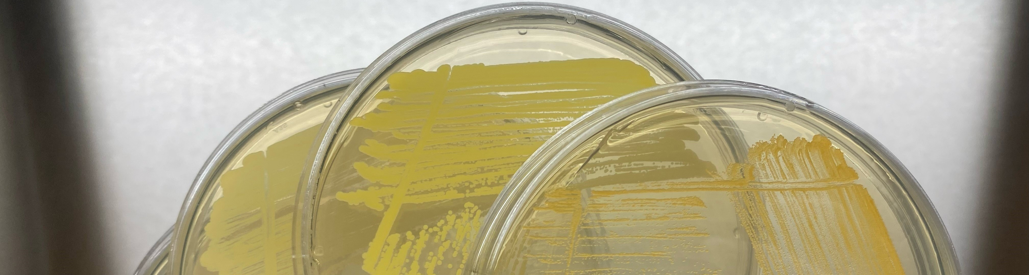

Cleanroom Microbes Survive Drying, Vacuum, and Proton Irradiation
Astrobiology and the Future of Life Meeting
17 October 2024
Houston, Texas/Virtual
Chelsi Cassilly, Atul Chander, Curtis Bahr, Jason Vaughn, Peter Bertone, Stefan Green, Kevin Kunstman, Kasthuri Venkateswaran, Samantha Marcella, Heather Morris
NASA Marshall Space Flight Center, Huntsville, AL
Jet Propulsion Laboratory, Pasadena, CA
Jacobs Space Exploration Group, Huntsville, AL
Rush University Medical Center Genomics and Microbiome Core Facility, Chicago, IL

Slide 2
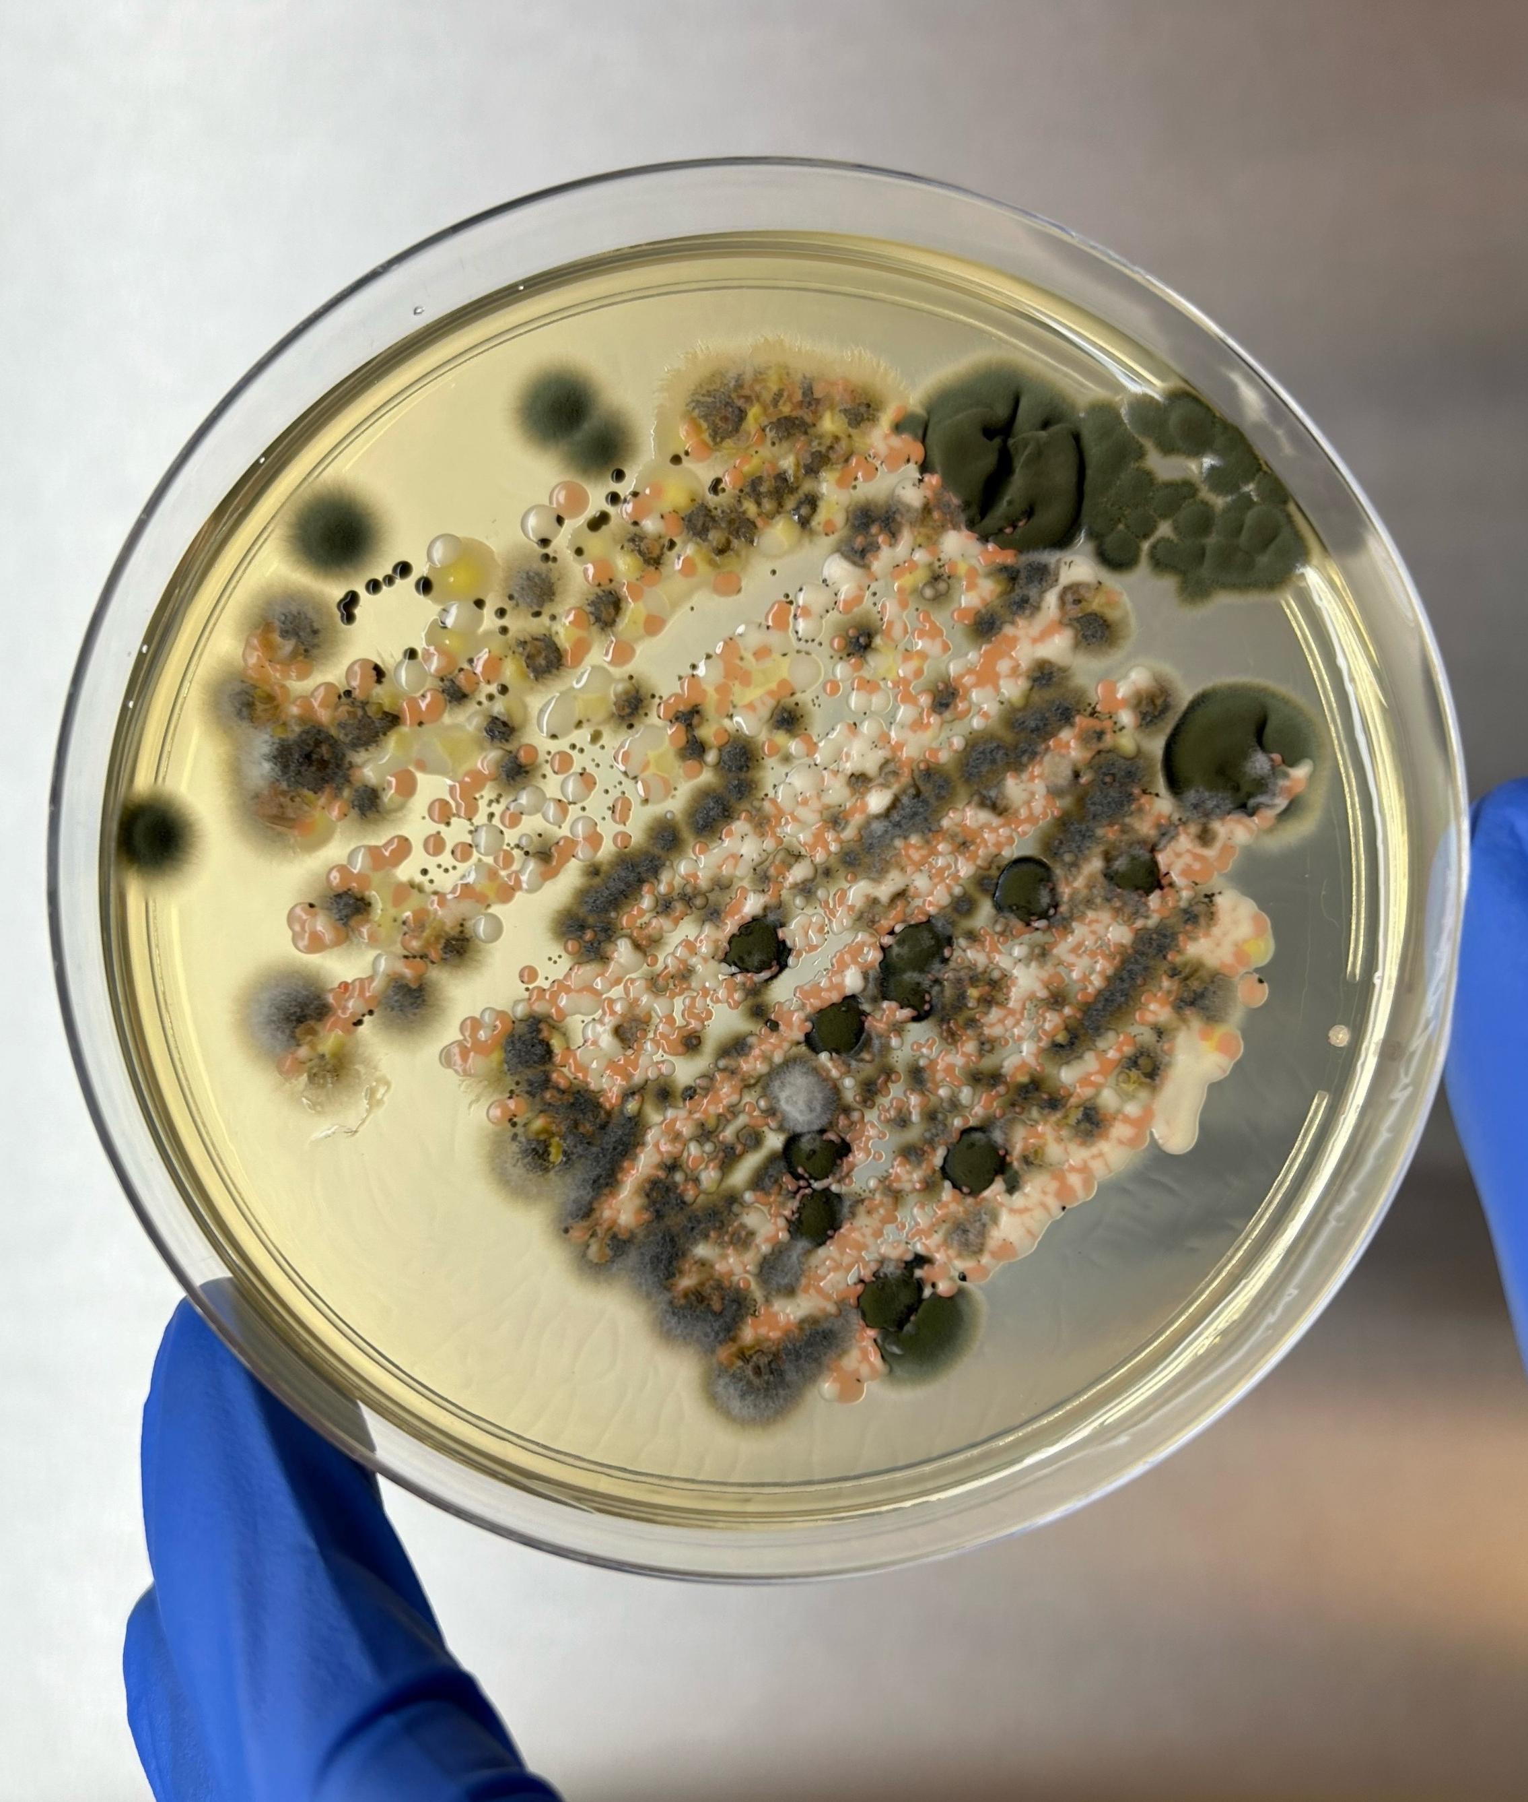
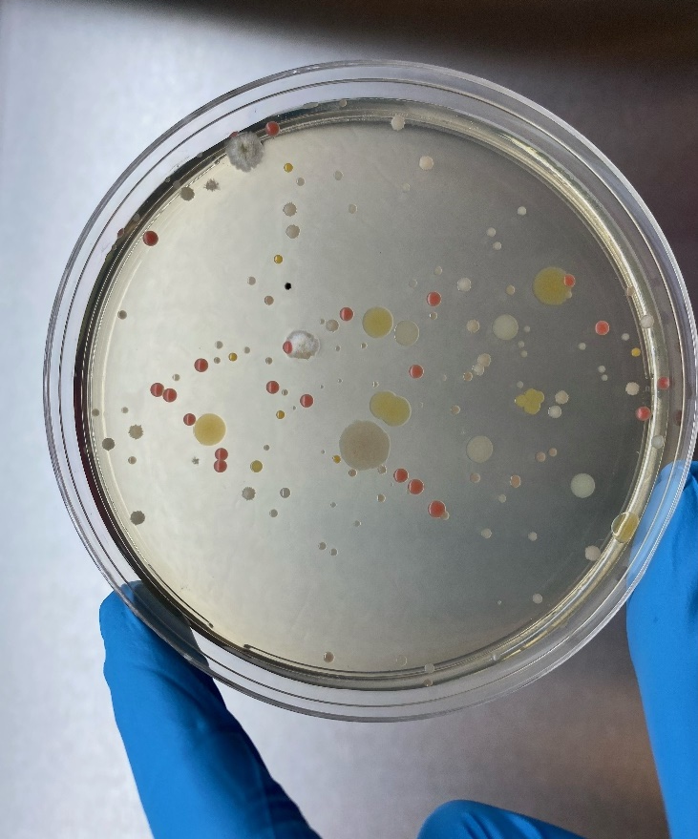
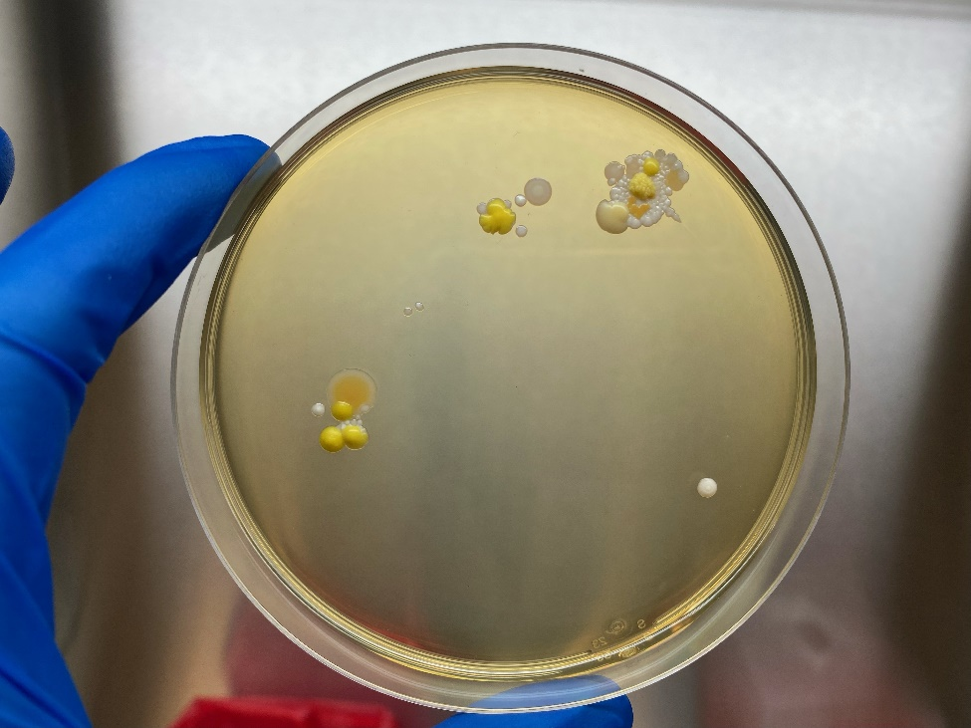
Introduction
The goal of planetary protection at NASA is to mitigate the risk of contaminating sensitive target bodies with biological life
Typically microorganisms
Processes
Humans
Environments

Slide 3
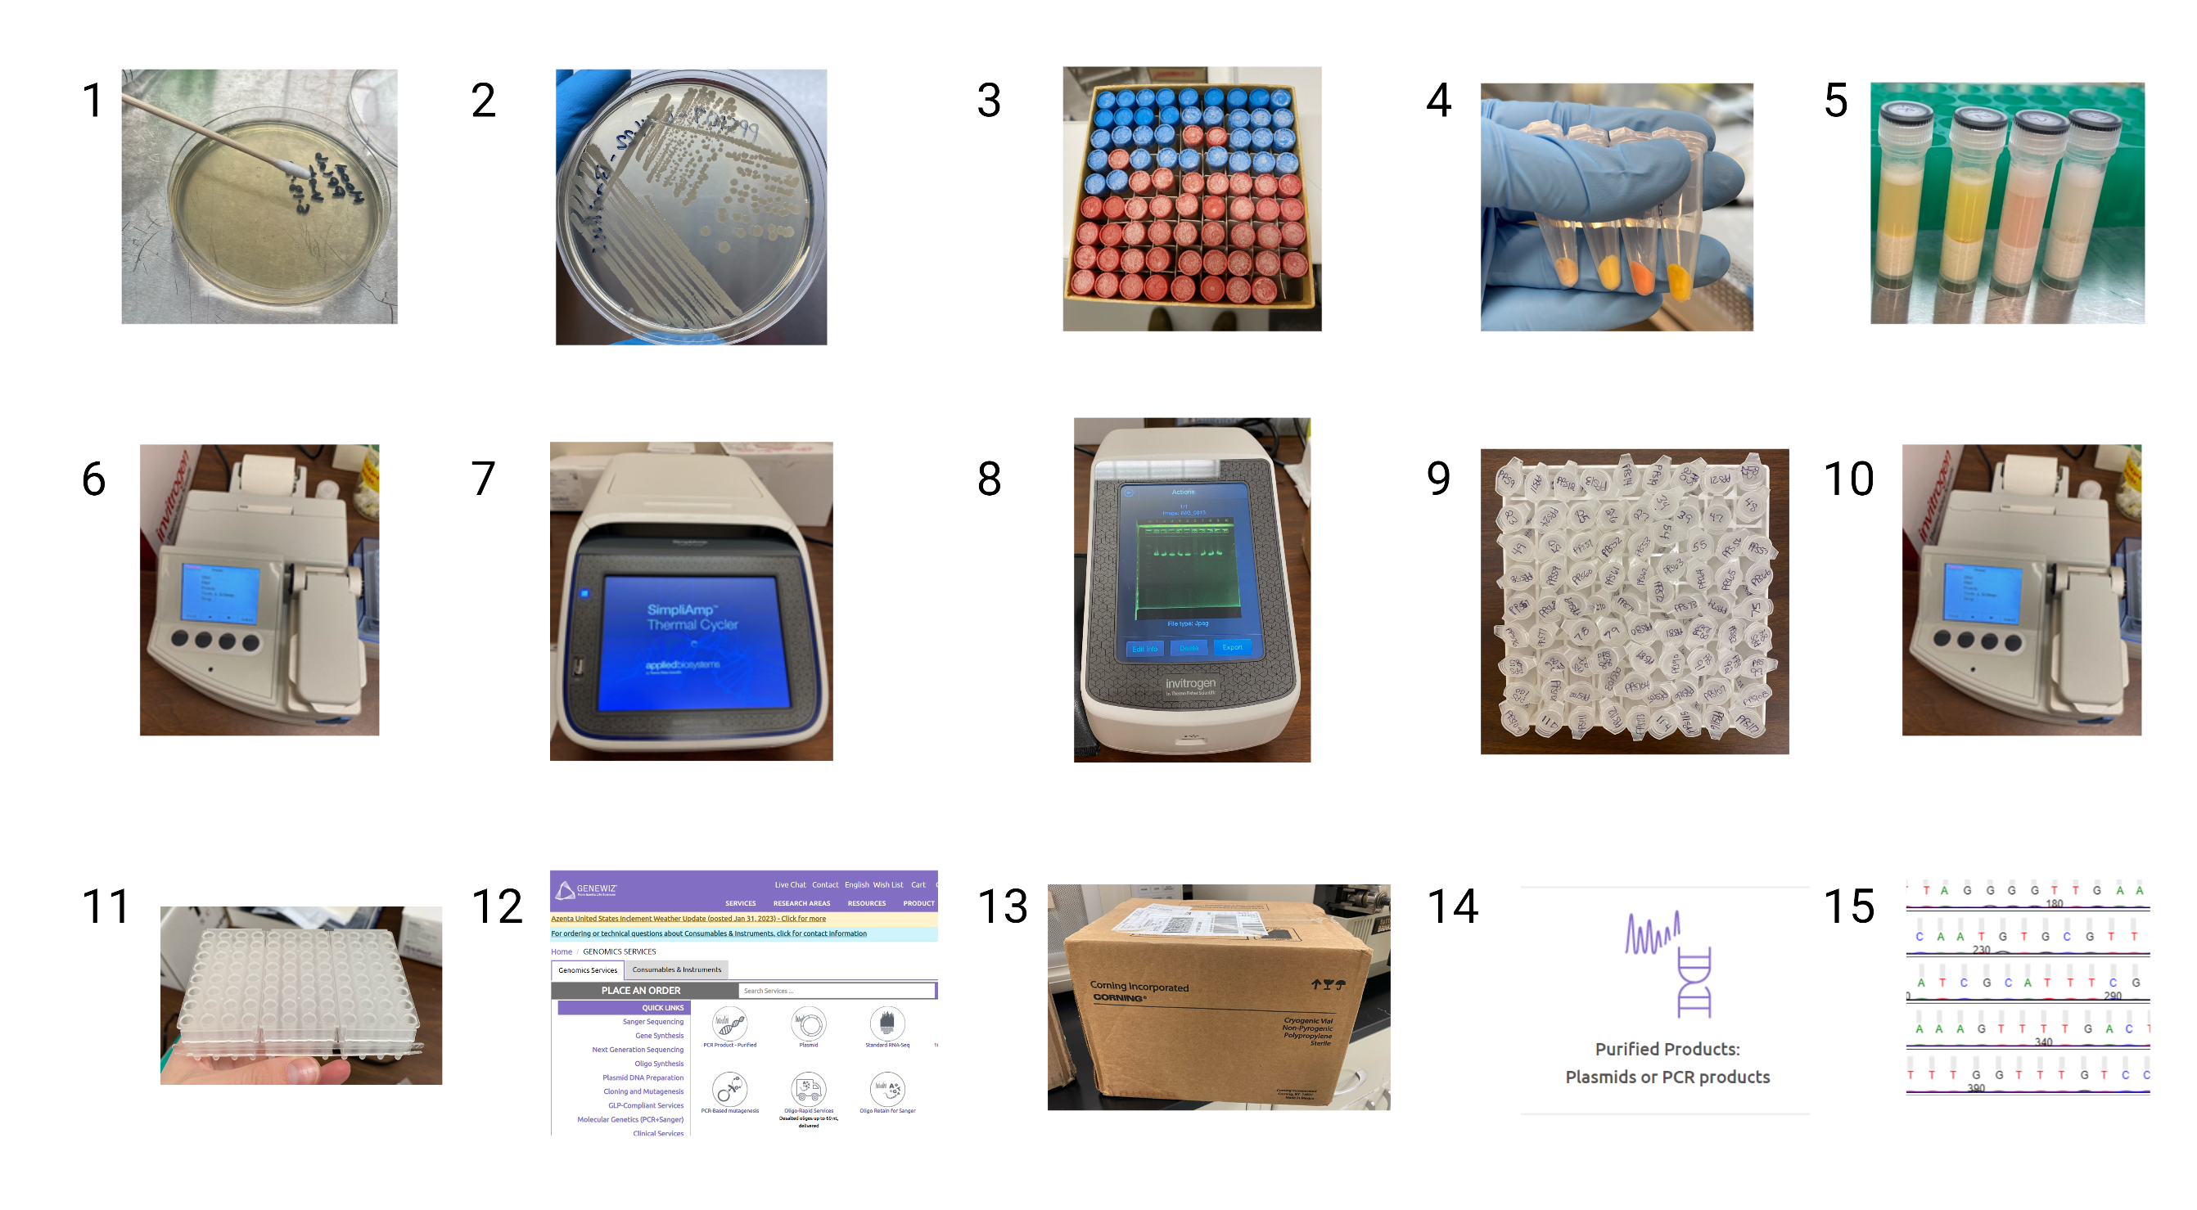
Curation and Identification of MSFC Cleanroom Microbes
Collect
Isolate colonies
Freeze/curate
Biomass accumulation
DNA extraction
DNA quantification
DNA amplification (PCR)
DNA visualization
DNA purification
DNA quantification
Sample plate array
Account set up/order
Shipment
DNA sequencing
DNA analysis/BLAST

Slide 4
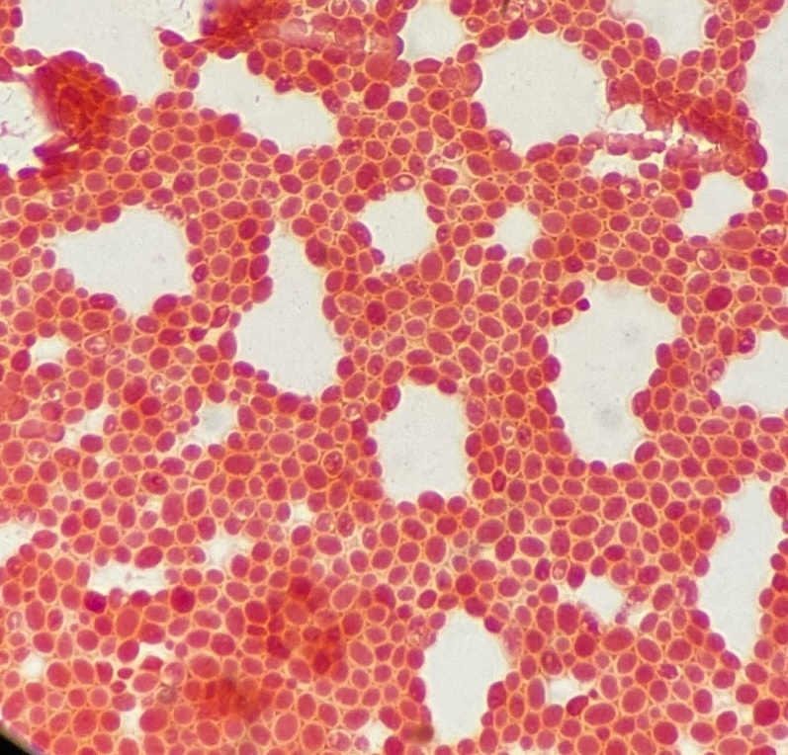
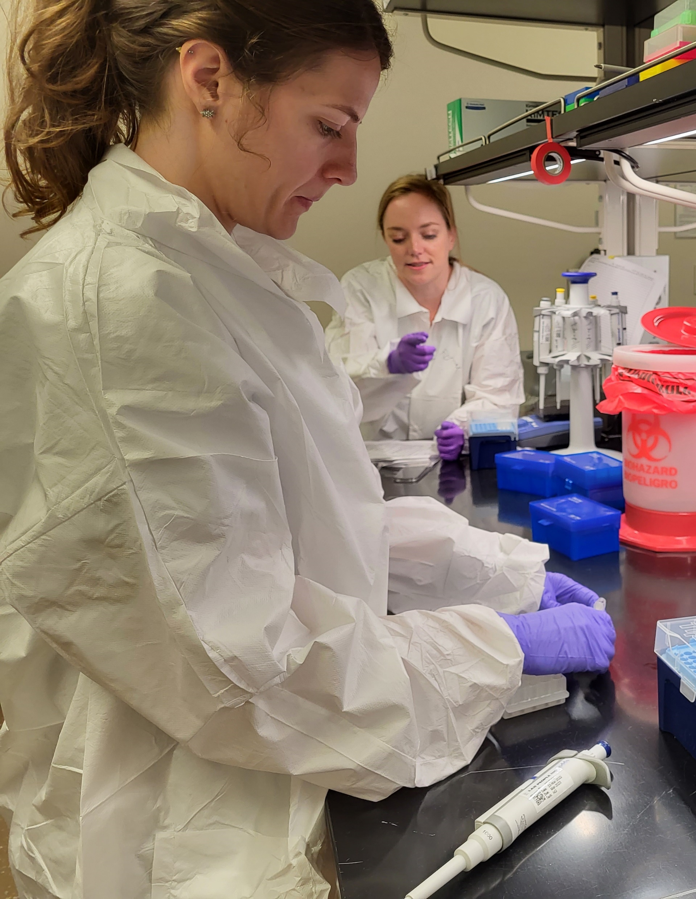
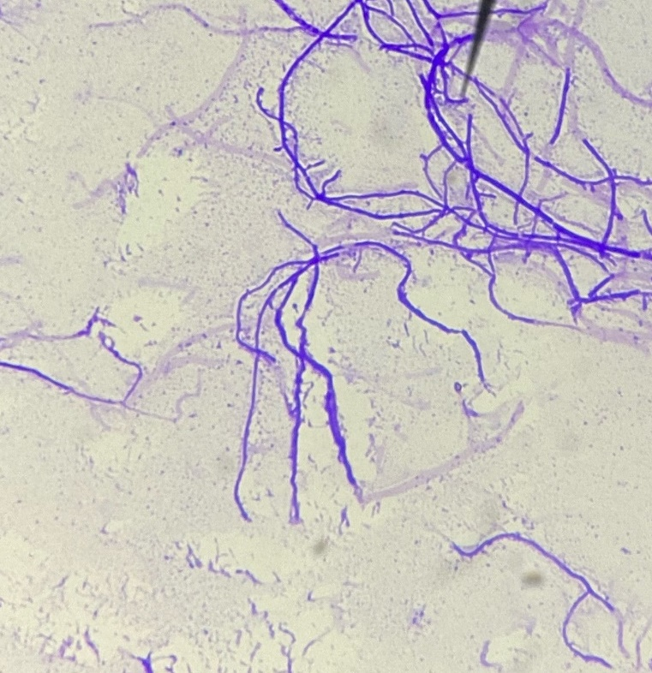
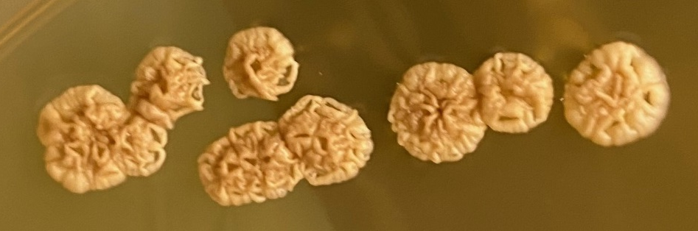
MSFC Cleanroom Microbial Library
Collected 95 microbial isolates
18 sent to JSC for identification (18 ID’d)
77 sent to Azenta for sequencing (59 ID’d)
11/77 samples had problems (~14%) – meaning that the results are not as reliable
5/77 sample failed (~6%) – meaning something about the DNA was not sufficient (misidentified yeast!)
2/77 unidentified (~3%)
~93% success rate
~86% highly confident identification
4

Slide 5
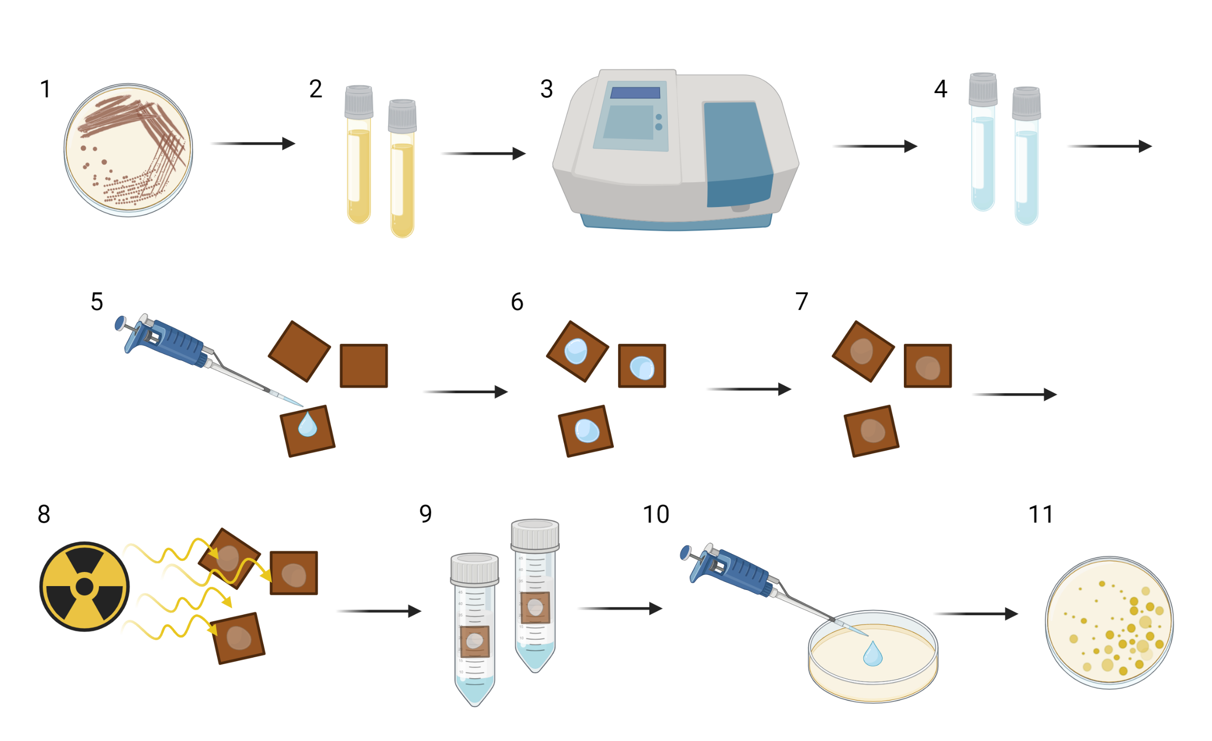
Exposure of Cleanroom Microbes to Simulated Space Environments
24
H⁺ Run 1
17
H⁺ Run 2
13
H⁺ Run 3
5
5
H⁺ Run 4|5
1
UV Run
Image created with Biorender
*experimental details can be found in abstract

Slide 6
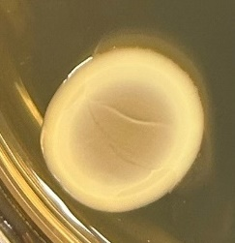
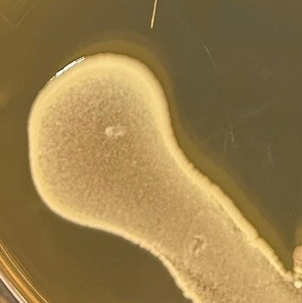
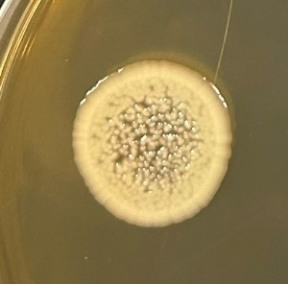
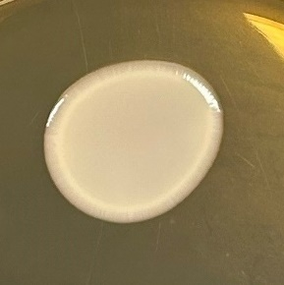
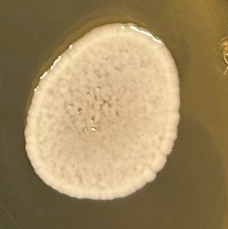
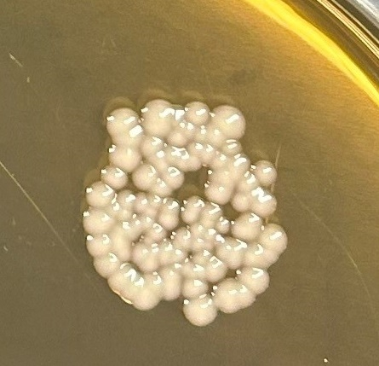
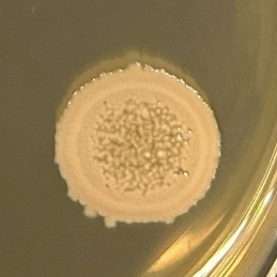
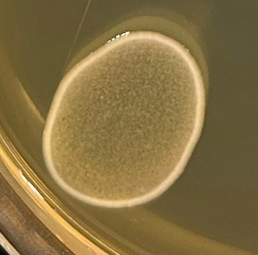
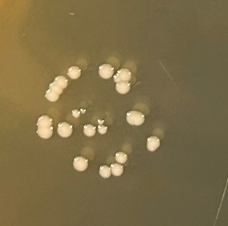
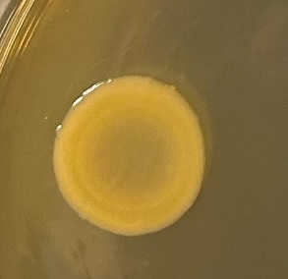
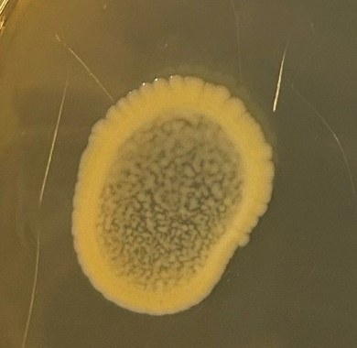
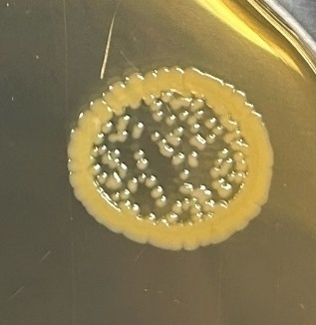
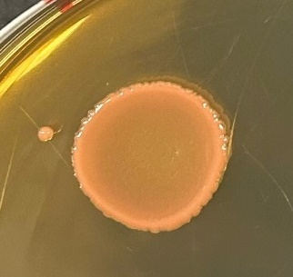
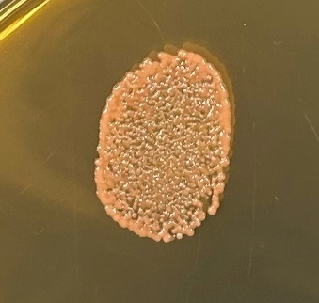
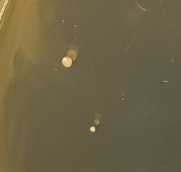
Four Isolates with Increased Ionizing Radiation Resistance
Inoculum Control Proton Rad
68
68
68
Run 3
Isolate # | Identity | Inoculum | Control | Proton Rad
PPS55 | Alkalihalobacillus gibsonii | + | - | -
PPS67 | Brevundimonas vesicularis/nasdae | + | - | -
PPS68 | Arthrobacter koreensis | + | + | +
PPS69 | Acinetobacter lwoffii or Prolinoborus fasciculus | + | + | minor
PPS72 | Paenarthrobacter nitroguajacolicus | + | + | +
PPS73 | Staphylococcus hominis | + | + | -
PPS74 | Brevundimonas sp. | + | minor | -
PPS77 | Janibacter hoylei | + | + | -
PPS111 | Bacillus licheniformis | + | minor | -
PPS114 | Bacillus atrophaeus | + | + | -
PPS117 | Mycetocola manganoxydans | + | + | +
PPS120 | Erwinia sp. | + | + | +
PPS125 | Neocylindroseptoria sp. | + | + | -
ATCC 13939 | Deinococcus radiodurans | + | + | minor
Negative | Water | - | - | -
72
72
72
117
117
117
120
120
120
DR
DR
DR
Control: ambient drying
Radiation: 100 keV protons at a fluence of 2x10¹⁵/cm² at ~10⁻⁶ Torr

Slide 7
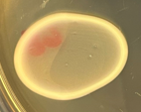
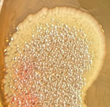
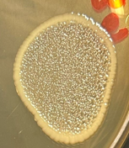
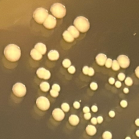
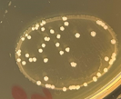
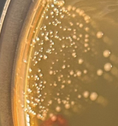
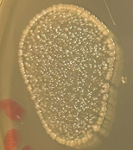
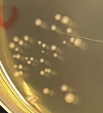
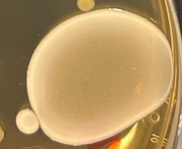
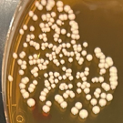
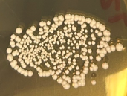

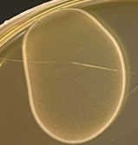
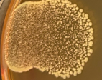
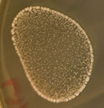
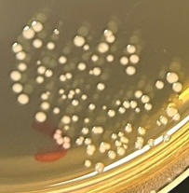
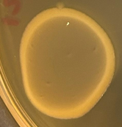

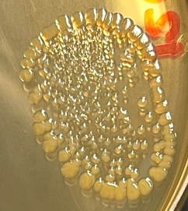
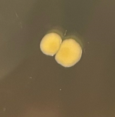
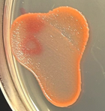
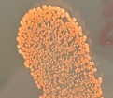
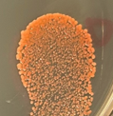
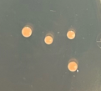
Four Isolates with Increased Ionizing Radiation Resistance
Inoculum Control Vacuum Proton Rad
68
68
68
68
69
69
69
69
Run 5
Isolate # | Identity | Inoculum | Control | Vacuum | Proton Rad
PPS68 | Arthrobacter koreensis | + | + | + | +
PPS69 | Acinetobacter lwoffii or Prolinoborus fasciculus | + | + | + | +
PPS72 | Paenarthrobacter nitroguajacolicus | + | + | + | -
PPS117 | Mycetocola manganoxydans | + | + | + | +
PPS120 | Erwinia sp. | + | + | + | minor
ATCC 9372 | Bacillus atrophaeus spores | + | + | + | +
ATCC 13939 | Deinococcus radiodurans | + | + | + | minor
Negative | Water | - | - | - | -
72
72
72
72
117
117
117
117
120
120
120
120
Control: ambient drying
Vacuum: ~10⁻⁶ Torr
Radiation: 100 keV protons at a fluence of 4x10¹⁵/cm² at ~10⁻⁶ Torr
DR
DR
DR
DR

Slide 8
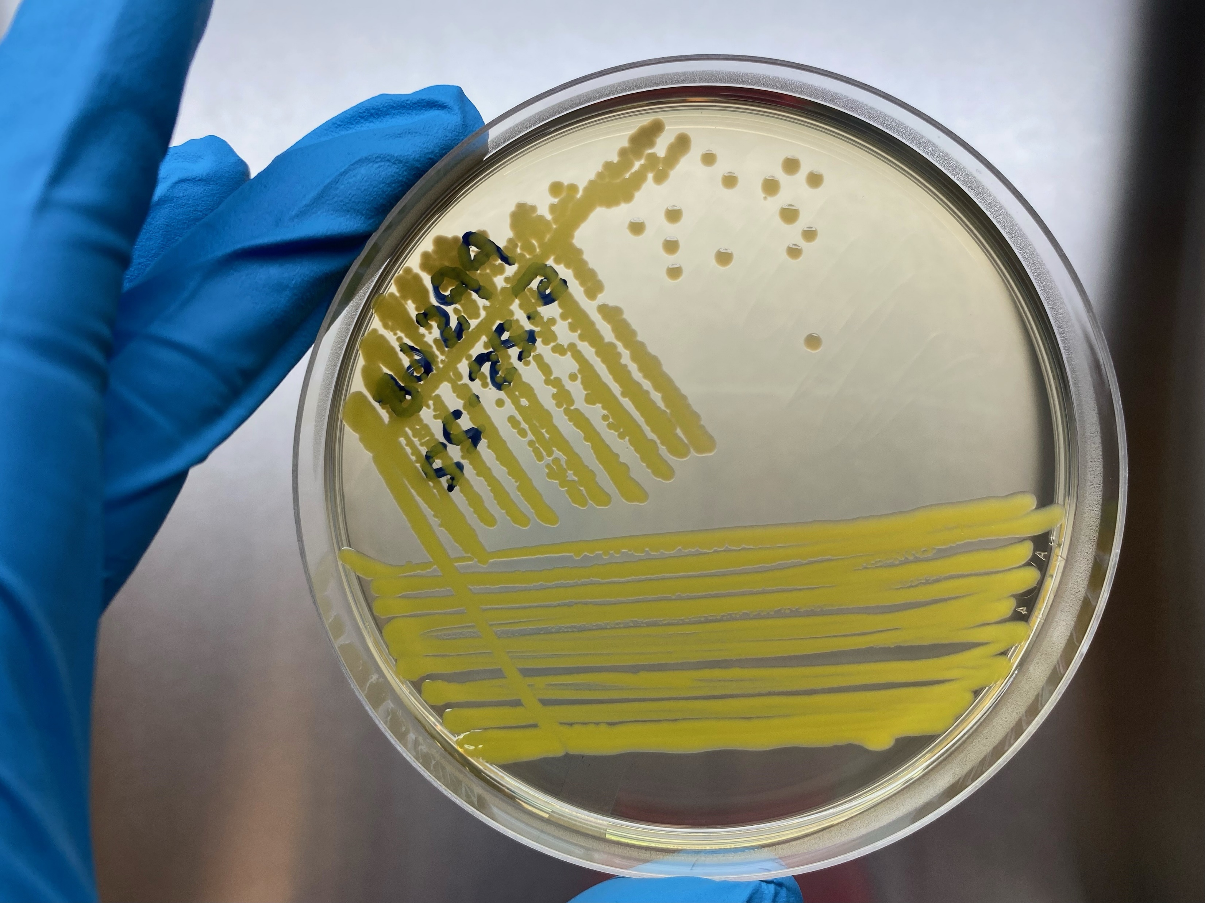
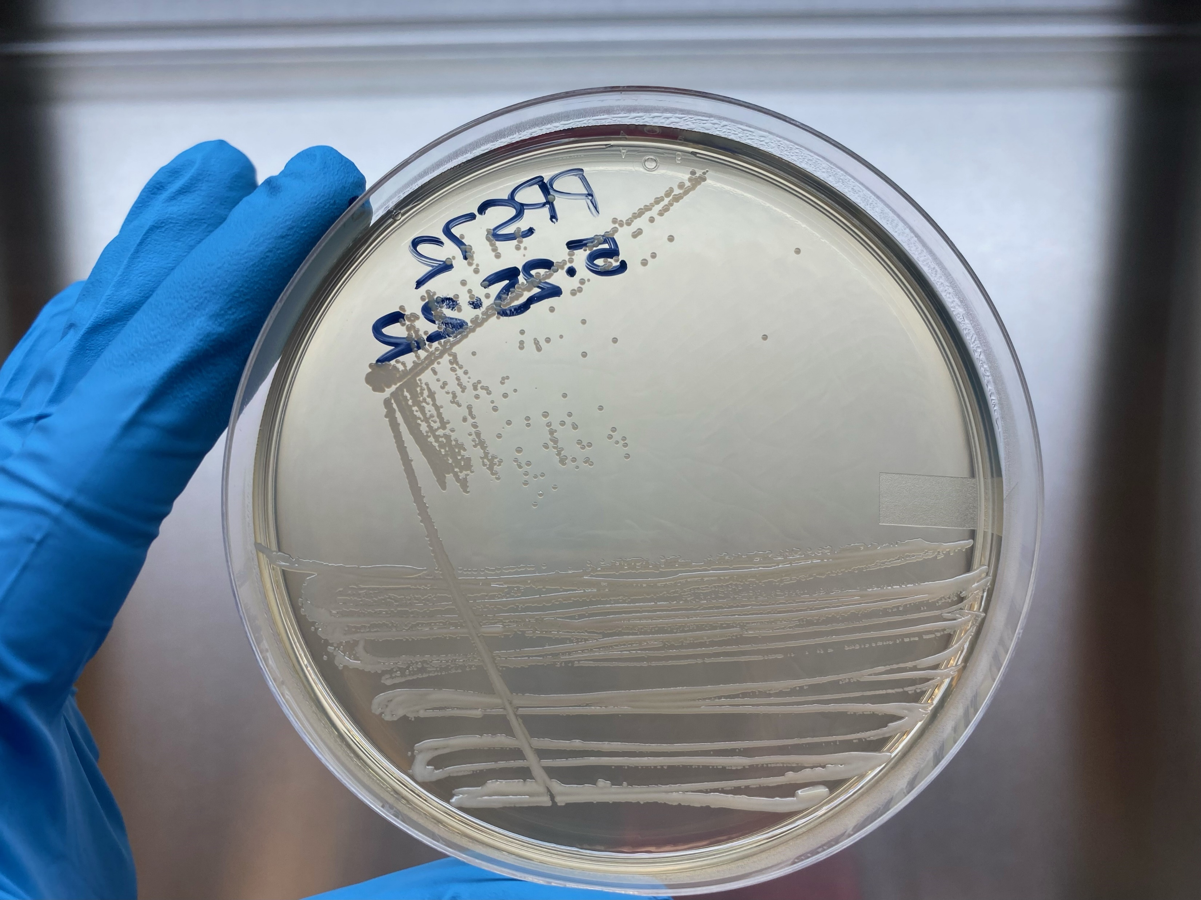
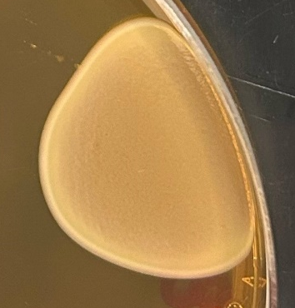







A. koreensis Demonstrates Resistance to UV
68
72
Inoculum Drying Control UV
68
68
68
DR
DR
DR
Arthrobacter koreensis
Paenarthrobacter nitroguajacolicus
117
120
UV: 254 nm wavelength light at an intensity of 80 W/m² at ~18 cm for 10 minutes
Four isolates sent for whole genome sequencing
Mycetocola manganoxydans
Erwinia sp.

Slide 9

Resistance Gene Profiles
Approximately 60-70% of general stress response genes are conserved
Oxidative stress
Detoxification
Genes coding for GGDEF and EAL domains with PAS/PAC sensors were only found in A. koreensis
Hypothesized to facilitate survival under drying, desiccation, and proton irradiation
pecies

Slide 10


Identification of Resistance Mechanisms in Non-Spore Forming Bacteria
Allows us to:
Assess planetary protection threat of specific microbes in cleanrooms/on spacecraft
Use a wider variety of microbes in harsh conditions off-world
Genetically improve non-resistant beneficial microbes
Help humans thrive in space
Understand potential survival mechanisms of extraterrestrial life

Slide 11
Future Efforts to Continue this Research
Manuscript in preparation
MISSE-22 experiment to expose A. koreensis to low earth orbit environment
PPR ROSES proposal submitted to continue work on A. koreensis in collaboration with UAH
ICAR proposal submitted to evaluate biosignatures with University of Alabama
MOSAICS proposal submitted to continue work on Deinococcus species in collaboration with Glendale Community College

Slide 12
Acknowledgements
NASA MSFC
Jason Vaughn
Dr. Peter Bertone
Todd Schneider
Dr. Erin Hayward
Dr. Jarvis Caffrey
JPL
Dr. Atul Chander
Dr. Kasthuri Venkateswaran
NASA JSC
Dr. Sarah Wallace
Dr. Hang Nguyen
Sarah Rommel
Christian Castro
Rush University
Dr. Stefan Green
Kevin Kunstman
Jacobs/ESSCA
Curtis Bahr
Samantha Marcella
Heather Morris
Funding by Jacobs Innovation Grants and NASA’s Office of Planetary Protection

Slide 13

Questions?

