Slide 1

Camera Exposure Time Determination For Artemis I Lunar Flyby
Kevin Kobylka
Aerospace Engineer
NASA Johnson Space Center

Slide 2
Overview
OpNav on Orion
  Purpose and camera
  Artemis I
Terrain Imaging Flight Test
  Background
  Outbound Powered Flyby Results
Exposure Time Determination for Return Powered Flyby
  Context
  Methods and Models
  Flyby exposure time calculation
  Results
Conclusions and Forward Work

Slide 3
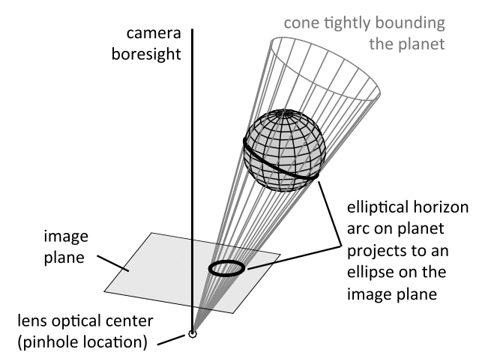
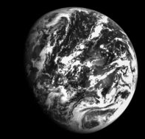
OpNav on Orion
Optical navigation Camera Purpose
  Uses pictures of the Earth and Moon (combined with known target ephemerides) to generate range and bearing measurements
  These measurements can be used in a Permanent Comm Loss (PCL) scenario to safely navigate the vehicle and crew home
  OpNav system first flight and certification on Artemis I
OpNav Camera
Christian, J.A., “Accurate Planetary Limb Localization for Image-Based Spacecraft Navigation,” Journal of Spacecraft and Rockets, Vol. 54, No. 3, 2017, pp 708-730.
OpNav Camera Image of the Earth from Artemis I (Photo Credit: NASA)

Slide 4
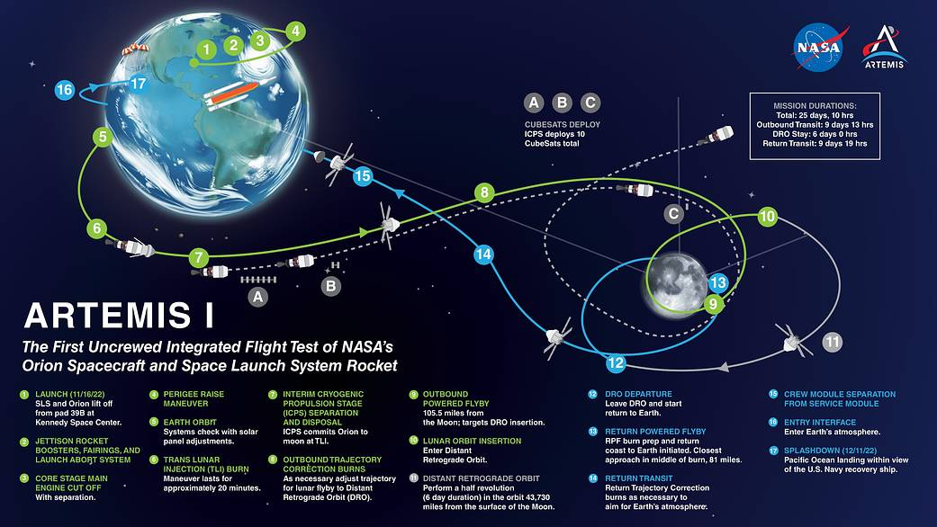
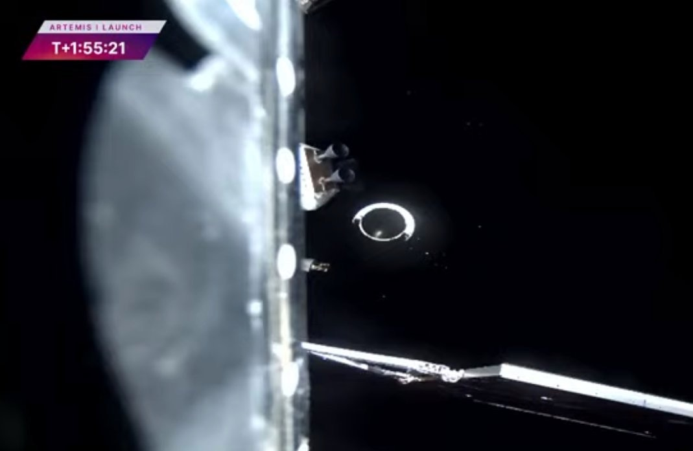
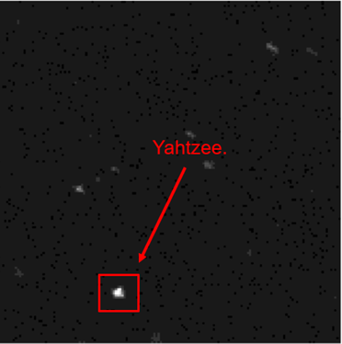
Artemis I
OpNav officially certified in flight
  Needed certification to officially be made an option for PCL return
  Certification successful
  Several imaging passes of target bodies and starfield imagery gathered throughout the flight
Other Flight Tests
  Long range bearing to ICPS (Interim Cryogenic Propulsion Stage)
  Terrain Imaging during low altitude powered flybys
Artemis I Flight Plan (Photo Credit: NASA)
ICPS just after separation and again at 2600 nautical miles (As seen by the OpNav Camera)
(Photo Credit: NASA)
Kobylka, Kevin R., and Derek A. Hutton. "Methods for Analytic Reflected Radiant Flux Modeling in Observing Space Vehicles." 46th Annual AAS Guidance, Navigation and Control (GN&C) Conference. No. AAS24-191. 2024.

Slide 5
Artemis I
OpNav officially certified in flight
  Needed certification to officially be made an option for PCL return
  Certification successful
  Several imaging passes of target bodies and starfield imagery gathered throughout the flight
Other Flight Tests
  Long range bearing to ICPS (Interim Cryogenic Propulsion Stage)
  Terrain Imaging during low altitude powered flybys
Artemis I Flight Plan (Photo Credit: NASA)

Slide 6
Terrain Imaging Flight Test
2 powered flybys where terrain imaging would be possible
  Occur when going to and returning from Distant Retrograde Orbit (DRO)
  Outbound Powered Flyby (OPF)
  Return Powered Flyby (RPF)
Goals of flight test
  Generate high resolution sets of Lunar imagery for use in developing Terrain Relative Navigation (TRN) based algorithms
  Demonstrate that OpNav Camera (designed for lit-limb navigation) can also capture adequate imagery for TRN
RPF
DRO
OPF

Slide 7
Outbound Powered Flyby Results
OPF images all over exposed
  Nominally, OpNav uses exposure times that are a function only of phase angle (when the Moon is being viewed as an extended body)
  Resulted in exposure times that were too long for the dynamic low altitude lighting environment when the moon is no longer an extended body
Needed new approach before RPF image gathering
OpNav Photos from Artemis I OPF (Photo Credit: NASA)

Slide 8
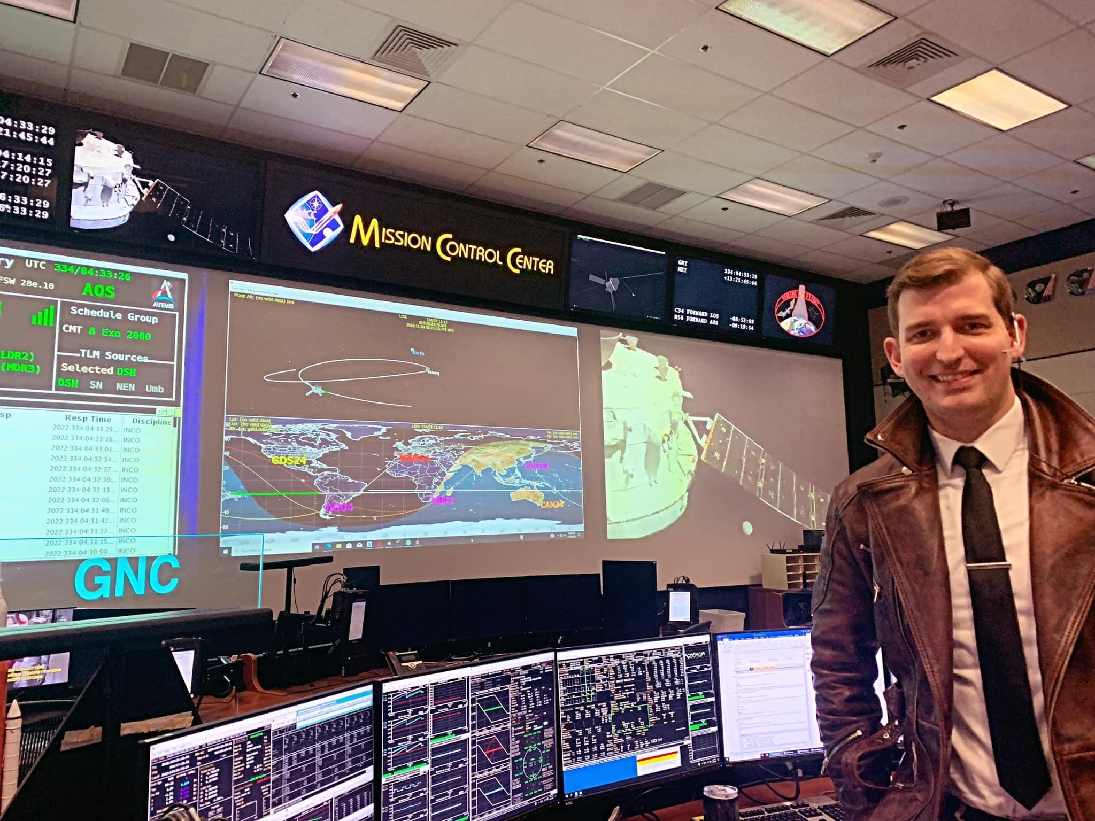
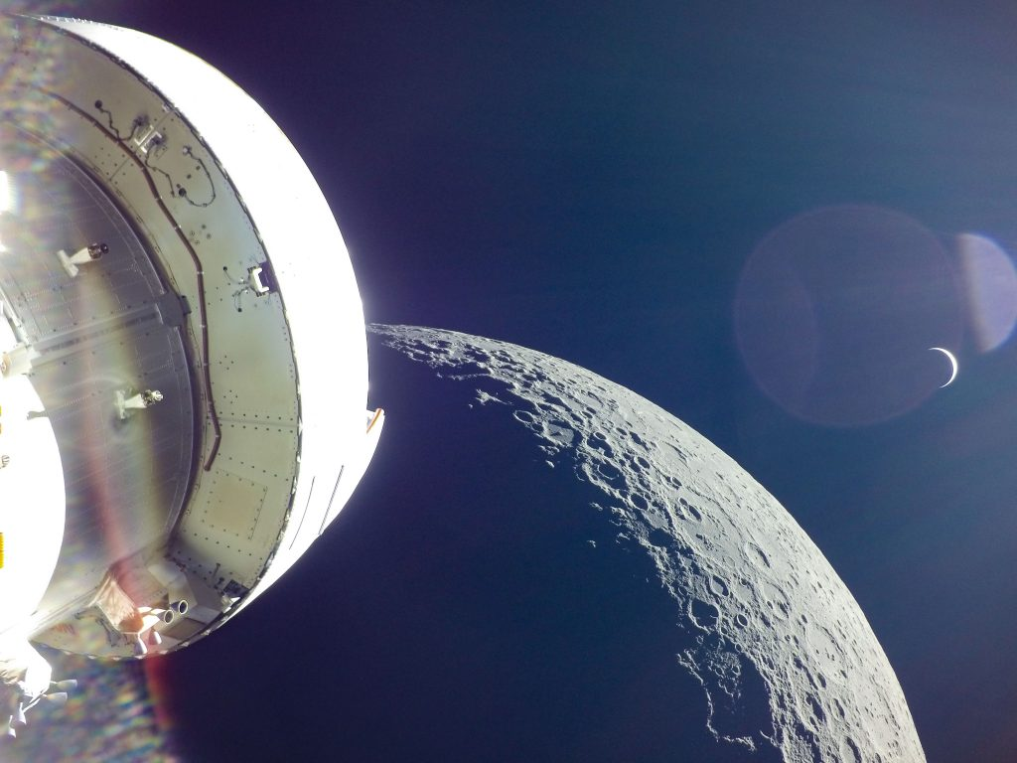
Exposure Time determination for RPF
I was brought in prior to RPF to help determine a solution
  Previously had been focused on training with various consoles in Mission Control
  Some of my PhD work with John Christian had focused on photometric modelling in image-based spacecraft navigation
  Only about 36 hours remained until RPF
LOS around the Moon - only one opportunity to upload exposure commands prior to RPF
  Once pre-scripted commands were sent, we wouldn’t know the results until AOS after burn completion
  Could only command a few exposure changes -- had to be strategic
White Flight Control Room during Artemis I
Artemis I spacecraft prior to RPF
(Photo Credit: NASA)

Slide 9
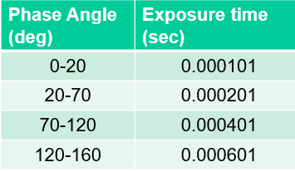


Context
Lighting Environment during low-altitude flyby extremely challenging
  When the Moon/Earth is an extended body, exposure time is only a function of phase angle.
  During the flybys, the lighting experienced in the imagery varies as a function of the vehicle pointing direction and altitude
    i.e. looking towards the lit limb or towards the terminator
  Simulation software does not yield realistic hardware settings (such as exposure time)
At the start, only had table with empirically determined phase angle and exposure time relationship for lit limb OpNav
Incoming Sunlight
$$u_{Sun}$$
Phase angle
θ (deg)
$$u_{S/C}$$
Description of phase angle and table showing associated OpNav exposure times

Slide 10
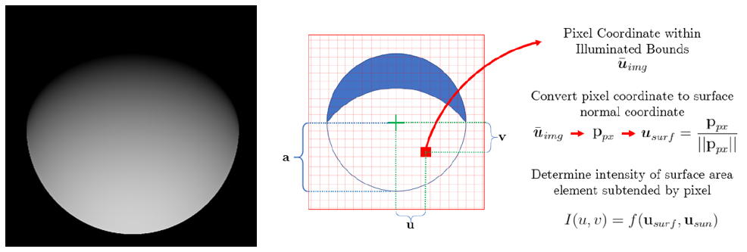
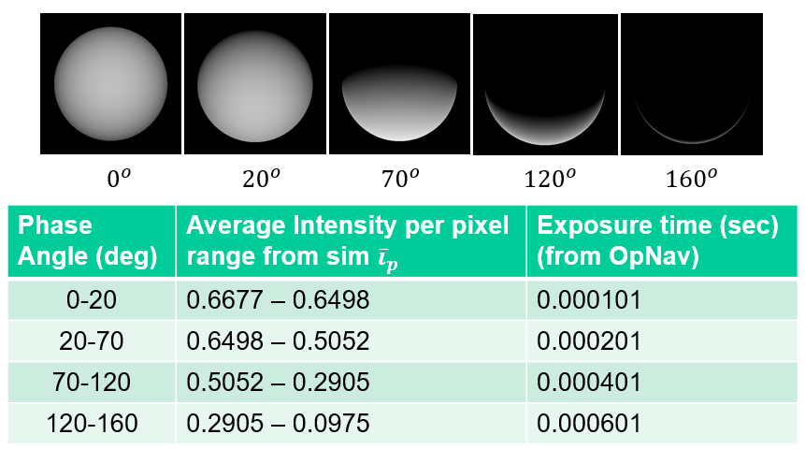
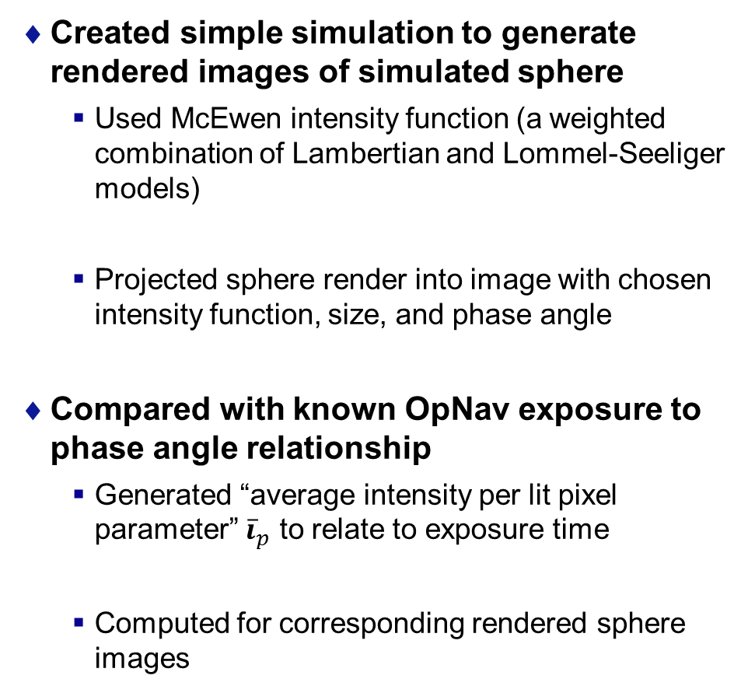
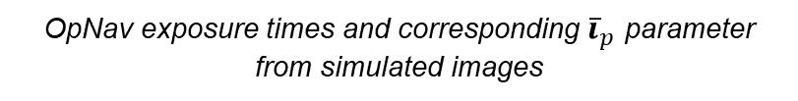
Methods and Models (1/2)
Created simple simulation to generate rendered images of simulated sphere
  Used McEwen intensity function (a weighted combination of Lambertian and Lommel-Seeliger models)
  Projected sphere render into image with chosen intensity function, size, and phase angle
Compared with known OpNav exposure to phase angle relationship
  Generated “average intensity per lit pixel parameter” ${\overline{i}}_{p}$ to relate to exposure time
  Computed for corresponding rendered sphere images
Diagram of how simulated sphere renders can be created with selected intensity function
OpNav exposure times and corresponding ${\overline{i}}_{p}$ parameter from simulated images

Slide 11
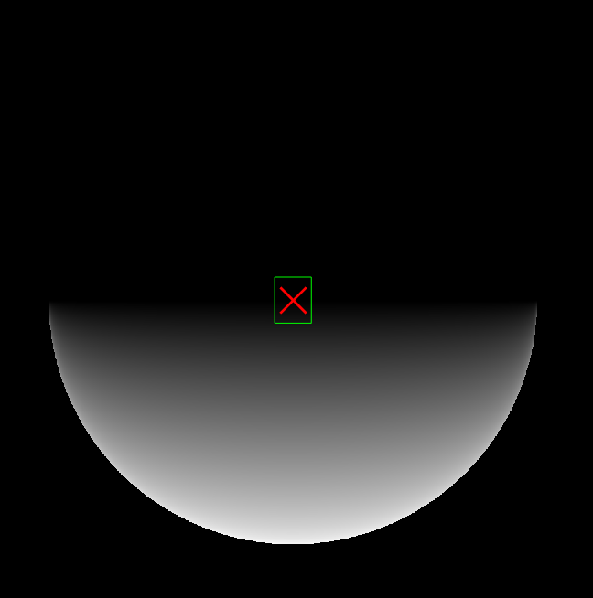
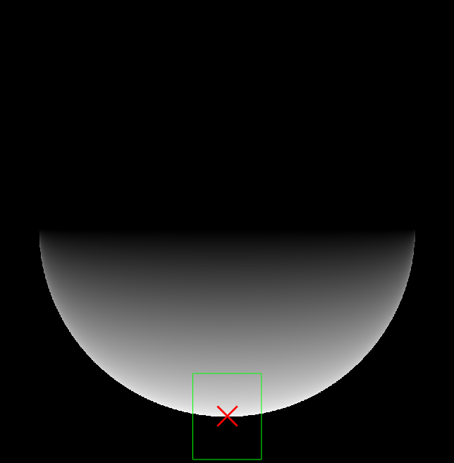
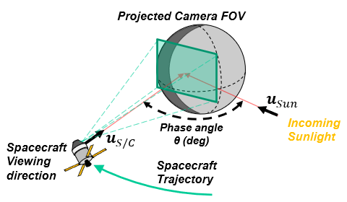

Methods and Models (2/2)
Trajectory info was used to determine lighting direction during flyby and approximate spacecraft altitude over the surface
  Working with friends in Flight Operations (GNC Pointing), we knew we would be pointed towards the Moon and transition over the lit limb as we descended, eventually reaching the terminator
  Using this information, a rough camera FOV was projected onto the low-fidelity image renders and the average intensity per lit pixel ${\overline{i}}_{p}$ computed over the transition from lit limb to terminator
Smaller FOV from lower altitude
Camera FOV
Camera Center

Slide 12
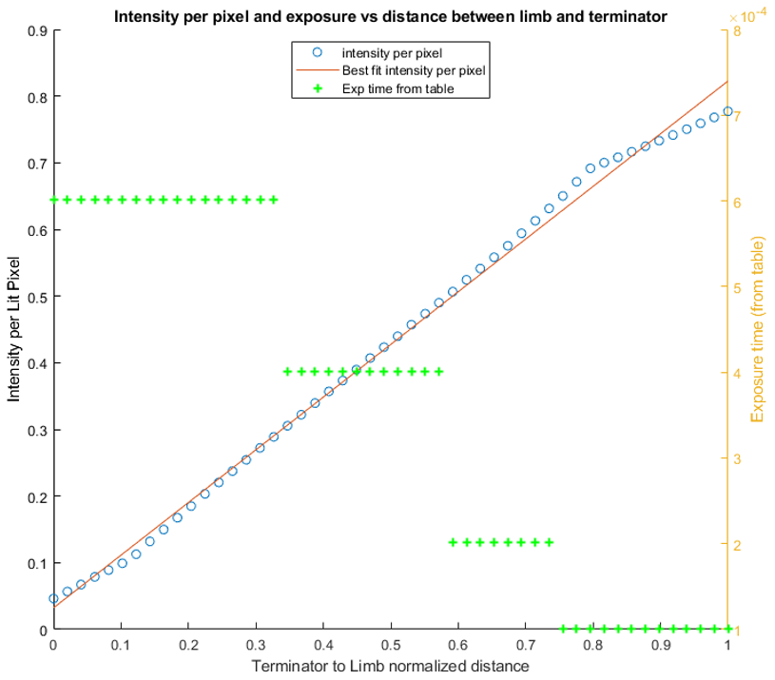
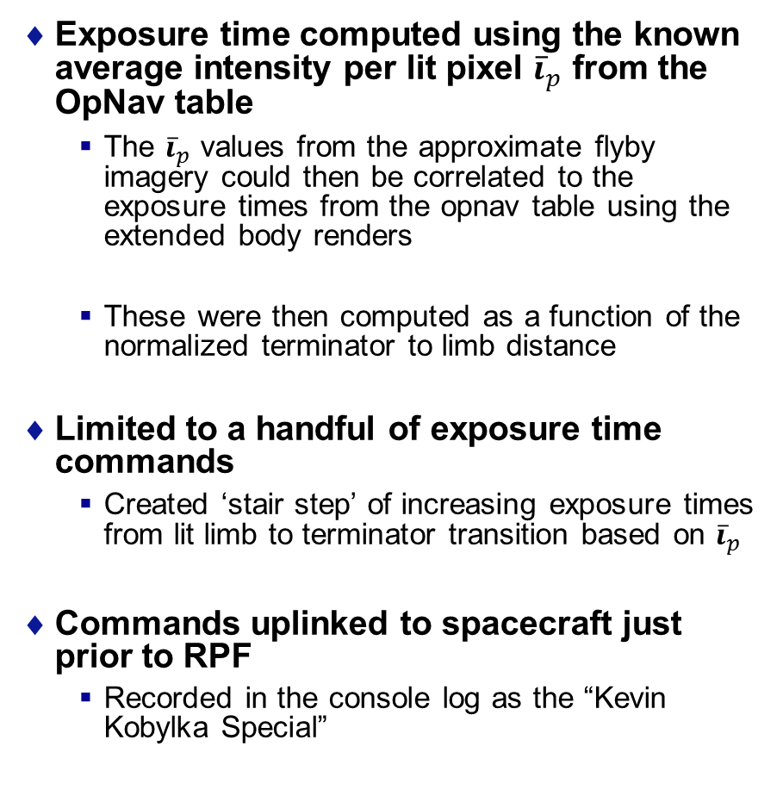
Flyby Exposure Time Calculation
Exposure time computed using the known average intensity per lit pixel ${\overline{i}}_{p}$ from the OpNav table
  The ${\overline{i}}_{p}$ values from the approximate flyby imagery could then be correlated to the exposure times from the opnav table using the extended body renders
  These were then computed as a function of the normalized terminator to limb distance
Limited to a handful of exposure time commands
  Created ‘stair step’ of increasing exposure times from lit limb to terminator transition based on ${\overline{i}}_{p}$
Commands uplinked to spacecraft just prior to RPF
  Recorded in the console log as the “Kevin Kobylka Special”

Slide 13
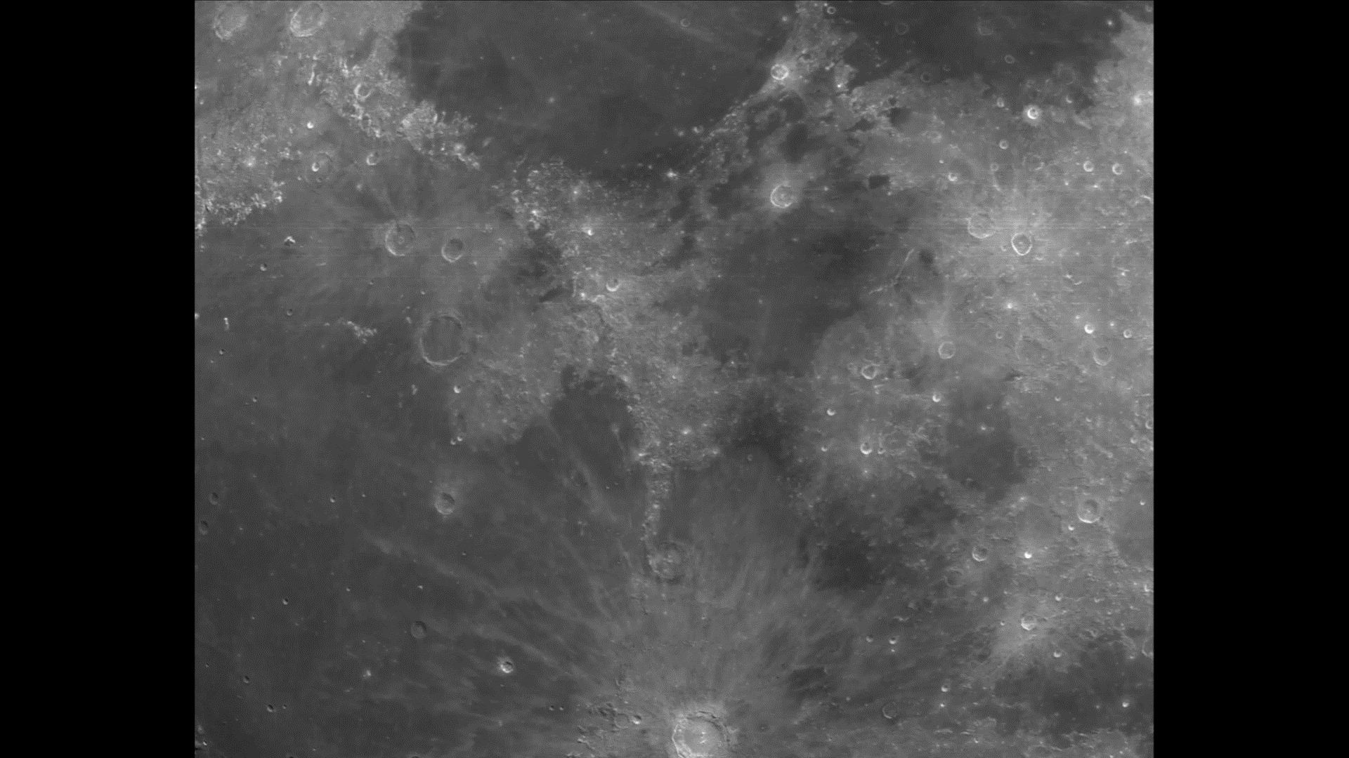
Results

Slide 14
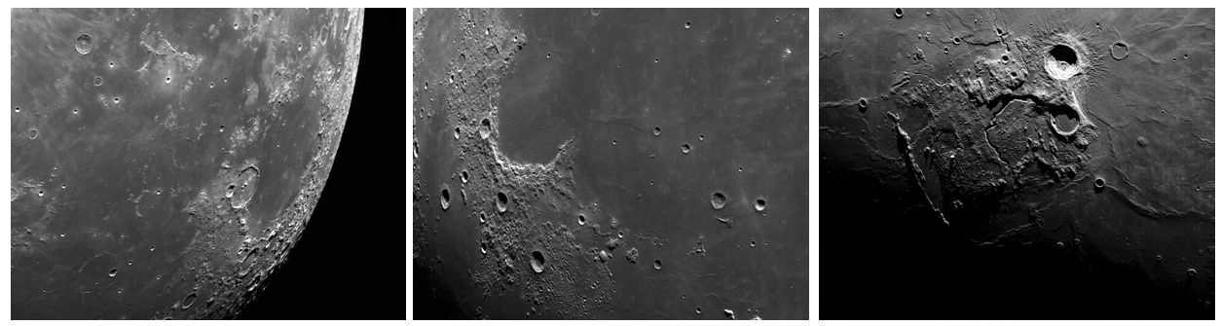
Conclusions and Forward Work
Briefing other partners on method
  Aim to develop more advanced techniques for determining camera settings on orbit in dynamic lighting environments
Imagery now used for development of Crater ID and TRN algorithms
Showed the versatility of an image based navigation system
  Something designed for lit-limb navigation can be reconfigured for TRN imagery and long range bearing

