Slide 1
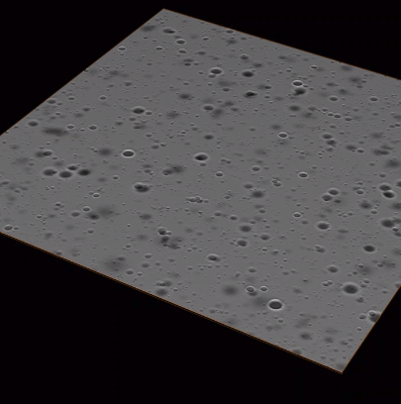
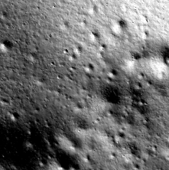
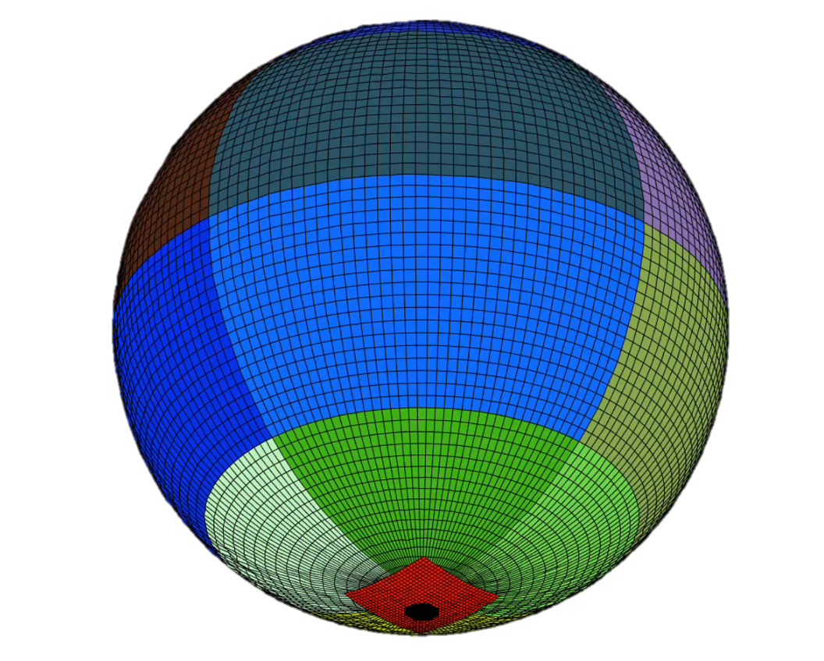
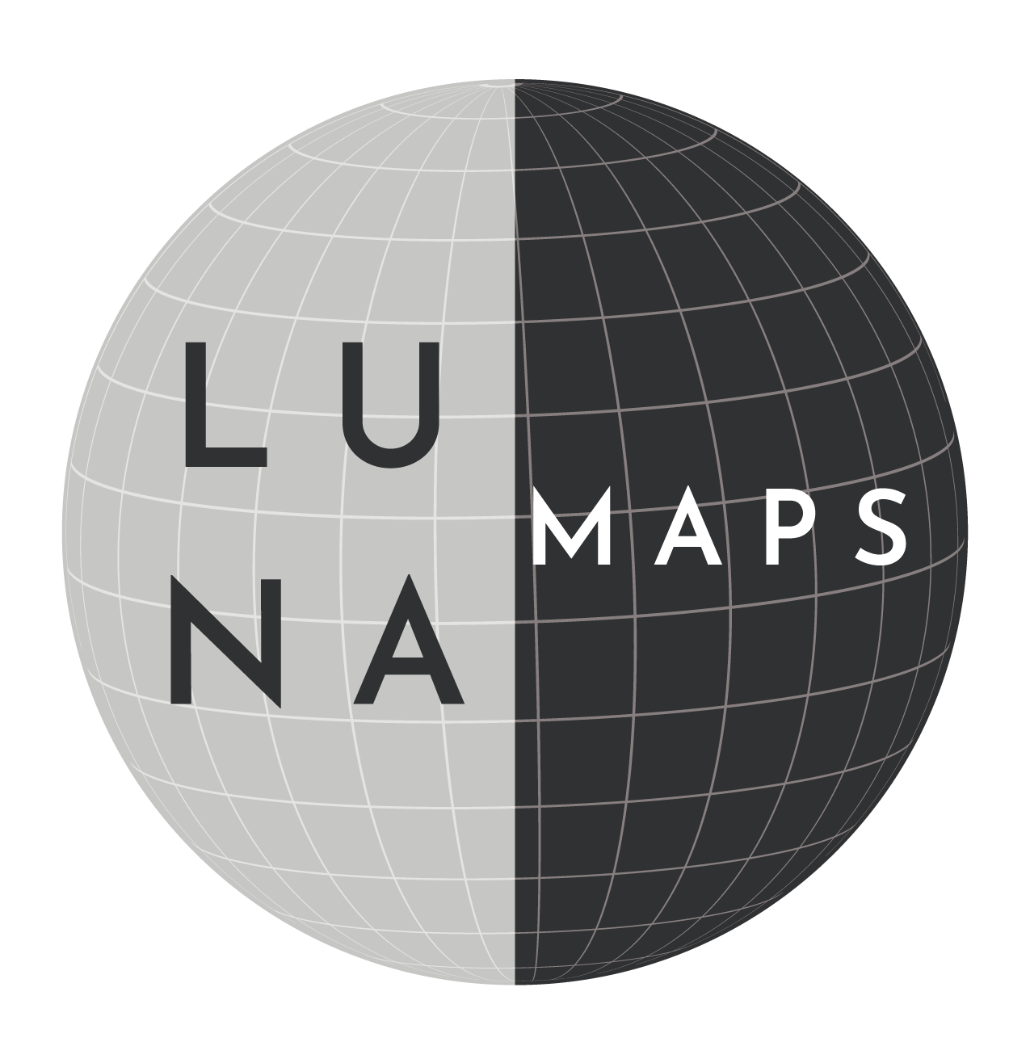
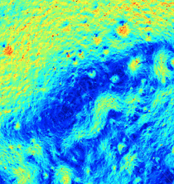
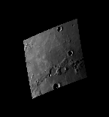
The LuNaMaps Team | 4th Space Imaging Workshop | October 7-9, 2024

Slide 2
Outline
Introduction
Building Digital Elevations Models
  Ames Stereo Pipeline
  Semi-automated Ground Track Digital Elevation Model Construction
Pre-built Maps
Map Validation (JPL, external slides)
TRN Validation
Synthetically Enhanced Digital Elevation Models
  analog Digital Elevation Model Tool
  synthterrain
  Synthetic Lunar Terrain (JPL, external slides)

Slide 3
Outline
Introduction
Building Digital Elevations Models
  Ames Stereo Pipeline
  Semi-automated Ground Track Digital Elevation Model Construction
Pre-built Maps
Map Validation
TRN Validation
Synthetically Enhanced Digital Elevation Models
  analog Digital Elevation Model Tool
  synthterrain
  Synthetic Lunar Terrain

Slide 4

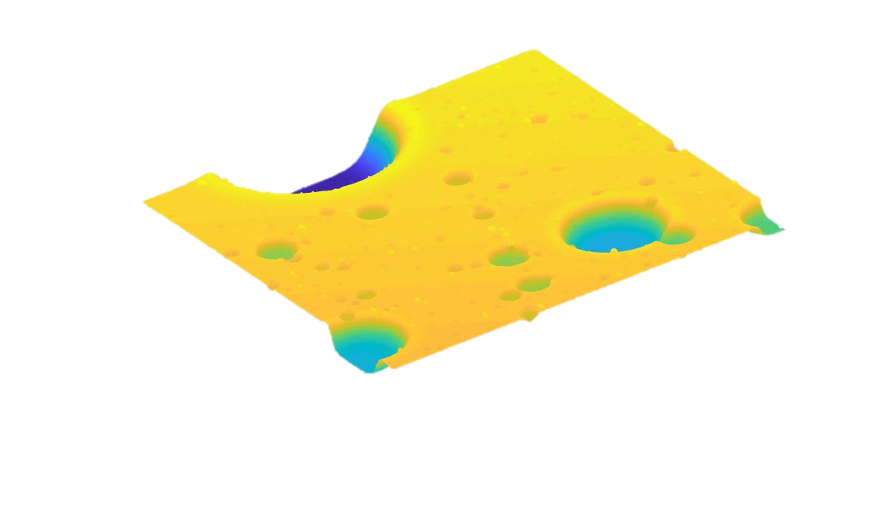
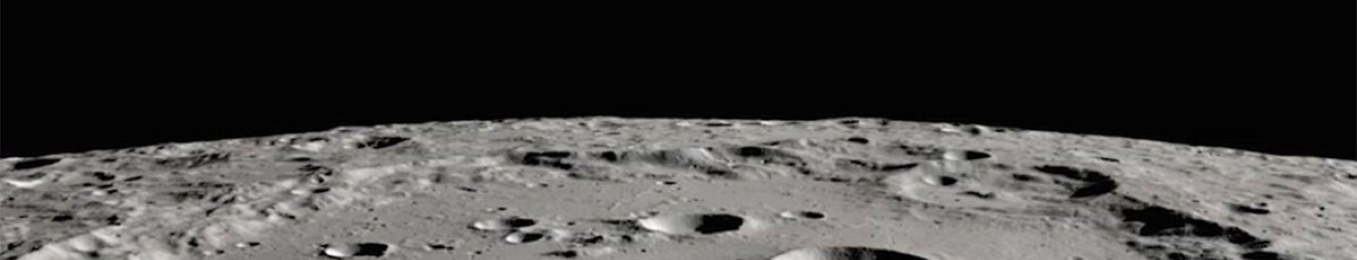
The Need for Better Lunar Map Products
TRN
Currently there are no lunar orbiters that can provide navigation solutions to landers or surface assets
Landers must rely on Terrain Relative Navigation (TRN) for precision landing
TRN systems use a reference map to localize the spacecraft in lunar coordinates
Hazard Detection and Avoidance (HDA) systems can quickly scan surface for hazards and perform divert maneuvers
HDA system development needs realistic terrain models
Powered Descent Initiation
Descent image
Ref. Map
Hazard Detection
3D Digital Elevation Map
Divert to hazard-free site
Controlled landing

Slide 5
Outline
Introduction
Building Digital Elevations Models
  Ames Stereo Pipeline
  Semi-automated Ground Track Digital Elevation Model Construction
Pre-built Maps
Map Validation
TRN Validation
Synthetically Enhanced Digital Elevation Models
  analog Digital Elevation Model Tool
  synthterrain
  Synthetic Lunar Terrain

Slide 6
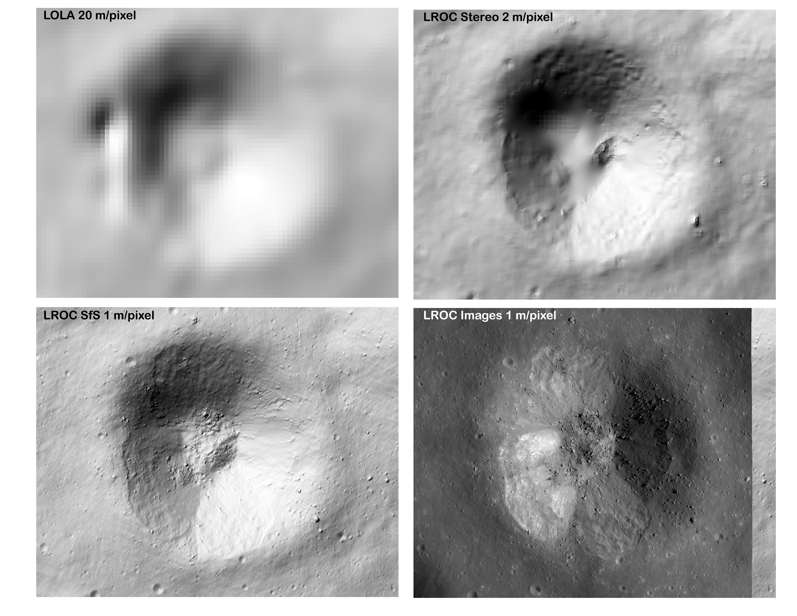
Ames Stereo Pipeline
A suite of free and open-source automated geodesy and stereogrammetry tools designed for processing stereo images captured from satellites (around Earth and other planets), robotic rovers, aerial cameras, and historical images, with and without accurate camera pose information.
ASP produces cartographic products, including digital terrain models (DTMs, synonymous with digital elevation models, DEMs), ortho-projected images, 3D models, and bundle-adjusted networks of cameras. These data products are suitable for science analysis, mission planning, and public outreach.

Slide 7
Ames Stereo Pipeline
ASP is a complex toolchain with a number of steps. Roughly these break down into:
  Select a set of overlapping images to process.
  Convert the images into ISIS cube files performing radiometric calibration and echo correction (typically using ISIS), and optionally generate community sensor model (CSM) files for your images.
  Perform bundle adjustment using the bundle_adjust or parallel_bundle_adjust command line interface (CLI)
  Generate a DEM from stereo (or structure from motion) using the stereo or parallel_stereo CLIs (or using the stereo_gui GUI) followed by the point2dem CLI
  (Optionally) generate a higher-resolution DEM using shape from shading with the sfs or parallel_sfs CLIs
  Align to some reference DEM (usually LOLA) using the pc_align CLI
  Iterate steps 3-6

Slide 8
Semi-automated Ground Track Digital Elevation Model Construction
Shape from Shading (e.g., within ASP) requires a careful selection and pre-processing of the input data
Calibrated input images need to be carefully aligned to each other and registered to the a priori DEM, to avoid aliasing and artifacts in the products
Careful images selection to lower computational costs without sacrificing coverage (surface, illumination)
Cumbersome pre-processing work for large areas and large number of images, delicate validation of the final products
Identify images and calibrate
Pre-process images and down-select
Start from input LDEM/SLDEM at 5-100 m/pix
Find overlapping images (shapes)
Bundle-adjust (BA) images (iterate)
Compute Shape-from-Shading (SfS) DEM
SFS DEM @ target resolution + ancillary products (validation)
Calibrate and project on DEM
Select subset for optimal coverage
Set paths, crs, target resolution, region of interest
Filter bad and shadowed images
Register images to a priori DEM (IA)
Main steps of our SfS pipeline
Notes:
Can we get the same plot for Connecting Ridge site?

Slide 9
Semi-automated Ground Track Digital Elevation Model Construction
Semi-automated pipeline of python scripts, USGS ISIS + Ames Stereo Pipeline (ASP) wrappers, and geospatial libraries (gdal, xarray, geopandas)
Published and ongoing applications to the Moon (LuNaMaps, AGDT) and Mercury
Successfully applied to large (e.g., 16x16 km, 300x300 km) regions and 2500+ LROC or MDIS NAC images
Distributed processing on the NCCS PGDA/ADAPT cluster
Identify images and calibrate
Pre-process images and down-select
Start from input LDEM/SLDEM at 5-100 m/pix
Find overlapping images (shapes)
Bundle-adjust (BA) images (iterate)
Compute Shape-from-Shading (SfS) DEM
SFS DEM @ target resolution + ancillary products (validation)
Calibrate and project on DEM
Select subset for optimal coverage
Set paths, crs, target resolution, region of interest
Filter bad and shadowed images
Register images to a priori DEM (IA)
Main steps of our SfS pipeline
Notes:
Can we get the same plot for Connecting Ridge site?

Slide 10
DEM Building Tools Availability
The Ames Stereo Pipeline has been available as open-source software for many years
  Software repository: https://github.com/NeoGeographyToolkit/StereoPipeline
  Detailed documentation and tutorials: https://stereopipeline.readthedocs.io/en/latest/introduction.html
A description of the semi-automated ground track process as well as the scripts used are available at
  https://pgda.gsfc.nasa.gov/products/92

Slide 11
Outline
Introduction
Building Digital Elevations Models
  Ames Stereo Pipeline
  Semi-automated Ground Track Digital Elevation Model Construction
Pre-built Maps
Map Validation
TRN Validation
Synthetically Enhanced Digital Elevation Models
  analog Digital Elevation Model Tool
  Synthterrain
  Synthetic Lunar Terrain

Slide 12
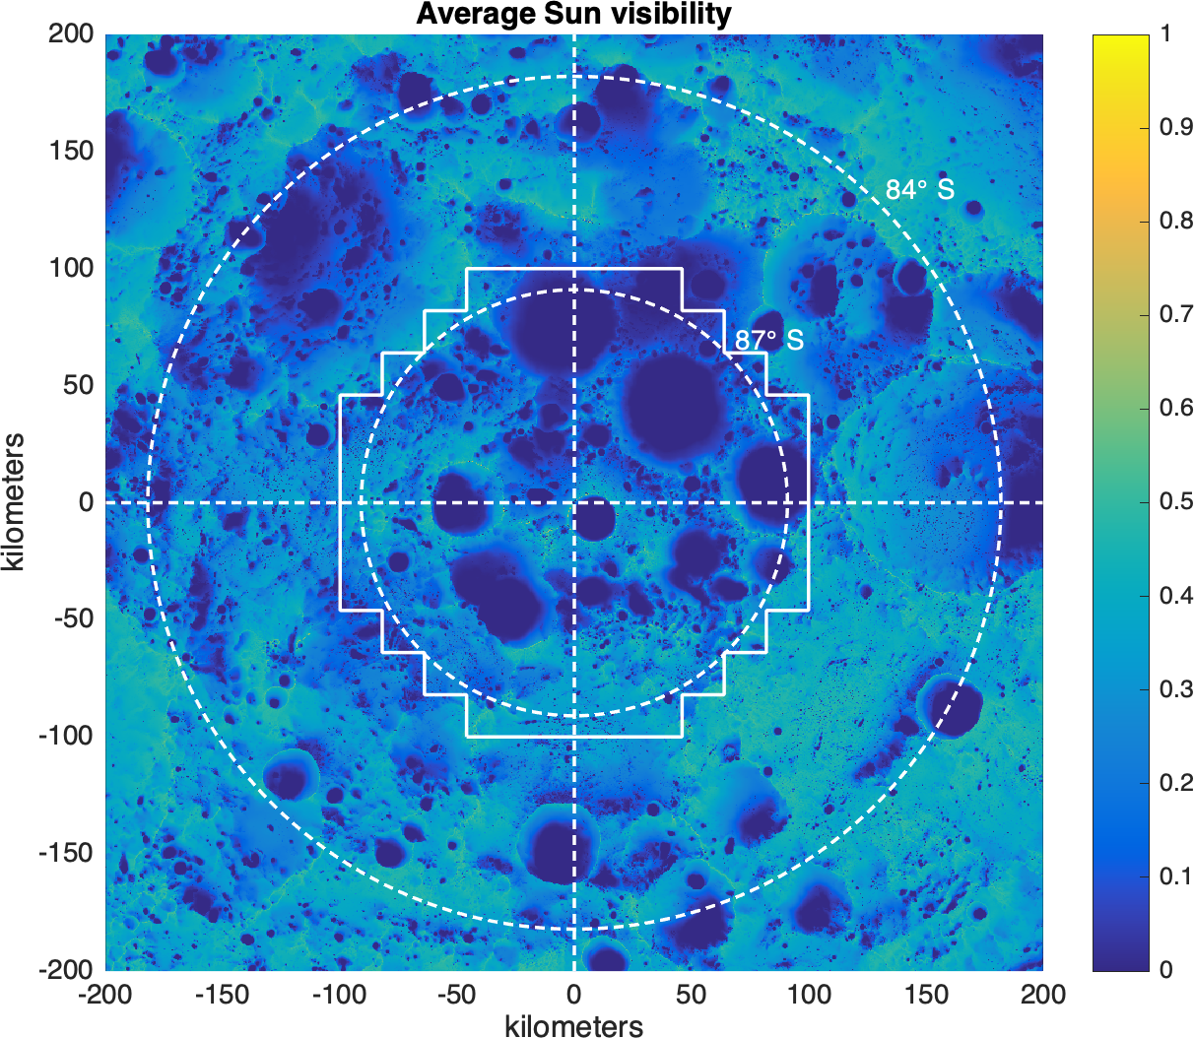
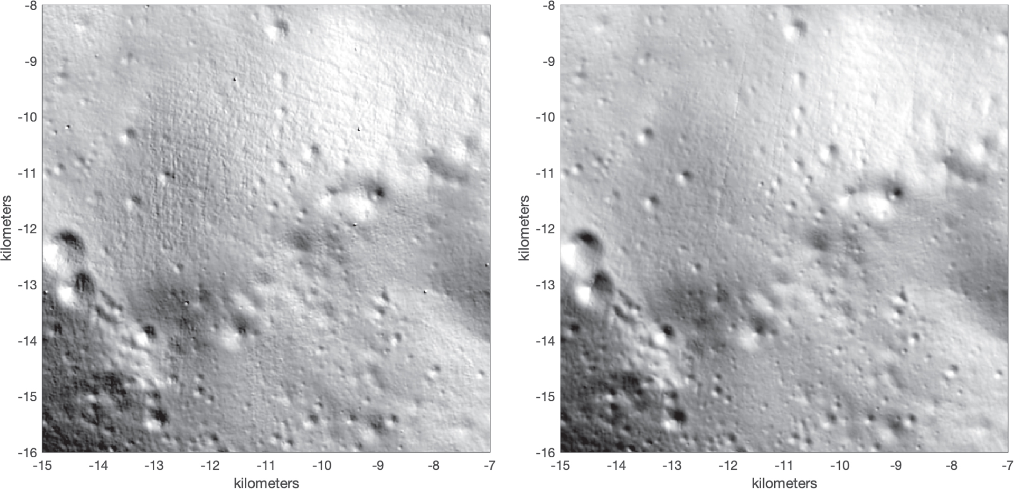
Pre-built maps
The project built high-quality digital elevation models of the lunar surface at key points of interest.
Cleaned and higher-resolution LOLA DEMs of the south pole:
  80º – 87º south 20 m/pix: https://pgda.gsfc.nasa.gov/products/90
  87º – 90º south 5 m/pix: https://pgda.gsfc.nasa.gov/products/81

Slide 13
The project built high-quality digital elevation models of the lunar surface at key points of interest.
1 m/pix shape from shading DEM of the Apollo 16 site:
  Will soon be available at the Planetary Data System (PDS) Cartography and Imaging Sciences Node Annex
Additional sites may be released after evaluation of data sensitivity

Slide 14
Outline
Introduction
Building Digital Elevations Models
  Ames Stereo Pipeline
  Semi-automated Ground Track Digital Elevation Model Construction
Pre-built Maps
Map Validation
TRN Validation
Synthetically Enhanced Digital Elevation Models
  analog Digital Elevation Model Tool
  synthterrain
  Synthetic Lunar Terrain

Slide 15
Outline
Introduction
Building Digital Elevations Models
  Ames Stereo Pipeline
  Semi-automated Ground Track Digital Elevation Model Construction
Pre-built Maps
Map Validation
TRN Validation
Synthetically Enhanced Digital Elevation Models
  analog Digital Elevation Model Tool
  synthterrain
  Synthetic Lunar Terrain

Slide 16






LuNaMaps TRN Validation Pipeline
Goal: Determine if it’s possible to derive concrete metrics or parameter ranges that relate DEM quality to TRN system performance.
  Use a combination of camera images and lidar measurements
  Use different TRN algorithms and implementations and different simulation pipelines
  Use different quality maps and different kinds of map errors and deformations
Maps
Create Lunar digital elevation maps of varying quality using LOLA altimetry data
Measurements
Test various TRN methods on the maps to generate results
Estimation
Analysis
Complete parametric runs to see how map quality affects TRN performance
Use observed and computed measurements in filter to generate state estimations

Slide 17
TRN Validation Pipeline
The TRN validation pipeline is run with the following steps
  Generate synthetic images using Vira
  Apply perturbations (to trajectory, to pointing, to navigation maps, etc)
  Generate TRN observations using GIANT (or other TRN tool)
  Process TRN observations in Monte (or other orbit determination tool)
  Repeat 2-5 for a range of variations
  Analyze the results
We are also working on finalizing/releasing a suite of scripts which automates much of these steps
We will present a detailed description of the pipeline at the upcoming SciTech conference in January.

Slide 18
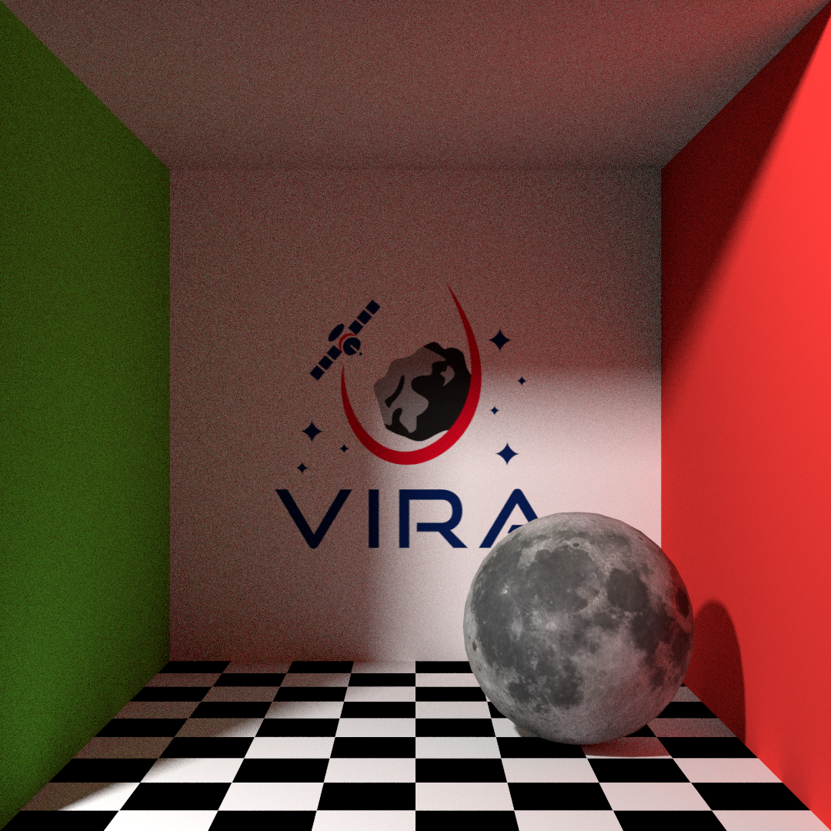
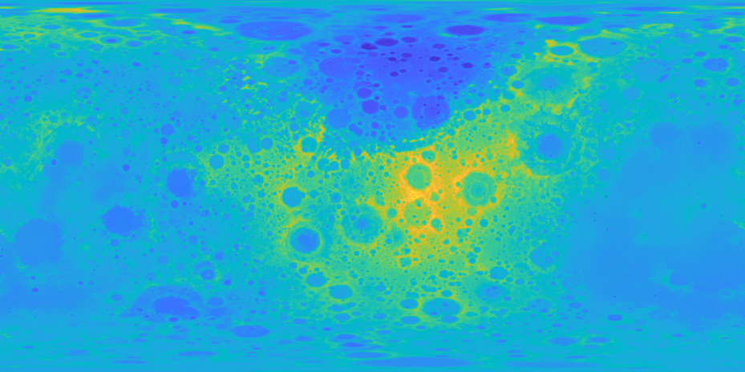
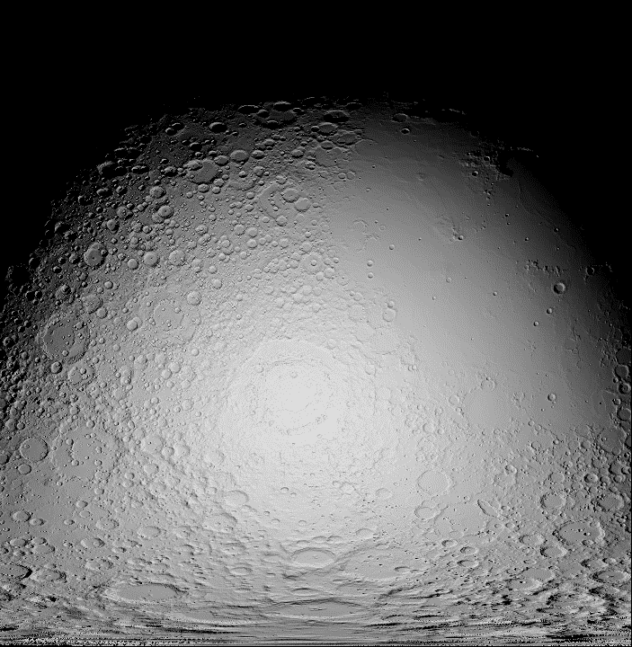
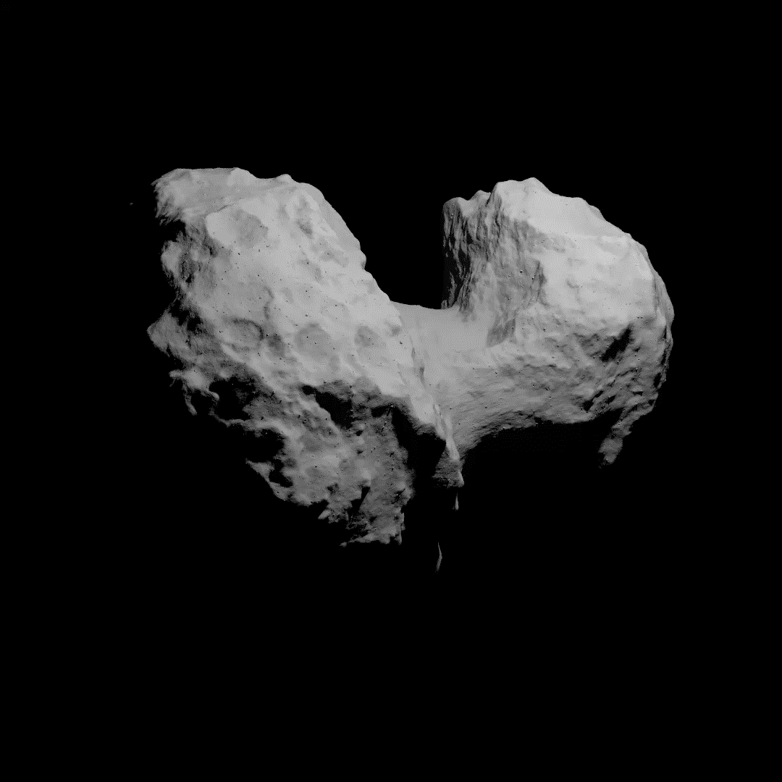
Vira – Rendering Tool
Aims to provide same science/engineering flexibility of tools like GIANT, with speed of tools like Blender.
  Will be all free and open-source
Supports GeoTIFF and SPC Maplets (read only), OBJ (read and write), PLY (binary/ASCII read and ASCII write)
  Level-of-Detail system Raster DEM formats (GeoTIFFs and SPC Maplets)
Written in C++20. Plan to eventually have python bindings (via pybindd11)
Supported on Windows, MacOS, and Linux
Currently CPU only (uses Intel Embree) though Vulkan implementation is in development
Named after Viracocha: Inca creator deity and creator of the Universe, Sun, Moon, and Stars
This image renders ~25% faster than Blender’s CPU Implementation

Slide 19
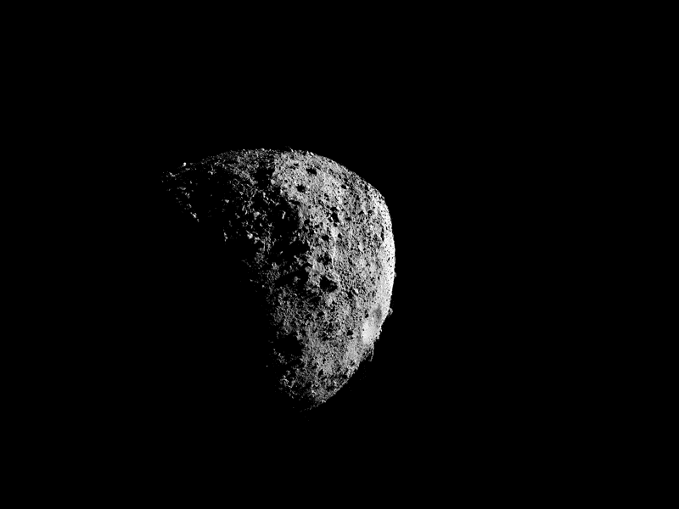
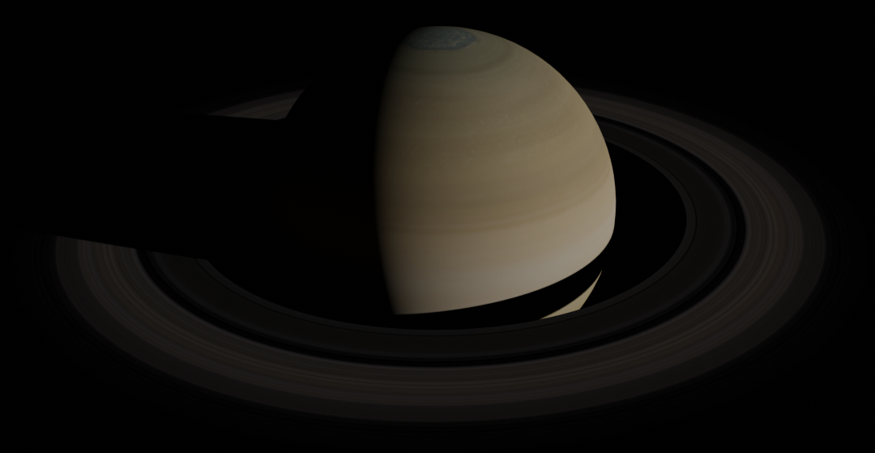
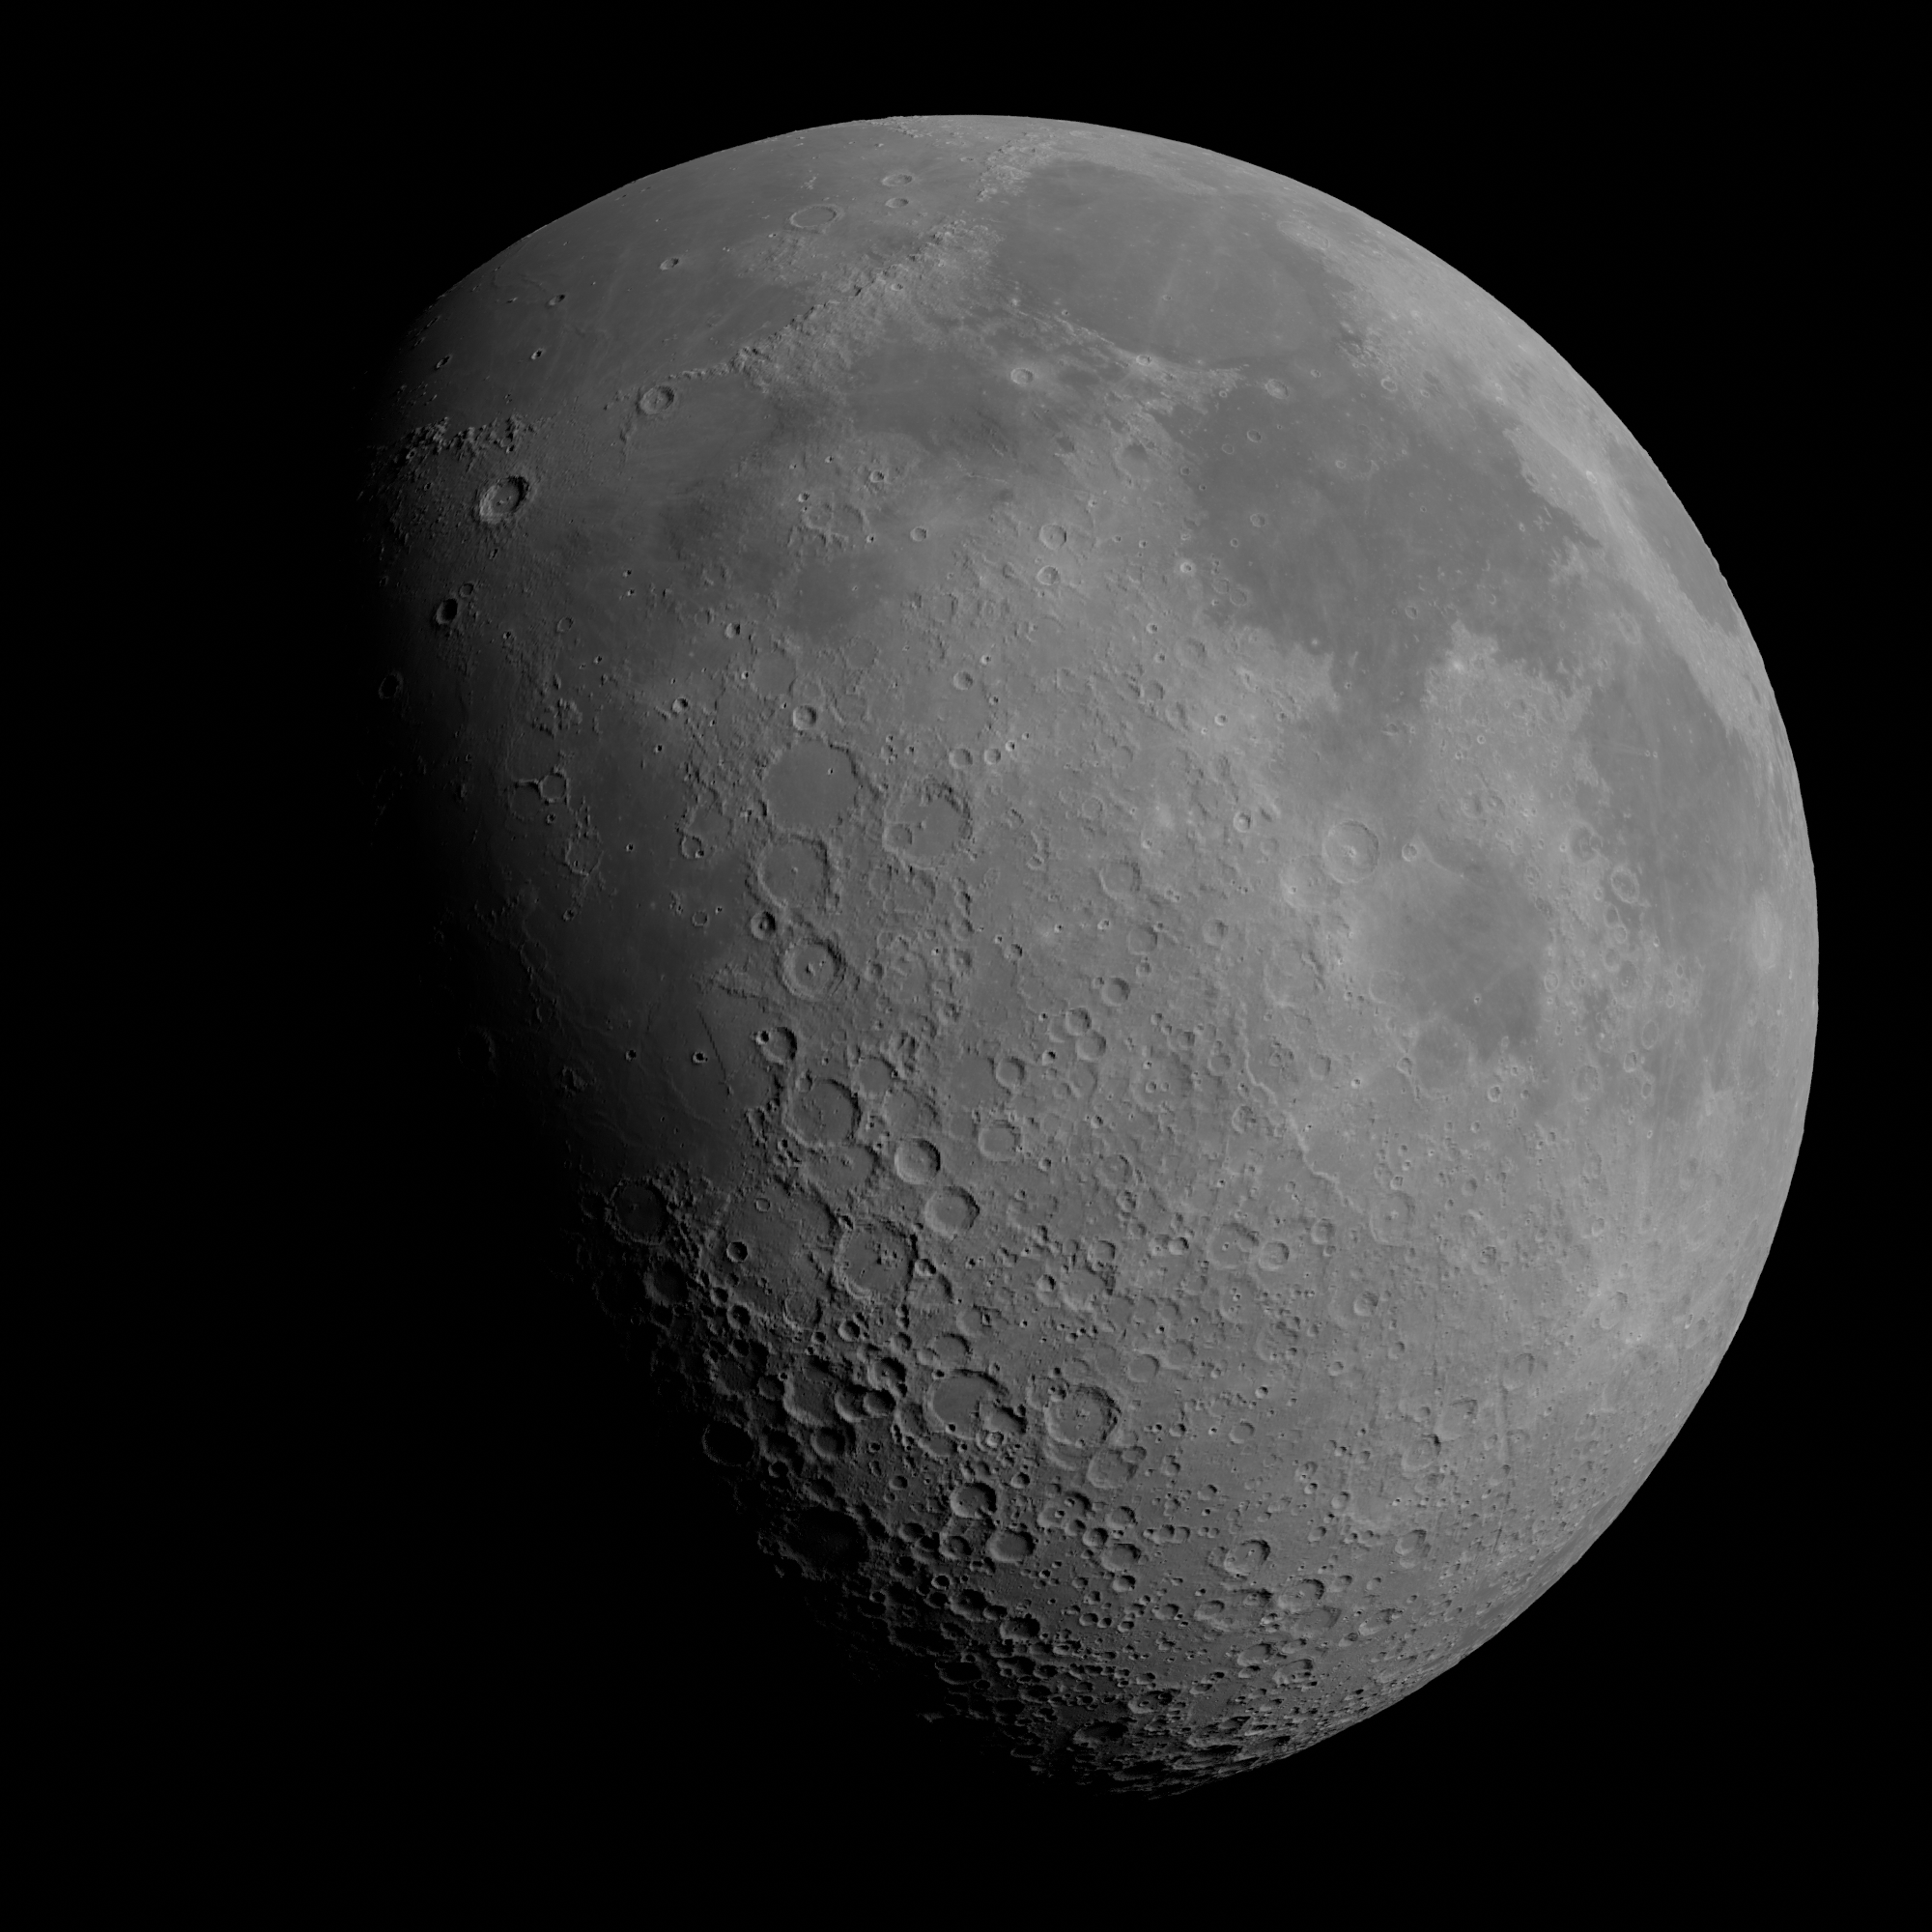
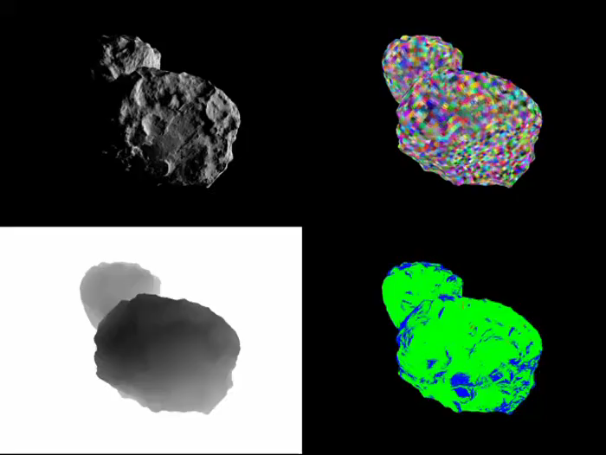
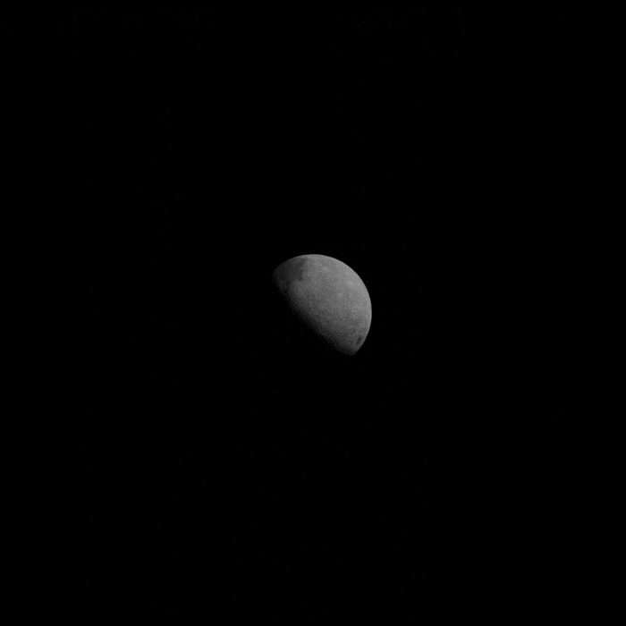
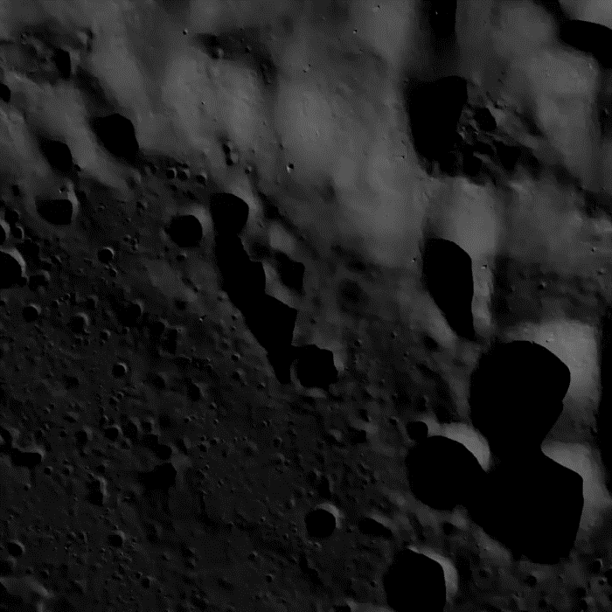
Vira – Rendering Tool
SLDEM2015 + LDEM60S DEMs wrapped with WAC albedo
Textured Saturn with Rings
67P SPC Maplets Level-of-Detail System
Bennu rendered with OSIRIS-Rex SPK/CK kernels
Lunar Descent Images

Slide 20
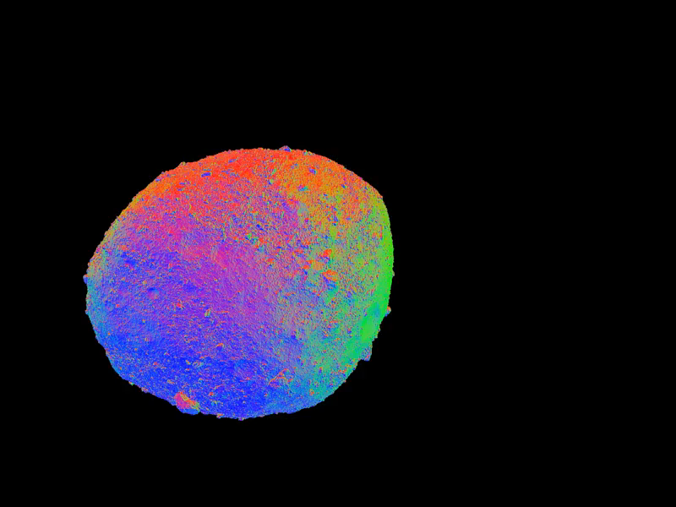
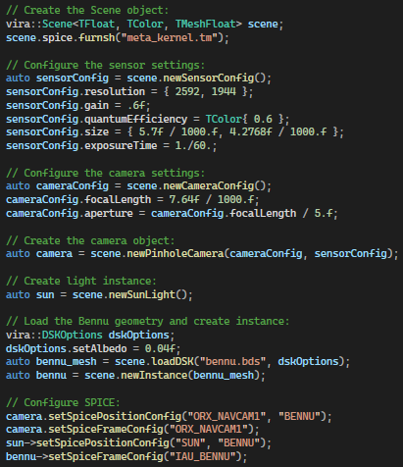
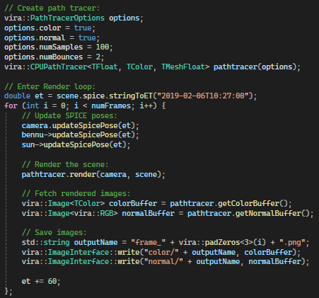
Using Vira
Configure Lights, Camera, Geometries
Configure Renderer

Slide 21
GIANT and Monte
In its default configuration, GIANT provides TRN processing capabilities and Monte provide orbit determination capabilities for the pipeline
Python package for optical navigation
Data ingest using command line utilities like obj_to_fc, spc_to_fc, dem_to_fc
Configuration and processing through python scripts
Python wrapper around c++ library for orbit determination (along with maneuver and trajectory design)
Data ingest using python scripts and command line utilities with an augmented python interpreter mpython
Uses the “lock – update – run” model

Slide 22
TRN Validation Pipeline
The component of the TRN validation pipeline are either available for license, open source, or in the process of being released
  Vira – will be released open source at https://github.com/nasa/vira
  GIANT – is available open source at https://github.com/nasa/giant
  Monte – is available for license at https://monteypy.jpl.nasa.gov
  The automated tool will be released open source on the NASA github
We are also working to release a representative set of TRN/direct altimetry flight software applications that can be plugged into the tool as well to demonstrate how different algorithms/software can be tested.
  These will hopefully be released open source on the NASA github but may need to be released for US Persons licensing pending export controls review.

Slide 23
Outline
Introduction
Building Digital Elevations Models
  Ames Stereo Pipeline
  Semi-automated Ground Track Digital Elevation Model Construction
Pre-built Maps
Map Validation
TRN Validation
Synthetically Enhanced Digital Elevation Models
  analog Digital Elevation Model Tool
  synthterrain
  Synthetic Lunar Terrain

Slide 24
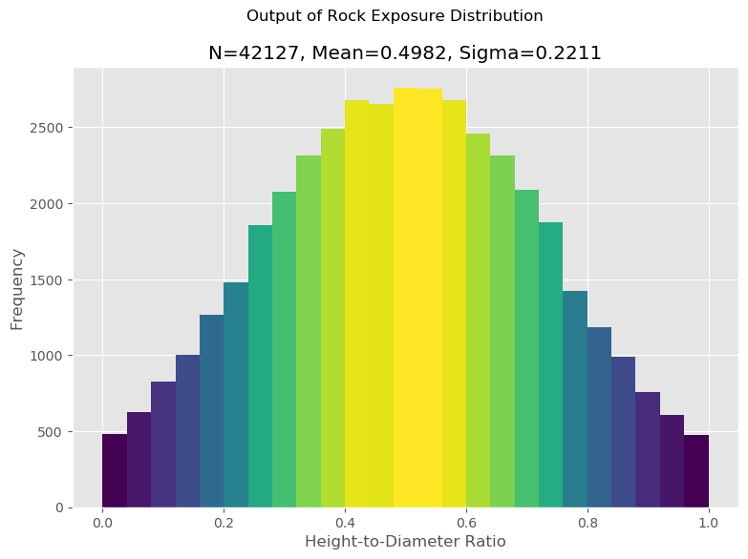
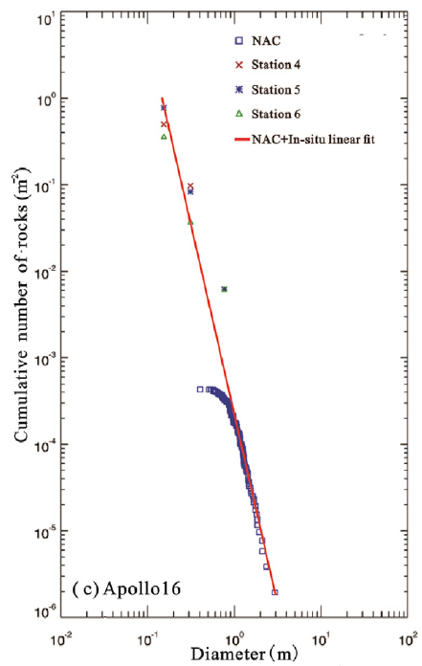
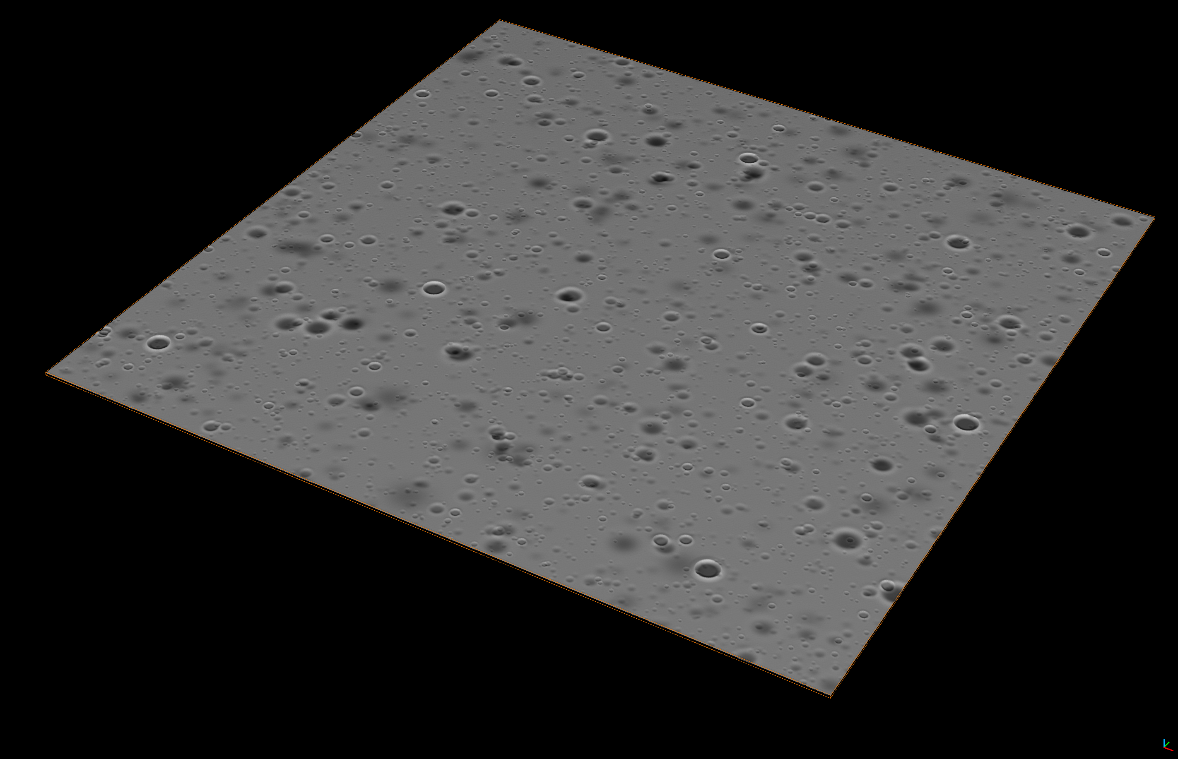
analog Digital Elevation Model (aDEM) Tool
The aDEM tool, analog_demaker is implemented in python and allows a user to create a large population of 3D models (as point clouds or mesh elements) to create realistic HD DEMs.
The output can be used directly in a native 3D environment or embedded into an existing DEM. The frequency and size distributions of terrain elements are customized by the user to fit specific planetary landing site scenarios (or according to user specifications).
The current implementation generates synthetic populations of craters and rocks with distributions and shapes that have been field tested or verified in the literature.
Craters are modeled to include specified ranges of expected depth, diameter, and land surface diffusion specified by the DNSE. Craters are embedded in “age order,” and intended to merge smoothly with existing surfaces.
Rocks are created a priori from real boulders, rocks and geological surface textures, and can be embedded in the DEM surface with variable depth according to a specified distribution curve.
Rock burial model from Demidov & Basilevsky (2014).
Apollo 16 rock distribution
from Li et al. (2017)
3D-rendered
example of crater output.

Slide 25
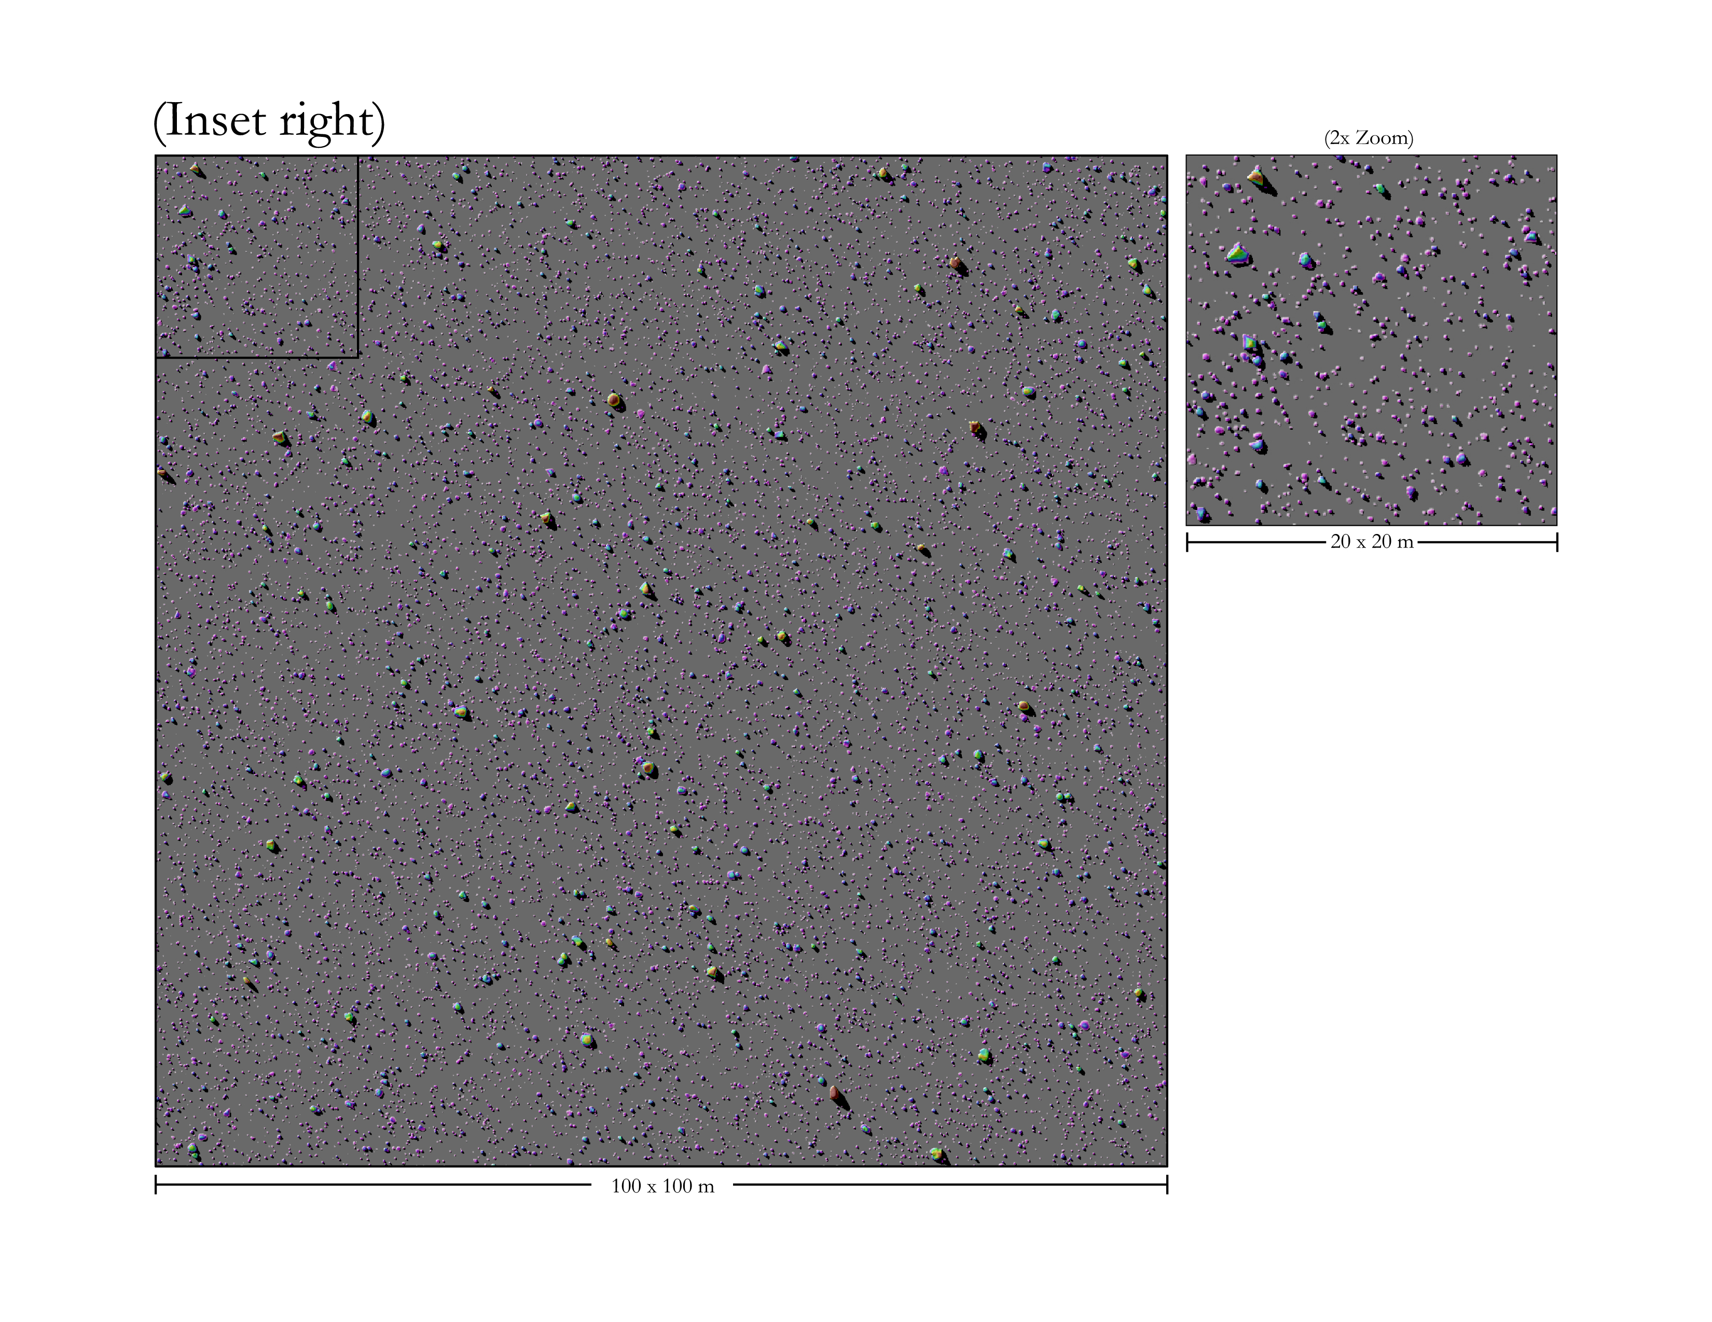
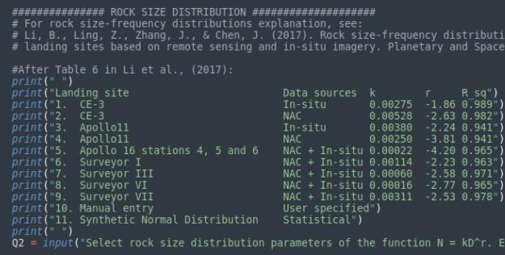
analog Digital Elevation Model (aDEM) Tool
Tool Components
  3D digital assets in an expandable library containing models of boulders, rocks, and surface textures, including Apollo samples.
  Subroutine program codes in python, outputs: ply or obj files, csv file of rock statistics, and plots
    The rocky surface generator (irockdem, internal call) manipulates and populates rocks
    The crater generator (crater_maker, internal call) manipulates and populates small craters
  Main python program (analog_demaker) prompts the user to input configuration options and parameters that specify frequency distributions, file names, etc. The final output is an HD DEM, i.e., the analog DEM (aDEM) (capable for < 10 cm/pixel) and statistical summaries for small elements below the resolution of the available target DEM’s spatial resolution. [Raster/Geotiff export nearly complete.]
  Code is currently implemented on a standard Linux terminal after installation of library dependencies, which are all open source.
Example of rock distribution from Apollo 16.
Example of user input for rock size frequency distribution to match ground truth.

Slide 26
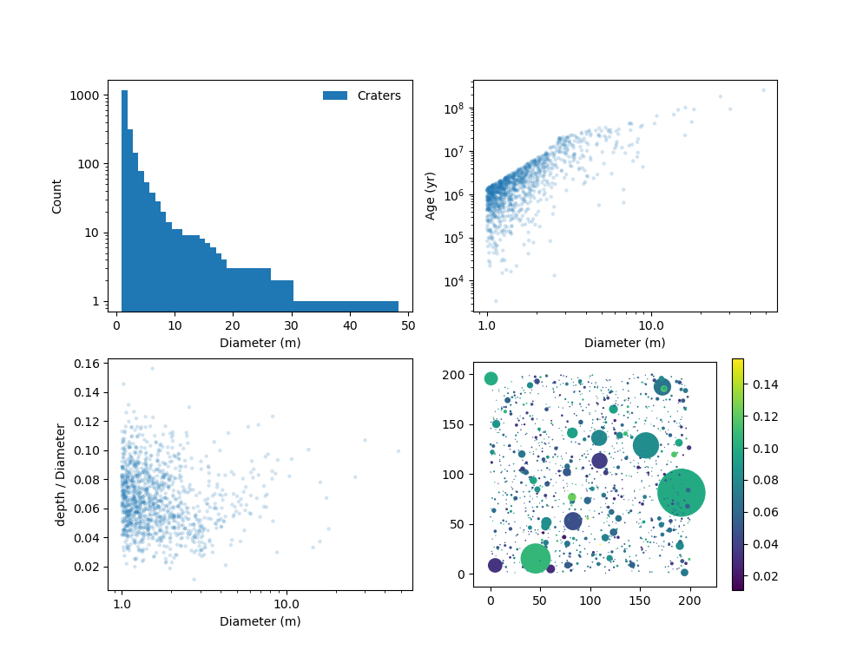
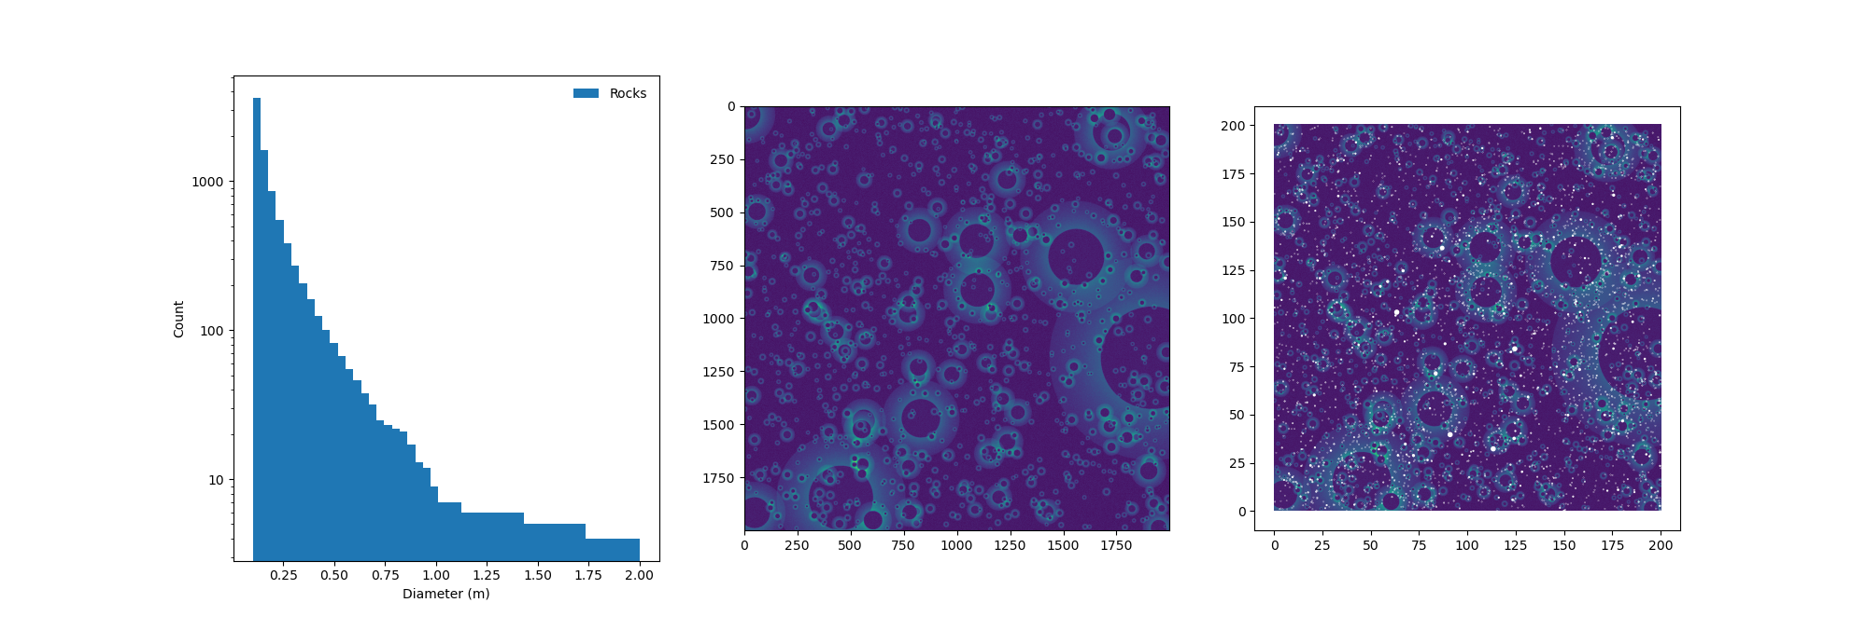
synthterrain
The synthterrain program uses methods and techniques anchored in the planetary science literature to generate populations of craters with realistic diameters, depths, and ages. It uses similar techniques to generate rock populations based on craters (either generated or provided).
The size-frequency distributions used for craters and rocks can be fine-tuned for different planets and regions, and there are a host of configuration options.
Synthetic crater populations
Size-frequency distribution
Age estimate
Synthetic rock populations
Result of diffusion modeling on depth
Probability map
Craters (in white) overlaid on map

Slide 27
synthterrain
The synthterrain tool is comprised of 4 command line interfaces built using python:
  synthcraters – Generate synthetic crater populations and save to a csv file and optionally a geotiff
  synthrocks – Generate synthetic rock populations and save to a CSV file
  synthterrain – Generates synthetic crater and rock populations and saves them to CSV files.
  synthcraterplot – Generates plots showing crater distributions.
synthterrain is available open source at https://github.com/NeoGeographyToolkit/synthterrain

