Slide 1
SAGE III/ISS Validation Communications
NASA Langley Research Center
10/22/2024

Slide 2
Validation Efforts
The validation team has continued efforts to validate the SAGE III/ISS data product against in-situ & satellite measurements collected via a variety of sources
Ground-Based Measurements: Lidar & Sonde Data
  Actively participating NDACC, SHADOZ, and WOUDC stations
Satellite-Based Measurements
  Aura Microwave Limb Sounder (MLS) v5
  Atmospheric Chemistry Experiment Fourier Transform Spectrometer (ACE‐FTS) v5.2
  Ozone Mapping and Profiler Suite (OMPS) Limb Profiler (LP) v2.6

Slide 3
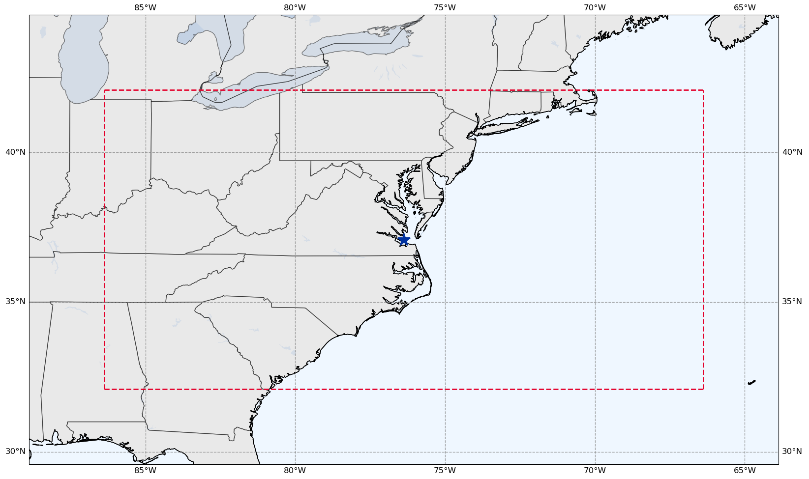

Validation Criteria
Species of Interest: Ozone, Water Vapor
  Plan to include Nitrogen Dioxide & Aerosol
Coincidence Criteria:
  ± 24 Hours
  ± 5 Deg Latitude
  ± 10 Deg Longitude
SAGE III/ISS Event Types:
  Solar Occultation
  Plans to include lunar
  occultation & limb events
Langley Research Center
(37.09N, 76.38W)

Slide 4
SAGE III/ISS Predictions
SAGE III/ISS has a public facing website that allows users to input coordinates & timeframes to view any SAGE III/ISS events that match the selected criteria.
  https://science-data.larc.nasa.gov/sage-data/validation/
    Note the URL change from previous years
    Previous URL should redirect to the new one
Prediction Website Curator: SAGE III/ISS Ground Systems
  Rick Farmer

Slide 5
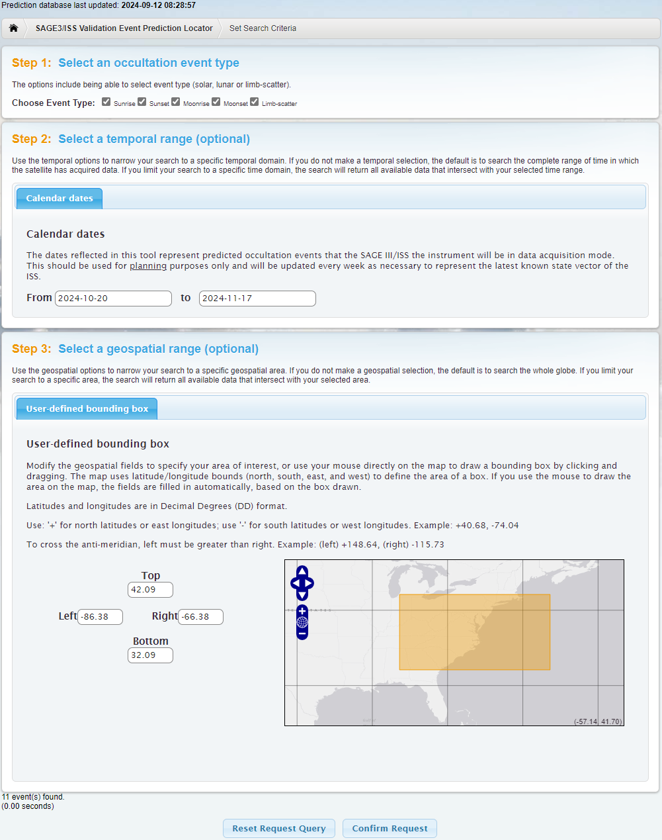
SAGE III/ISS Predictions
Choose Event Type(s)
  Sunrise, Sunset, Moonrise, Moonset, and/or Limb-Scatter
    Note: Limb-scatter events currently not shown in predictions
Select a Data Range
  2024-10-20 to 2024-11-17
Select an Area
  Using LaRC as the center point with the coincidence criteria as the bounds
Click “Confirm Request”

Slide 6
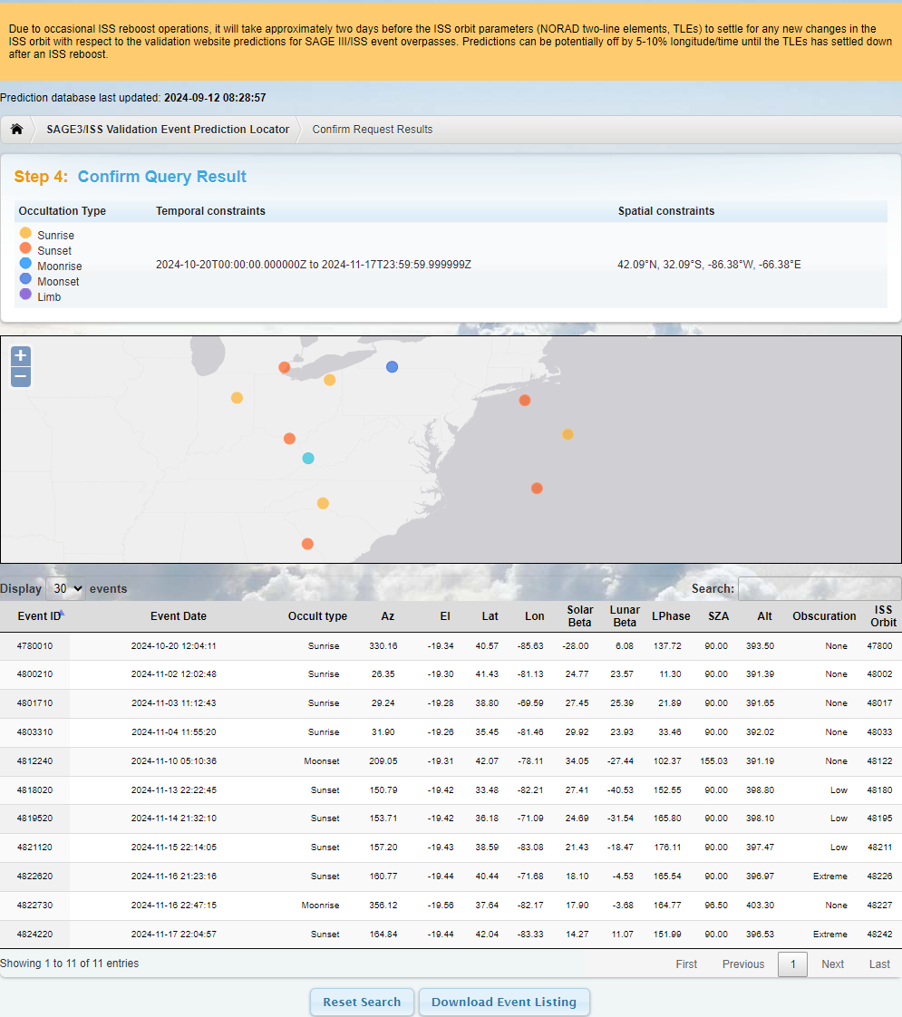
SAGE III/ISS Predictions
Reboost warning banner
Date prediction database was last updated
Occultation Type selected and user input Temporal & Spatial Constraints
Map of predicted events
Table of predicted events
  Includes additional information
Button to Download Events
  Downloads as a text file

Slide 7
Interested in Participating in Validation Efforts?
Interested in participating in validation efforts but don’t have the time to dive into the website to plan for coincident events?
  The Validation Team can bring weekly updates directly to YOU
Each participating station or PI will receive weekly emails. Emails Include:
  Coincident measurements approximately 3 weeks out
    Ensure the accuracy of the SAGE III/ISS event predictions & allows stations to have advance planning for possible coincident measurements.
  Upcoming activities that may affect predictions & science data collection
The SAGE III/ISS Team is always looking to add to new participants

Slide 8
Long Term Event Predictions
Long term predictions are available on the Validation website and via email to interested stations & PIs
Long term predictions are useful for long term planning but come with the caveat that the events are likely to shift in time & location
Predictions are approximately 6 months out but are not guaranteed
  Highly variable in both time & space due to activities in the coming months that can affect predictions

Slide 9
Activities that Affect Predictions
ISS Re/Deboosts
  Needed periodically for altitude maintenance
  Predictions may be slightly skewed in time & location until ISS TLEs have settled
    Typically takes 2-4 days for TLEs to settle out following re/deboosts
  Detailed in weekly emails and noted on the prediction website via warning banner
Blockages
  Visiting Vehicles, Modules, or Solar Panels can obstruct the view of SAGE III/ISS
  Blockage levels are: None, Low, Medium, High, & Extreme
    High & Extreme levels of blockages may still acquire but are not guaranteed
Station Activities & Maneuvers
  May sometimes miss events for scheduled activities & large attitude changes
  Activities & maneuvers that affect events are detailed in weekly emails

Slide 10
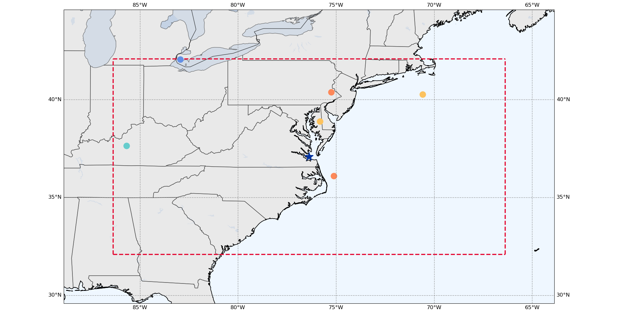
Predicted Events Before Reboosts
Oct. 20 – Nov. 17, 2024
Moonrise
16 Nov 2024 23:01:43
(37.64, -85.68)
Prediction File Generated: 2024-08-21
● Sunrise ● Sunset ● Moonrise ● Moonset

Slide 11
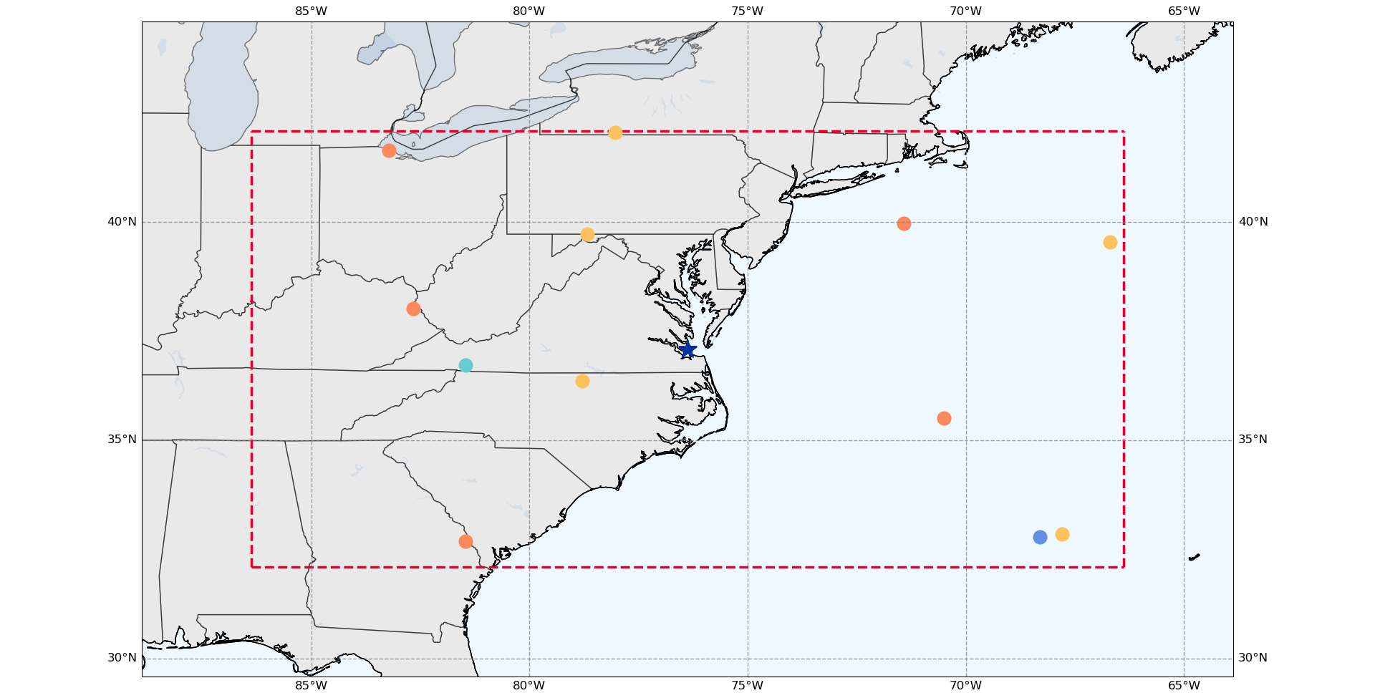
Predicted Events After Reboosts
Oct. 20 – Nov. 17, 2024
Moonrise
16 Nov 2024 22:47:26
(36.72, -81.47)
Prediction File Generated: 2024-09-13
● Sunrise ● Sunset ● Moonrise ● Moonset

Slide 12
Contact Information
If you’re interested in receiving weekly emails and/or long-term predictions or have any questions comments, concern, feedback, etc., contact the SAGE III Validation Team at:
  larc-dl-sage-predictions@mail.nasa.gov
Please include the following for predictions:
  Station Name and Location (Lat. & Lon.)
  Email addresses of everyone to receive the predictions
  Duration of predictions you’d like to receive
    i.e: Short Term (3 Weeks) or Long Term (6 Months)

Slide 13
Backup Slides

Slide 14
Downloaded Events Text File
# List generated: Thu Sep 12 05:26:20 2024
# Mission Name: SAGE3ISS
# Occultation type(s): [Sunrise][Sunset][Moonrise][Moonset][Limb]
# Temporal constraints: 2024-10-20T00:00:00.000000Z,2024-11-17T23:59:59.999999Z
# Spatial constraints: 42.09&deg;N, 32.09&deg;S,-66.38&deg;E,-86.38&deg;W
Event ID | Cycle ID | Event date | Event type | Azimuth | Elevation | Latitude | Longitude | Solar Beta Angle | Lunar Beta Angle | Lunar Phase | Solar Zenith Angle | Altitude | ISS Orbit | Obscuration | Notes
4780010 |  | 2024-10-20 12:04:11 | Sunrise | 330.1581 | -19.34374 | 40.56586 | -85.63167 | -28.00407 | 6.07685 | 137.725 | 89.99754 | 393.4992 | 47800 | None | N/A
4800210 |  | 2024-11-02 12:02:48 | Sunrise | 26.35157 | -19.30104 | 41.43395 | -81.13433 | 24.76801 | 23.56879 | 11.298 | 89.99753 | 391.3877 | 48002 | None | N/A
4801710 |  | 2024-11-03 11:12:43 | Sunrise | 29.23517 | -19.28232 | 38.79577 | -69.58694 | 27.45259 | 25.38956 | 21.887 | 89.99753 | 391.6451 | 48017 | None | N/A
4803310 |  | 2024-11-04 11:55:20 | Sunrise | 31.89774 | -19.26053 | 35.45394 | -81.46194 | 29.92374 | 23.92535 | 33.456 | 89.99753 | 392.016 | 48033 | None | N/A
4812240 |  | 2024-11-10 05:10:36 | Moonset | 209.046 | -19.30755 | 42.06685 | -78.10965 | 34.05468 | -27.44401 | 102.368 | 155.02544 | 391.1856 | 48122 | None | N/A
4818020 |  | 2024-11-13 22:22:45 | Sunset | 150.7857 | -19.41657 | 33.48341 | -82.20781 | 27.4075 | -40.53225 | 152.551 | 89.99753 | 398.8035 | 48180 | Low | N/A
4819520 |  | 2024-11-14 21:32:10 | Sunset | 153.7122 | -19.42354 | 36.17918 | -71.0896 | 24.68764 | -31.53777 | 165.804 | 89.99753 | 398.1036 | 48195 | Low | N/A
4821120 |  | 2024-11-15 22:14:05 | Sunset | 157.2015 | -19.43021 | 38.58645 | -83.08376 | 21.43343 | -18.47171 | 176.11 | 89.99753 | 397.4712 | 48211 | Low | N/A
4822620 |  | 2024-11-16 21:23:16 | Sunset | 160.769 | -19.43544 | 40.44382 | -71.6752 | 18.09574 | -4.53122 | 165.54 | 89.99753 | 396.9739 | 48226 | Extreme | N/A
4822730 |  | 2024-11-16 22:47:15 | Moonrise | 356.1224 | -19.56033 | 37.63534 | -82.17452 | 17.90372 | -3.67578 | 164.774 | 96.49689 | 403.3034 | 48227 | None | N/A
4824220 |  | 2024-11-17 22:04:57 | Sunset | 164.8437 | -19.43981 | 42.04152 | -83.32846 | 14.27323 | 11.07221 | 151.991 | 89.99752 | 396.5321 | 48242 | Extreme | N/A

Slide 15
Weekly Email Content Breakdown
(Sent Sept. 11, 2024)
Hello all,
Attached is a list of predictions for future SAGE III/ISS events near your station. This list contains 29 possible overpass events over the next 6 months.
Please be aware of a handful of activities coming up over the next month. Another reboost was for next week. Third time’s a charm for all the activities coming up. Again, quite a few things coming up that can affect predictions and events in some shape or form.
Continuing with the gauntlet of activities from the last several weeks, new for this week is yet another reboost added for October 4th (GMT 278).
For this week, there was the Inertia Data Collection that occurred September 9-10 (GMT 254-255), a set of OPMs and the Soyuz 72S docking September 11-12 (GMT 255 – 256), 2024. The OPM on GMT 255 occurred between 0615-0815 UTC, and we have already resumed science taking activities. The 72S docking occurs later in the day on GMT 255 but should have no effect on science taking activities. The last activity is a second OPM on GMT 256 between 0700-0905 UTC. For the activity on GMT 256, we will have science taking disabled between 0530 UTC and 1040 UTC for the maneuver.
Another Progress 89P reboost was recently added to the schedule for October 4 (GMT 278), 2024, from 0740-0845 UTC.
During each of the OPMs, we will not be taking science events. I have gone ahead and removed any potentially impacted events from the attached prediction file based on information that I currently have available, though be aware this may change as times for maneuvers do occasionally change.
Following the 89P Reboost, prediction times and locations can potentially be off until orbital parameters have settled out.
Please let me know if you all have any questions, comments, concerns, etc.
Number of Coincident Events and Duration of Search Window
  Blue: Number of Events
  Yellow: Duration of Search Window
Upcoming Activities
Activity Effects on Predictions

Slide 16
Prediction File for LaRC
PREDICTED SAGE III/ISS OVERPASS EVENTS RUN 2024-09-16 11:03:38.312250+00:00; Bounding Box +/-(lat/lon) = 5.00/10.00
SAGE EVENT PREDICTION FILE USED: <path\to\prediction\file>\AllEvents_SUT_20240913_20250312.csv
STATION = LaRC has 19 possible overpass events.
The table below may have less based on ISS activities.
Search window covers 12.0 weeks into the future from 2024-09-16 11:03:38.312250+00:00 .
DATE TIME (UTC) | Latitude [deg] | Longitude [deg] | EVENT TYPE | Obscuration Likelihood | Notes
29 Sep 24 22:40:26 | 38.87 | -74.94 | Sunset | None | N/A
18 Oct 24 11:37:46 | 32.37 | -81.83 | Sunrise | None | N/A
19 Oct 24 10:50:13 | 36.29 | -68.70 | Sunrise | None | N/A
20 Oct 24 11:35:14 | 39.72 | -78.67 | Sunrise | None | N/A
02 Nov 24 11:51:38 | 42.06 | -78.03 | Sunrise | None | N/A
03 Nov 24 11:02:33 | 39.55 | -66.69 | Sunrise | None | N/A
04 Nov 24 11:46:13 | 36.36 | -78.79 | Sunrise | None | N/A
05 Nov 24 10:57:10 | 32.85 | -67.79 | Sunrise | None | N/A
11 Nov 24 05:53:53 | 32.78 | -68.30 | Moonset | Extreme | N/A
13 Nov 24 22:21:17 | 32.69 | -81.46 | Sunset | Low | N/A
14 Nov 24 21:31:17 | 35.50 | -70.51 | Sunset | Low | N/A
15 Nov 24 22:13:45 | 38.02 | -82.67 | Sunset | Low | N/A
16 Nov 24 21:23:25 | 39.97 | -71.42 | Sunset | Extreme | N/A
16 Nov 24 22:47:26 | 36.72 | -81.47 | Moonrise | None | N/A
17 Nov 24 22:05:34 | 41.65 | -83.23 | Sunset | Extreme | N/A
27 Nov 24 21:18:04 | 41.81 | -72.99 | Sunset | None | N/A
28 Nov 24 21:59:21 | 39.94 | -82.04 | Sunset | None | N/A
29 Nov 24 21:08:05 | 37.64 | -67.71 | Sunset | None | N/A
30 Nov 24 21:49:31 | 34.40 | -76.05 | Sunset | None | N/A
Date/Time File was Generated (UTC)
Prediction File Used
  Start Date & End Date of prediction file
Number of Possible Coincident Events
Duration of Search Window
  Number of Weeks & Search Window Start Date (UTC)
Table of Predicted Events
  Predicted Start Date & Time
  Lat. & Lon.
  Event Type
  Possibility of Obstructions (Blockages)

Slide 17
Predictions Before and After Reboosts for LaRC
Oct. 20 – Nov. 17, 2024
Before Reboosts
Prediction File Generated Aug. 21, 2024
After Reboosts
Prediction File Generated Sept. 13, 2024
Datetime | Lat. | Lon. | Event Type | Obscuration Likelihood
20 Oct 2024 11:03:34 | 40.26 | -70.59 | Sunrise | None
03 Nov 2024 11:37:51 | 38.89 | -75.82 | Sunrise | None
10 Nov 2024 05:30:57 | 42.06 | -82.94 | Moonset | None
14 Nov 2024 21:48:28 | 36.09 | -75.11 | Sunset | Low
16 Nov 2024 21:37:43 | 40.38 | -75.25 | Sunset | Extreme
16 Nov 2024 23:01:43 | 37.64 | -85.68 | Moonrise | None
Datetime | Lat. | Lon. | Event Type | Obscuration Likelihood
20 Oct 2024 11:35:14 | 39.72 | -78.67 | Sunrise | None
02 Nov 2024 11:51:38 | 42.06 | -78.03 | Sunrise | None
03 Nov 2024 11:02:33 | 39.55 | -66.69 | Sunrise | None
04 Nov 2024 11:46:13 | 36.36 | -78.79 | Sunrise | None
05 Nov 2024 10:57:10 | 32.85 | -67.79 | Sunrise | None
11 Nov 2024 05:53:53 | 32.78 | -68.3 | Moonset | Extreme
13 Nov 2024 22:21:17 | 32.69 | -81.46 | Sunset | Low
14 Nov 2024 21:31:17 | 35.5 | -70.51 | Sunset | Low
15 Nov 2024 22:13:45 | 38.02 | -82.67 | Sunset | Low
16 Nov 2024 21:23:25 | 39.97 | -71.42 | Sunset | Extreme
16 Nov 2024 22:47:26 | 36.72 | -81.47 | Moonrise | None
17 Nov 2024 22:05:34 | 41.65 | -83.23 | Sunset | Extreme
In the time since the earlier prediction file was generated, three reboot activities have occurred.

Slide 18
Reboost Schedule
Jan. 2024 – Early Oct. 2024
2024/01/12 – 85P Reboost
2024/01/24 – 85P Reboost
2024/02/23 – 87P Reboost
2024/03/14 – 87P Reboost
2024/04/26 – 87P Reboost
2024/05/24 – Cygnus20 Reboost 1
2024/05/24 – Cygnus20 Reboost 2
2024/06/08 – Cygnus20 Reboost
2024/06/15 – 87P Reboost
2024/06/29 – 87P Reboost
2024/07/31 – 87P Reboost
2024/08/22 – Cygnus21 Reboost
2024/08/28 – 89P Reboost
2024/09/05 – 89P Reboost
2024/10/04 – 89P Reboost
Note: Starliner (CST-100) docked on 2024/06/06 and undocked 2024/09/06

