Slide 1
Development of computational materials workflows for additively manufactured metallic materials to enable accelerated prediction of fatigue performance
George Weber¹, Saikumar Yeratapally², Peter Spaeth¹, Erik Frankforter¹,
Joshua Pribe³, Brodan Richter¹, Edward Glaessgen¹
¹NASA Langley Research Center, Hampton, VA
²Science and Technology Corporation, Hampton, VA
³Analytical Mechanics Associates, Hampton, VA
MS&T 2024 Annual Meeting & Exhibition
Pittsburgh, Pennsylvania
October 8, 2024

Slide 2
Basic Fracture and Fatigue Control for
Qualification and Certification (Q&C)
Two classical design approaches
(1) Safe Life
(2) Damage Tolerance

Slide 3
Basic Fracture and Fatigue Control for
Qualification and Certification (Q&C)
Two classical design approaches
(1) Safe Life
(2) Damage Tolerance
Three basic elements ^{[1]} :
Working Wöhler (“S-N”) Curve
Design Loading Spectra
Cumulative Damage Theory
Basic philosophy ^{[1]} :
Acceptance that damage will occur
Adequate system of inspection so the damage may be detected
Adequate strength maintained in the damaged structure
“The safe life approach only applies to parts which define crack initiation as the limit of the useful life, such as rotating parts.”
- FAA AC 33.70-1
“The extent of damage for residual strength evaluation at any time within the operational life of the airplane must be consistent with the initial detectability and subsequent growth under repeated loads.”
– FAA 14 CFR 25.571
“The safe-life design approach, when properly executed, places statistically predictable failures at an extremely remote probability of occurrence. This approach does, however, assume the structure to be flaw free.” ^{[1]}
^{[1]} H. Reddick. Safe-life and damage-tolerant design approaches for helicopter structures (1983)
FAA: Federal Aviation Administration

Slide 4
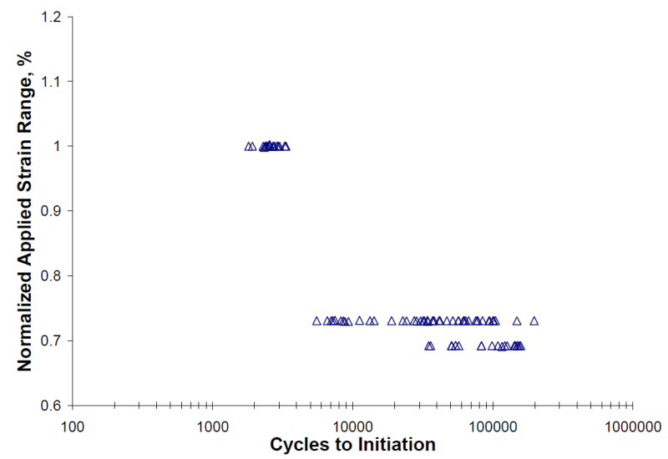
Basic Fracture and Fatigue Control for
Qualification and Certification (Q&C)
Two classical design approaches
Example S-N_{i} Curve
(1) Safe Life
Scatter is typically attributed to weakest link combinations of microstructural features and flaws
Three basic elements ^{[1]} :
Working Wöhler (“S-N”) Curve
Design Loading Spectra
Cumulative Damage Theory
Min.
Certified life
Loading Amplitude (S)
“The safe life approach only applies to parts which define crack initiation as the limit of the useful life, such as rotating parts.”
- FAA AC 33.70-1
10²
10³
10⁴
10⁵
10⁶
“The safe-life design approach, when properly executed, places statistically predictable failures at an extremely remote probability of occurrence. This approach does, however, assume the structure to be flaw free.” ^{[1]}
Cycles to Initiation (N_{i})
Current approaches that cannot account for microstructure must treat this uncertainty in life conservatively
^{[1]} H. Reddick. Safe-life and damage-tolerant design approaches for helicopter structures (1983)
FAA: Federal Aviation Administration

Slide 5

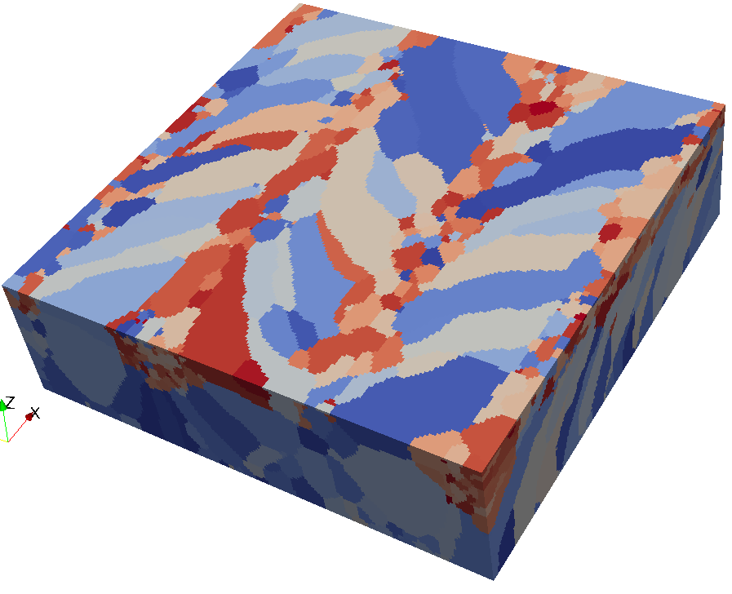
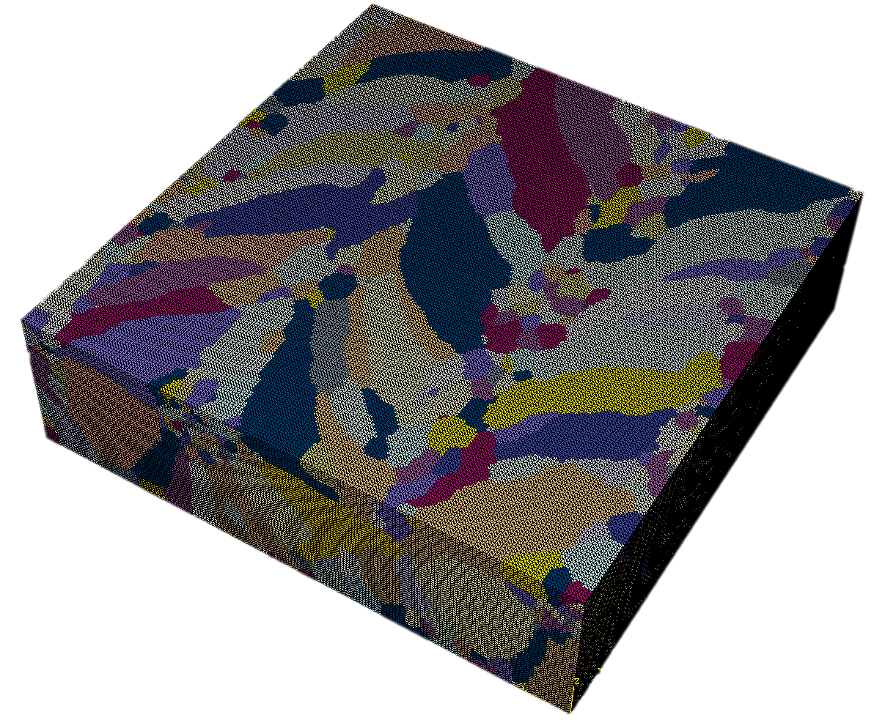
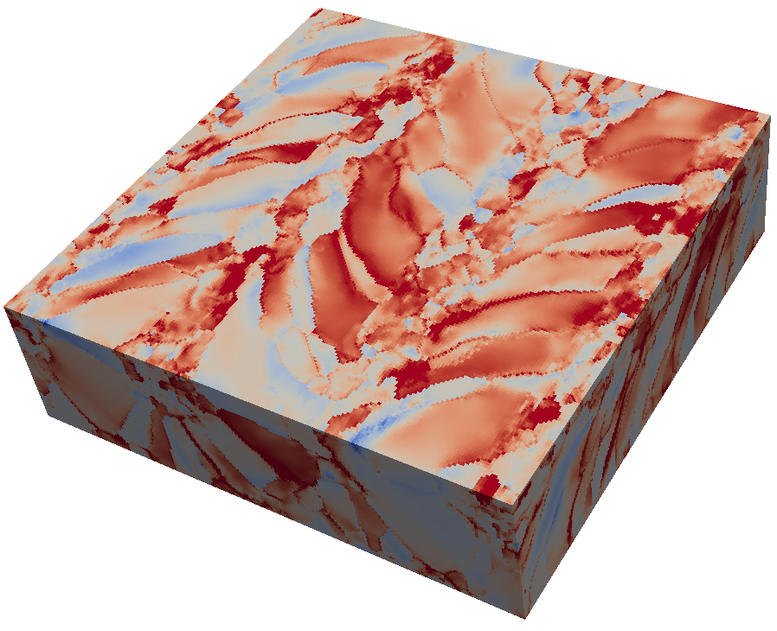

Basic Crystal Plasticity Workflow
Crystal plasticity is one of the most common mesoscale (µm-mm) frameworks for achieving a mapping between structure and property
Constitutive model / solver
Plastic flow rule
Saturating hardening law
Grain morphology and texture generation
Preprocessing and discretization
Constitutive parameters
“Material properties”
Boundary conditions
Characterization^{[1]}
Microstructure
Solution domain
Global solver
Output and visualization
Crack initiation and growth
Workflow is built for modularity
Upscaling
Workflow is built for iteration
Life prediction
Accuracy analysis
Model analysis
^{[1]} Image Credit: Wes Tayon, Bryan Koscielny

Slide 6
Crystal Plasticity and Q&C
Why is crystal plasticity not playing a significant role in Q&C?
Entry Points
Limitations
Trust
(1)
(2)
(3)

Slide 7
Crystal Plasticity and Q&C
Why is crystal plasticity not playing a significant role in Q&C?
Entry Points
Limitations
Trust
(1)
(2)
(3)

Slide 8
Q&C Entry Points for Crystal Plasticity
Difficult to define entry points to Q&C for mesoscale modeling frameworks
Most Q&C examples from industry are not publicly disclosed
General regulations exist but Q&C packages are domain-specific
Technical Entry Points
Regulatory Entry Points
Fracture Mechanics
Primarily test-driven with empirical modeling
Most mesoscale influence is implicit except flaw sizes
Material Allowables
Cycles to crack initiation
Stress intensity factor thresholds
Basic mechanical properties
Some Relevant Documents
FAA 14 Part 25
Airworthiness Standards: Transport Category Airplanes
FAA 14 Part 33
Airworthiness Standards: Aircraft Engines
NASA-STD-5019
Fracture Control Requirements for Spaceflight Hardware
NASA-STD-6040
Additive Manufacturing Requirements for Spaceflight Systems
MMPDS
Metallic Materials Properties Development and Standardization
Software
NASGRO®*
Fracture Mechanics and Fatigue Crack Growth Software
AFGROW*
Fracture Mechanics and Fatigue Crack Growth Analysis Software Tool
DARWIN®*
Design Assessment of Reliability with INspection
*This is not an endorsement by the National Aeronautics and Space Administration (NASA)

Slide 9
Crystal Plasticity and Q&C
Why is crystal plasticity not playing a significant role in Q&C?
Entry Points
Limitations
Trust
(1)
(2)
(3)

Slide 10
Limitations in Crystal Plasticity
Towards the end goal of crack initiation and microstructurally small crack growth
Fatigue indicator parameter-based approaches or explicit crack modeling are typically dependent on crystal plasticity
However, there is a complex interaction of assumptions and limitations in crystal plasticity
#1 Missing Physics
#5 Boundary Conditions
Size invariance, Hall-Petch effect
Dislocation transport, starvation, and conservation laws
Slip bands, extrusions/intrusions, and persistent slip bands
Grain boundary transmission and energetics
Periodicity, self-consistency
Concurrent or hierarchical coupling with higher spatial scale
Statistical equivalence of representative volume elements
Multi-time scale behavior
#2 Lower Scale Effects
#6 Extreme Values
Dislocation core effects and key dislocation mechanisms
Accounting for measured initial dislocation density
Nanoscale voids, precipitates, microcracks, and inclusions
Solid solution hardening, compositional effects
Multi-junctions and field localizations are critical
Confidence in discretization and solver near extremes
Nonlocal length scales
#3 Evolution of Microstructural Input
#7 Computational Cost
Grain boundary sliding, coarsening, rotation, migration, and local misorientation
Nanoscale changes such as rafting, phase transformations, deformation twinning, and vacancy generation
>1,000 grains requires supercomputing
CPU and GPU parallelization add user/developer complexity
Global and constitutive time integration accuracy/stability thresholds
#4 Fundamentals
#8 Workflow Efficiency
Continuum assumption, separation of scales
Decoupling of elastic and plastic constitutive behavior
Orowan’s equation and Schmid behavior
Infinitesimal deformation and strain measures
Software integration
Reproducibility is nontrivial
Constitutive relation development requires competence in tensor analysis

Slide 11
Limitations in Crystal Plasticity
Towards the end goal of crack initiation and microstructurally small crack growth
Fatigue indicator parameter-based approaches or explicit crack modeling are typically dependent on crystal plasticity
However, there is a complex interaction of assumptions and limitations in crystal plasticity
#1 Missing Physics
#5 Boundary Conditions
Size invariance, Hall-Petch effect
Dislocation transport, starvation, and conservation laws
Slip bands, extrusions/intrusions, and persistent slip bands
Grain boundary transmission and energetics
Periodicity, self-consistency
Concurrent or hierarchical coupling with higher spatial scale
Statistical equivalence of representative volume elements
Multi-time scale behavior
#2 Lower Scale Effects
#6 Extreme Values
Dislocation core effects and key dislocation mechanisms
Accounting for measured initial dislocation density
Nanoscale voids, precipitates, microcracks, and inclusions
Solid solution hardening, compositional effects
#1 Missing Physics
Multi-junctions and field localizations are critical
Confidence in discretization and solver near extremes
Nonlocal length scales
Size invariance, Hall-Petch effect
Dislocation transport, starvation, and conservation laws
Slip bands, extrusions/intrusions, and persistent slip bands
Grain boundary transmission and energetics
#3 Evolution of Microstructural Input
#7 Computational Cost
Grain boundary sliding, coarsening, rotation, migration, and local misorientation
Nanoscale changes such as rafting, phase transformations, deformation twinning, and vacancy generation
>1,000 grains requires supercomputing
CPU and GPU parallelization add user/developer complexity
Global and constitutive time integration accuracy/stability thresholds
#4 Fundamentals
#8 Workflow Efficiency
Continuum assumption, separation of scales
Decoupling of elastic and plastic constitutive behavior
Orowan’s equation and Schmid behavior
Infinitesimal deformation and strain measures
Software integration
Reproducibility is nontrivial
Constitutive relation development requires competence in tensor analysis

Slide 12
Limitations in Crystal Plasticity
Towards the end goal of crack initiation and microstructurally small crack growth
Fatigue indicator parameter-based approaches or explicit crack modeling are typically dependent on crystal plasticity
However, there is a complex interaction of assumptions and limitations in crystal plasticity
#1 Missing Physics
#5 Boundary Conditions
Size invariance, Hall-Petch effect
Dislocation transport, starvation, and conservation laws
Slip bands, extrusions/intrusions, and persistent slip bands
Grain boundary transmission and energetics
Periodicity, self-consistency
Concurrent or hierarchical coupling with higher spatial scale
Statistical equivalence of representative volume elements
Multi-time scale behavior
#2 Lower Scale Effects
#6 Extreme Values
Dislocation core effects and key dislocation mechanisms
Accounting for measured initial dislocation density
Nanoscale voids, precipitates, microcracks, and inclusions
Solid solution hardening, compositional effects
#5 Boundary Conditions
Multi-junctions and field localizations are critical
Confidence in discretization and solver near extremes
Nonlocal length scales
Periodicity, self-consistency
Concurrent or hierarchical coupling with higher spatial scale
Statistical equivalence of representative volume elements
Multi-time scale behavior
#3 Evolution of Microstructural Input
#7 Computational Cost
Grain boundary sliding, coarsening, rotation, migration, and local misorientation
Nanoscale changes such as rafting, phase transformations, deformation twinning, and vacancy generation
>1,000 grains requires supercomputing
CPU and GPU parallelization add user/developer complexity
Global and constitutive time integration accuracy/stability thresholds
#4 Fundamentals
#8 Workflow Efficiency
Continuum assumption, separation of scales
Decoupling of elastic and plastic constitutive behavior
Orowan’s equation and Schmid behavior
Infinitesimal deformation and strain measures
Software integration
Reproducibility is nontrivial
Constitutive relation development requires competence in tensor analysis

Slide 13
Limitations in Crystal Plasticity
Towards the end goal of crack initiation and microstructurally small crack growth
Fatigue indicator parameter-based approaches or explicit crack modeling are typically dependent on crystal plasticity
However, there is a complex interaction of assumptions and limitations in crystal plasticity
#1 Missing Physics
#5 Boundary Conditions
Size invariance, Hall-Petch effect
Dislocation transport, starvation, and conservation laws
Slip bands, extrusions/intrusions, and persistent slip bands
Grain boundary transmission and energetics
Periodicity, self-consistency
Concurrent or hierarchical coupling with higher spatial scale
Statistical equivalence of representative volume elements
Multi-time scale behavior
#2 Lower Scale Effects
#6 Extreme Values
Dislocation core effects and key dislocation mechanisms
Accounting for measured initial dislocation density
Nanoscale voids, precipitates, microcracks, and inclusions
Solid solution hardening, compositional effects
#8 Workflow Efficiency
Multi-junctions and field localizations are critical
Confidence in discretization and solver near extremes
Nonlocal length scales
Software integration
Reproducibility is nontrivial
Constitutive relation development requires competence in tensor analysis
#3 Evolution of Microstructural Input
#7 Computational Cost
Grain boundary sliding, coarsening, rotation, migration, and local misorientation
Nanoscale changes such as rafting, phase transformations, deformation twinning, and vacancy generation
>1,000 grains requires supercomputing
CPU and GPU parallelization add user/developer complexity
Global and constitutive time integration accuracy/stability thresholds
#4 Fundamentals
#8 Workflow Efficiency
Continuum assumption, separation of scales
Decoupling of elastic and plastic constitutive behavior
Orowan’s equation and Schmid behavior
Infinitesimal deformation and strain measures
Software integration
Reproducibility is nontrivial
Constitutive relation development requires competence in tensor analysis

Slide 14
Limitations in Crystal Plasticity
So how can this space be navigated?
Simple and complex community benchmarks / challenge problems
#1 Missing Physics
#5 Boundary Conditions
Size invariance, Hall-Petch effect
Dislocation transport, starvation, and conservation laws
Slip bands, extrusions/intrusions, and persistent slip bands
Grain boundary transmission and energetics
Periodicity, self-consistency
Concurrent or hierarchical coupling with higher spatial scale
Statistical equivalence of representative volume elements
Multi-time scale behavior
#2 Lower Scale Effects
#6 Extreme Values
Dislocation core effects and key dislocation mechanisms
Accounting for measured initial dislocation density
Nanoscale voids, precipitates, microcracks, and inclusions
Solid solution hardening, compositional effects
Multi-junctions and field localizations are critical
Confidence in discretization and solver near extremes
Nonlocal length scales
#3 Evolution of Microstructural Input
#7 Computational Cost
Grain boundary sliding, coarsening, rotation, migration, and local misorientation
Nanoscale changes such as rafting, phase transformations, deformation twinning, and vacancy generation
>1,000 grains requires supercomputing
CPU and GPU parallelization add user/developer complexity
Global and constitutive time integration accuracy/stability thresholds
#4 Fundamentals
#8 Workflow Efficiency
Continuum assumption, separation of scales
Decoupling of elastic and plastic constitutive behavior
Orowan’s equation and Schmid behavior
Infinitesimal deformation and strain measures
Software integration
Reproducibility is nontrivial
Constitutive relation development requires competence in tensor analysis

Slide 15
Crystal Plasticity and Q&C
Why is crystal plasticity not playing a significant role in Q&C?
Entry Points
Limitations
Trust
(1)
(2)
(3)

Slide 16
Calibration and Validation of Crystal Plasticity
Common Calibration and Validation Methods
Bulk and mesoscale polycrystalline testing
Single crystal testing
In-situ loading with digital image correlation or high energy diffraction microscopy
Micropillar and nanoindentation experiments
Lower scale modeling
Common Calibration and Validation Challenges
Measuring relevant quantities at relevant length and time scales
Many model parameters difficult to decouple experimentally
By adding model complexity without corresponding experimental measurement, typically physics-based principles and interpretations are deteriorated, and model generalizability is lost.

Slide 17
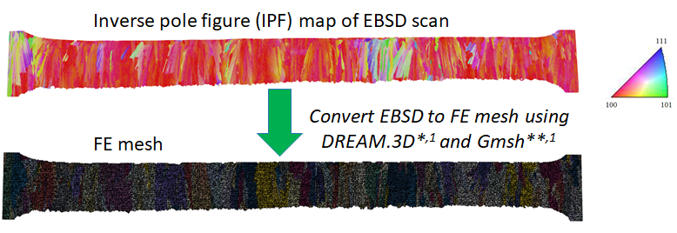
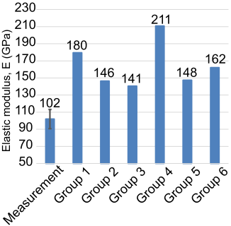
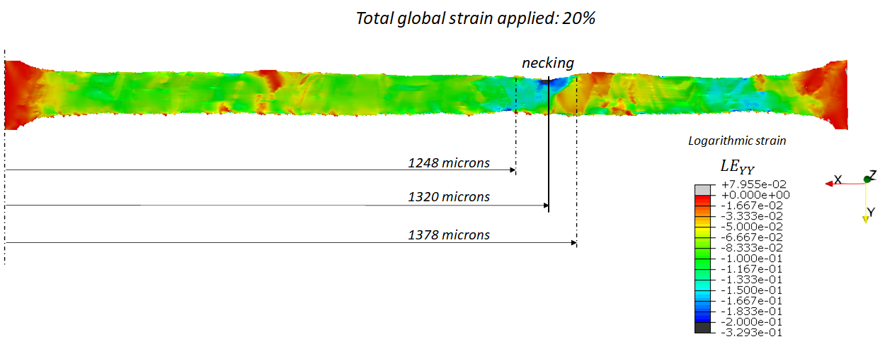
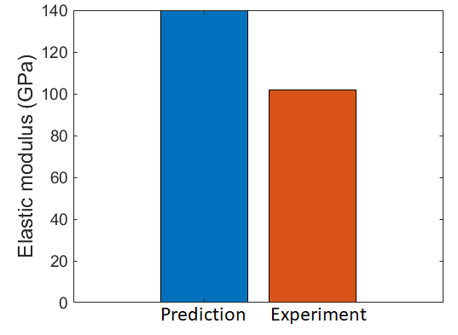

National Institute of Standards and Technology (NIST)
Additive Manufacturing Benchmarks 2022
Elastic modulus group predictions ^{[1]}
Inverse pole figure map of EBSD scan
111
111
500 μm
100
101
Finite element mesh
100
101
Loading direction
Global strain applied: 20%
Logarithmic strain (yy)
Error ~ 40%
-0.2
-0.1
0.0
Submitted tensile metric predictions for the
“Subcontinuum Mesoscale Tensile Challenge”
Prediction
Measurement
^{[1]} Kafka et al. IMMI (2023) 12:196–209

Slide 18
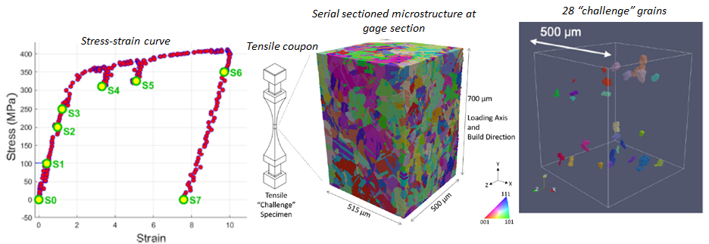
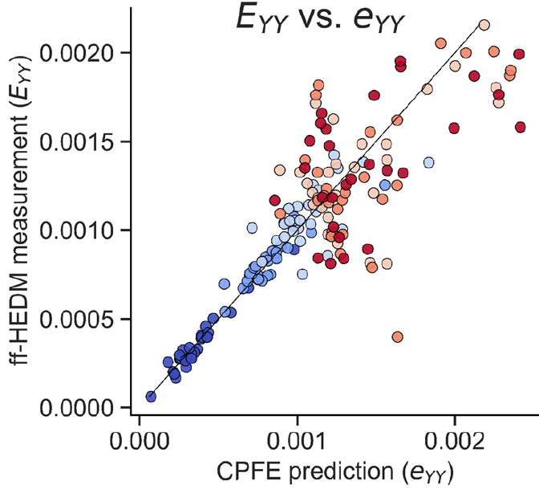
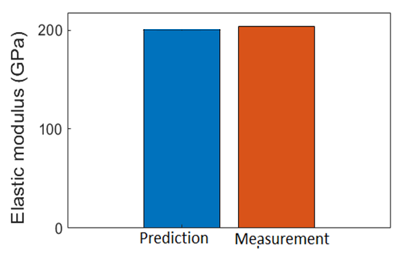
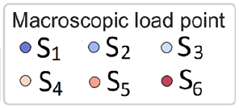
Air Force Research Laboratory (AFRL)
Additive Manufacturing 2020 Modeling Challenge
Serial-sectioned
microstructure
28 “challenge” grains
Stress-strain curve
Tensile
coupon
3D microstructure of Inconel 625 provided
515 μm
500 μm
x10⁻³
Elastic modulus predictions
Grain-average elastic strains predicted at “challenge” grains
Error < 2%
ff-HEDM: Far-field High-energy X-Ray diffraction microscopy

Slide 19
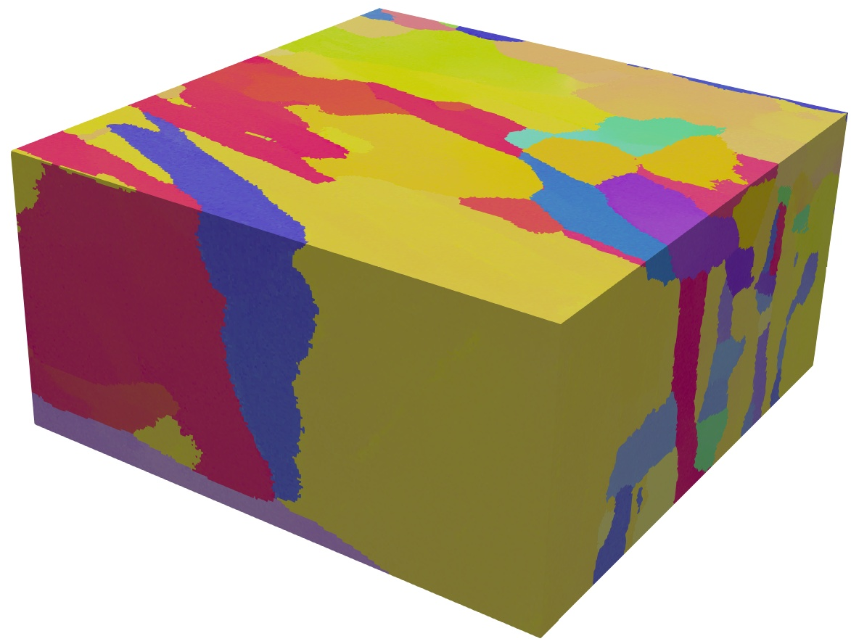
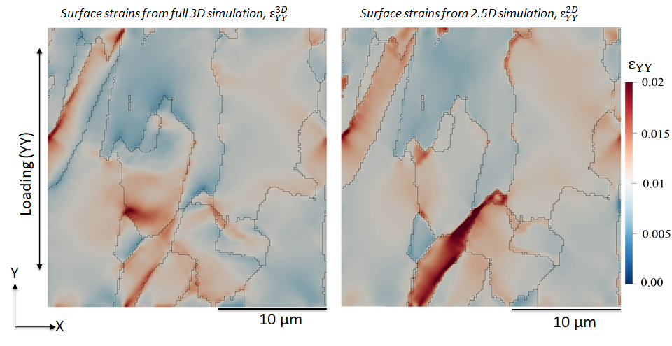
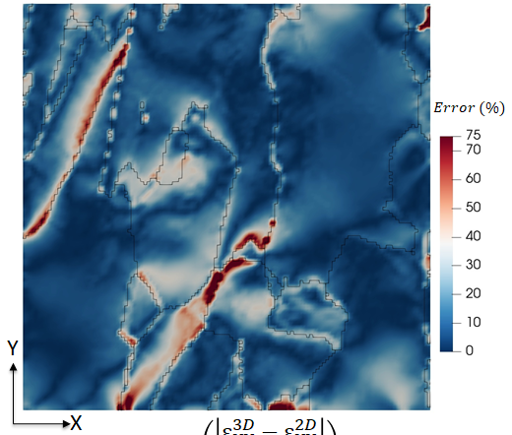
Influence of Subsurface Microstructure
Open-source 3D dataset^{[1]} of serial-sectioned Ti-6Al-4V alloy
Material produced via electron beam powder-bed fusion
Microstructure volume: 256 x 256 x 140 voxels
Voxel size: 0.1 x 0.1 x 0.1 μm
Z
25.6 µm
25.6 µm
Y
X
Surface strains from full 3D model
Surface strains from full “2.5D” model
Percentage error in surface strains
Relative Error
in (%)
^{[1]}DeMott et al. Mendeley Data, V1, doi: 10.17632/c5x7ckcfsp.1

Slide 20
Crystal Plasticity and Q&C
Why is crystal plasticity not playing a significant role in Q&C?
Entry Points
Limitations
Trust
(1)
(2)
(3)

Slide 21
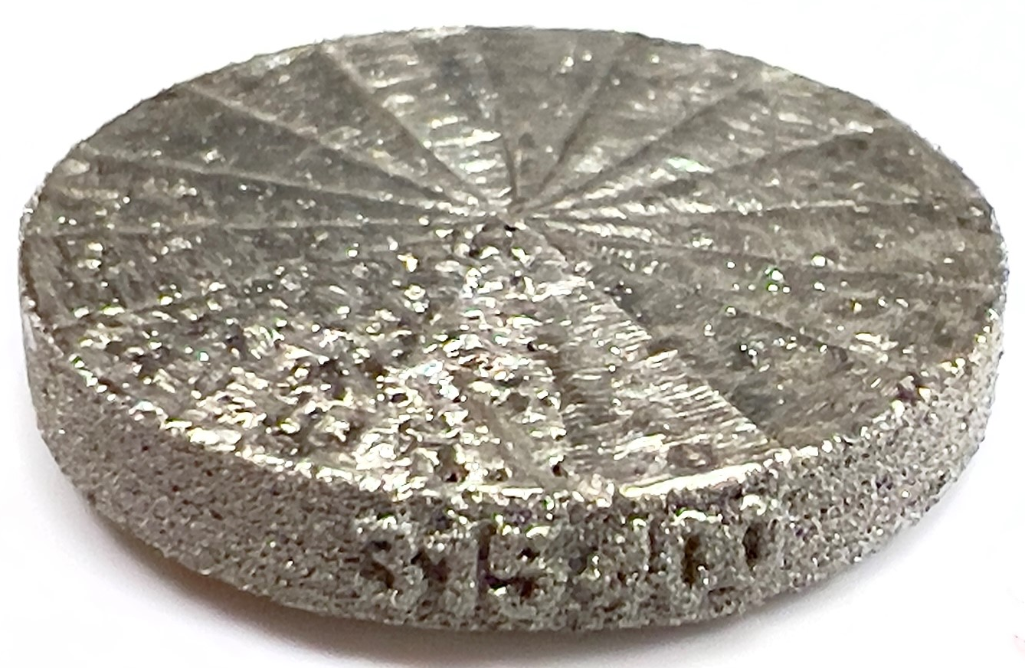
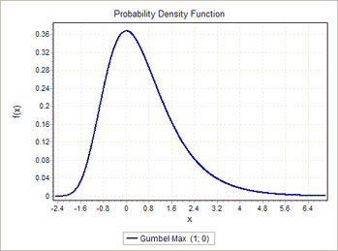
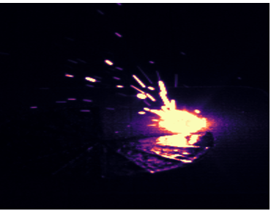

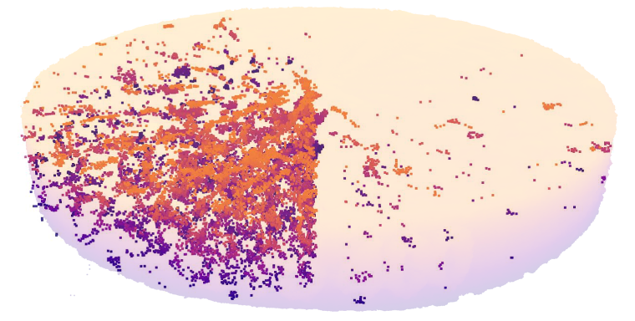
Computational Materials-Informed Qualification and Certification of Additively Manufactured (AM) Flight Hardware
5 mm
Porosity
Location-specific properties
Process
Structure
Property / Performance
Small deviations
in process conditions
Potentially large variation in fatigue performance
Goal: Change the Paradigm for Qualification and Certification (Q&C)
Develop a computational materials-informed ecosystem for quantifying sources of variability in performance of additively manufactured metallic materials through integrated multi-scale, multi-physics simulation, characterization and monitoring

Slide 22
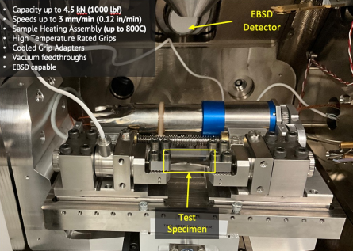
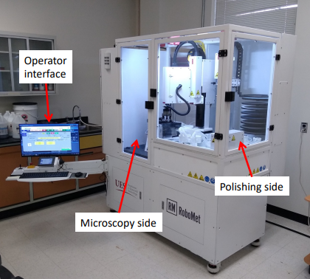
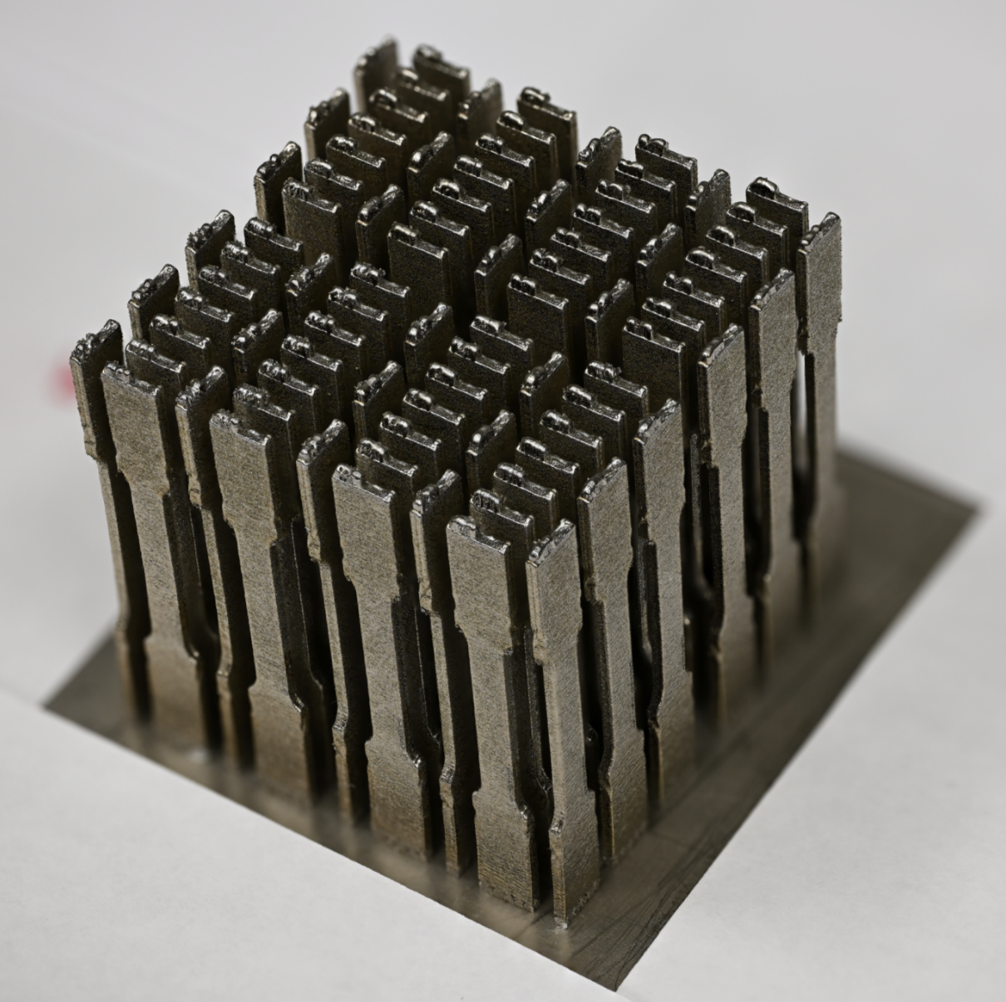
Structure-Property Calibration Workflow for AM Inconel 718
X-ray computed tomography
Porosity characterization
Fast Fourier Transform (FFT) crystal plasticity
with GPU support and auto-differentiation
Microstructure
with porosity
Fatigue indicator parameter based lifing
In-situ load stage^{[1]}
Grain-scale strain fields
Loading Amplitude
10²
10³
10⁴
10⁵
10⁶
RoboMet^{[1]}
Subsurface investigation
Cycles to Initiation
AM Specimens^{[1]}
Subscale ASTM E8
^{[1]}Image Credit: Lopamudra Das, Andy Newman, Sang-Hyon Chu

Slide 23
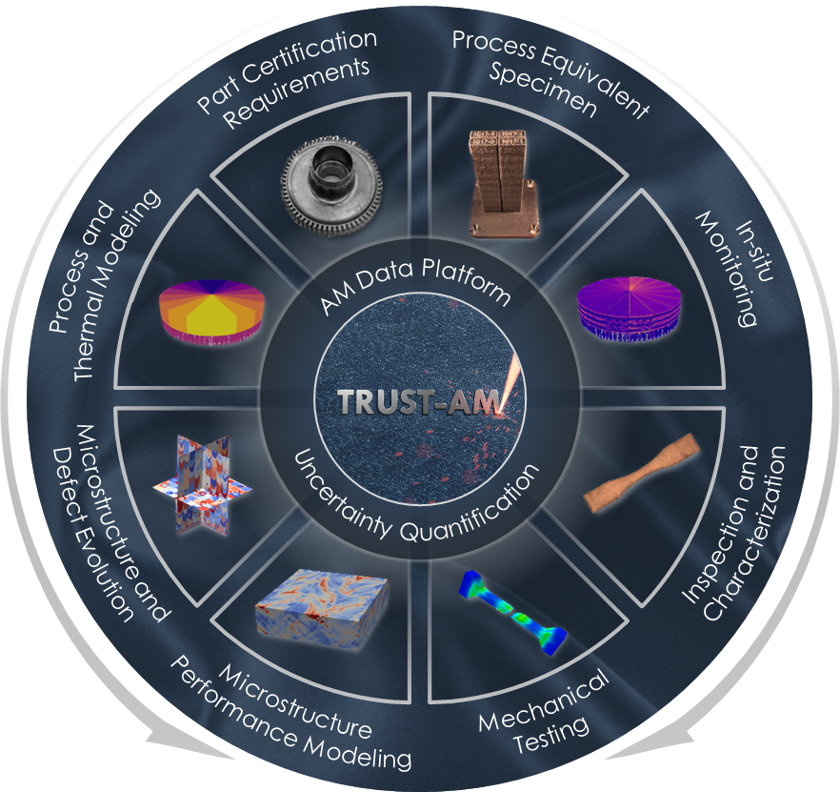
Platform for Prototyping Computational Materials for Q&C
TRUST-AM
Trust and Reliability through Unified Simulation and Testing for Additive Manufacturing
Integration of physical and computational capabilities within an AM data platform
Data model + database + data processing + registration
Computational
Physical
PSP-UQ
Integrated Process-Structure-Property, Uncertainty Quantification Framework
Focus on model integration for calibration/validation and uncertainty quantification
Simplicity and ease of use

Slide 24
Conclusions
Entry points for crystal plasticity to impact Q&C exist but need maturation.
  Connecting to fracture mechanics is a promising avenue, especially cycles to crack initiation.
Modeling Limitations
Missing Physics
Lower Scale Effects
Evolution of Microstructural Input
Fundamentals
Boundary Conditions
Extreme Values
Computational Cost
Workflow Efficiency
The number of decision points, assumptions, and limitations in a typical crystal plasticity workflow are vast.
Characterization and prediction must work hand in hand, ideally in 3D.
Community benchmarks for mesoscale models are a good idea.
Acknowledgements
This work was supported by the NASA Aeronautics Research Mission Directorate (ARMD) Transformational Tools and Technologies (TTT) project
Contact : george.r.weber@nasa.gov

