Slide 1
Non-Interference of Lunar Activities
Presented by: Therese Jones
Authors: Therese Jones, Marissa Herron, Amanda Hernandez,
Natasha Riegle, Charlotte Davis, Jacobo Garcia
October 16, 2024

Slide 2
Historical uses of [Harmful] Interference and Contamination
Contamination
Contamination concerns trace back to 1958 National Academy of Sciences study; predecessor to the Committee on Space Research (COSPAR), Committee on Contamination by Extra-terrestrial Exploration (CETEX), looked at atmospheric impacts, Project West Ford, planetary protection
Inclusion of avoidance of harmful contamination in Outer Space Treaty (OST) result of CETEX planetary protection work
Use of “contamination” generally limited to science impacts; harmful contamination limited to planetary protection
Interference
ITU included concept of interference in 1903 with “harmful interference” defined in 1947
  1979 differentiation between permissible, accepted, harmful
Inclusion of harmful interference in OST pushed by U.S.S.R. and allies citing Project West Ford; wanted mandatory consultation
  Inclusion of “passage through and operations in space” included in National Space Policy since 1978
Interference historically more operationally focused
Artemis Accords Section 11, “Deconfliction”, focuses on the avoidance of harmful interference through the use of safety zones

Slide 3
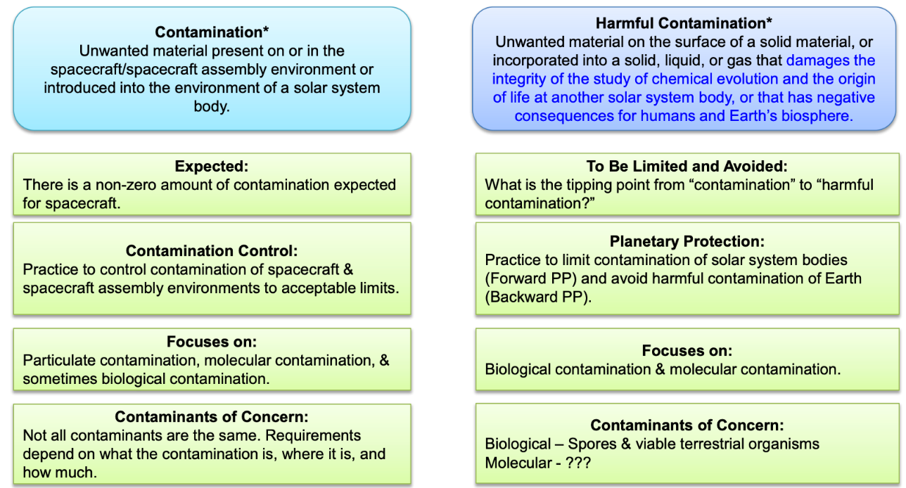
NASA STD 8719.27 (Contamination)
Contamination vs. harmful contamination in NASA Standard 8719.27 (* denotes definition in STD), courtesy of NASA Office of Planetary Protection, Office of Safety and Mission Assurance

Slide 4
Public Questionnaire and Workshop on Non-Interference
The following slides represent responses from the general public to a questionnaire shared at the "Non-Interference of Lunar Activities" workshop held at the April 2024 Lunar Surface Innovation Consortium. The questionnaire was posted on the OTPS website on NASA.gov in May 2024, and public responses were collected for a period of 30 days.*
Questionnaire topics:
Definitions of interference, contamination deconfliction
Understanding the Potential Value of a Site
Impacting the value of a site and timescale of effects
Data needed to inform value
Mitigation mechanisms (policy, technology)
*The information contained in the following slides reflect the responses provided by the general public and do not represent the views or opinions, nor should they be construed as endorsements by NASA.
Notes:
https://www.nasa.gov/organizations/otps/otps-seeks-input-from-the-lunar-community-to-inform-a-framework-for-further-work-on-non-interference-of-lunar-activities/

Slide 5
Public interference concerns highlights
Six main categories: physical contact, thermal disturbance, EMI/RFI, contamination, shadowing from large structures, seismic/vibration from movement
Scientific impact to volatiles, astronomical observation mentioned in many responses
Operational impacts of dust/debris, physical contact, blocking of access to infrastructure (e.g., paths, power, communications), and improper disposal highlighted
Very few best practices outside of RF and planetary protection
  Many suggested coordination mechanisms to help mitigate interference; infrastructure and technology investments also recommended

Slide 6
Public interference concerns, Part 1
Interference Concern | Orbital Operations | Entry, Descent, and Landing; Ascent | Static Surface Operations | Dynamic Surface Operations
Physical Contact | Cislunar conjunctions Occupation of highly desired orbits | Movement and compression of lunar soil, movement of dust (e.g., Plume Surface Interactions (PSIs)), which may impact geological samples or impede physical movement Dust coating scientific instruments, solar panels, or habitat surfaces Ejection of debris into cislunar space | Operations blocking desired path/location | Movement and compression of lunar soil, movement of dust (e.g., PSIs), which may impact geological samples or impede physical movement Dust coating scientific instruments, solar panels, or habitat surfaces Operations blocking desired path/location Threat of active physical contact, including due to uncertainty of positioning, especially between crewed and uncrewed operations
Thermal disturbance |  | Heating resulting in dissipation of volatiles (e.g., in PSRs) | Reflection of sunlight into another element or into PSRs | Heating resulting in dissipation of volatiles (e.g., in PSRs) Reflection of sunlight into another element or into PSRs
EMI/RFI | RFI from satellites, with particularly sensitive impacts to lunar astronomical observatories | RFI and EMI with particular concern for proximity to astronomical sites; unshielded electronics from ion propulsion engines flagged for EDL/Ascent Energy deposited into surface dust increasing charged particles on the lunar plasma and charged particle-antenna interactions, degrading passive use of radio band | RFI and EMI with particular concern for proximity to astronomical sites | RFI and EMI with particular concern for proximity to astronomical sites Energy deposited into surface dust increasing charged particles on the lunar plasma and charged particle-antenna interactions, degrading passive use of radio band
Red = operational concerns Blue = scientific concerns Black = both

Slide 7
Public Interference Concerns Part 2
Interference Concern | Orbital Operations | Entry, Descent, and Landing; Ascent | Static Surface Operations | Dynamic Surface Operations
Contamination (biological, mechanical, chemical) |  | Improper disposal of hazardous materials (e.g., batteries, lubricants) Unplanned disposal of materials (e.g., crash landing) Biological/mechanical waste Astrobiological contamination including human health hazards Topographic changes (e.g., drilling, structures) that impact processes such as water transport, energetic particle flow, temperatures Contamination of polar cold traps from exhaust Exospheric contamination | Improper disposal of hazardous materials (e.g., batteries, lubricants) Biological/mechanical waste Astrobiological contamination including human health hazards Topographic changes (e.g., drilling, structures) that impact processes such as water transport, energetic particle flow, temperatures | Improper disposal of hazardous materials (e.g., batteries, lubricants) Unplanned disposal of materials (e.g., crash) Biological/mechanical waste Astrobiological contamination including human health hazards Topographic changes (e.g., drilling, structures) that impact processes such as water transport, energetic particle flow, temperatures Exospheric contamination
Shadowing from large structures |  | Alteration of thermal environment | Operations blocking solar power Operations blocking communications (visibility to Earth, lunar-to lunar) Alteration of thermal environment | Operations blocking solar power Operations blocking communications (visibility to Earth, lunar-to lunar) Alteration of thermal environment
Seismic/Vibration from movement |  | Seismic/vibrational impacts from operations of particular concern to gravitational wave astronomy | Solar panels in proximity to seismic station | Seismic/vibrational impacts from operations of particular concern to gravitational wave astronomy Solar panels in proximity to seismic station
Red = operational concerns Blue = scientific concerns Black = both

Slide 8
Public spatiotemporal interference concerns
Interference Concern | Scientific Impact: Concurrent, short, or long-term? | Scientific Impact: Hyperlocal, regional, global? | Operational Impact: Concurrent, short, or long-term? | Operational Impact: Hyperlocal, regional, global?
Physical Contact | Can be long-term for movement of soil/dust | Hyperlocal: Soil disturbance, blocking of transit corridors Regional: dust | Primarily concurrent for surface operations unless physically blocking highly utilized corridor; orbital debris can be long-term | Dust is regional for surface operations, global for orbital debris. Physical blocking of activity is largely hyperlocal unless blocking a highly utilized corridor
Thermal Disturbance | Long-term; thermal disturbance itself is concurrent, but volatile disturbance could be permanent. | Regional for volatiles; for gravitational wave detectors hyperlocal thermal instabilities are of concern | Concurrent for sunlight reflected onto other elements | Hyperlocal
EMI/RFI | Concurrent | RFI: Global for cislunar satellites EMI: hyperlocal | Concurrent | RFI: Global for cislunar satellites EMI: hyperlocal
Contamination (biological, mechanical, chemical) | Long-term for some hazardous materials and for contamination of polar ice traps from exhaust; some exospheric impact temporary. Localized changes to surface likely permanent on human-timescales. | Can be global for exosphere short-term, long-term gases can be permanently trapped near lunar poles. Changes to surface will affect multiple processes (water transport, particle flow, temperature variation, illumination). Estimated that Starship could dump 70 T of water in the polar region and possibly a similar amount of CO₂ ; water may migrate into polar craters (Farrell et al. 2024) | Could be long-term for chemical contaminant health hazards | Hyperlocal
Shadowing from large structures | N/A | N/A | Long-term if no disposal protocol in highly utilized region | Hyperlocal
Seismic/Vibration from movement | Concurrent | Can be hyperlocal for some disturbances, global for others | Concurrent | Hyperlocal to regional
Aesthetic Degradation | Potentially long-term if structures are not disposed of | Depends on the extent of visible structures | N/A | N/A

Slide 9
Public recommended mitigation mechanisms
Interference Concern | Mitigation Mechanisms? | Existing Technical or Standards work?
Physical Contact | Infrastructure to minimize dust (roads/railways, landing pads, regolith walls) Pre-mission concept of operations (CONOPS) reporting requirements to include dust ejecta predictions
Thermal disturbance | See contamination recommendations
EMI/RFI | Pre-mission CONOPS to include planned spectrum use, characterization of EMI/EMC Maintaining a database of transmitter frequencies used by all lunar assets regardless of country of origin Coordination between active/passive users during early stages of tech development Minimizing active band spectrum to allow for more science (particularly at bands blocked by Earth’s ionosphere) Locating missions at geographically dispersed areas away from passive users | MIL-STD-461 for EMI ITU working groups 7a/7d Space Frequency Coordination Group CITEL
Contamination (biological, mechanical, chemical) | Designate (temporarily or indefinitely) certain regions for certain purposes. Studies of if and how sites may be ‘restored’ after e.g., ISRU Add environmental impact requirements to the NextSTEP Appendices used to procure HLS services. NASA guidelines on (1) what these sites are with respect to science and exploration, and (2) how lunar actors should conduct operations in their vicinity without compromising their value (e.g., recommended landing site or rover discouraging certain activities in certain areas) Industry best practices and standards, Economic incentives for companies to sell NASA in situ data prior to site compromise Expanding ITU framework and Interagency Operations Advisory Group work to consider preservation for scientific community Cryogenic sample collection and storage prior to executing surface activities that may impact future science in that area. | COSPAR
Seismic/Vibration from movement | Defining minimum distances between machines and a gravitational-wave detector (dependent on machine) Correct detector data with environmental monitoring systems measuring seismic disturbance
Aesthetic Degradation | Significant alteration of the Moon's surface must be prohibited to preserve its integrity as seen by Earth's inhabitants with the naked eye or amateur telescope (size smaller than 1 arcsecond from the Earth surface, or radius of 2 km at the Moon's equatorial location.. Areas at least 30 arcseconds apart prevent the formation of visible clusters.

Slide 10
Further questions
Are there CONOPS reporting recommendations that may help mitigate interference?
What best practices exist for interference mitigation, and where is more data needed?
What technologies/capabilities need to be developed to mitigate interference?
Want to chat further? Contact: therese.m.jones@nasa.gov

