Slide 1
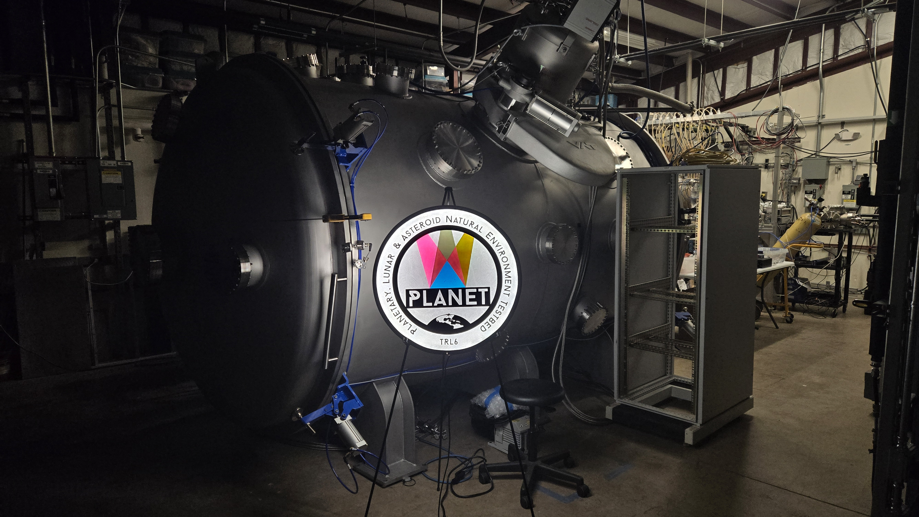
Update on Planetary, Lunar, & Asteroid Natural Environment Testbed (PLANET)
Erin Hayward,
Todd Schneider, Jason Vaughn,
Patrick Lynn, Peter Bertone, Mary Nehls
NASA MSFC
Space Environmental Effects Team (EM41)
ISMSE–ICPMSE 2024, Saint-Raphaël, France
October 11, 2024

Slide 2
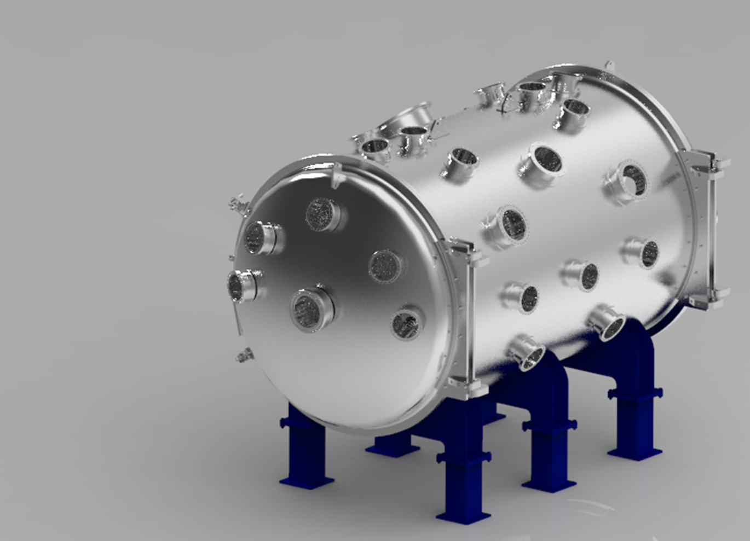


PLANET
PLANET is a new, high-fidelity, combined space environments laboratory located at NASA’s Marshall Space Flight Center
Based on a 2-meter diameter x 3-meter long cylindrical vacuum chamber
Significantly enhances NASA’s planetary surface simulation capabilities, providing the most “complete” lunar surface environment testbed available with greater than 1 m³ exposure envelope
Planetary, Lunar, & Asteroid Natural Environments Testbed
Notes:
PLANET is going to be our newest addition to the vacuum chamber family, and will significantly enhance our planetary surface simulation capabilities. With the Artemis program really spooling up to return us to the moon on a sustained basis, there’s a clear need for dusty and dirty chambers, and so we plan for lunar surface to be our immediate focus.
Right now, PLANET is still at the development and procurement stage, so I only have a rendering, not a real picture! The basis of the system is a 2m x 3m vacuum chamber, covered in lots of ports for bringing in different environments and equipment, and of course, we’ll have a large regolith simulant bed for doing dusty and dirty testing.

Slide 3
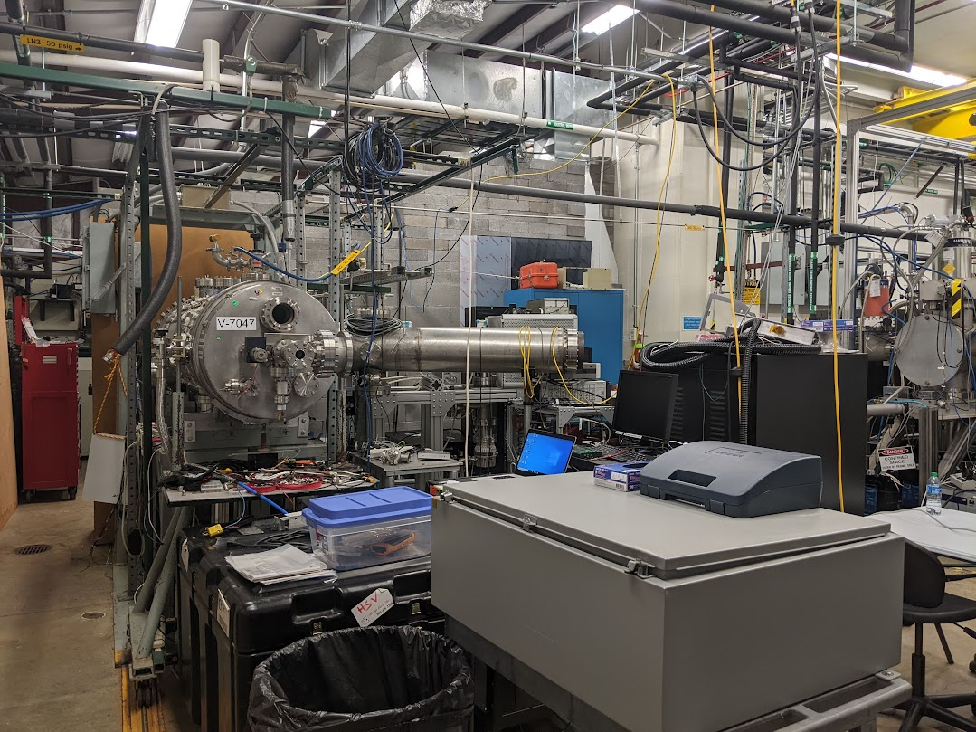
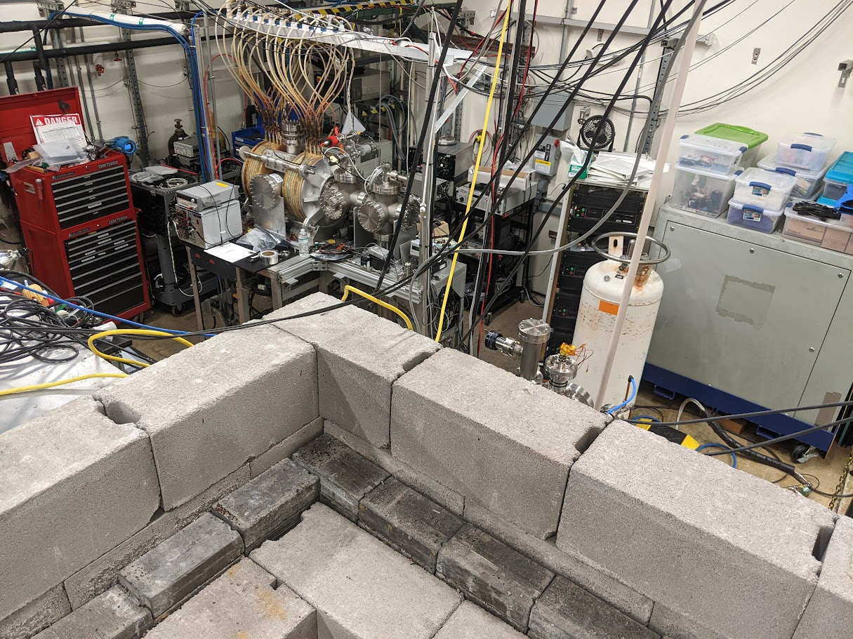
Preparing Room 14
August 2023
Lots to do!
Notes:
Bring in environments primarily from above
Additional Instrumentation – high speed cameras, RGAs, plasma diagnostic equipment, power supplies, thermocouples

Slide 4
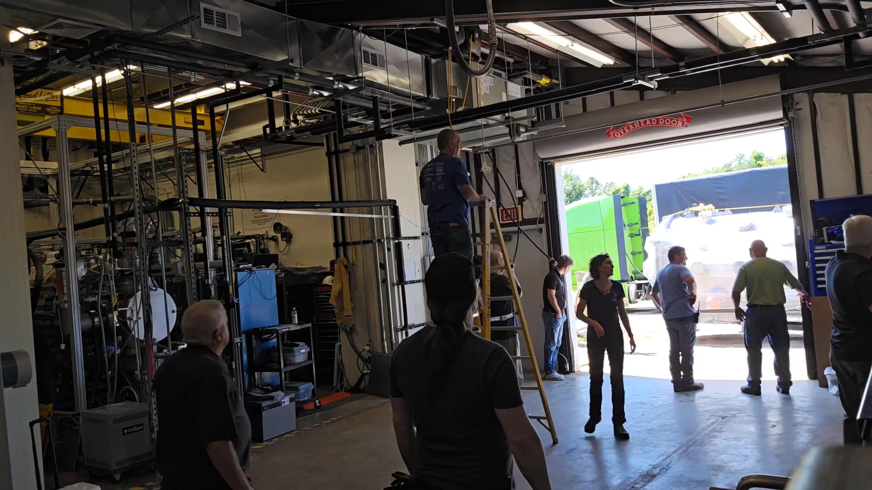
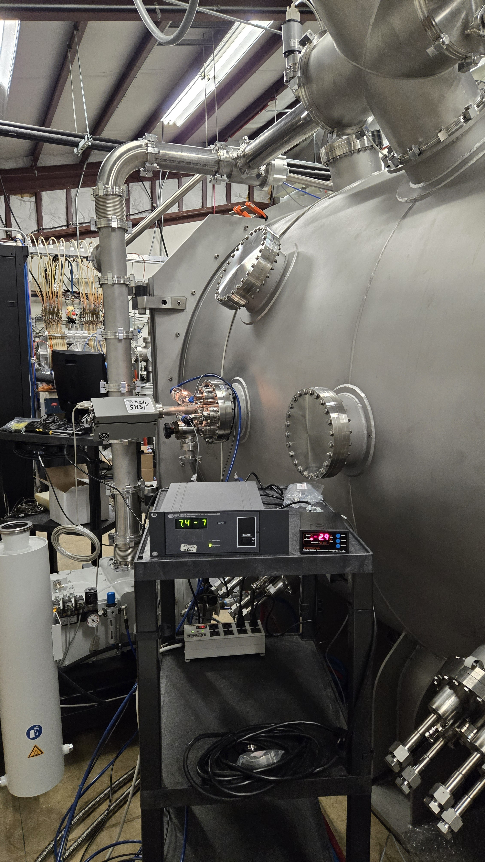
PLANET Arrival & Commissioning
Successful high-vac pumpdown! 7.4e-7 Torr (9.9e-7 mbar) →
Notes:
Bring in environments primarily from above
Additional Instrumentation – high speed cameras, RGAs, plasma diagnostic equipment, power supplies, thermocouples

Slide 5
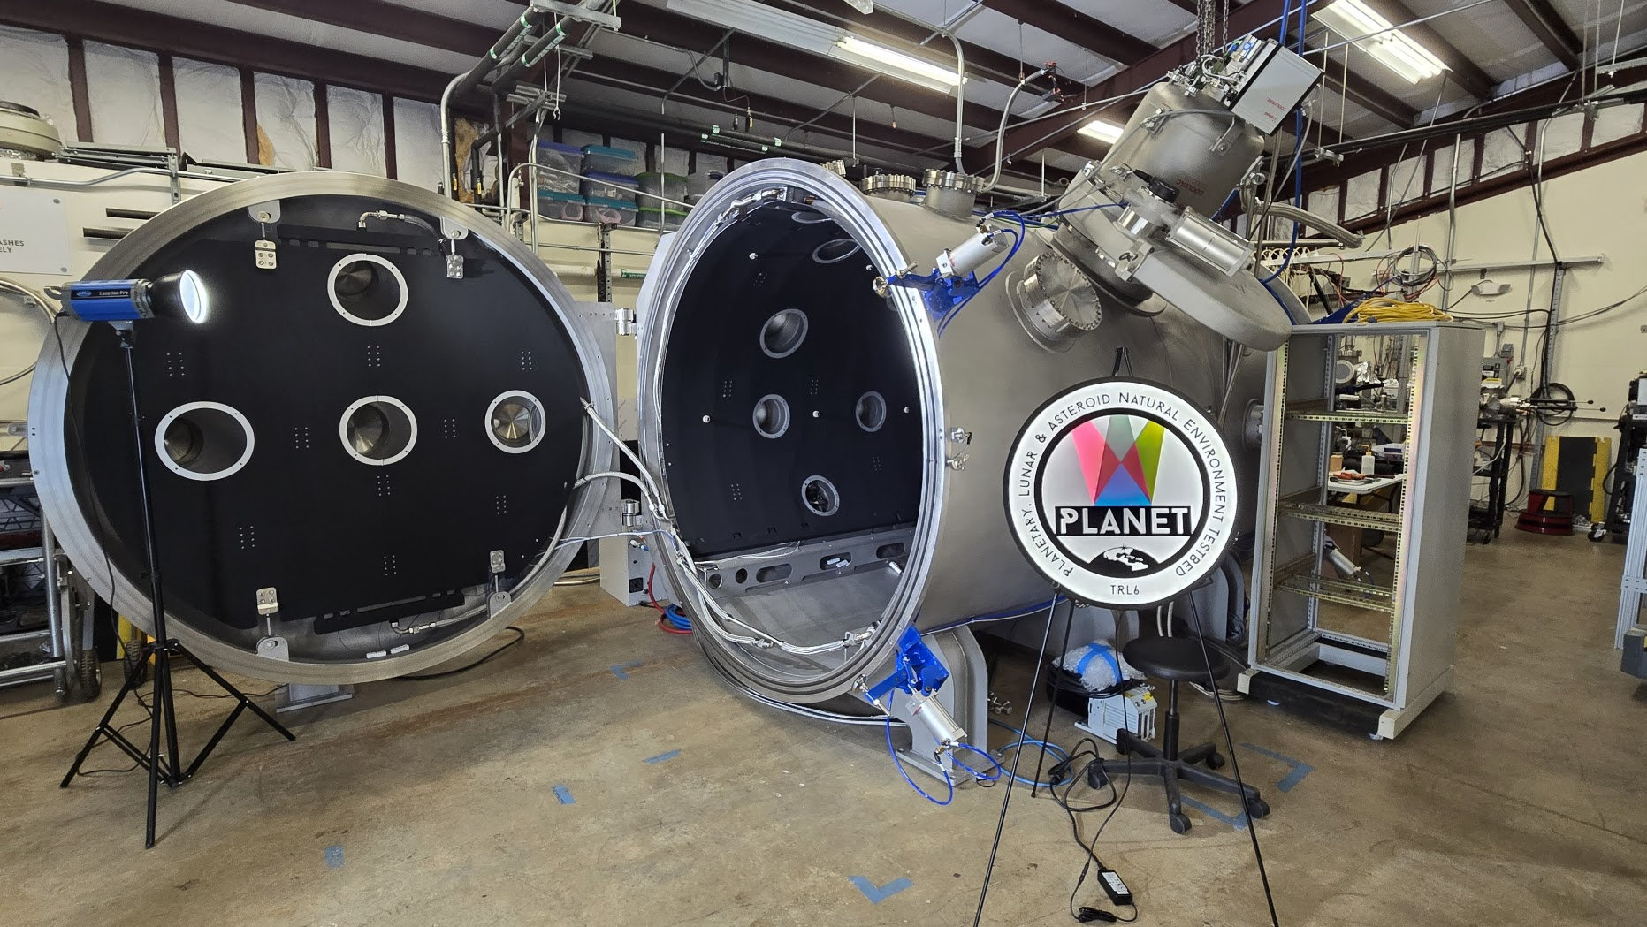
PLANET Arrival & Commissioning
Notes:
Bring in environments primarily from above
Additional Instrumentation – high speed cameras, RGAs, plasma diagnostic equipment, power supplies, thermocouples

Slide 6
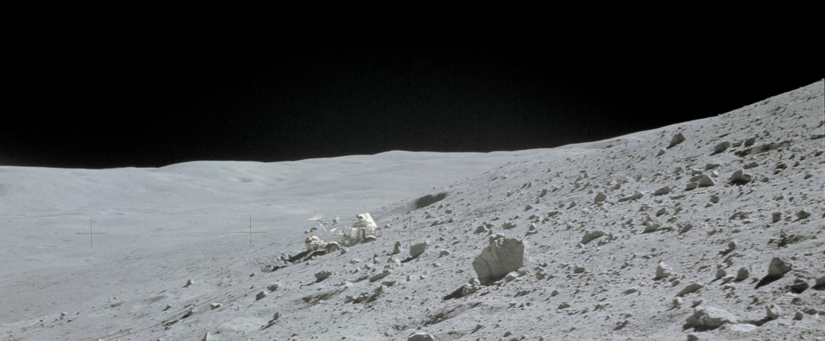

Planned Environmental Capabilities
High vacuum (${10}^{−7}$ Torr), low density plasma, or planetary atmosphere
Charged particle radiation
  Electrons up to 100 keV
  Protons/Ions up to ~30 keV
Thermal extremes
  LN2 cryogenic shroud: -180C/95K
    Potential future upgrade to helium
  Heating to >140C (radiative, conductive, bakeout, shroud)
Ultraviolet radiation (Near UV and Vacuum UV)
Regolith simulant bed (lunar mare or highlands, Martian) up to 2,000 pounds
  NUW-LHT-5M or JSC-1A
Notes:
Took the most important aspects of the planetary surface environment that are practical to apply at once
Ion source - duoplasmatron
Note: there are a couple things we won’t have here… for example, our higher energy sources that can produce a total ionizing dose. But, they are in the same building, so we can do sequential exposures.

Slide 7
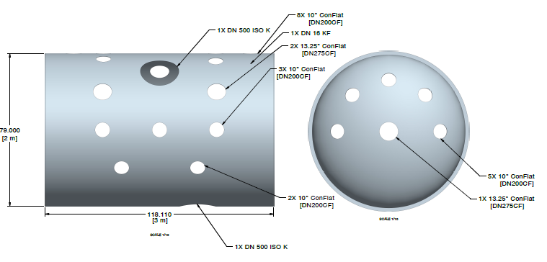
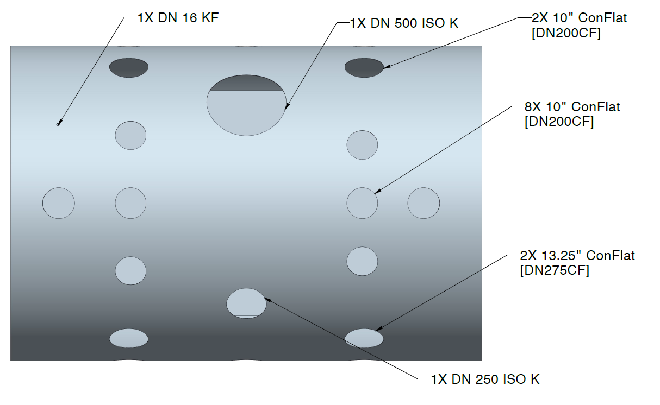
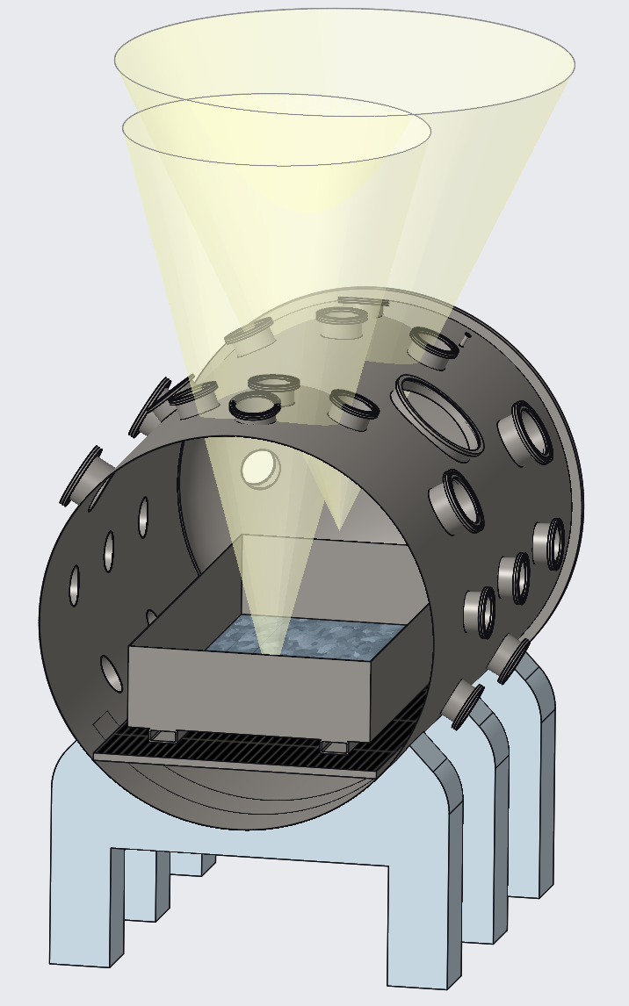
Port Arrangement & Zones
Side view
Top view
2 Zones with different focal points
Instrumentation and viewports
Primary environmental introduction ports
Cryopump port
Bottom port for deep regolith studies
36 ports total (mostly ConFlat)
Notes:
Bring in environments primarily from above
Additional Instrumentation – high speed cameras, RGAs, plasma diagnostic equipment, power supplies, thermocouples

Slide 8
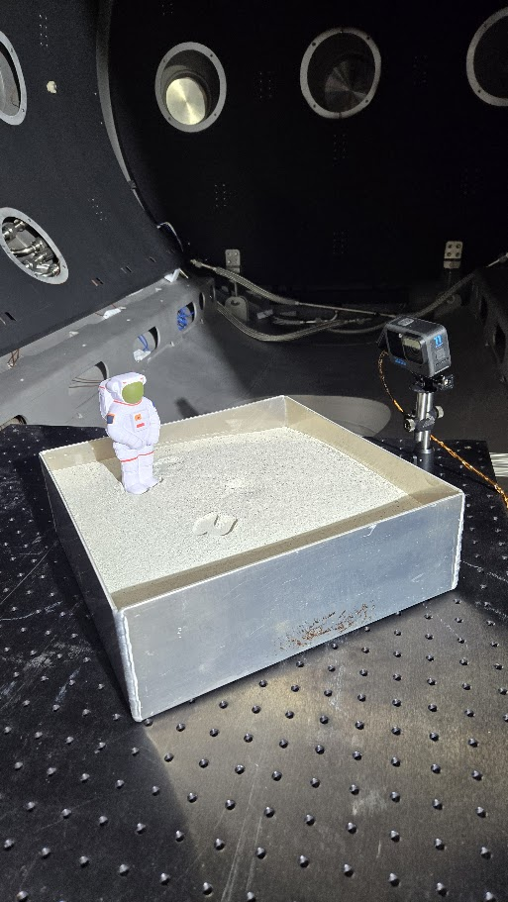
1st Pumpdown of Regolith Simulant!
Test Setup:
Simulant:
  Approximately 11 kg (25 lbs) of NUW-LHT-5M @ 4” depth
  Baked out for ~20 hours at 200 – 230 C in an atmospheric oven (to drive out surface water)
  Observed that texture and flow of simulant was different pre and post bake
    Pre: quite flowy when container was tapped or shaken,
    Post: firmer, not flowy, not dusty
GoPro video camera installed (powered USB, no battery, app control)
Thermocouples on camera and in simulant
Throttled rough pumping from 760 - 200 Torr
  Scroll pump through 2¾ flange vs screw pump on ISO 100
Notes:
Bring in environments primarily from above
Additional Instrumentation – high speed cameras, RGAs, plasma diagnostic equipment, power supplies, thermocouples

Slide 9
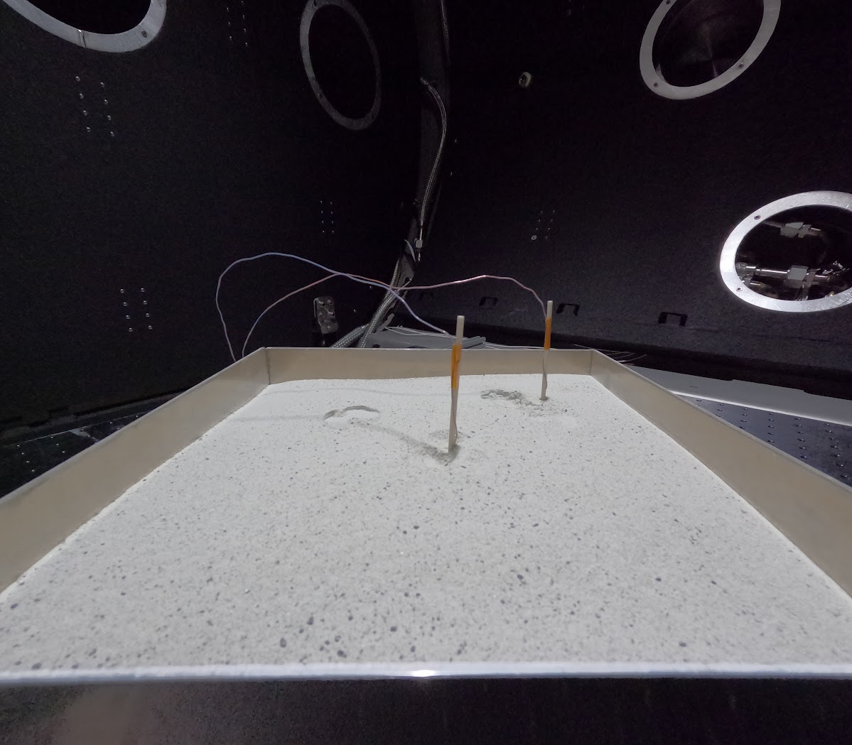
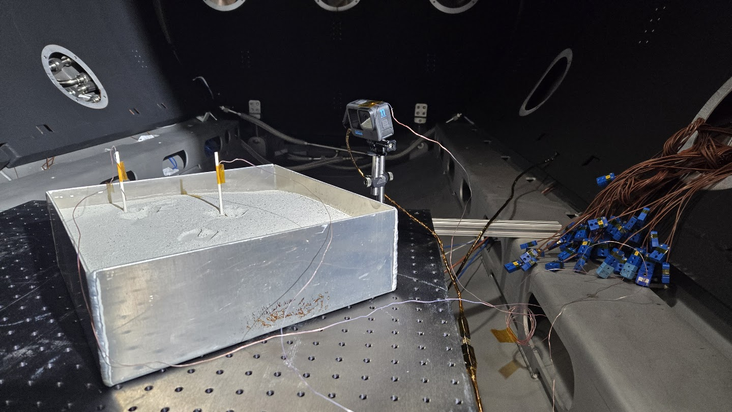
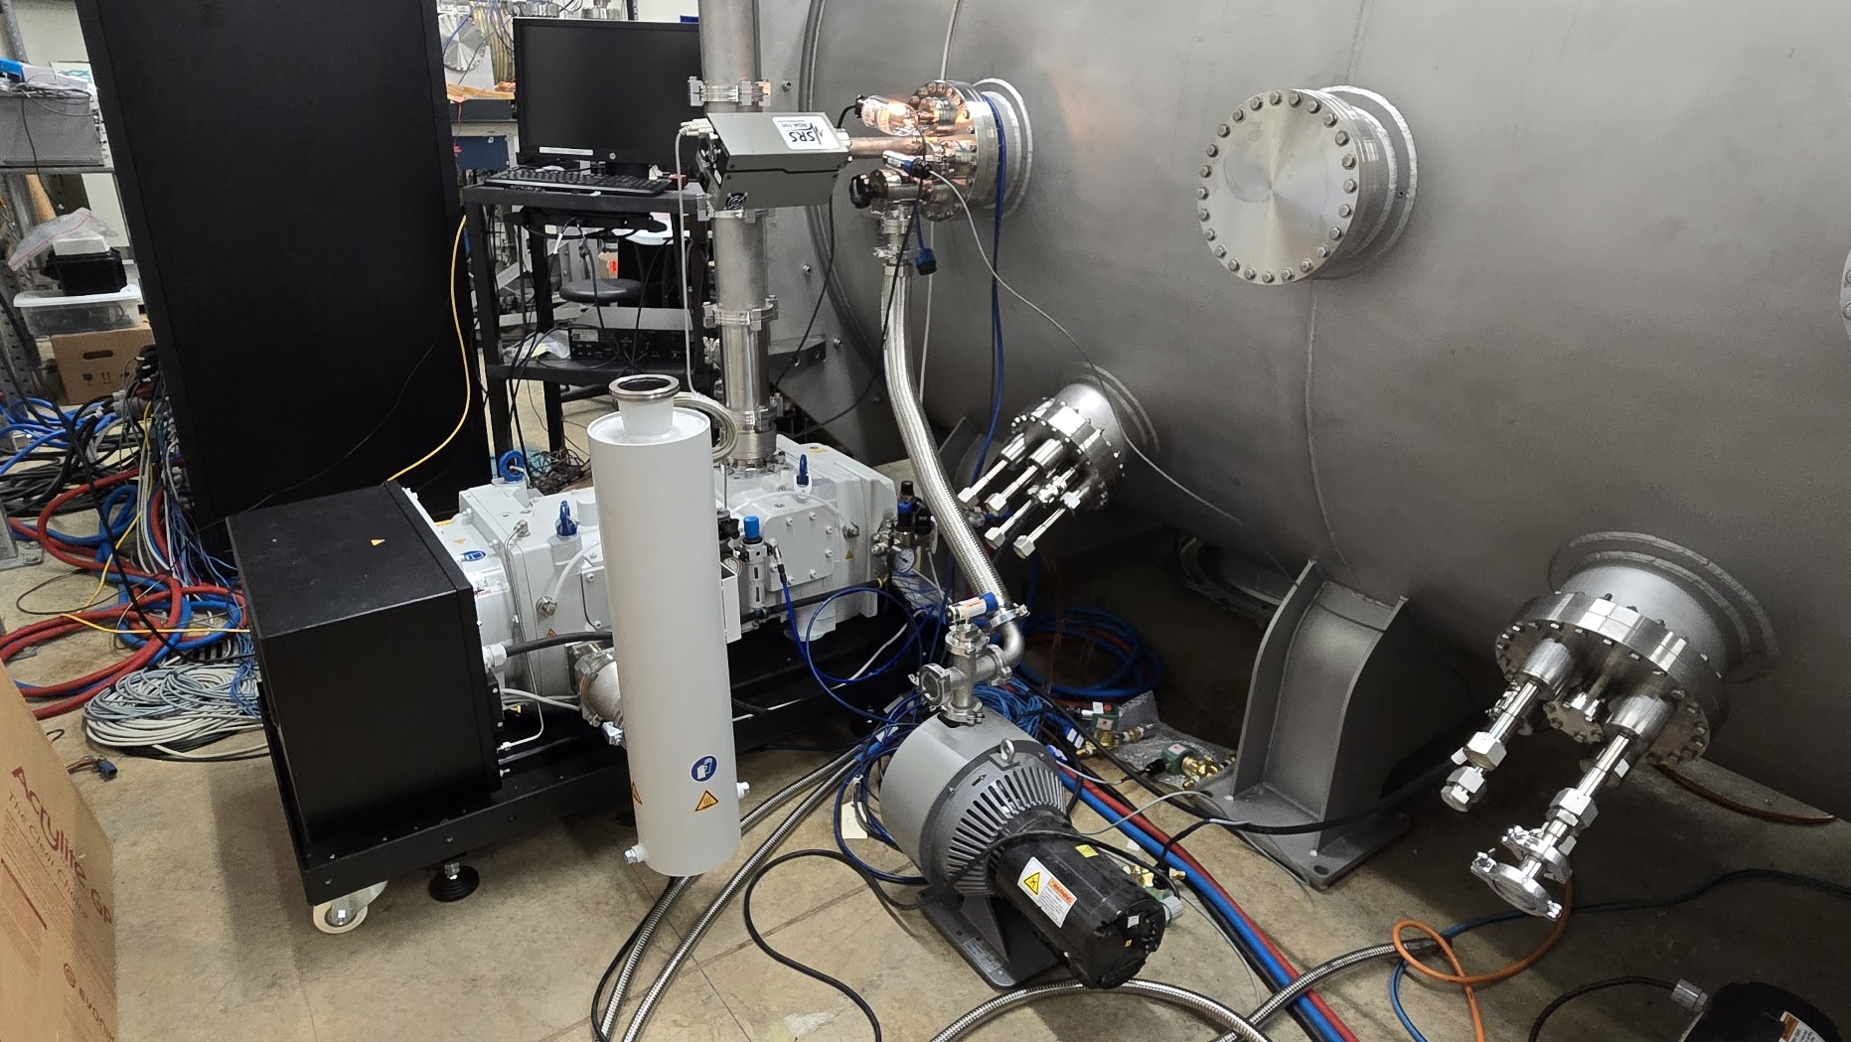
1st Pumpdown of Regolith Simulant!
 | With simulant | Clean chamber
ATM > 150 Torr | 45 min (throttled) | 25 min
150 Torr > 40 mTorr | 11 min
40 mTorr to 9.9E-6 Torr | 1 hr | 32 min
Pressure after 15 hours | 1.2E-6 Torr | 8.7E-7 Torr
Challenges:
Pumping speed & conductance
Closure on doors
Control system logic
Scroll pump
Success! The simulant never moved!
We took a video, but it’s super boring…
Screw pump
Leybold DRYVAC DV650
Notes:
Bring in environments primarily from above
Additional Instrumentation – high speed cameras, RGAs, plasma diagnostic equipment, power supplies, thermocouples

Slide 10
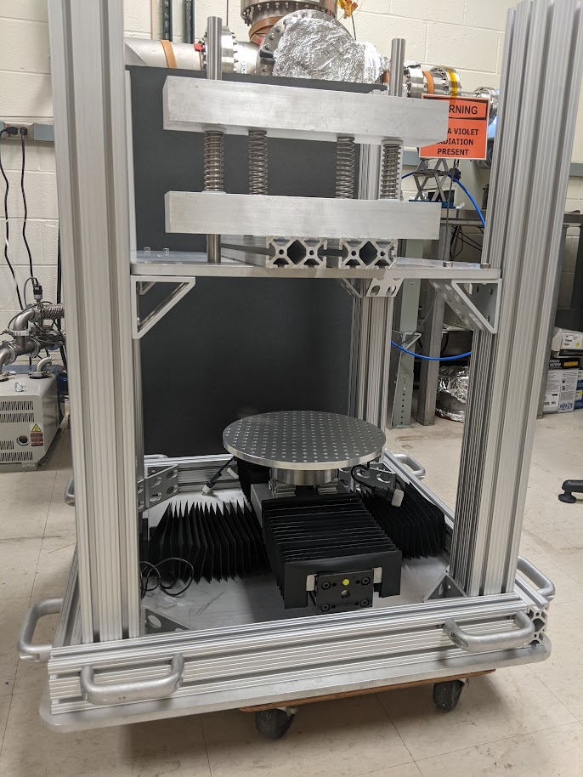
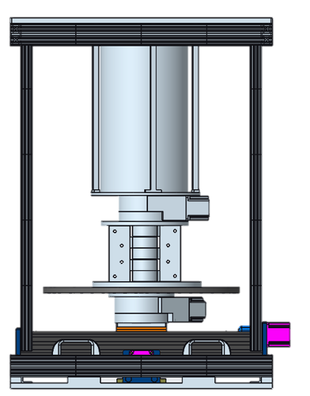
Mechanism Wear Tester
We have developed component wear tester that can be used under high vacuum
200 lb normal force
Variable motion with three linear stages and one rotary stage
Regolith deposition capability
Hinge, ball & socket, rod & slot, or custom mechanisms
Notes:
Bring in environments primarily from above
Additional Instrumentation – high speed cameras, RGAs, plasma diagnostic equipment, power supplies, thermocouples

Slide 11
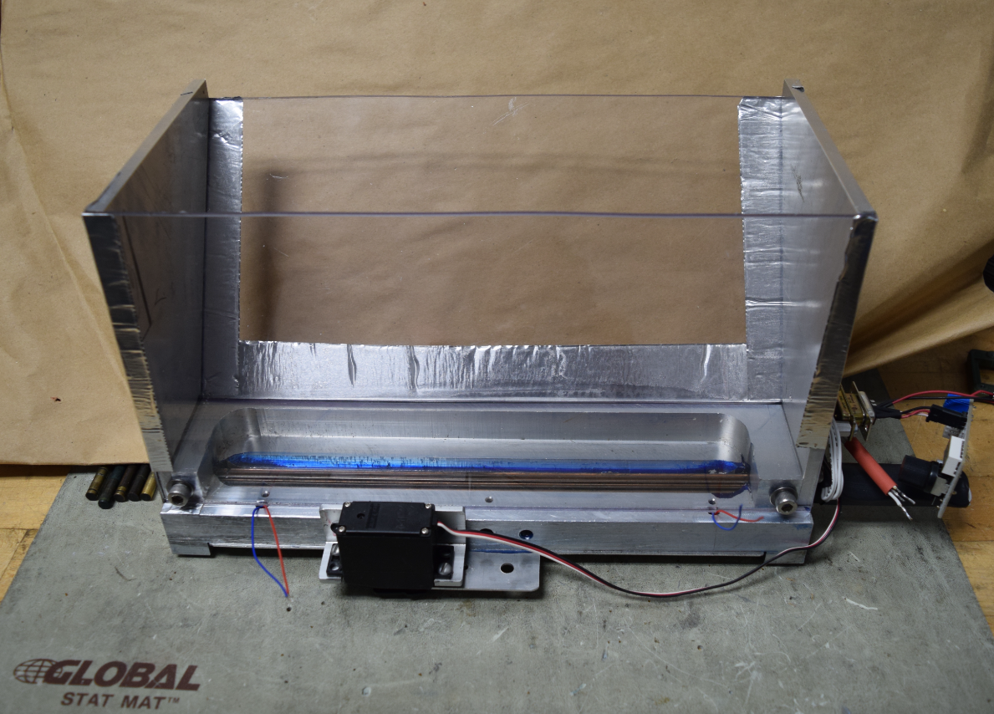
In-situ Regolith Distribution
Putting dust/simulant on a test article is non-trivial, especially if you want to do it in vacuum!
We have developed a feed system that can uniformly deposit regolith across a sample at a known rate
  This allows for better testing than simply bounding the problem by fully covering an article in regolith
Hopper is attached to motion stages for rastering coverage over test articles
Work is on-going to fully characterize distributed dust for uniformity of coverage, particle size distribution, and charging/adhesion behavior
Notes:
Bring in environments primarily from above
Additional Instrumentation – high speed cameras, RGAs, plasma diagnostic equipment, power supplies, thermocouples

Slide 12
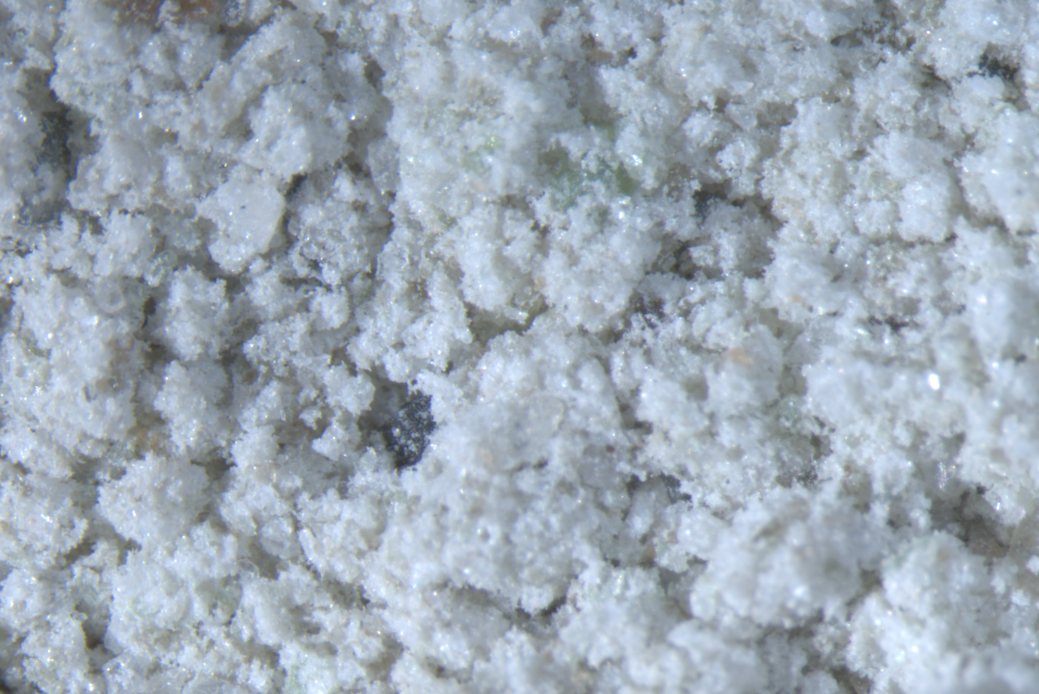
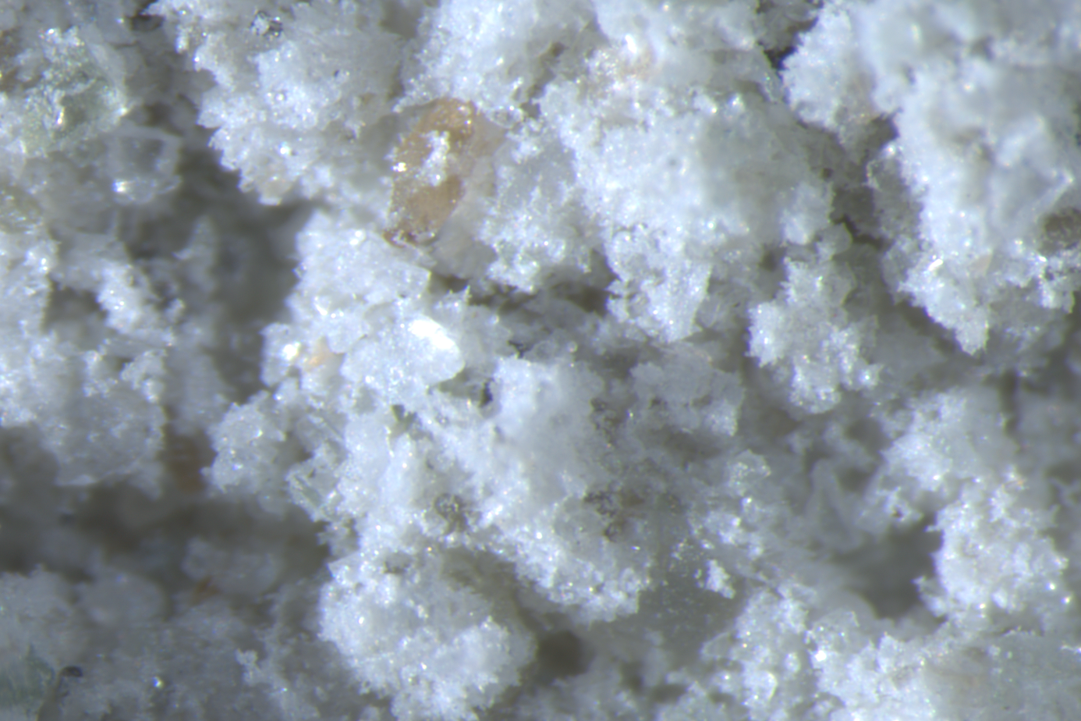
NUW-LHT-5M Simulant
“For the crystalline components the design of the simulant called for two rocks from the Stillwater Complex, Montana: 17.6 wt% norite, 37.7% anorthosite, and 4.7 wt% olivine from an unspecified commercial source. The other 40% of the simulant was a high calcium (An100), vesicular glass that Washington Mills made specifically for the simulant.”
Characterization of NUW-LHT-5M, A Lunar Highland Simulant; NASA TM-20240007991; Rickman et al.
https://ntrs.nasa.gov/citations/20240007991
PLANET has procured 1000 kg of this simulant!

Slide 13
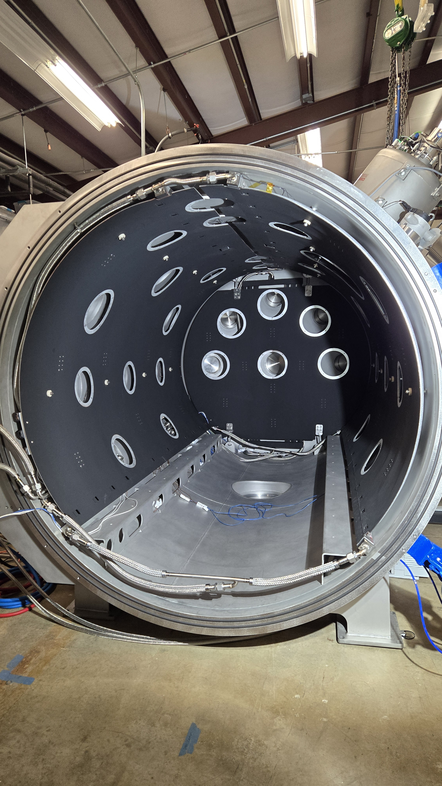
Testing Enabled!
Planetary surface ConOps
Basic materials property changes & aging
Charging (and discharging!) behavior
Thermal balance, performance, cycling
Regolith and dust adherence in a space environment
Dusty mechanism operations and wear
Synergistic/combined effects
Timeline (CY)
2022 2023 2024 2025
Design
Lab and Source Prep
Test all the things!
Chamber Procurement
Checkout
PLANET will be online and available for customer use by early CY2025!
What kind of planetary surface testing capability does your technology need?

Slide 14
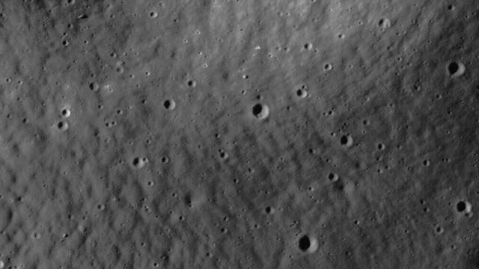
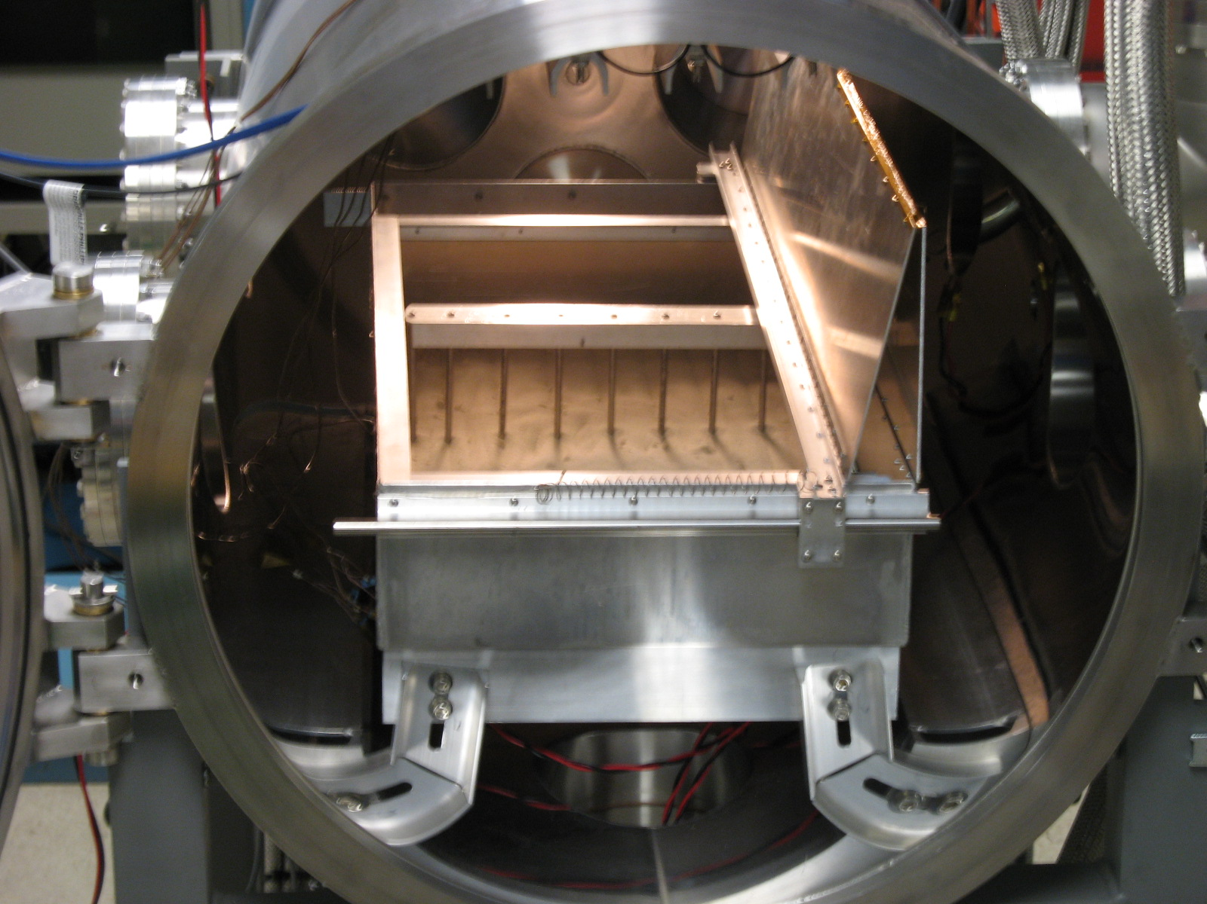
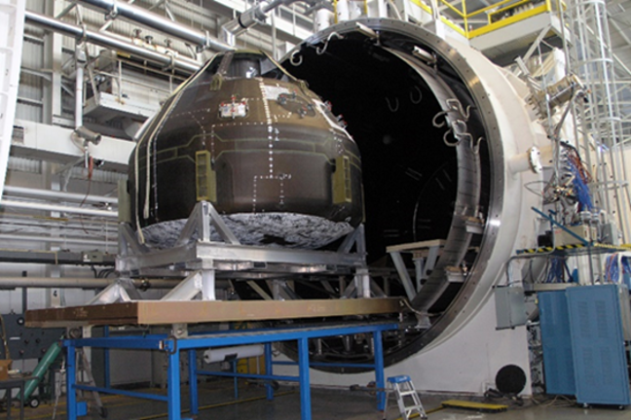
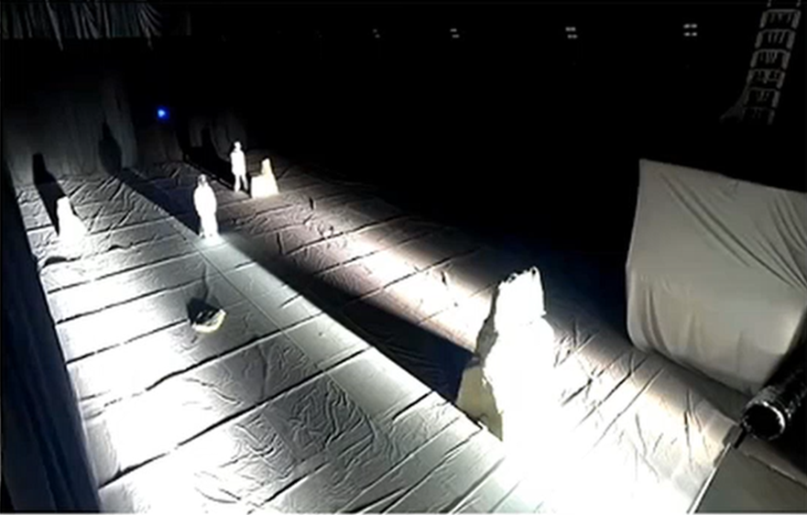
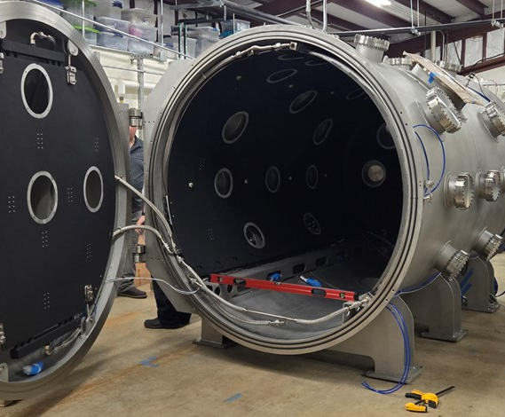
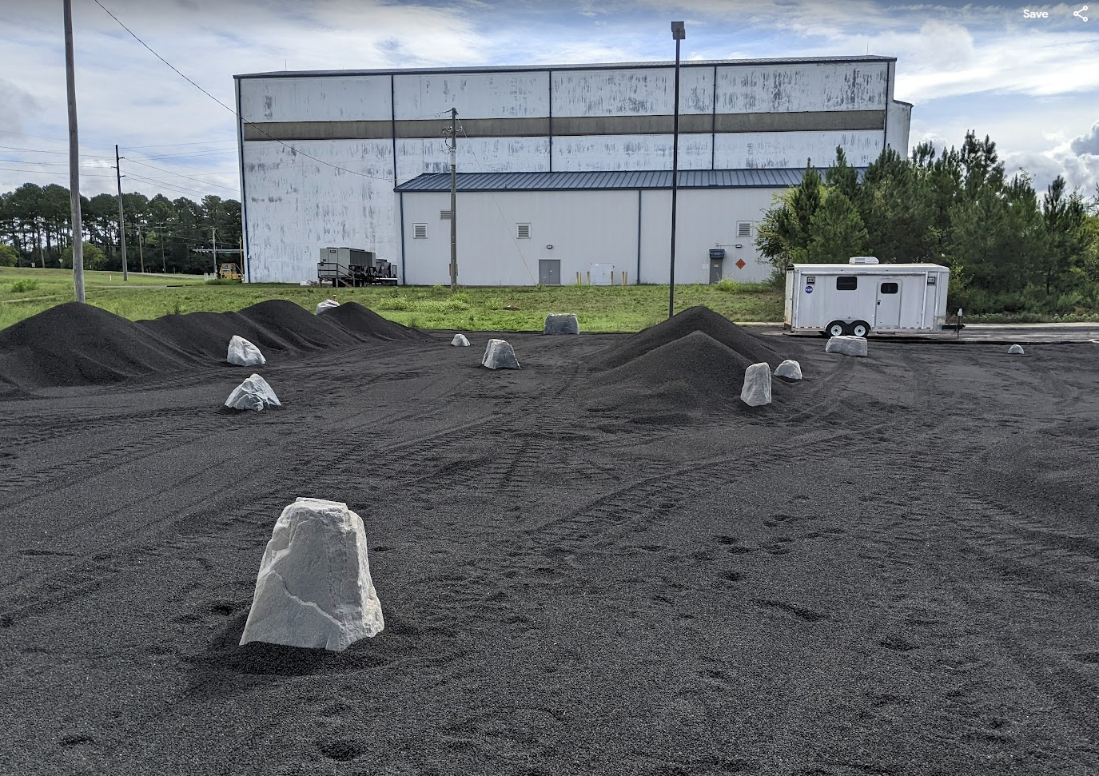

MSFC Lunar Testing Ecosystem
MSFC has multiple complementary planetary surface test capabilities, providing solutions for projects of different sizes, budgets, and development levels
FFF
Flat Floor Facility w/ Illumination
V20
LETS
Lunar Environment Test System
PLANET
Planetary, Lunar, & Asteroid Natural Environment Testbed
LRT
Lunar Regolith Terrain Field

Slide 15
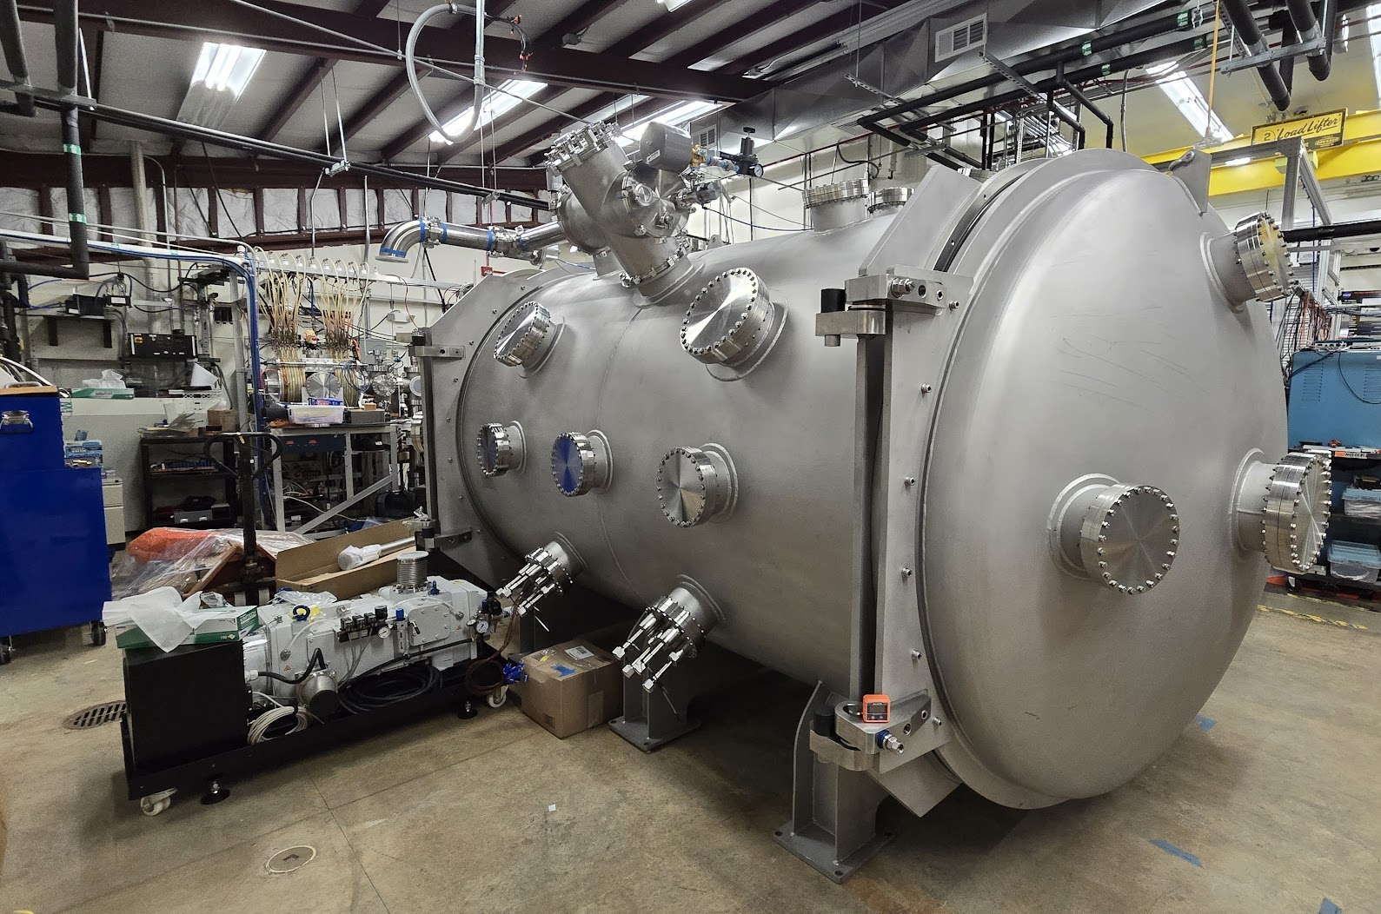
Working with MSFC
NASA MSFC partners with other NASA Centers, as well as other space agencies, universities, and commercial ventures, to
  perform basic materials research,
  advance new technologies, and
  lower mission risk!
Testing in one of our Space Environments chambers can raise your technology to Technology Readiness Level (TRL) 6 – Qualification in a Relevant Environment.
Please get in contact to see how we can work together to enable the future of exploration!
MSFC-SEE@mail.nasa.gov
or
Dr. Erin Hayward, erin.g.hayward@nasa.gov

Slide 16
Backup

Slide 17

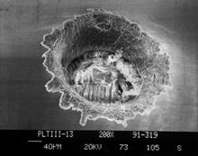
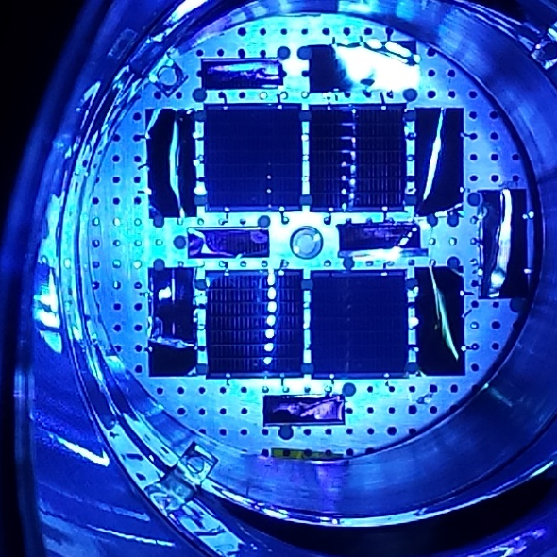
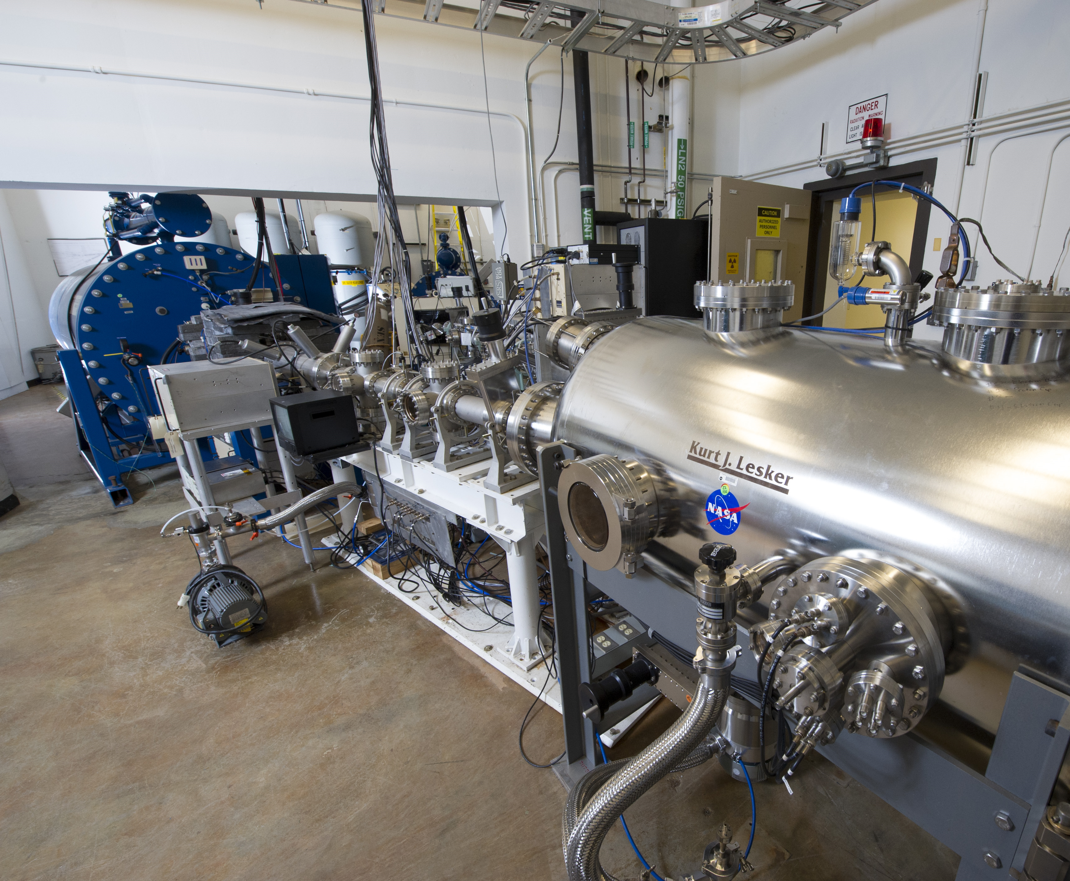
Space Environmental Effects Team Capabilities SUMMARY
Full-spectrum Ultraviolet Radiation (UV)
Ionizing Radiation – Charged Particle (p+, e-), X-ray
  Total Ionizing Dose (TID)
Space Plasma Interactions and Spacecraft Charging
  Internal charging/iESD, surface charging
Planetary Surface and Extraterrestrial Environments
Atomic Oxygen (AO)
Impact Testing
Planetary Protection
Analytical Capabilities
High Temperature Emissivity Measurement System (HiTEMS)
Materials Flight Experiments
Notes:
These is a summary list of our capabilities, many of which can be combined into a single test – vacuum, UV and VUV, ionizing radiation, plasma, thermal extremes, etc. I’ll talk details on the following slides.
Thermal extremes…

Slide 18
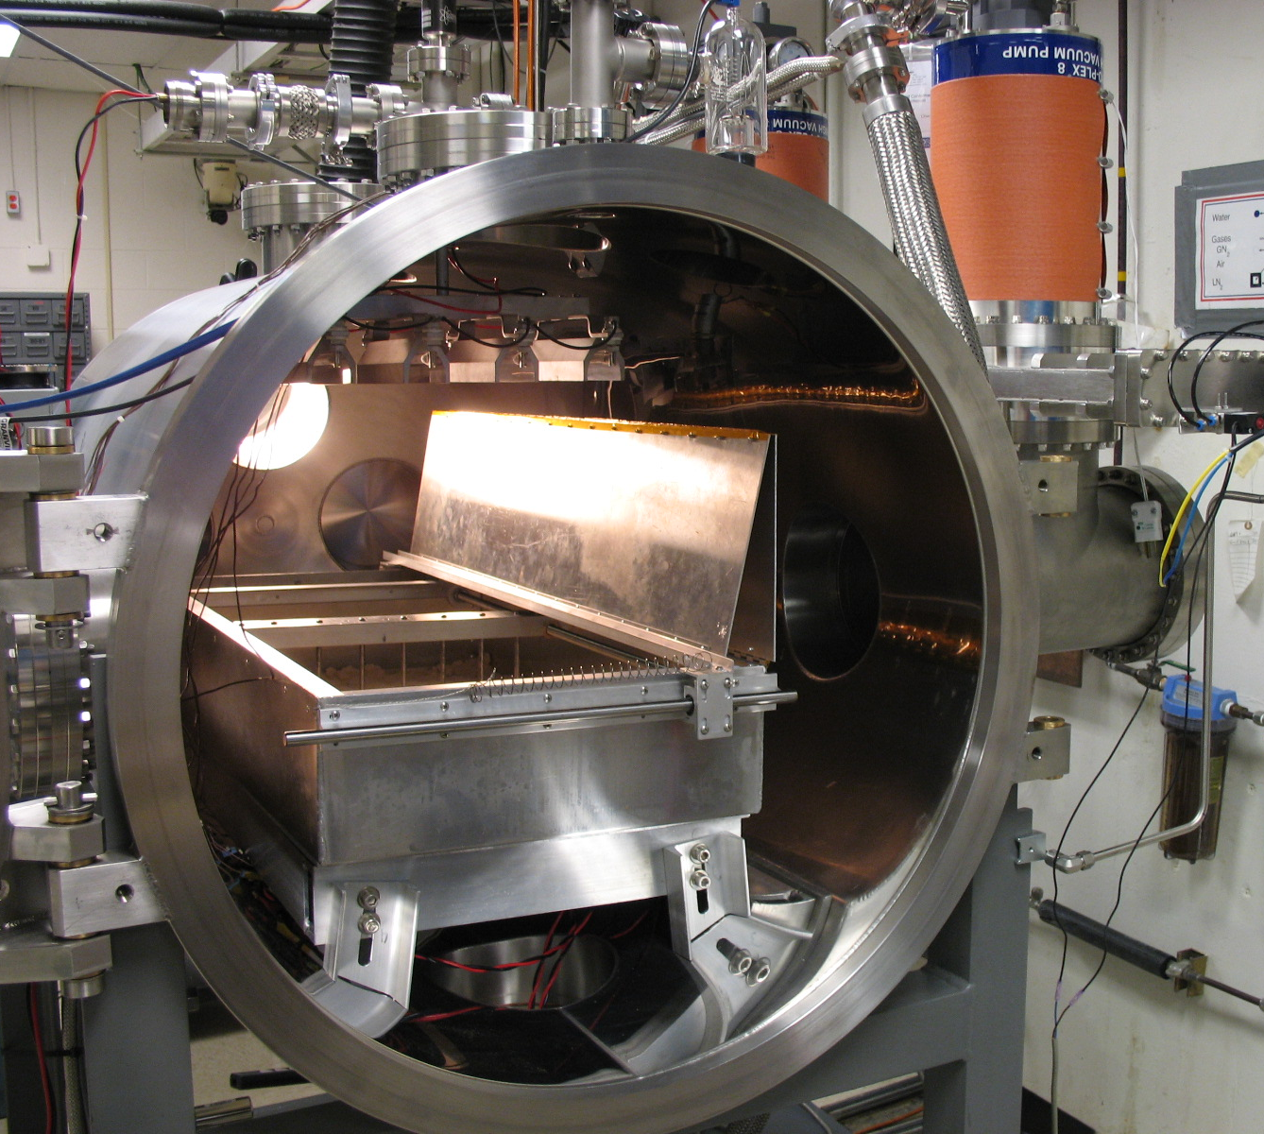
Other Facilities @ MSFC: LETS
Lunar Environment Test System – LETS
Operational since 2008
30” diameter
  Materials, components, and small mechanisms
Combined effects:
  High vacuum
  Cryogenic shroud
  IR heating
  Low energy electrons & protons
  UV (NUV/VUV)
  Particle Imaging Velocimeter
  Simulant box with cover
POC: Mary Nehls or Erin Hayward

Slide 19
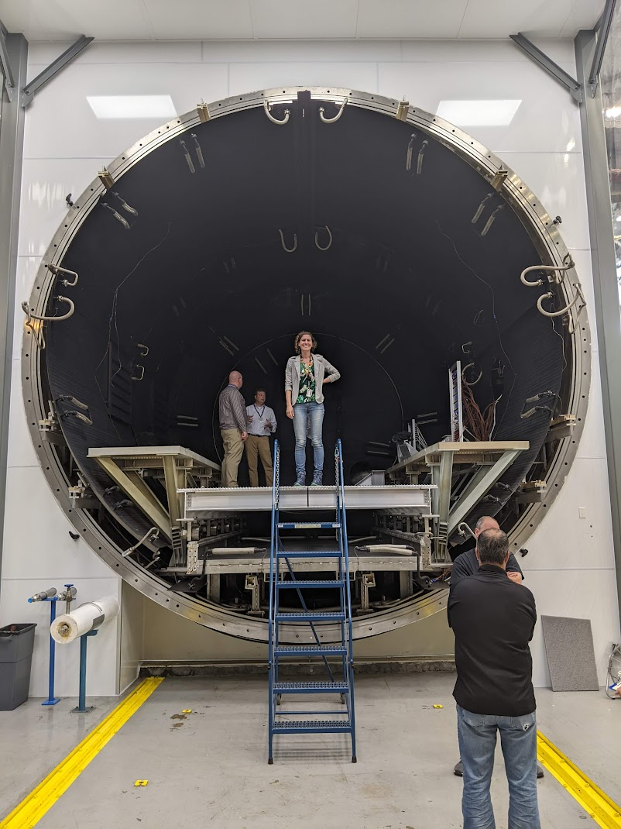
Other Facilities @ MSFC: V20
High vacuum, newly converted to DTVAC (dirty thermal vacuum) from clean
20’ (6m) diameter, 28’ (8.5m) length
  Full-scale hardware test & qual
Huge simulant beds available (14x19’), including shallow and deep options
Cryogenic (LN2) shroud and heating
POC: Patrick Lynn

Slide 20
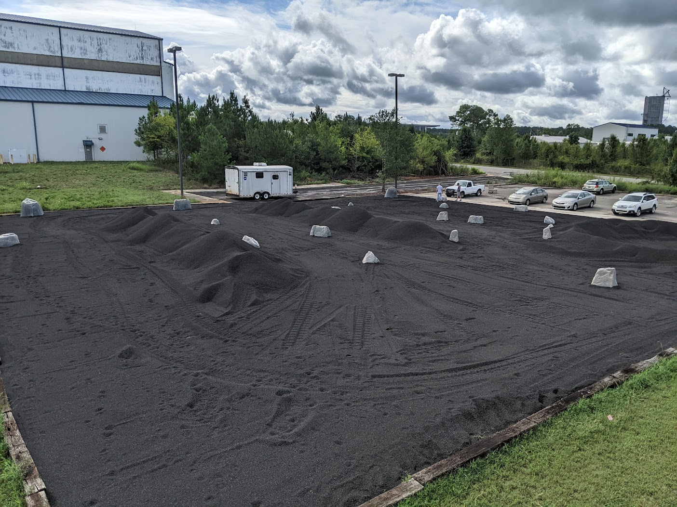
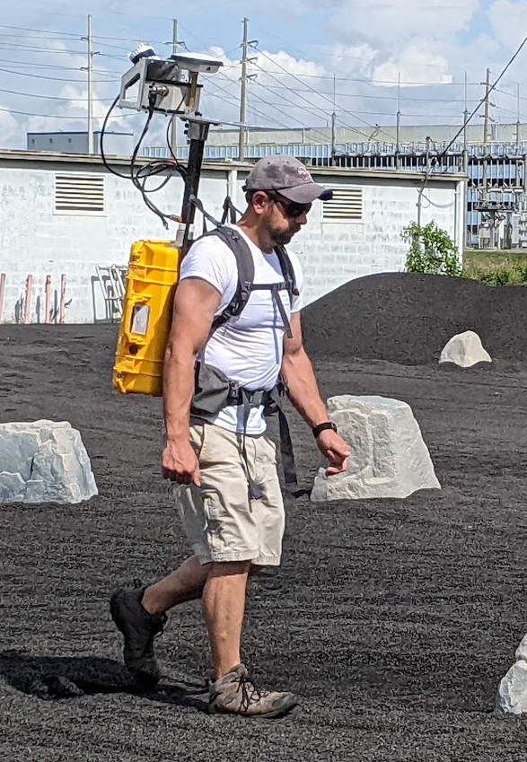
Other Facilities @ MSFC:
Lunar Regolith Terrain (LTR) Field
New capability as of August 2022
125 x 125’ with 8-12” depth
Simulant from Merriam Crater in Arizona (feedstock for JSC-1)
Movable obstacles & boulders
Potential uses:
  Terrain relative navigation and cartography
  Rover & swarm behavior
  Field testing of mechanisms
POC: Alex Summers / Mike Zanetti
Mike tests the KNaCK (Kinetic Navigation and Cartography Knapsack)

Slide 21
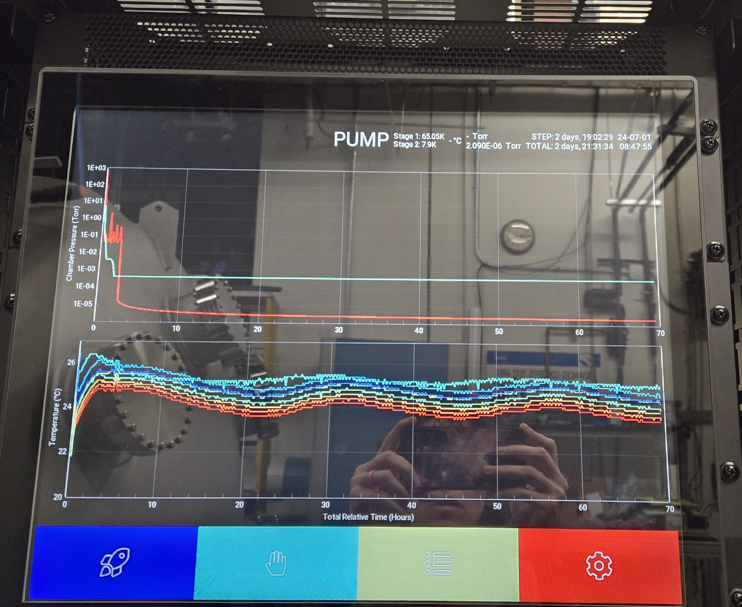
Lessons learned
Requirements matter!
  When writing this procurement, we focused strongly on the physical requirements of the chamber, but not on the specifics of the control system logic. The control system that was delivered is comprehensive but works very differently than we typically do (mostly manual controls!). It’s like there is a ghost in the machine sometimes, but it’s also nice to press one button and go from atmosphere to high vacuum in 25 minutes!
  We didn’t specify what size VCR LN2 connectors we needed, and were caught off-guard by ¾” ones (we only stock up to ½”!). We had to order additional parts, which caused delays.
Big pumps cover many sins.
  After having quickly reached high vacuum with the claw pump (25 minutes!), we wanted to throttle down for the regolith bed. But when we tried to rough slowly (with a scroll pump), we couldn’t move from atmosphere at all! We found that we needed to clamp the doors in additional locations, because the initial pumping speed could never overcome slight gaps in the O-rings!
Notes:
Bring in environments primarily from above
Additional Instrumentation – high speed cameras, RGAs, plasma diagnostic equipment, power supplies, thermocouples

