Slide 1
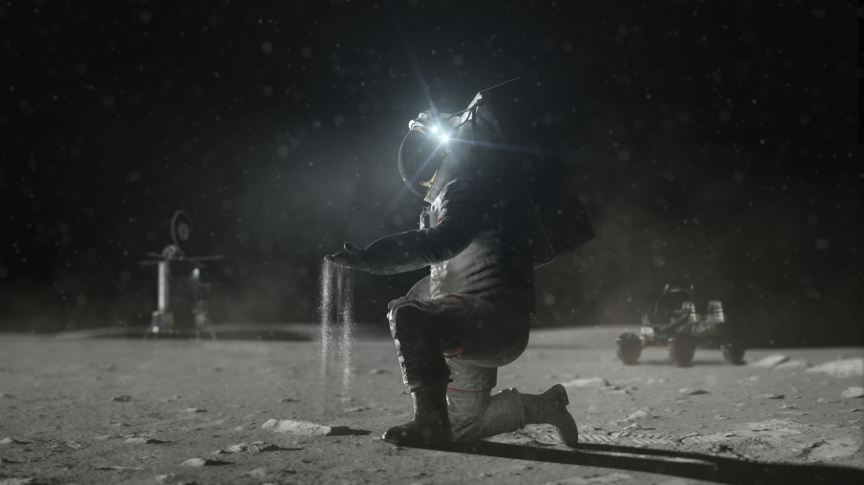

Development of Cryogenic Phase Change Materials for Lunar Sample Return
Erin Hayward,
Thomas Brooks, William Johnson, Jennifer Jones, Lawrence Lybrook, Elijah Stewart, and Joe Sanford
NASA Marshall Space Flight Center
erin.g.hayward@nasa.gov
ISMSE–ICPMSE 2024, Saint-Raphaël, France
October 10, 2024

Slide 2
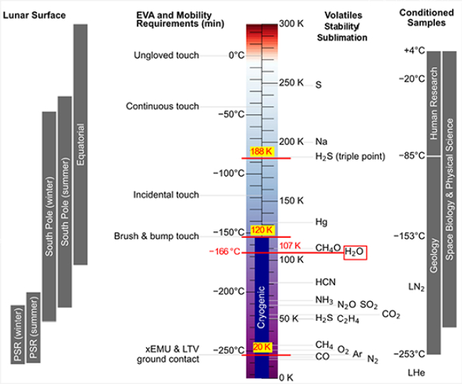
Motivation
Goal: Return lunar regolith samples in “pristine” form, including volatiles that may be present
  These volatiles will only be preserved if the sample can be kept cold from extraction until analysis!
Parameter | Requirement
Geology sample temperature | -153 C to -253 C (120 K to 20 K)
Geology sample mass | > 50 kg
FROSTE - “The Coolest Project at NASA”
FROSTE = Frozen Return Of Samples To Earth
  FROSTE is focused on providing the science community with mobile deep cryo cold stowage to be utilized on the lunar surface and provide environmentally controlled accommodation back to Earth for scientific research
  Working to develop design drivers and ConOps

Slide 3
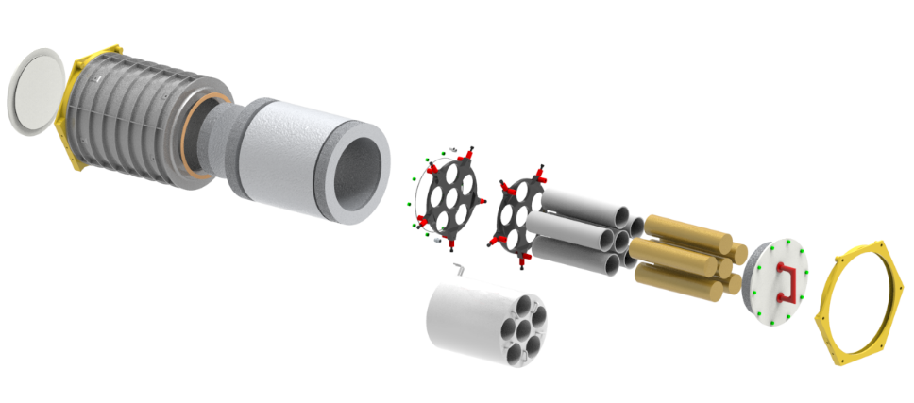
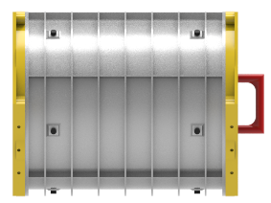
Dual paths to a solution for FROSTE
Stowage Interface (Notional)
Active solution
Keeping samples at 20K will require active cooling with cryocoolers. This solution is very mass and power intensive, and ConOps for non-powered phases will need to be carefully planned.
Top Lid , MLI
handle
Notional preliminary design for FROSTE
20 K Solution
Core Samples
Freeze Material
(for 120K version)
Fuel Cell on Lunar Surface
LTV
Lander
Return
Sample tubes
Cryocoolers (5)
Batteries
SSC (3)
Primary Sealed Containers (PSC)
SecondarySealed Container (SSC)
Tube holder
MLI wrap
Passive solution
Phase change material can be incorporated to increase time at cryo temps and reduce mass/power burden. HLS or Gateway to provide initial cooling or power to freeze/recharge phase change material.
120 K Solution
Outer Casing
SSC (3)
HLS Cold Plate

Slide 4
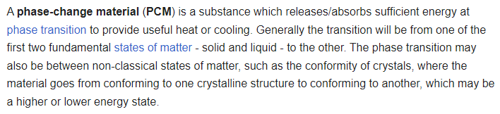
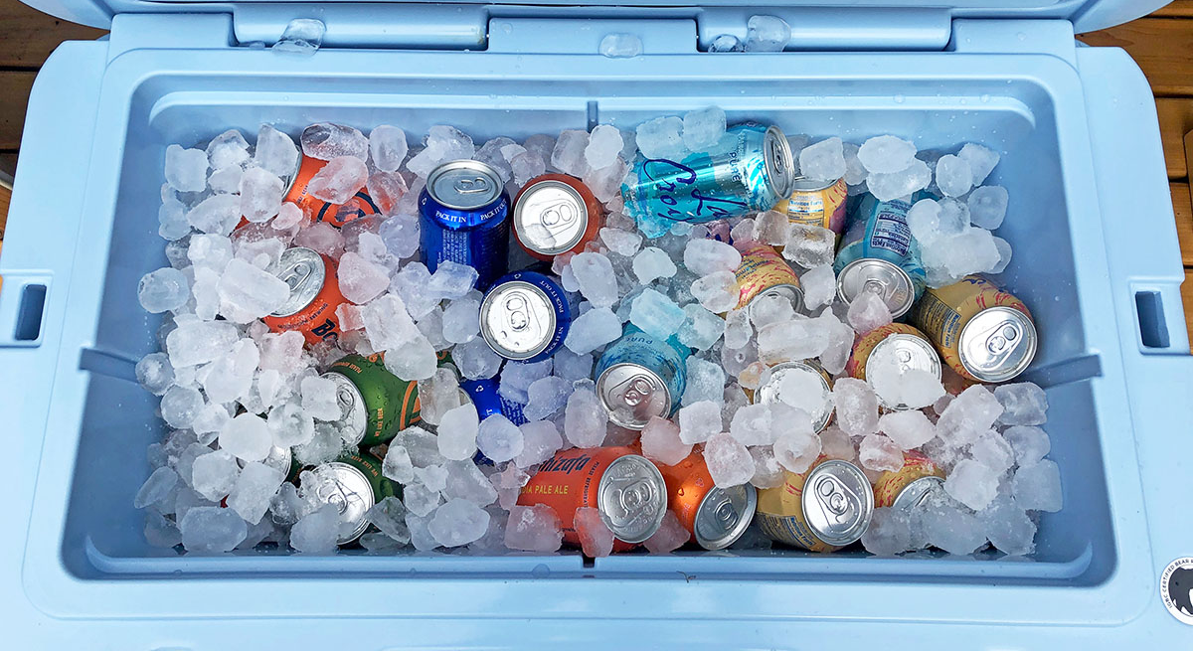
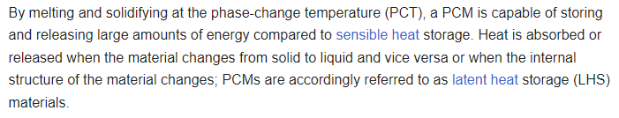
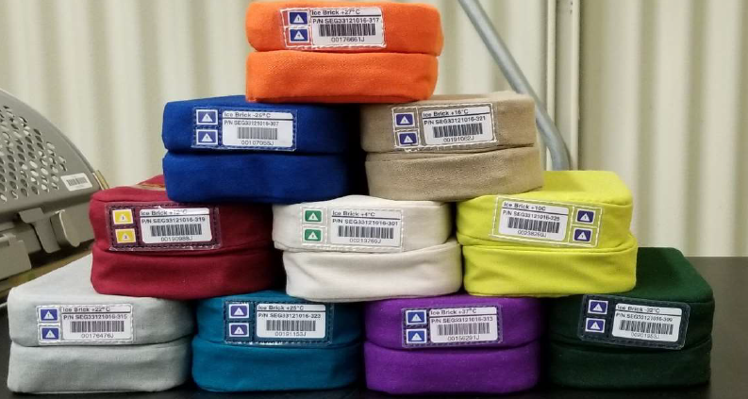
Phase Change Materials (PCM)
Current passive cold storage on International Space Station uses PCMs regularly, in the form of cold bricks. Available temps include: -32°C, -26°C, +4°C, +10°C, +12°C, +16°C, +22°C, +25°C, +27°C, +34°C and +37°C. (There are also several active cold storage options!)

Slide 5
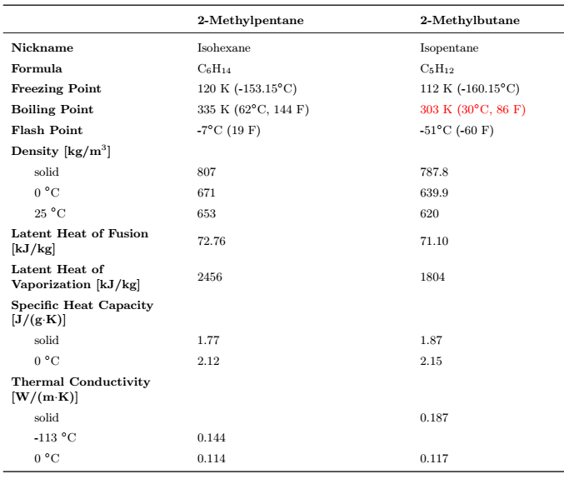
Phase Change Material Study
In a FY 2023 study, two materials were identified as the best initial candidates for PCMs for the “passive” path for FROSTE
An FY24 grant was awarded to advance development:
  Prove if one of these materials can act as an effective engineering PCM (or not)
  Understand handling characteristics – is it difficult/dangerous to work with?
  Provide input to thermal models for the full-scale Secondary Sealed Container (SSC)

Slide 6
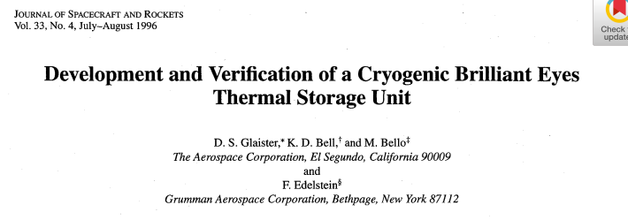

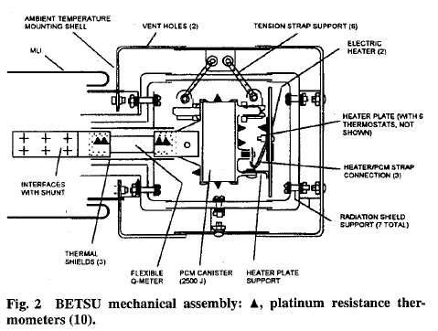

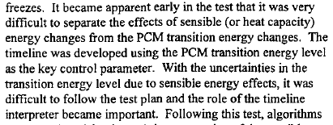

2-methylpentane has been to space before!
https://arc.aiaa.org/doi/pdf/10.2514/3.26800
But, FROSTE needs a LOT more PCM than BETSU… a few mg vs several kg!

Slide 7
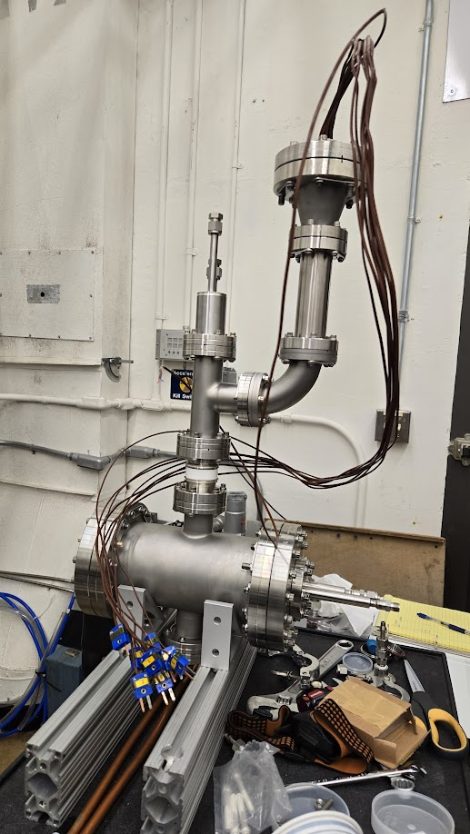
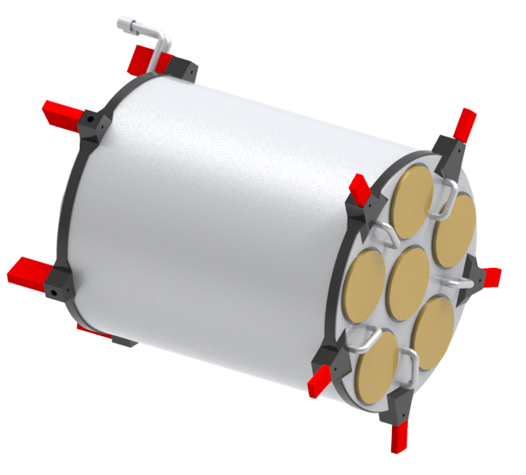
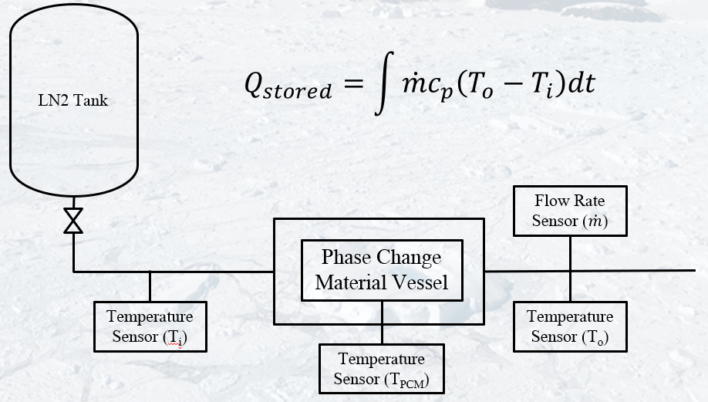
Test Concept
Vacuum HydroCarbon Reservoir (VHCR):
“Mini SSC” test article
Create a proxy SSC (the VHCR)
Fill it with PCM
Freeze and thaw that PCM until we understand it!

Slide 8
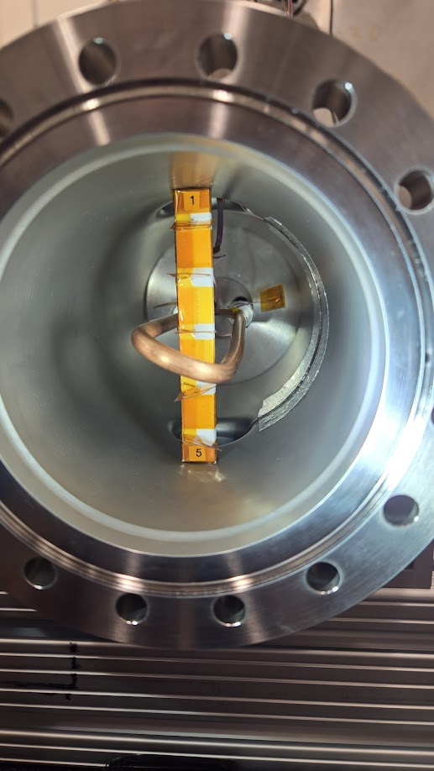
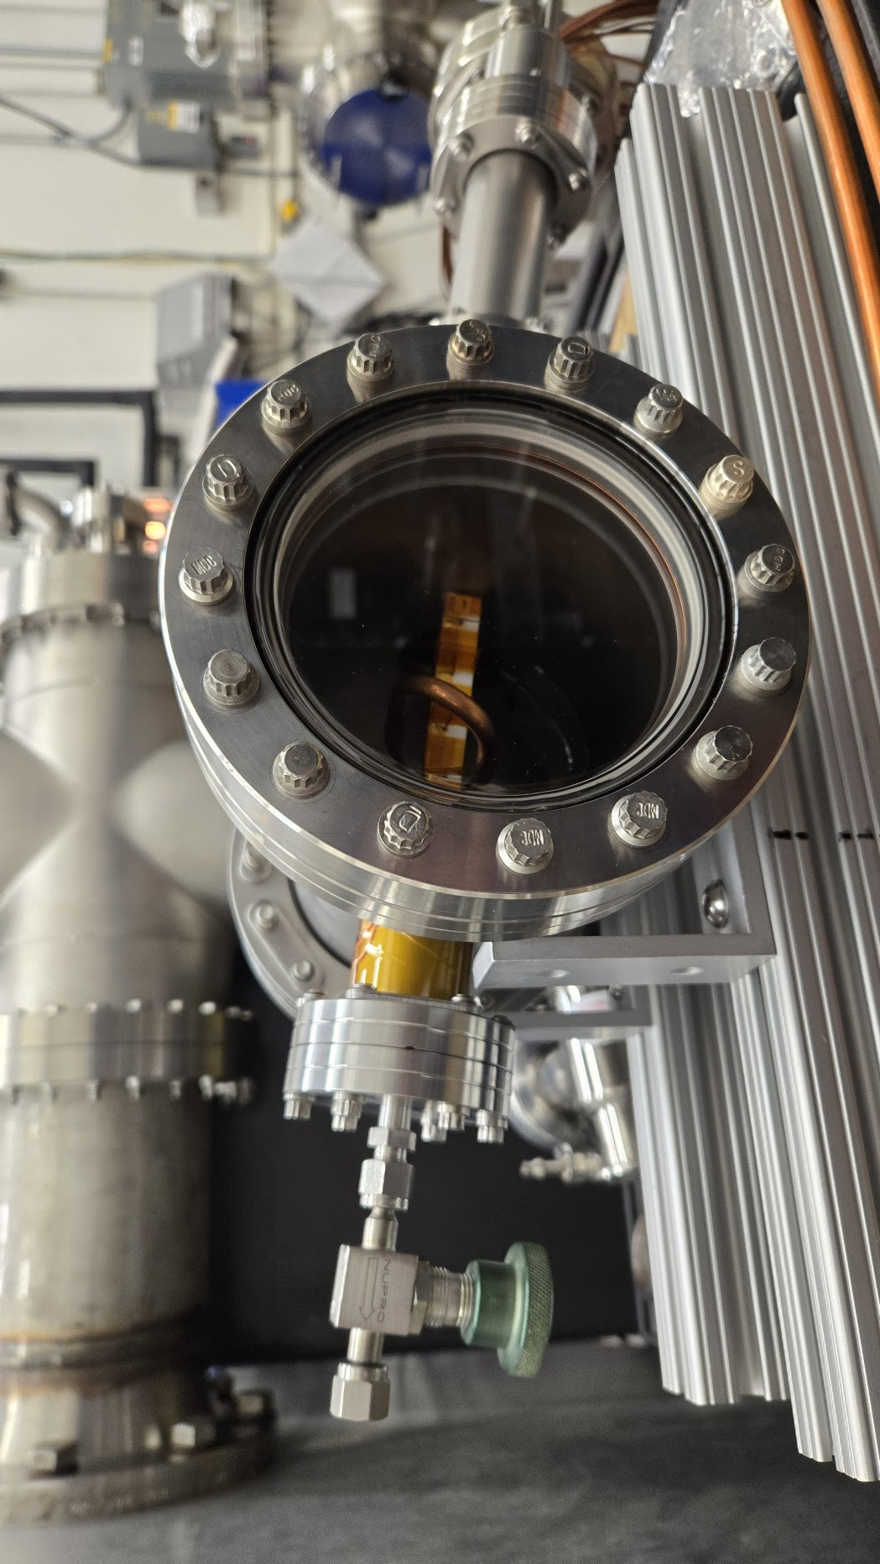
VHCR:
“Mini SSC” test article
Window on one side to (hopefully) view freeze behavior
PCM inlet and vent
8 thermocouples embedded in PCM
Copper LN2 loop simulates coolant channels inside the SSC
Thermal break
Inside of the VCHR, which will be filled with PCM
Gravity assisted drain

Slide 9
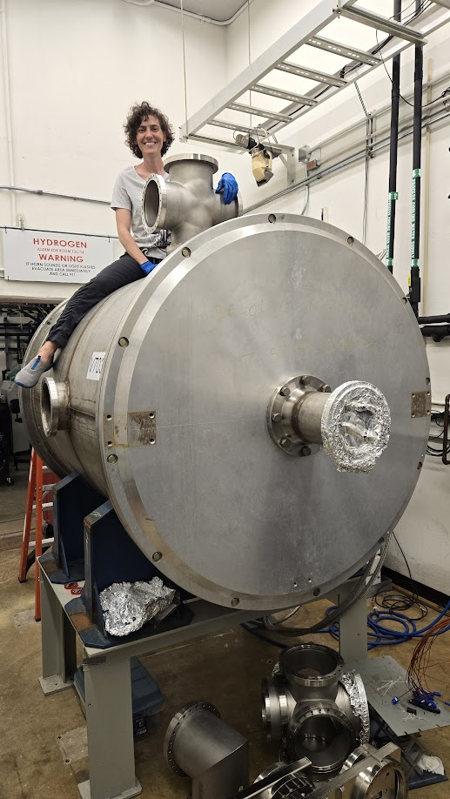
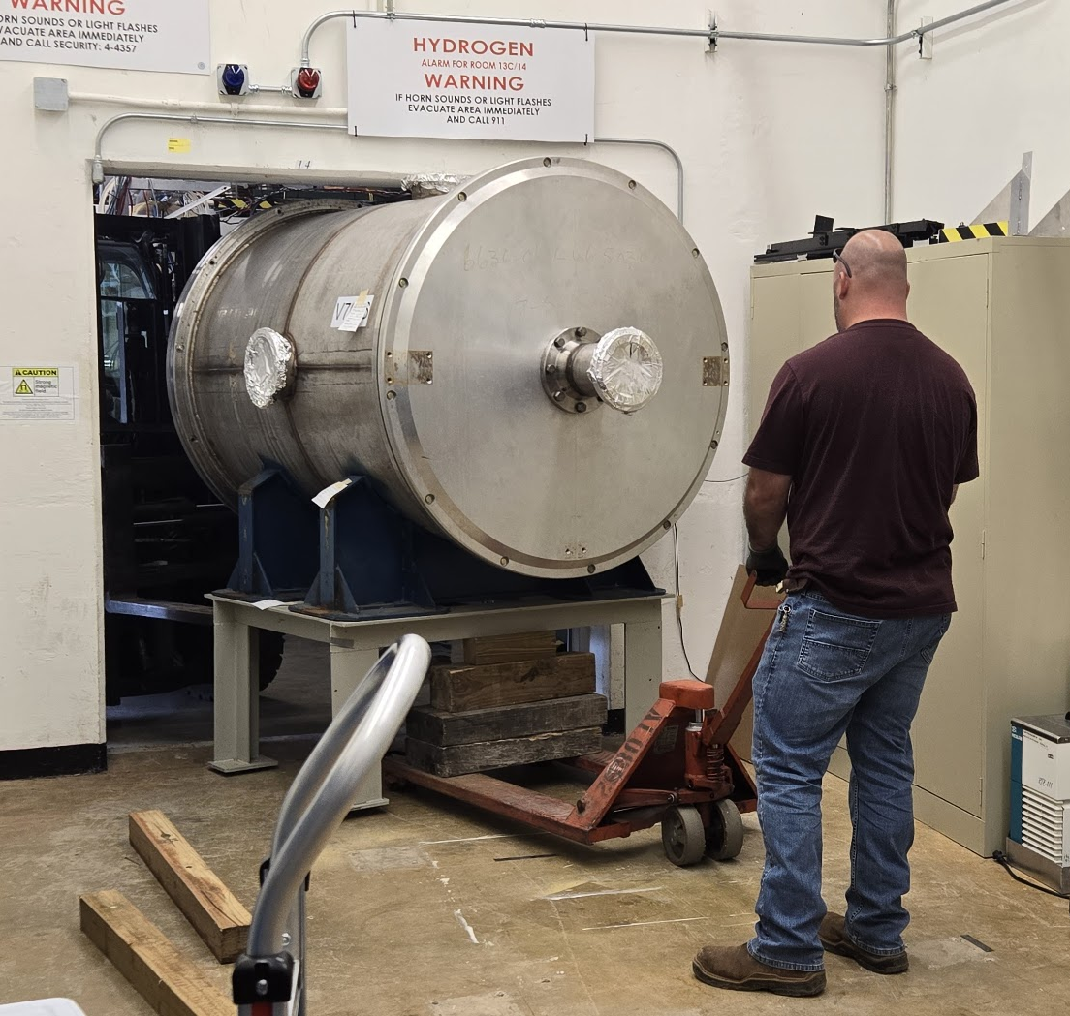

Thermal isolation of the VHCR is desirable to minimize heat losses to atmosphere…
Put it in a vacuum chamber!
Frosty: “new” chamber where test will be performed.
LN2 shroud coming soon!

Slide 10
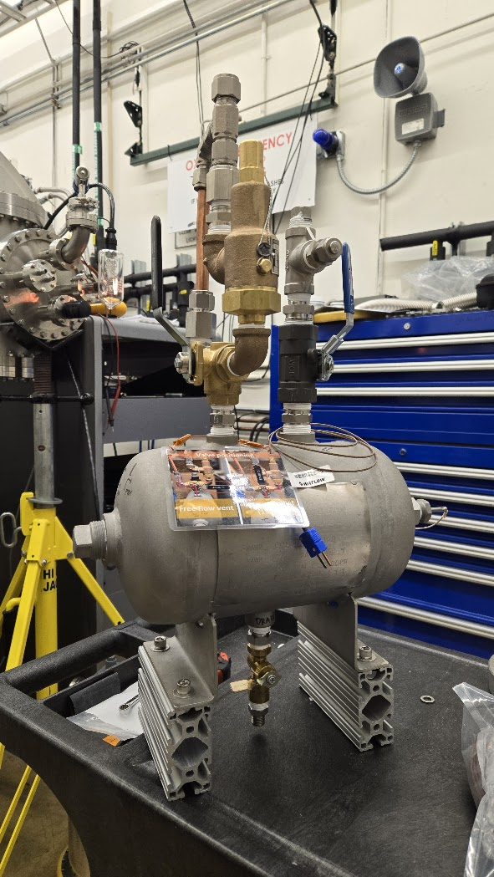
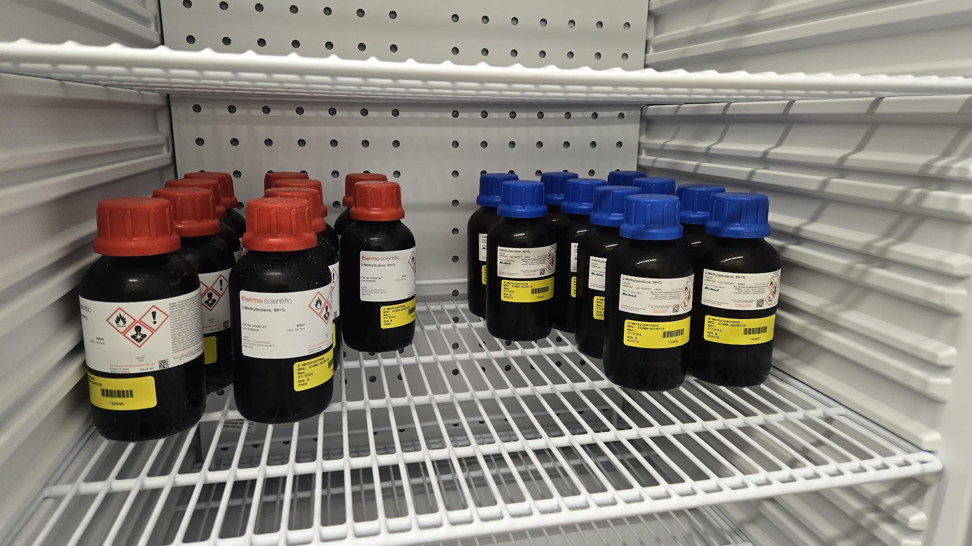

AHCR
  Mobile reservoir that holds hydrocarbons when they are not being actively tested
  Serves as vent and pressure relief in all configurations, including test
Ambient HydroCarbon Reservoir (AHCR)

Slide 11
CP2
vent outside building
pressure relief
(15 psi)
CP1
building GN2 supply (22 psi)
free flow
V2
pressure transducer
V1
ambient hydrocarbon reservoir
(AHCR-1)
flush line
power vacuum feedthrough
DAQ &
computer
V0
TC vacuum feedthrough
CP0
cryofluid vacuum feedthrough
CP4
CP3
building ground plate
manual valve
thermocouples
regulator to 5 psi
V3
pressure relief
9x outside VHCR
heater
8x inside VHCR
inlet
outlet
up-to-air valve V5
pressure relief
(2 psi)
vacuum hydrocarbon reservoir
(VHCR)
V6
CP2
ceramic break
(thermal/electric)
Frosty
Vacuum Chamber
LN2
dewar
pressure relief
(15 psi)
CP1
free flow
V2
pressure transducer
heaters
window
V1
ambient hydrocarbon reservoir
(AHCR-2)
Notional - Not to scale
Chamber pumps/valves not pictured
V4
V0
CP5
vent outside building
CP0

Slide 12
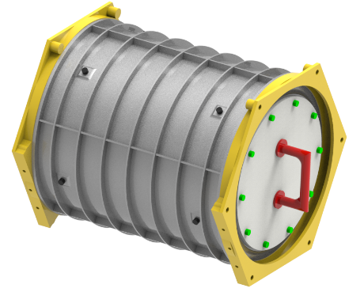
Forward Work
PCM study:
  Complete test campaigns for isopentane and isohexane (later this year)
    Safety measures are essential, but can slow down the speed of R&D
    First test will be procedure verification with less dangerous material (isopropyl alcohol)
  Investigate “soft” containment options for PCMs (as opposed to metallic containment)
  Investigate alternative materials – eutectics, solid/gas options – that may be less hazardous for crew to work near
Concurrent FROSTE studies in FY25:
  Further engineering of secondary sealed container design and building a prototype engineering unit
    Incorporate results from PCM study
    Conduct trade studies on sizes and materials based on simulations and refinement of programmatic requirements
      Dimensions geological samples
      Manufacturability… additive?
      Interaction with crew and potential vehicle ConOps
  Refine active solutions with further cryocooler research

Slide 13

Thank you! Questions??

