Slide 1


Plant nitrogen uptake responses to elevated carbon dioxide.
Luke Fountain, Ph.D.
NASA Postdoctoral Fellow
Space Crop Production
Kennedy Space Center

Slide 2
About me
MBiolSci - Molecular Biology (2014-2018), University of Sheffield, UK
Ph.D. - Plant and Soil Science (2018-2023), University of Sheffield, UK
Post-doc - Soil Carbon Cycling (2023), University of Manchester, UK
NASA Postdoctoral Fellow - Space Crop Production (2023-present), Kennedy Space Center, Florida
Notes:
Cover Artemis, then on to Mars. Pre-packaged diet won’t be sustainable, and many important nutrients break down over time.

Slide 3
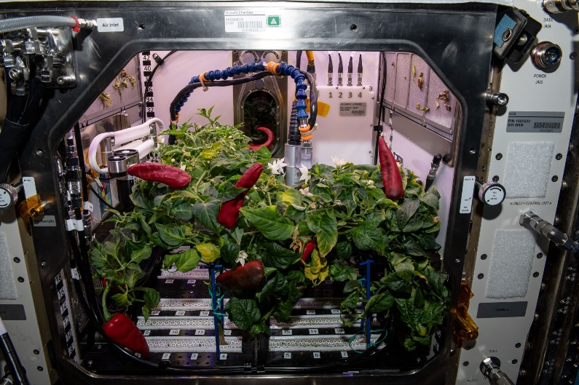
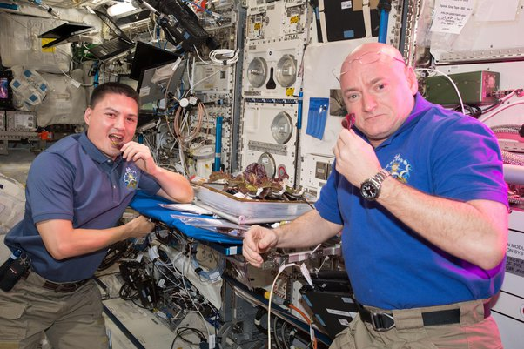
Why grow plants in space?
Food
Atmosphere
Psychological
CO₂
O₂
Image credit: NASA
Image credit: NASA
Importance increases with Earth independence
Notes:
Cover Artemis, then on to Mars. Pre-packaged diet won’t be sustainable, and many important nutrients break down over time.

Slide 4
Space Crop Production challenges
LEO/Deep Space
Surface
Microgravity
Lack of convection
Fluid movement
Radiation
Reduced pressure
Micrometeorites
Regolith/Dust
Partial gravity
Plant size
High CO₂
Food safety & microbiome
Sustainability
Waste
Vehicle resources
Crew time
Productivity
Stress tolerance
Environmental optimization
Crop scheduling
Crop
Notes:
Veggie 70 watt, APH 1000 watt.

Slide 5
Space Crop Production challenges
LEO/Deep Space
Surface
Microgravity
Lack of convection
Fluid movement
Radiation
Reduced pressure
Micrometeorites
Regolith/Dust
Partial gravity
Plant size
High CO₂
Food safety & microbiome
Sustainability
Waste
Vehicle resources
Crew time
CEA and SpaCEA challenges
Productivity
Stress tolerance
Environmental optimization
Crop scheduling
Crop
Notes:
Veggie 70 watt, APH 1000 watt.

Slide 6
Space Crop Production challenges
LEO/Deep Space
Surface
Microgravity
Lack of convection
Fluid movement
Radiation
Reduced pressure
Micrometeorites
Regolith/Dust
Partial gravity
Plant size
High CO₂
Food safety & microbiome
Sustainability
Waste
Vehicle resources
Crew time
CEA and SpaCEA challenges
Productivity
Stress tolerance
Environmental optimization
Crop scheduling
Crop
Notes:
Veggie 70 watt, APH 1000 watt.

Slide 7
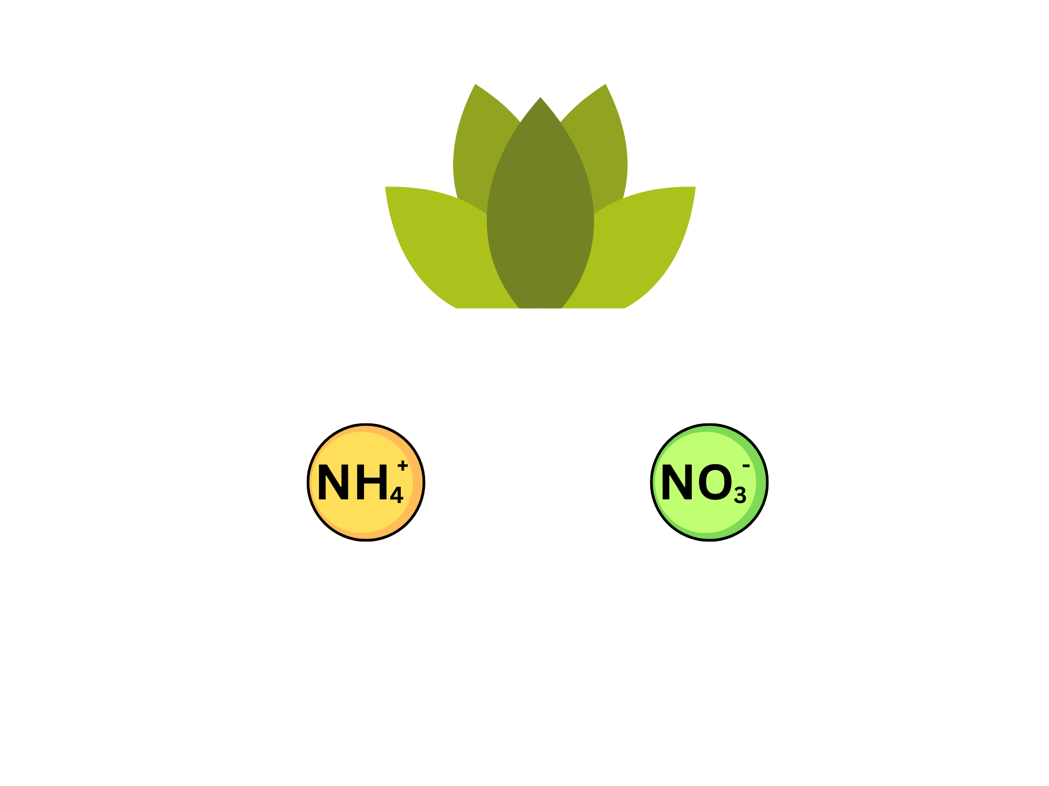
Nitrogen (N) uptake and preference
Crucial nutrient for plant survival
Inorganic forms used in agriculture
Major inorganic forms include ammonium (NH₄⁺) and nitrate (NO₃⁻)
Plants can show preference for different N forms
Key factors include environment, physiology and growth substrate
Notes:
Veggie 70 watt, APH 1000 watt.

Slide 8
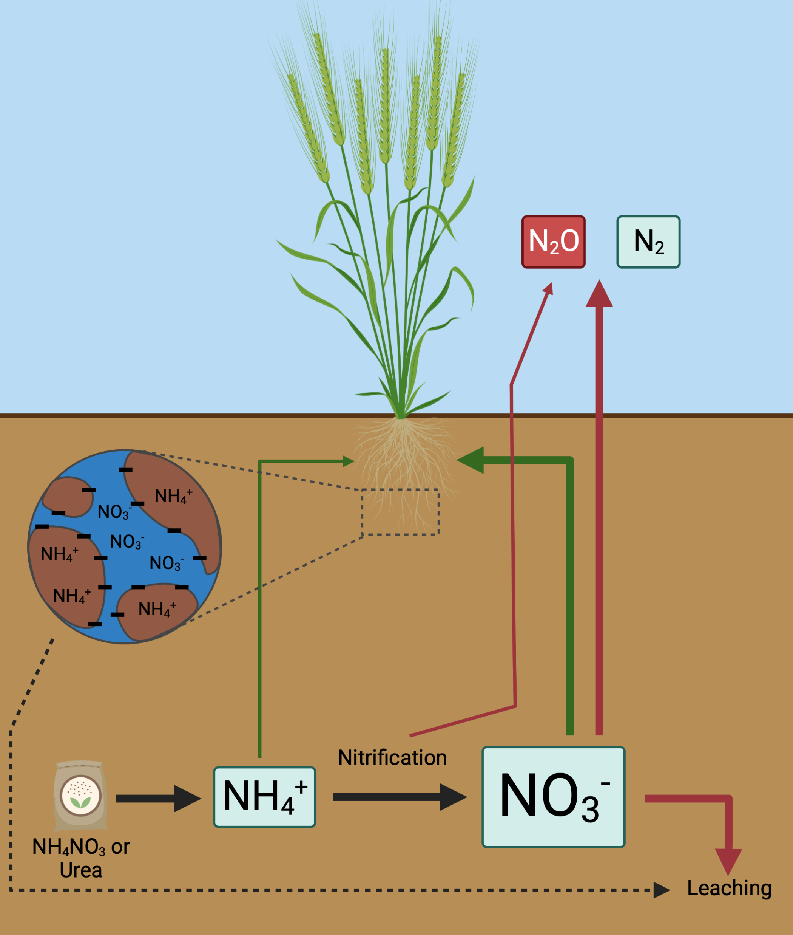
Soil N cycling in agriculture
Nitrification converts NH₄⁺ to NO₃⁻.
Often large NO₃⁻ pool due to rapid conversion.
Key driver of N preference.
Edaphic factors play a role.
Fountain (2023). PhD thesis, University of Sheffield.
Notes:
Veggie 70 watt, APH 1000 watt.

Slide 9
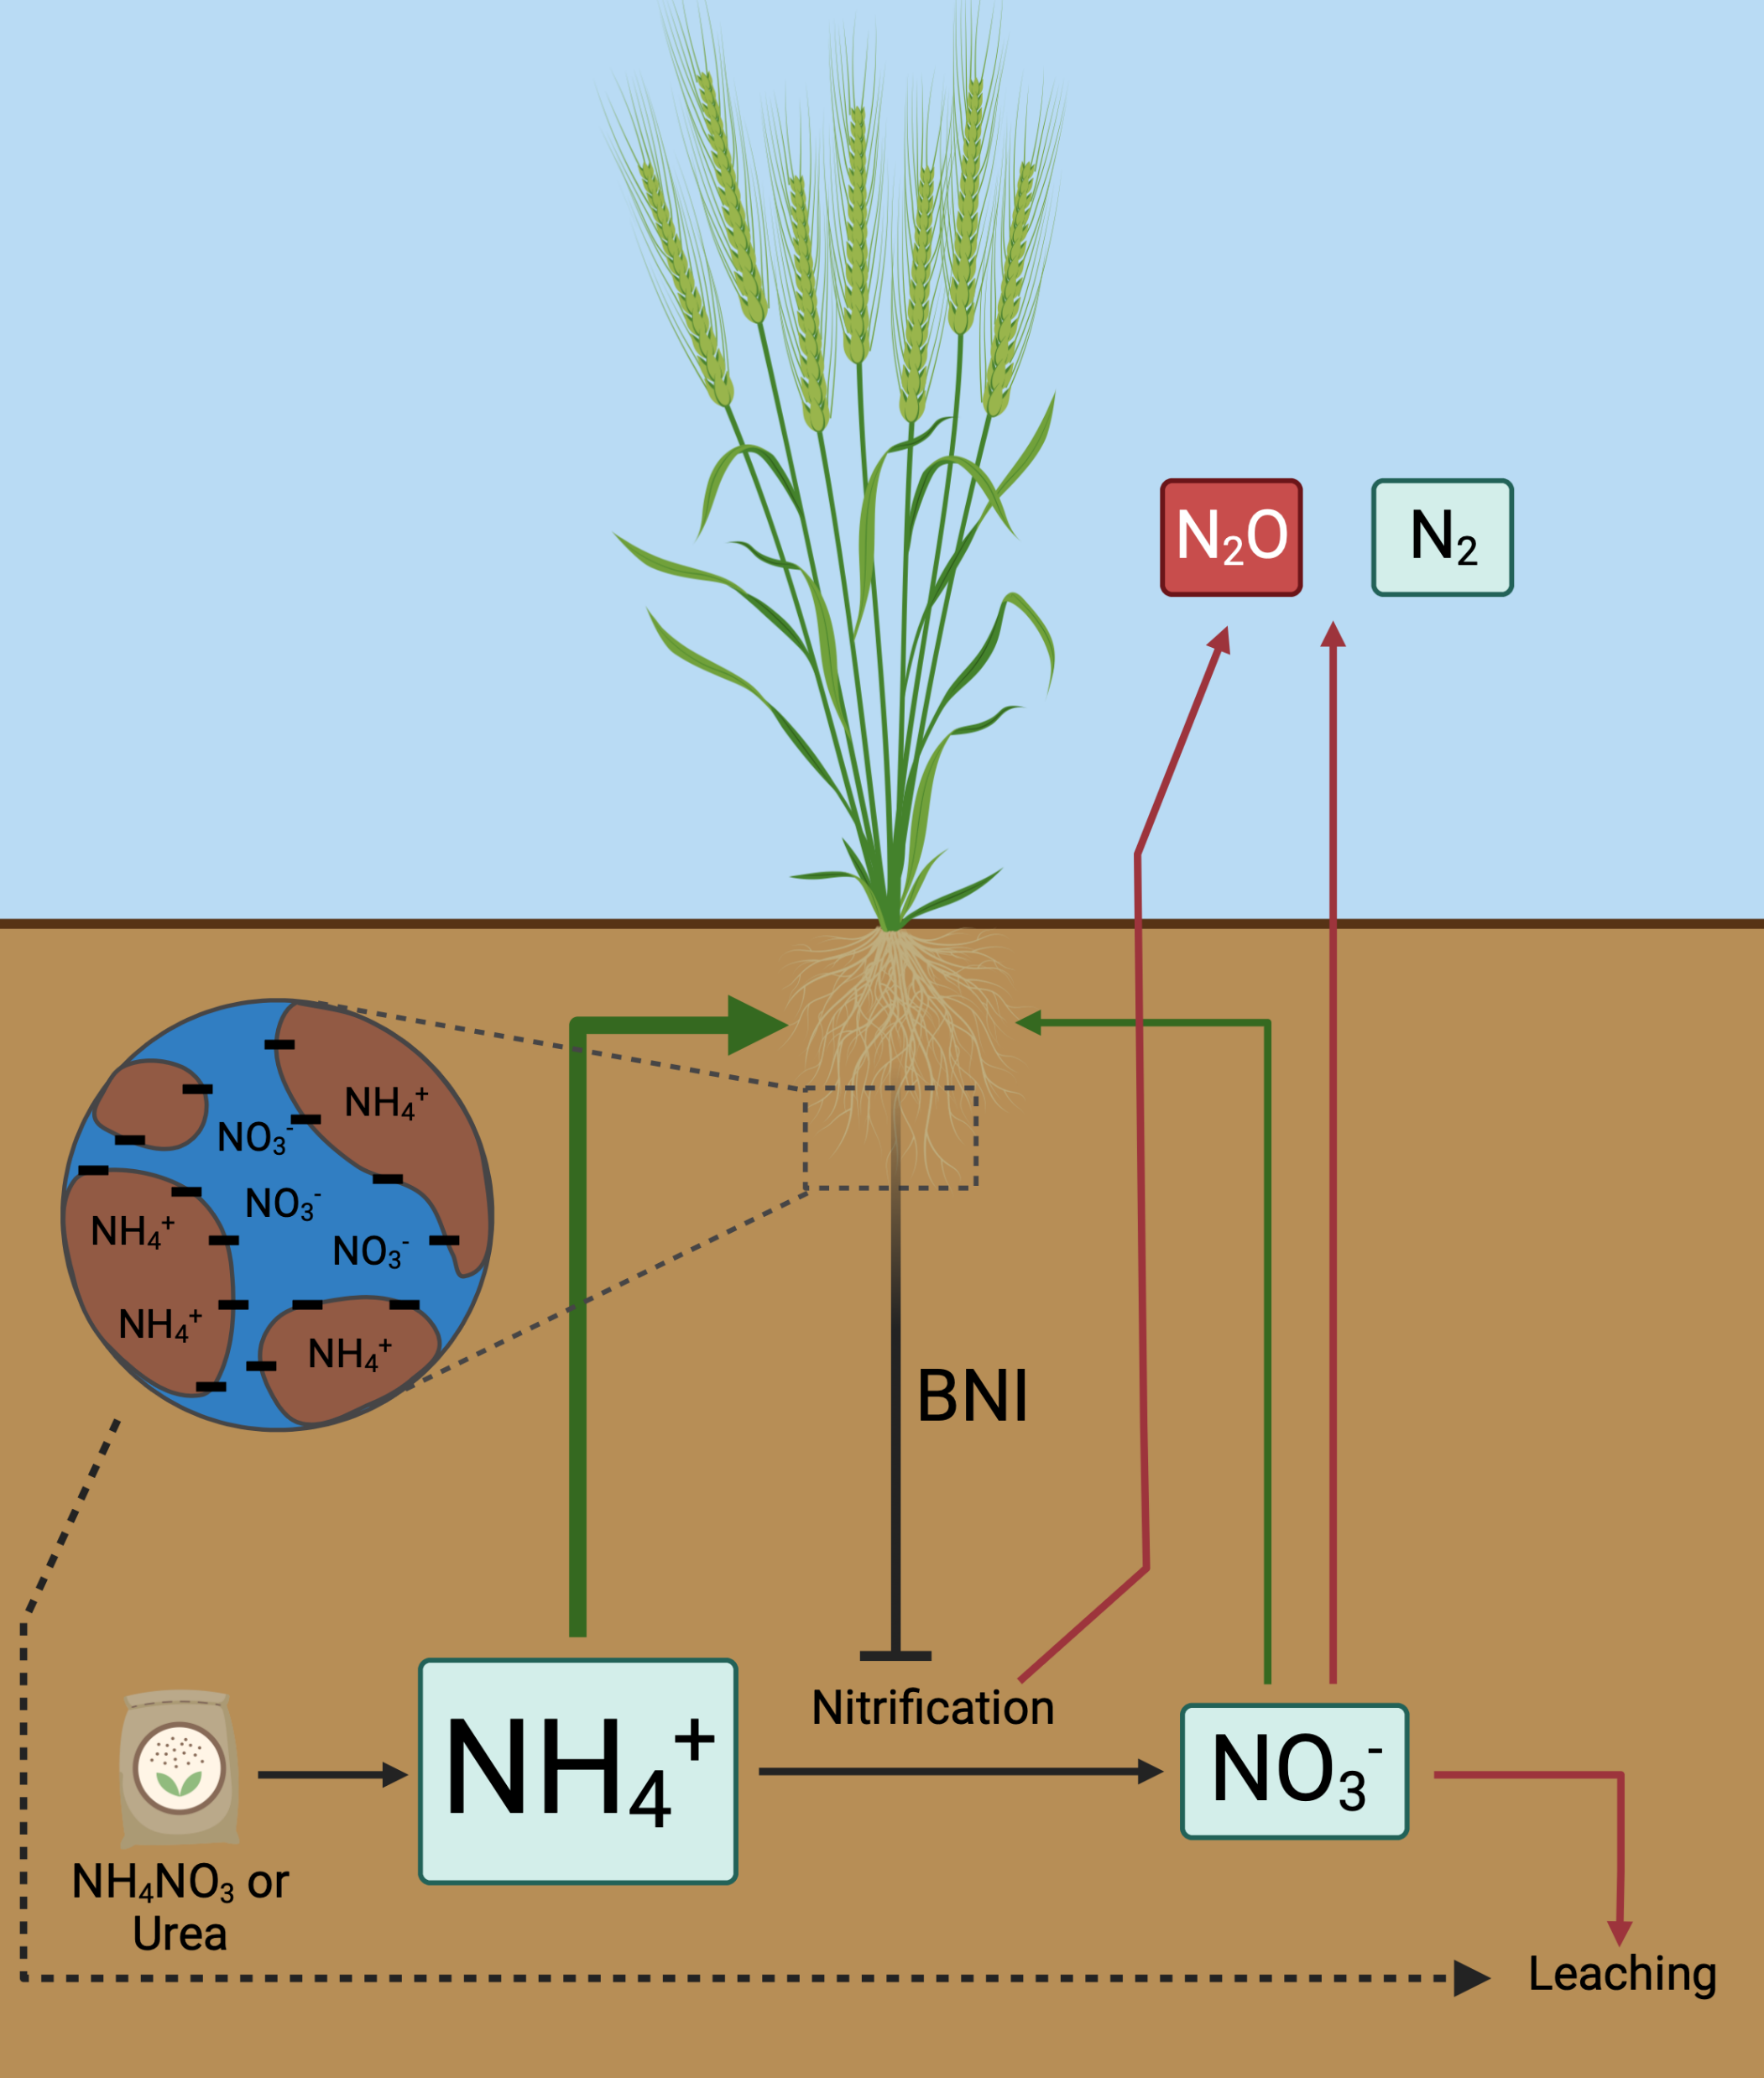
Soil N cycling in agriculture
Biological Nitrification Inhibition (BNI) can limit soil nitrification and increase NH₄⁺ pools.
Could increased plant ammonium preference improve BNI capacity?
Fountain (2023). PhD thesis, University of Sheffield.
Notes:
What if we had a plant that preferred ammonium? Would this show enhanced BNI activity, through direct inhibition and/or through increased competition with nitrifiers for ammonium?

Slide 10
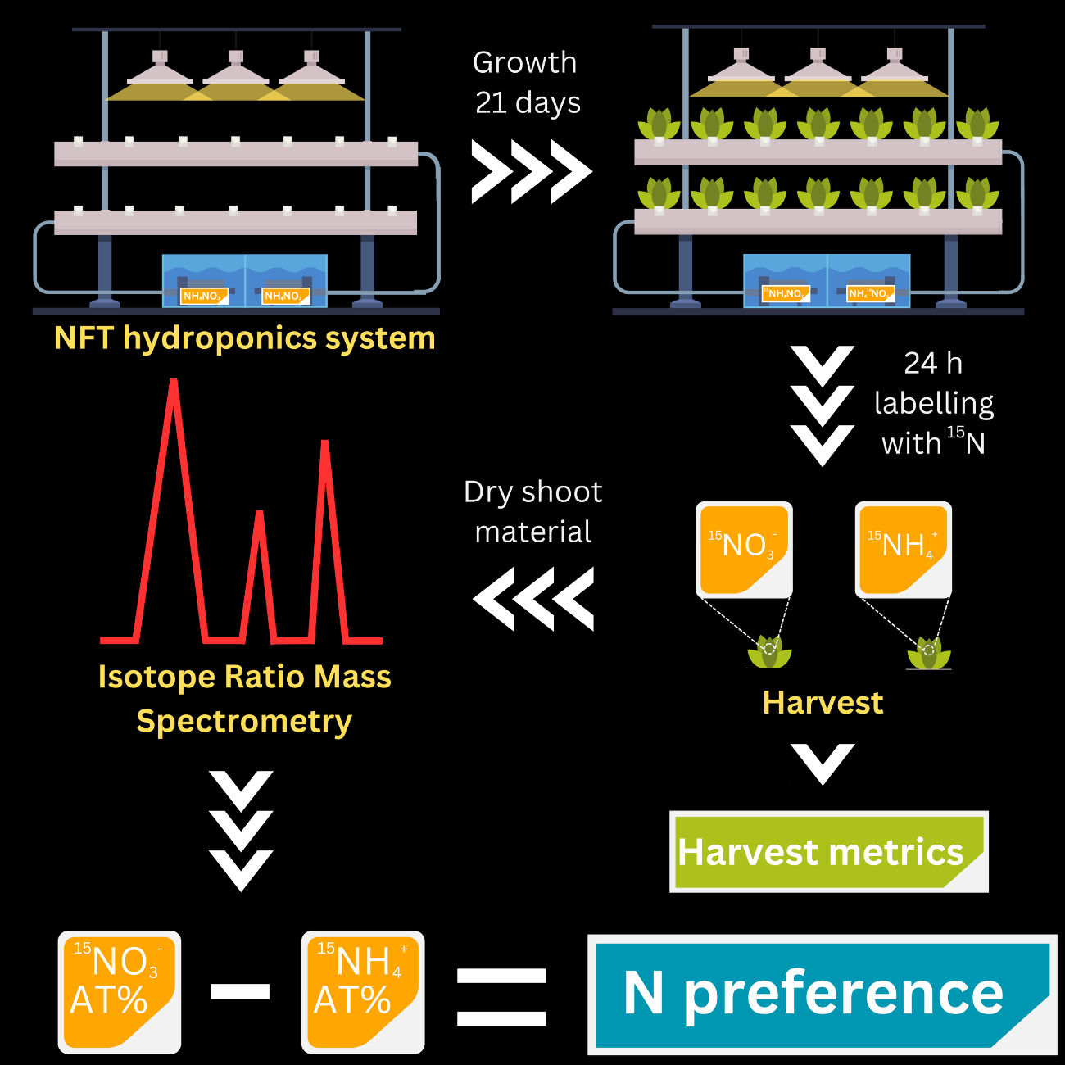
Measuring N preference using ¹⁵N stable isotopes
Fountain et al. (in prep.)
Notes:
What happens when plants have access to both N forms equally, and how does this play out in a spaceflight CO2 scenario?

Slide 11
N preference variation in barley
Significant preference
No significant preference
+
+
P<0.10
Fountain (2023). PhD thesis, University of Sheffield.
Notes:
What if we had a plant that preferred ammonium? Would this show enhanced BNI activity, through direct inhibition and/or through increased competition with nitrifiers for ammonium?

Slide 12
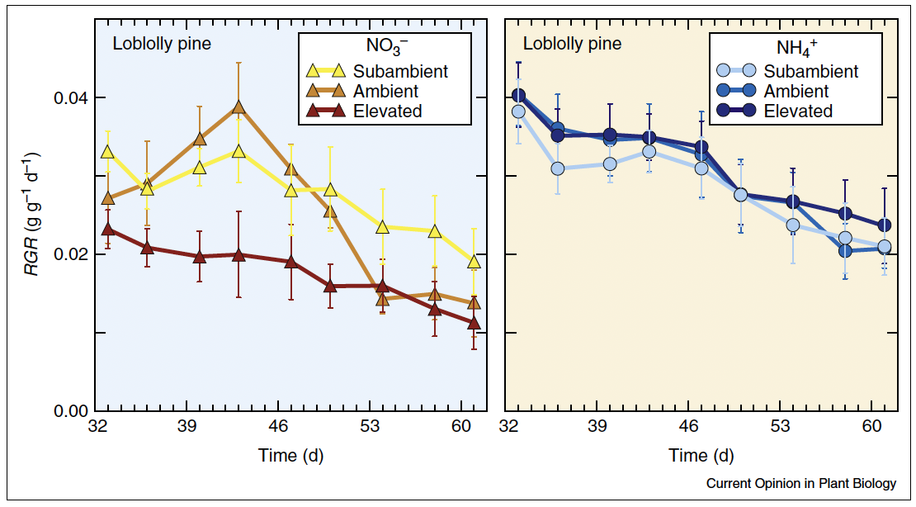
Plant growth at eCO₂ under varying N nutrition
Bloom et al. (2012), Ecology 93(2), pp. 355-367.
Notes:
Veggie 70 watt, APH 1000 watt.

Slide 13
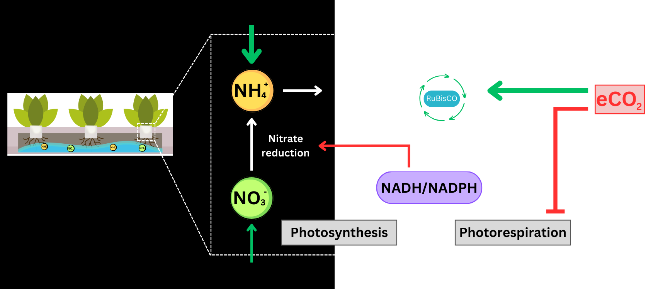
Plant growth at eCO₂ under varying N nutrition
Reducing power diverted to C fixation at eCO₂.
Inhibition of photorespiration through altered CO₂:O₂ ratio.
Fountain et al. (in prep.)
Notes:
What happens when plants have access to both N forms equally, and how does this play out in a spaceflight CO2 scenario?

Slide 14
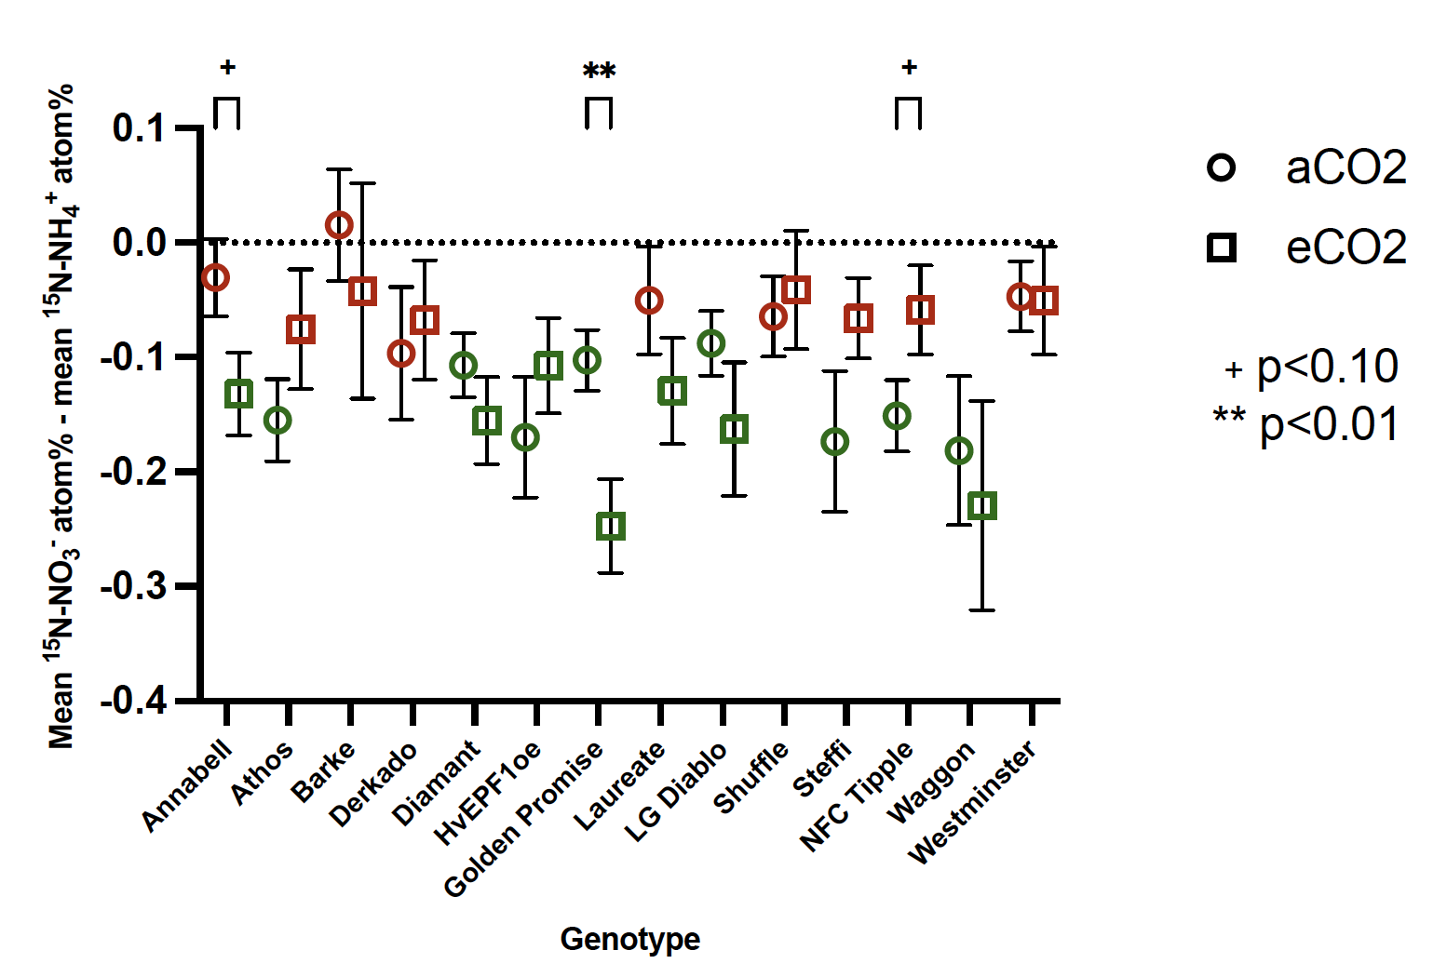
Shifts in N preference at eCO₂ in barley
Significant preference
No significant preference
Fountain (2023). PhD thesis, University of Sheffield.
Notes:
What happens when plants have access to both N forms equally, and how does this play out in a spaceflight CO2 scenario?

Slide 15
eCO₂ on the International Space Station
ISS CO₂ averages ~3000 ppm.
ISS CO₂ averages ~3000 ppm.
Due to inadequate scrubbing of CO₂ released by astronauts.
Notes:
What happens when plants have access to both N forms equally, and how does this play out in a spaceflight CO2 scenario?

Slide 16
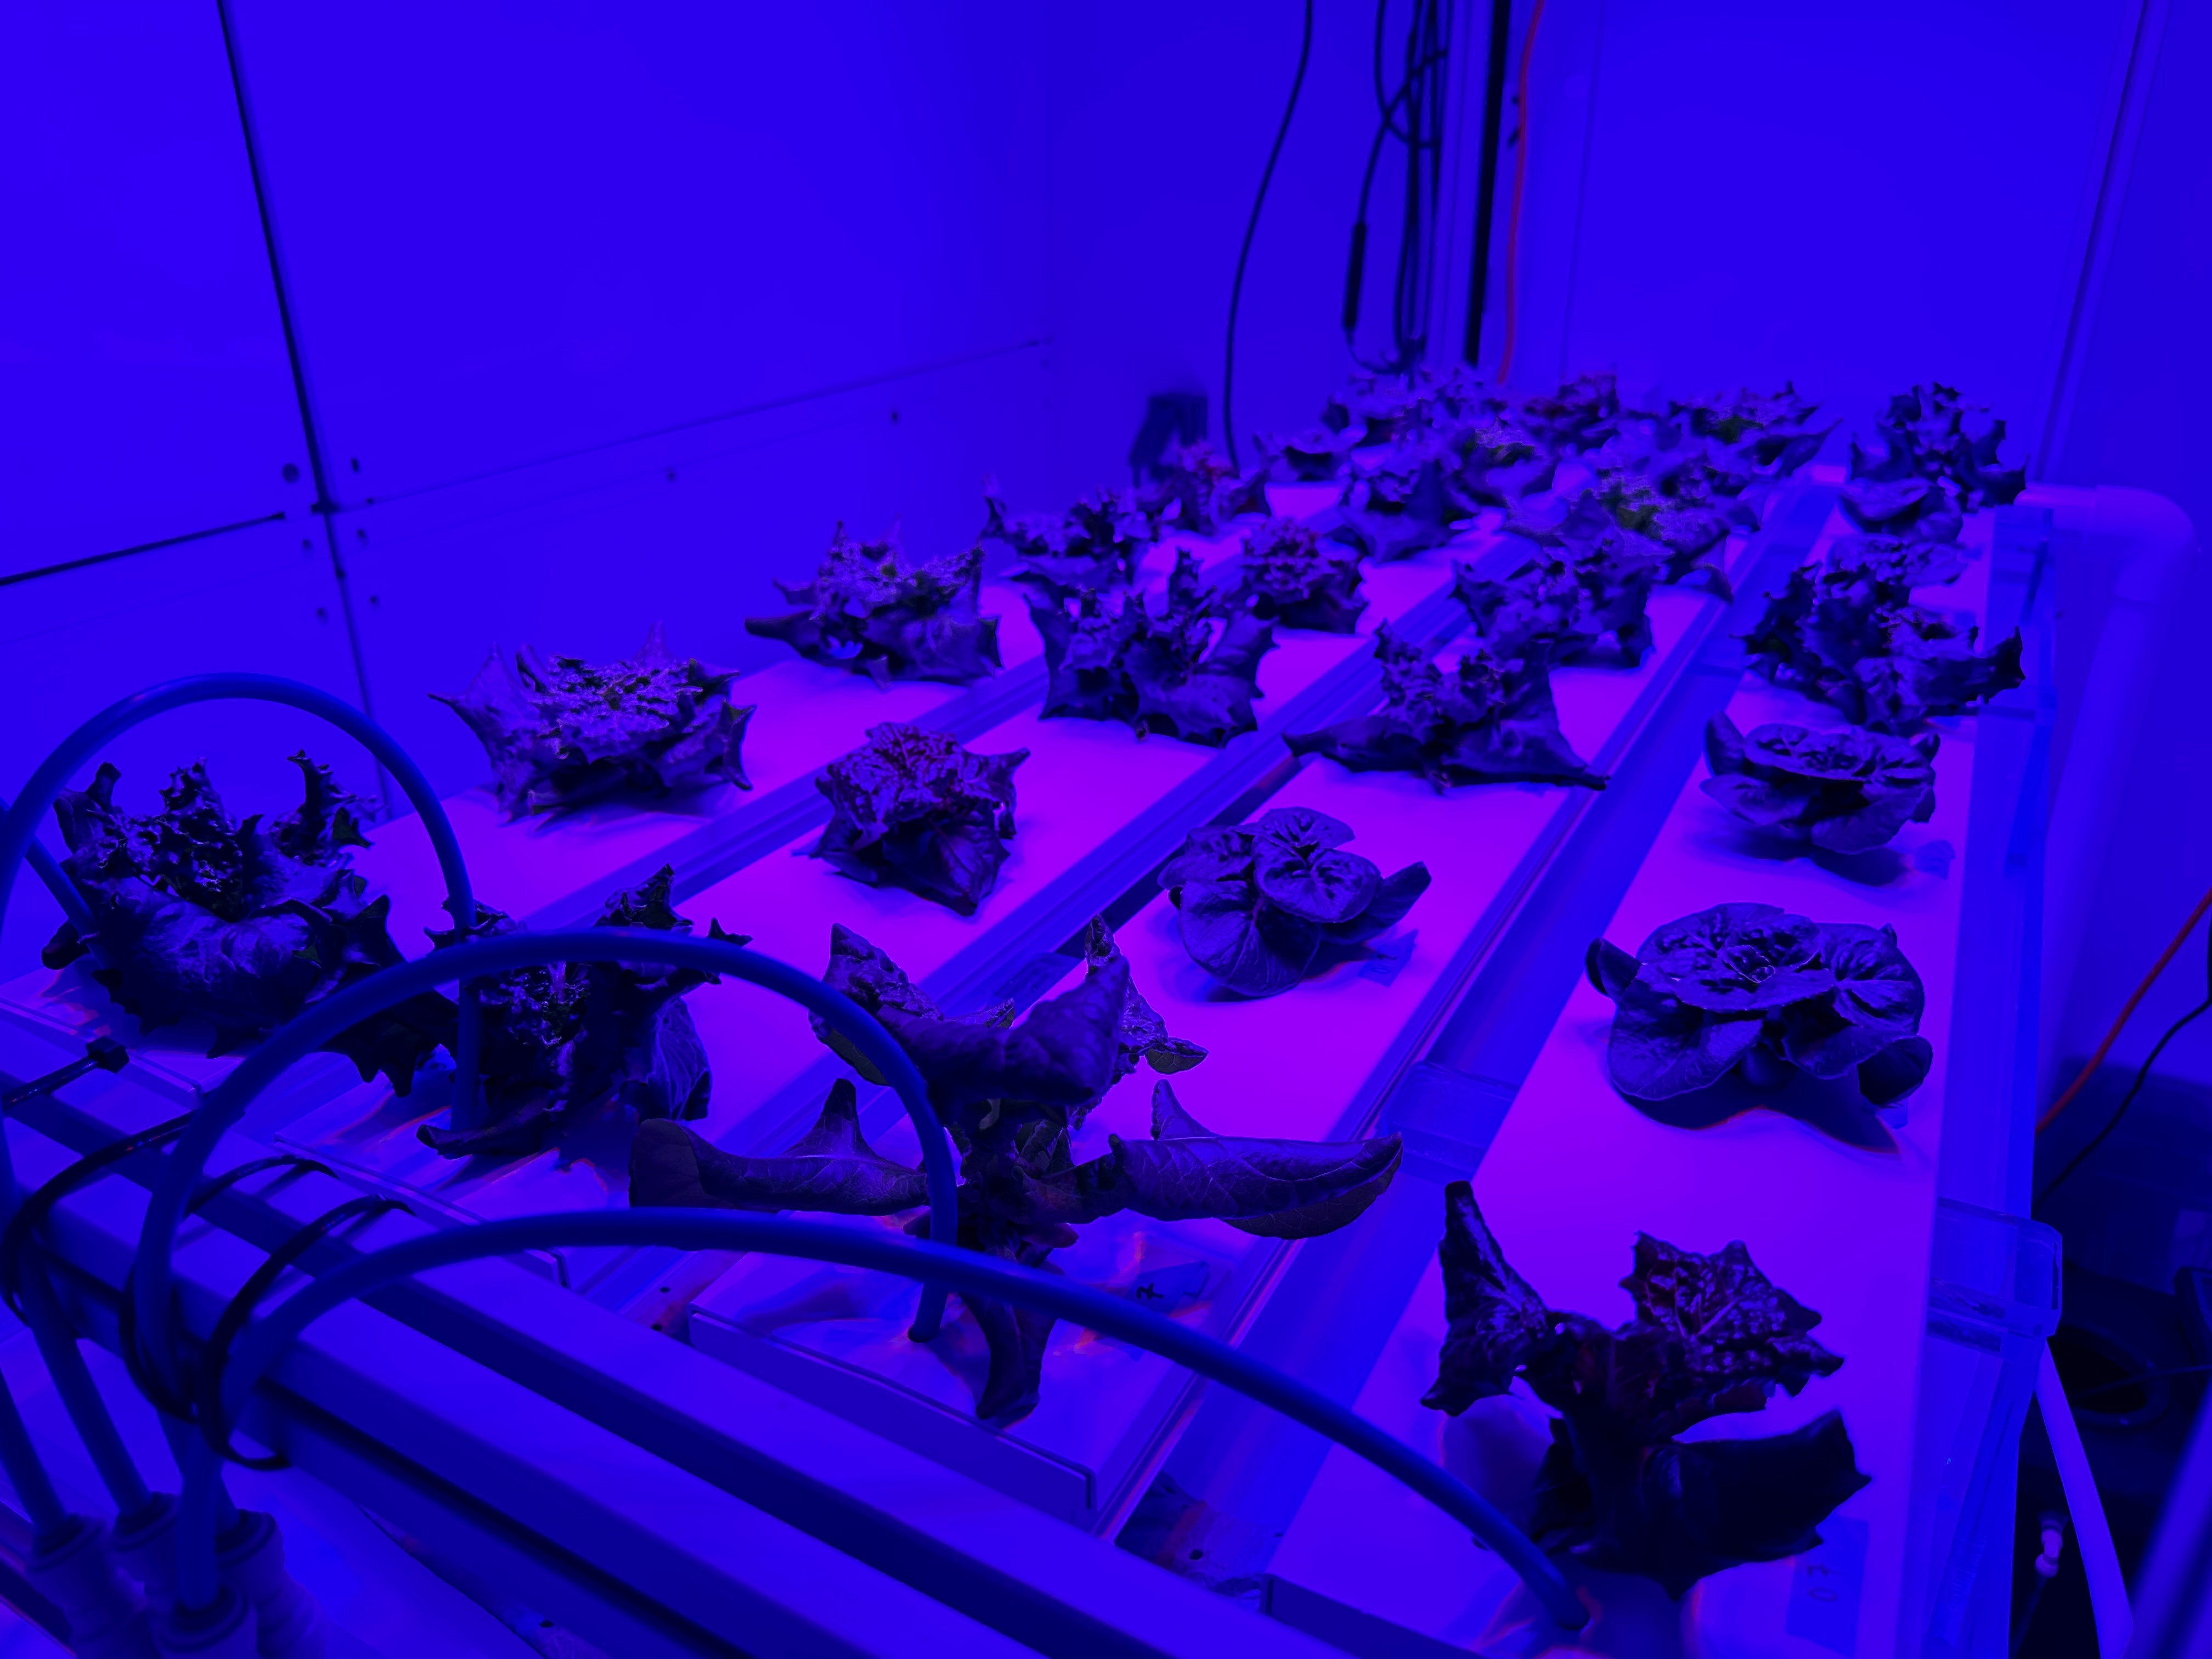
eCO₂ on the International Space Station
ISS CO₂ averages ~3000 ppm.
Due to inadequate scrubbing of CO₂ released by astronauts.
How will candidate space crops respond to this level of CO₂?
Notes:
What happens when plants have access to both N forms equally, and how does this play out in a spaceflight CO2 scenario?

Slide 17
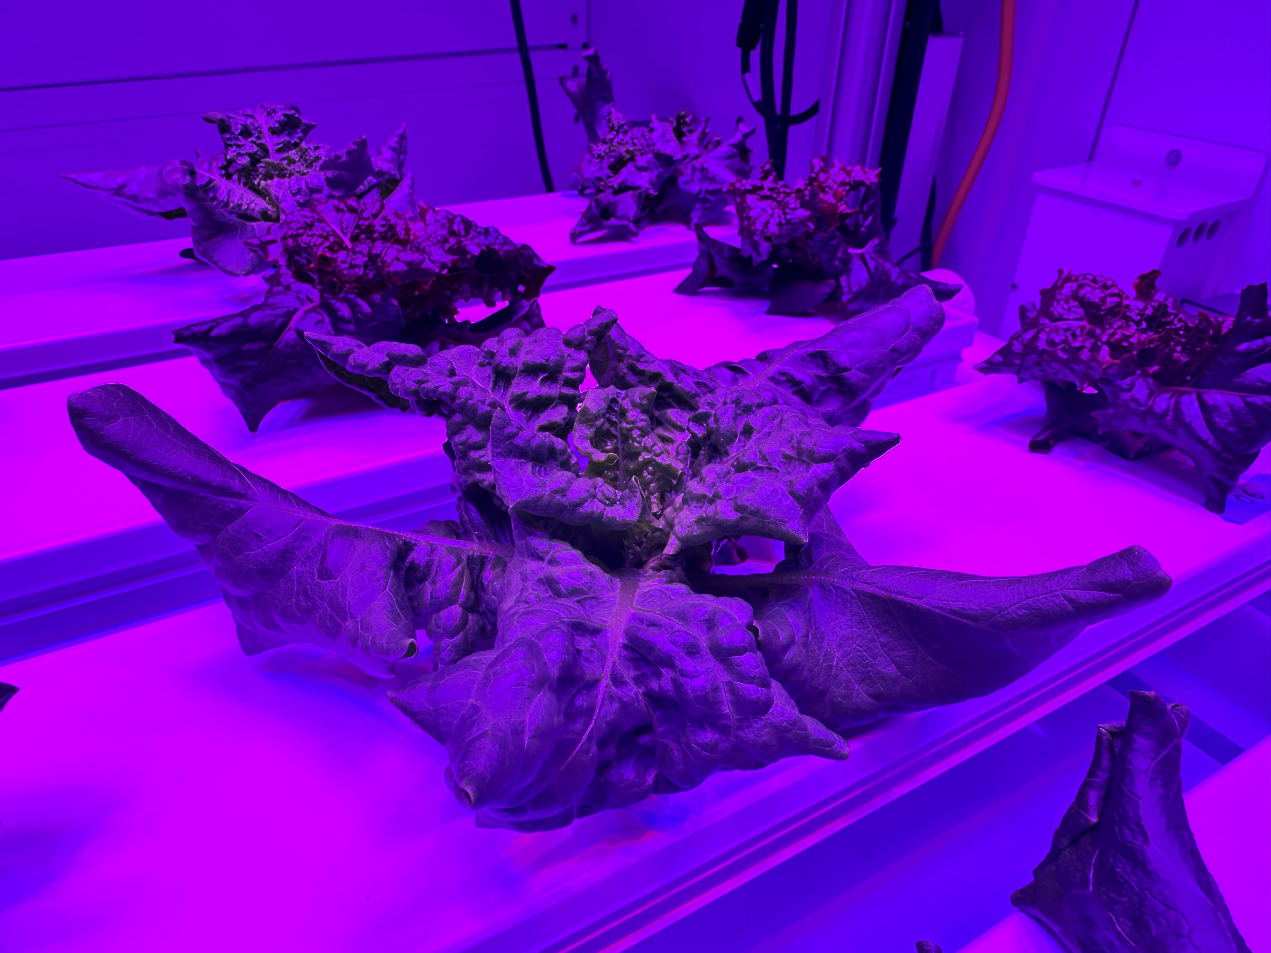
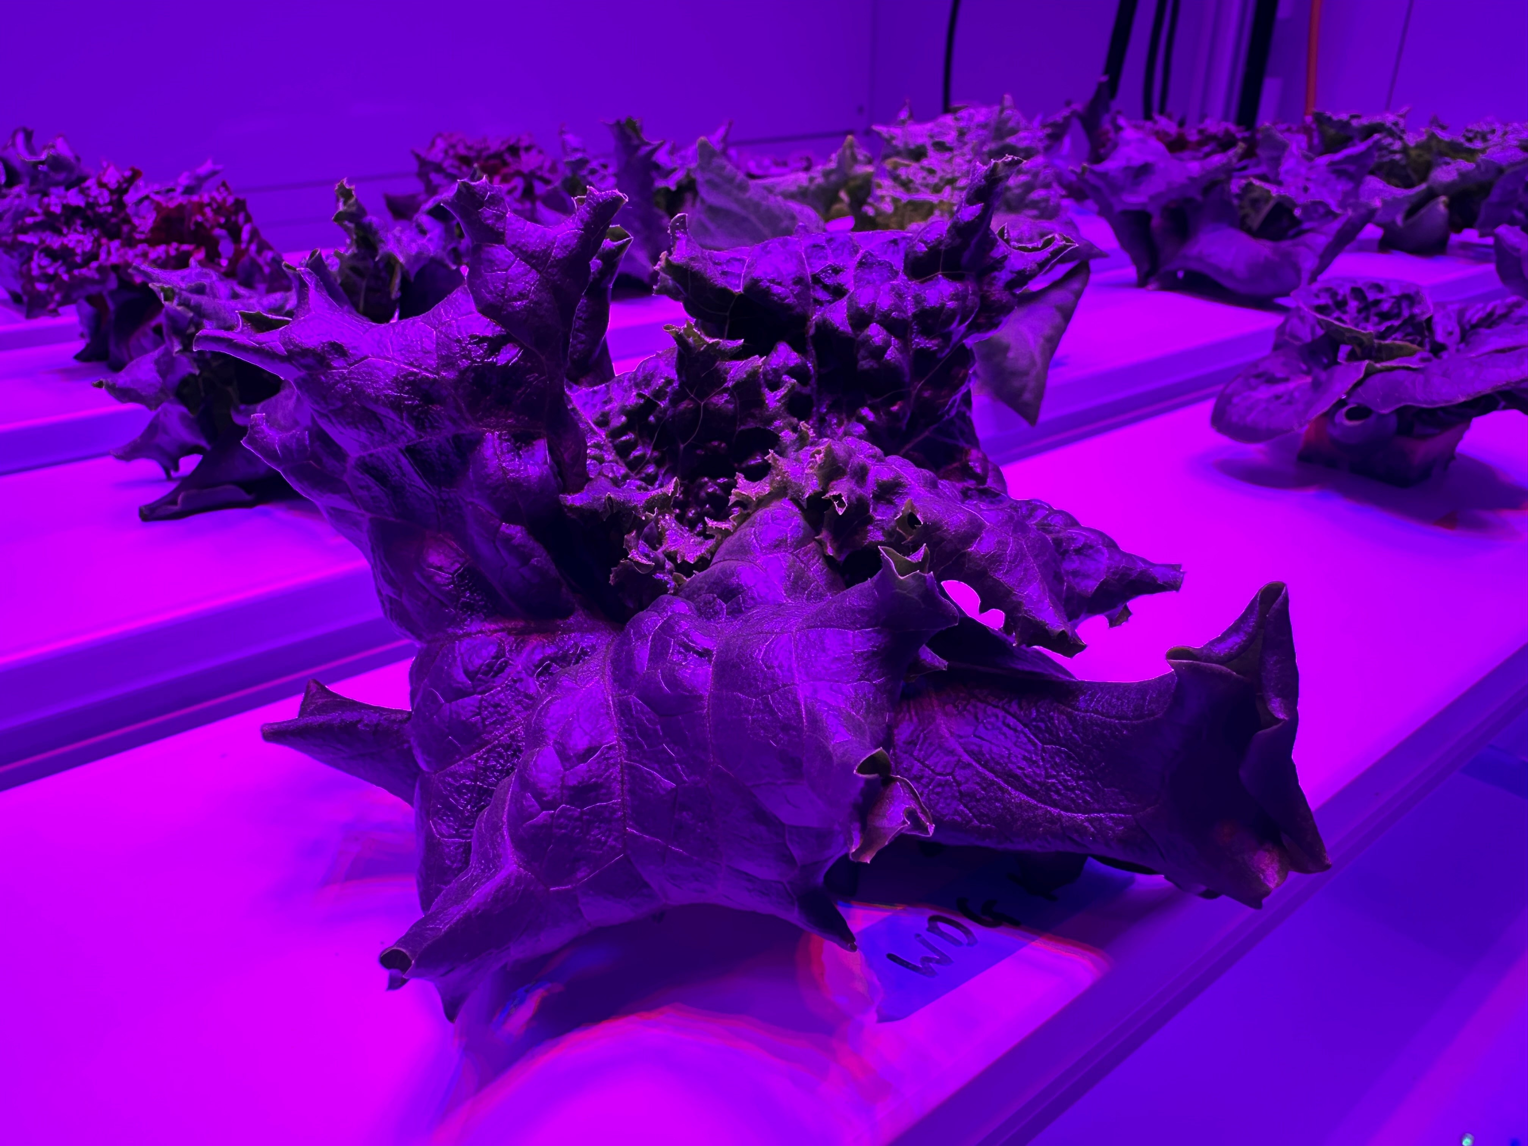
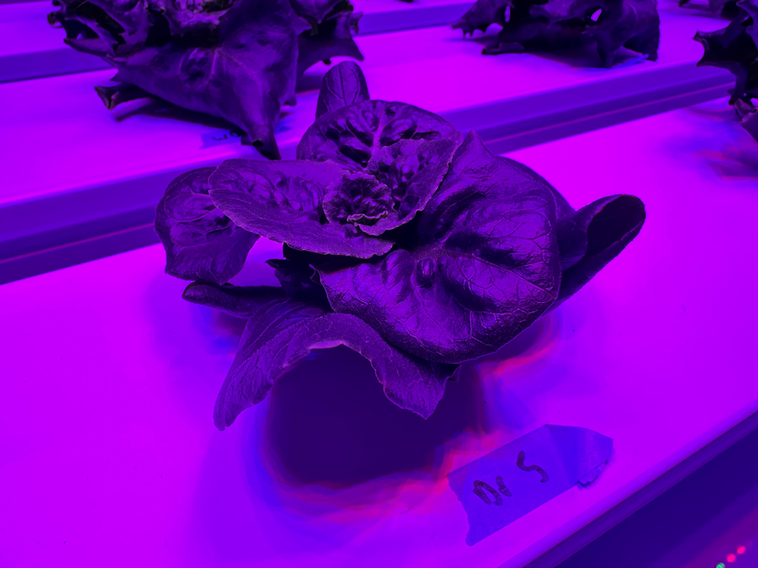
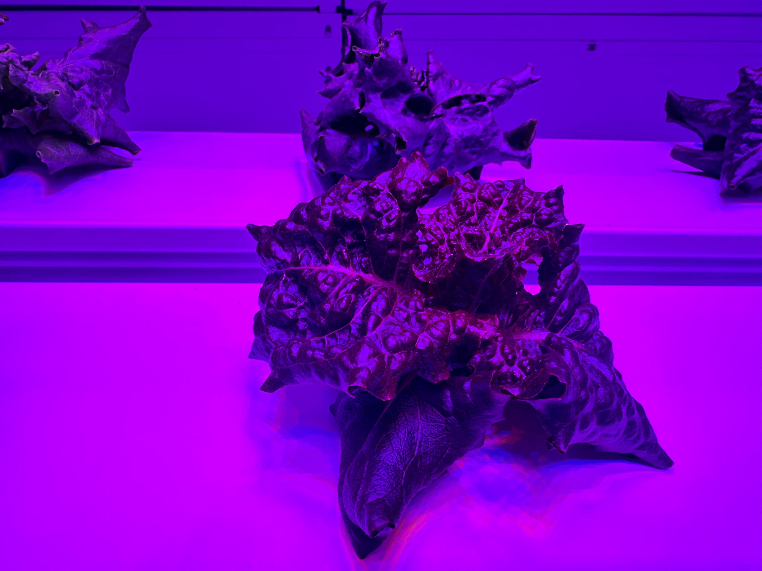
Lettuce N preference at ISS eCO₂
Black Seeded Simpson
Waldmann’s Dark Green
Dragoon
Outredgeous
Notes:
What happens when plants have access to both N forms equally, and how does this play out in a spaceflight CO2 scenario?

Slide 18
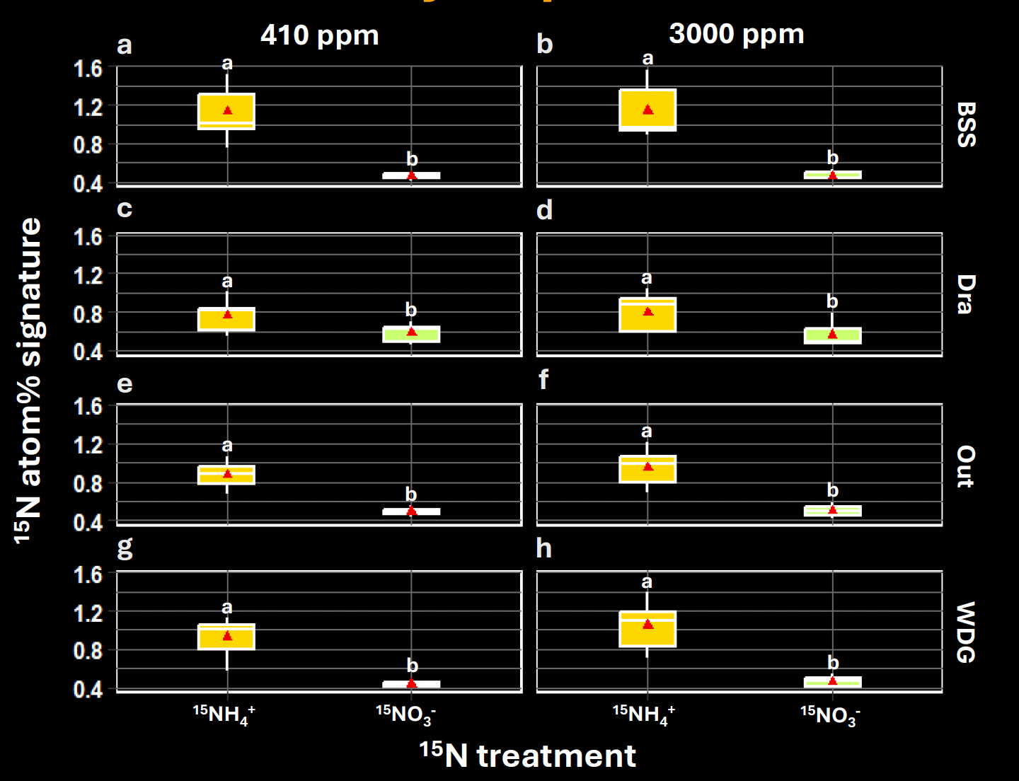
Lettuce N preference under hydroponic cultivation
BSS – Black Seeded Simpson
Dra – Dragoon
Out – Outredgeous
WDG – Waldmann’s Dark Green
Heirloom
Grown in space
Fountain et al. (in prep.)
Notes:
What happens when plants have access to both N forms equally, and how does this play out in a spaceflight CO2 scenario?

Slide 19
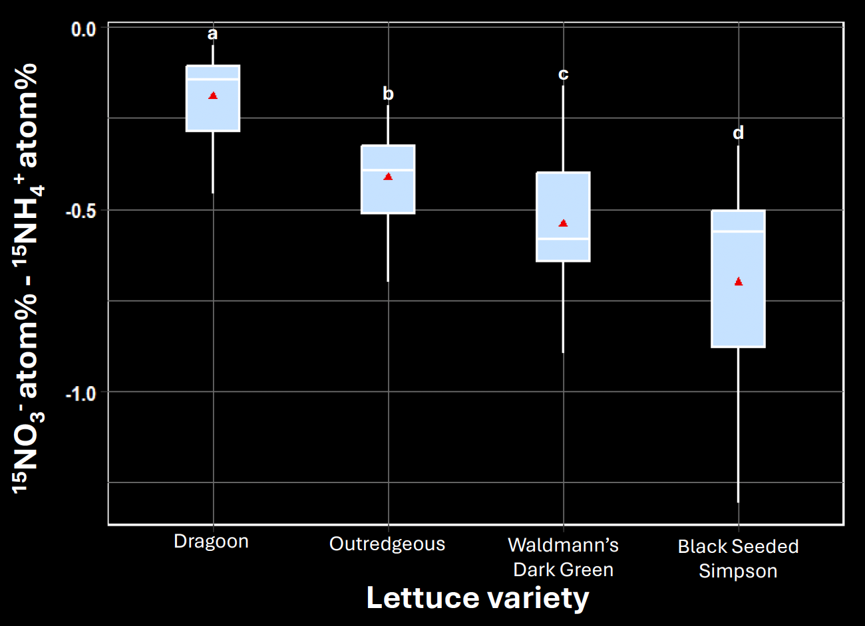
Lettuce N preference varies across varieties
Fountain et al. (in prep.)
Notes:
Main effects included here as same trend seen at both ambient and elevated CO2 (no significant interaction).

Slide 20
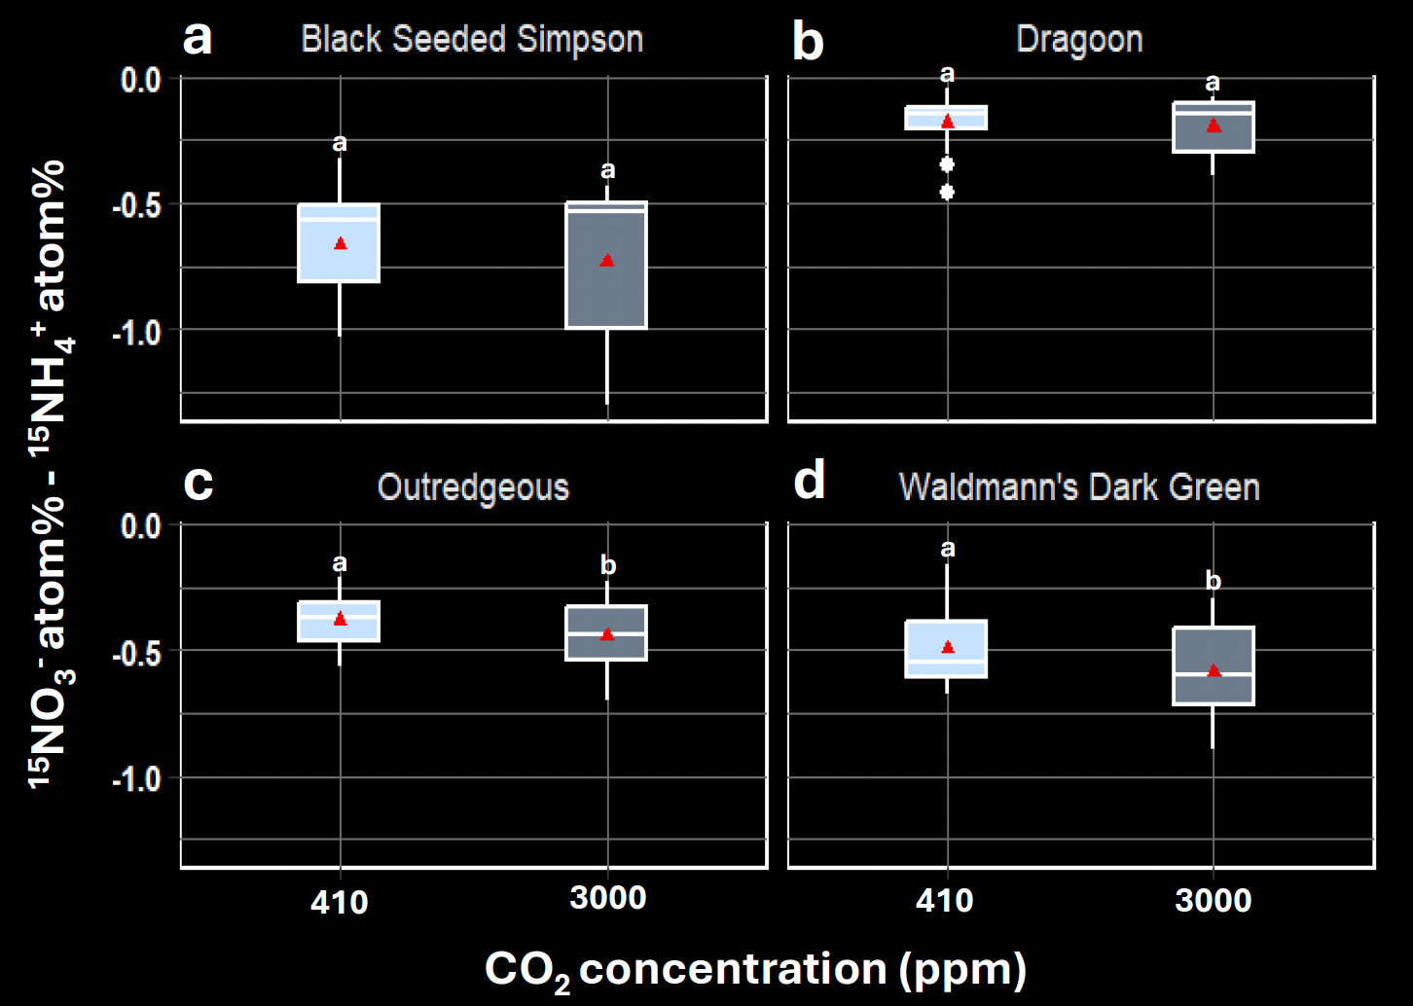
eCO₂ increases lettuce preference for ammonium
Fountain et al. (in prep.)
Notes:
What happens when plants have access to both N forms equally, and how does this play out in a spaceflight CO2 scenario?

Slide 21
Conclusions
Lettuce plants prefer ammonium as an N source under hydroponic cultivation.
This is exacerbated by eCO₂.
Future nutrient formulations for space crop production should favor ammonium as a dominant N source.
Potential implications for waste processing and nutrient recycling.
Potential route to improve agricultural sustainability on Earth.
Notes:
What happens when plants have access to both N forms equally, and how does this play out in a spaceflight CO2 scenario?

Slide 22
Future directions
What is the optimal NH₄⁺ : NO₃⁻ ratio for lettuce cultivation at high CO₂?
How is this affected by other spaceflight stressors?
Is the same phenomenon observed in other candidate space crops?
Notes:
Intern Annie Shelton working on different ratios, currently working with Growing Beyond Earth program to screen different crops for tolerance to high ammonium that may be of interest to us.

Slide 23
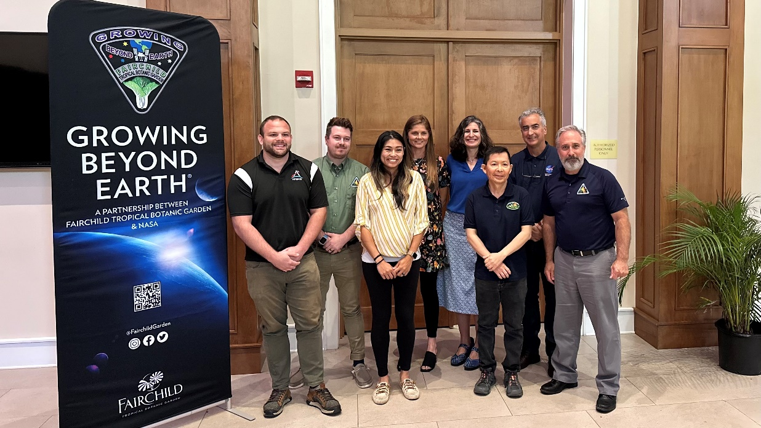
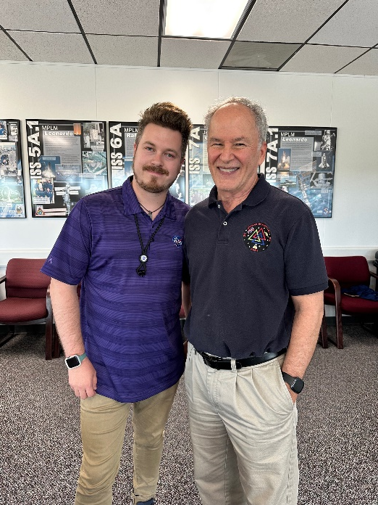

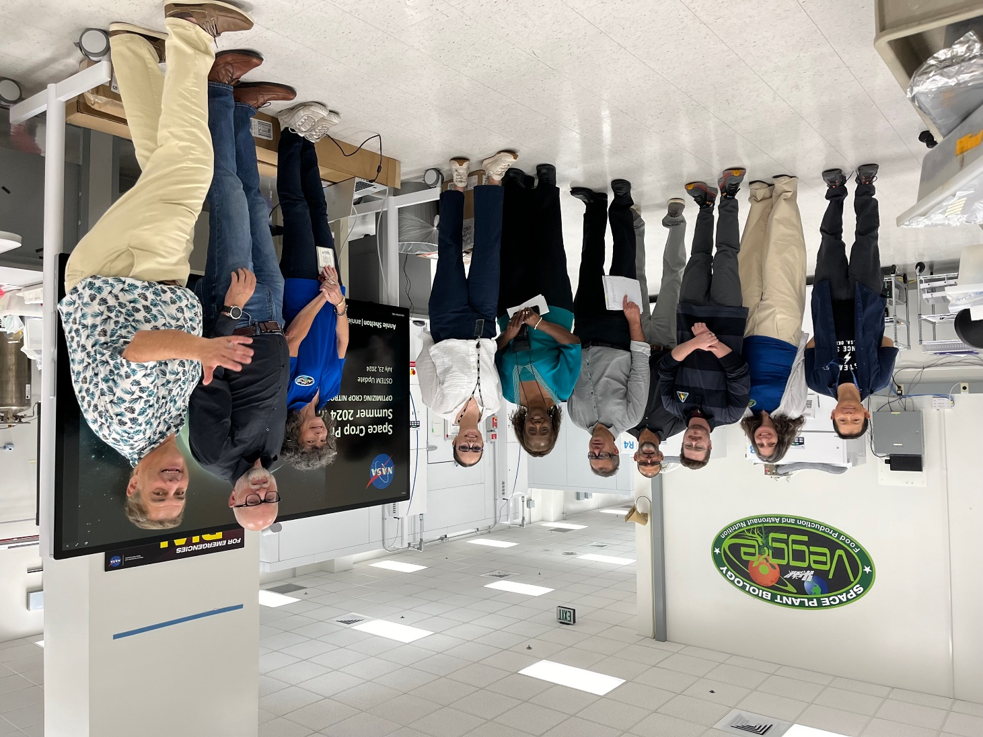
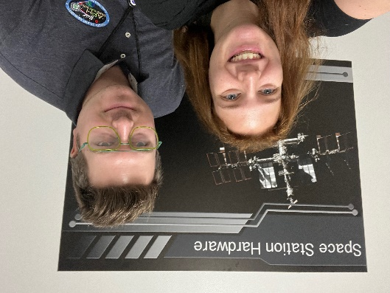

Acknowledgements
Advisors:
Gioia Massa
Elison Blancaflor
Ray Wheeler
Interns:
Kristen Saban
Annie Shelton
NASA KSC team
Notes:
What happens when plants have access to both N forms equally, and how does this play out in a spaceflight CO2 scenario?

Slide 24
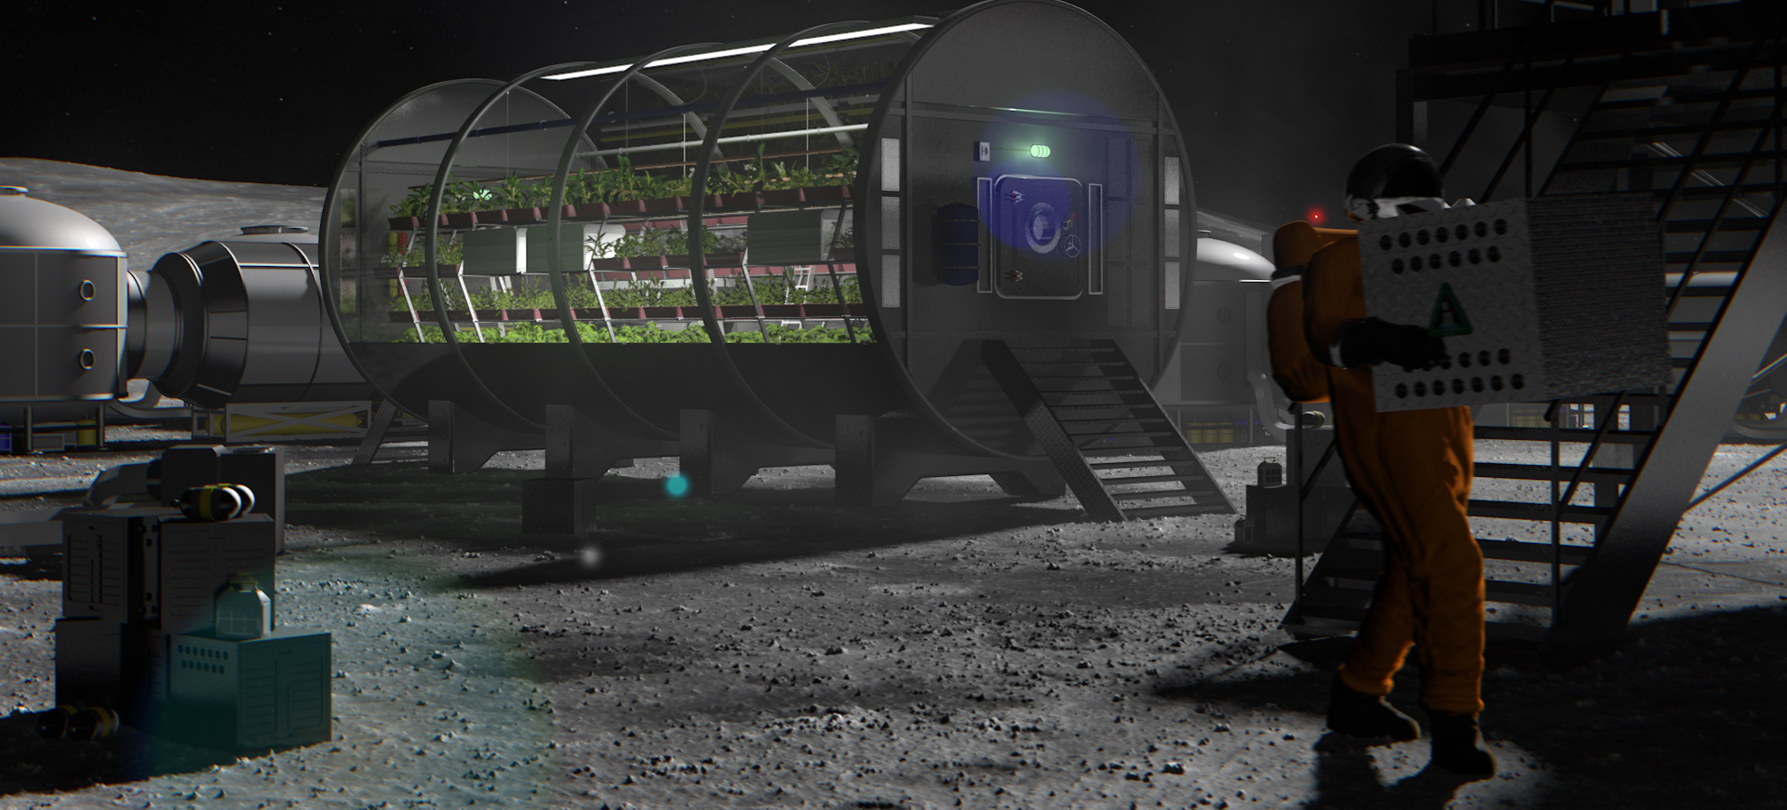
Any questions?
Notes:
What happens when plants have access to both N forms equally, and how does this play out in a spaceflight CO2 scenario?

