Slide 1

National Aeronautics and Space Administration
Space Environmental Testing at the NASA Neil A. Armstrong Test Facility Space Environments Complex
www.nasa.gov
https://www1.grc.nasa.gov/facilities/sec/

Slide 2
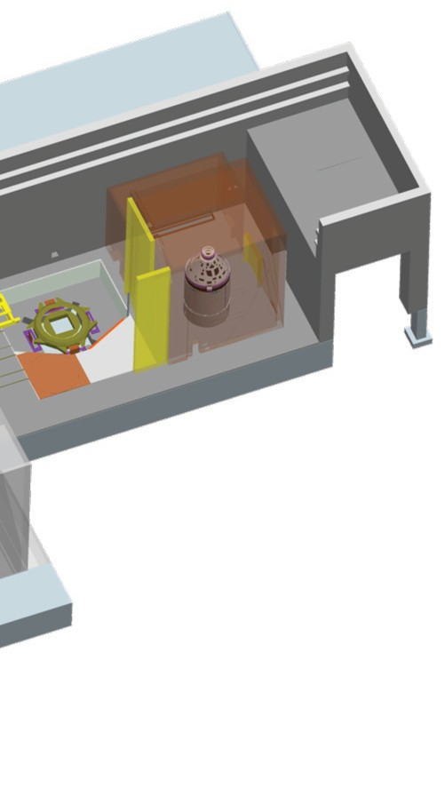
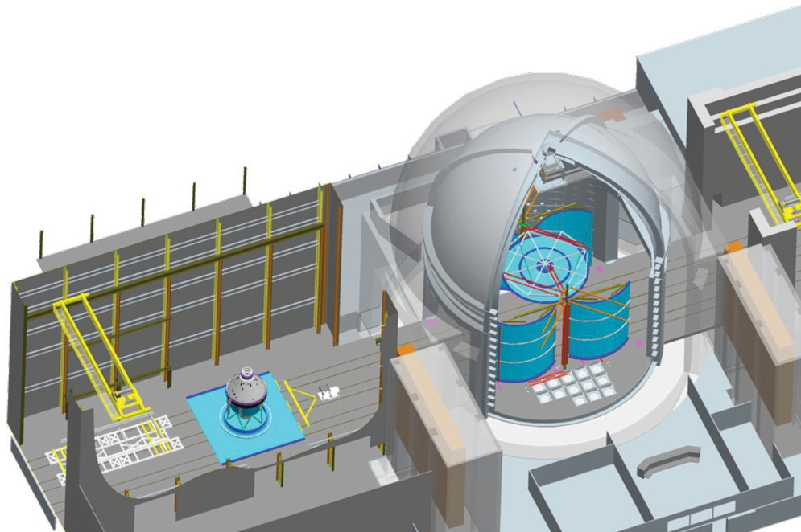
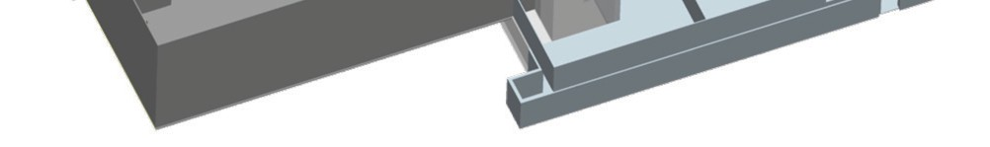
Space Environmental Testing at the NASA Neil A. Armstrong Test Facility Space Environments Complex (SEC)
The NASA Glenn Research Center operates the 6,400-acre Neil A. Armstrong Test Facility near Sandusky, Ohio. The Neil A. Armstrong Test Facility is home to the Space Environments Complex (SEC), which currently houses the world's largest Space Environment Simulation Chamber (measuring 100 ft in diameter by 122 ft high), largest and most powerful reverberant acoustic chambers and the highest capacity mechanical vibration test facility. The SEC serves as a primary, single location for spacecraft and launch vehicle environment tests. This “one-stop-shop” capability reduces risk by eliminating the need to transport a vehicle to multiple locations to complete the testing required for flight qualification.
Within the Space Environment Simulation Chamber, it is possible to perform development and flight qualification testing of full-scale space-flight systems in vacuum and temperature environments ranging from low Earth orbit to deep space to planetary surface conditions. The chamber’s wide-ranging capabilities have been extensively used to test launch vehicle payload fairings; orbital hardware, including International Space Station systems; and planetary landing systems like the Mars Pathfinder and the Mars Exploration rovers’ airbag systems. The chamber is positioned between two attached high bays for processing space-flight hardware. The vacuum chamber can be configured to perform reverberant-mode, electromagnetic interference/electromagnetic compatibility (EMI/EMC) testing in addition to thermal vacuum testing.
Electromagnetic Environmental Effects E³ testing can take place in ambient tem­ perature and pressure conditions inside the Space Environment Simulation Chamber. The aluminum chamber provides the radio- frequency shielding necessary to screen out interfering signals from local broadcasters, creating an “electromagnetically quiet” environment for high-sensitivity E³ testing of spacecraft. At the same time, the chamber walls prevent high-power test signals from leaving the test facility.
The Vibroacoustic Highbay, connected to the west side of the vacuum chamber, houses the Reverberant Acoustic Test Facility (RATF), Mechanical Vibration Facility (MVF) and a fixed modal plate constructed of 6” steel slab with >11E6 lb/in stiffness mounted to the 4.5 million pound seismic mass.
Reverberant Acoustic Test Facility (RATF)
The RATF simulates launch and ascent acoustic environments on a spacecraft. The 101,189-cubic-foot steel-reinforced-concrete chamber has 36 acoustic modulators to produce highly tailored acoustic spectrums on large spacecraft. It is one the most powerful chambers in the world, reaching an empty-chamber overall sound pressure level of 163 dB.
Assembly Highbay
In the Assembly Highbay, test articles are received and off-loaded from shipping containers and prepared for environmental testing. The facility includes a 20 ton overhead crane, a standard-gauge rail track system, and tow tractor to assist in moving test articles to each testing area.
Mechanical Vibration Facility (MVF)
The MVF exposes the spacecraft to a swept sinusoidal vibration (5 to 150 Hz). An 18-ft-diameter test table is driven by a series of 16 vertically mounted servo- hydraulic actuators and four horizontally mounted actuators to perform testing in three axes without having to reposition the test article.
Space Environment Simulation Chamber (SPF)
Thermal vacuum testing is performed in the world’s largest vacuum chamber. The vacuum chamber is an aluminum-plate vessel inside a concrete enclosure that can sustain a high-vacuum (10^{–6} torr) via roughing, turbomolecular, and cryogenic vacuum pumps. SEC can simulate background space temperatures ranging from –160°C to +89°C with a variable-geometry shroud. Solar heating can be simulated with an infrared heat flux system. The aluminum and concrete doors of the test chamber are 50 by 50 ft and have double o-ring seals to prevent leakage. Vacuum chamber is equipped with multiple high capacity attachment points, ideal for arresting payload fairing deployment tests. The chamber floor is designed for distributed loads up to 300 tons, and the chamber has an overhead polar crane with a variable-radius trolley, 20-ton capacity main hoist, and a fixed-radius 10-ton auxiliary hoist.
Vibroacoustic High Bay
In the Vibroacoustic Highbay, test articles can be prepared for environmental testing. The facility includes a 30 ton overhead crane, and tow tractor assist in moving test articles to MVF and RATF. The Vibroacoustic High Bay also includes a modal plate constructed of 6” steel slab with >11E6 lb/in stiffness mounted to the 4.5 million pound seismic mass

