Slide 1
Occupant Protection at NASA
Nate Newby
Lead Applied Injury Biomechanics &
Anthropometry and Biomechanics Facility
NASA Johnson Space Center
UTMB
February 7, 2024

Slide 2
What is occupant protection?

Slide 3
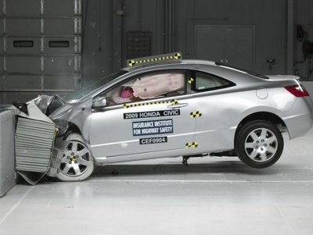
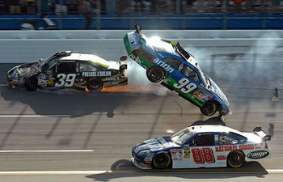
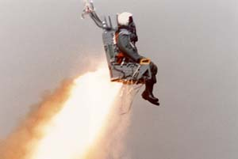
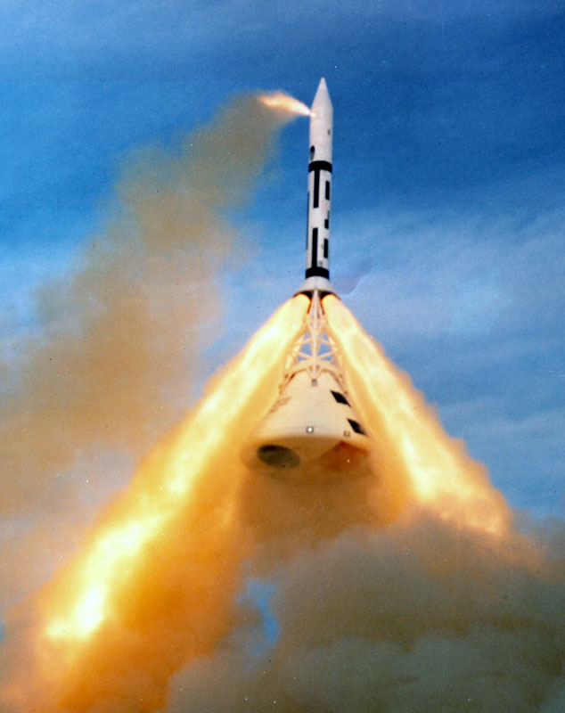
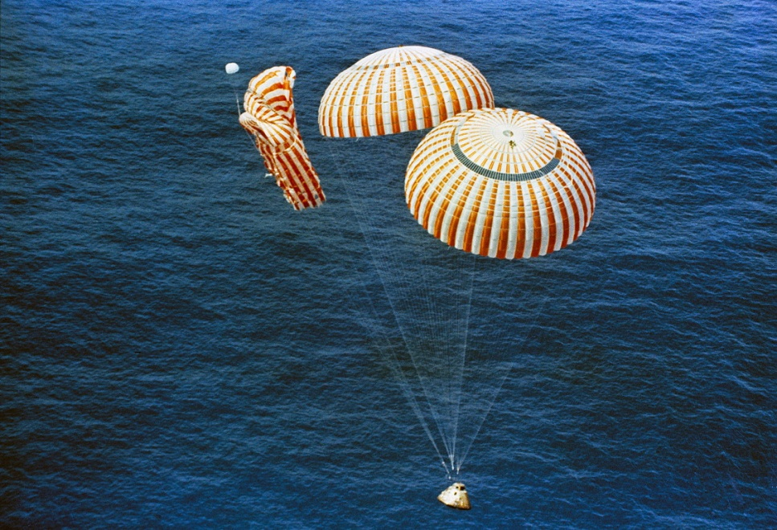
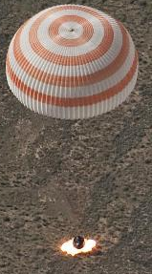
Protecting people during “dynamic events.”

Slide 4
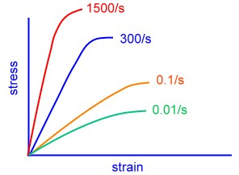
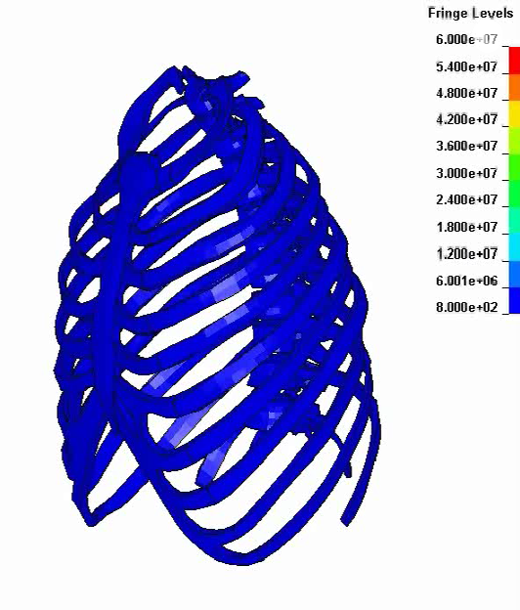
What is Injury?
x
Material failure is related to its stress-strain relationship
  Before the yield point (o), any deformation of a material under stress will return to its original shape. Beyond the yield point, the material begins plastic deformation which will not return to its original shape when the stress is removed. At the ultimate tensile strength (x), the material fails
Tissues of the human body
  Have various stress/strain relationships
  Are rate dependent (stiffer with higher loading rates)
  May differ depending on loading direction
    i.e. for bone, axial strength is higher
  May have complex material properties depending on the body region and interactions between tissues
    Injury modes are dependent on these complex interactions
o
o
x
o
x
o
x

Slide 5
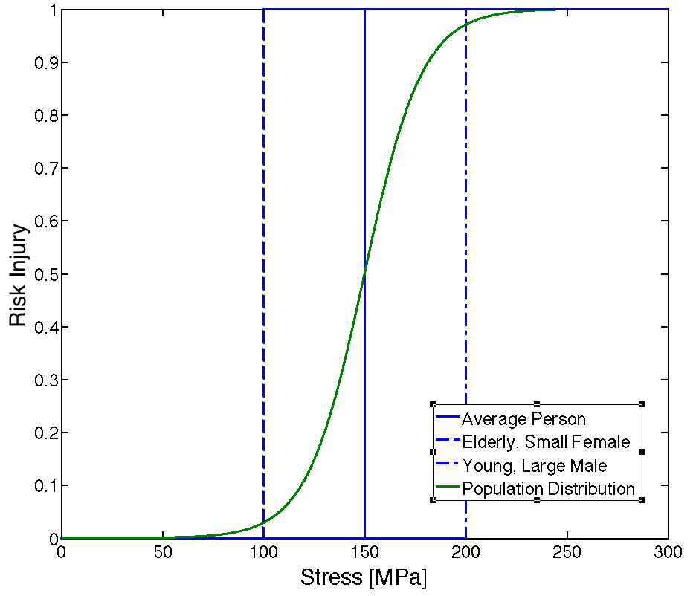
What is Injury?
Injury can be defined as the stress-strain value where the material will fail or break (ultimate strength), which varies with individuals and loading rate
Because each individual is different, this value is a distribution for a general population. This gives varying injury risk relative to a given stress-strain (i.e. at a give stress-strain, 5% of subjects may experience a failure)
However, the stress/strain in a human body cannot be directly measured, so alternative assessment methods are used such as forces, moments, deflections, and accelerations
Two Approaches to Mitigate Injury
Determine Injury Risk Function
Correlate injury outcomes with assessment response
Difficult to determine true injury risk at very low levels because the underlying distribution is not known
Human surrogates introduce uncertainty
Determine Human Tolerance
Use binomial statistics to reach desired confidence level and relate to assessment response
Does not determine injury threshold or risk of injury, just whether a level is safe
Greater confidence in safety
May be conservative

Slide 6
Occupant protection at NASA

Slide 7
NASA Occupant Protection
For any system that imparts dynamic loads to the crew, NASA has several standards that must be met & are shepherded by OP
  Sustained acceleration limits
  Jerk limits
  Rotation rate limits
  Rotational acceleration limits
  Cross-coupled acceleration limits
  Vibration limits
  Transient acceleration limits
  Flail and blunt force trauma limits

Slide 8
  Operationally-Relevant Injury Scale (ORIS)
  Developed Injury scale that considers not only severity, but also self-egress ability and flight status impact
  AIS tells us severity with regard to survival, but not SIGNIFICANCE within a certain operational context
  Uses a weighted algorithm to calculate a composite score indicating the appropriate injury level
  Example: Clavicle Fracture is a minor injury by AIS standards, but could prevent a crewmember from self-egressing the vehicle immediate after landing
Injury Severity (IS)
0 | 1 | 2 | 3 | 4 | 5 | 6
None | Minor | Moderate | Serious | Severe | Critical | Maximal
Self-Egress Capability (SE)
0 | 1 | 2 | 3 | 4
No Impact | Able with Minor Impact (within 3min req) | Able with Major Impact (not within 3min req) | Unable without assistance | Unable, requires rescue and/or stabilization
Return to Flight Status Estimate (FS)
0 | 1 | 2 | 3 | 4
No Delay in Return | Short Delay in Return (<3mo.) | Intermediate Delay in Return (<1y) | Long Delay in Return (>1y) | Ended Flight Status/ DQ'd
Operationally Relevant Injury Class
0 | I | II | III | IV
No Injury | Minor Injury | Moderate Injury | Severe Injury | Life-Threatening or Fatal Injury

Slide 9
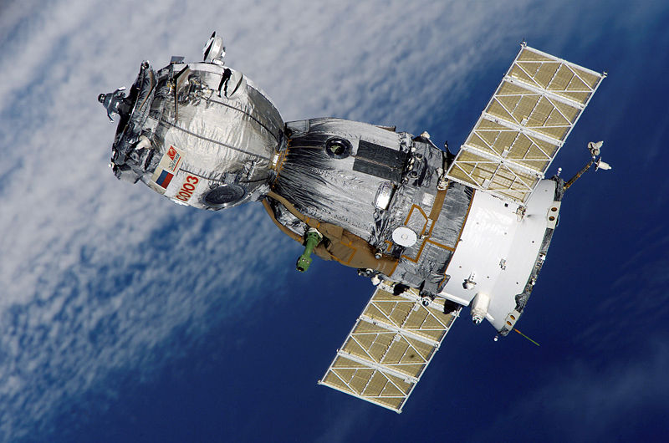
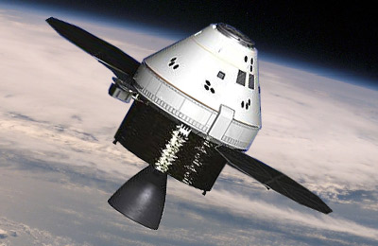
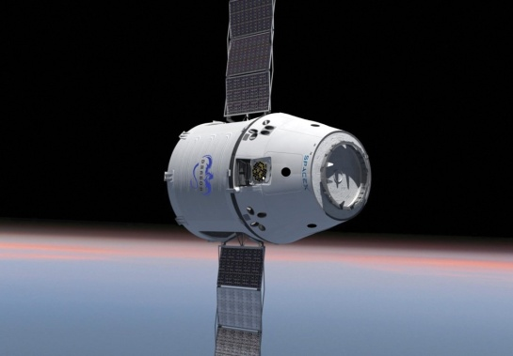
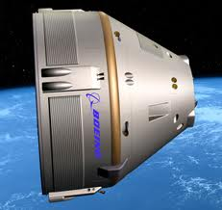
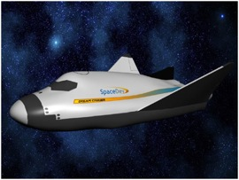
Spaceflight Vehicles
Current System
Multi-purpose Crew Vehicle Program
Soyuz TMA-M
Orion
Commercial Crew Program
SpaceX Dragon
Boeing CCT-100
Sierra Nevada Dream Chaser

Slide 10
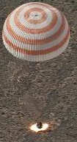
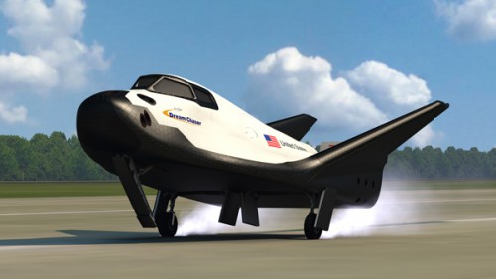
Space Vehicle Occupant Protection
Dynamic Phases of Flight
  Launch
    All proposed vehicles launch with crew laying on their backs (eyeballs in accelerations)
  Abort
    Primarily X-axis loads (Eyeballs in)
  Reentry
    Primarily X-axis loads (Eyeballs in)
    May have transient dynamics due to parachute deploy
  Landing
    The landing mode is specific to the vehicle design.
      Water Landing
      Land Landing
      Runway Landing
Credit: SNC

Slide 11
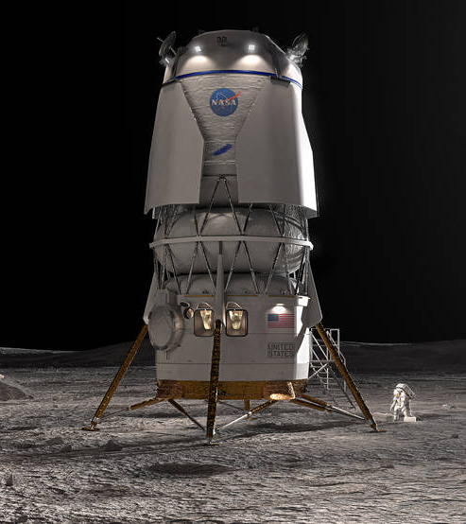
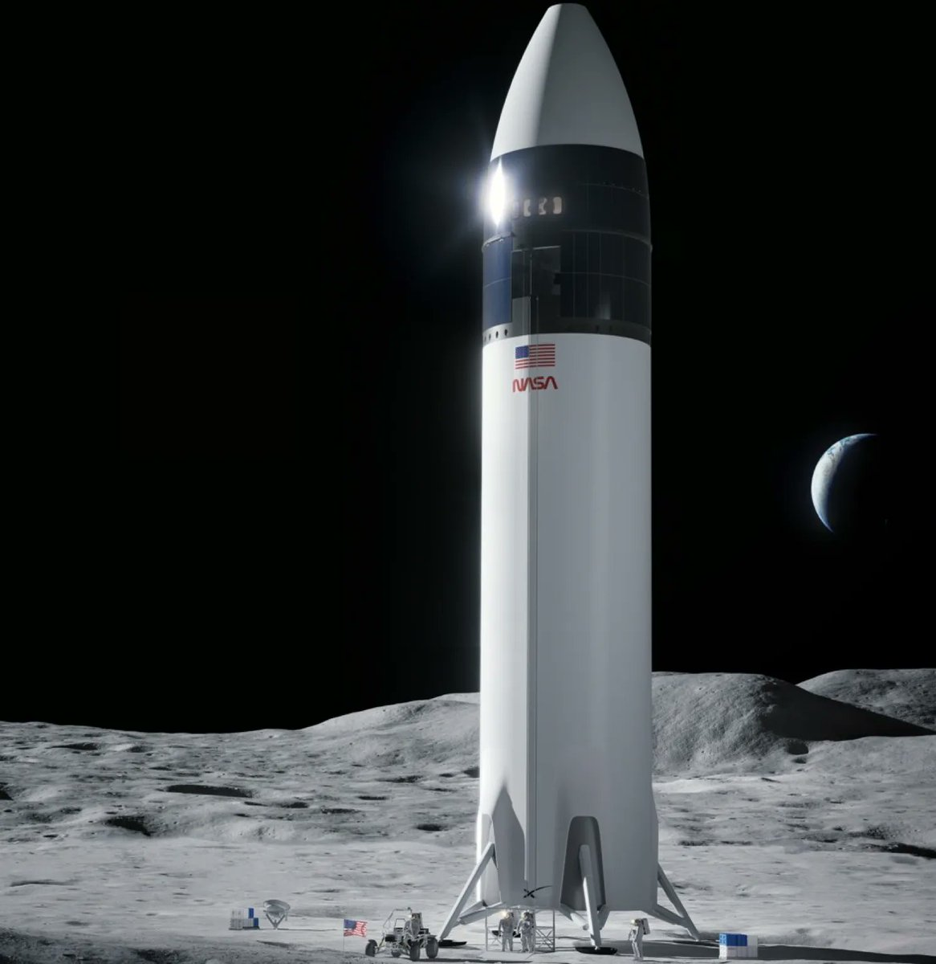

Human Landing Systems

Slide 12
HLS Considerations
Current requirements are based on Earth return landings, when the mission is over
These limits may be inappropriate for landings on other planetary surfaces
  Medical support is limited
  Injuries may have increased consequences for mission objectives/success
For early Artemis missions, two planetary landings will be experienced in the span of ~10 days
Unknown risk associated with landing in an EVA suit. Current requirements limits the additional load allowed to 20% of shirtsleeve mass
Best methodology for assessing injury risk in a standing posture is not mature
Best practices for restraints in a standing position are not well developed

Slide 13
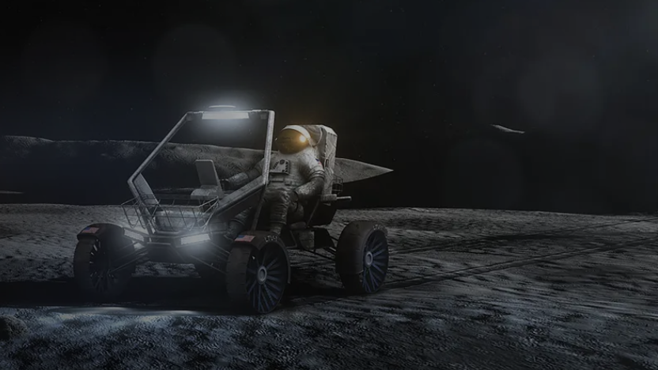
Lunar Terrain Vehicles

Slide 14
Rover Considerations
Unpressurized rovers
  Require occupants to don a pressurized EVA suit during operation
    This puts the suit and all of its rigid elements in the load path between the rover and the crewmember
  How to restrain the suited crewmember?
    Rigid fixture leads to clapper in a bell situation, where the human can run into the suit
    Other restraint configs that allow some suit motion are difficult to assess overall risk
  Seated, semi-recumbent, standing?
  Some minor injuries take on greater significance in a suit, i.e. a cut on the face
  Repeated use/comfort
Pressurized Rovers
  Can rely more heavily on automotive standards
  In a contingency, the vehicle must be operable unpressurized

Slide 15
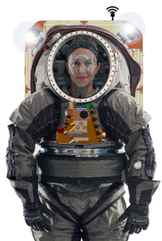
EVA Spacesuits

Slide 16
EVA Spacesuit Consideration
More injuries occur in training than inflight
Shoulder injuries have been one of the more serious issues
  Limited sizes of Hard Upper Torsos in EMU
  Inverted ops in the NBL has also been identified as a major contributor
Almost everyone who gets in a suit develops hand pain, soreness, nail delamination
Current training paradigm is no more than 1 NBL session/week
  What happens as we update this cadence for Artemis
Consideration of repeated use injuries
We have two spacesuit development contracts in work
  High-level requirement that the suit cannot hurt the crew
    How to verify?

Slide 17
Current NASA Tools to Assess Requirements

Slide 18
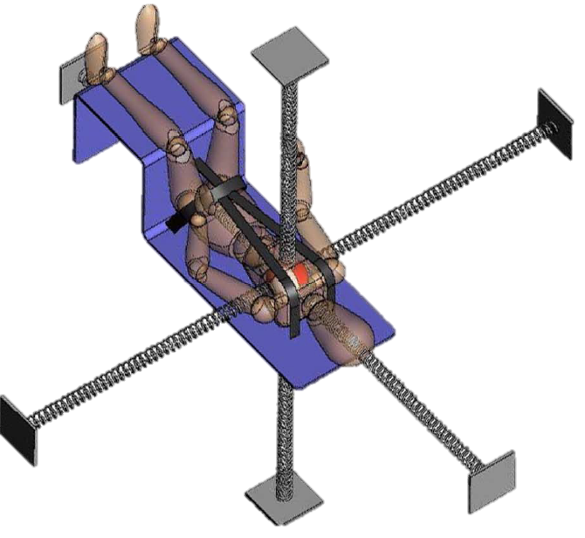
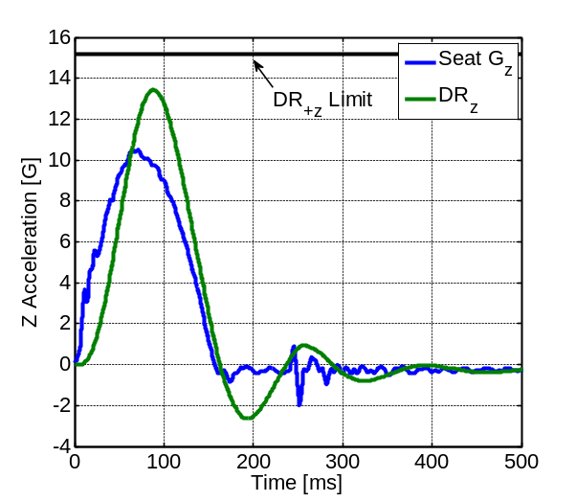





Two Main Requirements:
Brinkley Dynamic Response Criterion (BDRC)
BODY
Dynamic Response (DR)
  Estimates the acceleration of the human body
  A single degree of freedom lumped mass model
  Calculated independently in each direction
  Responses are highly specific for seat used in development
Injury Risk Criterion (β)
  Preset DR limits in each direction estimate the injury risk
  Limits based on limited statistical analysis of injury data
  Estimates an injury risk but not severity
    Low: 0.05 to 0.5%
    Moderate: 0.5 to 5%
    High: 5 to 50%
Model Accuracy Varies by Direction
Damping
(ζ)
Natural
Frequency
(ω_{n})
SEAT
a(t)
Direction | DR (Response) | β (Injury Risk)
+X (rear) | Insufficient data, so –X model used | Human injury exposure
-X (frontal) | 17 male subjects only at 10G, age 22-35 | Human injury exposure
±Y (lateral) | 11 male, 2 female, only at 8G, age 22-34 | Expert opinion
+Z (spinal) | 57 yo cadaver (ω_{n}) and 8 males (ζ), age 29-47 | Ejection injury rates
-Z (headward) | 11 male, 1 female, only at 10G, ages 22-37 | Expert opinion
Injury Level
Low | 35 | -28 | ±15 | 13.0/15.2 | -11.5/-13..4
Moderate | 40 | -35 | ±20 | 15.4/18.0 | -14.1/-16.5
High | 46 | -46 | ±30 | 19.5/22.8 | -17.5/-20.4
Deconditioned / Conditioned Values

Slide 19
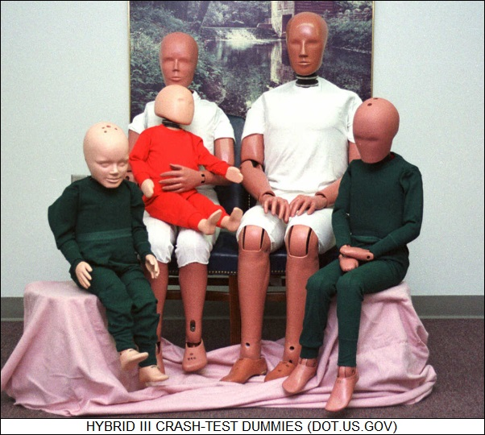
Two Main Requirements:
Hybrid III Anthropomorphic Test Device (ATD)
The Hybrid III was developed in the 1970’s for frontal car crash testing
It has been adapted over the years for various industries
Several configurations are currently available including
  Available in 5th female, 50th male and 95th male adult sizes
  Straight and curved spine designs
  Sitting and articulating pelvis designs
  Various heads available
Several commercial numerical models are available for the Hybrid III
  COTS FE models of ATDs do not include some of the configuration options
  Evaluate of the fidelity of the various COTS models is needed
  FE ATD models which include pressure suit elements do not currently exist
Limitations
  The Hybrid III is not intended for lateral use
  The neck responses are not biofidelic in any direction
  Chest is very stiff
New Occupant Protection requirements levied on MPCV and CCP include the use of the 5th and 95th percentile Hybrid III
  Further investigation of sensitivities to variations in ATD configurations, seated versus articulated pelvis and straight versus curved spine, is needed
 | Height | Weight
5th Female | 5’ | 110lb.
95th Male | 6’2” | 223 lb.

Slide 20
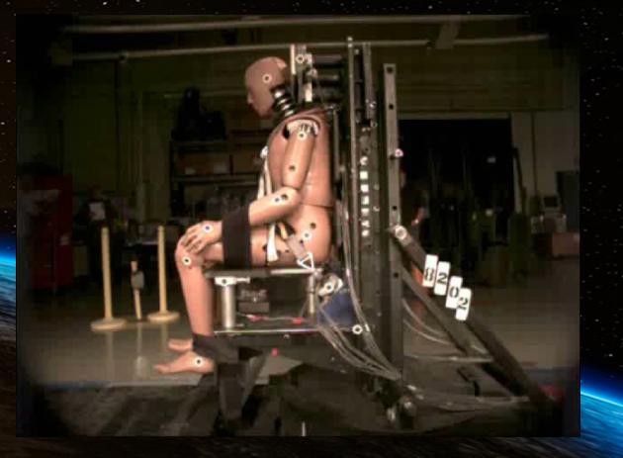
Hybrid III: NASA Limits
Injury Assessment Reference Values (IARV) Limits
¹The following ATDs shall be used to evaluate the metrics:
5th percentile female automotive Hybrid III
95th percentile male automotive Hybrid III with straight spine
²Values in table are evaluated at varying time durations as specified in J
³Required only if Occupant Response Amplification ground rule is not met by the design
ATD Metric | ATD Size¹ | Non-Deconditioned |  | Deconditioned
 |  | Nominal | Off-Nominal | Nominal | Off-Nominal
HIC 15 | 5th Female | 375 | 525 | 375 | 525
 | 95th Male | 325 | 450 | 325 | 450
Head Rotational Acceleration [rad/sec²] | 5th Female | 2,500 | 4,200 | 2,500 | 4,200
 | 95th Male | 2,100 | 3,600 | 2,100 | 3,600
N_{ij} | 5th Female | 0.5 | 0.5 | 0.4 | 0.4
 | 95th Male | 0.5 | 0.5 | 0.4 | 0.4
Peak Neck Axial Tension Force [N]² | 5th Female | 890 – 1,840 |  | 765 – 1,580
 | 95th Male | 2,000 – 3,390 |  | 1,720 – 2,910
Peak Neck Axial Compression Force [N]² | 5th Female | 890 – 2,310 |  | 765 – 1,990
 | 95th Male | 2,000 – 4,360 |  | 1,720 – 3,750
Flail | 5th Female | Pass
 | 95th Male | Pass
Peak Lumbar Axial Compression [N]³ | 5th Female | 3,500 | 4,200 | 3,000 | 3,600
 | 95th Male | 6,600 | 7,800 | 5,700 | 6,700

Slide 21
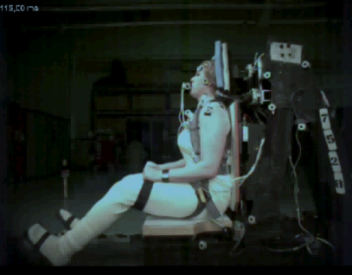
Supplemental Human Volunteer Tests
Current ATDs are not sensitive predictors of bruising, pich points, etc.
ATDs are not biofidelic to space flight loading magnitudes and directions
ATDs cannot capture complex interactions like head, helmet, headrest interactions

Slide 22
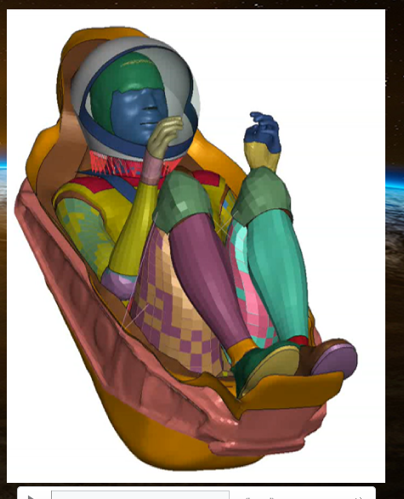
Human Finite Element Models
Models based on human tissue, not foam, metal, etc. in ATD
Rapidly gaining validation in the automotive safety field
Lend themselves much better to EVA suit and suited rover than ATDs for assessing injury risk
Currently not included in NASA standards

Slide 23
Flight History: Soyuz

Slide 24
NASA Study Background
First study to catalog Soyuz landing injury occurrence and types
Aim 1: Collect post-landing questionnaire and injury data to develop an injury database.
Aim 2: Determine the occurrence of landing injuries to crewmembers.
Aim 3: Determine whether the Soyuz meets current Orion and Commercial Crew Program (SpaceX Dragon and Boeing Starliner) requirements.
Aim 4: Evaluate whether Soyuz injury rates are consistent with injury risk curves we developed for the Hybrid III by running an FE simulation of each landing. Update injury risk metrics where necessary.

Slide 25
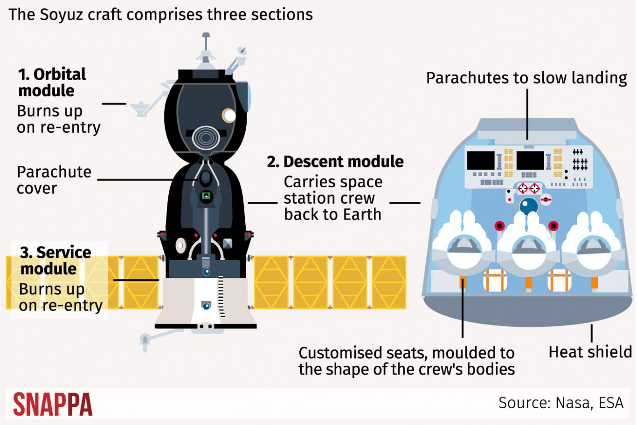
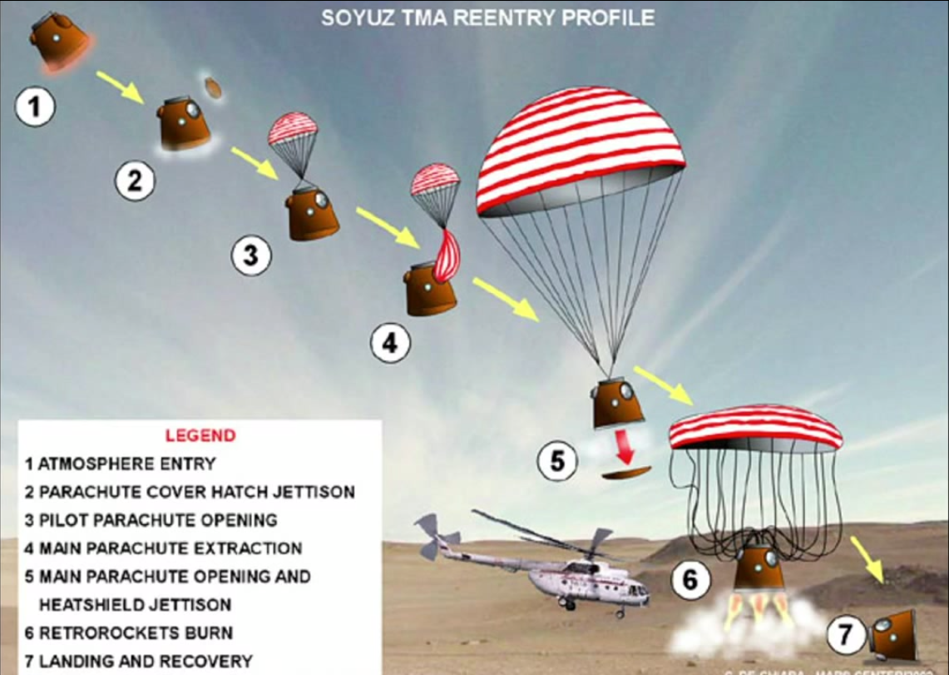
Soyuz Reentry
http://home.bt.com/news/science-news/tim-peakes-return-this-is-what-the-astronauts-journey-will-be-like-on-the-soyuz-tma-11364067838534
https://www.reddit.com/r/space/comments/2w5iw4/a_visual_representation_of_a_soyuz_reentry/

Slide 26
Soyuz Reentry & Landing Characteristics
Reentry friction slows the Soyuz from 17,000 mph to 500 mph
  Peak Gx ~4.5 for tens of seconds
  Ballistic reentry can result in ~7 Gx for tens of seconds
Main parachute slows the vehicle to ~19 mph
  Backup parachute is smaller, so higher but unknown velocity
Retro rockets fire ~3 ft above ground & slow the vehicle to ~3 mph
  Estimate peak loading of ~4-8 G
Horizontal vehicle velocity is driven by wind speeds
Ground conditions affect impact load
  Estimate ~4-8 G
Seat tilts under main chutes so crew are slightly head up
  Impact loads are mostly rear impact with some spinal loading
  Other impact directions are possible due to wind speeds & attitude at retro firing
  Seat can stroke to attenuate off-nominal loads
Vehicle often tumbles, and can be dragged by parachutes

Slide 27
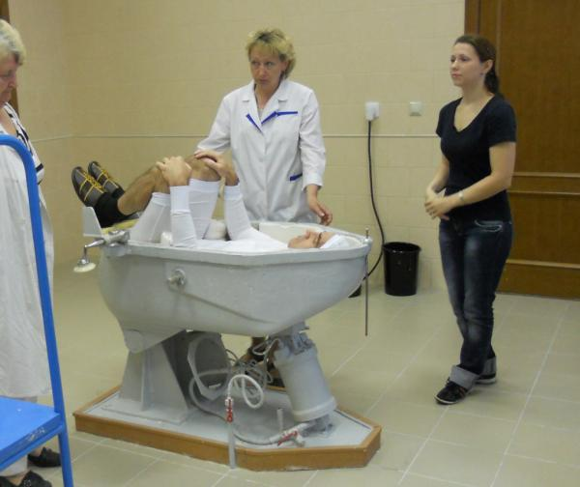
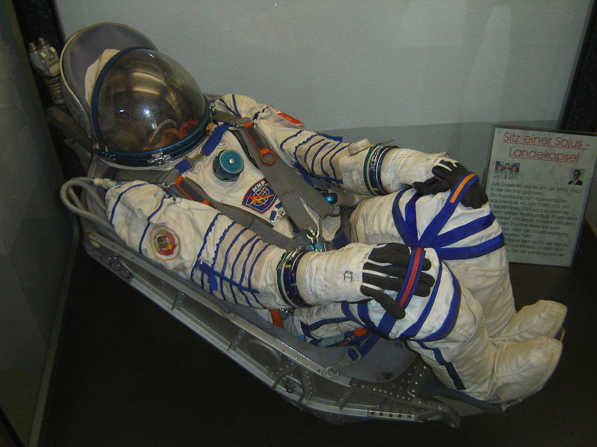
Soyuz Seat
https://twitter.com/astrorm/status/235321042015498240
https://commons.wikimedia.org/wiki/File:Soyuz_seat.jpg

Slide 28
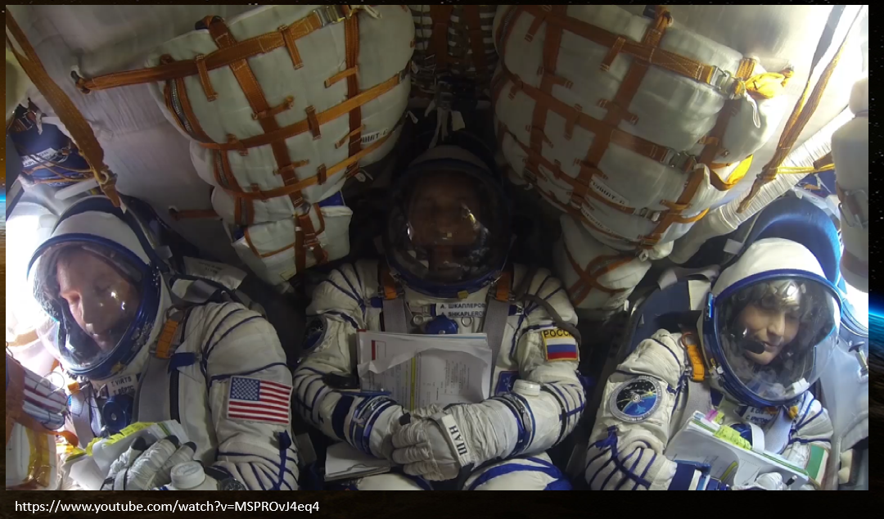
Interior Landing Perspective
https://www.youtube.com/watch?v=MSPROvJ4eq4

Slide 29
Methods: Aim 1: Medical Data & Survey
 | Soyuz Landers | Consented to Medical Data | Declined Medical Data | Consented to Survey | Declined Survey | No Response to Survey Consent | Completed Survey | Survey In Progress | Survey and/or LSAH Data
US | 48 | 36 | 2 | 40 | 2 | 6 | 28 | 12 | 43
USOS | 27 | N/A | N/A | 7 | 0 | 0 | 6 | 1 | 6
Spaceflight Participants | 6 | N/A | N/A | 1 | 0 | 5 | 1 | 0 | 1
Totals | 81 | 36 | 2 | 48 | 2 | 11 | 35 | 13 | 50

Slide 30
Results: Soyuz Landing Injuries
  Examples of minor injuries
    Contusions and abrasions
      Includes flail Injuries
      Multiple knee injuries due to console impact
    Several cervical spine soft tissue injuries
    Lumbar and thoracic back pain
  Examples of moderate injuries
    Radial nerve palsy – resolved after 1-2 months
    Lumbar intervertebral disk injuries with unresolved back pain
  Limitations
    Several cases of on-orbit back pain and injury exacerbated by landing impact
Injury Classification | Number of Crew Injured | Injury Rate [%] | Future Vehicle Injury Rate Requirements [%]
0 (Contusion/Abrasion) | 17 | 21.8 | <5
I (Minor) | 3 | 3.8 | <5
II (Moderate) | 3 | 3.8 | <1
III (Significant) | 0 | 0 | 0
IV (Severe) | 0 | 0 | 0
Newby N, Greenhalgh P, Somers J, “Soyuz Landing Injury Risk Characterization”, SAFE Journal 039, 1-6 (2020).
NASA/TP-2015-218578 Final NASA Panel Recommendations for Definition of Acceptable Risk of Injury due to Spaceflight Dynamic Events

Slide 31
Discussion
A number of the injuries occurring in the Soyuz are due to the confined space within the cabin and contact with rigid elements.
Even excluding contact injuries, we are observing more inertial-related injuries to the neck and back than predicted.
Possible explanations:
  It remains unclear the role that spaceflight deconditioning plays in tolerance to the Soyuz landing impact.
  It is also possible that Soyuz impacts are harder than the drop test data would indicate.
    Each seat has an accelerometer, but that data is not owned by NASA
  Given the uniqueness of Soyuz impacts (suit, deconditioning, loading directions, etc.) our predictive tools may be inadequate.

Slide 32
Potential Concerns with Current Space Vehicle Requirements
Soyuz injuries are under-predicted by Brinkley and ATDs
  Limited knowledge of actual acceleration
Reconstructed Soyuz landing study showed ATDs were a better predictor of an injury than BDRC, but not injury type/location
Human volunteer tests showed that ATD’s were unable to predict human head injuries in flight-like loading conditions
Data supporting standing during dynamic phases of spaceflight is limited

Slide 33
Flight History: Surface EVA

Slide 34

Surface Operations
12 Astronauts have performed a lunar EVA
14 EVA in total
Apollo 17 spent 75 hours total on the lunar surface
Totaled just over 22 hours of suited surface time across 3 EVAs
Artemis III will set new records
  First lunar South Pole landing
  6.5 total surface days
  4 EVAs planned nominally, with an option for a 5th

Slide 35
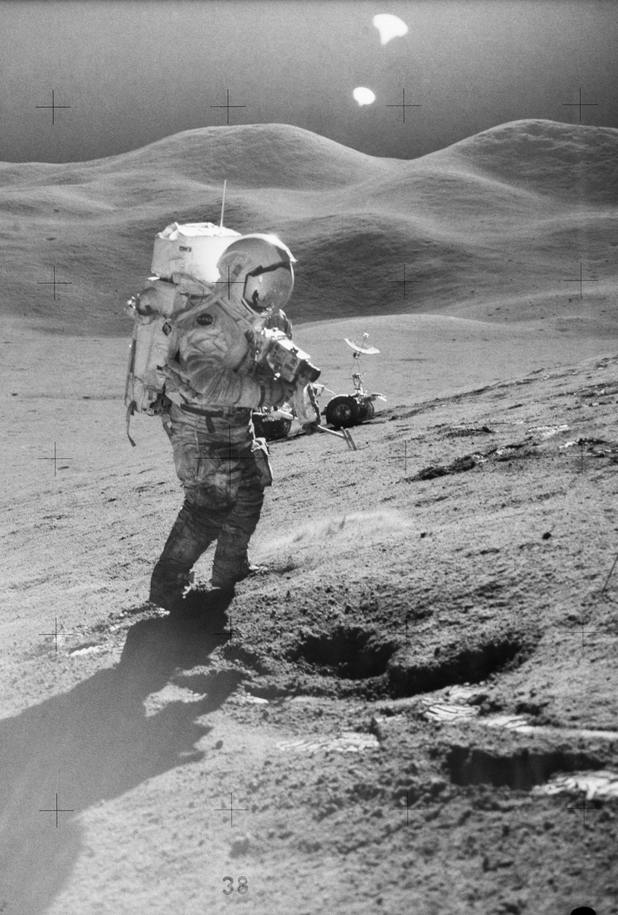
Apollo MSK injuries
9 Events were reported on the lunar surface related to EVA
5 events located in the hand
2 Events occurred in the wrist
  Wrist laceration due to suit wrist ring cutting into the skin
1 event resulted in a shoulder strain after EVA 2/3
  Crew member injured shoulder during surface drilling activity
1 event described as general LE muscle fatigue while covering large distances by foot on the lunar surface
Scheuring RA, Davis, JR, et. al. The Apollo Medical Operations Project: Recommendations to Improve Crew Health and Performance for Future Exploration Missions and Lunar Surface Operations. Acta Astronautica, 63 (2008); 980 – 987.
Notes:
Muscle fatigue during lunar EVA related to activities in the glove (unscrewing core tubes, deploying ALSEP, etc.)
Finger soreness attributed to high work load
MCP, distal phalanx pain, swelling after lunar EVAs
“Completing a subsequent EVA would have been very difficult on account of how sore and swollen my hands were”

Slide 36
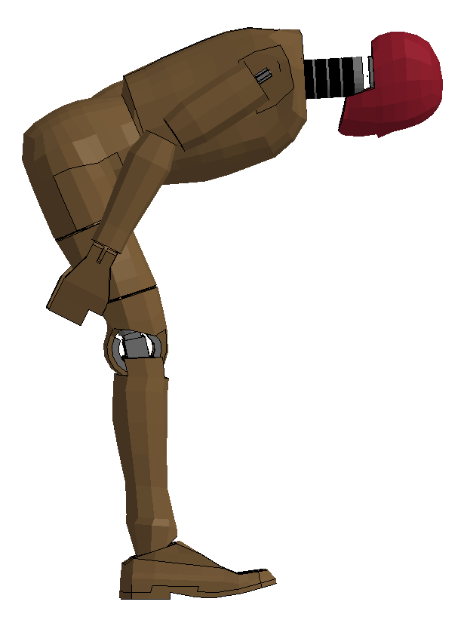
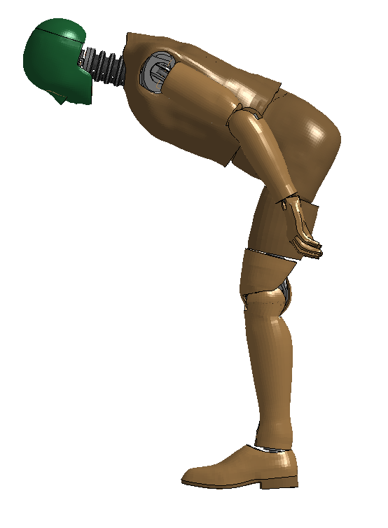
Questions?

Slide 37
Backup

Slide 38
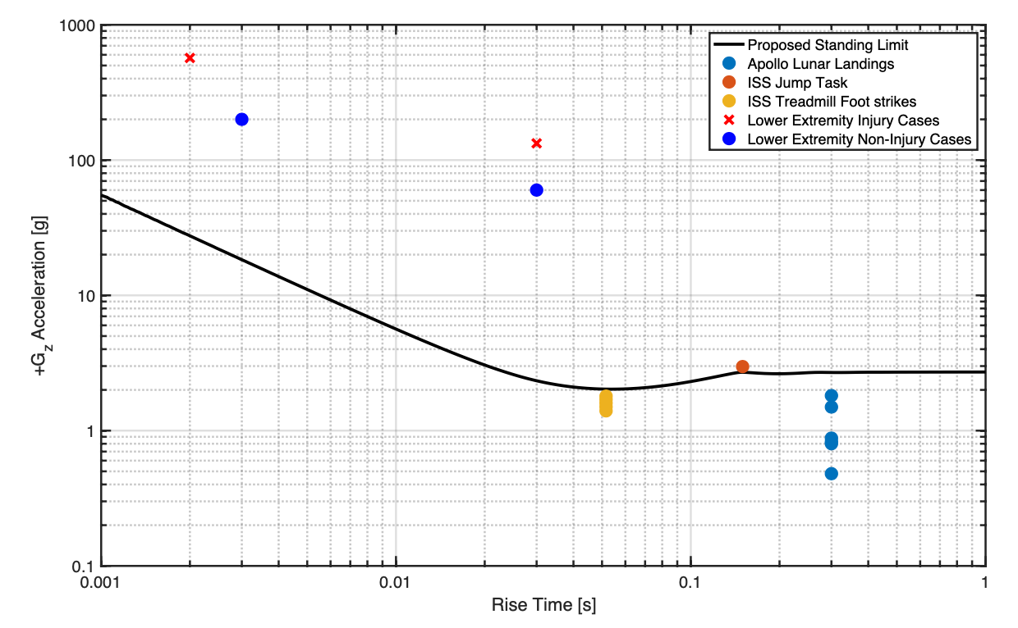
HLS Requirement for Standing Posture during Dynamic Loads: +Gz
12 crewmembers landed on the Moon in Apollo in a standing posture with no known complications
Very little additional data in literature
  Leveraged International Space Station (ISS) treadmill heel strike data
  Leveraged voluntary jumping task data
  Leveraged military lower leg injury due to blast data (includes injuries at high accelerations)
Contribution of the suit to injury risk is unquantified
HLS Limit
HLS limit intended to be conservative, but uncertainties exist particularly related to the xEMU

