Slide 1
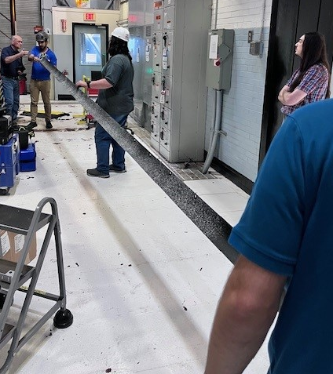
Experimental Setup for Mechanically Testing Subscale Triangular, Rollable, and Collapsible Deployable Composite Booms
Cyrus J. R. Kosztowny*¹, Gregory D. Dean¹, David Long², Richard A. Larson², Jason P. Moore¹, José E. Morel¹, Joshua E. Salazar¹, Matlock M. Mennu¹, and Nathaniel W. Gardner¹
*Structural Mechanics and Concepts Branch
¹NASA Langley Research Center
²Analytical Mechanics Associates, Inc.
American Society for Composites 39th Technical Conference
October 21-23, 2024
San Diego, CA

Slide 2

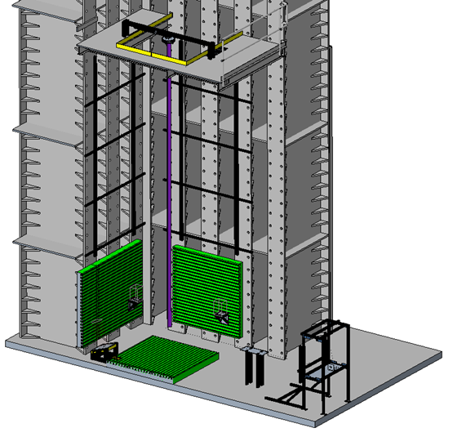
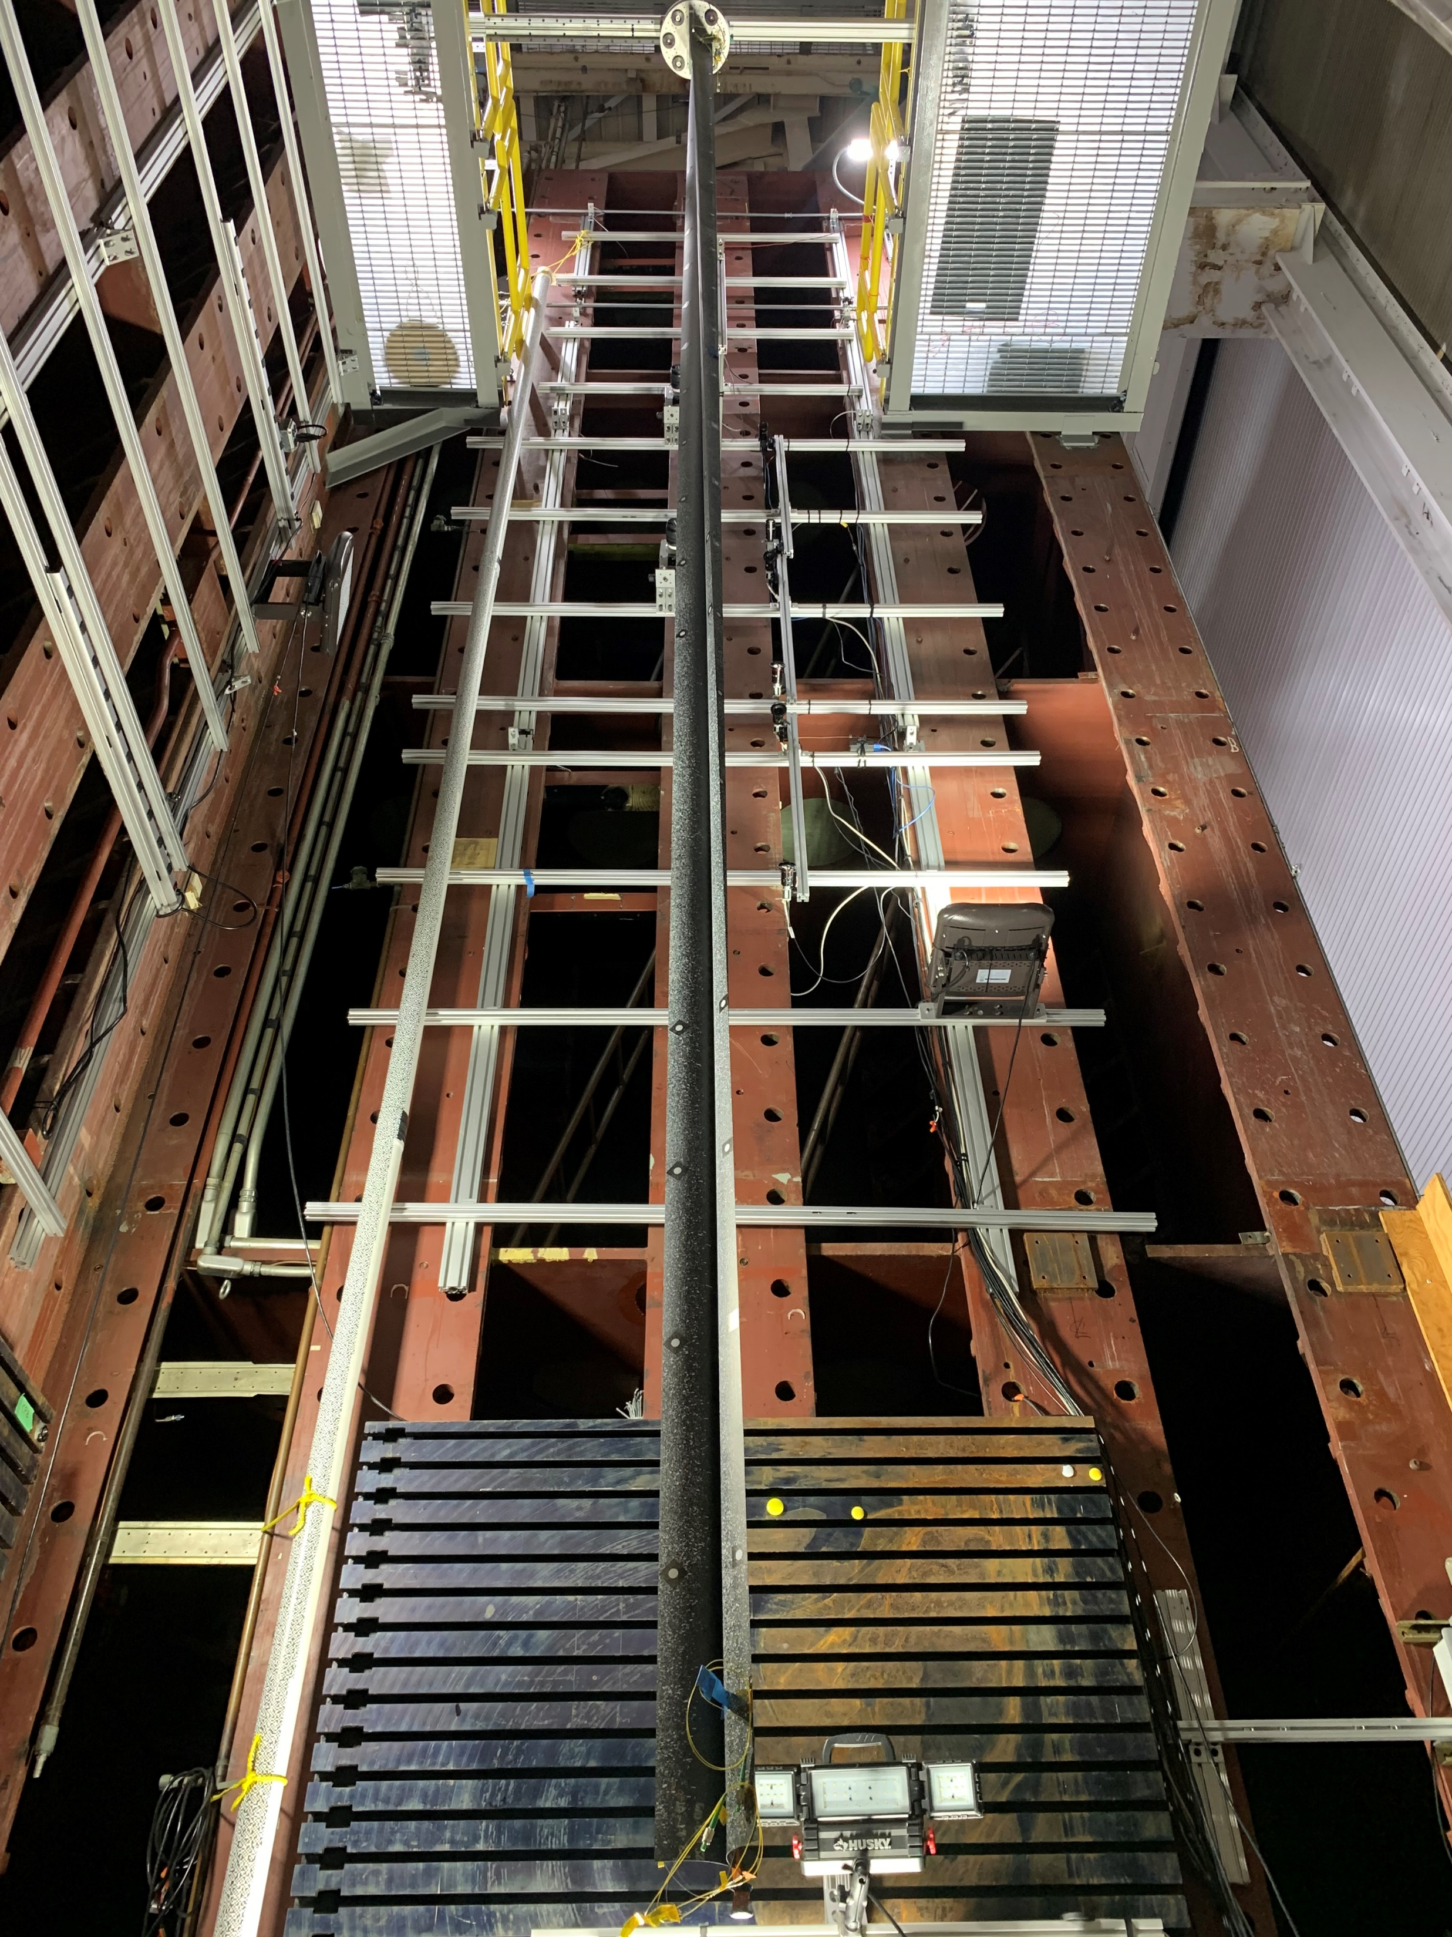
Outline
Motivation
Objectives
Test approach
Test setup
Instrumentation
Example data
Concluding remarks

Slide 3
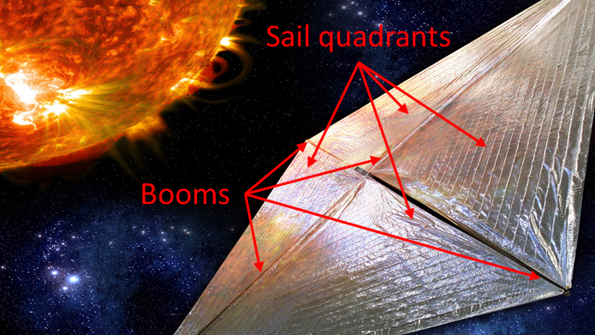
Motivation
Deployable structures are one approach to realizing large-scale space-based platform concepts for science and exploration missions such as Solar Cruiser
Ground testing of deployable systems is challenging due to the significant effects of Earth’s gravity
The Gravity Offloading and Analysis of Long
Imperfection-sensitive Elements (GOALIE)
team is developing testing capabilities to provide experimental data for test-analysis correlation and model validation for deployable structures

Slide 4

Objectives
To develop experimental testing capability for a subscale (7-m) triangular, rollable, and collapsible (TRAC) boom
To conduct quasi-static mechanical testing to gather data that may be used to improve analysis models
To gain experience testing high-aspect-ratio, compliant, and deployable space structures
To apply the lessons learned from the subscale testing activity to a full-scale (30-m) TRAC boom test

Slide 5
Test Approach
Vertically suspend the test article
Clamped-free beam conditions at the root and distal ends, respectively
Apply a quasi-static mechanical load to the fully deployed test article
Consider bending and compression cases
Collect boom response data using multiple types of instrumentation methods
Conduct a series of sub-critical tests (i.e., not intentionally taken to collapse or failure) prior to performing a critical test (i.e., intentionally taken to failure)
Load Case | Predicted Collapse Load (N) | Predicted Collapse Location from Root (m) | Predicted Collapse Mode
Out-of-plane bending | 8.9 | 0.47 | Buckling
In-plane bending | 2.2 | 0.20 and 1.14 | Sequential crippling
Compression | 79 | 7.00 | Complex collapse progression
Notes:
Shout-out for Richard’s talk on analysis of the TRAC booms.

Slide 6
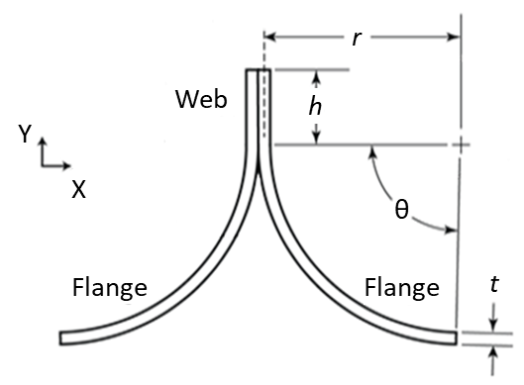
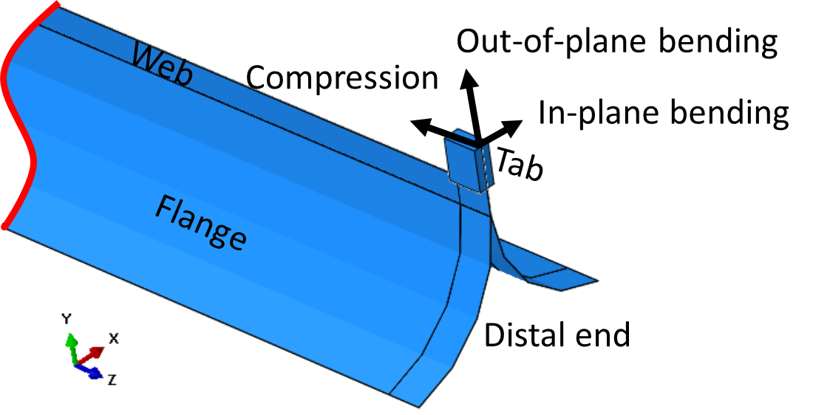
Article
Two flanges are adhesively bonded in a region referred to as the web
Each flange is a combination of plain woven (PW) and
unidirectional (UD) carbon fiber plies
PMTF7_1A adhesive
MR70 fiber in PW, M40J in UD
[45_{PW}/0_{UD}/90_{UD}/0_{UD}/45_{PW}]
Three loading cases are implemented
Parameter | Value
Flattened height | 127 mm
Flange radius, r | 78.2 mm
Web height, h | 17.0 mm
Laminate thickness, t | 0.252 mm
Flange sweep angle, θ | 80.9°

Slide 7
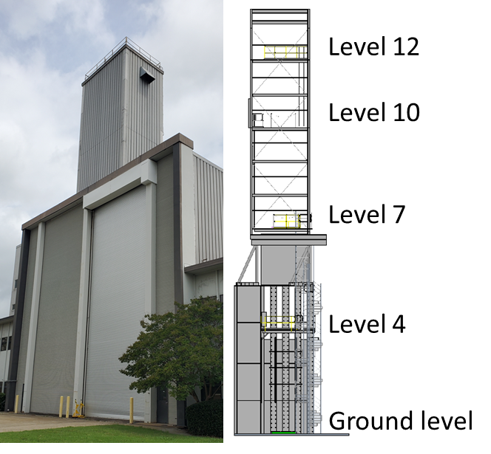
Facility
31-m tower with four levels
Subscale test is from the ground to level 4
Significant use of structural backstops
Modular and off-the-shelf hardware is used where possible

Slide 8
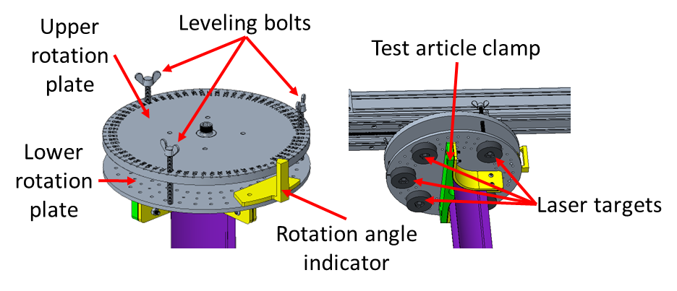
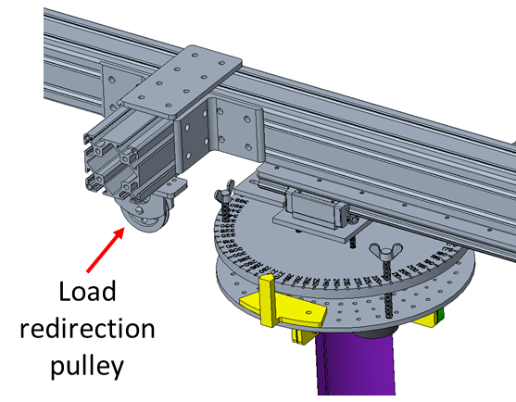
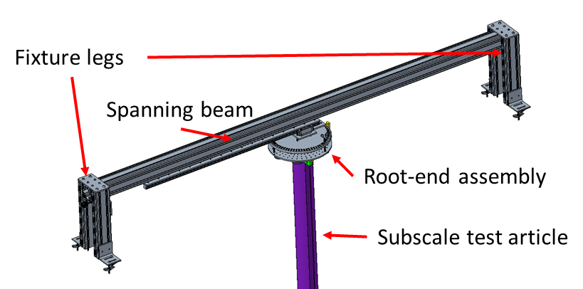
Hardware
Test fixture includes the root-end assembly and a pulley to use in the compression load case
Aluminum rail (not pictured) is used to create mounting points for data system installation

Slide 9
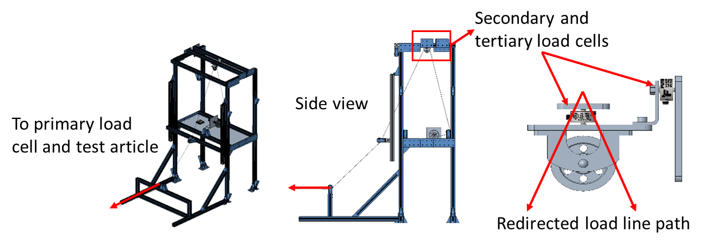
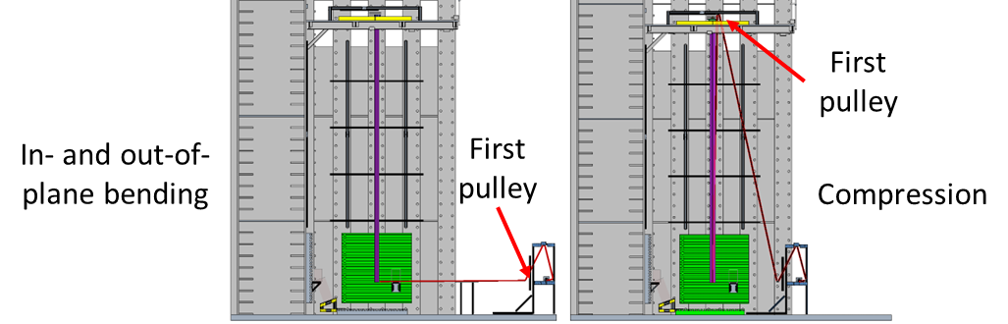
Hardware (concluded)
A loading frame is used to load the test article by spooling a load line actuated via electric motor
Pulleys are used to redirect the load line into the spooling mechanism mounted to the frame

Slide 10
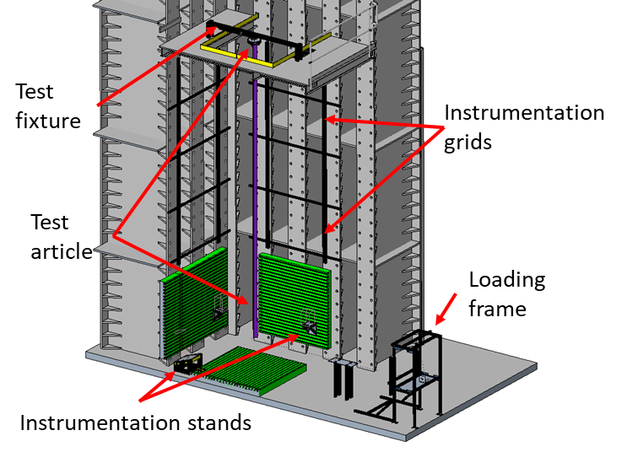
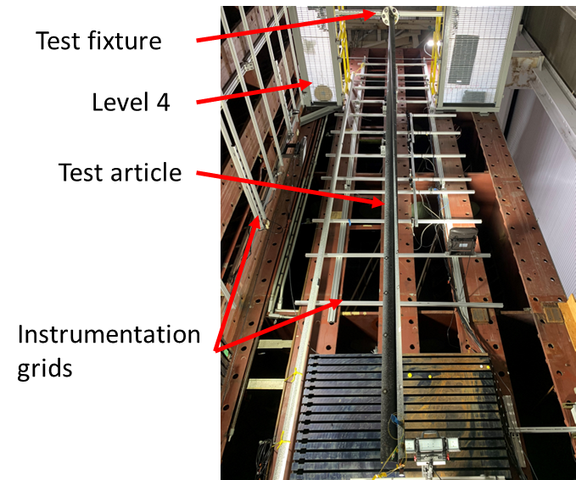
Test Setup
Notes:
To serve as a summary of the approach, article, facility, and hardware content

Slide 11
Instrumentation
Collected experimental data is intended for analysis model validation
Data capture is primarily driven by pre-test predictions
Boundary and load application conditions
High-strain regions
Predicted collapse regions
Many systems are synchronized by an external timing signal
Other systems collected data on demand
Motor encoder to track load-line take-up
Multiple load cells with a range of load capacities
Fiber optic strain sensing (FOSS) for longitudinal and transverse strains at the root and distal ends
Multiple laser trackers to monitor
Position of distal end
Position of test fixture hardware
Position of loading frame
Position of backstops in the facility
Load Case | Predicted Load (N) | Primary Load Cell (N) | Secondary Load Cell (N) | Tertiary Load Cell (N)
Out-of-plane bending | 8.9 | 44 | 44 | 4.4
In-plane bending | 2.2 | 4.4 | 44 | 4.4
Compression | 79 | 222 | 222 | 4.4
Notes:
Purpose of instrumentation and point-wise (and text-based output) data collection systems: Motor, load, FOSS, and laser trackers

Slide 12
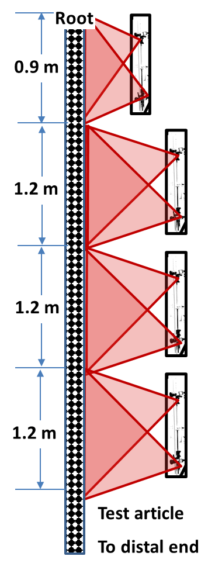
Instrumentation (continued)
Full-field (i.e., surface-based) instrumentation includes digital image correlation (DIC) and laser scanners
DIC can provide displacement, strain, and shape data
Laser scanning can also provide shape data when post-processed to interpolate many discrete data points
Local 1
Local 2
Configuration | Camera Resolution (MP) | Lens Focal Length (mm) | Standoff (m) | Pixel Resolution (px/mm)
Local 1 | 12 | 16 | 1.0 | 4.5
Local 2 | 12 | 16 | 1.4 | 3.5
Global | 6.4 | 8.5 | 1.4 | 2.5
Global
Global distal-end DIC system is not pictured
Notes:
Surface-based data collection systems: DIC and laser scanner

Slide 13
Instrumentation (concluded)
Many systems are implemented
Most systems have duplicate capability for redundancy
The subscale test activity also serves as a fact-finding effort to understand which systems are advantageous for the full-scale test effort
Instrumentation System | Displacement or Position | Strain | Shape | Load
Load Cells |  |  |  | ✓
Motor Encoder | ✓
Digital Image Correlation | ✓ | ✓ | ✓
High-Speed Video
High-Speed Digital Image Correlation | ✓ | ✓
Fiber Optic Strain Sensing |  | ✓
Laser Tracker | ✓
Laser Scanner | ✓ |  | ✓
Notes:
To serve as a summary of the instrumentation and which systems are intended to capture which data

Slide 14
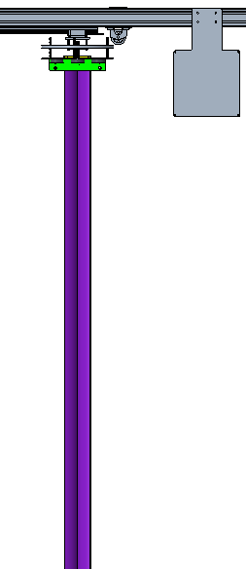
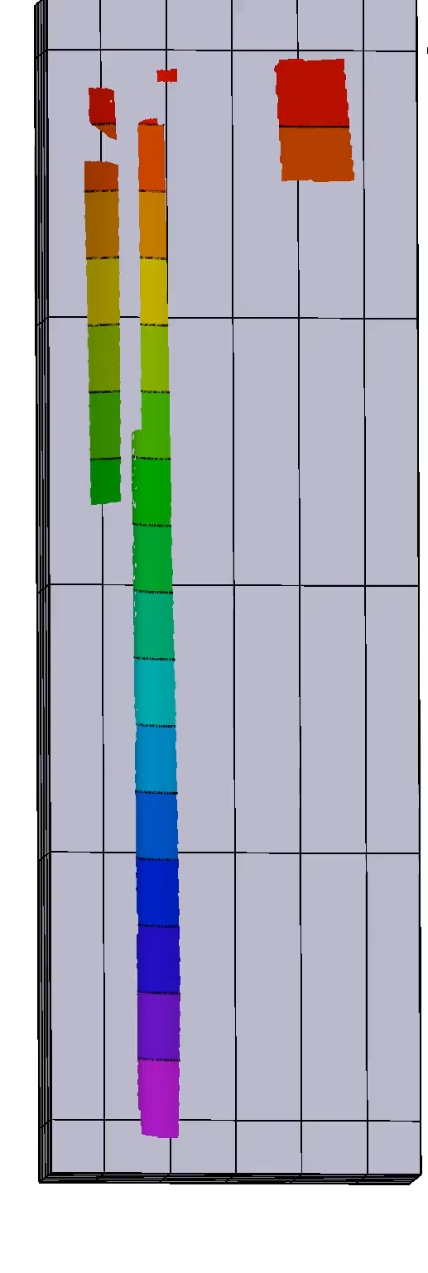
Example Test Data
Critical load case was conducted in compression
Pulley offset from boom centerline imparted combined bending, torsion, and compression
Global collapse was a rapid progression of cross-section flattening followed by significant bending
Global collapse occurred after initial local buckles formed in the right flange and shifted towards the root as loading continued
-0.09
0.32
0.74
1.16
1.58
Longitudinal Station (m)

Slide 15
Concluding Remarks
A capability was created to mechanically test a 7-m TRAC boom and record data in support of analysis model improvement and validation
The test setup can be adjusted to load a boom in bending and compression
Multiple data systems are implemented to capture the response of the test article
Other boom designs and/or loading concepts can be studied in future work
Contact cyrus.j.kosztowny@nasa.gov for information and to start a conversation
Notes:
Include mention of Redwire’s testing on a quadrant-level system tests.

Slide 16
Acknowledgements
The Gravity Offloading and Analysis of Long Imperfection-sensitive Elements project is an Announcement of Collaborative Opportunity funded by the Game Changing Development (GCD) program within the Space Technology Mission Directorate at NASA. The GOALIE team thanks GCD for their continued support.
The GOALIE team also thanks Redwire, Inc. for providing the subscale and full-scale TRAC booms to use supporting test development activities and for their thoughtful discussion on boom testing.
The GOALIE team thanks those who have supported us: Kenny McNeil, Michael McNeil, Jasmine Knowles, Jason Hall, Jason Baker, Jay Warren, Nigel Schneider, Dave McClain, Quinton Duncan, Olive Stohlman, Marc Schultz, Rick Walker, and Micah Bullard.

Slide 17
Backup slides

Slide 18
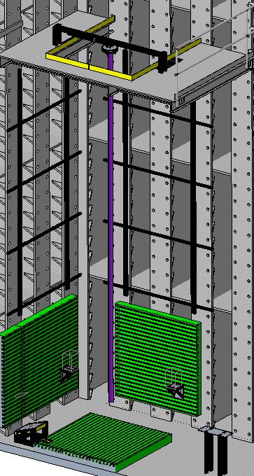
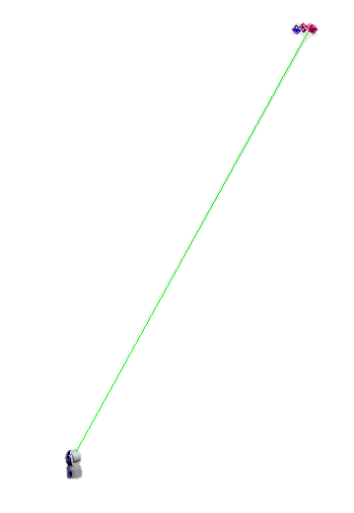
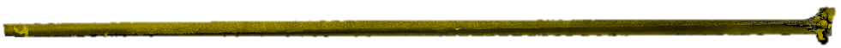
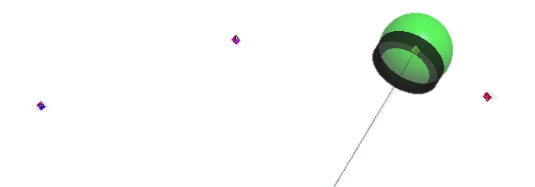
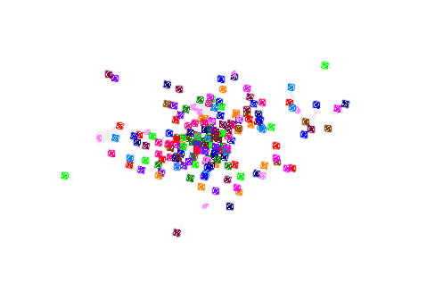
Representative Data
Laser targets
Many systems provide tabular data in text files (motor encoder, loads, strain from FOSS, and laser trackers)
Laser tracker (right) and scanner data (below) can be visualized in a point cloud
Laser tracker
0.305 mm
Distal end
Root end
Notes:
Laser scanner and tracker data

Slide 19
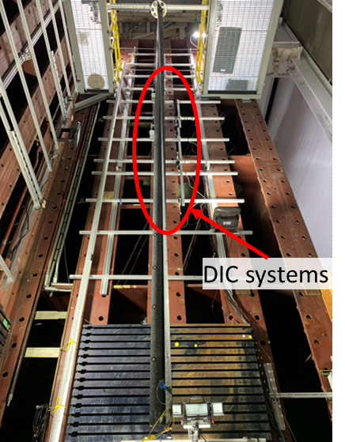
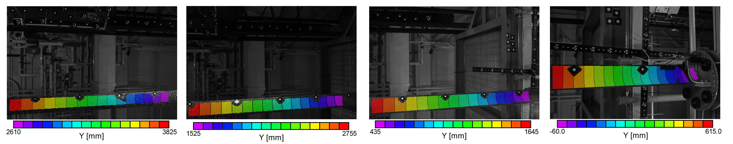
Representative Data (concluded)
Full-field strain and displacement data can be extracted from DIC
Systems may be referenced into a common coordinate system to provide stitched, continuous field data
3825
2610
2755
1525
1645
435
615
-60
Local Stations (mm)
Article mid-span
Root
3825
Stitched Longitudinal Station (mm)
-60
Notes:
DIC

