Slide 1
NASA’s Development of Commercial Low Earth Orbit
75TH INTERNATIONAL ASTRONAUTICAL CONGRESS
ANGELA HART
MANAGER, NASA’S COMMERCIAL LOW EARTH ORBIT DEVELOPMENT PROGRAM
OCTOBER 15, 2024

Slide 2
AGENDA
TITLE TEXT - 16 PT FONT, BOLD, ALL CAPS
NASA's LEO Microgravity Strategy
Commercial LEO Destination Strategy
Acquisition Strategy
Two-Phase Approach
  Partners
  Phase 2 Plans
Certification Strategy
Requirements Development

Slide 3
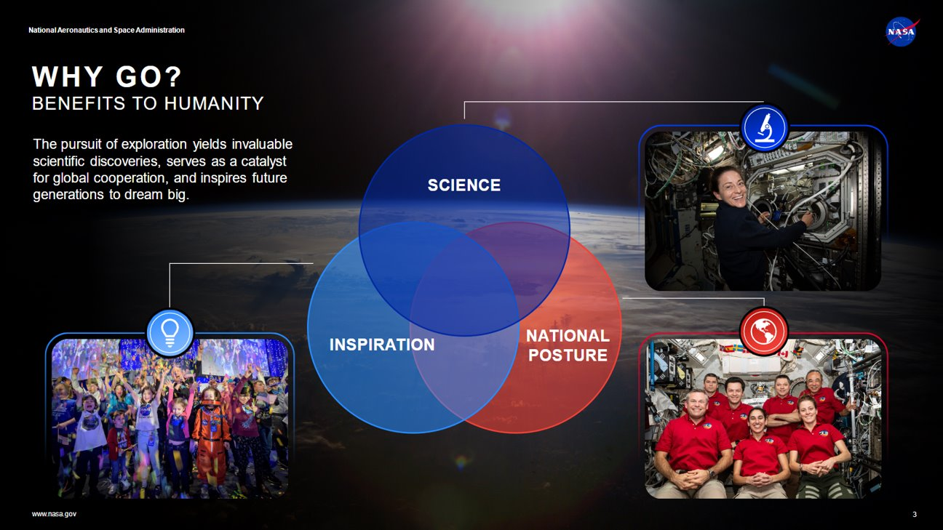

Slide 4
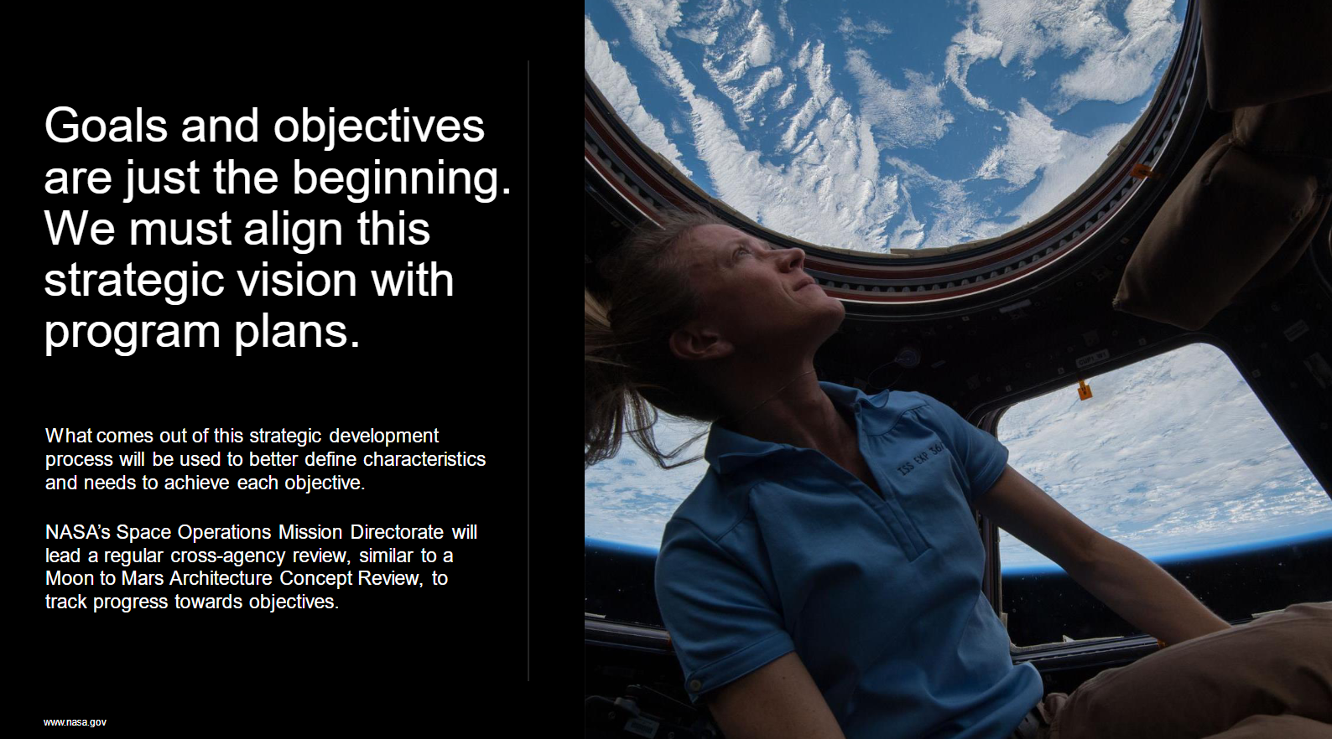

Slide 5
COMMERCIAL LEO DESTINATION STRATEGY
2020
2021
2022
2023
2024
2025
2026
2027
2028
2029
2030
2031
Goal for CLD Initial Capability
Planned ISS Deorbit
International Space Station (ISS) Operations CLD Operations
Transition Period
CLD Phase 1: Design Maturation
Commercial Destinations for ISS (CDISS)
Axiom Space
2-year Option
Commercial Destinations Free Flyer (CDFF)
Blue Origin & Sierra Space Orbital Reef
Commercial Destinations Free Flyer (CDFF)
Nanoracks & Voyager Space Starlab
CLD Phase 2: Certification and Services
NASA Certification of CLD(s) and Purchase Services
Full and open competition, one or more awards

Slide 6
ACQUISITION STRATEGY
NASA intends to purchase end-to-end mission services from the commercial owner/operator of the CLD, including:
  Crew pre-flight and on-orbit training
  Pre- and post-flight payload processing
  Crew and cargo transport to and from the CLD
  In-flight accommodation and support for crew, payloads, activities, studies, and technology demonstrations, etc.
The goals of this approach are to maximize CLD partner involvement and their ability to support NASAs and their other customers needs while NASA concentrates on ensuring crew safety and NASA mission objectives are completed
  NASA insight and oversight will include joint mission authority for the safety of NASA crew and the execution of NASA research

Slide 7
TWO-PHASE APPROACH
NASA is using a two-phase approach to:
  Support the development of commercial destinations through the use of funded and unfunded partnerships
  Followed by the certification of CLDs and purchase of services
This strategy for LEO builds on the successful legacy of its commercial cargo and crew programs that are now delivering important research, supplies, and astronauts to the International Space Station
During Phase 1, which extends through 2025, the agency is supporting multiple commercial companies through both funded and unfunded agreements
  Through the funded agreements, NASA is supporting partners in reaching preliminary and critical design reviews
  Under the unfunded agreements, NASA is providing technical expertise, assessments, and data
Notes:
Talk what we've learned in Phase 1

Slide 8
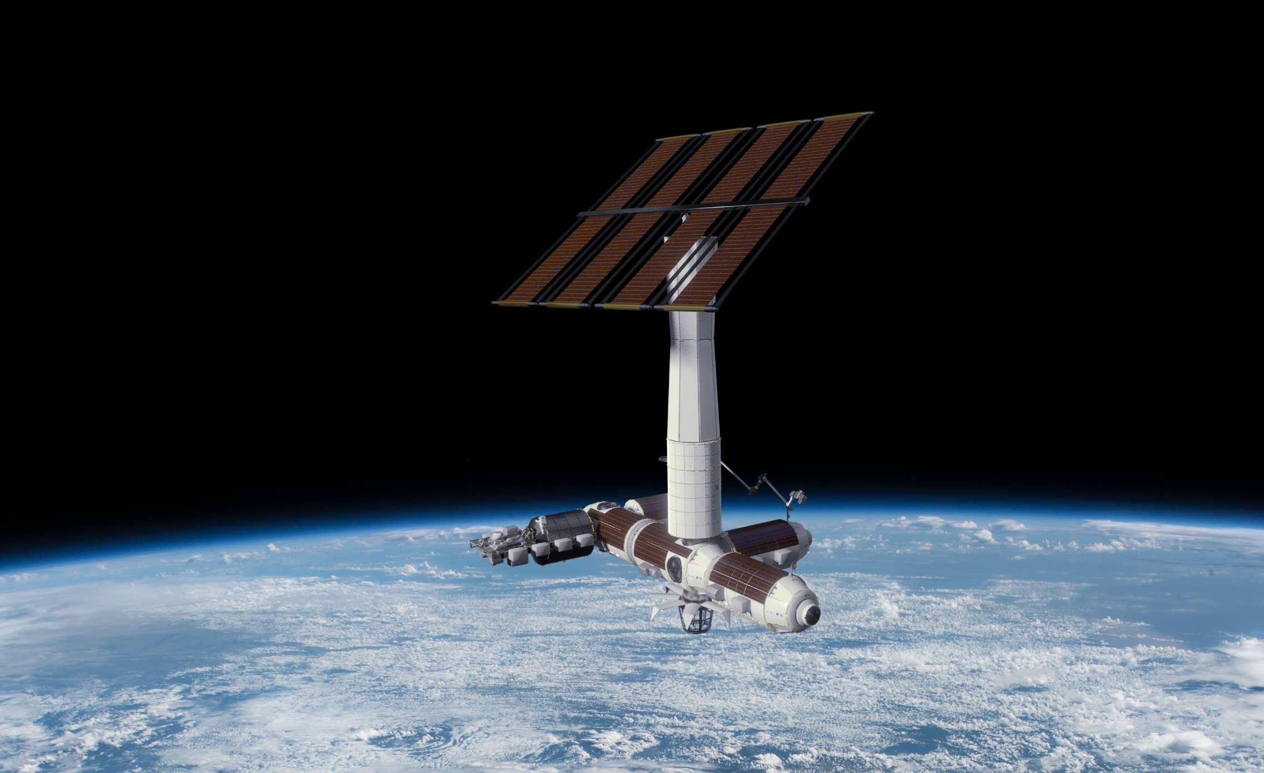
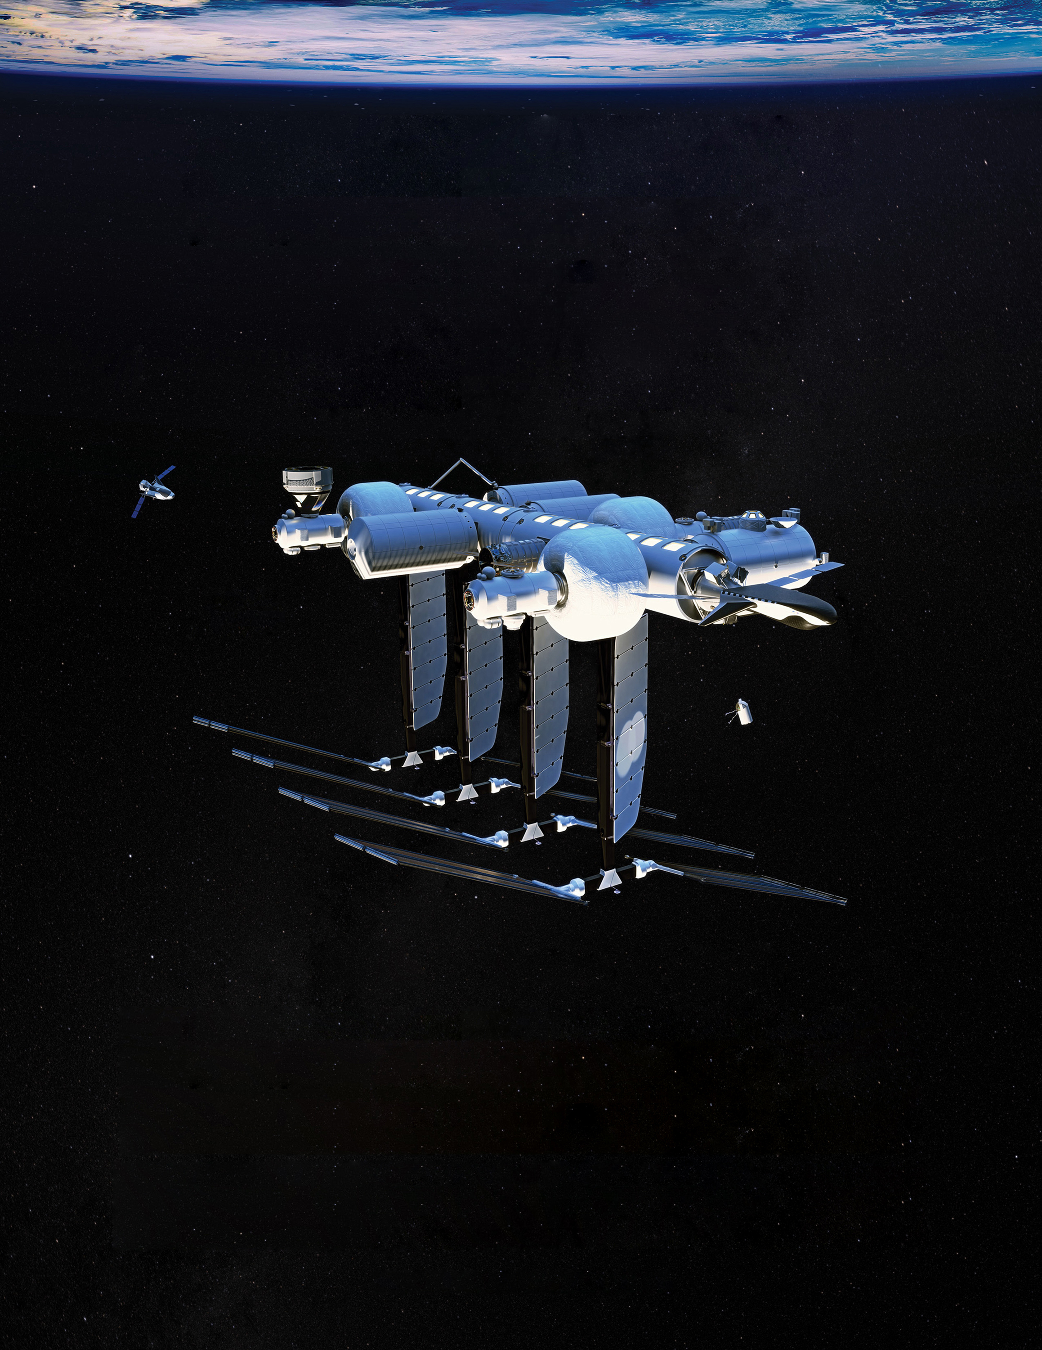
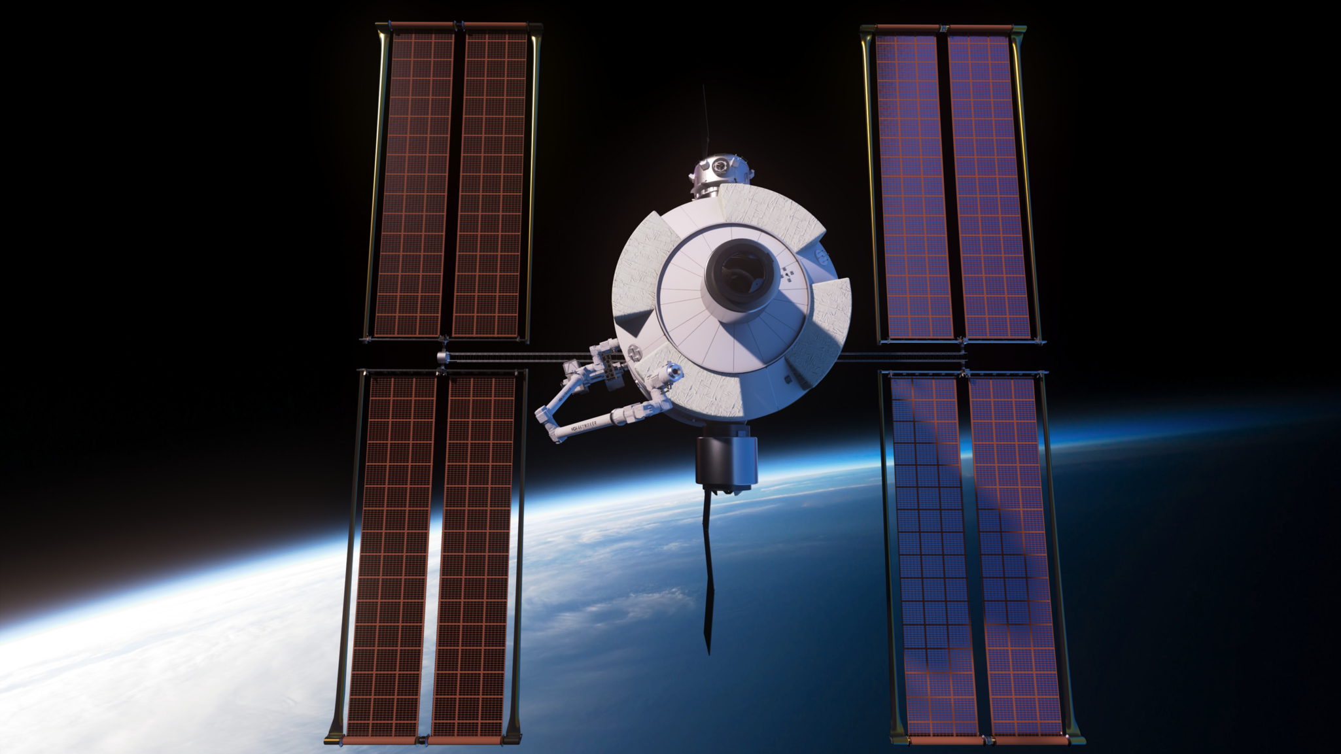
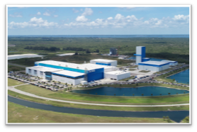

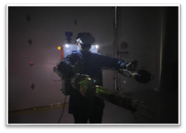
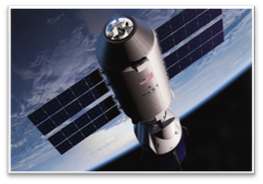
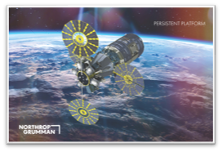
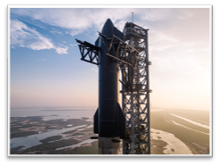
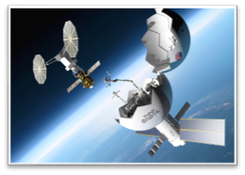
FUNDED PARTNERS
Axiom Station
Orbital Reef
Starlab
CCSC-2 PARTNERS
Blue Origin
Sierra Space
SAS
Vast Space
Northrop Grumman
SpaceX
ThinkOrbital

Slide 9
PHASE 2 PLANS
Phase 2 will focus on the certification of CLDs and the purchase of services
NASA is planning for the Phase 2 service contract award(s) to be in the 2026 timeframe, with a Request for Proposals (RFP) being issued in late 2025
Phase 2 solicitations will be free and open competitions, accessible to any US company to propose
Any company meeting the requirements within the RFP can propose even if they did not have a Phase 1 contract or agreement with the agency
Notes:
Share solicitation information
Also talk now that we have goals & objectives, what it means to this procurement
Mention gap assessment

Slide 10
CERTIFICATION STRATEGY
Per NASA requirements, systems utilizing USG astronauts are required to be human rated and certified
The certification approach is dependent upon both shared accountability and shared assurance between NASA and the CLD partner
  The commercial provider’s accountability for mission success will be enforced through contract provisions, while NASA retains acceptance of any safety risk for NASA crew
  Shared assurance will be accomplished through the careful allocation of roles and responsibilities across various technical authorities within the system certification and flight readiness planning
NASA will conduct oversight and insight activities that culminate in the agency granting system certification and human rating prior to USG astronaut missions
  Evaluation will include performance and mission milestones to review and/or approve the provider’s progress toward CLD system certification and mission readiness
  It is expected that demonstration and validation of key on-orbit processes and activities will be required for full certification and human rating

Slide 11
REQUIREMENTS DEVELOPMENT
To support the upcoming procurement, NASA has been concentrating on developing the key requirements needed on future LEO platforms
Utilization Requirements
Basic Laboratory Capabilities
Beyond Basic Laboratory Capabilities
Requirements to Ensure NASA Heritage Express Rack Can Be Accommodated
Human Rating Requirements
Flow down NASA Human Rating Requirements to CLDs
Requirement to follow a systematic safety review process
Key Governing Requirements Documents include:
CLDP-REQ-1130: Requirements and Standards for the Commercial LEO Development Program
CLDP-REQ-1150: Operational Requirements and Standards
Note: NASA is utilizing the Request for Information process and providing draft documents via sam.gov

Slide 12
THE FUTURE IN LOW EARTH ORBIT IS NEAR
As we get closer to the retirement of the International Space Station, it is critical that we have opportunity to continue to maintain our leadership and research in low Earth orbit.
It is NASA's goal to reduce or eliminate any gap in LEO operations to ensure our workforces, industry and research is not interrupted.
NASA is committed to supporting the commercial development of the next generation platforms in LEO and is excited about this next chapter.

Slide 13

www.nasa.gov/humans-in-space/commercial-space/

