Slide 1
Evaluation of Test Criteria for the G124 Standard Test Method for Determining the Combustion Behavior of Metallic Materials in Oxygen-Enriched Atmospheres
(Valid Ignition Criteria and Sample Holder Affected Zones)
Susana A. Harper, Alfredo Juarez, Ilse Reyes, Roberto Robles, Brenton Woods

Slide 2
G124 - Determining the Combustion Behavior of Metallic Materials in Oxygen-Enriched Atmospheres
G124 is a key test method for materials evaluation and selection for both spacecraft and industry applications.
As spacecraft and industry designs push the boundaries of materials selection, it is important to clearly define test method criteria.
  Valid Test Criteria
  Sample holder affects on regression rate analysis
Presenting data from WSTF test campaign.
Proposed refinements to the existing G124 standard.

Slide 3
Valid Test Criteria

Slide 4

G124-18 Scope
Section 1.1 states: This test method covers test apparatus and techniques to determine the minimum test gas pressure and sample temperature that supports self-sustained burning and the regression rate of the melting surface of a standardized sample of a metallic material that has been ignited using a promoter.
Evaluates how much input energy is required to ignite a material.
G124 is NOT an ignition test.
“Overwhelming” ignition source
Once ignition is confirmed & you exit ignitor-affected area, now you can evaluate self-sustained burning.
How do you verify material was ignited sufficiently to achieve self-sustained burning?
Ignition Test
Self
Sustained Burning
Test

Slide 5
G-124-18 Igniter and Promoter Definitions
3.1.5 igniter, n—a material used to ignite the promoter that can burn under an electrical influence, such as a small-diameter wire.
3.1.8 promoter, n—an optional material that can add supplemental
heat and increase the temperature to start burning of the
metallic material being tested.
Self-
Sustained Burning
Test
How do you verify material burning has started?

Slide 6
G124-18 Valid Test Criteria
Section 3.1.13 defines: valid test, n—a test in which the igniter and/or promoter combination has melted the bottom section of the test sample where the igniter and/or promoter is located.
Self-
Sustained Burning
Test
What constitutes melt?
What constitutes bottom section?

Slide 7
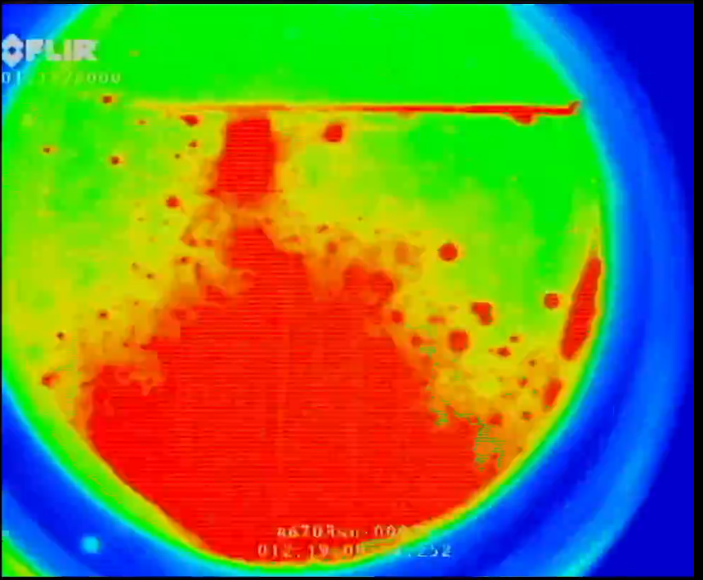
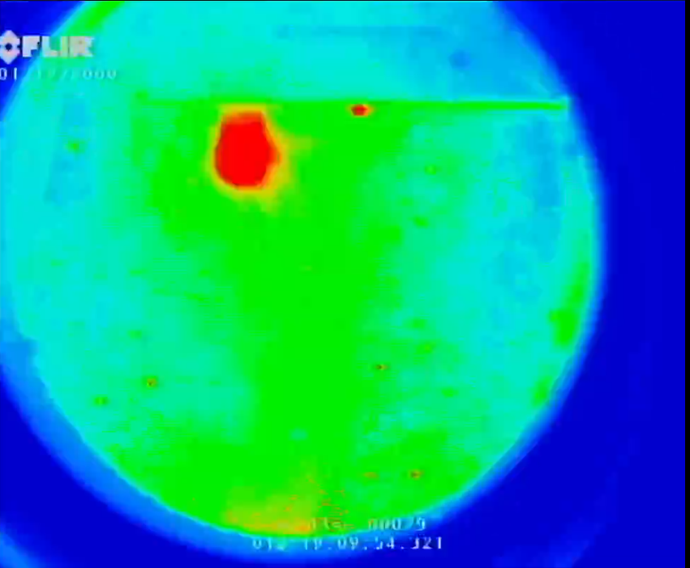
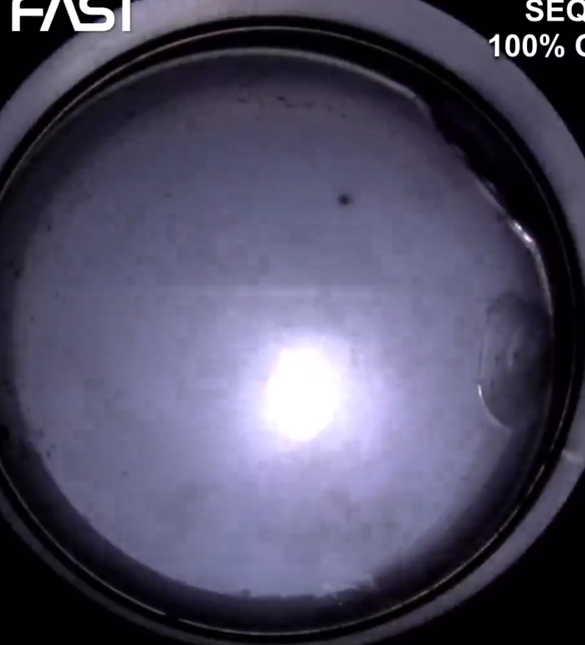
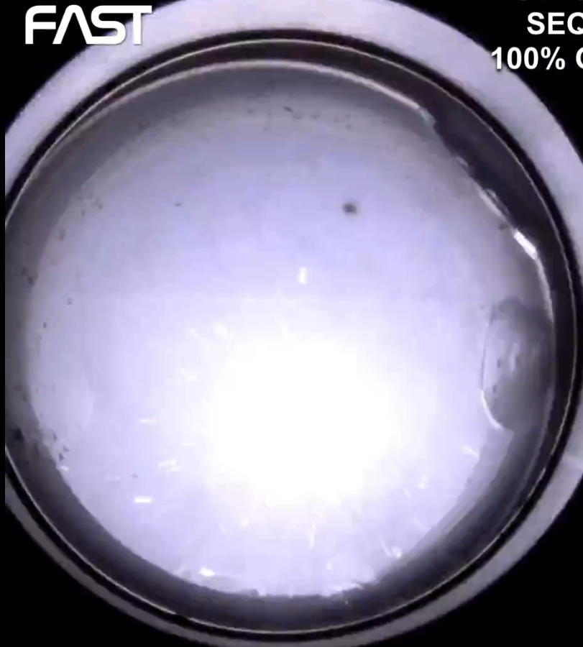
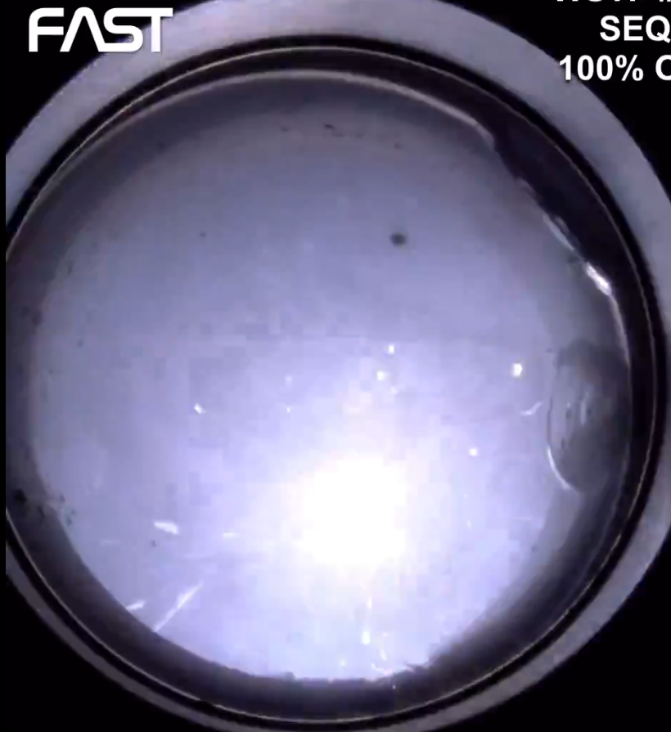
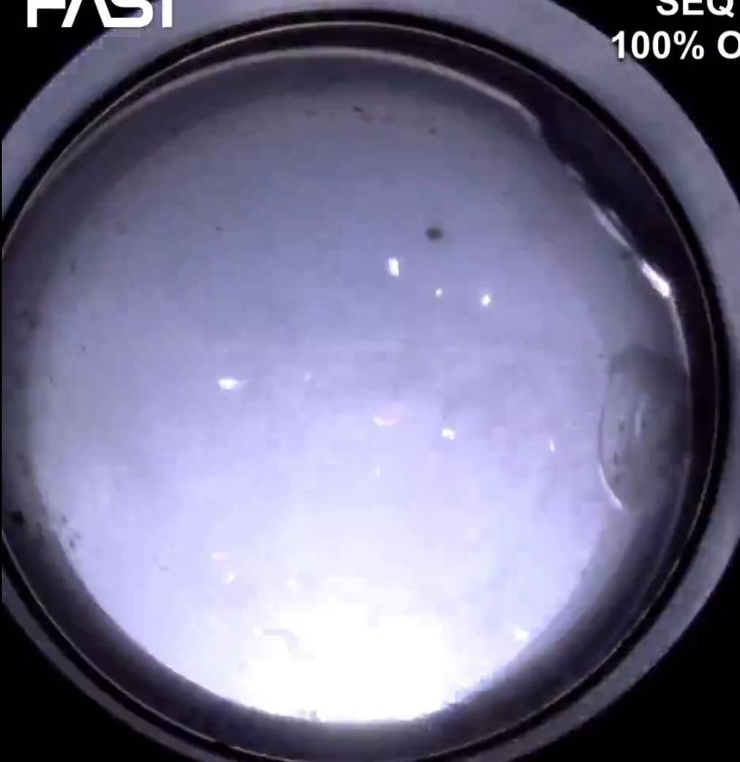
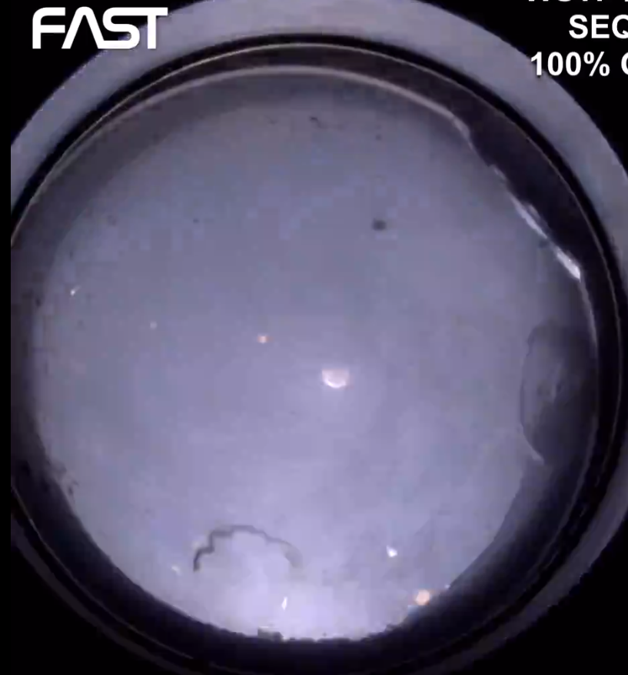
Melt and Drip
“valid test, n—a test in which the igniter and/or promoter combination has melted the bottom section of the test sample where the igniter and/or promoter is located.”
Melt and Drip is preferred way to confirm full melt of bottom section of material.

Slide 8
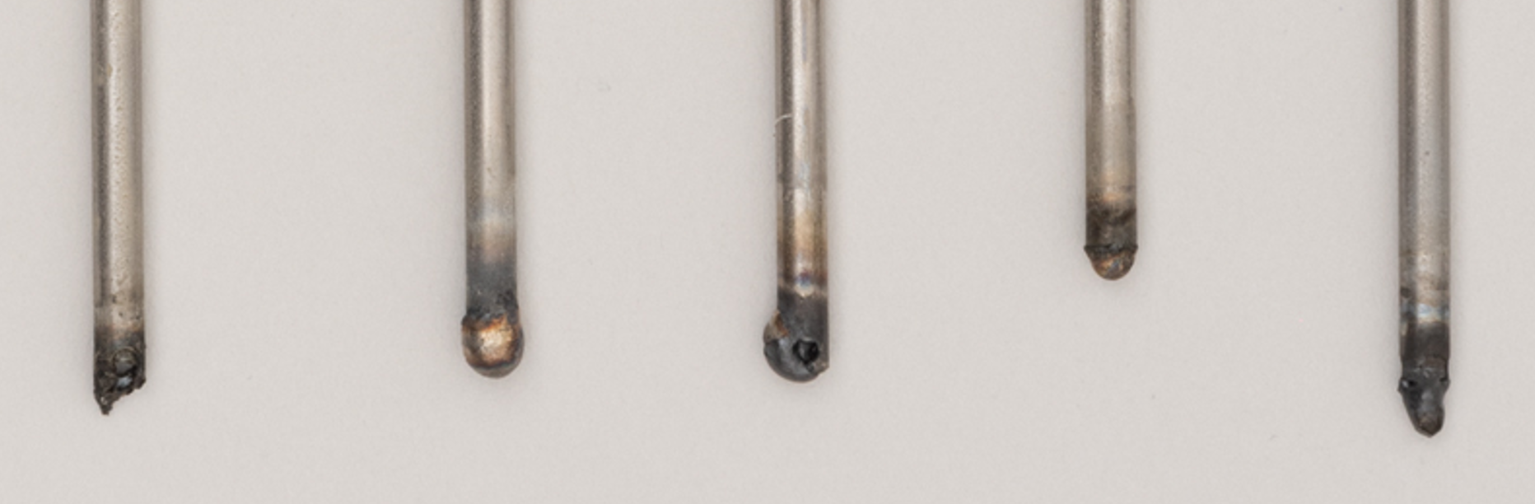
Ensuring Valid Test in Challenging Conditions
“valid test, n—a test in which the igniter and/or promoter combination has melted the bottom section of the test sample where the igniter and/or promoter is located.”
Depending on material and conditions, achieving full drip can be challenging.
Clarification needed for “Bottom Section.”
  Full Cross Section
  Full Promoter Area
Partial Melt
=
Invalid Test
Full Cross Section Melt
=
Valid Test
Partial Melt
=
Invalid Test
Melt & Drip
=
Valid Test
Partial Melt
=
Invalid Test
Promoter Interface
Initial Sample Length
Notes:
316 SS @25%02, 10K psi

Slide 9

Ensuring Valid Test in Challenging Conditions
Clarification needed for “Bottom Section.”
  Full Cross Section
  Full Promoter Area
Can be evaluated via pre- & post-test measurements.
Evaluate post-test sample length at lowest point with no melt.
Post-Test Sample Length (Final) Measured at Lowest
Un-melted Point
Lowest Point,
No Melt
Promoter Interface
Promoter
Length
$${SL}_{i}−{SL}_{f}≥PL$$
$${SL}_{i}=Initial Sample Length \left(pretest\right)$$
$${SL}_{f}=Final Sample Length \left(posttest\right)$$
$$PL=Promoter Length$$
Example:
$$14−13.5=0.5≤1.0cm PL=Invalid Test$$
$$14−12.9=1.1≥1.0cm PL=Valid Test$$

Slide 10
G124-18 Recommended Clarifications
Current:
Section 3.1.13 defines: valid test, n—a test in which the igniter and/or promoter combination has melted the bottom section of the test sample where the igniter and/or promoter is located.
Proposed Clarification:
Section 3.1.13 defines: valid test, n—a test in which the igniter and/or promoter combination has melted the bottom section of the full cross section of the test sample where the igniter and/or promoter is located, ideally sufficiently to induce melt and drip. (SLi- SLf ≥ PL, Sample Length Initial (SLi), Sample Length Final (SLf), Promoter Length(PL))

Slide 11
G124-18 Recommended Clarifications
Current:
3.1.1 burn length, n—the burn length is the length of the sample that has been consumed by combustion.
  3.1.1.1 Discussion—The burn length is determined by subtracting the post-test sample length from the pre-test sample length (which does not include the promoter length or region used by the test sample support).
Proposed Clarification:
3.1.1 burn length, n—the burn length is the length of the sample that has been consumed by combustion.
  3.1.1.1 Discussion—The burn length is determined by subtracting the post-test sample length from the pre-test sample length (which does not include the promoter length or region used by the test sample support). As sample melt fronts are often uneven, this measurement should be taken at the furthest point (undisturbed/un-melted point) away from the test sample support.

Slide 12
Sample Holder Effects on Regression Rate Analysis

Slide 13
G124-18 Scope
Section 1.1 states: This test method covers test apparatus and techniques to determine the minimum test gas pressure and sample temperature that supports self-sustained burning and the regression rate of the melting surface of a standardized sample of a metallic material that has been ignited using a promoter.
What is the minimum sample length required to accurately evaluate regression rate?

Slide 14
Sample Holder Impacts on Regression Rate
Igniter heat affected was previously evaluated and determined to be <3 cm (1.2”).
  Used to define current G124-18 failure criteria
WSTF performed characterization to evaluate if regression rate impacts would be observed from in-sample support heat sink area.
  6061-T6 Aluminum 1/8” Rod
  100% O₂
  ~50 psi
  Ensure flammable but minimize burn rate for better accuracy.
  Evaluated from post-drip to post-drip.
Test Sample Support
Sample Holder Heat Sink
Affected Area
Igniter Heat Affected Area

Slide 15
Sample Holder Impacts on Regression Rate
Test Sample Support
Evaluated 2 Ranges
  Sample Holder Affected Area (<4 cm from holder)
  Center of Sample (4-8 cm from holder)
Sample Holder Heat Sink
Affected Area
(<4 cm from holder)
Center of Sample
(4-8 cm from holder)
Igniter Heat Affected Area

Slide 16
Sample Holder Affected Area Data

Slide 17
Pressure Impacts on Sample Holder Affected Area
Pressure impact observed on burn rate
Focused on ~40-50 psi range for sample holder evaluation

Slide 18
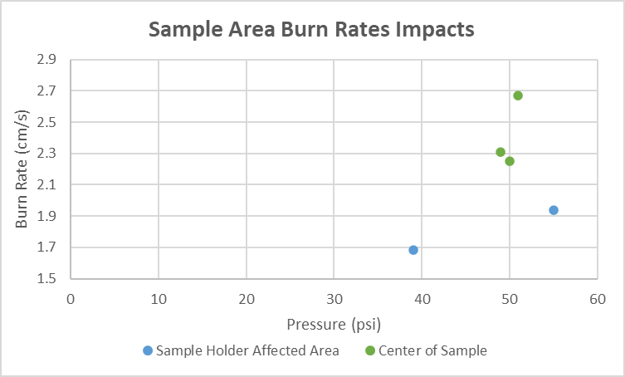
Sample Holder Impact Burn Rate Comparisons
Burn rate was found to be ~33% higher in center of sample vs in area closest to sample holder.
This suggests that regression rate evaluations should be performed >4 cm away from the sample holder.

Slide 19
G124-18 Minimum Sample Length Impacts:
Recommended Clarifications
Test Sample Support
Data suggests that for regression rate analysis, minimum sample lengths may need to be longer than the 101 mm currently required.
Additional margin (1 cm) added to recommend heat affected sample holder area compared to evaluated (4 cm).
3.1.11 standard rod test sample, n—a 3.2 mm (0.125 in.) diameter rod with a minimum length of 101.6 mm (4 in.).
Sample Holder Heat Sink
Affected Area
(<5 cm from holder)
Current:
Center of Sample
(5-10 cm from holder)
Proposed Clarification:
3.1.11 standard rod test sample, n—a 3.2 mm (0.125 in.) diameter rod with a minimum length of 101.6 mm (4 in.). For regression rate analysis, a minimum length of 130 mm (5 in.) is recommended to provide sufficient length to avoid performing regression rate analysis in <5 cm range closest to sample support and in <3 cm range closest to igniter/ promoter.
Igniter Heat Affected Area
3 cm

Slide 20
Conclusions
Valid Ignition/ Sustained Propagation Criteria
  Evaluations at WSTF suggest that ambiguity exists in how to apply G124-18 valid test and burn length criteria.
  Recommendation to clarify “valid test” definition to include:
    Full cross-section melt as part of criteria
    Post-test burn length verification to ensure promoter length area was fully melted or consumed
  Recommendation to clarify “Burn Length” definition:
    To clarify the furthest point of undisturbed/un-melted material as the point to be used for post-test burn length evaluation
Sample Holder Heat Affected Area
  Testing at WSTF showed that sample holder heat sink effects can impact regression rates in <4 cm range.
  Recommendation provided to update G124 to increase minimum sample length to 130 mm (5 in.) when being used for regression rate analysis and for data <5 cm of the sample holder to be avoided.

Slide 21
Questions?

