Slide 1
Exploratory Analytic Cases (EACs)
EAC Report and Upcoming Analysis
Mike Menzel, MSE
Alice Liu, Deputy MSE
Marie Levine, Integrated Modeling
Charley Noecker, Starlight Suppression SE

Slide 2
EAC System Design and Modeling Team
Attitude and LOS Control
  Design: Eric Stoneking, Oscar Alvarez-Salazar, Tupper Hyde
  Modeling: Cameron Haag, Connor Mulrenin, Milan Mandic, Kong Ha
  Jitter: Parker Lin, Sam Sirlin, Cory Smiley
Mechanical
  Jon Lawrence (lead), Brian Childs (Co-lead, CI), Marcel Bluth, Chas Carlson, James Cooper, Joe Pitman, Drew Jones, Ben Mignosa, Alberto Rosanova, Jim Whipple
Optical
  Joe Howard (co-lead), Mike Rodgers (co-lead), Brandon Dube, James Corsetti, Guangjun Gao, Qian Gong, Der-you Kao, Jonathan Papa
  Coronagraph: John Krist, Scott Will
  WFS&C: Dave Redding (lead), Alden Jurling (co-lead), John Tesch, John Lou, Brandon Dube, Jeff Jewell
Structures
  Greg Walsh (lead), Brian Childs (Co-lead, CI), Michael Akkerman, Michael Behrend, Chas Carlson, Kevin Carpenter, Katie Cheng, KJ Dziak, Michael Eisenhower, Judy Hults, Brock Johnson, Will Krieger, Parker Lin, Cory Smiley, Alex Sprunt, Sheila Wall
Thermal
  Shaun Thomson (lead), Jordan Effron (IM Co-Lead), Brad Moore (IM Co-Lead, CI), Hume Peabody, Carson McDonald, Sang Park, Emily Maheras, Jordan Thompson, Sharon Peabody
System Engineering
  SEs: Josh Abel, Erik Bailey, Jason Derleth, James Govern, Tyler Groff, Brian Kern, Marie Levine, Bijan Nemati, Charley Noecker, Breann Sitarski, Stuart Shaklan, Julie Van Campen
  SMEs: Dave Redding (WFS&C), Phil Stahl (Mirrors), Patrick Morrissey (Detectors)
  Integrated Modeling Lead Analysts: KJ Dziak and Gary Kuan

Slide 3
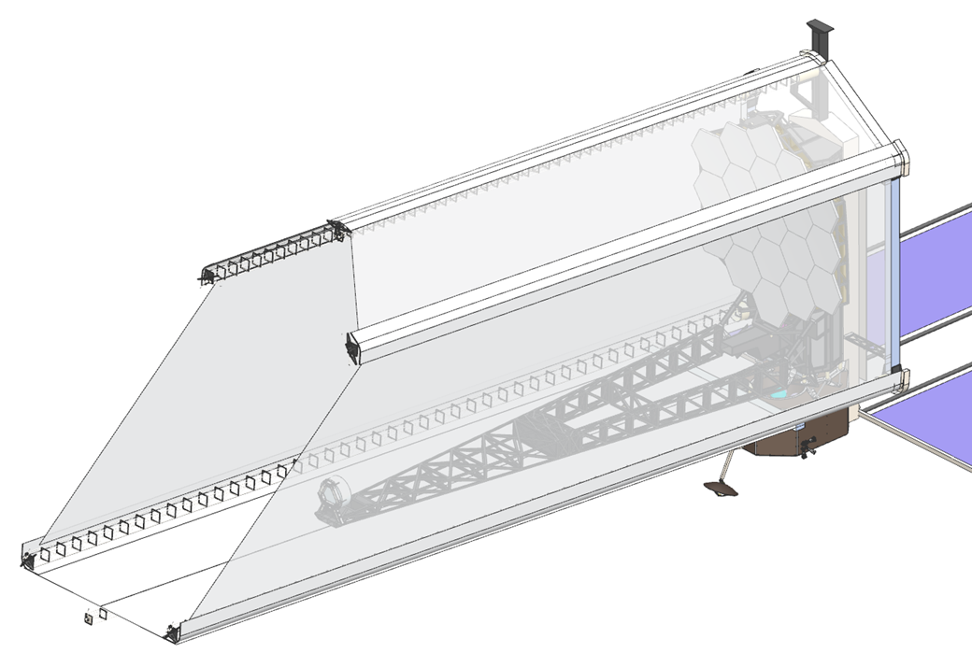
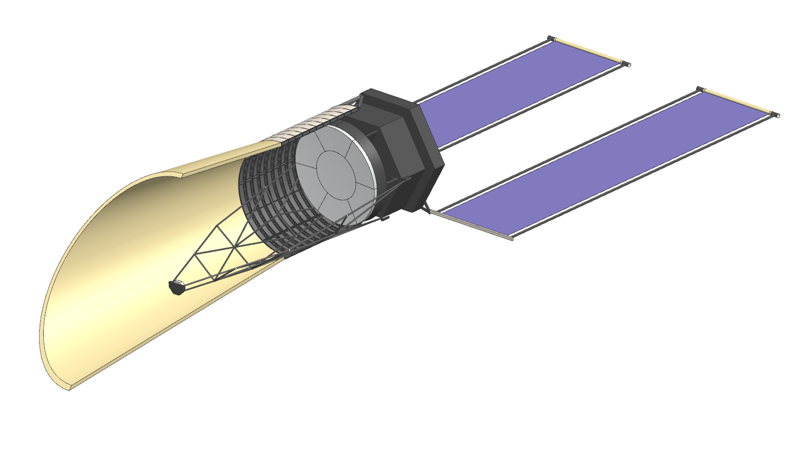
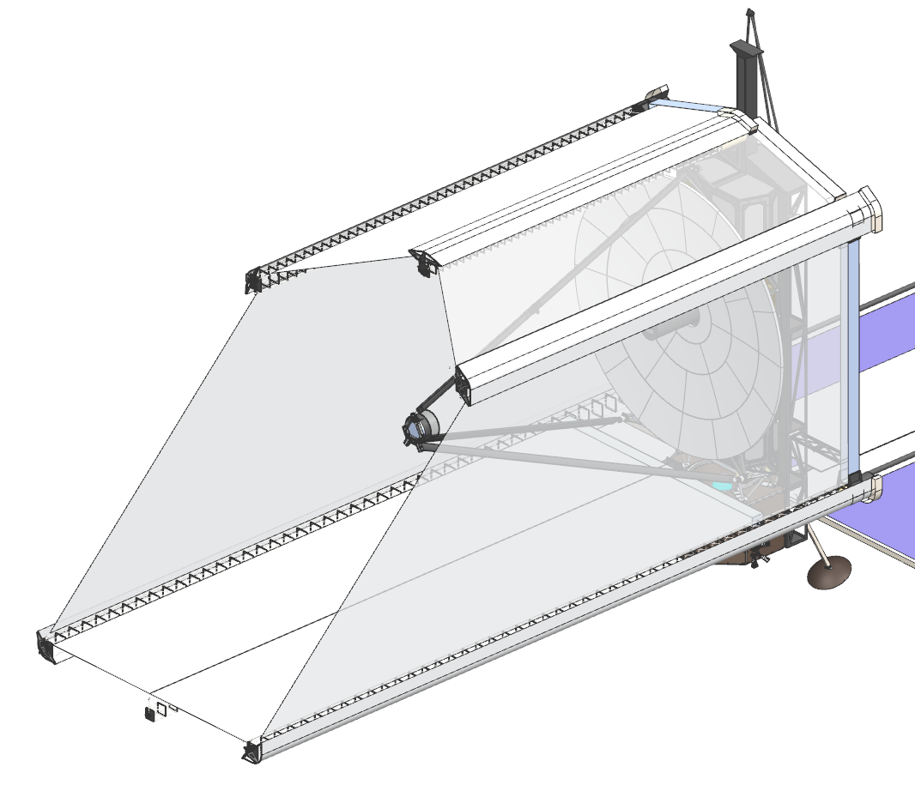
Exploratory Analytic Cases
  EAC1:
  6m ID/7.2m OD off-axis
  19 hex segments
  PM faces horizontal in rocket
  JWST like wing deployment
  Fits in New Glenn, Starship Standard
  Low Areal Density Mirrors
  EAC2:
  6m ID (round) off-axis
  Non-deployed Primary mirror
  Central 3 m round mirror + 6 keystone
  PM faces up in rocket
  Lower barrel is fixed, upper barrel and SM deploy
  Fits in Starship Standard
  Higher Areal Density Mirrors
  EAC3:
  8m ID (round) on-axis
  34 keystone segments
  PM Faces horizontal in rocket
  JWST like wing deployment
  Fits in Starship Standard
  Low Areal Density
  Large FOV guider/active wavefront sensing and control
All options use .1% gaps (starting point)

Slide 4
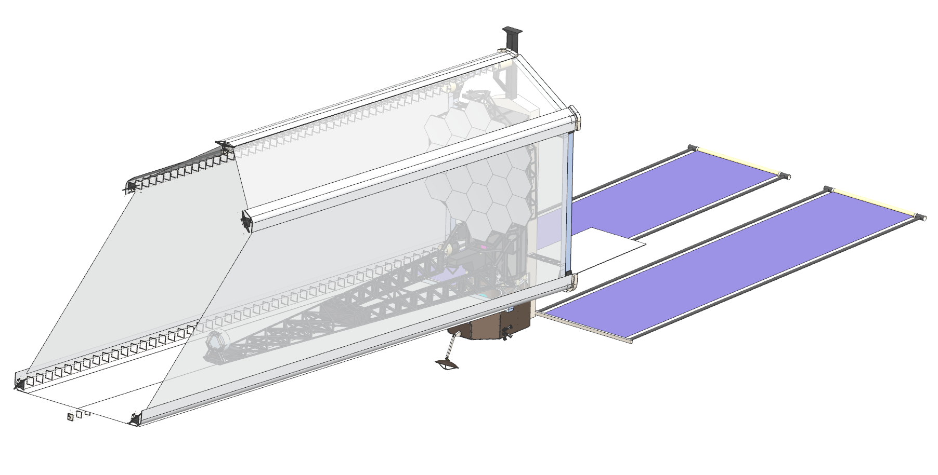
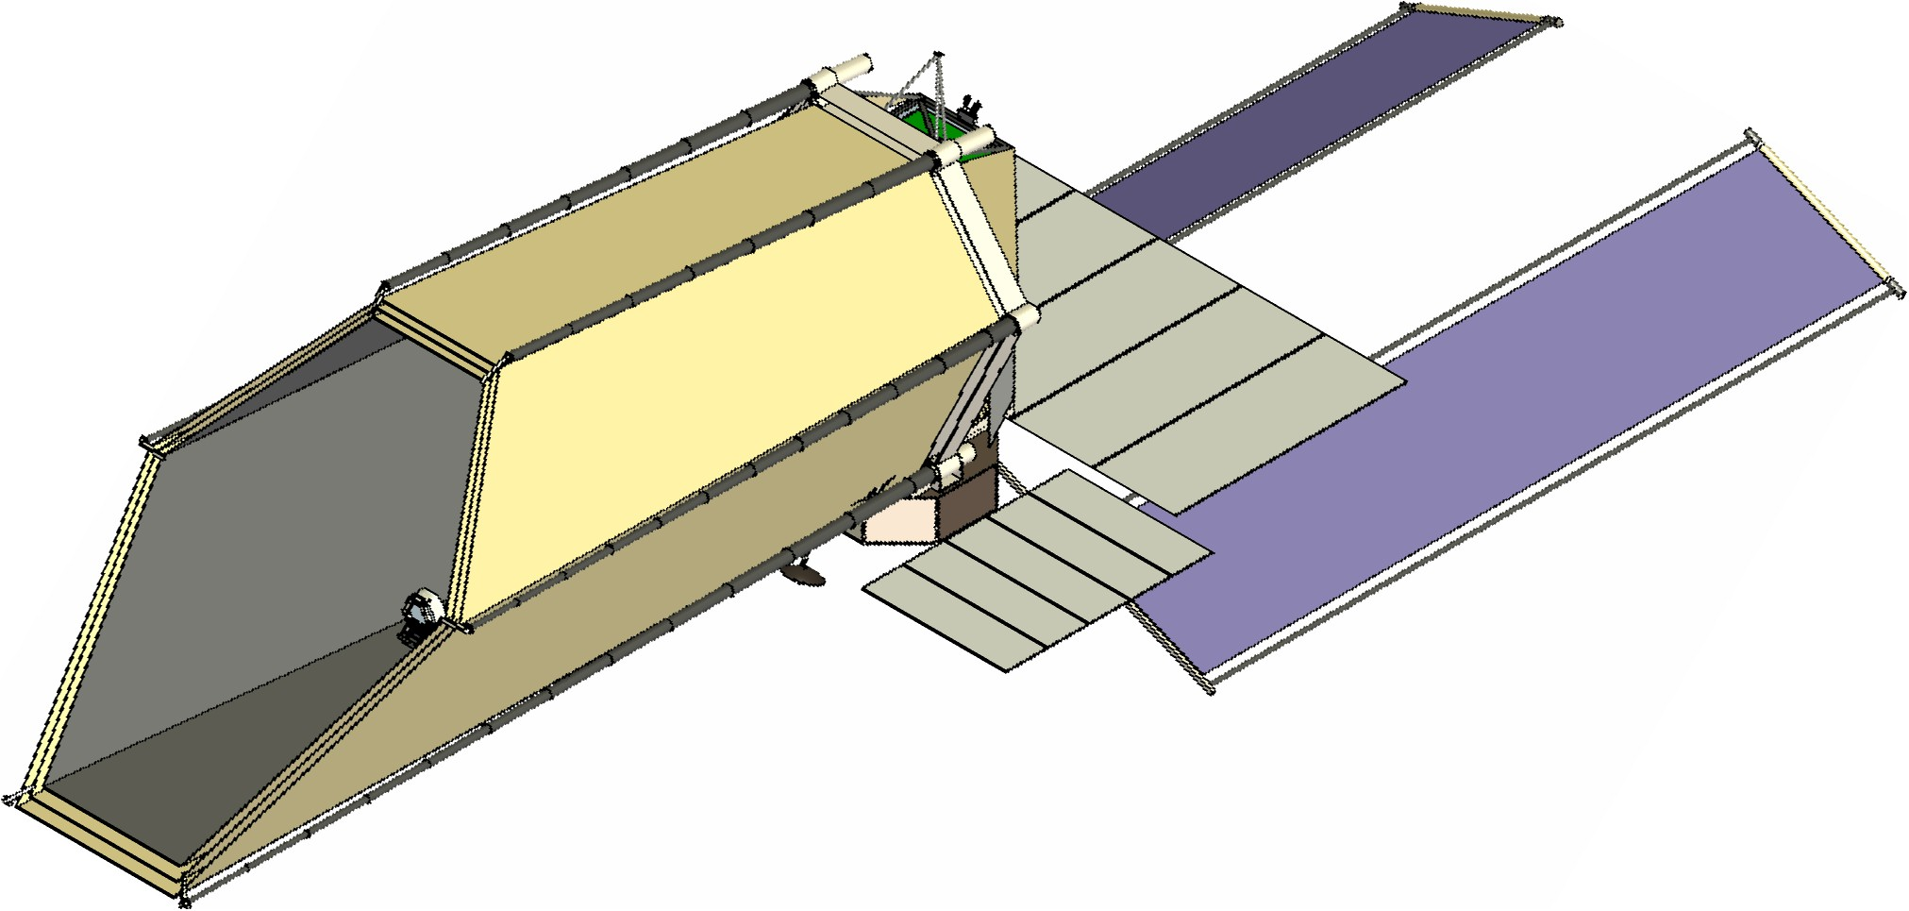
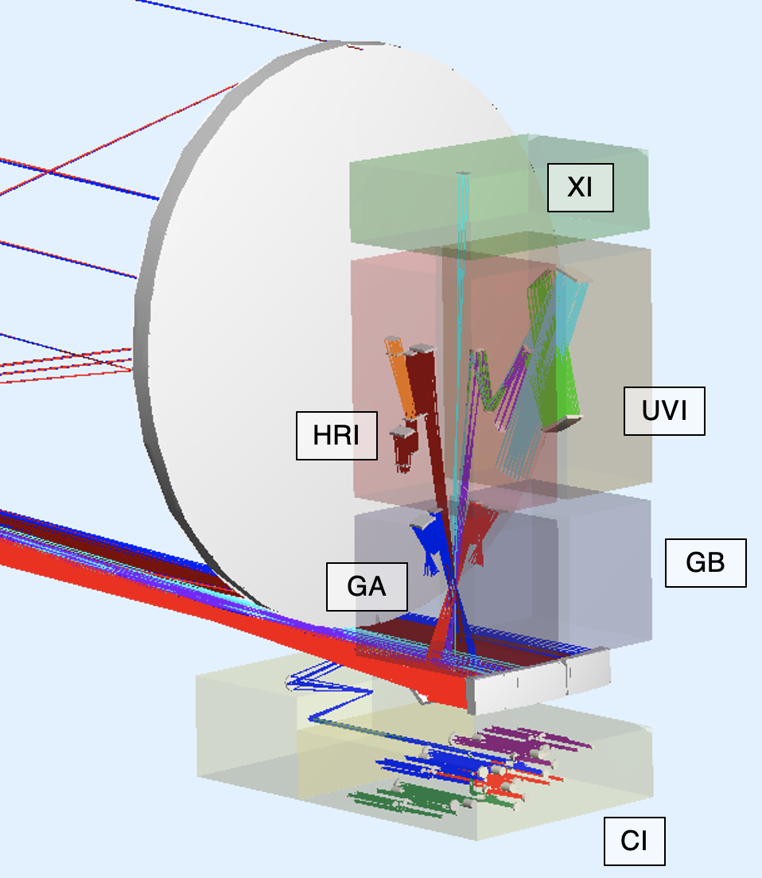
EAC-1 Design Evolution
Initial EAC-1 Concept
Current EAC-1 Concept
Science Instrument (SI) concepts were developed:
  SI Field of View Allocations were defined
  Optical layouts required considerable SI volume, particularly for the Coronagraph Instrument (CI)
  Number of CI NIR Cryogenic Detectors increased from 1 to 4
  SI dissipations were developed with significant values for temperatures less than room temperature
Roll Range increased from +15° to +22.5°
  Thermal Shields added to minimize thermal back-loads
  Solar Canted to reduce thermal back-loads
Desire to maximize Primary Mirror Backplane Assembly (PMBA) and Secondary Mirror Support Structure (SMSS) stiffness

Slide 5
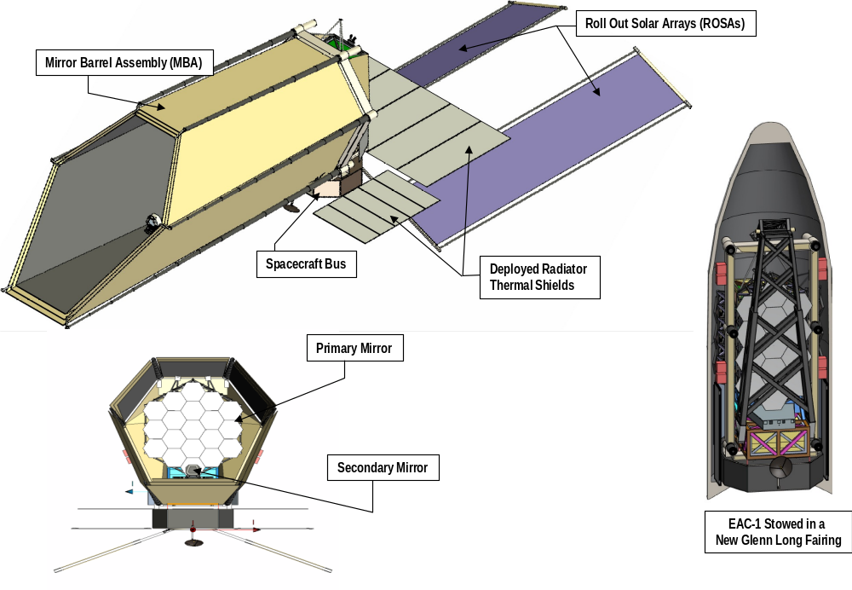
EAC-1 Design Configuration
The HWO Systems Engineering Team presented the EAC-1 Design Concept on July 19, 2024.
  The EAC-1 Concept is shown below in the deployed and stowed configurations.
Main Baffle Assembly (MBA)

Slide 6
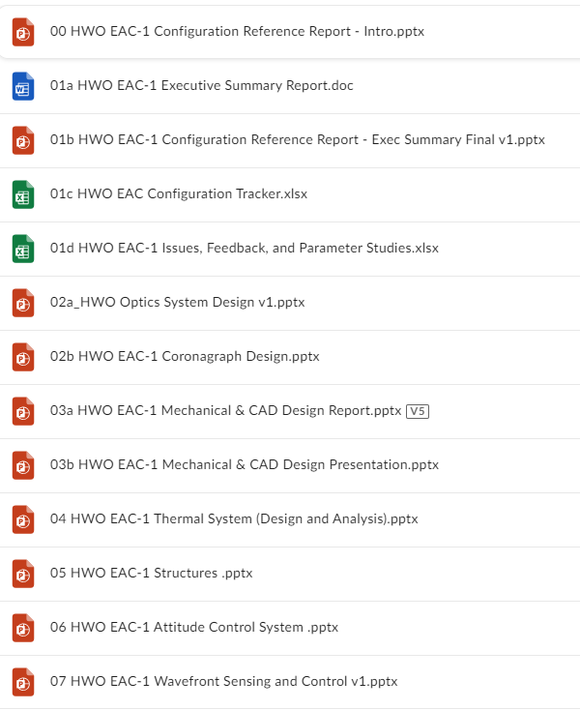
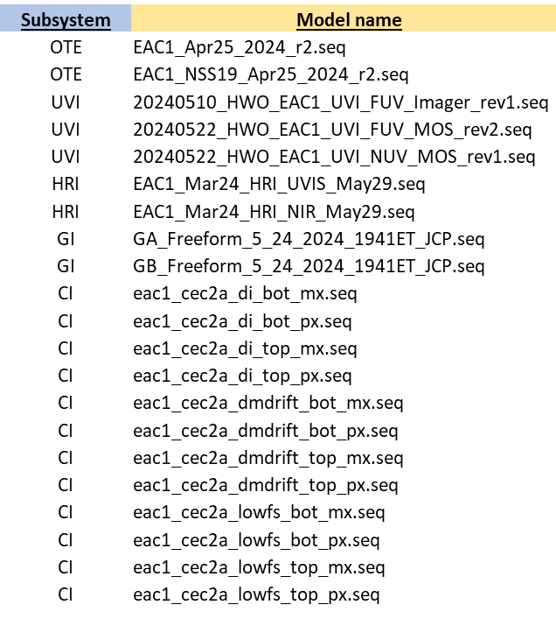
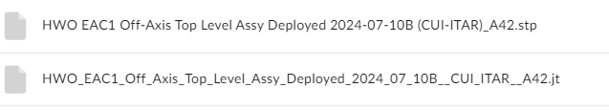
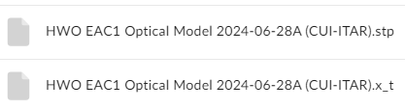
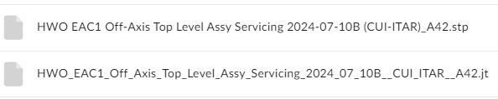
EAC-1 Design Reports and Models
EAC-1 Summary Reports
EAC-1 Optical Models
EAC-1 CAD Models
Deployed Operational
Deployed Optical
Deployed Servicing
Design configuration review completed in May 2024
EAC-1 CAD and optical models, along with design reports, delivered to D19 industry participants in July 2024
For access to these files, contact Alice Liu and Marie Levine (Note: CAD files are ITAR restricted)

Slide 7
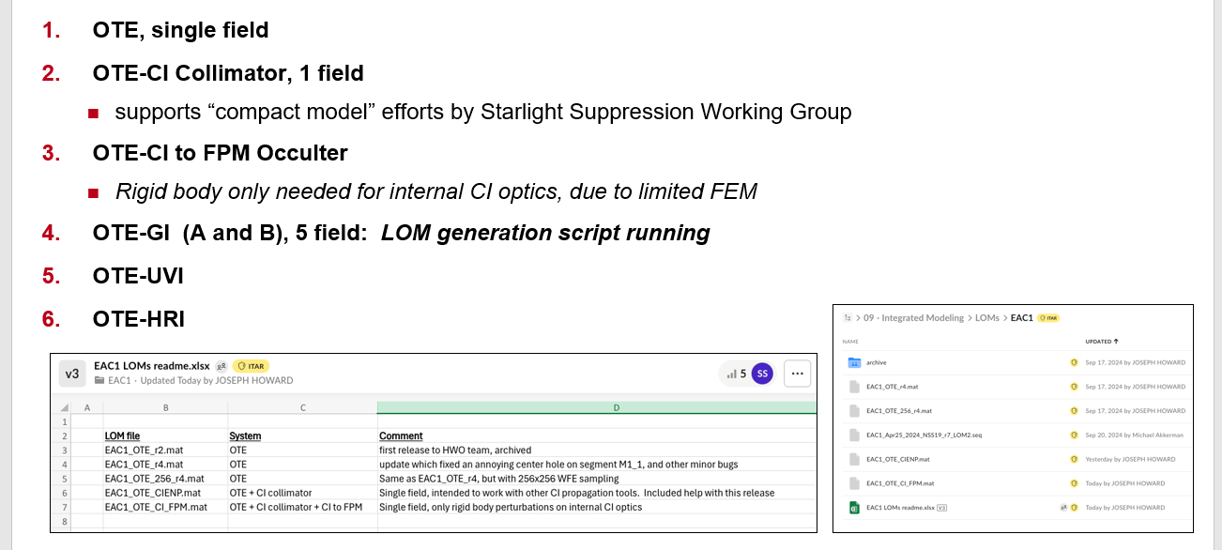
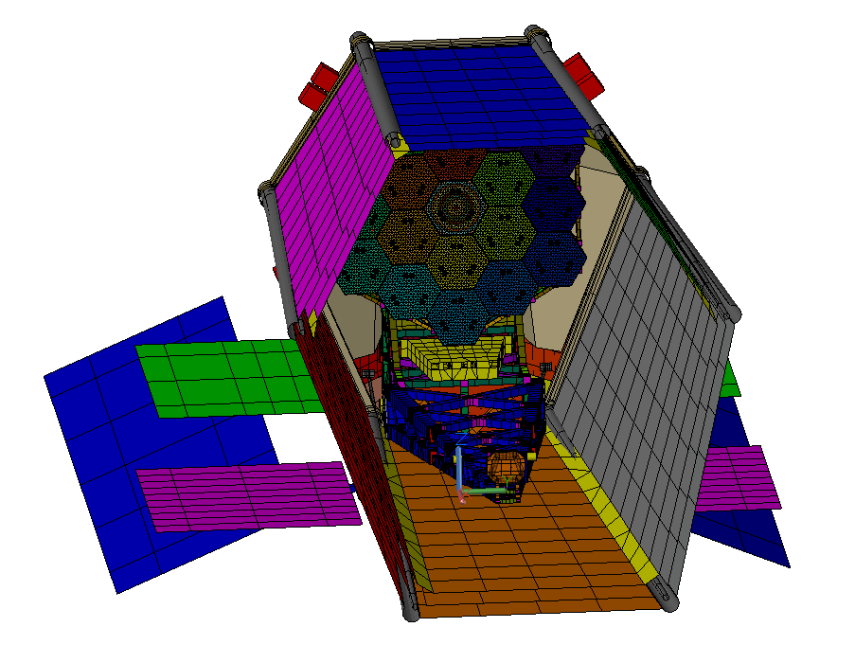
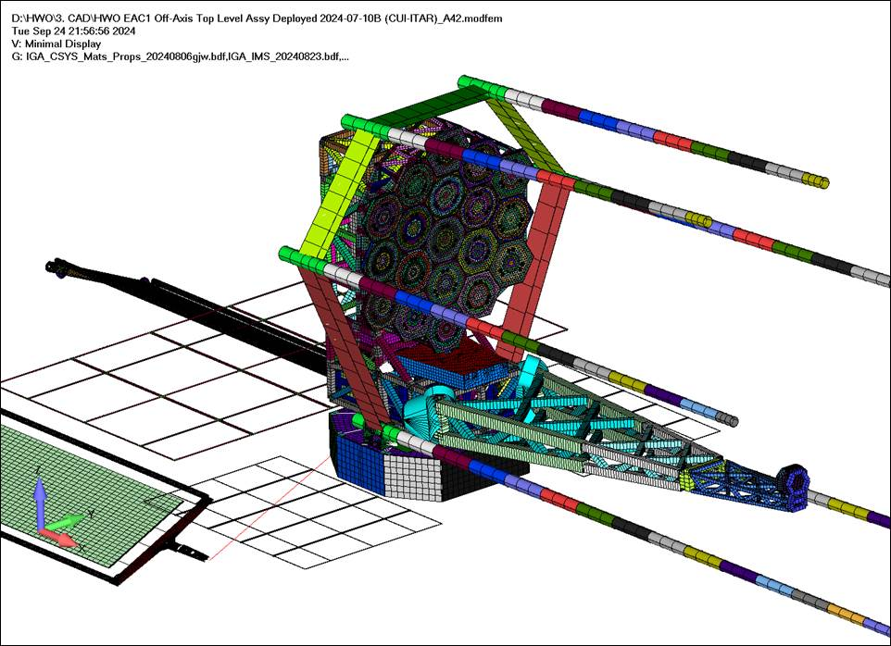
EAC-1 Analysis Model Configuration
System Modeling team successfully completed EAC-1 Model Configuration Review at the end of September
  This milestone marks the delivery and readiness of the discipline models to begin the EAC-1 IM pipeline.
  The IM activities remain on schedule for a final EAC-1 analysis review in February 2025 to meet the Concept Maturity Level (CML) 3 Milestone.
Purpose of the Modeling Configuration meeting was to finalize the EAC-1 analysis models and review the modeling assumptions before starting the analysis
  Model descriptions and assumptions
    Element and system models
    Element interface models and assumptions
    Mass properties
    Material and optical and thermophysical properties
  Model Verification Checks and Liens
  D19 industry participants will receive LOM, FEM, and thermal model (expected no sooner than mid-November delivery).
Linear Optical Models (LOMs)
Finite Element Model (FEM)
Thermal Model

Slide 8
Starlight Suppression Modeling Flow
STOP
Observing Scenario
PROPER
(compact model)
Thermal
STOP FEM
SigFit
(conversion)
CodeV
(optical)
WFS&C
Post-processing
(differential)
Telescope
(PM to coronagraph entrance pupil)
Simple Coronagraph
(only DMs, masks, occulter, detector)
Speckle time series output
Contrast Stability
(nonlinear)
LOM
(Linear Optical Model)
Equivalent WFSC Filters
LOS, WFE, Beam walk, Pupil Stability
LEM
(Linear E-Field Model)
Coronagraph sensitivities
Contrast Stability
(linear)
Observing Scenario
(statistics of contrast)
ACS/LOS/Jitter
Integrated Modeling pipeline includes controls and post-processing assumptions.
Different levels of LOS and WFS&C control can be exercised through pipeline.
Disturbances
Jitter
FEM
LOM
(Linear Optical Model)
ACS/LOS Control
LOS, WFE, Beam walk

Slide 9
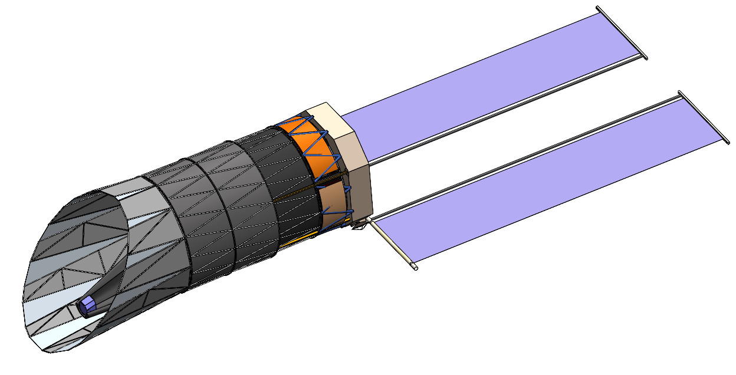
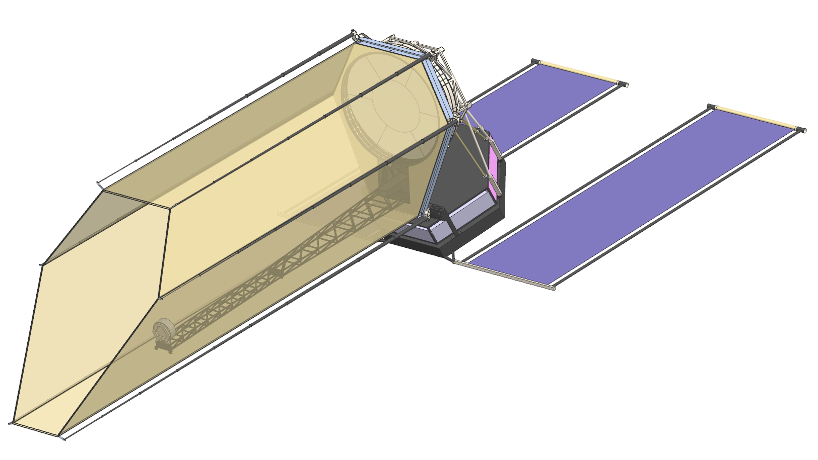
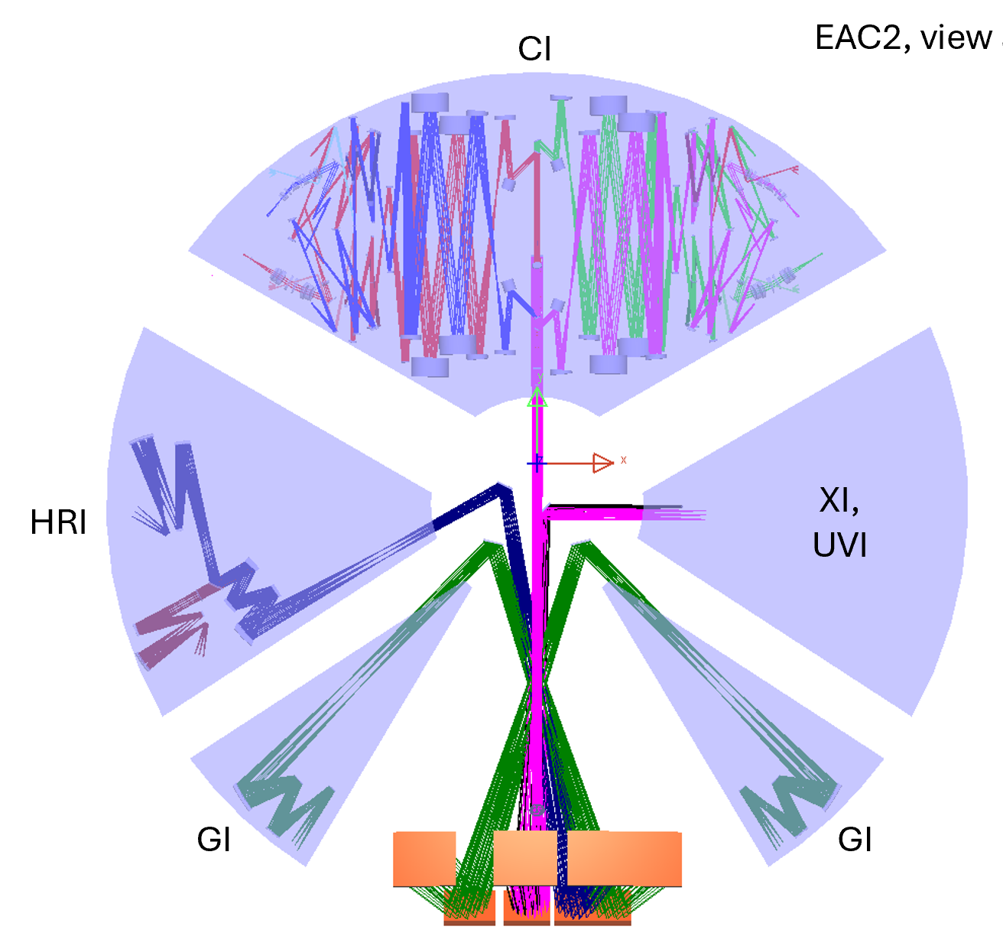
EAC-2 Design Status (1 of 4)
Current EAC-2 Concept
Initial EAC-2 Concept
EAC-2 Design is proceeding toward a completion in early November. The concept for the observatory are shown on the right.
Science Instrument volumes and locations have been finalized.
  Positioning Coronagraph Instrument (CI) on the cold side of the observatory enables most advantageous thermal/radiator views.
Optical design layouts have been completed for CI, UVI, HRI, and 2 guiders.
  Integrated Field Spectrometers (IFS) were added to each CI channel.
  In the CI design, the dichroic and polarization splitter elements were swapped, positioning the Near-Infrared (NIR) detectors closer to the volume edge and improving the interface with radiators.
  Ultra-Violet Imager (UVI) volume was reduced to allow space sharing with a reserved instrument (XI), while maintaining the same specifications as EAC-1.
EAC2, view along Z

Slide 10
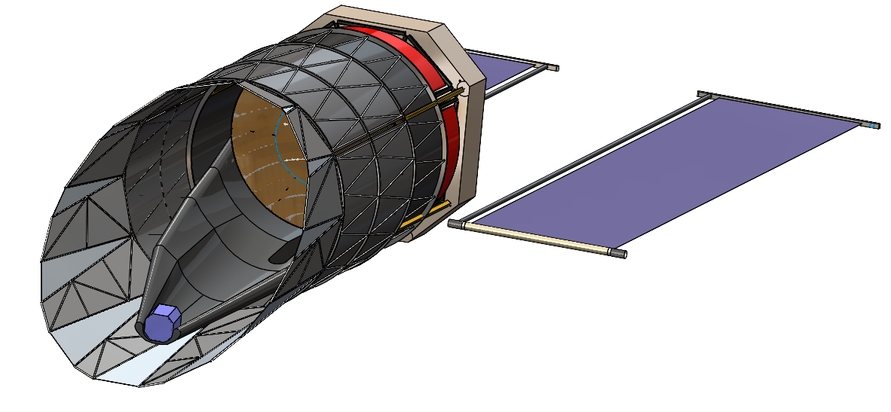
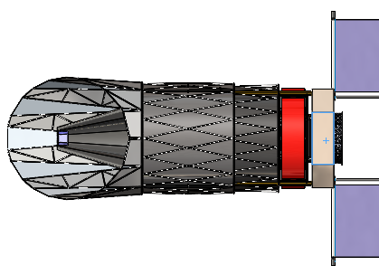
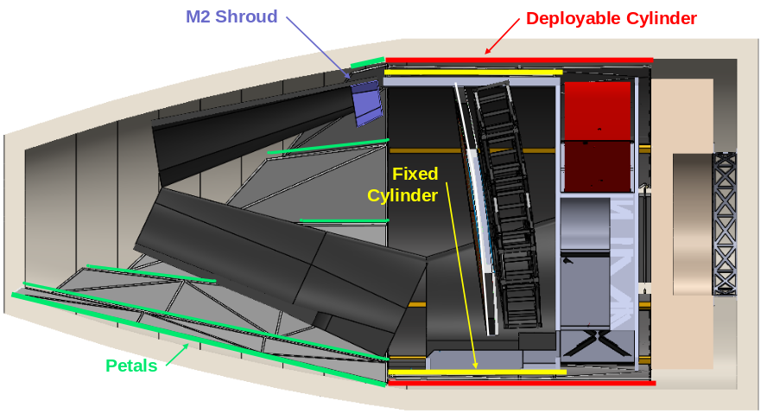
EAC-2 Design Status (2 of 4)
The mechanical team has developed their deployable barrel concept to fit within the Launcher Volumes.
  The barrel consists of two concentric solid cylinders. One cylinder deploys along the telescope boresight, with unfolding petals at the end to form a “scarf”.
  Deployed configuration on the right
  Stowed configuration on the lower left.
Working with the thermal and optical teams on selecting barrel material
Deployed Configuration
Stowed Configuration

Slide 11
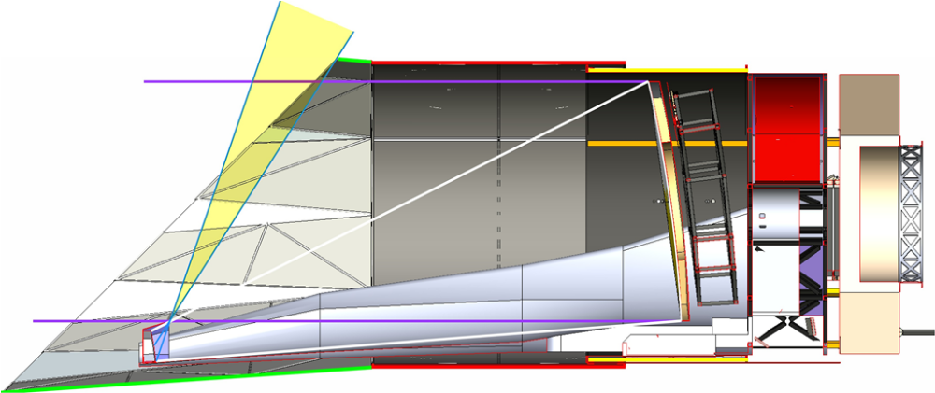
EAC-2 Design Status (3 of 4)
A design lien was accepted in order to change the “scarf” angle to 38 degrees to provide micrometeor protection to the secondary mirror while avoiding interference between the upper forward petals and the launcher. (See figure on the right)
  This would decrease maximum pitch angle toward the sun from 45 degrees to 36 degree with the maximum 22.5 degree roll angle.
  If this becomes a significant impact to science there are multiple ways to correct, but they would consume an inordinate amount of schedule.
  MSE decided that these investigations could be delayed to future EAC studies at this time.
    Low level geometric investigations will be conducted to gain some insight into the sensitivities of some of these mitigations.
Initial petal sizing leaves a portion of secondary mirror exposed to the micrometeor environment as shown in yellow.
This exposure can be eliminated by extending the upper deployed petal shown in green.
The lower petal cannot grow due to fairing volume constraints. Therefore increasing the upper petal and keeping the lower constant will decrease the “scarf” angle.

Slide 12
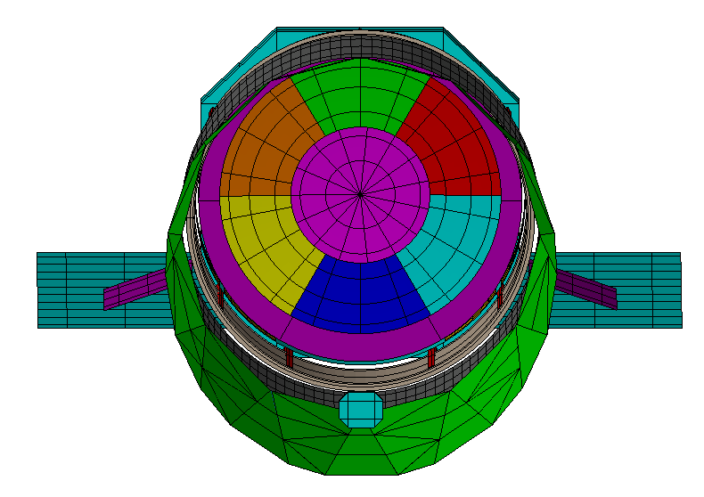
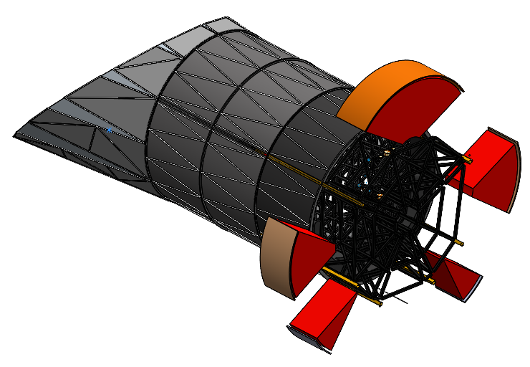
EAC-2 Design Status (4 of 4)
Thermal model being built from supplied CAD
  Model will inform sink temperatures for the instruments and update radiator calculations
  Assume MBA interior is fully black for stray light consideration
    Final coating choice will depend on MBA material and be made after working with stray light expert from Roman
Additional alterations being made:
  Modifying MBA model to explore heating options
  Adjusting model to ensure cold biasing of the primary mirror heaters
  Required EAC2 area calculations are in-work
Initial trade space to be explored
  Primary Mirror (PM) sink temps throughout the field of regard (FOR, fully passive)
  PM sink temps through FOR (active heating)
  Radiator sink temps (with revised bus)
Thermal Model
Instrument Radiator Areas
CI Radiator
UVI Radiator
HRI Radiator
Guider-B Radiator
Guider-A Radiator

Slide 13
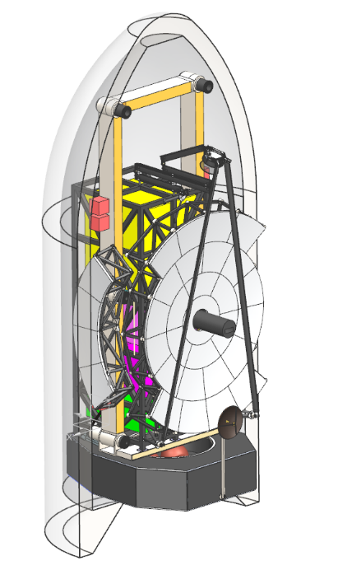
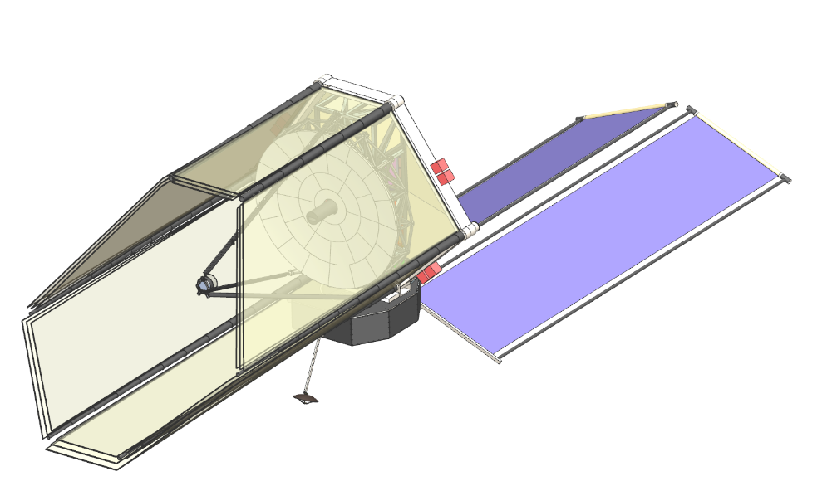
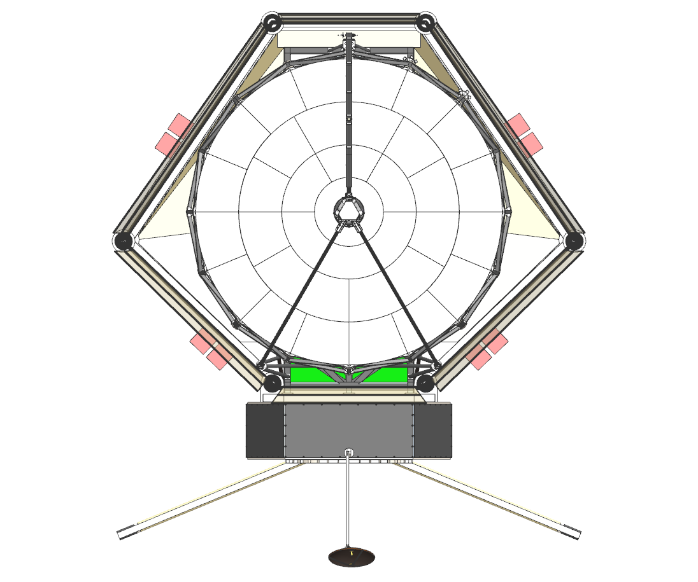
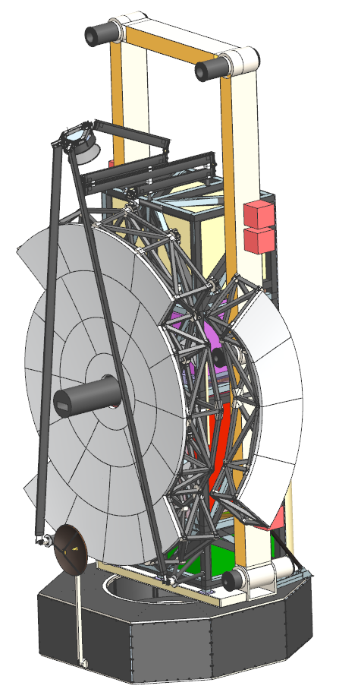
EAC-3 Design Status
Initial EAC-3 Concept
Current EAC-3 Concept
EAC-3 design is being worked in parallel with the EAC-2 Concept proceeding toward a freeze date in early Feb 2025.
  The concept for the observatory are shown on the right leverages many features from EAC-1.
EAC3 packaging maturing (within SLS & Starship fairings)
  PM backplane CAD driven by equations for stiffness maturing.
  Delta-frame interfaces to PMSA, BP starting to be conceptualized
  SMSS strut width exceeds optical goal of <= 80 mm. Working on frequency assessment and CI performance impacts
EAC3 aft optics (in “snout”) will require ”collimator” to provide acceptable light path through ~90° bend
    Will allow CI to be in high position to enable most advantageous thermal/radiator views

Slide 14
EAC 1-3 Design and Modeling Milestone Dates
Sept
Oct
Nov
Dec
Jan
Feb
Mar
PSDDs Check-in
PSDDs Complete
EAC-1
September 25, 2024
EAC-1 Model Configuration Meeting
Mid-November 2024
EAC-1 Model Delivery Meeting (with Industry)
February 26, 2025 (TBD)
EAC-1 Analysis Results Meeting
EAC-2
Early November 2024
EAC-2 Design Configuration Meeting
December 4, 2024 (TBD)
EAC-2 Design Reports
February 5, 2025 (TBD)
EAC-2 Model Configuration Meeting
EAC-3
February. 2-3, 2025 (TBD)
EAC-3 Design Configuration Meeting
March 3, 2025 (TBD)
EAC-3 Design Reports

Slide 15
Summary
EAC designs and modeling have progressed rapidly across all cases
  EAC-1 design was successfully completed in July, with a Model Configuration meeting held at the end of September.
  For EAC-2, the team has completed the optical layout for instruments and guiders, and made significant progress on the MBA deployment concept.
  EAC-3 design is currently focused on optical design and defining instrument volumes and layout.
  Overall, these advancements demonstrate substantial progress in all EAC designs.
System design and modeling teams have collaborated effectively across government organizations to achieve EAC design objectives:
  Sizing the observatory, conducting performance studies, performing design reconnaissance, and refining process through ‘pipe-cleaning’
Disciplinary models are now complete for EAC-1, allowing the start of integrated modeling analysis
  Initial stability performance assessments for contrast, LOS, WFE, pupil, and beam walk
  Define controller bandwidths and closed-loop performance for thermal control, WFS&C for telescope and Coronagraph Instrument, ACS, and LOS control

