Slide 1
The Value of Graphical Models for Quantifying Risk
Paul Britton (NASA) and Will Janzer (Bastion)
paul.t.britton@nasa.gov
william.o.Janzer@nasa.gov

Slide 2
Table of Contents
Background and History
General benefits
Definitions
Algebraic Calculation of Risk
The Fundamentals of Various Graphical Representations of Risk
  Reliability Block Diagrams
  Event Sequence Diagrams
  Event Trees
  Fault Trees
  Bayesian Networks
  Influence Diagrams
Summary

Slide 3
Background and History
Block diagrams were introduced in the early 1920s at an ASME conference
These methods of problem analysis would begin seeing use in industry in the 30s and 40s
In 1947 ASME released Operation and Flow Process Charts standardizing the symbols required in these diagrams
These methods evolved into block diagrams as we know them today and eventually fault trees
In the 1960 the Nuclear industry began applying Probabilistic Risk Assessment to their plants in a similar way to how we use it today
Notes:
Flow charts introduced by Frank and Lillian Gilbreth in 1921 at ASME convention

Slide 4
General Benefits
Facilitate design influence at lower levels and make risk informed decisions prior to your mission
Quantify risk with no top-level data
Eliminate inefficient serial process flows from risk analysis via collaborative development and division of labor
Useful way to communicate risk to others who might not be as well versed in the way risk is mapped and calculated
Shows others how you are using their data (e.g. software, part reliability, structures etc.) in calculating risk to support a more transparent risk management approach

Slide 5
Definitions
Reliability is the probability that component or system will perform its intended function adequately for a specified duration in a specified environment
Unreliability or Failure Probability is the probability that component or system fails to perform its intended function adequately for a specified duration in a specified environment
Notational Conventions
  The reliability of components 1 and 2 are called R1 and R2
  The failure probabilities of components 1 and 2 are called Q1 and Q2
  The reliability and unreliability of a system are called Rs and Qs
Basic result: From the Axioms of a Probability Space, R + Q = 1

Slide 6
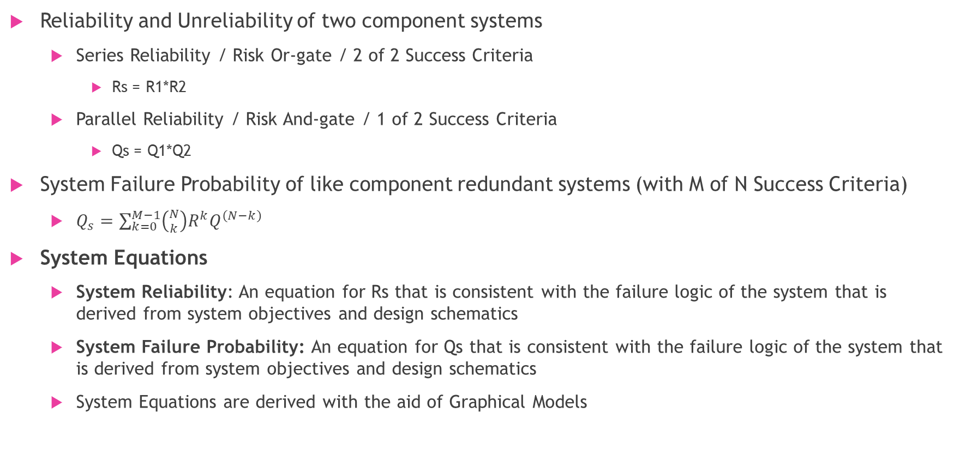
Algebraic Calculation of Risk
Reliability and Unreliability of two component systems
  Series Reliability / Risk Or-gate / 2 of 2 Success Criteria
    Rs = R1*R2
  Parallel Reliability / Risk And-gate / 1 of 2 Success Criteria
    Qs = Q1*Q2
System Failure Probability of like component redundant systems (with M of N Success Criteria)
  $Q_{s}=\sum_{k=0}^{M−1}{\left({N \atop k}\right)R^{k}Q^{\left(N−k\right)}}$
System Equations
  System Reliability: An equation for Rs that is consistent with the failure logic of the system that is derived from system objectives and design schematics
  System Failure Probability: An equation for Qs that is consistent with the failure logic of the system that is derived from system objectives and design schematics
  System Equations are derived with the aid of Graphical Models

Slide 7
The Fundamentals of Various Graphical Representations of Risk
Reliability Block Diagrams
Event Sequence Diagrams
Event Trees
Fault Trees
Bayesian Networks
Influence Diagrams

Slide 8
Reliability Block Diagrams
1
Reliability Block Diagrams depict component reliability and redundancy relationships throughout and with a system
Their main use is to aid with computing system reliability
0
2
2/3
4
3
Rs = R0 * R2/3 * R4 = R0 * (Q1^3 + 3*R1*Q1^2) * R4
assuming components 1, 2, and 3 are like components

Slide 9
Event Sequence Diagram (ESD)
Bottom-up approach
“Yes” will always lead right and “No” will always lead down
ESDs represent a chain of Boolean Events or even a tree of Boolean Events
The initiating event and end states are circles, and the pivotal events are diamonds
In this example:
  IE = Drive to Store
  E1 = Wreck Given IE
  E2 = Air Bag Fails Given E1
  P(OK) + P(< OK) + P(Not OK) = 1
ESDs are simple yet flexible since they allow multiple end states
IE
E1
E2
Not OK
OK
< OK
P(OK) = 1 – E1
P(< OK) = E1 * (1 – E2)
P(Not OK) = E1 * E2

Slide 10
Event Trees
Engine Receives Nominal Fuel Supply
Nominal Thrust
Event Trees are an extension of ESDs
Formally, ESDs are binary trees whereas Event Trees are N-ary trees
Event Trees are not restricted to Yes/No events although some Event Trees are formulated with binary branching
Pivotal events can have multiple outcomes, but the outcomes must be mutually exclusive (i.e. they are Categorical rather than just Boolean)
The probability of achieving a specific end state given the initiating event is computed as a sum-product of the branches leading to that end state
Event Trees model all possible pathways within the scope
Re-pressurization Activated
Under-press Condition
Nominal Thrust
Initiating Event
Low Thrust
End States
High Thrust
Over-press Condition
Venting
Nominal Thrust
Pivotal Events
Tank Failure
P(Nominal Thrust) = P(Under-press leads to Nominal Thrust) + P(Over-press) * P(Venting leads to Nominal Thrust)

Slide 11
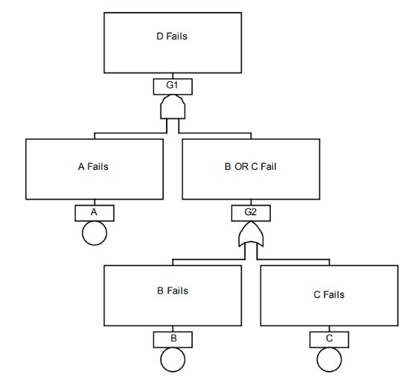

Fault Trees
Top-down approach. End event is undesired with sub events being failures that lead there.
Gates are used to represent Boolean logic
And =
Or =
Not, XOR and M/N Gates are also used
Each basic event (circles) has an associated failure rate or failure probability
You can solve any individual gate for the failure probability of that specific part of the system
Allows easy integration of uncertainty calculations to impact results in an informative way.
Fault Trees are useful throughout the design process
Qd = Qa * (1 – Rb*Rc)

Slide 12
Bayesian Networks
Above 90°F | AC On
 | T | F
T | 0.5 | 0.2
F | 0.2 | 0.1
Above 90°F
T | F
0.7 | 0.3
Weather
AC Usage
Probabilistic model depicting random variables and their conditional dependencies
Mathematically they are directed acyclic graphs
A pair of nodes where there is no path connecting them are conditionally independent
Note: In this example, all three variables are Boolean, but they can be discrete or continuous variables
Engine Temp
Above 90°F | AC On | Engine Redline
 |  | T | F
T | T | 0.3 | 0.2
T | F | 0.15 | 0.05
F | T | 0.15 | 0.05
F | F | 0.06 | 0.04

Slide 13
Influence Diagrams
Mathematically, influence diagrams are also directed acyclic graphs
Four main node types:
  Ovals are uncertain
  Double ovals are deterministic
  Rectangles are decisions
  Diamonds are output values
Decision nodes represent control variables that can be adjusted to affect the output values
Once programmed into a spreadsheet or script language, algorithms like Newtons Method can be used to optimize the output values
Maintenance
Part Failure
Yearly Cost
Milage

Slide 14
Summary
Graphical quantifications of risk are a developmental tool that create and encourage a deeper understanding of a systems risk prior to having any hard test data on the system or its components
They can and should be used throughout the design process to assess and communicate system risk
Risk models get more accurate and more complex as a system goes through its design process which is why graphical representation can be beneficial for communication

Slide 15
Source links
nasa.sharepoint.com/teams/HLSSMARMPRA/Shared Documents/Forms/AllItems.aspx?id=%2Fteams%2FHLSSMARMPRA%2FShared Documents%2FTraining%2FPRA Guide_NASA%2Epdf&parent=%2Fteams%2FHLSSMARMPRA%2FShared Documents%2FTraining
NUREG-0492, "Fault Tree Handbook". (nrc.gov)
#1 - ASME standard; operation and flow process charts, 1947 - Full View | HathiTrust Digital Library
NUREG/KM-0010, "WASH-1400 - The Reactor Safety Study - The Introduction of Risk Assessment to the Regulation of Nuclear Reactors." (nrc.gov)
Boolean algebra - Wikipedia
Flowchart - Wikipedia

Slide 16
Backup

Slide 17
Basic Risk Modeling Concepts
Boolean Algebra
  Most graphical models are just visual ways of presenting Boolean algebra. Simple Boolean algebra, for our purposes, is AND and OR.
    AND
      Notation: x∧y
      Definition: x∧y = 1 if x = y = 1, x∧y = 0 otherwise
      Multiplication
    OR
      Notation: x∨y
      Definition: x∨y = 0 if x = y = 0, x ∨y = 1 otherwise
      Addition
Cutsets
  The divisions of events in sequence that result in the undesired end state.

