Slide 1
Evaluation of Life Testing Schemes
Paul Britton, NASA
Kelby Starchman, Bastion
paul.t.britton@nasa.gov
kelby.l.starchman@nasa.gov

Slide 2
Contents
Background
Weibull Distribution Overview
Problem Statement
Default Approach
A More Pragmatic and Useful Approach
Measuring Reliability from Data
Visualization of Qualification Effectiveness
Revised Problem Statement
Summary

Slide 3
Background
We will explore the age-old question: What reliability can we infer from a qualification life test with zero failures? Moreover, we will offer an alternate and more pragmatic way to approach this problem.
Notional Situation:
  If we test 4 Units to 2x Lives without failure, can we infer the same reliability as if we tested 1 Unit to 4x Lives?
Ground rules:
  The life distribution is Weibull
  The failure mode of interest is wear-out
  The reliability requirement is 0.99
  The Notional Program has high tolerance for risk

Slide 4
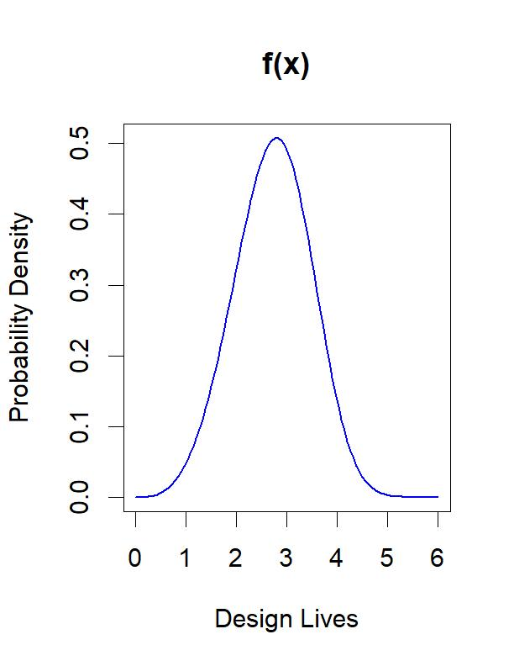
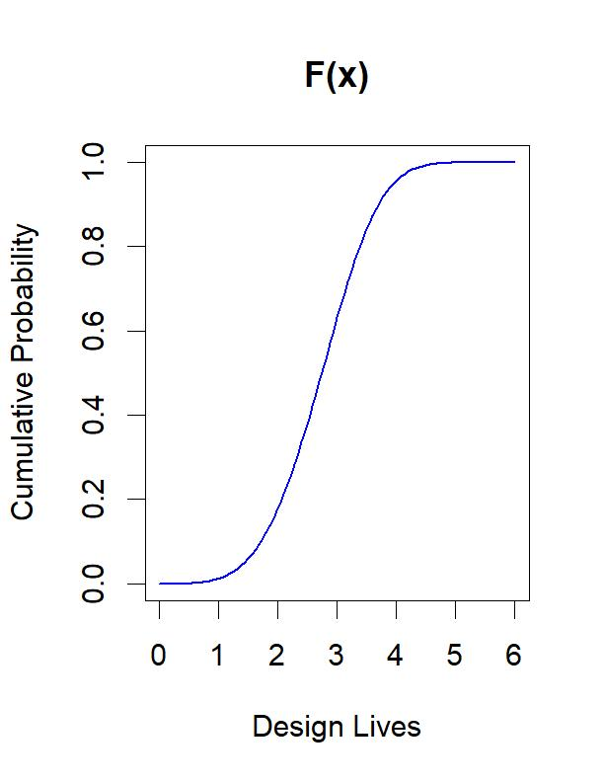
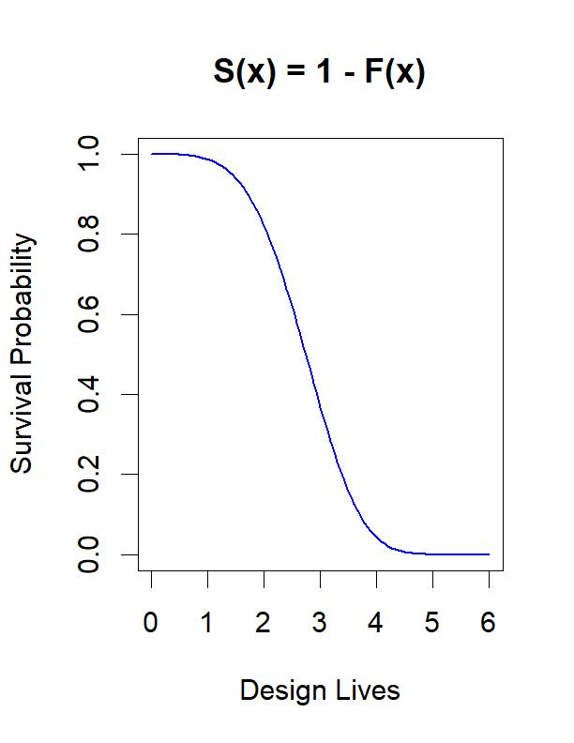
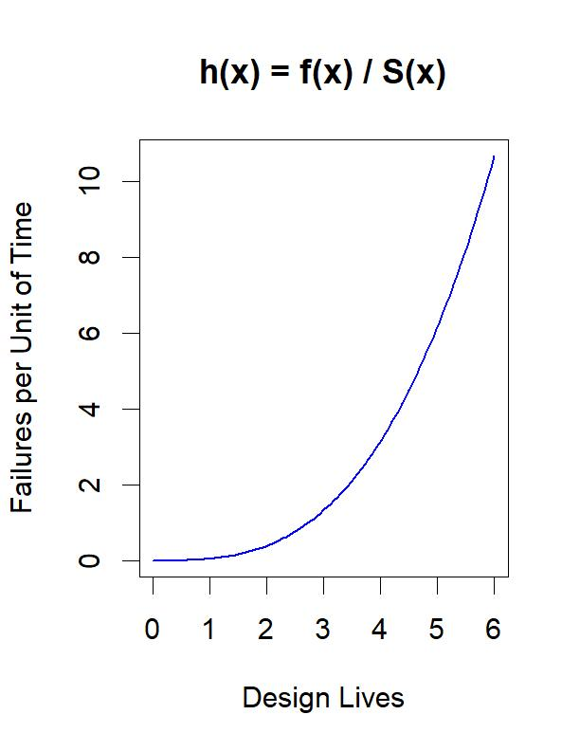


Weibull Distribution Overview
$$f\left(x\right)= \frac{β}{η}{\left(\frac{x}{η}\right)}^{β−1}e^{−{\left(x/η\right)}^{β}}$$
$$F\left(x\right)≝\int_{0}^{x}{f\left(t\right)dt}=1−e^{−{\left(x/η\right)}^{β}}$$
Example Weibull plots for beta = 4, eta = 3
beta represents the acceleration of failure rate
eta represents characteristic life independent of beta
Note1: $F\left(η\right)≅0.63 and S\left(η\right)≅0.37$
Note2: $For β>1, h\left(x\right) increases over time$
Failure Space

Slide 5
Problem Statement
Given that design life qualification is successful, what reliability can we infer?
Misconception: Design life qualification tests informs reliability

Slide 6
Default Approach
This requires finding the optimal Weibull fit using the data from the qualification test
Mathematically, this optimization problem has unbounded solutions, at best, if not undefined
However, if we fix the shape parameter beta, then a solution for eta can be found; and reliability can be calculated at a given confidence level
The issue with this approach is that it makes a weakly supported yet a very specific defining assumption to obtain a solution

Slide 7
A More Pragmatic and Useful Approach
Qualification success criteria is pass/fail in nature
  To minimize false positive and false negative test errors we follow the structured procedure below
Use engineering judgment and a bootstrapping strategy to make data driven steps towards useful conclusions
  Step 0) Solicit Program reliability thresholds and risk posture
  Step 1) Collect development and failure mode data
  Step 2) Perform Weibull Analysis on anticipated Qualification test results
  Step 3) Construct contour overlays based on Weibull Analysis
  Step 4) Evaluate Qualification Test Effectiveness against objective measures
  Step 5) Iterate on Qualification success criteria, if needed
Notes:
Estimating reliability must follow from a mathematical model such as the Weibull model
Mathematically applicable data points are required to estimate Weibull parameters that are representative of the design

Slide 8
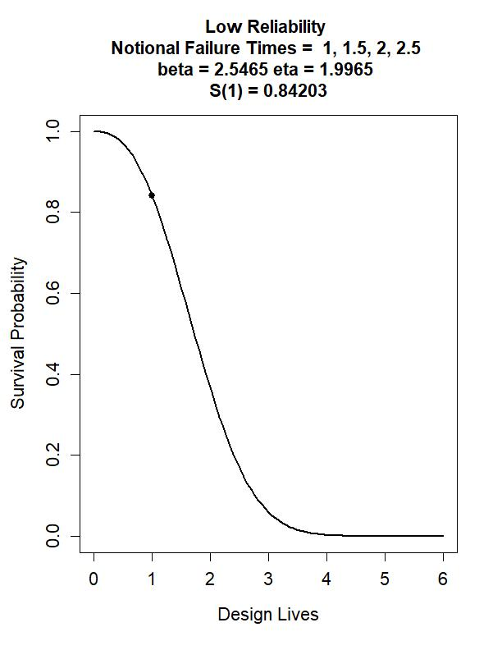
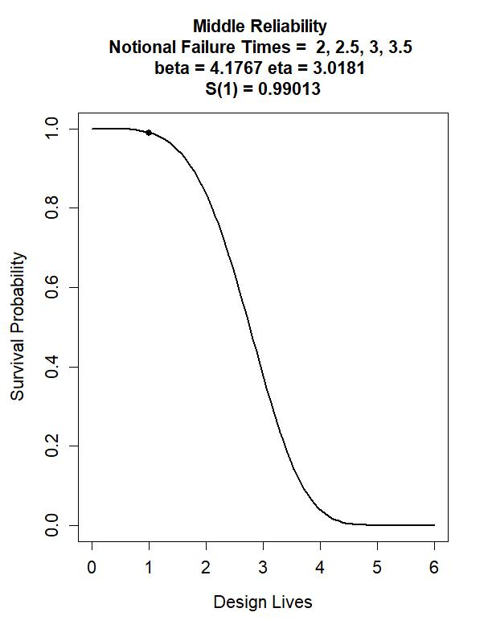
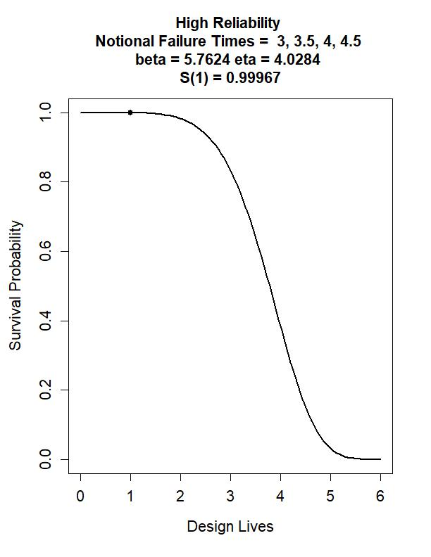
Measuring Reliability from Data
Survival curve fits, based on three sets of hypothetical 4-Unit Qualification Tests using Median Rank Regression
For these sets, the ranges beta = [2, 6] and eta = [1.5, 4.5] establish a focus region of anticipated Weibull parameters
Meets Requirement

Slide 9
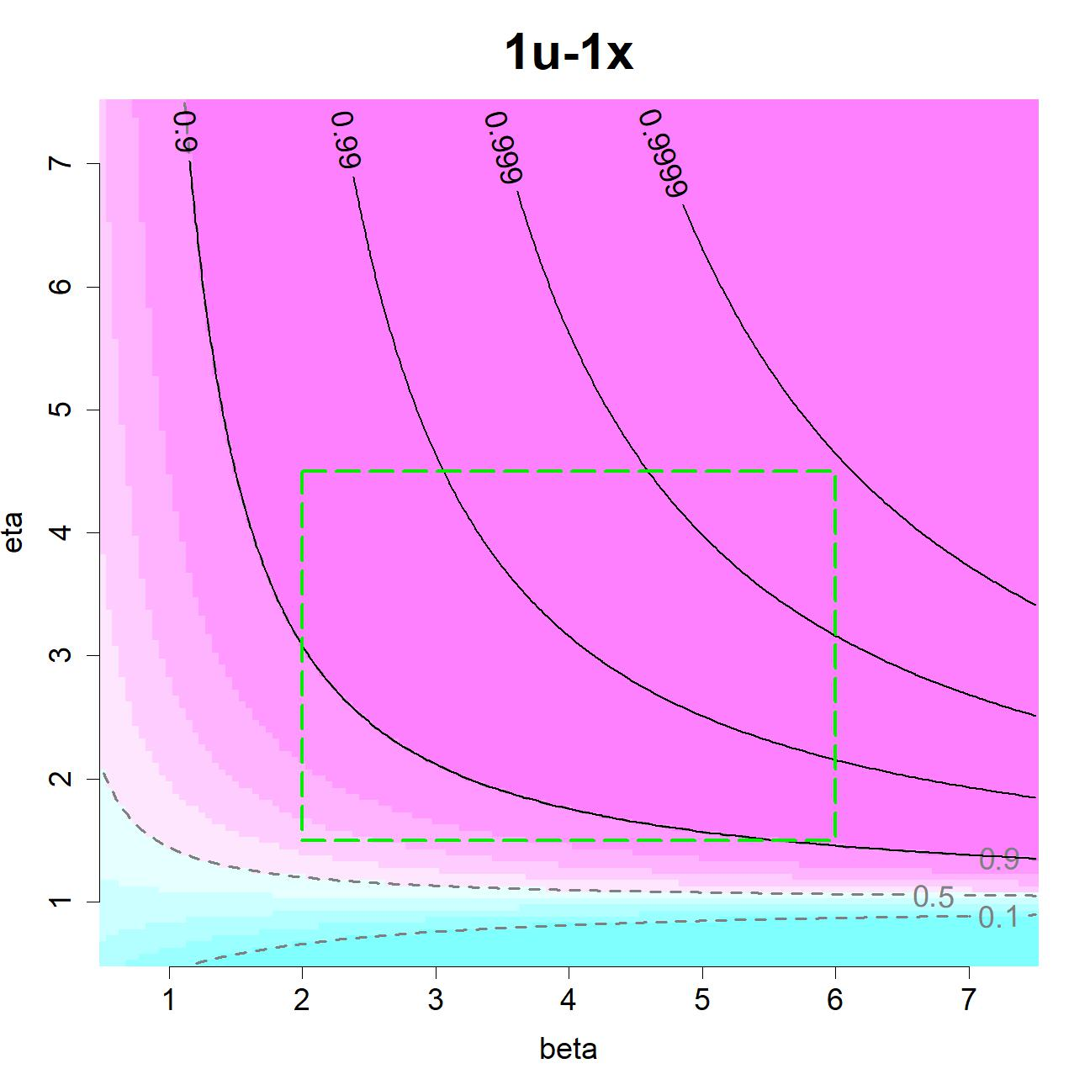
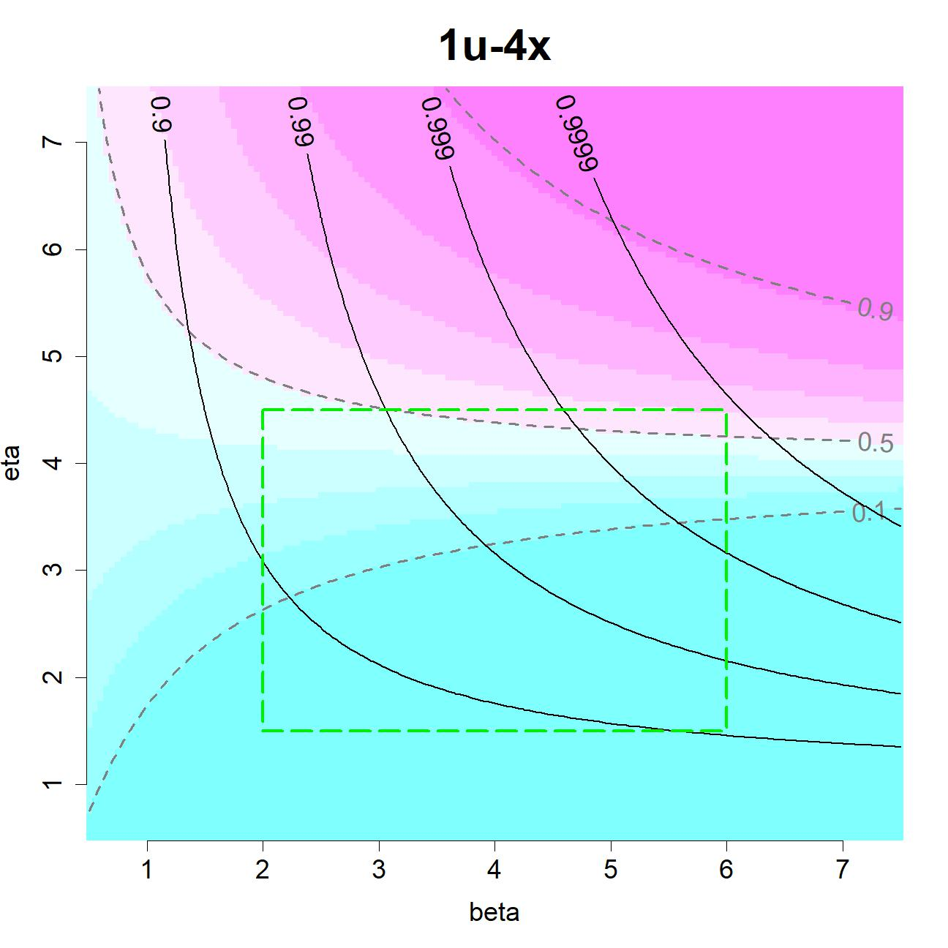
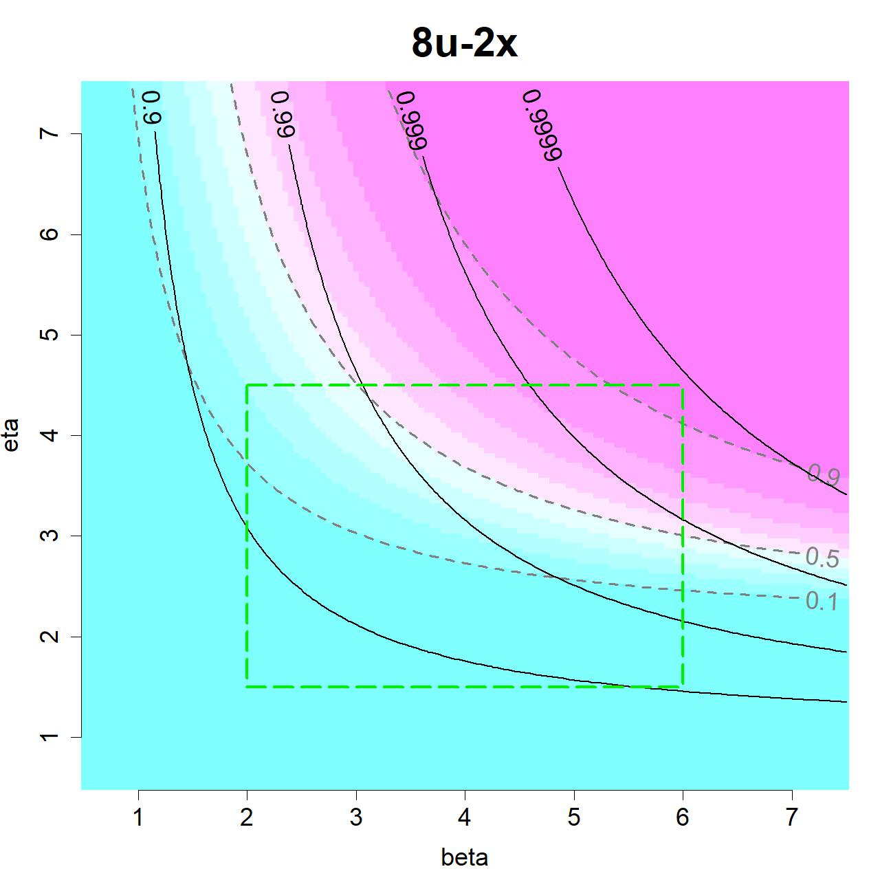
Visualization of Qualification Effectiveness
1x Mission Reliability (S(1)) overlaid onto Probability of Successful Qualification (S(x)^n) reveals the landscape of false positives and false negatives for different qualification test schemes
The focus region (beta = [2, 6] and eta = [1.5, 4.5]) , derived from data that is likely to be representative of anticipated designs

Slide 10
Revised Problem Statement
Optimize Cost, Schedule and Reliability Qualification Test Effectiveness
Solution: Given a reliability threshold and risk posture for false negatives and false positive risk, contour overlays can aid in objectively measure the effectiveness of a qualification test scheme

Slide 11
Summary
Development Test Data
Failure Mode Knowledge
Program Risk Posture
Weibull Analysis
Qualification Scheme
Contour Overlays
Reliability Requirements
Measure Effectiveness

Slide 12
Backup

Slide 13
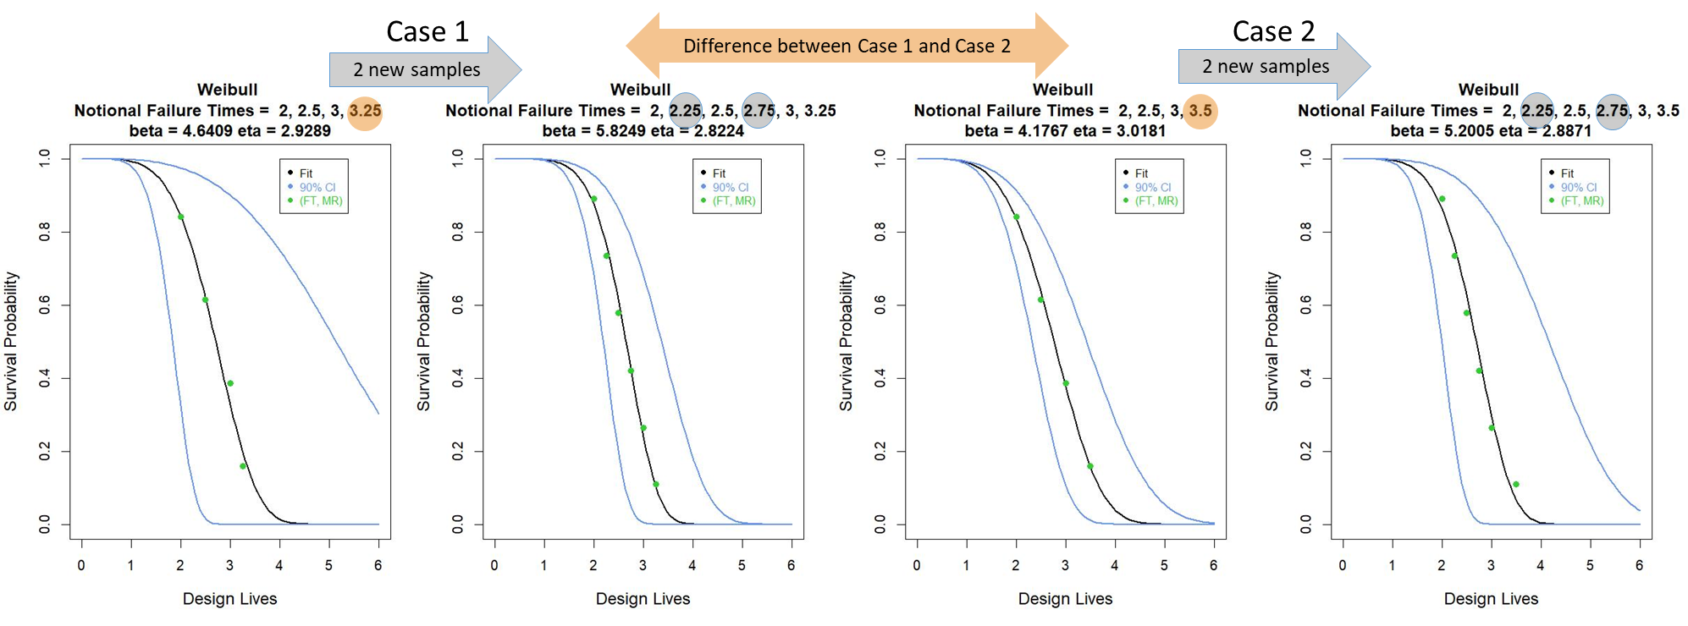
Uncertainty in Reliability Estimation
Comparison of notional Median Rank Regression survival curve fits with 90% confidence intervals and (Failure Time, Median Rank) points
Estimated uncertainty is sensitive to the sample size, goodness of fit, and variability in sampled values

Slide 14
Censored Data
x is right censored
0
x

Slide 15
