Slide 1
NASA Information Technology
Universidad Complutense de Madrid
October 22, 2024
Jeff Seaton
NASA Chief Information officer

Slide 2

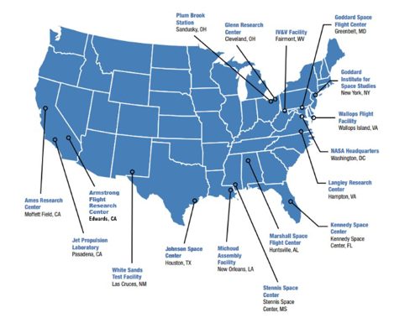
About NASA
We are America’s civil space program and the global leader in space exploration.
More than 19,000 civil servants with many more U.S. contractors, academia, and international and commercial partners to explore, discover, and expand knowledge for the benefit of humanity.
Science: studies Earth, including its climate, our Sun, and our solar system and beyond.
Aeronautics: We conduct research, testing, and development to advance aeronautics, including electric propulsion and supersonic flight.
Space Tech: We develop and fund space technologies that will enable future exploration and benefit life on Earth.
Human Spaceflight: NASA will land the first woman and first person of color on the Moon, using innovative technologies to explore more of the lunar surface than ever before.
NASA Locations
2
Notes:
Updated as of 5/1/2024

Slide 3
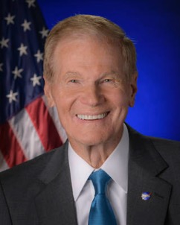
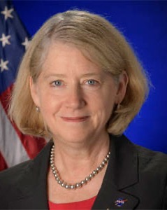
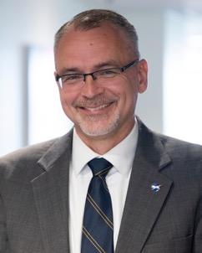
NASA Leadership
Bill Nelson
Administrator
Pam Melroy
Deputy Administrator
Jim Free
Associate Administrator
3

Slide 4
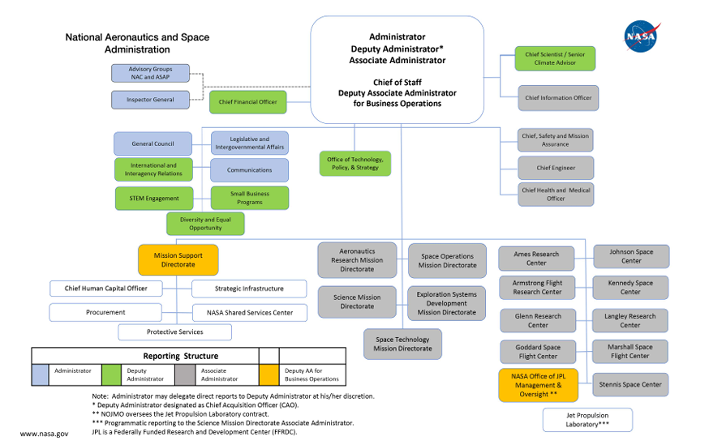
4
4

Slide 5
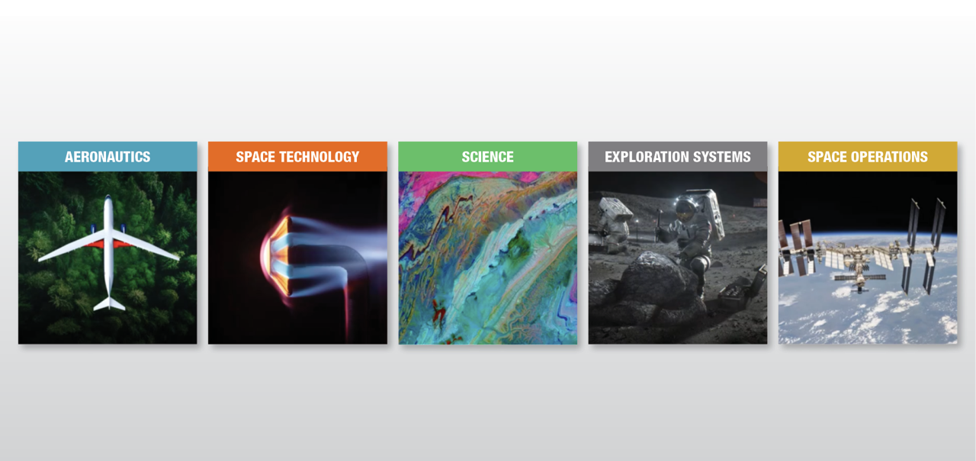
NASA OCIO Supports &
Partners with all of NASA
NASA’s work is primarily structured within these Mission Directorates:

Slide 6
A Few NASA Missions

Slide 7
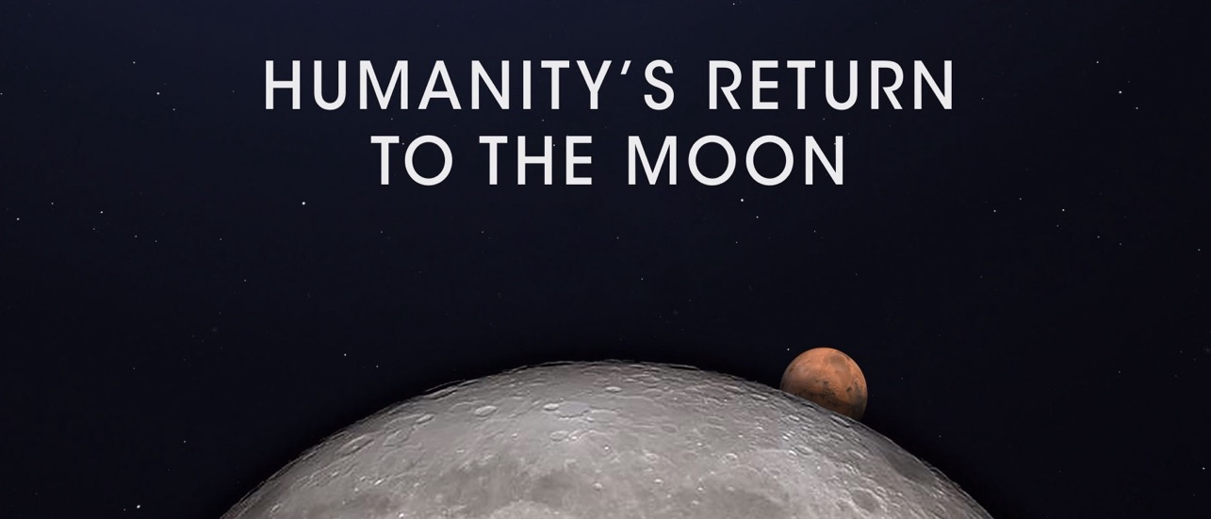
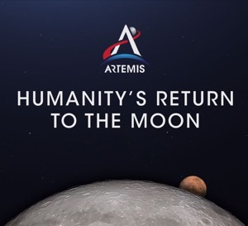
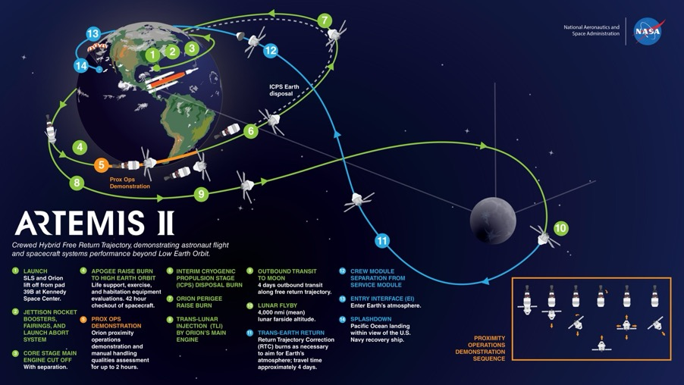
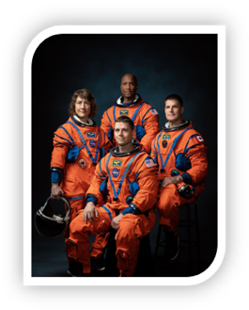
Artemis
Notes:
Updated as of 5/1/2024

Slide 8
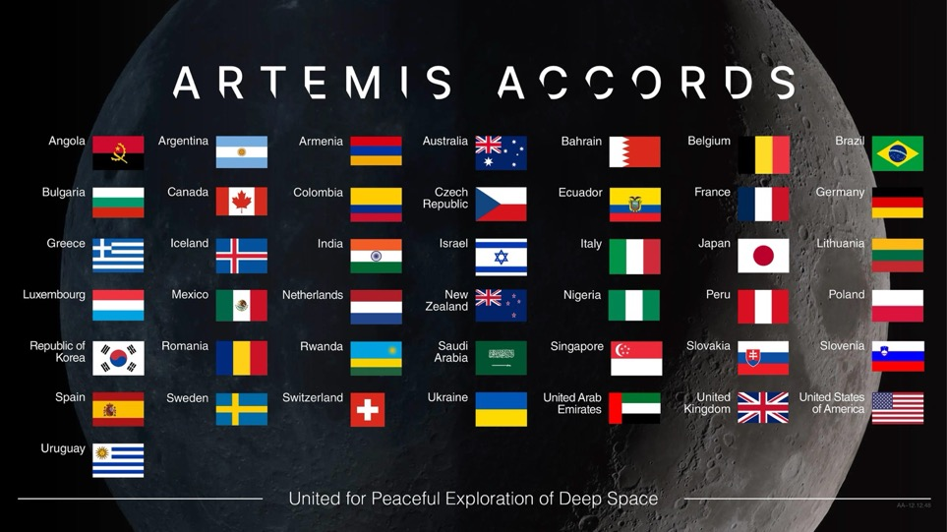
Artemis Accords
www.nasa.gov/artemis-accords/
Notes:
Updated as of 5/1/2024
28 countries have signed the Artemis Accords: Argentina, Australia, Bahrain, Brazil, Canada, Colombia, Czech Republic, Ecuador, France, India, Israel, Italy, Japan, Luxembourg, Mexico, New Zealand, Nigeria, Poland, the Republic of Korea, Romania, Rwanda, Saudi Arabia, Singapore, Spain, Ukraine, the United Arab Emirates, the United Kingdom, and the United States. This mission is for everyone!

Slide 9

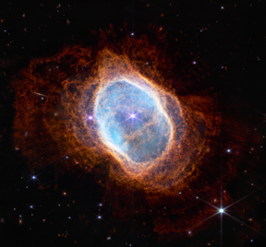
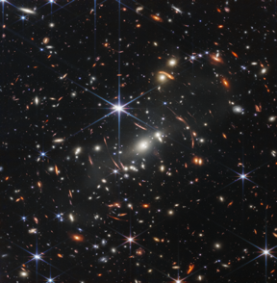
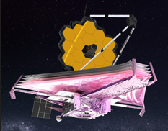
James Webb Space Telescope
Notes:
Updated as of 5/1/2024
The James Webb Space Telescope is an international collaboration between NASA and its partners, ESA (European Space Agency) and the Canadian Space Agency. Thousands of engineers and hundreds of scientists worked to make Webb a reality, along with over 300 universities, organizations, and companies from 29 U.S. states and 14 countries.
Webb’s revolutionary technology will study every phase of cosmic history—from within our solar system to the most distant observable galaxies in the early universe. Webb’s infrared telescope will explore a wide range of science questions to help us understand the origins of the universe and our place in it.
Webb is NASA’s largest and most powerful space science telescope ever constructed.
Astronomers worldwide will then be able to conduct scientific observations to broaden our understanding of the universe.

Slide 10
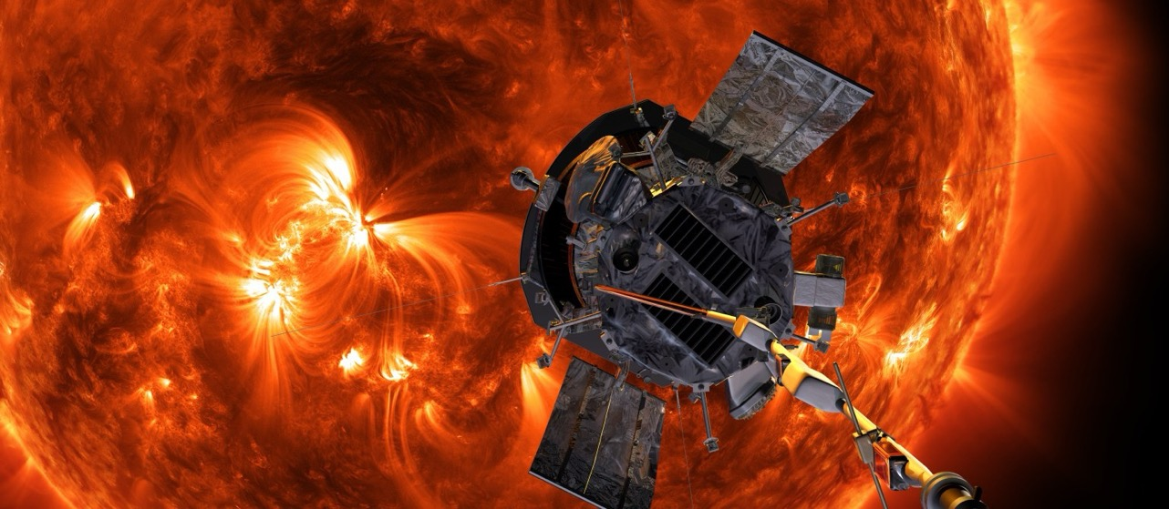
Parker Solar Probe
On December 24, 2024, NASA's Parker Solar Probe will make its closest approach yet.

Slide 11
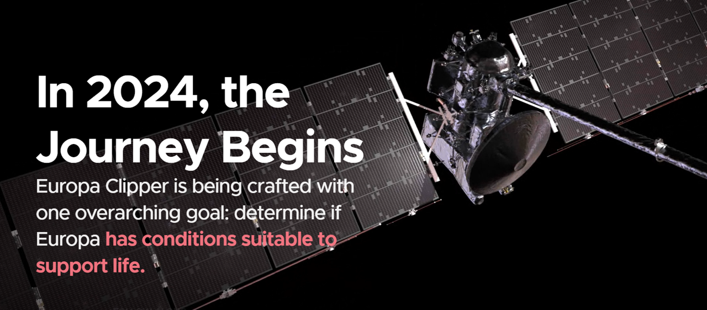
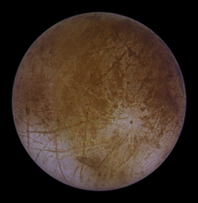
Europa Clipper

Slide 12
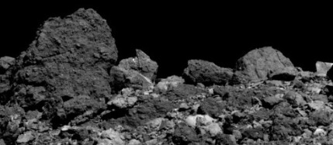
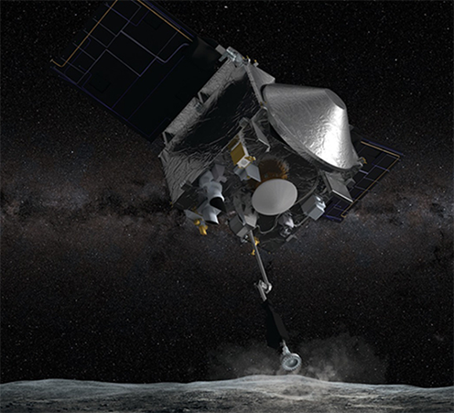
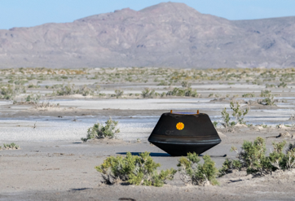

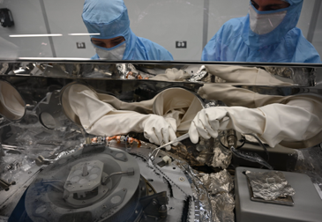
OSIRIS-REx
OSIRIS-REx
Origins, Spectral Interpretation, Resource Identification, and Security – Regolith Explorer
Notes:
Updated as of 5/1/2024

Slide 13

PACE Mission
Learn more at https://pace.gsfc.nasa.gov/
Notes:
Updated as of 5/1/2024

Slide 14
NASA Chief Information Officer
Organization, Services, Priorities

Slide 15

About the NASA Office of the CIO
The NASA Office of the Chief Information Officer is responsible for NASA IT policy and operations.
  10 Centers
  3 Divisions
  8 Agency-level offices
  6 Service lines
  ~750 civil servants and > 2,000 contractors

Slide 16
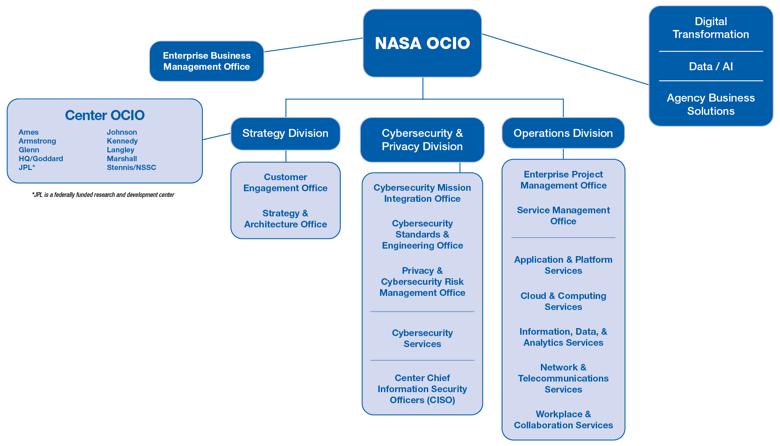
OCIO Organizational Structure

Slide 17
NASA OCIO Services & Capabilities
Applications & Platforms
Cloud & Computing
Information, Data & Analytics
Network & Telecommunications
Workplace & Collaboration
Business Intelligence
Cybersecurity Applications
Flight Ops Support
Microsoft Power Apps Platform
Robotic Process Automation
Science & Engineering Apps
ServiceNow Platform
Business Applications
Integration Services
IT Tool Applications
IT Management
Cloud Compliance Support
Could Services
Data Center Services
Business Management
IT Management
Data Platforms & Engineering
Data Science Services
Data Stewardship Services
Information Collection Services
Records Management Service
STI Publishing Services
IT Management
Data Center Network
Land Mobile Radio
Mission Ops & Maintenance
Motion Picture & Photo Conversion
NASCOM Security Management
Operational Voice Intercom Systems
Paging & Warning
Photography Operations
Recording, Storage & Archival
Video Operations
Cable Plant
Circuits
Corporate Local Area Network
Distributed Antenna Systems
Enterprise Systems Software
Security Infrastructure
Telephone/VOIP
Wide Area Network
IT Management
SEB Services
Conferencing
Desktops & Laptops
End User Core Services*
Enterprise Content Management
Graphics
In-Plant Printing
MFD & Network Printers
Peripherals
Access Management
Credentialing Management
Email & Instant Messaging
Identity Management
IT Management
Cybersecurity & Privacy
$110.8M; 110 FTE
Continuous Diagnostics & Mitigation
CSP Audit & Policy
CSP Standards, Architecture, Engineering
Cybersecurity Posture Assessment
Enterprise Assessment Services
Data Analysis, Reporting & Examination
ICT Supply Chain Risk
Information System Security Officers
IT Security & Awareness Training Center
Risk Information Security Compliance
Security Operations Center
SOC Infrastructure
IT Management
Center CIO Offices
Management and Operations
Modernization
Data & AI
Executes and manages approved Non-Enterprise/Center-unique services
Interface w/Enterprise, missions, stakeholders on strategies, services, and issue resolution
E-Government Fees
IT Enterprise Acquisitions
Service Management
Software License & Asset Mgmt
IT Investment Fund
Digital Transformation
Agency Business Solutions
Enable Core AI Capabilities
Inventory NASA data and AI
Operationalize Governance
Develop improved Architecture
Customer Experience
Investment Mgmt
IT Strategy
IT Management
Notes:
*WCS: End User Core Services includes M365/G5 license costs

Slide 18
OCIO FY25 Priorities
How we make it happen
Operational Excellence
Great Customer Experiences
Mission Enabling Transformation
What we will do next
Deliver & make them want more
Become Enabling Business Partners to Missions
GenAI for All
Execute NASA Data Strategy & Evolve EDP
Enterprise Capabilities for External Collaboration
Modernize Agency Business Systems
Zero Trust as Mission Enabler
Accelerate Enterprise ICAM
Streamline Governance
Publish Strategic Roadmaps
Evolve #oneOCIO Culture
Enterprise Contracts
Revise Business Models
Strengthen Communications
#oneOCIO
Hybrid Conference Room Solutions
Seamless Refresh Process
Data Center Optimization
Classified Network
Demystify “What to use when”
Facilitate Digital Upskilling at Scale
Notes:
Operational Excellence: OCIO transformation/reorg is still work in progress… it doesn’t move fast enough for DT yet (still very waterfall vs agile) & hasn’t yet figured out how to balance ops & transformation
Great Customer Experiences: can be hard to lead bold transformation from an org that is perceived as having trouble delivering conference rooms; must “fix the basics” & be customer centric in all things
Mission-Enabling Transformation: FY25 a tough budget year, so constant challenge to balance ops w/future investment. But there is appetite for solutions. If we can deliver in time (they wont wait)

Slide 19
External Collaboration Is Increasingly Important to NASA
NASA’s Missions and Centers have always required the ability to share data and interact with non-NASA entities on all sorts of data ranging from publicly accessible to confidential and protected in nature.
NASA’s strategic pivot to commercialization on multiple fronts has significantly increased the need to share, collaborate, and provide access to external partners.
International Artemis Accords expand on historic international partnerships and drive an increasing need for data pipelines and collaborative engineering and development.
Moon to Mars Architecture
Advanced Robotics on Gateway
Lunar Surface Exploration Technologies
Orion European Service Module
Lunar Surface Operations
Communications and Ground Stations
“Yesterday’s” Solutions
Today’s Enablers
Planning, Investing, and Building
Websites
Email
FTP
Contractor Run Systems
Multiple Identities, accounts, and systems
Data Use Agreements
Cloud Collaboration Tools
Network Segmentations
Early stage Zero Trust Architecture
Early Stage Identity Federations
Improved identity and MFA solutions
Select federations
Containerized cloud architectures
Cloud-based DevSecOps platform(s)
Robust Zero Trust Architectures
Improved Data Tagging

Slide 20
Cybersecurity Functions
Strategy & Business
Management
Cybersecurity & Privacy Division (CSPD)
Center CISOs
CSPD Resources and Budget Management
Strategic Planning and Road Mapping
CSPD Governance
Pathways Intern Coordination
OCIO Workforce Coordination
NASA Center Coordination between CSPD and Center Authorities
Privacy & Cybersecurity Risk Management Office
Cybersecurity Standards & Engineering Office
Cybersecurity Mission Integration Office
Cybersecurity Service Line
Privacy/Controlled Unclassified Information (CUI)
A&A and Cybersecurity Risk Management Oversight
Congressional/Federal Reporting (HVA, FISMA)
Audit Management (OIG/GAO/SAR/RVA)
Vulnerability Management (C-CAR/ED/BOD/CyHy/ CyberStat/FAST)
Cybersecurity & Privacy Policy/Handbooks/SOPs
Cybersecurity Engineering/SERTs
Cybersecurity Standards
Operational Technology (OT)
Space Operations Mission Directorate (SOMD) Cybersecurity Mission Integration
Exploration Systems Development Mission Directorate (ESDMD) Cybersecurity Mission Integration
Science Mission Directorate (SMD) Cybersecurity Mission Integration
Aeronautics Research Mission Directorate (ARMD) Cybersecurity Mission Integration
Science & Technology Mission Directorate (STMD) Cybersecurity Mission Integration
Next Slide

Slide 21
Cybersecurity Functions
Cybersecurity Service Line
Technical Integration
Business and Resource Mgmt.
Cybersecurity Infrastructure
Security Operations
Cyber Protection
Service Management
CDM – Hardware Asset Mgmt (HWAM)
CDM – Software Asset Mgmt (SWAM)
CDM – Configuration Setting Mgmt (CSM)
CDM – Vulnerability Mgmt (VUL)
DHS Continuous Diagnostics and Mitigation (CDM) Program Office Coordination
Center Cybersecurity Infrastructure
Enterprise Security Data Store (ITSEC-EDW)
Enterprise Cyber Logging (ECL)
SOC Systems and Svcs
Specialized Security Platforms (Governance, Risk, and Compliance; Antivirus; Endpoint Detection & Response; etc.)
Triage
Monitoring and Detection
Cyber Forensics and Incident Analysis
Cyber Threat Detection (Hunt)
Cyber Threat Analysis and Intelligence
Cyber Incident Response
Security Data Analysis/Reporting Cybersecurity Scorecard
Cyber Training & Awareness
Enterprise Assessment Service (EAS)
ISSO Services
Supply Chain Risk Management
Cybersecurity and Posture Assessment (Red/Blue Penetration Testing, Anti-Phishing, Vulnerability Scanning, HVA, etc.)
Project Management
Service Delivery
Continuous Improvement
Service Integration
Strategy & Design
Portfolio Management
Service Level Management
Change Mgmt
Config Mgmt
Demand & Transition
Incident & Problem
Communications & User Experience
The functional view defines work areas within a work unit. Work may be geographically distributed.

Slide 22
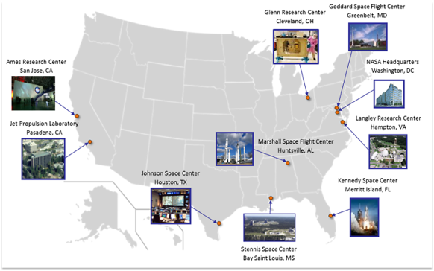
Changing Approach to IT at NASA
(cybersecurity as an example)
Yesterday
Yesterday: Federated Cybersecurity Teams
Today: Centralized Cybersecurity Team
Today
Center Director
NASA Administrator
Center CIO
NASA OCIO
x1
x9
Center CISO
Cybersecurity & Privacy Division
Center Cybersecurity Team

Slide 23
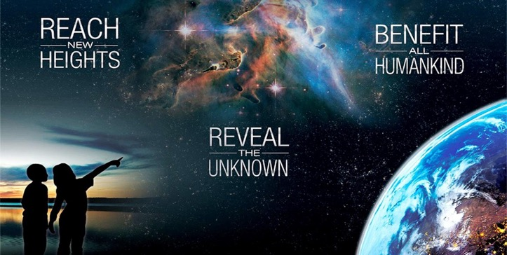


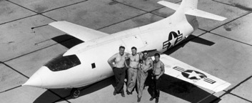
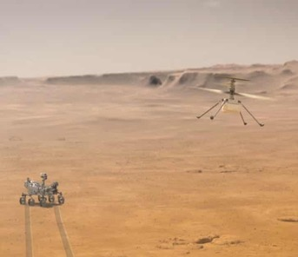
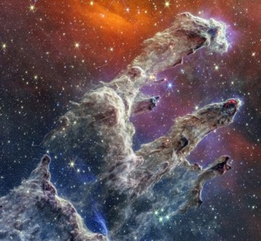
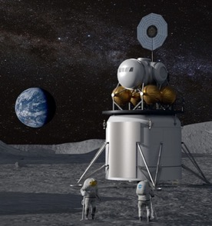

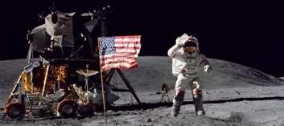
Digital Transformation at NASA
Enduring
Bold
Mission…
…now in a Changing World
Increasingly bold & complex missions
Increasingly partnered
Increasingly fast
Increasingly affordable
Increasingly transparent
Increasingly inclusive
NASA DIGITAL
TRANSFORMATION
Notes:
What the pictures are:
Bell X-1 break sound barrier
Apollo landing on Moon
Ingenuity – first atmospheric flight off Earth (72 flights!)
Webb – origins of universe
Artemis – sustainable human presence on Moon as proving ground for Mars (34 countries on Artemis accords)

Slide 24
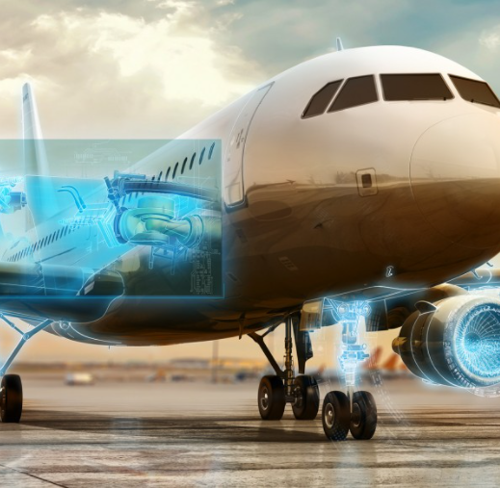
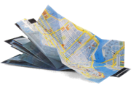
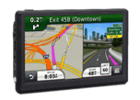
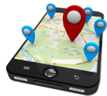

Digital Transformation
DT ≠ IT
DT = transformation focused
IT = technology focused
[dij-i-tl trans-fer-mey-shuhn] noun:
Employing digital technologies to change a process, product, or capability so dramatically that it’s unrecognizable compared to its traditional form.
TRADITIONAL
DIGITIZED
TRANSFORMED
“When digital transformation is done right, its’ like a caterpillar turning into a butterfly. But when done wrong, all you have is a really fast caterpillar.”
- George Westerman, MIT Sloan Institute on the Digital Economy
From Maps to Apps…
Digital Transformation
has already changed our world
Notes:
Often helpful to level set how we define digital transformation

Slide 25

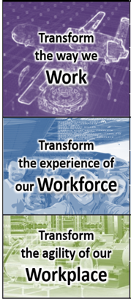

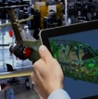
















NASA’s DT Strategic Framework
Synchronize DT Plans & Catalyze DT Progress
3
4
5
6
7
+
FUTURE STATE
GOALS
TRANSFORMATION
TARGETS
DIGITAL
LEVERS
TECHNOLOGY
FOUNDATIONS
MISSION
OUTCOMES
Establish Interoperable Architectures
Intelligent Automation
Transform Discovery
Bolder, More Complex Missions
Transform Engineering
Faster, More Agile Processes
Transform Critical Processes
Artificial Intelligence/ Machine Learning
Seamless Partner Teaming
Model-Based Anything
Inspire & Engage Citizens
Maximize the Impact of our Data
Affordable Sustainable Operations
Transform Decision Making
Attract & Retain Workforce
Transform Operations
Adopt Common Tools
Zero
Trust
Architecture
Internet of Things
Extended Reality
Modern Future of Work
Strengthen Inclusive³ Teaming
One
Future NASA
NASA TM 20220018538

Slide 26
Evolution of DT Initiative
The DT Initiative’s focus has evolved as NASA’s DT journey has progressed
DT’s role evolved from Igniter to Connecter, and now to Integrator and Facilitator to enable NASA’s Transformation Journey.
FY24+
FACILITATOR
Derived shared future state vision & roadmaps for “transformation targets” to align/integrate org DT plans via “Agency Roadmap Manager” (ARM)
Mostly smaller “early win” prototype projects by single organizations
Launched larger multi-org “catalyst projects” where we were willing to team on common challenges
Identified duplication & unfunded needs across org DT plans & facilitated strategic investment in “IT modernization for transformation” (ITMX)
FY23
FY22
INTEGRATOR
FY21
CONNECTOR
IGNITER
GETTING STARTED
JOINING FORCES
BUILDING MOMENTUM
SCALING SOLUTIONS
Where We Seeded Early Wins and Sparked Change
Where we built coalitions to attack select challenges
Where began to intentionally work together for key results
Where we invested strategically across the agency

Slide 27
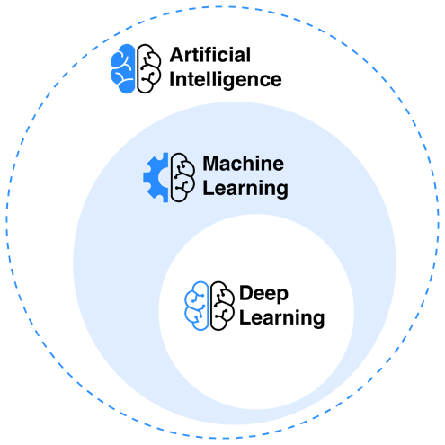
Digital Transformation:
Artificial Intelligence
ARTIFICIAL INTELLIGENCE REFERS TO COMPUTER SYSTEMS THAT CAN PERFORM COMPLEX TASKS NORMALLY DONE BY HUMAN-REASONING, DECISION MAKING, CREATING, ETC.
ARTIFICIAL INTELLIGENCE
Computer systems that can perform tasks normally done by humans – reasoning, decision making, creating, etc.
For official purposes, NASA uses the definition from the 2019 National Defense Authorization Act, a de facto government standard
MACHINE LEARNING
Subset of AI that uses statistical methods to enable machines to improve with experience using datasets vs. programming
DEEP LEARNING
Subset of ML that uses neural networks (processing that imitates brain neurons)

Slide 28
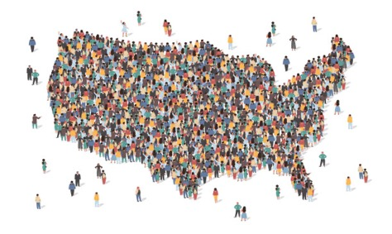


What is Different About AI Today?
THEN: AI for Gurus |  | NOW / SOON: AI for All
AI experts at NASA |  | Every worker at NASA
created custom AI tools |  | uses powerful, plentiful, secure AI tools
to perform critical work at NASA |  | to augment all work across NASA Missions and Support
with individual investments |  | with largely shared investments
Generative AI

Slide 29
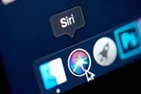
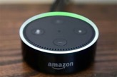


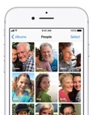
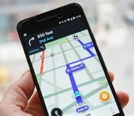

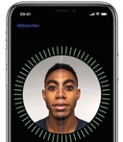
Artificial Intelligence at NASA
AI (Artificial Intelligence): The broad field of creating machines or software that can perform tasks usually requiring human intelligence, such as learning, reasoning, and problem-solving.
Everyday AI
Generative AI
Voice-Controlled Assistant
Facial Recognition
Intelligent Navigation

Slide 30
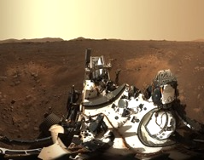
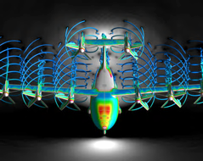
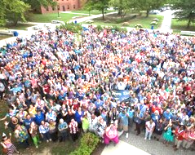
Mission Value from AI @ NASA
Enable the Impossible
AI Image Analysis for Space Inspection (e.g., Glove)
Enable Scaled Air Traffic Control
Detect and Recover from Emergencies
Mission-Embedded AI:
Rovers, Satellites, Spacecraft, Aircraft, UAS, Habitats, Coordination & Control…
Early Warning of Severe Storms
Discover Exoplanets and Multi-Star Systems
Fuel Technical Work
AI-Assisted Vehicle Design / Engineering
AI-Enabled Project Management
AI-Augmented PSR Images for Lunar Plans
Mission-Enabling AI:
Research, Engineering, Science;
Labs, Experiments, Tests, Requirements, Plans, Analysis…
AI-Augmented System Engineering
Predictive Modeling –
AI-Enhanced Digital Twin
Bolster Effectiveness
Automate Repetitive Processes
Condition Based Facilities Maintenance
AI-Fueled IT Security
AI in Mission Support:
Finance, Procurement, Information Technology, Security, Facilities, Human Resources…
HR – Resume Reviews; Performance
AI-Enabled Financial Analysis & Fraud Det.
NASA AI Objective Function: Maximize Mission Benefit from AI while Managing AI Risks
Notes:
NASA has been safely using AI for decades to support missions
Mars Rovers
Autopilots
Climate Analysis

Slide 31

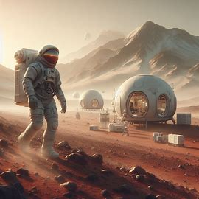


GenAI Opportunities at NASA
Text: Written paragraphs, summaries, outlines, blog posts, poetry, songs, more
Engineering Digital Assistant
Literature Reviews
Digital Assistant for State-of-the-Art Instrumentation
NASA Document Writing
Co-Pilot
NASA Materials Advisor
NASA Process Navigator
NASA Project Co-Pilot
Procurement Requirements Advisor
Code: Create, document, explain, debug; translate between coding languages
Application modernization
Augmented Reality/Virtual Reality (AR/VR)
Images: Rapidly create art, including photo-realistic
Mission concepts
Citizen inspiration
Prompt: “Create a realistic image of astronauts exploring mars with habitats and scientific instruments based on NASA's Artemis mission concept”

Slide 32
How Can You Get Involved With NASA?

Slide 33

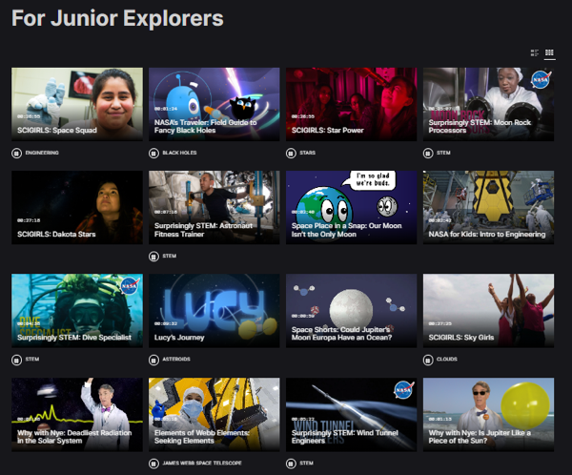

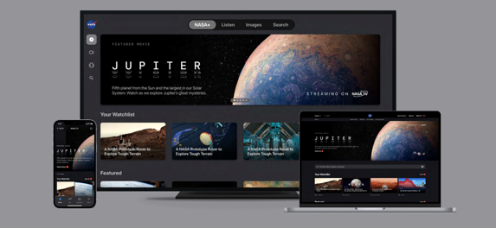
NASA+
NASA+: Video on Demand & Live Coverage

Slide 34








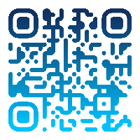
Student Launch
Colleges, universities,
high schools, and
middle schools.
Research-based,
Provides research and development of rocket propulsion systems.
Human Exploration Rover Challenge
High school and college students worldwide
create a vehicle designed to traverse the simulated surface of another world.
Neutral Buoyancy Experiment Design Teams (Micro-g NExT)
Undergraduate students
Design, build, and test Addresses an authentic, space exploration challenge.
First Nations Launch
Native American college students
Build and launch class K high-powered rockets.
workshops teach concepts necessary for a successful launch.
ARTEMIS STUDENT CHALLENGES
NASA is committed to landing the first woman and first person of color on the Moon using innovative technologies to explore more of the lunar surface than ever before! Discover the Artemis Student Challenges and explore how you can take part in one of NASA’s mission-related challenges.
App Development Challenge
Middle and high school students
Coding-based challenge to solve technical problems provided by NASA as they relate to deep space exploration missions.
Spacesuit
User Interface Technologies
for Students (SUITS)
Undergraduate and graduate teams
Design and create spacesuit information displays within an augmented reality environment.
Lunabotics
University-level teams
Design, build, and run autonomously operated robot, traverse the simulated off-world terrain, and excavate the simulated lunar regolith.
Big Idea Challenge
Student teams at Space Grant-affiliated colleges and universities.
Support the Space Technology Mission Directorate’s work maturing high-impact technologies for a broad array of NASA missions.
To learn more about the Artemis Student Challenges visit stem.nasa.gov/artemis
Notes:
Updated as of 5/1/2024

Slide 35


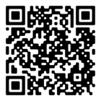




Citizen Science with GLOBE
When you download the GLOBE Observer app, you join the community of The GLOBE Program – citizen scientists, students, and teachers in 120+ countries around the world contributing to Earth system science research.
What is GLOBE Observer?
A citizen science app allowing volunteers in GLOBE countries to take observations and contribute to the Global Learning and Observations to Benefit the Environment (GLOBE) community
A way to collect data to track changes in the environment in support of Earth system science research, and interpret NASA and other satellite data
An open data set available to scientists, and supporting students of all ages in doing real scientific research through the GLOBE Program
Download the app and follow the instructions to get started. Always follow guidelines from your local officials, and only participate in GLOBE activities or use the GLOBE Observer app if it is safe to do so.
Notes:
Updated as of 5/1/2024

Slide 36



Space Apps Challenge
SOLVE REAL-WORLD CHALLENGES ON EARTH & IN SPACE
The NASA International Space Apps Challenge is a hackathon for coders, scientists, designers, storytellers, makers, technologists, and innovators around the world to come together and use open data from NASA and its Space Agency Partners to create solutions to challenges we face on Earth and in space.
SCAN ME!
Scan the QR code to learn more!
Notes:
Updated as of 5/1/2024

Slide 37






International Space Station and Crew 7
Watch the International Space Station pass overhead! It is the third brightest object in the sky and easy to spot if you know when to look up. NASA’s Spot the Station mobile application and website make knowing when to see it easy.
Notes:
Updated as of 5/1/2024
The International Space Station
An international partnership of five space agencies from 15 countries operates the International Space Station.
The space station has been continuously crewed since November 2000.
The 55-foot robotic Canadarm2 has seven different joints and two end-effectors, or hands, and is used to move entire modules, deploy science experiments and even transport spacewalking astronauts.
There have been over 3,700 investigations from over 5,000 scientists from 116 countries on the ISS to date.

Slide 38
Questions & Answers

