Slide 1
Geodetic Reference Instrument Transponder for Small Satellites (GRITSS)
S. M. Merkowitz, M. Hassouneh, W.-C. Huang, H. C. Livingston
NASA Goddard Space Flight Center
C. Beaudoin
University of Massachusetts Lowell
23rd International Workshop on Laser Ranging, Kunming, China
October 20-26, 2024

Slide 2

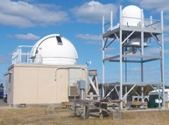
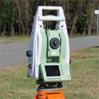
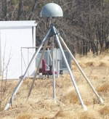

The Geodetic Measurement System
VLBI
Orientation of ITRF with respect to ICRF
ITRF Scale
SLR
Origin of ITRF (Earth’s CM)
ITRF Scale
Position spacecraft in ITRF (“Orbits”)
GNSS
Precise monitoring of Polar Motion and Rotation Rate
Position spacecraft in ITRF (“Orbits”)
Position instruments on Land and Sea (Tide Gauges and Buoys, Geodetic Instruments)
Technique Connectivity (Station Co-Location)
DORIS
Position spacecraft in ITRF (“Orbits”)
Enhances global distribution of ITRF Station positions and velocities
Fully Define ITRF
VTS: ITRF Performance Improvement
Low-Density Global Distribution
High-Density Global Distribution
Origin, Scale, Orientation

Slide 3
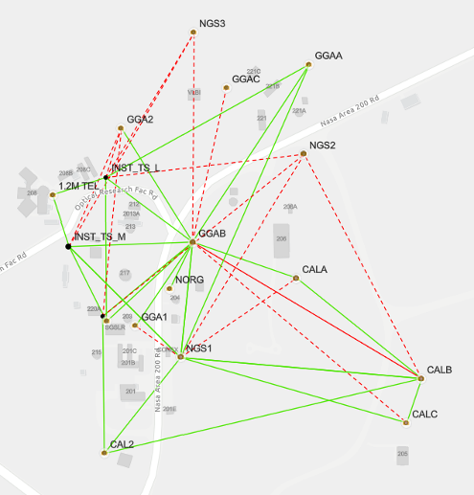
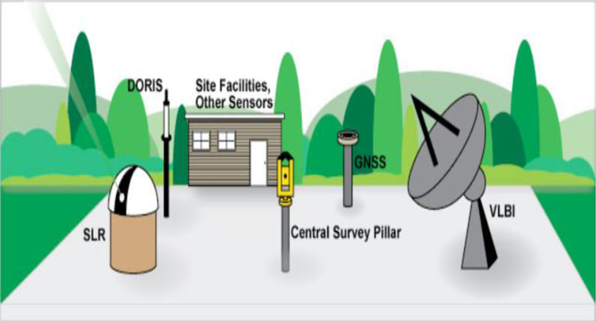
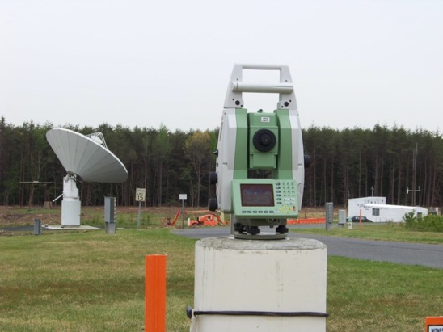
Traditional Local Tie Surveys
Survey of site ground control network, site reference, optical access points, and supplemental targets to estimate the measurement points of space geodesy instruments.
The actual instrument measurement point is often not accessible to survey techniques and must be estimated, introducing errors in the local tie.
Surveys are only performed periodically further introducing the possibility of errors.

Slide 4
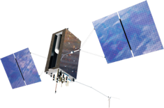
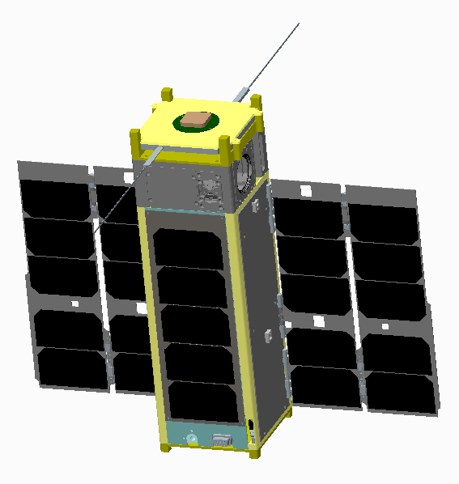
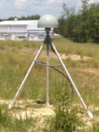
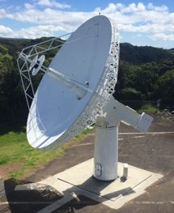
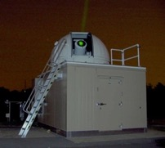
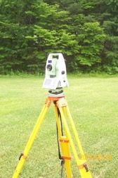
Geodetic Colocation In Space
GRITSS/GENESIS
GNSS/GPS
GNSS/GPS
Observations of a common space-based reference has the potential for reducing the uncertainty in the local-ties to the mm level thus improving the ITRF combination.
GNSS
SLR
VLBI
Survey

Slide 5

The GRITSS Dog-Leg
L-band
GPS
GRITSS upconverts and transponds GPS signals to individual VGOS ground stations.
S & X-band
VGOS

Slide 6

The GRITSS Observables
τ_{sv} observable is a clock bias term that is obtained through differencing of space/VLBI GPS clock biases
Differencing allows direct suppression of common clock terms.
Fitting τ_{sv} to model given CubeSat Precision Orbit Determination yields VLBI position
GPS
GPS
GRITSS
τ_{1S}
τ_{2S}
τ_{1G}
τ_{2G}
τ_{SV}
τ_{SL}
VG
SG
GNSS
SLR
VLBI
Common Ground Clock

Slide 7

The GRITSS Demonstration Mission
A NASA Earth Science and Technology Office sub-class D technology demonstration mission
Jointly developed by the University of Massachusetts, Lowell and NASA GSFC
12UXL CubeSat, launch, and operations services provided by ISISpace in the Netherlands.
Nominal operations: 1 year (extendable)
Orbit: ~550km sun synchronous, Nadir pointing
Only broadcasts GRITSS signals over VGOS stations as spacecraft power permits
Spacecraft kept nadir pointing throughout orbit to enable global SLR tracking.
Initially targeting US NASA VOGS stations and will invite other VGOS stations to participate after successful first phase

Slide 8
GRITSS Instrument Subsystems
GPS Receiver Assembly
Ultra-Stable Oscillator (USO)
X-band Transmitter and Timing extenSionN (X-TTSN) Module - 10.2 GHz
S-band Transmitter - 3.2 GHz
Antennas (L1/L2 GPS, X-band, and S-band)
Laser Retroreflector
S-band data to S-band Antenna
X-band data to X-band Antenna
Payload CMD/TLM to s/c bus
GPS Receiver Assembly
S-band Tx
X-TTSN Module
L1/L2 GPS Signal
GPS Data
S-band IF

Slide 9
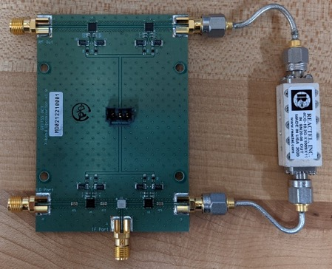
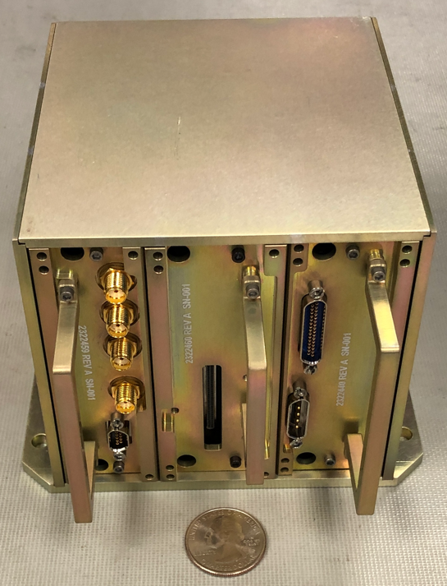
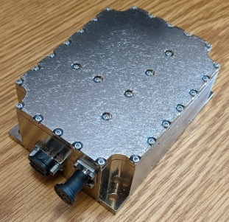
Completed Technology Readiness Level 5 Development
S-band Transmitter
X-band Transmitter
GPS Receiver Assembly
Wenzel USO

Slide 10
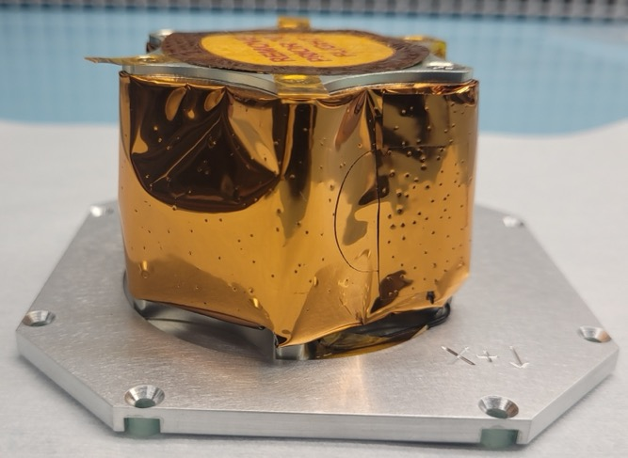
Laser Retroreflector
Single 1.6 inch diameter cube corner with measured dihedral angles offsets of 1.7, 1.4, and 1.5 arcsec designed and built by KBR.
Mounted to the nadir deck that will be kept nadir pointing for the majority of time.
ILRS tracking is a critical component to the success of the GRITSS demonstration.

Slide 11
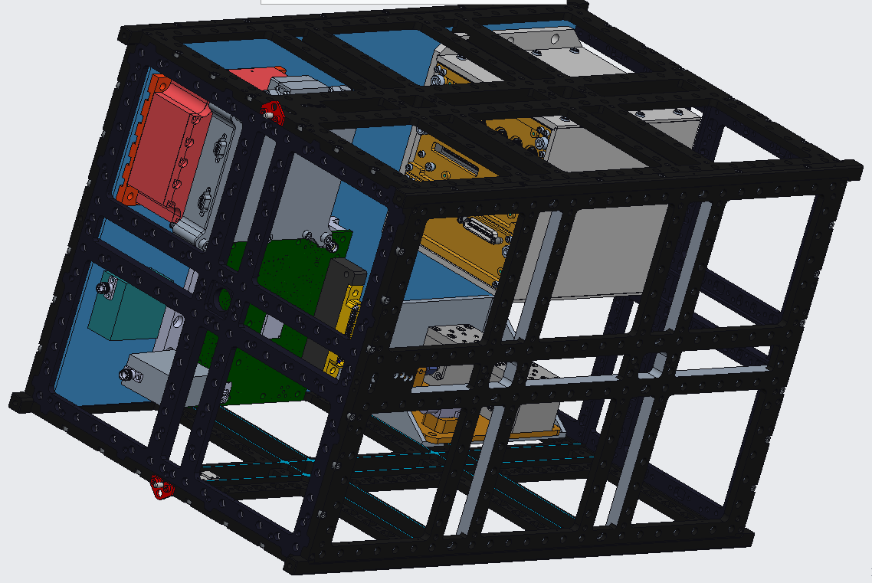
GRITSS Instrument Fits Within 6U Volume
X-TTSN Module
USO
GPS Receiver Assembly
NavCube3-mini
Low-Noise Amplifier (LNA)
Instrument Size:
20 cm × 11 cm × 34 cm
S-band Tx

Slide 12
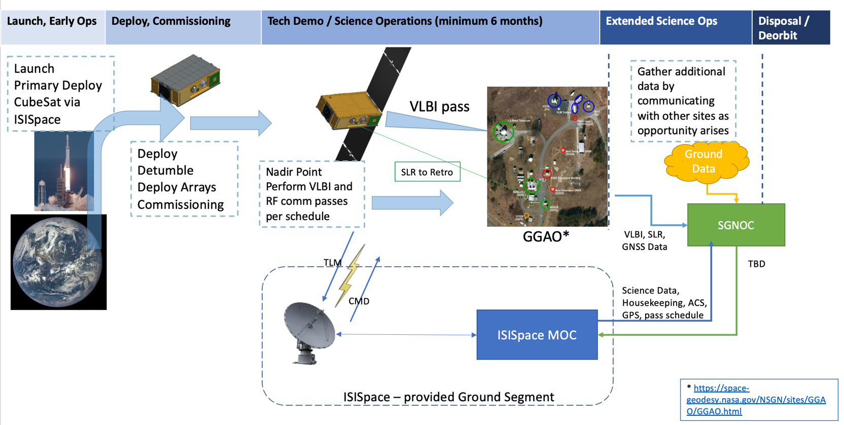
Concept of Operations

Slide 13
Project Status
2022 - Demonstrated Technology Readiness Level 5
July 2023 - Payload Preliminary Design Review
Feb 2024 - Spacecraft Design Review
Apr 2024 - Payload Final Design Review
Oct 2024 - Spacecraft Final Design Review
May 2025 - Instrument-Spacecraft Integration and Test
Oct 2025 - Launch

Slide 14
Summary
GRITSS will demonstrate a space-tie using the novel approach of transponding the GPS signals to a VGOS antenna.
GRITSS is on a fast-track for launch and operations in 2025.
We look forward to working with the ILRS!

