Slide 1
Planetary Protection Overview
Dr. Parag Vaishampayan
Space Biosciences Division, NASA, Ames Research Center

Slide 2
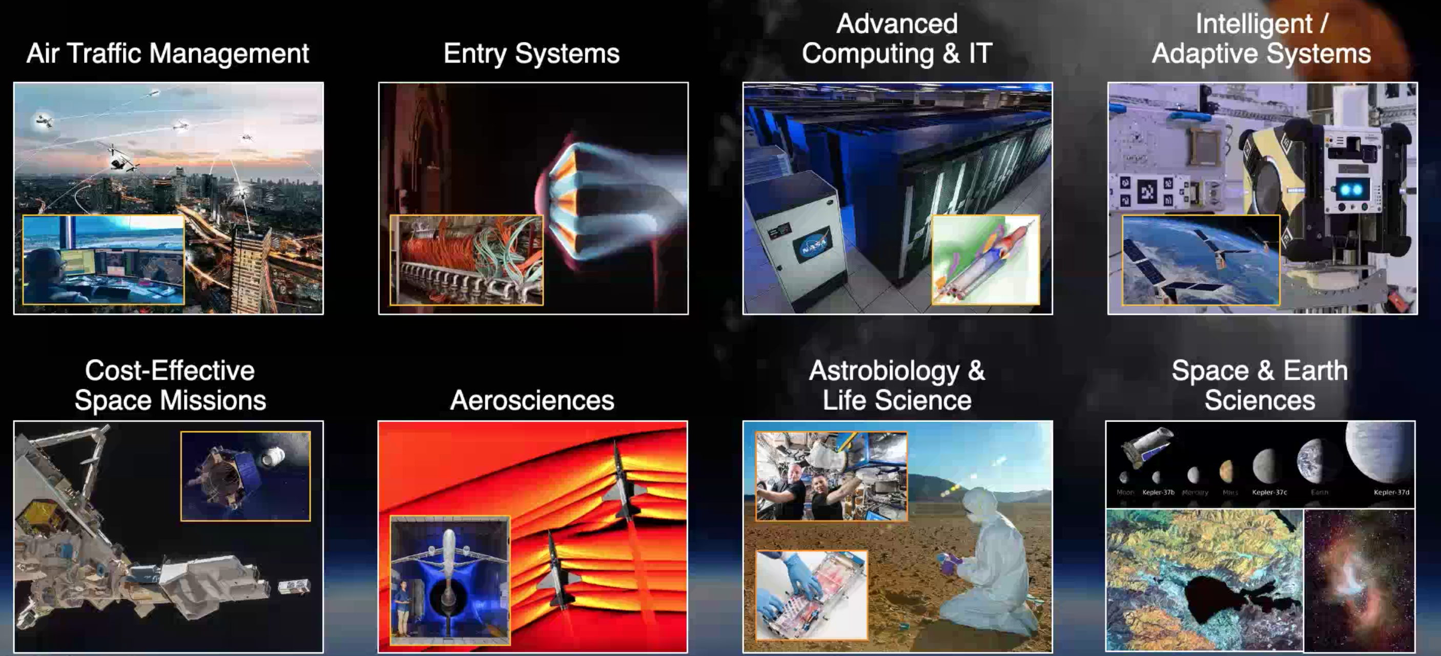
ARC Core competencies
Credit: ARC, NASA

Slide 3
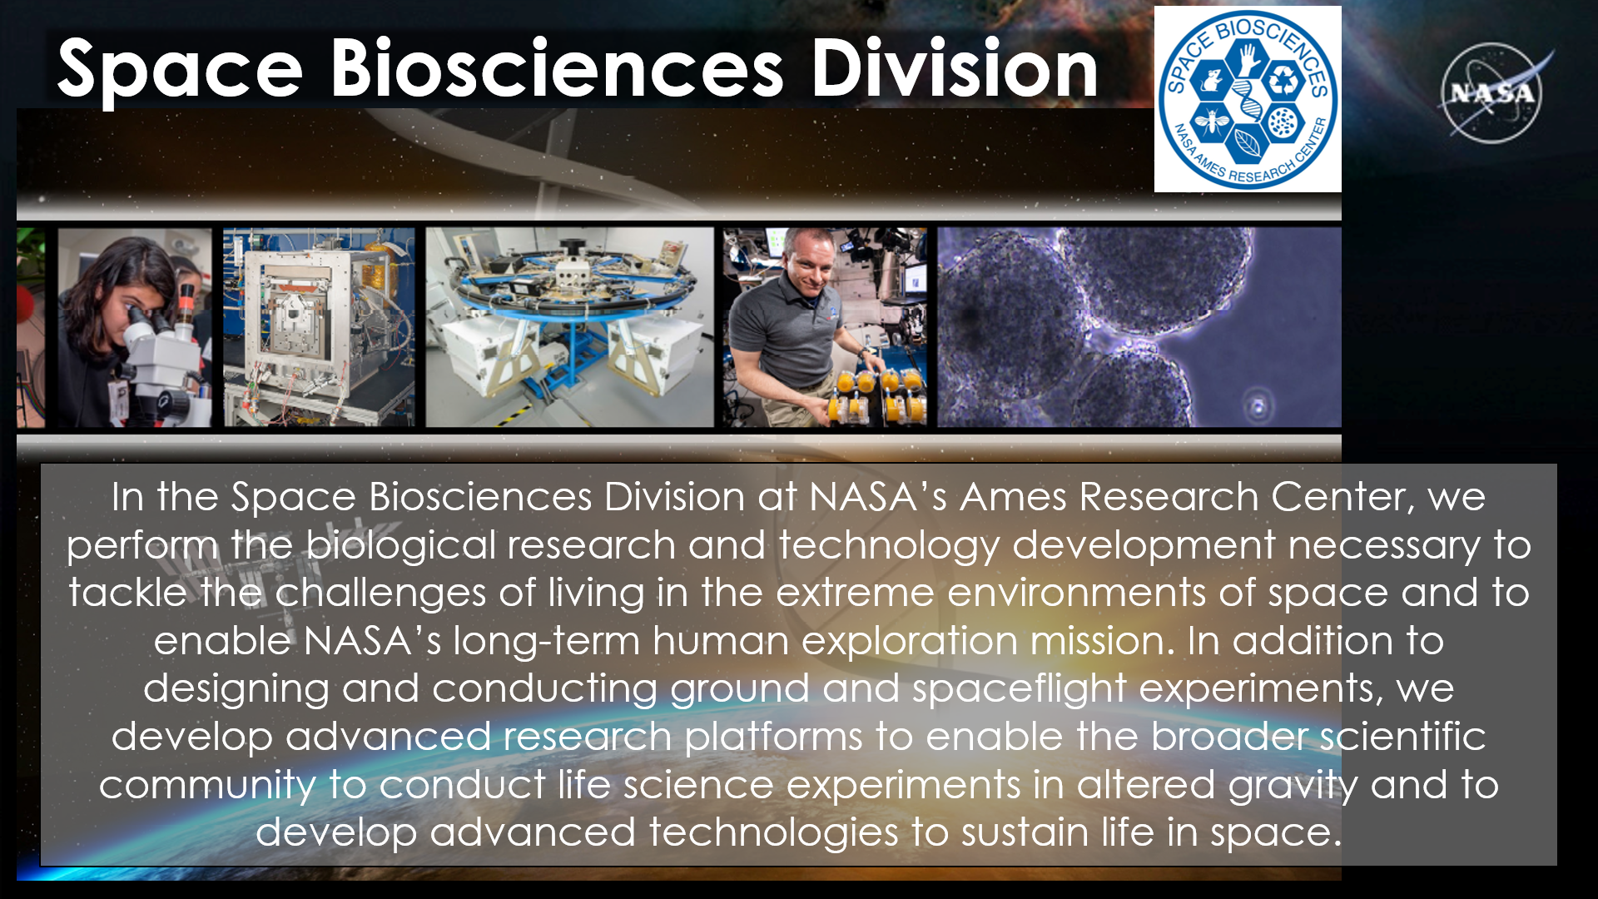
Credit: ARC, NASA

Slide 4




Space Biosciences-Bringing Life into Space
Biosciences Research: SCR Research on the ground and in space to learn how the space environment affects living organisms
Bioengineering: SCB Development of next generation technologies for human life support in space
Flight Systems Implementation:SCF Development and operation of hardware for life sciences research in space and altered gravity environments
Credit: ARC, NASA

Slide 5















From molecules to organisms, to populations and environment
Fluid Shift &
ICP
Neuro/Cognition
Plant
Physiology
Repro- duction
Vestibular
Cardio- vascular
Plant/ Microbe
From molecules to organisms, to populations and environment
Gravity Sensing
Immune
Nutrition/ Digestion Microbiome
DNA Damage/ Repair
Reproduction
Musculoskeletal
Exomicrobiome
Credit: ARC, NASA

Slide 6
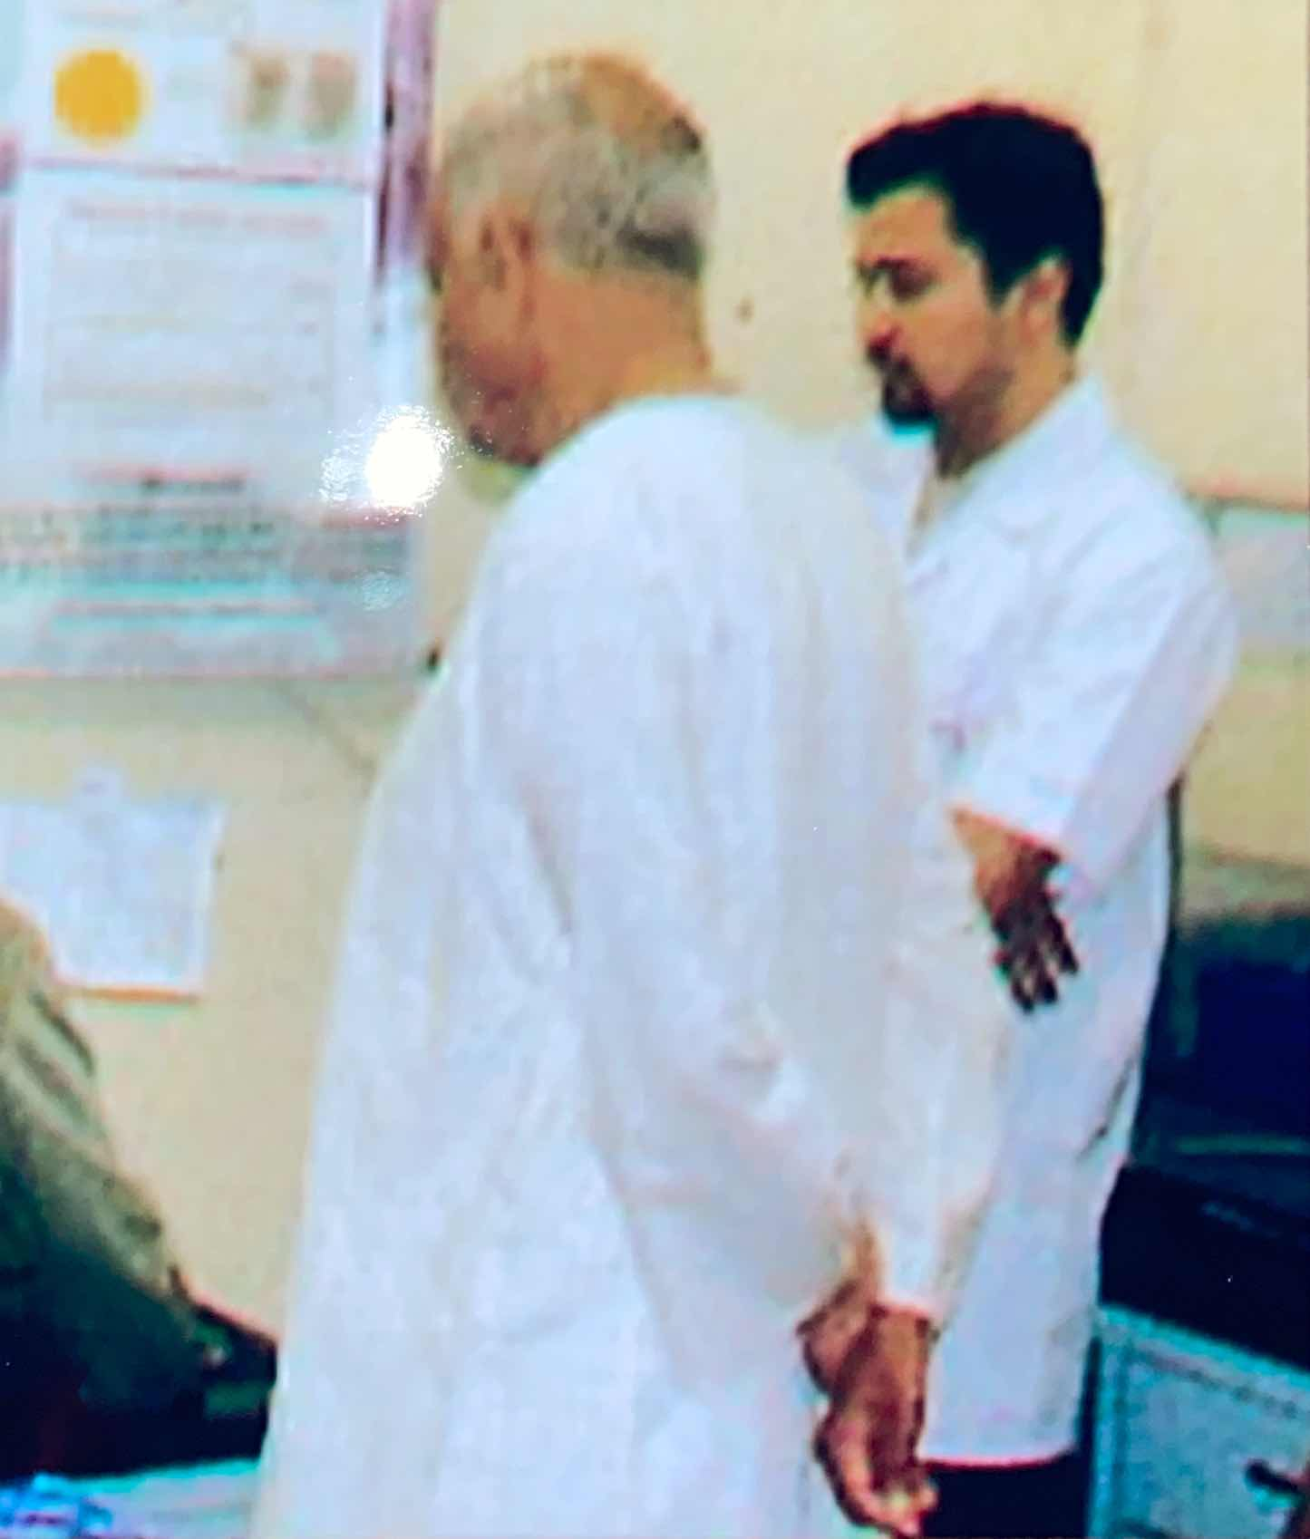
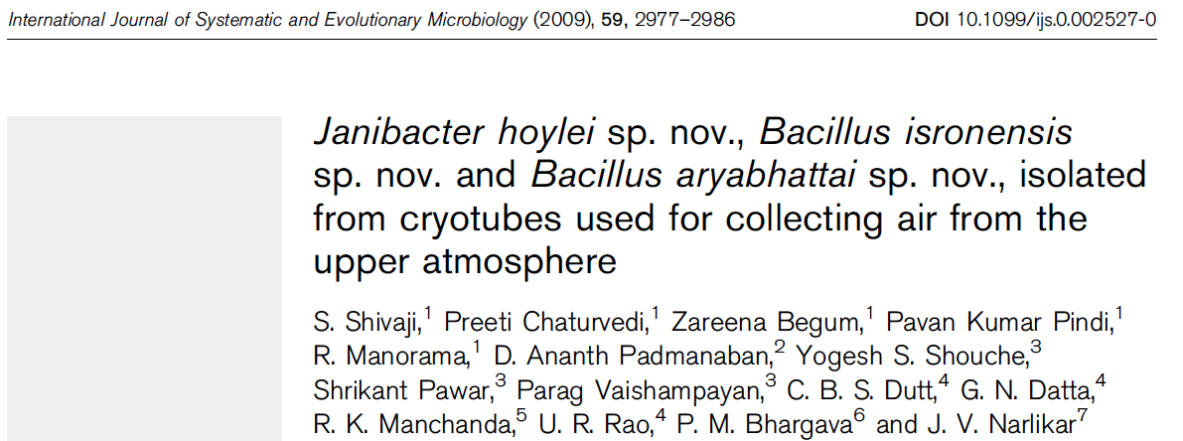
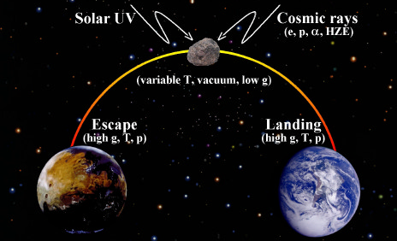
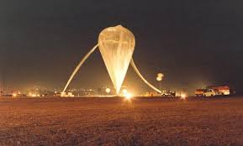
Panspermia: the likelihood of interplanetary transfer of life

Slide 7

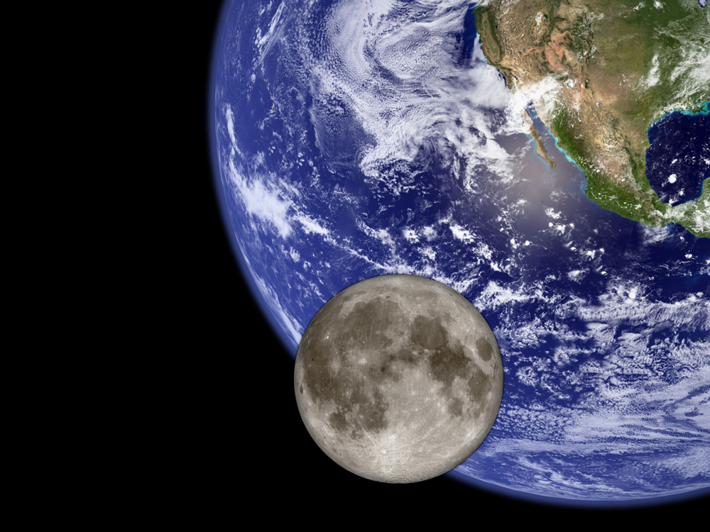
Planetary Protection Objective
Protect current and future scientific investigations by limiting biological and relevant molecular contamination of other solar system bodies through exploration activities and protecting the Earth’s biosphere by avoiding harmful biological contamination carried on returning spacecraft, as described in the Outer Space Treaty.
Forward PP - Understand and control harmful contamination of other worlds by terrestrial organisms, organic materials, and volatiles from spacecraft
Backward PP - prevent harmful biological contamination of the Earth-Moon system by potential extraterrestrial life and bioactive molecules in returned samples
Credit: Office of Planetary Protection

Slide 8
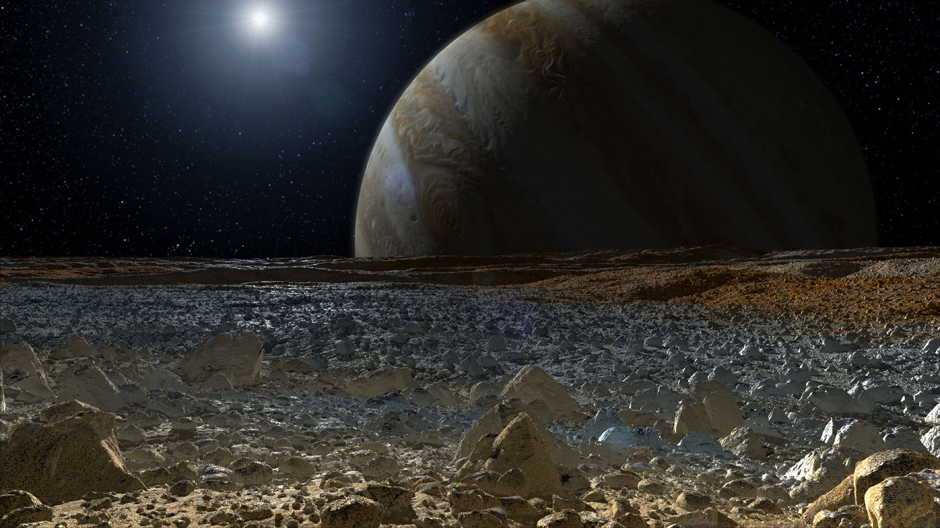
International Planetary Protection Process
The Outer Space Treaty of 1967
International Responsibility
Planetary Protection
Article VI:
States Parties to the Treaty shall bear international responsibility for national activities in outer space, including the moon and other celestial bodies, whether such activities are carried on by governmental agencies or by non-governmental entities, and for assuring that national activities are carried out in conformity with the provisions set forth in the present Treaty
Article IX:
States Parties to the Treaty shall pursue studies of outer space, including the Moon and other celestial bodies, and conduct exploration of them so as to avoid their harmful contamination and also adverse changes in the environment of the Earth resulting from the introduction of extraterrestrial matter and, where necessary, shall adopt appropriate measures for this purpose
Committee on Space Research (COSPAR)
Panel on Planetary Protection forms international consensus guidelines
Defines PP Categories I – V based on target body and mission type
Support the science-based international consensus process
Develop new guidelines and provide significant input to COSPAR
NASA
Supports the science-based international consensus process
Develops new guidelines and provides significant input to COSPAR
8
Credit: Office of Planetary Protection

Slide 9

NASA’s Planetary Protection Policy & Guidance
NPD 8700.1F
Replaced NPD 8020.7G
NASA Policy for Safety and Mission Success
Effective Date July 28, 2022
Expiration Date: July 28, 2028
NASA Policy Directives (NPDs)
Documents Agency policy statements
Describe what is required by NASA management to achieve NASA’s vision, mission, and external mandates
NID 8715.129 (“Mars NID”)
Biological Planetary Protection for Human Missions to Mars
Effective Date: July 9, 2020
Expiration Date: Sept 30, 2025
NPR 8715.24
Replaced NPR 8020.12D/NID 8020.109A
Planetary Protection Provisions for Robotic Extraterrestrial Missions
Effective Date September 24, 2021
Expiration Date: September 24, 2026
NASA Procedural Requirements (NPRs)
Provide detailed procedural requirements to implement policy
Guide how policy directives are implemented in the context of specific missions
NASA Interim Directives (NIDs)
Documents an immediate, short-term statement of the Agency’s policies, requirements, and identifies responsibilities for implementation
Temporarily modify policy directives or implementation requirements
Link to NASA Planetary Protection policy and guidance documents at www.sma.nasa.gov
NASA Standards
Provide technical requirements
Each NASA Technical Standard is assigned to a Technical Discipline
NASA-STD-8719.27
Implementing Planetary Protection Requirements for Space Flight
Effective Date August 30,2022
NASA-HDBK-6022
Handbook for the Microbial Examination of Space Hardware
Expiration Date: N/A
Status: Revision planned. Last draft revision released Aug 17, 2010
NASA Handbooks
Companion documents to NPRs and NASA Standards
Provide supporting material such as guidelines, lessons learned, procedures, and recommendations
All published documents found in NODIS: https://nodis3.gsfc.nasa.gov/ or
the OPP website: https://sma.nasa.gov/sma-disciplines/planetary-protection#PolicyGuidance
= Document being updated
Credit: Office of Planetary Protection

Slide 10
NASA’s Planetary Protection Roles
Chief Scientist
Administrator’s Office
White House / OSTP
Inter-Agency
Mission Directorates
Office of Safety and
Mission Assurance
National Academies
implement
maintain NASA policy
Office of Planetary Protection
oversee implementation
(Technical Authority)
Review Panels
International Partners
Programs Projects
Program/Project-level
Technical Authority
NPD 1000.3 §4.13.2 “OVERALL RESPONSIBILITIES. The Chief, Safety and Mission Assurance reports to the NASA Associate Administrator and advises senior leadership, including the Administrator, on matters related to risk, safety, and mission success. Serves as the lead Technical Authority for safety and mission assurance, providing independent oversight of programs and projects in support of safety and mission success. Serves as the designated Agency-level "official voice" for institutional safety and the associated requirements established by NASA policy, law, and other external mandate aimed at protecting the public..”
Credit: Office of Planetary Protection

Slide 11
NASA Policy Enabling Missions
Increased flexibility for gate products and reviews
  Enables missions to streamline PP reporting into the standard project life cycle reviews.
Risk-informed decision-making leveraged per NPR 8000.4.
  Enables missions in that they can propose a performance or prescriptive approach.
Adds the ability to leverage NASA, other government agency, and industry consensus standards.
  Enables missions by increasing the potential implementation trade space through adopting or adapting consensus standards of their choice.
Current scientific consensus used throughout the project life cycle
  Enables missions to propose alternative and analytical approaches that are both responsive to PP requirements and fit within a projects allocated resources.
Credit: Office of Planetary Protection

Slide 12
Planetary Protection Categorization – Outbound + Inbound
Planetary Target Priority | Mission Type | Planetary Protection Category | Example Target Bodies
Not of direct interest for understanding the process of chemical evolution or where exploration will not be jeopardized by terrestrial contamination. | Any (Flyby, Orbiter, Lander) | I | Undifferentiated, metamorphosed asteroids, Io
Of significant interest relative to the process of chemical evolution but only a remote chance that contamination by spacecraft could compromise future investigations. | Any (Flyby, Orbiter, Lander) | II | Earth’s Moon (Cat. IIa & IIb), Venus, Comets, Asteroids, Jupiter; Jovian Satellites (excluding Io, Ganymede and Europa), Saturn; Saturnian Satellites (excluding Titan and Enceladus), Uranus, Uranian Satellites, Neptune, Neptunian Satellites (excluding Triton), Kuiper-Belt Objects <1/2 the size of Pluto
 |  | II* | Jovian Satellites: Ganymede, Saturnian Satellites: Titan, Neptunian Satellites: Triton, Pluto/Charon
Of significant interest relative to the process of chemical evolution and/or the origin of life and for which scientific opinion provides a significant chance that contamination by spacecraft could compromise future investigations | Flyby, Orbiter | III | Mars, Europa, Enceladus, Others to be determined
 | Lander, Probe | IV | Mars (Cat. IVa, IVb & IVc), Europa, Enceladus, Others to be determined
Any Solar System Mission | All Earth Return | V(r): Restricted Earth Return | Restricted Earth Return: Mars Europa Enceladus Others to be determined
 |  | V(u): Unrestricted Earth Return | Unrestricted Earth Return: Earth’s Moon Venus Most asteroids and comets (e.g., Bennu, Ryugu) Others to be determined
Credit: Office of Planetary Protection

Slide 13
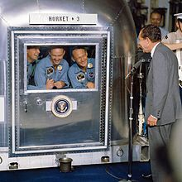
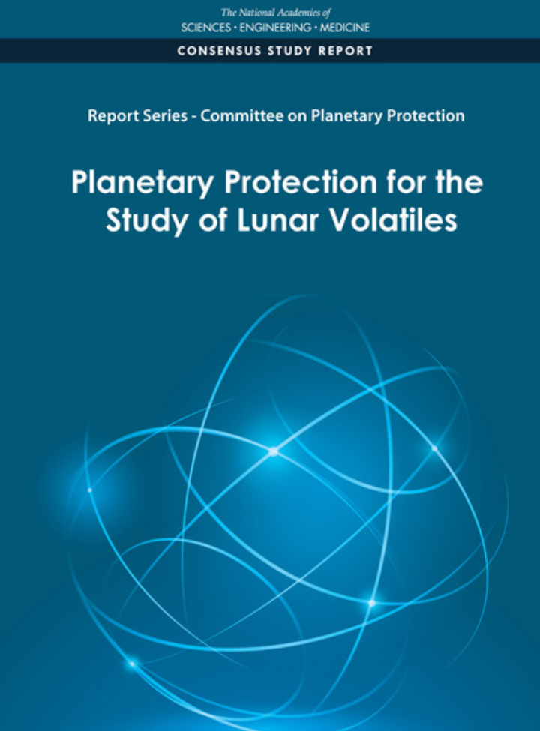
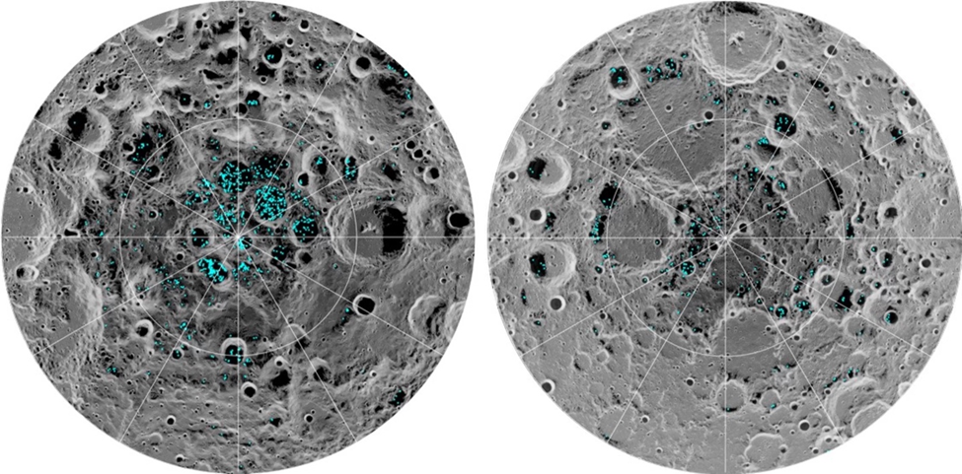
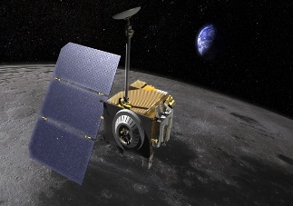
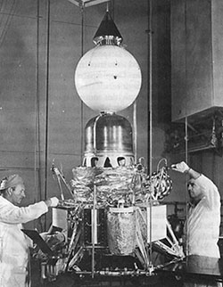
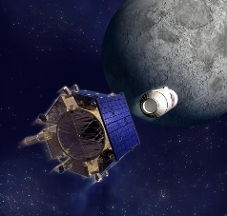
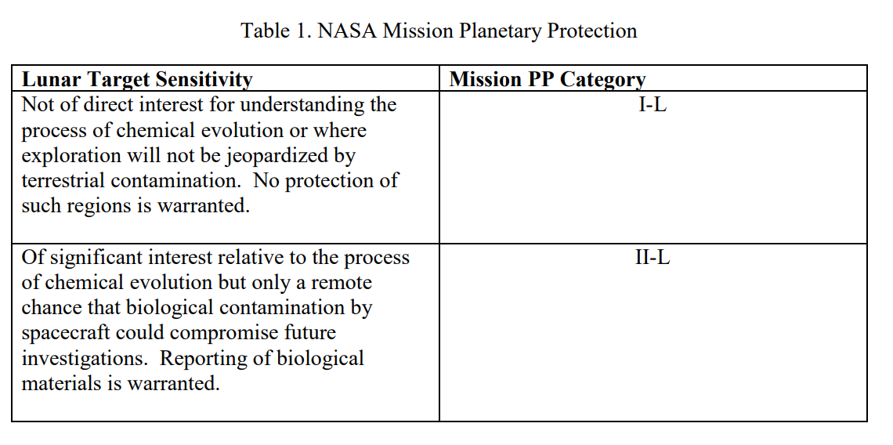
Planetary Requirements Evolve – Moon Case Study…
June 2021 COSPAR / NASA NPR Update
Sept. 1963 – Policy Change. Relaxed Full Sterilization Requirement. "Required Procedures"
Clean-room assembly policies be adopted,
Sporicidal agents be used when "appropriate“, and
Recontamination Prevention for launch processing - covering
PP Category III*
July 1969 - The crew of Apollo 11 in quarantine after returning to Earth in visited by President Nixon. 21-day quarantine.
2004 - COSPAR PP Panel
Investigate whether the permanently shaded areas near the lunar poles should be “protected” in the sense of imposing the mandatory record-keeping required under.
Proposed PP Category II
Category | Description | Volatiles Released by Propulsion System | Spacecraft Organic Inventory
II | Orbiter | -- | --
IIa | Moon surface not IIb | Required | --
IIb | PSR and lunar poles | Required | Required
PP Category IV*
PP Category V Restricted*
PP Category II, IIa, IIb
Apollo 15-17
PP Category I*
PP Category V Unrestricted*
Sept – Oct 2020
NASEM Study
1983 – COSPAR Post-Apollo PP Category I
PP Category V Unrestricted
July 2020 NASA NID 8715.128
July 1969 – Interagency Agreement on Back PP. Quarantine Provisions.
Introduction of alien life forms to the Earth's biosphere could be catastrophic.
Preserve Lunar sample science
PP Category V Restricted*
December 23, 1960 Memo "Decontamination and sterilization procedures for lunar and
planetary space vehicles." The memo was signed by Hugh L. Dryden.
2008 – COSPAR General Meeting
Lunar Reconnaissance Orbiter + LCROSS Impactor Assign the Earth’s Moon to Category II because of the potential for missions to disrupt polar volatile deposits (≥ 70 N & S latitude).
PP Category II
Proposed PP Category I-L, II-L
PP Category IV*
*Notional Category
Credit: Office of Planetary Protection

Slide 14
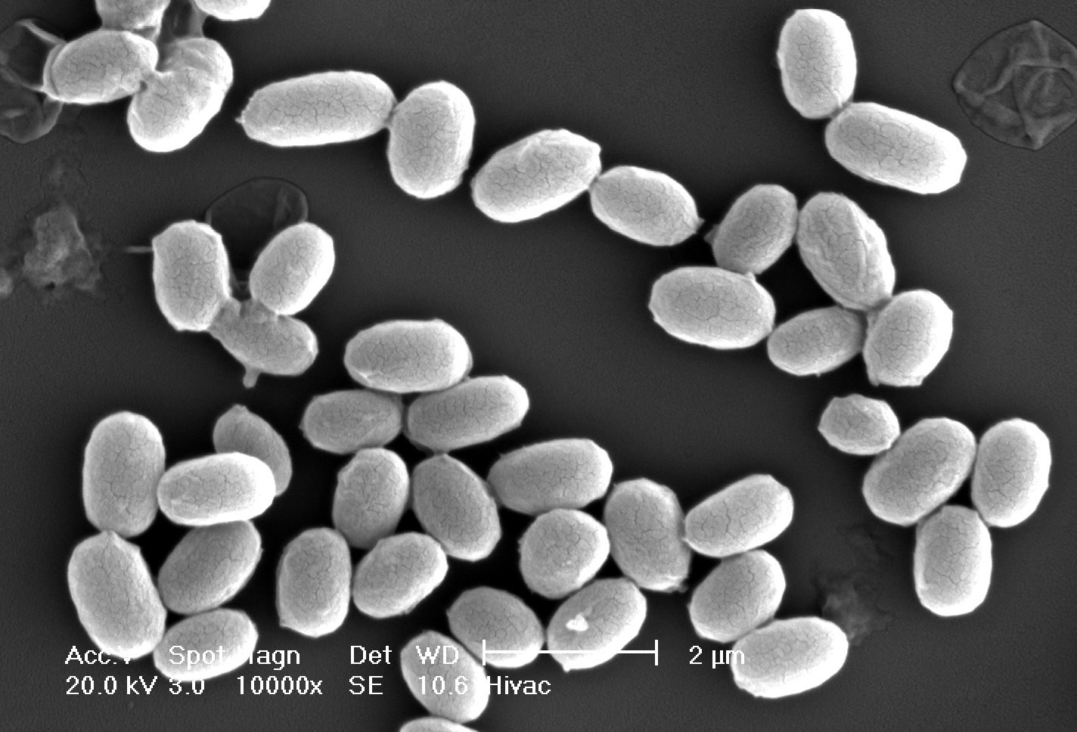
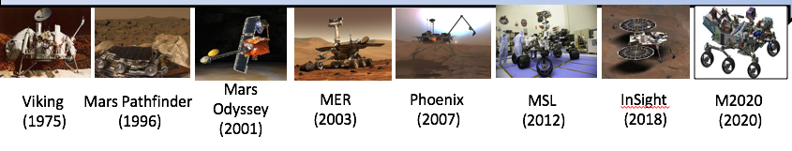
NASA Standard Bioassay
Does detect:
  spores
  viable, cultivable, aerobic
  32°C, 3 days
Does not detect:
  non-cultivable, vegetative cells grown under various conditions
We need simple, reliable molecular microbial assays that detect all microbial contamination.

Slide 15
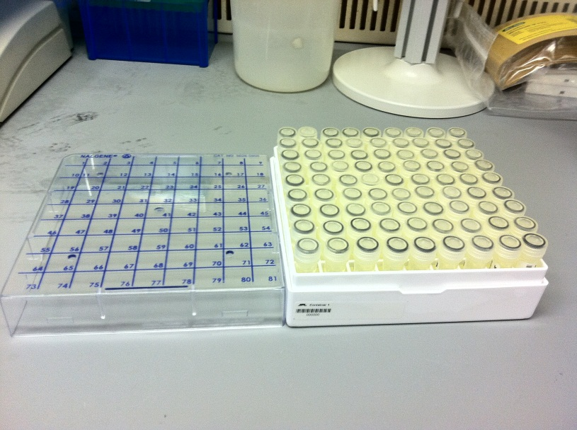
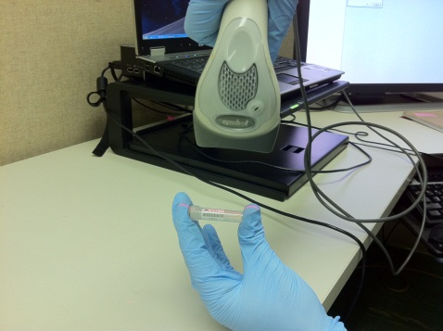
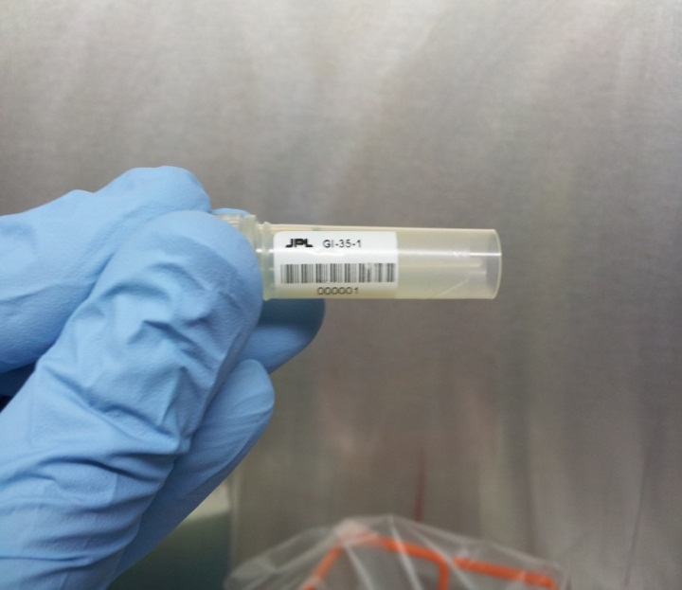
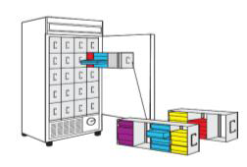
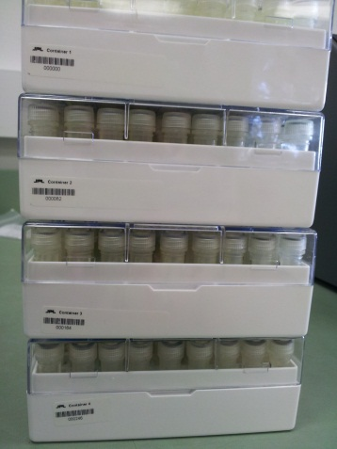
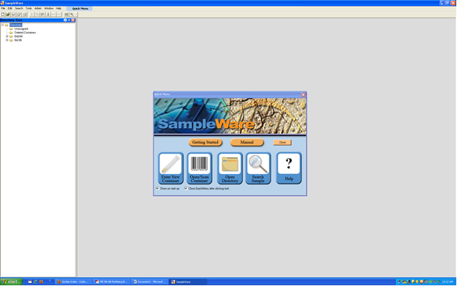
Space Microbial Culture Collection (SMCC)
Sample labeling and storage
Easy sample Tracking
(-80°C freezer)
SIMS
Long Term Sample storage

Slide 16
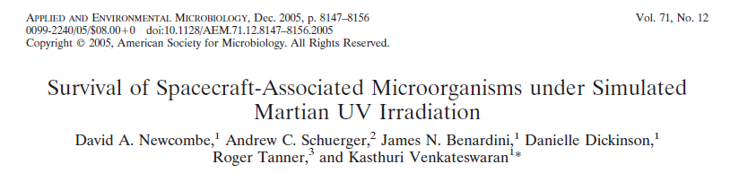
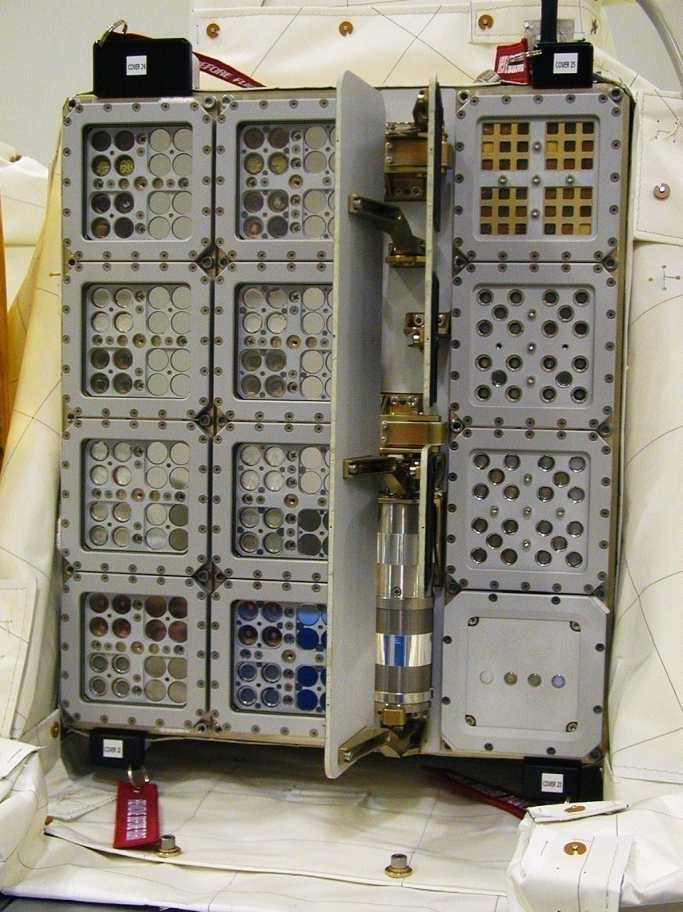
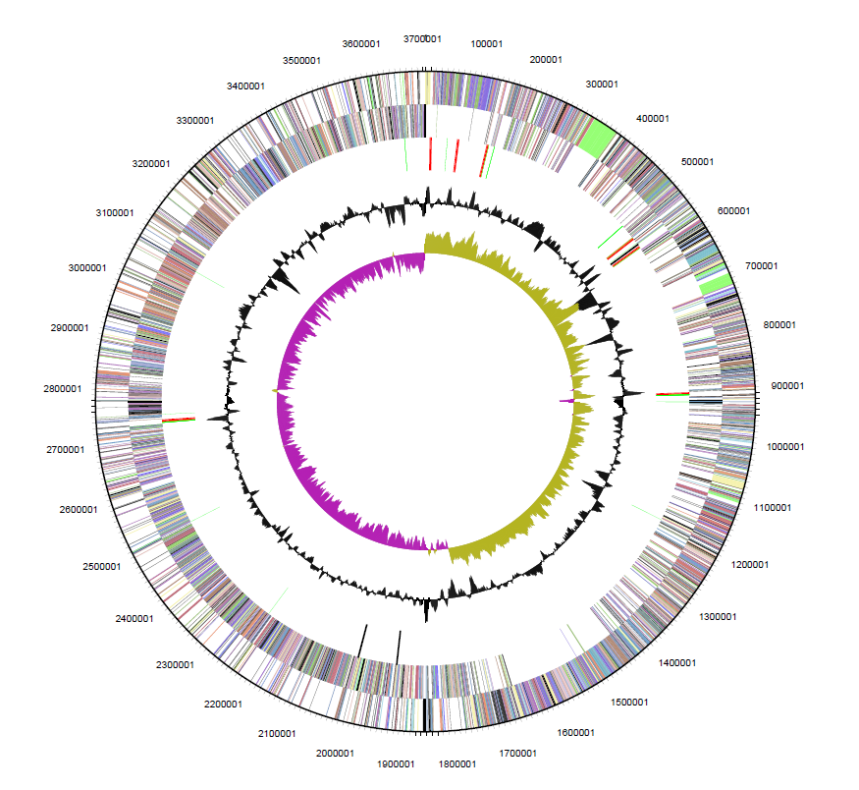
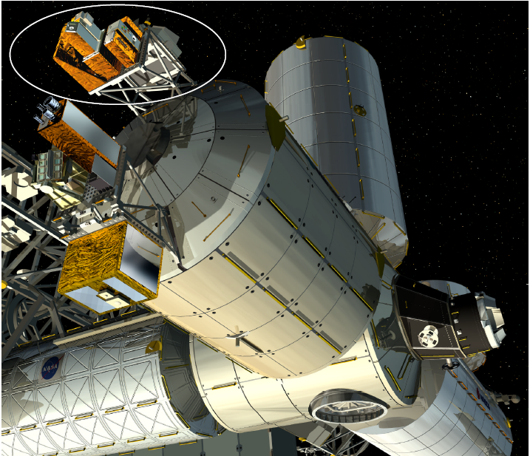
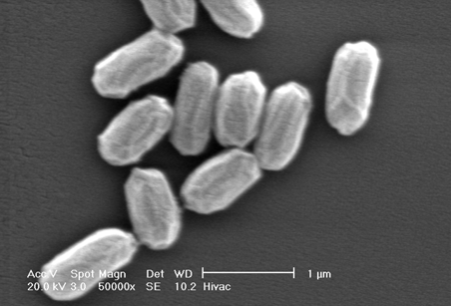
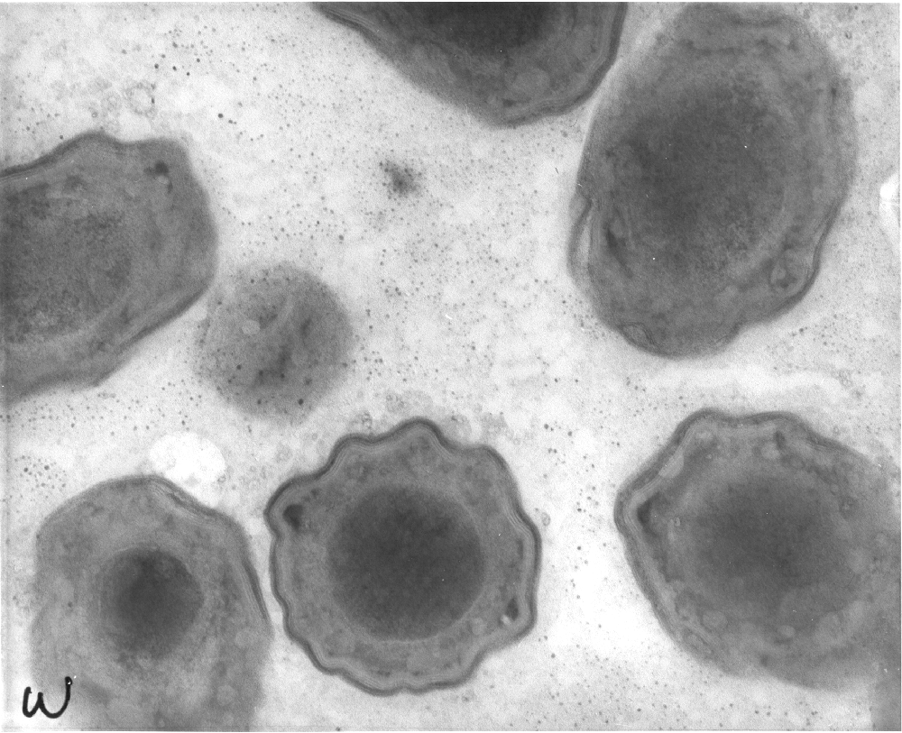
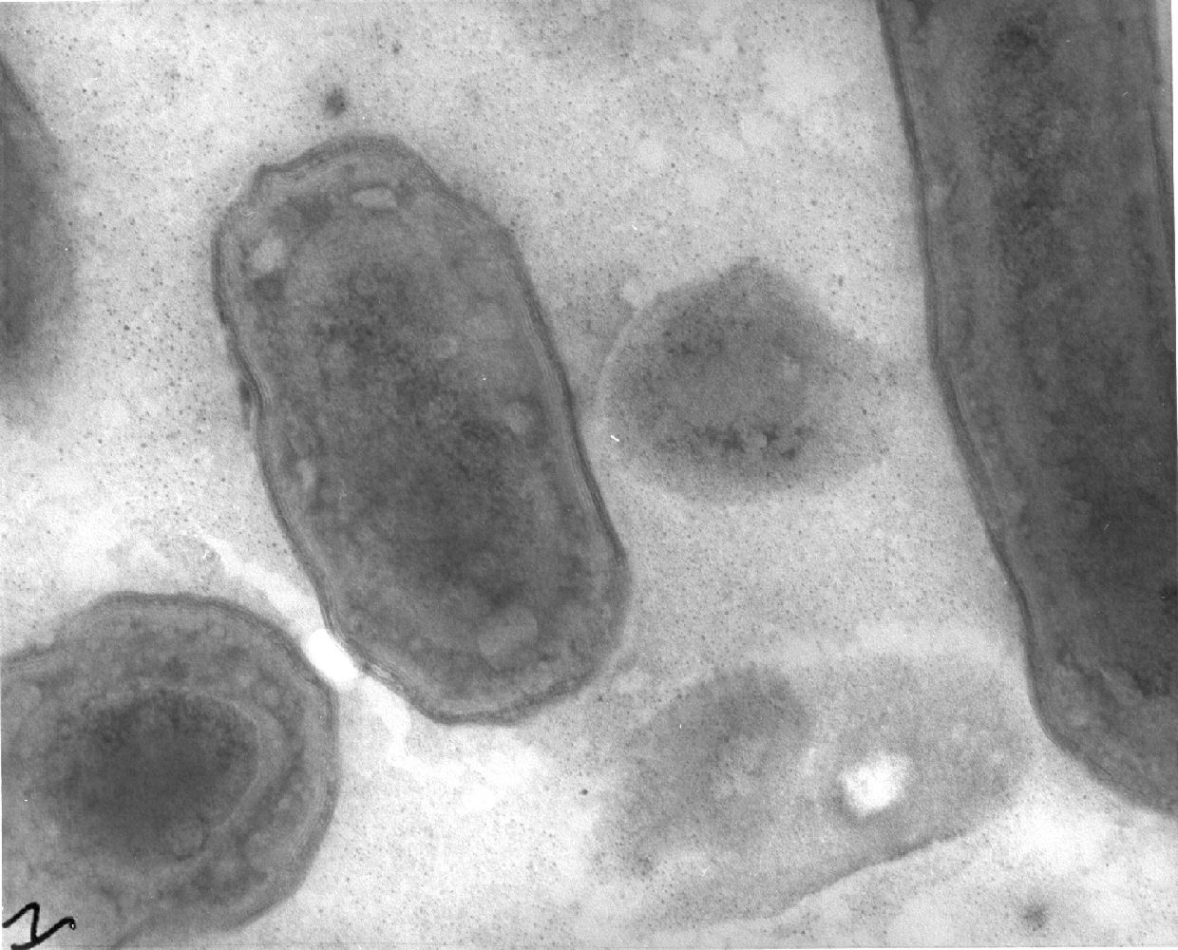


Slide 17
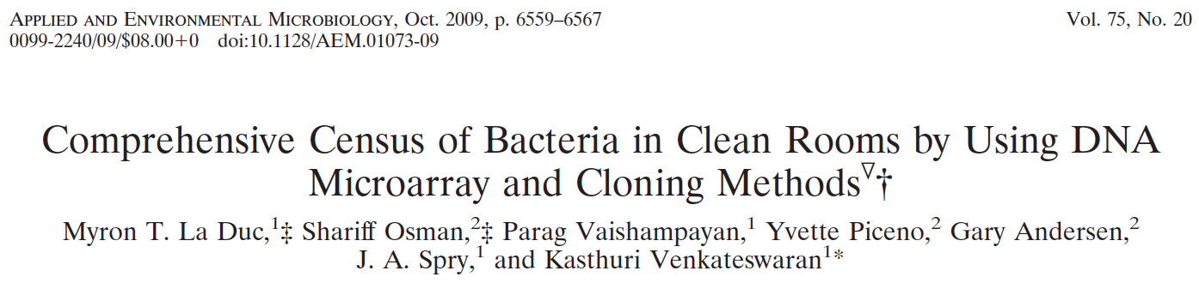
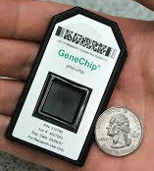
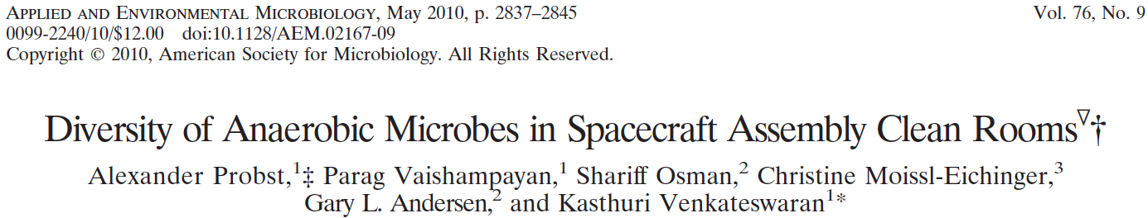
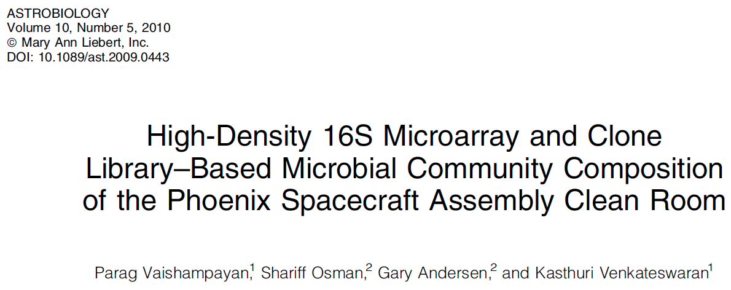
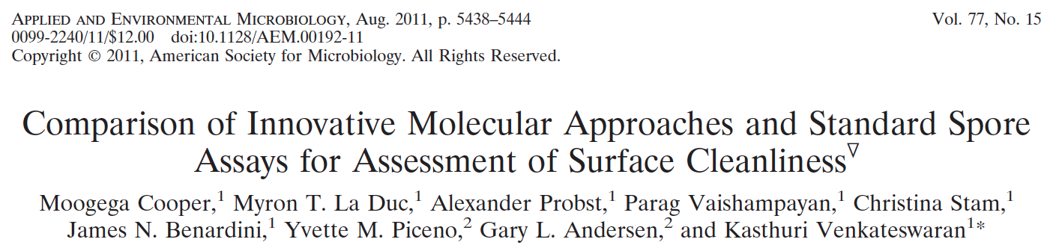
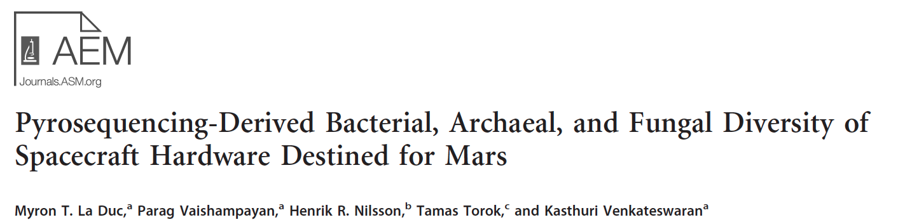
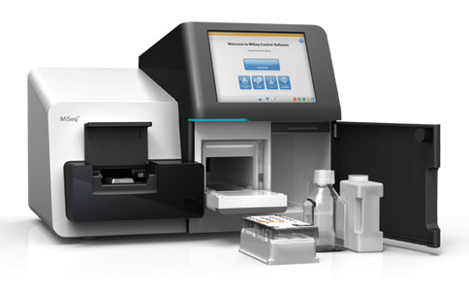
Microbial diversity of clean rooms

Slide 18
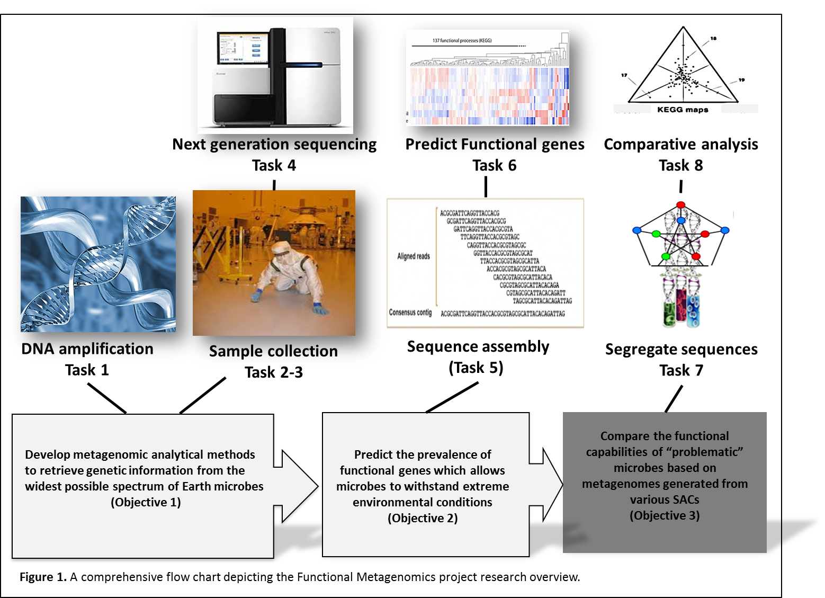
Metagenome Study Overview

Slide 19
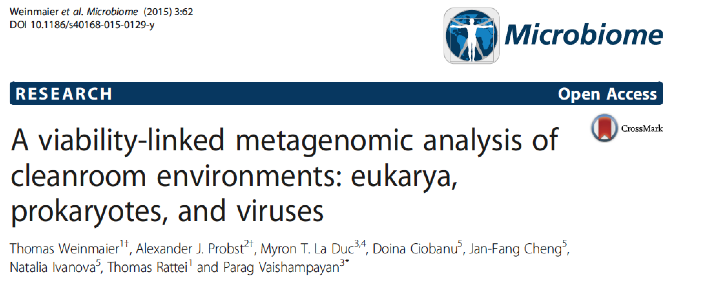
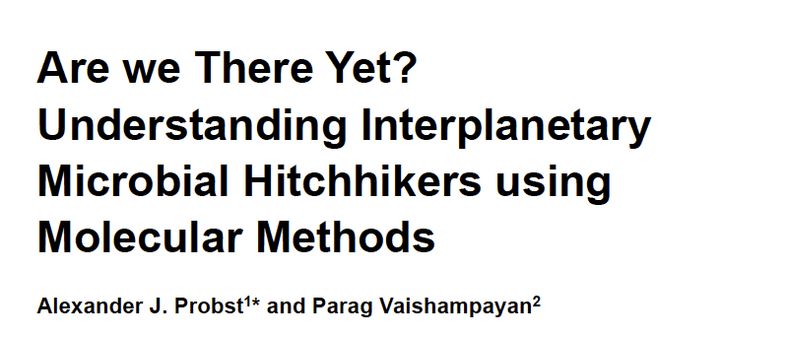
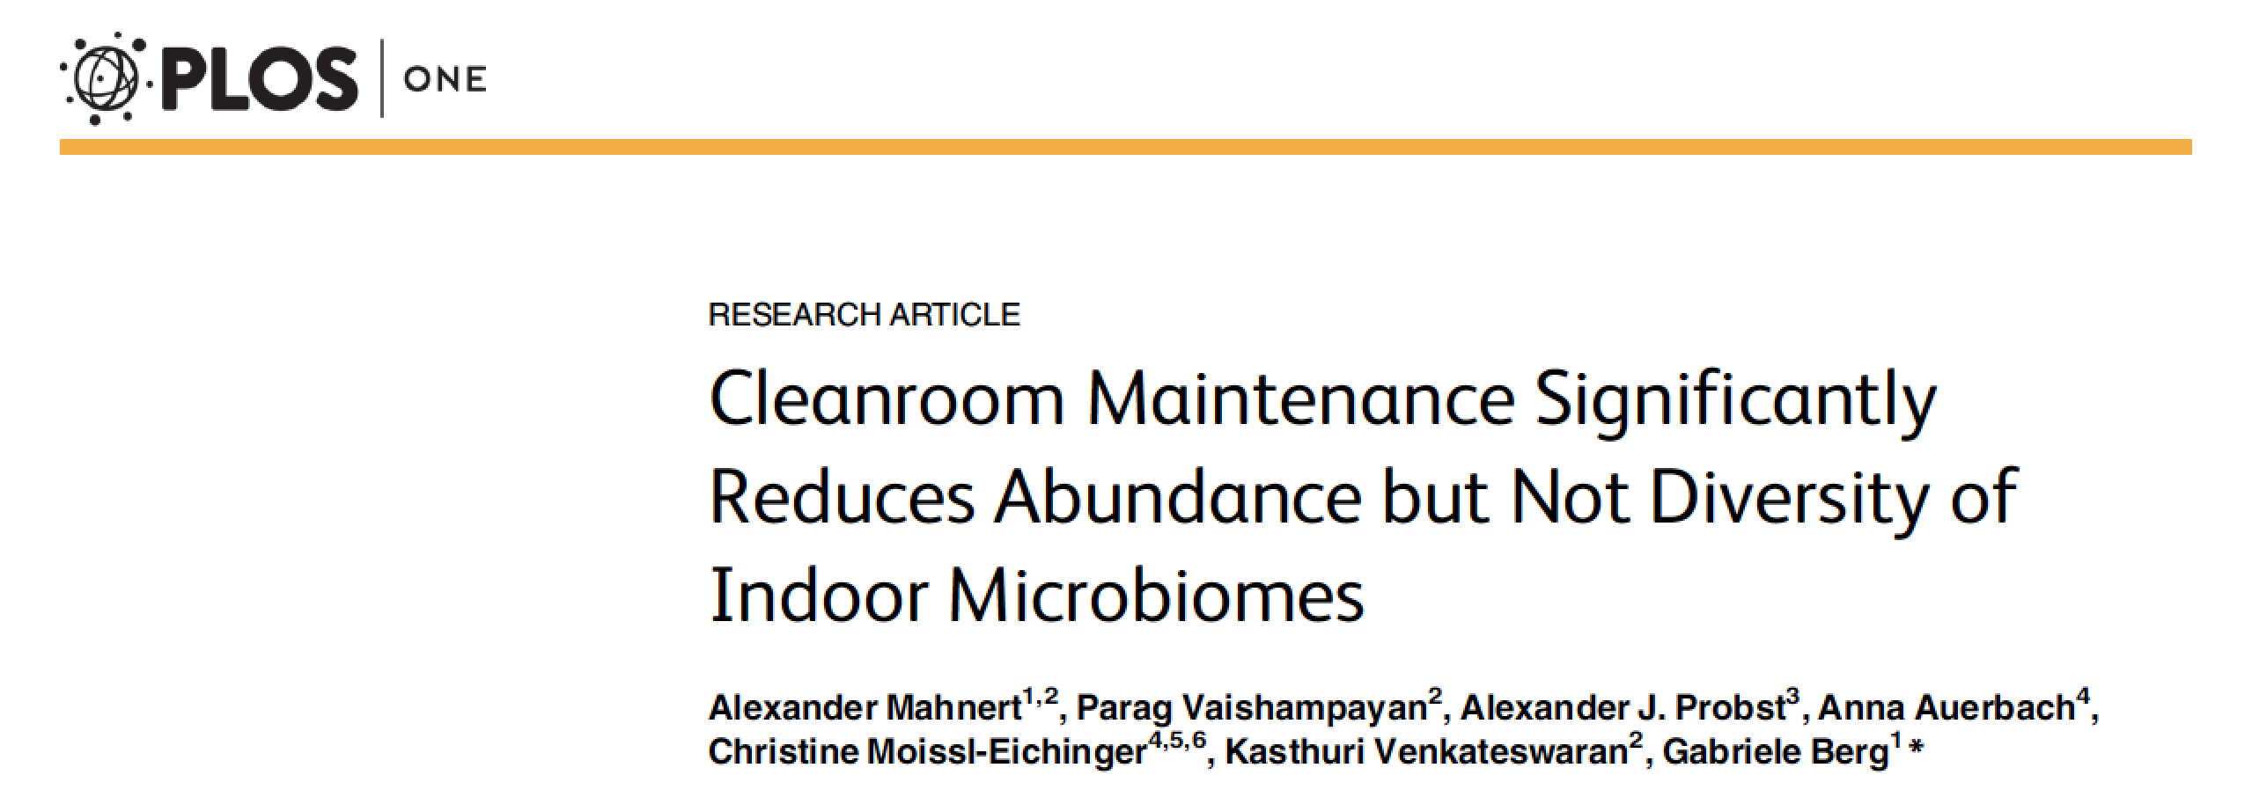
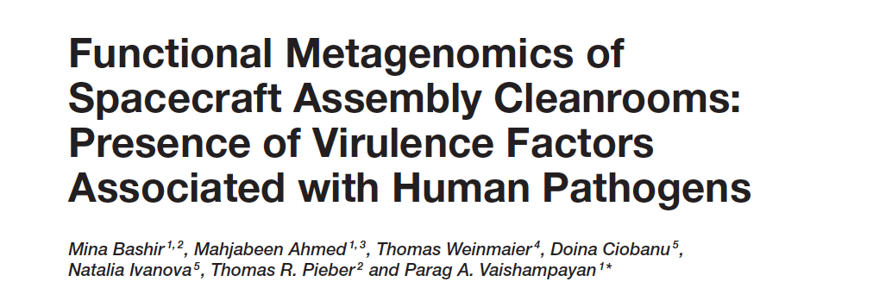
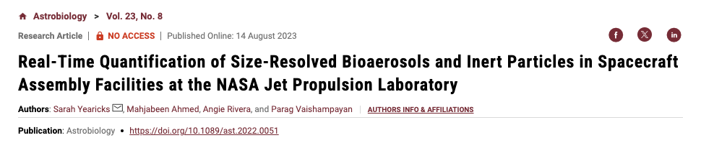

Slide 20
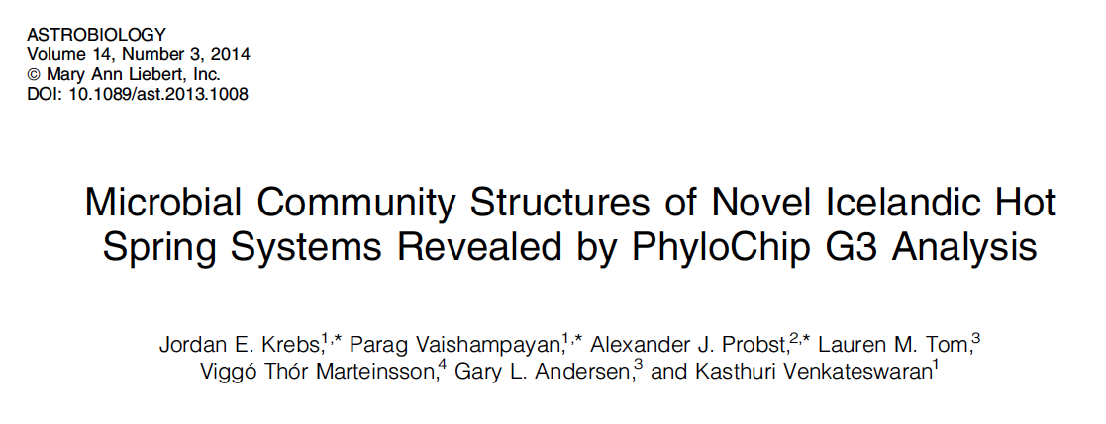
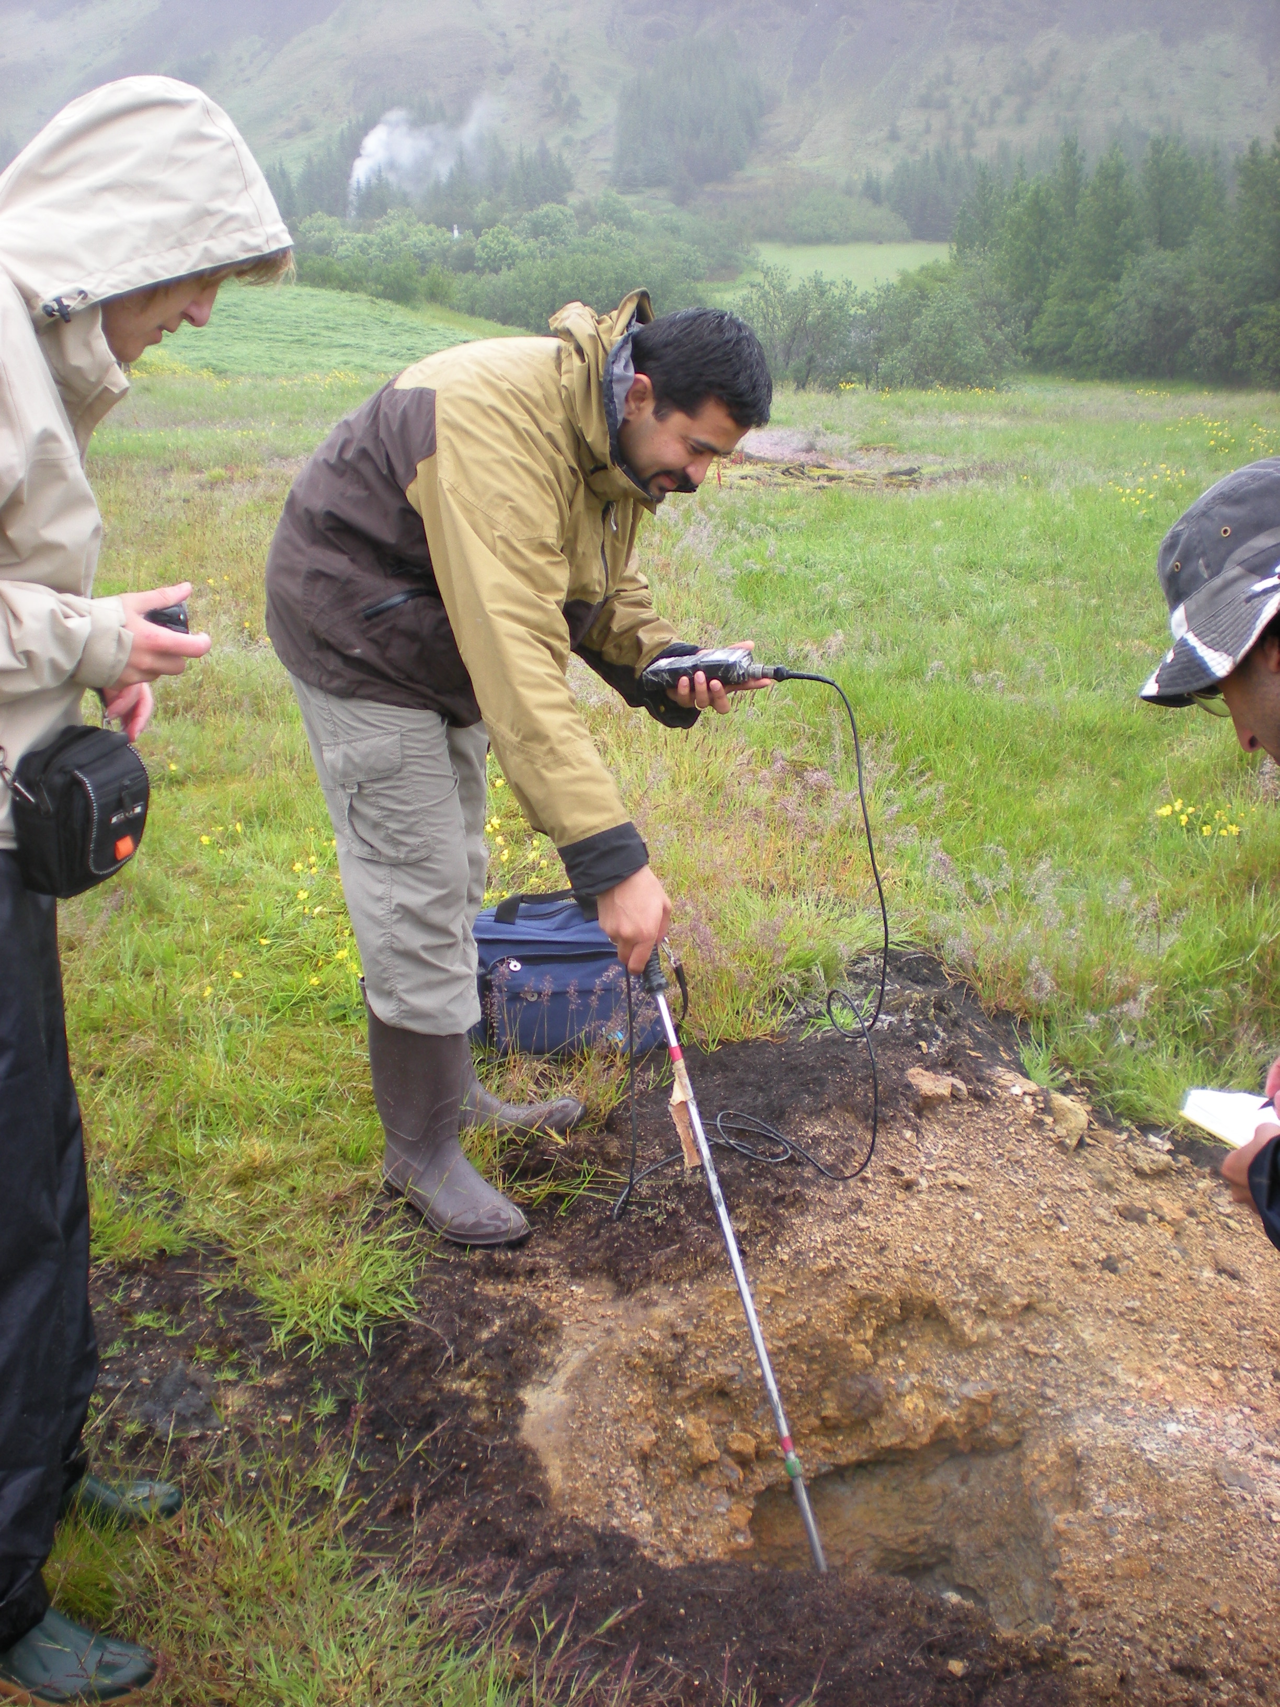
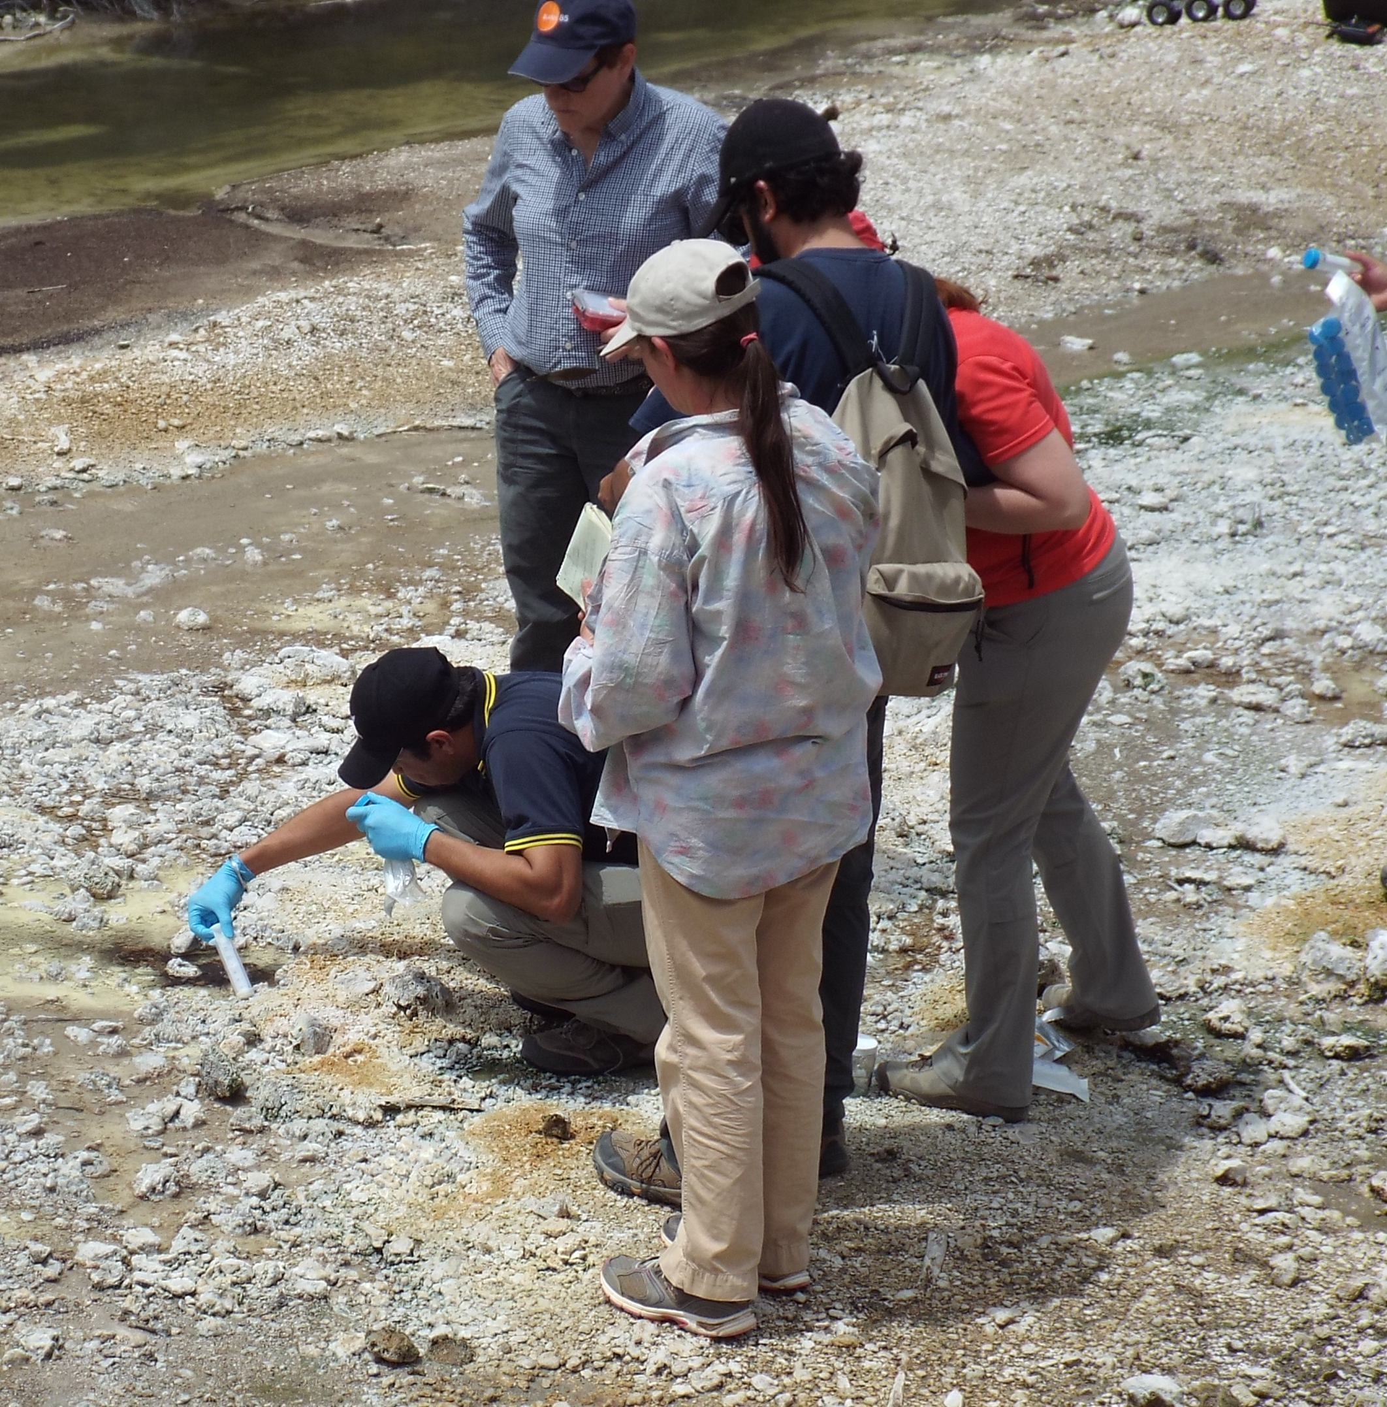
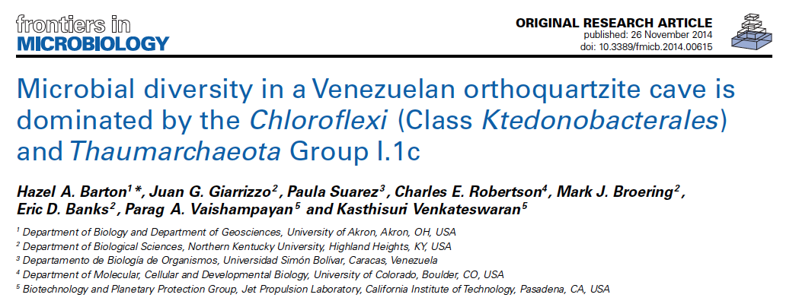

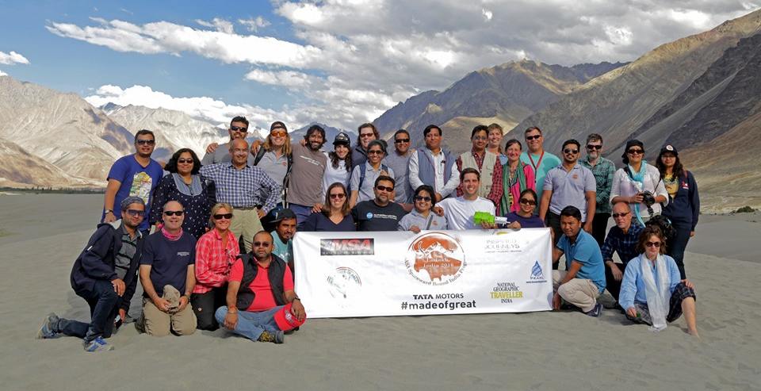
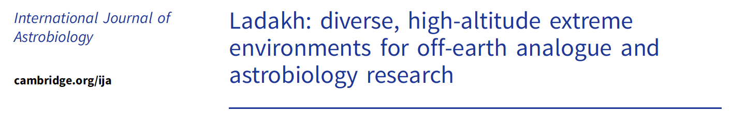
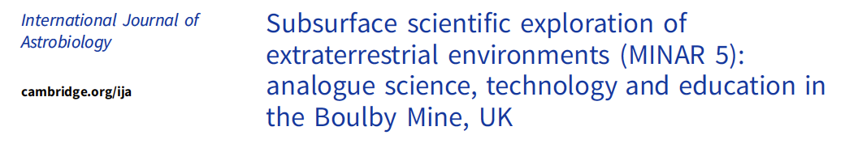

Astrobiology and Educational Outreach
Hot Springs in New Zealand

Slide 21

Exploration Planetary Protection Comparison: Moon vs Mars
EASY
Mars
COSPAR Assessment: “a target body of chemical evolution and/or origin of life interest and for which scientific opinion provides a significant chance of contamination which could compromise future investigations.”
Categorization (Outbound): III/IVa/IVb/IVc
Implication: Documentation Avoidance of Impact and/or Cleanliness Requirements
Categorization (Return): V(restricted)
Implication: Documentation Rigorous containment of unsterilized material to protect Earth’s biosphere Quarantine of crew
Moon
COSPAR Assessment: “of significant interest relative to the process of chemical evolution and the origin of life, but where there is only a remote chance that contamination carried by a spacecraft could compromise future investigations.”
Categorization (Outbound): II/IIa/IIb
Implication: Documentation
Categorization (Return): V(unrestricted)
Implication: No further constraints
NOT SO EASY
Credit: Office of Planetary Protection
Notes:
Comparison of Moon and Mars from a planetary protection perspective

Slide 22





Control of Forward Contamination
Mission Design & Categorization
Spacecraft Assembly, Test, Transport, Launch, and Operations
Avoiding Contamination following Inadvertent Impact
Avoiding Contamination for Robotic Landed Missions
End of Mission Disposition
Information to be included in the PP Mission Categorization Proposal
Biological and organic contamination knowledge inventory materials
Controlled manufacturing environments and cleanrooms
Bioburden Control Approach
Analytical Approach
Documentation requirements and communication of data/analysis updates
Avoiding inadvertent impact of solar system bodies by spacecraft and launch elements during flyby, gravity assist, or orbital insertion
  Mars (Cat III-IV)
Secondary and auxiliary payloads
Prevent occurrence of a biological inoculation event into a potentially habitable environment during landing and surface operations
  Stationary and mobile activities
Mars IVa, IVb, IVc requirements
Bioburden Control Approach
Analytical Approach
Documentation of final disposition of hardware
Updates to organic, biological, and combustion product inventories
Information to be included in End of Mission PP Report
Credit: Office of Planetary Protection

Slide 23

Backward Contamination – Restricted Earth Return
NASA/USG has obligations under the Outer Space Treaty to safeguard the Earth-Moon system.
  Article IX: States Parties to the Treaty shall pursue studies of outer space, including the Moon and other celestial bodies, and conduct exploration of them so as to avoid their harmful contamination and also adverse changes in the environment of the Earth resulting from the introduction of extraterrestrial matter.
Key Tenants
NASA Procedural Requirements 8715.24 §3.4
Implementation Example
NASA-Standard 8719.27 §5
Preventing harmful biological contamination of Earth’s biosphere is the highest priority.
Establish and implement a strategy and design concepts to break the chain of contact with the target body, isolate, and robustly contain restricted samples.
Approach to assure public safety and containment requires approval by relevant government entities.
Alternative approaches allowed with scientific and engineering consensus.
Credit: Office of Planetary Protection

Slide 24












Notional Forward PP Mars Exploration Trade Space
REQUIREMENTS
Prescriptive
Credit: NASA
Robotic - Mars Lander
PP Category IVb – Life Detection
Viking Lander
Credit: NASA
Credit: NASA/JPL-Caltech
Credit: NASA
Credit: NASA
Robotic - Mars Orbiter
PP Category III – Orbital Lifetime
Mars Odyssey
Robotic - Mars Orbiter
PP Category III – Bioburden
MAVEN mission
Credit: NASA/JPL-Caltech/MSSS
Robotic - Mars Lander / Rover
PP Category IVa
Mars Science Laboratory – Curiosity
Robotic - Mars Lander / Rover
PP Category IVc – Mars Special Region
Phoenix Lander
NASA/JPL-Caltech
Knowledge Gaps
IMPLEMENTATION
Credit: CoSTAR / NASA / CalTech
Easier
Challenging
Credit: NASA
Credit: NASA
Credit: NASA
Crewed + Robotic - Special Region Exploration
Credit: NASA
Crewed – Habitat / Close EVA Study
Key
Robotic
Robotic + Crewed
Crewed
Credit: NASA
Crewed – Habitat / Far (kilometers?) EVA Study
Credit: ESA
Performance Based
Crewed Special Region/Sampling for life detection/In-situ life detection
Credit: Office of Planetary Protection

Slide 25

Knowledge-Based Robotic to Crewed Transition
Priority = safeguard the Earth from potential biologicals
Priority = crew safety
Driving question
How do we define contamination vs. harmful contamination?
Assumption
Microbial assessment + control of human associated contamination = key to preserve astrobiological exploration (PP enabling science)
Assumptions
Landed missions ≠ closed systems
Crew will be exposed to Mars
Crew is a constant source of bioburden unlike robotic spacecraft.
Guidelines
Maintain intent of PP to avoid harmful contamination
Mars Special Regions apply
Backward PP will require containment/quarantine
Baseline understanding of site
Knowledge gaps need to be established and mitigated
Credit: Office of Planetary Protection
Notes:
To frame the discussions, and constrain the problem, this “evolved” set of assumptions provided boundaries so that we didn’t devolve into speculative conversations about terraforming, and the like.

Slide 26




















Resources Available Through The OPP Website
Articles
What Are Spores?
How to Build a Clean Spacecraft
Cleanroom Gowning or How to Dress in the Cleanroom
Ground Support Equipment
Protecting the Planet: Planetary Protection vs. Planetary Defense
OSIRIS REx Sample Return Doesn’t Pose a Risk to Earth’s Biosphere
Bioburden Accounting Tool Release
Organic Inventory Workshop
PP Crewed Knowledge Gaps
https://sma.nasa.gov/sma-disciplines/planetary-protection
Videos
Missions & Studies
Planetary Protection: An Introduction
Just How Small is a Spore?
Forward and Backward PP Overview
Behind the Spacecraft Perseverance
Mission Reports
Mission Design and PP Categorization
Probability of Impact
Ocean Worlds
End of Mission Disposition
NASEM Study Reports
Credit: Office of Planetary Protection

Slide 27
Questions?
https://sma.nasa.gov/sma-disciplines/planetary-protection

